Slide 1
2020 CENuM WORKSHOP
김 경 식
한국항공대학교
1. Lepton scattering
2. Analysis of nuclear reaction around Coulomb barrier
2020.07.03

Slide 2
1. Lepton scattering
Kinematics
l + Α l’+ Ν + (Α−1)
Y
X
reaction plane
scattering plane
N
φ
l’
θl
θ
Z
(ω, q )
target
l

Slide 3
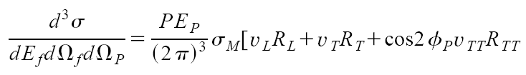

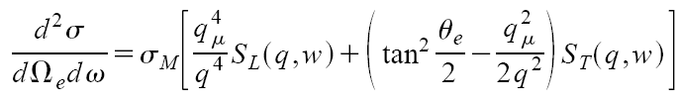
Exclusive (e,e’p) reaction :
Inclusive (e,e’) reaction :
Inclusive ν−Α scattering :

Slide 4

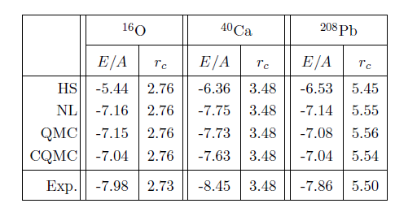
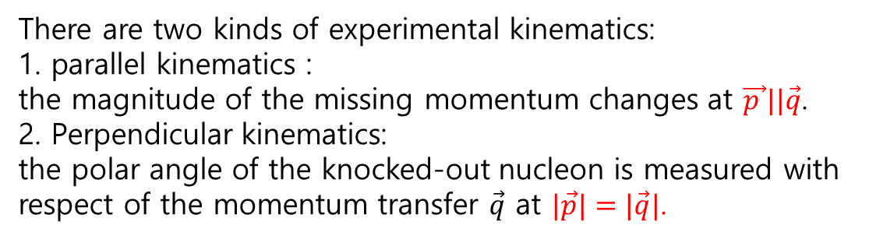
A. Exclusive (e,e’p) reaction
Reduced cross section :
extracted the off-shell electron-nucleon cross section
$$\vec{p_{m}}=\vec{p}−\vec{q}$$
$$\vec{p }||\vec{q}$$
$$\vec{q}$$
$$|\vec{p}|=|\vec{q}|$$
HS : relativistic mean field (σ−ω model)
NL : non-linear σ model
QMC : quark meson coupling model
CQMC : chiral QMC

Slide 5
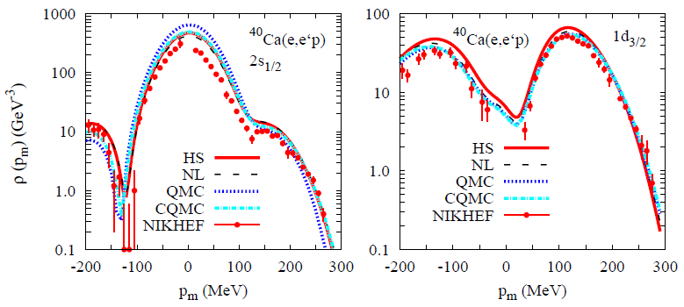
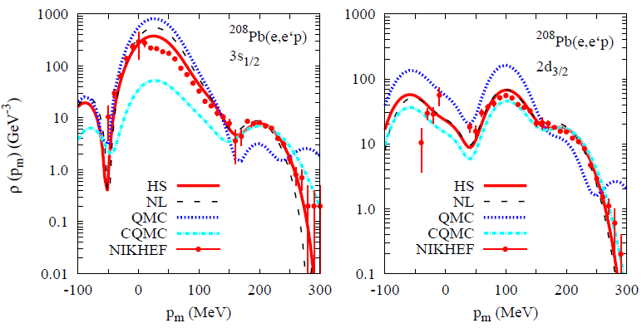
parallel kinematics

Slide 6

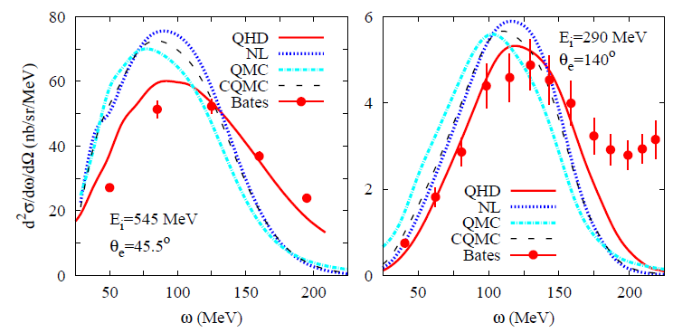
B. Inclusive (e,e’) reaction

Slide 7
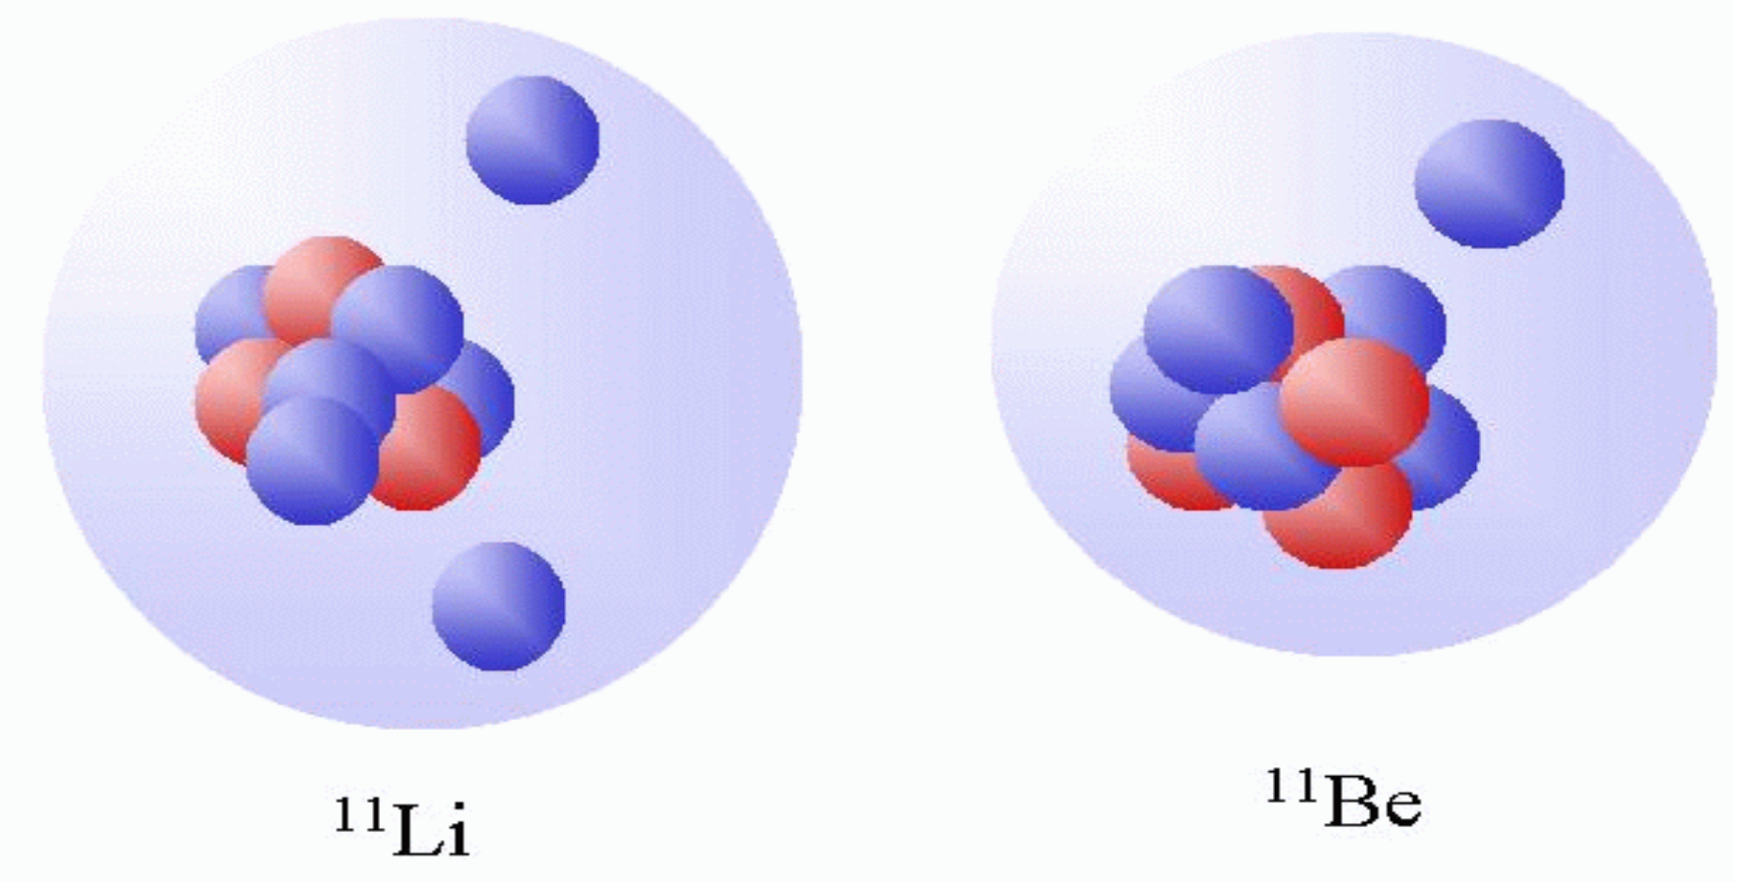
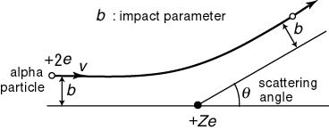
2. Analysis of nuclear reaction around Coulomb barrier
A. Optical model
What happens in nuclear reaction with weakly bound nuclei
Dipole excitation
(Coulomb excitation )
Coulomb breakup
Coulomb repulsion

Slide 8



Construction potential for nuclear reaction with weakly bound nuclei
elastic scattering + inelastic scattering + Coulomb breakup
we don’t know exact potential between projectile and target
core
target
valance
target
core
valance
potential for core -target
+
additional effective potential
Vsh
Vlo

Slide 9
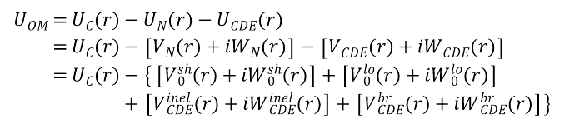
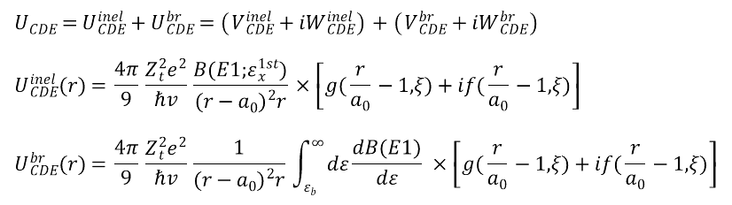


and
elastic scattering + inelastic scattering + Coulomb breakup
contribution of dipole Coulomb excitation
$$U_{CDE}=U_{CDE}^{inel}+U_{CDE}^{br}=\left(V_{CDE}^{inel}+iW_{CDE}^{inel}\right)+\left(V_{CDE}^{br}+iW_{CDE}^{br}\right)$$
$$U_{CDE}^{inel}(r)=\frac{4π}{9}\frac{Z_{t}^{2}e^{2}}{ℏv}\frac{B(E1;ε_{x}^{1st})}{{(r-a_{0})}^{2}r}×\left[g(\frac{r}{a_{0}}-1,ξ)+if(\frac{r}{a_{0}}-1,ξ)\right]$$
$$U_{CDE}^{br}(r)=\frac{4π}{9}\frac{Z_{t}^{2}e^{2}}{ℏv}\frac{1}{{(r-a_{0})}^{2}r}\int_{ε_{b}}^{∞}{dε\frac{dB(E1)}{dε}}×\left[g(\frac{r}{a_{0}}-1,ξ)+if(\frac{r}{a_{0}}-1,ξ)\right]$$
$$a_{0}=\frac{Z_{1}Z_{2}e^{2}}{{2E}_{cm}} : closest distance$$
$$ξ=\frac{a_{0}ε}{ℏv}$$
$$U_{OM}=U_{C}(r)-U_{N}(r)-U_{CDE}(r)$$
$$=U_{C}(r)-\left[V_{N}(r)+iW_{N}(r)\right]-\left[V_{CDE}(r)+iW_{CDE}(r)\right]$$
$$=U_{C}(r)-\left\{\left[V_{0}^{sh}(r)+iW_{0}^{sh}(r)\right]+\left[V_{0}^{lo}(r)+iW_{0}^{lo}(r)\right]\right.$$
$$+\left.\left[V_{CDE}^{inel}(r)+iW_{CDE}^{inel}(r)\right]+\left[V_{CDE}^{br}(r)+iW_{CDE}^{br}(r)\right]\right\}$$

Slide 10
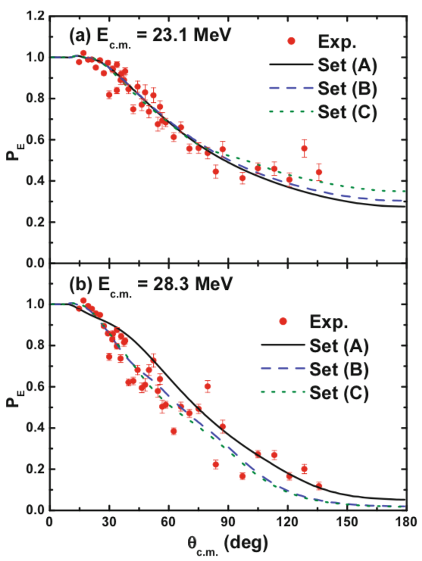
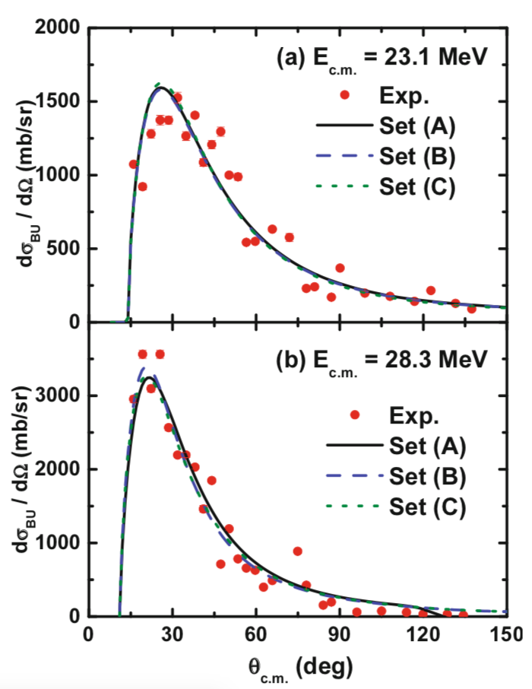
¹¹Li + ²⁰⁸Pb
elastic scattering
breakup reaction

Slide 11



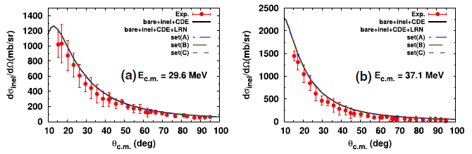
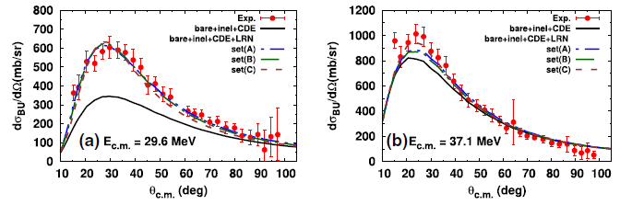
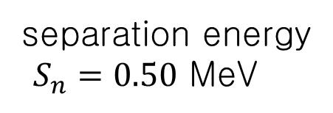

¹¹Be+¹⁹⁷AU
continuum states
¹¹Be level information
$$S_{n}=0.50$$
$$ε_{x}^{1st}=0.32$$
TRIUMF-ISAC,
PRL 118, 152502 (2017).
EPJA, 56, 42 (2020).

Slide 12
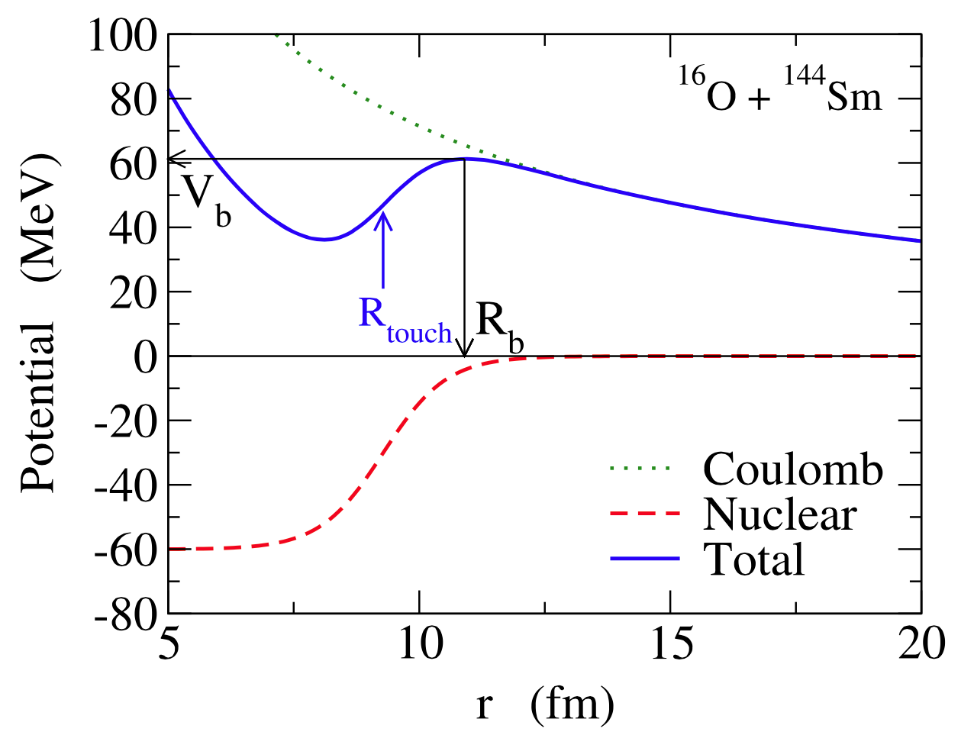
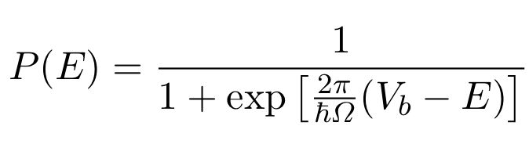
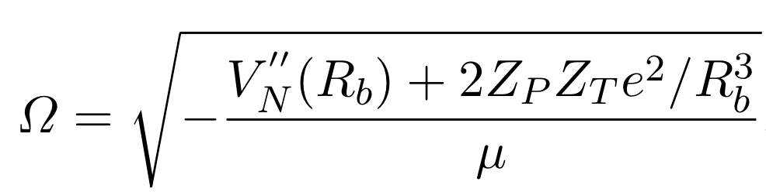
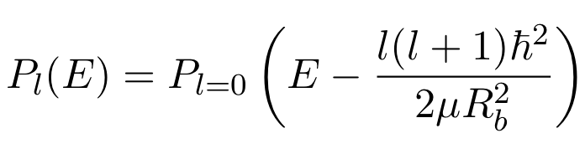
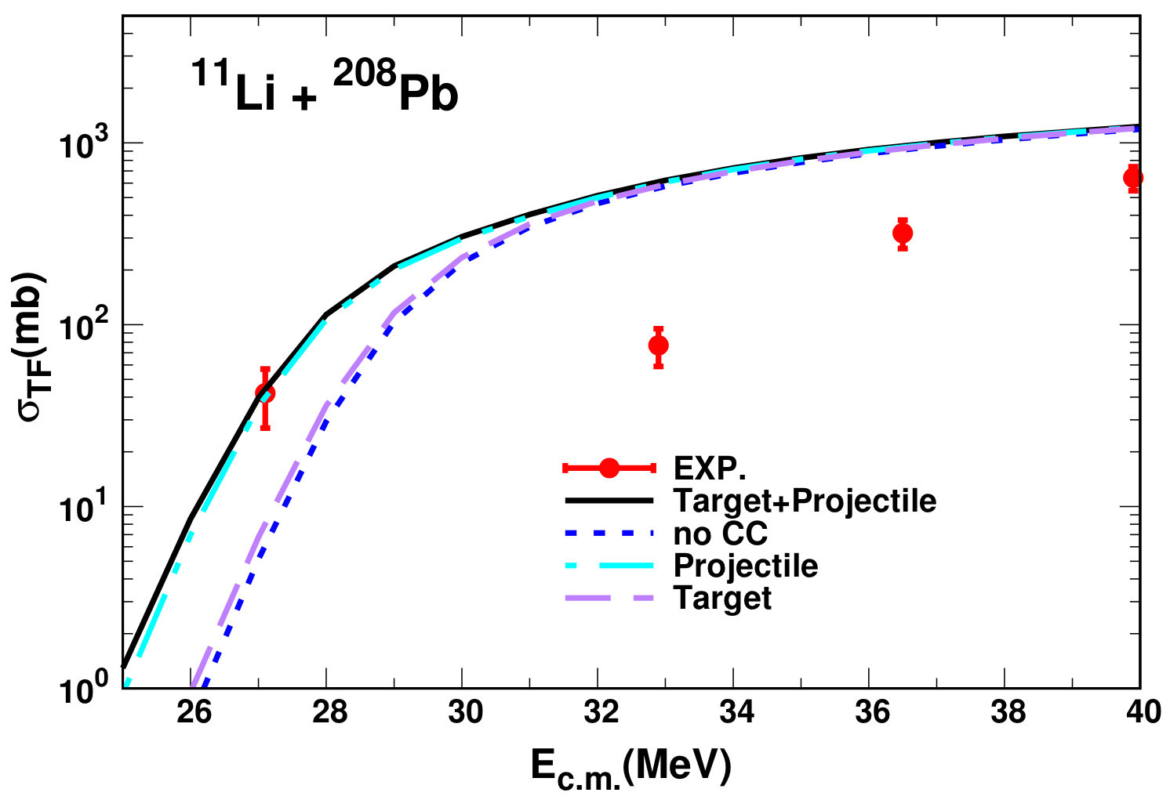

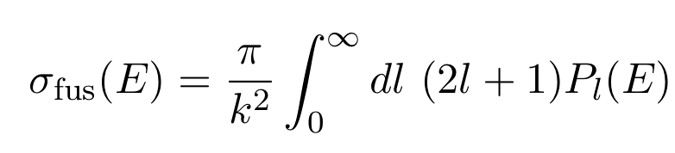
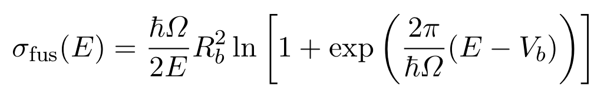
B. Fusion reaction using coupled channel (CC) method
Wong’s Formula
penetrability of parabola
:curvature
approximated penetrability of parabola
with l dependence
Why did we study the CC method ?
Total fusion cross section of ¹¹Li + ²⁰⁸Pb
C. Y. Wong, Phys. ReV. Lett. 31, 766 (1973)

Slide 13

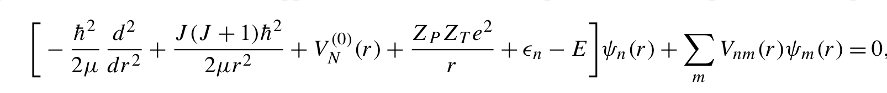
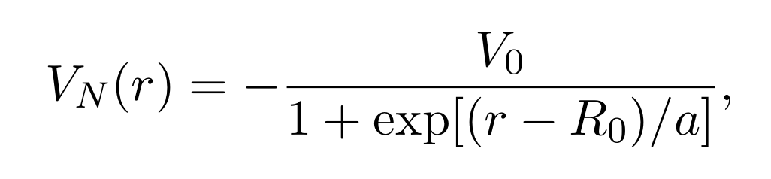
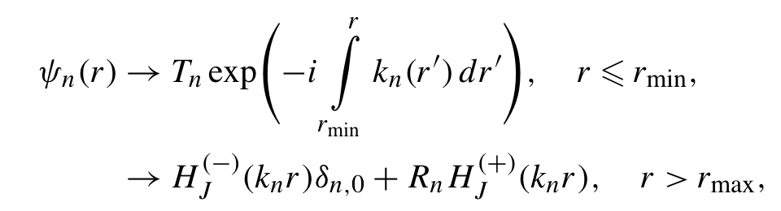
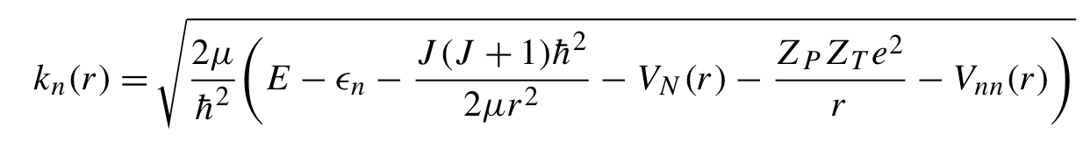
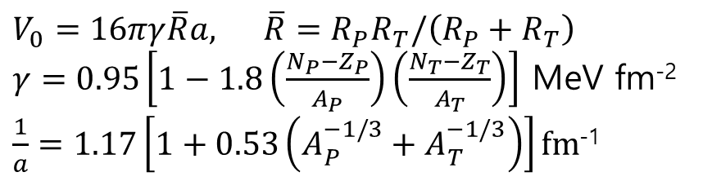
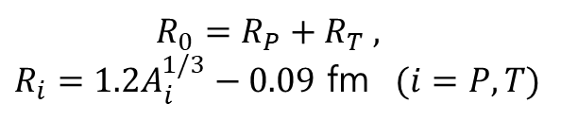
Fusion reaction with Coupled-Channel method in BPM
(Barrier penetration model)
$$R_{0}=R_{P}+R_{T} ,$$
$$R_{i}=1.2A_{i}^{1/3}−0.09$$
$$(i=P, T)$$
Akyuz-Winter potential
(global potential)
$$V_{0}=16πγ\overline{R}a, \overline{R}=R_{P}R_{T}/\left(R_{P}+R_{T}\right)$$
$$γ=0.95\left[1−1.8\left(\frac{N_{P}−Z_{P}}{A_{P}}\right)\left(\frac{N_{T}−Z_{T}}{A_{T}}\right)\right]$$
$$\frac{1}{a}=1.17\left[1+0.53\left(A_{P}^{−1/3}+A_{T}^{−1/3}\right)\right]fm$$

Slide 14
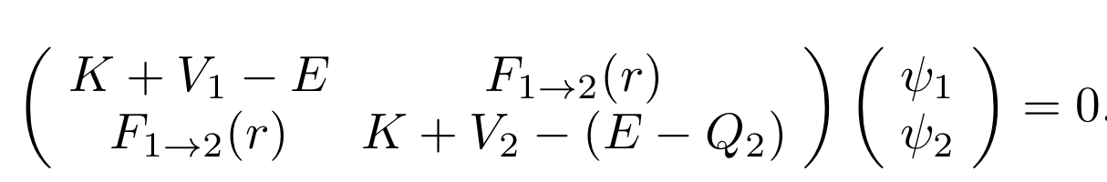




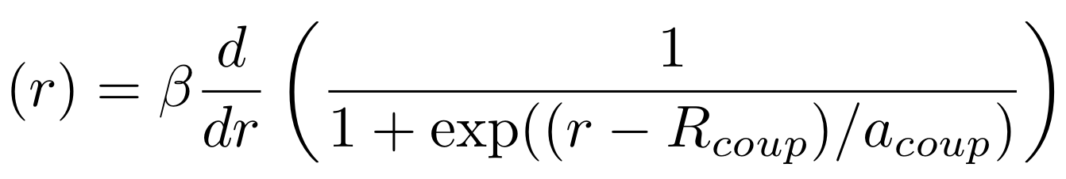
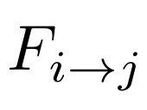
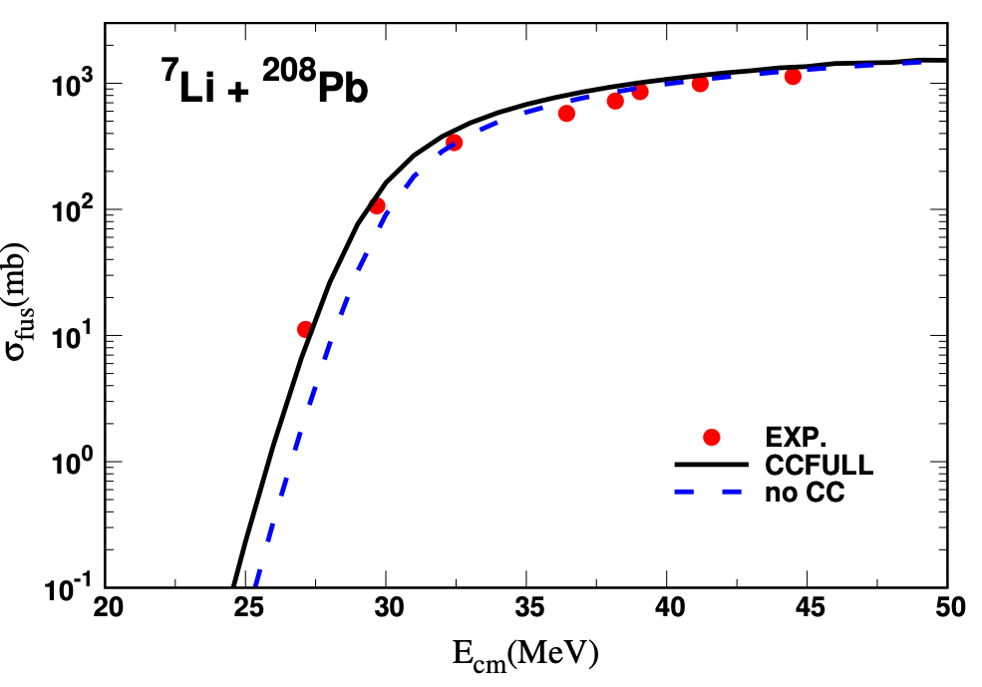
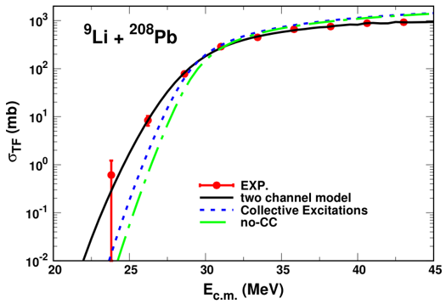
Coupled channel equation
CH1 :
2-neutron transfer
Ch2 :
:macroscopic form factor

Slide 15
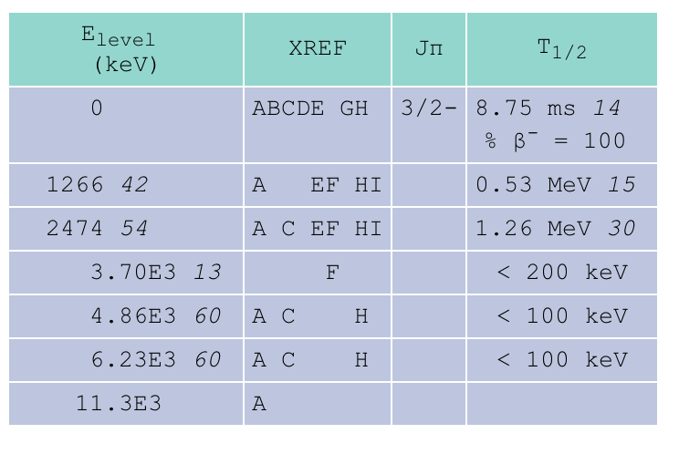

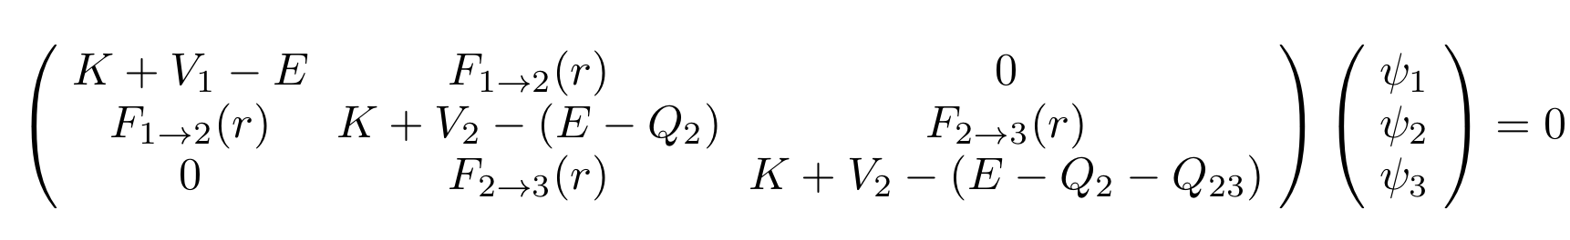



¹¹Li level information
2.474MeV
Unbound state?
1.266MeV
S2n=369KeV
ground state
dominant channel : ⁹Li + ²¹⁰Pb
⁹Li is also unstable!
transfer channel will be opened
Modification of coupled channel equation
Ch1 :
2-neutron transfer
Ch2 :
Ch3 :
2-neutron transfer

Slide 16
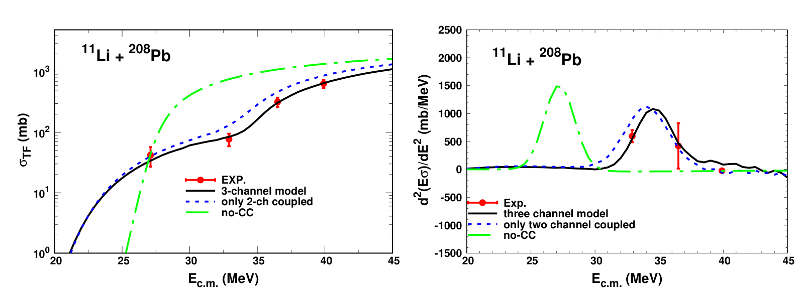
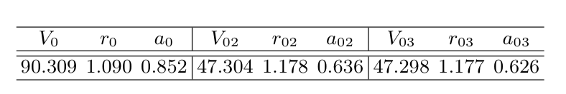
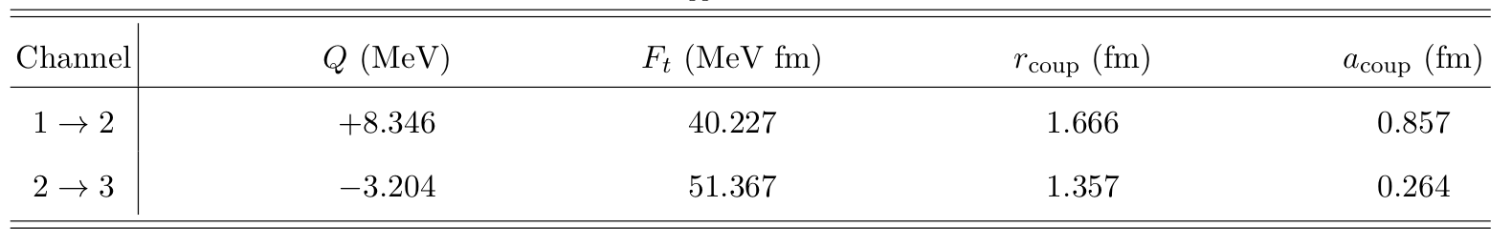
¹¹Li + ²⁰⁸Pb fusion reaction with transfer contribution
form factor
channel potential
fitting parameters
Ki-Seok Choi et. al. :PLB. 780, 455 (2018)

Slide 17
Next works :
1. Lepton scattering
Find out the way of applying nonrelativistic nuclear models.
Investigate the relativistic effect.
Obtain the precise limits of weak form factors.
2. Low energy reaction
Study other halo system like ¹⁵C using CC method.
Exploit continuum discretized coupled channel (CDCC) approach.

Slide 18
THANK YOU

