Slide 1
Beam Diagnosis System
Seonghak Lee, Hyunchul Kim, Dong Ho Moon,
Sanghoon Hwang
Chonnam National University, KRISS
2020/05/15 LAMPS Collaboration Meeting

Slide 2
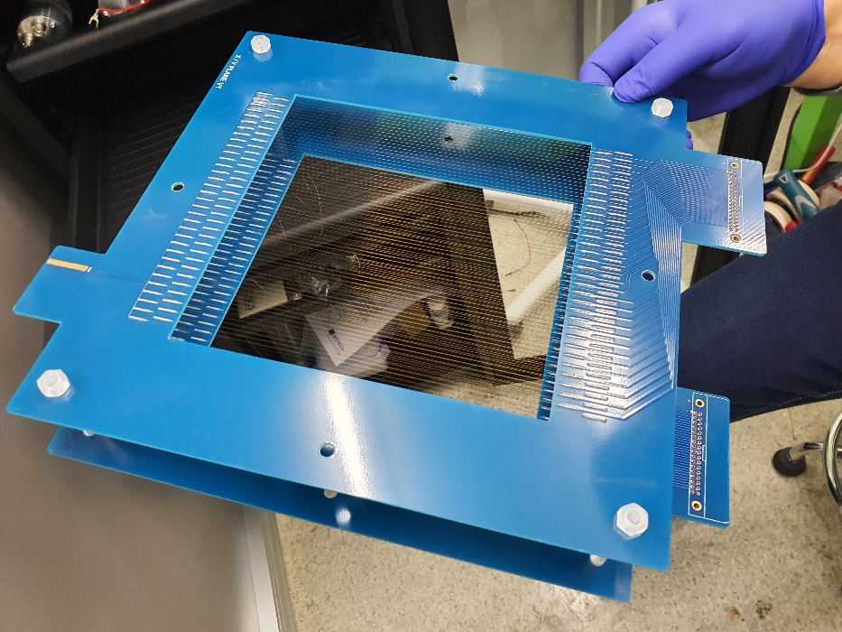
News from CNU
Clean room installation : next Tuesday
Hard type 1500 mm x 1500 mm
Cleanliness class 1000 same as KRISS requirement
Price : 5556000 won
Purchase of Equipment to construct
Reopen KRISS from next week
Jaein will visit and restart wiring
To do list
Purchase of Gas (P10) and regulator
Making chamber frame and spacer
Test trigger system
Plastic Scintillator
PMT
BDC
PMT
Plastic Scintillator

Slide 3
LAMPS 3D (이형준 학생 작품)

Slide 4
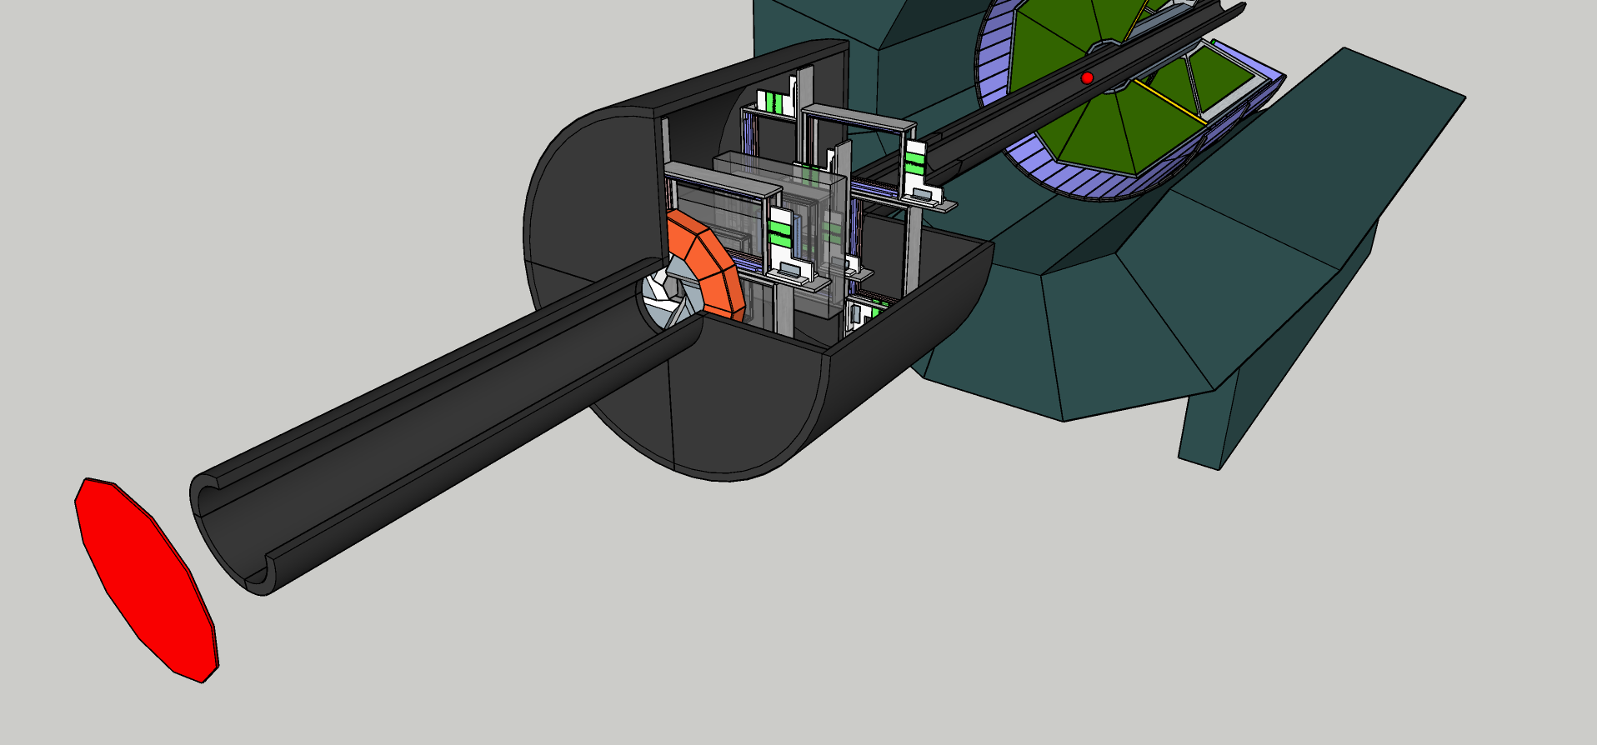
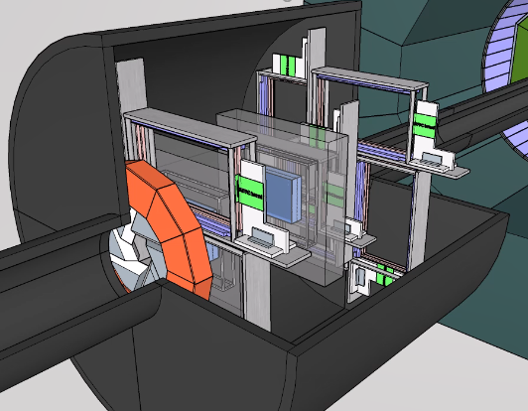
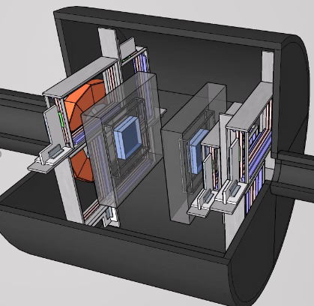
LAMPS 3D (이형준 학생 작품)
Vacuum chamber

Slide 5
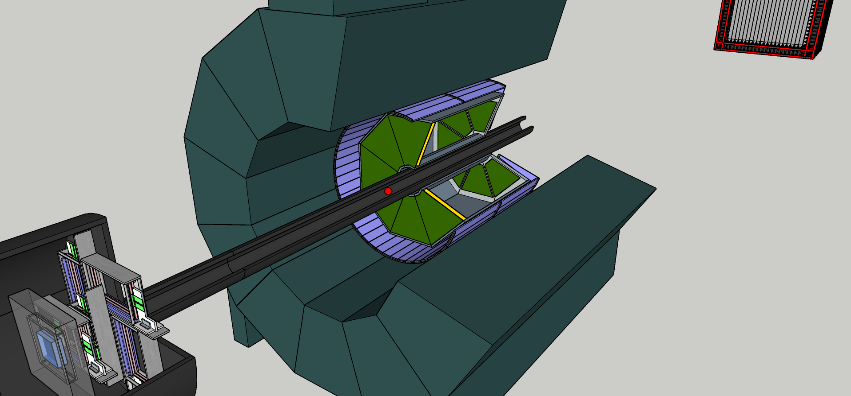
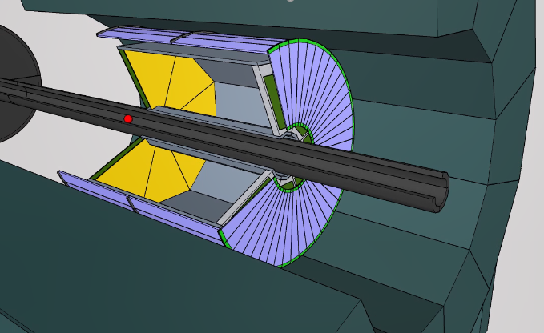
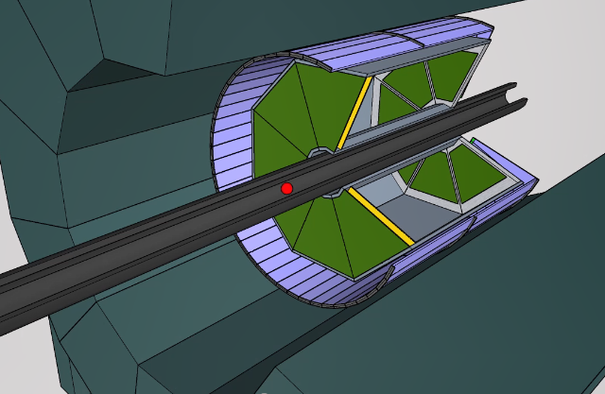
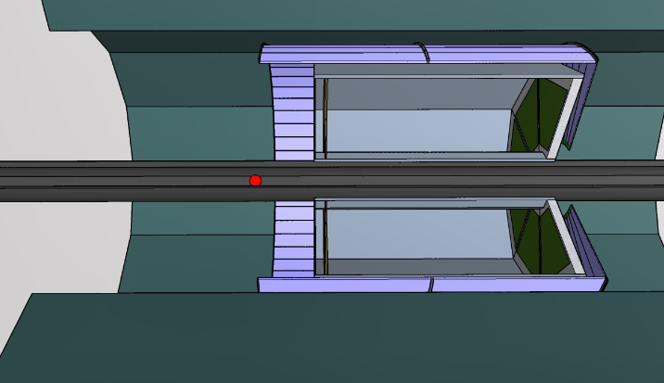
LAMPS 3D (이형준 학생 작품)
Solenoid

Slide 6
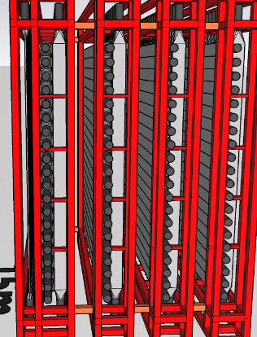
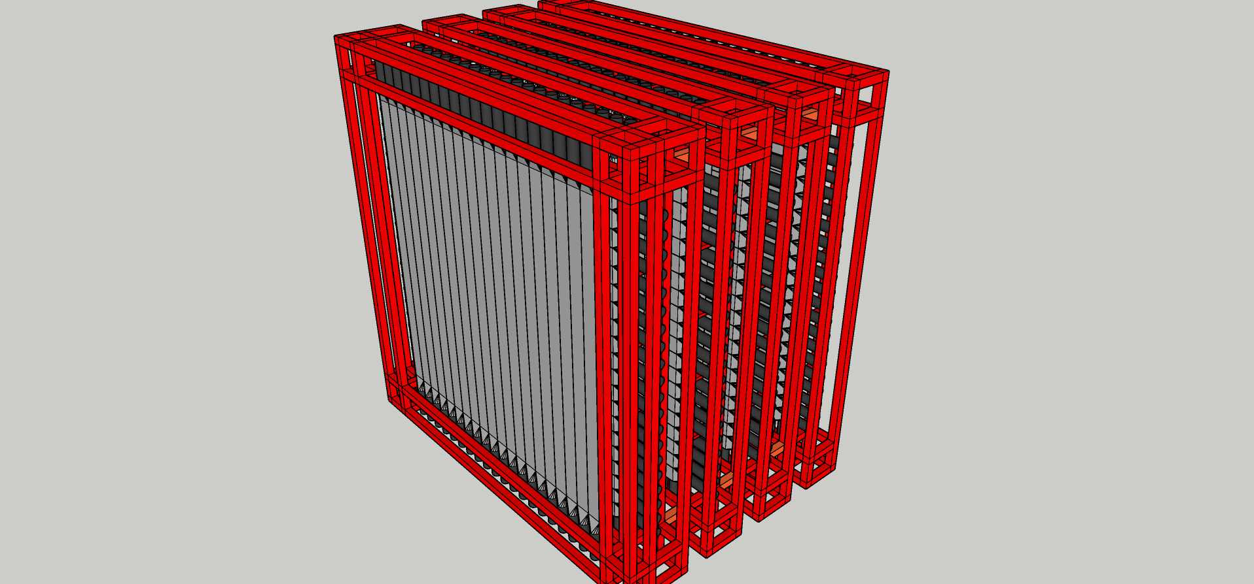
LAMPS 3D (이형준 학생 작품)
Neutron Detector (V : Veto, N : Neutron detector)
VNNNN (Current design)
VNVNVNVN
VNNVNN

Slide 7
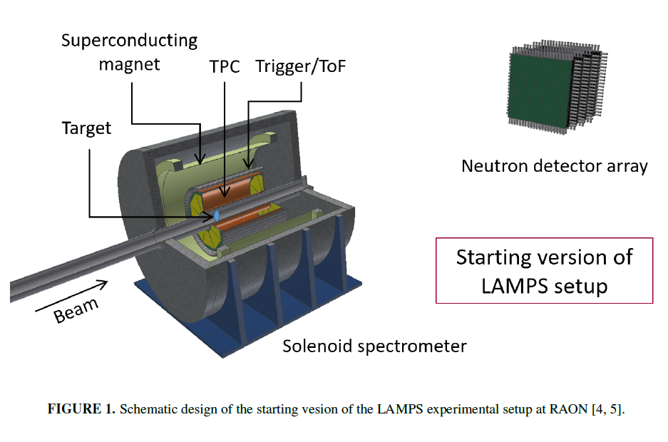
전시 모형 만들기, 생각해 볼 것들
빔라인 TPC 까지만 만들 것인가?
Target 위치
TOF 는 제대로 구현되었는가?
중성자 검출기 최종 시나리오는 ? VNNVNN or VNVNVNVN
Anything else?

Slide 8
Summary & Plan

Slide 11
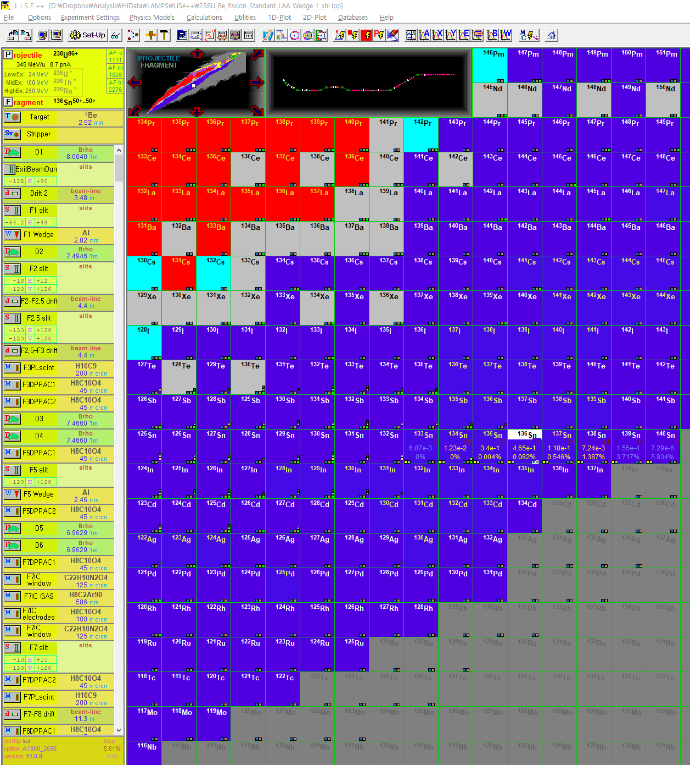
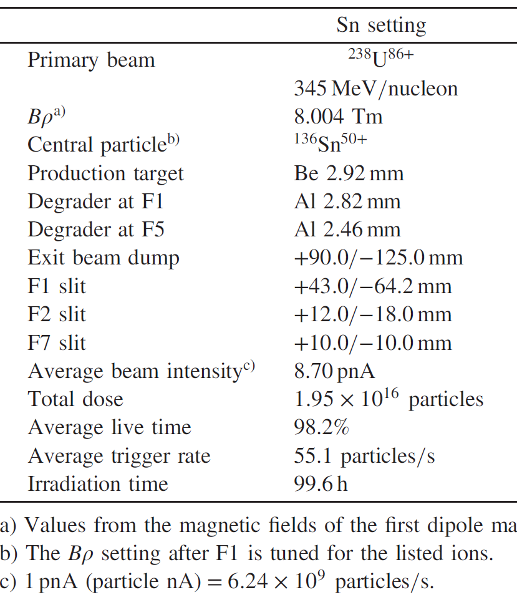
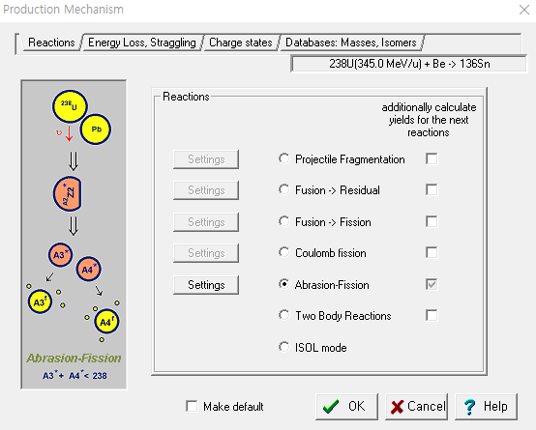
Get Yield of ¹³⁶Sn by LiSe++
In order to verify if our understanding would be correct or not, we reproduced yield of ¹³⁶Sn by LiSe++
BigRIPS results : Y. Shimizu et al., JPSJ 87 (2018) 014203

Slide 12
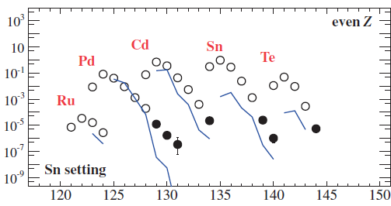
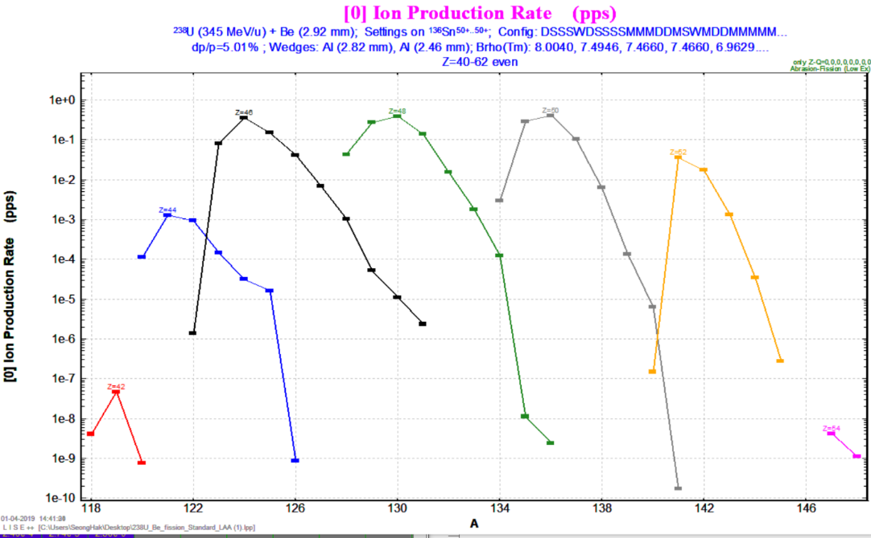
Get Yield of ¹³⁶Sn by LiSe++
Results
Sn
Not same but similar order of magnitude for the yield of ¹³⁶Sn

Slide 13
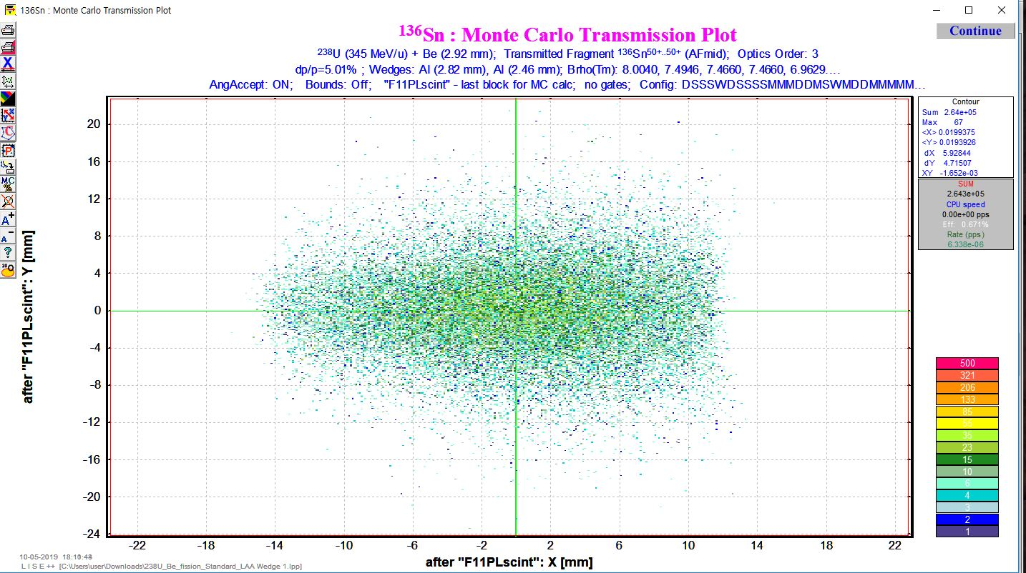
Beam Size Study
Final observed beam size : x (-1.4 ~ 1.2 cm) and y (-1.2 ~ 1.2 cm)
Possible to trace ¹³⁶Sn beam step by step

Slide 14
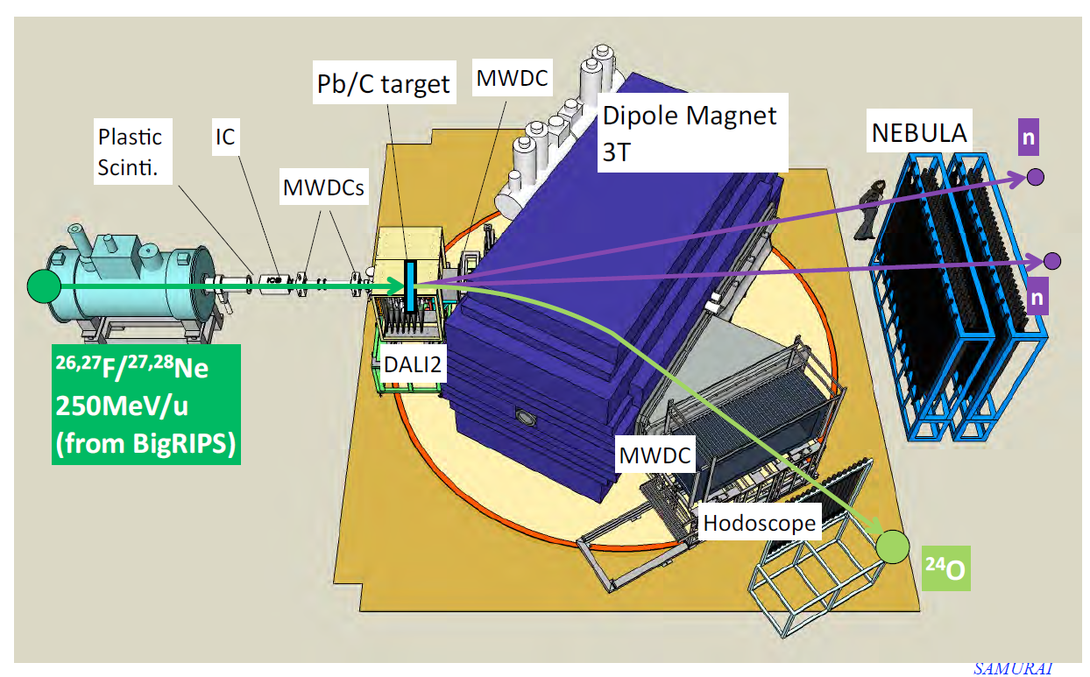
SMURAI Detector

Slide 15
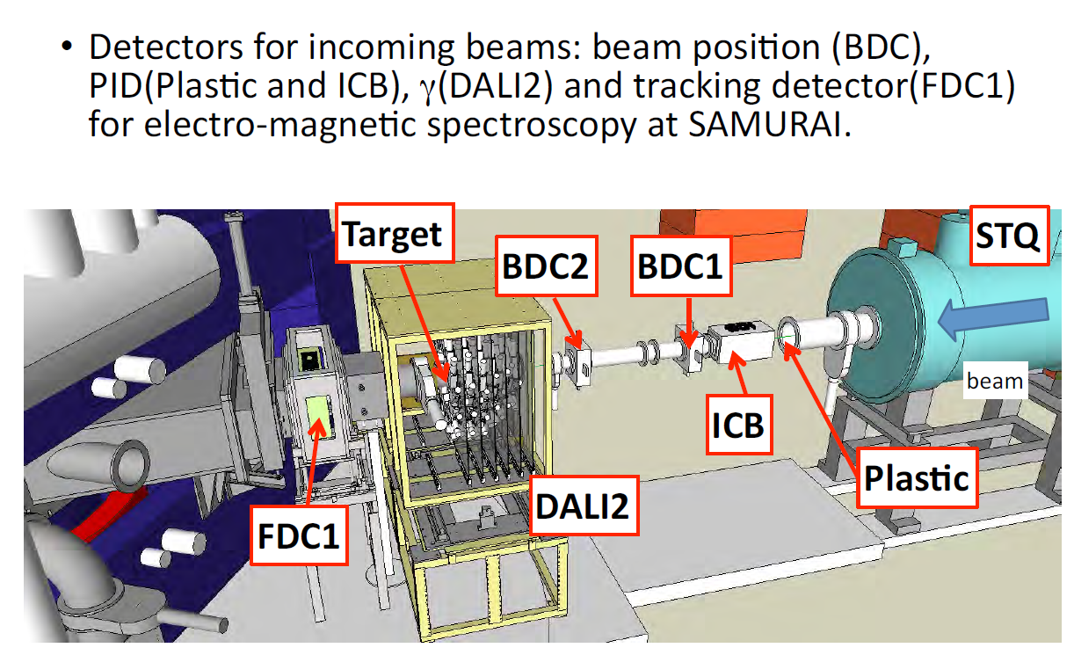
Beam Profile Detector in SMURAI

Slide 16
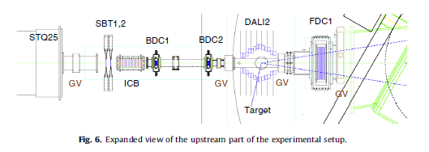
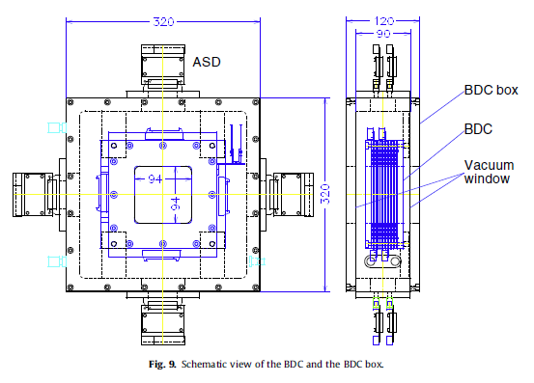
SMURAI BDC (Beam Drift Chamber)
NIMB 317 (2013) 294-304
Walenta type Drift chamber
2.5 mm drift length
i-C₄H₁₀ at 50-100 torr
Anode, potential wire diameter of 20 μm(Au-W), 80 μm(Au-Al)
Cathode (gas window) 8 μm^{t} Al-Kapton
Effective area : 8 cm x 8 cm

Slide 17
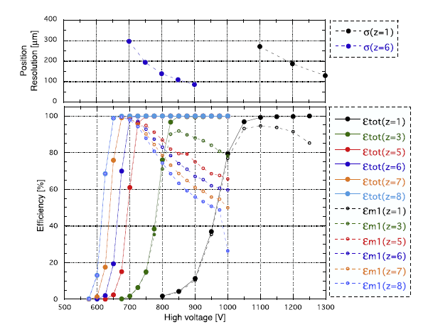
SMURAI BDC (Beam Drift Chamber)
NIMB 317 (2013) 294-304
Walenta type Drift chamber
2.5 mm drift length
i-C₄H₁₀ at 50-100 torr
Anode, potential wire diameter of 20 μm(Au-W), 80 μm(Au-Al)
Cathode (gas window) 8 μm^{t} Al-Kapton
Effective area : 8 cm x 8 cm
Requirements
Position resolution : ~ 100 μm
Efficiency : 100 % at > 600 V

Slide 18
SMURAI BDC (Beam Drift Chamber)
Beam Rate Estimation : LiSe++ (Seonghak Lee)
Expected Beam : ¹³²Sn : 8 x 10⁺⁶ pps with 133.2 MeV/u
To determine specific conditions of Drift Chamber, we will use GarField program (Dr. Hwang with Seonghak Lee)

Slide 19
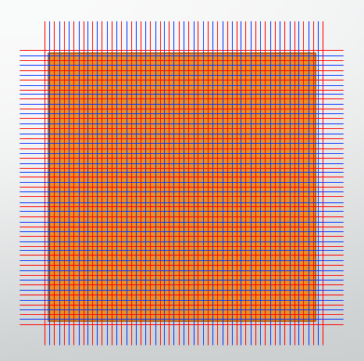
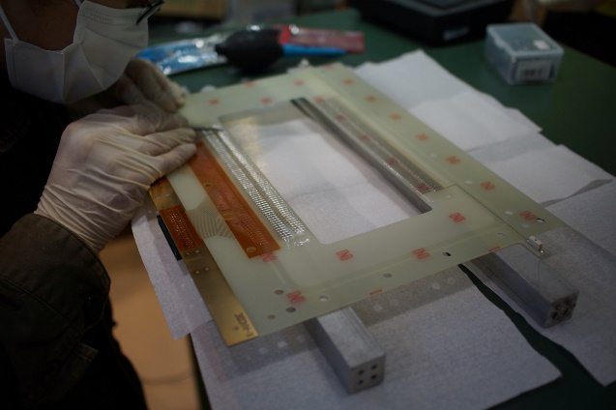
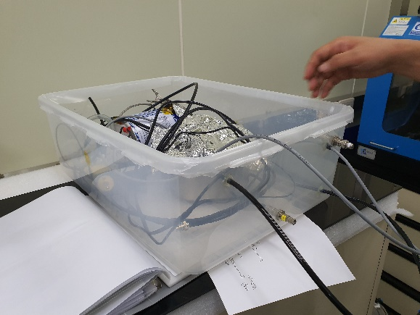
BDC Construction
Prototype Design
Configuration : xx’yy’ (4 planes)
Sensor Wire : 32ch
Potential Wire : 33ch
Drift Length : 2.5 mm
32 * 2.5 * 2 = 160 mm
Active Area : 160 x 160 mm²

Slide 20
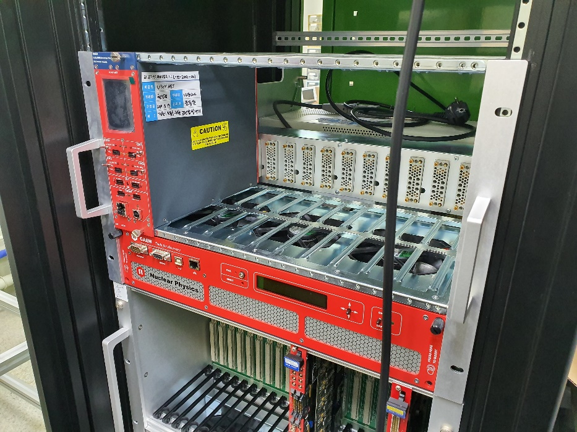
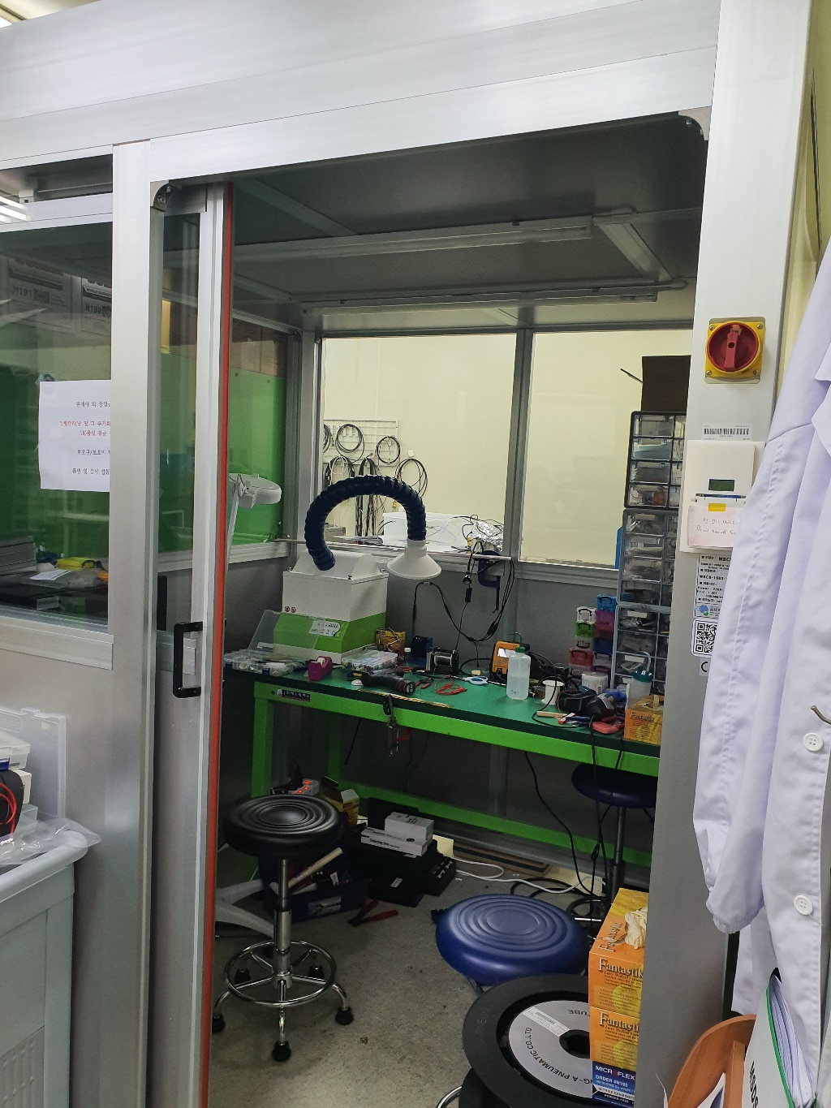
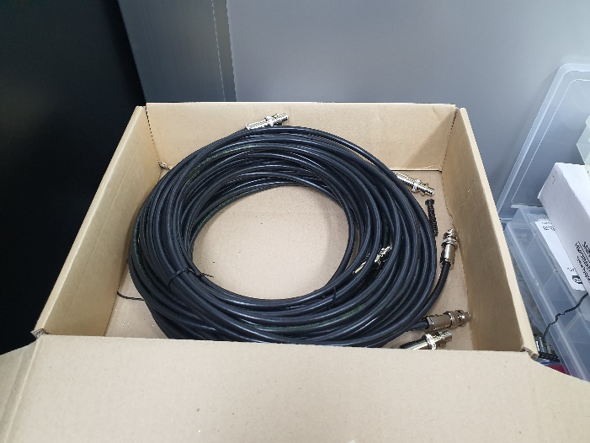
BDC Construction
Place for wiring
NIM Crate & Power Supply & SH Cable

Slide 21
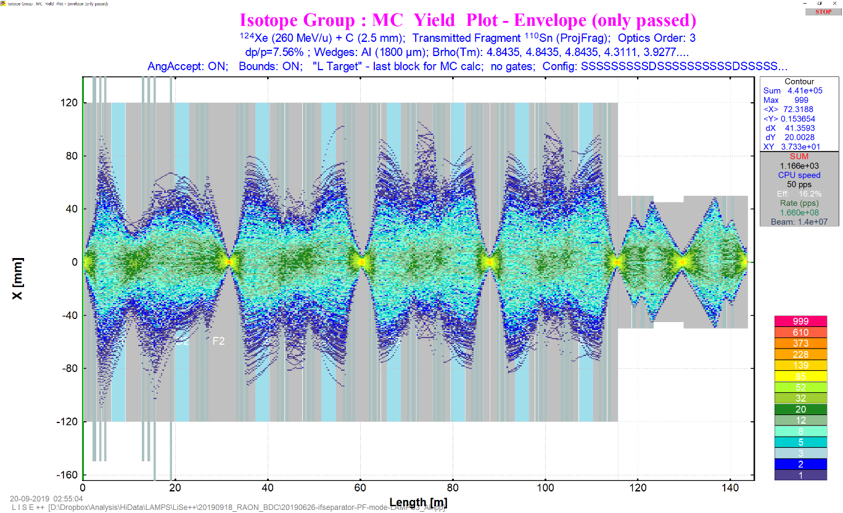
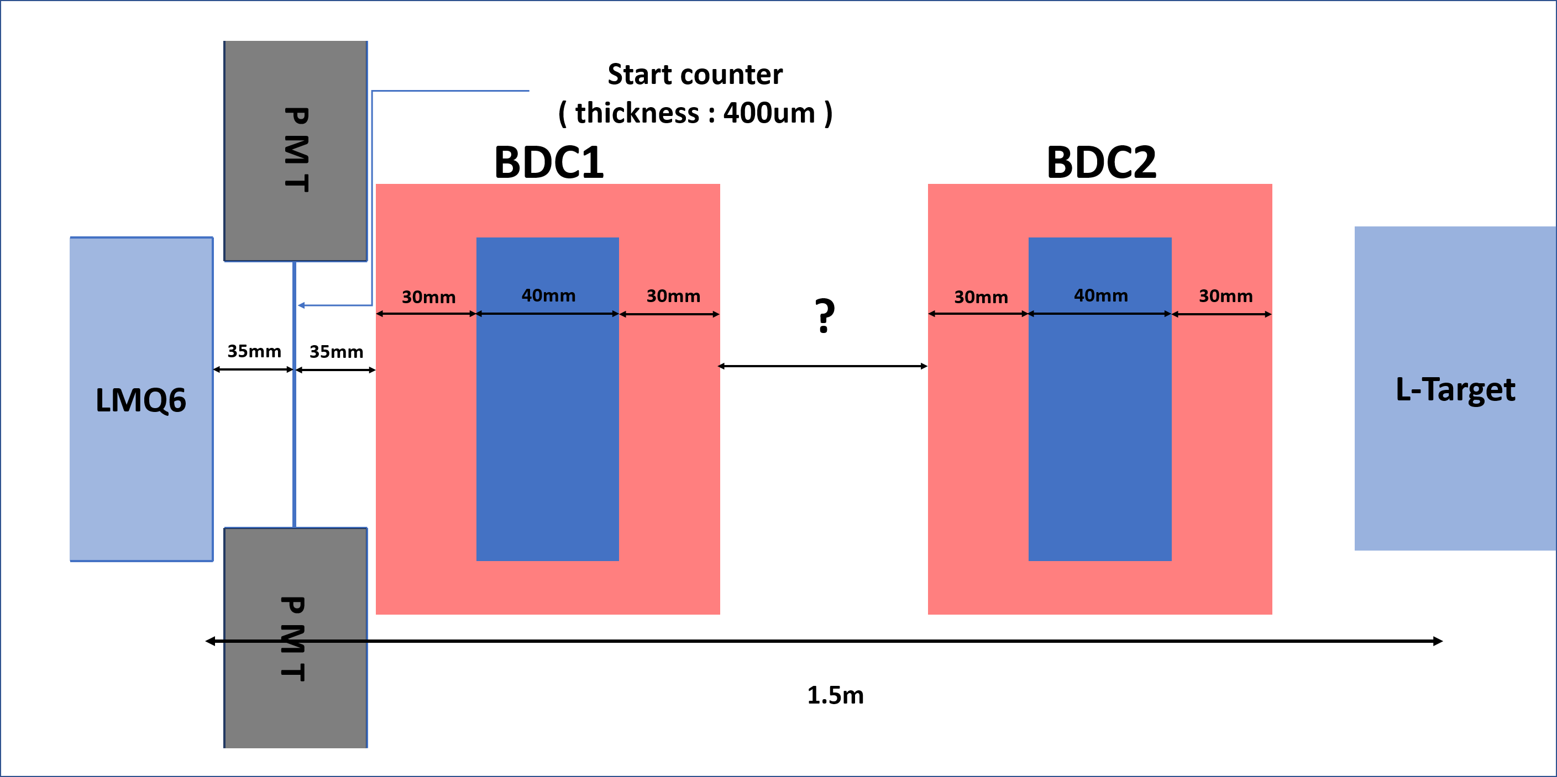
Beam Study with LiSe++
¹²⁴Xe (260 MeV/u) Beam and¹⁴C target
Simple layout
Beam size at L-Target (x)
: ± 4.2 mm

Slide 22
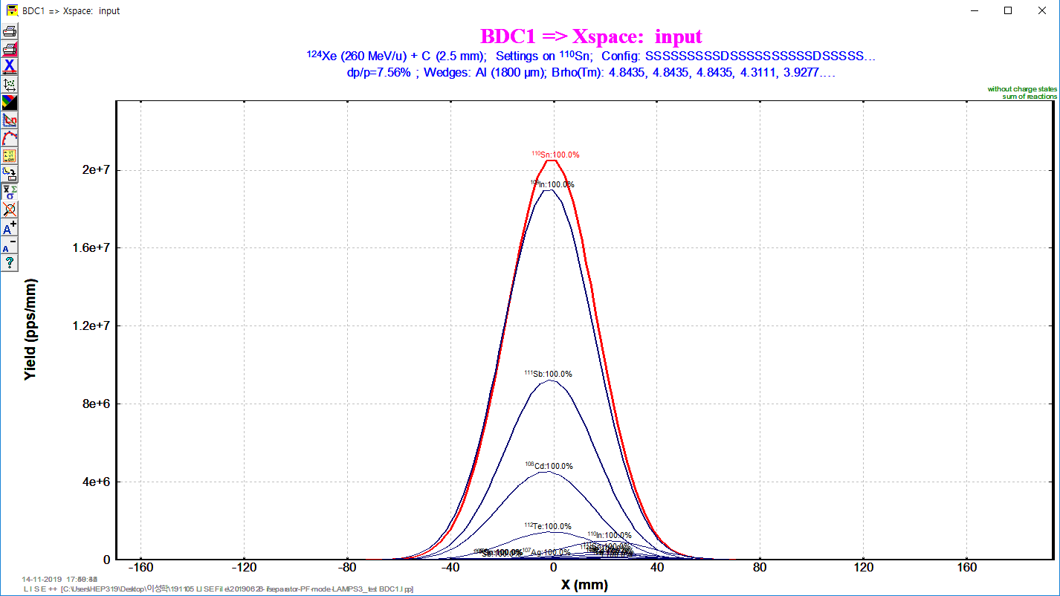
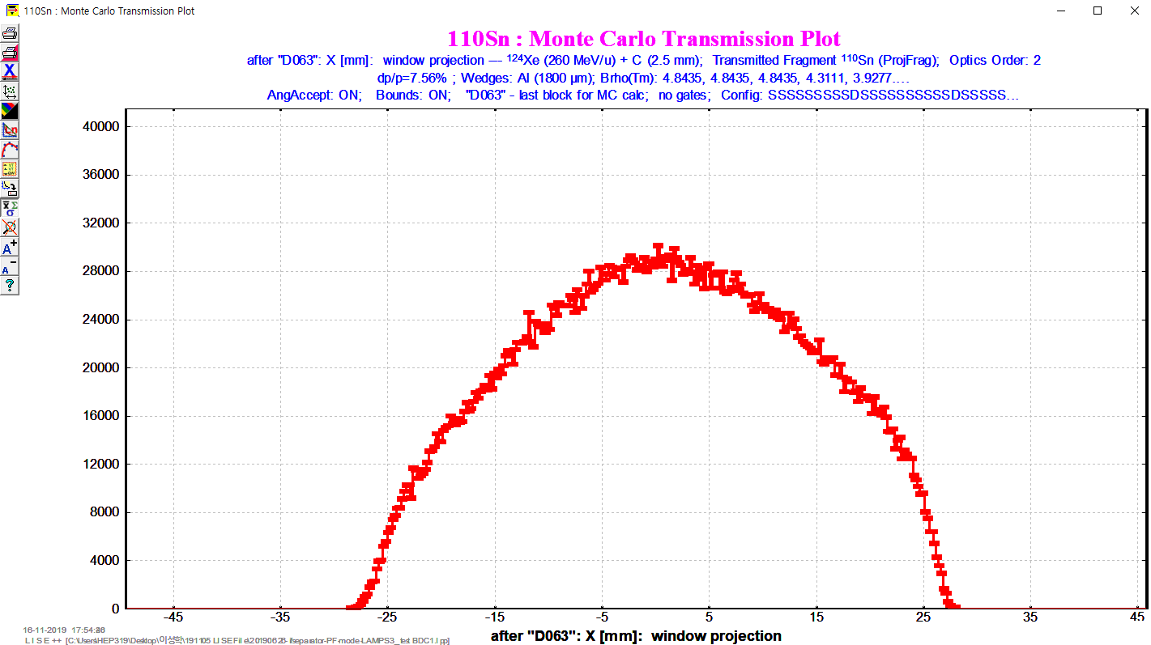
Beam Study with LiSe++
Comparison of Distribution Method and MC Method
Distribution method : fast analytical method to calculate the fragment transmission through all optical blocks of the spectrometer.
MC method : developed for a qualitative analysis of fission fragment kinematics and utilized in the Kinematics calculator. (random event generation one by one)
Distributions are quite different but MC method is more reliable due to considering more effect of optical matrix.
X axis beam size
at BDC1
X axis beam size
at BDC1

Slide 23
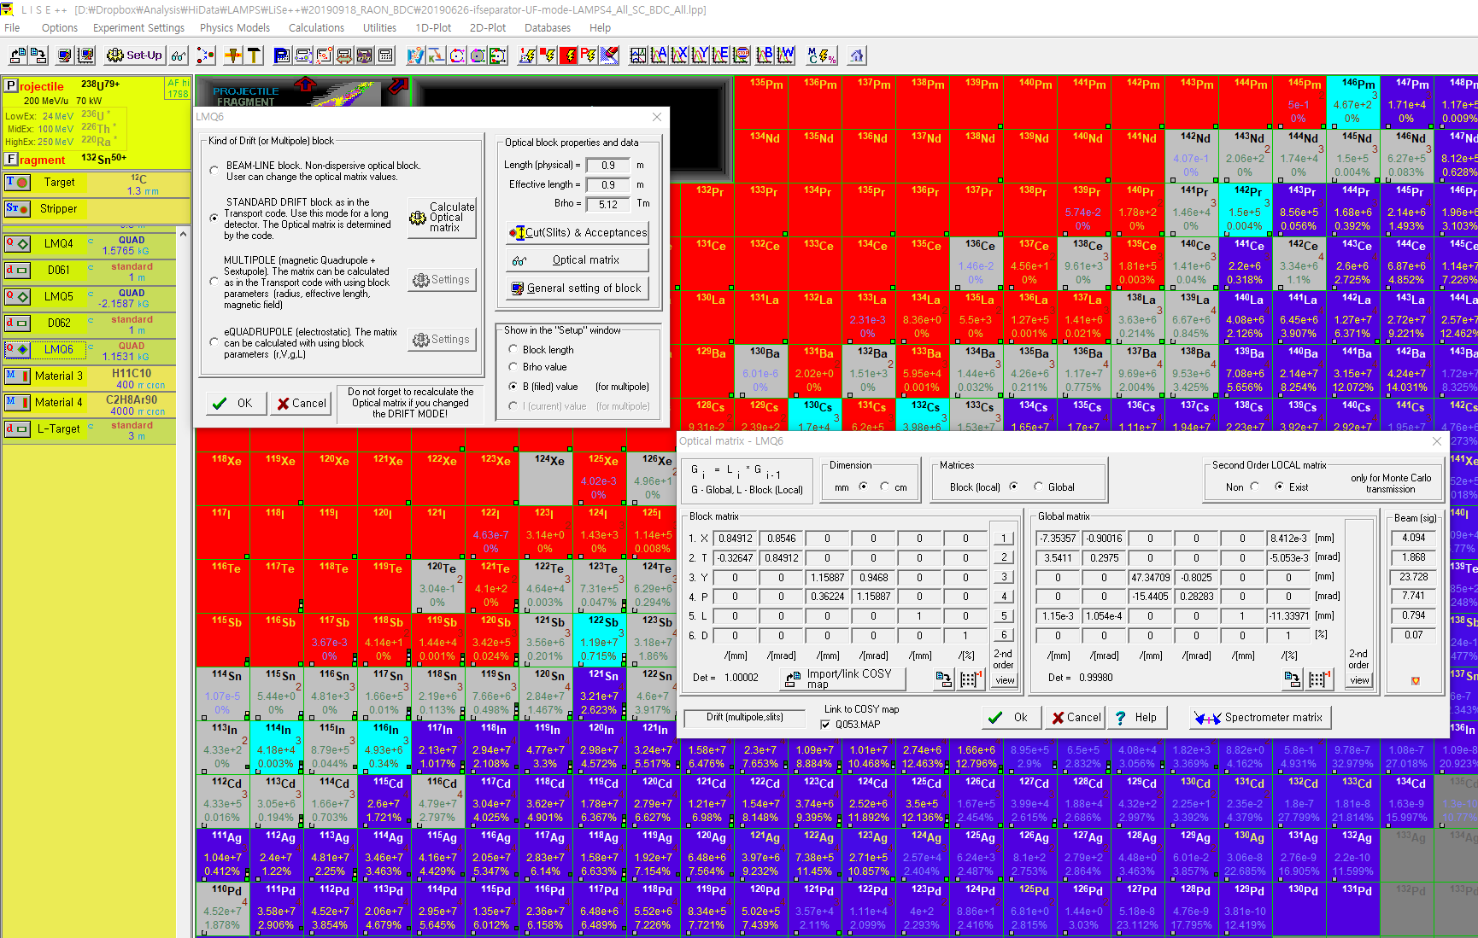
Beam Study with LiSe++
MC method in IF system (possible up to 2nd order calculation)
Local matrix
(1st order)
Global matrix
(1st order)
2nd order optical matrix is defined here

Slide 24
Beam Study with LiSe++
MC method in IF system (possible up to 2nd order calculation)
1st order calculation
X, Θ, Y, Φ, L, δ
X₁
Θ₁
Y₁
Φ₁
L₁
δ₁
X₂
Θ₂
Y₂
Φ₂
L₂
δ₂
L : Beam pulse length
δ : Relative momentum dp/p
1st order
Transformation
Matrix
=
2nd order calculation
X², Θ², Y², Φ², L², δ²
1st order matrix : 6 x 6
2nd order matrix
In only 1st order matrix,
2nd order elements are empty

Slide 25
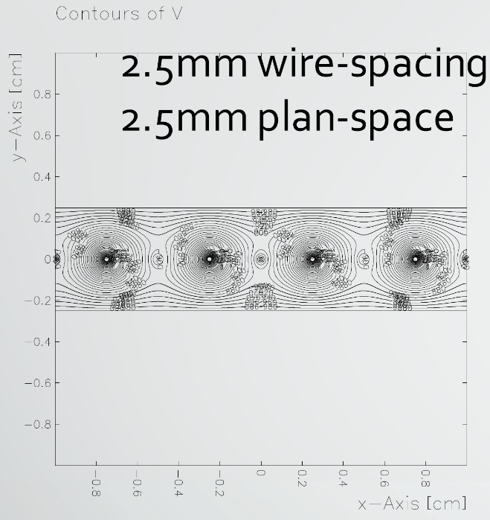
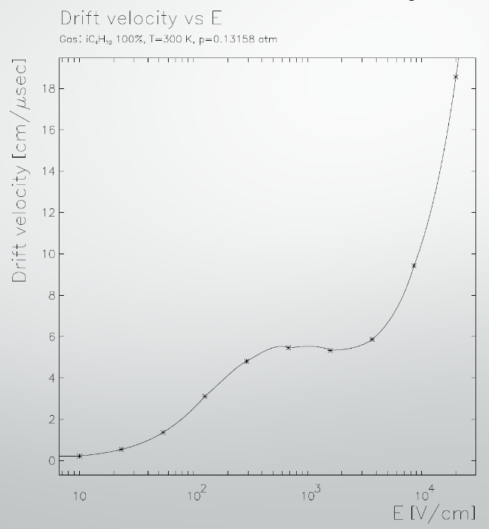
Beam Study with LiSe++
Plastic Scintillator
PMT
BDC
PMT
Plastic Scintillator

