Slide 1
Current Status of LAMPS TPC
RISP, IBS
이효상, 이청수
2020.08.13.

Slide 2
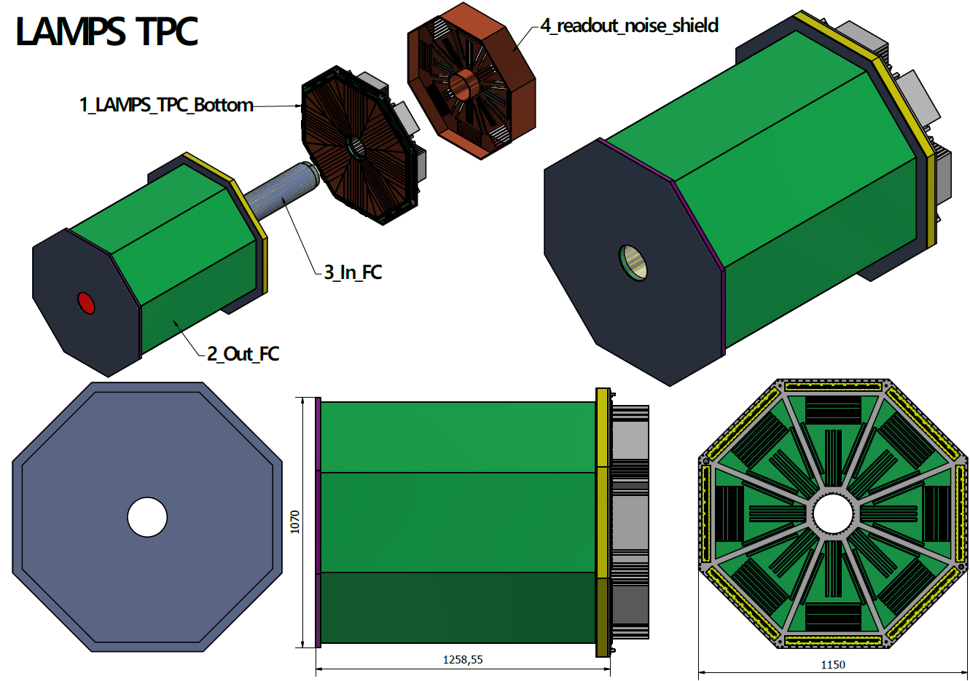
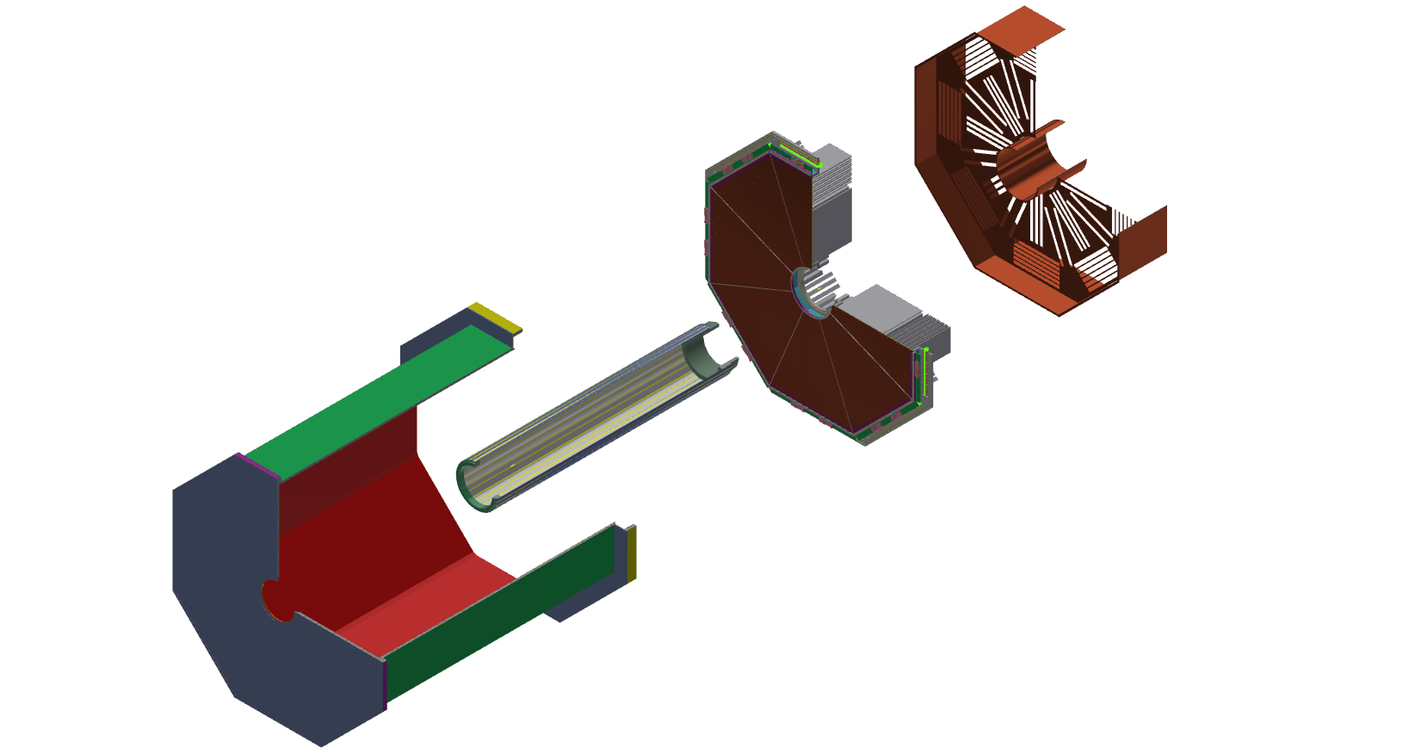
LAMPS TPC design
Drift length : 1200mm

Slide 3
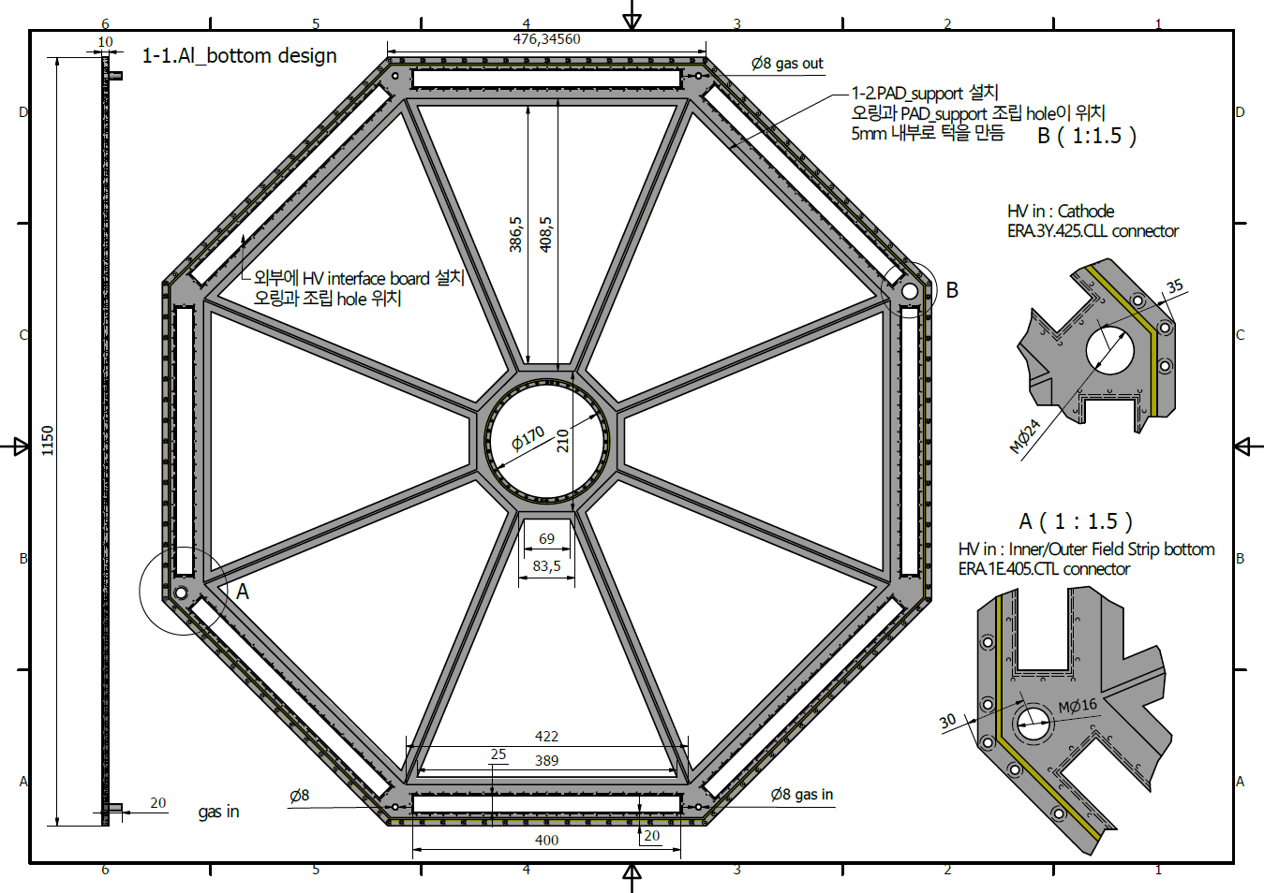
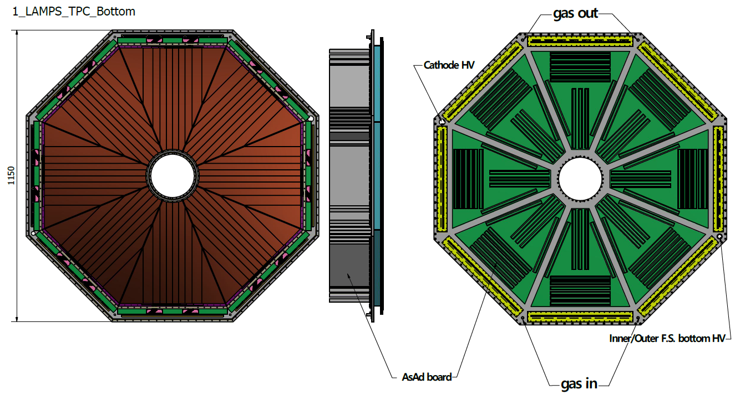
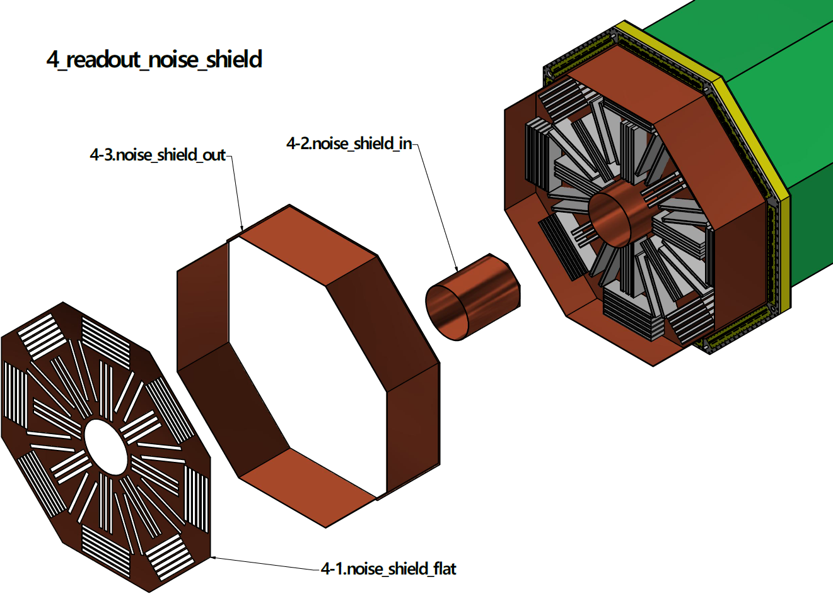
LAMPS TPC design – Readout

Slide 4
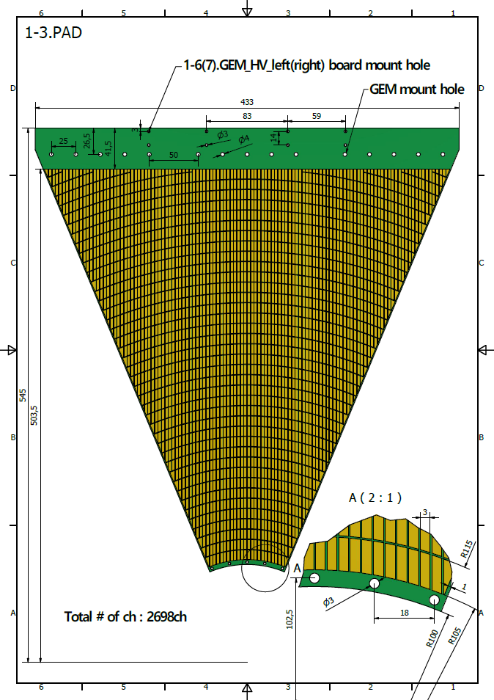
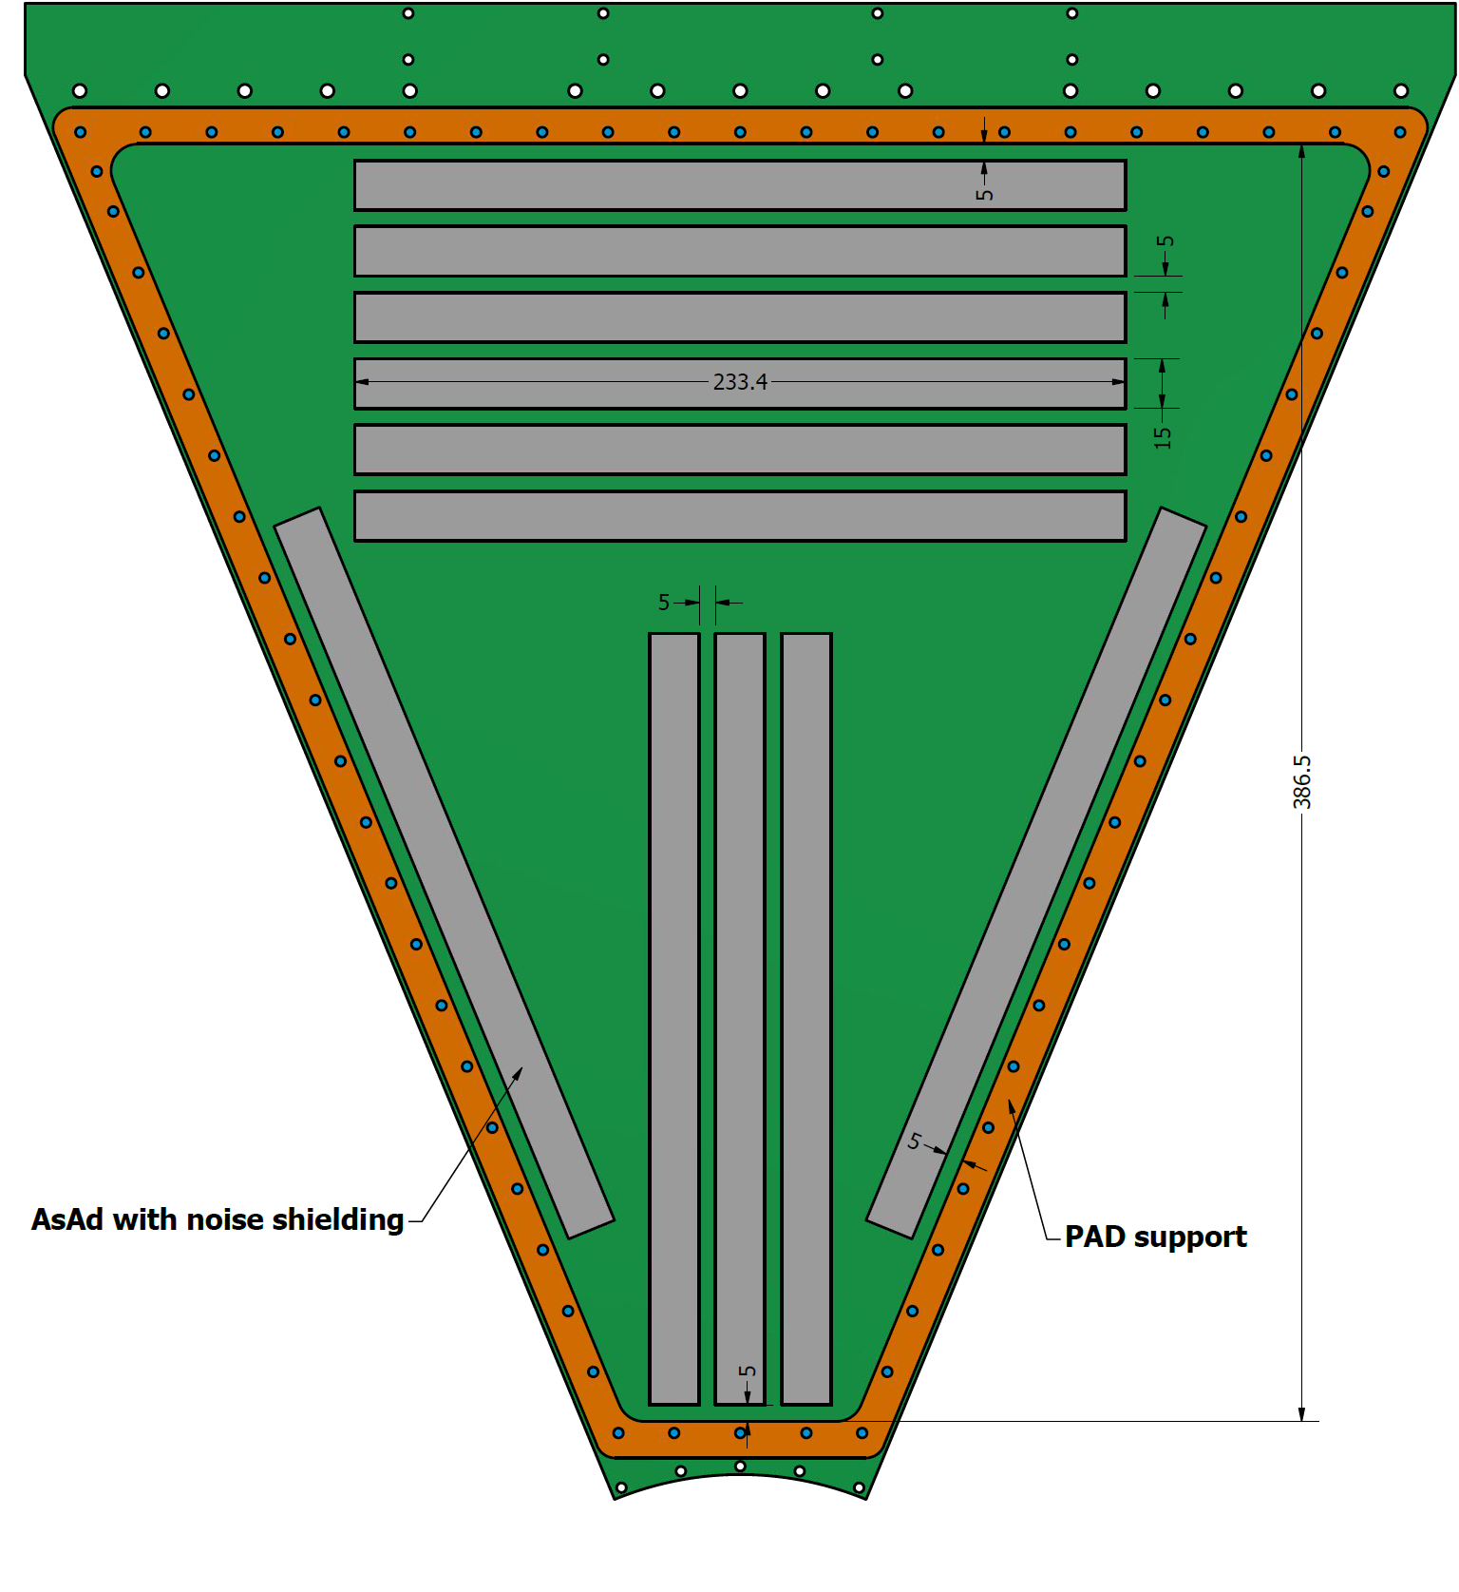
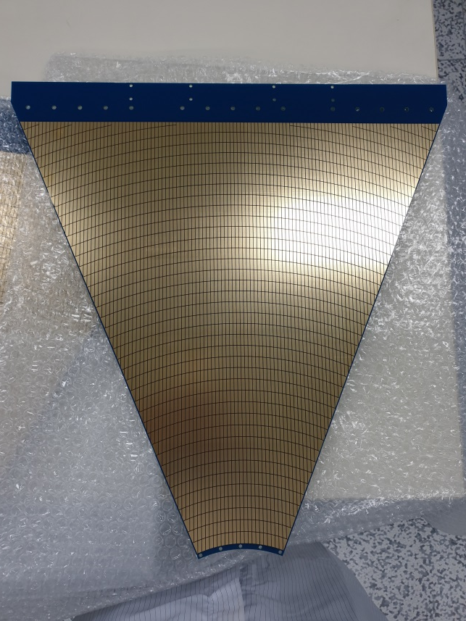
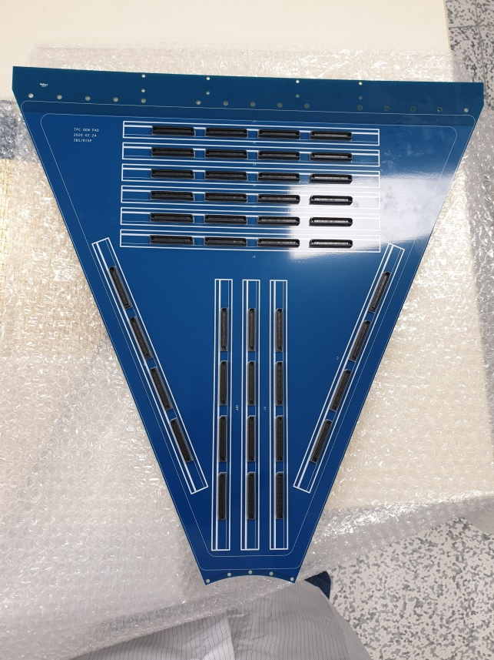
LAMPS TPC design – Readout : PAD
PAD size ~ 3 mm x 10 mm
# of PAD PCB = 9 (8 for TPC, 1 for GEM test)
# of PAD / 1section = 2,689ch (11 AsAd)
Total # of PAD = 21,512ch (88 AsAd – 22CoBo – 3μTCA)

Slide 5
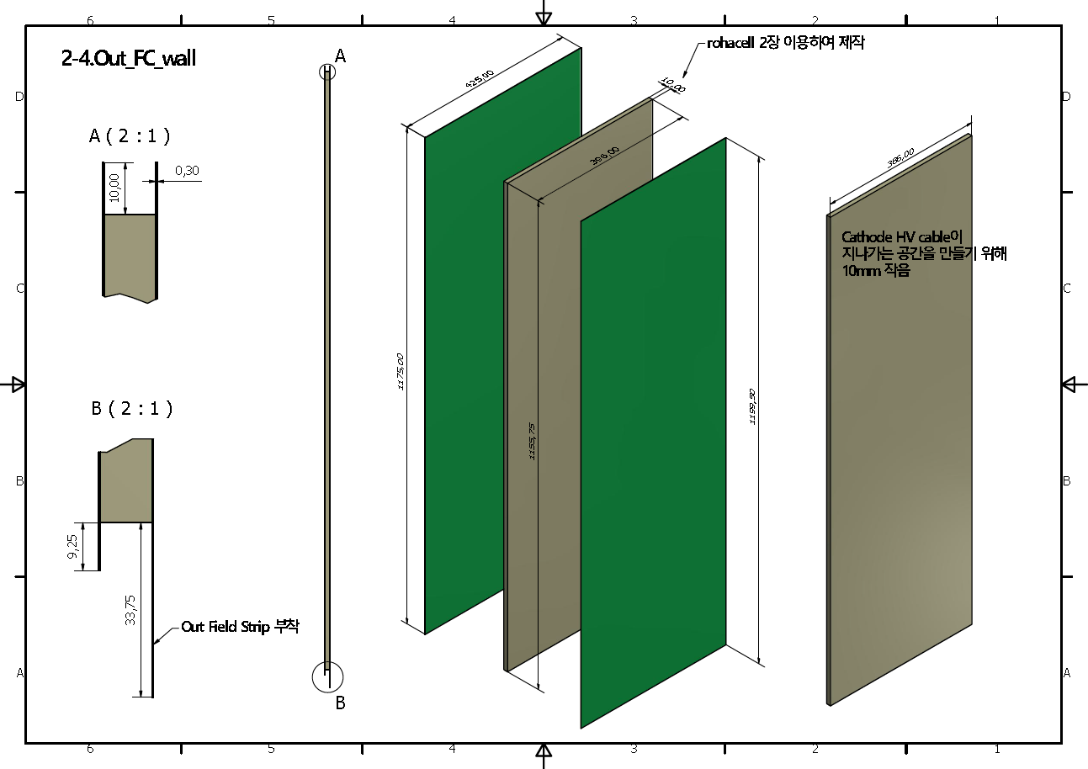
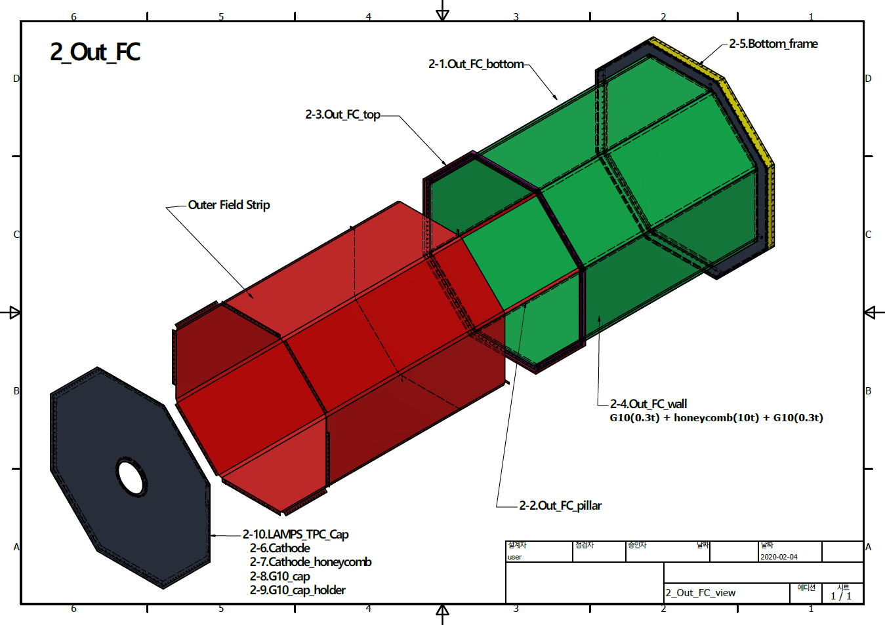
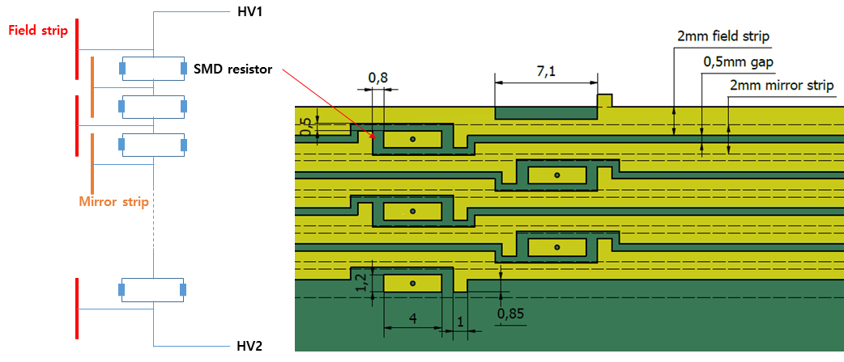
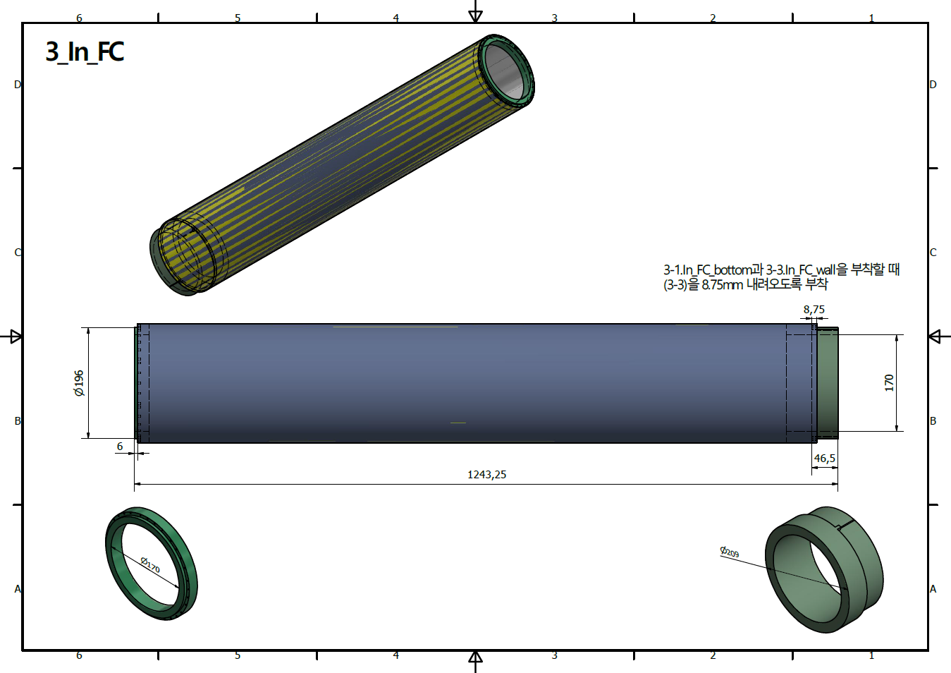
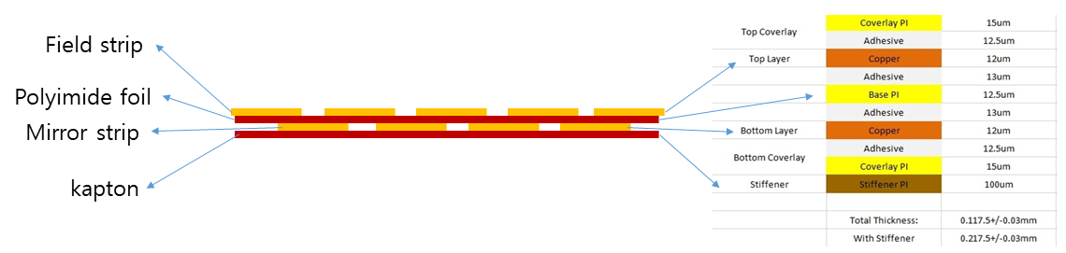
LAMPS TPC design – FieldCage

Slide 6
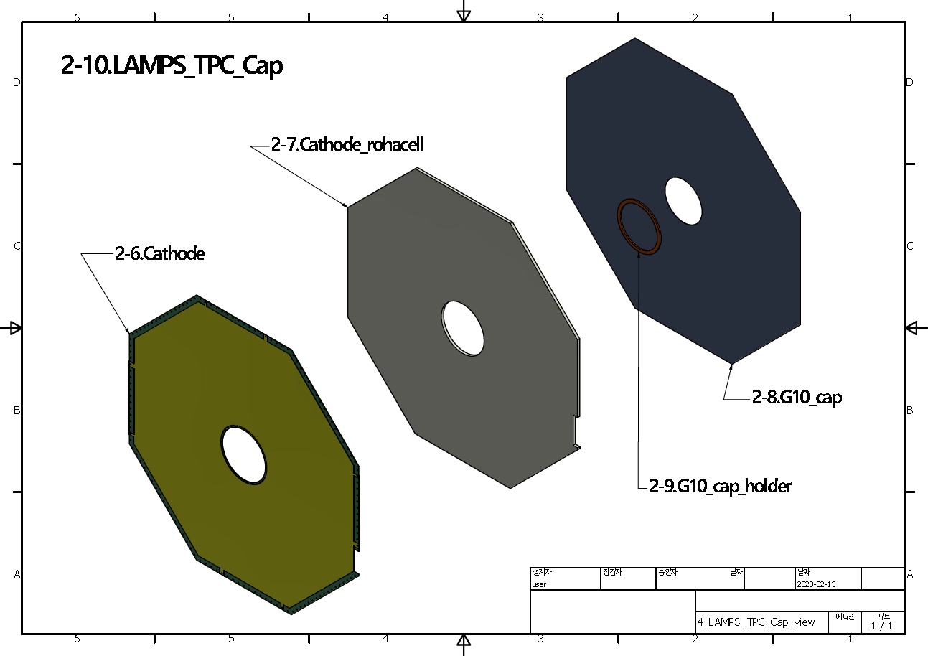
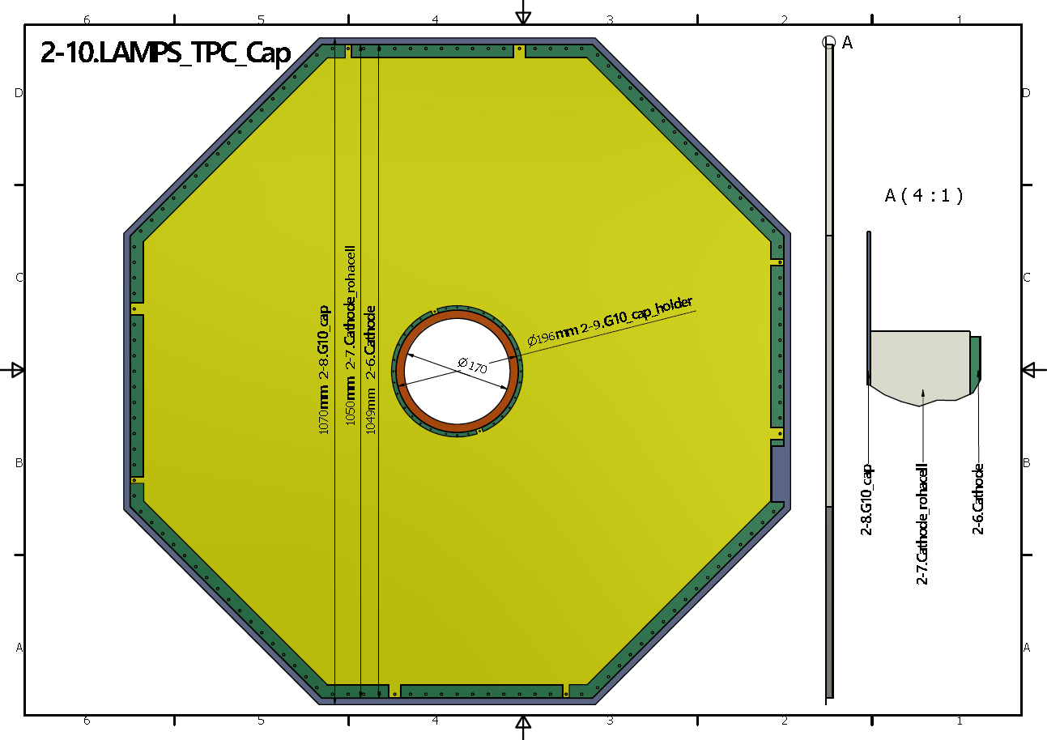
LAMPS TPC design – EndCap

Slide 7
LAMPS TPC design – Material budget
Layer # | Material | Thickness t [mm] | X₀ [mm] | t/X₀ [%]
1 | air | 85 | 304200 | 0.02794214
2 | Al | 0.0002 | 89 | 0.0002247
3 | PI(Kapton) | 0.0254 | 286 | 0.0088811
4 | Epoxy | 0.007 | 352 | 0.00198864
5 | G10 | 0.3 | 167.608 | 0.17898907
6 | Epoxy | 0.007 | 352 | 0.00198864
7 | PI(Kapton) | 0.1 | 286 | 0.03496503
8 | Epoxy | 0.007 | 352 | 0.00198864
9 | Cu | 0.012 | 14.3 | 0.08391608
10 | PI(Kapton) | 0.0125 | 286 | 0.00437063 | Inner FC
11 | Cu | 0.012 | 14.3 | 0.08391608 | 0.401228649
12 | P20(gas) | 460 | 223240 | 0.20605626
13 | Cu | 0.012 | 14.3 | 0.08391608
14 | PI(Kapton) | 0.0125 | 286 | 0.00437063
15 | Cu | 0.012 | 14.3 | 0.08391608
16 | Epoxy | 0.007 | 352 | 0.00198864
17 | PI(Kapton) | 0.1 | 286 | 0.03496503
18 | Epoxy | 0.007 | 352 | 0.00198864
19 | G10 | 0.3 | 167.608 | 0.17898907
20 | Epoxy | 0.007 | 352 | 0.0019886
21 | Rohacell | 5 | 5440 | 0.0919118
23 | Epoxy | 0.007 | 352 | 0.0019886
24 | PI(Kapton) | 0.125 | 286 | 0.0437063
25 | Epoxy | 0.007 | 352 | 0.0019886
26 | Rohacell | 5 | 5440 | 0.0919118
28 | Epoxy | 0.007 | 352 | 0.0019886
29 | G10 | 0.3 | 167.608 | 0.1789891
30 | Epoxy | 0.007 | 352 | 0.00198864
31 | PI(Kapton) | 0.0254 | 286 | 0.00888112 | Outer FC
32 | Al | 0.0002 | 89 | 0.0002247 | 0.815702087
 |  |  | total t/X₀ | 1.4509291 | [%]
Layer # | Material | Thickness t [mm] | X₀ [mm] | t/X₀ [%]
1 | Cu | 0.012 | 14.3 | 0.08391608
2 | PCB(FR4) | 1 | 159.3 | 0.62774639
3 | Epoxy | 0.007 | 352 | 0.00198864
4 | PI(Kapton) | 0.125 | 286 | 0.04370629
5 | Epoxy | 0.007 | 352 | 0.00198864
6 | Rohacell | 5 | 5440 | 0.09191176
7 | Epoxy | 0.007 | 352 | 0.0019886
8 | PI(Kapton) | 0.125 | 286 | 0.0437063
9 | Epoxy | 0.007 | 352 | 0.0019886
10 | Rohacell | 5 | 5440 | 0.0919118
11 | Epoxy | 0.007 | 352 | 0.00198864
12 | G10 | 0.3 | 167.608 | 0.17898907
13 | Epoxy | 0.007 | 352 | 0.00198864
14 | PI(Kapton) | 0.0254 | 286 | 0.0088811
15 | Al | 0.0002 | 89 | 0.0002247
 |  |  |  | EndCap
 |  |  | total t/X₀ | 1.1829253 | [%]
HoneyComb : X0 = 13830mm
HoneyComb를 사용한 경우
Outer FC : 0.70%
EndCap : 1.07%
FOPI(prototype, 10um Cu shielding) : 1.21% (<2%)

Slide 8
LAMPS TPC – GEM test
Leakage current test - 1 min. 500 V @ MECARO - 10 min. 500 V @ RISP - <5 nA/100 cm²
Gain curve measurement - Quadruple GEM - Fe-55 source - ΔV_{GEM} : 350V ~ 380V
Gain uniformity - Fe-55 source - 28 positions - ΔV_{GEM} : 360 V
Long term stability
Laser test

Slide 9
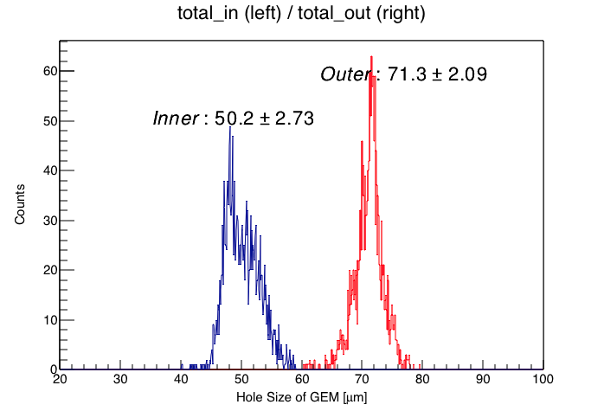
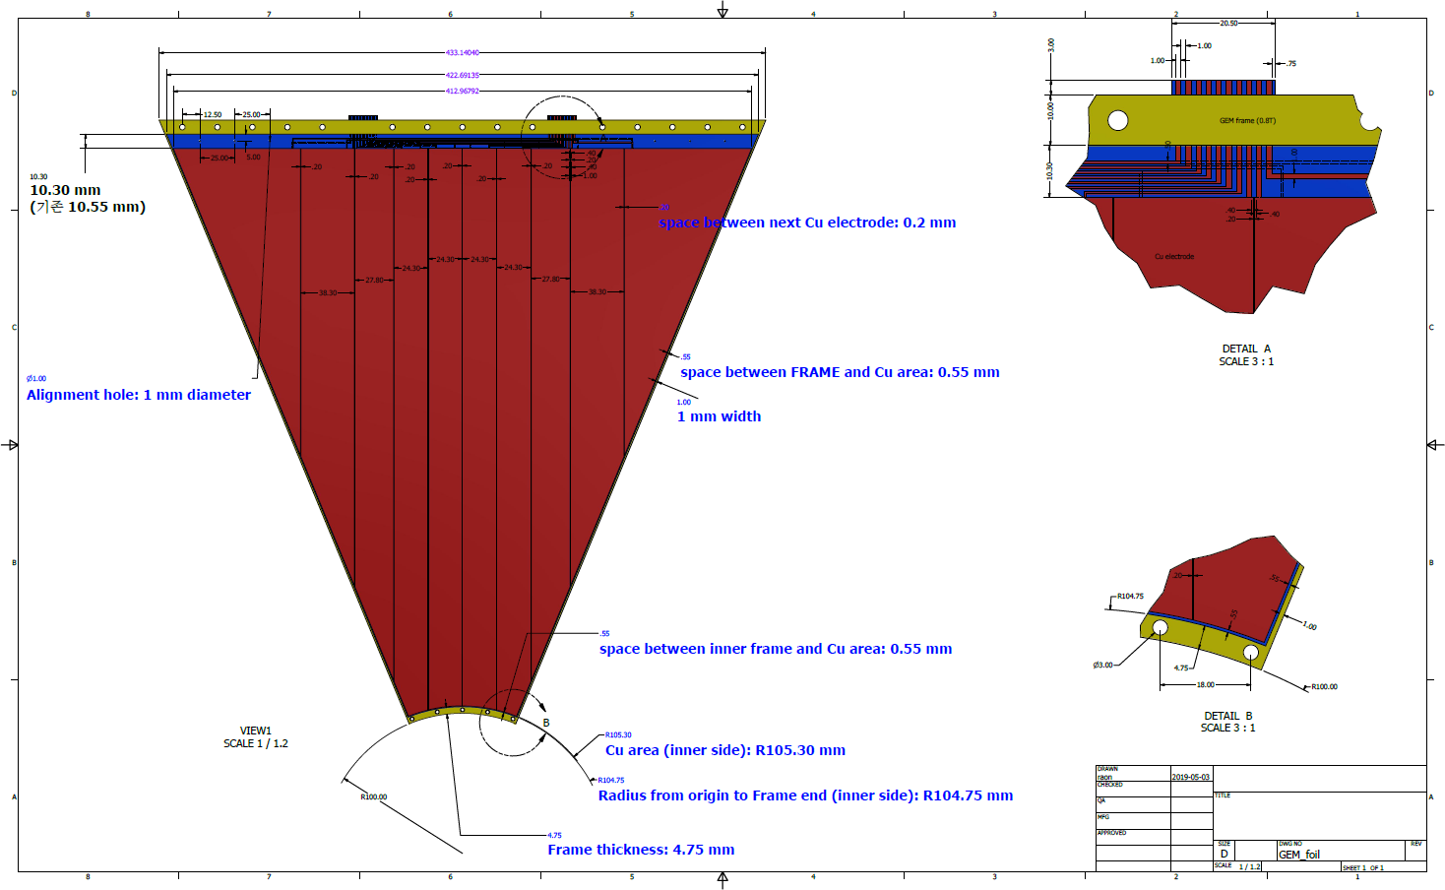
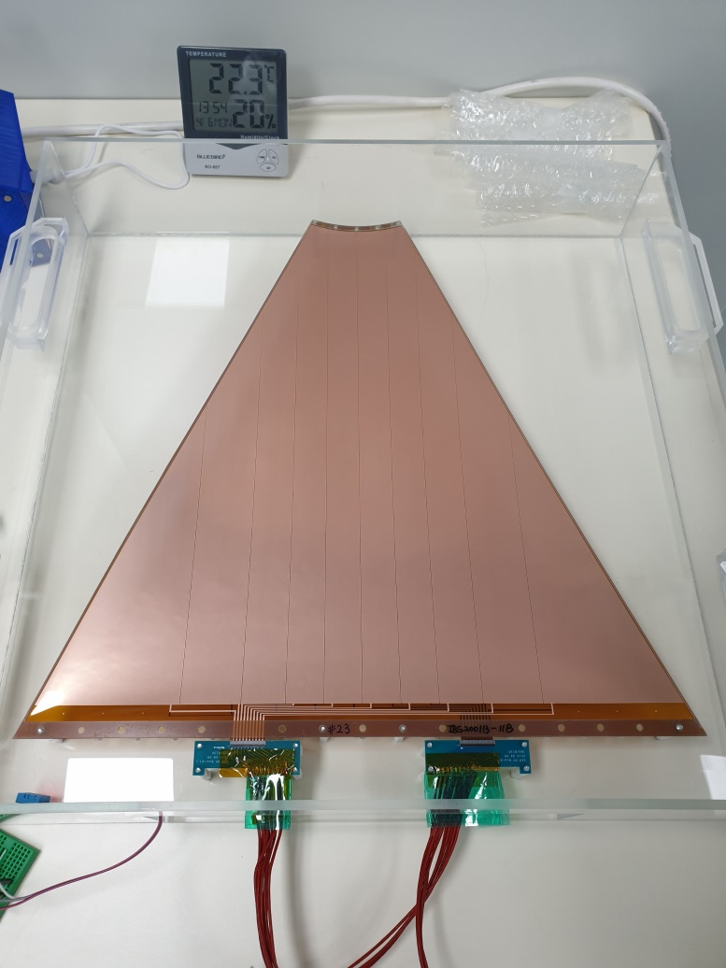
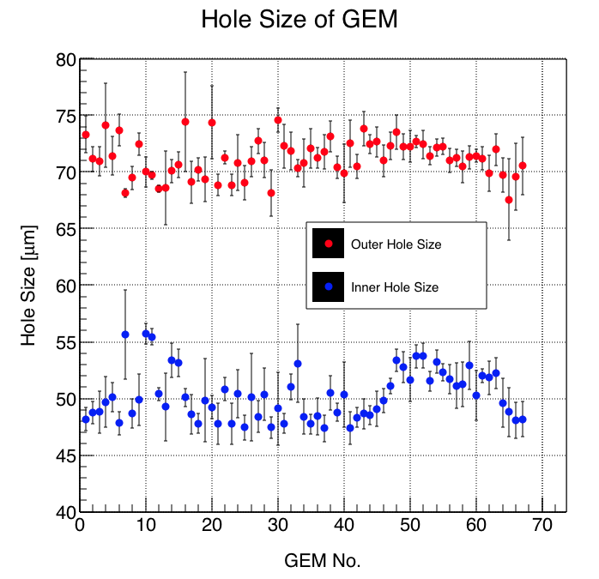
LAMPS TPC - GEM
Total # of GEM : 64
Required # of GEM : 32
Segmentation: 10 sector, 100 cm² each area
70 μm(outer hole) – 50 μm(inner hole) – 140 μm(pitch)

Slide 10
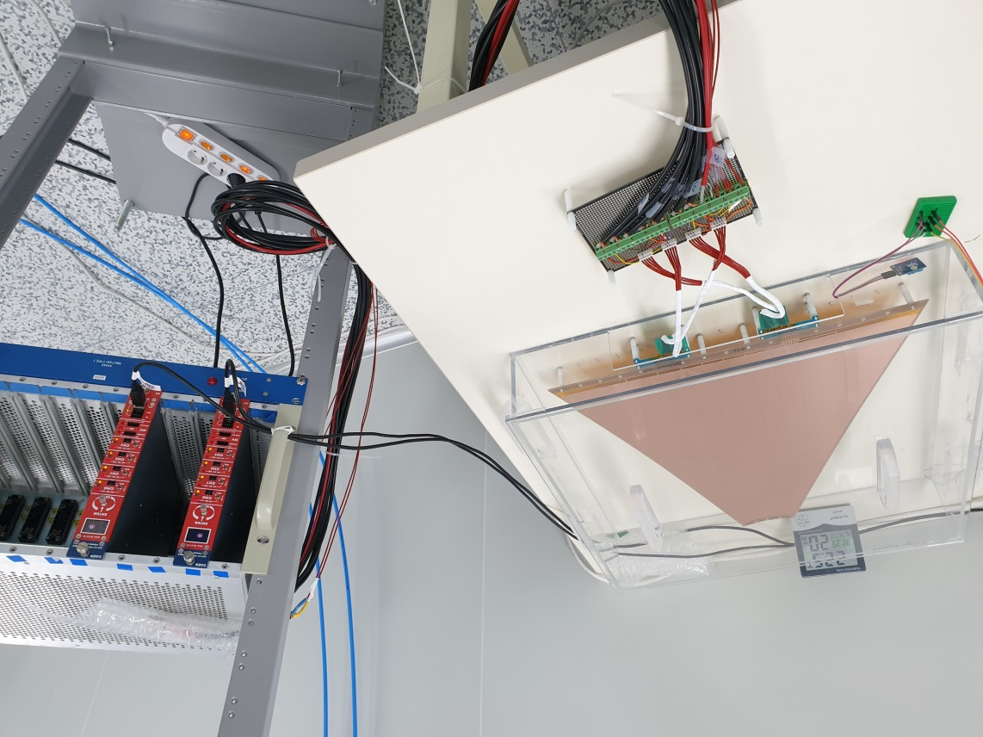
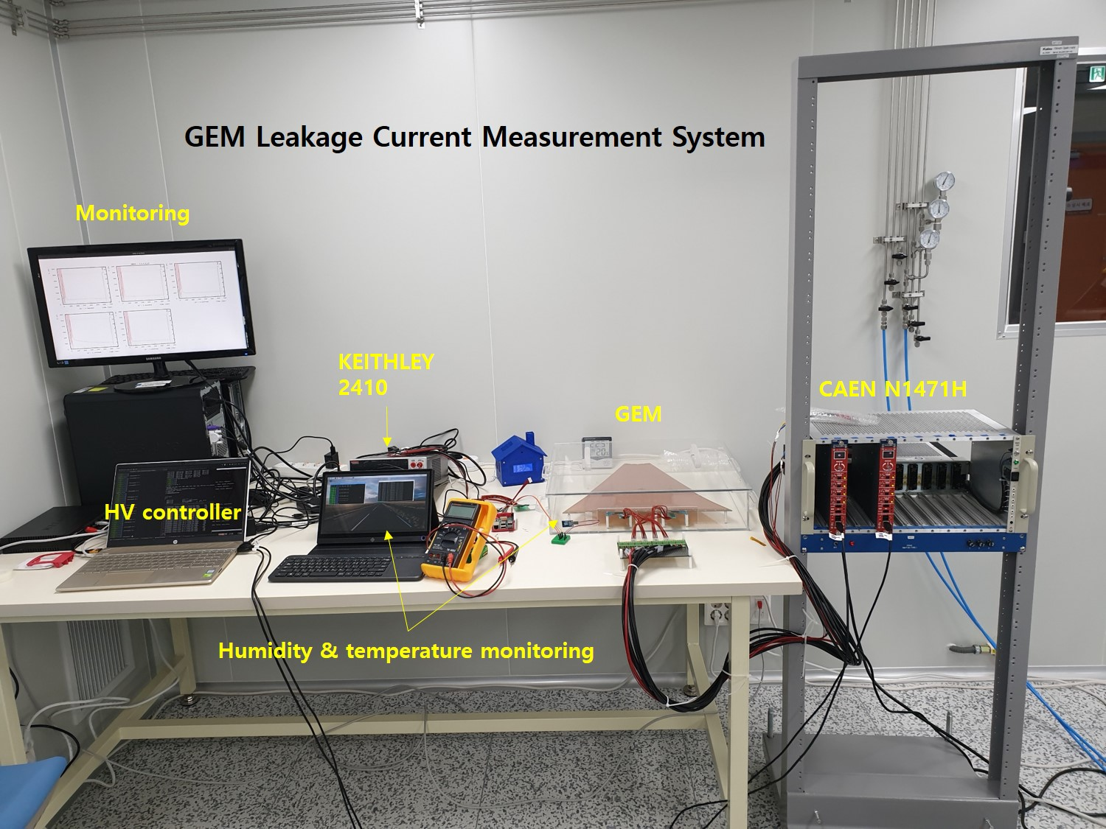
LAMPS TPC – GEM Leakage Current test
CAEN N1471H
KEITHLEY 2410
10 min. 500 V
< 5 nA/100cm²

Slide 11
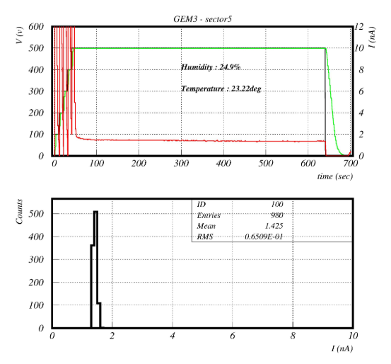
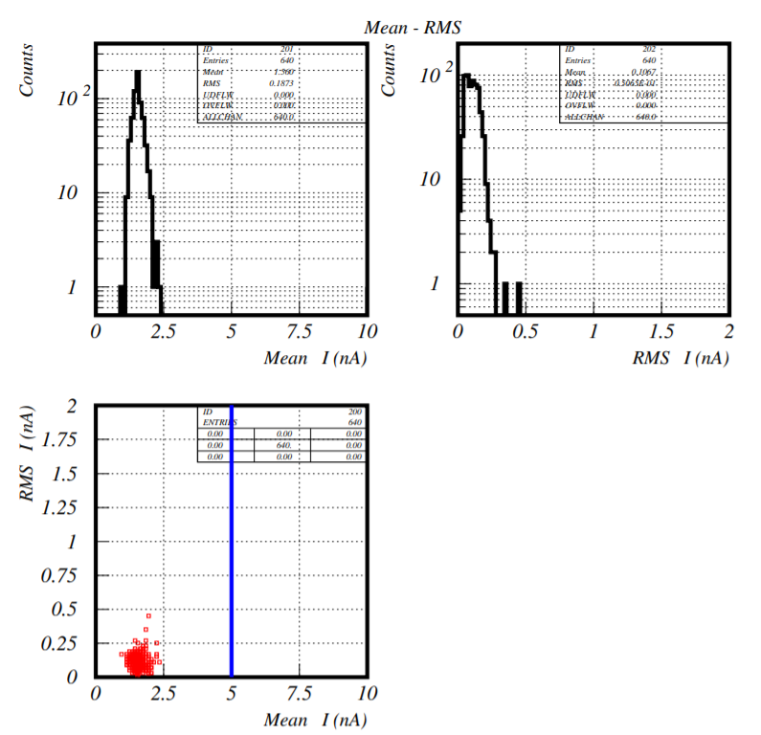
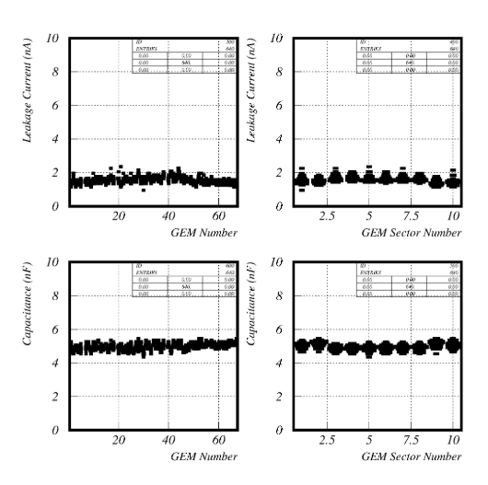
LAMPS TPC – GEM Leakage Current test

Slide 12
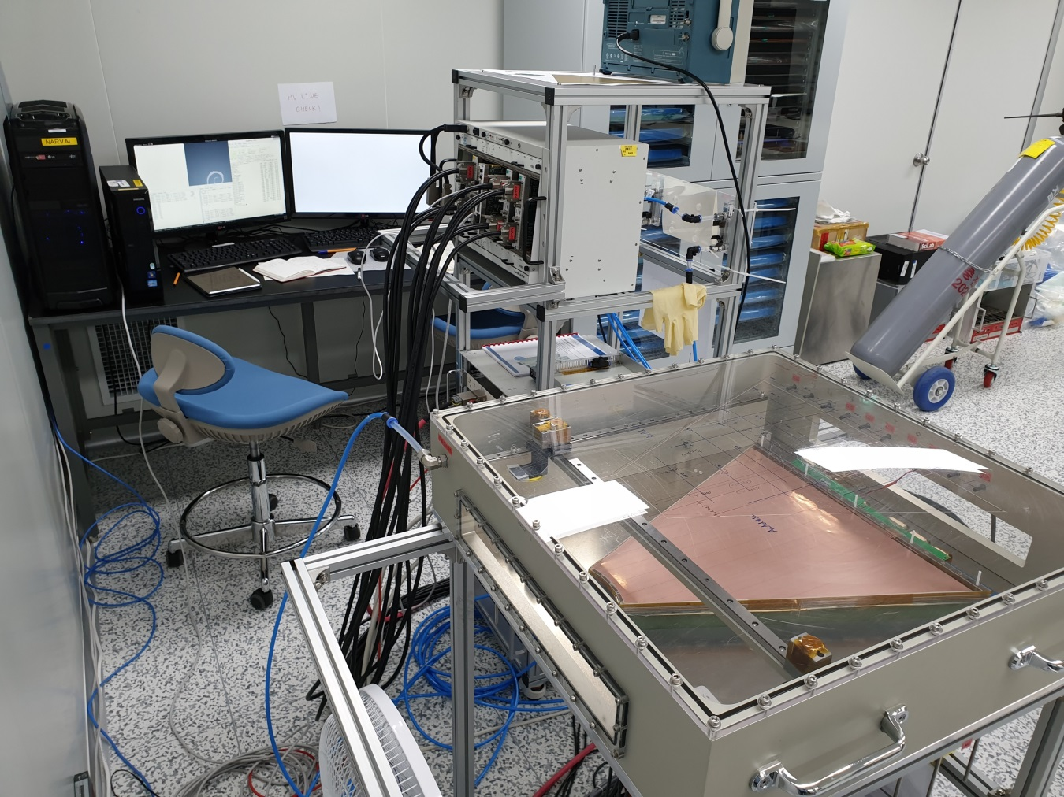
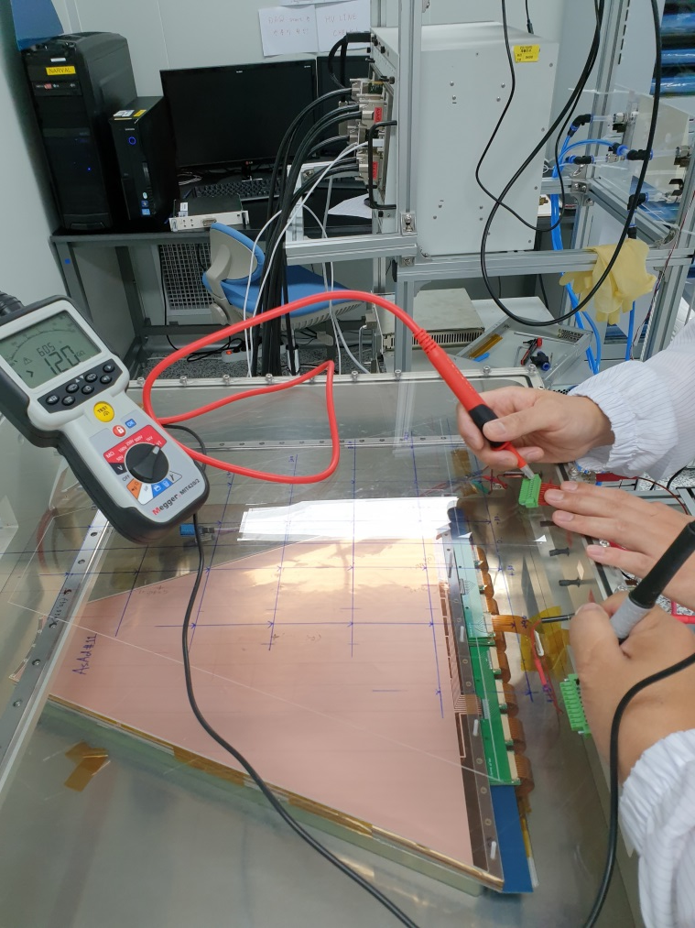
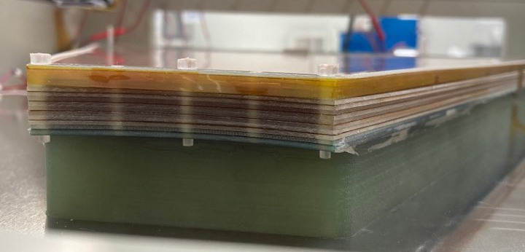
LAMPS TPC – GEM gain test
4GEM gain test system
Checking GEM by Megger
GEM gain test
1. GEM HV test with N₂ gas
2. GEM gain test with P-20 gas
3. GEM position uniformity test with P-20 gas

Slide 13
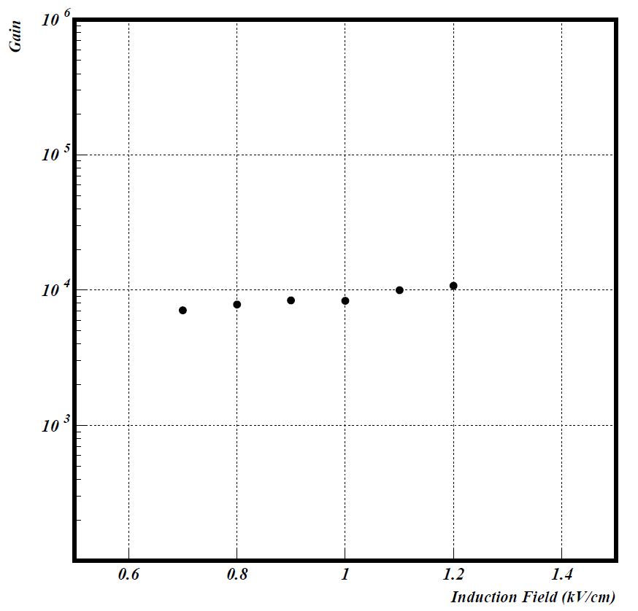

LAMPS TPC – GEM gain test
Fe-55
X-ray 5.9keV
Cathode GEM
Drift region : 5mm
GEM4
GEM3
Transfer region : 2mm
GEM2
Transfer region : 2mm
GEM1
Transfer region : 2mm
Induction region : 2mm
Readout PAD

Slide 14
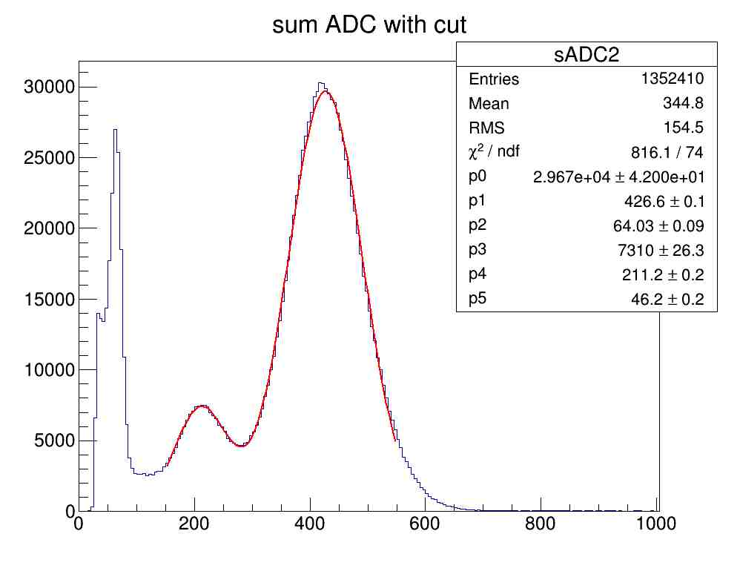
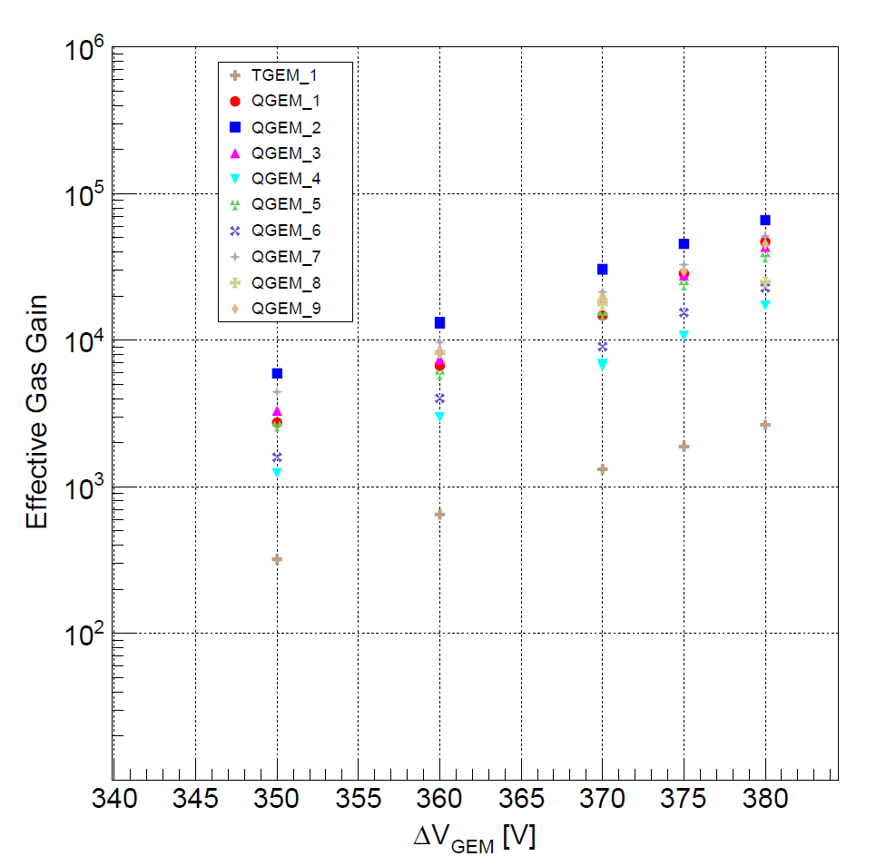
LAMPS TPC – GEM gain test
5.9 keV
Escape peak 2.9keV

Slide 15
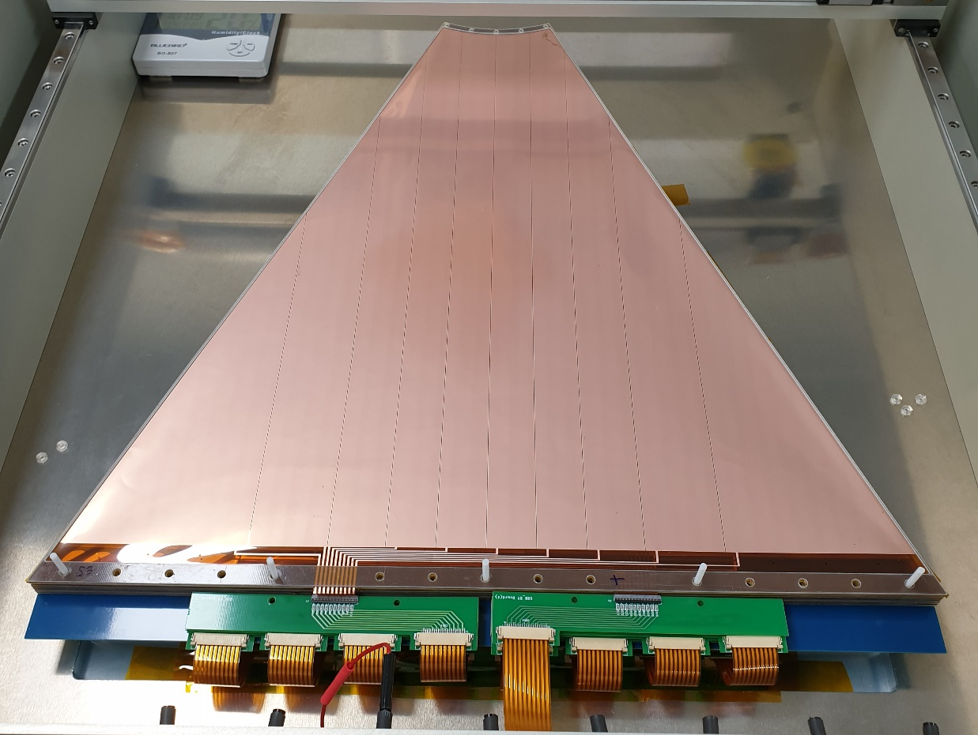
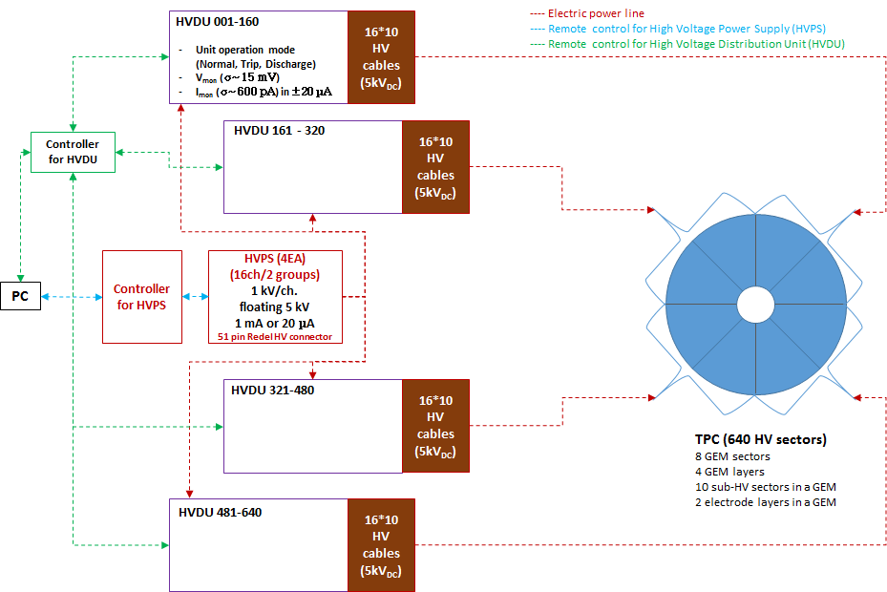
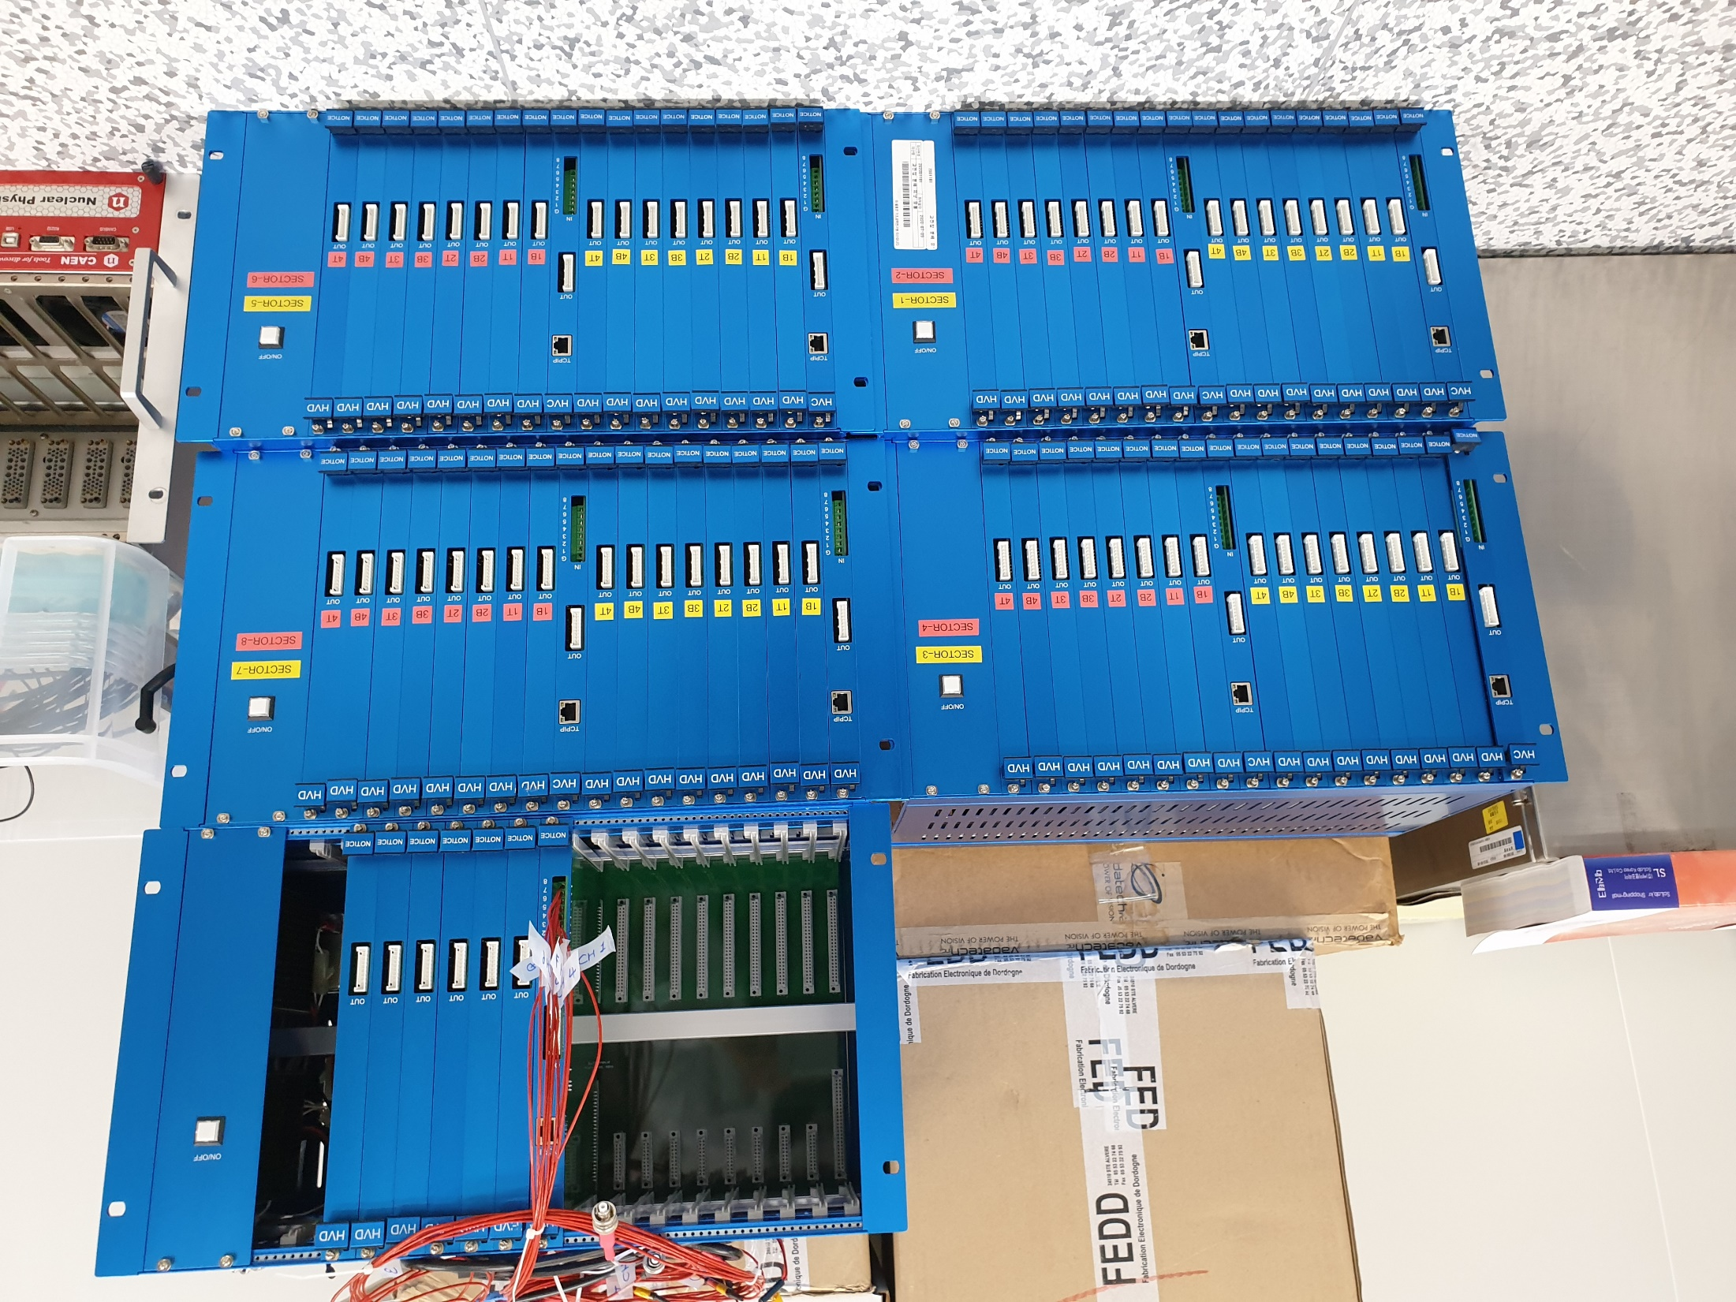
LAMPS TPC – GEM HV distributor
Total # of GEM HV channel = 640 ch (10 ch/GEM)
HV distributor = 10 ch /module
# of module = 8 modules/section x 8 section = 64 modules

Slide 16
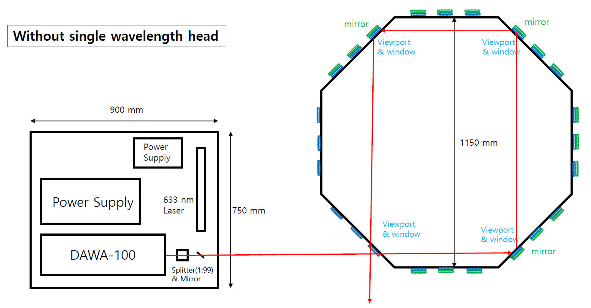
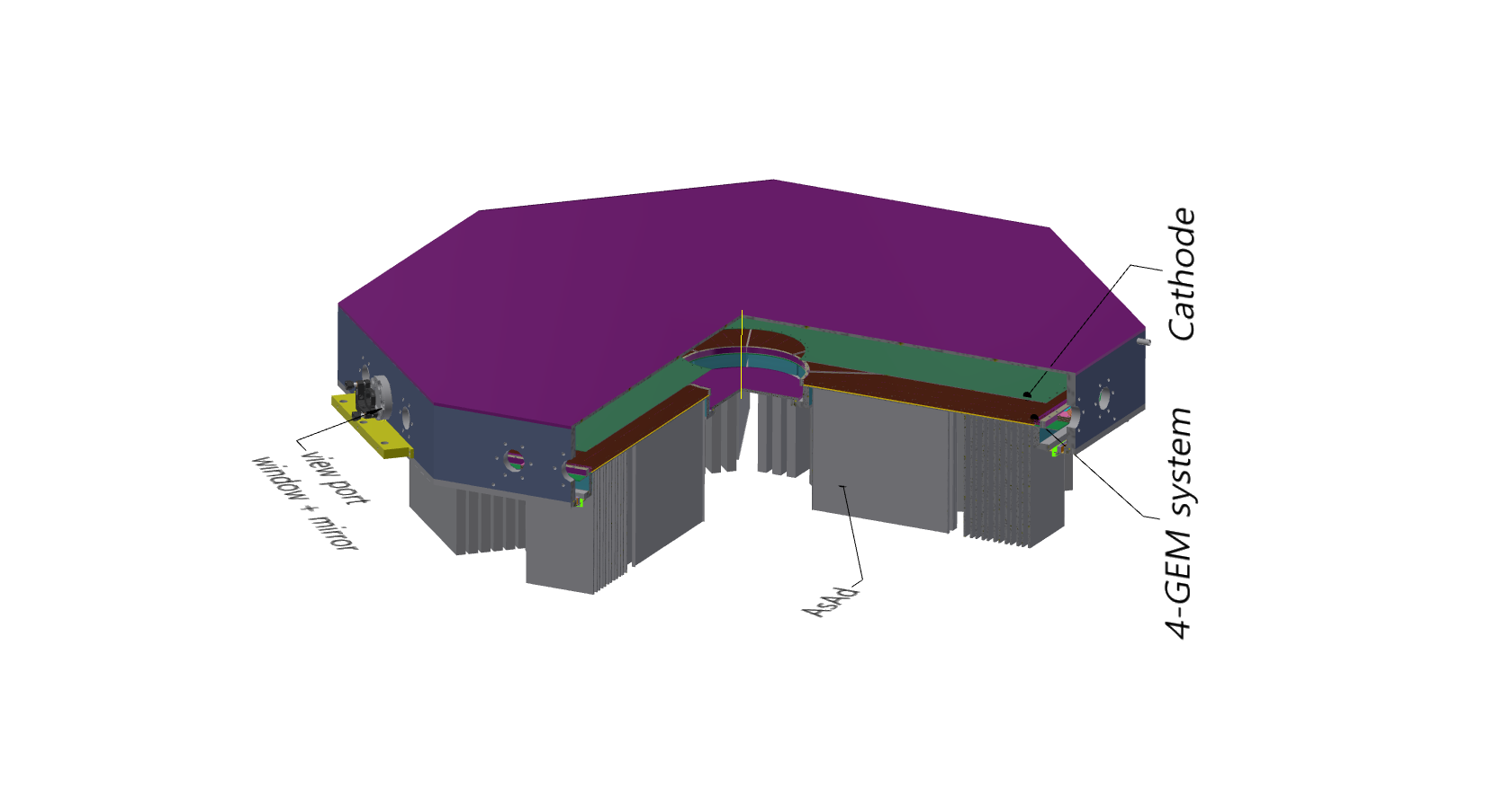
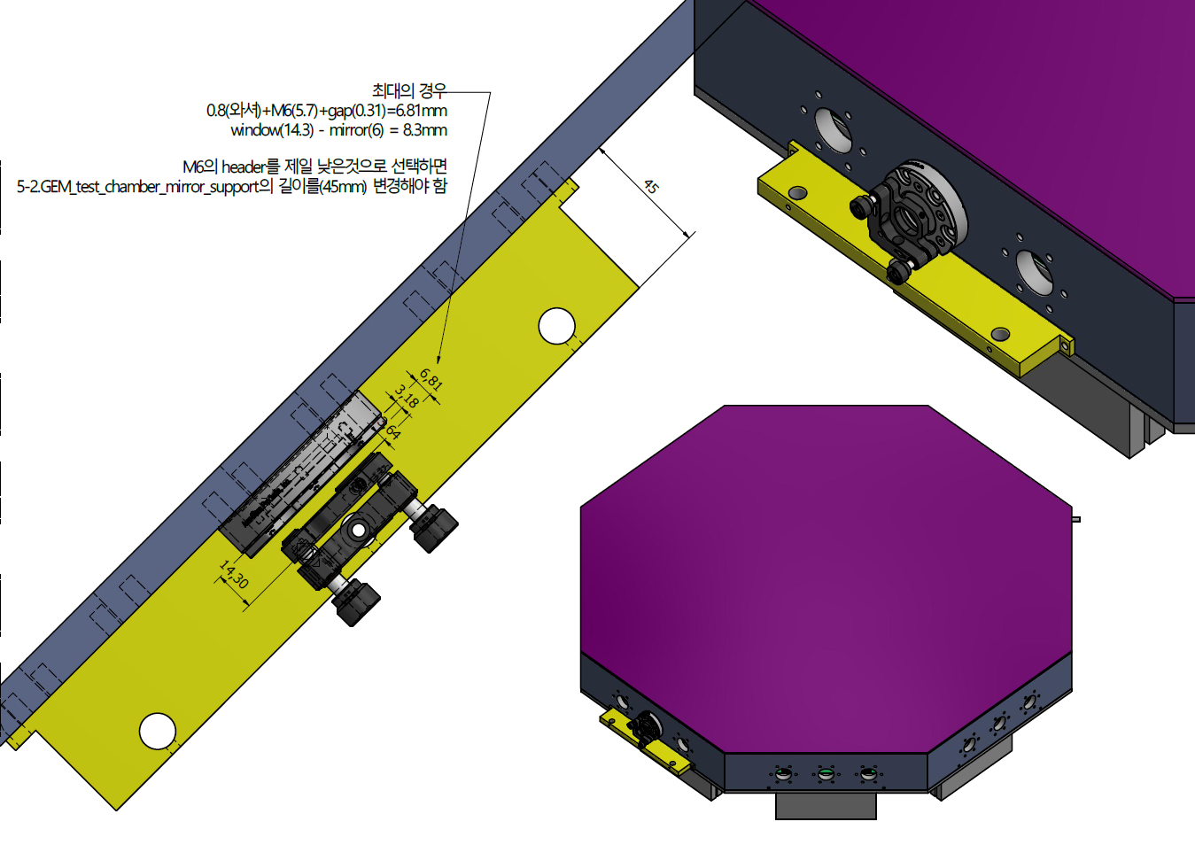
LAMPS TPC – Laser calibration (plan)
266nm Nd:YAG laser

