Slide 1
MC for surveying requirements on neutron detector and others
Lee Jong won

Slide 2
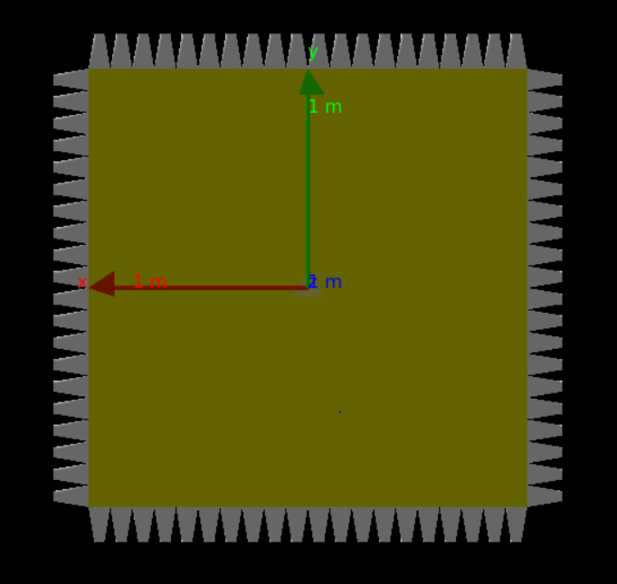
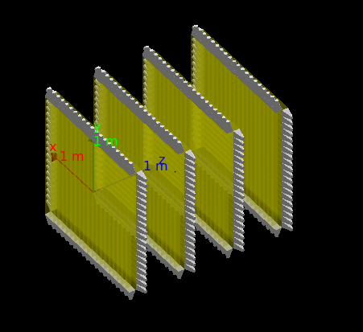
Neutron detector
Detection efficiency // done
Position resolution // done
Timing resolution // done
Multiple hit resolution requirements & performance
Waveform analysis
Multiplicity in experiment
Data analysis & MC
Data : 2 months cosmic ray data
MC : Should be built for neutron detector

Slide 3
Geometries

Slide 4
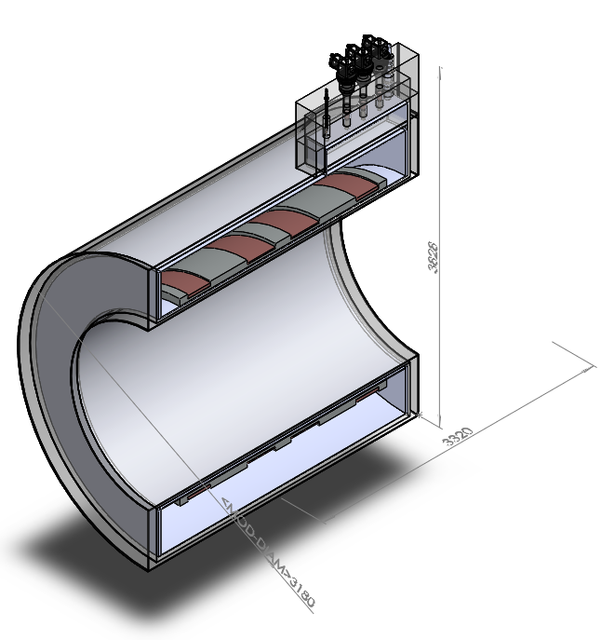
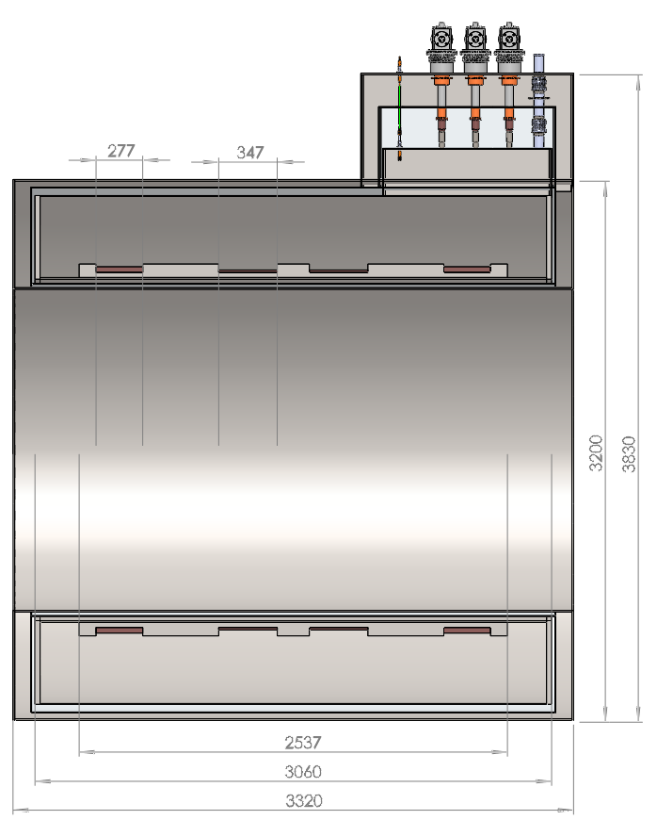
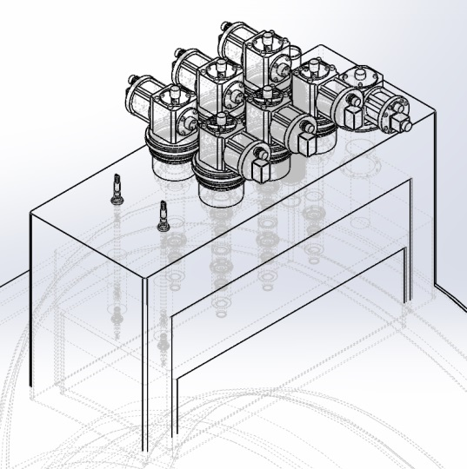
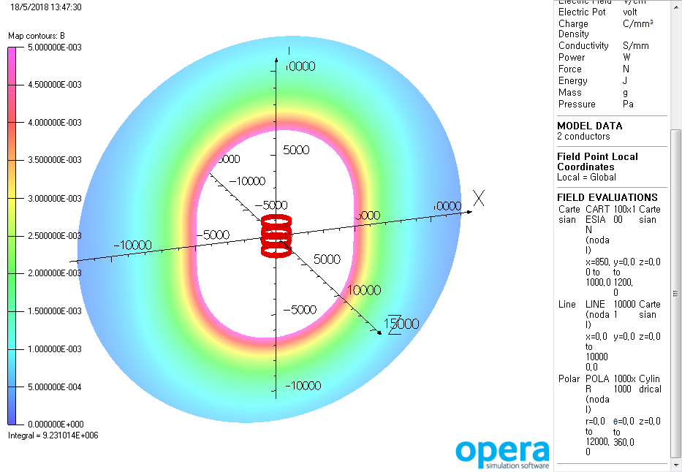
Detector geometry – solenoid magnet
Field map ?
Material : SUS, Liquid He, Copper

Slide 5
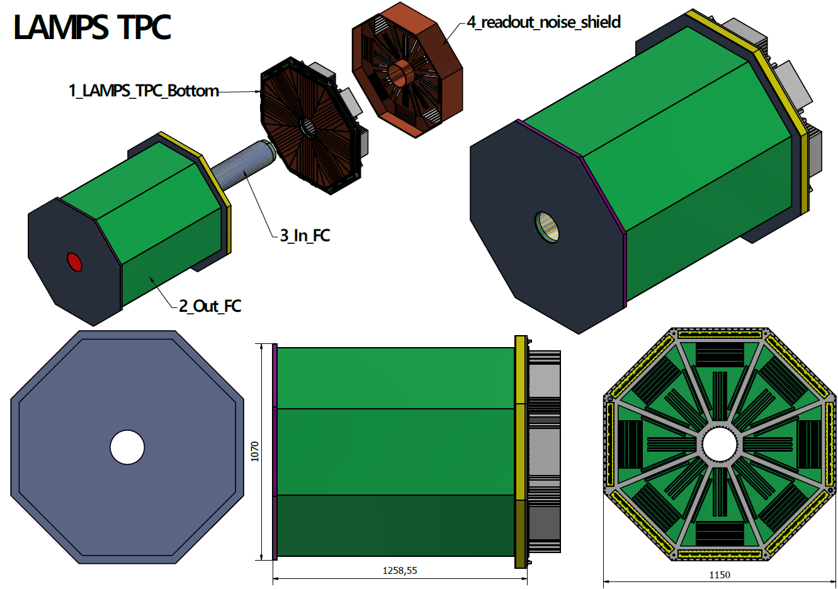
Detector geometry – TPC
1199.5
1026

Slide 6
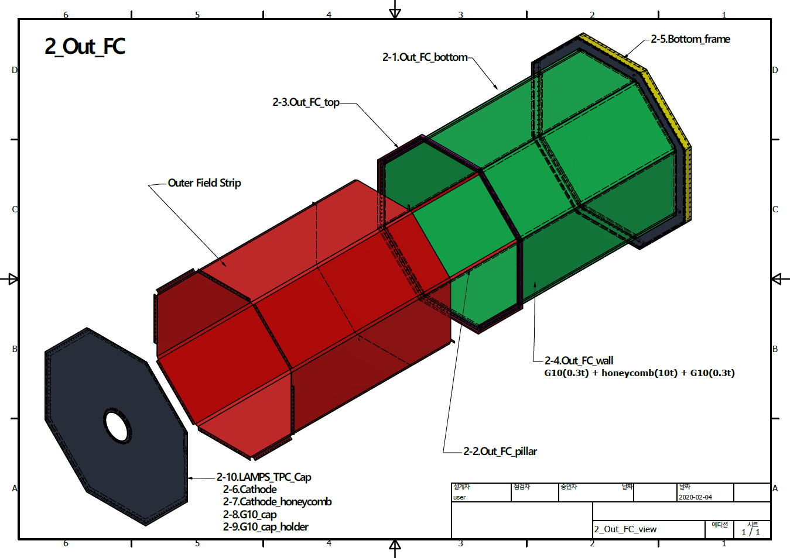
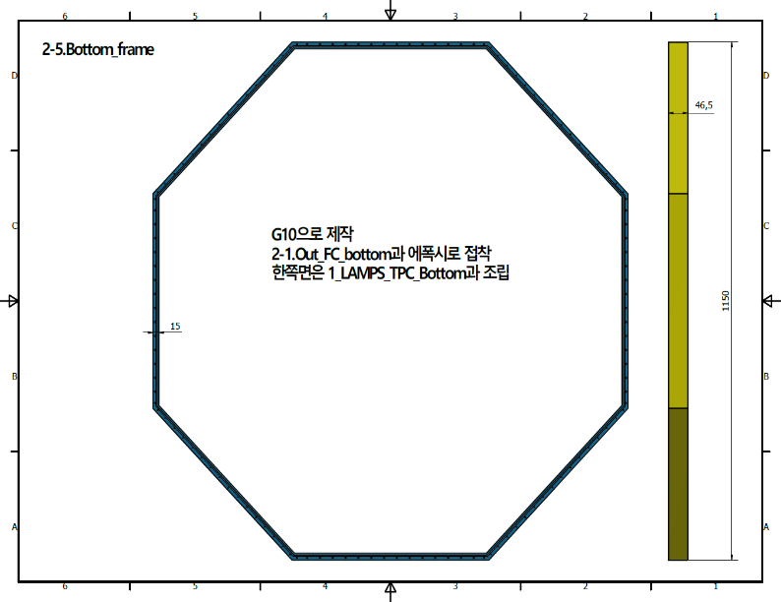
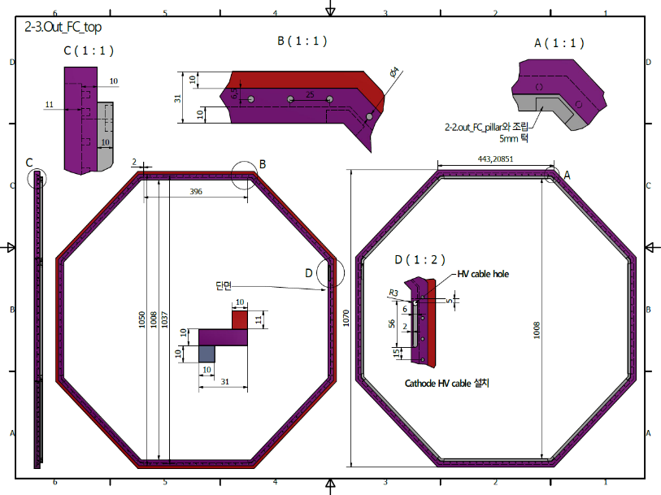
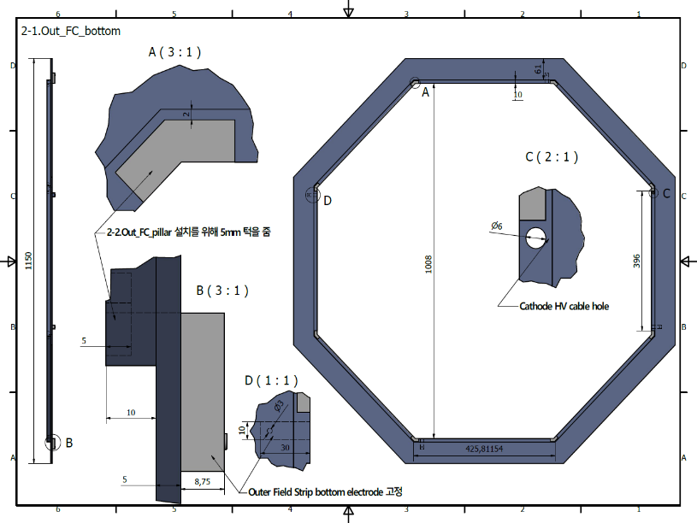

Slide 7
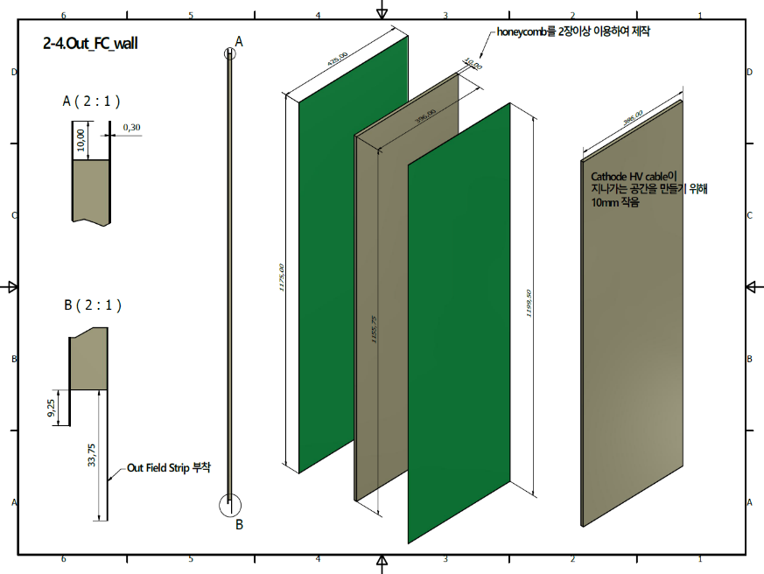
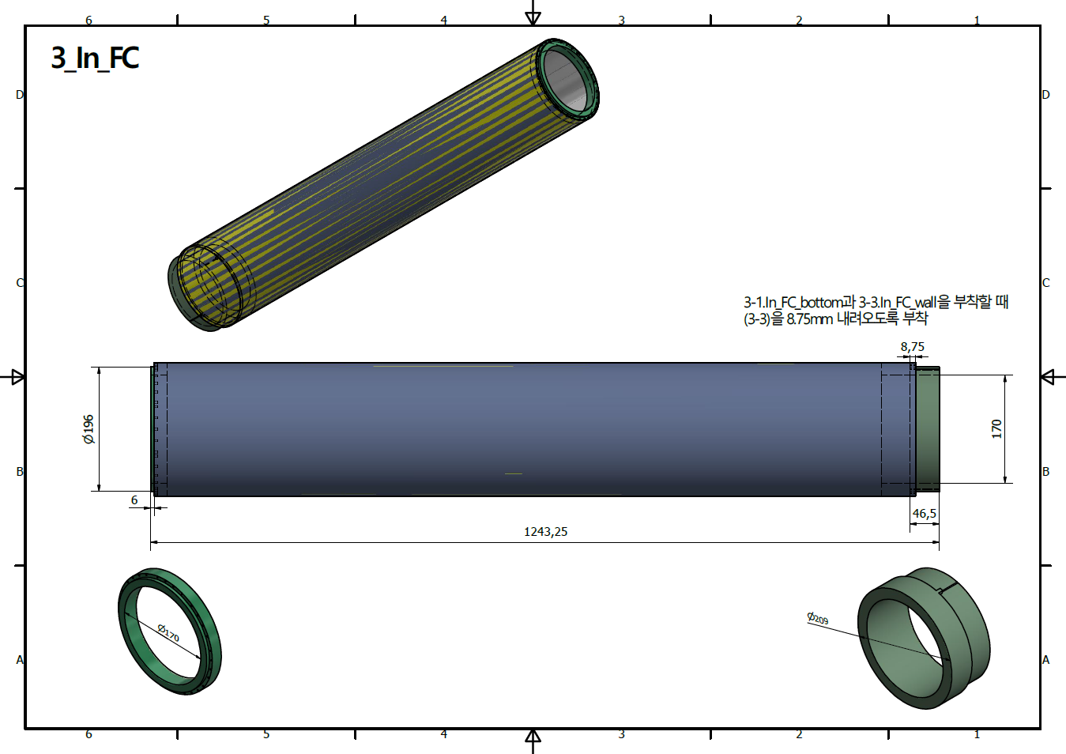

Slide 8
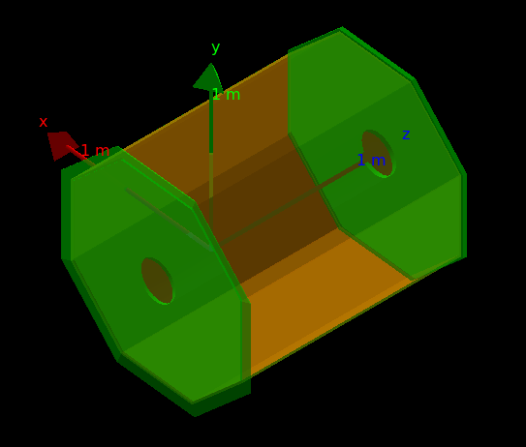
TPC in MC

Slide 9
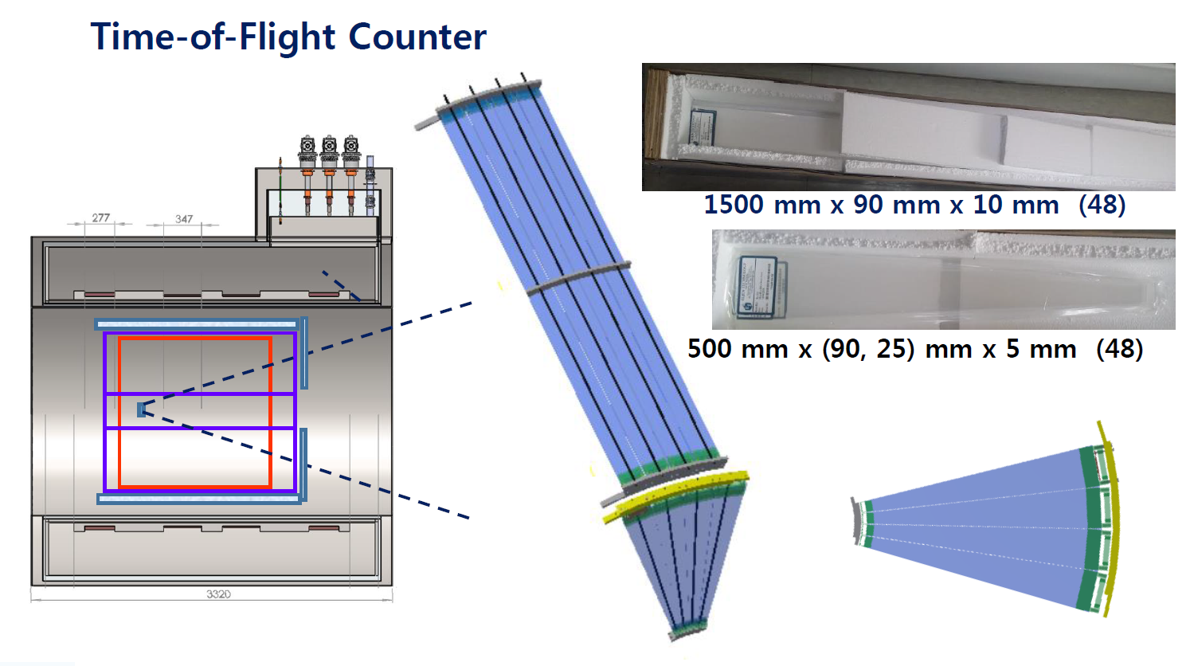
Detector geometry – TOF

Slide 10
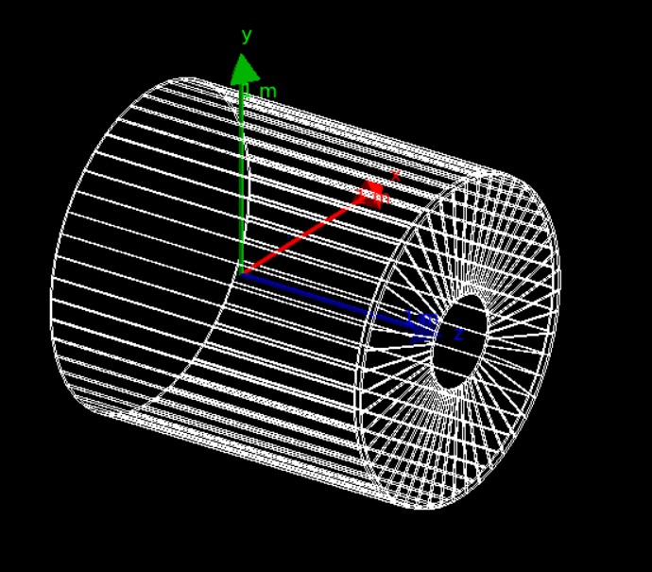
TOF in MC
1400mm

Slide 11
Detector geometry – Neutron detector
10 cm x 10 cm x 2m BC408 x 20

Slide 12
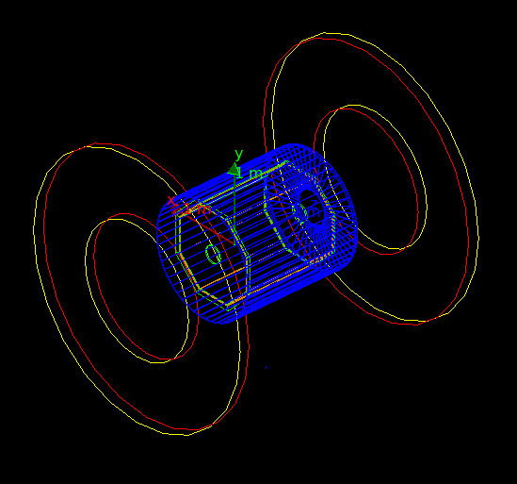
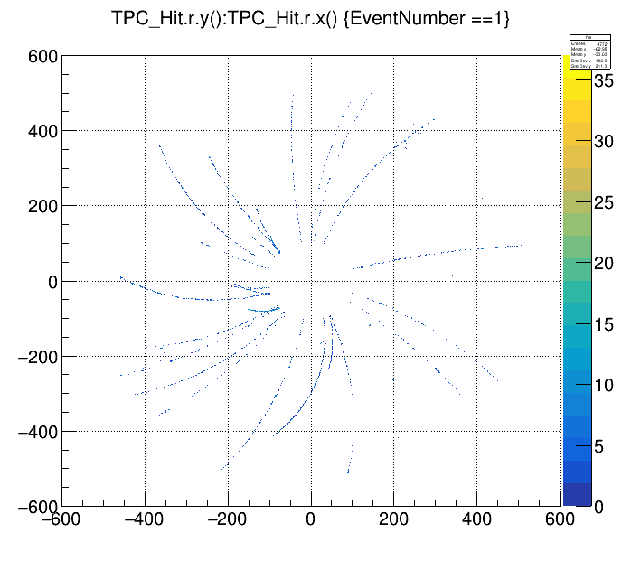
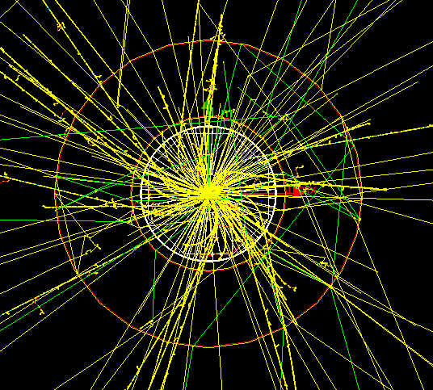
Spectrometer
TPC hit information

Slide 13
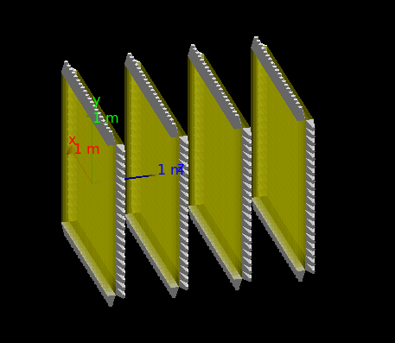
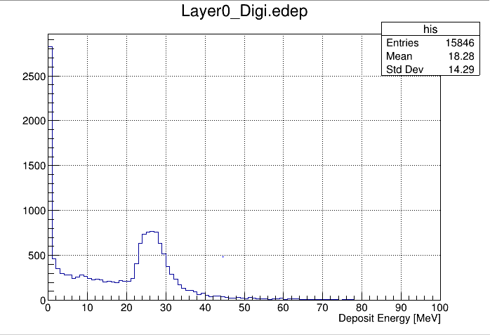
Neutron detector array
Neutron detector energy deposit

