Slide 1
Current status of LAMPS neutron detector cosmic ray data analysis
Lee Jong-won

Slide 2
Cosmic ray data taking
Feb. 17th – Mar. 30th
Total data size : 8.1TB
Run number : 401 – 567, 1 run/4 hr
Total data taking duration : 665 hr
Using 3 layers of neutron detector
Avg 4 kHz Trigger rate.
Dep E of MIP is 20 MeV.
20 MeV = 500mV( = 1000 count )
Energy calibration is done with Charge of signals.
Timing calibration is done with vertically penetrated events.
P5
P4
780 mm
P3
P2
P1
P0
2000 mm

Slide 3
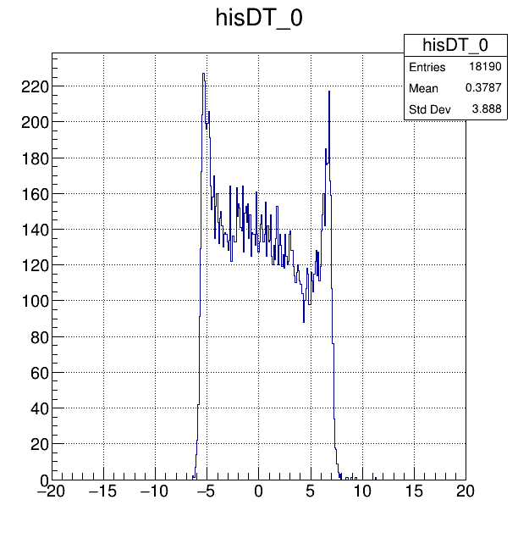
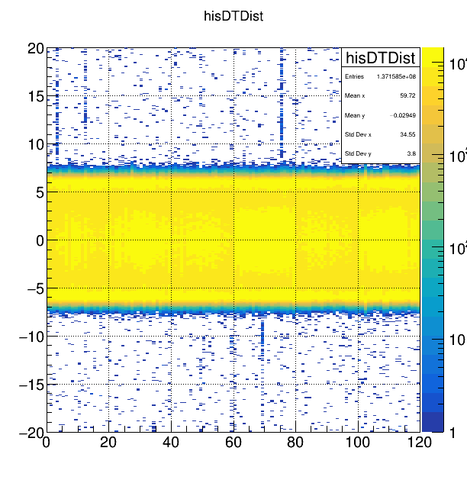
D offset alignment
D offset = Position
Position alignment methods
Edge finding : Find edge & get offsets
Track fitting : Fit event with line & get offsets
T_{l}
T_{r}
T_{off}= (T_{r} + T_{l})/2

Slide 4
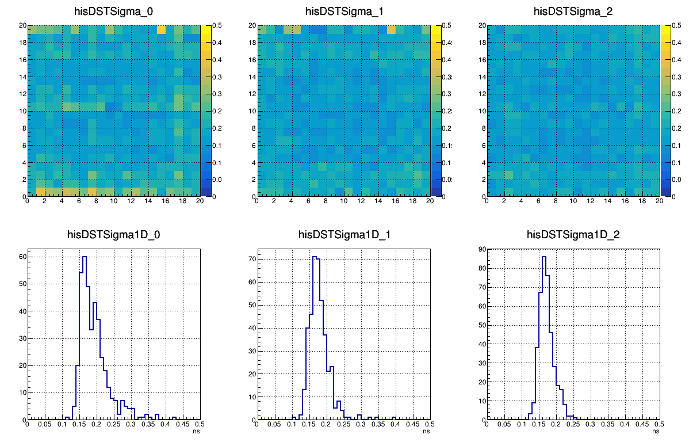
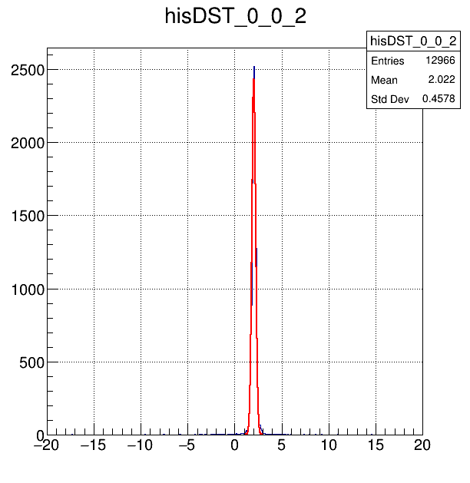
S offset alignment
Timing of detector : T_{i} = (T_{r}+T_{l})/2
Timing offsets exist for every case.
Time stamp difference between FADC channels
Cable length
PMT signal speed
D_{ij} = t_{i}-t_{j}
Distribution of sigma (S_{ij} dist. for i, j)
Offset : O_{ij}
Sigma : S_{ij}
Layer 1
Layer 2
Layer 3
Mean value of Sigma : 181 ps -> Expected Timing resolution(FWHM) = 301 ps

Slide 5
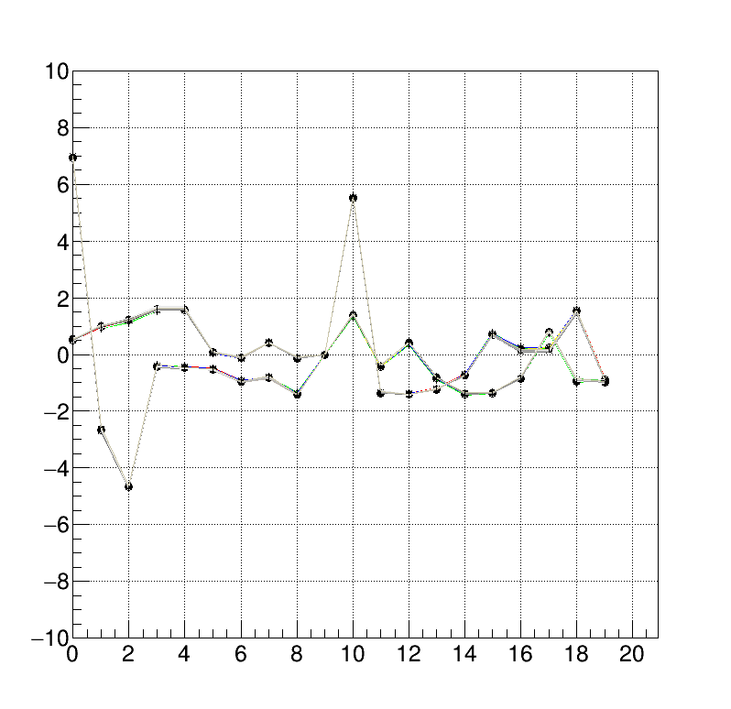
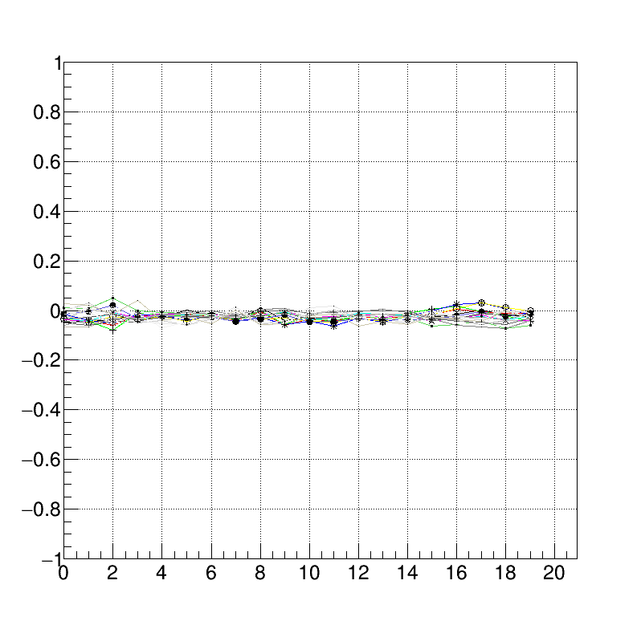
Simple method for t cal
Black : layer 1
Red : layer 2
Green : layer 3
Offsets between two modules in diff. planes
Before Offset subtraction(O_{ij} dist)
grX[i](j) = Ai-Bj –(Ai-B9)
After Offset subtraction
grY[i](j) = Aj-Bi–(A9-Bi)
After Offset subtraction, O_{ij} distribution was aligned to 0, with 20 ps deviation

Slide 6
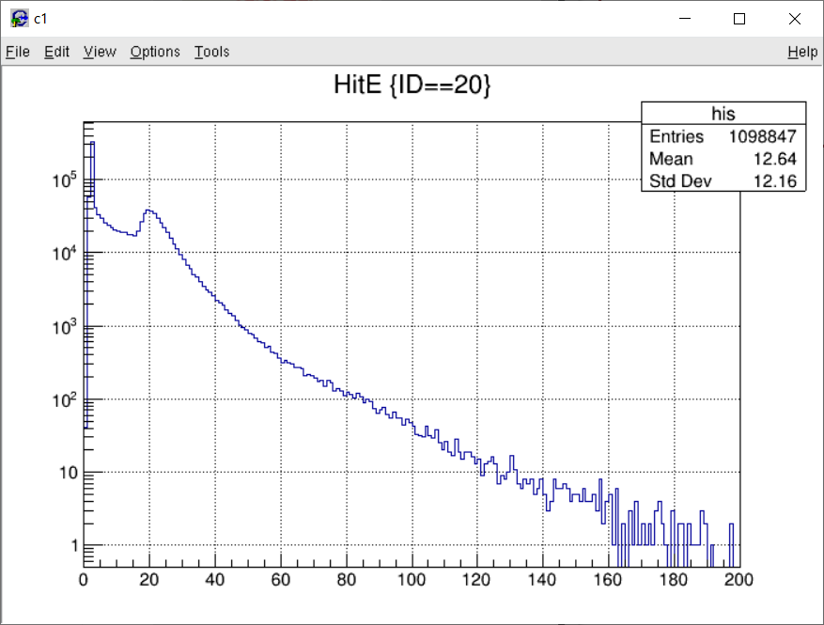
Energy calibration
MIP peak = 20 MeV

Slide 7
What I want to see was…
Proton penetrated 4 planes and..
Neutron? hits p4 or p5 and
P5
P5
P4
P4
or
P3
P3
P2
P2
Stopped at p1
Leaves two hits on NDA
P1
P1
P0
P0

Slide 8
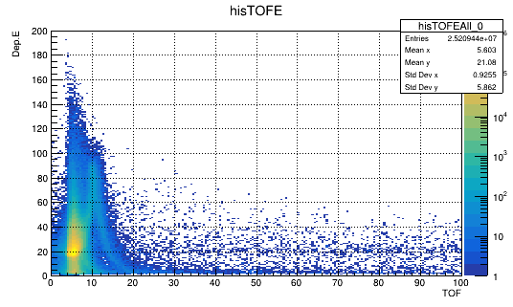
What I saw
Deposit E on P1 vs T1-T5
High beta particle
Some particle stopped at p1
Cut condition : P1-5 have single hits. No req. on P0.

Slide 9
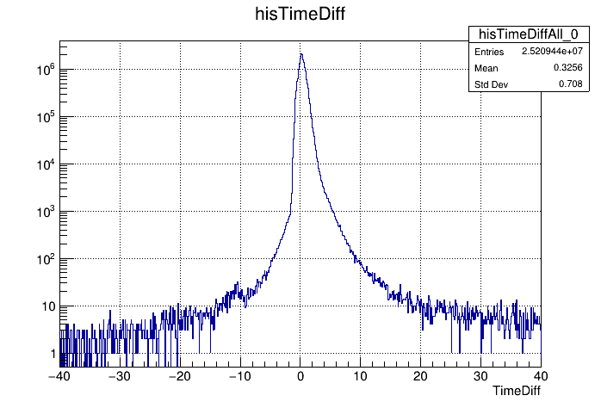
Time diff distribution
T1-T5 (before offset adjust)
11ns ~ 1.65m x2
Up going particle?

Slide 10
Analysis 25 run ( 100 hr ) data with tight cut
Cut condition
P1-5 had single hit.
Dep. E on P2-4 > 15 MeV
Abs( x,y ) < 0.9 (fiducial cut)
Hit position on P3 is on the track ( distance < 5 cm )

Slide 11
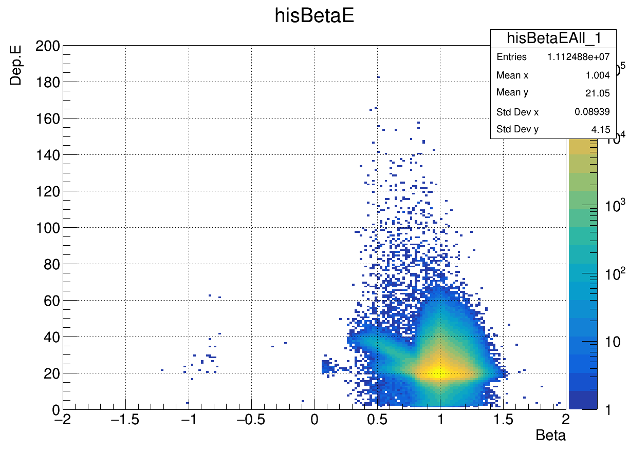
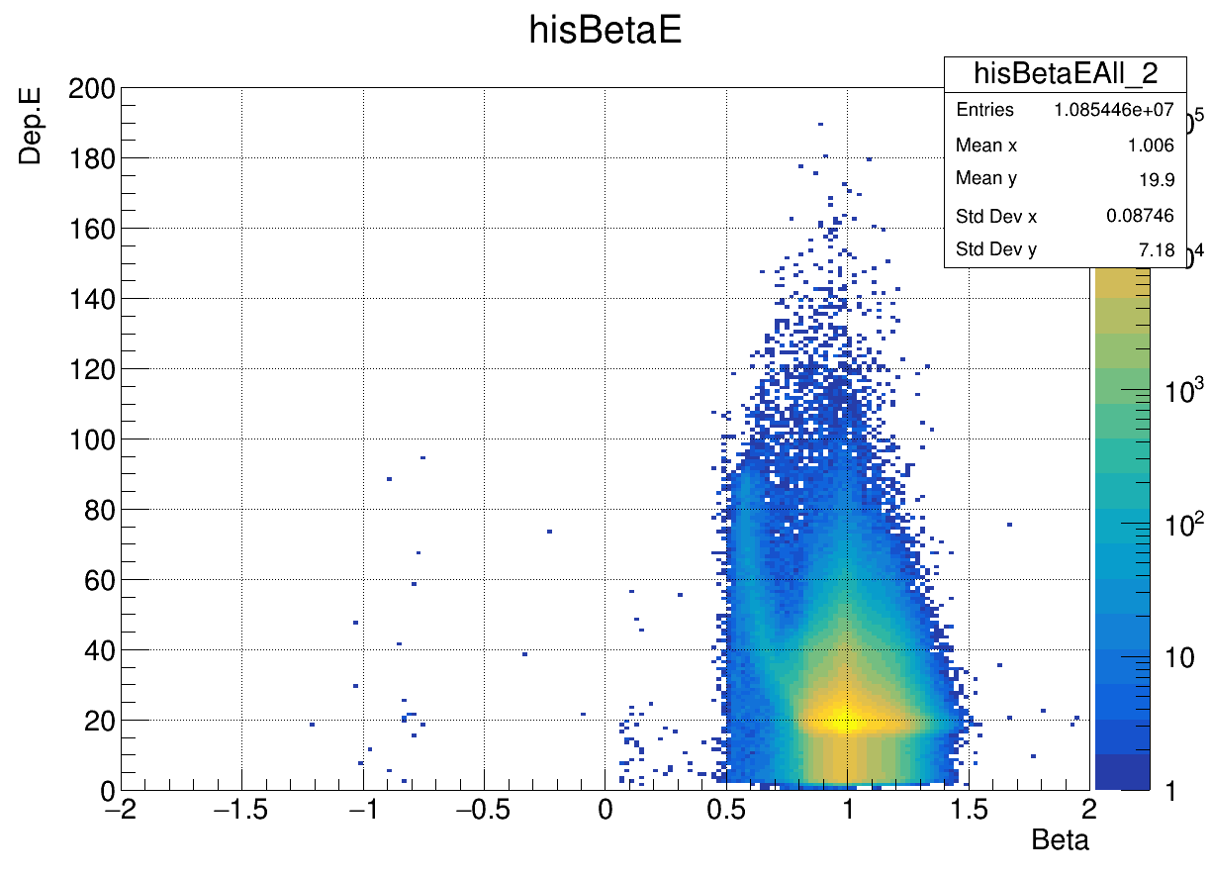
Dep. E on P1 vs beta(p1-p5)
Dep. E on P5 vs beta(p1-p5)
Two slow particles
Two tails
Dep. E on P0 vs beta(p1-p5)
There were two peak-like structure.
No particle found under beta < 0.5( particle was stopped at p1 )
Two tails
Slow particle with high energy loss(kaon??)
Fast particle with MIP energy loss (pion, muon)
Check with bethe-bloch equation
No particles
with beta < 0.5

Slide 12
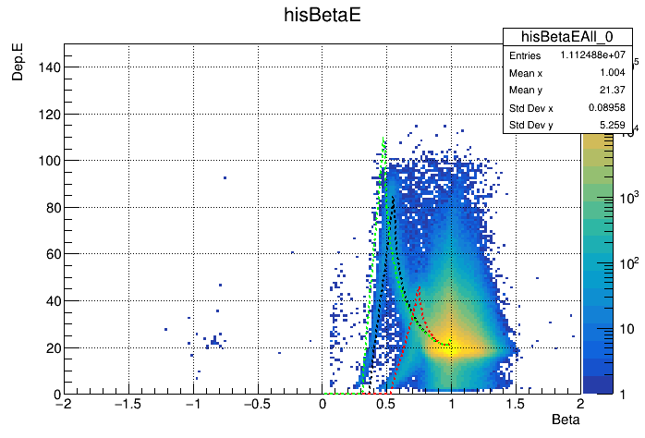

Slide 13
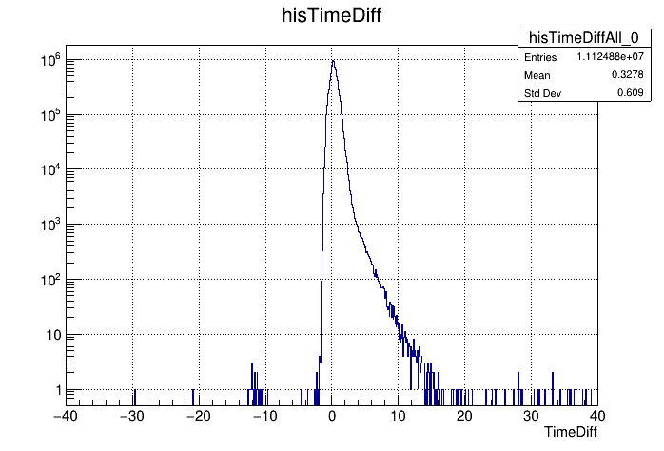
Upgoing particle…
23 events

