Slide 1
Chiral unitary model and Neural Network
Donghyeok-Kim & Junghyun- Park
(Department of physics, Pukyong Nat’s Univ)
Center for Extreme Nuclear Matters (CENuM)

Slide 2
Contents
Chiral Symmetry & QCD Lagrangian
Low Energy Effective Theory (ChPT)
Meson-Baryon Interaction at O(p) order (WT interaction)
Unitarized Scattering Amplitude (Lippmann-Schwinger eq)
Determine the Scattering Amplitude based on CNN

Slide 3
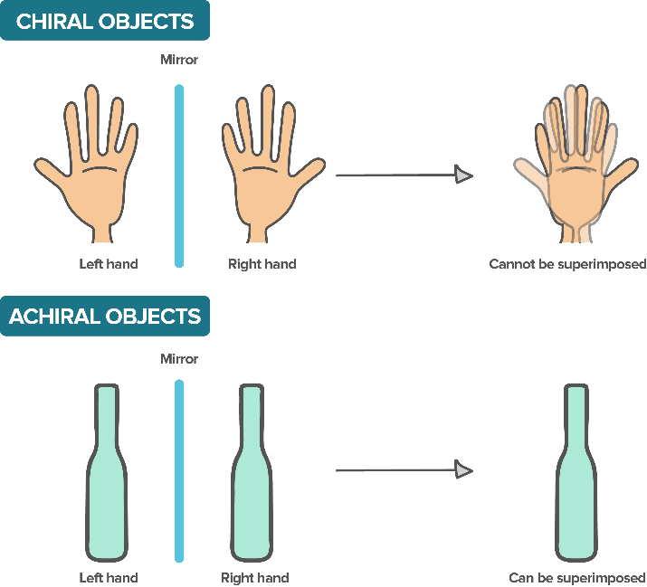
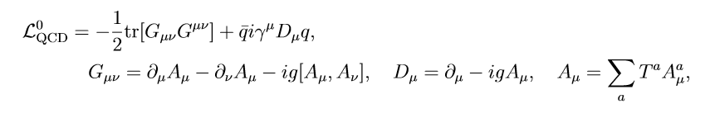








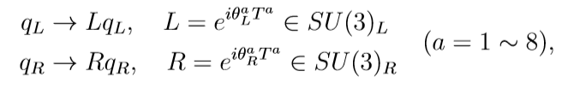
Chiral Symmetry & QCD Lagrangian
q : massless quark field in 3-dim flavor space
Aμ : SU(3) gauge field (gloun field)
Gμν : gluon field strength tensor
using
U(N) = U(1)×SU(N)
Flavor-chiral symmetry
Vector chiral symmetry
(corresponding baryon number conservation)
Axial chiral symmetry (broken)
acting on q fields :

Slide 4
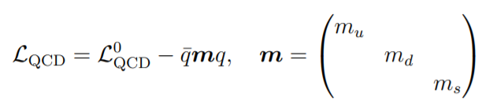





Chiral Symmetry & QCD Lagrangian
Lagrangian for massive quark :
Due to these properties :
,
Mass term breaking chiral symmetry :
Mixes the right-handed, left-handed fields
Quark condensate (vacuum expectation value of the (qbar)q) :
Mixes the right-handed, left-handed fields
Masses of quarks & Quark condensate
Chiral symmetry breaking!
Corresponding eight (approxi) NG-bosons : (small masses) Mesons (π±,0, Κ±,0, Κbar, η)

Slide 5
Low Energy Effective Theory (ChPT)
QCD :
Theory about strong interaction of q, g-fields
At low energies(short distances)
Color confinement, Chiral symmetry breaking
Need of effective field theory :
Theory about nuclear interaction of m, b-fields(Hadrons) instead of q, g-fields
Weinberg’s theorem :
“Effective Lagrangian includes all terms that are compatible with the symmetries of the underlying theory(QCD)”
Weinberg’s power counting scheme(p-expansion)
Coupling constants for each term can be determined from experimental data
Examples of EFT from QCD : Quantum hadrodynamics(QHD), Chiral perturbation theory(ChPT), Heavy quark effective theory(HQET), Non-relativistic QCD(NRQCD), Lattice QCD

Slide 6
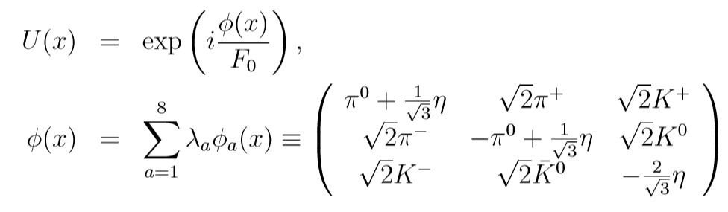
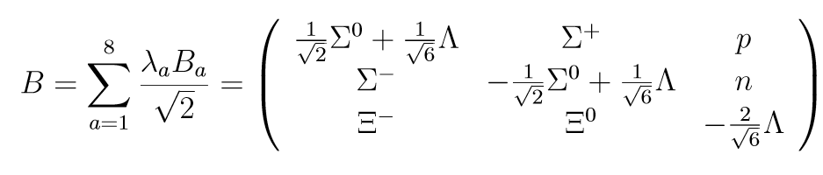

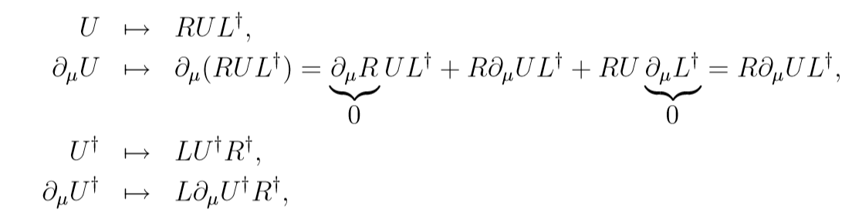
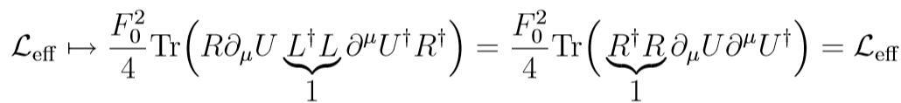
Low Energy Effective Theory (ChPT)
Effective Lagrangian of ChPT
Instead of q, g-fields, introduce meson fields, baryon fields : φ, U(φ), B,
where
Effective Lagrangian for meson with minimal number of derivative :
We can check that this term actually invariant under global chiral transformation (R, L) :
Transformation
of fields

Slide 7



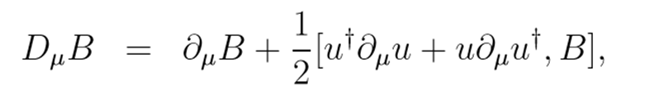

Low Energy Effective Theory (ChPT)
O(p^2) term of effective Lagrangian for meson :
Where ,
O(p) term of effective Lagrangian for meson & baryon :
Where

Slide 8
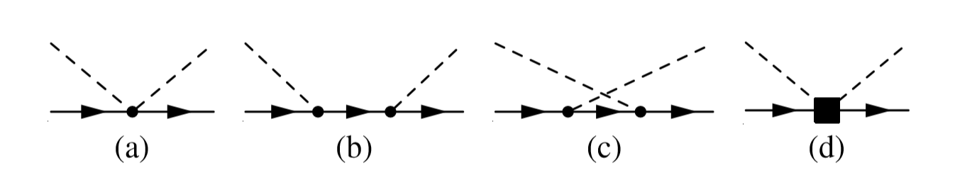
Meson-Baryon Interaction at O(p) order
Feynman diagrams for m-b interaction in ChPT
(a) Weinberg-Tomozawa interaction
(b) s-channel Born term
(c) u-channel Born term
(d) NLO(next to leading order) interaction
Scattering amplitude from chnn i to j
Depends on W(E_tot in com frame), Ω(solid angle of the scattering), σ_i(spin of baryon in chnn i)
Order O(p)
Order O(p^2)

Slide 9
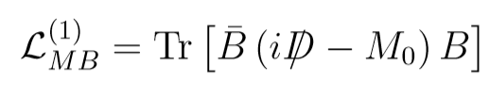
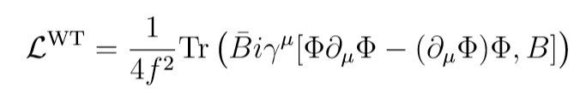
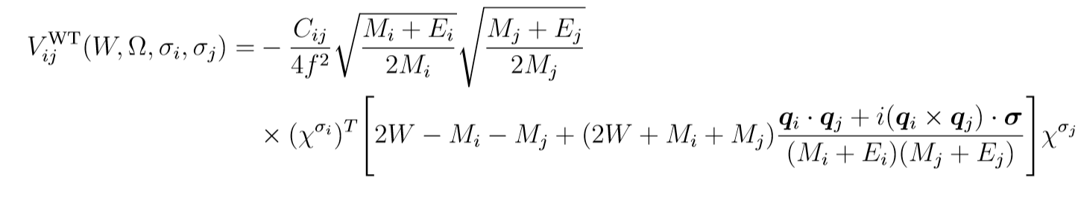
Meson-Baryon Interaction at O(p) order
Expanding the covariant derivative term in m & b effective Lagrangian
Weinberg-Tomozawa interaction Lagrangian
Weinberg-Tomozawa interaction amplitude

Slide 10
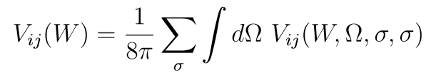
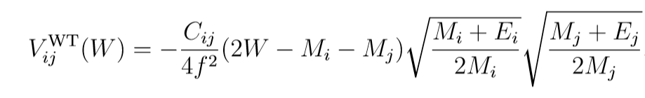
Meson-Baryon Interaction at O(p) order
S-wave projection
Scattering of the spinless NG bosons off the spin ½ baryon target
→ Considering only s-wave is good approximation
Spin summation
After summation, spin dependence of amplitude vanishes,

Slide 11
Chiral unitary model
Based on chiral perturbation theory Imposing the unitarity condition
ChPT in regions of higher energy than in the original perturbative calculation, and we can study properties of resonances generated by non-perturbative resummation
Due to threshold energy, hadron masses adopted in the scattering equation with the leading order interaction kernel
We consider the nonrelativistic amplitude and s-wave

Slide 12
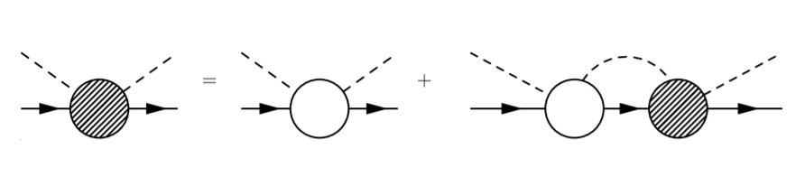
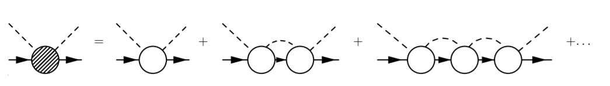


Nonperturbative amplitude
Lippman-Schwinger equation for Chiral unitary approach
We define T , V and G operators
Figures from Ref.1

Slide 13
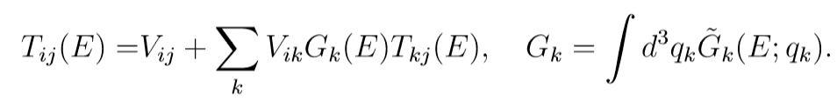

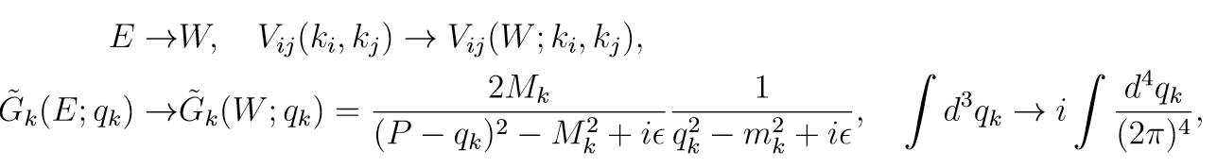
Scattering amplitude
Scattering amplitude can be expressed infinite sum
Apply the framework to the MB scattering
→ denoting the total center of mass energy W

Slide 14
Apply Neural Network
If we know V & G operator , we will get the scattering amplitude
But it is not easy to decide G operator(poles)
It’s time to start computer
We able to training the computer to classify and decide G operator
Input V, Output T -> training the G operator
After the training, if only put V, automatically classify and find G
Connect V to T

Slide 15
Convolutional Neural Network
CNN improved the image classification greatly
G operator, from LS scattering, is Kernel of CNN
Kernel/Filter: weights only depends on the distance
→ Apply the same weights to different neurons
Adopted kernel comes from interaction V
Automatically classify G and determine the T

Slide 16
Reference
1. The nature of the Lambda(1405) resonance in chiral dynamics DOI:10.1016/j.ppnp.2011.07.002
2. Flavor SU(3) breaking effects in the chiral unitary model for meson-baryon scatterings (Phys. Rev. C 68, 018201 – Published 24 July 2003)
3. Detailed Analysis of the Chiral Unitary Model for Meson-Baryon Scattering with Flavor SU(3) Breaking Effects
DOI:10.1143/PTP.112.73
4.Saito goki “ Deep Learning From Scratch”
5. https://github.com/alphacentaury-github/NPSS2020
….. Thank you!

