Slide 1
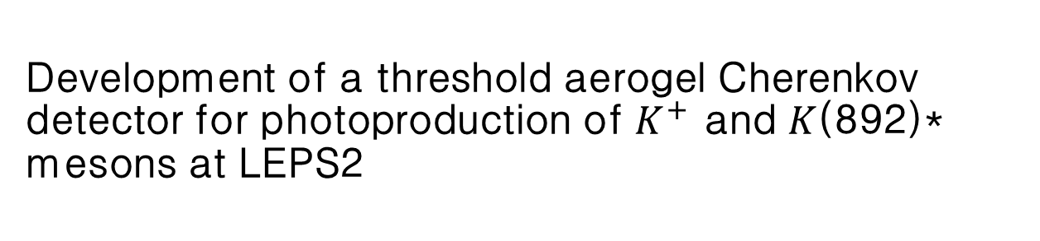
Development of a threshold aerogel Cherenkov detector for photoproduction of $K^{+}$ and $K$(892)* mesons at LEPS2
Yang Hyun Min
Notes:
Keyword lambda 1405 photoproduct gamma p -> lambda(1405), k(892)
Pdg note on LAMBDA(1405) two pole structure Sigma+pi, Kp
Scattering plane 공부할것

Slide 2
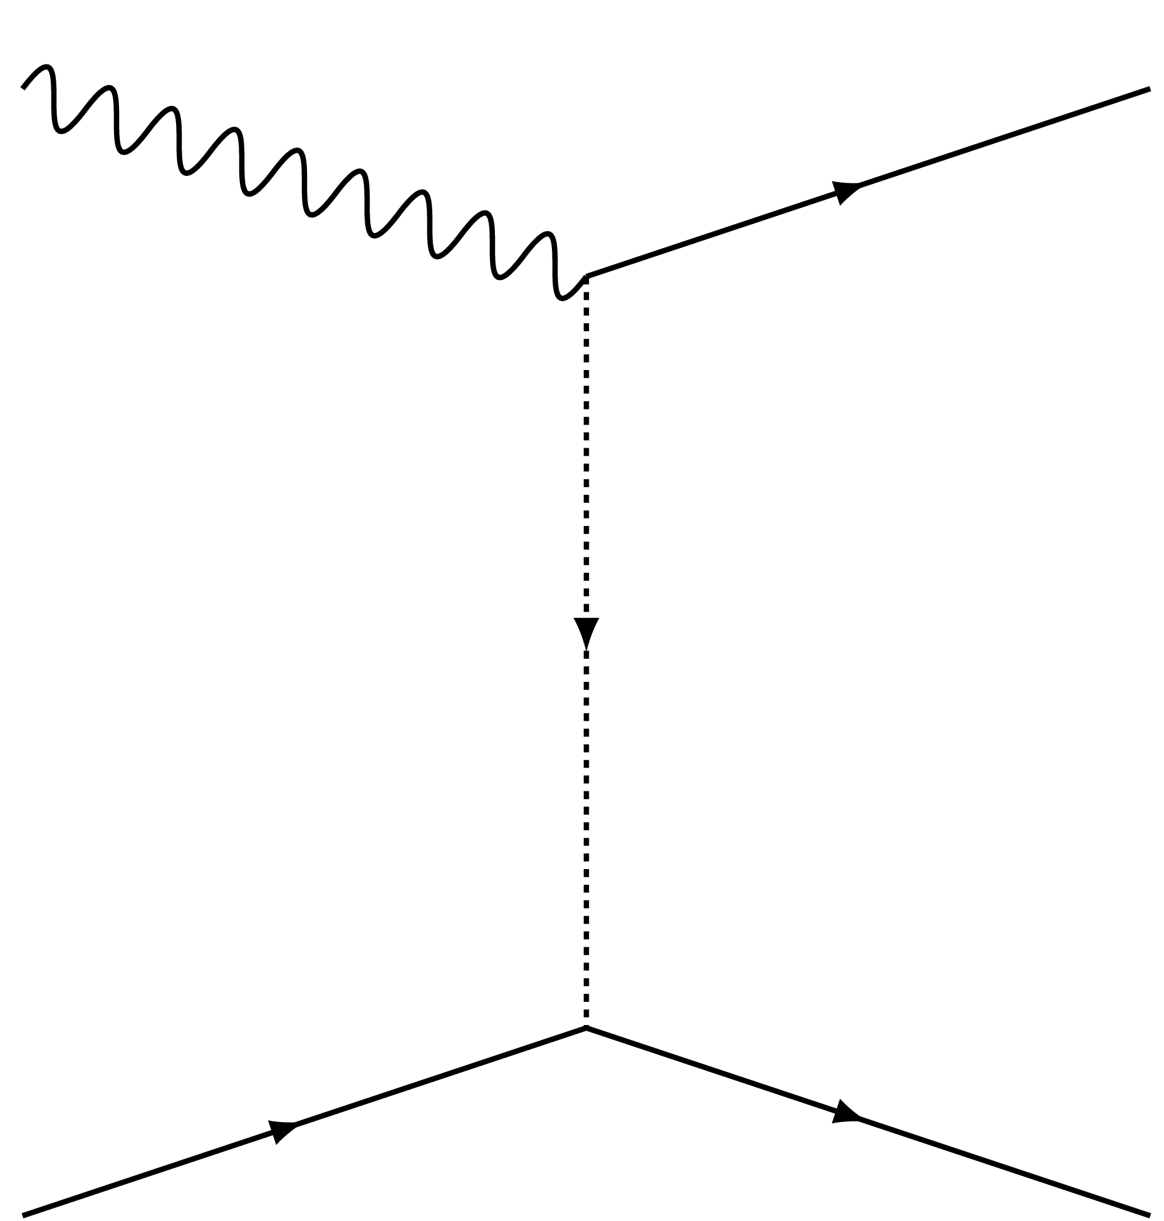


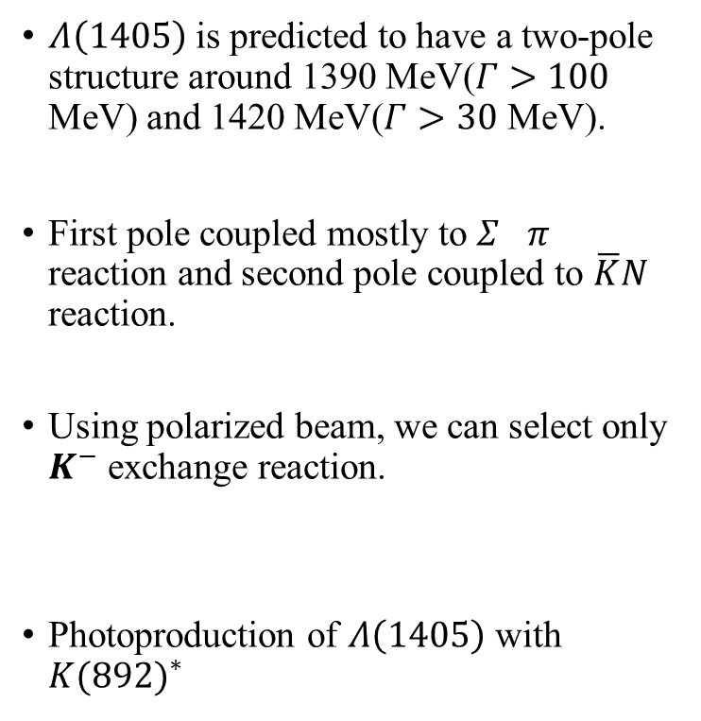





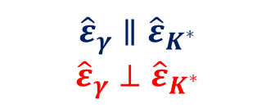


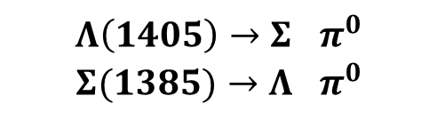


Physics Motivation
$$K^{}$$
$${\hat{ε}}_{γ}$$
$$K^{}$$
$Λ\left(1405\right)$ is predicted to have a two-pole structure around 1390 MeV($Γ>100$ MeV) and 1420 MeV($Γ>30$ MeV).
First pole coupled mostly to $Σ^{}π^{}$ reaction and second pole coupled to $\overline{K}N$ reaction.
Using polarized beam, we can select only $K^{−}$ exchange reaction.
Photoproduction of $Λ\left(1405\right)$ with ${K(892)}^{∗}$
$$γ$$
$${\hat{ε}}_{K^{∗}}$$
$$γ$$
$$K^{∗}$$
$${\hat{ε}}_{K^{∗}}$$
$$π^{}$$
$$π^{}$$
$${\hat{ε}}_{γ}∥{\hat{ε}}_{K^{∗}}$$
$${\hat{ε}}_{γ}⊥{\hat{ε}}_{K^{∗}}$$
$$K^{−},K^{∗}$$
$$p$$
$$Λ\left(1405\right)→Σ^{}π^{0}$$
$$Σ(1385)→Λ^{}π^{0}$$

Slide 3
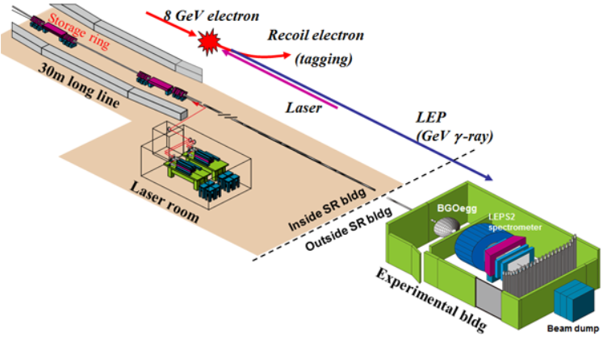
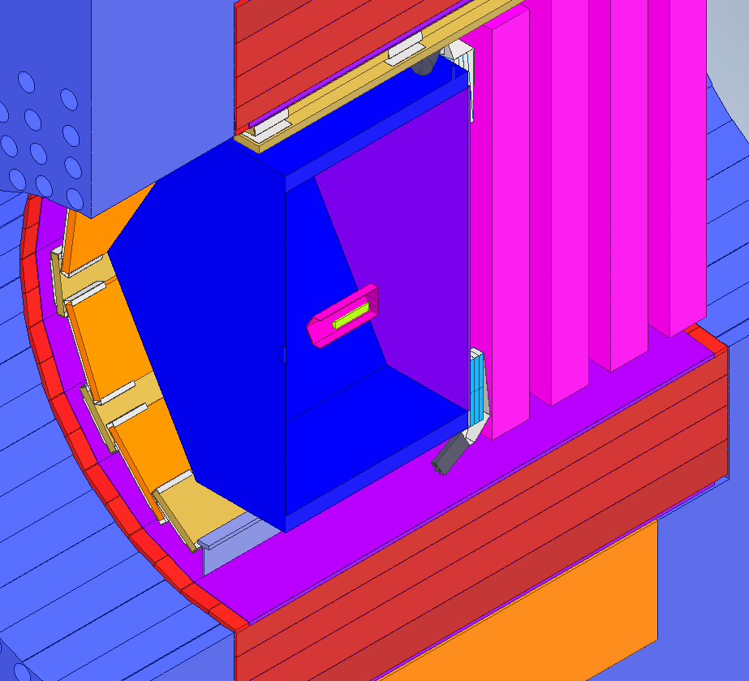
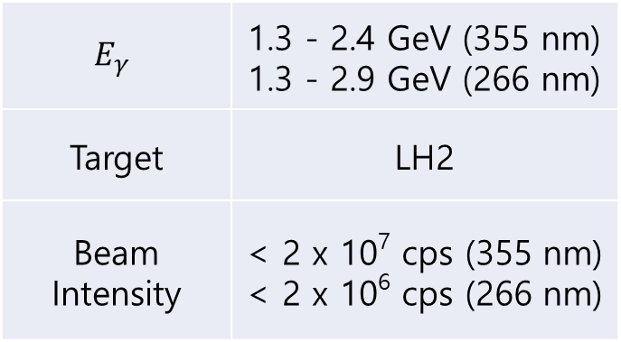

LEPS2 experiment at SPring8
DC
TPC
AC1
$$E_{γ}$$ | 1.3 - 2.4 GeV (355 nm) 1.3 - 2.9 GeV (266 nm)
Target | LH2
Beam Intensity | < 2 x 10⁷ cps (355 nm) < 2 x 10⁶ cps (266 nm)
$$γ$$
Target in SC
Barrel gamma
BRPC
Notes:
Physics
궁금한 내용
LEPS2 설명(photoproduction, 특징, 커미션 런)
PID, AC1 필요성, 요구 성능 조건
Prototype 개발
AC1 검출기의 종류, 개발 과정
예상되는 PID?-> PID plot, (ex, momentum vs tof….)
완성이 된다면, 요약

Slide 4
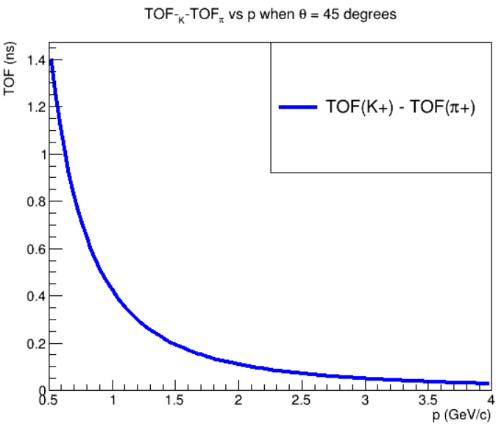
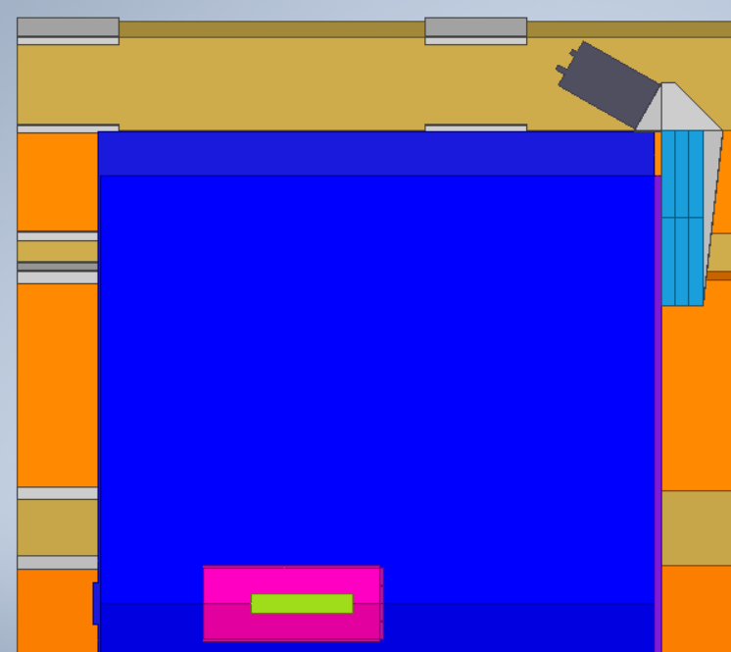


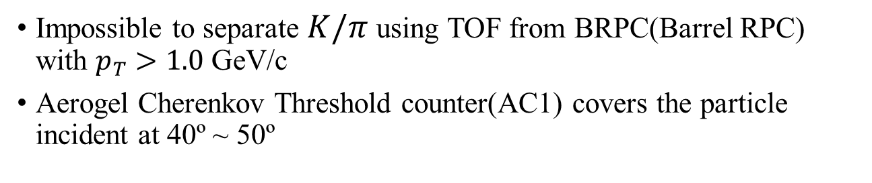

$K/π$ Separation for PID
50º
PID by TOF
$$σ_{TOF(BRPC)}=80\sim 100 ps$$
40º
$$γ$$
PID by Cherenkov Det.
Impossible to separate $K/π$ using TOF from BRPC(Barrel RPC) with $p_{T}>1.0$ GeV/c
Aerogel Cherenkov Threshold counter(AC1) covers the particle incident at 40º ~ 50º
Notes:
Physics
궁금한 내용
LEPS2 설명(photoproduction, 특징, 커미션 런)
PID, AC1 필요성, 요구 성능 조건
Prototype 개발
AC1 검출기의 종류, 개발 과정
예상되는 PID?-> PID plot, (ex, momentum vs tof….)
완성이 된다면, 요약

Slide 5
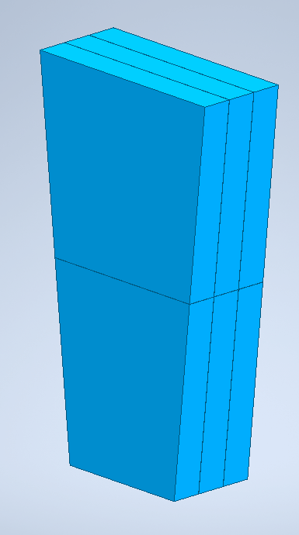
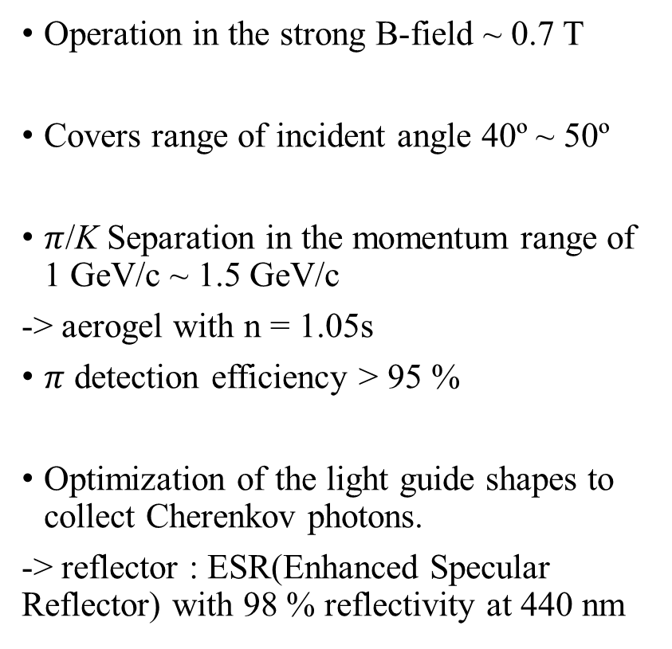
AC1 Performance Required
Operation in the strong B-field ~ 0.7 T
Covers range of incident angle 40º ~ 50º
$π$/K Separation in the momentum range of 1 GeV/c ~ 1.5 GeV/c
-> aerogel with n = 1.05s
$π$ detection efficiency > 95 %
Optimization of the light guide shapes to collect Cherenkov photons.
-> reflector : ESR(Enhanced Specular Reflector) with 98 % reflectivity at 440 nm
144
60
256.4
91
(unit : mm)

Slide 6
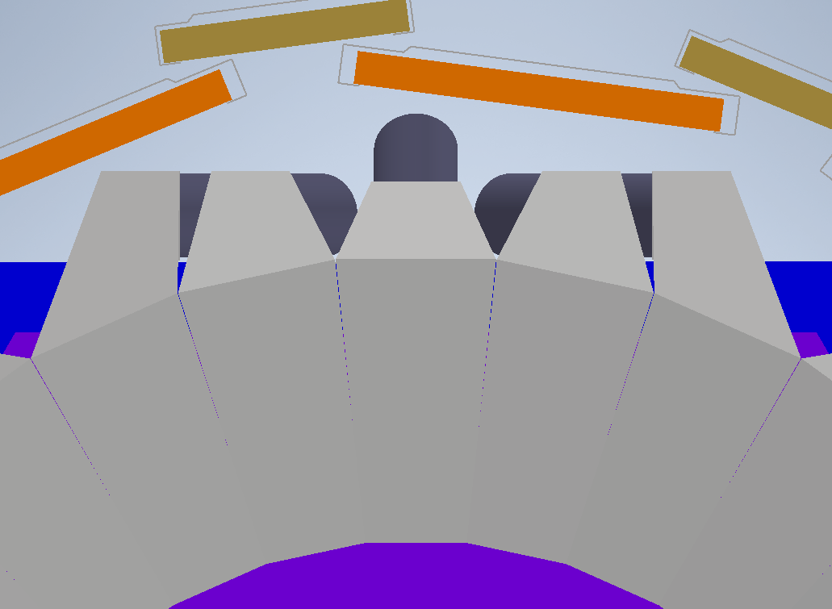
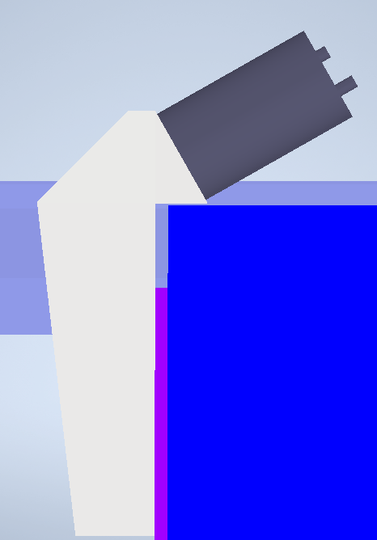
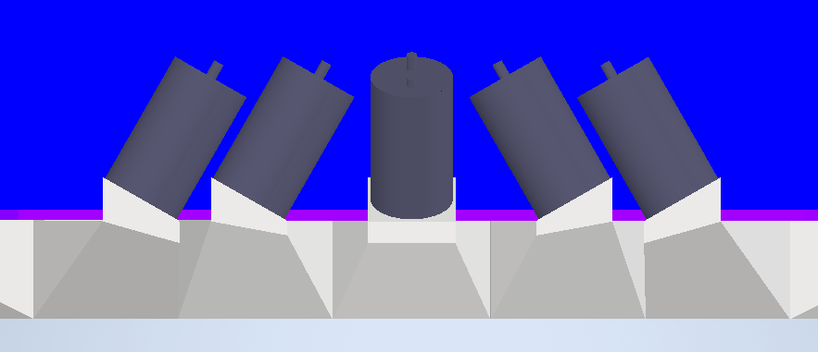
AC1 Light Guide Types
Front View
Side View
Total 30 modules are mounted on the TPC edge in ring shape.
PMT installed with its axis to be 30º regard to the B-field direction.
To fit in the space between TPC and RPC
→ Three types of light guide with FMPMT
→ Type A, Type B, Type C
B-field
30º
TPC
C
A
B
C
B
A
y
y
x
z
z
x
y
B-field
x
TPC
z
30º
C
B
A
B
C
Top view
91.5
Notes:
너무 내용 많음. RPC time resolution (TOF 로서). 모듈의 그림은 따로.
Finemesh PMT언급, 특수한 모양

Slide 7
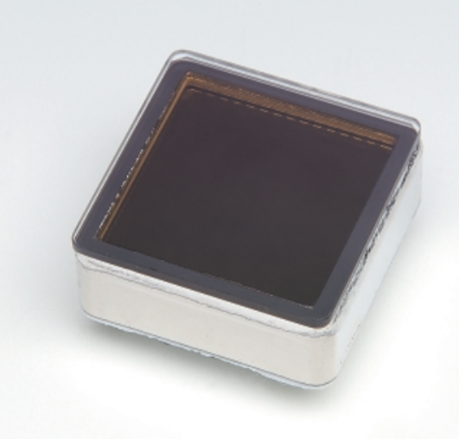
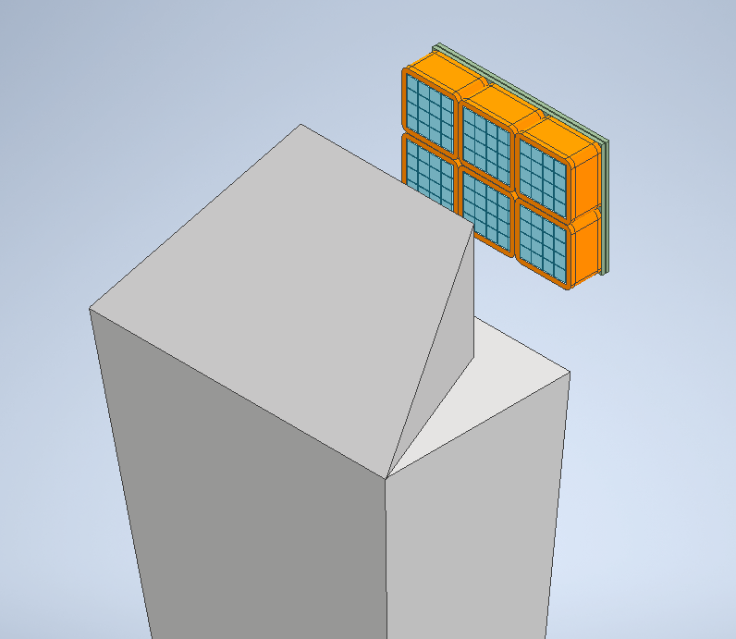
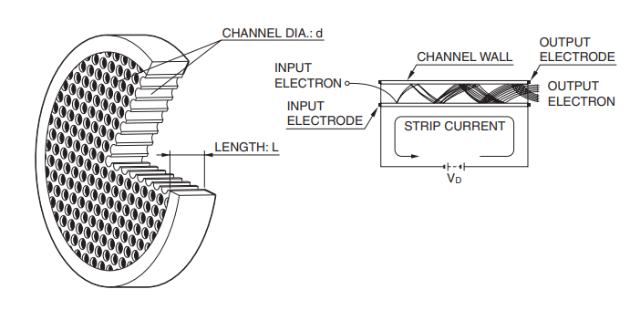
AC1 Light Guide Types
FMPMT of Some modules conflict with TPC support structure
→ The candidates are
MCP-PMT(Micro Channel Plate PMT)
1. Medium coverage area
2. Single Photoelectron Response is not gaussian → Hard to estimate Npe
3. Tube axis must be parallel to B-field
4. Aging Effect is critical!
MPPC(Multi Pixel Photon Counter)
1. Very small coverage area
(smaller than 6 mm× 6 mm)
2. Excellent photo counting performance.
B-field
91.5
Notes:
너무 내용 많음. RPC time resolution (TOF 로서). 모듈의 그림은 따로.
Finemesh PMT언급, 특수한 모양

Slide 8



Beam Test at Spring8
LEPS/SPring8 Spectrometer
Performance test using electron beam in LEPS/SPring8
→ measured ADC and TDC with different incident point.
3 kinds of reflector have been tested.
- Al mylar(88 % )
- ESR film(98 %)
- Tyvek(diffuse, 98%)
ADC distribution with aerogel inside and outside.
$$e^{+}$$
$$γ$$
$$E_{max}=2.4 GeV$$
$$e^{−}$$
p~450 MeV/c
incident
positions
Pair production in Pb
incident angle :
40 ˚
Dipole Magnet
B ~ 0.35 T

Slide 9
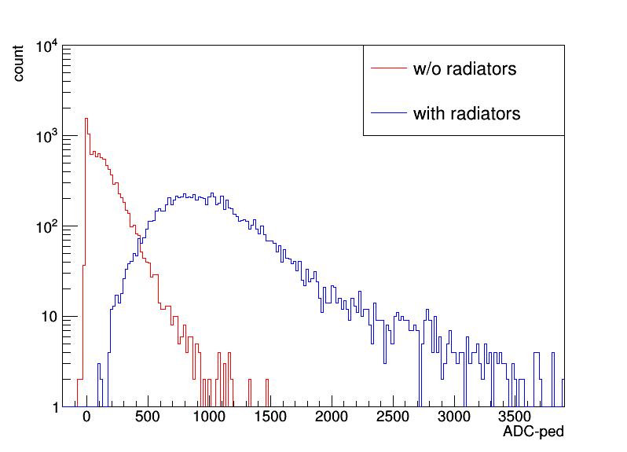
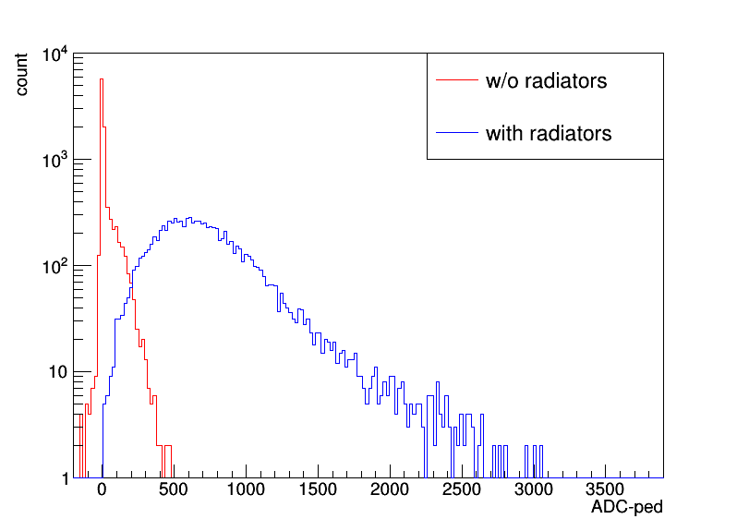
Reflector Performances
ADC spectra of AC1 detector(Type-A)
Only scintillation
without absorption
Scintillation +
Cherenkov radiation
ESR film
Al mylar
Even without radiators inside, photons are detected when beam passes(scintillation).
ESR reflector has shown best light collection, but emitted scintillation most.
Type C has shown worst light collection due to its long shape.

Slide 10
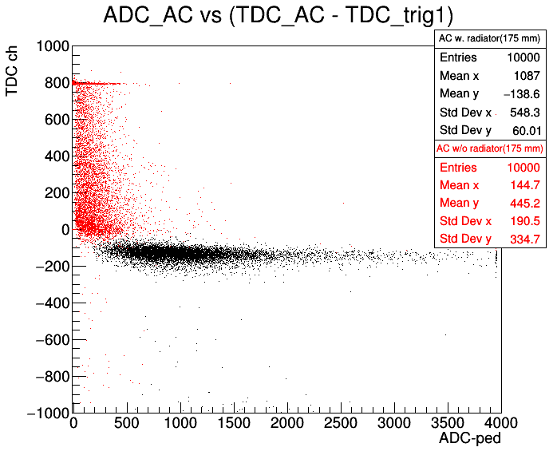
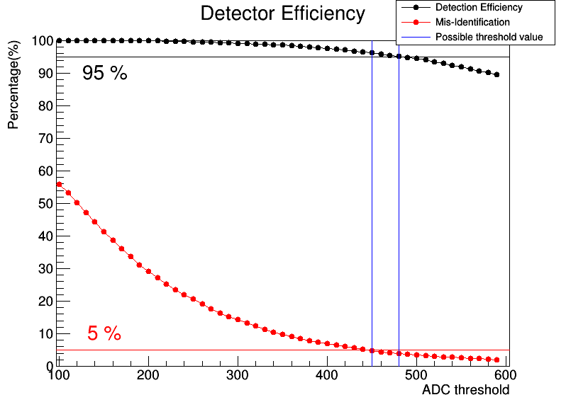
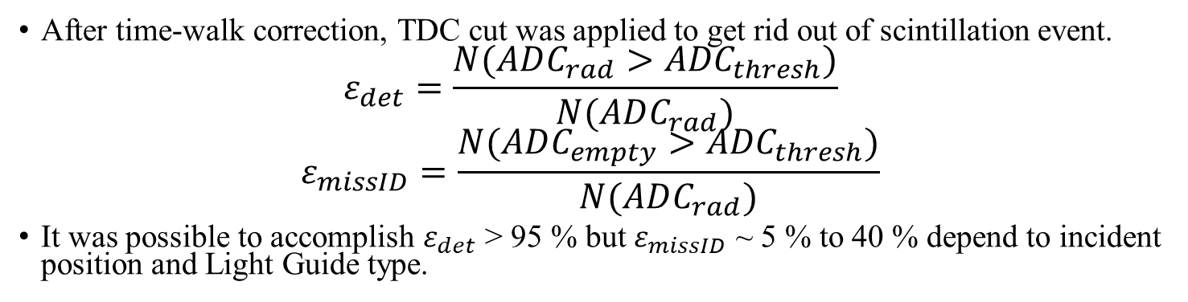

Detection Efficiency Calculation
Event selection :
t< 3 $σ_{t}+t_{mean}$
After time-walk correction, TDC cut was applied to get rid out of scintillation event.
$$ε_{det}=\frac{N(ADC_{rad}>{ADC}_{thresh})}{N(ADC_{rad})}$$
$$ε_{missID}=\frac{N(ADC_{empty}>{ADC}_{thresh})}{N(ADC_{rad})}$$
It was possible to accomplish $ε_{det}$ > 95 % but $ε_{missID}$ ~ 5 % to 40 % depend to incident position and Light Guide type.

Slide 11
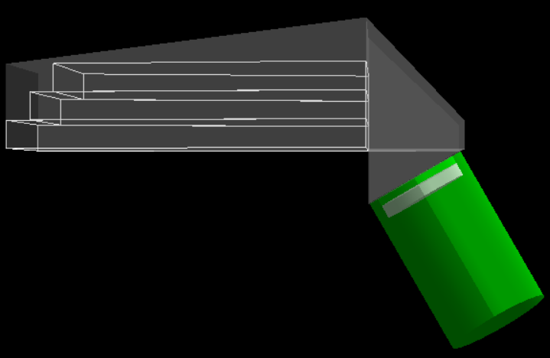
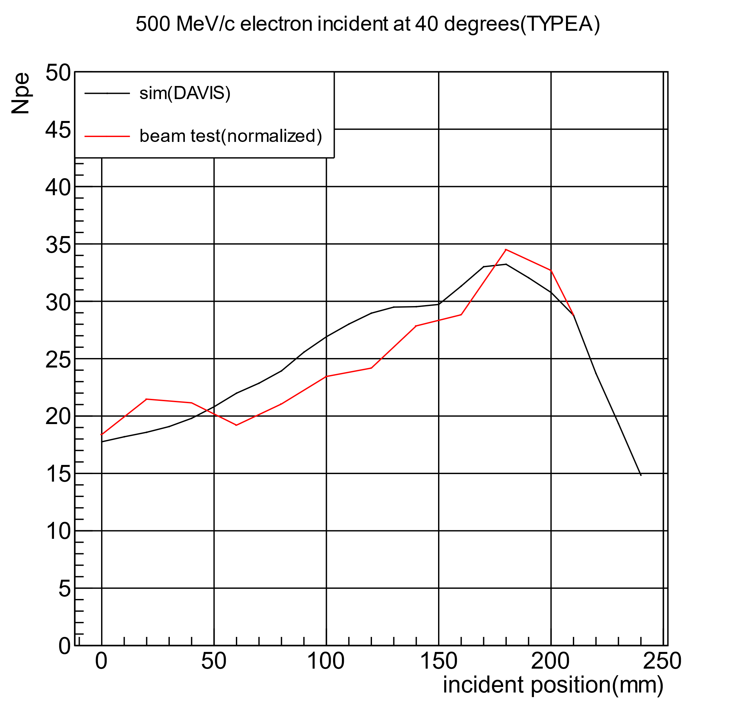
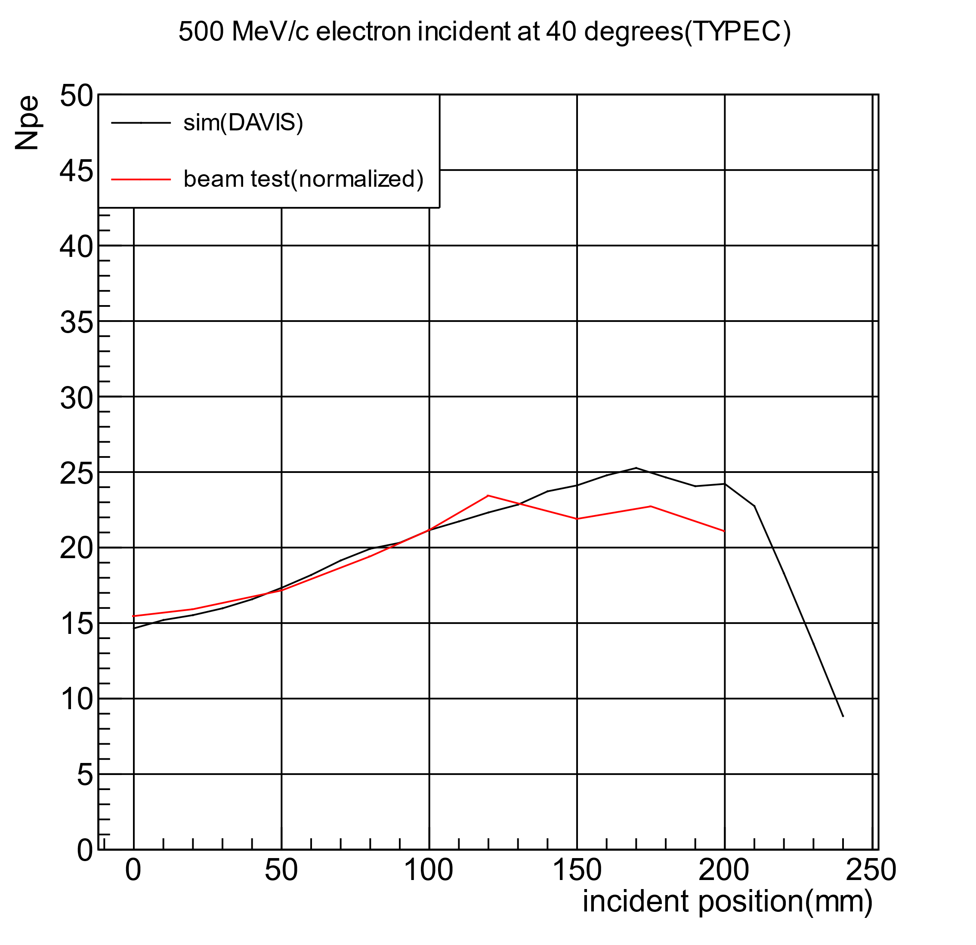
Geant4 Simulation
N_ cherenkov ~ 1110
Optical Simulation(Geant4) is used to optimize light guide and reflectors.
- quantum efficiency of FMPMT
- wavelength dependent reflectivity
- Absorption and Scattering in aerogel material
Position dependence of light collection shows similar behavior.
-> However, estimating Npe from ADC means must be done!

Slide 12
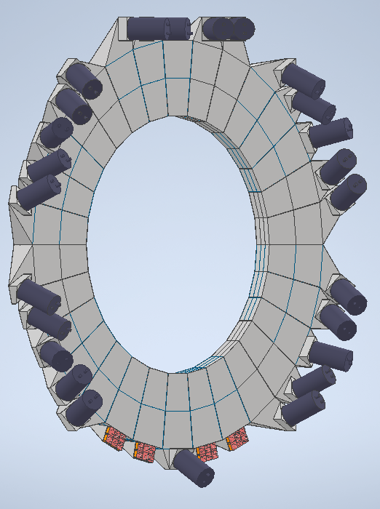
Summary
Various types of light guides and photodetectors are under development for AC1 at LEPS2/Spring-9
Plan to write an event generator and a simulation program with all AC1 types installed.
To estimate accurate detection efficiency and double-check with simulation, single photon response of FMPMT and MCP-PMT must be studied more.
Also, goal is to start mass production in the beginning of 2021.

Slide 13
Than you for listening! Back up slide

Slide 14
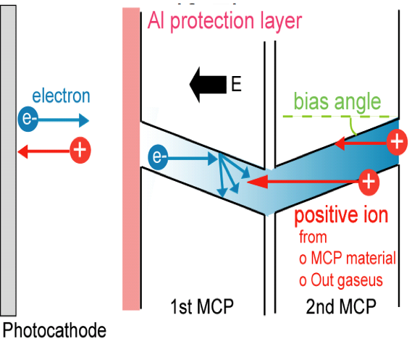
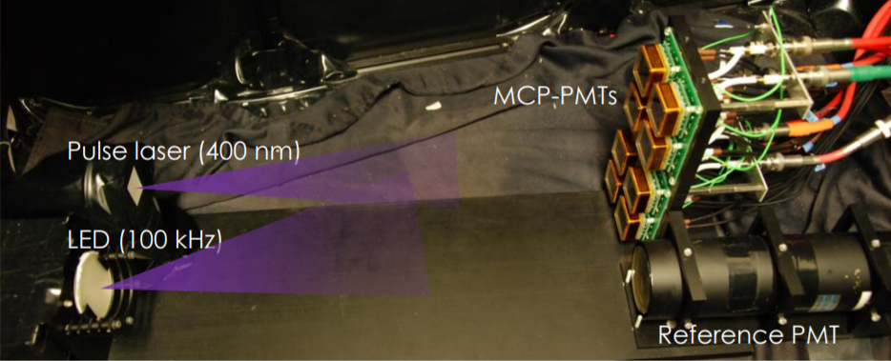
Main Problem of MCP PMT
While electrons are amplified, neutral gas (H20 and CO2) are generated from micro channel.
Photocathode is damaged by the gas and the Q.E. of the MCP PMT is degraded more and more as the amount of amplified charge accumulates.
gas
Notes:
Reference PMT : 총 증폭된 전하의 량을 모니터하기위해
Pulse laser : single photon electron의 hit rate를 비교해서 상대적 QE 를 계산하기 위해
LED : 전하 증폭 부담을 주기 위하여

Slide 15
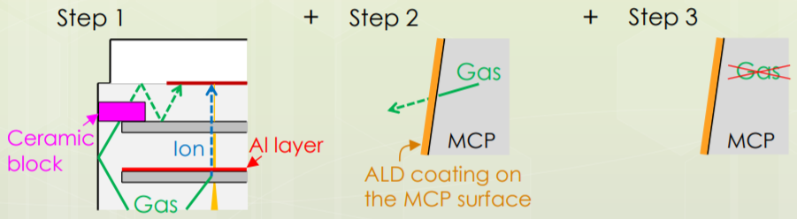
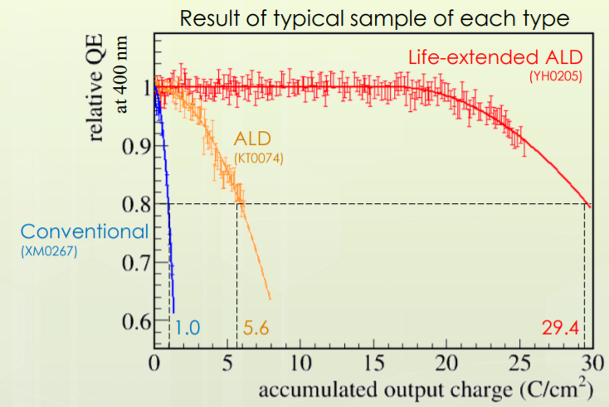
Improvement of MCP-PMT
Step 1)
Placing ceramic block to prevent gas going to photocathode
-> Conventional
Step 2)
Apply ALD(Atomic Layer Deposition) to suppress outgassing.
-> ALD
Step 3)
Change micro channel material with less gas generation.
-> Life-extended ALD

Slide 16
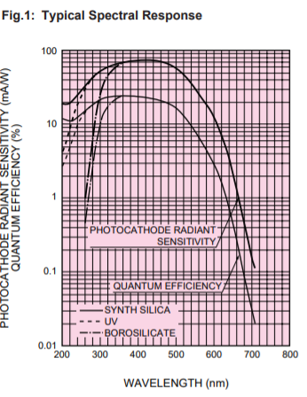
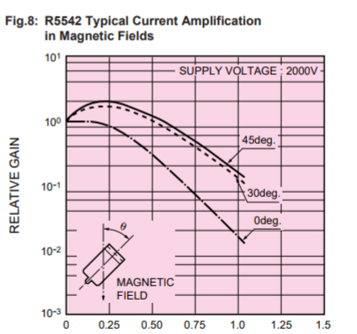
R5543 characteristic
R5543 : UV type of R5542 model

Slide 17
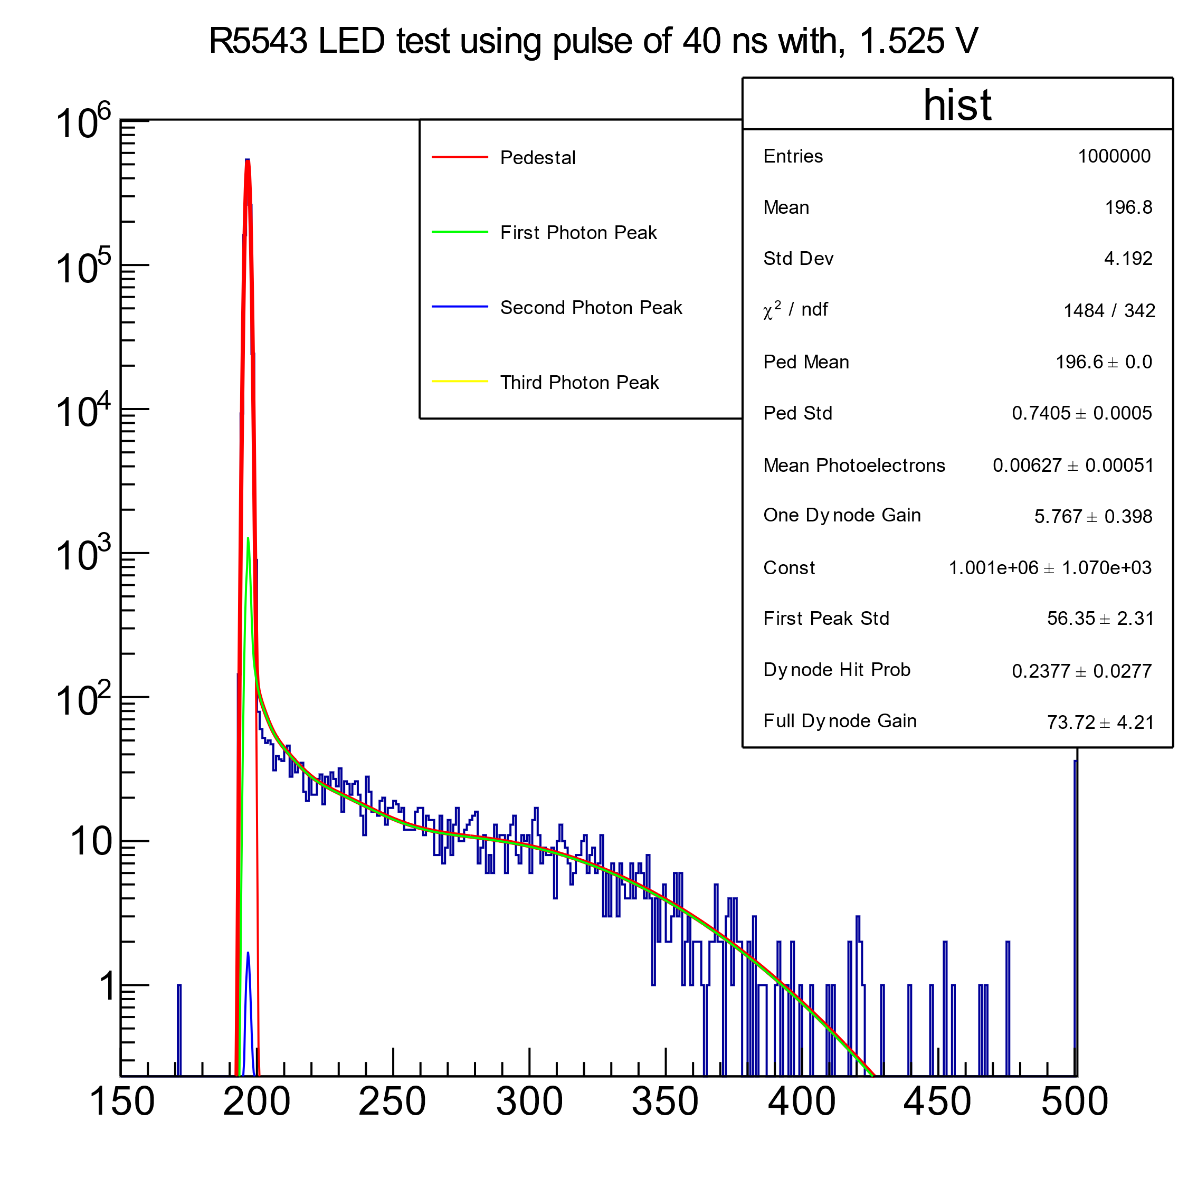
LED test using R5543 Finemesh PMT

Slide 18
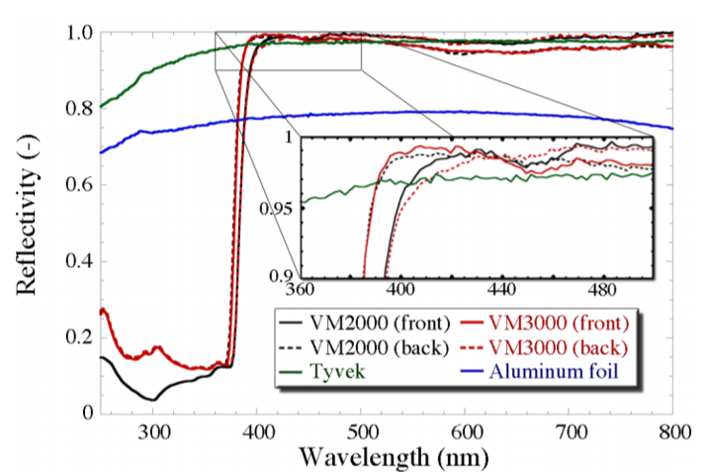

Slide 19
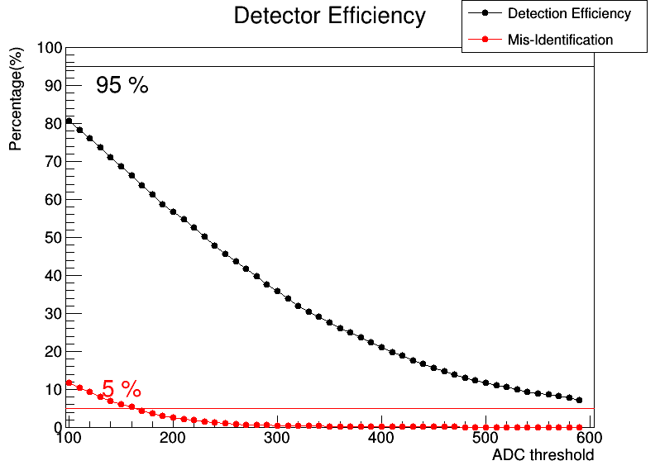
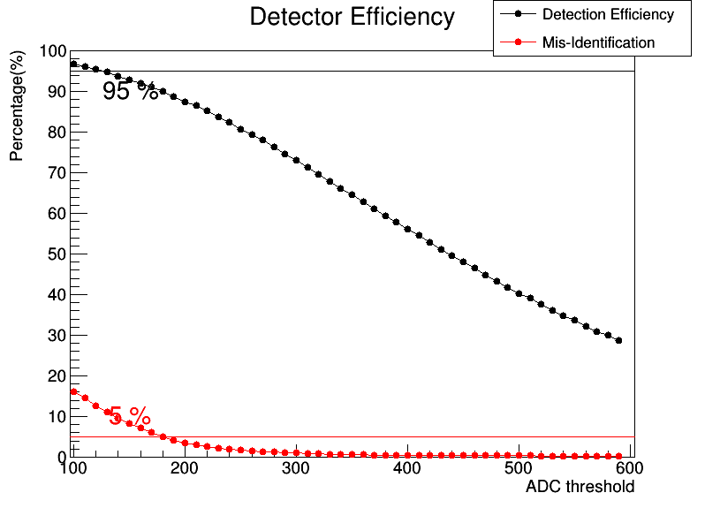
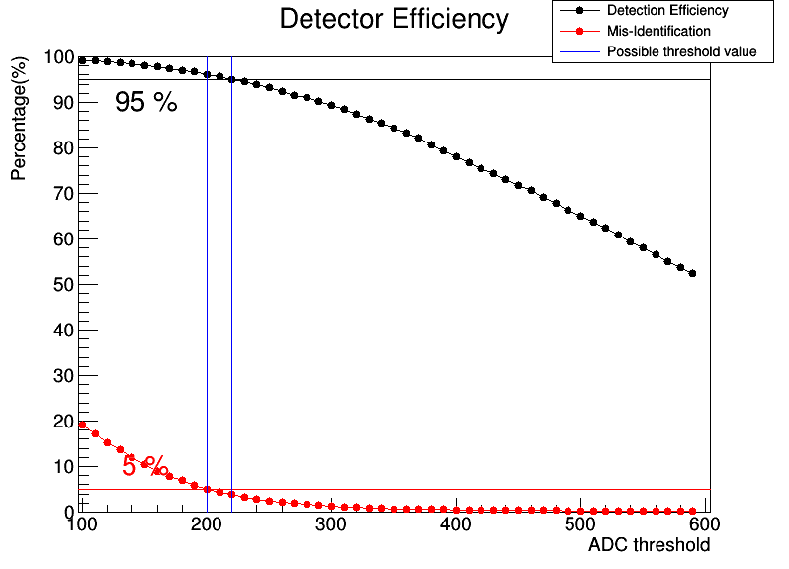
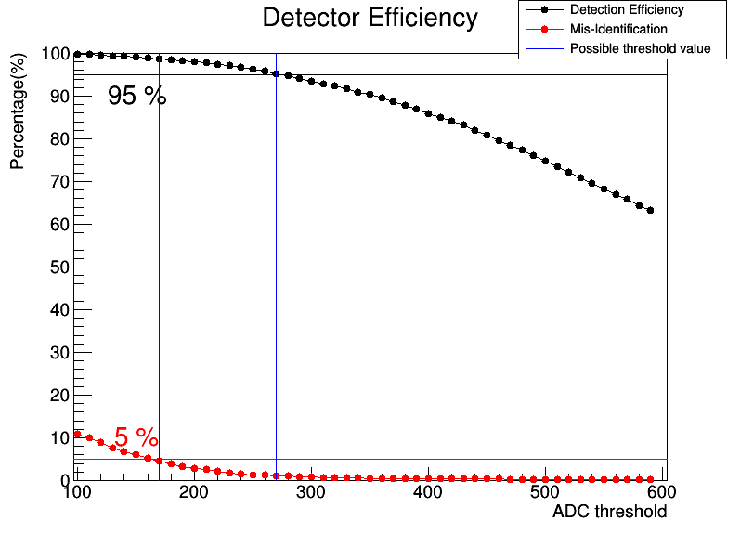
TYPEA, Aluminized Mylar
50 mm
100 mm
150 mm
175 mm

Slide 20
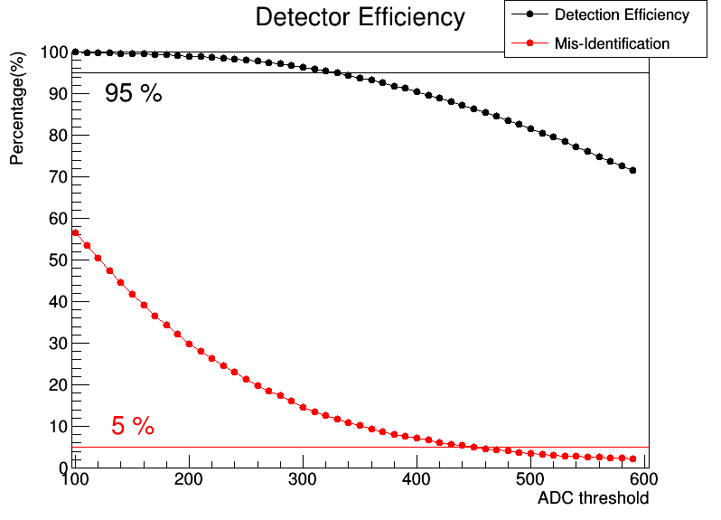
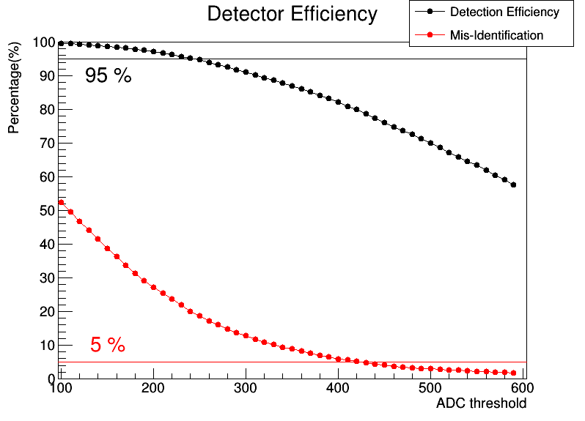
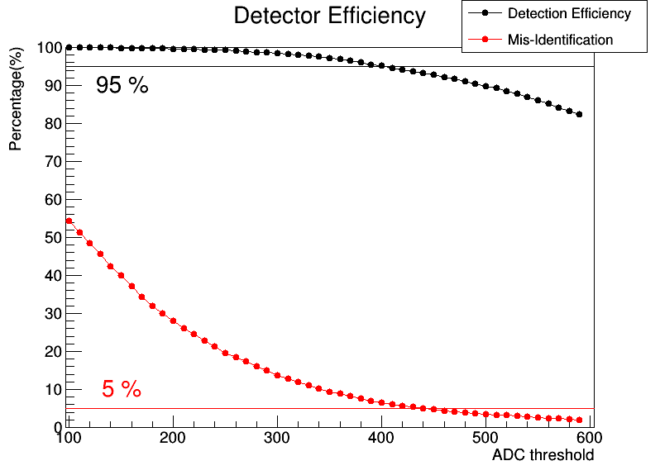
TYPEA, ESR
50 mm
100 mm
150 mm
175 mm

Slide 21
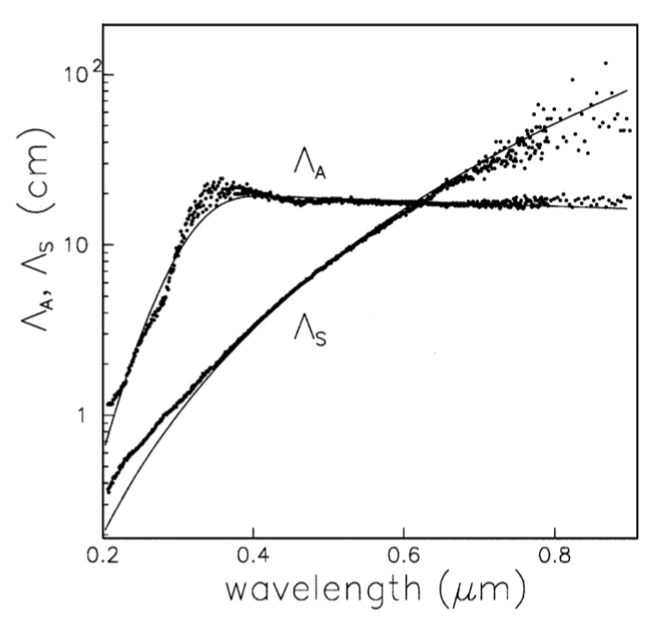

Geant4 Material Optical Properties
Aerogel
- 0.05 mm airgap between each blocks
- Optical Boundary(with air)
- Model : unified
- Finish : polished
- Type : dielectric_dielectric
Scattering and Absorpsion length
(E. Aschenauer et al.,“Optical characterization of n=1.03 silica aerogel used as radiator in the RICH of HERMES”)
ESR film
- Thickness : 65 um
- Optical Boundary(with air)
- Model : DAVIS
- Finish : PolishedESR_LUT
- Type : dielectric_LUTDAVIS

Slide 22

Trigger logic
CCNET
PM AMP
Discriminator
Delay
TDC(REPIC RPC-060)
Gate Generator
AC1
x10
-25 mV
-30 mV
-30 mV
-30 mV
- 30 mV
105 ns
105 ns
105 ns
105 ns
105 ns
100 ns
200 ns
200 ns
200 ns
200 ns
START
INTREG
150 us Delay
Trig 1
In
Out
Trig 2
Trig 3
In
Trig 4
Signal Divider
Coin.
Gate in
Clock
(100 Hz)
Veto
ADC(REPIC RPC-022)
Delay
GATE
Ch 3
Ch 4
Ch 5
Ch 6
Ch 7
Gate out (200 ns)
100 ns
200 ns
200 ns
200 ns
200 ns
Flip Flop
Out
OUTREG
Set
Out
Reset

Slide 23
Trigger logic
Signal
Divider
FAST BUS TDC
1875S
PM AMP
Discriminator
AC1
x10
-15 mV
-15 mV
-15 mV
-25 mV
Ch0
Ch1
Ch2
Ch3
Trig 1
Trig 2
Trig 3
Clock
(100 Hz)
in
out
31.5 ns
Gate Gen
delay
-
coin.
Ch0
Ch1
Ch2
Ch3
gate
Delay and High Pass Filter
FERA 4300B

Slide 24
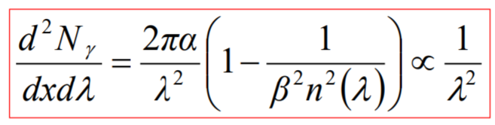

Slide 25
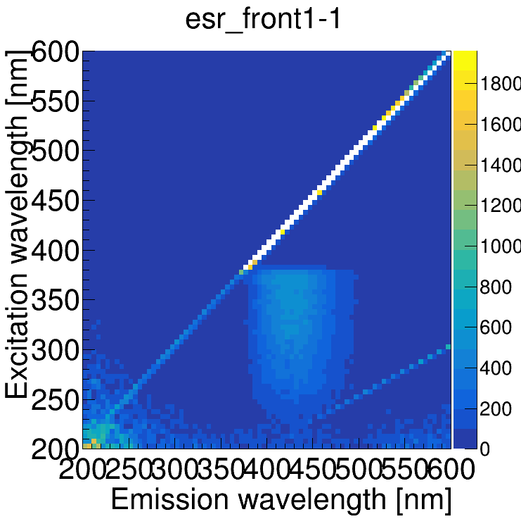
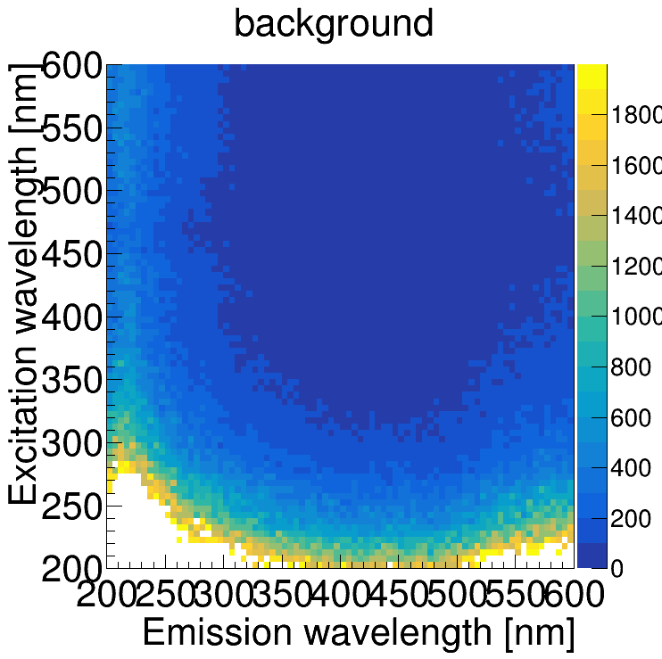
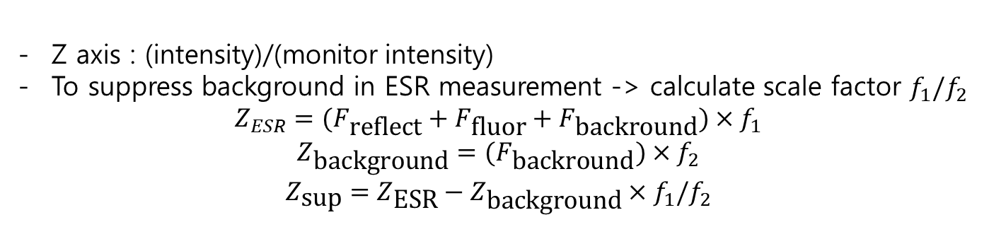
Background suppression
Z axis : (intensity)/(monitor intensity)
To suppress background in ESR measurement -> calculate scale factor $f_{1}/f_{2}$
$$Z_{ESR}=(F_{\text{reflect}}+F_{\text{fluor}}+F_{\text{backround}})×f_{1}$$
$$Z_{\text{background}}=(F_{\text{backround}})×f_{2}$$
$$Z_{\text{sup}}=Z_{\text{ESR}}−Z_{\text{background}}×f_{1}/f_{2}$$

Slide 26
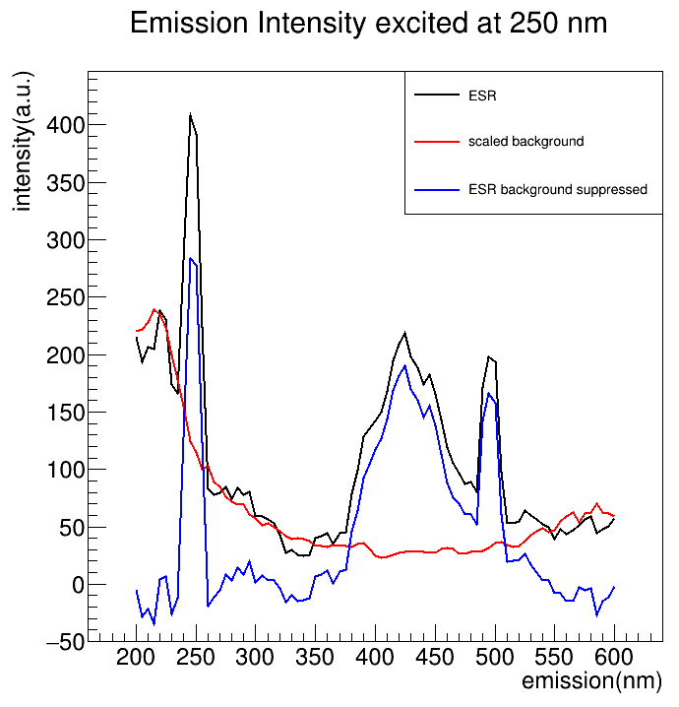
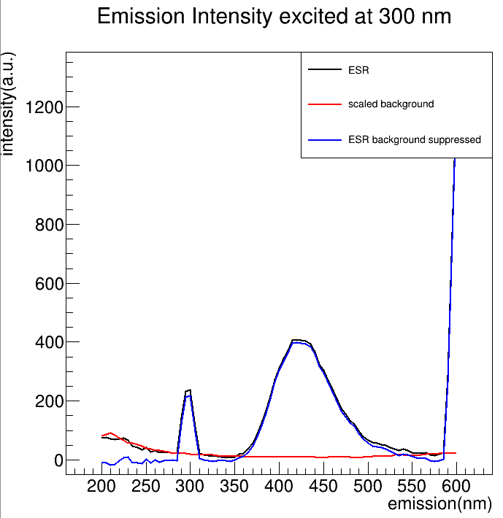
Result
fluorescence
reflection
2 Lamda peak
2 Lamda peak
Even after suppressing, data with excitation < 250 nm are not good.
Within excitation < 300 nm, we have to also separate 2 lamda peak.

