Slide 1
New RPCs for High-Energy Physics Experiments and for Applications to Nuclear Science
Kyong Sei Lee / Korea University

Slide 2
Traditional role of trigger RPCs
Provide fast trigger signals with a time resolution of ~ 1 ns and a position resolution of ~ 1 cm
Time resolutions
Trigger RPCs (panel shape) ~ 1 ns
Timing RPCs (bar shape) ~ 50 ps
RPCs are the detectors for both tracking and triggering with a best time resolution of less than 1 ns
Tracking & trigger RPCs where not so high position (not better than 1 mm) is not required.
↔ 2D tracking capability with a sub ns time and a sub-cm position resolutions
→ Muon trigger RPC systems for accelerator-based experiments like CMS and ATLAS
→ Large-scale accelerator-based experiments pursuing New Physics (BSM, Dark matters…) like SHiP and Matshula
→ Neutrino-physics experiments
→ Various applications like muon radiography and medical purpose

Slide 3
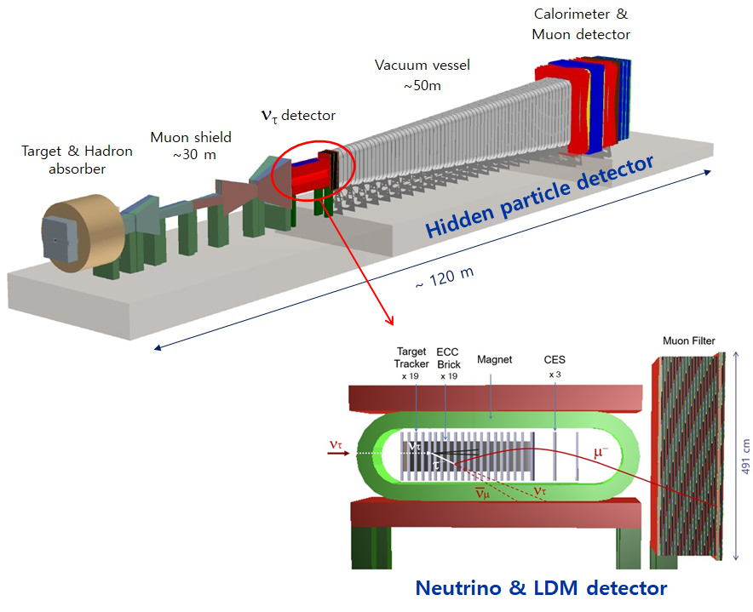
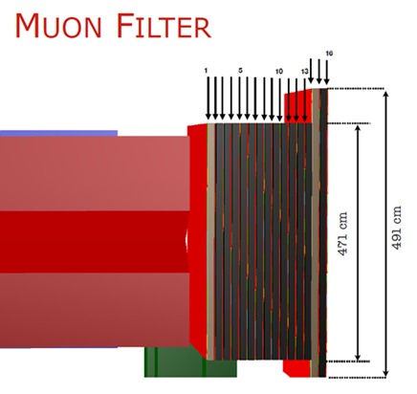

R&D target: SHiP tau neutrino RPCs
SHiP detector system
Target
Hadron absorber
Muon Absorber
Tau neutrino detector + magnet
Decay vacuum vessel
Muon veto detectors
Downstream detectors
ECAL
HCAL
TOF RPC
Better triggers for tau associated muons
Better VETO for neutrino associated muons impinging the decay vessel
In RPC2020, “RPCs and readout system for the neutrino detector of the SHiP experiment” by Liliana Congedo
RPCs dedicated to Scattering Neutrino Detector (SND)
Collaboration of ~ 250 members from 52 institutes, 17 countries
Technical Proposal: arXiv:1504.04956 (2015)

Slide 4
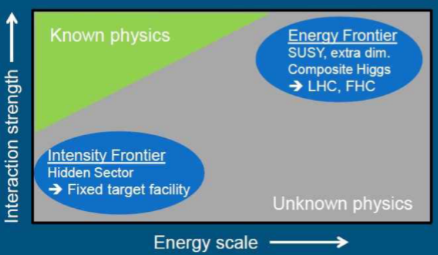
SHiP experiment to address beyond Standard Model Physics
To search for 'hidden particles’ in theoretically ‘hidden sectors’
Searching for new particles in a mass range from sub-GeV to О(10) GeV
Dark photons (vector portal)
HNLs (neutrino portal)
Scalar portal: hidden sector interacting with a known sector of SM Higgs fields
Light SUSY particles decaying into a light neutralino χ^{~0}→ K + l
Axion like Particle
Tau neutrino physics measuring tau-neutrino cross section
→ Structure functions F₄ & F₅
RPC system will differentiate tau and anti-tau reactions need a position resolution of better than 4 mm.
SHiP: Dump experiment for 5 years using 2×10²⁰ protons of 400 GeV
Called an intensive frontier experiments
Collider experiments -> energy frontier experiments
Unfortunately, European strategy meeting (ESPPU) prefers e⁺e⁻ Higgs factory and ILC support in future.

Slide 5
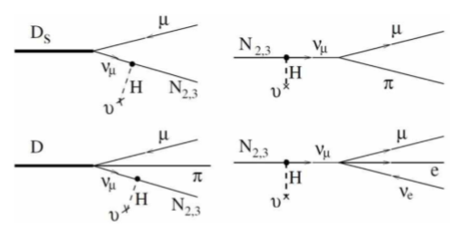
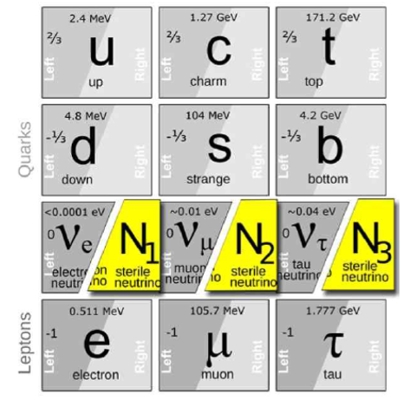
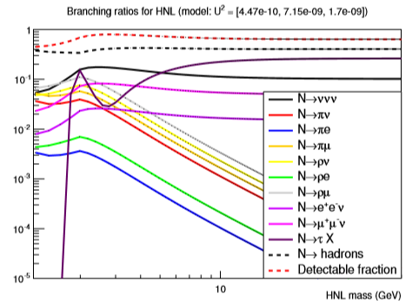
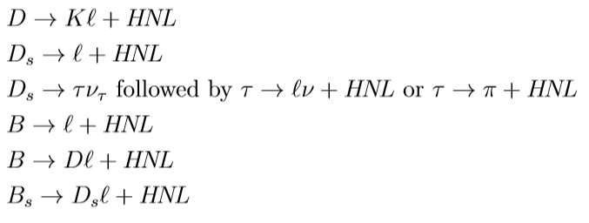
Heavy neutral leptons (sterile neutrinos, neutrino portal)

Slide 6
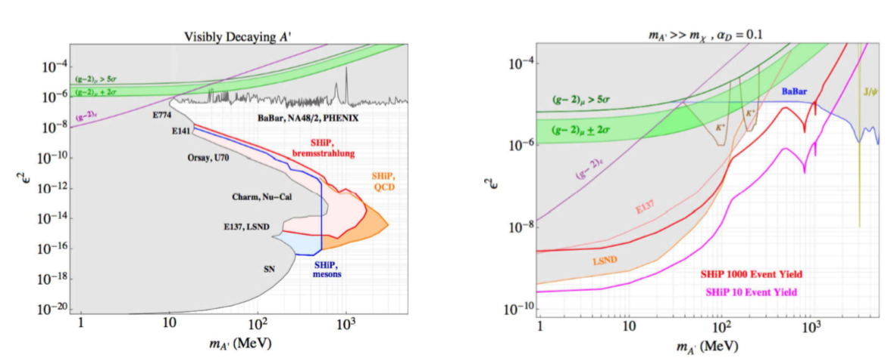
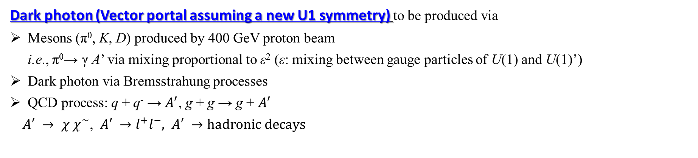

Dark photon (Vector portal assuming a new U1 symmetry) to be produced via
Mesons (π⁰, K, D) produced by 400 GeV proton beam
i.e., π⁰→ γ A’ via mixing proportional to ε² (ε: mixing between gauge particles of U(1) and U(1)’)
Dark photon via Bremsstrahung processes
QCD process: q + q⁻ → $A^{′}$, g + g → g + $A^{′}$
$A′ → χ χ^{\sim }$, $A′ →l^{+}l^{−}, A′ →$ $hadronic decays$
Delayed decay up to m_{A} ~ 2 GeV
Prompt decay $A → χ χ^{\sim }$

Slide 7
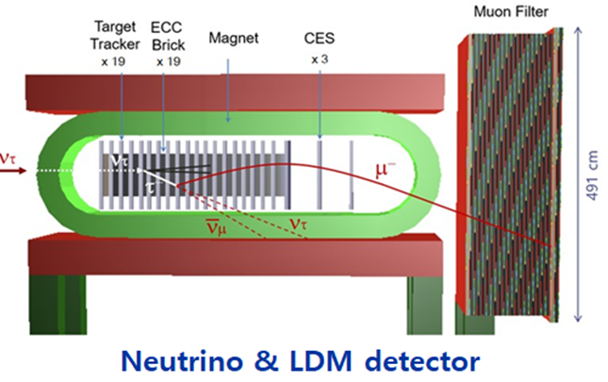
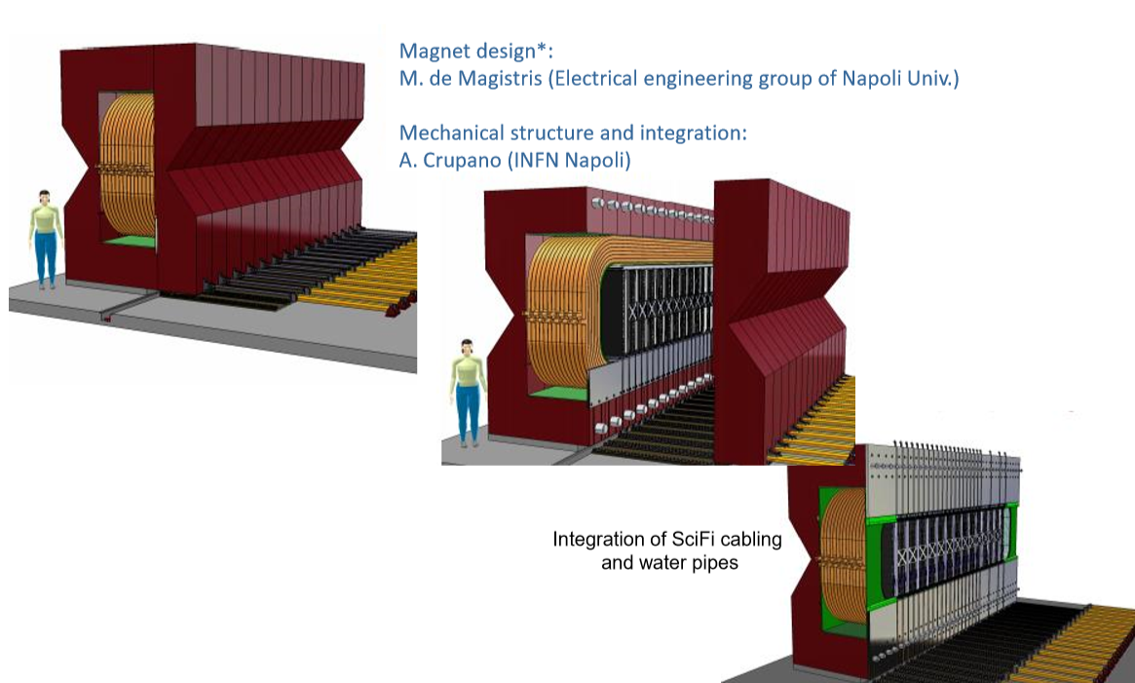
Scattering and Neutrino Detector
Warm magnet
Target system
Muon system
M. De Serio (University of Bari and INFN Bari)
SHiP Collaboration Meeting, 2 April 2020
JINST 15 P01027 (2020)

Slide 8
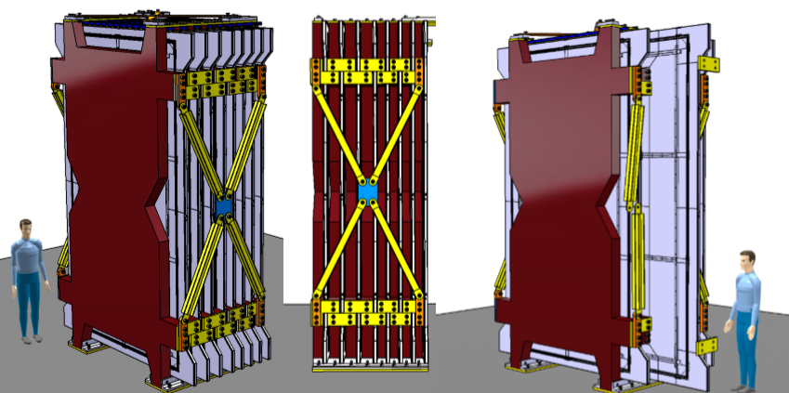
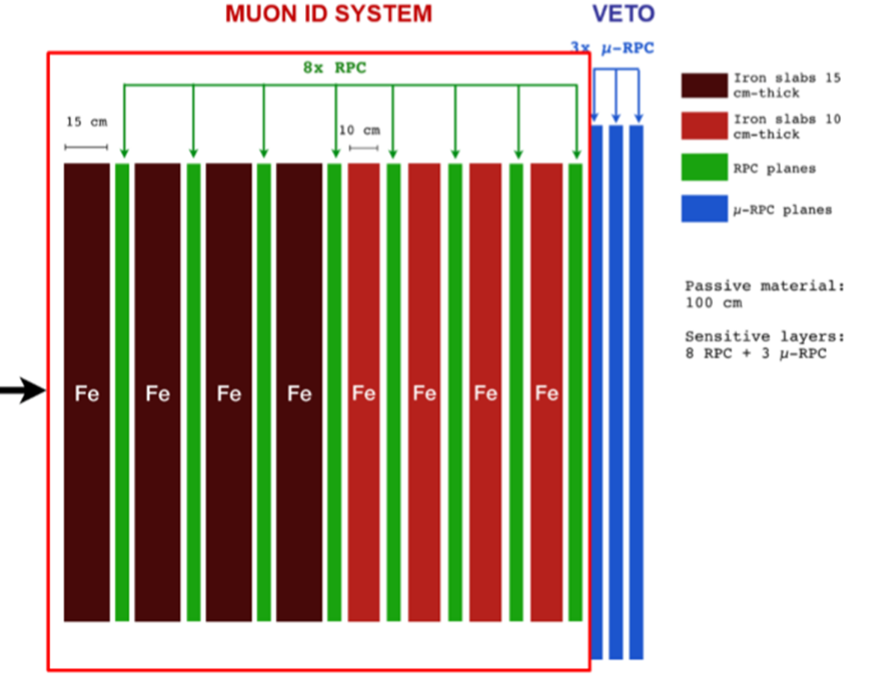
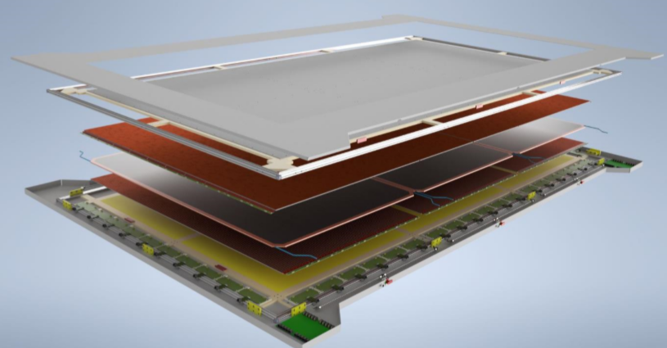
Muon tagger
11 layers of RPC planes and Fe absorbers
Tagging tau-decayed muons and VETO of neutrino associate muons
8 layers of muon tagging RPCs (σ ~ 1 ns) also used for muon VETO
3 layers of TOFs (σ < 300 ps) for muon VETO
RPCs for muon tagger requiring 3 ~ 4 mm resolution
→ able to differentiate muon charges from the tau neutrino interactions (ν_{τ}→τ⁻→µ⁻, ν⁻_{τ}→ τ⁺→µ⁺)
Structure of 2D single-gap RPC

Slide 9
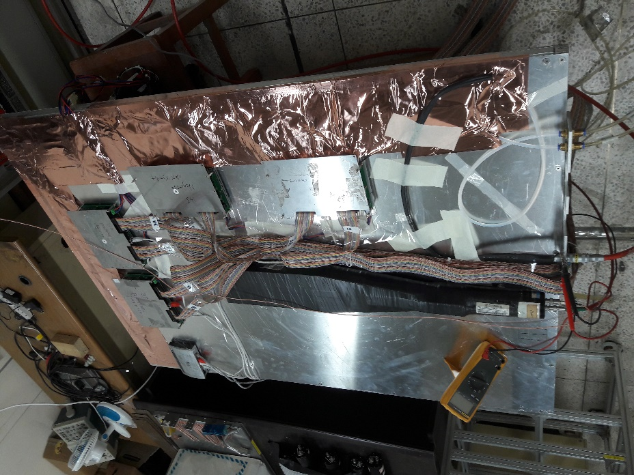
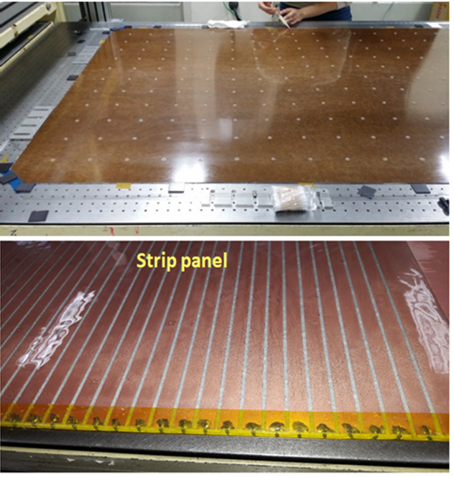
For SHiP: in 2018, 1st prototype: 2-mm single-gap 2D RPCs
Baseline structure for SHiP RPCs
One of the backup designs for CMS iRPCs
Cathode + anode strips (orthogonal)
Cathode signals: positive polarity
Anode signals: negative polarity
Avalanche mode
2 orthogonal strip readouts for 2D trigger measurements
Strip pitch = 10.625 mm for both coordinates
10- mm thick Honeycomb panel
30 μm thick copper
50 Ω
2-mm single-gap
x strips
5- mm thick foam panel
200 μm thick PET
GND side electrode
Gas gap
- HV side electrode
200 μm thick PET
y strips
200 μm thick PET
30 μm thick copper
5- mm thick foam panel
50 Ω termination resistors
10- mm thick Honeycomb panel

Slide 10
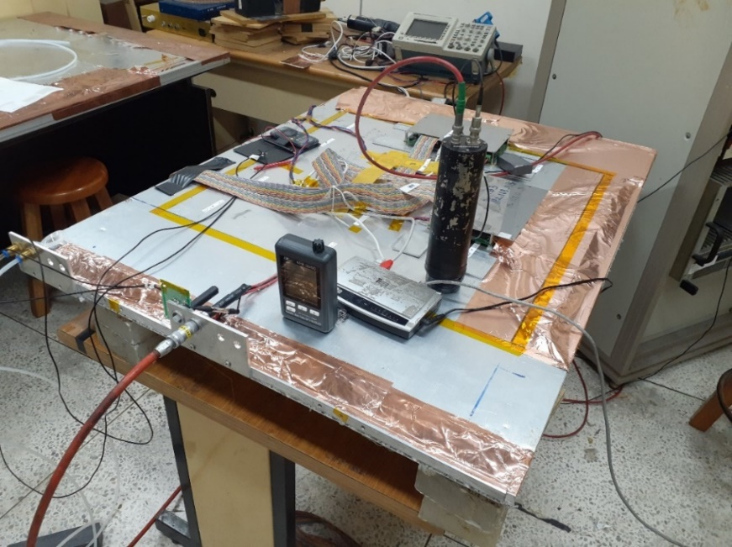
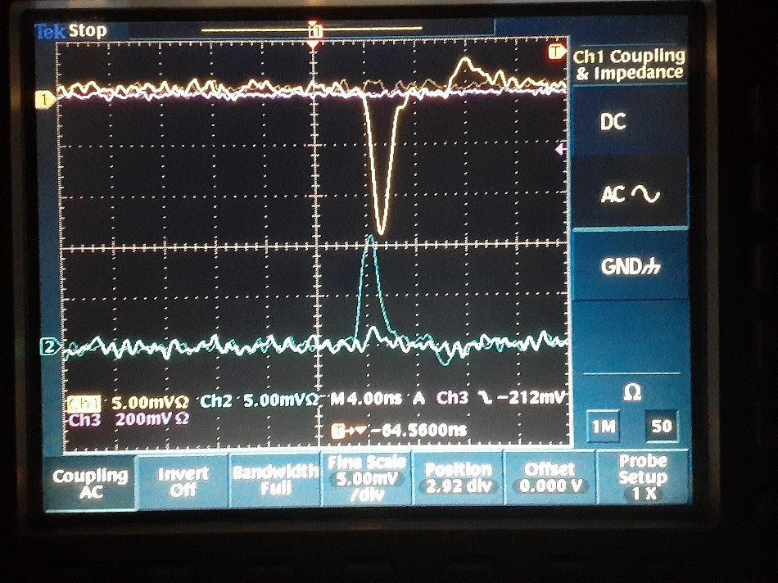
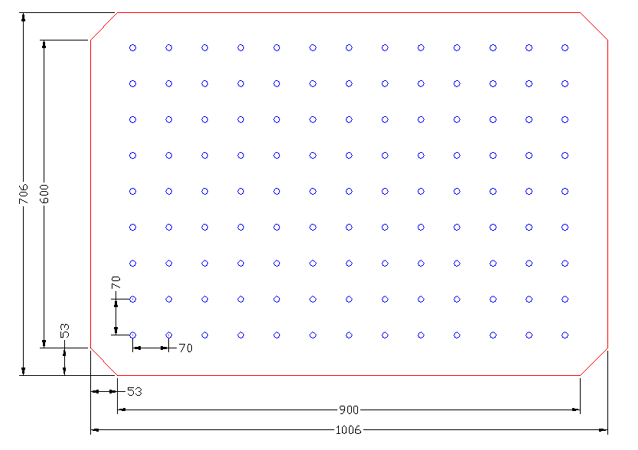
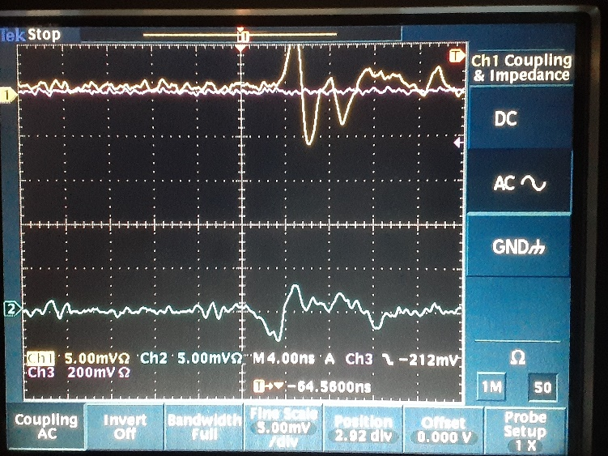
A small prototype using a 100 cm x 70 cm 1-mm single gap
Main pulses
Active area
= 64 cm x 64 cm
64 cm x 64 cm active area using two orthogonal strips
Capacitive coupling

Slide 11
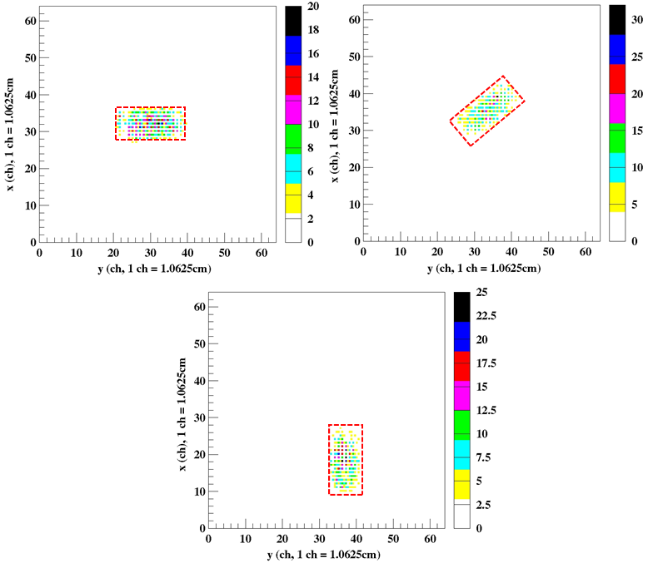
Reconstructed 2D images of cosmic muons
(tagged by plastic scintillators)

Slide 12
In July 2018, KODEL provided RPC electrodes and strips for an experiments using CERN SPS 400 GeV/c proton beam at H4 area
KODEL provided RPC gaps and strips.
Measurement of muon flux
SHIP target replica: TZM 58 cm-thick + Tungsten 58 cm-thick
Spectrometer (Goliath+DTs) to measure momentum and charge of the muons
Muon tagger (RPCs) to identify muons
Inclusive charm cross section measurements
ECC (Emulsion Cloud Chamber) target: 12.5×10 cm² lead plates interleaved with emulsion films to detect both production and decay of the charmed hadrons
Spectrometer (Goliath+DTs) to measure momentum & charge of charm daughters
Muon tagger (RPCs) to identify muons

Slide 13
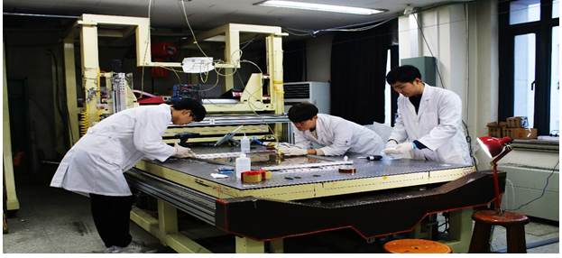
In 2019, R&D on 1-mm single-gap 2D RPCs
Same structure but with a narrower gap thickness
Aiming for faster time response < 10 ns and a time resolution ~ 500 ps for the trigger system
2 orthogonal strip readouts for 2D trigger measurements + a time resolution mush better than 1 ns
Thickness of Bakelite = 1.4 mm
Thickness of gap = 1.0 mm
Strip pitch for both x and y = 20 mm

Slide 14
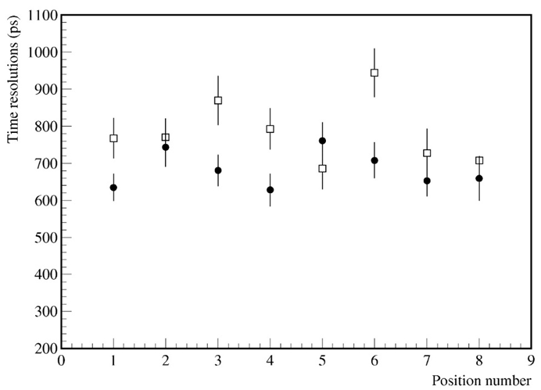
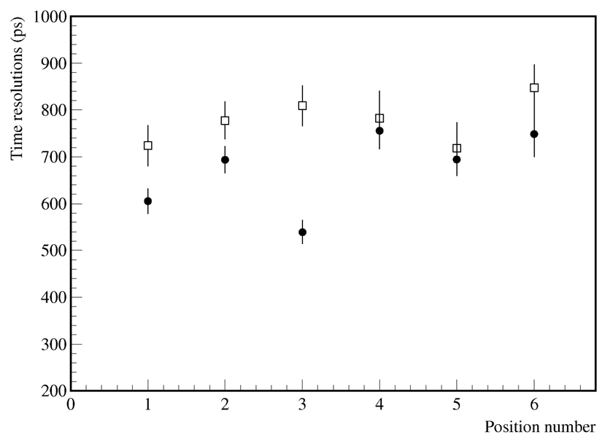
Intrinsic time resolution of 1-mm single-gap RPCs
σ_{FEB} ~ 390 ps
σ_{trigger} ~ 300 ps
Th = 0.4 mV (~ 60 fC) for x strips
= 0.3 mV (~ 45 fC) for y strips
Th = 1.0 mV (~ 150 fC) for x strips
= 0.8 mV (~ 120 fC) for y strips
σ _{x, int} = sqrt (684.4² – 390² – 300²) = 475.7 ps
σ _{y, int} = sqrt (787.5² – 390² – 300²) = 614.9 ps
σ _{x, int} = sqrt (672.7² – 390² – 300²) = 458.7 ps
σ _{y, int} = sqrt (777.5² – 390² – 300²) = 602.0 ps

Slide 15
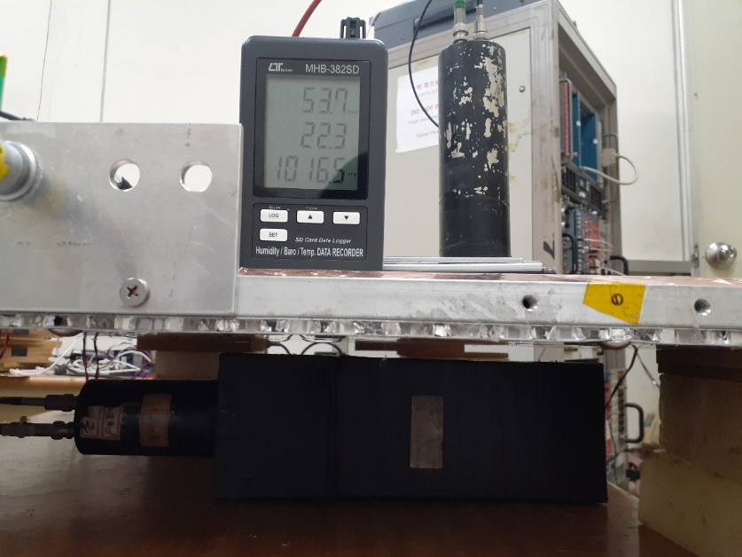
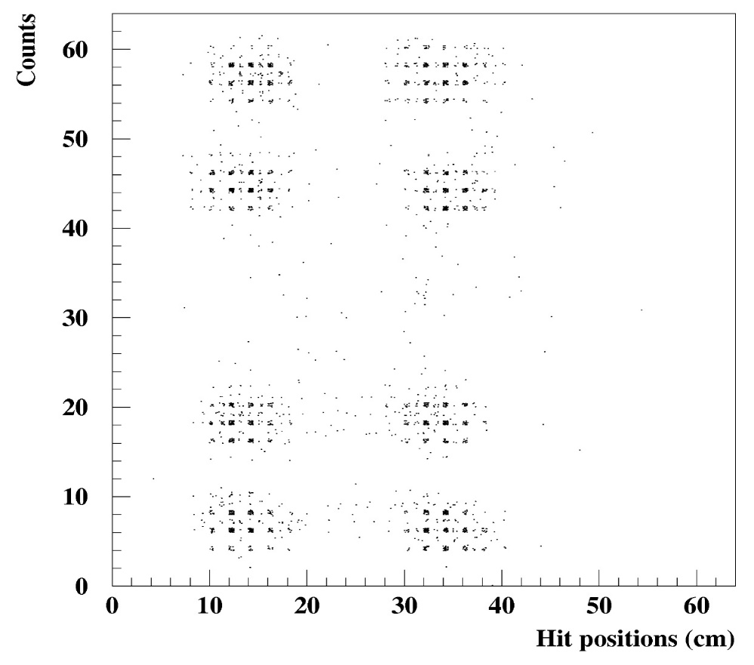
Time measurement and corrections for x strips using a y strip position
Signal arrival times vary position by the position on the strips
Can apply time corrections for x strips using y strip positions using a speed of signal transfers of ~ 19.2 cm/ns (valid when impedance ~ a few 10s Ω)
Position corrected anode time → t_{x}^{c} = t_{x} + 52.08 ps cm⁻¹ × y
→ Hit-position corrected time distribution of the anode (x) strip times
using vertical y-strip positions
σ_{trigger} ~ 300 ps
Th = 0.4 mV (~ 60 fC) for x strips
= 0.3 mV (~ 45 fC) for y strips
σ_{FEB} ~ 390 ps
Pos4
Pos8
Pos3
Pos7
300 ps
Pos2
Pos6
0.16 triggers/s
Pos1
Pos5

Slide 16
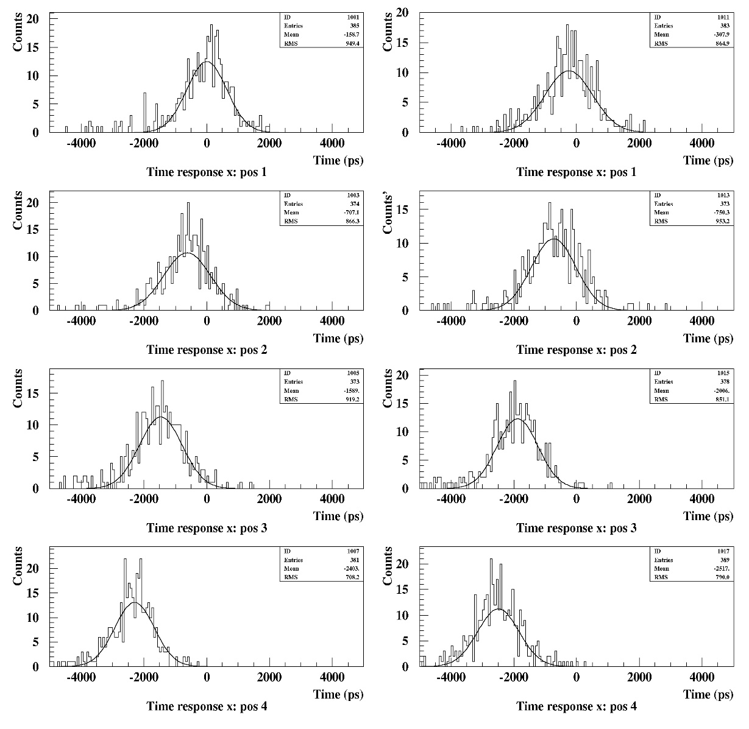
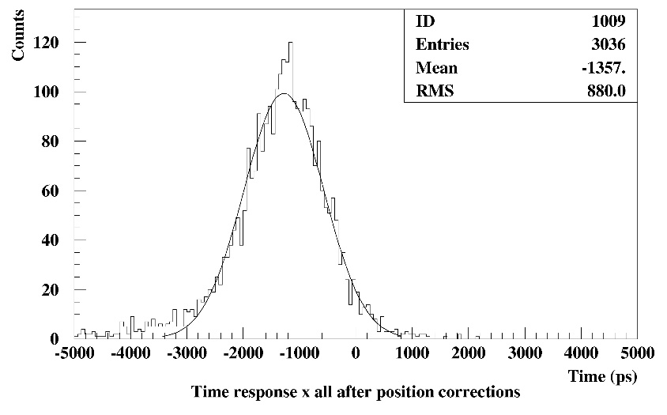
Corrections for signal arrival times on x strips
After the hit-position corrections, the signal arrival time on anode strips are corrected for a reference position of the detector layer.
Adding all the time data measured at 8 positions after the position-time corrections
→ σ_{x, all} = 707.9 ps, then,
σ_{x, all int} = sqrt (707.9² – 390² – 300²) = 508.4 ps
t_{x}^{c} = t_{x} + 52.08 ps cm⁻¹ × y
σ_{x, all} = 707.9 ps
σ_{FEB} ~ 390 ps
σ_{trigger} ~ 300 ps

Slide 17
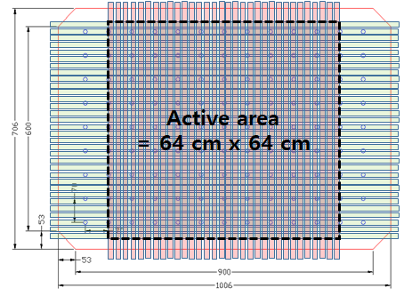
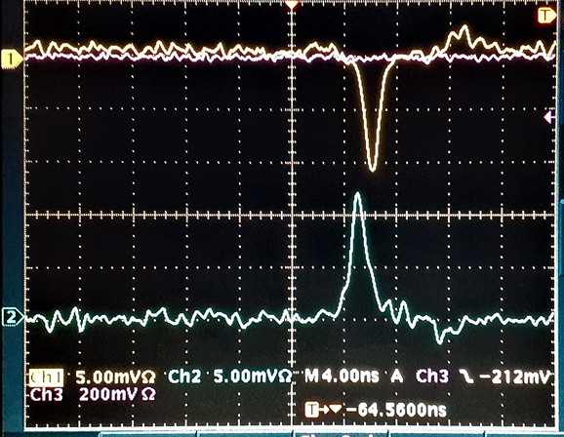
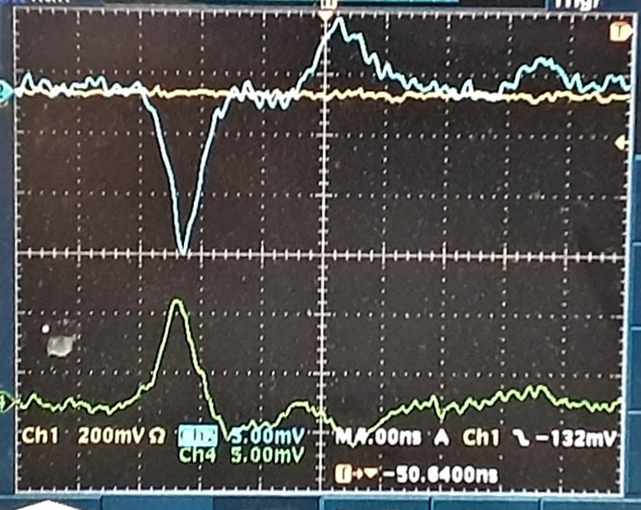

In 2019, R&D on 1.6-mm single-gap 2D RPC
Same detector structure but with a 1.6 mm gap
The WP HV (~ 8.2 kV) is lower compared to 2-mm gap RPCs (~ 9.6 kV)
→ WP HV < 11 kV when using a new HFO1234a based eco gas
Applied 2 orthogonal strip readouts for 2D trigger measurements
with a time resolution better than 1 ns
The intrinsic time resolution is relatively poor compared to the 1.0-mm case
Thickness of Bakelite = 2.0 mm
Thickness of gap = 1.6 mm
Strip pitch for both x and y = 20 mm
Test gas = 95.2% TFE + 4.5% iC₄H₁₀ + 0.3% SF₆
1.0-mm single-gap 2D RPC
1.6-mm single-gap 2D RPC

Slide 18
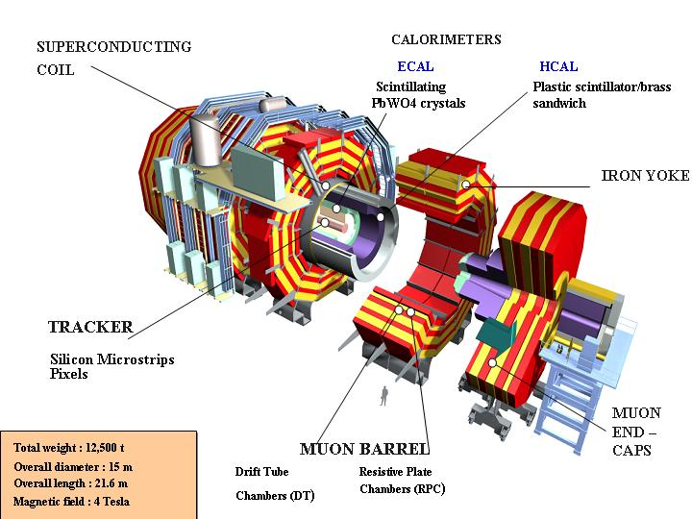
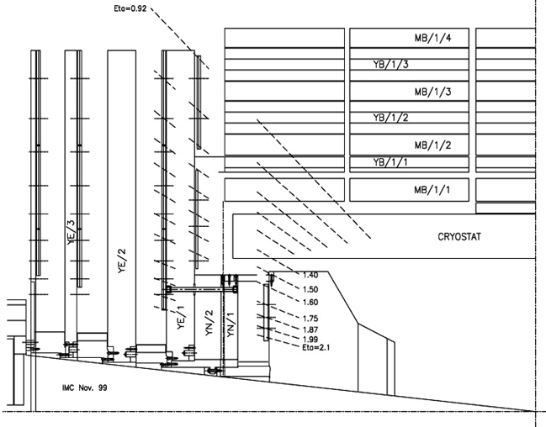


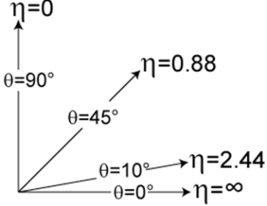
Adding new RPCs to the Compact Muon Solenoid
Barrel RPCs
- 6 stations (layers)
- Fully covering up to η = 0.8
- Partially covering up to η = ~ 1.2
Endcap RPCs
- 2 wings (RE+, RE-)
- 4 stations (RE1, RE2, RE3, RE4) in each wing
- Covering 0.92 < η <2.1
Low-η
Forward
RPCs
4-th Station
via PHASE I
upgrade
(2014)
RE3
RE2
RE1
RE4/3
RE3/3
RE2/3
Barrel RPCs
RE1/3
RE4/2
RE3/2
RE2/2
RE1/2
Backup solution for CMS iRPCs
2D double-gap RPCs
RE4/1
RE3/1
RE2/1
High-η Forward
RPCs (Plan)
RE3/1
GE1/1
GE2/1

Slide 19
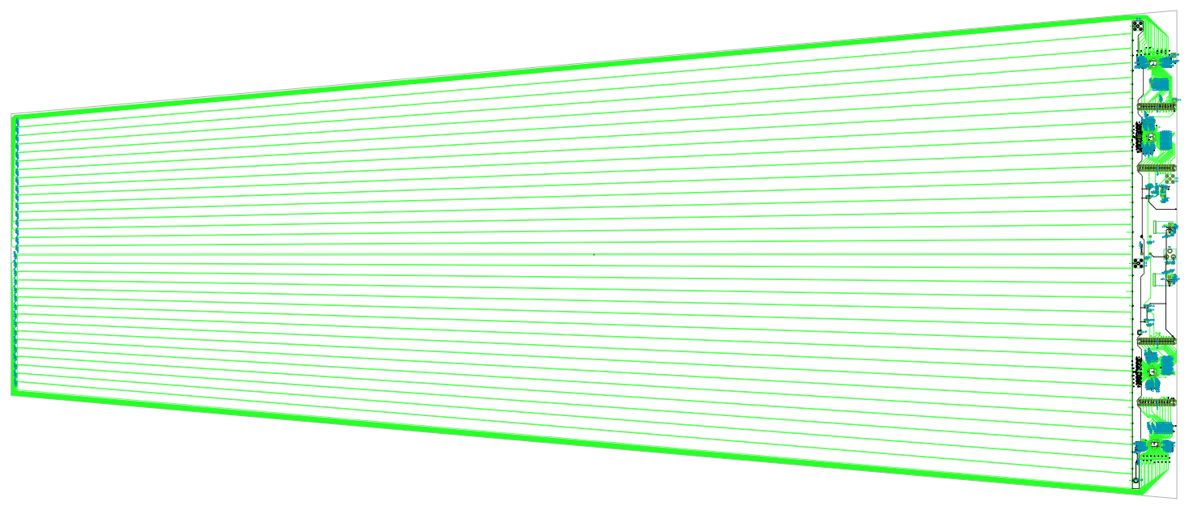
Baseline design for CMS iRPCs
96 strips (0.2083°)
R
Reading φ-r positions (2-dimensional tracking)
Position resolutions: ~ 3 mm for φ and ~ 20 mm for r
1.4-mm thick double-gap RPCs
WP efficiency > 0.97 @ HV=7.3 kV
Mean C_{s} at WP ~ 2.2 @WP
Reading signals from both ends of strips
Signal propagation speed in the strips
= 18.4 cm/ns @ strip 30 Ω < Z < 70 Ω
φ
On-detector Strips
Off-detector Strips
96 strips (0.2083°)
φ resolution ~ 3 mm
R = L/2 – v × (t_{L} - t_{R}) / 2
σ(R) = v (19.2 cm/ns) × σ_{(tL - tR)} / 2 (ns) ~ 2.0 cm
10- mm thick Honeycomb panel
Front-end electronics: PETIROC ASIC + TDC
16 channels
Gain 25: lowest digitization threshold ~ 80 fC
→ The minimum threshold < 20 fC in a new version
essential for rate capability & longevity (chemical hardness)
Fast pre-amplifier and fast discriminator in SiGe
technology → time resolution (jitter) <100 ps
essential for HSCP
30 μm thick copper
200 μm thick PET
- HV side electrode
GND side electrode
Gas gap
x strips
GND side electrode
Gas gap
- HV side electrode
200 μm thick PET
30 μm thick copper
10- mm thick Honeycomb panel

Slide 20
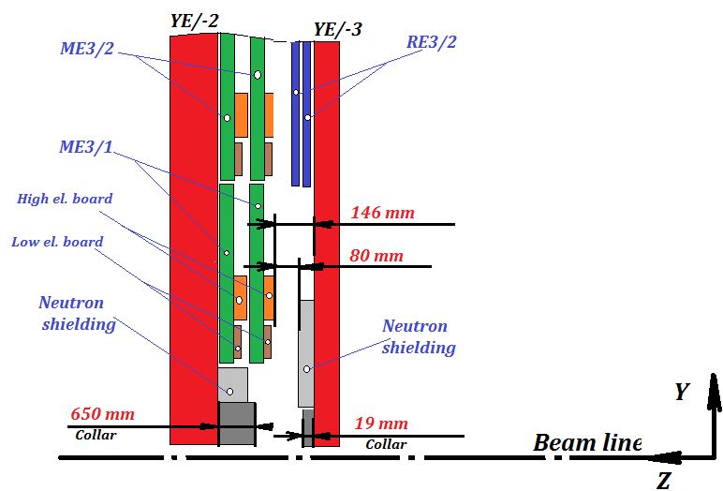
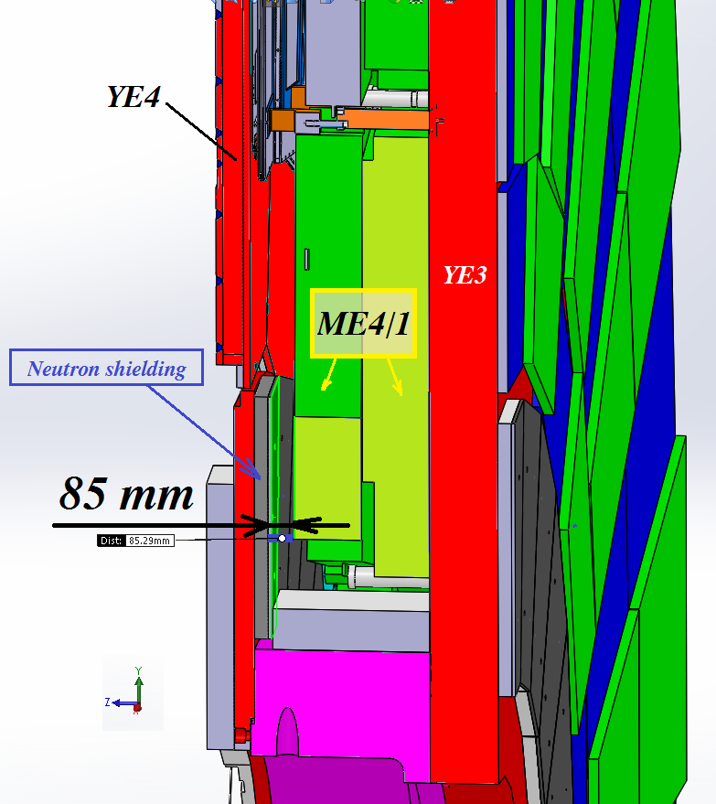
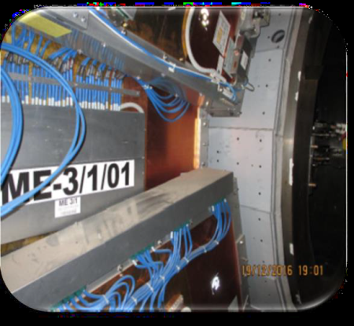
New iRPCs in the RE3/1 and RE4/1 stations with the improved technology
RE4/1 in ME4/1
RE3/1 in ME3/1

Slide 21
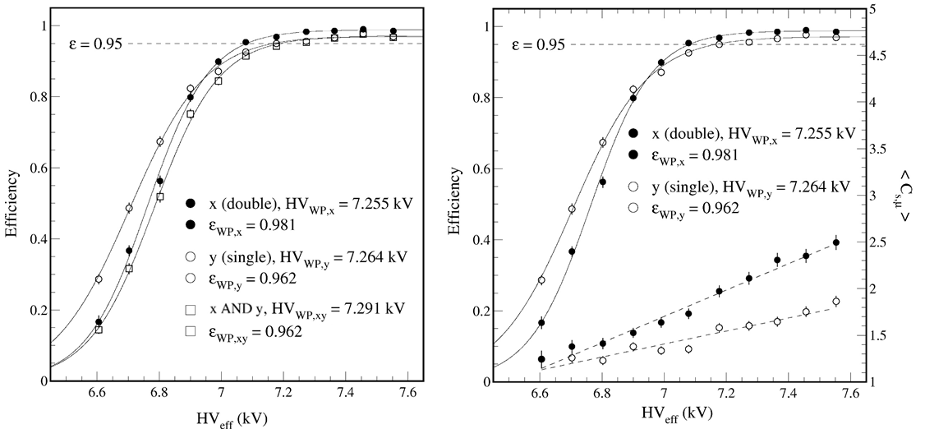
Another 2D RPC model with double gaps
Asymmetric detector structure for the signal readout
Anode signals from double gaps
Cathode signals from top single gap
Anode side efficiency @WP ~ 0.98
Cathode side efficiency @WP ~ 0.96
Coincidence efficiency @ WP ~ 0.96
Merit:
higher anode side efficiency compared to the single-gap case
Thin 2D double-gap detectors for the CMS RPC system
Drawback:
Operational complexity. Have to make the WPs matching as close as possible by adjusting the thresholds
Cathode strips are the lower part of the reference ground. They affect to the impedance for the anode strips
10- mm thick Honeycomb panel
30 μm thick copper
200 μm thick PET
- HV side electrode
Gas gap
25 Ω
GND side electrode
x strips
GND side electrode
Gas gap
- HV side electrode
200 μm thick PET
y strips
30 μm thick copper
5- mm thick foam panel
50 Ω termination resistors
10- mm thick Honeycomb panel

Slide 22
Conclusions
2-mm single-gap 2D RPCs: KODEL provided gaps & strips
→ successfully tested for beam test at H4 in 2018 and satisfied the SHiP requirement.
1-mm single-gap 2D RPC: capable of 2D tracking with ~ 500-ps time resolution
Applied position corrections to x-strip signal arrival times using y strip positions
-> Over all time resolution adding all measured data after the position corrections ~ 700 ps
With better front-end-electronics with σ_{FEB} ~ 100 ps, then, we expect σ_{system} ~ 500 ps for multi-layer RPCs
1.6-mm single-gap 2D RPC: the WP HV can be reduced from 10 kV to ~ 8.2 kV
-> Will provide a good chance for using an eco gas mixture whose WPs < 11 kV
1.4-mm asymmetric double-gap RPCs: thin detector structure -> nice candidate for a backup solution for CMS iRPCs
The present model RPCs with better time & position resolutions
Nice to apply to accelerator-based experiments like CMS
-> Provides a better condition of selecting heavy slow charge particles (HSCP) for CMS
Nice to accelerator-based experiments pursuing New Physics (BSM, Dark matters, etc…) and neutrino physics that not so high position and time resolutions are required.

Slide 23
Milestones
CMS iRPCs
2020 07: Completion of production facilities for gap electrodes and the QC
2020 09 - 2021 03: Preproduction for gap electrode and first RE4.1 prototypes
2021 06: Final version Front-end electronics (digitization + TDC)
2021 08: Final version Back-end electronics
2021 04 - 2022 06: Main production of gap electrodes for iRPCs (during preproduction period)
2022 12: 1st 4 ~ 6 RE3.1 or RE4.1 iRPCs
2021 10 - 2023 04: Production of iRPCs and completion of installations.
SHiP SND RPCs
2020 11: Delivery of 3 ~ 4 gap electrodes to CERN (the 1.6-mm 2D single-gap model is the final.)
New detector R&Ds to produce a few real size prototypes
The final model will provide the solution for the use of the environmental friendly gas mixture.

Slide 24
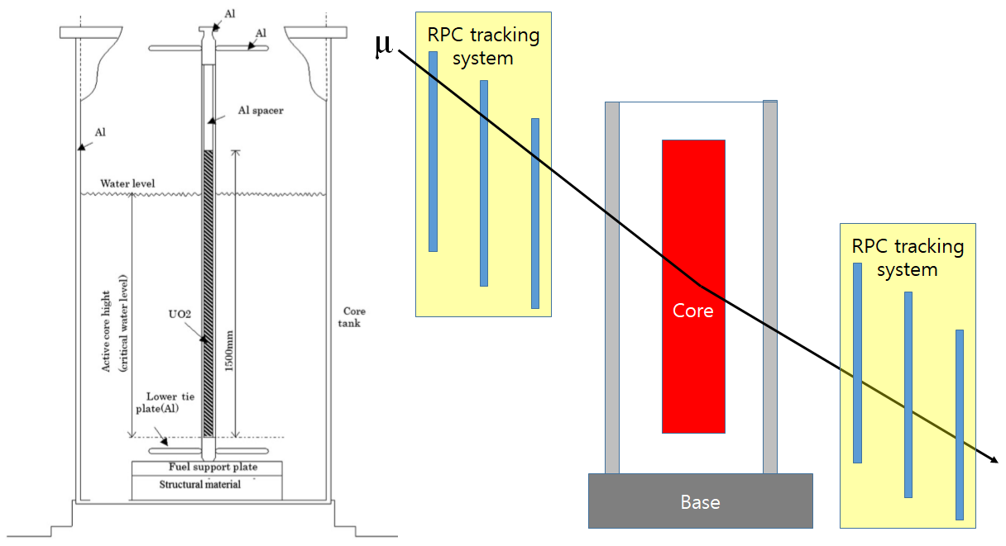

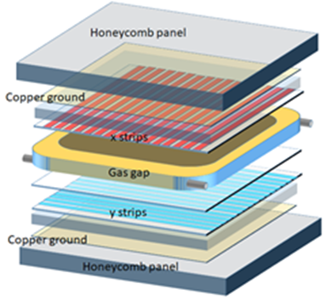
Muon radiography
뮤온 래디오그래피는 방사선이 물질에 흡수되지 않고 약하게 쿨롱 산란되는 원리(주된 산란이 한번일 확률이 높아야 무거운 대상 물질에서의 반응 위치를 찾아냄)를 이용하여 투과된 뮤온의 궤적 추적으로부터 투시 대상을 영상화하는 기술.
두께가 T, (단위 g cm⁻²) 전하량이 Z, 질량수가 A인 물체를 대전입자가 투과 할 때 쿨롱 산란에 의한 산란각 분포(가우스)의 편차를 나타낸 식. X₀는 radiation length
핵반응로 내에 존재할 물, 콘크리트, 철, 우라늄 등에 대한 radiation length는 각각 36.08, 26.57, 13.84, 6.00 g cm⁻²

Slide 25
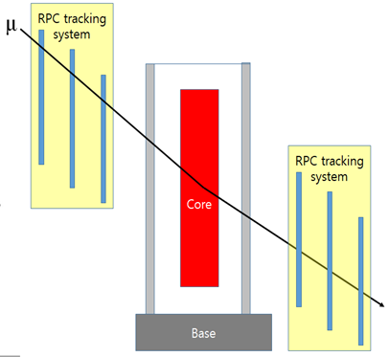
Muon radiography
RPCs system
Much cheaper to build a large system (detection area 2 m × 2 m)
RPCs are themselves capable of triggers
Very low noise
Selection of muons with momentum range larger than 0.5 GeV/c
For typical 1 GeV/c muons, β = 0.995
σ_{ϴ} ~ 50 mrad in UO2
TOF in a 10 m track = 33.49 ns (light = 33.37 ns)
To reject soft muons of 0.5 GeV/c (β = 0.983)
TOF in a 10 m track = 33.88 ns
→ We need a detector system better than a 500 ps time resolution
Assuming 8 2D RPC system,
50 cm gap between adjacent layers → total detector thickness < 2 m
Position resolution of each detector layer ~ 3 mm
Angle resolution ~ 2 mrad
Expected position resolution for ‘kink’ point voxel image ~ 2 cm
Then, we select muon tracks with deflection angles > 30 mrad

Slide 26
BACKUPS

Slide 27
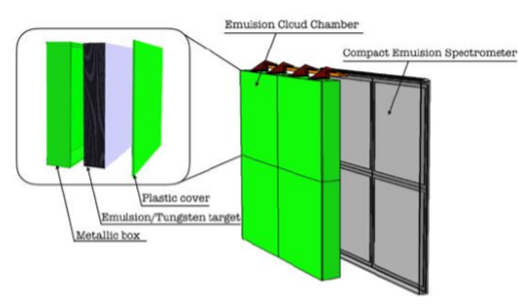
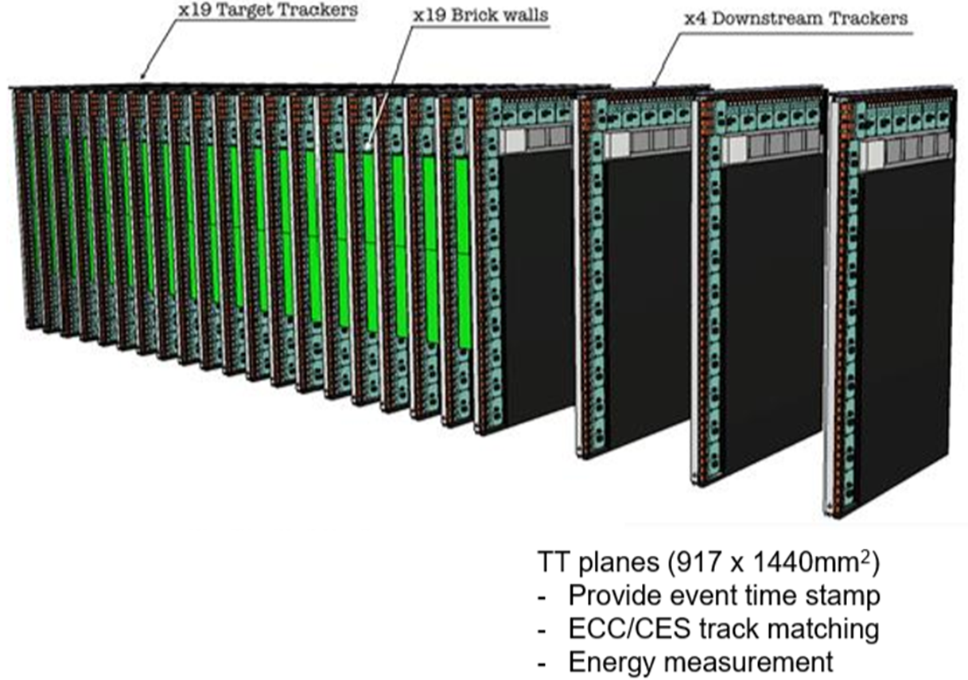
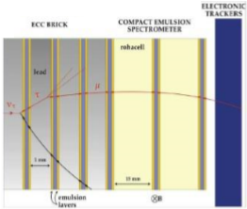
Target System
To allow neutrino interactions and potential detection of light dark matter
19 layers of Emulsion Cloud Chambers + Compact Emulsion Spectrometer
Four 2D TT planes compose of scintillation fibers equipped with SiPMs
ECC + CES
19 layers of Emulsion Cloud Chambers + Compact Emulsion Spectrometer

Slide 28
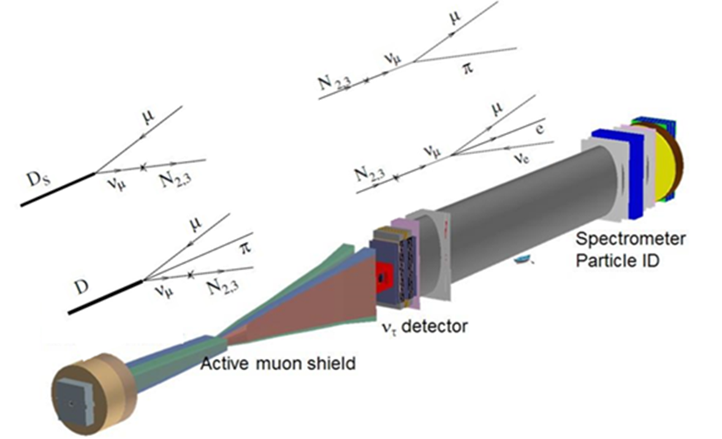
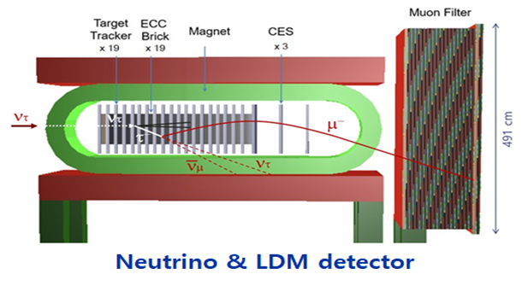
RPC system will be used to reject neutrino associated charged particles coming into decay volume for hidden particles.

Slide 29
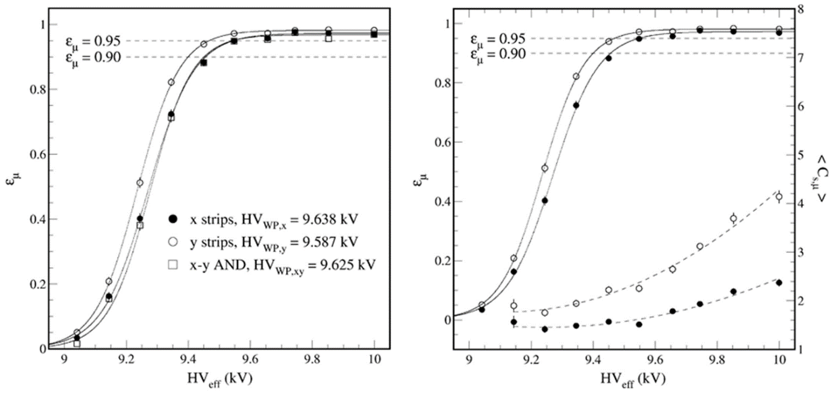
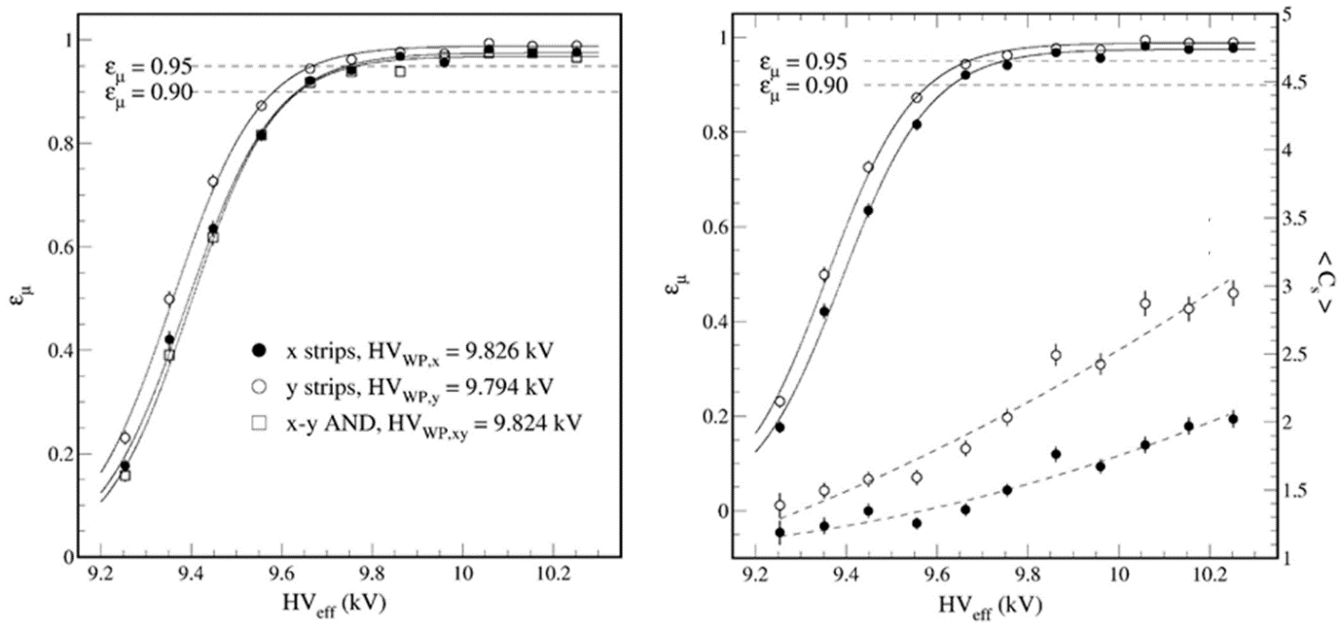
Cosmic-muon test for a first prototype of 2-mm single gap type
Working point HV = 9.63 kV / 9.82 kV with low/high threshold setups, respectively.
Working point efficiency requiring both x and y signals > 95 %.
Mean cluster sizes at the WP: 1.8 for anode (x) and 2.5 for cathode (y) strips
Probability of large pulses (defined by cluster size > 6) at the WP ~ 1%
Noise rate at the WP in coincidence of x and y: < 1 k Hz m⁻²
Used current sensitive mode FEBs
Test gas = 95.2% TFE + 4.5% iC₄H₁₀ + 0.3% SF₆
Th = 0.33 mV (~ 50 fC) for x (anode strip, negative)
Th = 0.40 mV (~ 60 fC)for y (cathode strips, positive)
Th = 0.80 mV (~ 120 fC) for x (anode strip, negative)
Th = 1.00 mV (~ 150 fC) for y (cathode strips, positive)

Slide 30
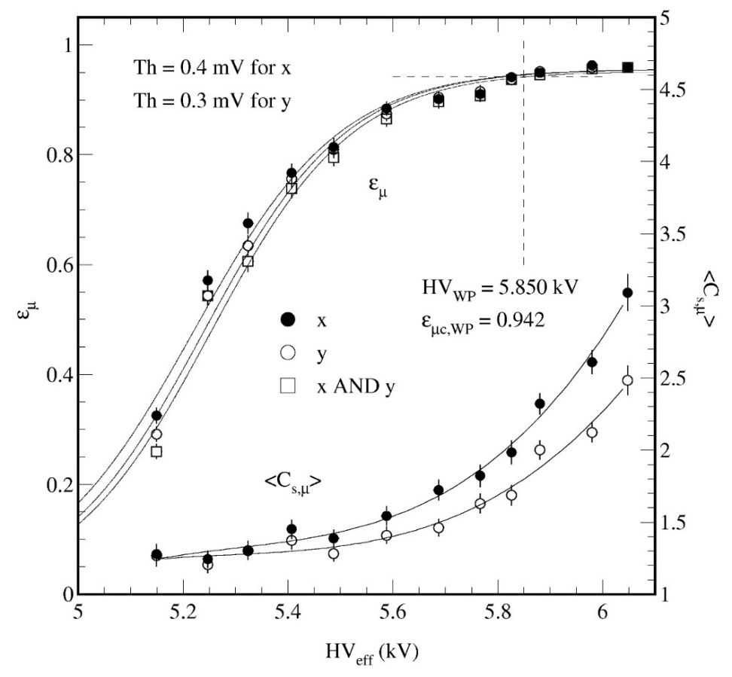

Tests with cosmic muons
Gas: 95.2% TFE + 4.5% i-C₄H₁₀ + 0.3% SF₆
Used 1.0m-mm thick 1.2-cm diameter spacers
-> Efficiency loss due to spacers ~ 3%
-> Maximum efficiency is at best ~ 0.96
-> Typical WP efficiency = 0.942 @ HV_{eff} = 5.85 kV
-> Strip pitch for both x and y = 20 mm
-> Position resolution ~ 7 mm in both directions
Estimated time resolution for KODEL FEBs ~ 390 ps
Time resolution for triggers
Using two block scintillators ~ 500 ps
Using a block + a disc scintillators = 300 ps
Threshold for x = 0.4/1.0 mV (~ 60 fC/150 fC)
Threshold for y = 0.3/0.8 mV (~ 45 fC/120 fC)
Test gas = 95.2% TFE + 4.5% iC₄H₁₀ + 0.3% SF₆
HV_{WP} = HV₉₅ + 200 V
500 ps
300 ps
0.55 triggers/s
0.16 triggers/s

Slide 31


Th = 0.4 mV (~ 60 fC) for x strips
= 0.3 mV (~ 45 fC) for y strips
Block Scintillators only
Disc + block scintillators
Block Scintillators only
Disc + block scintillators

Slide 32

KODEL FEBs used in the previous R&Ds
The gain of the amplification is 200 mV/mV, which roughly corresponds to ~ 2 mV/fC in a typical charge sensitive mode amplification (for the current CMS RPC FEBs, the gain is set to 1.8 mV/fC).
The digitization threshold value ~ 0.3 mV roughly corresponds to 40 ~ 50 fC for typical RPC pulses of double-gap trigger RPCs.
RMS noises of the FEB ~ 0.02 mV
Time jitter at comparators & One shots ~ 200 ps
Ethernet communication using a web browser and an intranet communication:
i.e. setup in your PC with 192.168.0.1 and
192.168.0.2 ~ 10 in each FEB board

Slide 33
1. Preamplifier (current sensitive mode)
function = converts current to voltage signal and linearly amplifies the pulse
gain = 200 mV/mV for an input pulse
band width = 200 MHz
input impedance = 20 ohm
part = ADA4895 (Analog Device)
2. Comparator
function = compares preamplifier's output with a given threshold and generates logic pulse if input signal
is larger than the threshold
threshold voltage = 0 ~ 2,000 mV
propagation delay = 3.5 ns
minimum pulse width = 3 ns
part = ADCMP600 (Analog Device)
3. One shot
function = generates a logic pulse with given width regardless of comparator's output width which
depends on the pulse shape and amplitude of analog input signal from preamplifier
pulse width = 30 ~ 500 ns
propagation delay = 2.2 ns
minimum pulse width = 2.7 ns
part = SN74LVC1G74 (Texas Instruments)

Slide 34
4. TTL to LVDS translator
function = converts LVTTL logic pulse to LVDS logic pulse
propagation delay = 1.2 ns
Adjustable width = 20 ns ~ 60 ns
part = DS90LV047 (Texas Instruments)
5. Digital to Analog Converter(DAC)
function = generates threshold voltage to comparator
threshold voltage = 0 ~ 2,000 mV (0 ~ 10 mV input voltage equivalent)
resolution = 12 bit (precision = 2.5 us input voltage equivalent)
part = TLV5630 (Texas Instruments)
6. Micro Controller Unit(MCU)
function = controls DAC via TCP/IP protocol
part = ATMEGA64 (Atmel) + TCP/IP interface

Slide 35

A Hidden Sector (HS) of BSM particles
Motivation of SHiP
SHiP: a 400-GeV proton-beam dump experiment @SPS CERN starting 2026
Use of SPS protons → Nearly no interference to Phase-2 LHC runs
The current Standard Model fails in explanation of
Dark Matter
Neutrino oscillation and masses
Matter/antimatter asymmetry in the Universe
A Hidden Sector (HS) of weakly interacting BSM particles is for the explanation
Long-lived weakly interacting particles → requires high intensity beams
Collaboration of ~ 250 members from 52 institutes, 17 countries
Technical Proposal: arXiv:1504.04956 (2015)

Slide 36



Construction of Trigger RPCs for the 2018 Dump Experiment @ CERN SPS
5 RPC modules prepared for a beam-dump measurement at SPS/CERN in July 2018
118 horizontal and 184 vertical strips (pitch = 10.625 mm) per RPC
Detector size = 2100 mm x 1350 mm / Active area = 1900 mm x 1200 mm
Gas gaps and strip panels manufactured at Korea University
Strip panel
Gas gaps delivered to CERN

Slide 37



Charm measurement
Sample data
Presented in ShiP-Charm meeting on 2nd October 2018
A. Pastore, INFN Bari and University of Bari
Slop measurements

Slide 38


Construction & Test of the 1st Prototype RPC module
First prototype manufactured and tested with cosmic muons at Korea University for a technical assurance
112 horizontal (x) and 80 vertical (y) strips (pitch = 10.625 mm)
Detector size = 1300 mm x 1000 mm / Active area = 1200 mm x 800 mm
Gas mixture = 95.2% C₂H₂F₄ + 4.5% iC₄H₁₀ + 0.3% SF₆
Prototype RPC
Digitization thresholds at Front-end-electronics in a current sensitive mode
Th = 0.33/0.8 mV for x
(anode strip, negative)
Th = 0.40/1.0 mV for y
(cathode strips, positive)
Th = 0.4 mV ↔ 60 fC
Th = 1.0 mV ↔ 150 fC
Front-end electronics
for anode strips
for cathode strips

Slide 39


Hit positions on x strips
Hit positions on y strips
Hit positions on x strips
Hit positions on y strips

Slide 40


Th = 0.5 mV (~ 75 fC) for x strips
= 0.4 mV (~ 60 fC) for y strips
Th = 1.0 mV (~ 150 fC) for x strips
= 0.8 mV (~ 120 fC) for y strips

