Slide 1
Neutron drip line of Ca, Ni, Zr, Sn and Pb nuclei with KIDS EDF
Chang Ho Hyun
Daegu University, Korea

Slide 2
KIDS-BUD Collaboration
KIDS: Korea:IBS-Daegu-Sungkyunkwan
BUD: Busan-Ulsan-Daegu,Daejeon
Panagiota Papakonstantinou (IBS)
Young-Ho Song (IBS)
Youngman Kim (IBS)
Hana Gil (Kyungpook National University)
Yongseok Oh (Kyungpook National University)
Kyujin Kwak (UNIST)
Young-Min Kim (UNIST)
Chang-Hwan Lee (Pusan National University)
Myungkuk Kim (Pusan National University)
Sangyoung Jeon (McGill University)

Slide 3
Introduction
Founding a model
Basic prediction
Neutron drip line
Summary

Slide 4
Introduction
Motivation, Inspiration

Slide 5
Motivation
* There are hundreds of models for nuclei and nuclear matter.
* No established rules to build, modify and improve a model.
* Can there be a systematic way to improve a model?
* Can there be a systematic way to improve prediction?
* Can there be a systematic way to estimate the uncertainty?
1/20

Slide 6
Inspiration: EFT in Nuclear Physics
* Started in the two-nucleon (NN) interactions and external currents
* Aimi at the estimation of uncertainty of prediction
* Pionful theory: energy or momentum less than rho-meson mass
* Pionless theory: energy or momentum less than pion mass
Common and essential in the EFTs
* Assume a large scale (Λ) and small scales (p, E)
* Integrate out degrees of freedom heavier than Λ
* Assume a perturbative expansion in terms of p/Λ, E/Λ
* Assume rules for expansion
2/20

Slide 7
Pionless theory
* Large scale Λ = m_{π} (pion mass): pions integrated out.
* All interactions are represented in the contact form with low-energy constants.
* LECs are fit to low-energy data.
* Application
EM form factors of the deuteron
np → dγ cross section at BBN energies
Polarization, analyzing power in dγ → np
Hadronic parity violation
νd → νnp, e-np, e+nn at solar energies
3/20

Slide 8
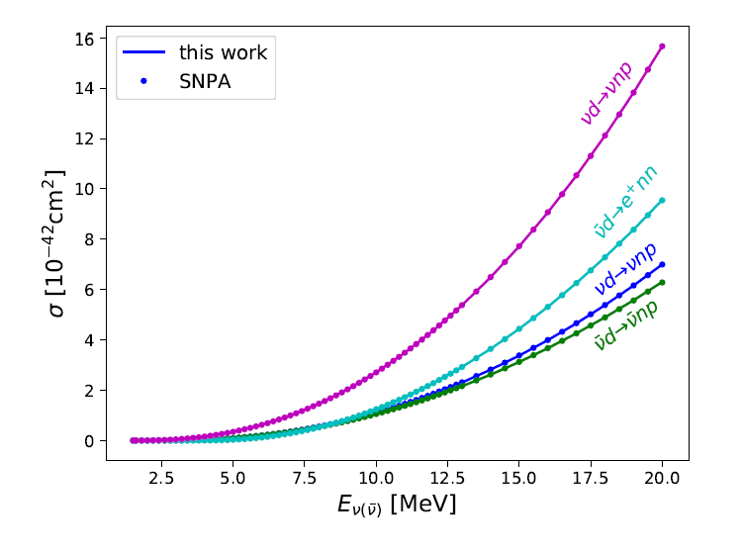
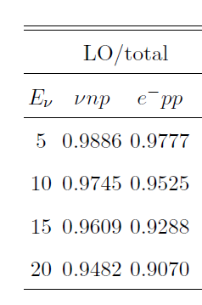
Example: νd → νnp, e-pp at solar energies
* Nuclear reactions in the sun: synthesis and abundance of
elements.
* Test of standard model: mass and flavor oscillation.
Work with Y.-H. Song, S.-I. Ando
LO dominance
Larger high-order contribution at larger energies
4/20

Slide 9
Founding a model
Small scale, Large scale, and Rules

Slide 10
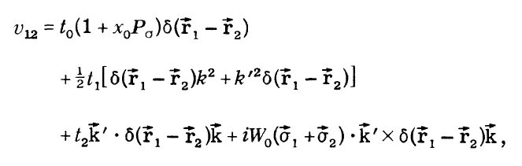
Nuclei and Nuclear Matter
* Ab initio, RMF, Skyrme, Gogny, …
* Skyrme force: effective NN interactions in the form of
contact terms → Similar to pionless EFT
* Mimic the pionless EFT:
What is the small scale?
What is the large scale?
What are the rules?
5/20

Slide 11
Scales
* k_{F} ~ 300 MeV at ρ = ρ₀
* k_{F} ~ 600 MeV at ρ = 8ρ₀
* Role of one-pion exchange in nuclear matter seems minor.
* ρ meson is the next lightest well-defined meson: assume Λ = m_{ρ} (~ 800 MeV).
Rule
1. Assume k_{F} a small scale, and m_{ρ} a large scale.
2. Expand energy density for infinite matter in powers of k_{F}/m_{ρ}.
3. Fitting1: Parameters to EoS of infinite nuclear matter.
4. Fitting2: Additional parameters appearing in the HF calculation fit to nuclear data
6/20

Slide 12
Basic prediction
Bulk properties of magic nuclei

Slide 13
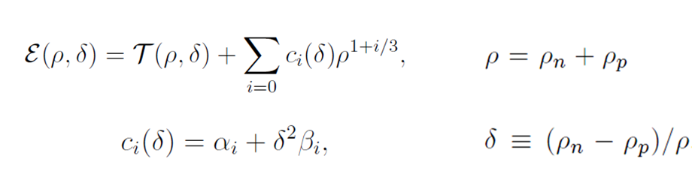
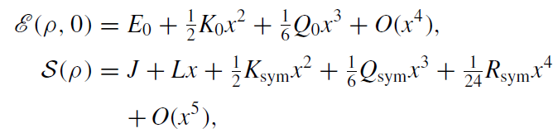
Strategy
1. Expand energy density in powers of ρ^{1/3}.
2. Fix α_{i} to ρ₀=0.16fm⁻³, E/A=16.0 MeV, K₀=240 MeV of symmetric nuclear matter (SNM).
3. Fix β_{i} to J=32.8, L=49.3, K_{sym}=-156.3, Q_{sym}=583.1 MeV, and
three R_{sym} values -2170, -2470, and -2770 MeV (P5a, P5b, and P5c).
4. Obtain Skyrme type force, fit the additional parameters to E/A and R_{c} of ⁴⁰Ca, ⁴⁸Ca and ²⁰⁸Pb.
5. Solve HF equation.
7/20

Slide 14
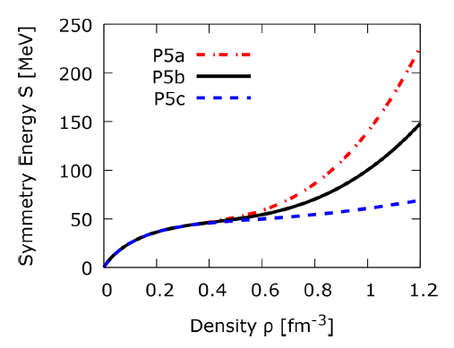
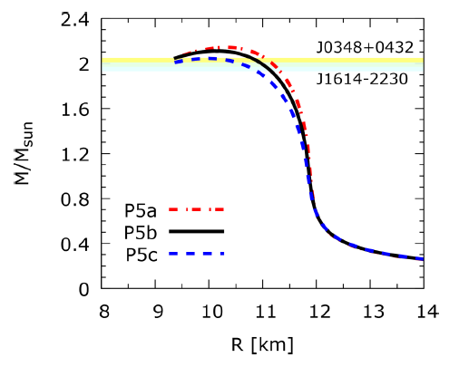
Result: Nuclear matter
Symmetry energy (left): models converge to ρ~0.6 fm⁻³ (~4ρ₀) and huge difference at high densities.
However, neutron star mass-radius (right) is weakly dependent on the symmetry energy at high densities. (density at the center of 2M_{sun}~8ρ₀)
8/20

Slide 15
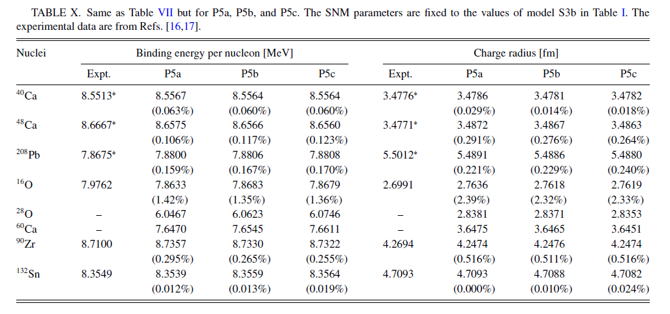
Result: Nuclei
9/20

Slide 16
Neutron drip line
Separation energy, skin thickness, and symmetry energy

Slide 17
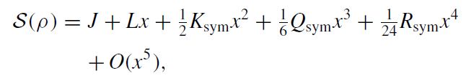
Ways to explore symmetry energy
1. Heavy ion collision
2. Astrophysics
Reactions in stars
Nuclear synthesis in supernova explosion
Neutron star properties
Gravitational waves
3. Nuclear structure
Neutron skin thickness
Dipole polarizability
Neutron drip line
10/20

Slide 18
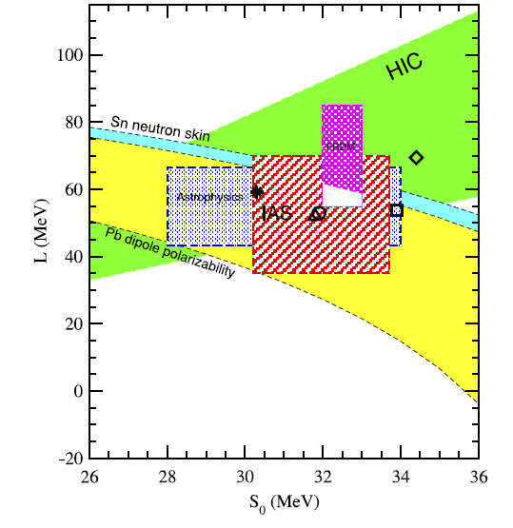
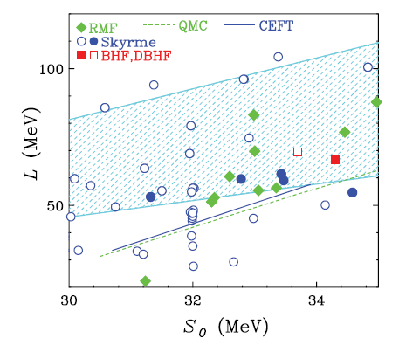
J vs L
Left: Experiment (PPNP91, 203)
Right: Theory (PRC86, 015803)
No correlation in practice
11/20

Slide 19
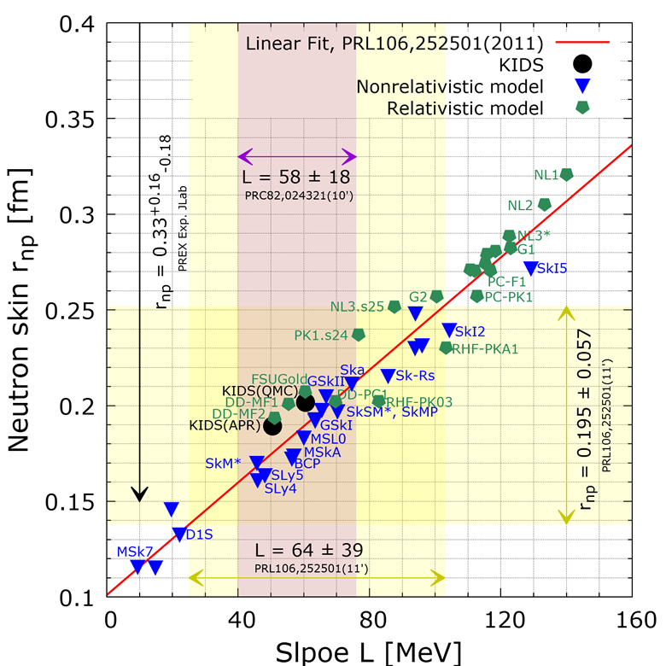
L and r_{np}
Clearly correlated: precise measurement can pin down L….?
Show model dependence.
Will the models be still good at very neutron rich region?
12/20

Slide 20

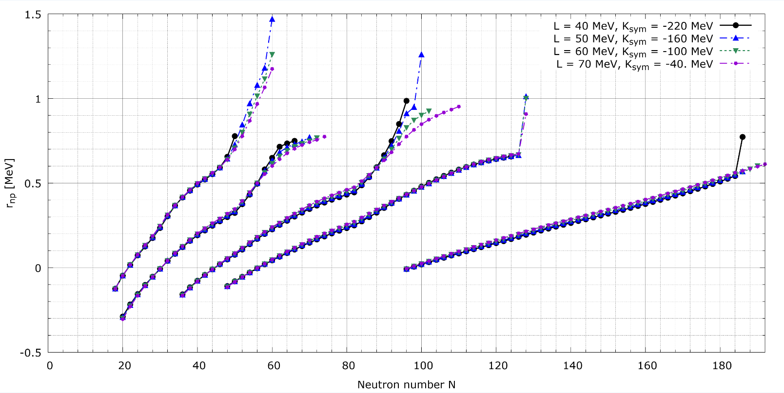
r_{np} and K_{τ} with KIDS
r_{np}
J = 32 MeV, K_{τ} ~ -460 MeV, Q_{sym} = -650 MeV
Skin thickness depends on L for very neutron rich isotopes.
13/20

Slide 21
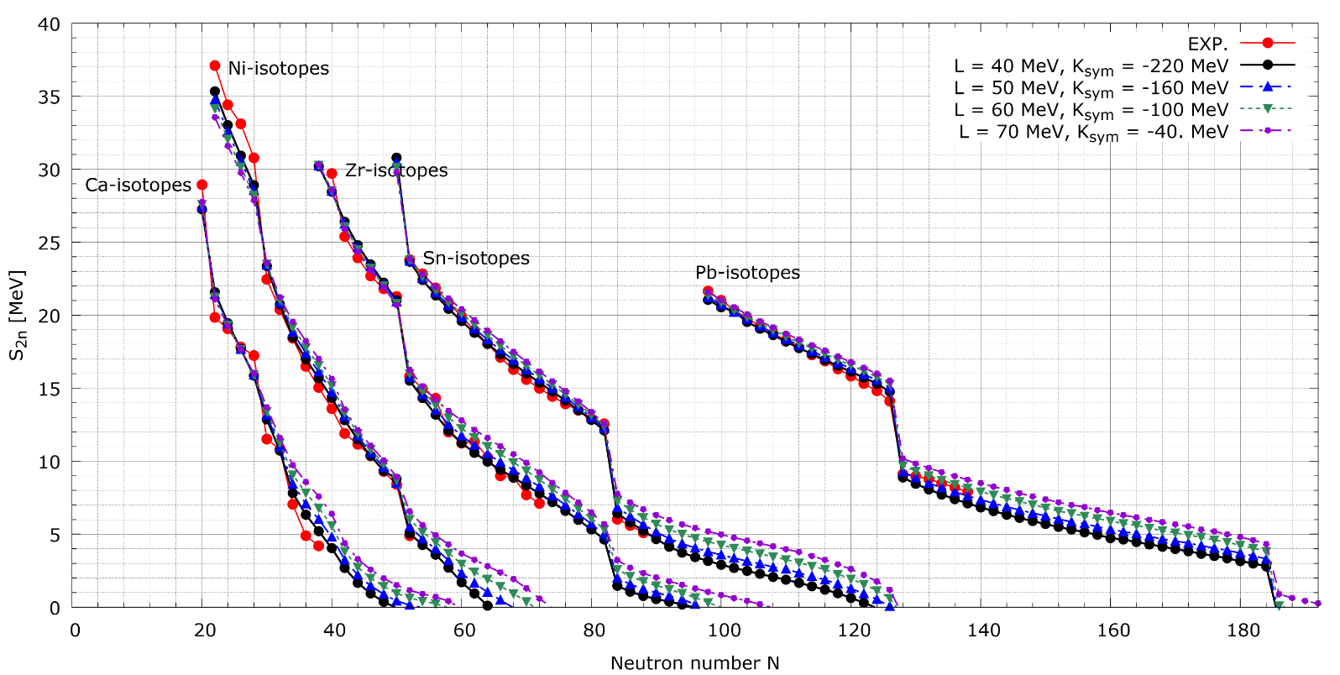
However, two-neutron separation energy S_{2n} depends strongly on L.
S_{2n}
J = 32 MeV, K_{τ} ~ -460 MeV, Q_{sym} = -650 MeV
Neutron drip line sensitive to L.
Prediction at large neutron excess uncertain.
14/20

Slide 22
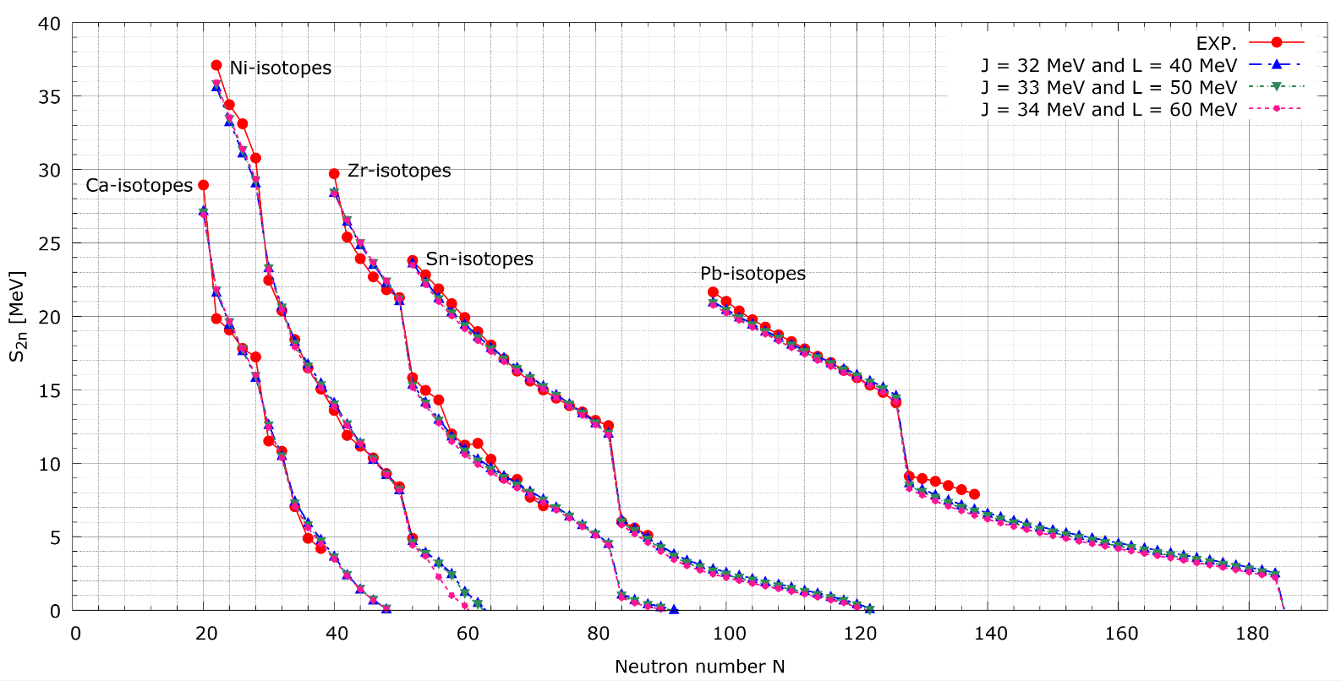
We try to vary both J and L to reproduce S_{2n}.
S_{2n}
K_{τ} = -380 MeV, Q_{sym} = -650 MeV
Good at reproducing experiment.
Drip line of Ni depends on L; others do not.
15/20

Slide 23
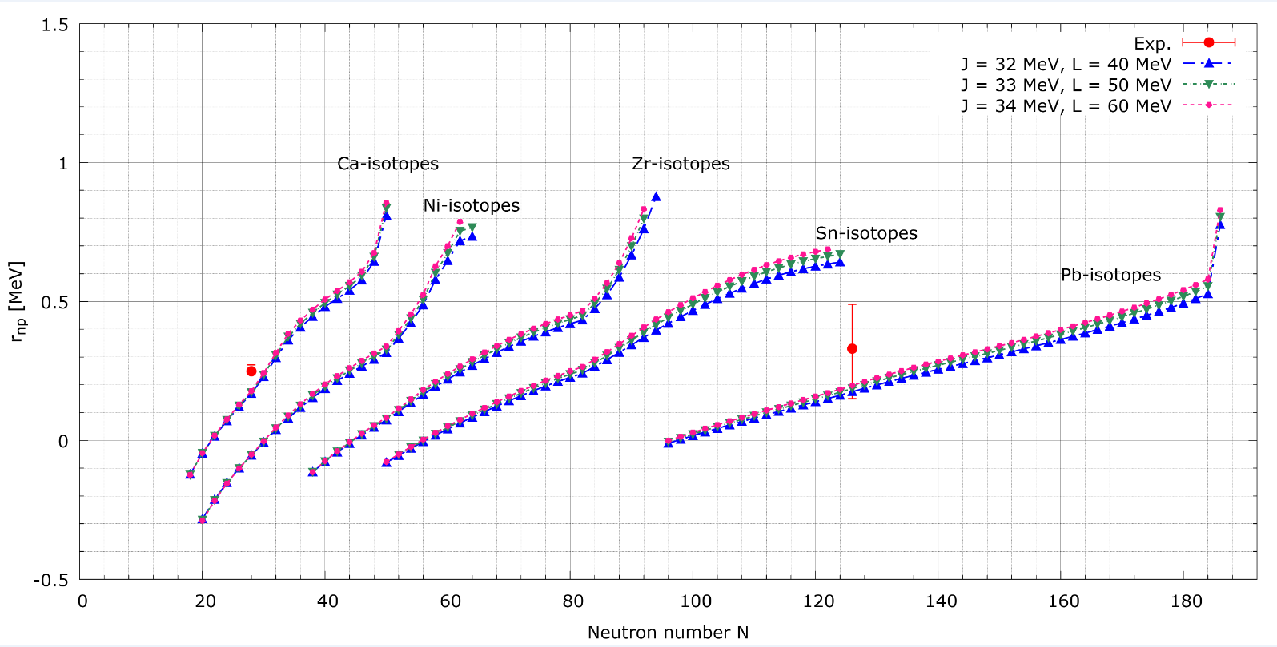
r_{np}
K_{τ} = -380 MeV, Q_{sym} = -650 MeV
J and L can be correlated strongly via S_{2n} of neutron-rich nuclei.
Measurement of r_{np}, S_{2n} and neutron drip line can provide more stringent constraints and correlations of J, L and K_{sym}.
16/20

Slide 24
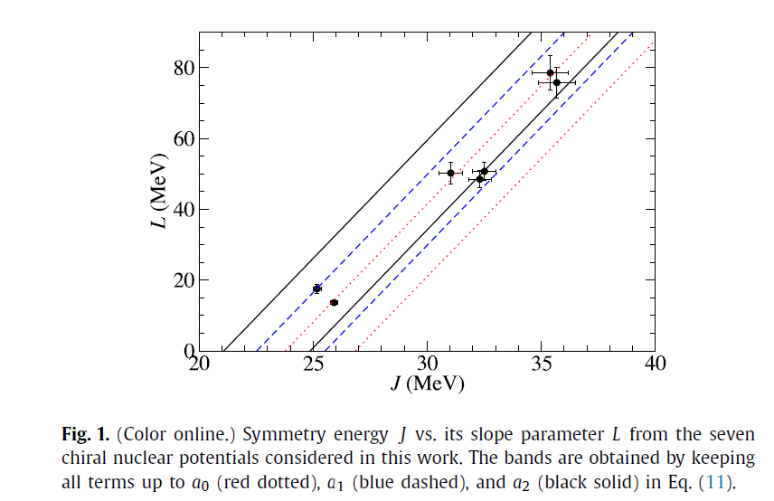
Comparison with EFT
J. Holt and Y. Lim, PLB784, 77 (2018)
(34, 60)
(33, 50)
(32, 40)
17/20

Slide 25
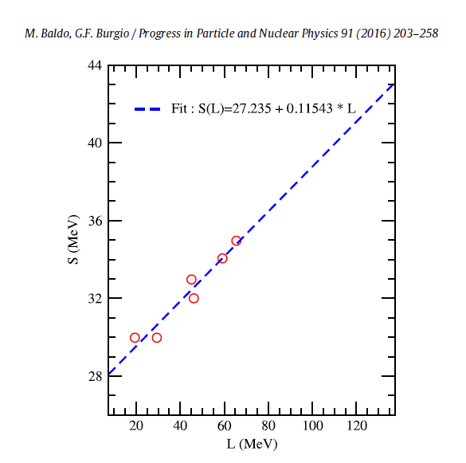
Comparison with dipole polarizability
L = 8.7J – 235.9
Our rough result:
L ∼ 10J - 280
(34, 60)
(33, 50)
(32, 40)
Which (J, L) is the answer?
18/20

Slide 26
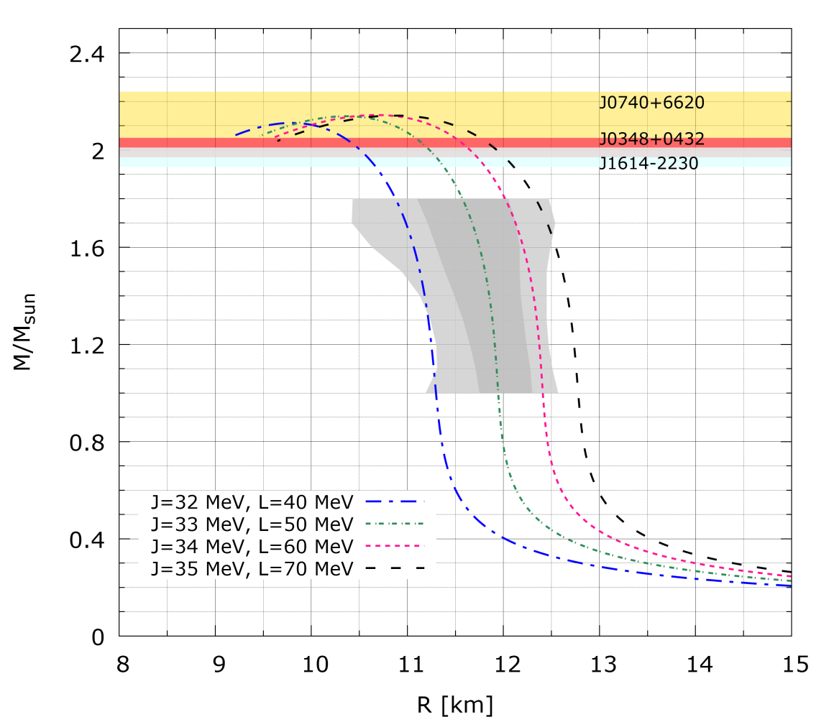
Neutron star
Mass-Radius
Tidal deformability
(J,L) | Λ_{1.4} | R(km)
(32,40) | 221.1 | 11.2
(33,50) | 325.4 | 11.9
(34,60) | 412.5 | 12.3
(35,70) | 459.1 | 12.7
arXiv:180511581v1: 70 <Λ_{1.4}< 580
19/20

Slide 27
Summary

Slide 28
Way to build and fix a model for nuclei and nuclear matter has been proposed.
KIDS EDF separates fitting to nuclei and fitting to nuclear matter.
Not referring to numerous nuclear models, correlations and dependencies between parameters and observables can be explored with the KIDS model.
Measurement of S_{2n} and r_{np} can put stringent constraints on the symmetry energy parameters J, L and K_{sym}.
Observation of neutron stars and gravitational waves is absolutely important and necessary.
20/20

Slide 29
More fun to come with KIDS Thank you!

