Slide 1
β-delayed decay study at RIBLL and BRIF
Su Jun
College of Nuclear Science and Technology
Beijing Normal University
Notes:
Good afternoon, everyone. Thanks the organizer for giving me this opportunity to talk about my recent works. My name is Su Jun, I am from College of Nuclear Science and Technology, Beijing Normal University, My topic is beta delayed decay study at RIBLL and BRIF radioactive facility

Slide 2
Outline
⁵³Ni β delayed decay (RIBLL, IMP)
²⁰Na β delayed decay (BRIF, CIAE)
Design of a new Total Absorption Gamma Spectroscopy
Notes:
This is a outline of my talk. I will introduce two experiments, the first one is the beta decay of nickel fifty three, this experiment is performed at RIBLL facility at Institute of Modern Physics. And the second one is the beta decay of sodium twenty, this experiment was carried out at BRIF facility in CIAE. In the end, I would also like to introduce our design of a new total absorption gamma spectroscopy, this devices will be used to detect the beta decay of fission products produced by BRIF facility.

Slide 3
β delayed decay
Powerful tool for nuclear structure studying
B(GT) distribution, stringent test of theoretical modes
B(F) splitting, isospin mixing
mass of IAS, test of IMME
….
B(F)
B(GT)
M J G Borge, Phys. Scr. T152(2013)014013
Notes:
This a general beta decay scheme of proton rich nucleus. We can see the beta decay can populate excited states in daughter nucleus within the decay energy. Usually, if the state is lower than particle separation energy, it will deexcite by emit gamma rays. And if it is higher than particle separation energy, it will emit proton, neutron or alpha particle. If the precursor is very close to drip line, the states maybe decay by two proton emission. In the experiment, it is hard to measure the beta energy, so the best way to investigate these states is to measure the beta delayed gamma rays or beta delayed particles. It will help us to reconstruct the hole decay scheme. And we can get lots of information's of the nuclear structure of daughter nucleus, such as Gamow-Tallor strength distribution, it is very useful to test theoretical modes. Or the splitting of Fermi transition strength to near states, it will help us to investigate the isospin mixing degree of the IAS. Of course, we can also extract the mass of the isobaric analog state by measuring the gamma or proton emission from it. The mass of IAS can be used to test the isobaric multiplet mass equation. And for some particular case, we can determine the gamma proton width ratio of levels near proton threshold, these data are important in the nuclear astrophysics study. And the first experiment I want to talk about, Nickel fifty three beta decay, is related to the test of IMME

Slide 4
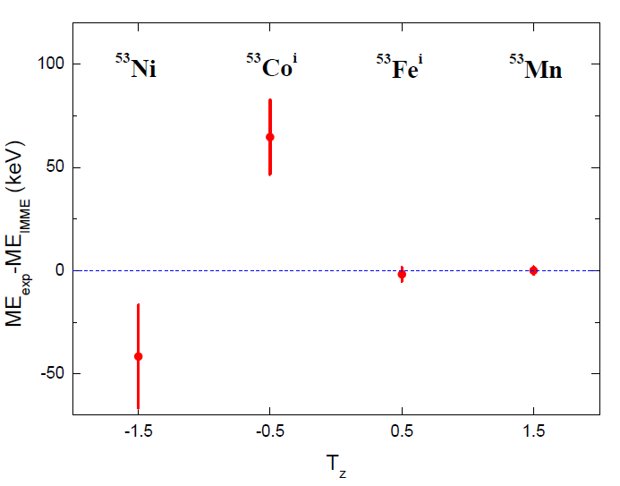
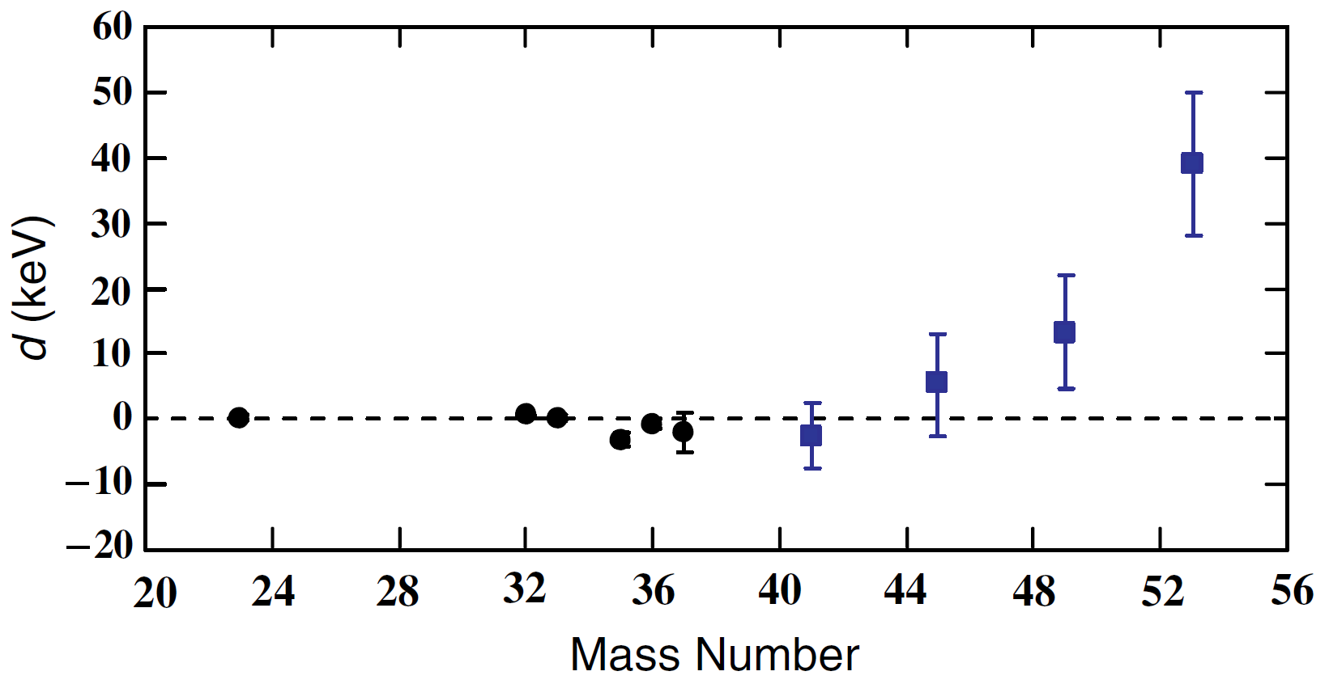
IMME deviation at A=53 quartet
$$M\left(T,T_{z}\right)=a+bT_{z}+cT_{z}^{2}+dT_{z}^{3}$$
d= 39(11) keV
3.6 σ
Y. H. Zhang et al., Phys. Rev. Lett. 109(2012)102501
M. MacCormick,G.Audi, Nucl. Phys. A 925(2014)61
The deviation mainly arises from the mass of T=3/2 IAS in ⁵³Co
Notes:
The IMME equation is an important application of isospin symmetry. If our understanding of isospin symmetry is correct, the IMME should hold its quadratic form. However, in few cases, the IMME deviates from the experimental result a lot. Among them, the deviation at mass number of fifty three is the largest one. And if we do a careful calculation, we will find that that deviation is mainly determined by the mass of isobaric analog state in cobalt fifty three. And the mass of the ground state in cobalt fifty is well determined by penning trap. So the biggest problem is the excitation energy of the isobaric analog state, and this data is from the measurement of nickel fifty three beta decay

Slide 5
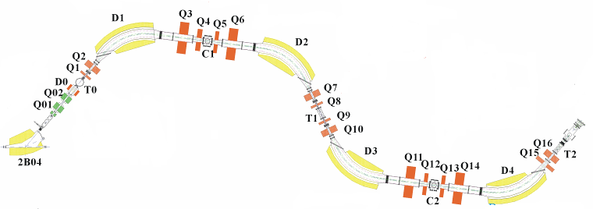
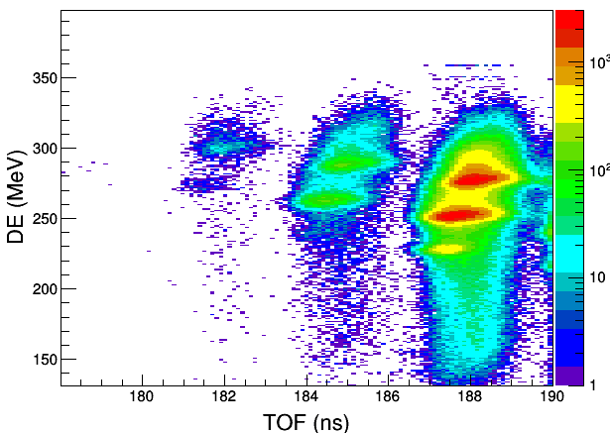
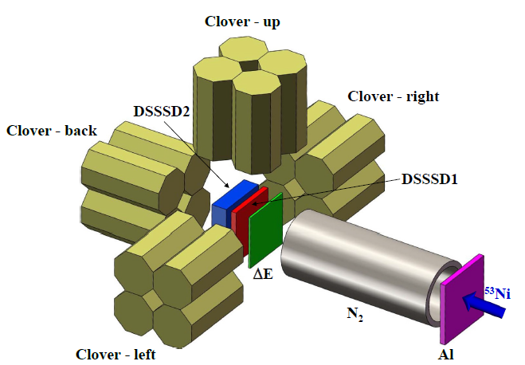
Experiment setup
Be target
500 μm
⁵³Ni
RIBLL1
Primary beam ⁵⁸Ni
E=68.3 MeV/u
TOF-ΔE particle identification
Al+N₂ gas degrader to adjust the implantation depth
⁵³Ni are implanted into a 16x16 strip DSSSD1 (500 μm).
All silicon detector are cooled
Four 200% clover detectors.
Notes:
So we decide to do a new experiment on RIBLL1 radioactive beam facility. This facility is Projectile fragmentation type. We use nickel fifty eight primary beam to bombard beryllium target. The nickel fifty three was identified by Time of flight and energy loss. The ions were implanted into a double side strip silicon detector. This implantation detector also used to measure the beta particle and protons. Around the silicon detector, we used four clover type High purity Germanium detectors to measure the beta delayed gamma rays.

Slide 6
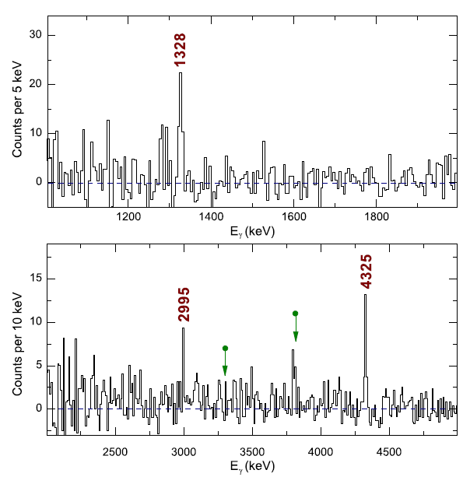
⁵³Ni β-delayed γ spectrum
⁵³Ni
7/2⁻
50(11)%
4325
2995
4325
7/2⁻ IAS
log ft=3.36(10)
B=2.7(6)
39(10)%
11(4)%
1328
1328
9/2⁻
7/2⁻
⁵³Co
Notes:
This is the beta delayed gamma spectrum we obtained. We identified three gamma lines. The lowest one has been already observed in a previous work. Using the gamma information, we build a decay scheme of Cobalt fifty three. All of the gammas come from a state at forty three twenty five keV. And the branching ratio from nickel fifty three to this state is determined to be fifty percent. The corresponding log ft is three point three six, and the beta decay strength is two point seven. This result is in agreement with the theoretical prediction. Thus it is suggest to be the IAS of cobalt fifty three.

Slide 7
⁵³Co IAS mass and IMME revalidation
Pervious：
Present：
M(⁵³Co^{i}) = M(⁵²Fe_{g.s.}) + E_{p} + M(¹H)
M(⁵³Co^{i}) = M(⁵³Co_{g.s.}) + E_{γ}
-38264(18)
-48332(7)
-1929(18)
-38333.6(27)
-42658.6(18)
-4325(2)
39(11) keV
5.4(46) keV
Our result restores the validity of IMME at A=53
J. Su et al. Phys. Lett. B 756(2016)323
Notes:
Then using the new excitation energy and the precise mass value of ground state. We obtain the mass of cobalt fifty three IAS. And the new value is seventy keV lower than the previous result. With this change, the d coefficient reduce from forty keV to five point four keV. It means our result restores the validity of IMME at this quartet.

Slide 8
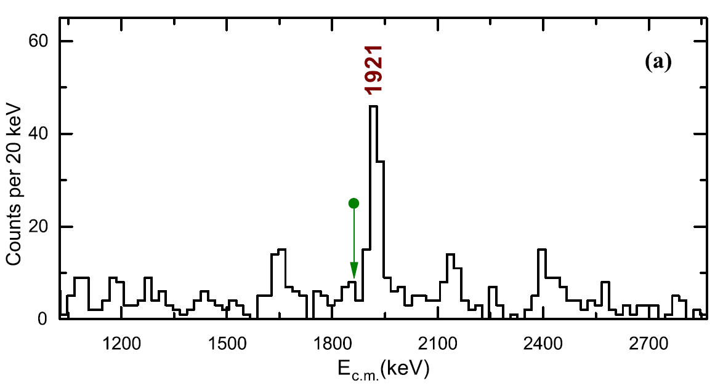
Proton emission from ⁵³Co IAS
⁵³Ni
IAS
β decay
proton
< 0.9(3)%
IAS T=3/2
T=1/2
γ decay
50(11)%
Proton emission of IAS is isospin forbidden
So the Γ_{p} is very narrow
In most case Γ_{p}>> Γ_{γ}
For ⁵³Co IAS, reversion Γ_{p} << Γ_{γ}
T=0
⁵²Fe
⁵³Co
Notes:
Using the new mass data, we can predict the proton decay energy, the result is eighteen sixty one keV. This figure shows the proton spectrum we obtained. The energy of the main proton peak is ninety twenty one keV, the result is in agreement with the previous data, but it is sixty keV higher than the prediction. So we believed it is not emitted from the IAS. With the improved resolution, we find a weak peak at eighteen forty four keV, the energy is in agreement with the prediction. Thus it is suggested to be emitted from the IAS. The we build the decay scheme of cobalt fifty three IAS. It is almost dominated by the gamma transition, and very small branching ratio, only zero point nine percent is taken by proton emission. Then we deduced the Gamma p to gamma gamma ratio to be zero point zero eight.

Slide 9
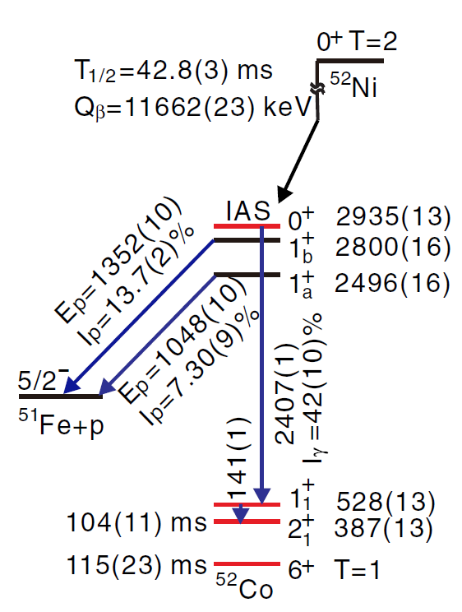
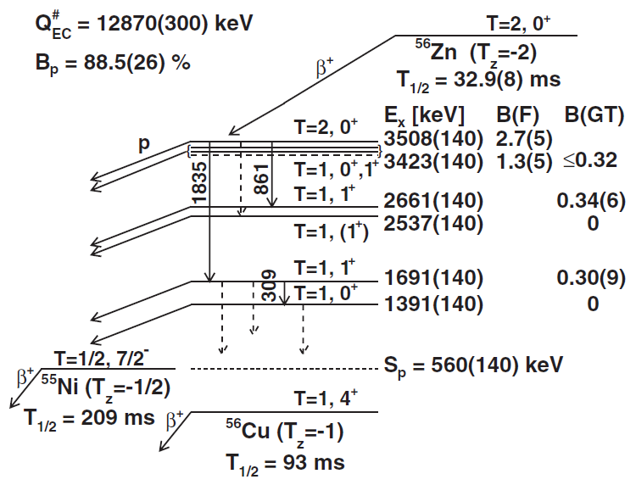
Isospin forbidden proton emission
M. Bhattacharya et al., Phys. Rev. C 77(2008)065503
X. Xu et al., Phys. Rev. Lett. 117(2016)182503
Exotic decay mode
β-γ-p decay
S. E. A. Orrigo et al., Phys. Rev. Lett. 112(2014)222501

Slide 10
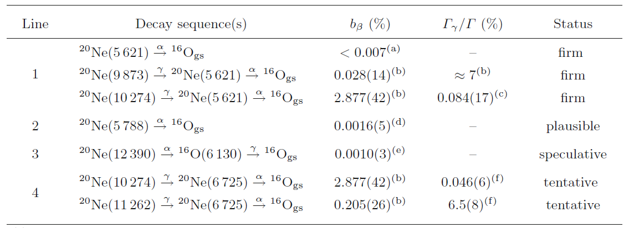
Exotic decay mode in ²⁰Na β decay
K. L. Laursen et al., Eur. Phys. J. A 49(2013)79
No direct evidence for
β-γ-α decay sequence

Slide 11
Beijing Radioactive Ion beam Facility
Proton Beam: 100 MeV，5 μA
Target: MgO
²⁰Na beam: 110keV, 2×10⁴ pps

Slide 12
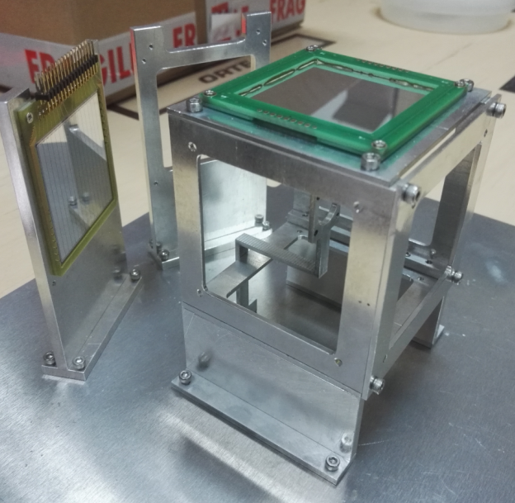
Experiment setup
²⁰Na
Two 175% HPGe detect γ rays
5×MSQ 1500 μm detect β rays
2×DSSD 65 μm detect α particle

Slide 13
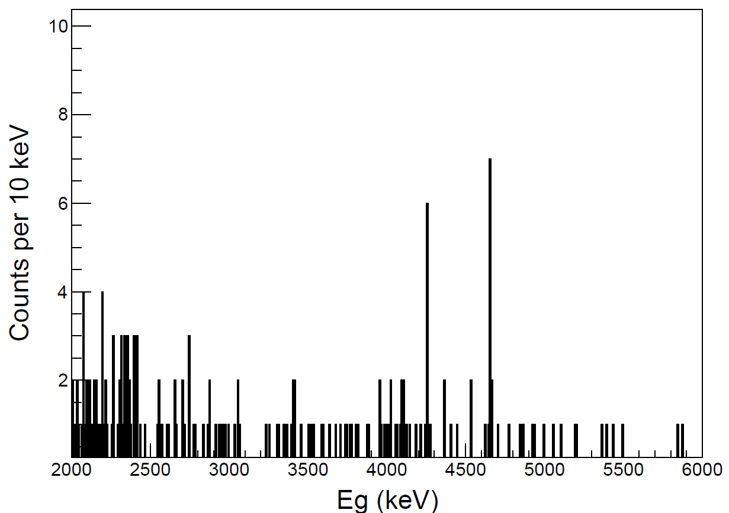
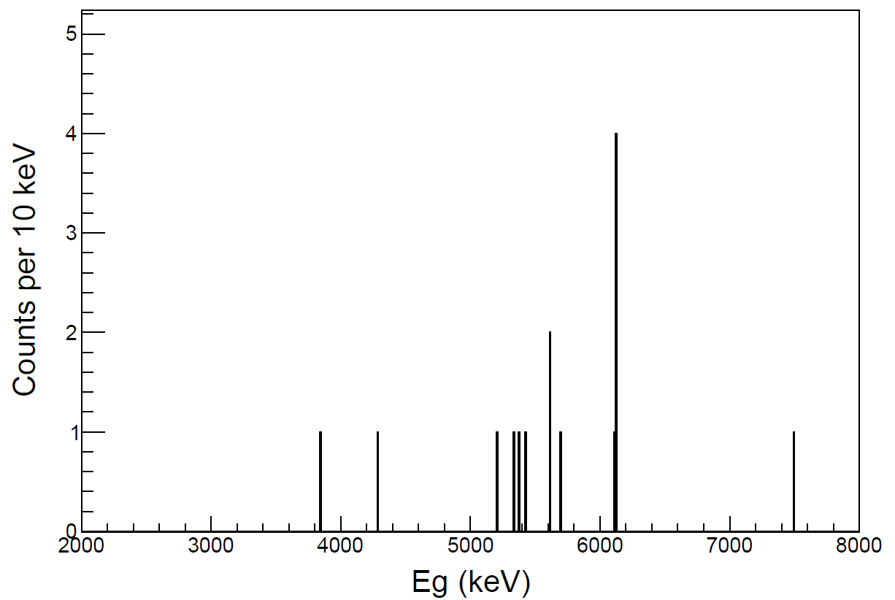
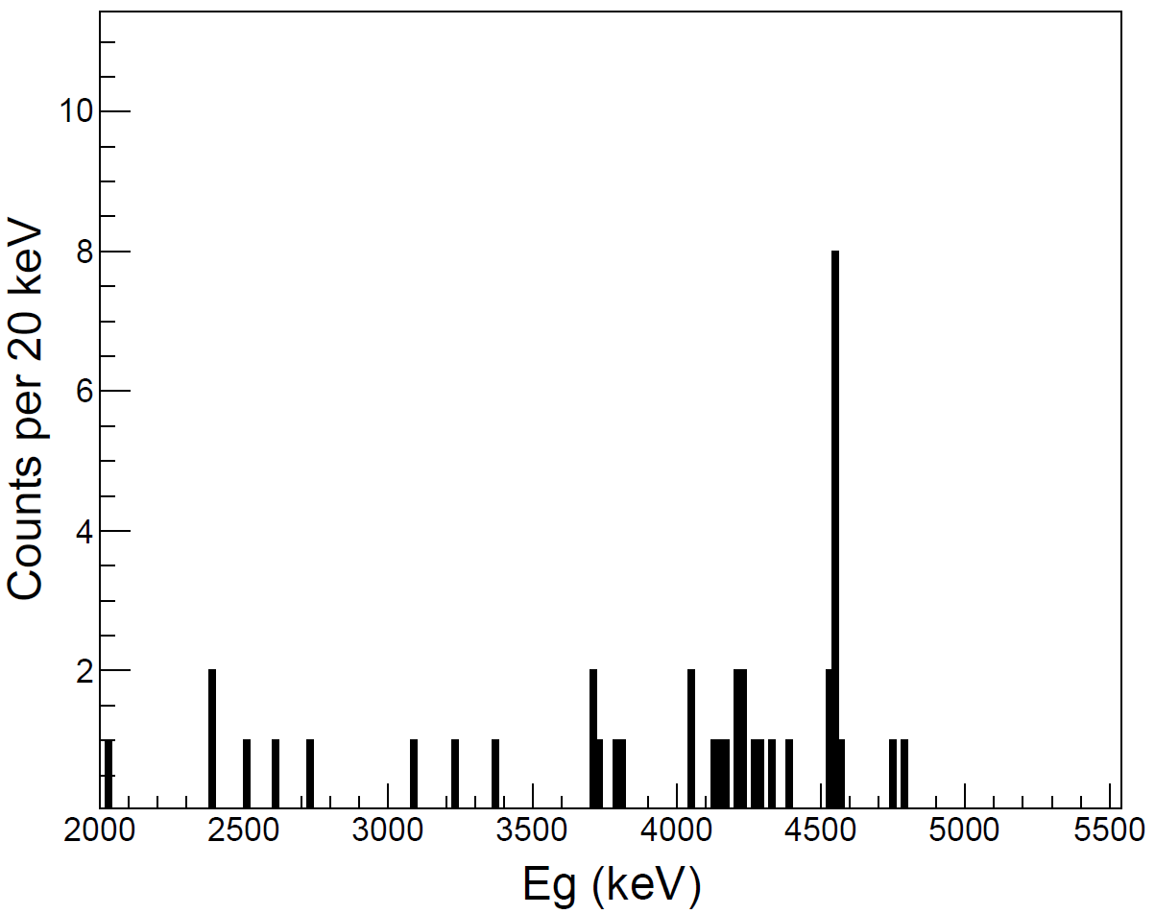
α-γ coincidence
Gated by E_{α} = 712 keV
E_{α} = 1224 keV
E_{α} = 1596 keV
4653
6130
4537
4252
Branching ratios are in processing

Slide 14
Experimental result
Confirmed three exotic β-γ-α decay sequences

Slide 15
Fission fragments
p + ²³⁸U, fission products beam
Most of them are β⁻ radioactive

Slide 16
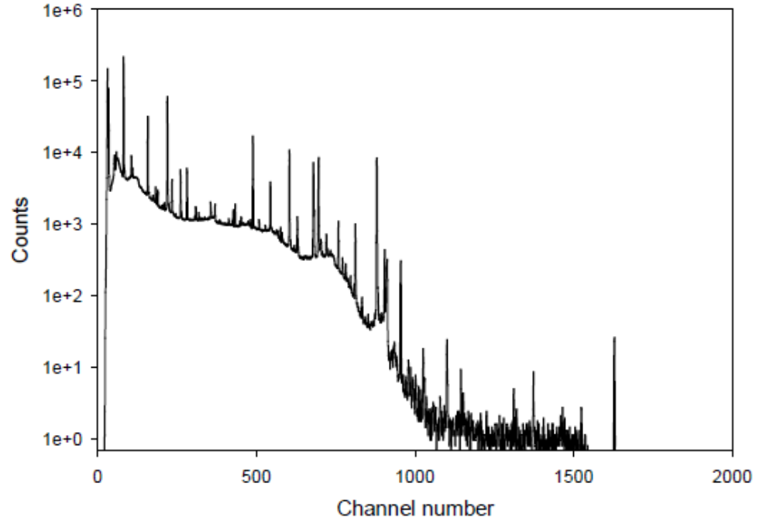
“pandemonium effect”
β decay scheme of fission fragments
β decay scheme from HPGe
J. Hardy et al., Physics Letters 71 B, 307, 1977
weak β-transitions
cascades of γ-transition
weak γ-rays，difficult to detect

Slide 17
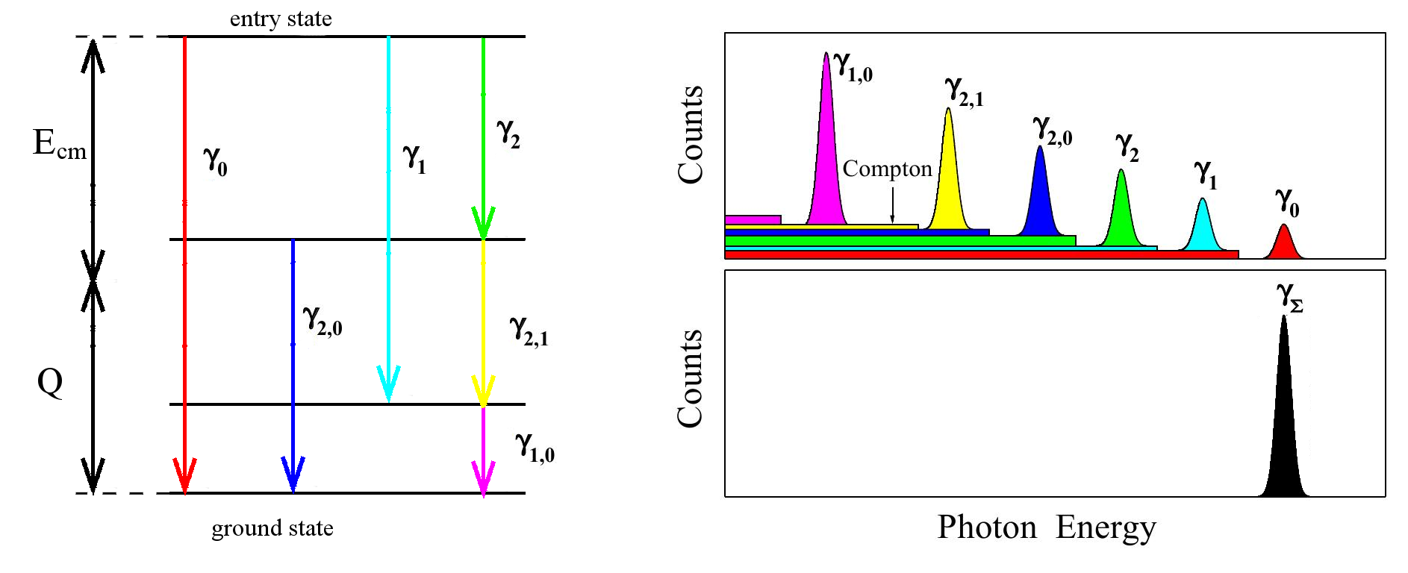
Total Absorption Gamma Spectroscopy
Scintillator array
4π solid angle
~100% efficiency
With 100% detection efficiency, TAGS can measure total gamma energy (=Ex) directly, whatever the cascade mode is.
TAGS is used to determine
β decay intensity (level structure of daughter nucleus)
decay heat of nuclear reactor
anti-neutrino spectrum of nuclear reactor

Slide 18
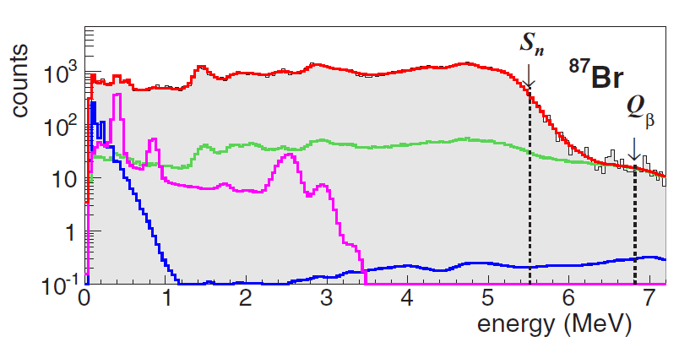
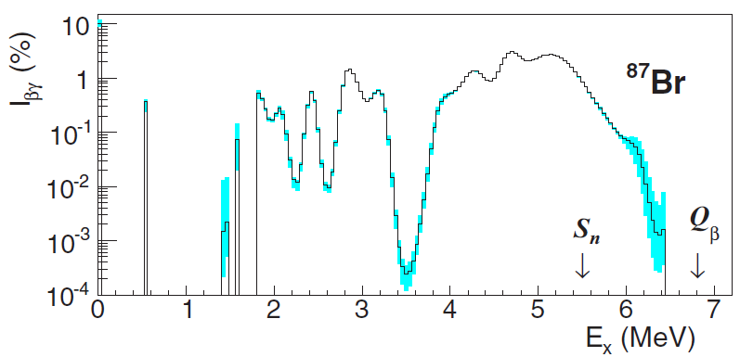
TAGS spectrum unfolding
$$C_{γ}=n∙R∙I_{βγ}$$
Ideal TAGS,
ε_{γ} = 100%, R = 1, C_{γ} = nI_{βγ}
Actual TAGS,
ε_{γ} < 100%, iteration method
Response function (R) is key parameter.
Single γ, R can be obtained by Geant4 + calibration
Cascade γ，R is related to multiplicity M

Slide 19
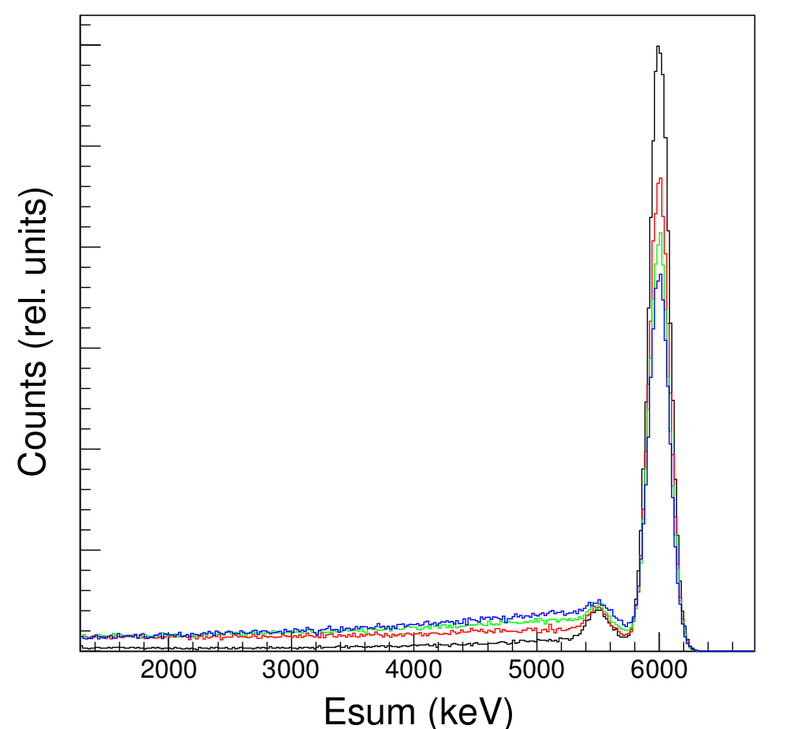
Response function and multiplicity
63%@ 6MeV
6MeV
1γ
2γ
3γ
4γ
For new levels, multiplicity is unknown,
We need Theoretical calculation
Extra uncertainty

Slide 20
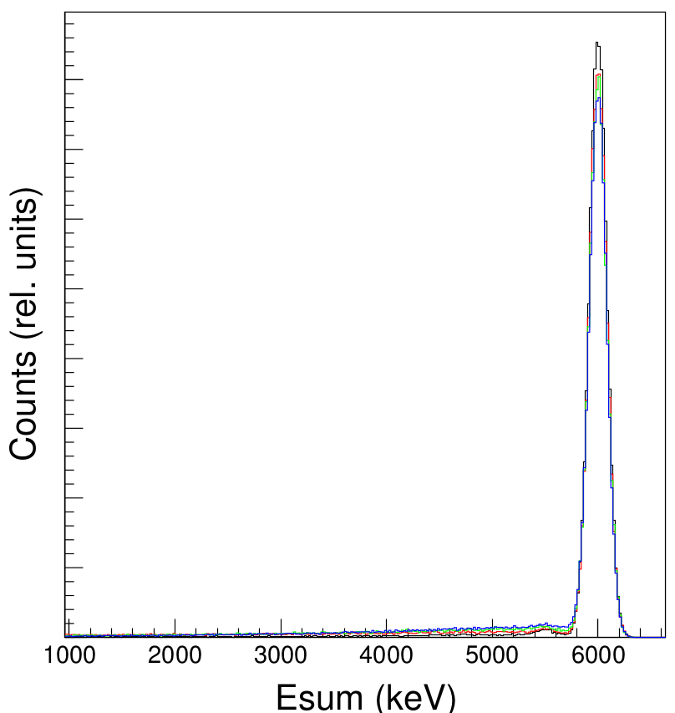
Increase detection efficiency
63%@ 6MeV
88%@ 6MeV
R is moslty independent with the multiplicity of cascade

Slide 21
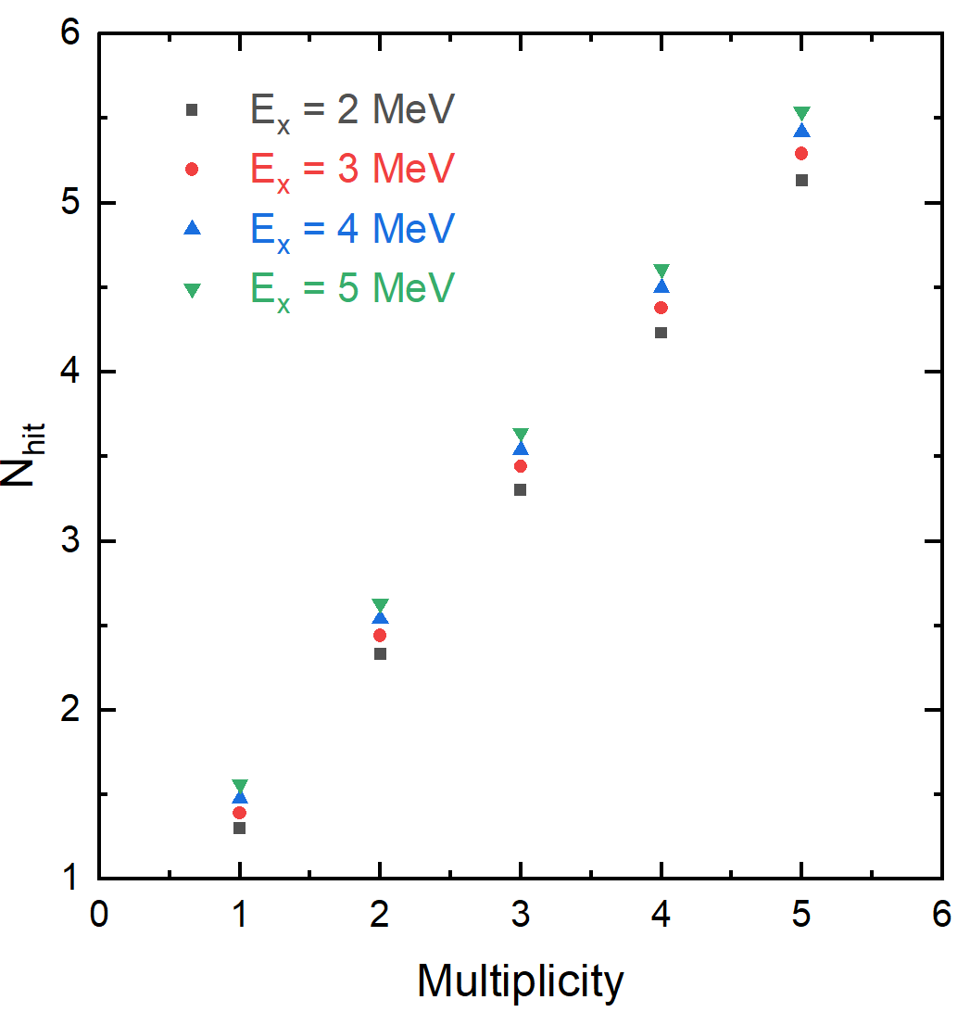
Determine multiplicity
A. Simon et al., Nucl. Instr. Meth. Phys. Res. A703(2013)16
N_{hit}：number of segment fired/triggered
Average N_{hit} → Average Multiplicity → R_{M}
More segments

Slide 22
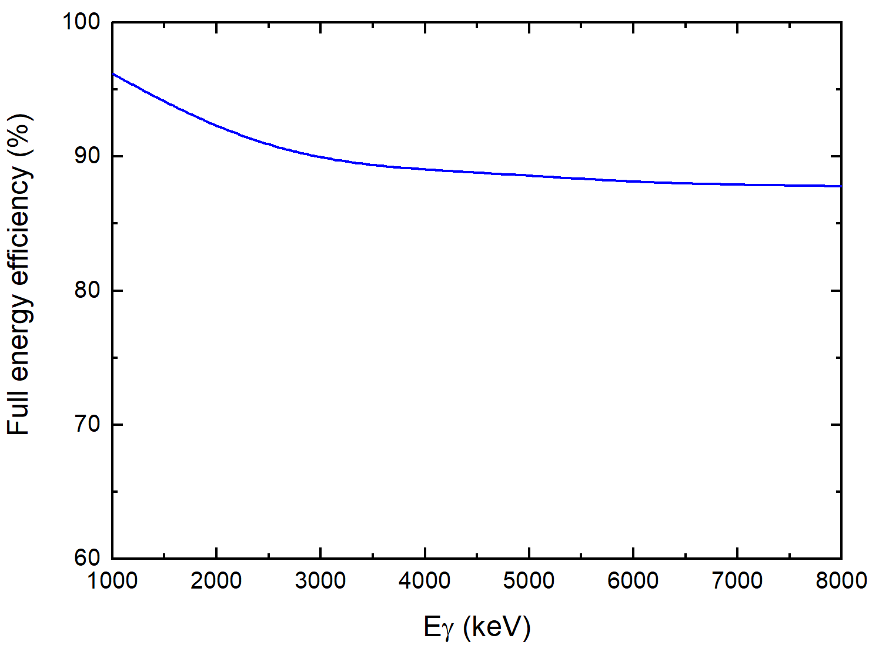
TAGS design
ε > 87% (1-8 MeV)
BGO (Germanium acid bismuth) :
132 segments: 6×6×12 cm
Total crystal volume: 57000 cm³
Cost estimation: 0.6M $

Slide 23
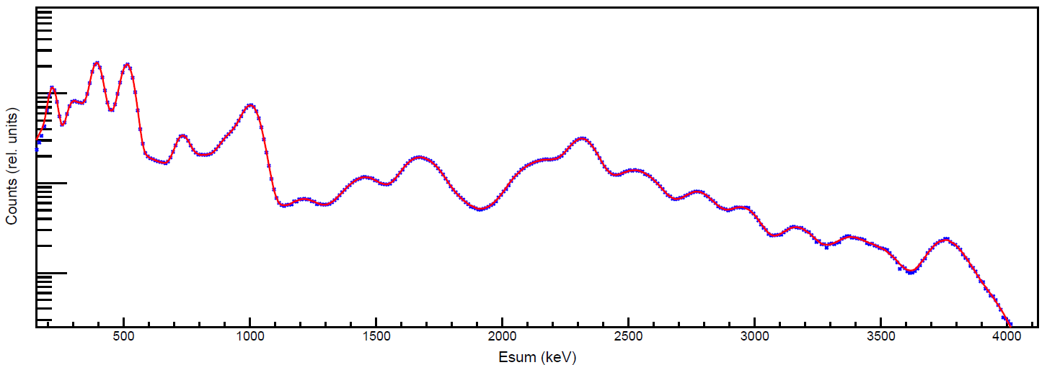
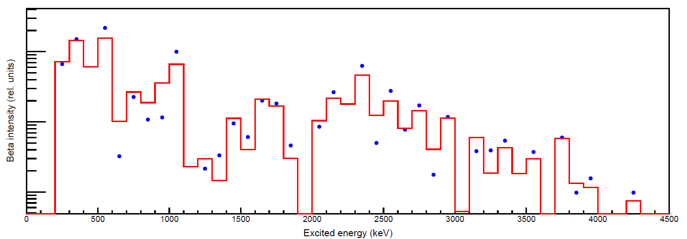
Performance test of new TAGS
$C_{γ}=n∙R_{m}∙I_{βγ}$ iteration method
¹³⁹Xe-¹³⁹Cs
× Exp result (simulation)
— fitting
Difference with previous works,
We have not use level information of daughter nucleus
Rm is directly determined by N_{hit}
Low ambiguity result
● Input data
— fitting

Slide 24
Summary
⁵³Ni β delayed decay was measured at RIBLL1, the mass of T=3/2 IAS in ⁵³Co was determined by the energy of β delayed γ rays. This new mass value restored the validity of IMME at A=53 quartet.
²⁰Na β delayed decay was measured at BRIF, three exotic β-γ-α decay sequence were confirmed via γ-α coincidence measurement.
We design a new high efficiency TAGS with BGO scintillator, which will be used to detect the β decay intensity of fission fragments. Due to the high efficiency and multiplicity measurement, the theoretical calculation maybe not needed anymore in the spectrum unfolding .

Slide 25
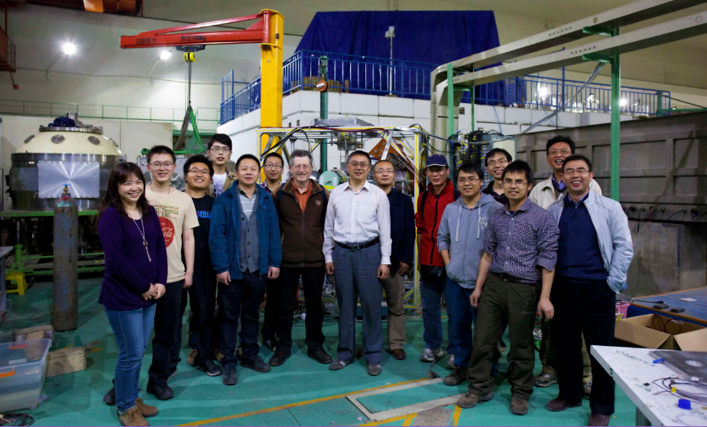
Thank you for your attention！

Slide 26
Decay heat calculation uncertainty
Isotope | Average γ energy ${\overline{E}}_{γ}$ (keV)
 | Input | Fitting | Deviation
⁸⁷Br | 3129 | 3154 | 1%
¹⁰⁴Tc | 1893 | 1890 | 0.2%
¹³⁶I | 2372 | 2395 | 1%
¹³⁹Xe | 933 | 926 | -0.8%
1% accuracy

Slide 27
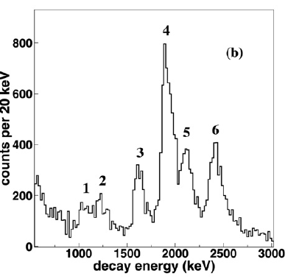
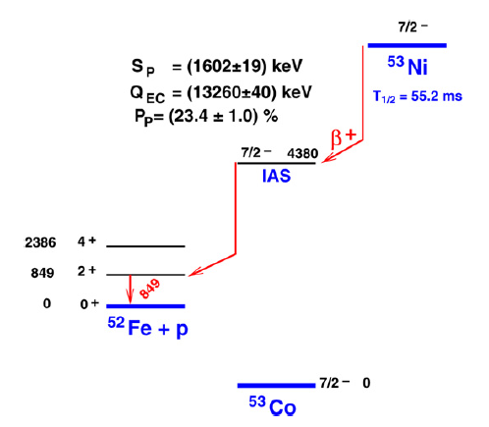
Previous works
C. Dossat et al. Nucl. Phys. A 792(2007)18
B(F) = |N-Z| = 3
1.929 MeV
B(F)=3
~60%
5.4%
~ 55% γ ray
missed
The small branching ratio is not enough to identify IAS
New experiment is necessary
Notes:
The most recent measurement of nickel fifty three beta decay was performed at GANIL in two thousand and seven. In this work, the beta delayed protons were measured, and the main proton peak with highest intensity, is suggested to be emitted from the isobaric analog state in cobalt fifty three. But there is a obvious problem in this assignment. If this state is the isobaric analog state, the Fermi transition should have a sixty percent branching ratio, and this proton peak just have five point four percent branching ratio. The rest fifty percent branching ratio must be taken by gamma decay. But due to some experimental reason, this work cannot meaure high energy gamma rays, so a new experiment is very important.

Slide 28
Theoretical calculation

Slide 29
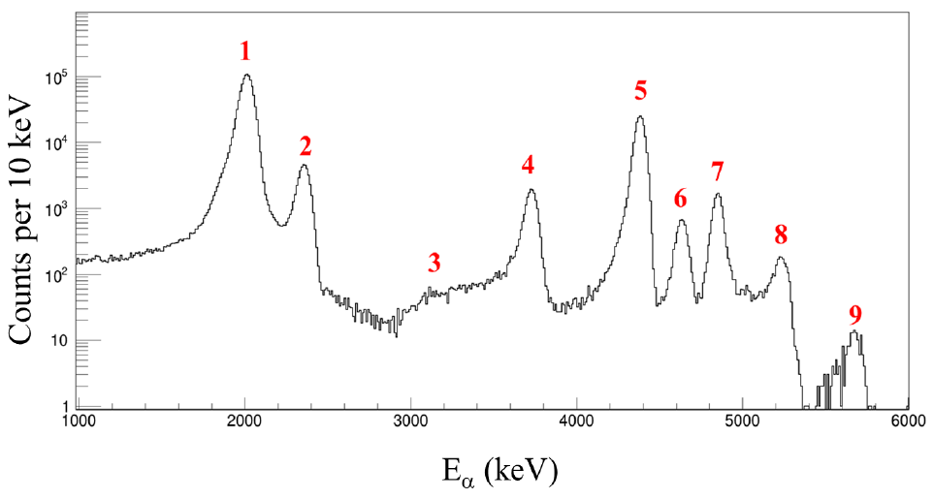
²⁰Na β delayed α spectrum

Slide 30
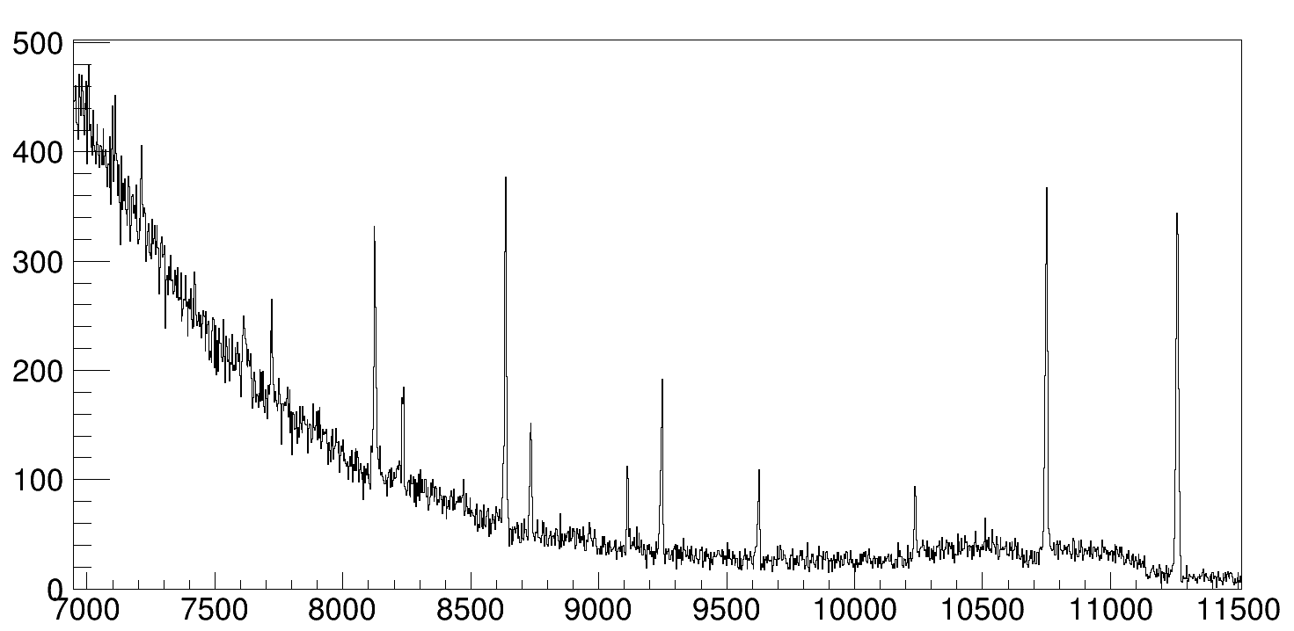
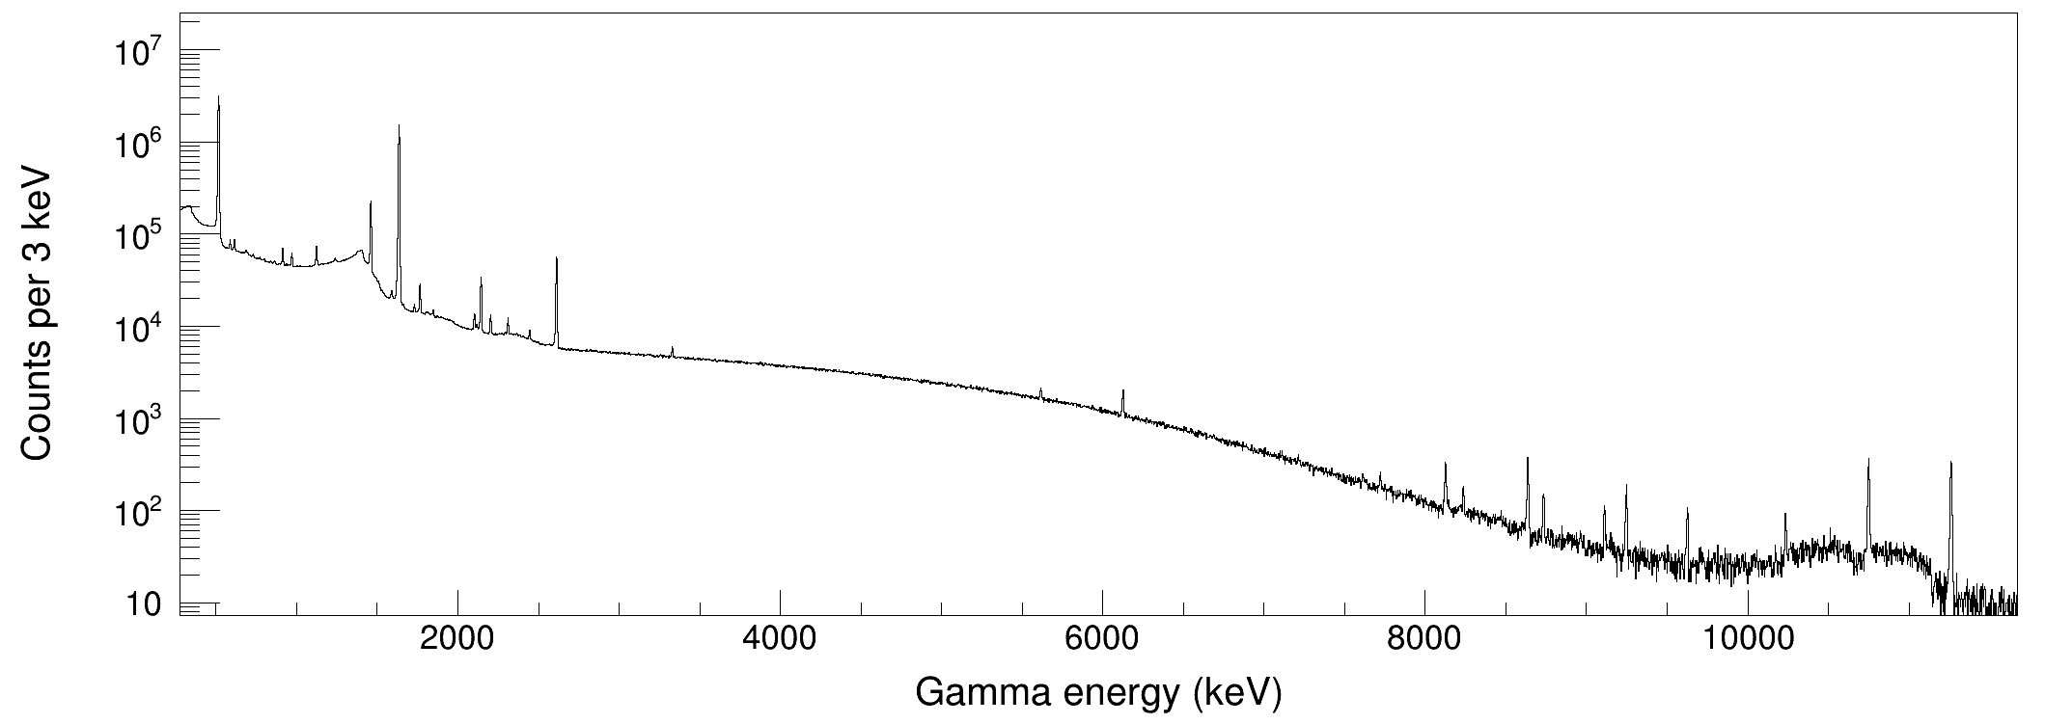
²⁰Na β delayed γ spectrum
9873→1633
11262→0
10274→1633
10884→1633
11262→1633
511
1633→0

Slide 31
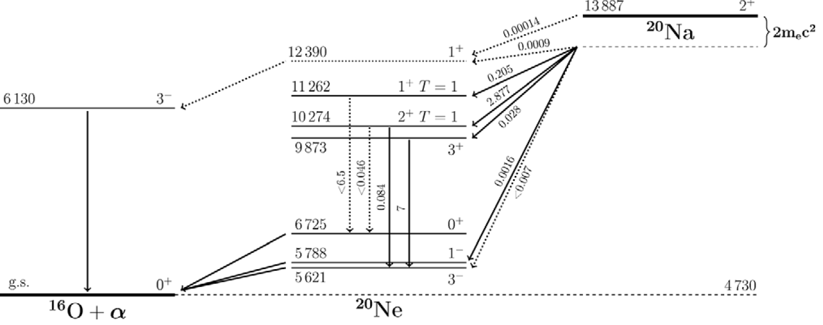
γ - α energy relation
E_{γ} (keV) | E_{α} (keV)
4252 | 712
4653 | 712
6130 | 1224
3549 | 1596
4537 | 1596

Slide 32
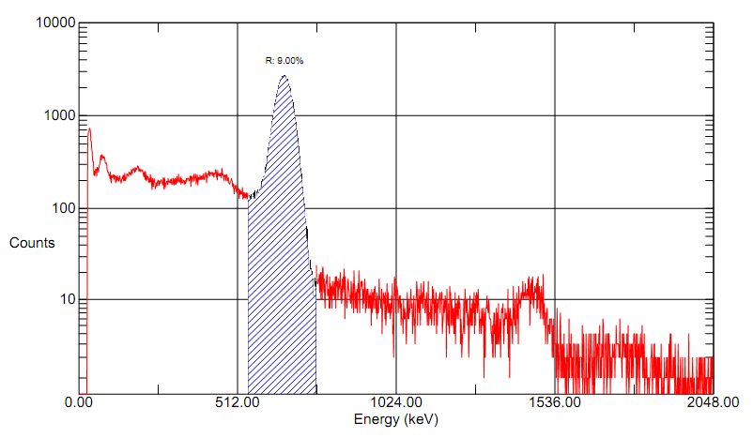
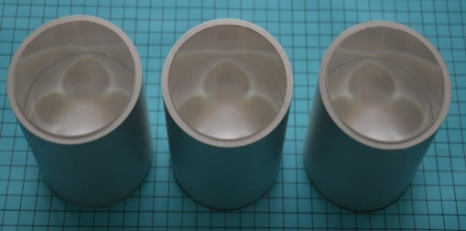
Increase efficiency
Performance | NaI(Tl) | BGO
density | 3.67 g/cm³ | 7.13 g/cm³
Z_{eff} | 50.8 | 74
Thickness to stop 50% 662 keV γ | 2.5 cm | 1 cm
Hygroscopic | yes | no
Light yeild | 38/keV | 10/keV
BGO (Germanium acid bismuth) :
Advantage
high efficiency
packaging free (65 um reflector)
small volume
low cost (~10 $/cm³)
Disadvantage
low ∆E/E (~12%@662 keV for 3 inch crystal)
Our collaborator, SICCAS
(Shanghai Institute of Ceramics, Chinese Academy of Science)
9%@662 keV for 3 inch BGO detector

