Slide 1

Baryons in symmetric and asymmetric nuclear matter
Su Houng Lee
Few words on Baryons in symmetric and asymmetric matter
Nucleons in matter: Sum rule approach
Hyperon in medium
Delta in medium
Three nucleon interaction in a constituent quark model
Acknowledgements:
Kiesang Jeong (Seattle), Aaron Park, Woosung Park (Yonsei), Sungtae Cho (Kangwon)

Slide 2
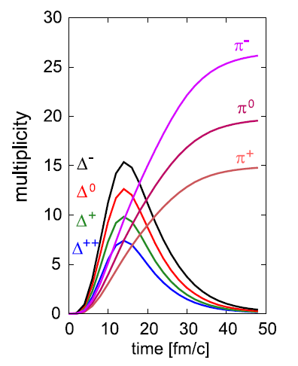
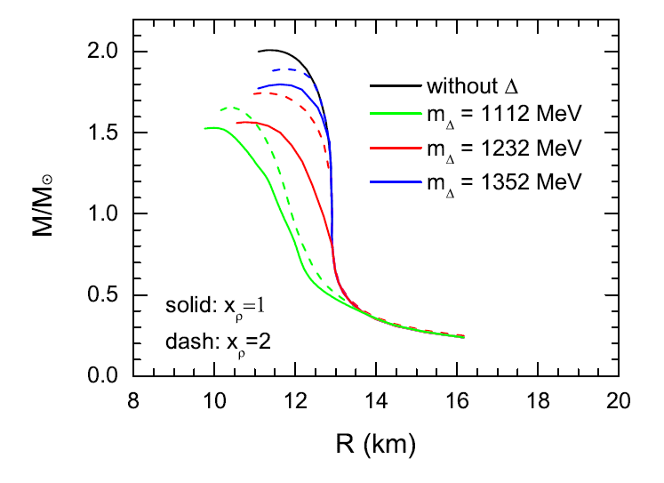
Importance of Delta in medium
Effects Related to symmetry energy
[Ikeno, Ono, Nara, Ohnishi (PRC93 (2016) 044612]
Effects in neutron star
[Cai, Fattoyev, Bao-An Li, Newton (PRC92 (2015) 015802)]
Au+Au collisions at 1GeV/nucleon
at b=0; JAM calculation

Slide 3
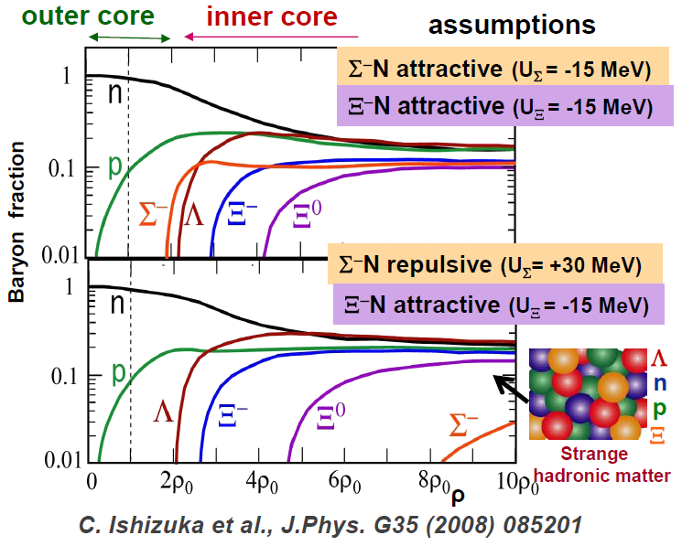
Hyperon puzzle: Slide by Tamura
Baryons in nuclear matter ?
NNN NNY interaction ?
Changes in coupling, masses ?

Slide 4
Nucleon and Hyperons in matter
Scalar attraction vs Vector repulsion
Ref:
Marques, Lee, Park, Matheus, Jeong, PRC98 (2018) 025206
Jeong, Gye, Lee, PRC94 (2016) 065201
Jeong, Lee, PRC87 (2013) 015204

Slide 5

Naïve picture of vector repulsion in Baryon Baryon interaction
p
Σ
Hyperons
p
p
Compared to Nucleon ?
3-body
p
p
Short distance
q
q
q
q
p
p
q
q
q
q
q
p
p
NNN or medium effects?
Quark dynamics and Pauli effect ?

Slide 6
Baryon in nuclear matter : QCD sum rule approach
Baryon correlation function in medium
Phenomenological side: Positive parity states
Operator Product Expansion
Scalar attraction and vector repulsion
Cohen, Griegel, Furnsthal 91

Slide 7
Consequence of chiral symmetry restoration ?
Finite T Lattice result (Aarts et al. arXiv:1710.00566 )

Slide 8
Nucleons in symmetric and asymmetric matter (K. Jeong, SHL 2013)
Quark operators at finite density with isospin asymmetry
Important operators
symmetric
asymmetric

Slide 9
Nucleons in symmetric and asymmetric matter
Symmetry energy from QCD sum rule: K. Jeong, SHL, PRC87, 015204 (2013)
Ioffe Current
where
Larger vector repulsion
+ < 50 MeV
Smaller scalar attraction
→ Feature similar to Relativistic mean field models

Slide 10
Hyperons in symmetric and asymmetric matter
QCD sum rule: Interpolating field determines how well OPE converges
Needed additional input

Slide 11
Λ in symmetric nuclear matter
Λ in nuclear matter (Jeong, Gye, SHL PRC94 (2016)065201 )
Operator Product Expansion when the current has a strong u-d scalar diquark
Nucleon with Ioffe current
Λ with strong u-d diquark current
Both Smaller than 2/3 from Quark counting but similar total binding
Vector repulsion
<
Scalar attraction

Slide 12
Σ in symmetric nuclear matter
Σ in nuclear matter (Jeong, Gye, SHL PRC94 (2016)065201 )
Operator Product Expansion is similar with Ioffe current with d→s
Nucleon with Ioffe current
Λ with Ioffe current d→s
Vector repulsion
Scalar attraction
>>
Total repulsion is larger than 100 MeV at nuclear matter :
Larger than expected

Slide 13
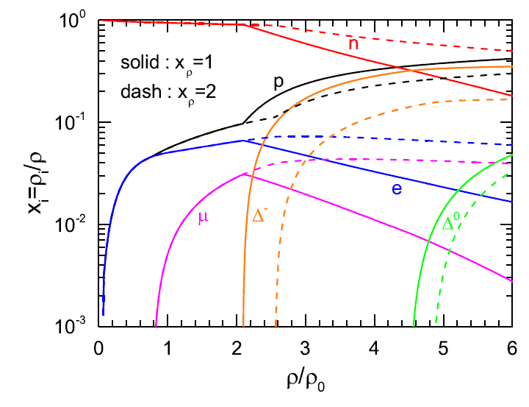
Δ in nuclear matter
Baryon in Relativistic Mean Field models
Effects in neutron star [Cai, Fattoyev, Bao-An Li, Newton (PRC92 (2015) 015802)]

Slide 14
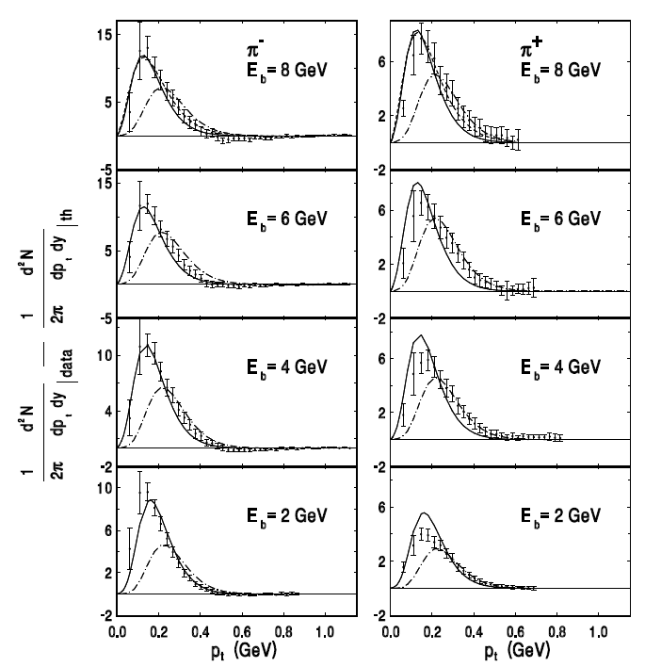
Experimental results on Delta mass shift
At symmetric Nuclear matter in γ -A
Broadening
No clear observable Mass change?
Heavy Ion Collisions
possible mass shift at higher density
Analysis of pion Pt spectra (Rafelski 2007)
BNL: Au+Au
Raon
Can produce through subthreshold production in heavy ion collision

Slide 15
Delta in nuclear matter
Δ interpolating currents (Marques, SHL, A. Park, Matheus, Jeong PRC98 (2018)025206)
Nucleon Ioffe current
Delta Ioffe current
→ Δ Has smaller vector repulsion compared to nucleon
scalar attraction : 150 MeV, Δ Vector repulsion: 75 MeV

Slide 16
Delta in asymmetric nuclear matter
Δ vector self energy (Marques, SHL, A. Park, Matheus, Jeong PRC98 (2018)025206)
Nucleon vector self energy (Marques, SHL, A. Park, Matheus, Jeong PRC98 (2018)025206)

Slide 17
Intrinsic 3-Baryon interaction
Short distance in a quark model
Ref:
A Park, Lee, arXiv:1908.08333
A Park, Lee, Inoue, Hatsuda, arXiv:1907.06351

Slide 18
B-B interaction: Insights from Constituent quark model
Color-spin interaction
☞ Color-color interaction is not important
☞ Color-spin interaction for 2 body:
Color | A | S | A | S | 1 | 8 | 1 | 8
Flavor | A | A | S | S
Spin | A(1) | S(3) | S(3) | A(1) | 1 | 1 | 3 | 3
K | -8 | -4/3 | 8/3 | 4 | -16 | 2 | 16/3 | -2/3
q
q
q
q
u
d
meson
→ Responsible for

Slide 19
Comparison with lattice (HAL QCD) – NN interaction
(arXiv:1907.06351 A Park, SHL, Inoue, Hatsuda)
☞ NN force in SU(2) spin 1 vs spin 0 channel
→ comparison
☞ H dibaryon channel: Flavor 1 vs Flavor 27

Slide 20
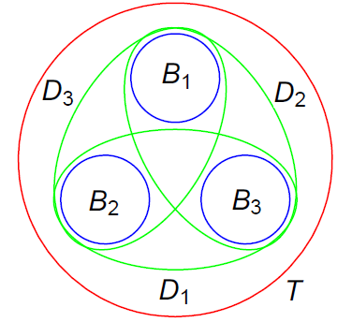
K factors in NNN vs NNΛ
(arXiv:1908.08333 Aaron Park, SHL)
☞ Tribaryon configuration
Intrinsic three-body force
☞ After calculating the transformation coefficients, one can prove that it vanishes for all quantum numbers in SU(3) symmetric limit

Slide 21

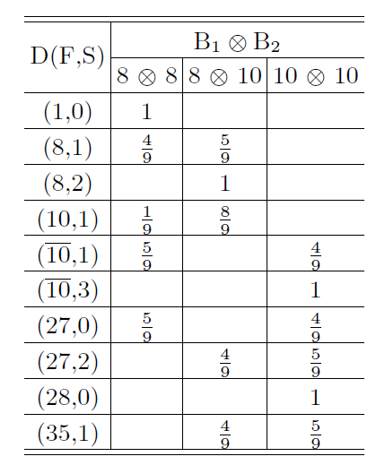

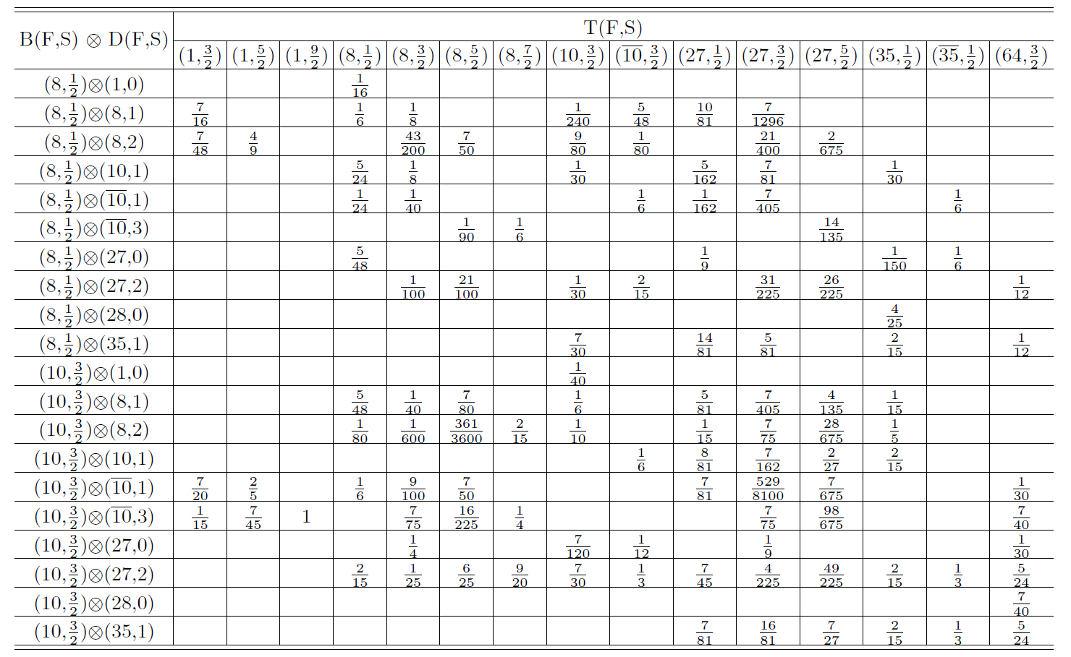
Transformation coefficients in SU(3) flavour
(arXiv:1908.08333 Aaron Park, SHL)

Slide 22
Summary
QCD sum rule approach offers a way to calculate the potential part of the nucleon, delta and hyperons in medium→ similar to RMF models.
Symmetry energy is positive and due to larger vector repulsion and smaller scalar attraction.
Λ has smaller self energies than 2/3 of nucleon, but repulsion is even smaller
Σ repulsion in matter is larger than naïve expectation. 100 MeV
Δ has smaller vector repulsion compared to nucleon
Further studies with different currents will be useful
Intrinsic three-baryon interaction should be small

