Slide 1
Beam Size Study
Seong Hak Lee, Dong Ho Moon
Chonnam National University
LAMPS Meeting @ GwangJu

Slide 2
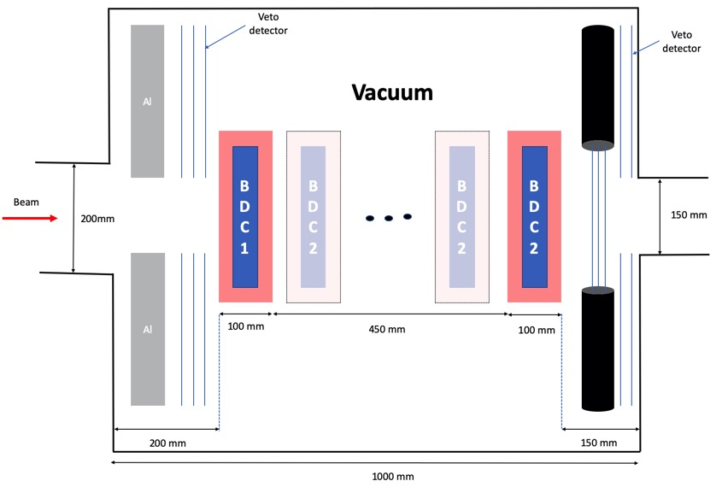
BDC Schematic
-> Beam size was calculated as moving the position of the BDC2

Slide 3
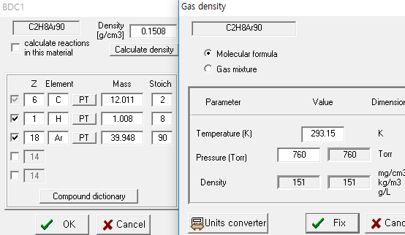
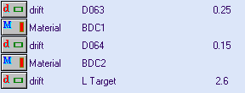
BDC Setting
BDCs are filled with P10 gas (mixture of Methane and argon ratio 9 to 1)
The pressure of P10 gas set with 100 torr
LISE++

Slide 4
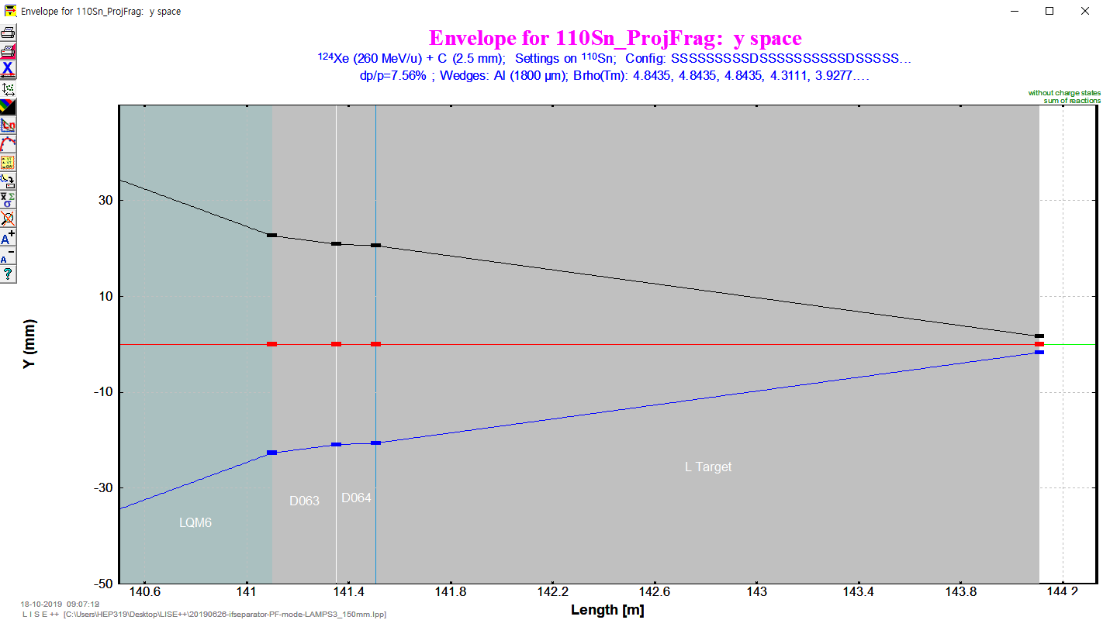
Beam Size Estimation
Envelope plot of tested P10 with 100 torr.
Beam size seems not influenced much.

Slide 5
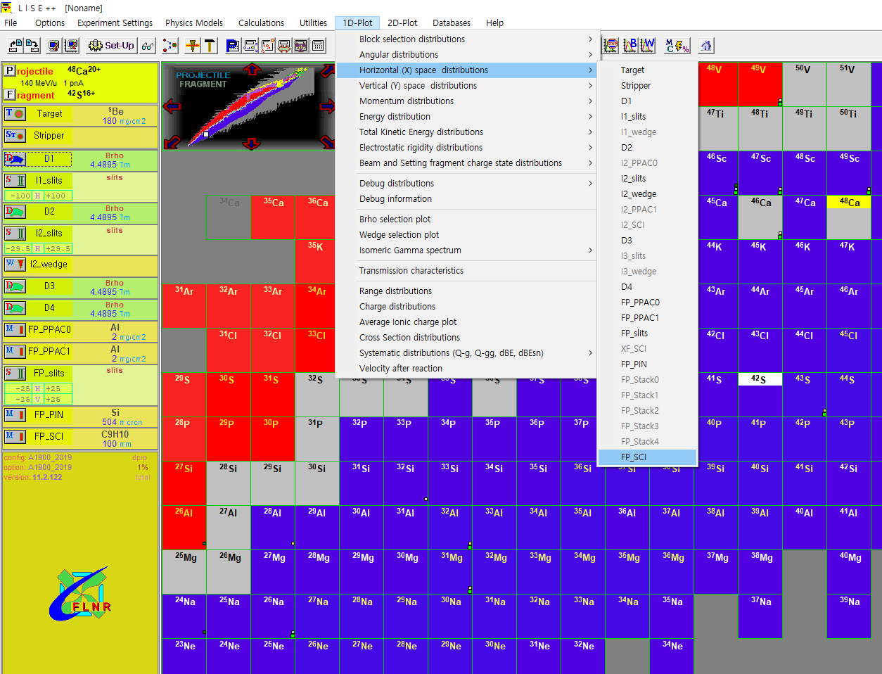
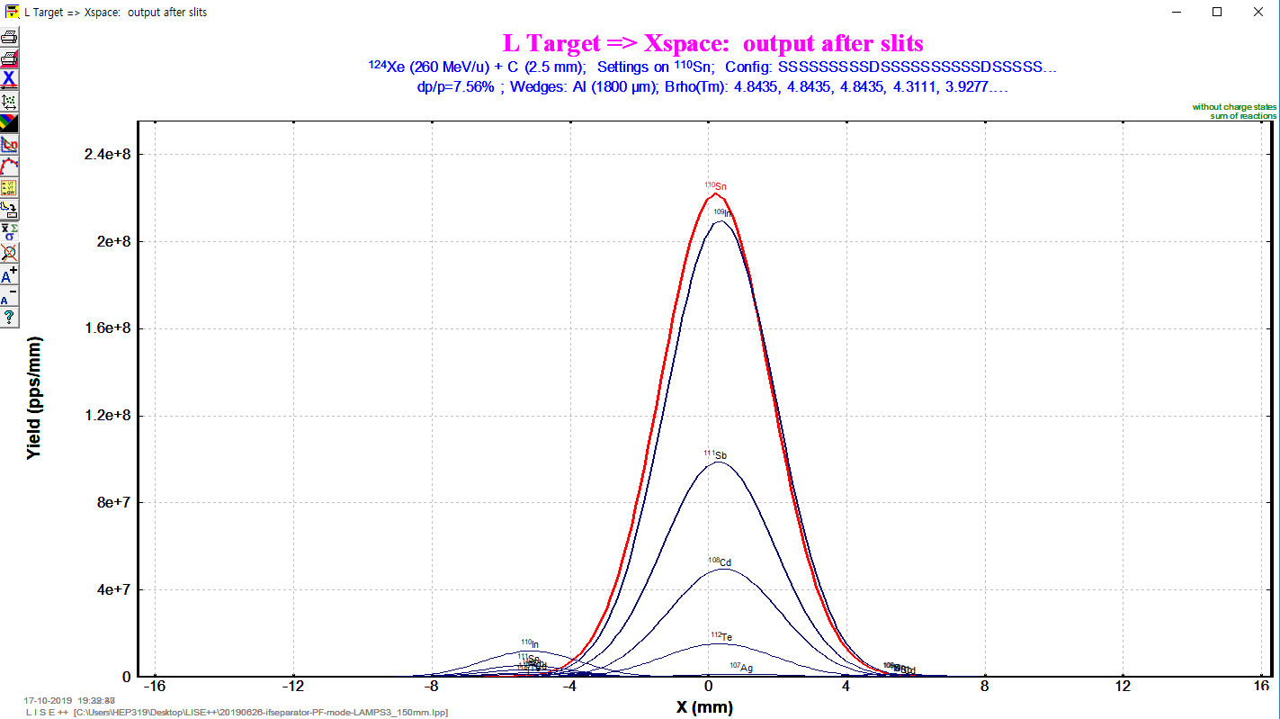
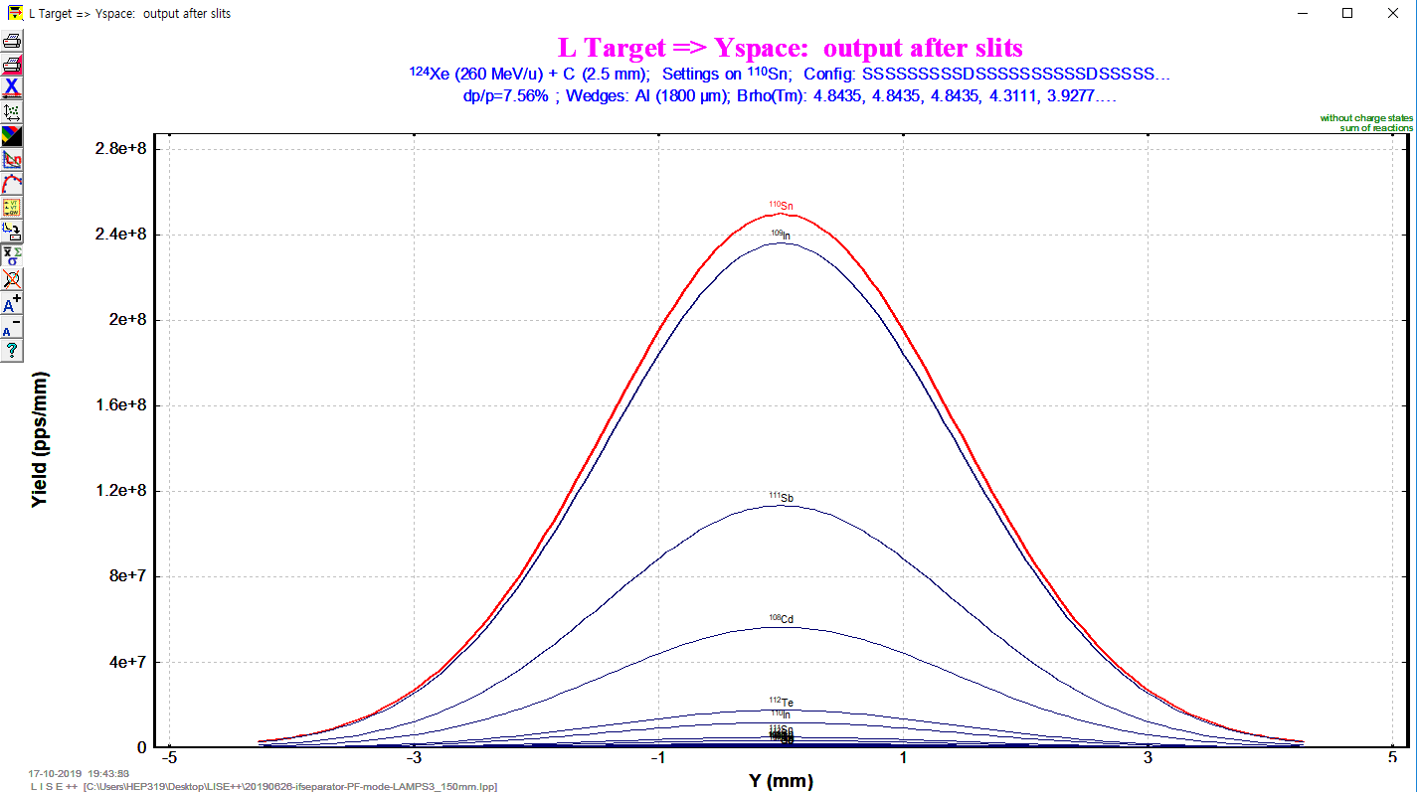
Beam Size Estimation with 1-D Plots
X
Y

Slide 6
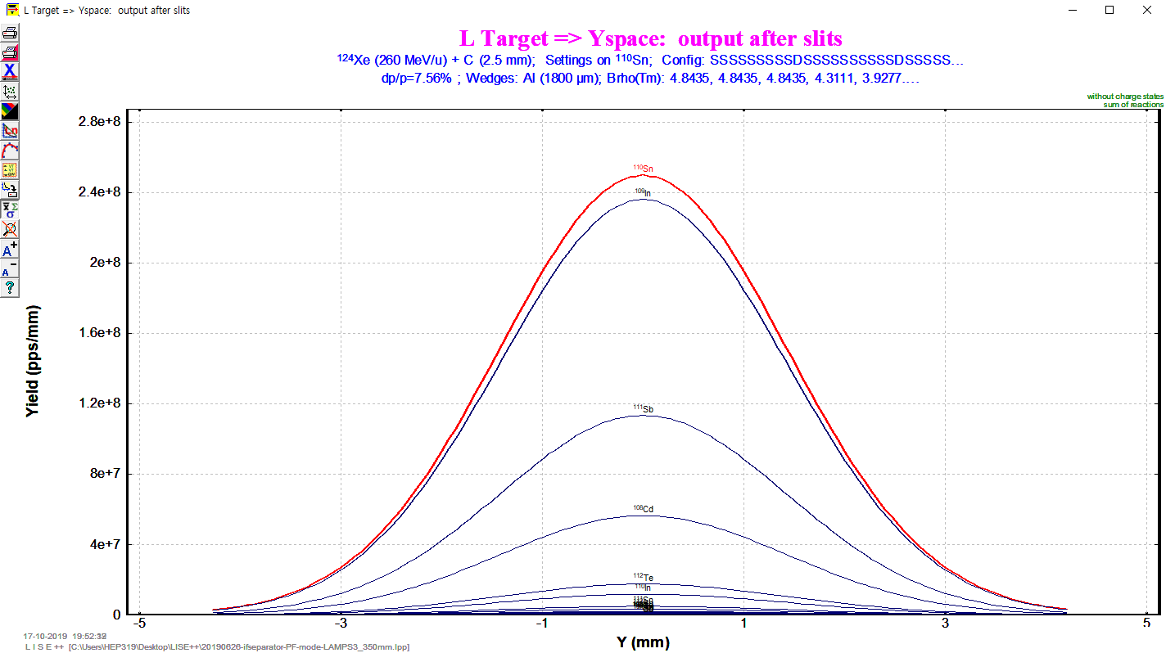
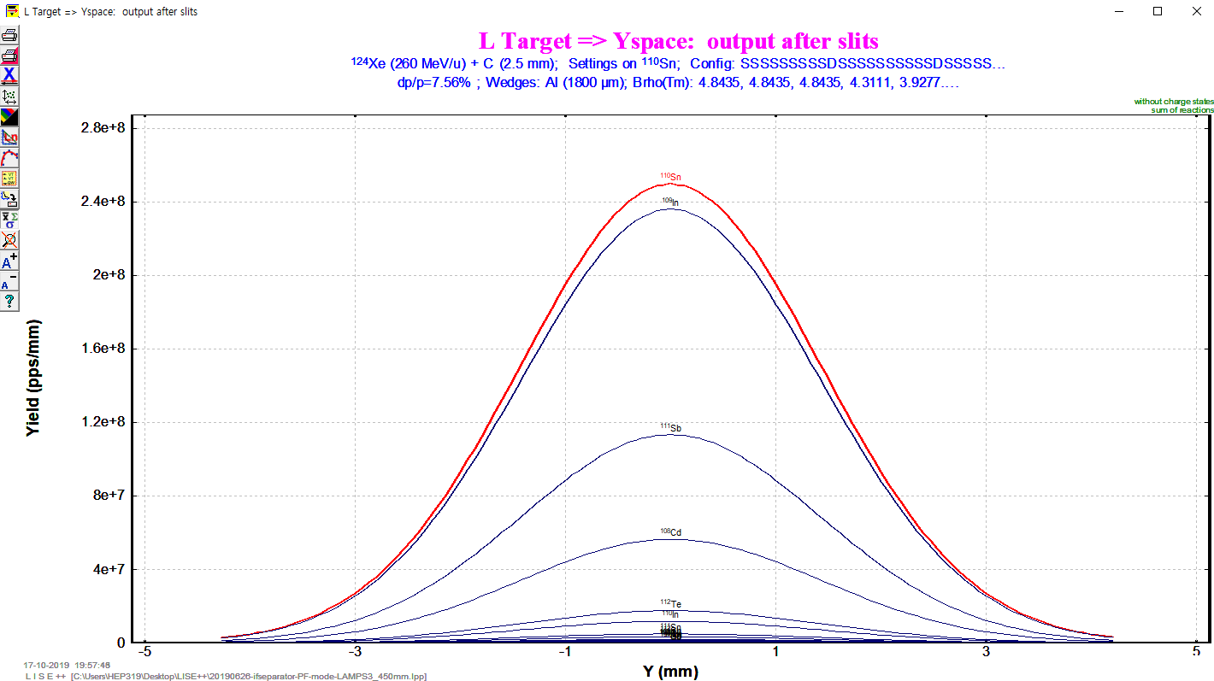
Beam Size Estimation with 1-D Plots
Distance of BDCs
X
Y
50 mm
150 mm
250 mm
350 mm
450 mm

Slide 7
Beam Size Estimation
FWHM(X) = 13.07 mm
-> Beamsize(X) ≈ 16.46 mm
1D-Plot FWHM
Beamsize(3σ) ≈ $\frac{3}{2.35482}$ FWHM
FWHM(Y) = 13.53 mm
-> Beamsize(Y) ≈ 17.237 mm
Distance of BDCs | 50 mm | 150 mm | 250 mm | 350 mm | 450 mm
FWHM X(mm) | 3.759 | 3.759 | 3.759 | 3.759 | 3.759
FWHM Y(mm) | 3.35 | 3.35 | 3.35 | 3.35 | 3.35
All of beam sizes are same.
Need to check with MC.

Slide 8
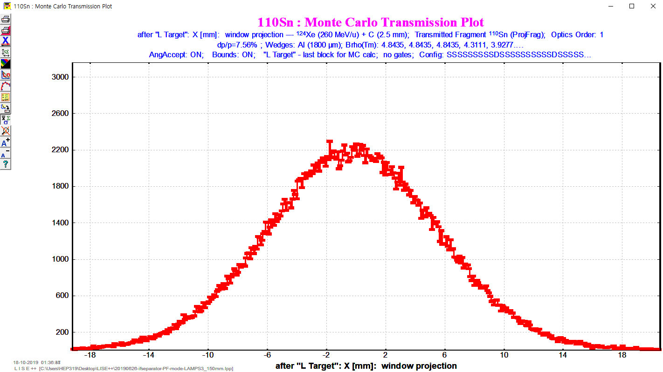
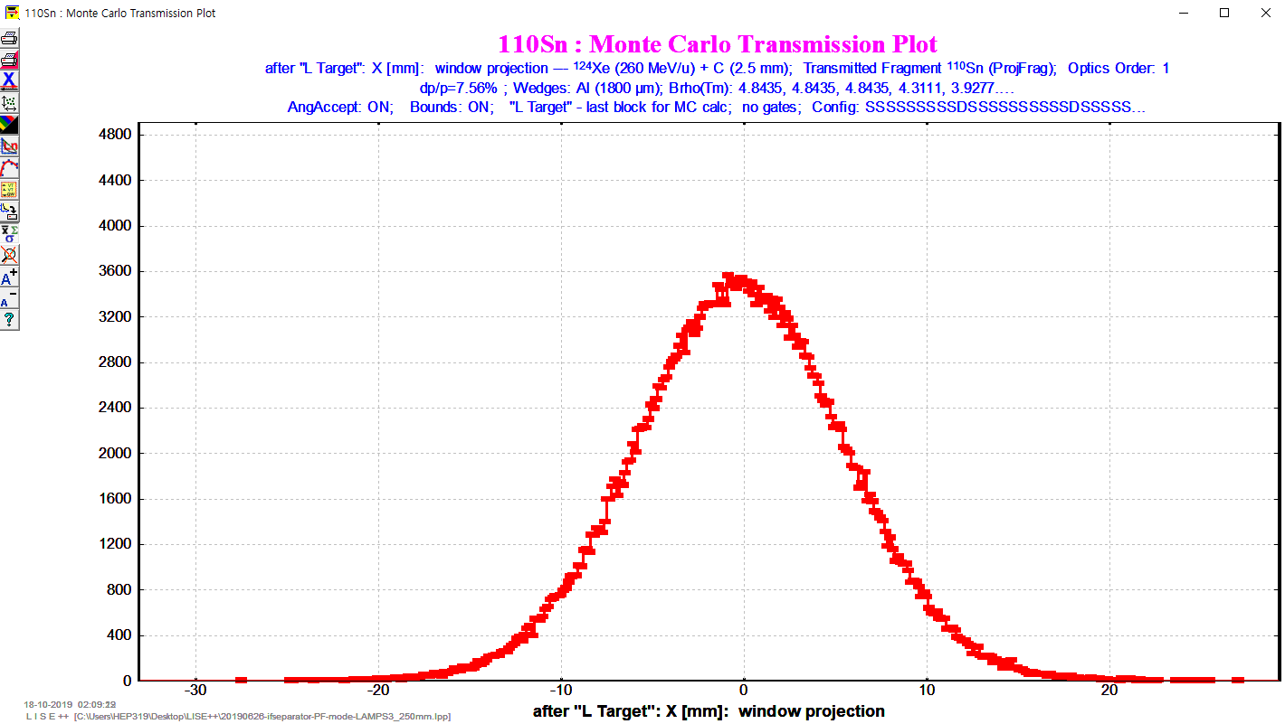
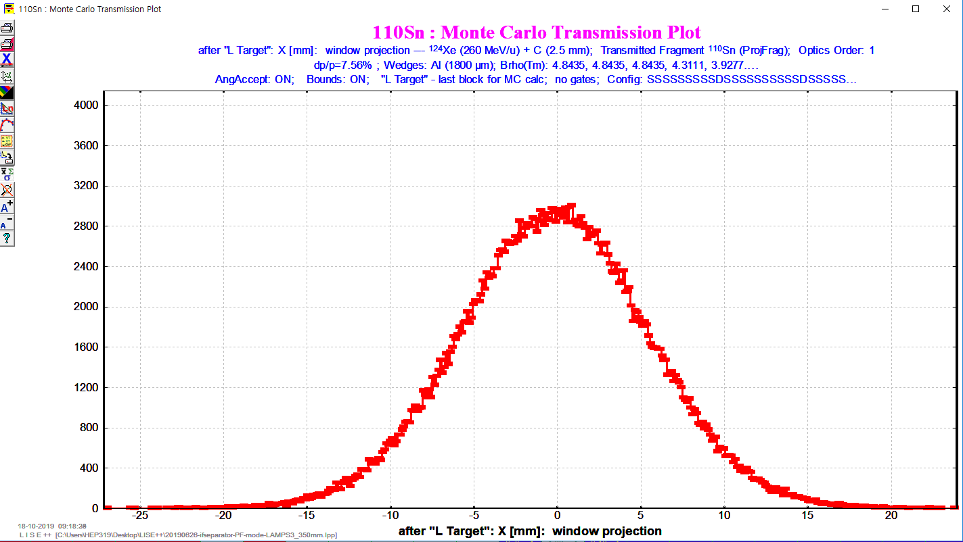
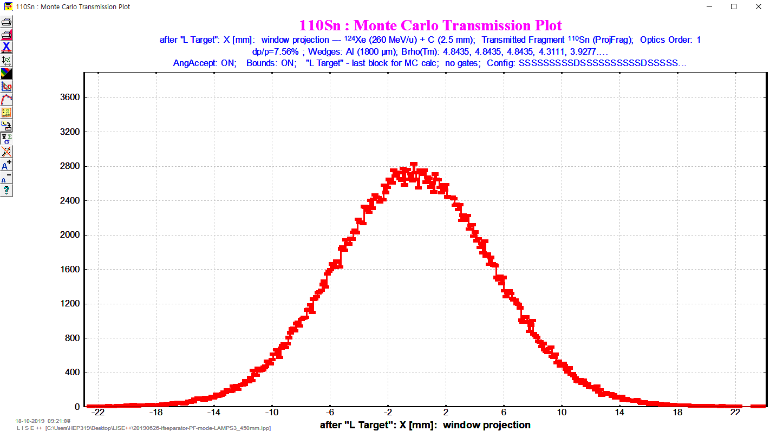
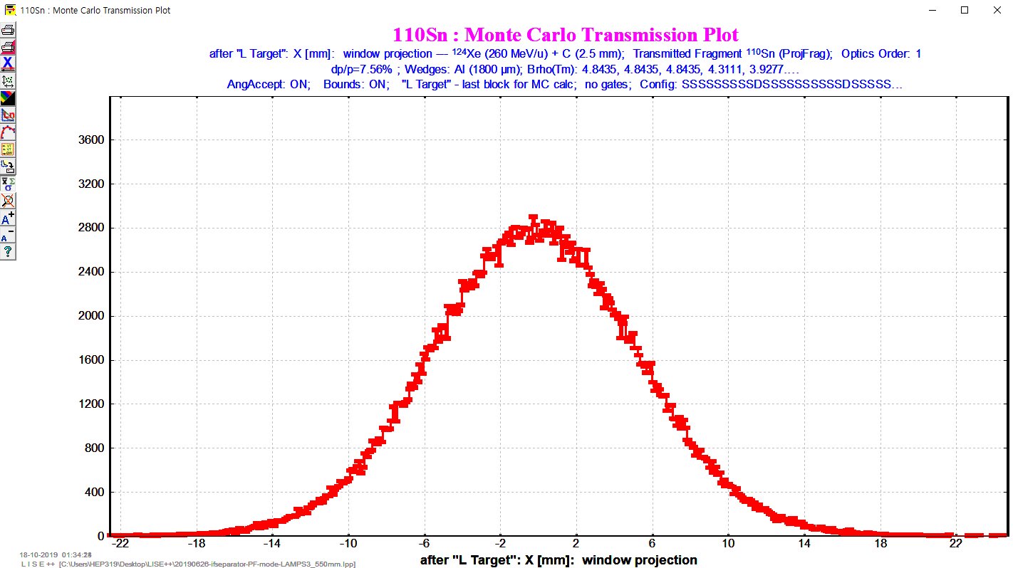
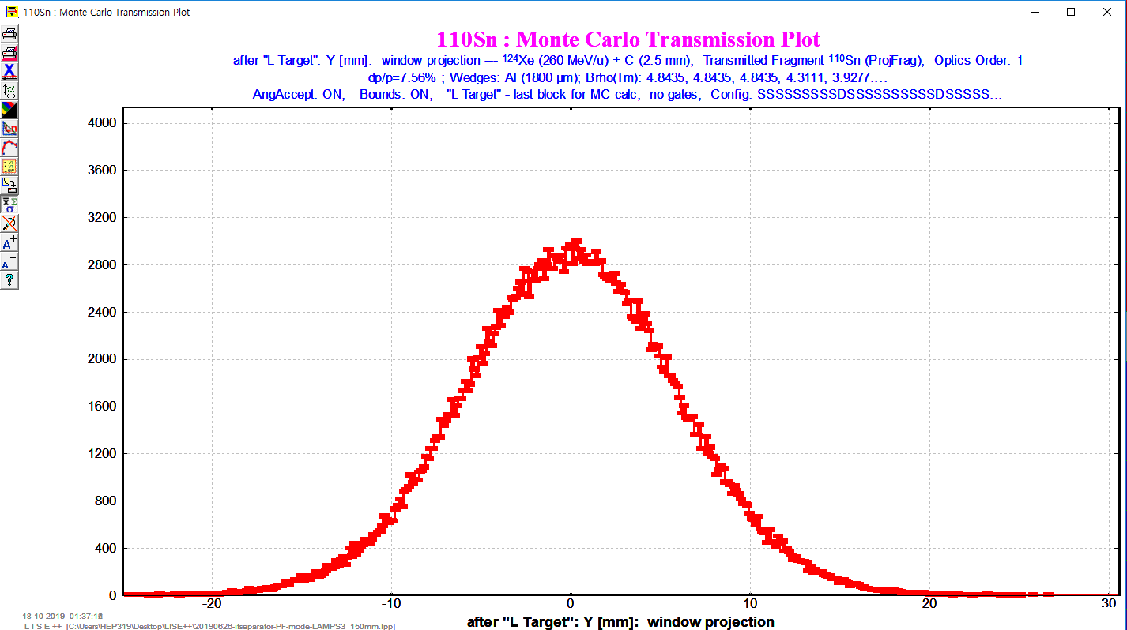
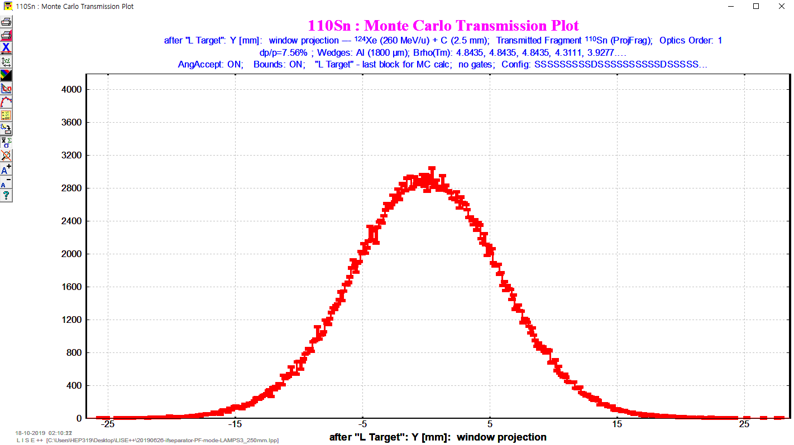
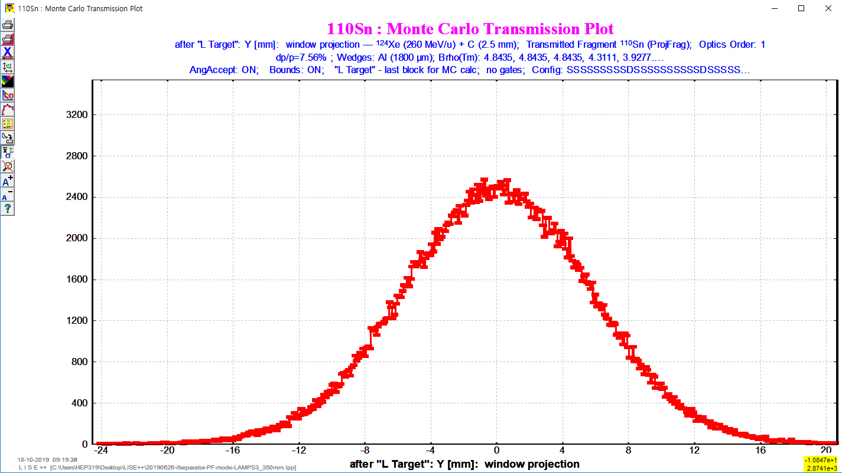
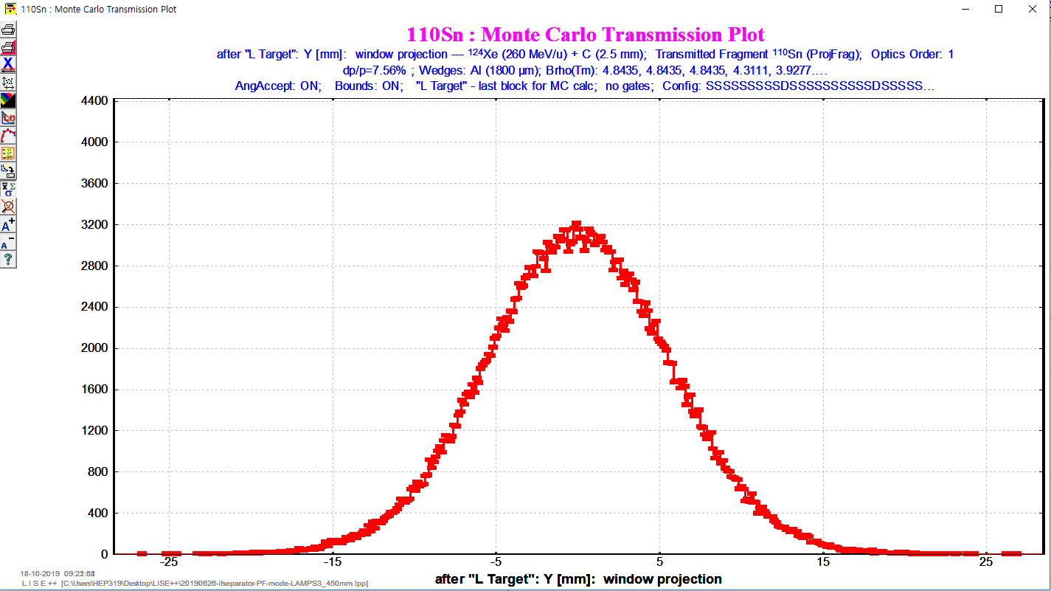
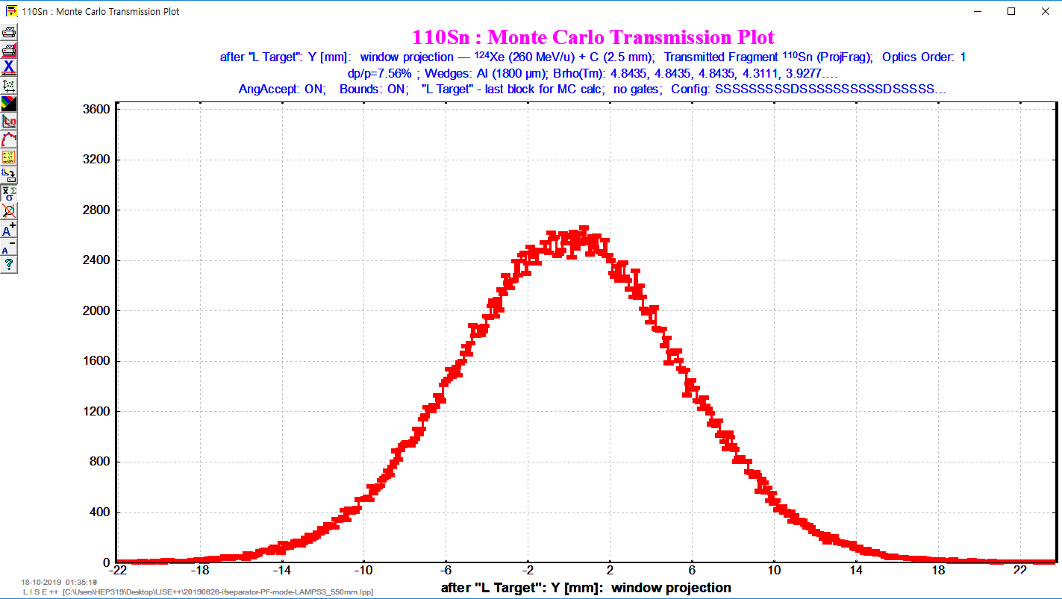
Beam Size Estimation with MC
Distance of BDCs
X
Y
50 mm
150 mm
250 mm
350 mm
450 mm

Slide 9
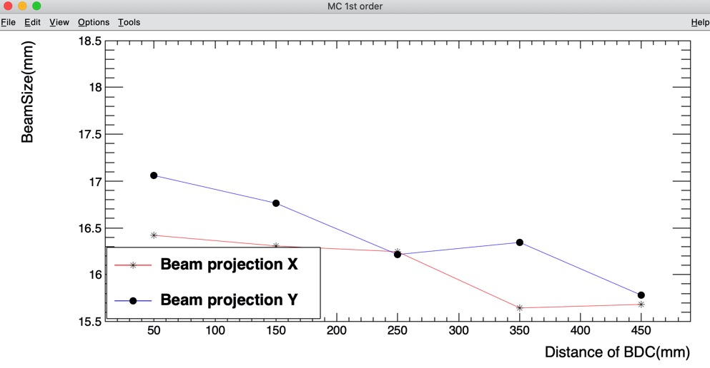
Beam Size Estimation
1st order MC (events : 3.5e+05)
Distance of BDCs | 50 mm | 150 mm | 250 mm | 350 mm | 450 mm
Beamsize ofX(mm) | 12.89 | 12.8 | 12.75 | 12.28 | 12.31
Beamsize ofY(mm) | 13.39 | 13.16 | 12.73 | 12.83 | 12.39

Slide 10
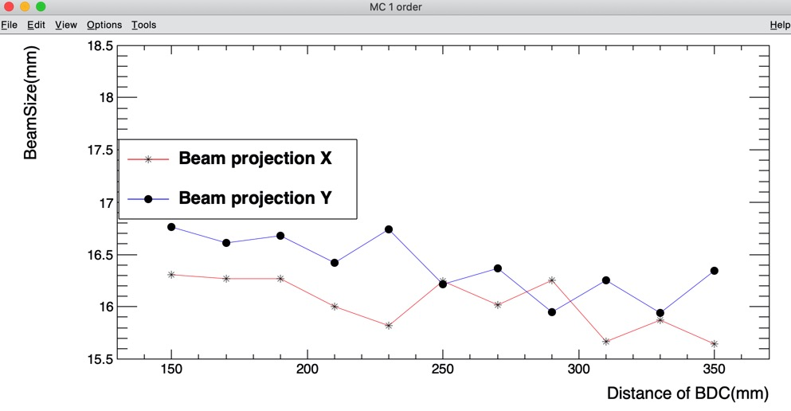
Beam Size Estimation
1st order MC (events : 3.5e+05)
Distance of BDCs | 150 mm | 170 mm | 190 mm | 210 mm | 230 mm | 250 mm | 270 mm | 290 mm | 310 mm | 330 mm | 350 mm
Beamsize of X(mm) | 16.307 | 16.269 | 16.269 | 16.001 | 15.823 | 16.243 | 16.014 | 16.256 | 15.670 | 15.874 | 15.645
Beamsize of Y(mm) | 16.766 | 16.613 | 16.676 | 16.422 | 16.740 | 16.218 | 16.371 | 15.950 | 16.256 | 15.938 | 16.345

Slide 11
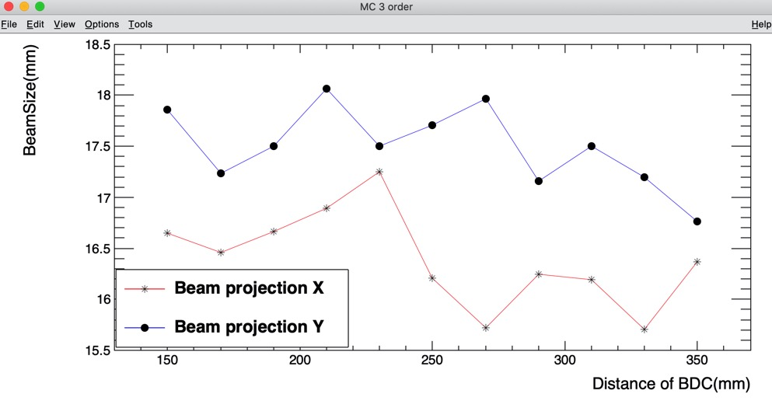
Beam Size Estimation
3rd order MC (events : 3.5e+05)
Distance of BDCs | 150 mm | 170 mm | 190 mm | 210 mm | 230 mm | 250 mm | 270 mm | 290 mm | 310 mm | 330 mm | 350 mm
Beamsize of X(mm) | 16.651 | 16.460 | 16.664 | 16.893 | 17.250 | 16.205 | 15.721 | 16.243 | 16.192 | 15.708 | 16.371
Beamsize of Y(mm) | 17.861 | 17.237 | 17.505 | 18.065 | 17.505 | 17.708 | 17.963 | 17.161 | 17.505 | 17.199 | 16.766

Slide 12
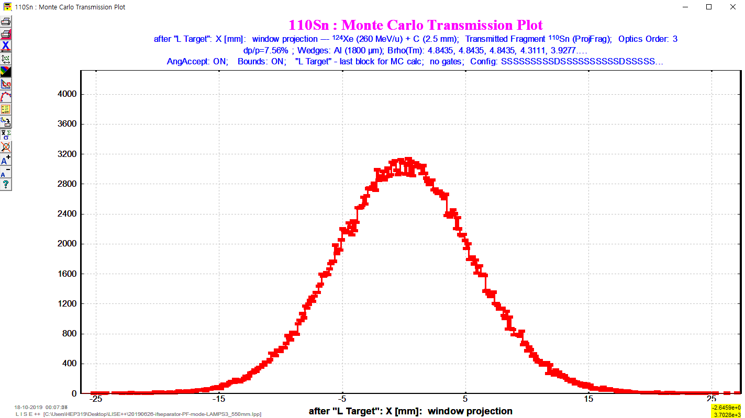
Problem 1
1D-Plot FWHM
Ex) Distance of BDCs : 450 mm
FWHM(X) = 13.07 mm
-> Beamsize(X) ≈ 16.46 mm
FWHM(Y) = 13.53 mm
-> Beamsize(Y) ≈ 17.237 mm
1st order MC (events : 3.5e+05)
Distance of BDCs | 50 mm | 150 mm | 250 mm | 350 mm | 450 mm
Beamsize of X(mm) | 12.89 | 12.8 | 12.75 | 12.28 | 12.31
Beamsize of Y(mm) | 13.39 | 13.16 | 12.73 | 12.83 | 12.39
3rd order MC (events : 3.5e+05)
Distance of BDCs | 50mm | 150mm | 250mm | 350mm | 450mm
Beamsize ofX(mm) | 13.59 | 13.07 | 12.72 | 12.85 | 13.04
Beamsize ofY(mm) | 14.24 | 14.02 | 13.9 | 13.16 | 13.18
Beam size of 1D-Plot is very different from the beam size of Monte Carlo

Slide 13
Results & Plan
Results
Beam size of 1D-Plot is very different from the beam size of Monte Carlo
According to the graphs, 250 mm ~ 350 mm section shows the smallest beam size
The results show decreasing trend as increasing the distance of BDCs
Plan
Calculate beam size with more events and finer distance
Calculate beam size in 350 mm ~ 450 mm of BDC distance

Slide 14
Backup

Slide 15
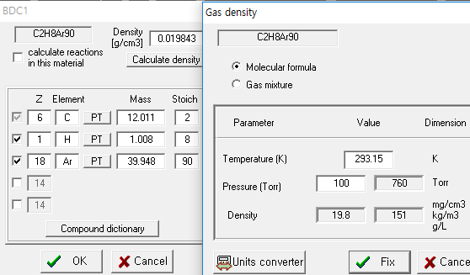
BDC Setting
LISE++
BDCs are filled with p10 gas (mixture of Methane and argon ratio 9 to 1)
The pressure of P10 gas set with 100 torr
Wikipedia
Methane
Argon
Methane (g/cm^3) | Argon (g/cm^3) | p10 (g/cm^3)
0.000717 | 0.001784 | 0.0008237

Slide 16
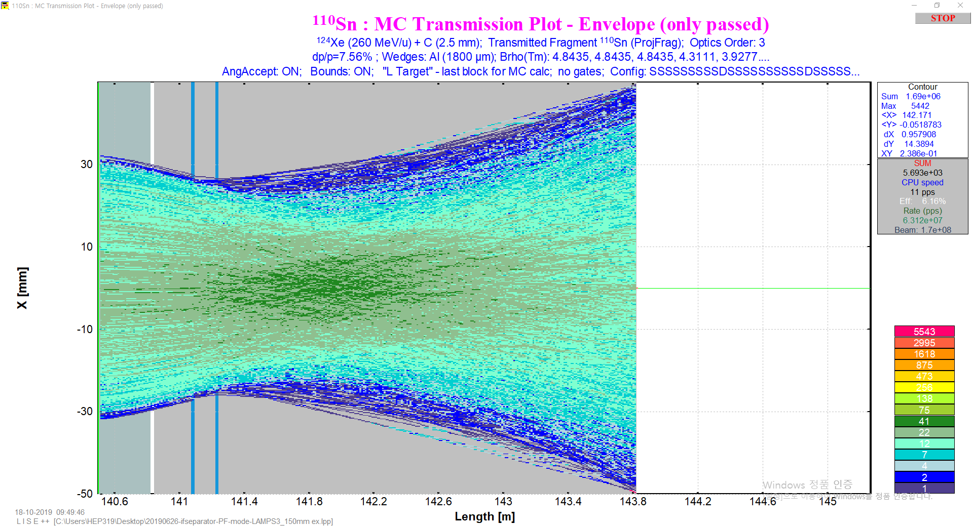
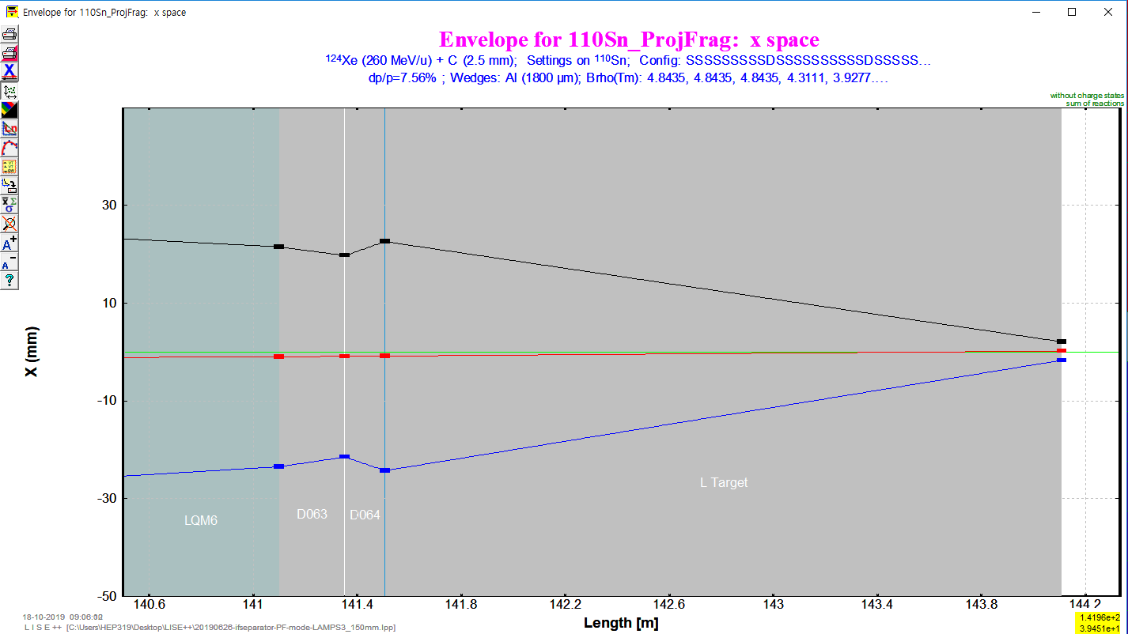
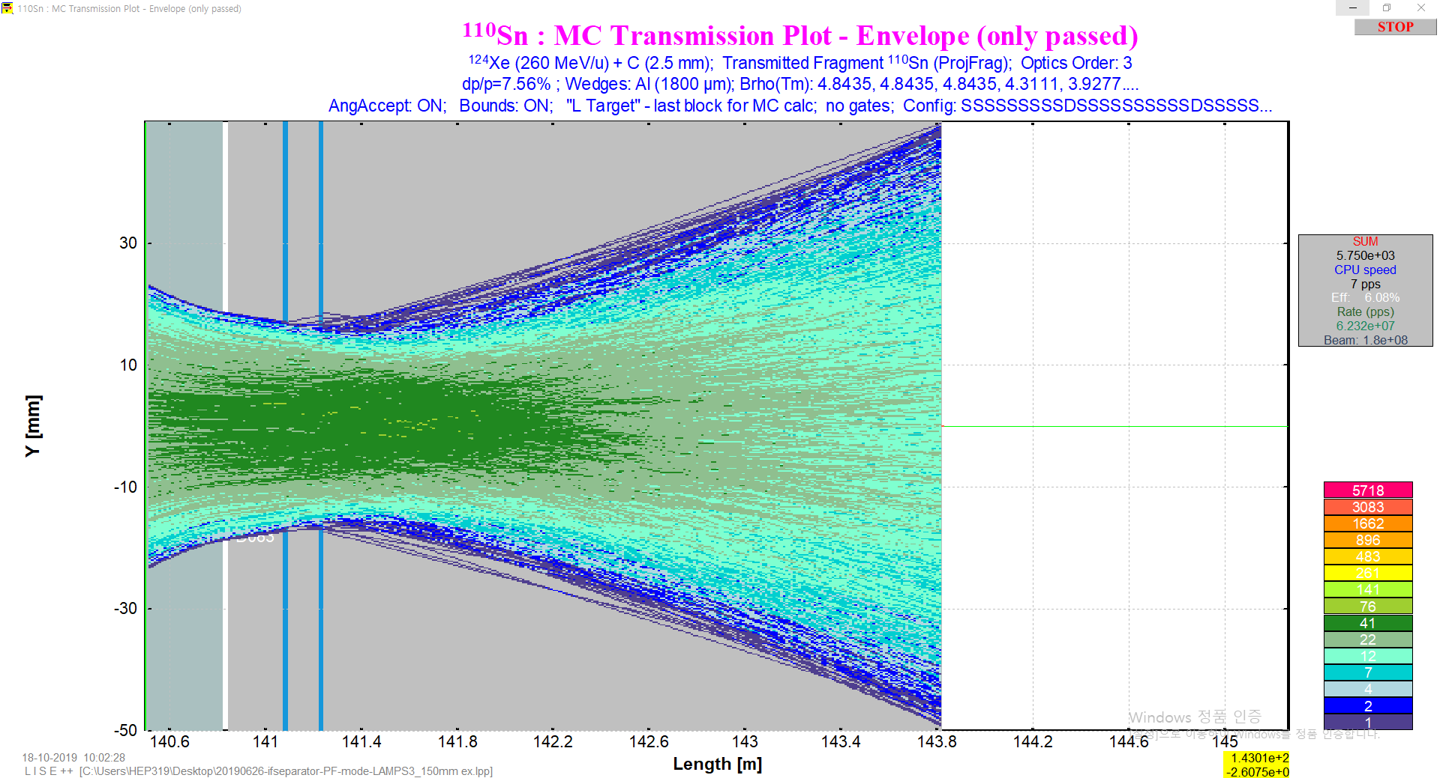
Beam Size Estimation
First step, Set the BDC1 pressure of P10 gas to 760 torr
to know Whether BDCs actually effect to Beam
Second step, compare to Envelope that pressure is 100 torr

Slide 17
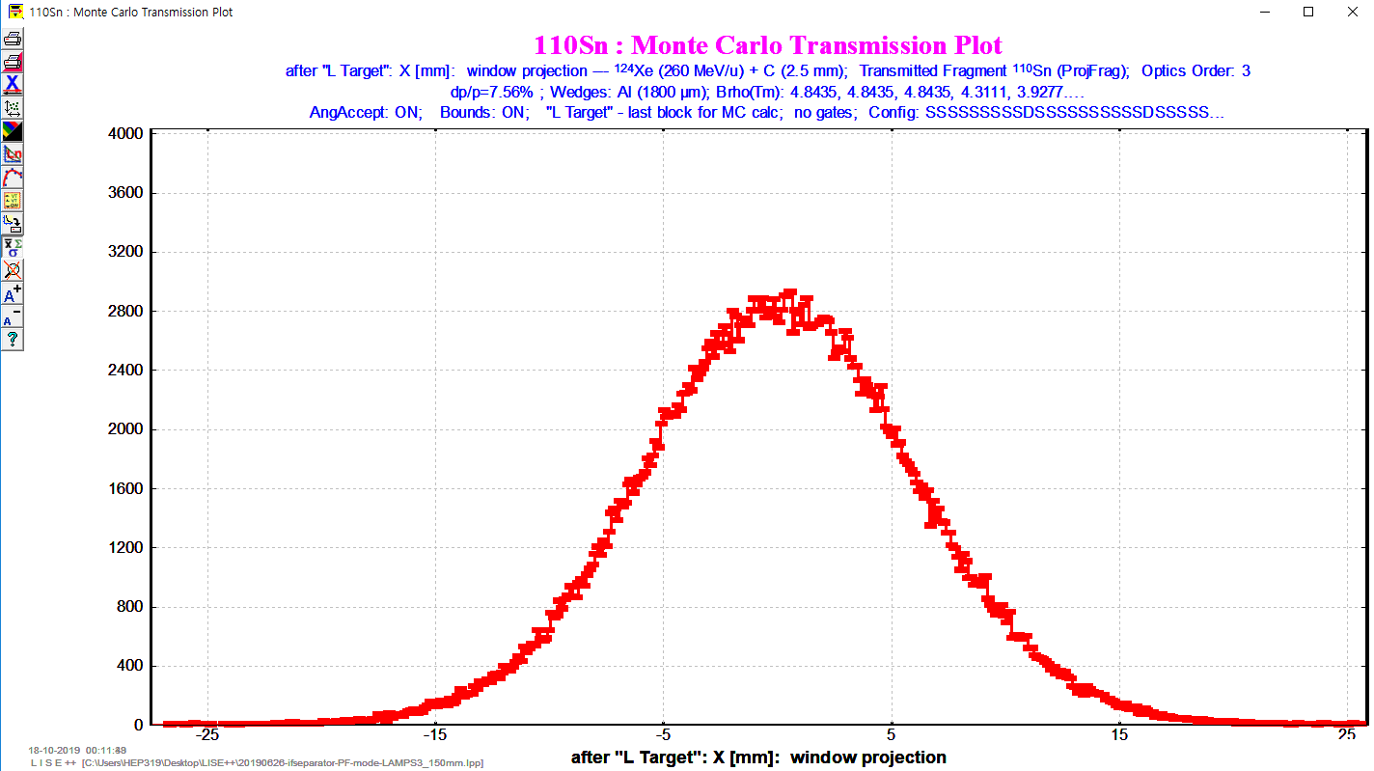
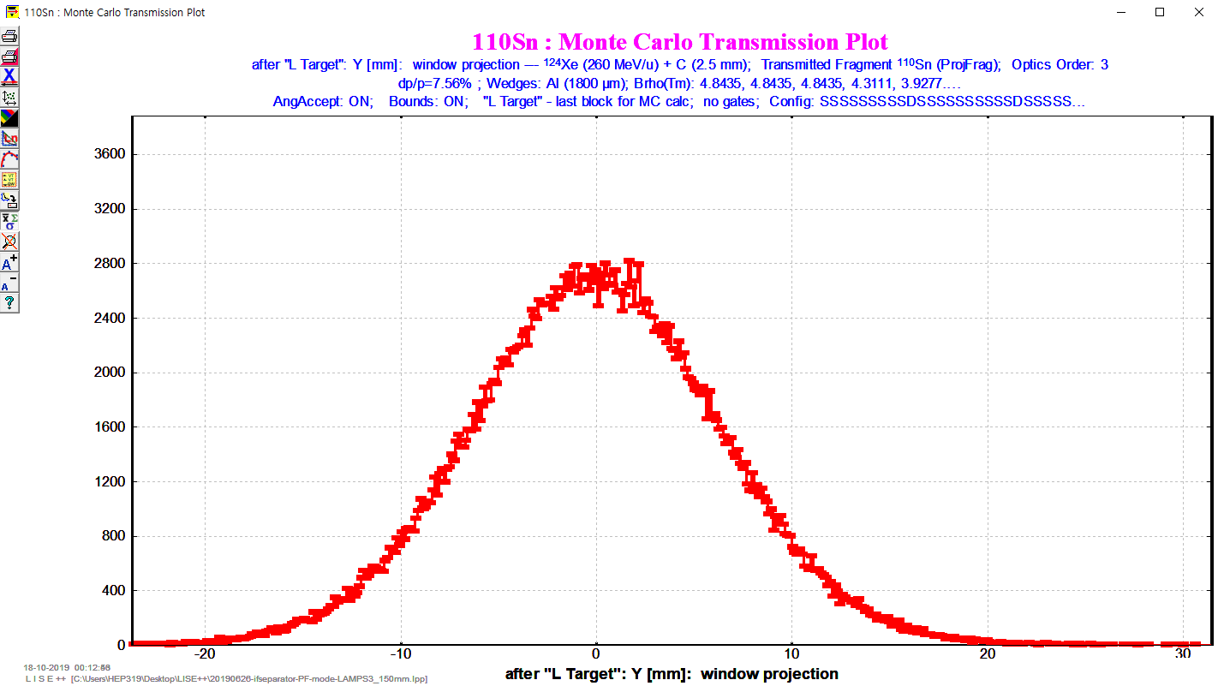
Beam Size Estimation with 1-D Plots
Distance of BDCs : 50 mm
1D-Plot
Monte Carlo

Slide 18
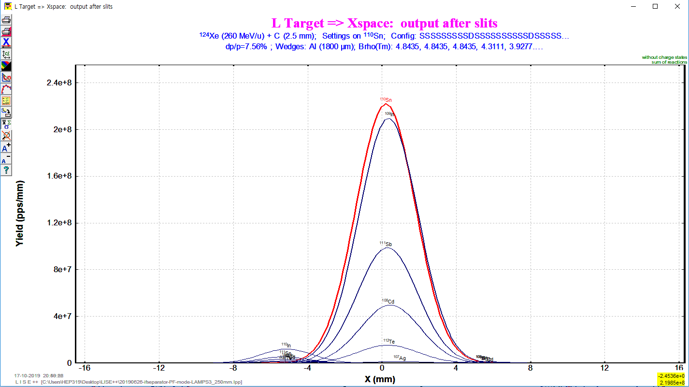
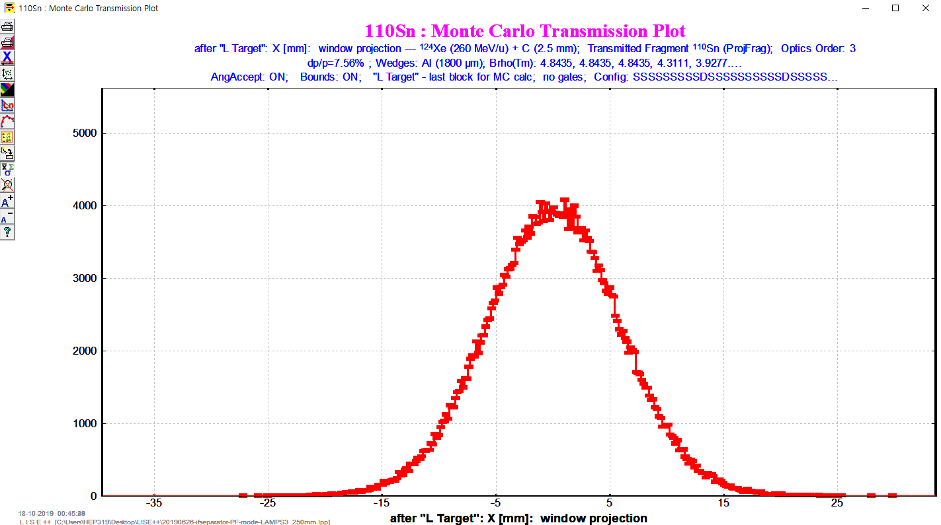
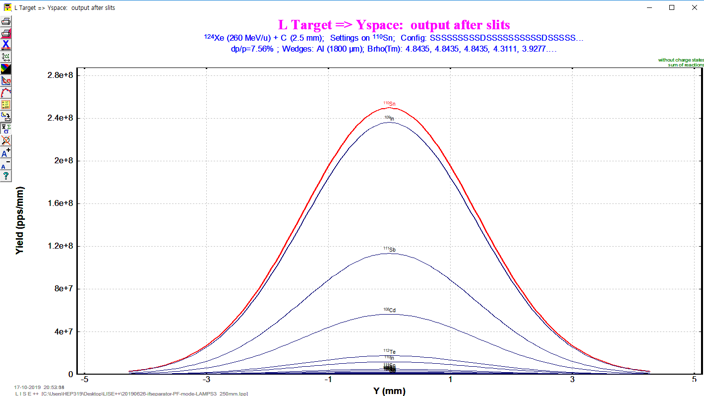
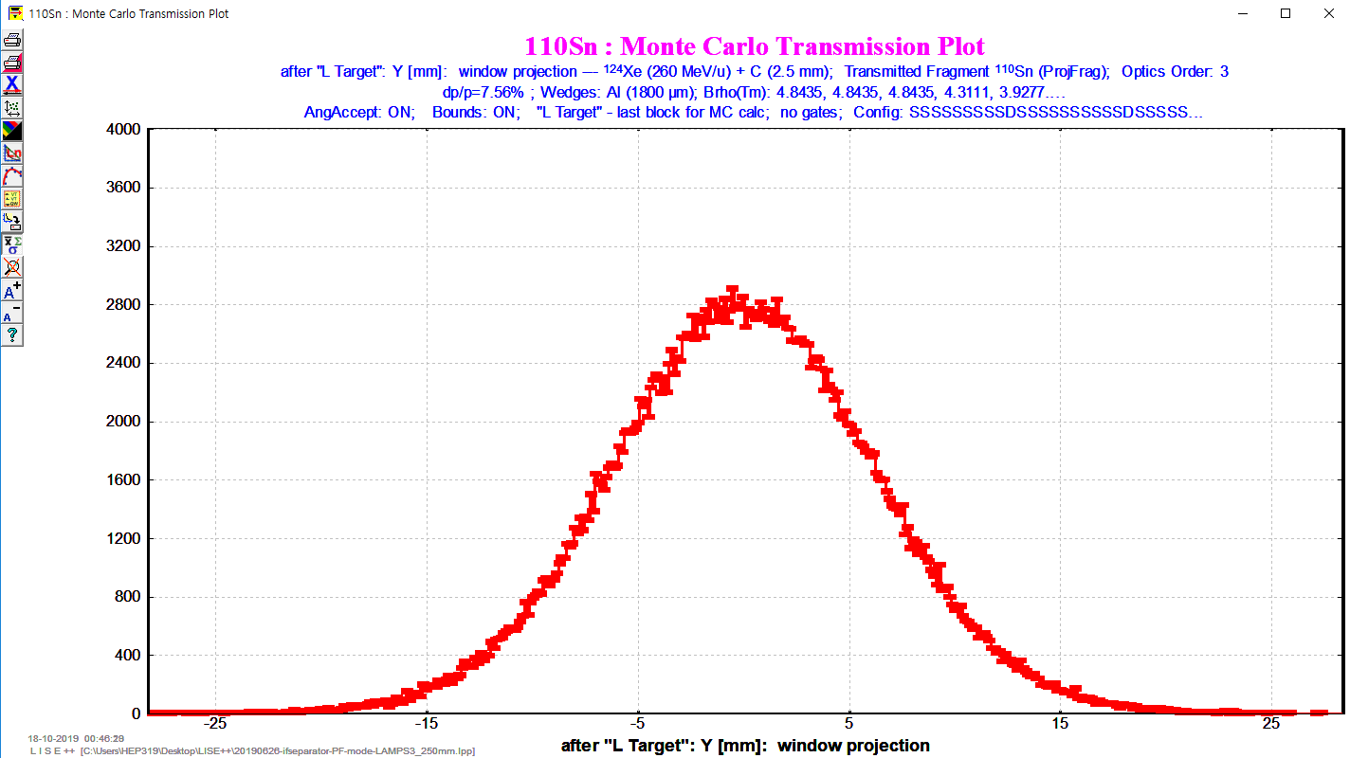
Beam Size Estimation
Distance of BDCs : 150 mm
1D-Plot
Monte Carlo

Slide 19
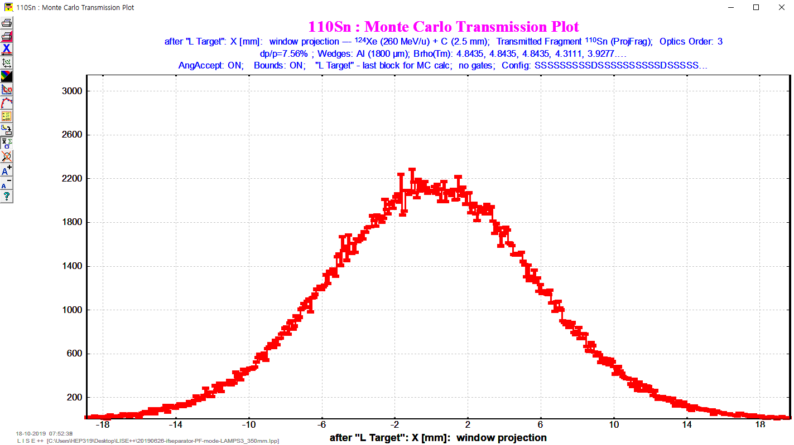
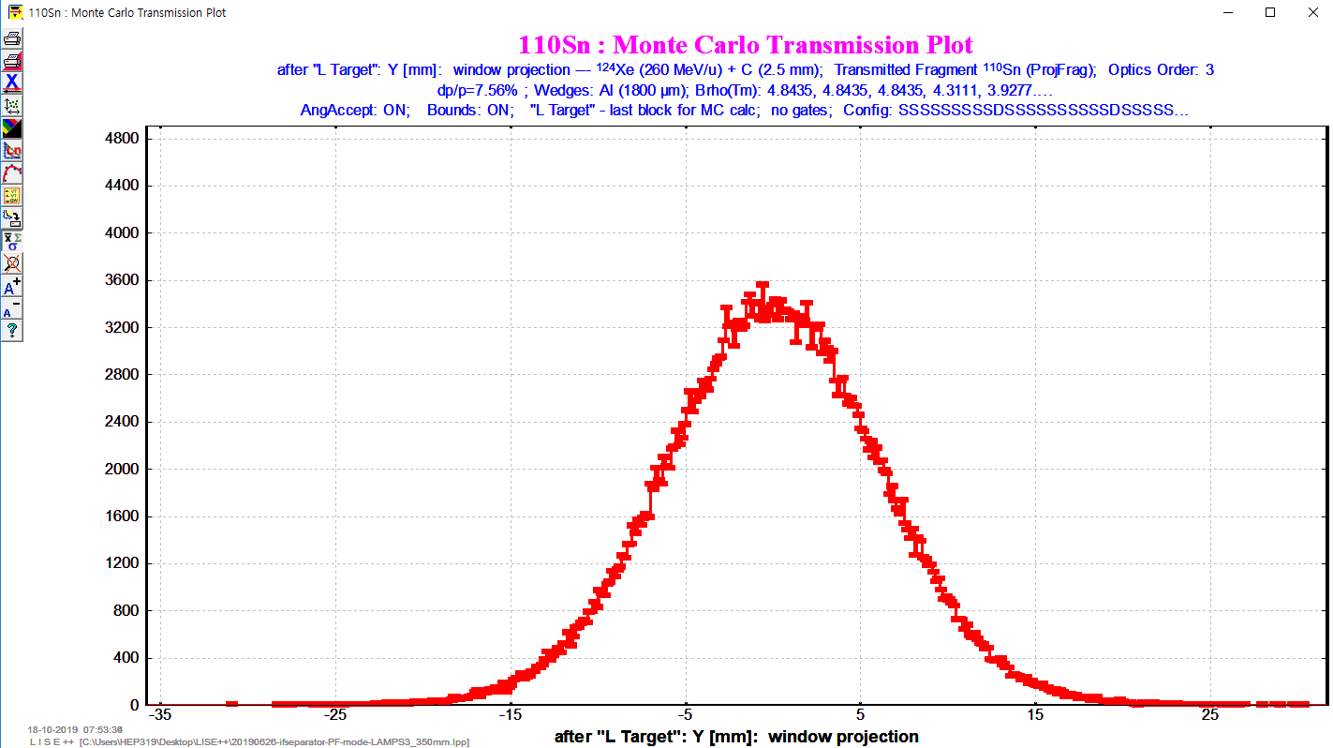
Beam Size Estimation
Distance of BDCs : 250 mm
1D-Plot
Monte Carlo

Slide 20
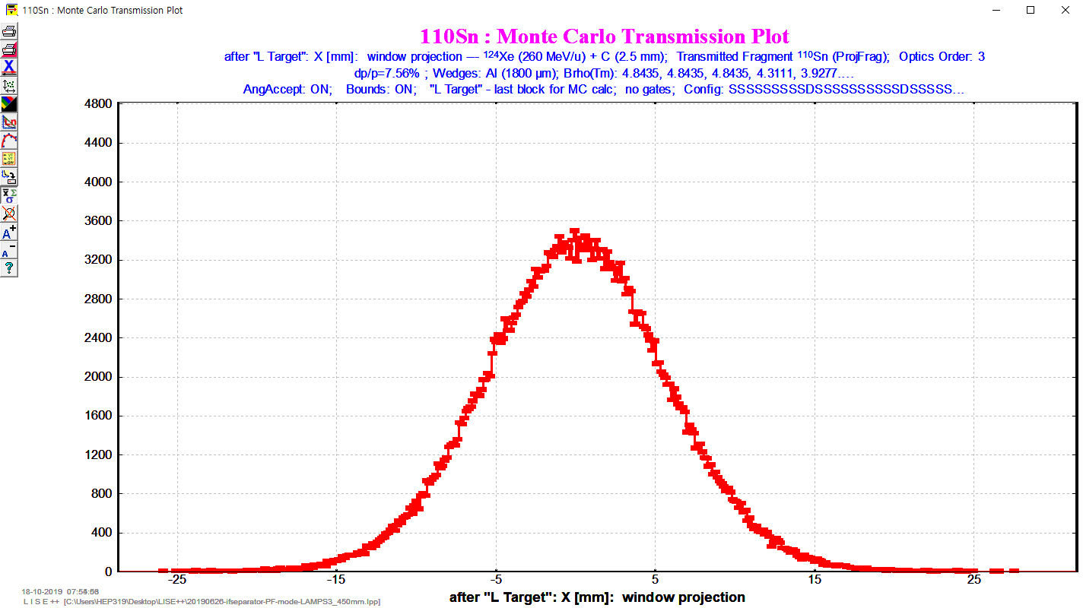
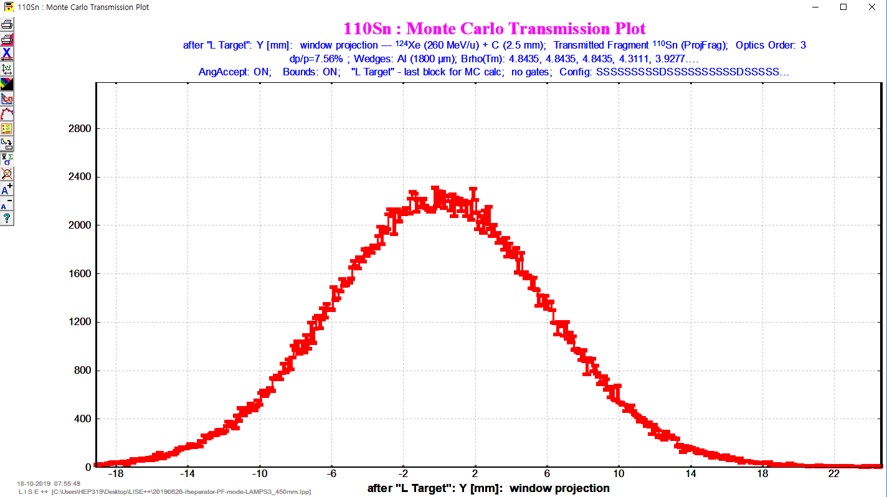
Beam Size Estimation
Distance of BDCs : 350 mm
1D-Plot
Monte Carlo

Slide 21
Beam Size Estimation
Distance of BDCs : 450 mm
1D-Plot
Monte Carlo

Slide 22
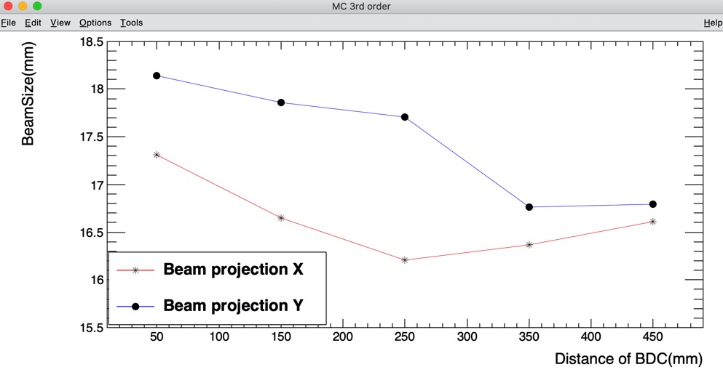
Beam Size Estimation
1D-Plot FWHM
Distance of BDCs | 50 mm | 150 mm | 250 mm | 350 mm | 450 mm
FWHM X(mm) | 3.759 | 3.759 | 3.759 | 3.759 | 3.759
FWHM Y(mm) | 3.35 | 3.35 | 3.35 | 3.35 | 3.35
FWHM(X) = 13.07 mm
-> Beamsize(X) ≈ 16.46 mm
Beamsize(3σ) ≈ $\frac{3}{2.35482}$ FWHM
FWHM(Y) = 13.53 mm
-> Beamsize(Y) ≈ 17.237 mm
1st order MC (events : 3.5e+05)
3rd order MC (events : 3.5e+05)
Distance of BDCs | 50 mm | 150 mm | 250 mm | 350 mm | 450 mm
Beamsize ofX(mm) | 12.89 | 12.8 | 12.75 | 12.28 | 12.31
Beamsize ofY(mm) | 13.39 | 13.16 | 12.73 | 12.83 | 12.39
Distance of BDCs | 50mm | 150mm | 250mm | 350mm | 450mm
Beamsize ofX(mm) | 13.59 | 13.07 | 12.72 | 12.85 | 13.04
Beamsize ofY(mm) | 14.24 | 14.02 | 13.9 | 13.16 | 13.18

Slide 23
Beam Size Estimation
1st order MC (events : 3.5e+05)
Distance of BDCs | 150 mm | 170 mm | 190 mm | 210 mm | 230 mm | 250 mm | 270 mm | 290 mm | 310 mm | 330 mm | 350 mm
Beamsize of X(mm) | 16.307 | 16.269 | 16.269 | 16.001 | 15.823 | 16.243 | 16.014 | 16.256 | 15.670 | 15.874 | 15.645
Beamsize of Y(mm) | 16.766 | 16.613 | 16.676 | 16.422 | 16.740 | 16.218 | 16.371 | 15.950 | 16.256 | 15.938 | 16.345
3rd order MC (events : 3.5e+05)
Distance of BDCs | 150 mm | 170 mm | 190 mm | 210 mm | 230 mm | 250 mm | 270 mm | 290 mm | 310 mm | 330 mm | 350 mm
Beamsize of X(mm) | 16.651 | 16.460 | 16.664 | 16.893 | 17.250 | 16.205 | 15.721 | 16.243 | 16.192 | 15.708 | 16.371
Beamsize of Y(mm) | 17.861 | 17.237 | 17.505 | 18.065 | 17.505 | 17.708 | 17.963 | 17.161 | 17.505 | 17.199 | 16.766
1st order MC (events : 3.5e+05)
3rd order MC (events : 3.5e+05)

Slide 24
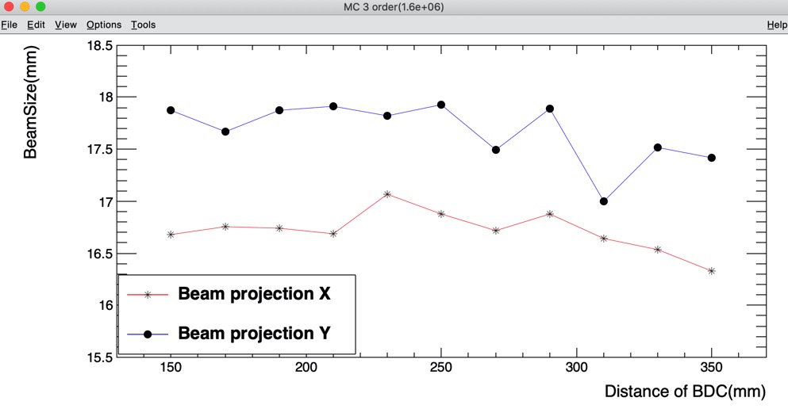
Problem 2 & Plan
Ex) Distance fo BDCs : 250 mm
Shape is not clear
Monte Carlo events : 1.6e+06
Shape is more clear than before
Monte Carlo events : 3.5e+05
-> Modified Graph from the problem by taking more events
Monte Carlo Events : 3.5e+05
Monte Carlo Events : 1.6e+06
Calculate beam size with more events and finer distance

