Slide 1
CENuM-RULiC Joint Workshop on
Extreme Nuclear States and Reactions
Dajeon, Korea, Oct. 30 - Nov. 2, 2019
Symmetry energy extracted from transport models
Yingxun Zhang (张英逊)
China Institute of Atomic Energy
Collaborators:
Yangyang Liu, Ying Cui, Li Li, Zhuxia Li (CIAE)
M. Liu (GXNU)
Y. J. Wang, Q. F. Li, (HZU)

Slide 2
Outline
1, symmetry energy and transport models
2, symmetry energy extracted from transport models:
    At subsaturation density: isospin diffusion data
    At suprasaturation density: pion multiplicity and pi-/pi+ ratios
3, Summary and outlook

Slide 3
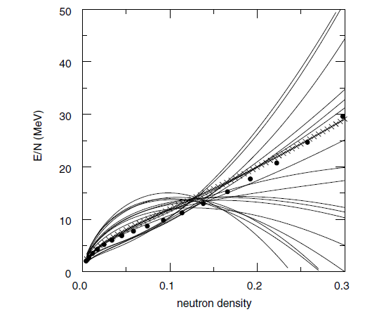
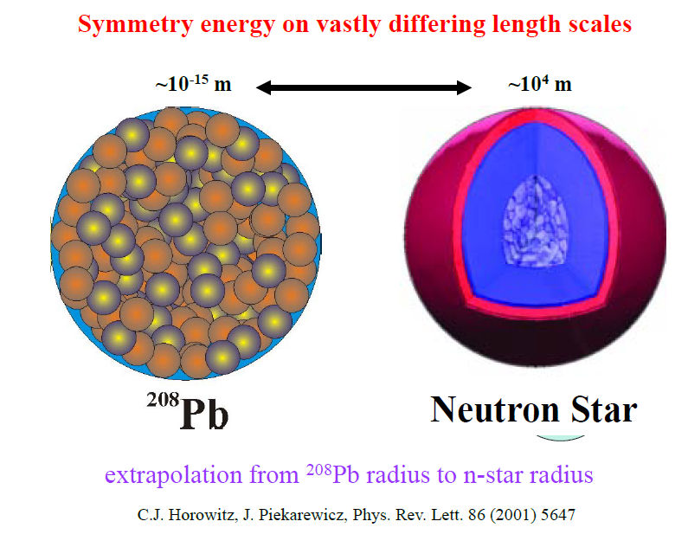
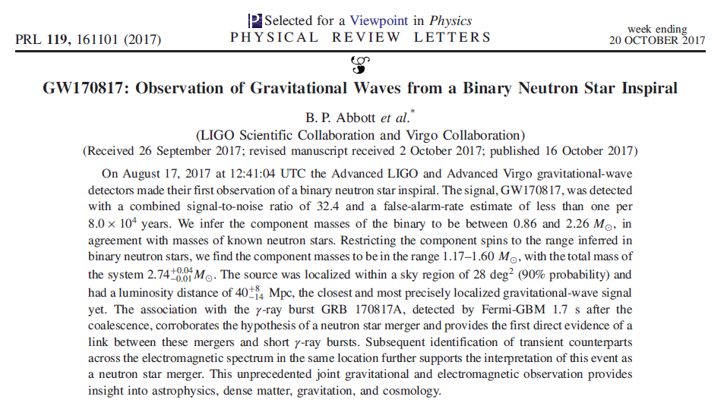
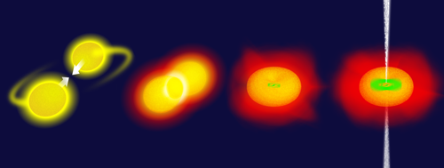
Isospin asymmetric Equation of State
Brown, PRL, (2000)
It is a fundamental properties of nuclear matter, and is very important for understanding
properties of nuclear structure
properties of neutron star
properties of heavy ion reaction mechanism
Low density to high density

Slide 4
Heavy ion collisions + Transport model calculations
E/A(ρ,δ) = E/A(ρ,0) + δ²⋅S(ρ) ; δ = (ρ_{n}- ρ_{p})/ (ρ_{n}+ ρ_{p}) = (N-Z)/A
Danielewicz, Lacey, Lynch, Science 298,1592 (2002)
Pressure (MeV/fm³)
symmetric part is constrained by the flow data

Slide 5
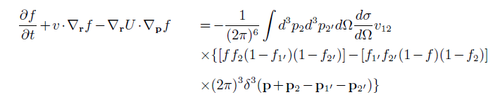


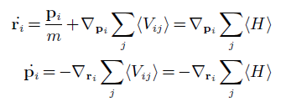
Input of Transport model:
nucleonic potential or interaction (→EoS), and cross section
A, BUU type: f(r,p,t) one body phase space density
Mean field
Two-body collision: occurs between test part.
Solved with test particle methods
B, QMD type: solve N-body equation of motion
nucleon
Two body collision: occurs between nucleons
Rearrange whole nucleon-> large fluctuation

Slide 6
Probing the symmetry energy:
by measuring the isospin contents of emitted nucleons and clusters in HICs
BALi, PRL78,1997
Tsang, PRL92,062701(2004)
B. A. Li, et al.,
n/p, t/He3, isospin diffusion, pi-/pi+, ……

Slide 7
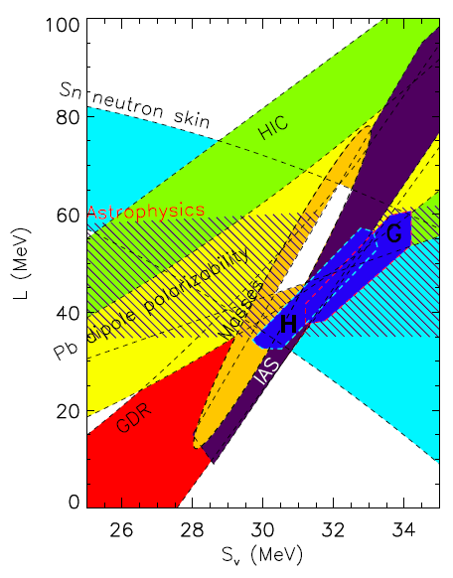
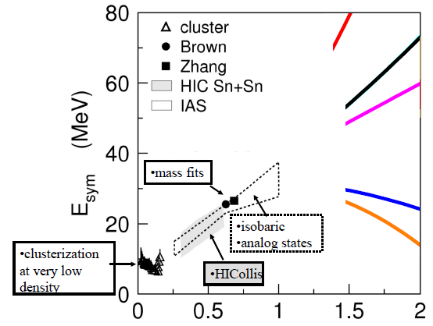
Progress on symmetry energy constraints
Lattimer, EPJA 50 (2014) 40
Constraints on the symmetry energy at suprasaturation density
Feng et al.
pions
Ko et al.
pions
Cozma
PRC 95, 014601 (2017)
pions
Hong et al.
PRC 90, 024605 (2014)
pions
Xiao et al.
pions
Xiao et al.
pions
Xie et al.
pions

Slide 8
Lattimer, EPJA 50 (2014) 40
Around and at subnormal density
(isospin diffusion analysis with ImQMD in 5-D parameter space, and its validity in the prediction of neutron skin)
S₀ and L

Slide 9
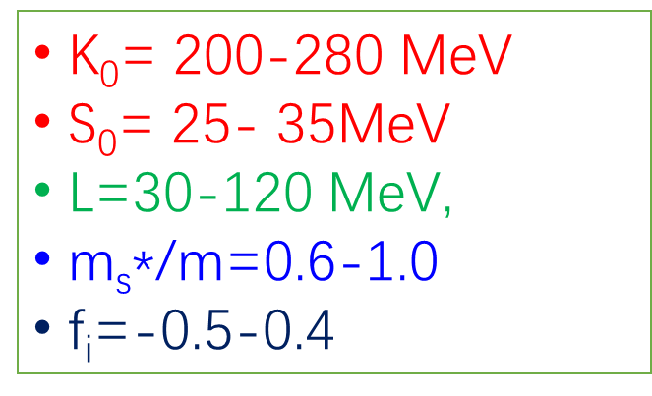
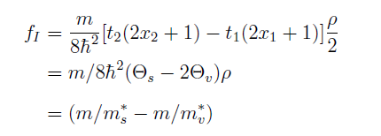
Range of nuclear matter parameters {K₀, S₀, L, ms*, fi} from ~200 Skyrme sets
Y.X.Zhang, et al, submitted to PRC
Symmetry energy and effective mass
Compressibility and effective mass
After 2000,

Slide 10
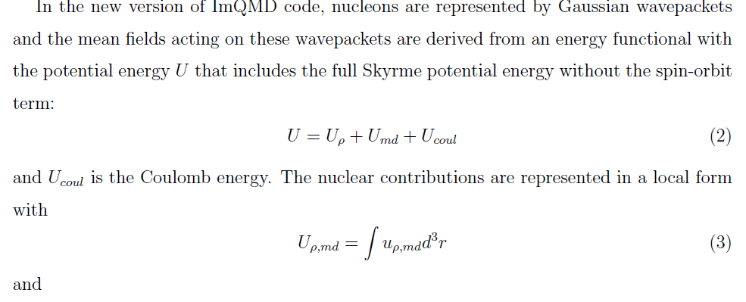
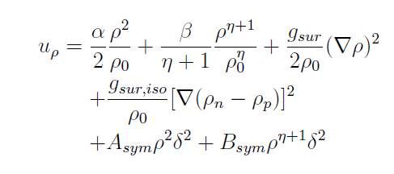

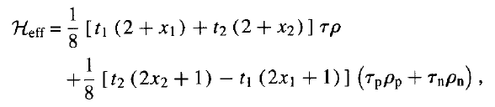
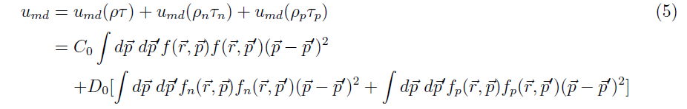

Improvements-I: adopting nuclear matter parameters as an input in ImQMD, Standard effective Skyrme EDF in ImQMD
Skyrme type Momentum Dependent Interaction
Y.X. Zhang, M.B.Tsang, Z.X. Li, HLiu, PLB732,186 (2014)

Slide 11


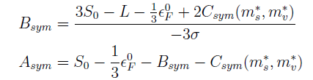
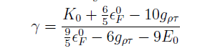

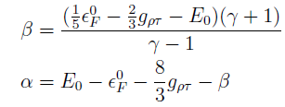
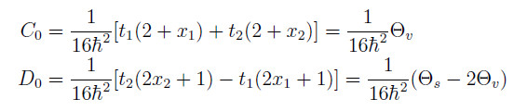
Interaction parameter →Nuclear matter parameters in SHF
7 nuclear matter parameters!

Slide 12
Ri data at 35 and 50 MeV
Ri= (2X-X_{a}-X_{b})/(X_{a}-X_{b})
New the projectile rapidity region, Ri reflect the isospin diffusion
Ri=+/-1, no isospin diffusion
Ri=0, reach isospin equilibrium
From isoscaling
Z. Y. Sun, PRC82, 051603( 2010)
TX Liu, PRC76,034603

Slide 13
120 set points
Simulating ^{112,124}Sn+^{112,124}Sn, E=35MeV/u and 50 MeV/u
Consider the impact parameter smearing effects
Y.X.Zhang, et al., submitted to PRC
22 sets can reproduce Ri at 35 and 50 MeV/u

Slide 14
neutron skin from 22 sets
Neutron skin data of 208Pb calculated with density variation method with 22 sets, 0.18+-0.04 fm
Y.X.Zhang, et al., submitted to PRC
Minimizing the total energy of system, to obtain rho_n and rho_p

Slide 15
Symmetry energy and effective mass information
Y.X.Zhang, et al., submitted to PRC
Black points: Assume:
Consistent with previous constraints
S0 and L correlation is different, L is weakly correlated to ms*

Slide 16
At suprasaturation density (pion multiplicity and pi-/pi+ with UrQMD)
Constraints on the symmetry energy at suprasaturation density
Feng et al.
pions
Ko et al.
pions
Cozma
PRC 95, 014601 (2017)
pions
Pion production mechanism in UrQMD
Hong et al.
PRC 90, 024605 (2014)
pions
Xiao et al.
pions
Xiao et al.
pions
Xie et al.
pions

Slide 17
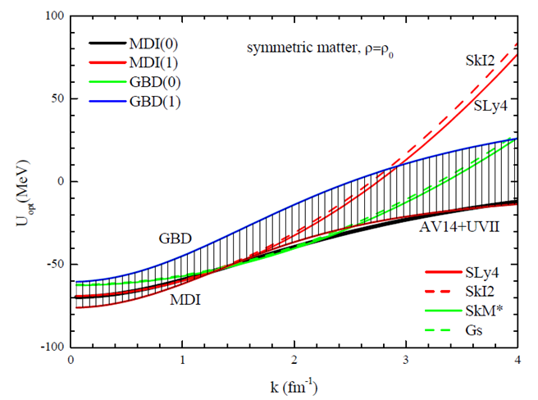
Interaction parameters in UrQMD
Skyrme is not suitable for high energy heavy ion collisions
Hartnack, et al., PRC49,2801

Slide 18
Cross section of ND-NN
Q.F. Li, et al., JPG 32, 151(2006)
“a little higher nD-nn cross section used in our UrQMD transport model …. , smaller pion multiplicities for the HICs at intermediate energies are obtained.”

Slide 19
Ying Cui, Yingxun Zhang, et al., submitted to CPC
Cross section of ND-NN from OBEM model ($σ,ω,ρ,δ,π$)

Slide 20
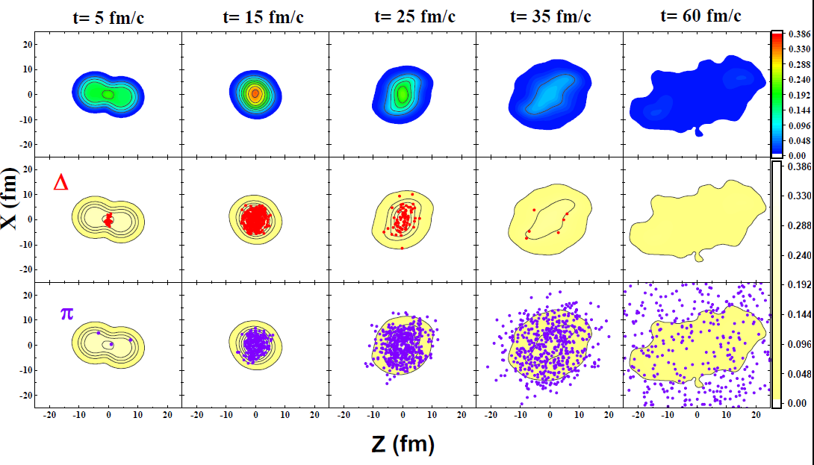
Yangyang Liu, Yongjia Wang, Ying Cui, QFLi, Yingxun Zhang， in preparation

Slide 21
Keep sensitive to high density
degrade sensitive to high density
n→p→n, weak the symmetry energy effects
Emitted pion experience about 4.5 Npi-D loops

Slide 22
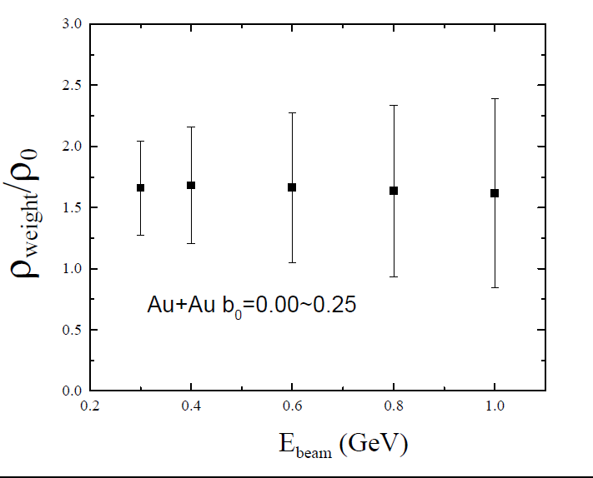
Yangyang Liu, Yongjia Wang, Ying Cui, QFLi, Yingxun Zhang， in preparation
Pion production rate weighted density

Slide 23
reproduce pion multiplicity and ratios,
But the sensitivity is not strong!

Slide 24
Yangyang Liu, Yongjia Wang, Ying Cui, QFLi, Yingxun Zhang， in preparation
Zhang and Li, EPJA55:39(2019).
E_{sym}(2r0)=47+-10 MeV
Xie and Li, arXiv:1907.10741
E_{sym}(2r0)=39+12-8 MeV
Tong, P.W. Zhao, Jie Meng, arXiv.1903.05938
E_{sym}(2r₀)<53MeV

Slide 25
4, Summary and outlook
Isospin diffusion analysis in 5-D parameter space consistent with previous results.
FOPI pion data, both for multiplicity and their ratios, is reproduced, and the extracted symmetry energy is consistent with the constraints from flow, v2np
The pion ratios are sensitive to the symmetry energy from 1-2 normal density, but the sensitivity is not strong.
New probes for high/low density symmetry energy, and effective mass splitting

Slide 26
Other physics,
    Threshold effects,
    energy conservation in Delta related process,
    Pion potential
need to be understood by new data as a function of KE, angular, momentum, in future.
Improve the transport models
Code comparison under control (transport code comparison project, 2009-2017, workshop after nusym18, Transport 2019)
Thanks a lot for your attention!

