Slide 1
중성자 검출기 현황 및 내년 계획 20191129
고려대학교 이종원

Slide 2
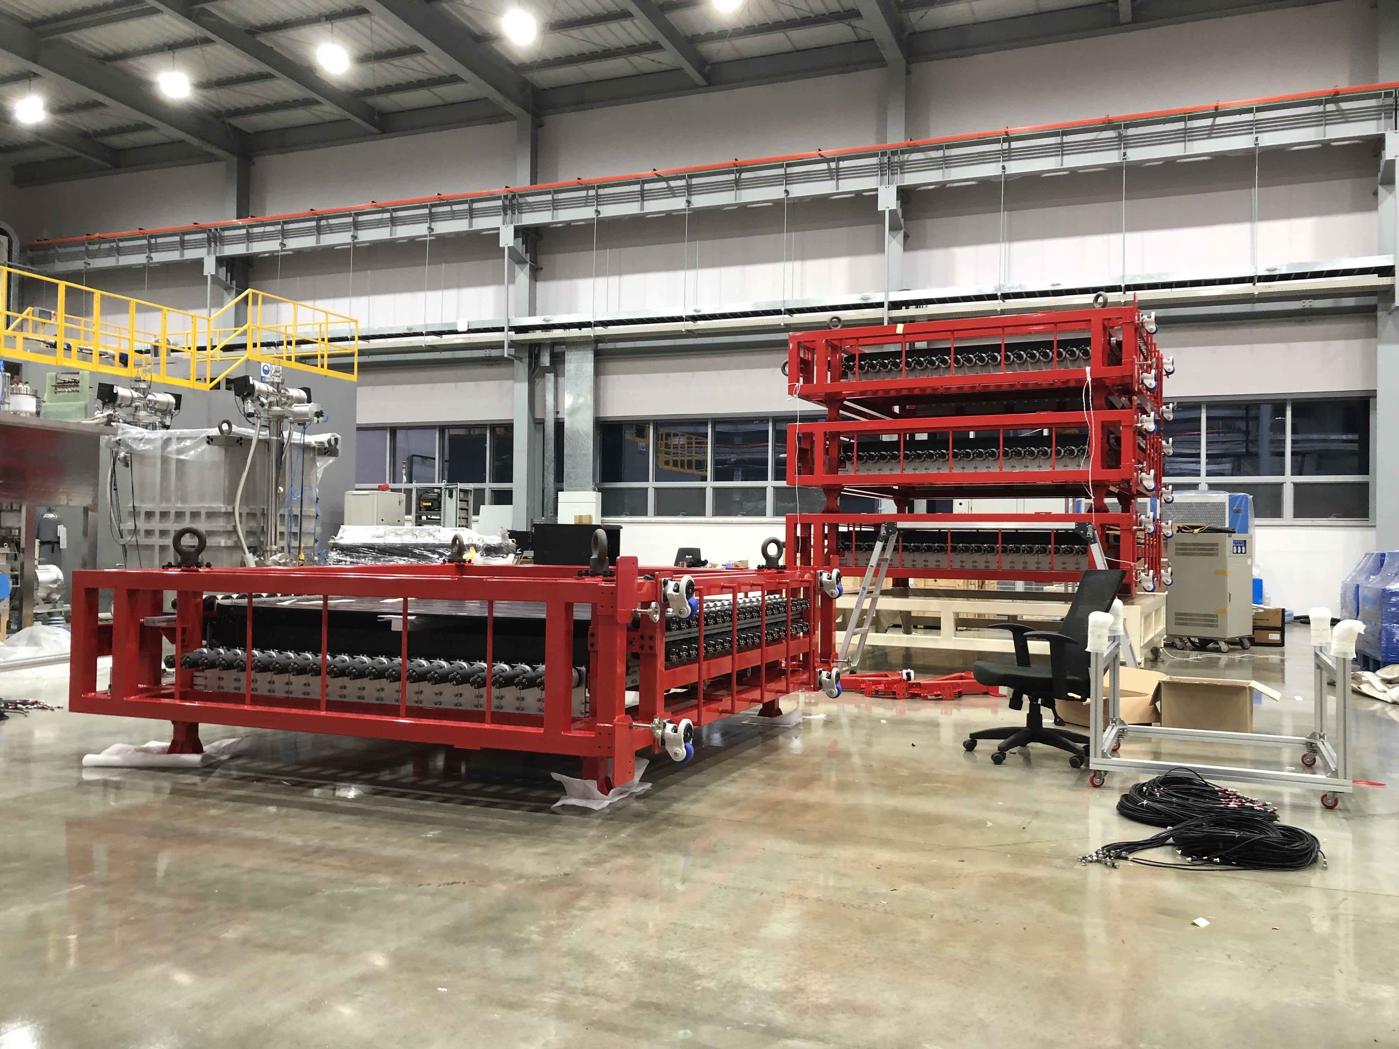
Status of NDA
3개의 레이어가 DAQ에 장착
1개의 레이어 + CV는 보관중
우주선 데이터 취득 : 1일간 데이터 측정
DAQ firmware 문제
LTE trigger mode에서 TCB의 triggering이 멈추는 현상( ~ 1시간 )
현재 Notice 김상렬박사님께서 펌웨어 체크중
일정은 현재 미정
DAQ PC 등 : 현재 사업단에서 진행 중
DAQ program : 기본동작은 완성, 1일 동안 동작확인, 이효상박사님과 협의하여 조정예정
Calibration/Aliment program : MIP 측정, HV setting/adjustment, Timing calibration, Position calibration 등 완료. EventBuilder 제작완료.

Slide 3
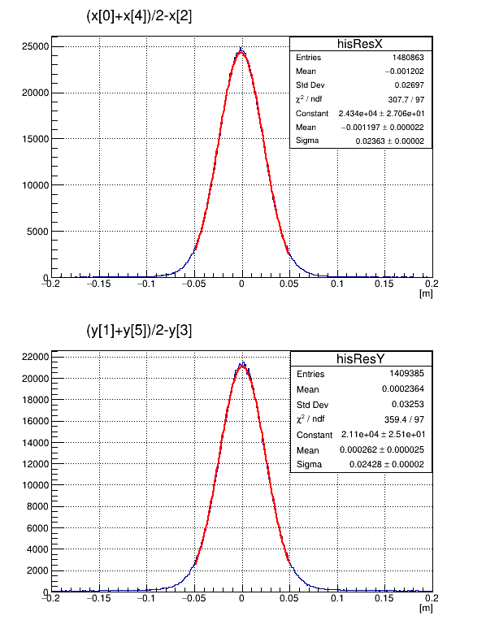
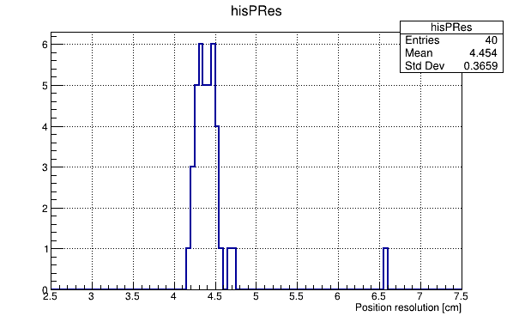
Detector Performance – Position resolution
Layer 3 (4,5)
X[4]
$σ_{fit}$=$\sqrt{3σ_{x}^{2}/2}$
Layer 2 (2,3)
X[2]
Layer 1 (0,1)
X[0]
X[2] ~ (X[0]+X[4])/2
Position resolution by module IDs
Prototype
X resolution (global): 4.5 cm (FWHM)
Y resolution (global): 4.7 cm (FWHM)
Position resolution by module : 4.1~4.6 cm
Two large resolution module
Consisted with prototype module result ( 4.56 cm )

Slide 4
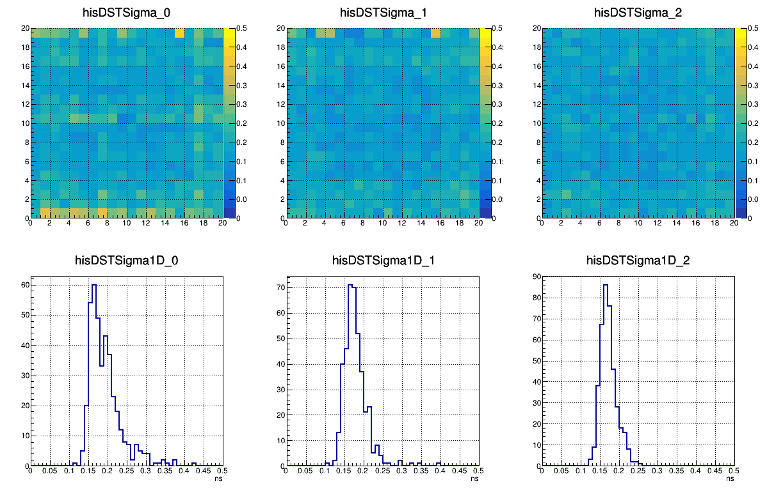
Detector Performance - Timing resolution
Time difference between orthogonally overlapped two modules in same layer
Sigma of (Ti - Tj ) distribution
Layer 1
Layer 2
Layer 3
400 combinations of (i,j)
j
…
…
i
Mean value : 181 ps (sigma) /sqrt(2)*2.35-> Expected Timing resolution = 301 ps(FWHM)
->How to get intrinsic timing resolution of each modules ?

Slide 5
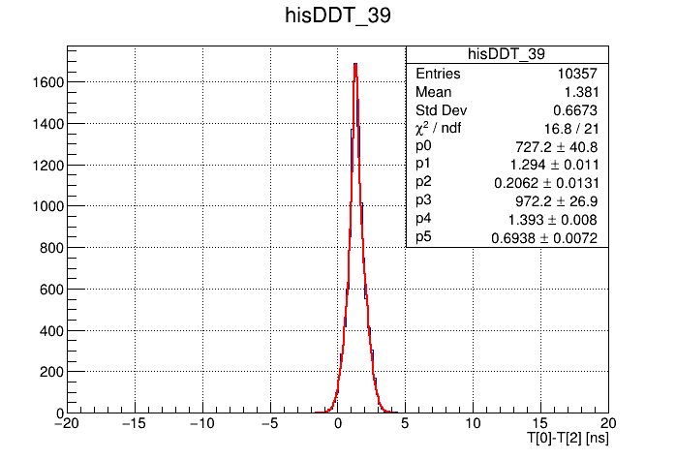
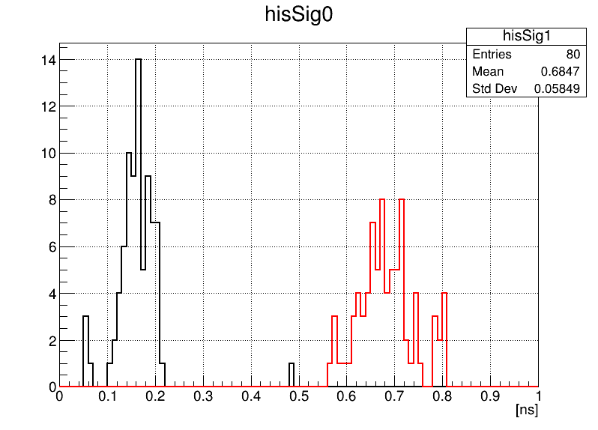
Detector performance – Time Jitter
Time jitter between crates
Crate 2
T[4]
Crate 1
T[2]
Crate 0
T[0]
T[0]-T[2] or T[0]-T[4] for vertical events
Distributions were double gaussian distribution
Narrow component : 0.1~0.2 ns
Wide component : 0.6~0.8 ns (?)
-> Clocks between crates were synchronized.

Slide 6
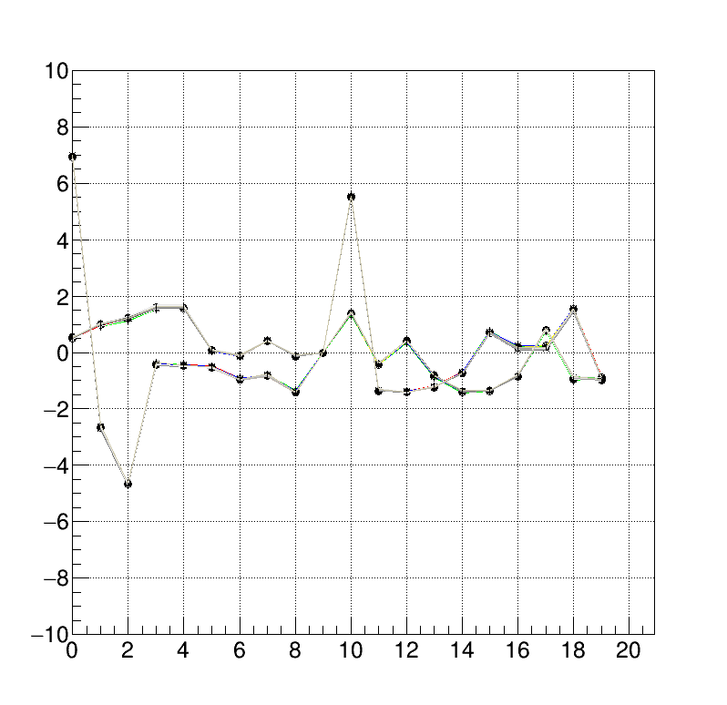
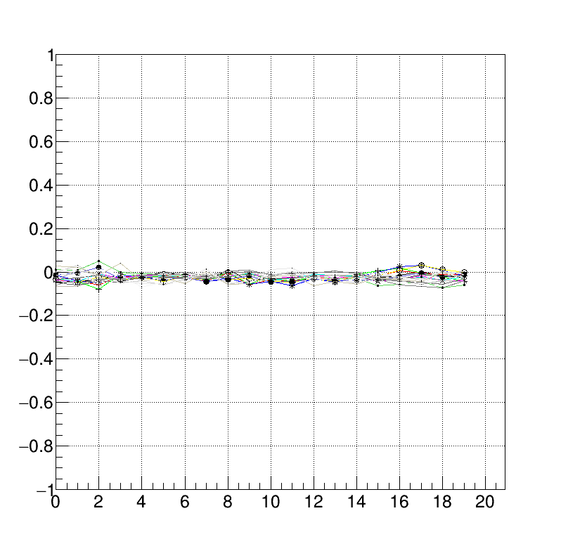
Time offset alignment
Calculate time offset from 20x20 combinations D_ij = T_i – T_j
Get D_ij by set D_99 = 0
Time offset distribution after applying offset : mean < 0.03 ns, deviation : <~ 0.02 : no effect on Timing resolution( sigma_t: 0.18 )
Time delta
Time delta
Module ID
Module ID
Time information based information (TOF, Position) calibration methods were developed.

Slide 7
Plan 2020
CV 제작 : 20?~60? 모듈
DAQ & 데이터 취득:
사업단에서 구매한 PC/networ로 교체
우주선 데이터 취득(1년간)
DAQ performance measurement (Maximum event rate, VETO algorithm)
Merge with other detector’s DAQ.
Analysis program
Event builder 향상 : realtime-event builder / event monitor
Online event selection ( Merging with other detector data )
Waveform analysis

