Slide 1
Status Report of Beam Diagnosis System
Sanghoon Hwang¹, Seonghak Lee², Dong Ho Moon²
KRISS¹,
Chonnam National University²
2019/11/29 LAMPS Meeting

Slide 2
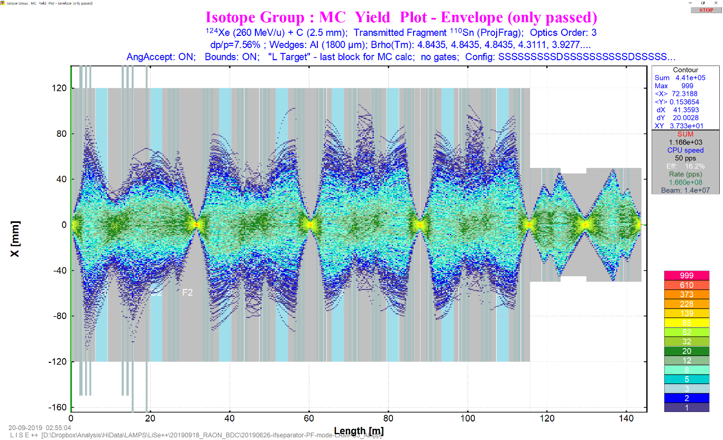
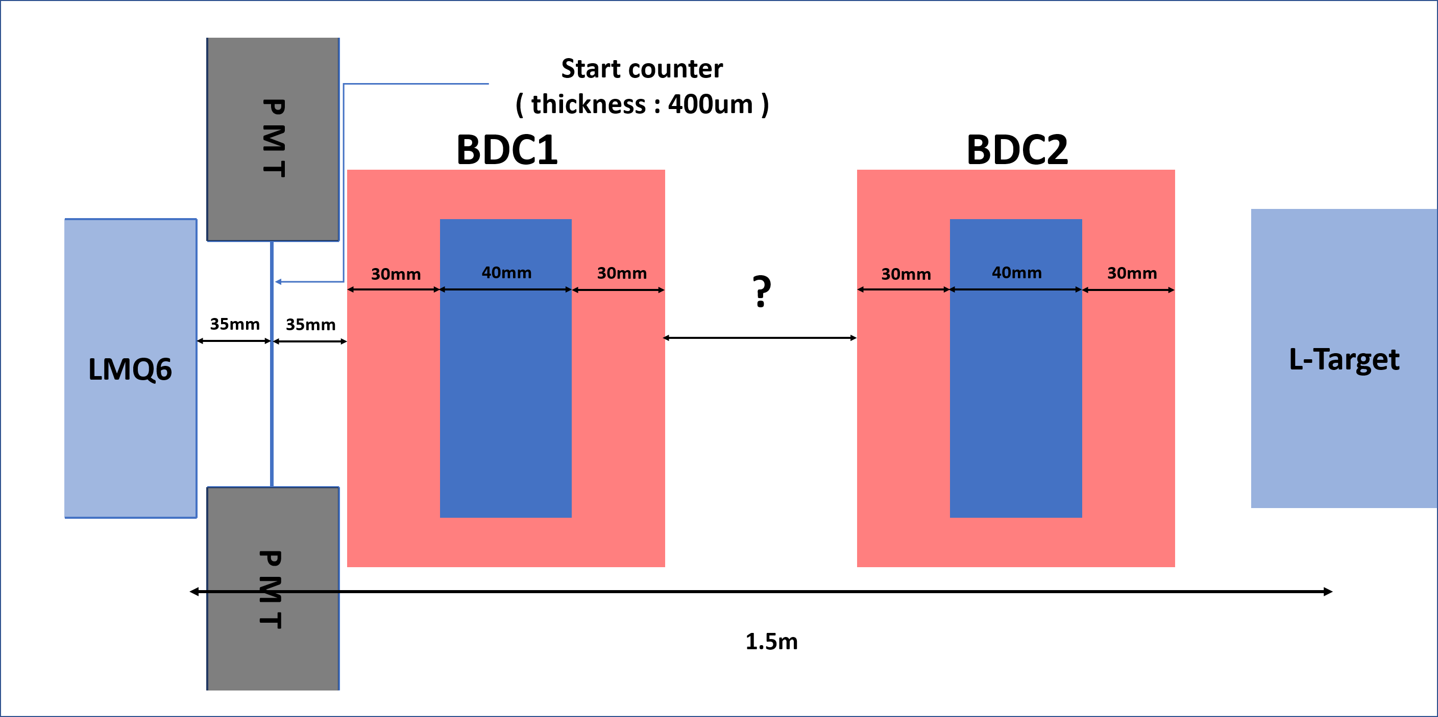
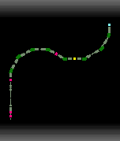
Beam Study with LiSe++
¹²⁴Xe (260 MeV/u) Beam and¹⁴C target
Simple layout
Beam size at L-Target (x)
: ± 4.2 mm
Active Area of BDC1 ?

Slide 3
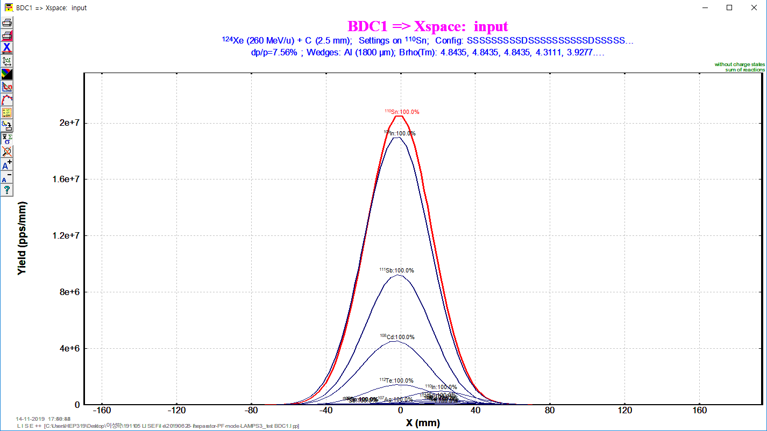
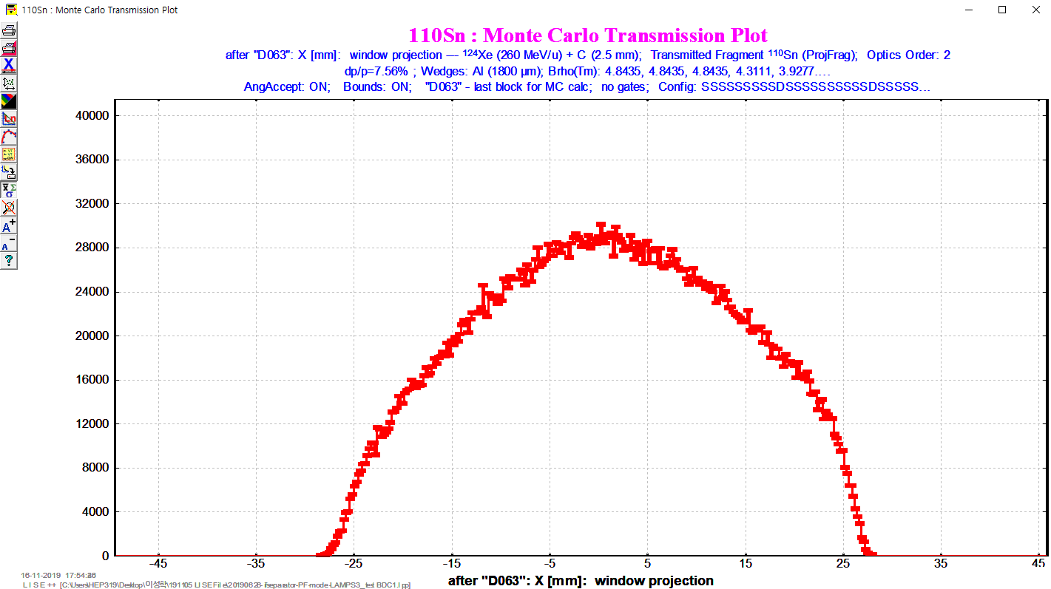
Beam Study with LiSe++
Comparison of Distribution Method and MC Method (Oleg Tasarov, NSCL)
Distribution method : fast analytical method to calculate the fragment transmission through all optical blocks of the spectrometer.
MC method : developed for a qualitative analysis of fission fragment kinematics and utilized in the Kinematics calculator. (random event generation one by one)
Distributions are quite different (Oleg says that this is very natural) but MC method is more reliable due to considering more effect of optical matrix.
X axis beam size
at BDC1
X axis beam size
at BDC1

Slide 4
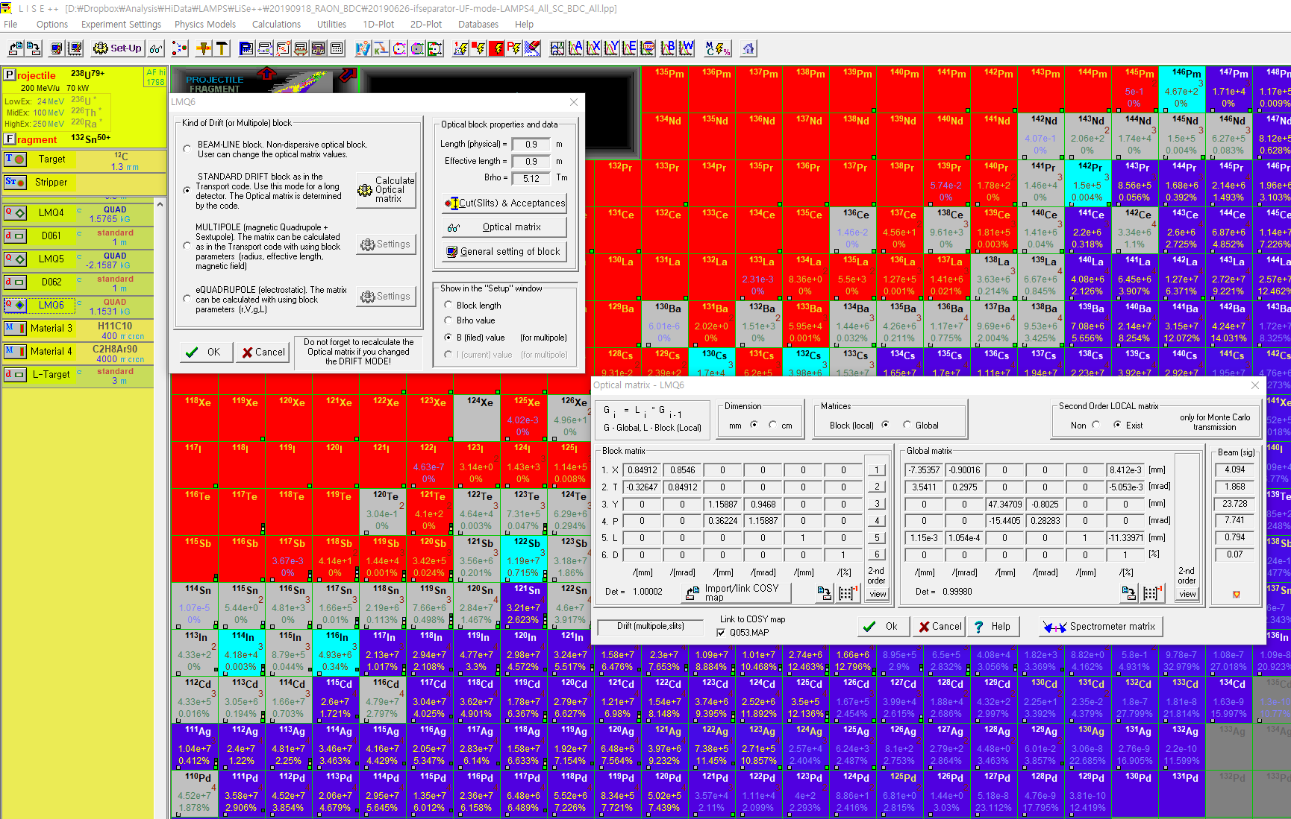
Beam Study with LiSe++
MC method in IF system (possible up to 2nd order calculation)
Local matrix
(1st order)
Global matrix
(1st order)
2nd order optical matrix is defined here
From 3rd order, COSY files are needed.

Slide 5
Beam Study with LiSe++
MC method in IF system (possible up to 2nd order calculation)
1st order calculation
X, Θ, Y, Φ, L, δ
X₁
Θ₁
Y₁
Φ₁
L₁
δ₁
X₂
Θ₂
Y₂
Φ₂
L₂
δ₂
L : Beam pulse length
δ : Relative momentum dp/p
1st order
Transformation
Matrix
=
2nd order calculation
X², Θ², Y², Φ², L², δ² ~~
1st order matrix : 6 x 6
2nd order matrix
In only 1st order matrix,
2nd order elements are empty

Slide 6
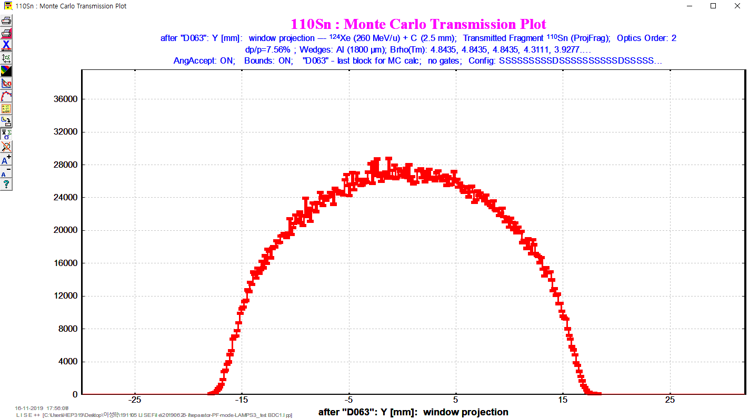
Active Area Calculation at BDC1
MC results with 2nd order calculation
X (mm)
Y (mm)
X : ± 26.5 mm
Y : ± 18.5 mm

Slide 7
Active Area Calculation at BDC1
X (mm)
5M events, 2nd order calculation
Y (mm)
X : ± 26.5 mm
Y : ± 18.5 mm
Active area of BDC1 from 2nd order MC
: 53 x 37 mm² (roughly ~ 60x40 mm²)

Slide 8
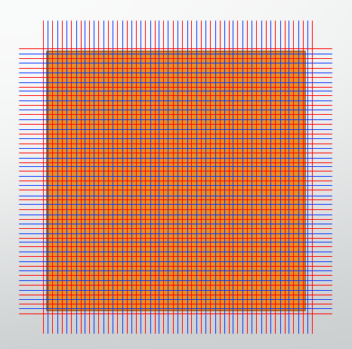
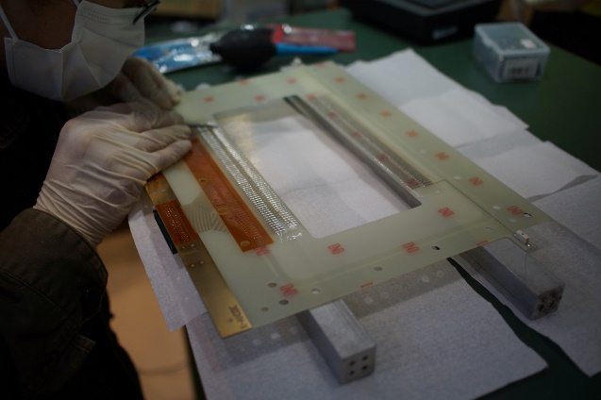
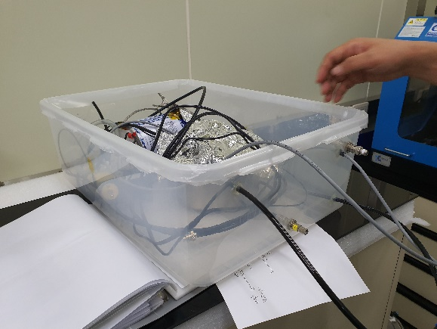
BDC Construction
Prototype Design
Configuration : xx’yy’ (4 planes)
Sensor Wire : 32ch
Potential Wire : 33ch
Drift Length : 2.5 mm
32 * 2.5 * 2 = 160 mm
Active Area : 160 x 160 mm²
Still under discussion to determine
final design

Slide 9
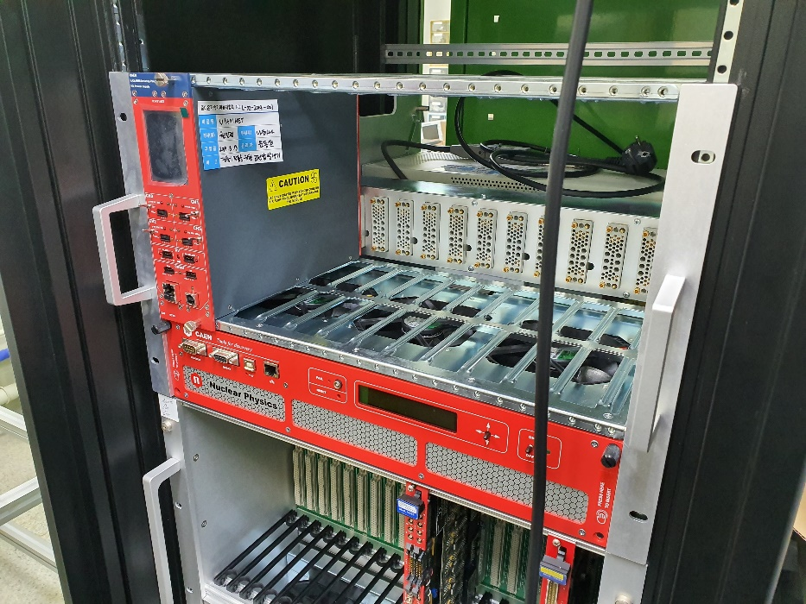
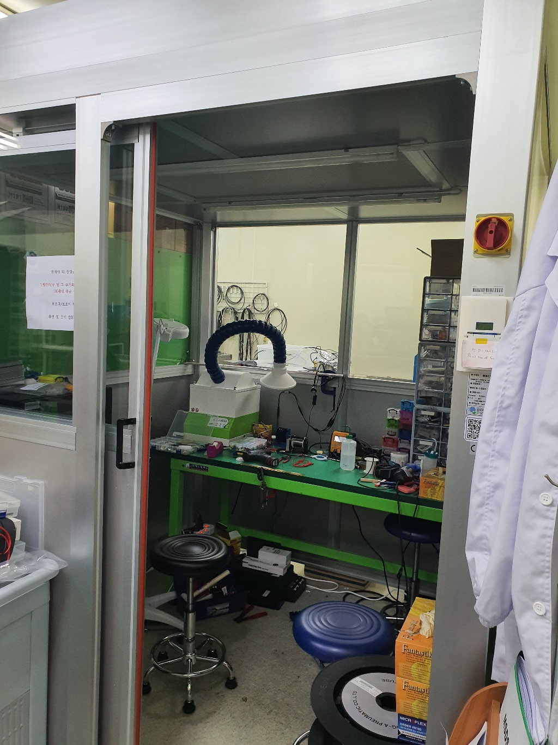
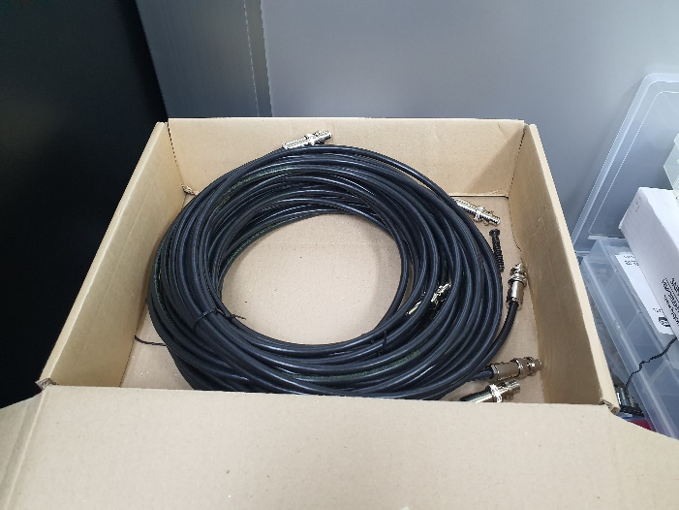
BDC Construction
Place for wiring
NIM Crate & Power Supply & SH Cable

Slide 10
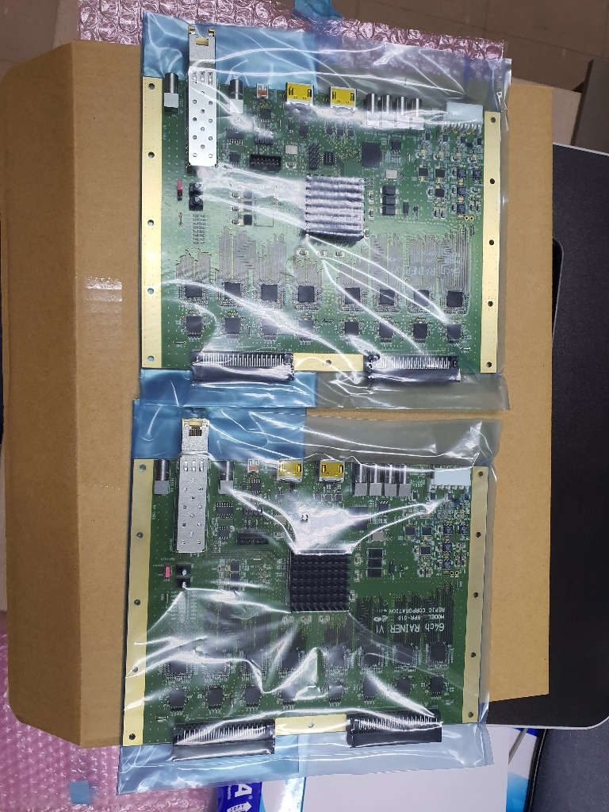
BDC Construction
NIM Crate & Power Supply & SH Cable
ASD and Mylar

Slide 11
Summary & Plan
Active area study at BDC without Slit (200 x 200 mm²) is done.
~ 60 x 40 mm²
Active area study at BDC is ongoing with Slit (200 x 200 mm²).
Purity study is ongoing (but not easy to make drift chamber with LISE++).
2020 Plan
Jan. – Feb. : Finalizing assembly of prototype BDC
Mar. – Apr. : Cosmic muon test
May – Jun. : Data analysis and finalize real type detector design
Jun. – Oct. : Start to construct real type BDC
Oct. – Dec. : Beam test (not specific beam type determined yet)

Slide 14
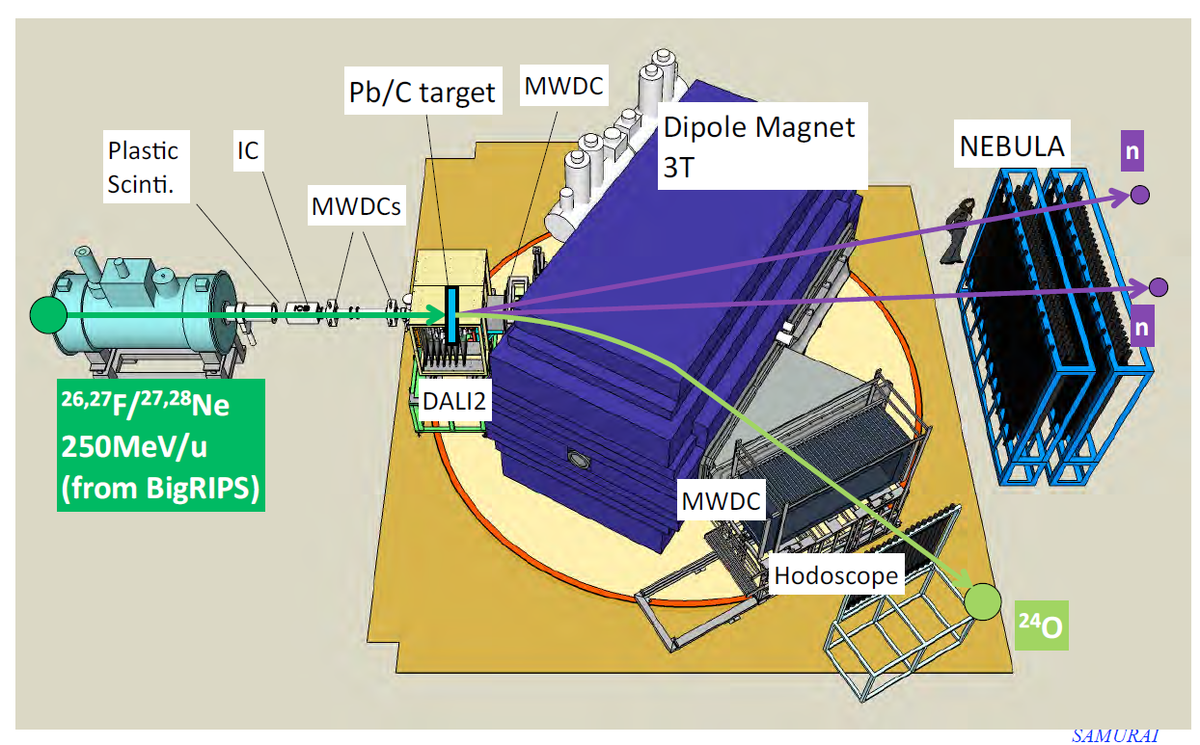
SMURAI Detector

Slide 15
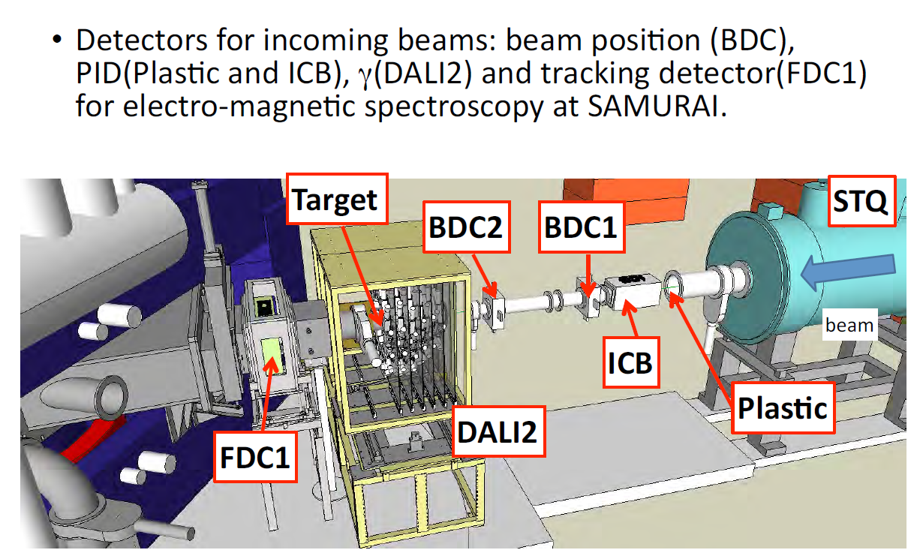
Beam Profile Detector in SMURAI

Slide 16
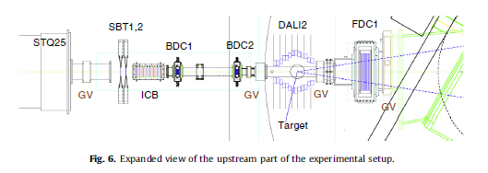
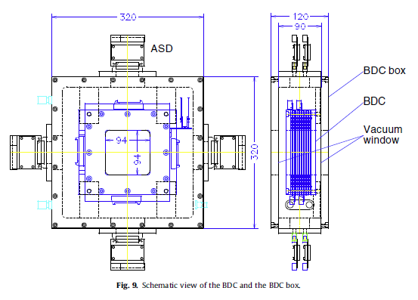
SMURAI BDC (Beam Drift Chamber)
NIMB 317 (2013) 294-304
Walenta type Drift chamber
2.5 mm drift length
i-C₄H₁₀ at 50-100 torr
Anode, potential wire diameter of 20 μm(Au-W), 80 μm(Au-Al)
Cathode (gas window) 8 μm^{t} Al-Kapton
Effective area : 8 cm x 8 cm

Slide 17
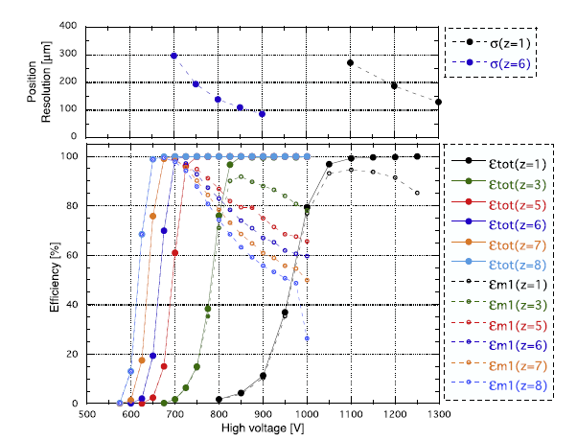
SMURAI BDC (Beam Drift Chamber)
NIMB 317 (2013) 294-304
Walenta type Drift chamber
2.5 mm drift length
i-C₄H₁₀ at 50-100 torr
Anode, potential wire diameter of 20 μm(Au-W), 80 μm(Au-Al)
Cathode (gas window) 8 μm^{t} Al-Kapton
Effective area : 8 cm x 8 cm
Requirements
Position resolution : ~ 100 μm
Efficiency : 100 % at > 600 V

Slide 18
SMURAI BDC (Beam Drift Chamber)
Beam Rate Estimation : LiSe++ (Seonghak Lee)
Expected Beam : ¹³²Sn : 8 x 10⁺⁶ pps with 133.2 MeV/u
To determine specific conditions of Drift Chamber, we will use GarField program (Dr. Hwang with Seonghak Lee)

