Slide 1
CENuM-RULiC Joint Workshop on Extreme Nuclear States and Reactions
Precision mass measurement for shot-lived nuclides at HIRFL-CSR
Meng WANG
Institute of Modern Physics, Chinese Academy of Sciences
Introduction
IMS experiment
New results
Double-TOF IMS

Slide 2
CSRe IMS Collaboration
Y. H. Zhang, M. Wang, H. S. Xu, R. J. Chen, X. Zhou, C. Y. Fu, B. S. Gao, X. C.Chen, Y.H. Lam, P. Shuai, M.Z. Sun, X. L.Tu, Y.M. Xing, X. Xu, X. L. Yan, Q. Zeng, P. Zhang, X. H. Zhou, Y. J. Yuan, J. W. Xia, J. C. Yang, Z. G. Hu, S. Kubono, X. W. Ma, R. S. Mao, B. Mei, G. Q. Xiao, H. W. Zhao, T. C. Zhao, W. L. Zhan (IMP-CAS, Lanzhou, China)
Yu.A. Litvinov, S. A. Litvinov, S.Typel (GSI, Darmstadt, Germany)
K. Blaum (MPIK, Heidelberg, Germany)
Baohua SUN (Beihang University)
Y. Sun (Shanghai Jiao Tong University, Shanghai, China)
F.R. Xu (Beijing University, China)
H. Schatz, B. A. Brown (MSU, USA)
G. Audi (CSNSM-IN2P3-CNRS, Orsay, France)
A. Ozawa (University of Tsukuba, Japan)
T. Yamaguchi (Saitama University, Saitama, Japan)
T. Uesaka, S. Naimi, Y. Yamaguchi (RIKEN, Saitama, Japan)

Slide 3



Nuclear Mass
Mass → binding energy → interaction
= N× +Z×
－ binding energy
Filed of application | Required uncertainty
Chemistry: identification of molecules | 10⁻⁵–10⁻⁶
Nuclear physics: shells, sub-shells, pairing | 10⁻⁶
Nuclear fine structure: deformation, halos | 10⁻⁷–10⁻⁸
Astrophysics: r-process, rp-process, waiting points | 10⁻⁷
Nuclear models and formulas: IMME | 10⁻⁷–10⁻⁸
Weak interaction studies: CVC hypothesis, CKM unitarity | 10⁻⁸
Atomic physics: binding energies, QED | 10⁻⁹–10⁻¹¹
Metrology: fundamental constants, CPT | 10⁻¹⁰
K. Blaum, Physics Reports 425 (2006) 1–78

Slide 4
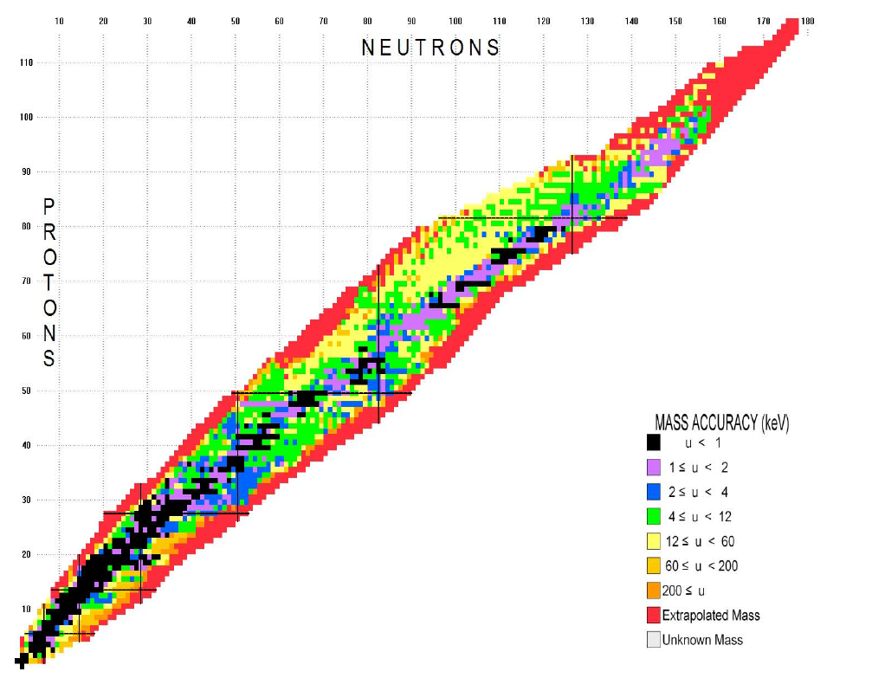
Nuclear Mass
prediction 7000-9000
discovery ~3400
Mass-known ~2500
<100keV ~2300
M. Wang et al., CPC 41,030003 (2017)

Slide 5
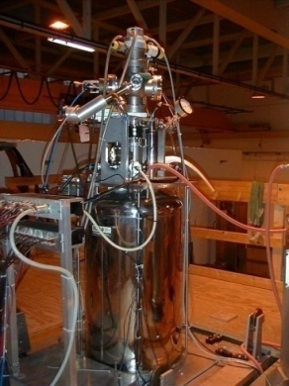
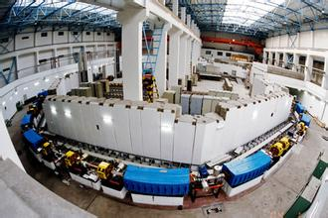
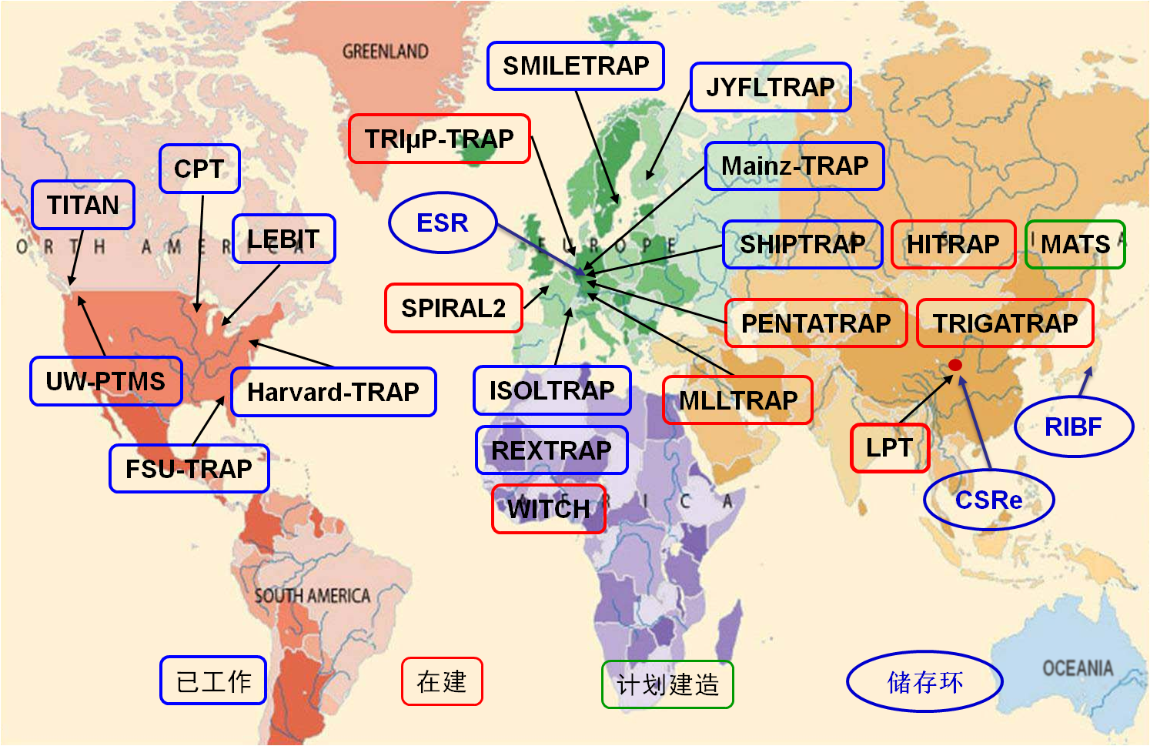
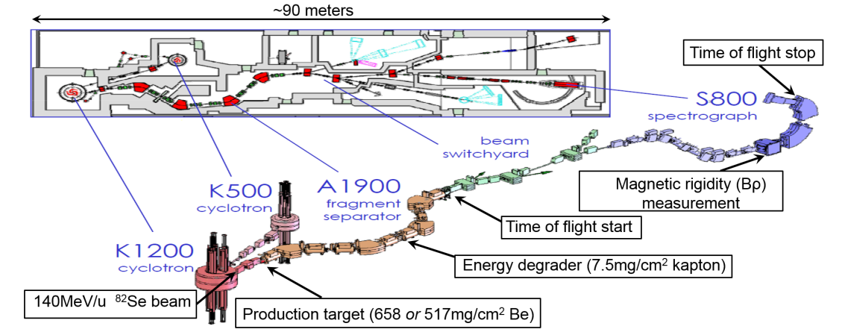
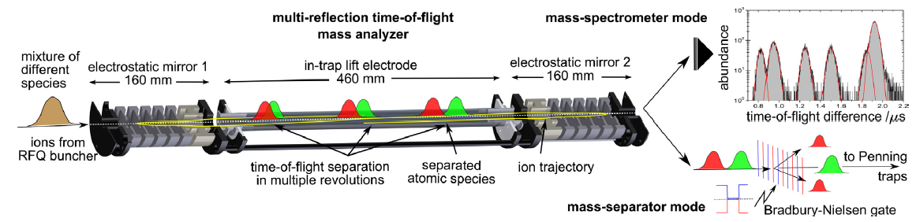
Present activities
ESR
time： Bρ-TOF, IMS < MRTOF < PTMS < SMS
precision： PTMS > SMS, IMS, MRTOF > Bρ-TOF
many masses simultaneously
RIBF
CSR

Slide 6
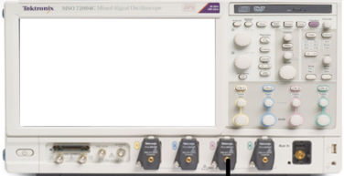
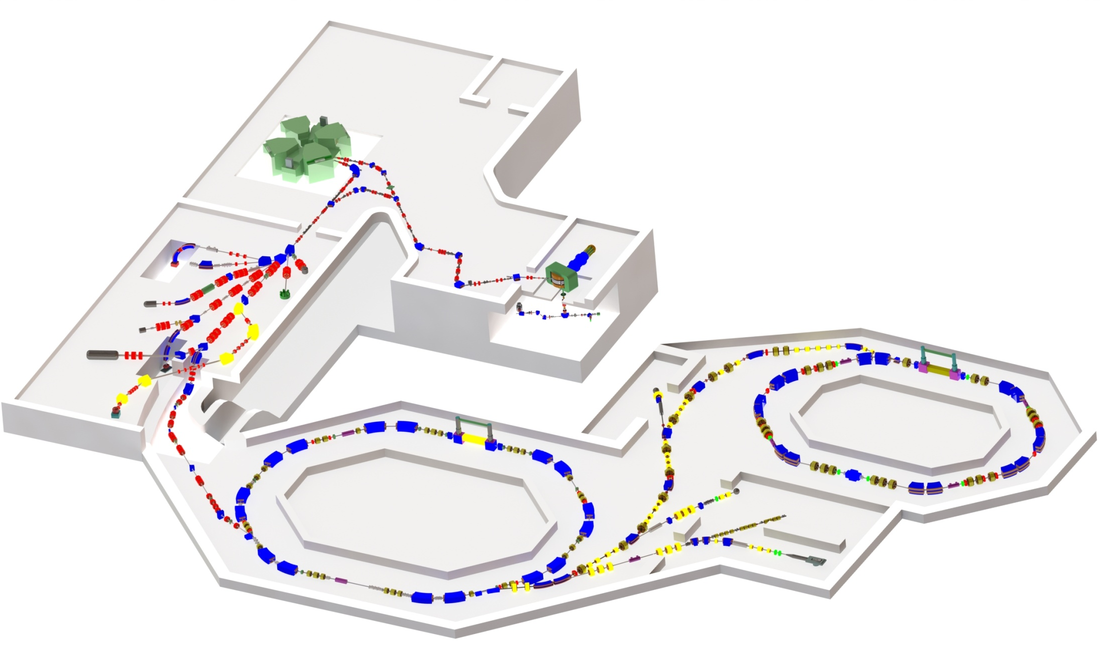
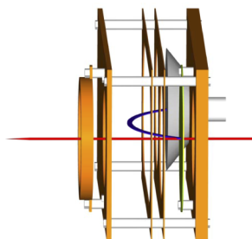
Mass measurement at CSR, Lanzhou
Heavy Ion Research Facility in Lanzhou (HIRFL)
e-
C foil
MCP
CSRe
TOF Detector
RIBLL2
CSRe
CSRm

Slide 7
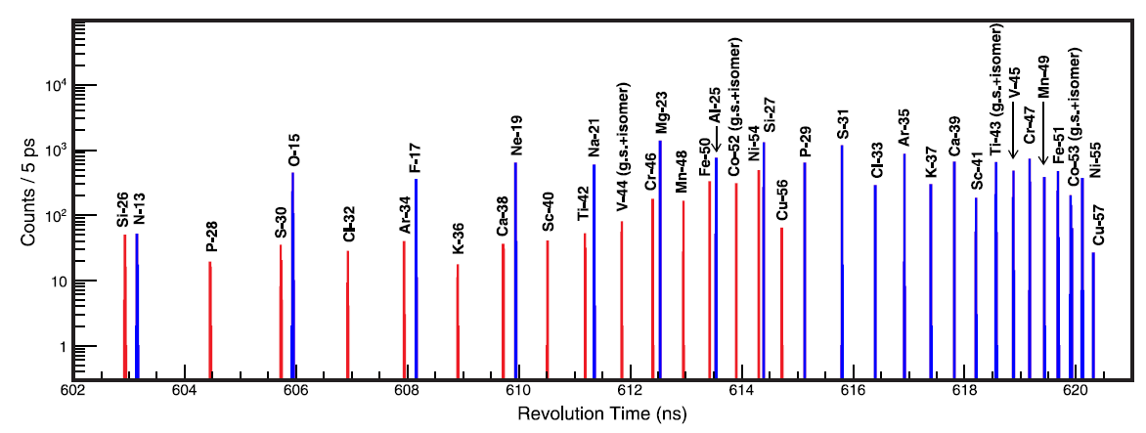
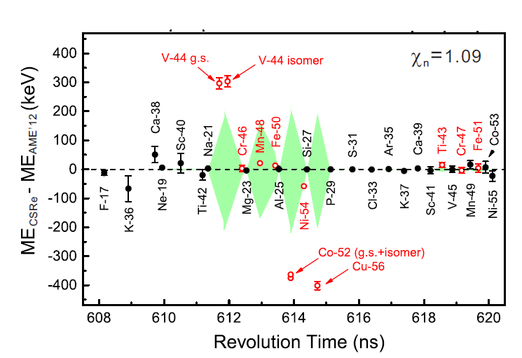
PRC 98, 014319 (2018)
m/q = a₀+a_{1*}t+a_{2*}t²+a_{3*}t³

Slide 8


Measurement time and precision
TOF1
TOF2

Slide 9

Measurement time and precision

Slide 10
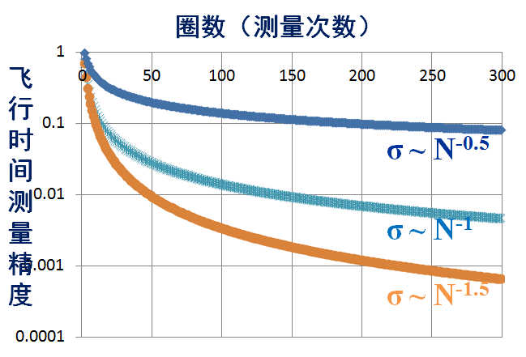

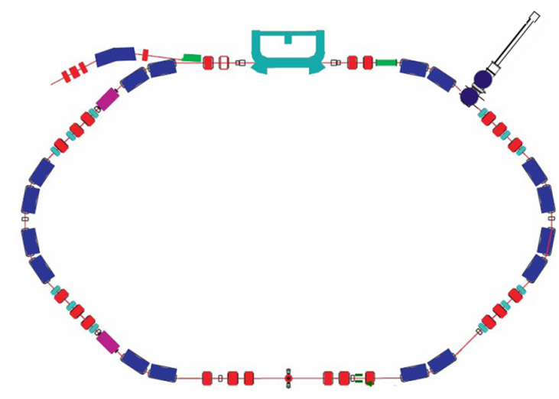
Measurement time and precision

Slide 11
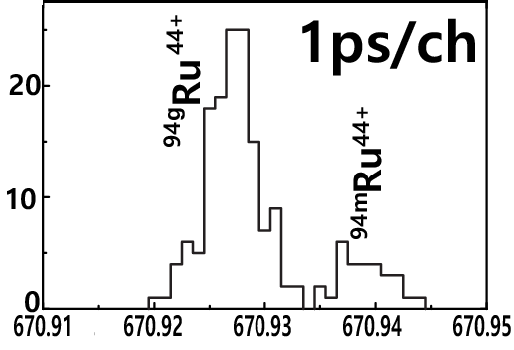
Measurement time and precision
^{94m}Ru
T_{1/2} = 71 μs
Ex=2645 keV
8⁺
6⁺
4⁺
2⁺
Decay point
0⁺
Q. Zeng , M. Wang* et al., PRC (R) 96, 031303 (2017)

Slide 12
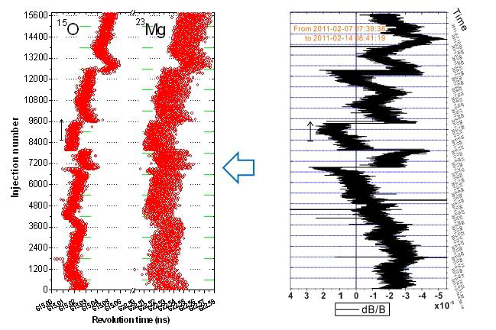
Correction for magnetic-field drift

Slide 13
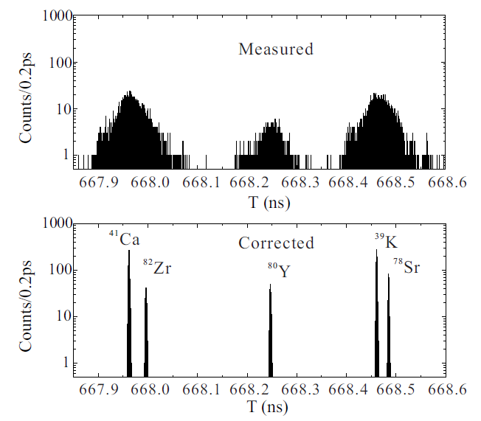
Correction for magnetic-field drift
Y.M. Xing, Y.H. Zhang*, M. Wang* et al., NIM A 941 (2019) 162331

Slide 14
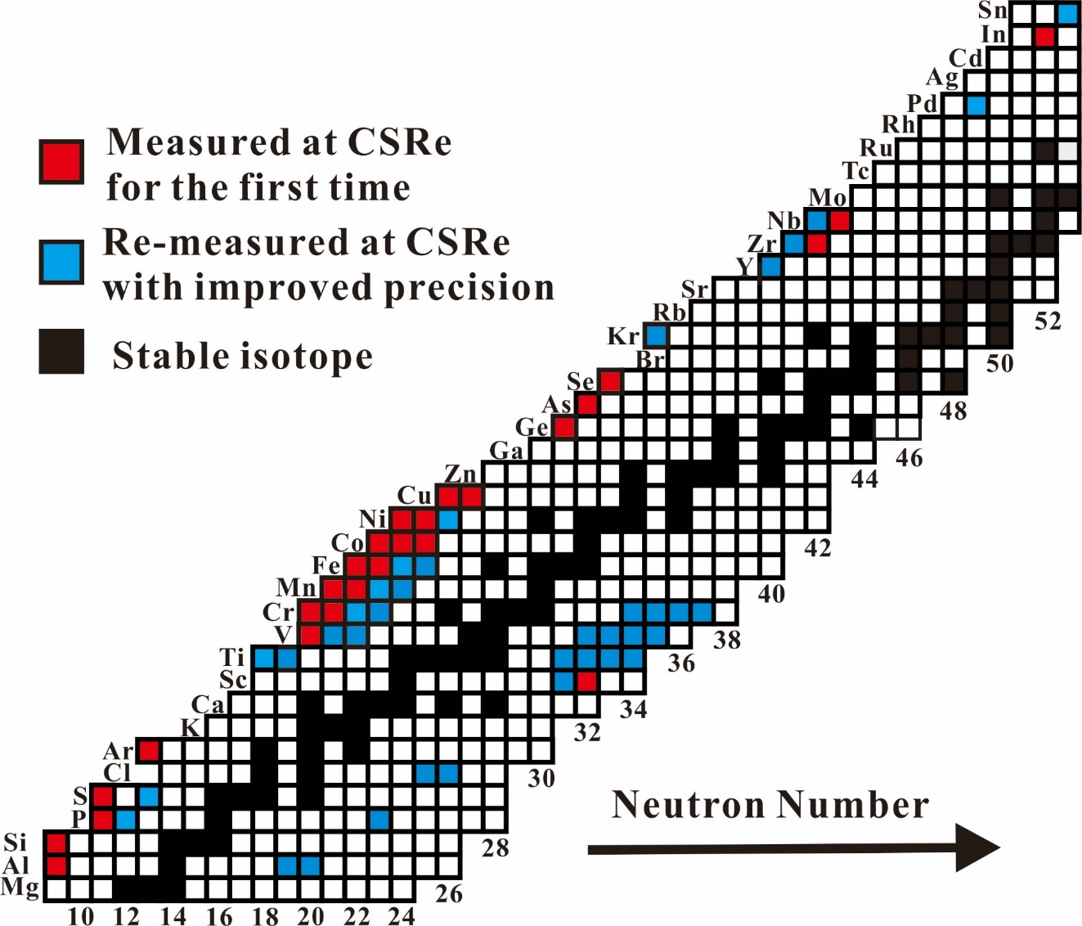
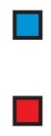
Overview of CSR results
M. Wang et al., IJMP E 18, 352 (2009)
B. Mei et al., NIM A 624, 109 (2010)
X. L. Tu et al., PRL 106, 112501 (2011)
X. L. Tu et al., NIM A 654, 213 (2011)
Y. H. Zhang et al., PRL 109, 102501 (2012)
X. L. Yan et al. ApJL 766, L8 (2013)
H. S. Xu et al., IJMS 349, 162 (2013)
X. L. Tu et al., JPG 41, 025104 (2014)
W. Zhang et al., NIM A 755, 38 (2014)
W. Zhang et al., NIM A 756, 1 (2014)
B. Mei et al., PRC 89, 054612 (2014)
P. Shuai et al., PLB 735,327 (2014)
J.J. He et al., PRC 89, 035802 (2014)
X. Xu et al., CPC 39, 104001 (2015)
X. Xu et al., CPC 39, 106201 (2015)
R.J. Chen et al., PS T166, 014044 (2015)
Y.M. Xing et al., PS T166, 014010 (2015)
Y.H. Lam et al., APJ 818, 78 (2016)
P. Shuai et al., NIM B 376, 311 (2016)
X.L. Tu et al., NPA 945, 89 (2016)
B. Mei et al., PRC 94,044615 (2016)
X. Xu et al., PRL 117, 182503 (2016)
P. Zhang et al., PLB 767, 20 (2017)
X.L. Tu et al., PRC 95, 014610 (2017)
Q. Zeng et al., PRC (R) 96, 031303 (2017)
Y.H.Zhang et al., PRC 98, 014319 (2018)
C. Y. Fu et al., PRC 98, 014315 (2018)
Y.M.Xing et al., PLB 781, 358 (2018)
X. Xu et al., PRC 99, 064303 (2019)
Primary beams: ⁷⁸Kr, ³⁶Ar, ⁵⁸Ni, ⁸⁶Kr, ¹¹²Sn
Higher precision
First time
precision
10⁻⁶ ~10⁻⁷
(10-200 keV)

Slide 15
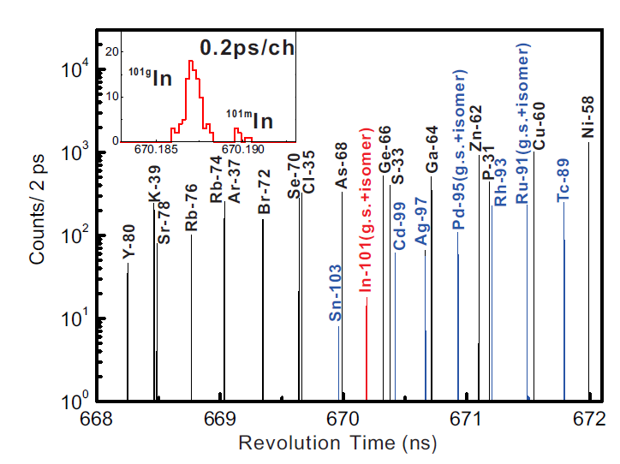
Masses of ^{101g,m}In

Slide 16
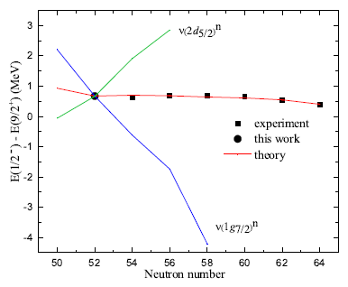
Masses of ^{101g,m}In
9/2⁺
1/2⁻
50
50
1g_{9/2}
1g_{9/2}
40
40
2p_{1/2}
2p_{1/2}
1f_{5/2}
1f_{5/2}
2p_{3/2}
2p_{3/2}

Slide 17
Masses of ^{101g,m}In
2d_{5/2}
1g_{7/2}
9/2⁺
50
50
1g_{9/2}
1g_{9/2}
40
2p_{1/2}
2p_{1/2}
1f_{5/2}
1f_{5/2}
2p_{3/2}
2p_{3/2}
T. Otsuka et al., Phys. Rev. Lett. 95, 232502 (2005)

Slide 18
Masses of ^{101g,m}In
2d_{5/2}
1/2⁻
1g_{7/2}
50
50
1g_{9/2}
1g_{9/2}
40
2p_{1/2}
2p_{1/2}
1f_{5/2}
1f_{5/2}
2p_{3/2}
2p_{3/2}
T. Otsuka et al., Phys. Rev. Lett. 95, 232502 (2005)

Slide 19
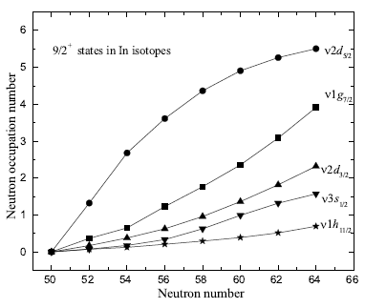
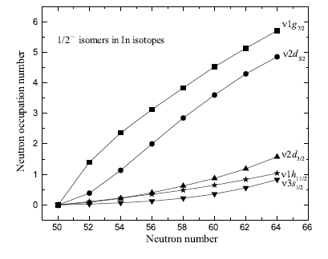
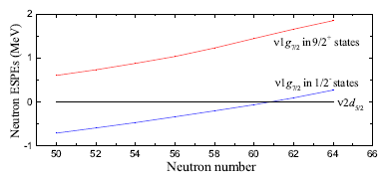
Masses of ^{101g,m}In

Slide 20
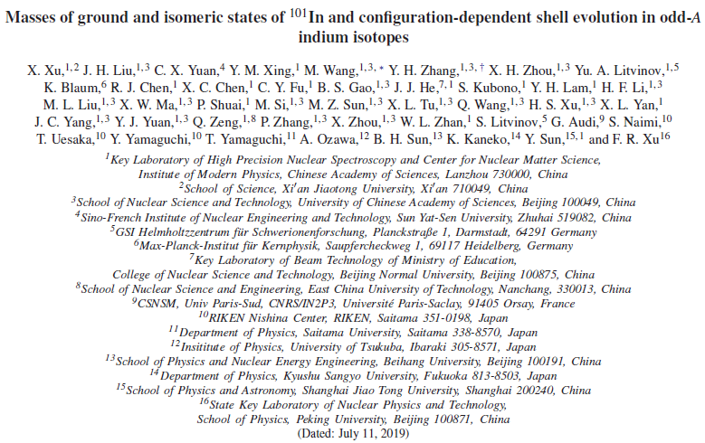
Masses of ^{101g,m}In
arXiv:1907.04584

Slide 21
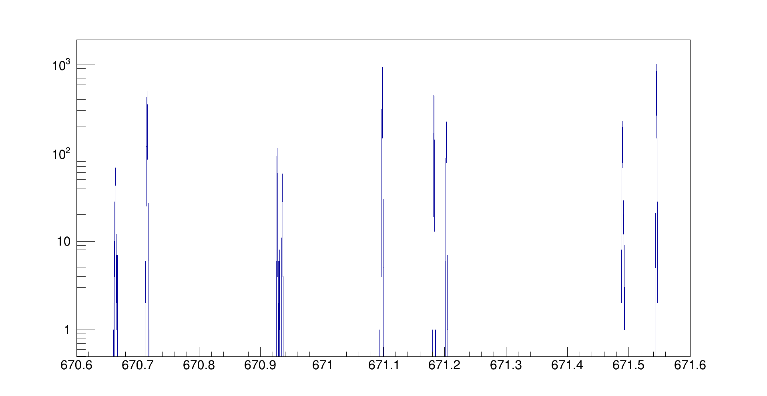
Isomers
⁹⁷Ag
⁹⁵Pd
⁹³Rh
⁹¹Ru
πp_{1/2}
isomer
νp_{1/2}
isomer
πp_{1/2}
isomer
νp_{1/2}
isomer
?
⁶²Zn
⁶⁰Cu
⁶⁴Ga
³¹P
⁹¹Ru
^{95m}Pd(1/2⁻)
⁹³Rh
⁹⁷Ag
⁹⁵Pd
^{95n}Pd
counts/0.2ps

Slide 22
Isomers in νp-process
Qp = 2.007 MeV
J. Fallis et al., PHYSICAL REVIEW C 78, 022801(R) (2008)
⁹²Ru+p
(p,γ)↔(p,γ)
Isomer ?
1/2 -
9/2 +
⁹³Rh
⁹⁴Pd
⁹³Rh
⁹²Ru
solar abundance ratio
⁹²Mo/⁹⁴Mo =1.57
⁹²Mo
⁹⁴Mo
Y_{e} (electron fraction)=0.57,
 Sp(⁹³Rh)=1.64±0.1 MeV

Slide 23
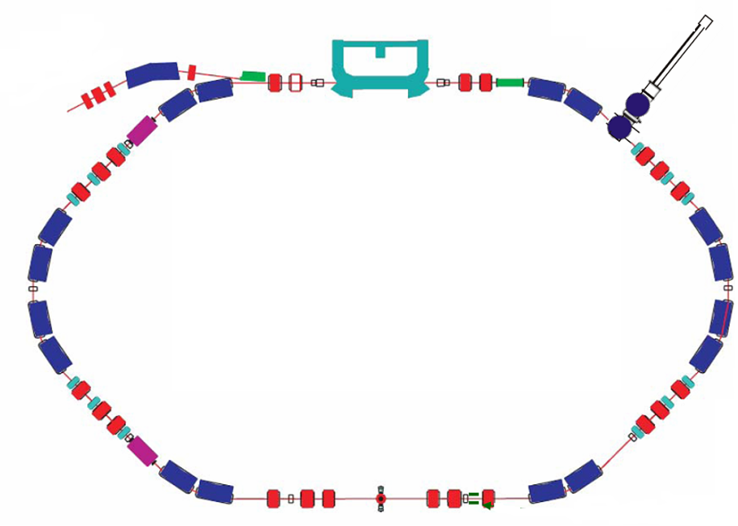
Double-TOF IMS at CSRe
T=L/v
Bρ=m/q βγc

Slide 24
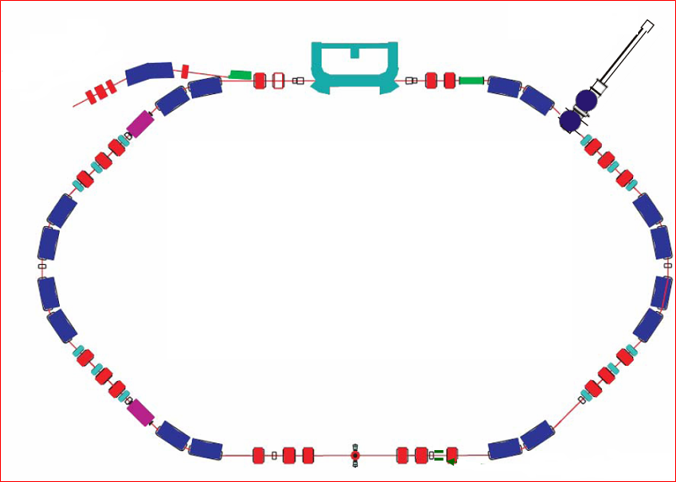

Double-TOF IMS at CSRe
injection
ToF0
γ = γ_{t}
Revolution time
Orbital length
γ > γ_{t}
γ < γ_{t}
ToF2
ToF1

Slide 25
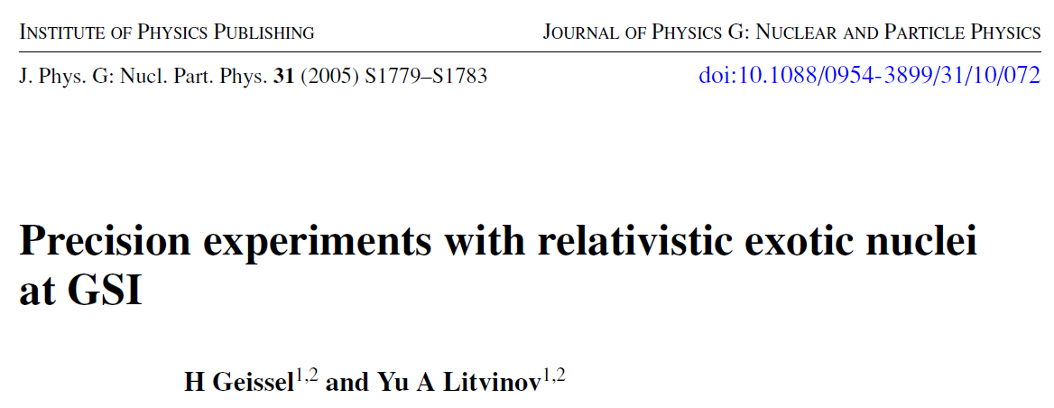
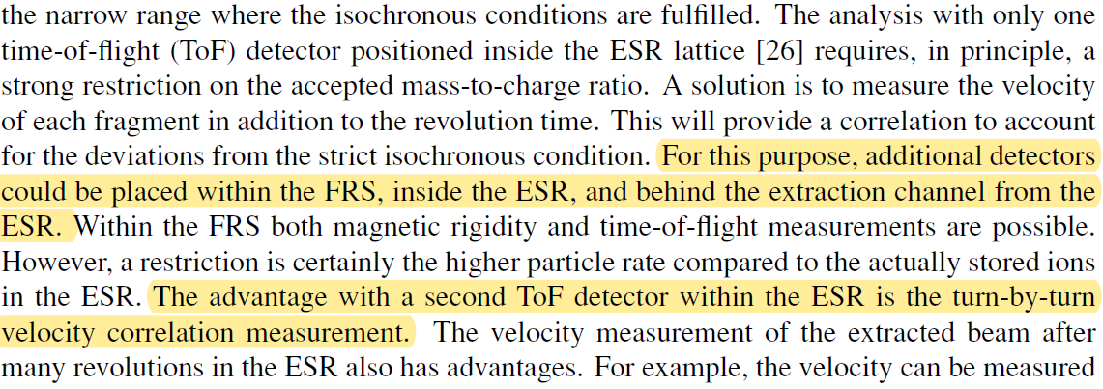
Double-TOF IMS at CSRe

Slide 26
Double-TOF IMS at CSRe
D-TOF IMS with ⁷⁸Kr, test of detectors
D-TOF IMS with ⁴⁰Ar, optical setting of CSRe
D-TOF IMS with ⁵⁸Ni
2017
2018
2013
2013
2015
2016
2018
Installation of two TOF detectors
D-TOF IMS with ³⁶Ar, optical setting of CSRe
D-TOF IMS with ⁵⁸Ni

Slide 27
Double-TOF IMS at CSRe
D-TOF IMS with ⁷⁸Kr, test of detectors
D-TOF IMS with ⁴⁰Ar, optical setting of CSRe
D-TOF IMS with ⁵⁸Ni
2017
2018
2013
2013
2015
2016
2018
Installation of two TOF detectors
D-TOF IMS with ³⁶Ar, optical setting of CSRe
D-TOF IMS with ⁵⁸Ni
W. Zhang et al., NIM A 756 (2014) 1
Y. M. Xing et al., Phys. Scr. T166 (2015) 014010;
X. Xu et al.,CPC 39(2015)2015
Notes:
.

Slide 28

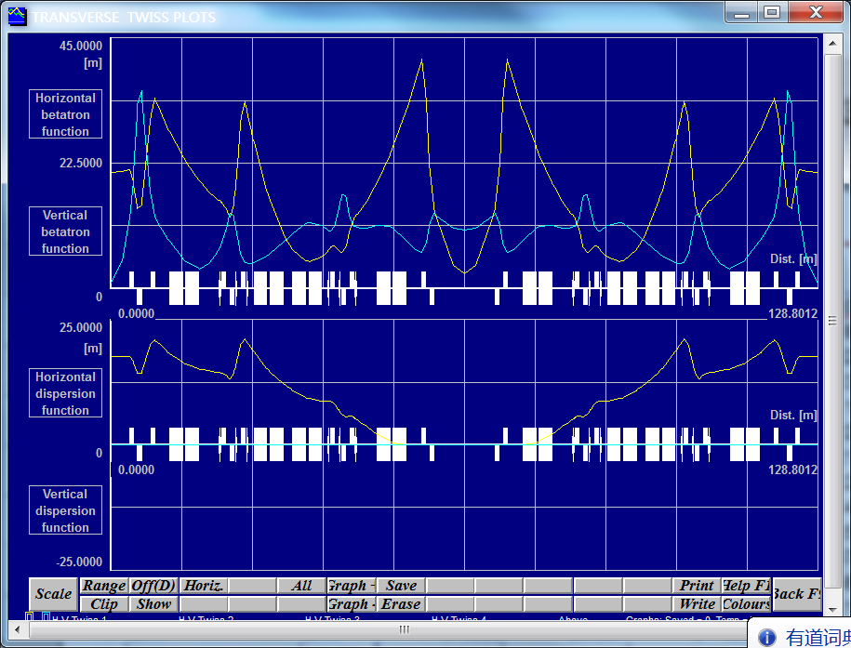
Double-TOF IMS at CSRe

Slide 29
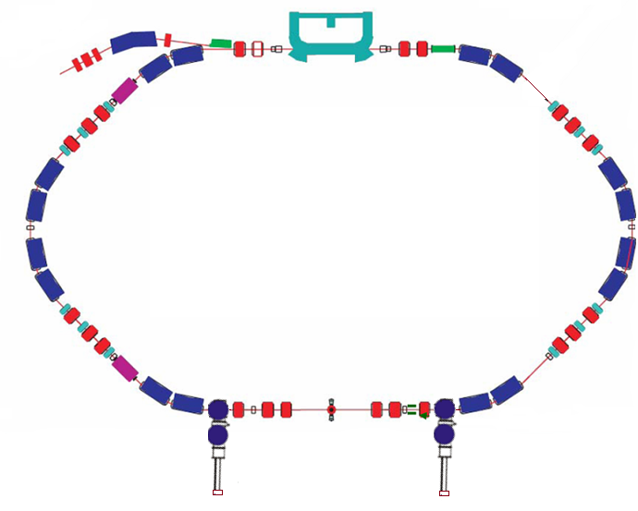
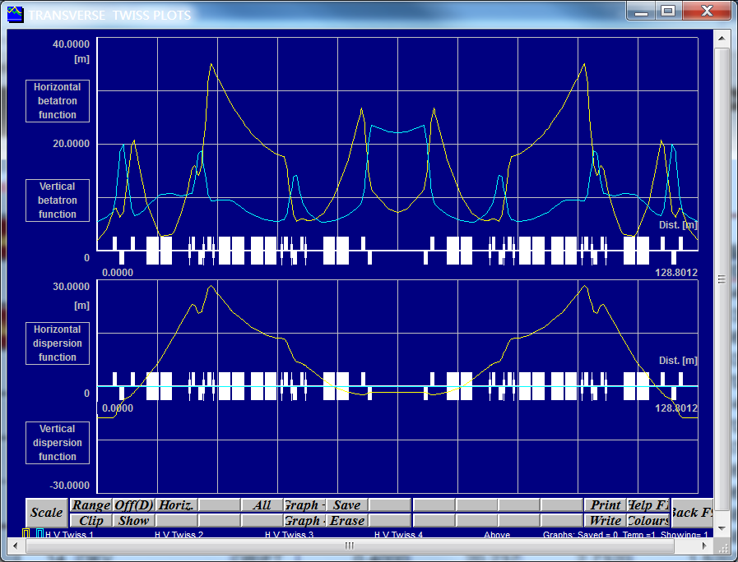
Double-TOF IMS at CSRe

Slide 30
Double-TOF IMS at CSRe
D-TOF IMS with ⁷⁸Kr, test of detectors
D-TOF IMS with ⁴⁰Ar, optical setting of CSRe
D-TOF IMS with ⁵⁸Ni
2017
2018
2013
2013
2015
2016
2018
Installation of two TOF detectors
D-TOF IMS with ³⁶Ar, optical setting of CSRe
D-TOF IMS with ⁵⁸Ni
W. Zhang et al., NIM A 756 (2014) 1
Y. M. Xing et al., Phys. Scr. T166 (2015) 014010;
X. Xu et al.,CPC 39(2015)2015

Slide 31
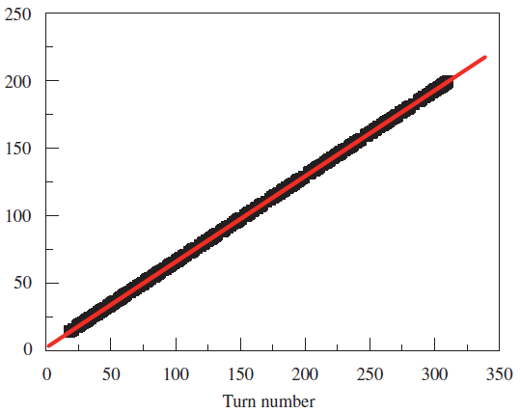



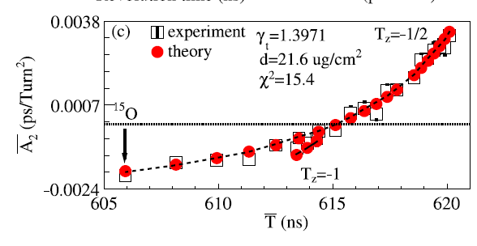
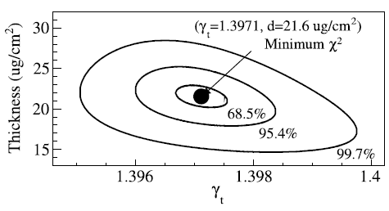
Double-TOF IMS at CSRe
γ < γ_{t}
γ > γ_{t}
²⁷Si
⁵⁴Ni
R.J.Chen, X.L.Yan, W.W.Ge, Y.J.Yuan*, M. Wang* et al., NIM A 898 (2018) 111.
Notes:
我的第二项工作是提出了一种可以测量储存环转变能的新方法。此外，这种方法还可以测量碳膜的厚度。这个方法可以实时监测储存环的转变能随时间的变化以及测量储存环的转变能曲线。比如，这是实验测量的储存环的转变能岁时间的变化。我在3个月之前将这项工作投稿给NIMA，审稿人给了我很积极的评价。审稿人说，这个方法毫无疑问是新颖的，这项工作一定得发表。

Slide 32
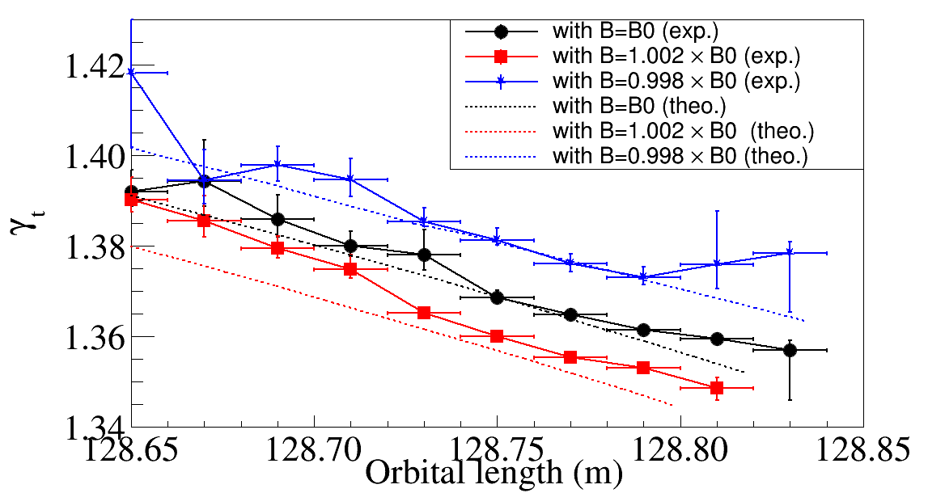
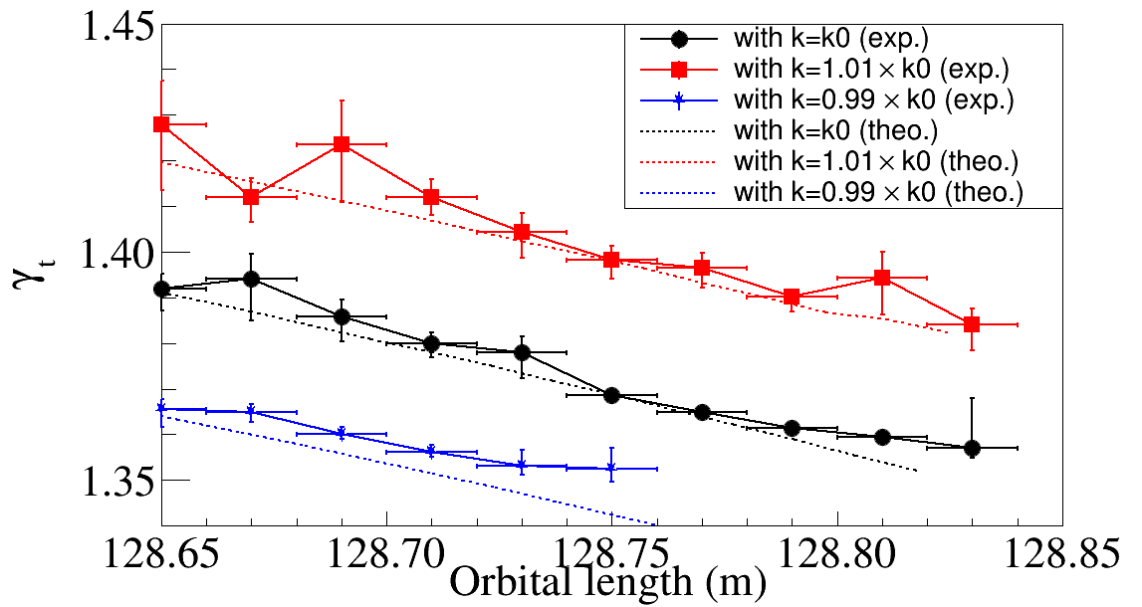
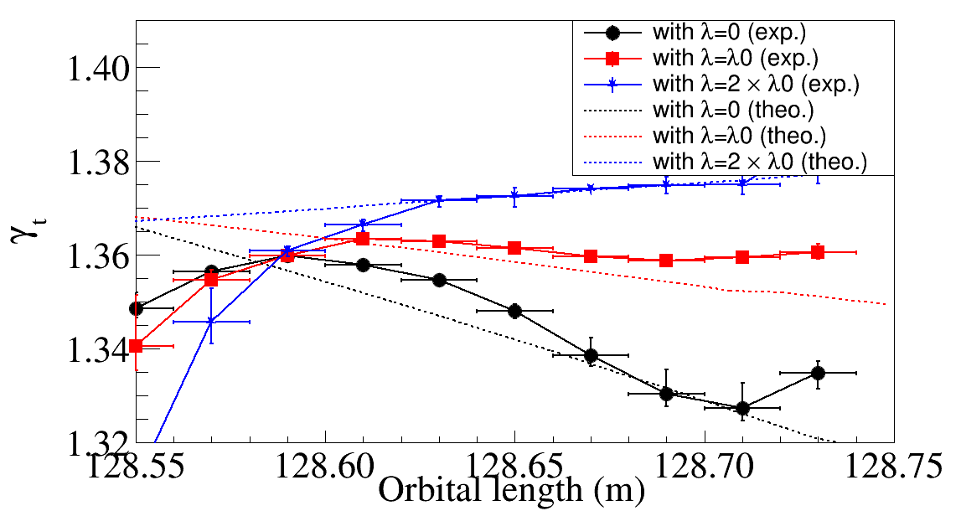
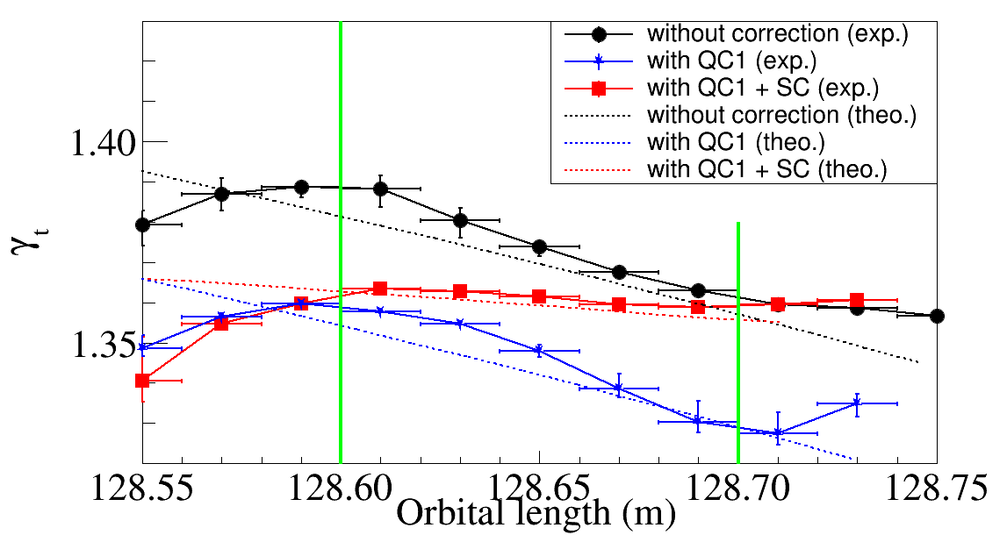
Double-TOF IMS at CSRe
dipole
quadrupole
C = T × v
sextupole
W.W. Ge et al., NIM A 908 (2018) 388-393

Slide 33
Double-TOF IMS at CSRe
D-TOF IMS with ⁷⁸Kr, test of detectors
D-TOF IMS with ⁴⁰Ar, optical setting of CSRe
D-TOF IMS with ⁵⁸Ni
2017
2018
2013
2013
2015
2016
2018
Installation of two TOF detectors
D-TOF IMS with ³⁶Ar, optical setting of CSRe
D-TOF IMS with ⁵⁸Ni
W. Zhang et al., NIM A 756 (2014) 1
Y. M. Xing et al., Phys. Scr. T166 (2015) 014010;
X. Xu et al.,CPC 39(2015)2015
R. J. Chen et al., NIM A 898 (2018) 111.
W.W. Ge et al., NIM A 908 (2018) 388-393

Slide 34
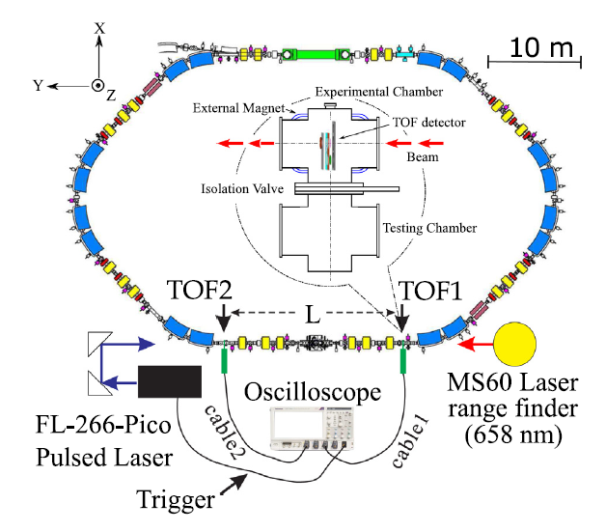
Double-TOF IMS at CSRe
Beam
X. L.Yan et al., NIM A 931 (2019) 52

Slide 35

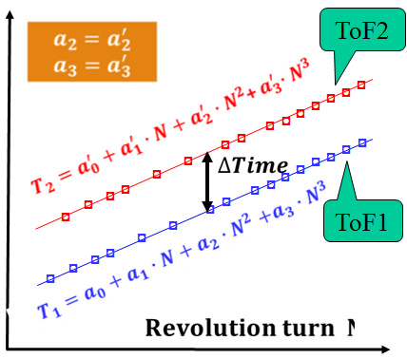



Double-TOF IMS at CSRe
TOF2
TOF1
 | Uncertainty | Example：σ₁=σ₂=30 ps，η₁=η₂=20%，N=400
Coincident signals |  | 10.5 ps，1.2×10⁻⁴
Independent fitting |  | 9.5 ps，1.1×10⁻⁴
Combined fitting |  | 4.7 ps, 5.6×10⁻⁵

Slide 36
Double-TOF IMS at CSRe
D-TOF IMS with ⁷⁸Kr, test of detectors
D-TOF IMS with ⁴⁰Ar, optical setting of CSRe
D-TOF IMS with ⁵⁸Ni
2017
2018
2013
2013
2015
2016
2018
Installation of two TOF detectors
D-TOF IMS with ³⁶Ar, optical setting of CSRe
D-TOF IMS with ⁵⁸Ni
W. Zhang et al., NIM A 756 (2014) 1
Y. M. Xing et al., Phys. Scr. T166 (2015) 014010;
X. Xu et al.,CPC 39(2015)2015
R. J. Chen et al., NIM A 898 (2018) 111.
W.W. Ge et al., NIM A 908 (2018) 388-393
X. L.Yan et al., NIM A 931 (2019) 52
Notes:
.

Slide 37
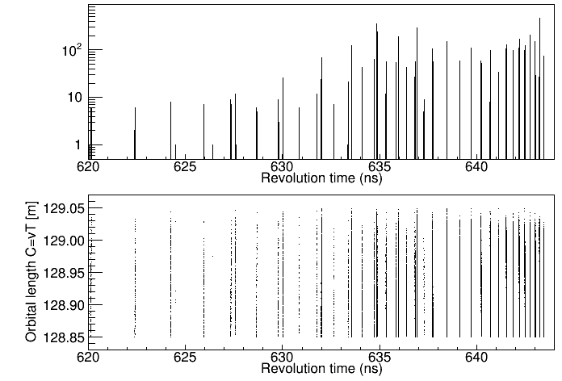
Double-TOF IMS at CSRe
Primary beam : ⁵⁸Ni, Dec. 2017
Raw revolution time spectrum
⁴⁴V_{gs+Iso.}
⁵²Co_{gs+Iso.}
²⁸P
⁵²Co_{gs+Iso.}
Raw revolution time spectrum vs C
Notes:
This is a raw revolution time spectrum. This is a raw revolution time spectrum vs orbital length. Orbital length is calculated by revolution time and velocity. We select for isotopes and zoom in their spectrum.

Slide 38
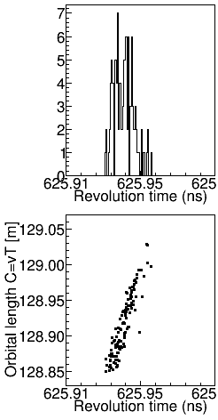
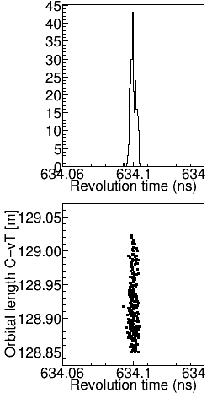
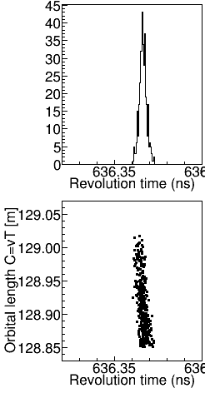
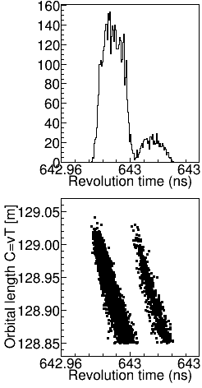
Double-TOF IMS at CSRe
Raw data
²⁸P
⁴⁴V_{gs+Iso.}
⁵²Co_{gs+Iso.}
⁵³Co_{gs+Iso.}

Slide 39
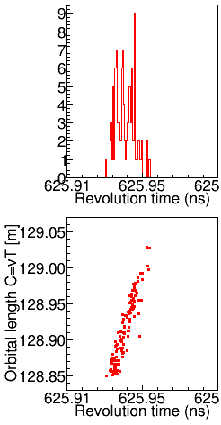
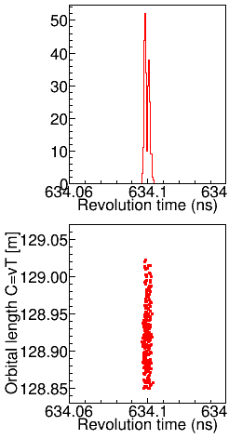
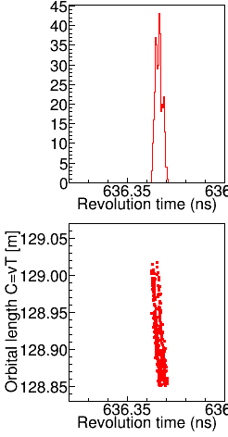
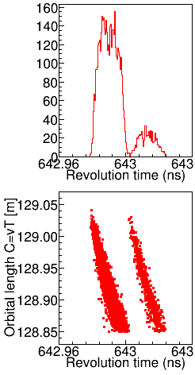
Double-TOF IMS at CSRe
Magnetic correction
²⁸P
⁴⁴V_{gs+Iso.}
⁵²Co_{gs+Iso.}
⁵³Co_{gs+Iso.}

Slide 40





Double-TOF IMS at CSRe
$$T_{0}=T_{i}−∆T_{i}$$
Orbital correction
²⁸P
⁴⁴V_{gs+Iso.}
⁵²Co_{gs+Iso.}
⁵³Co_{gs+Iso.}

Slide 41





Double-TOF IMS at CSRe
⁴⁴V g.s. + is.(~270keV)
⁵²Co g.s. + is.(~380keV)
No velocity corr.
No velocity corr.
preliminary
With velocity corr.
With velocity corr.
No velocity corr.
Setting
With velocity corr.

Slide 42

Institute of Modern Physics, CAS

Slide 43

十二五装置HIAF总体规划
Thank you！

Slide 44
Thank you!

Slide 45


Slide 46

T₀=2.5687
T₁=-8.1*10⁻⁵
A=84ps
Sigma:39.4ps

Slide 47
Double-TOF IMS at CSRe
T=L/v
Bρ=m/q βγc

