Slide 1
Nucleon Pairs and Pairing in atomic Nuclei
Y. M. Zhao
[Shanghai Jiao Tong University]
in collaboration with my teachers J. Q. Chen from Nanjing, and A. Arima from Tokyo, my collaborators (N. Yoshinaga from Saitama, S. Yamaji from RIKEN，J. N. Ginocchio from LANL), and my former students (G. J. Fu, Y. Y. Cheng, L. Y. Jia, Y. Lei, Z. Y. Xu, M. Bao, H. Jiang, Y. Lu), from 1992 [when I was a Ph D student in Nanjing].

Slide 2
Nucleon Pairs and Pairing in atomic Nuclei
An introduction to pair models
nucleon-pair truncation approach
pairing with random interactions
odd-even features in nuclear mass models
Summary

Slide 3
The strong interaction between nucleons are dominantly short-range and attractive.
Why short range ? The total binding energy of atomic nuclei is, at a very
rough approximation, proportional to the mass number A (i.e., the number
of total nucleons, protons and neutrons). If the interaction were long-range,
then the total binding energy would have been approximately proportional to
A^2-A, or roughly A^2. One simple model for short-range interaction is delta force.
Why attractive ? There exists a strong repulsion due to Coulomb force between
protons . In order that atomic nuclei are bond states, the strong interaction
between nucleons has to be attractive to balance against the Coulomb force.
The interaction between nucleons can therefore take the following form as an
approximation: V= - G delta (\vec{r}_1 – \vec{r}_2).
That is the reason why the single-particle potential looks similar to the distribution
of nucleon inside the nucleus.

Slide 4
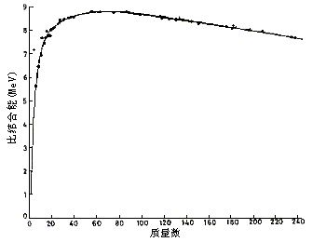
Binding energies per nucleon versus mass number A
Binding energy per nuclei is, roughly speaking, a constant，
This demonstrates that the interactions between nucleons
inside nucleus is attractive with Short Range in the scale of
nucleus radius.

Slide 5
pairing between valence particles
With removal of the mean field part (which gives us
the single particle motion) of the nuclear hamiltonian,
the residual part is, to a large extent, of the
short-range nature. For example, odd-even staggering
of binding energies, the spin-zero ground state of
even-even nuclei, demonstrate the pairing correlation.
As one goes to the unstable nuclei, pairing correlation
could play a key role in many phenomenon.

Slide 6

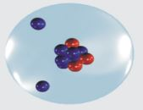
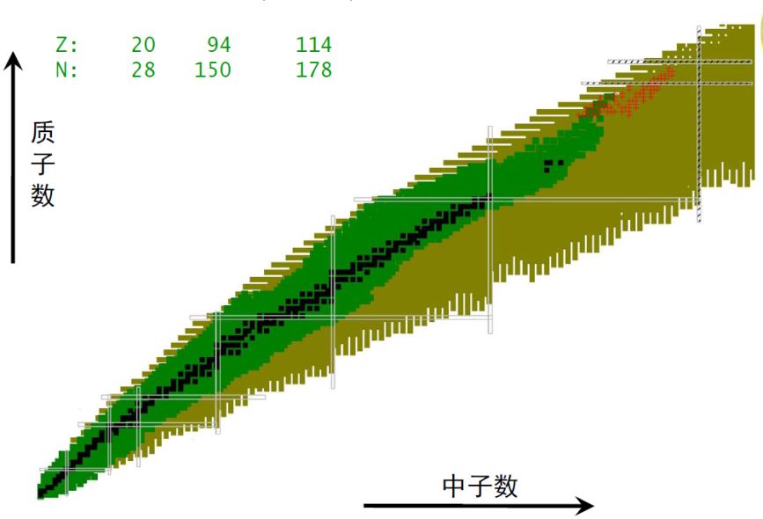
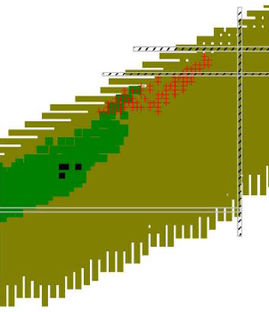
关键科学问题
配对图象及其关键作用：决定核素图边界
✗
✓
核内核子配对图象
锂-10 假象图
锂-11 核示意图

Slide 7



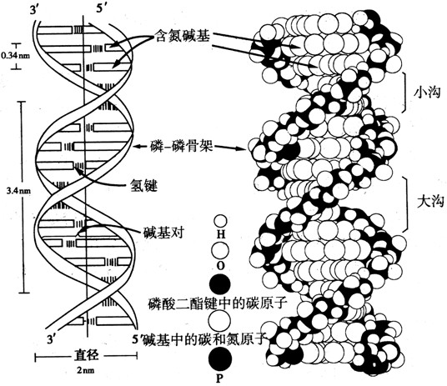

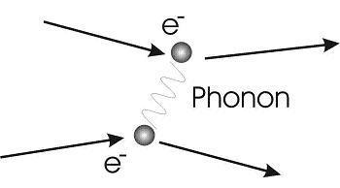
Cooper pair
The common feature seems to be the existence of an attractive
(effective) interaction between the“building blocks”of the system.
Then the system achieves the smallest energy in the pairing
configuration and becomes more stable.
This is particularly true for atomic nuclei which we shall discuss today.

Slide 8
Nucleon-pair models

Slide 9
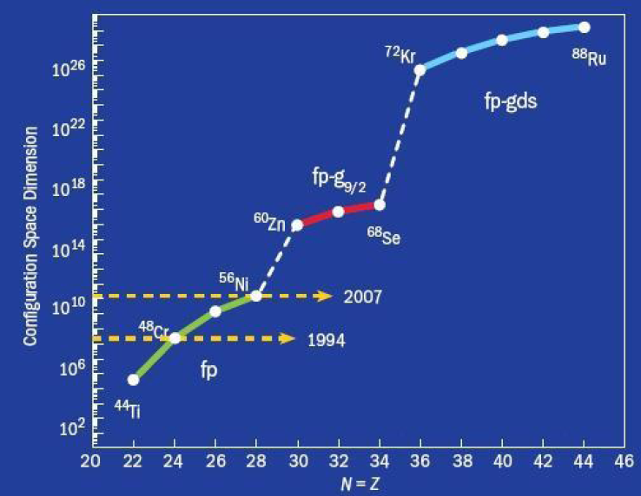

Slide 10
Nucleon-pair approximation
Shell-model basis:
nucleon pair：
pair basis:
Considering all possible nucleon pairs :
the NPA space = the SM space
Hamiltonian and transition operators:
same as those in the SM

Slide 11
Pair truncation
pair basis:
1. A VERY few pairs with good spin and parity
S pair ---- spin zero and positive parity
D pair ---- spin two and positive parity
2. Using collective pairs
collective S pair
j₄
j₃
Dimension does not change with the number of single-j orbits.
j₂
j₁

Slide 12
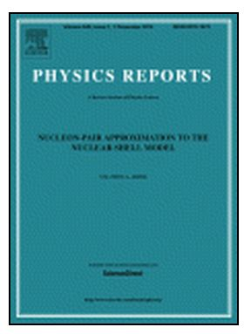
Great efforts have been devoted to develop nucleon-pair approximation, since the shell model established in 1949 (almost 70 years)
1952年 Single-j orbit (Racah)
1971年 Multi-j oribits (Talmi)
1981年 broken pairs (e.g., Allart 等)
1982-87年 Symmetry dictated pairs
(Ginocchio、C. L. Wu、J. Q. Chen, D. H. Feng)
1997年 Pair model (J. Q. Chen)
2000年 Unified formalism (YMZ, J. Q. Chen, A. Arima)
2013年 isospin-conserved pairs (G. J. Fu, YMZ, A. Arima)
2018年 particle-hole pairs （Y Y. Cheng, YMA, A. Arima）
Challenges: couplings of many-particles
Zhao and Arima,
Phys. Rep. 545, 1 (2014).

Slide 13
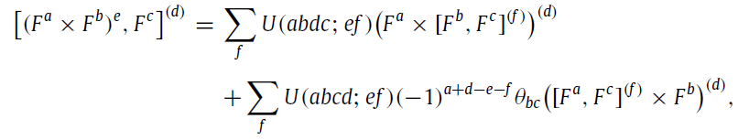
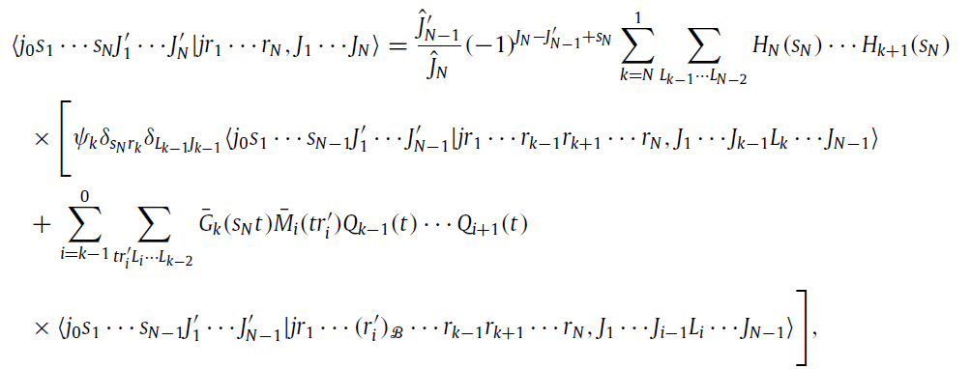
Fundamental formulas

Slide 14
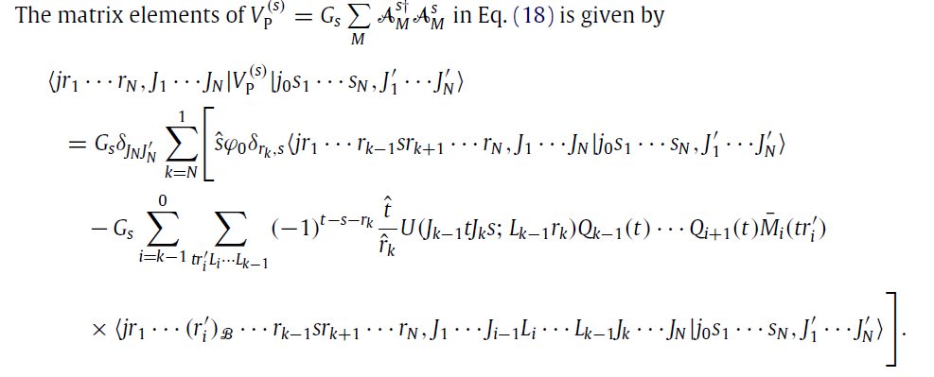

Slide 15

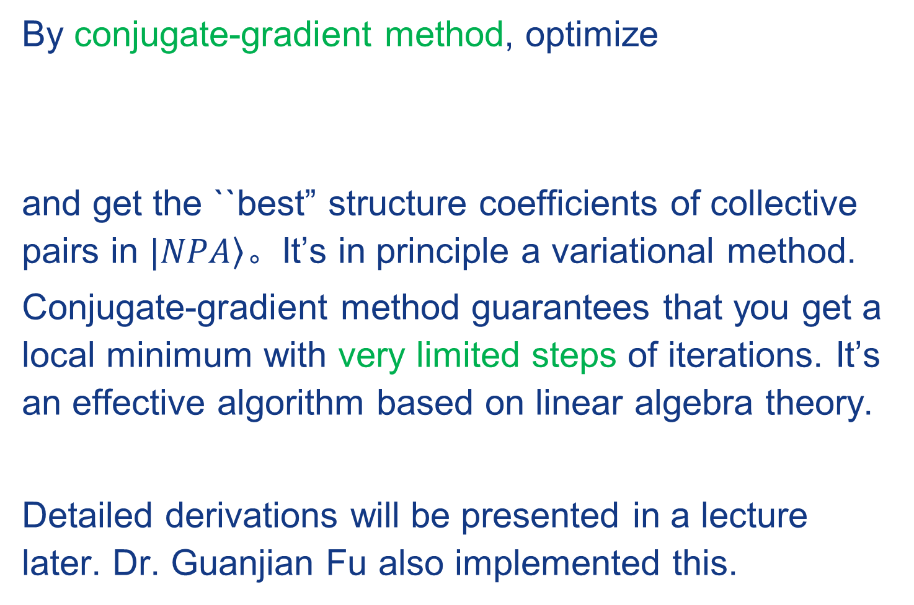
1、Nucleon-pair structure coefficients
By conjugate-gradient method, optimize
and get the ``best” structure coefficients of collective pairs in $|\left.NPA\right\rangle$。It’s in principle a variational method.
Conjugate-gradient method guarantees that you get a local minimum with very limited steps of iterations. It’s an effective algorithm based on linear algebra theory.
Detailed derivations will be presented in a lecture later. Dr. Guanjian Fu also implemented this.
This was one of challenges we have faced for a long time.

Slide 16
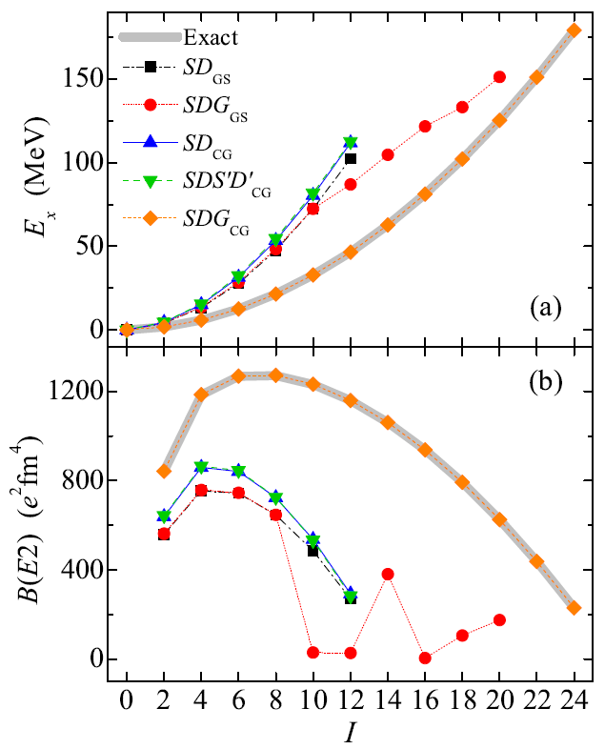
Results by Guan-Jian Fu
Elliott’s model in the pf shell
GS: pair-structure coefficients obtained in the generalized seniority scheme
(proton-neutron correlation is missing!)
CG: pair-structure coefficients optimized by iterative NPA calculations to minimize the ground-state energy
(numerically optimal solution for coefficients)

Slide 17
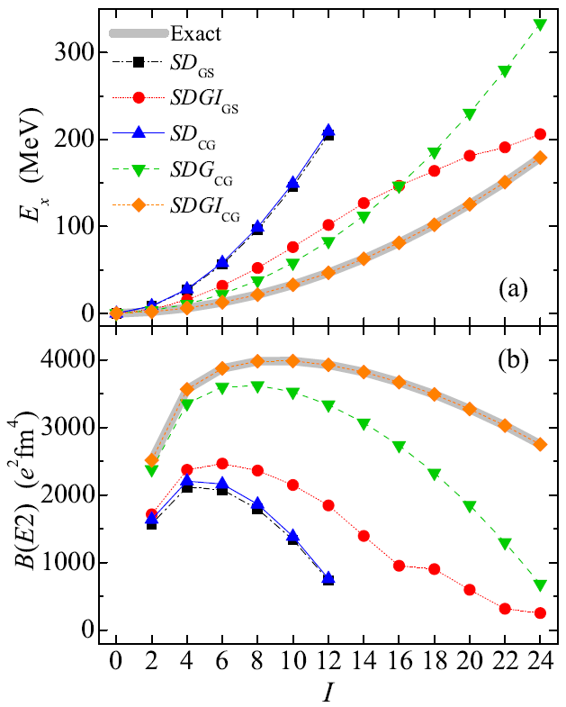
Results by Guan-Jian Fu
Elliott’s model in the sdg shell
GS: pair-structure coefficients obtained in the generalized seniority scheme
(proton-neutron correlation is missing!)
CG: pair-structure coefficients optimized by iterative NPA calculations to minimize the ground-state energy
(numerically optimal solution for coefficients)

Slide 18
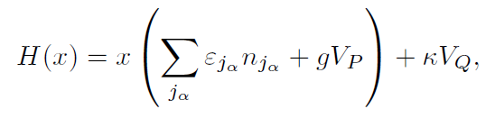
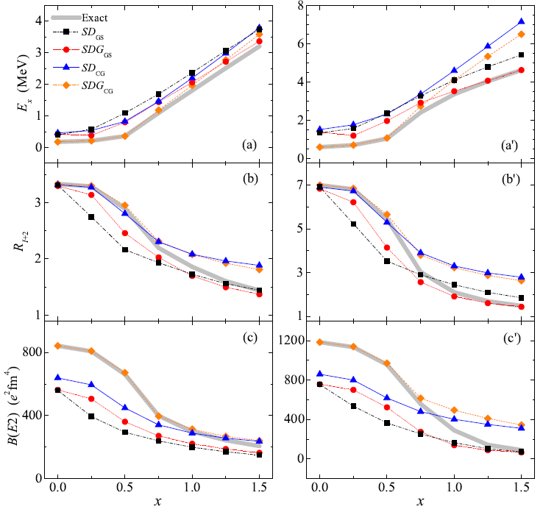
Results by Guan-Jian Fu
Shape evolution driven by interactions
I^{π} = 2⁺
I^{π} = 4⁺

Slide 19
We diagonalize the SM Hamiltonian in three spaces
2、Results mainly by Yi-Yuan Cheng, Nucleon-pair states !
1. Full shell-model space (SM)
2. Truncated NPA space (NPA)
3. One-dimensional, optimized pair basis state
All possible non-collective pairs
A few collective S and non-S pairs

Slide 20
Nucleon-pair states
Hamiltonian: monopole-optimized effective interactions based on realistic CD-Bonn nucleon-nucleon potential
(C. Qi et al., Phys. Rev. C 86, 044323)
Pair basis: constructed by 56 collective pairs which correspond to all wave functions obtained in the v≤2 space

Slide 21
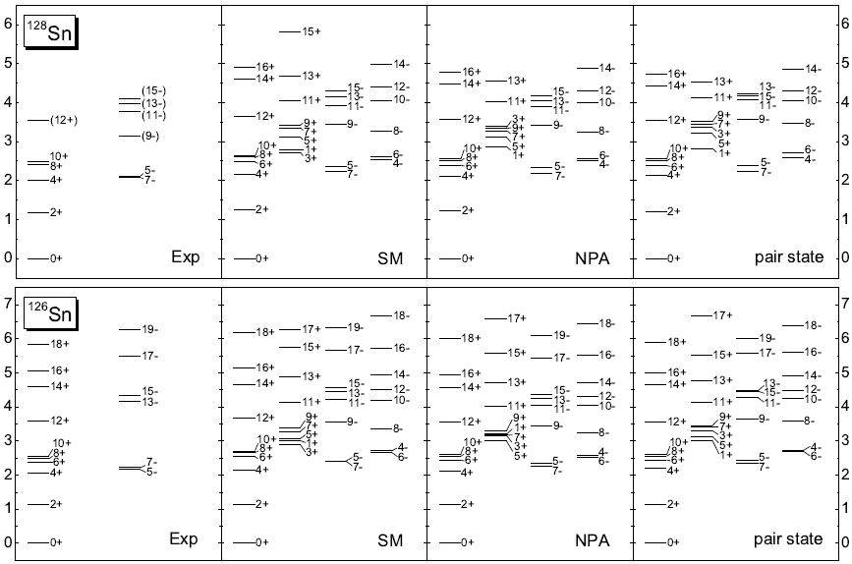
Nucleon-pair states
Y.Y.Cheng, et al.,PRC94, 024321(2016)

Slide 22
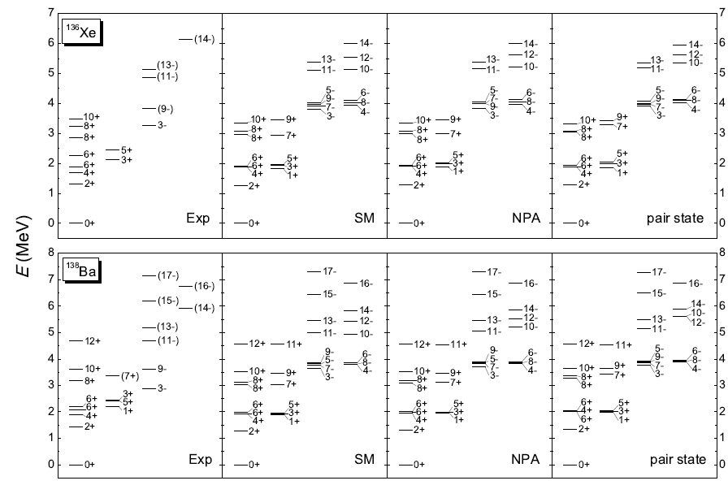
Pair states of N=82 isotones – energy levels
Y.Y.Cheng, Y.M.Zhao, A.Arima, PRC94, 024307(2016)

Slide 23
For each spin, we find a lowest-energy pairs, and then construct basis states by using these pairs. Then we calculate the diagonal matrix elements of the Hamiltonian.
The basis state which yields the lowest H_ii well represents the shell model wave function. We can this basis states as pair-states.
The solution is not unique. Non-orthogonal basis

Slide 24
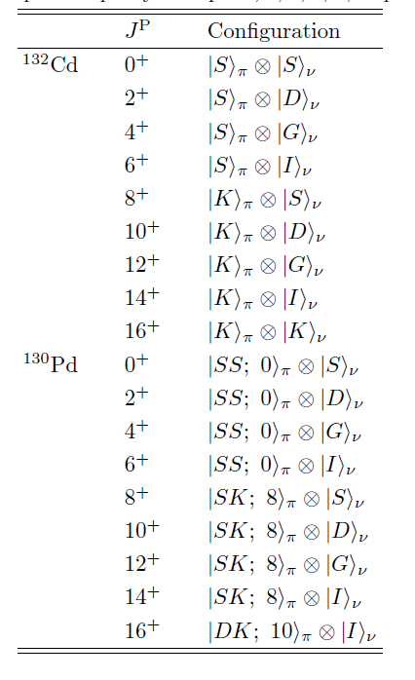
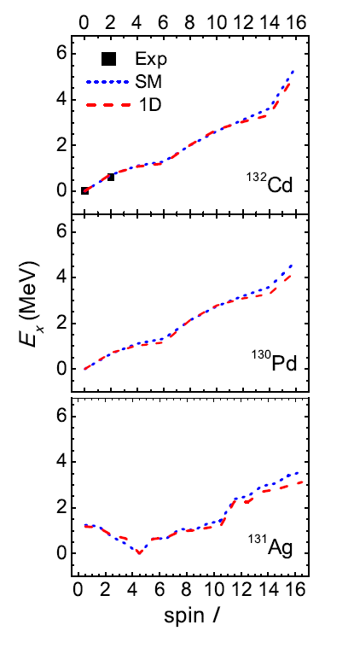
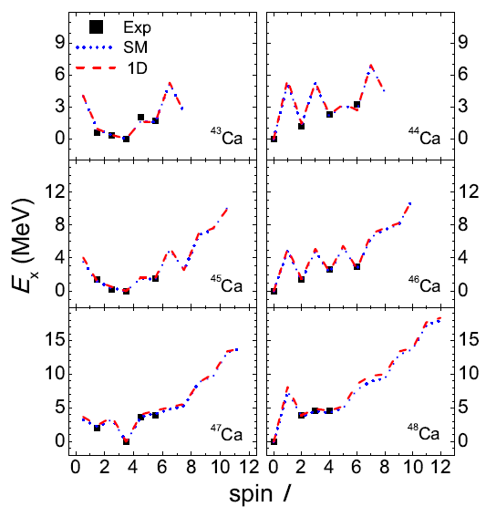
Results mainly by Y. Y. Cheng, Phys. Rev. C100 (2019), in press

Slide 25
苏东坡 (宋朝)
横看成岭侧成峰
远近高低各不同
The low-lying states are very simple in terms of nucleon pair basis; they are very complicated if we look at them in terms of other basis.

Slide 26
The reason why we are able to observe the existence of pair states, while it was difficult before is as follows.
We are able to perform exact shell model calculations in terms of nucleon pair basis states. Then it is very straightforward and easy for us to compare the two set of wave functions, exact shell model wave functions and nucleon-pair truncated functions. We can compute the overlap between the two.
<1 | 2> =? 1

Slide 27
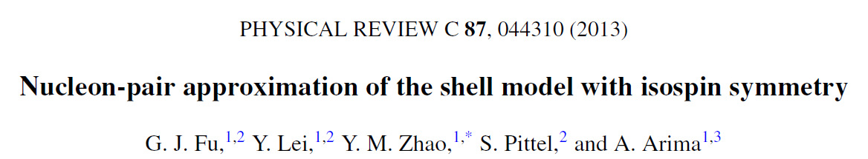
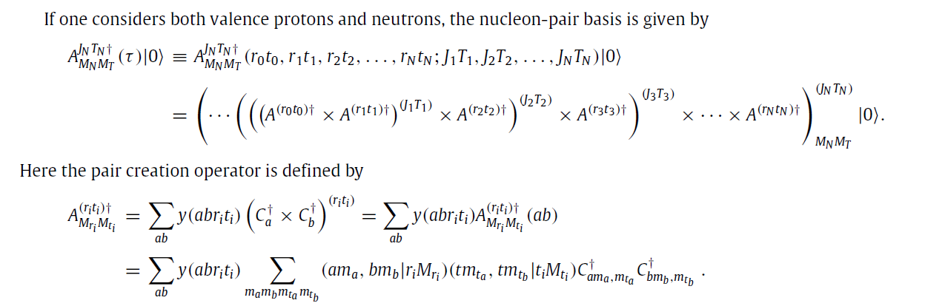
3、isoscalar pair correlation, mainly by Guan-Jian Fu

Slide 28
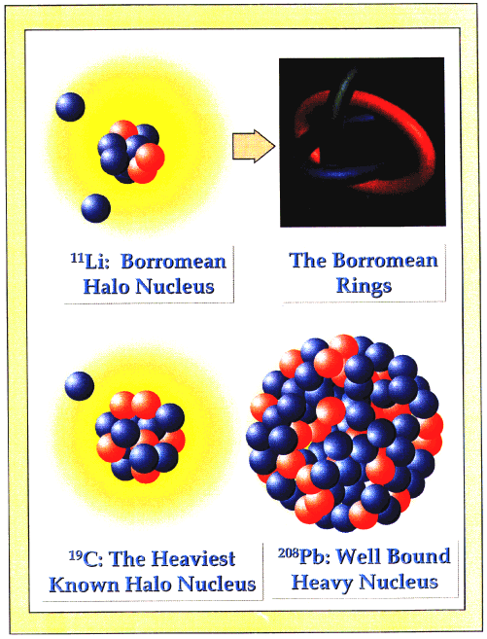
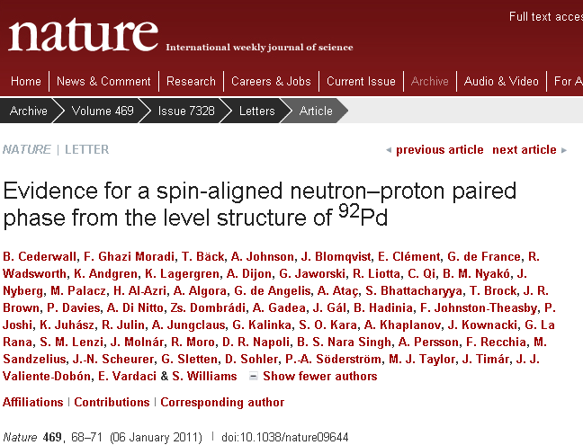
Spin-aligned neutron-proton pair
The Stockholm group reported the evidence of isoscalar spin-aligned pair configuration in low-lying states of the Pd-92 nucleus.
The NPA with isospin is the direct approach
to study this phenomenon.
Notes:
28

Slide 29
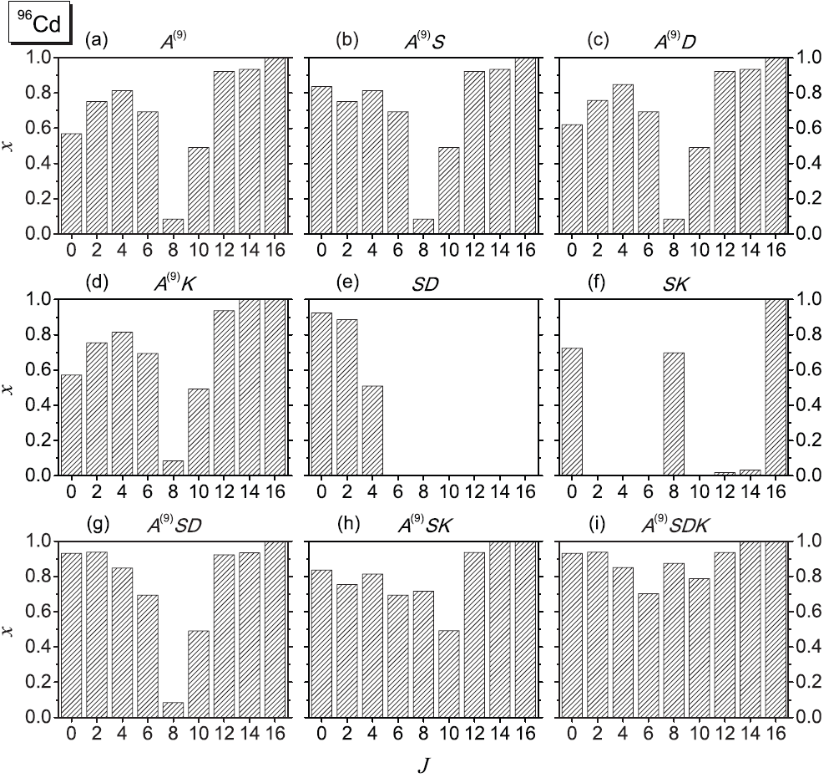
Fu, YMZ, Arima, PRC88, 054303 (2013).

Slide 30
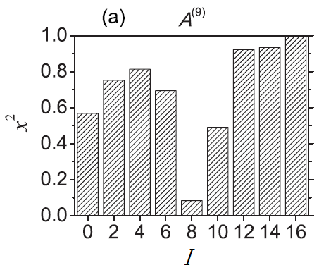

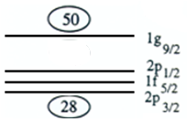
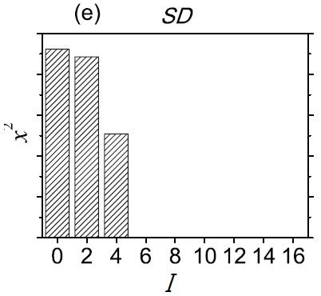
⁹⁶Cd: dual description
Results by Guan-Jian Fu
S pair: J=0,T=1
D pair : J=2,T=1
A⁽⁹⁾ pair : J=9,T=0
+ JUN45
Dual description:
Non-orthogonality feature of nucleon-pair basis!
Seniority two state
G. J. Fu, J. J. Shen, Y. M. Zhao, and A. Arima, Phys. Rev. C 87, 044312 (2013).

Slide 31
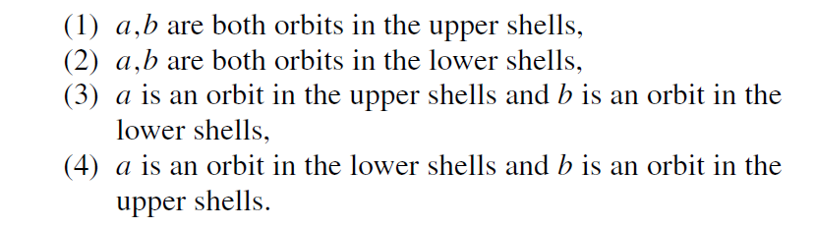
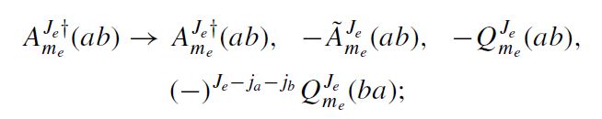
4、nucleon-pair model with particle-hole configurations, mainly by Yi-Yuan Cheng

Slide 32
Pair truncation for particle-hole excitations
“Mixed representation”
particle-particle
pair
hole-hole
pair
particle-hole
pair
not change
ph conjugate trans.
Two types of excitations across closed shell
can be flexibly included.
Y.Y.Cheng, Y.M.Zhao, A.Arima, PRC97, 024303(2018)

Slide 33

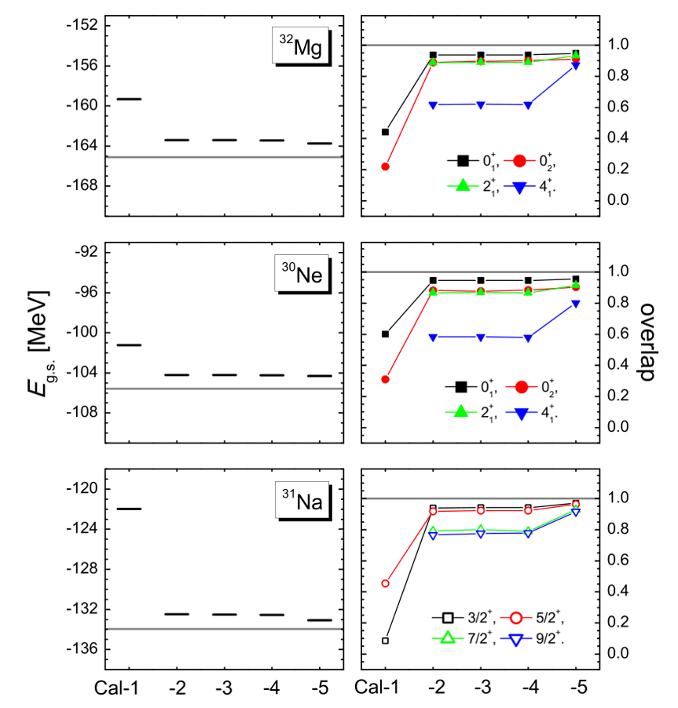
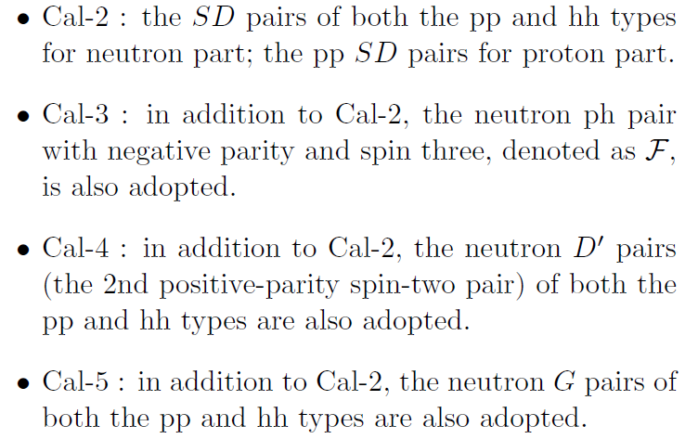
Inversion-island nuclei: validity study
particle-hole config. dominant
shape-coexisting state;
consistent with the result of two-neutron transfer reaction for Mg-32 (PRL 105, 252501)

Slide 34
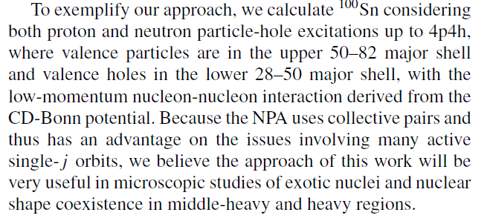

Slide 35
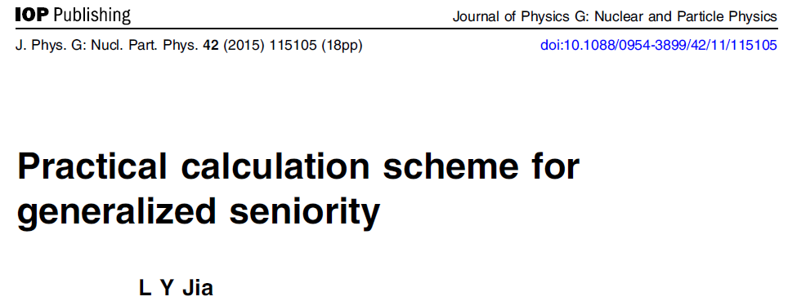
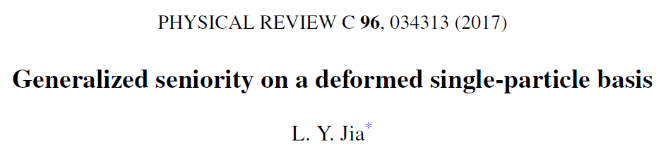
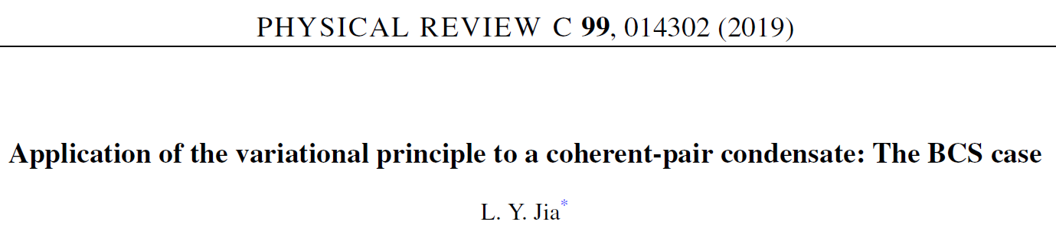
5、by Li-Yuan Jia : Generalized [Generalized Seniority approach]

Slide 36
Key Formula
Computer time cost depends on S (generalized seniority), independent of N (total number of valence nucleons).

Slide 37
III. Pairing correlation with random interactions

Slide 38
Why nuclear physicists (nuclear structure people) are interested in the present problem ?
Atomic nuclei provide ideal laboratories to study the features of microscopic many-body systems with finite number of constituents less than 300. They are complex objects with many degrees of freedom and exhibit almost all features found in other many-body systems. The regularities in atomic nuclei in the presence of random two-body interactions therefore provide us with an excellent window to study general features of low-lying states of many-body systems.

Slide 39
Why nuclear physicists (nuclear structure people) are interested in the present problem ?
In many-body systems such as molecules and atomic nuclei, the interactions by themselves have no trace of symmetry groups for vibrational or rotational modes. However, the low-lying states often exhibit a pattern suggestive of symmetries for these modes. One may ask to what extent the low-lying states acquire order from the basic properties of interactions such as rotational invariance and possibly other symmetries such as isospin invariance. In other words, some properties such as vibration or rotation might dominantly occur in the low-lying states of many-body systems while the others might occur only with small probabilities.

Slide 40
Why nuclear physicists (nuclear structure people) are interested in the present problem ?
Spin zero parity plus ground state for even-even nuclei, odd-even staggering of binding energies, collective motion, …
One can ask whether these features are robust for general many-body systems. This can be studied by permitting interactions to be more and more arbitrary.
/噪声(noises)对于集体运动的影响—1980年代。

Slide 41
What does 0 g.s. dominance mean ?
In 1998, Johnson, Bertsch, and Dean discovered that spin parity =0+ ground state dominance can be obtained by using random two-body interactions (Phys. Rev. Lett. 80, 2749)．
This result is called the 0 g.s. dominance.
Similar phenomenon was found in other systems, say, sd-boson systems.
C. W. Johnson et al., PRL80, 2749 (1998);/Zuker, 1982 ？？
R. Bijker et al., PRL84, 420 (2000);
L. Kaplan et al., PRB65, 235120 (2002).

Slide 42
Shell model calculation

Slide 44
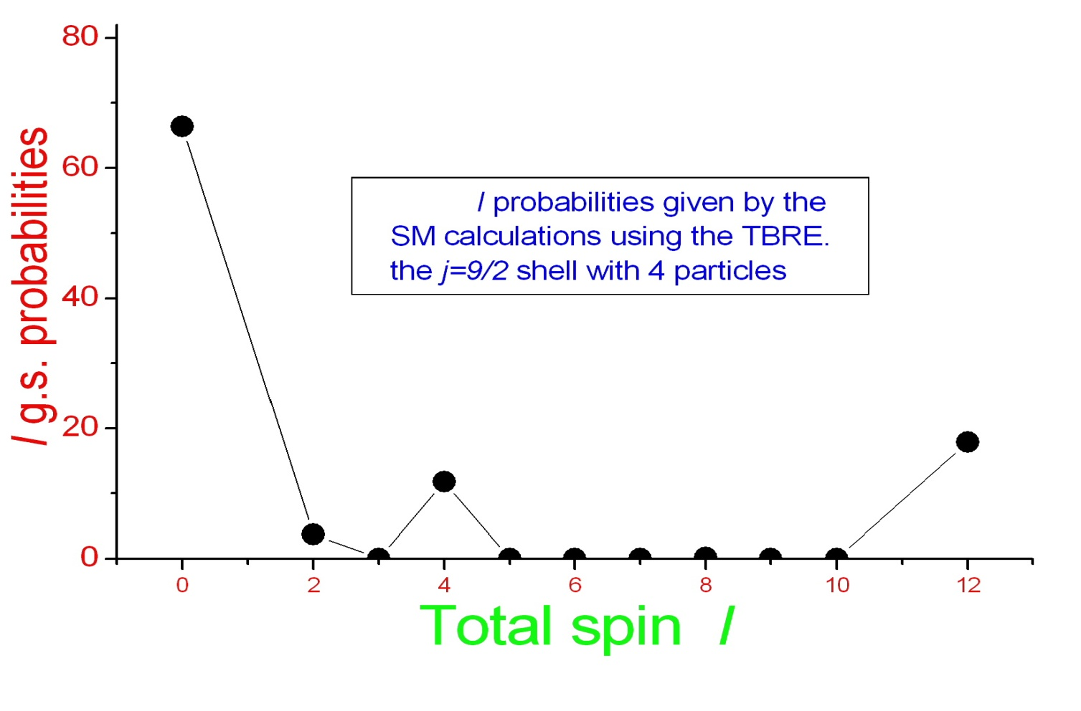

Slide 45
Parity distribution in the ground states
(A) Both protons and neutrons are in the shell which corresponds to nuclei with both proton number Z and neutron number N ~40;
(B) Protons in the shell and neutrons in the shell which correspond to nuclei with Z~40 and N~50;
(C) Both protons and neutrons are in the shell which correspond to nuclei with Z and N~82;
(D) Protons in the shell and neutrons in the
shell which correspond to nuclei with Z~50 and N~82.

Slide 47



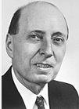


随机作用下偶偶核基态自旋为零，即使没有对力也如此【a big surprise】。该问题是挑战性问题，受到了广泛关注。
学术创新点&
被摘引情况
Wigner Commented on this problem:“Computers understand this problem , and I wish to understand it, too. ”
基态J=0

Slide 48
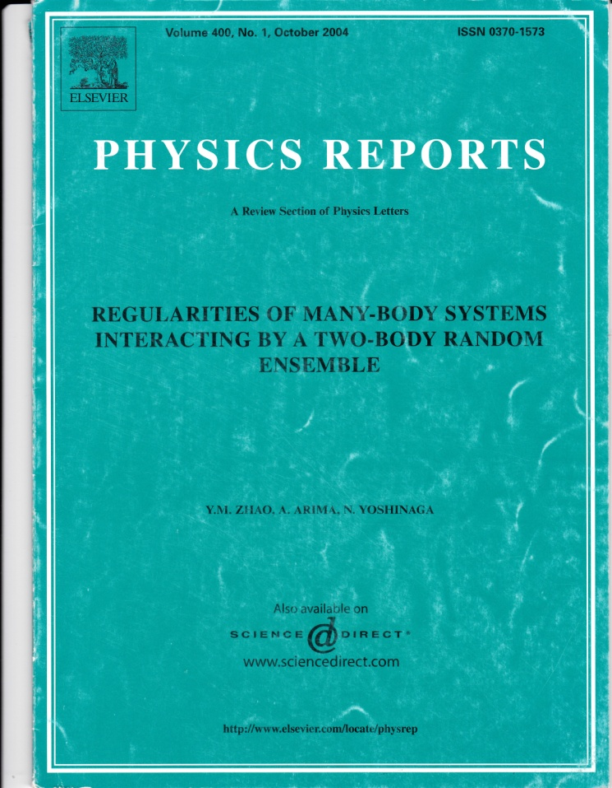
Physics Reports Vol. 400, 1 (2004).
创新点
★ 准确预言不同自旋基态上的几率
★ 揭示基态自旋为零来自特别相互作用
【没有这些作用基态自旋为零现象消失】
★ 预言基态取最大自旋几率的新规律。
Y. M. ZHAO, A. ARIMA, N. YOSHINAGA

Slide 49
A more recent efforts have been summarized in
a review paper by me in Frontiers of Physics (2018),
in honor of Professor Arima’s 88 birthday

Slide 50
4、Predicting atomic masses by extrapolations
We have suggested many empirical formulas, called local mass relations, in the last ten years.
Here I wish to mention one interesting result, which is as follows.

Slide 51
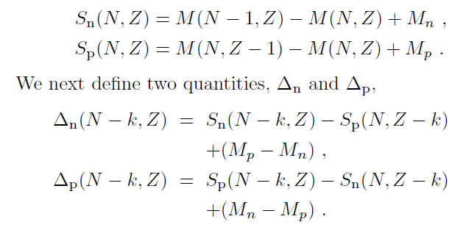

Slide 52
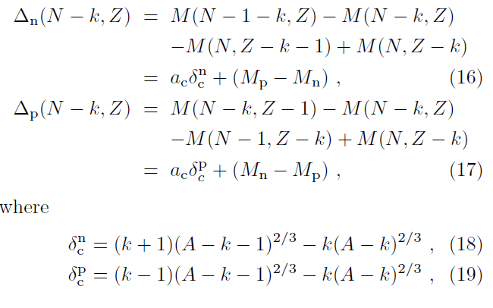
We suggest very simple relations which works remarkably well
for light nuclei, based on isospin symmetry !!

Slide 53
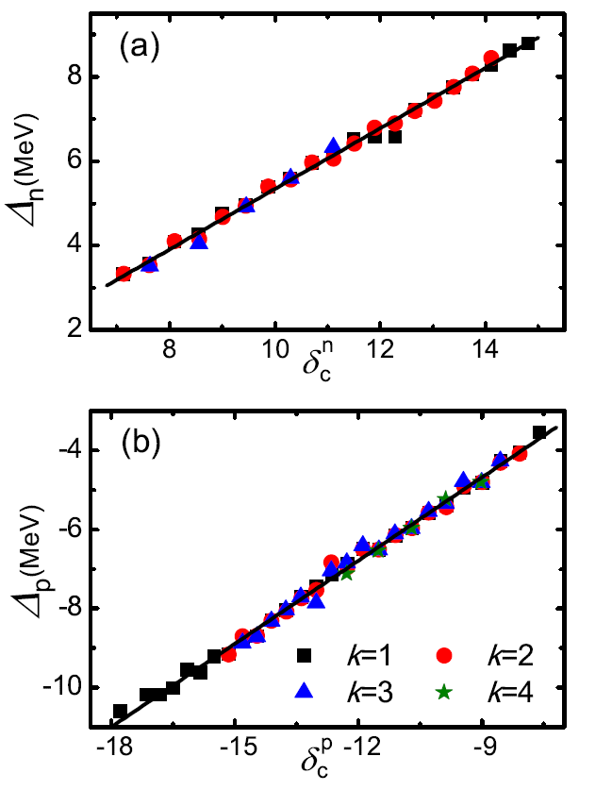

Slide 54
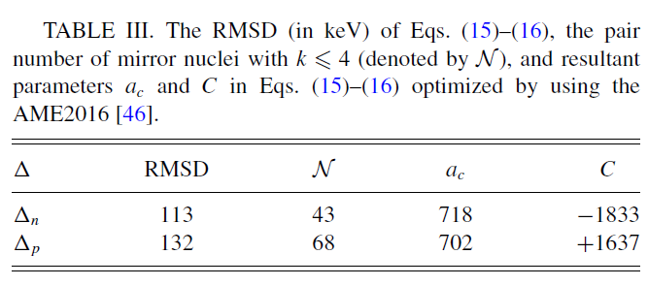
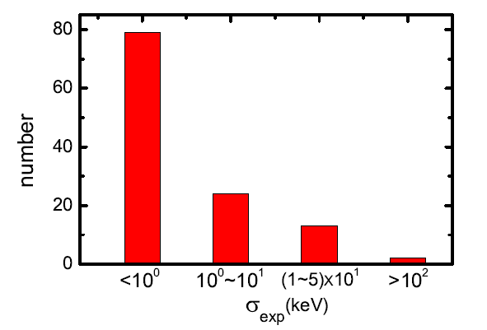
Y. Y. Zong et al., PRC100, in press.

Slide 55
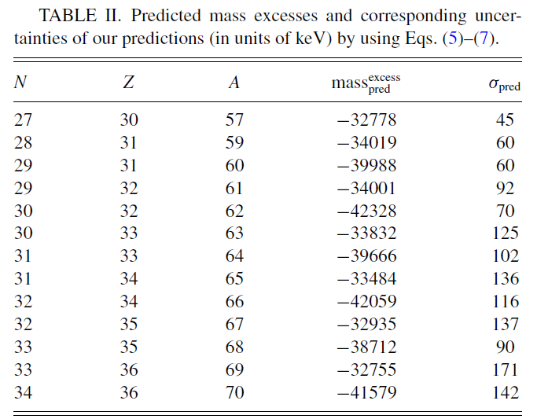

Slide 56
Summary: Nucleon Pairs and Pairing correlation in atomic Nuclei
An introduction to pairing correlation
nucleon-pair truncation approach
YMZ, AA, Yoshinaga, Physics Reports, Vol. 400, 1 (2004).
pairing correlation with random interactions
YMZ, AA, Physics Reports, Vol. 545, 1 (2014).
odd-even features in nuclear mass models
Y. Y. Zong et al., PRC100, in press.

Slide 57

1、low-lying states of heavy nuclei
2、isoscalar pairing phenomena
3、particle-hole excitations
4、unbound states, exotic states
5、random interactions
6、nuclear mass models
perspective

Slide 58
THANK YOU FOR YOUR ATTENTION !

