Slide 1
Proton mass and RAON
Youngman Kim
Institute for Basic Science, Daejeon, Korea

Slide 2
QCD vacuum and RAON: proton mass as an example
Accurate, reliable and microscopic theoretical description of nuclear properties should be the top priority.
At the same time, one has to try to propose a (relatively new) topic to enrich RAON science.
Anyhow, to prove/falsify the new topic, the microscopic theory should be timely developed.

Slide 3
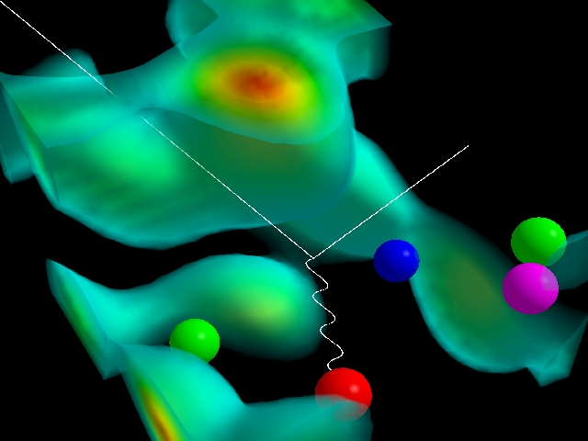
Artist's Rendition of a Proton
Three quarks indicated by red, green and blue spheres (lower left) are localized by the gluon field.
A quark-antiquark pair created from the gluon field is illustrated by the green-antigreen (magenta) quark pair on the right. These quark pairs give rise to a meson cloud around the proton.
The masses of the quarks illustrated in this diagram account for only 3% of the proton mass. The gluon field is responsible for the remaining 97% of the proton's mass and is the origin of mass in most everything around us.
Experimentalists probe the structure of the proton by scattering electrons (white line) off quarks which interact by exchanging a quantum of light (wavy line) known as a photon.
http://www.physics.adelaide.edu.au/theory/staff/leinweber/VisualQCD/QCDvacuum/

Slide 4
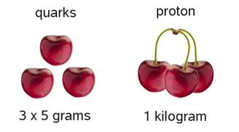
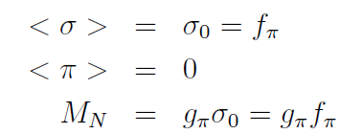
Origin of nucleon mass?
Can nuclear matter and nuclei do anything for this?
Nucleon mass (in the chiral limit) in the linear sigma model

Slide 5
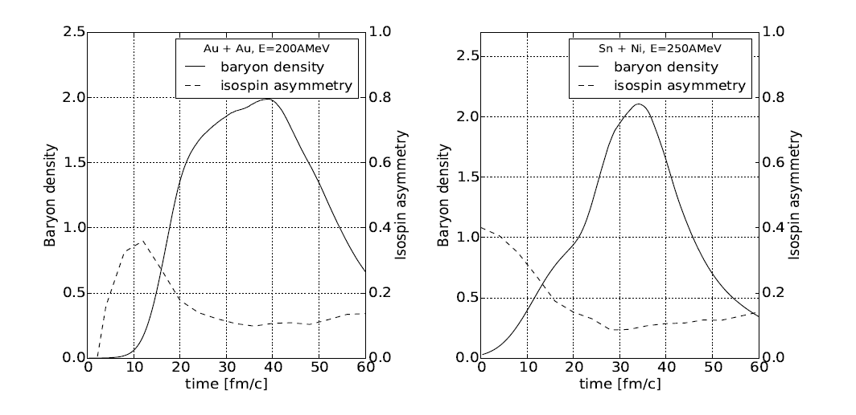
Yujeong Lee, Chang-Hwan Lee, YK, T. Gaitanos, JKPS 69 1430 (2016)
From RBUU simulation

Slide 6
Contents
QCD at low energy (quark-antiquark condensate, etc)
In terms of hadrons
In terms of quarks
Summary

Slide 7
Low energy QCD
Mesons and baryons
(spontaneous) Chiral symmetry breaking
Condensates
Various EFTs

Slide 8
Chiral symmetry at low energy
Note that gluons are flavor-blind
: vector transform
: axial-vector transform

Slide 9
Chiral symmetry breaking
→ Explicit chiral symmtery breaking
→ chiral limit: m=0
→ SSB of chiral symmetry

Slide 10
A BCS-like trial ground state --> true vacuum contains chiral (quark-antiquark) condensates in free space [Finger & Mandula, NPB 199, 168 (1982)]
In dense matter, chiral condensates will be reduced as low energy phase space is already occupied by the fermions in Fermi sea.
Therefore, nucleon mass from spontaneous chiral symmetry is supposed to be reduced in dense matter.

Slide 11
Mesons and chiral symmetry
→

Slide 12
Linear sigma-model
* SSB →

Slide 13
Parity doublet model in dense matter
Introduce two nucleon fields that transform in a mirror way under chiral transformations:

Slide 14
The state N+ is the nucleon N(938). while N- is its parity partner conventionally identified with N(1500).
“Linear sigma model with parity doubling,” C. E. DeTar and T. Kunihiro, Phys. Rev. D 39, 2805 (1989)

Slide 15
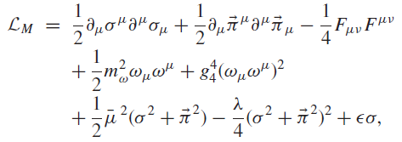
Cold, dense nuclear matter in a SU(2) parity doublet model
D. Zschiesche, L. Tolos, Jurgen Schaffner-Bielich, Robert D. Pisarski, Phys.Rev. C75 (2007) 055202

Slide 16
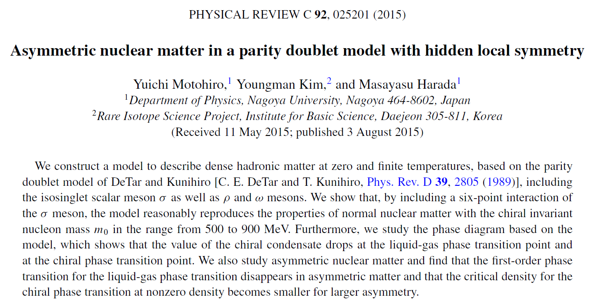
Y. Motohiro, M. Harada, YK, Erratum: Phys.Rev. C95 (2017) 059903

Slide 17
Delta matter in a parity doublet model (within MFA)
Yusuke Takeda, YK, Masayasu Harada, Phys. Rev. C97 (2018) 065202
* In symmetric matter, Delta enters into matter at (1-4) times the saturation density.
The stable Δ-nucleon matter is realized around 1.5 times the saturation density, and the phase transition from nuclear matter to Δ-nucleon matter is of first order in the wide parameter region.
* In asymmetric matter, the phase transition from the nuclear matter to the stable Δ-nucleon matter can be of the second order for most parameter region. The onset density is smaller than that in symmetric matter.
* In symmetric dense matter, larger chiral invariant nucleon mass tends to lower the transition density to the stable N-Δ phase.
* Partial restoration of chiral symmetry is enhanced by Delta matter.

Slide 18
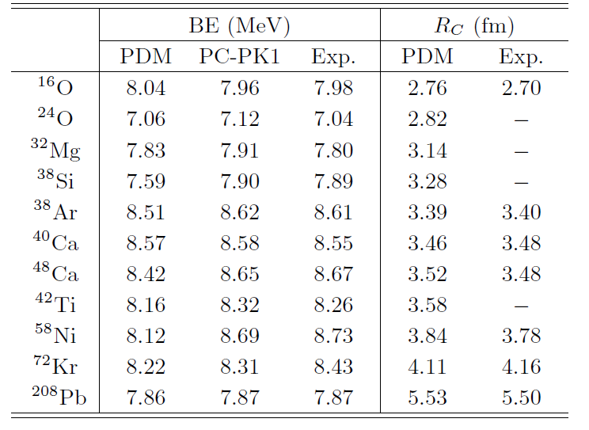
We observed that our results, especially the binding energies, are closest to the experiments when we take m₀ = 700 MeV.
Ik Jae Shin, Won-Gi Paeng, Masayasu Harada, YK, 1805.03402 in nucl-th

Slide 19
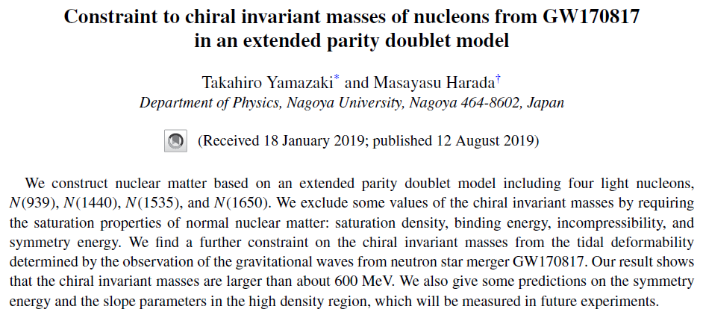

Slide 20
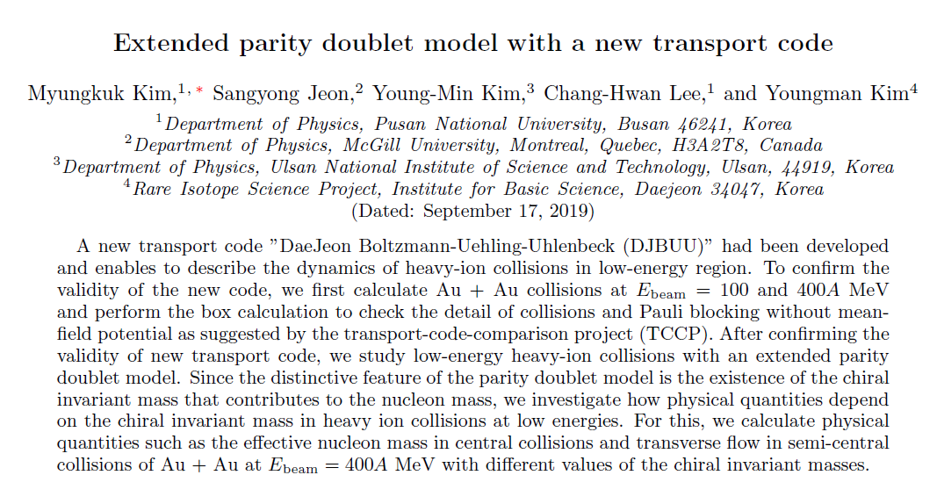

Slide 21
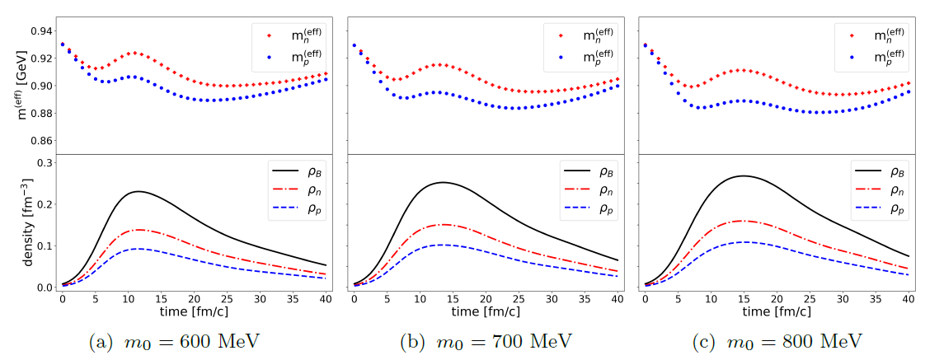

Slide 22
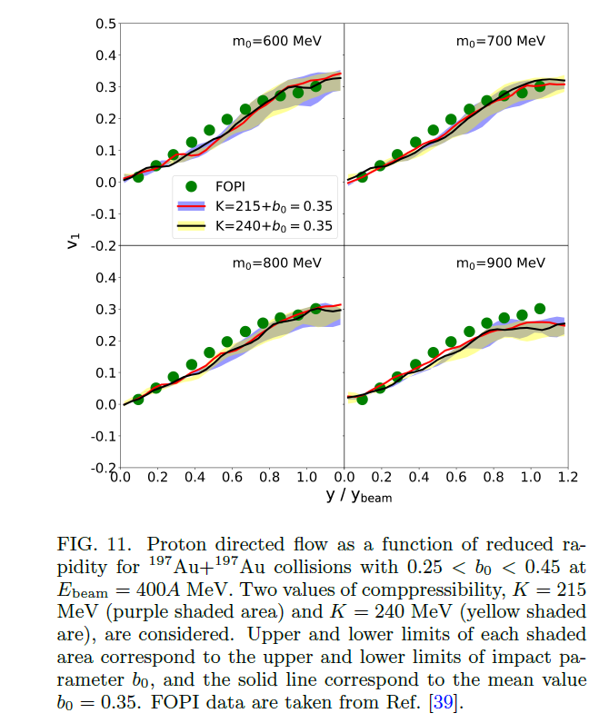

Slide 23
In terms of quark degrees of freedoms
QCD vacuum is often characterized by non-trivial gluon background configuration.
Hadrons does not carry color charges.
Back to old wisdom: constituent quark picture, chiral symmetry, explicit gluon field.
M_{p}=3m_{Q}
There is an adequate model, called chiral quark model.
We assume that the mass of constituent quark mass in the model has two components.

Slide 24
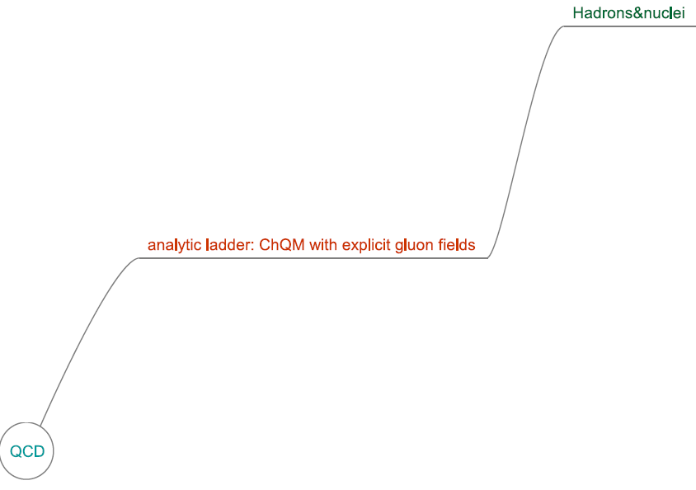
Chiral quarks in Savvidy vacuum

Slide 25
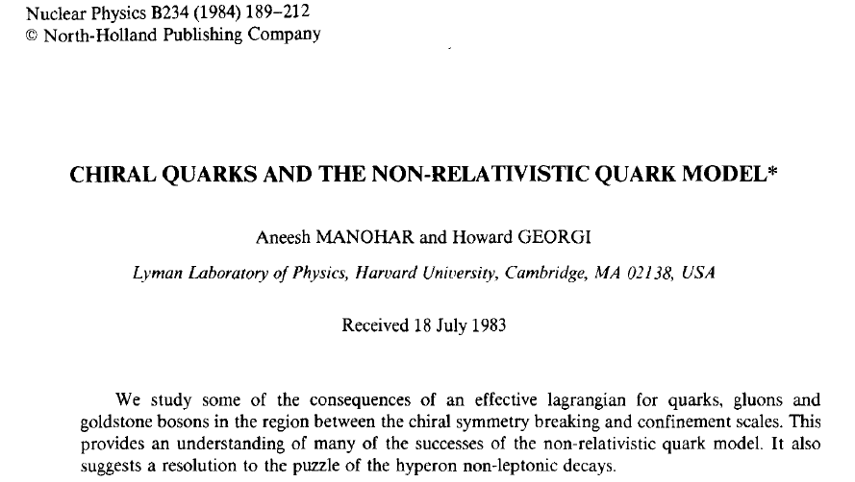
The success of the NR QM?
First of all the quarks should be massive, having constituent mass.
So, we assume that the bulk of the light quark mass is the effect of
chiral symmetry breaking.
The leading contribution to the baryon mass is just sum of
the constituent quark masses.

Slide 26
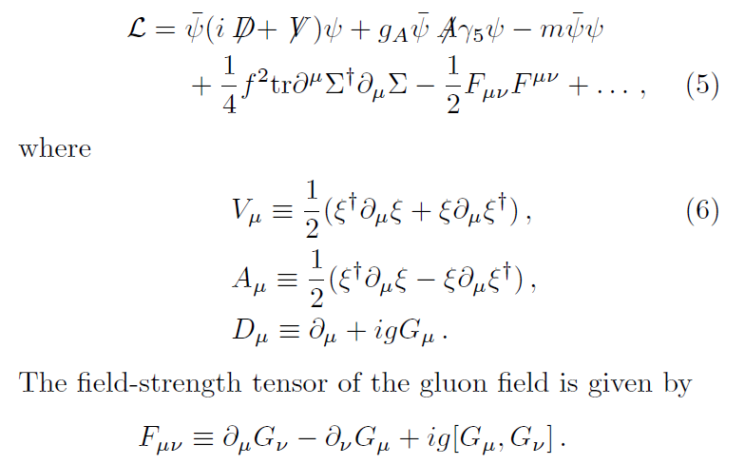

Slide 27
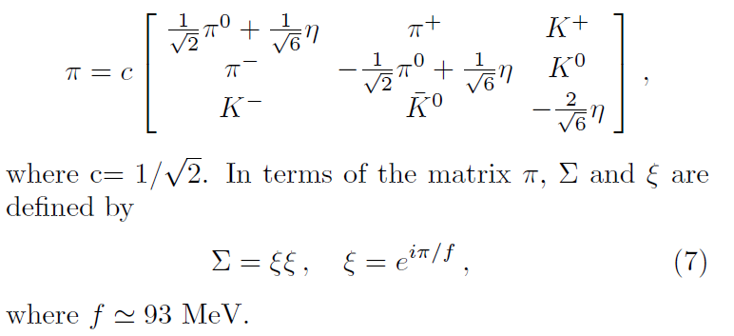

Slide 28
Pions are perturbative!
How about gluons?
which was computed by looking at the ratio of color and electromagnetic hyperfine splittings of the baryon spectrum

Slide 29
Then no room for the gluon in this model to develop any non-trivial v.e.v?
Yes, if the constituent mass is not fully from quark-antiquark condensate.
After all, Copenhagen (Spagetti) vacuum has also a small gauge coupling constant!

Slide 30
Background gluon field?
Reminder: fermions in external field

Slide 32
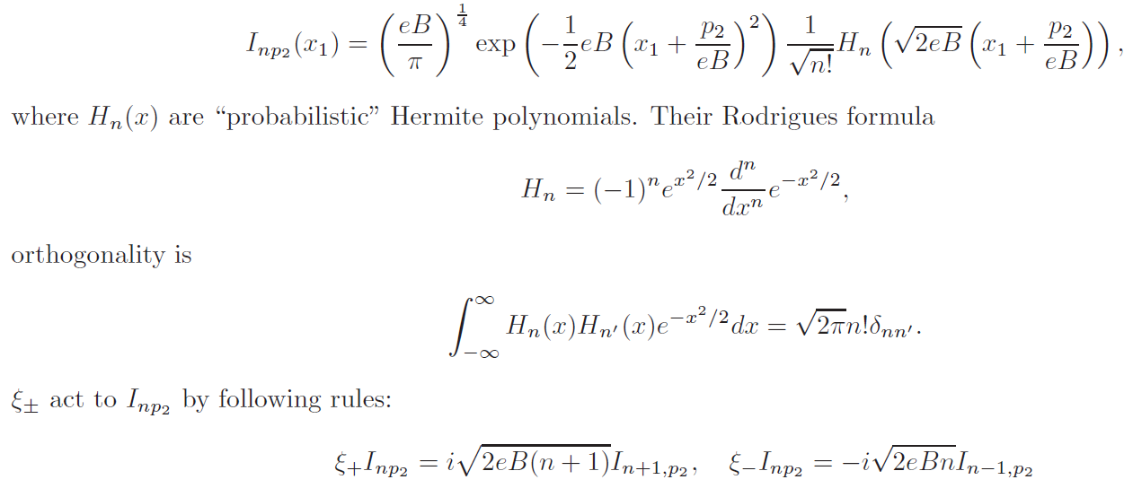

Slide 34
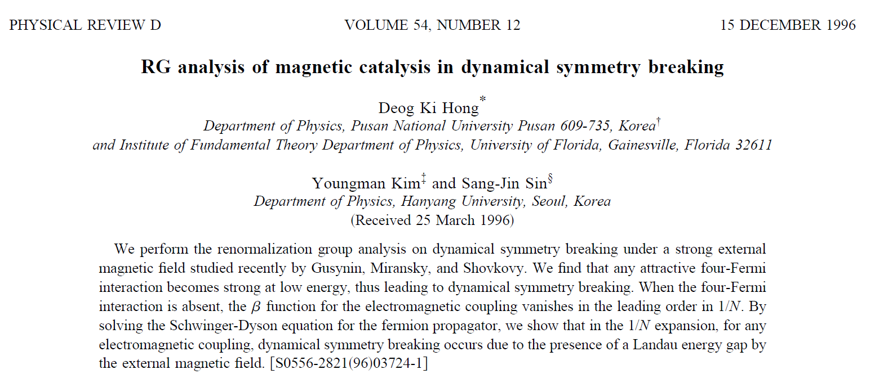
Fermions at the LLL are 1+1 dimensional !

Slide 35
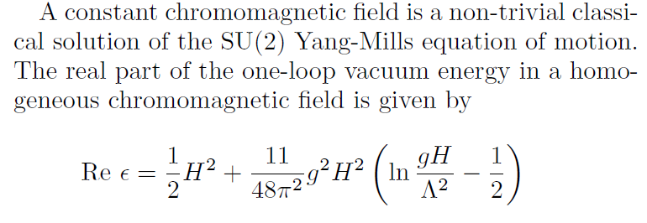

Slide 36
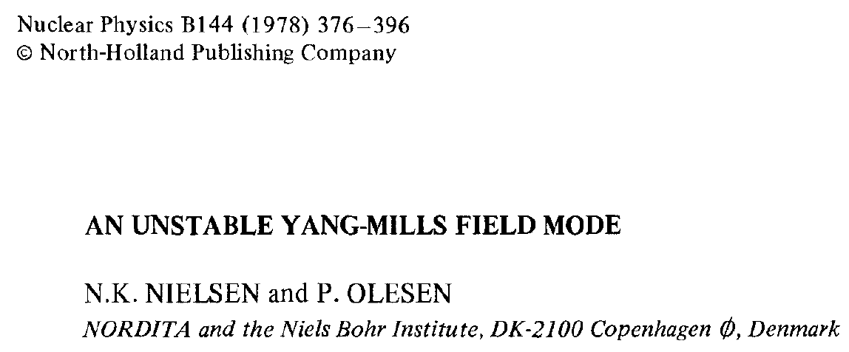
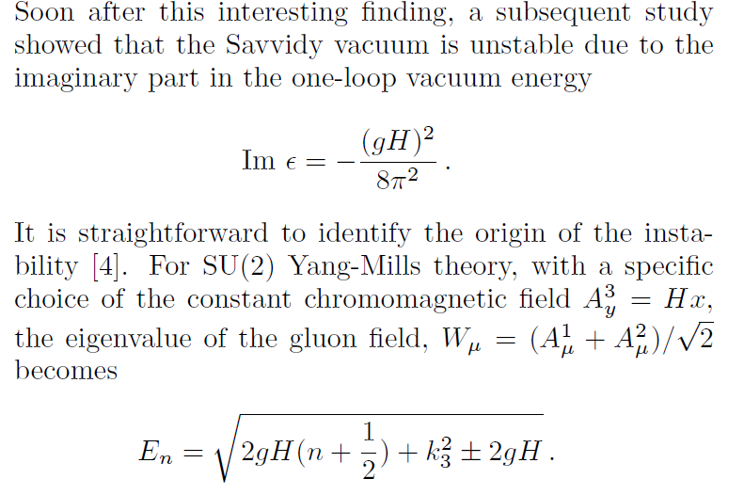

Slide 37
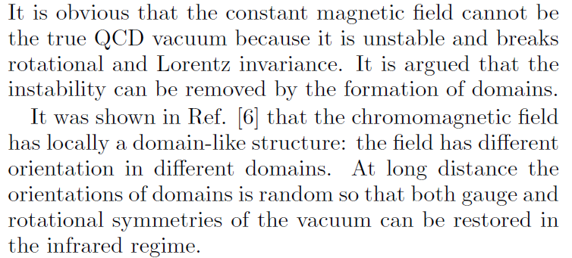
Extension to SU(3) and SU(4) were done in Ref. [5].
The domain structure introduces an infrared cutoff that prevents the momenta from taking the smaller values causing the instability
(it is still controversial, though …)

Slide 39
At least for the evaluation of the effective action, we can use the results
from dense matter with external U(1) magnetic field.
The difference is that the gluon field has a color matrix T³ whose
eigenvalue is +1/2, -1/2.

Slide 40
P. Elmfors, D. Persson, B.-S. Skagerstam, Astroparticle Physics (1994),
D. Persson, V. Zeitlin, Phys. Rev. D 51 (1995), …
Explicit evaluations of the mass corrections at one-loop
with H in dense matter is underway with Igor Mazru (CENuM).

Slide 41
Summary
ChQM + (improved) Savvidy vacuum may be a way to connect QCD vacuum with real world.
Since certain gluon background fields ensure confinement, the combined one may also provide a handy platform for QM and NM.
As a concrete attempt; ChQM in Savvidy vacuum (H) → chiral invariant mass → parity doublet model→ dense matter, finite nuclei, observables in HIC through nuclear transport.
Hoping to enrich RI physics!

