Slide 1

Isoscalar Pair Condensation and Tensor Force inside Nuclei
Myung-Ki Cheoun¹
in collaboration with
Eun Ja Ha^{1,} W. Y. So³ and Hiroyuki Sagawa²
Origin of Matter and Evolution of Galaxy (OMEG) Institute, Soongsil University, Seoul, Korea
RIKEN and University of Aizu, Japan
Kangwon National University, Dogae, Korea

Slide 2
Contents
Motivations
Formalism
Results
Summary
Motivation
Formalism
- Deformation & Pairing correlation in nuclei
The ratio of Isoscalar(IS) and Isovector(IV) pairing in N=Z nuclei
(Ongoing work)
- Summary 1
4. Effects of deformation & pairing correlations
in the ground & excited state (for Gamow-Teller transition).
(Previous work)
- Summary 2
Notes:
Nucleus is a many-body system. So it is impossible to solve the problem exactly. We introduce the meanfield concept. But there is still short range force
Which is considered by the pairing correlation.

Slide 3
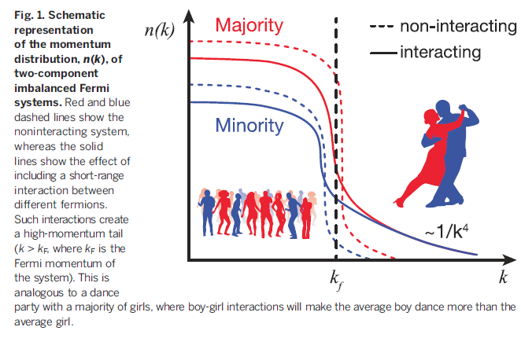

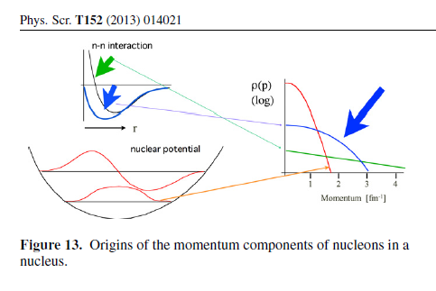
Mean field potential (Fermi momentum)
gives the low momentum region.
N-N SRC gives high momentum.
Tensor force contributes also
to the high momentum.

Slide 4
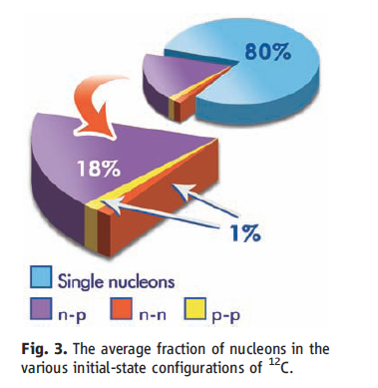
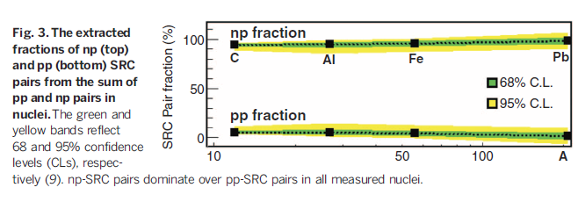
High momentum part in 12C configuration is dominated by n-p SRC.
But, the SRC is not necessarily to be tensor force ! !

Slide 5
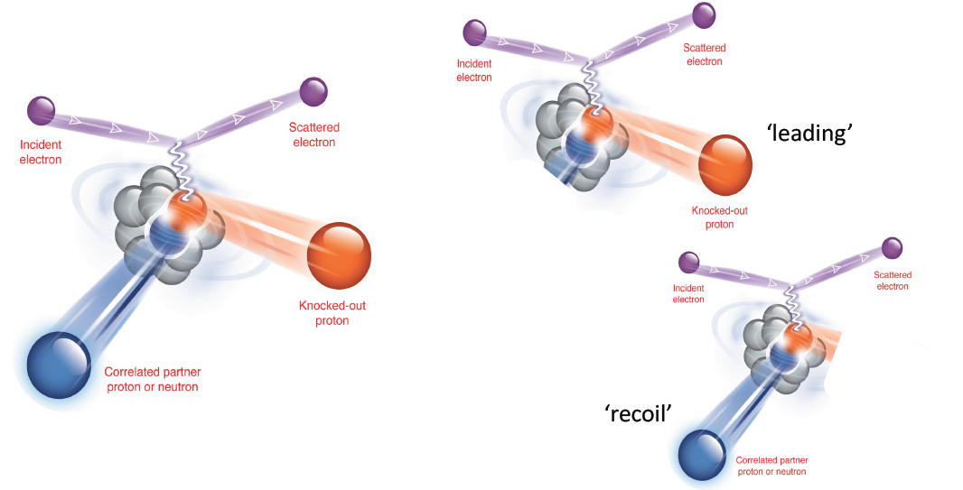
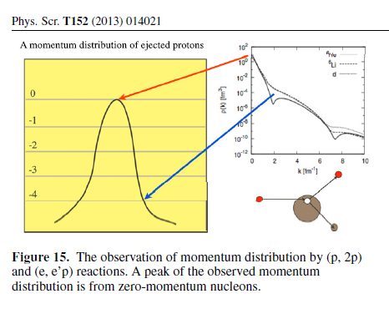
But, the high momentum part is four times
smaller than the main strong peak
by the incident particle and kicked out proton.

Slide 6
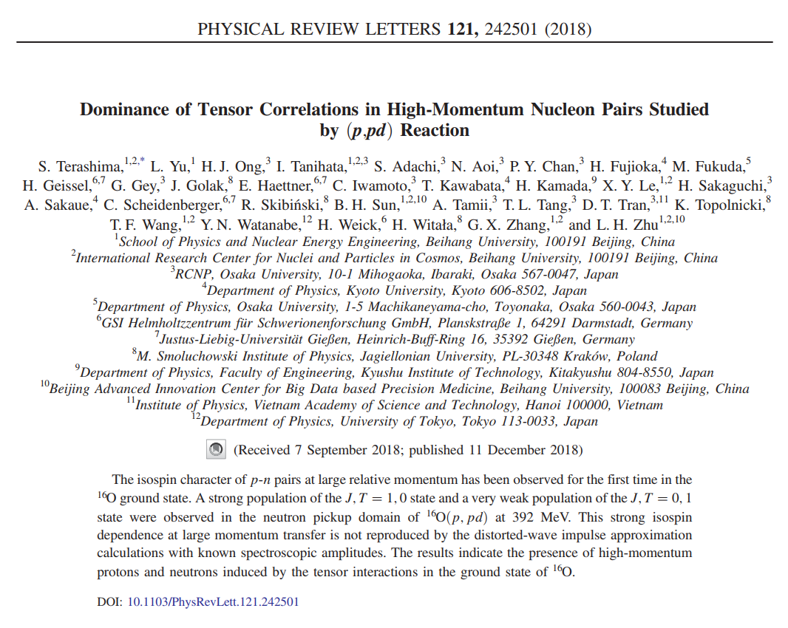
Motivations
Formalism
Results
Summary

Slide 7
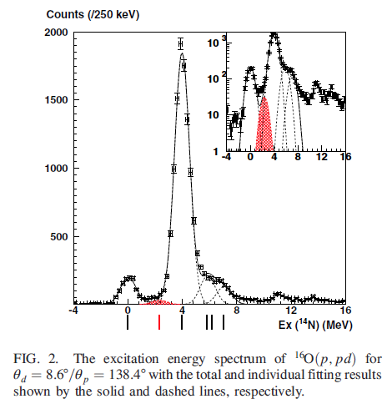
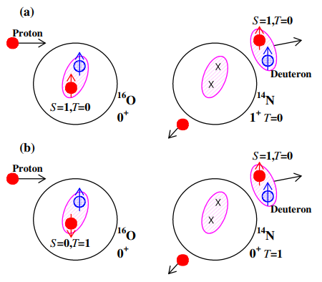

Motivations
Formalism
Results
Summary
$16O\left(p,pd\right)…. \& (p,d)reaction$
S.Terashima, et al. PRL 121 (2018)
S=1,T=0 channel (by tensor force) in the cross section is small, but can be measurable from 14N spectrum through (p,pd) reactions.
The unlike-pairing correlations coupled through a higher momentum, L= 2, can exist inside nuclei, which is a direct measure of the tensor force in the ground state of N=Z nuclei.
Notes:
After a proton and T=0 pair collide deuteron is emitted.

Slide 8
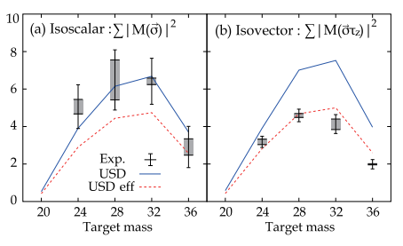
Motivations
Formalism
Results
Summary
M1 spin transition data shows the IV quenching for the N = Z sd-shell nuclei.
: IS T = 0 pairing by the tensor force well-known in deuteron structure may
become more significant even inside nuclei.
According to a study on the relationship between nuclear deformation and np-pairing correlation, the IV and IS pairing may have a large coexistence and the deformation can cause the quenching of the IV np-pairing.
H. Matsubara, et al. PRL 115 (2015)
: One multiplies a factor 1.5 due to IV quenching for the IS T=0 pairing.
Sagawa et al.
Danilo Gambacurta, et al. PRC 91 (2015)

Slide 9
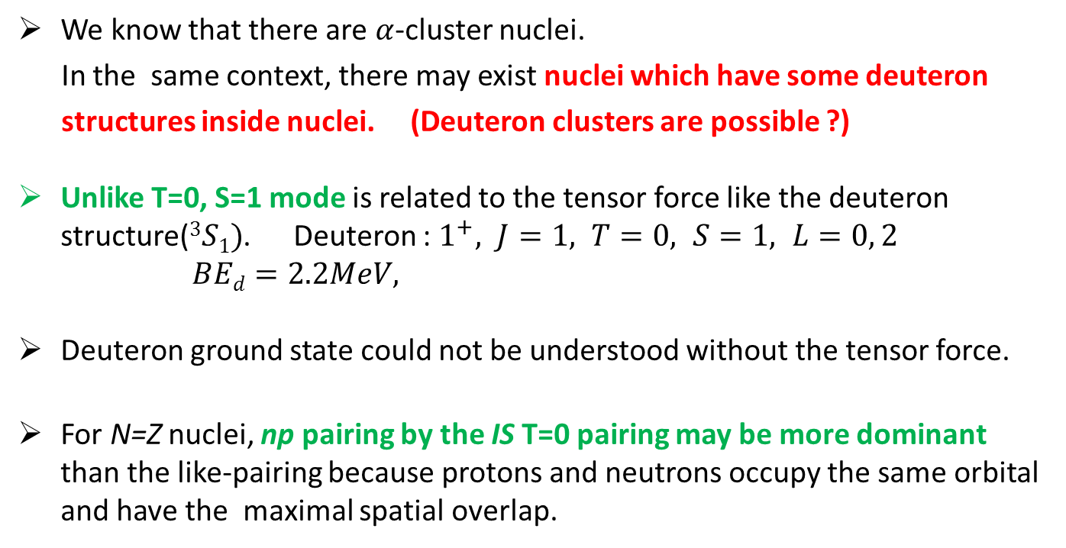
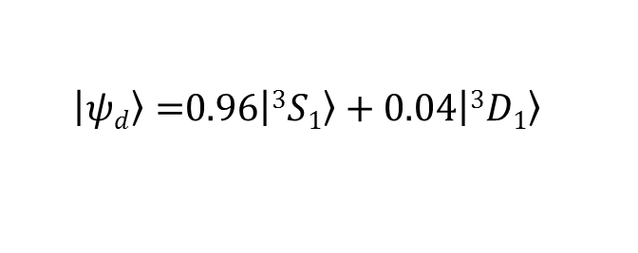
Motivations
Formalism
Results
Summary
Deuteron-like structures in N=Z nuclei ? Or How about the n-p SRC ?
We know that there are $α$-cluster nuclei.
In the same context, there may exist nuclei which have some deuteron
structures inside nuclei. (Deuteron clusters are possible ?)
Unlike T=0, S=1 mode is related to the tensor force like the deuteron structure($3S1)$. Deuteron : $1^{+}, J=1, T=0, S=1, L=0, 2$
$BEd=2.2MeV,$
Deuteron ground state could not be understood without the tensor force.
For N=Z nuclei, np pairing by the IS T=0 pairing may be more dominant than the like-pairing because protons and neutrons occupy the same orbital and have the maximal spatial overlap.
$\left|\left.ψd\right\rangle =\right.0.96\left|\left.3S1\right\rangle \right.+0.04\left|\left.3D1\right\rangle \right.$
Notes:
Deuteron ground state could not be understood without tensor force.

Slide 10
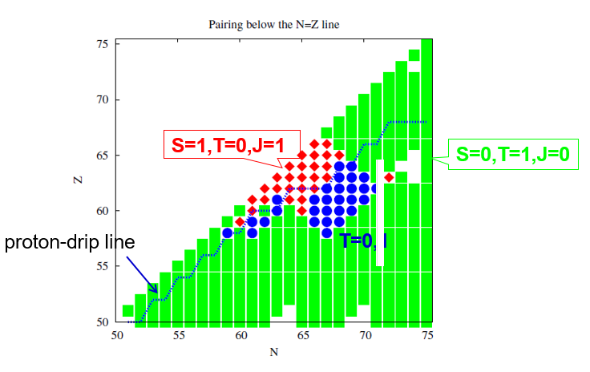
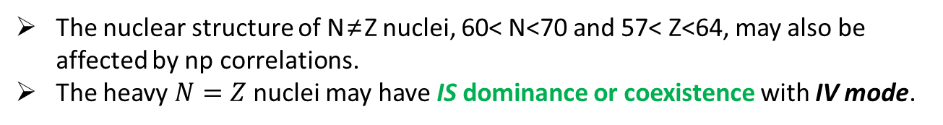
Motivations
Formalism
Results
Summary
Unlike-pairing correlations in $N\sim Z nuclei$
A. Gezerlis, et al. PRL 106, 252502(2011)
The nuclear structure of N≠Z nuclei, 60< N<70 and 57< Z<64, may also be affected by np correlations.
The heavy $N=Z$nuclei may have IS dominance or coexistence with IV mode.

Slide 11
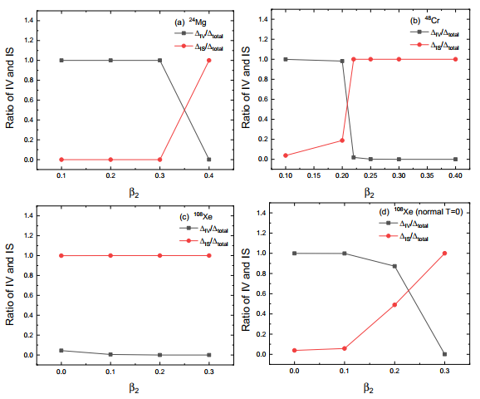
Motivations
Formalism
Results
Summary
Ratio of IV and IS np-pairing
Ha, Cheoun, Sagawa, PRC99,064304 (2019)
enhanced T=0
enhanced T=0
enhanced T=0
normal T=0
IS condensation by the enhanced T=0 np pairing may happen in deformed ²⁴Mg and ⁴⁸Cr.
Rapid phase transition from IV to IS component in the np pairing. But it may happen slower in heavy nuclei, which may mean the coexistence of IV and IS in some deformation region.
Notes:
Phase transition is not related to statistic mechanics. It means the transition from IV to IS pairing mode.

Slide 12
Motivations
Formalism
Results
Summary
In our early papers, the IV np-pairing was included in a spherical formula and IS np-pairing was taken into account by renormalizing the IV np-pairing implicitly. M.K. Cheoun et al. NPA 561(1993), NPA 564(1993)
In the recent previous papers, the effects of deformation and IS np- pairing are taken into account explicitly within the deformed BCS and deformed QRPA approach.
1. Spin singlet and spin triplet pairing correlations on shape evolution in
sd-shell N=Z nuclei. Ha et al. PRC97, 024320(2018)
2. Neutron-proton pairing correlations and deformation for N = Z nuclei in pf-shell by the deformed BCS and HFB approach. Ha et al. PRC97, 064322(2018)
3. Isoscalar condensation in N = Z nuclei. Ha et al. Acta Physica Polonica B 50, 697(2019).
4. Effects of the Coulomb and the spin-orbit interaction in a deformed mean field on the residual pairing correlations for N=Z nuclei. Ha et al. PRC99, 064304 (2019)
5. Competition of deformation and neutron-proton pairing in Gamow-Teller transitions for ^{56,58,60,62,64}Ni. Ha et al. JPG 46, 105109 2019.
6. Isoscalar Condensation in the p- and sd-shell N=Z nuclei (in preparation).
In this talk, we include explicitly the tensor interaction acting on the spin-triplet
np pairing by taking into account the angular momentum in the DBCS theory.

Slide 13
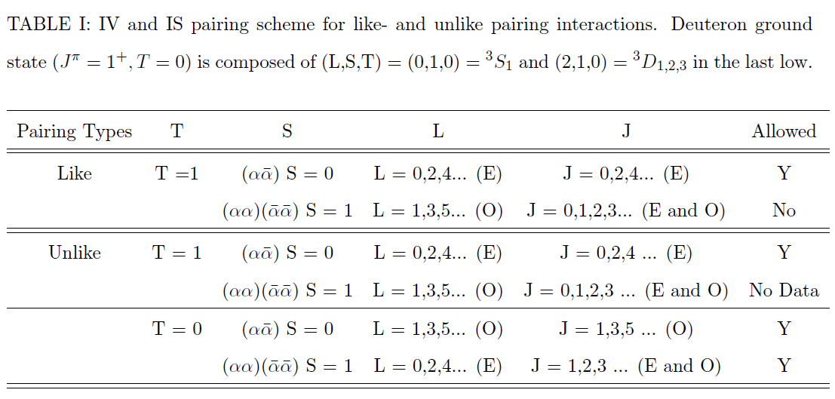
T=1, S=0 (Isovector(IV), spin- singlet)
Motivations
Formalism
Results
Summary
Pairing scheme
T=0, S=1 (Isoscalar(IS), spin- triplet)
T_{z} : +1 0 -1 S_{z} : +1 0 -1
p
p
n
p
n
p
n
n
n
p
n
p
n
p
n
p
deformed formalism !!

Slide 14
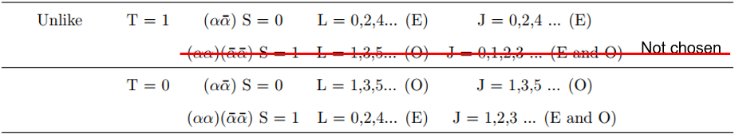
Motivations
Formalism
Results
Summary
High-momentum components in nuclei are important for understanding the roles of non-central nuclear interactions, such as the tensor force, beyond the single particle motion.
In the present pairing matrix elements calculated by the Brueckner theory, we can not separate the total orbital angular momentum L.
We consider the maximum of total angular momentum J, J_{max,} instead of L to find the effect of high L.
We can evaluate the effect of the tensor force correlations by using different J_max.
This method is a kind of the projection of the angular momentum J on to axis in the nuclear symmetry axis, thanks to the deformed BCS approach.

Slide 15
For T = 0 pairing, which has S=0 (a and abar) and S=1 (aa, abar,abar)
Me1) PRC 2019
g_{np}^{0,1}*E_factor*T_factor*G(T=0,S=0) for J = odd
where E_factor is for enhanced T = 0 and T_factor = 2 is for spin triplet
Me2) Previous one which includes explicitly the S=1 (L = 0,2,4,6…) contribution
by including all J= 1,2,3…
g_{np}*E_factor*T_factor*G(T=0,S=0)
where E_factor is for enhanced T = 0 and
T_factor = 2 for J = odd and T_factor = 1 for J = even
Me3) Final one which includes explicitly the S=1 (L = 0,2,4,6…) contribution
by including all J= 1,2,3…
g_{np}*E_factor*T_factor*G(T=0,S=0)
where E_factor is unity and
T_factor = 3 for J = odd and T_factor = 1 for J = even
* If the J = even contribution is negligible, Me3) is equal to Me2) for E_factor = 1.5, which implies that the enhanced IS (Enhanced factor) comes from the neglected J = odd from LS coupling for the spin triplet state, i.e. takes only one of the both L+S and L-S coupling scheme in Me2.

Slide 16
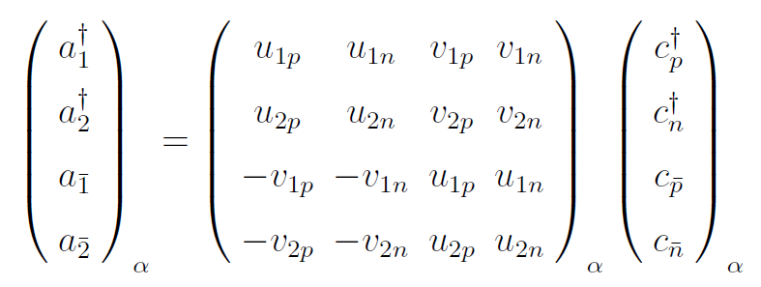
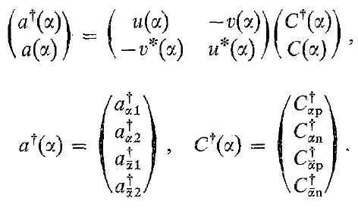
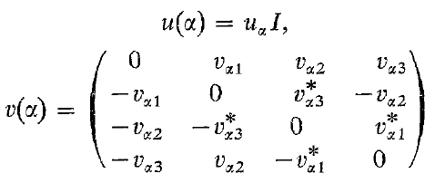
T=0, S=1 (IS, spin- triplet)
n
p
n
p
A. L. Goodman, NPA 186, 475(1972)
n
p
n
p
n
p
n
p
Notes:
In order to include two parallel pairs 4 by 4 matrix have to be changed to 8 by 8 matrix.

Slide 17
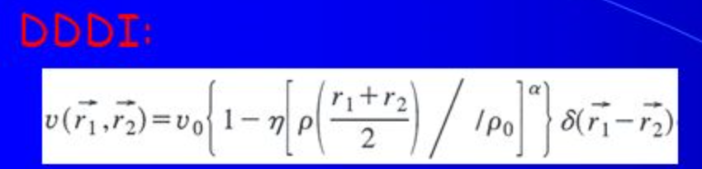
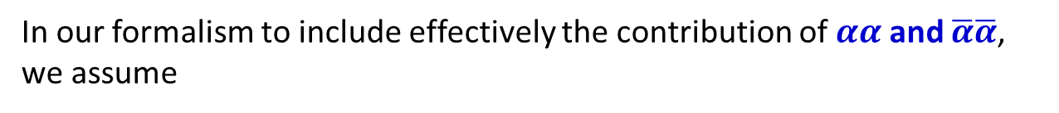
Motivations
Formalism
Results
Summary
T=0, S=1 (Isoscalar(IS), spin- triplet)
In our formalism to include effectively the contribution of$αα$ and $\overline{α}\overline{α}$, we assume
A. L. Goodman, PRC 58, R3051(1998)
Pairing Interactions usually used in Skyrme Interactions !!
Notes:
A is the B by multiplied by two.

Slide 18
Ha et al. PRC99, 064304 (2019)

Slide 19
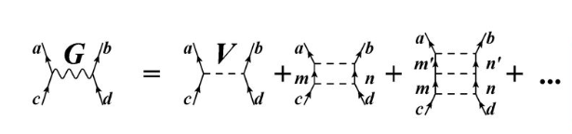

Brueckner G-matrix
Bethe-Goldstone equation
a,b,c,d : single particle state from a Woods-Saxon potential
w : starting energy
ε : single particle energy
Q : Pauli operator
V^{OBEP} : one boson exchange potential of the Bonn group

Slide 20
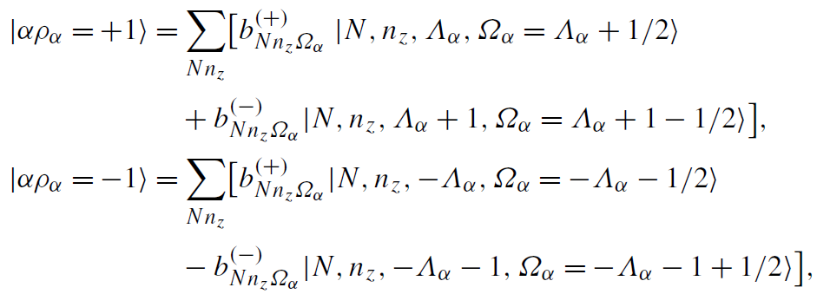
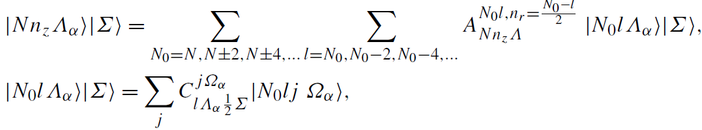
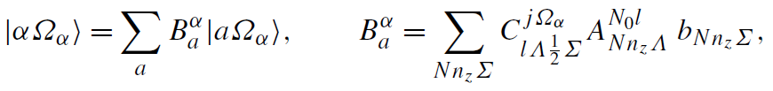

Motivations
Formalism
Results
Summary
Deformed single particle state(SPS)
Ha et al. NPA934, 73(2015)
By solving the $schr\ddot{o}dinger$ eq. in deformed WS potential.
Expand deformed HO basis into spherical HO basis.
Deformed SPS Sph. HO
$a≡N_{0}lj$
Notes:
B is expantion coefficient which consist of 3 coefficient.

Slide 21
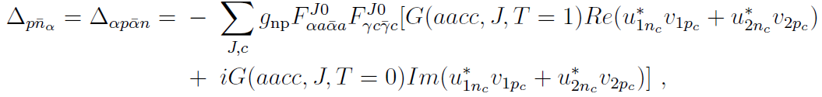
Motivations
Formalism
Results
Summary
Pairing correlation
deformed HFB deformed BCS
K=0
K=0
Ω
Ω -Ω
-Ω
BCS
HFB

Slide 22
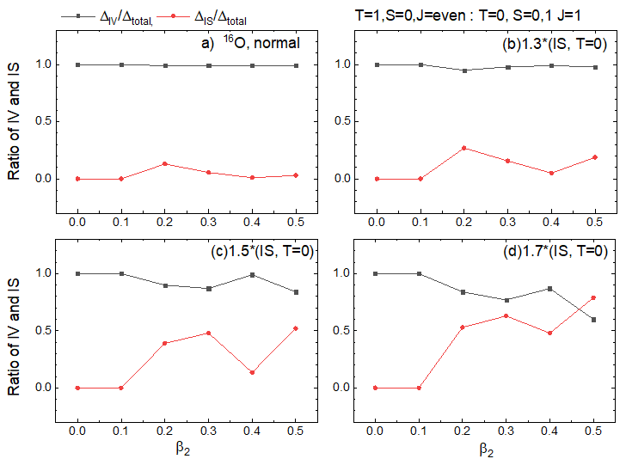
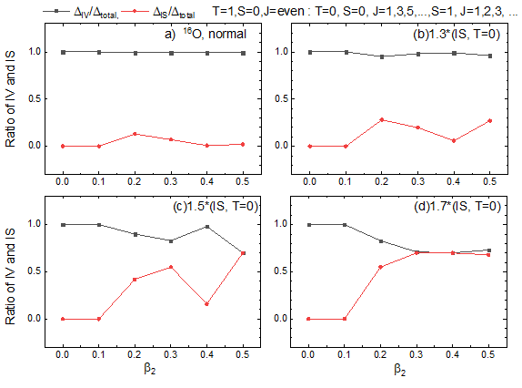

Motivations
Formalism
Results
Summary
Ratio of IV and IS pairing gap for ¹⁶O ; $β_{2}$
We investigate the contribution of high (angular) momentum couplings to the pairings.
For IS np-pairing we multiplied a weighting factor from 1.0 to 1.7.
Preliminary
$β_{2}=0.364$ from E2
IS contribution to the np-pairing increases with large deformation and large weighting factor.
IS np-paring in high angular momentum state is non-negligible.
Notes:
IS pairing becomes larger and contribution of two pairing is same.

Slide 23
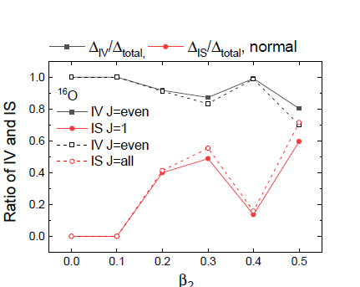
Motivations
Formalism
Results
Summary
Ratio of IV and IS pairing gap for ¹⁶O ; $β_{2}$
Method 3 (No Enhanced IS factor)
We investigate the contribution of high (angular) momentum couplings to the pairings.
For IS np-pairing we multiplied a weighting factor from 1.0 to 1.7.
With increasing the deformation,
The IS np pairing is increased
about 10 – 20 %.
But with the decrease of IV part.

Slide 24
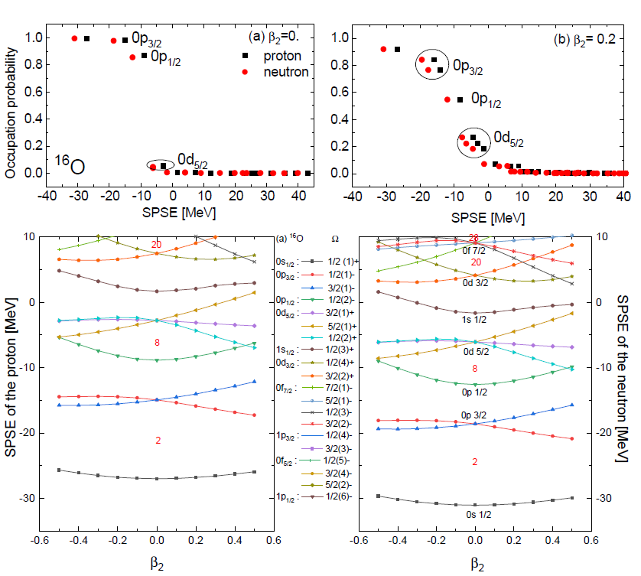
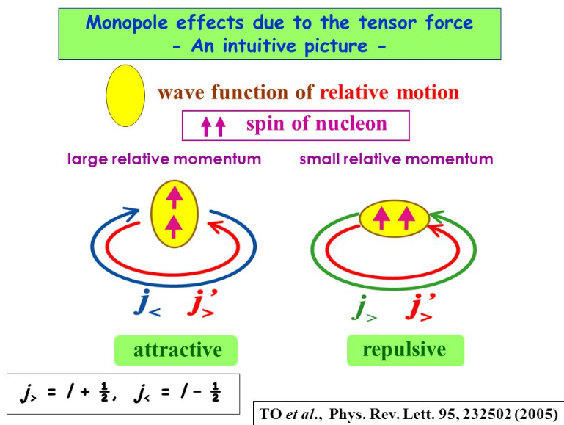
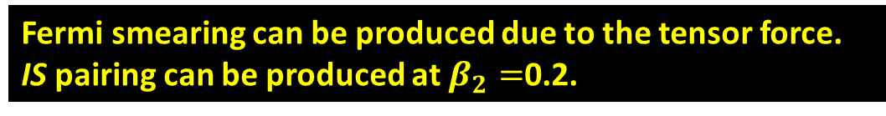


Motivations
Formalism
Results
Summary
Smearing of Fermi surface by DBCS & Single particle state E(SPSE) by DWS of ¹⁶O
Fermi smearing can be produced due to the tensor force.
IS pairing can be produced at $β_{2}=$0.2.
$$0d5/2$$
$$0p3/2$$
Notes:
I checked the following. Two nucleons are occupied in each orbit in deformed formalism.

Slide 25
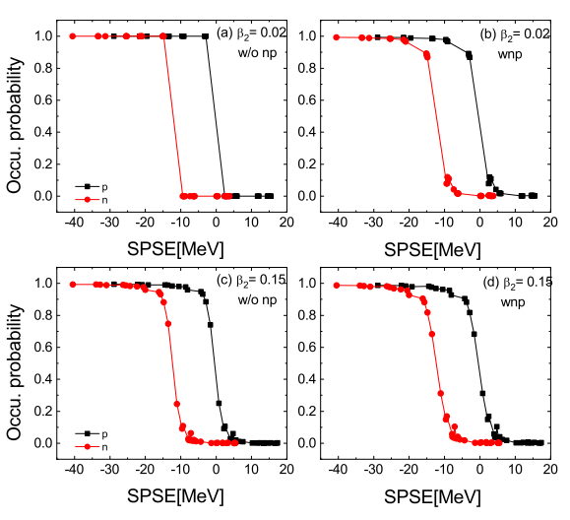

Motivations
Formalism
Results
Summary
Why np-pairing is important?
Production of the high-lying GT state
Occupation probability of ⁵⁶Ni
With np-pairing
W/O np-pairing
ʎ_{n}
ʎ_{p}
a
$$×$$
a
p n
The transition by nucleons below the Fermi orbit can be allowed.
The high-lying GT states can be produced.
The np-pairing makes the smearing of Fermi surface.
Notes:
If we switch on np pairing nucleons gather on the Fermi surface.

Slide 26
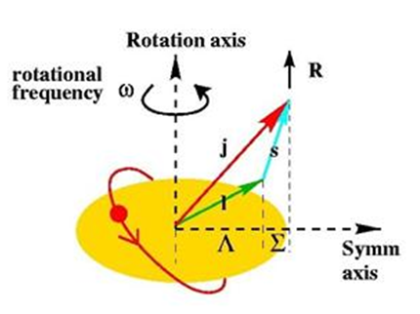
Motivations
Formalism
Results
Summary
Pairing correlations in the deformed basis
BCS deformed BCS
K : projection of J on symm. axis.
J=0
T=1
K=0
j m j -m
Ω -Ω
(J=0,1, 2, 3 ∙∙∙)
T=0 J=1, 3, 5, ∙∙∙
T=1 J=0, 2, 4, ∙∙∙
Ω= ½
j ≥ Ω
The different total angular momenta of the SP basis states would be mixed
because the deformed SPS are expanded in terms of the spherical SP bases.

Slide 27
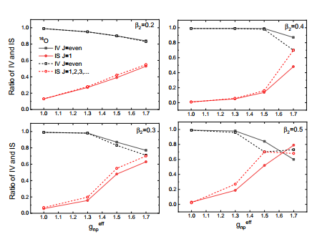
Motivations
Formalism
Results
Summary
Ratio of IV and IS pairing gap for ¹⁶O ; represented as $β_{2}$
Preliminary
IS contribution due to high J increases with large deformation and the effective coupling strength${ gIS}_{np}^{}={ geff}_{np}^{}$.
Notes:
The gap of dotted line and solid line is the contribution of high angular momentum due to orbital angular momentum. This effect becomes larger with large deformation and large weighting value.

Slide 28
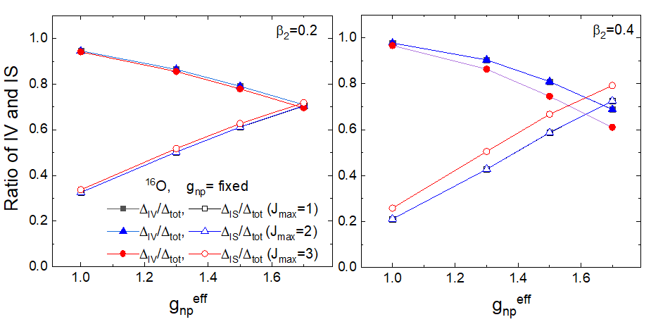
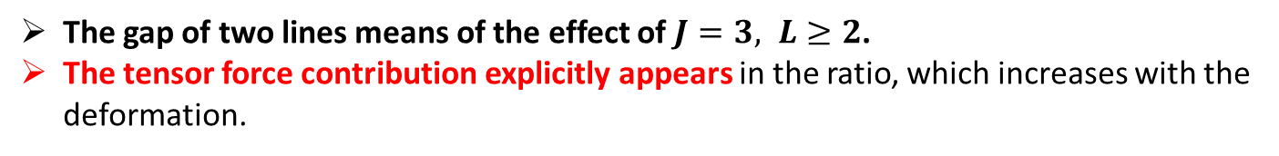
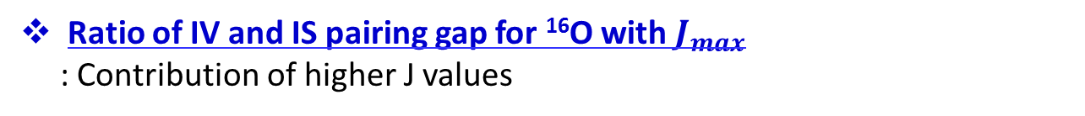
Motivations
Formalism
Results
Summary
Ratio of IV and IS pairing gap for ¹⁶O with $J_{max}$
: Contribution of higher J values
Preliminary
The gap of two lines means of the effect of $J=3, L≥2$.
The tensor force contribution explicitly appears in the ratio, which increases with the deformation.
Notes:
The gap of two lines mean the effect of L greater than or equal to 2.

Slide 29
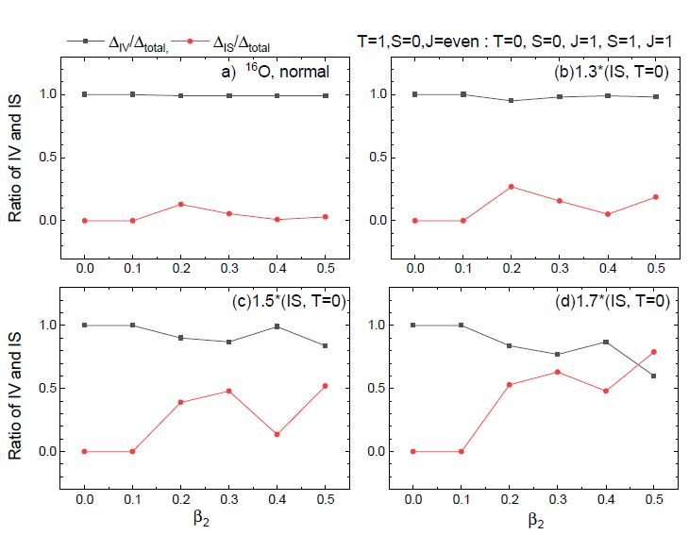
Motivations
Formalism
Results
Summary
Ratio of IV and IS pairing gap for ¹⁶O ; $β_{2}$
Notes:
The pairing E is getting bigger with prolated deformation

Slide 30
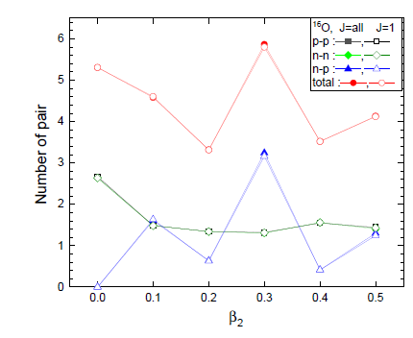
Motivations
Formalism
Results
Summary
Number of pp, nn, np pairs
Preliminary
Done by Method 3
Number of Neutron-protons pairs depends on the deformation parameter.
Neutron-proton pairs are increased around beta2 = 0. 3 region, which may stem from the tensor interaction.
Now we do not need the enhanced IS (T=0) factor by including all J numbers i.e. L-S and L+S coupling.

Slide 31
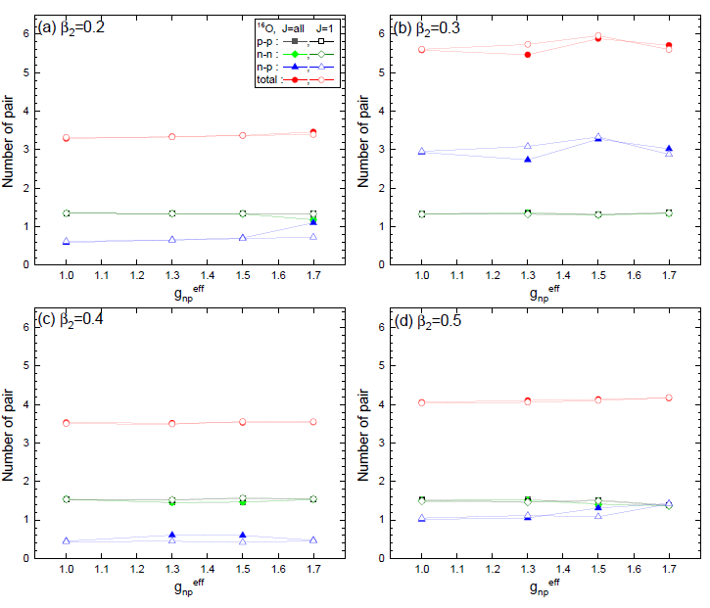
Motivations
Formalism
Results
Summary
Number of pp, nn, np pairs
Preliminary
We investigated the dependence on the strength parameter. But it is almost independent of the strength.
In these results, the tensor force effect on the np pairing is noticiable at beta_2 = 0.3.
Notes:
IS pairing becomes larger and contribution of two pairing is same.

Slide 32
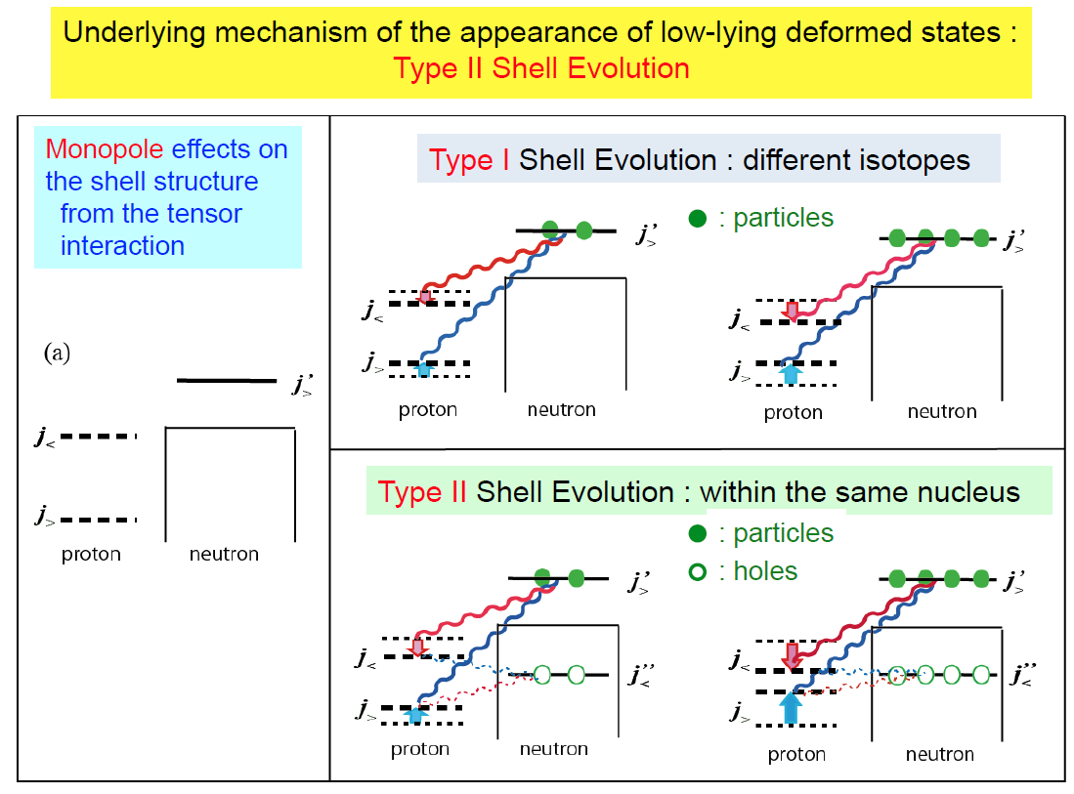

Slide 33
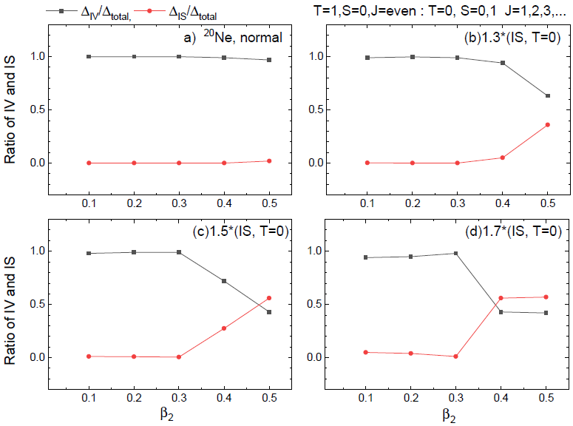

Motivations
Formalism
Results
Summary
Ratio of IV and IS pairing gap for ²⁰Ne; $β_{2}$
We investigate the contribution of high angular momentum couplings to the pairings.
For IS np-pairing we multiplied a weighting factor from 1.0 to 1.7.
Preliminary
$β_{2}=0.727$ from E2
IS np-paring in high angular momentum state becomes greater than IV np-pairing
in $β_{2}=0.5 and g_{eff}^{}>1.5$.

Slide 34
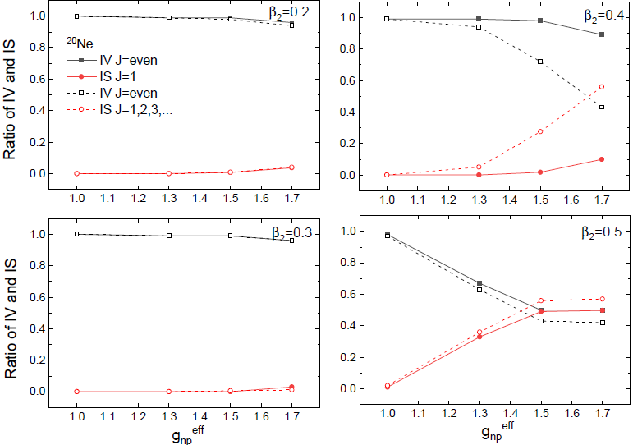
Motivations
Formalism
Results
Summary
Ratio of IV and IS pairing gap for ²⁰Ne; Enhanced T=0 pairing
Preliminary

Slide 35
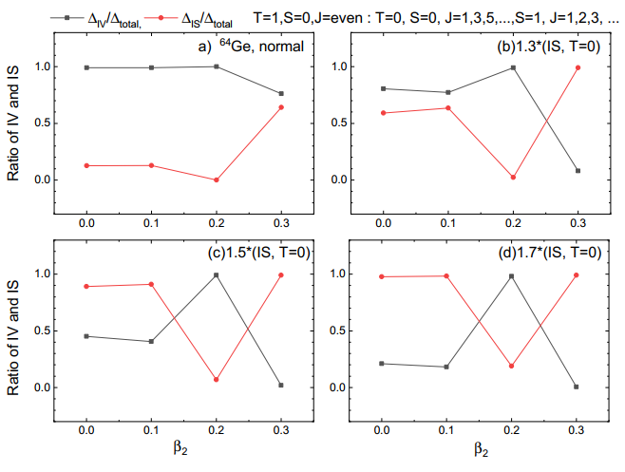
Motivations
Formalism
Results
Summary
Ratio of IV and IS pairing gap for ⁶⁴Ge ; $β_{2}$
Preliminary
IS contribution becomes larger with the large deformation even in the normal strength.
Notes:
The pairing E is getting bigger with prolated deformation

Slide 36
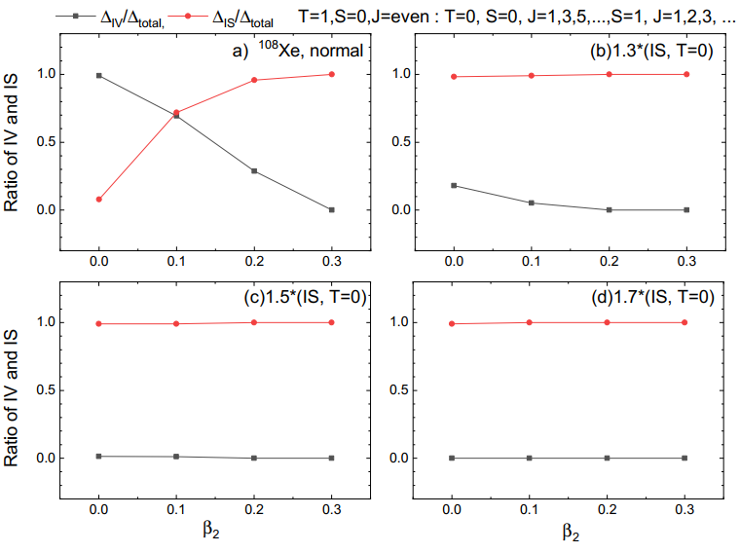
Motivations
Formalism
Results
Summary
Ratio of IV and IS pairing gap for ¹⁰⁸Xe ; $β_{2}$
Preliminary

Slide 37
Summary 1
Motivations
Formalism
Results
Summary
IS pair condensation may occur in deformed N = Z nuclei, such as ²⁴Mg and ⁴⁸Cr, through an abrupt phase transition from IV to IS interaction due to the enhanced T = 0 np-pairing correlations.
2. For heavy nuclei such as ¹⁰⁸Xe, the transition may happen more smoothly
even with the normal T = 0 pairing interaction.
3. Deuteron structures may exist inside nuclei through the IS pair condensation.
4. We have done more detailed and systematic calculations regarding the IS pair condensation and the coexistence of the IV and IS phase for p-shell N= Z nuclei by decomposing each angular momentum J, in order to study the effect of the tensor force inside nuclei.
5. Overestimated enhanced IS pairing factor becomes reasonable by taking the (a,a) and (abar,abar) pairing as well as (a,abar).
6. The tensor force acting on the S=1 state becomes larger with the deformation and the increase of the g_{np} due to the IV quenching from the M1 spin data.
7. Number of np pairings may be larger than those of nn and pp for p-shell and sd-shell N=Z nuclei.
8. Also, we expect lots of the experimental data like A(p, pd)B in the inverse kinematics and A(e,ed)B reactions
and extend our calculations to sd- and pf-shell nuclei.

Slide 38
Thanks for your attention !!

Slide 39
Contents
Motivations
Formalism
Results
Summary
Motivation
Formalism
- Pairing & deformation
The ratio of Isoscalar(IS) and Isovector(IV) pairing in N=Z nuclei
(Ongoing work)
- Summary 1
4. Effects of deformation & pairing correlations
in the ground & excited state (for Gamow-Teller transition).
(Previous work)
- Summary 2

Slide 40
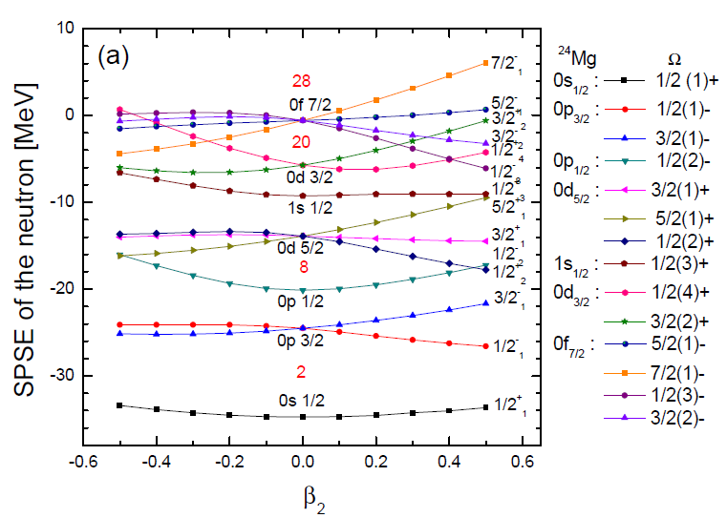
Motivations
Formalism
Results
Summary
To find the effects of deformation & pairing correlations in the ground state
Single particle state E(SPSE) by DWS of ²⁴Mg
Ha et al. PRC97,024320(2018)

Slide 41
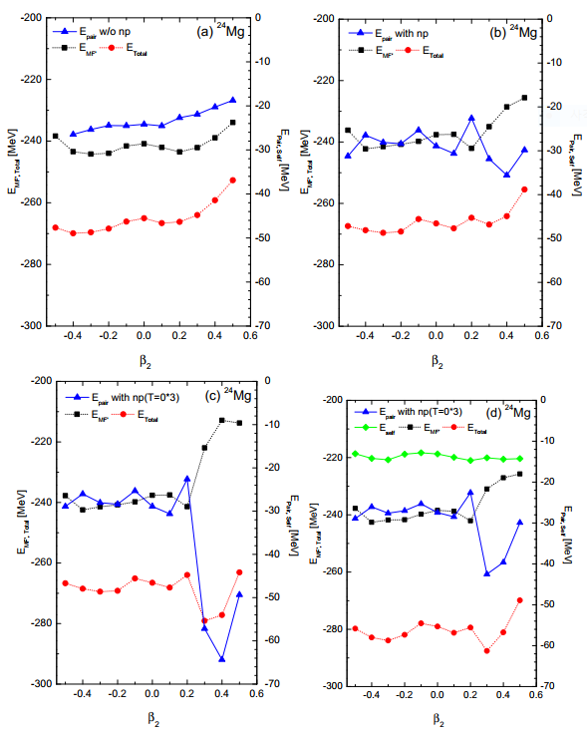

Motivations
Formalism
Results
Summary
Shell evolution of ²⁴Mg
Enhanced IS np pairing correlations may be an indispensable ingredient to understand the prolate deformation.
w/o np-pairing
(like-pairing,T=1)
with np-pairing
with enhanced T=0
with enhanced T=0
+ self E
Notes:
Mg is well known deformed nucleus.

Slide 42
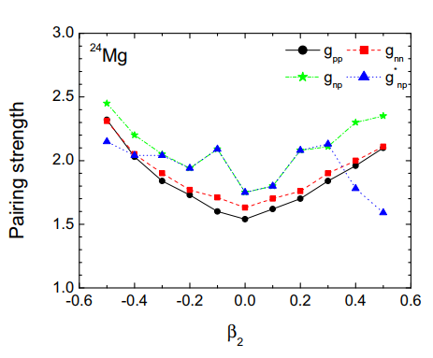

Motivations
Formalism
Results
Summary
Evolution of pairing strength of ²⁴Mg in sd-shell
Ha et al. PRC97,024320(2018)
enhanced T=0
T=0 (IS) condensation
Coexistence of T=0 and T=1 pairing
The smaller g_{np}* value in mean the larger pairing energy is obtained.
Notes:
Gnp is multiplied to G-mat to renormalize G-matrix

Slide 43



Motivations
Formalism
Results
Summary
To find the effects of deformation & pairing correlations in the excited state
GT strength, B(GT) of ²⁴Mg
Main peak near 15MeV is well reproduced at $β_{2}$=0.5.
Notes:
The pairing E is getting bigger with prolated deformation

Slide 44




Deformation effect (pairing fixed)
np-pairing effect (deformation fixed)
Notes:
Which effect is greater the deformation or np-pairing?

Slide 45

Motivations
Formalism
Results
Summary
Evolution of pairing strength of ⁷²Kr in pf-shell
Ha et al. PRC97, 064322(2018)
enhanced T=0
There is also the coexistence of T=0 and T=1 np-pairing at large deformation
similarly to sd-shell N=Z nuclei.

Slide 46


Motivations
Formalism
Results
Summary
Shell evolution of ⁷²Kr
Enhanced IS np pairing correlations may be an indispensable ingredient to understand the oblate deformation.

Slide 47


Motivations
Formalism
Results
Summary
Ha et al. JPG (in press)
Gamow-Teller strength for ⁵⁶Ni
M.Sasano et al. PRL 107, 202501(2011)
In particular, ⁵⁶Ni is thought to be almost spherical because of its double magic numbers.
If we take α-cluster model for ⁵⁶Ni, the ground state may be slightly deformed. PRC 84, 024302(2011)
The 2nd high energy peak in the data does not appear within a small deformation region $β_{2}<0.1.$ But 2nd peak appears at $β_{2}=0.1$ with np pairing.
Notes:
If we compare two pannel C, second peak can be produced with np pairing.

Slide 48

Motivations
Formalism
Results
Summary
Running sum of GT strength for ⁵⁶Ni
The np pairing is important to explain the GT strength although the deformation is also another important property.

Slide 49

Motivations
Formalism
Results
Summary
Why np-pairing is important?
Production of the high-lying GT state
Occupation probability of ⁵⁶Ni
With np-pairing
W/O np-pairing
ʎ_{n}
ʎ_{p}
a
$$×$$
a
p n
The transition by nucleons below the Fermi orbit can be allowed.
The high-lying GT states can be produced.
The np-pairing makes the smearing of Fermi surface.
Notes:
If we switch on np pairing nucleons gather on the Fermi surface.

Slide 50

Motivations
Formalism
Results
Summary
IS(T=0) np pairing effects on B(GT)
The shift of the GT strength distributions by the enhanced T=0 np pairing is mainly attributed to the IS coupling condensation. Even though the small deformation, the second peak appears by the enhanced T=0 pairing.

Slide 51


Motivations
Formalism
Results
Summary
Gamow-Teller strength for ^{62,64}Ni
Ha et al. JPG (in press)
Y. Fujita et al. PPNP 66, 549(2011)
np pairing effects divide the GT strength distribution into two parts: a low- and a high-energy part near the main GT peak position.
The position of GTR near the 10 ∼ 12 MeV in 64Ni is consistent with the GTR data.

Slide 52
Summary 2
Motivations
Formalism
Results
Summary
We described the N=Z nuclei ground states by the Deformed BCS theory with the like- and unlike pairing correlations. The enhanced IS np pairing interaction is shown to play important roles of determining properly nuclear deformations of sd-, pf- and sdgh shell nuclei.
There can be a coexistence of two types of superconductivities (T=0 and T=1). But the IS condensation may occur through a phase transition at the large deformation in N=Z nuclei such as 24Mg and 72Kr.
Not only high-lying GT states, but also spin M1 states, could be a good test-bed for the np pairing, which plays significant roles of explaining the excited states. Specifically, the IS condensation part may play a vital role to explain the GT strength fragmentations of ⁶⁴Ni nucleus.
We need a self-consistent approach such as Skyrme- Hartree- Fock approach instead of Woods-Saxon potential.
Notes:
We have a self-inconsistency coming from the phenomenological DWS.
The present DQRPA may have spurious states from the breaking of particle number conservation
Due to BCS approach and the self-inconsistency coming from the phenomenological DWS potential.

Slide 53
Thanks for your attention !!

Slide 54
Back-up files

Slide 55


Slide 56

Motivations
Formalism
Results
Summary
Self energy in BCS
E_{mean} E_{self} E_{pair}
: self energy
: pairing gap
The self energy term was usually neglected in BCS eq. because it results from particle-hole correlations beyond the BCS and affects a renormalization of the single particle energy.
Notes:
The self E represents the contribution to the particles E due to interaction between the particle and its system.

Slide 57
Motivations
Formalism
Results
Summary
Pairing correlation
deformed HFB deformed BCS
K=0
K=0
Ω
Ω -Ω
-Ω
BCS
HFB

Slide 58
Brueckner G-matrix
Bethe-Goldstone equation
a,b,c,d : single particle state from a Woods-Saxon potential
w : starting energy
ε : single particle energy
Q : Pauli operator
V^{OBEP} : one boson exchange potential of the Bonn group

Slide 59

Motivations
Formalism
Results
Summary
In sd-shell N=Z nuclei , Q_{exp} of ²⁸Si is different from ²⁴Mg and ³²S
for 2⁺, Q₂₊ = -2/7 Q₀
Q₂₊ : experimental quadrupole moment
Q₀ : intrinsic quadrupole moment
²⁸Si is not heavy. Where does it come from ?

Slide 60

backup file
Parameter set of Deformed Woods-Saxon

Slide 61

In gd-shell N=Z nuclei

Slide 62
Used parameters in this work.

Slide 63
Motivations
Formalism
Results
Summary
Tensor force

Slide 64
Motivations
Formalism
Results
Summary
Two-body interaction
Realistic two body interaction inside nuclei was taken by Brueckner g-matrix, which is a solution
of the Bethe-Salpeter Eq., derived from the Bonn-CD potential for nucleon-nucleon interaction in
free space.
a,b,c,d : single particle states from the Woods-Saxon potential.
V_{ab,cd} : phenomenological nucleon-nucleon potential in free space.
Notes:
Residual interaction contains two parts.
A particle-hole force are defined with positive sign, which is repulsive, and particle-particle force is negative sign which is attractive.

Slide 65

Motivations
Formalism
Results
Summary
How to include the deformation?
Ha et al. NPA934, 73(2015)
Deformed Woods-Saxon(WS) potential
(cylindrical WS, Damgaard et al 1969)
distance function
β₂ : quadrupole deformation parameter
β₄ : hexadecapole deformation parameter
We can determine these two parameters by taking values giving the minimum ground state energy.
To exploit G-matrix elements, which is calculated in the spherical basis, deformed bases are expanded in terms of the spherical bases.
Deformed SPS Sph. HO w. f.

