Slide 1

AN MR-TOF SIMULATOR FOR PRECISE MASS MEASUREMENT
CENuM-RULIC Workshop
Nguyen Ngoc Duy
Experimental Nuclear Astrophysics Lab
Department of Physics, Sungkyungkwan University, Suwon 16419
Daejeon – Oct.31 ~ 2 Nov. 2019

Slide 2
Outline
Overview
MR-TOF Simulator
Design of computer program
Preliminary testing results
III. Summary and Outlook

Slide 3
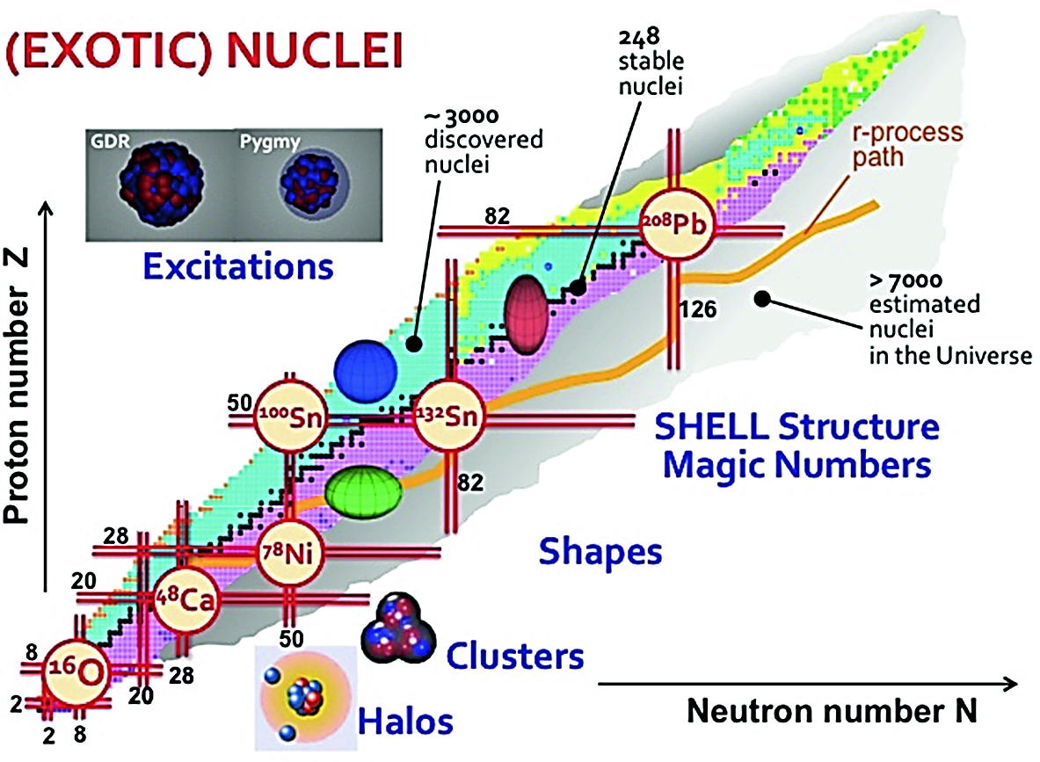
I. Overview
Unstable isotopes
Taken from Leoni S. et al. (2018), Toward a Science Campus in Milan. CDIP 2017. Springer, Cham

Slide 4

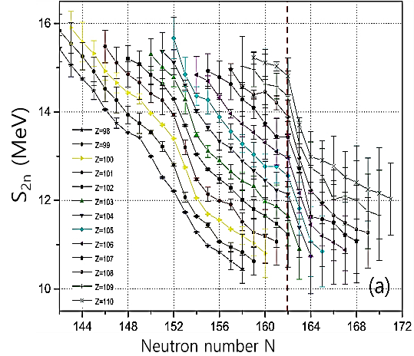
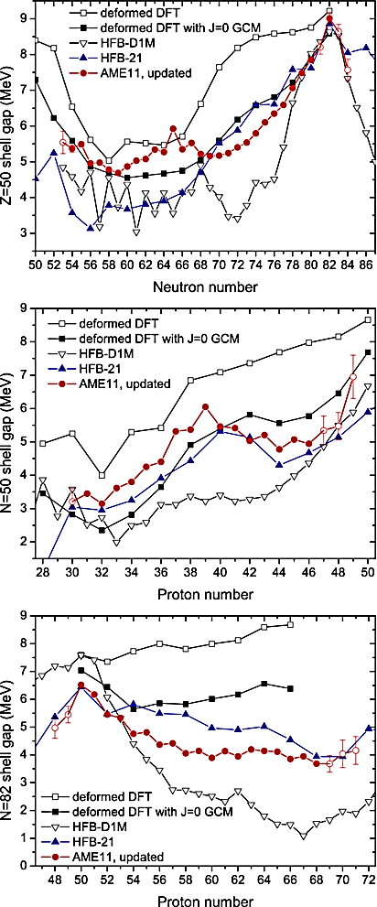
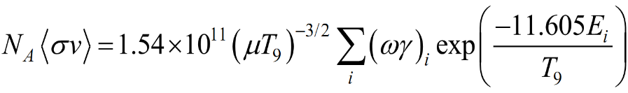
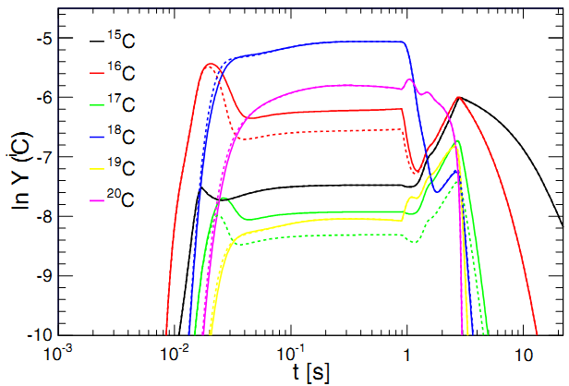
I. Overview
Importance of Precise Mass
AME2012
Shell closures
→ magic numbers, deformation.
(1)
(2)
(3)
T. Burvenich et al., EPJA3,139-147 (1998);
M.Block, NPA 944, 471(2015); Q. Mo et al., PRC90, 024320 (2014)
A. Kankainen, J. Äystö and A. Jokinen, J. Phys. G 39 (2012) 093101
(4)
Astrophysical rates:
(5)
5
(6)
Astrophysical implications
E_{i} = E_{cm} + Q
Q = (m_{I} – m_{O}) × 931.5 MeV
(7)
Photodissociation rate in r-process:
(8)
Saha Equation:
Change of the *C abunadance due to reaction rates of ¹⁷C(n,γ)
(9)
M. Heine et al., PRC 95, 014613 (2017)

Slide 5
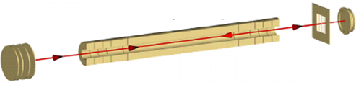
I. Overview
MR-TOF mass measurement
L
Working principle
0
KE = qU
t
Time of flight
→ Longer L, better m precision
MCP
Extending L by MultiReflection
MR-TOF Analyzer
Ion Injector
MR-ToF Features
Δt (FWHM): ~ 20 ns
T_{1/2}: ~ ms.
Intensity: ~ 1 pps.
Resolving power: 10⁴ ~ 10⁵.
Mass precision δm/m: 10⁻⁶ ~ 10⁻⁷.
Mass uncertainty: ~ 10 keV.
Measurement time: ~ 10 ms.
Mirror2
Gate
Mirror1
Mass Resolving Power:
(10)
Mass precision:
(11)
Mass determination:
(12)
Notes:
To measure precise mass, we can use the MR-TOF technique.
The principle of this technique is based on the time-of-flight of the particles.
To get accurate tof, we should extend the travel length of the particles. However, the space of the facility is limited, so we extend the length by Multi-Reflection.
In this technique, the main parameters we should consider are:
- mass resolving power which is defined as the ratio of the tof to the timing spread;
- the mass accuracy which defined based on the resolving power and the statistical error.

Slide 6
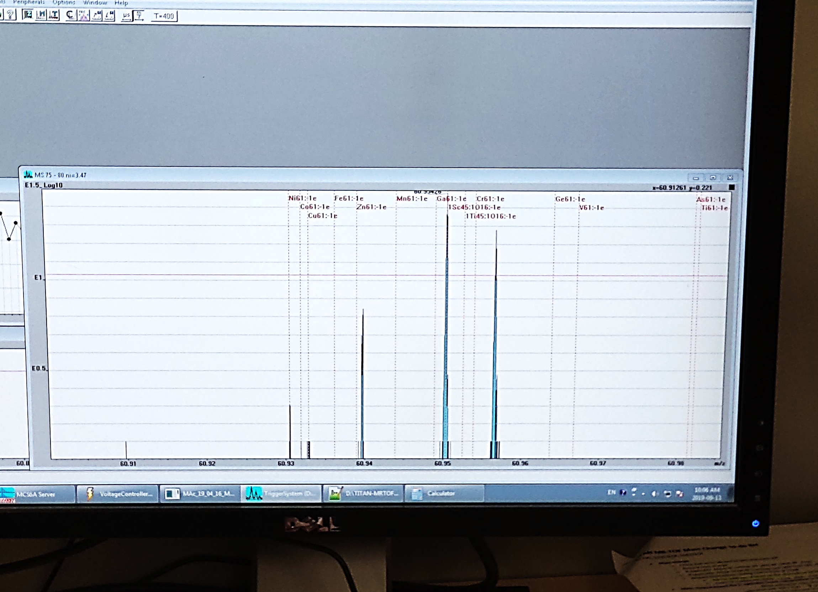
I. Overview
MR-TOF mass measurement
Mass Resolving Power:
Mass determination
Time of flight ➔ How many turns should be?
How does Δt depend on the number of turns?
Ion separability or PID depends on the R_{m}
Separation & PID
TRIUMF
A computer program for MR-TOF simulation is necessary !!!

Slide 7
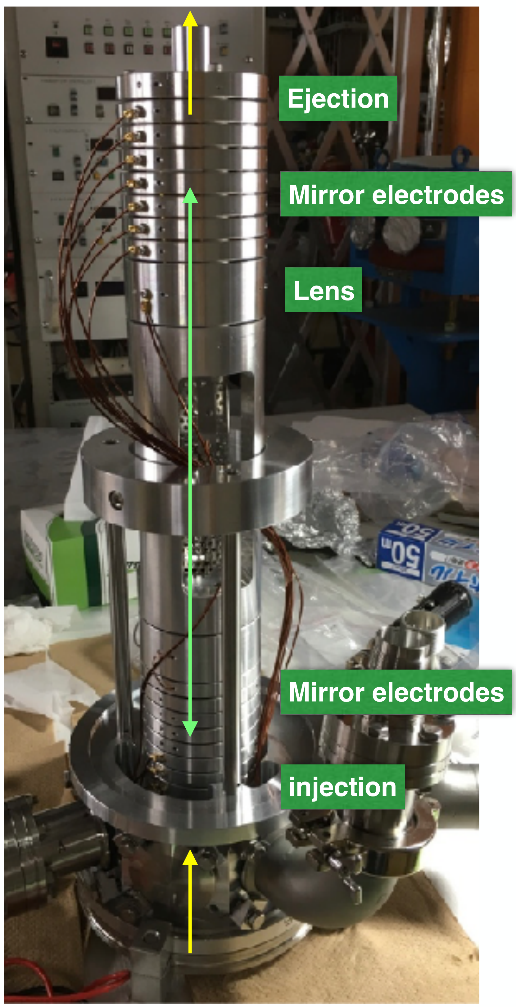
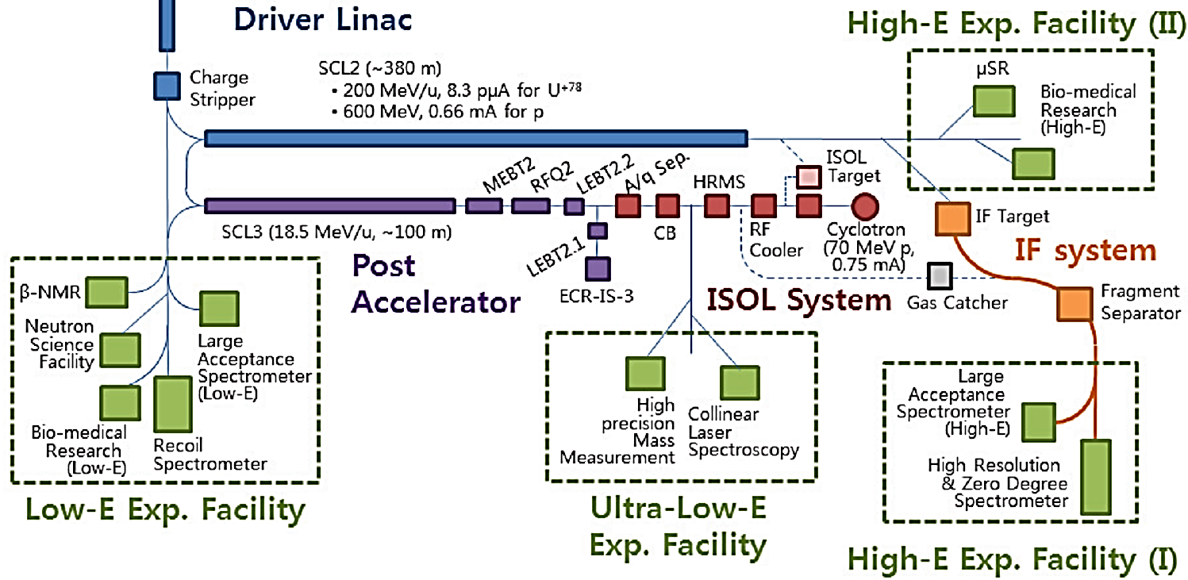
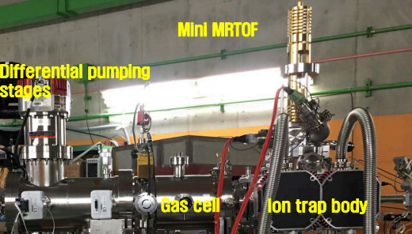
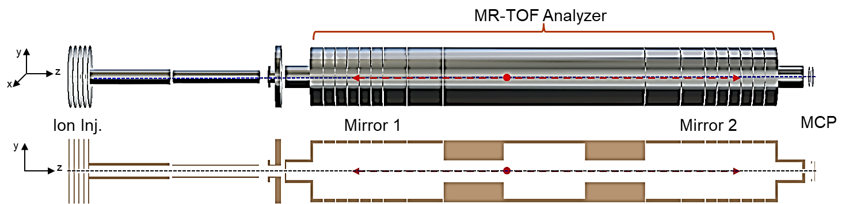
I. OVERVIEW
MR-TOF @ RAON
Y. K. Kwon et al., AIP Conf. Proc. 1594, 190 (2014)
Notes:
This is the sketch of the RAON facility.
The MR-TOF-MS is planned to be installed at the ultra-low-energy facility using ISOL beam.
This is the photo of the MR-TOF analyzer which is designed and tested at RIKEN.

Slide 8
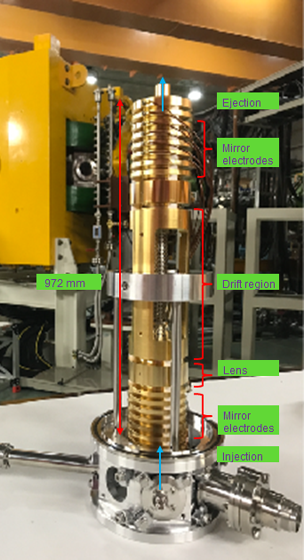
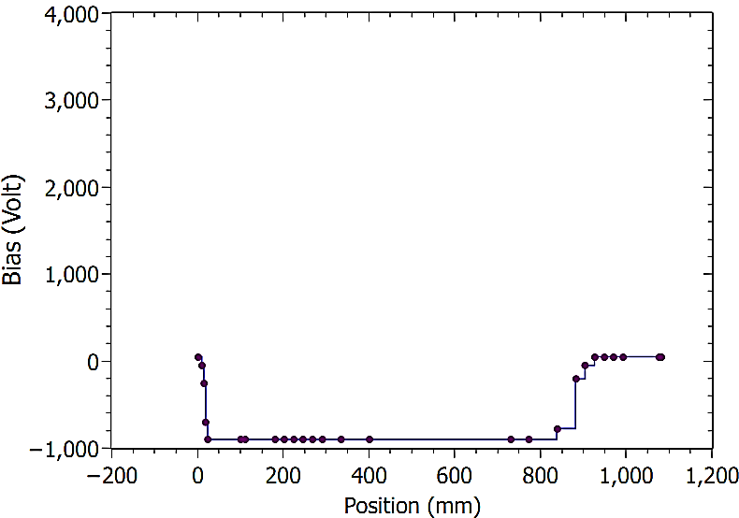
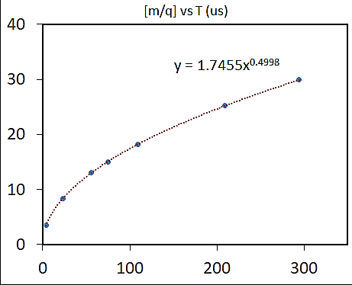
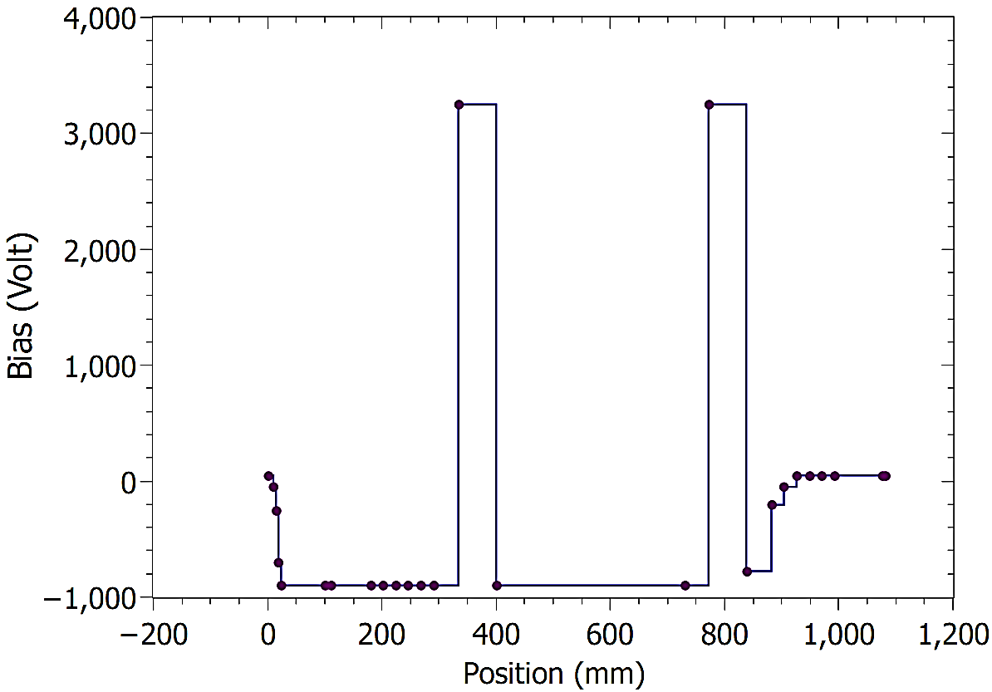
II. MR-TOF Simulator
1. Computer program
Mirror electrodes
Lens
Drift region
Lens
Mirror electrodes
70 mm
152 mm
66 mm
372 mm
66 mm
152 mm
84 mm
200.5 mm
972 mm
Bias for electrodes was optimized by using SIMION.
Dynamic parameters depend on m/q and ion-trap potential.
NonReflection
KE = 1.0 keV
MultiReflection
KE = 1.0 keV

Slide 9
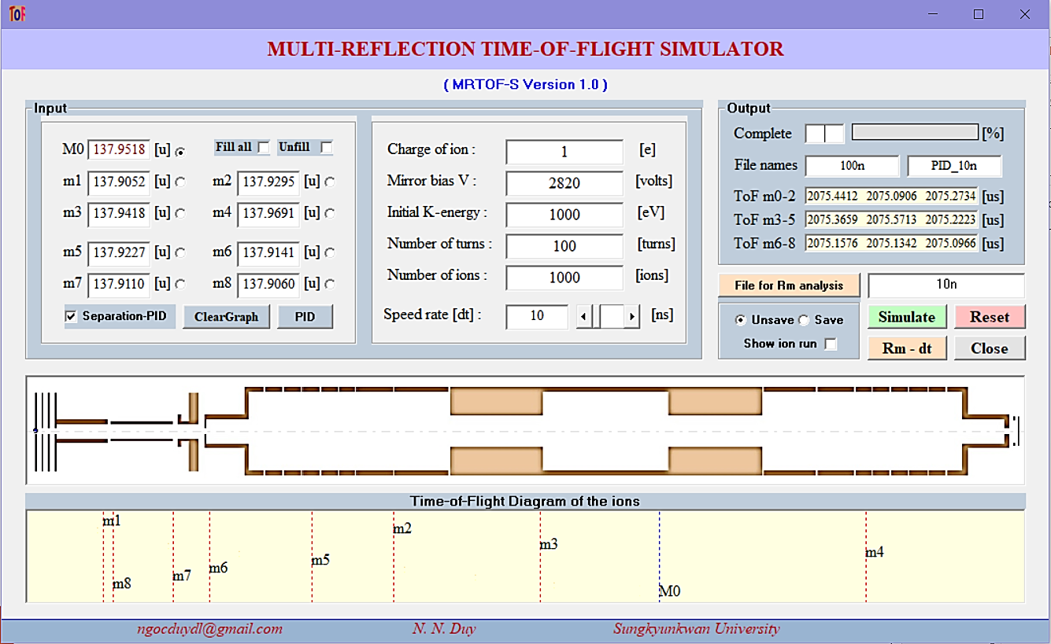
II. MR-TOF Simulator
1. Computer program
MRTOF-S version 1.0, Windows OS, Portable program, 250 kB.
1
2
4
5
6
3
7
8
9
10

Slide 10
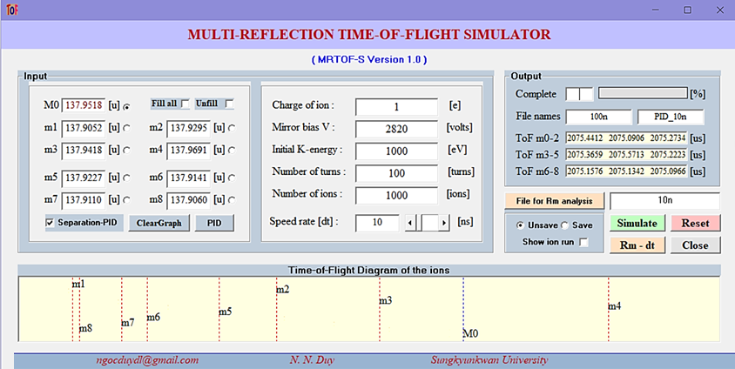
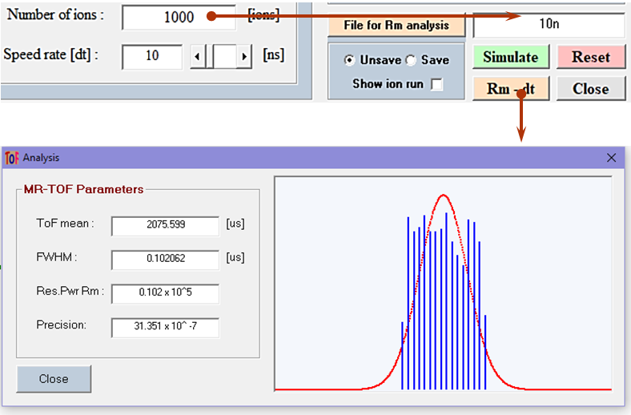
II. MR-TOF Simulator
1. Computer program
Simulation
→ Estimating the timing spread Δt and Resolving power R_{m}
→ Optimizing the number of turns that should be applied.
→ Separation and PID of contaminants from the concerned ions.
PID and Separation estimation
R_{m} & Δt Analysis

Slide 11
II. MR-TOF Simulator
1. Computer program
How does MRTOF-S work?

Slide 12
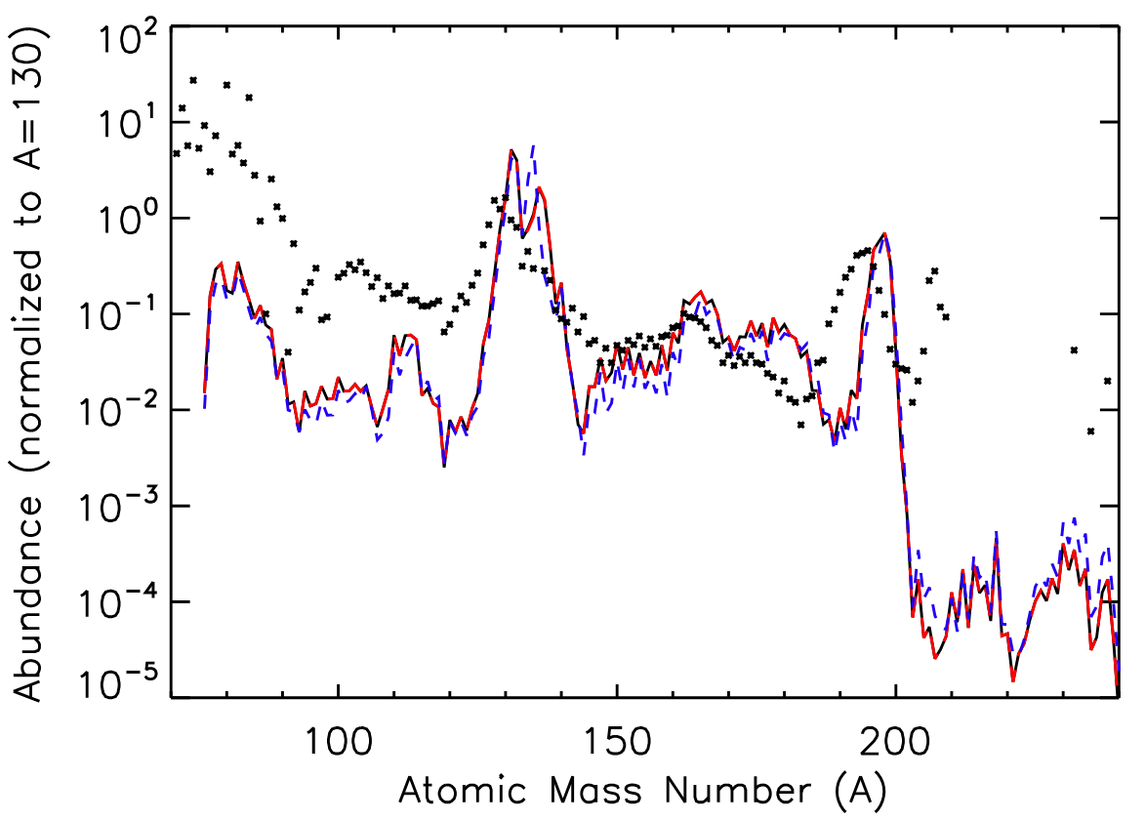
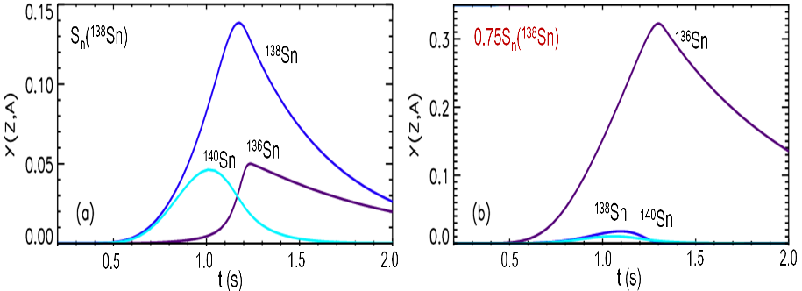
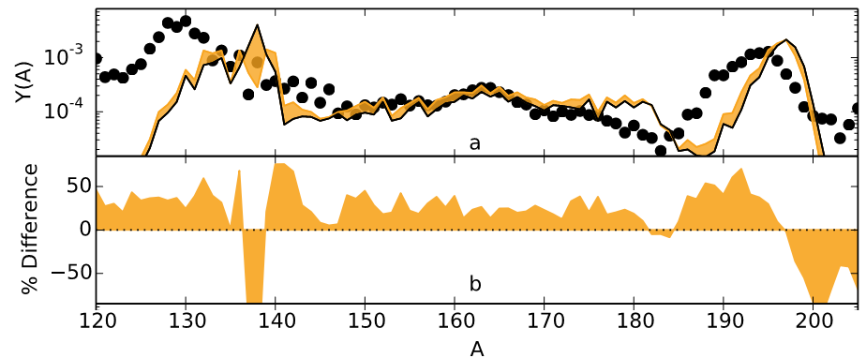
II. MR-TOF Simulator
2. Testing - Estimation for the ¹³⁸Sn
Why ¹³⁸⁻¹⁴⁰Sn ?
Baseline H-scenario
The equilibrium abundance in r-process
+25%S_{n}(¹³⁸Sn)
+25%S_{n}(¹³⁸Sn)
Final r-process abundance
Final r-process abundance is drastically changed by the change of S_{n}(¹³⁸Sn).
S. Brett et al., Eur. Phys. J. A 48, 184 (2012)
Baseline
Final r-process abundance is changed by more than 50% with S_{n}(¹⁴⁰Sn) + 500 keV.
M.R. Mumpower et al., Prog. Part. Nucl. Phys. 86, 86 –126 (2016)

Slide 13
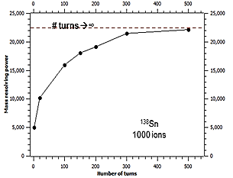
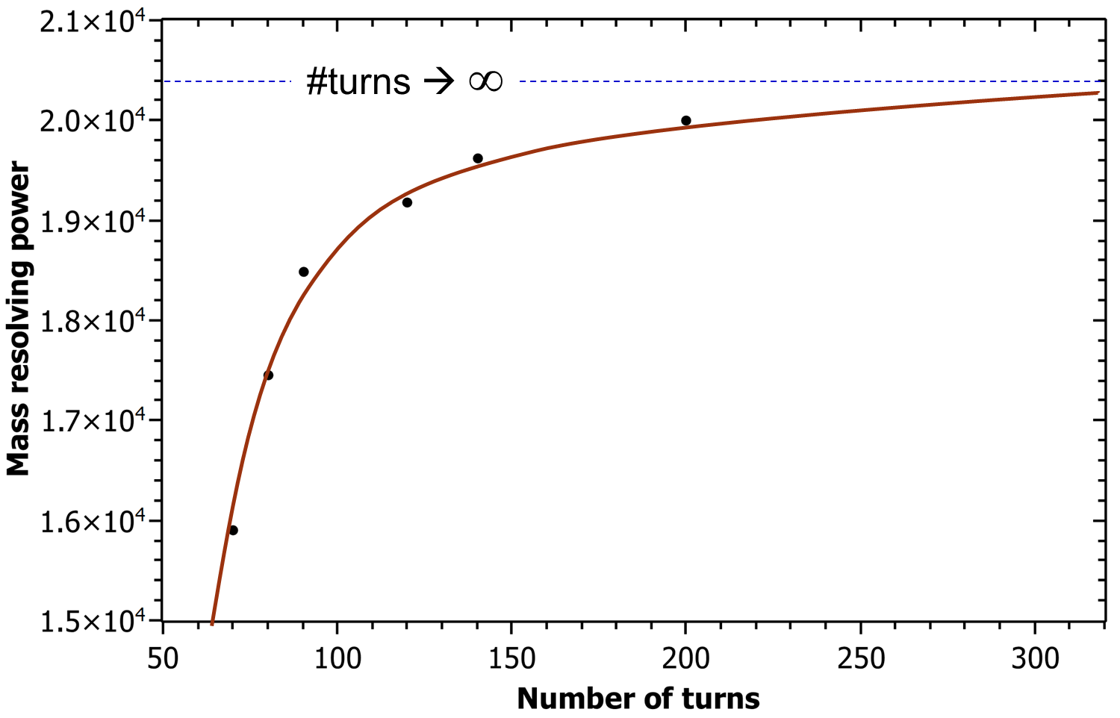
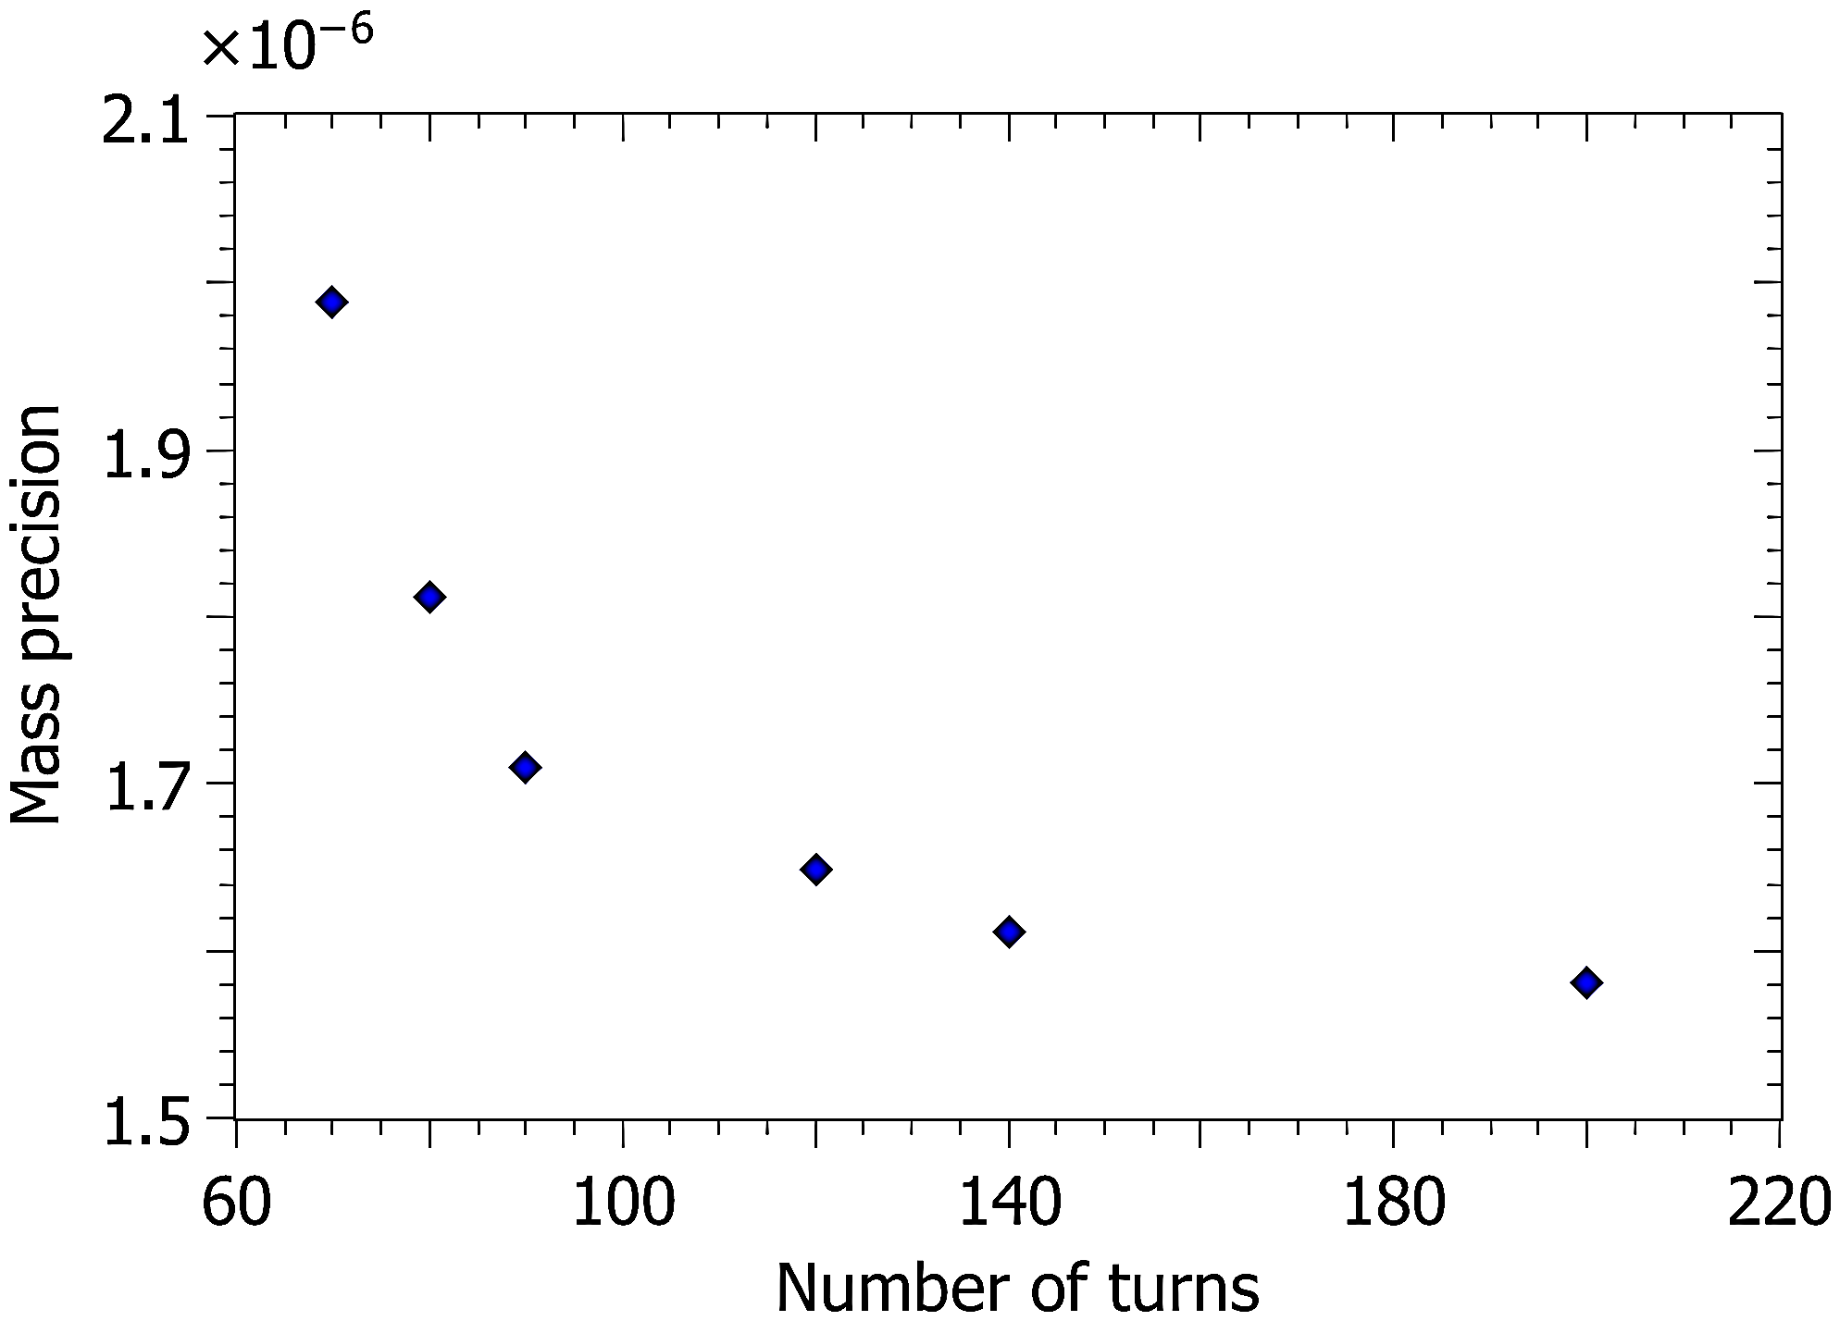
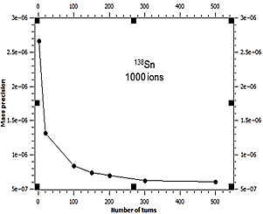
II. MR-TOF Simulator
2. Testing results
MRTOF-S
SIMION 8.1
~3. minutes for 150 turns, 1000 ions.
~2. minutes for 150 turns, 1000 ions.
¹³⁸Sn
¹³⁸Sn
1000 ions

Slide 14
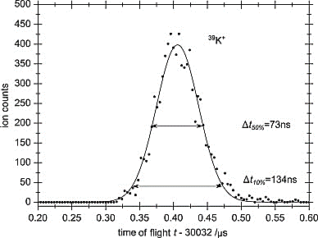
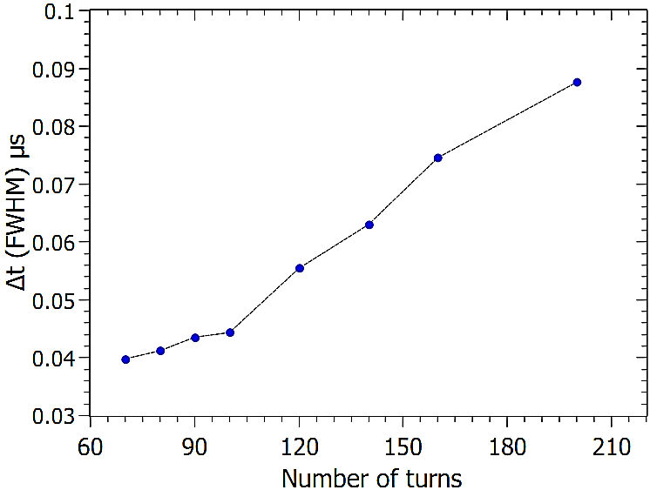
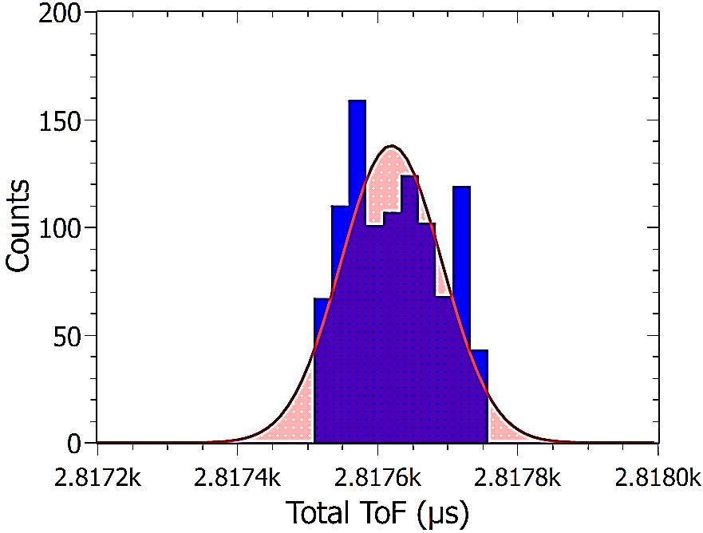
II. MR-TOF Simulator
2. Testing results
R.N. Wolf et al., NIMA686 (2012) 82-90
FWHM = 74 ns @ 160 turns
160 turns
FWHM @ 160 turns is compatible with the one measured at ISOLTRAP/CERN before upgrade.
With 200 turns
m_{138Sn} = 137.95270 ± 0.00021 u
Δm_{(MRTOFS – AME16)} = 0.0006 u
~ 550 keV
Δm_{AME16} = 540 μu ~ 503 keV
(N = 1000 ions)
→ Compatible with the mass precision @ ISOLTRAP before upgrade
W.J. Huang et al 2017 Chinese Phys. C 41 030002

Slide 15
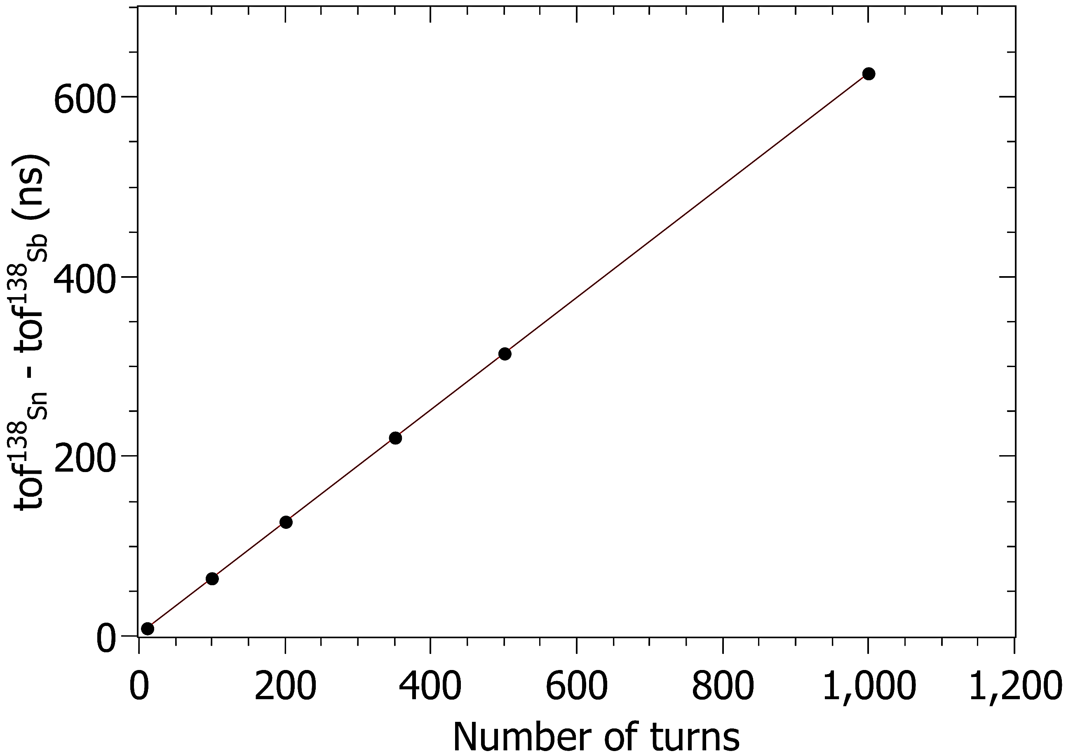
II. MR-TOF Simulator
2. Testing results
PID for Isobars
10 turns
Ions | ID | Mass
¹³⁸Sn⁺ | M | 137.9518 u
¹³⁸Ba⁺ | m1 | 137.9052 u
¹³⁸Te⁺ | m2 | 137.9295 u
¹³⁸Sb⁺ | m3 | 137.9418 u
¹³⁸In⁺ | m4 | 137.9691 u
¹³⁸I⁺ | m5 | 137.9227 u
¹³⁸Xe⁺ | m6 | 137.9141 u
¹³⁸Cs⁺ | m7 | 137.9110 u
¹³³Ce⁺ | m8 | 137.9060 u
8.5 ns
100 turns
64.6 ns
200 turns
127.1 ns
350 turns
220.8 ns
ΔToF = 0.6246N +2.1940
500 turns
314.5 ns
1000 turns
626.8 ns
50 turns

Slide 16
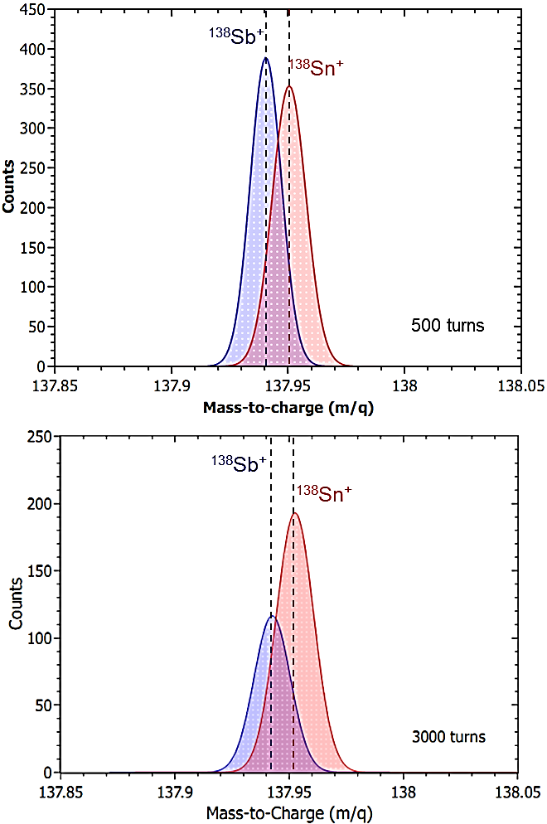
II. MR-TOF Simulator
2. Testing results
Separation
Main contaminant is ¹³⁸Sb
Δm = 0.01 u ⬄ ΔE ~ 10 keV
Isotopes | ¹³⁸Sn |  | ¹³⁸Sb
Turns | 500 | 3000 | 500 | 3000
Δt_{FWHM} (ns) | 236.659 | 1476.339 | 218.659 | 1427.932
Δm_{FWHM} (u) | 0.008779 | 0.008223 | 0.009488 | 0.007954
R_{m} | 1.8 × 10⁴ | 1.8 × 10⁴ | 1.9 × 10⁴ | 1.8 × 10⁴
ΔToF (ns) | 500 turns: 249.427 3000 turns: 1795.336
Resolving powers are almost 1.8 × 10⁴
Δt_{FWHM} ~ ΔToF
Δm_{FWHM} = 0.008 u ~ Δm = 0.01 u ⬄ ΔE ~ 10 keV
Challenge: Separation of ¹³⁸Sn & ¹³⁸Sb with ΔE ~ 10 keV @ R_{m} = 1.8 × 10⁴ !!!

Slide 17
III. Summary and Outlook
MRTOF-S is useful for estimating the ion separation & PID, and resolving power.
MRTOF-S results are compatible with SIMION 8.1.
Resolving power and mass precision does not change so much at a certain number of turns.
ToF spread is proportional to the number of turns → the number of reflections should be optimized.
It is difficult to separate ions with Δm = 10 keV/c² (¹³⁸Sn & ¹³⁸Sb) at R_{m} = 2 ×10⁴ and mass precision of 10⁻⁶.
Simulation speed will be improved.

Slide 18
Thank you for your attention!

