Slide 1
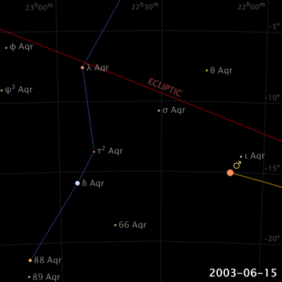
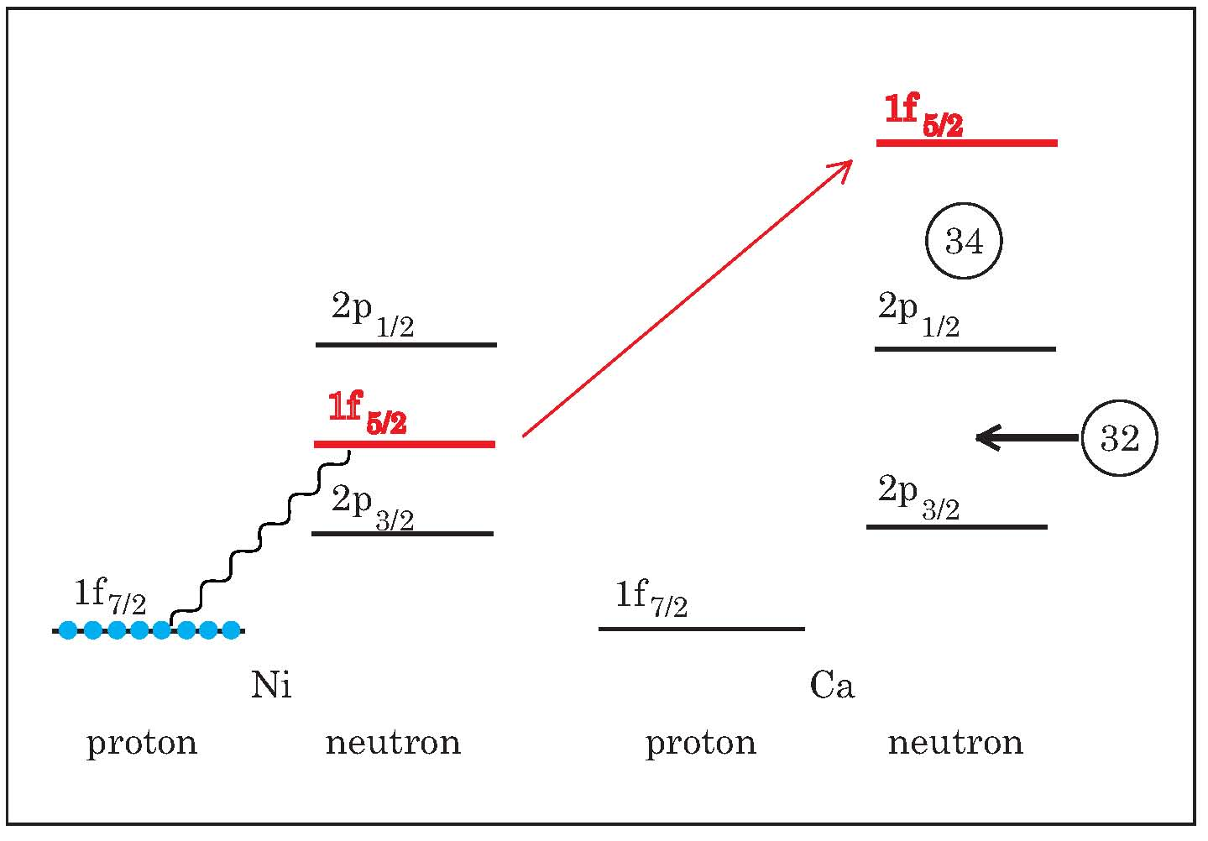
Nuclear structure from semi-inclusive nucleon knockout reaction
CENuM-RULiC Joint Workshop on Extreme Nuclear States and Reactions
IBS, Daejeon, Korea, October 31 – November 2, 2019
Shell evolution of neutron orbits from Ni back to Ca
Satou Yoshiteru
Rare Isotope Science Project
Institute for Basic Science
T.Otsuka et al., arXiv:1805.06501v4 [nucl-th]
Notes:
This phenomenon, shell evolution, is not only quantified by the appearance of new magic numbers, but also a variety of observables and features.
Phenomenon, beyond the independent particle shell-model picture.

Slide 2
Outline
Introduction
Cross-shell states in ¹⁷C from one-neutron knockout of ¹⁸C at 245 MeV/nucleon
S.Kim et al., In preparation.
c.f.) J.W.Hwang et al., Phys. Lett. B 769 (2017) 503.
Proton excited states in neutron-rich carbon isotopes
J.W.Hwang et al., In preparation.
c.f.) S.Kim, K.I.Hahn et al., Experimental proposal.
“Proton excited states and change of the Z=6 shell gap in neutron-rich carbon isotopes”.
Summary

Slide 3
SAMURAI DAY-1 Collaborators
LPC-Caen, ENSICAEN, University de Caen, CNRS/IN2P3: N.L.Achouri, F.Delaunay, J.Gibelin, S.Leblond, M.Marques, N.Orr
Tokyo Institute of Technology: Y.Kondo, T.Nakamura, N.Kobayashi, R.Tanaka, R.Minakata, S.Ogoshi, S.Nishi, D.Kanno, T.Nakashima
RIKEN: H.Baba, P.Doornenbal, N.Fukuda, N.Inabe, T.Isobe, D.Kameda, T.Kubo, J.Lee, H.Otsu, T.Motobayashi, H.Sato, Y.Shimizu, H.Suzuki, H.Takeda, S.Takeuchi, K.Yoneda
Institute fur Kernphysik, Technische Universitat Darmstadt: T.Aumann
Seoul National University: Y.Satou, J.W.Hwang, S.Kim
Tohoku University: T.Kobayashi, K.Muto, K.Takahashi
Rikkyo University: D.Murai
Kyoto University: N.Nakatsuka, T.Murakami
University of York: A.G.Tuff
GANIL: A.Navin
Extreme Matter Institute and Research Division, GSI: Y.Togano
Institute de Physique Nucleaire: M.Vanderbrouck
Notes:
45 participants
12 institutes
Here I report the observation of two new neutron resonances: one above the one neutron threshold of 17C, the other located above the three neutron threshold of 19C.
The works are those of Korean Ph.Ds, who worked on a subset of data taken at RIKEN in experiments organized by our French colleagues, who are actually a part of the organizers of this conference.
A part of the results has been presented by Dr. Hwang in the last DREB conference some weeks ago.

Slide 4
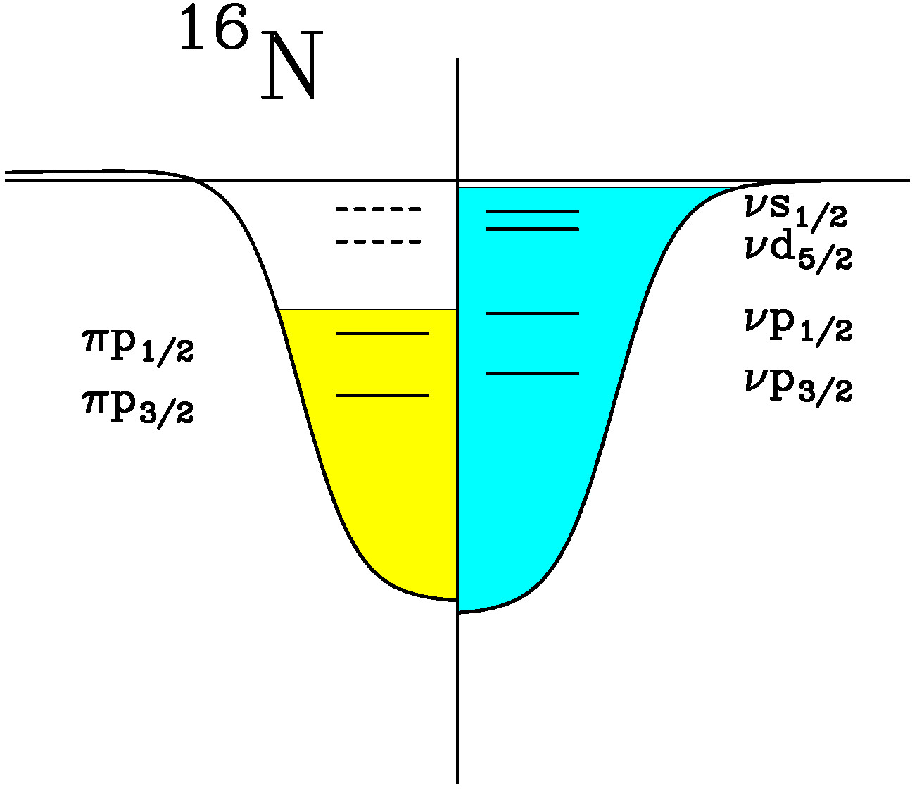
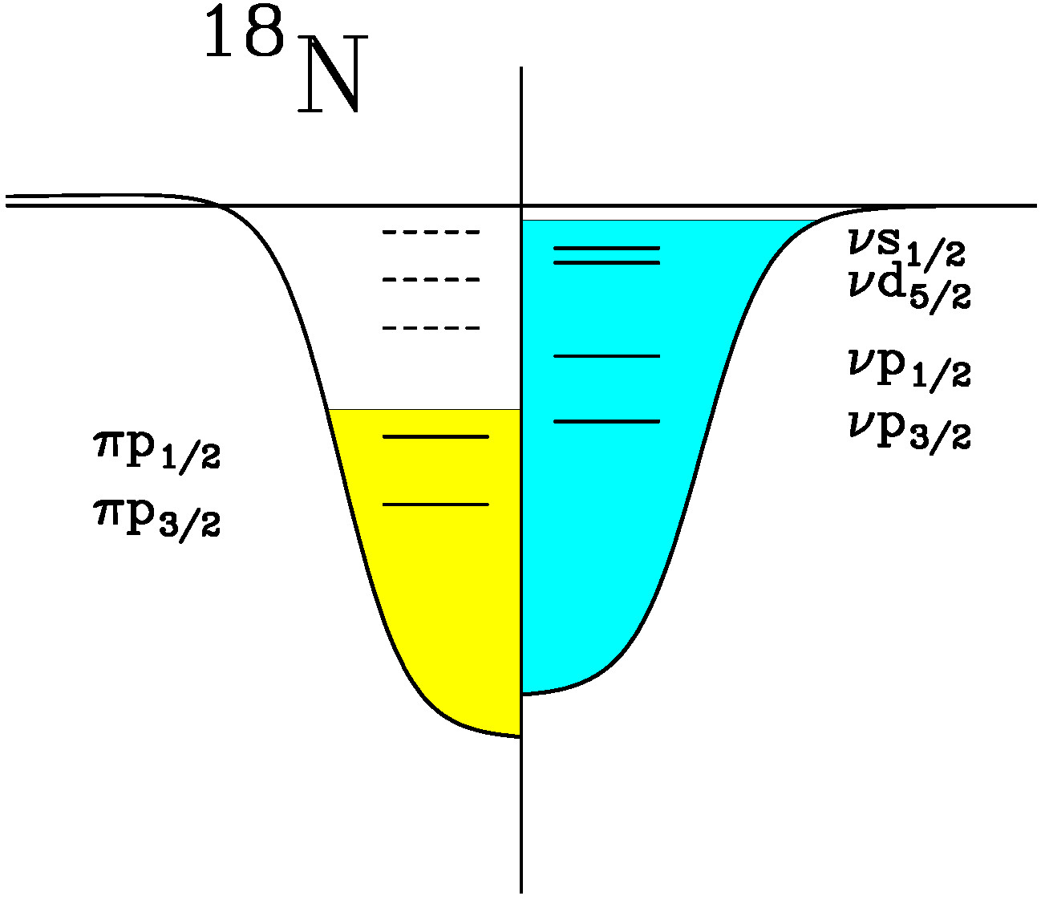
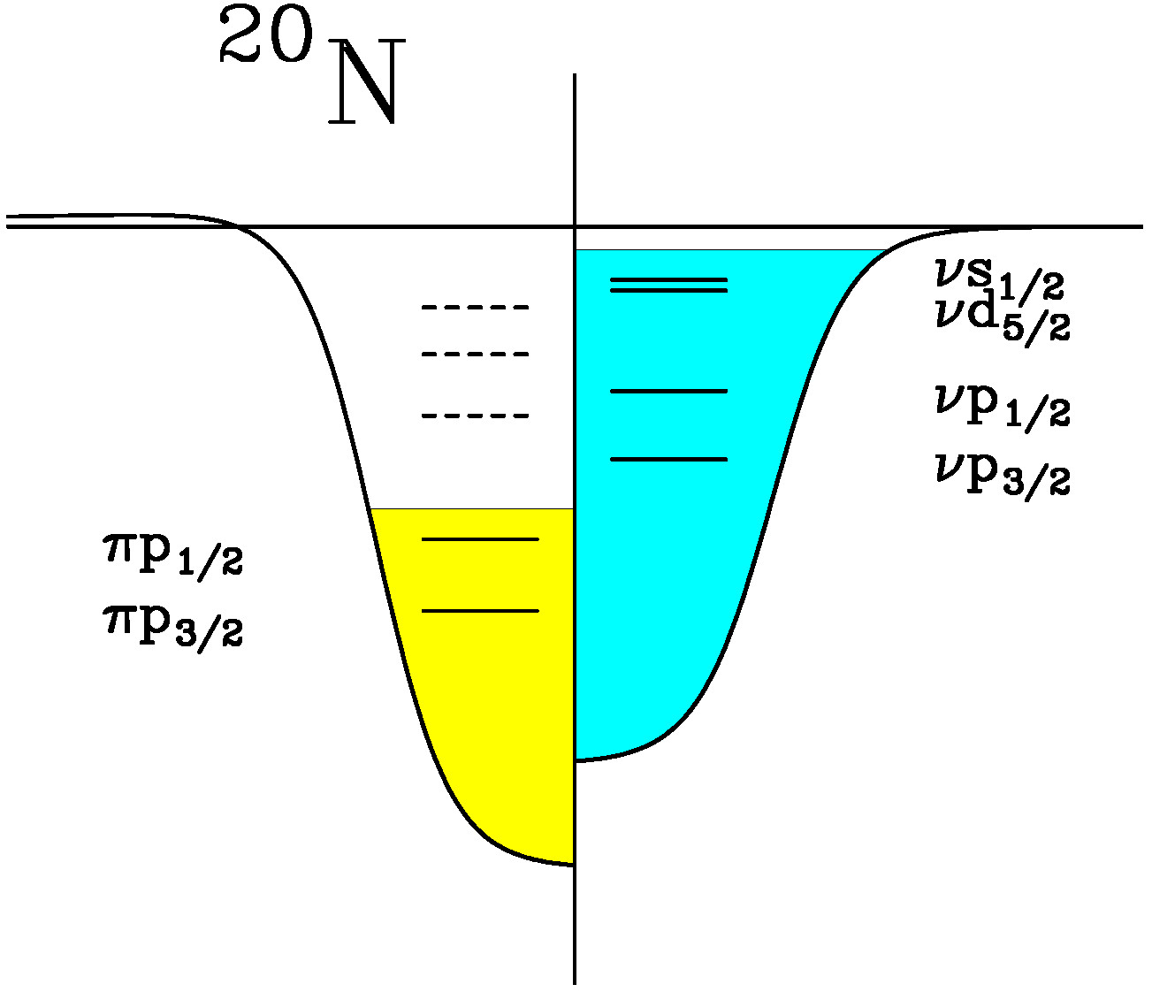
Exotic structures of neutron-rich nuclei
Exotic properties are expected due to large excess of neutrons and weak binding of valence neutrons: (1) Modified nucleon density distributions
(2) Change in shell structures
(3) Coupling with the continuum
(4) Altered effects of Pauli blocking.
(I) Neutron deep hole states
(II) Proton (deep) hole states
M.Ishihara, in International School of Heavy Ion Physics, 4th Course: Exotic Nuclei, edited by R.A.Broglia and P.G.Hansen (World Scientific, 1998), pp.291.

Slide 5
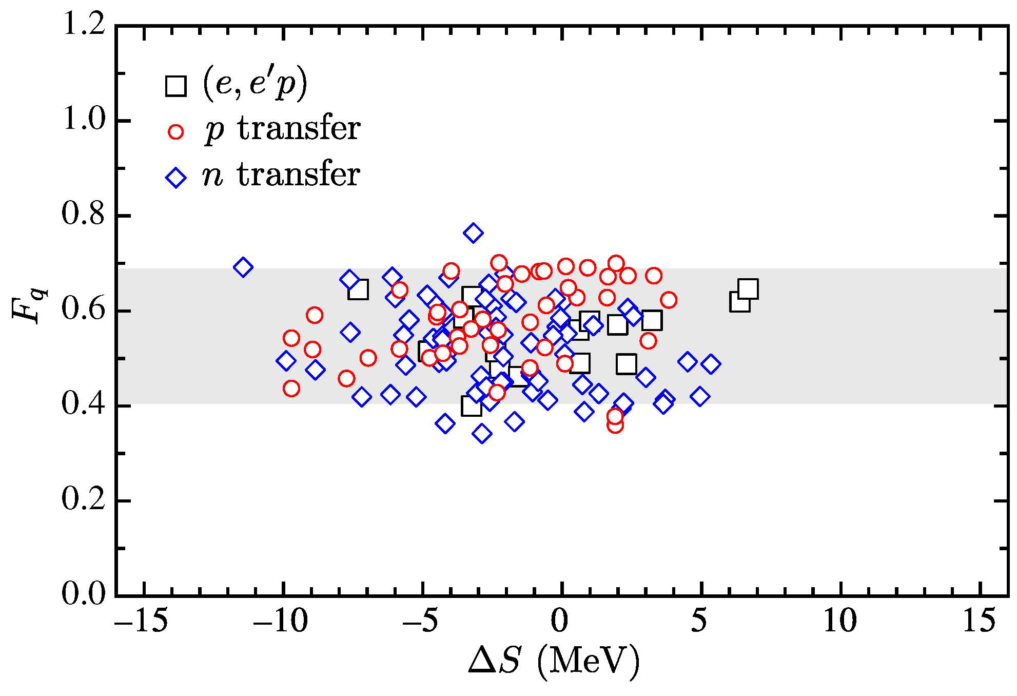

Reduction factors of C²S
$$R=\frac{C^{2}S^{exp}}{C^{2}S^{SM}}$$
Reduction factor
B.P.Kay, et al., Phys. Rev. Lett. 111, 042502 (2013).
‘‘at any time only 2/3 of the nucleons in the nucleus act as independent particles moving in the nuclear mean field’’

Slide 6
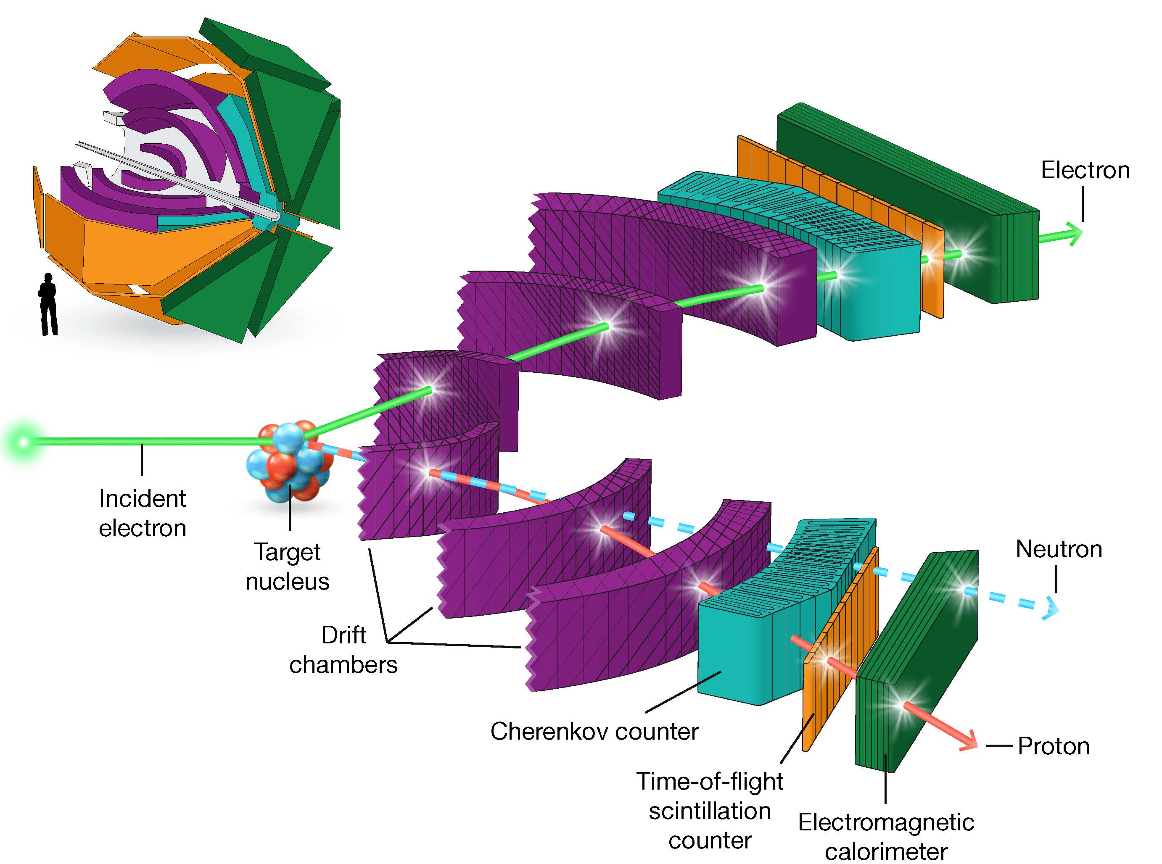
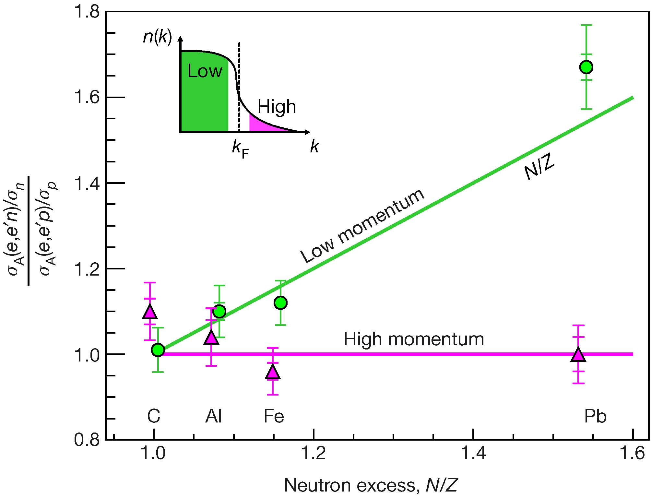

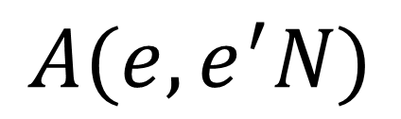



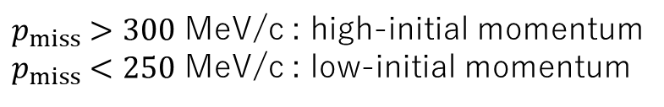




High-momentum protons and neutrons in neutron-rich nuclei
M.Duer et al., Nature 560, 617 (2018)
$$A(e,e^{′}N)$$
Neutron-to-proton reduced cross section ratio
$$e′$$
$$N$$
$$p_{f}$$
$$q$$
$$p_{miss}$$
$$A$$
CLASS@Jefferson Labratory
$p_{miss}>300$ MeV/c : high-initial momentum
$p_{miss}<250$ MeV/c : low-initial momentum
$$e$$
$K_{F}≅250$ MeV/c (Fermi energy)
Notes:
There are equal number of high-initial-momentum protons and neutrons in asymmetric nuclei.

Slide 7
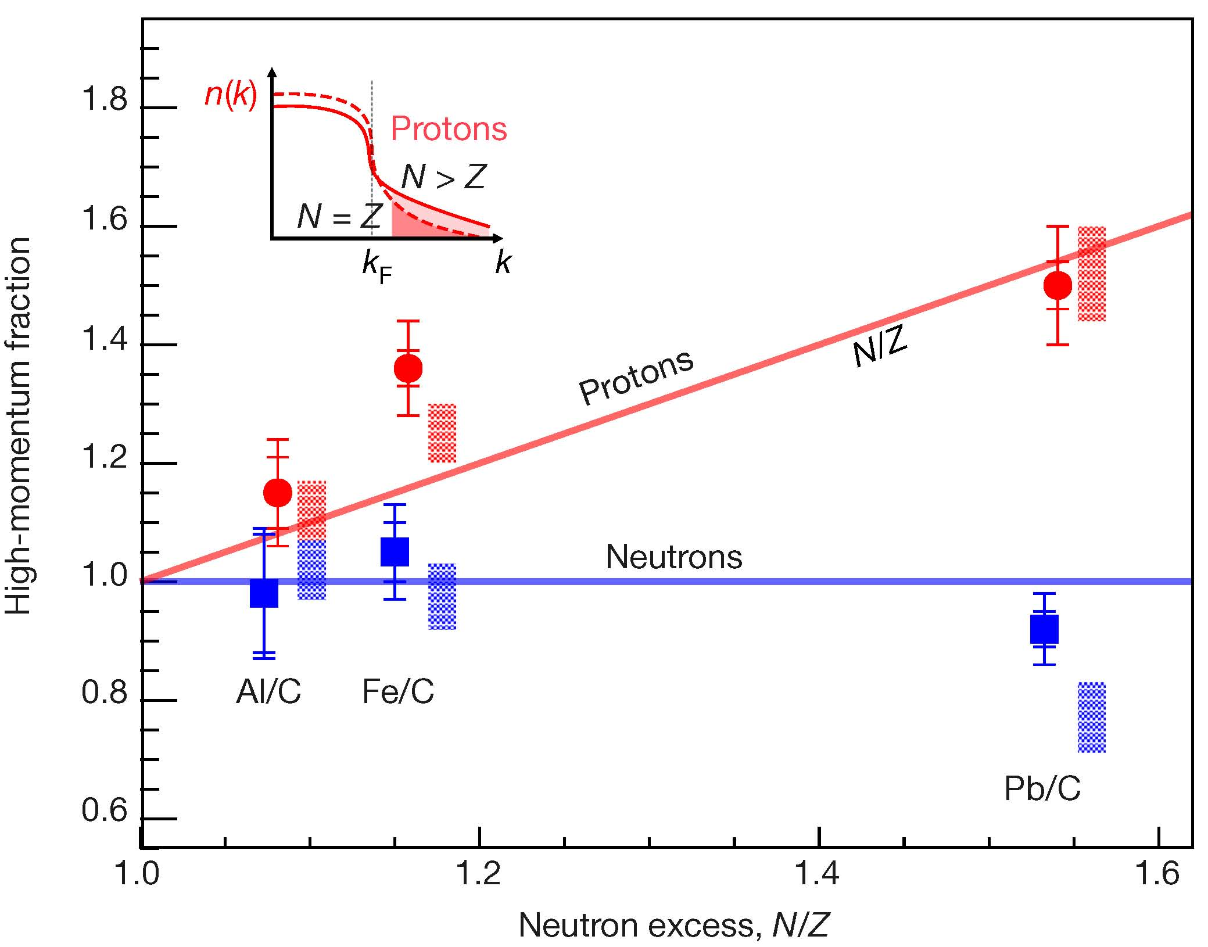
High-momentum protons and neutrons in neutron-rich nuclei
M.Duer et al., Nature 560, 617 (2018)
$$A(e,e^{′}N)$$
Double ratio of the number of high-to-low momentum events relative to carbon for p/n.
N/Z=1.86
$$e′$$
$$N$$
$$p_{f}$$
$$q$$
$$p_{miss}$$
$$A$$
CLASS@Jefferson Labratory
$p_{miss}>300$ MeV/c : high-initial momentum
$p_{miss}<250$ MeV/c : low-initial momentum
$$e$$
Probing short-range correlations in asymmetric nuclei with quasi-free pair knockout reactions
S.Stevens et al., PLB777(2018)374.
$K_{F}≅250$ MeV/c (Fermi energy)
Notes:
Increasing the number of neutrons in a nucleus increases the fraction of high-initial-momentum protons.

Slide 8
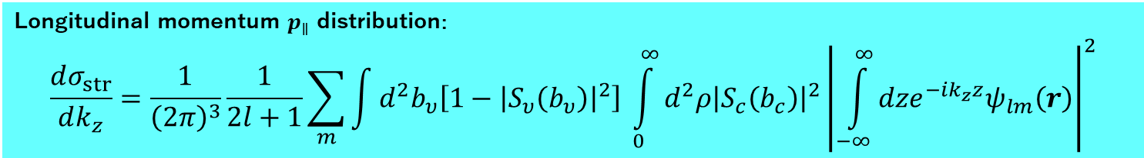

One-nucleon knockout reaction
Introduction
P.G.Hansen and J.A.Tostevin, Annu. Rev. Nucl. Part. Sci. 53, 219 (2003).
Experimental scheme
  Exhibit large cross sections ~10-100 mb.
  Knocked-out nucleon is democratically
  selected from valence orbits or below.
Cross sections leading to finals states
translate to C2S (occupancy).
Momentum distributions of the residue reflect the Fermi motion of the removed nucleon (L-value).
Knockout of minor species can be used to create further exotic nuclei.
Theoretical tools are readily available (MOMDIS, CSC_GM).
Knockout
nucleon
Knockout
residue
Decay
Neutron
(detected)
Projectile
$${}_{}^{18}C$$
Decay
Residue
(detected)
Decay γ
(detected)
Target
Target recoil
Single-particle
wave function
Longitudinal momentum $p_{∥}$ distribution:
$$\frac{dσ_{str}}{dk_{z}}=\frac{1}{{\left(2π\right)}^{3}}\frac{1}{2l+1}\sum_{m}{\int{d^{2}b_{υ}\left[1−{\left|S_{υ}\left(b_{υ}\right)\right|}^{2}\right]}} \int_{0}^{∞}{d^{2}ρ{\left|S_{c}\left(b_{c}\right)\right|}^{2}}{\left|\int_{−∞}^{∞}{dze^{−ik_{z}z}ψ_{lm}\left(r\right)}\right|}^{2}$$
Core survival probability
Valence nucleon removal probability
Notes:
This feature together with the following property [momentum distribution …] makes this one-neutron knockout reaction an ideal tool for probing single-particle properties of unstable nuclei.

Slide 9
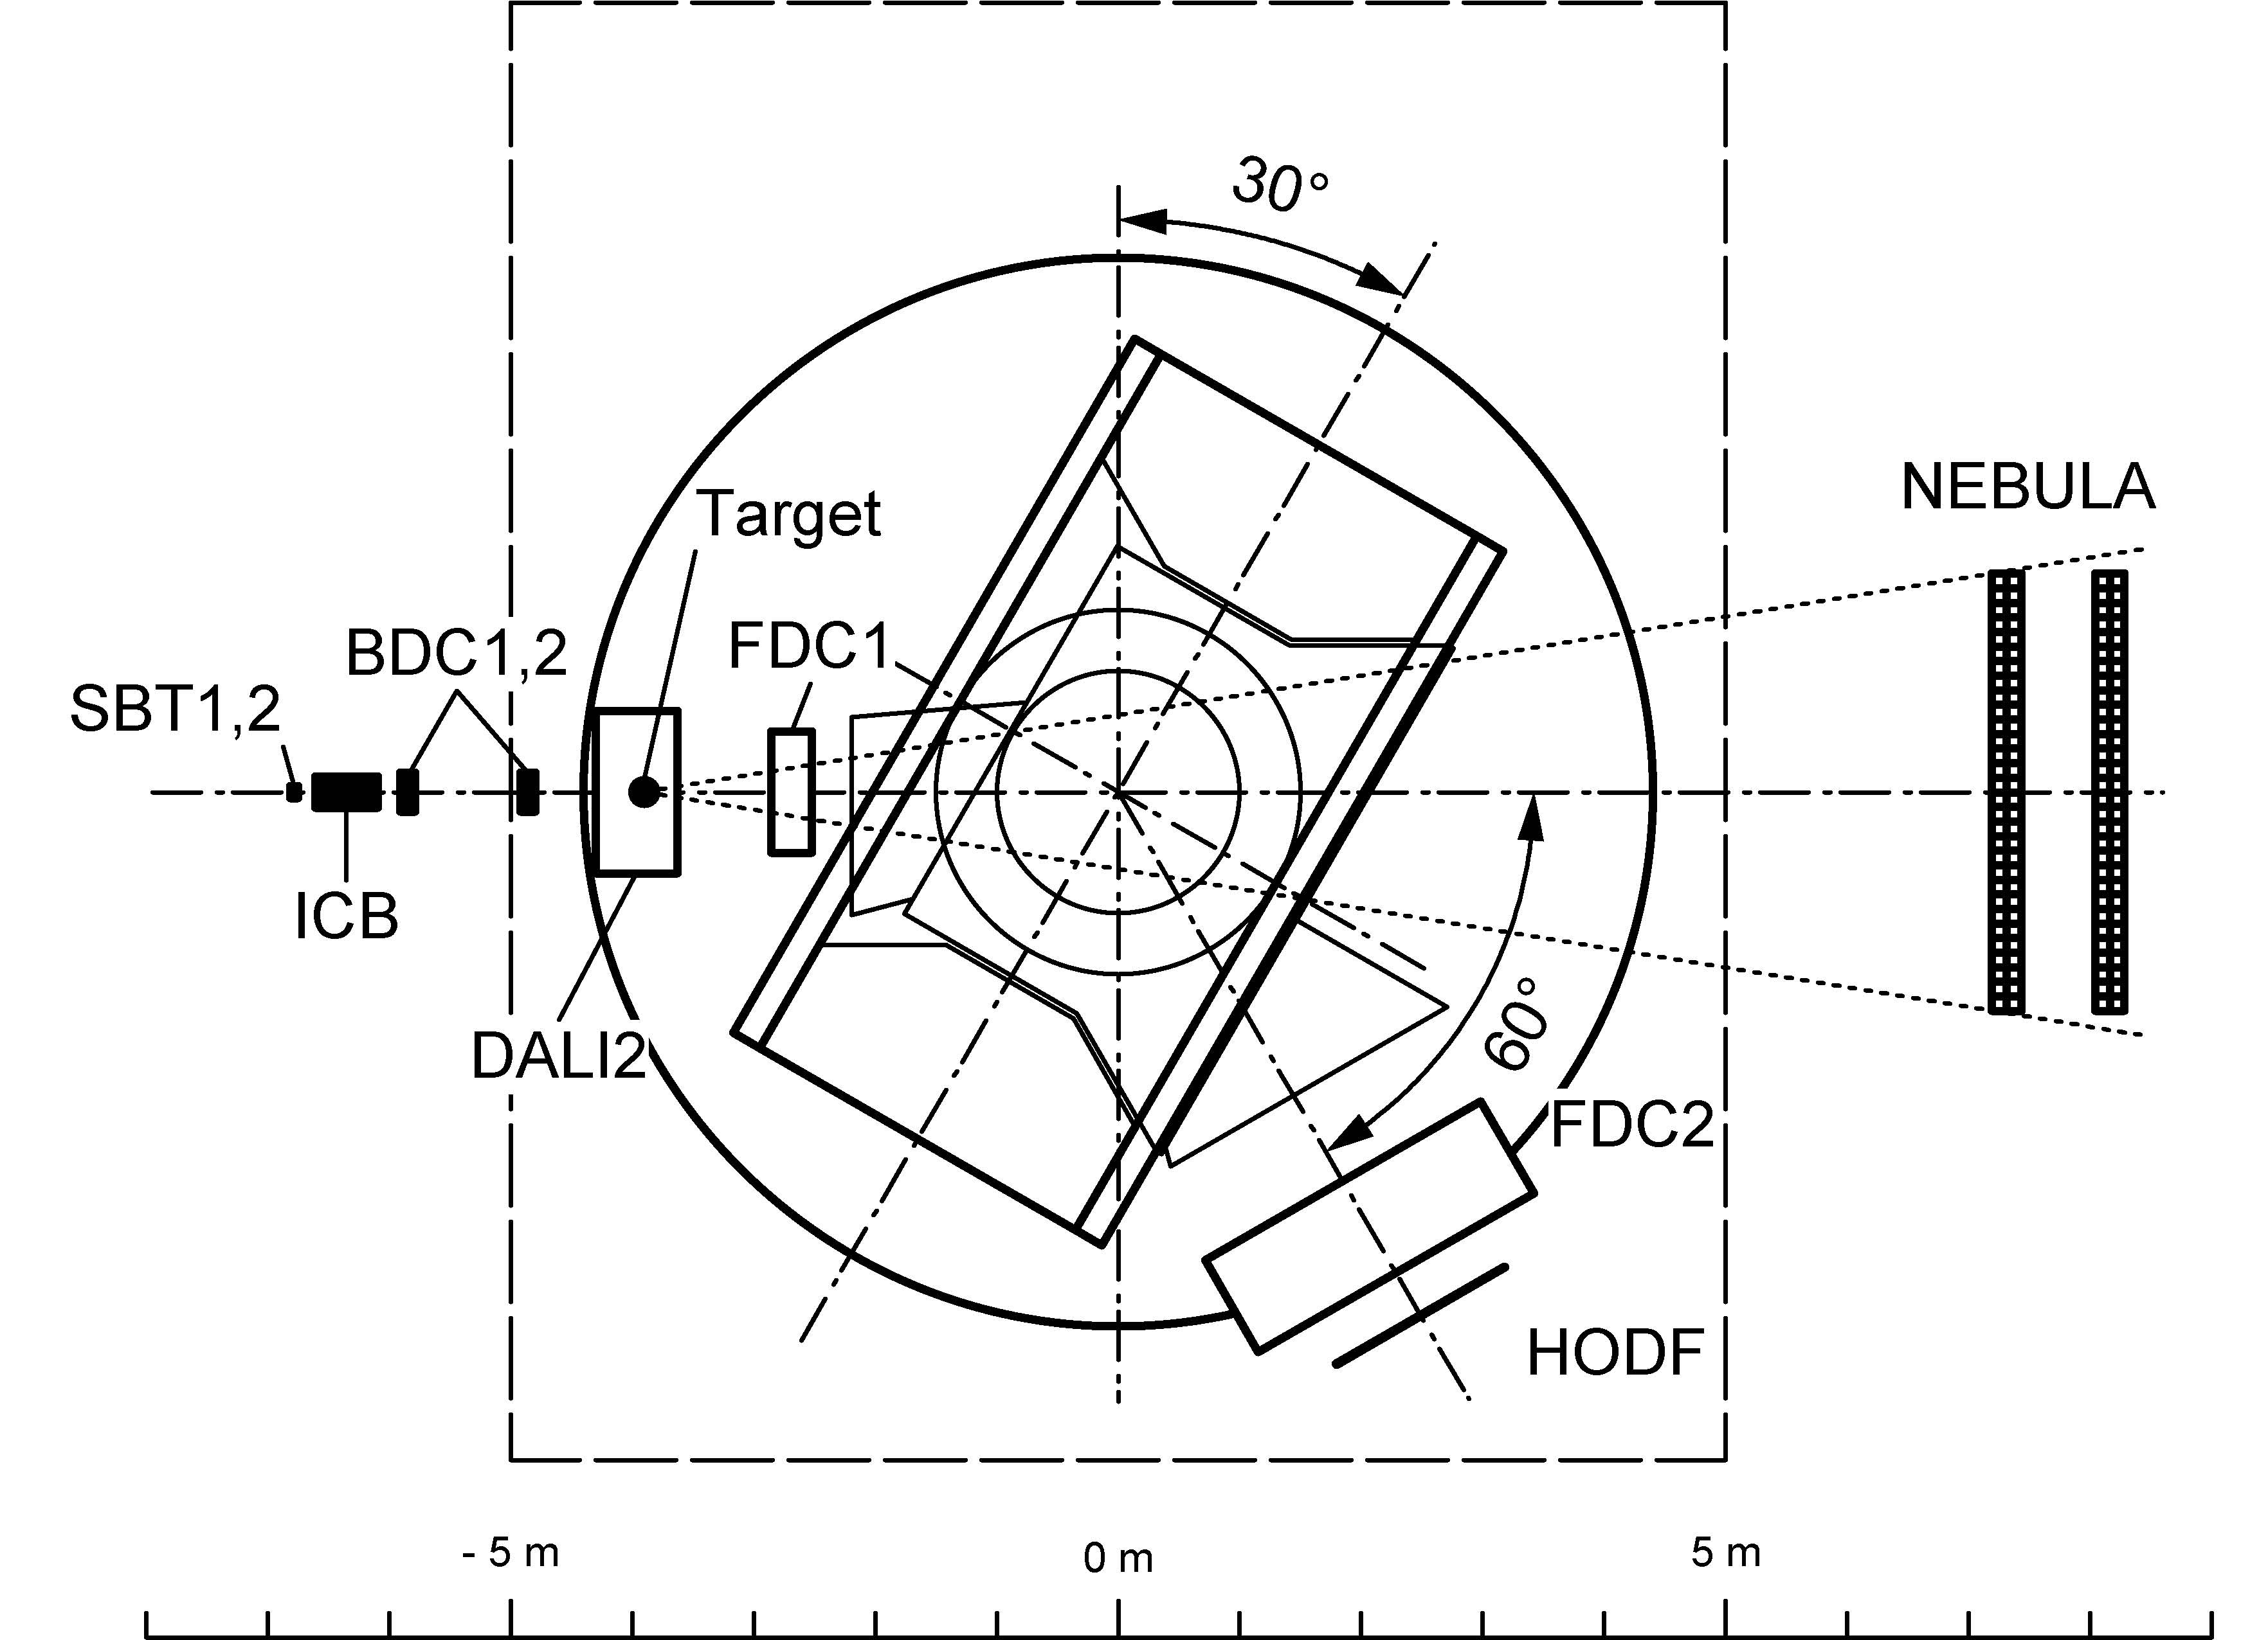





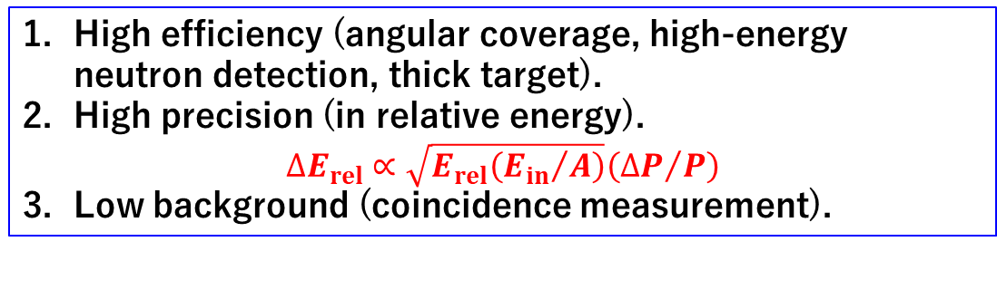

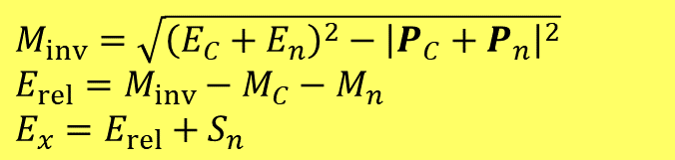

Experimental setup: SAMURAI spectrometer at RIKEN-RIBF
Superconducting Analyzer for MUlti-particles from RAdioIsotope beams
T.Kobayashi et al, NIMB317,294(2013).
Invariant mass method coupled with the nucleon knockout reactions
High efficiency (angular coverage, high-energy neutron detection, thick target).
High precision (in relative energy).
$$∆E_{rel}∝\sqrt{E_{rel}\left({E_{in}}/A\right)}\left({∆P}/P\right)$$
Low background (coincidence measurement).
¹²C(¹⁸C,¹⁷C*→¹⁶C+n)@245 MeV/u
¹²C(²⁰N,¹⁹C*→¹⁸C+n)@257 MeV/u
$M_{inv}=\sqrt{{\left(E_{C}+E_{n}\right)}^{2}−{\left|P_{C}+P_{n}\right|}^{2}}$
$E_{rel}=M_{inv}−M_{C}−M_{n}$
$E_{x}=E_{rel}+S_{n}$
(3T, 2m dia. Pole, 80 cm gap)
$$\frac{∆P}{P}\sim 1/1500$$
Knocked-out
nucleon
undetected
Neutron
$$E_{x}$$
$$n$$
$$E_{rel}$$
¹⁸C beam
$$n$$
$$γ$$
$$S_{n}$$
¹⁶C
¹⁶C fragment
¹⁷C
Notes:
The scheme is characterized by (1) high efficiency, (2) high precision, (3) low background.

Slide 10
Cross-shell states in ¹⁷C from one-neutron knockout of ¹⁸C at 245 MeV/nucleon
S.Kim et al., In preparation.
c.f.) J.W.Hwang et al., Phys. Lett. B 769 (2017) 503.

Slide 11
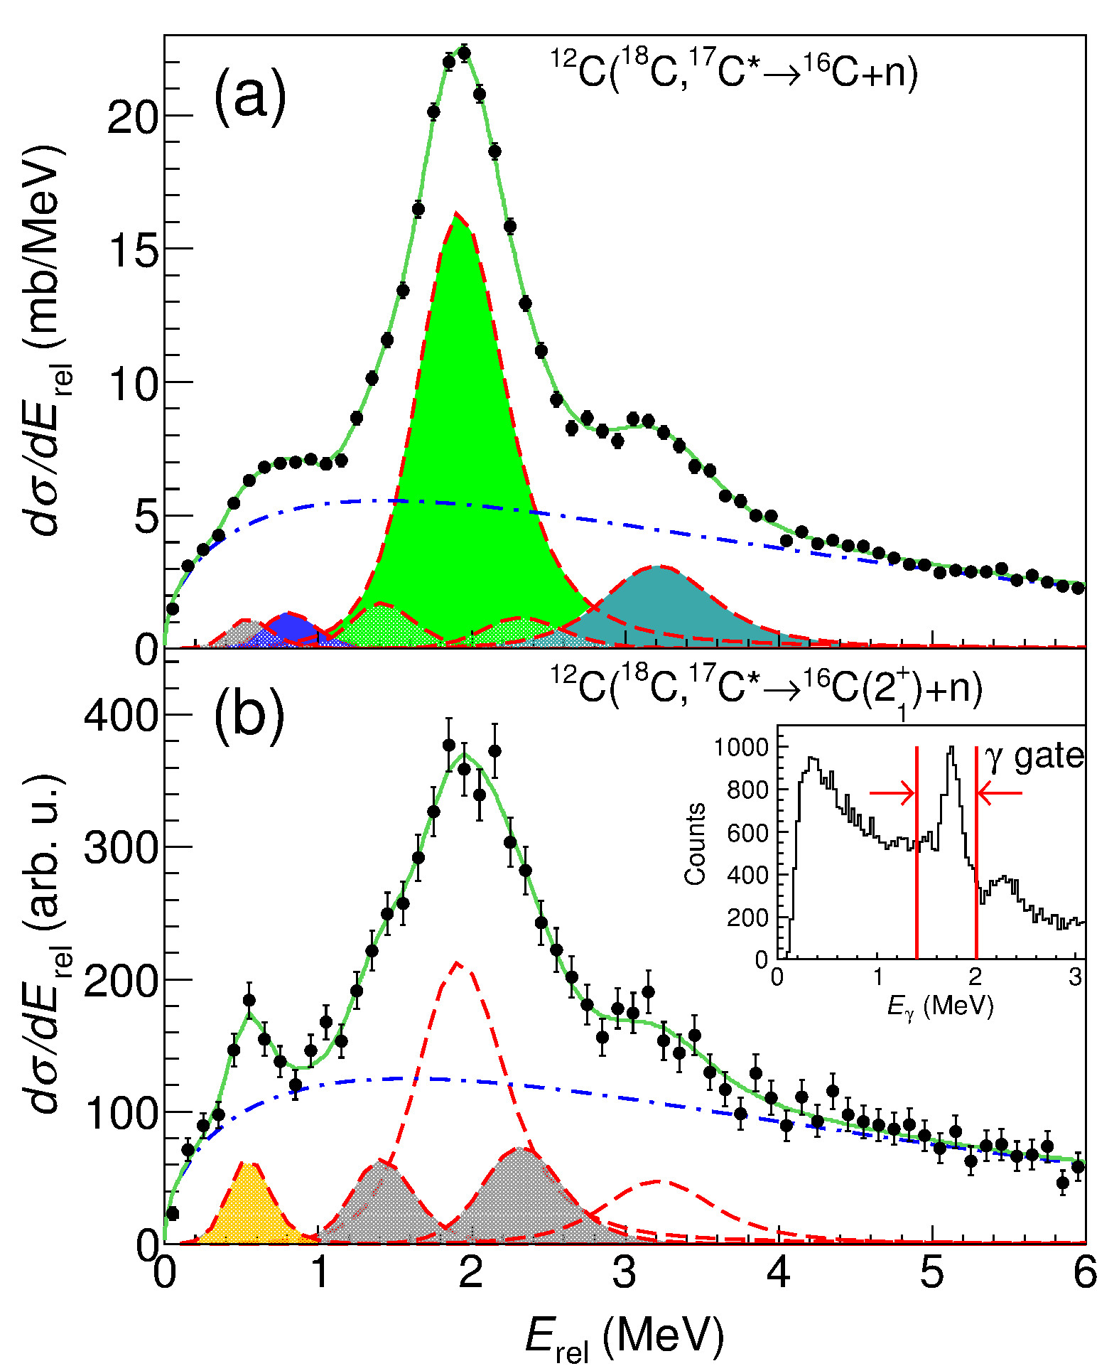
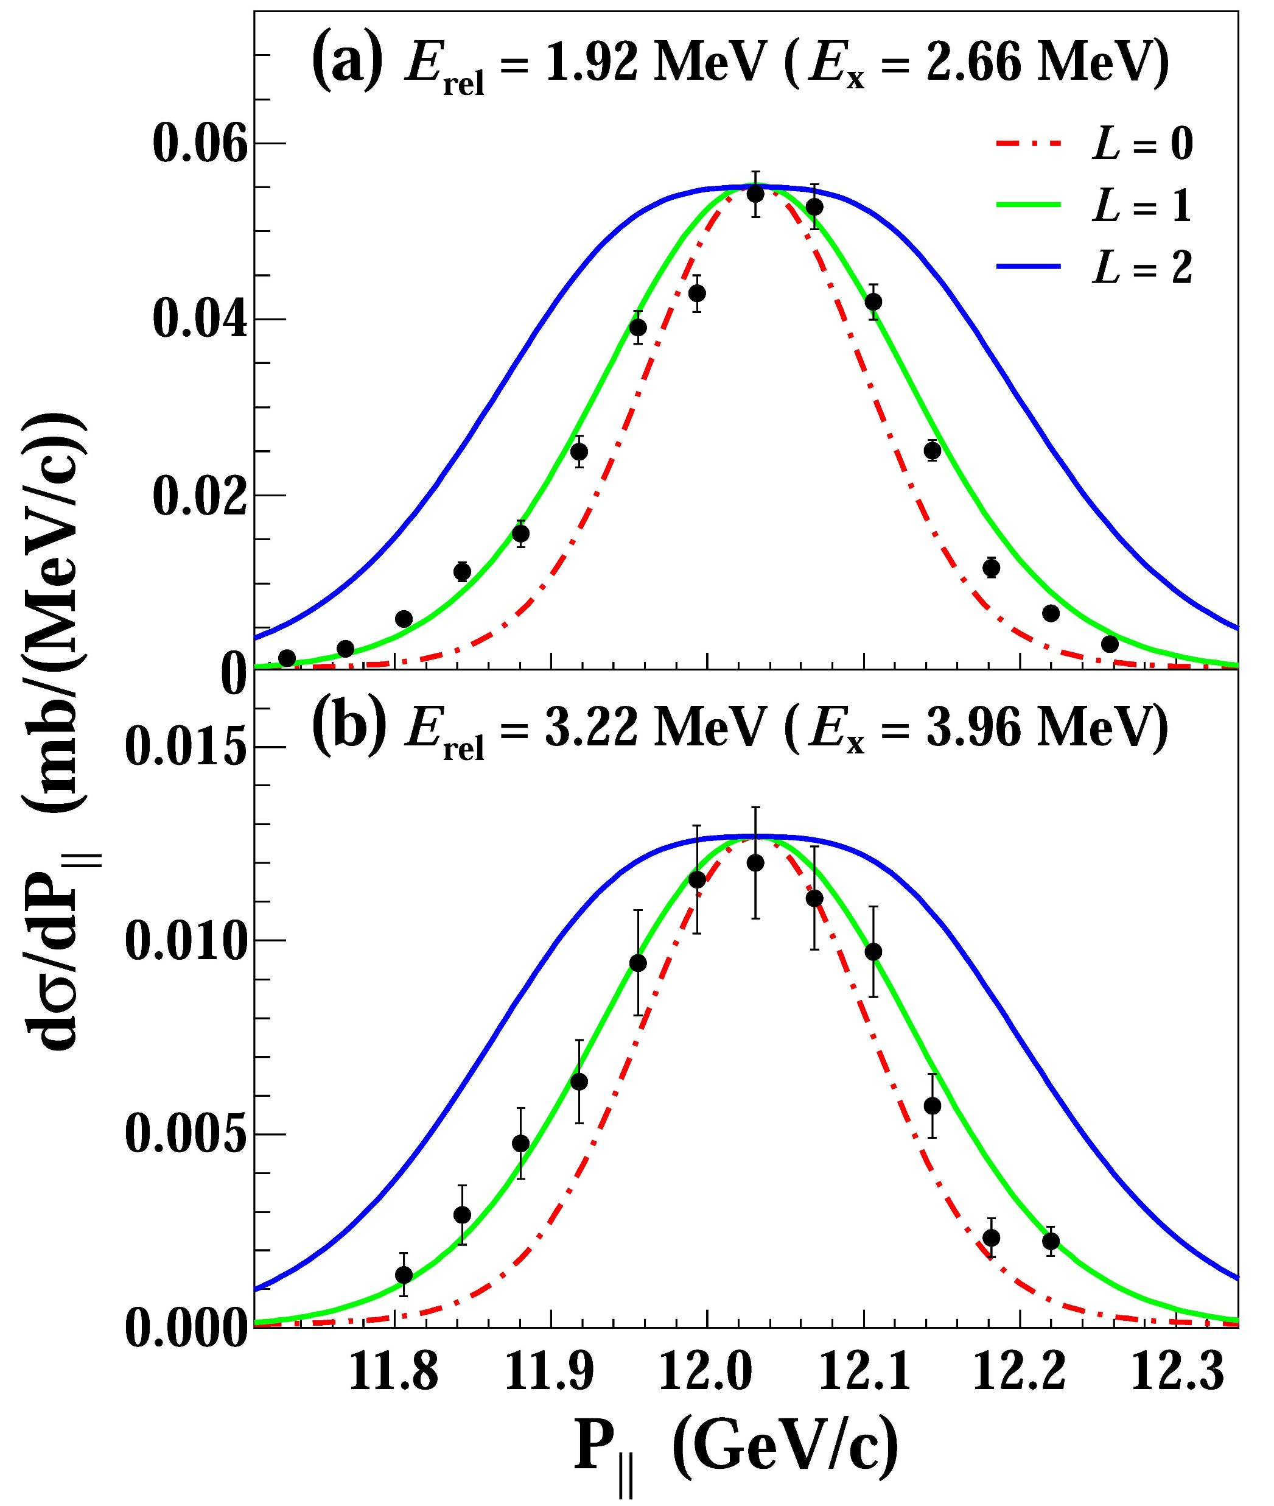
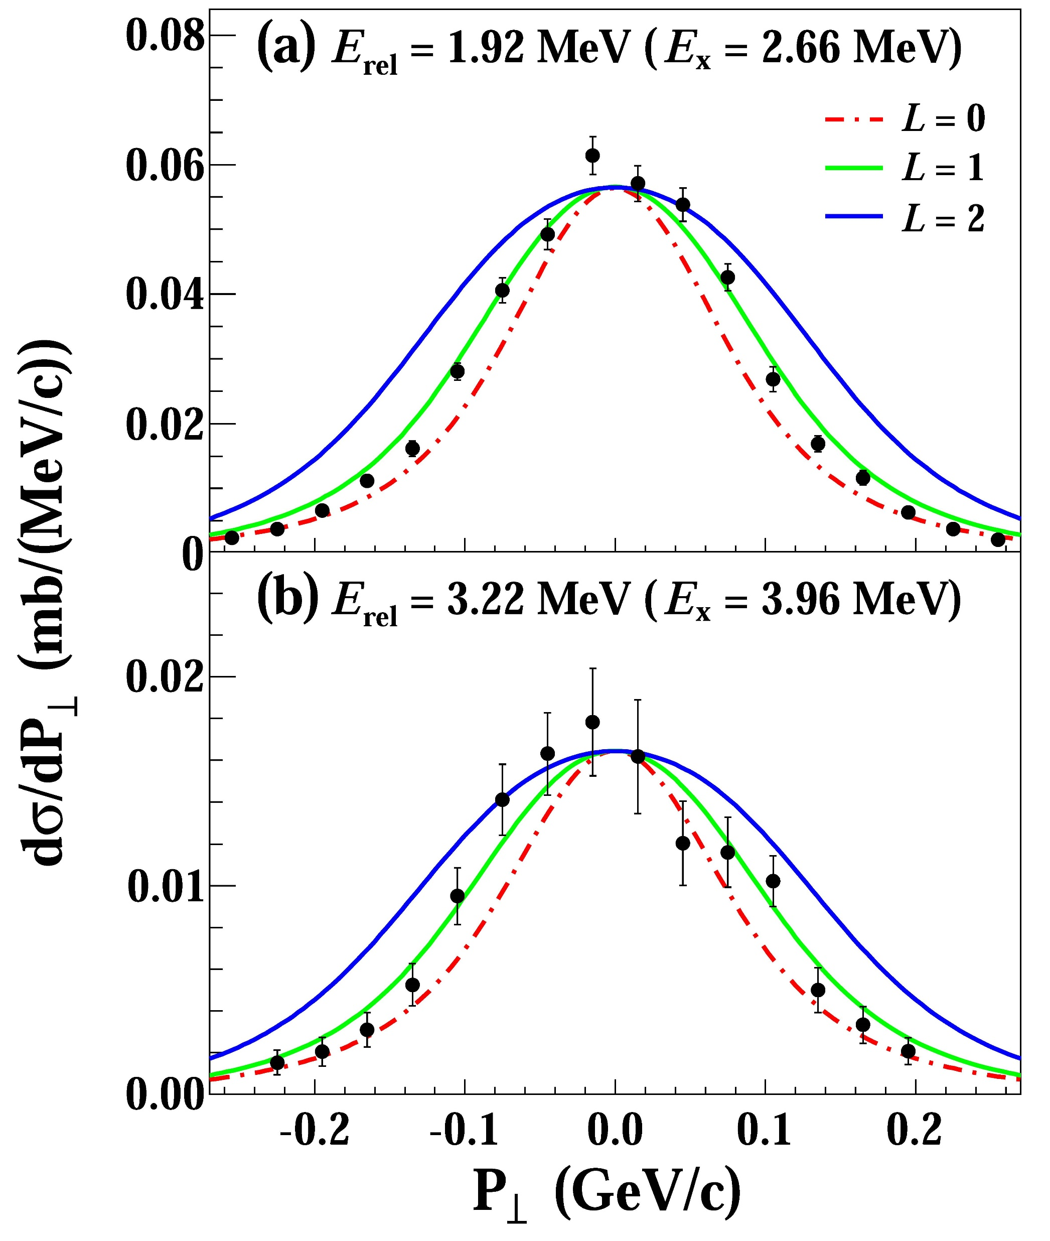
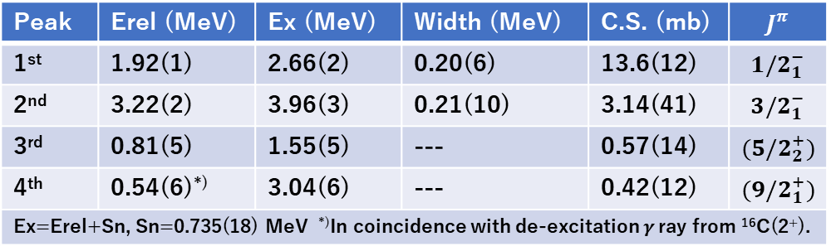
Experimental results: ¹⁸C(-1n)¹⁷C*→¹⁶C+n
S.Kim
1st
2nd
1st
1st
1st
4th
2⁺
3rd
2nd
3rd
Sn=
0.73(2) MeV
¹⁶C
¹⁷C
MOMDIS: C.A.Bertulani and A.Gade, CPC 175 (2006) 372.
2nd
2nd
4th
Peak | Erel (MeV) | Ex (MeV) | Width (MeV) | C.S. (mb) | $$J^{π}$$
1st | 1.92(1) | 2.66(2) | 0.20(6) | 13.6(12) | $${1/2}_{1}^{−}$$
2nd | 3.22(2) | 3.96(3) | 0.21(10) | 3.14(41) | $${3/2}_{1}^{−}$$
3rd | 0.81(5) | 1.55(5) | --- | 0.57(14) | $${(5/2}_{2}^{+})$$
4th | 0.54(6)^{*)} | 3.04(6) | --- | 0.42(12) | $${(9/2}_{1}^{+})$$
Ex=Erel+Sn, Sn=0.735(18) MeV ^{*)}In coincidence with de-excitation $γ$ ray from ¹⁶C(2⁺).

Slide 12
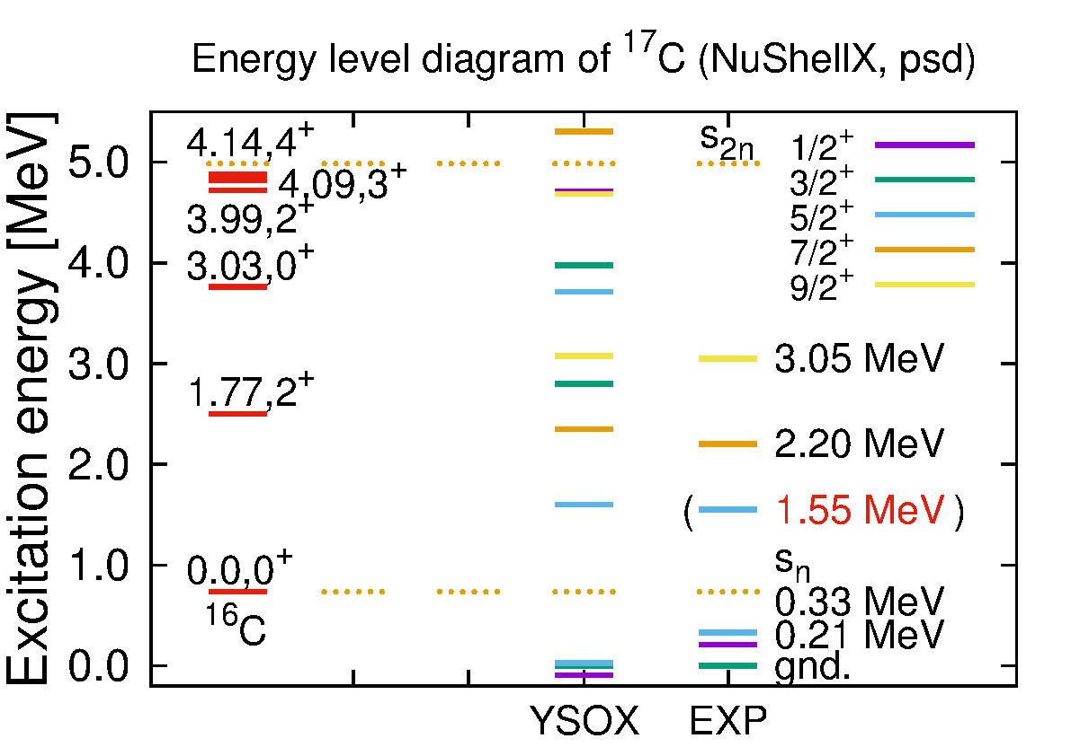
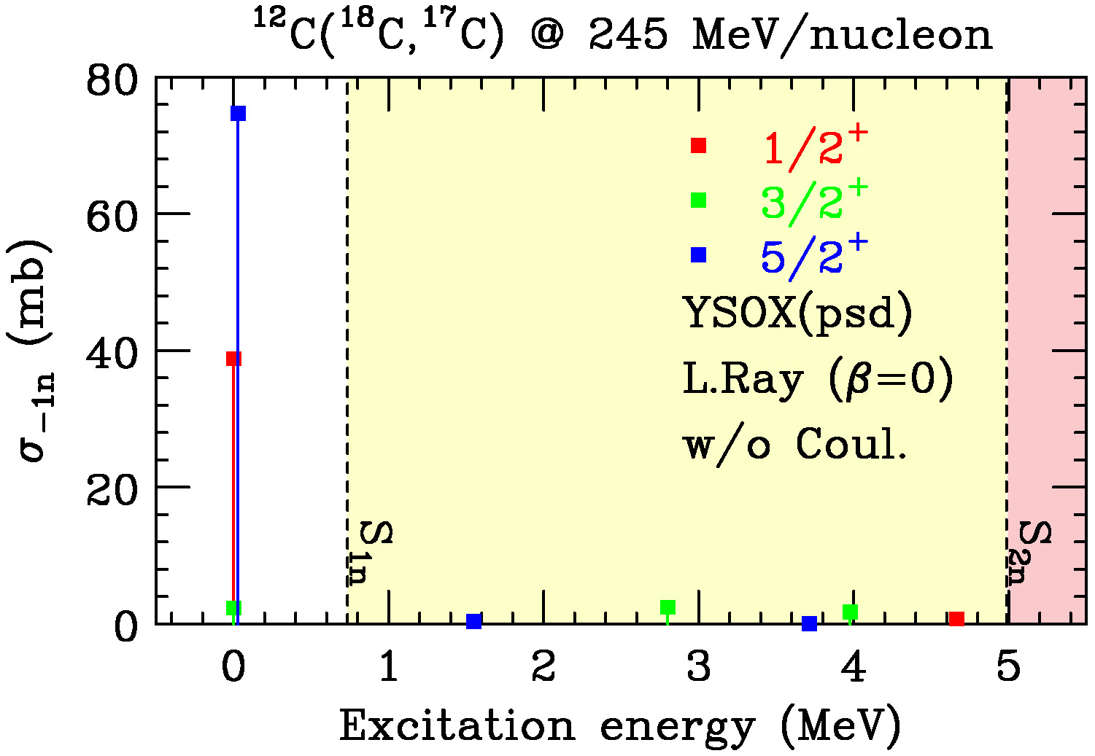
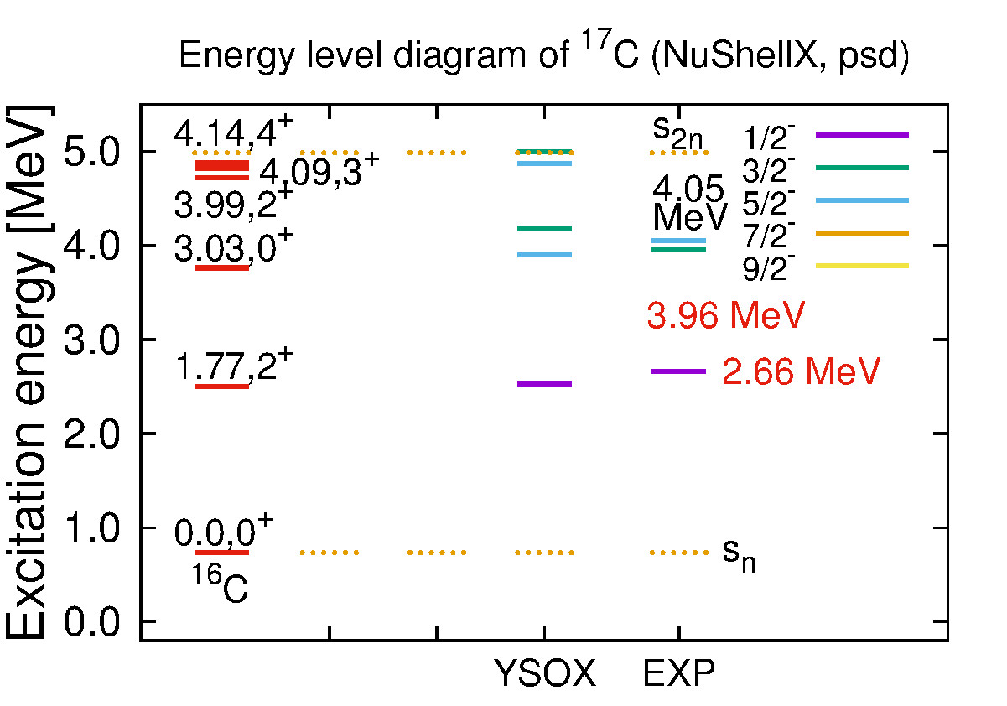
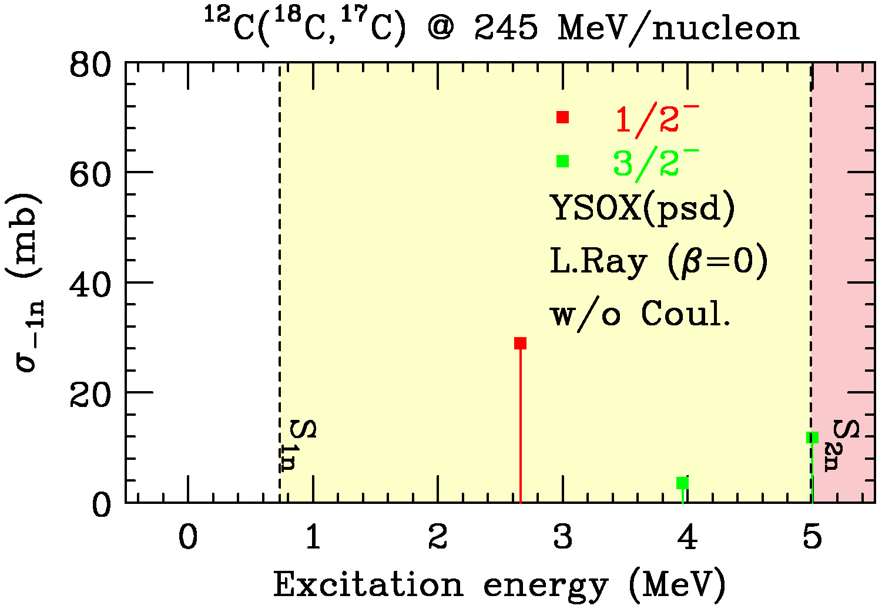
Energy level / Strength distribution: ¹⁸C(-1n)¹⁷C*→¹⁶C+n
Positive parity
YSOX: C.Yuan et al., Phys. Rev. C85 (2012) 064324.
MOMDIS: C.A.Bertulani and A.Gade, CPC 175 (2006) 372.
Negative parity
Notes:
The states which we believe we observed are marked by red characters in the left diagrams, and surrounded by circles in the left strength distributions.

Slide 13
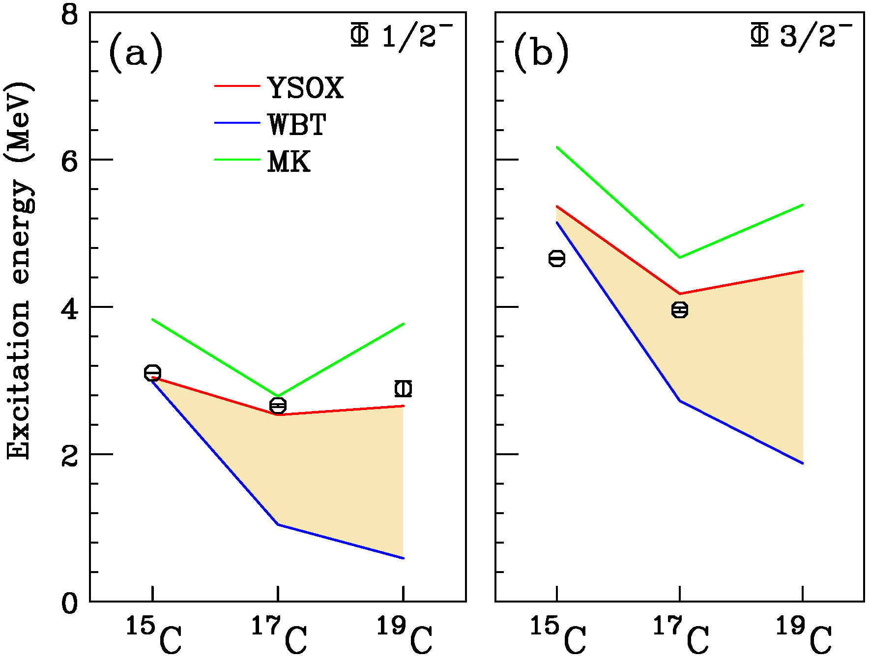
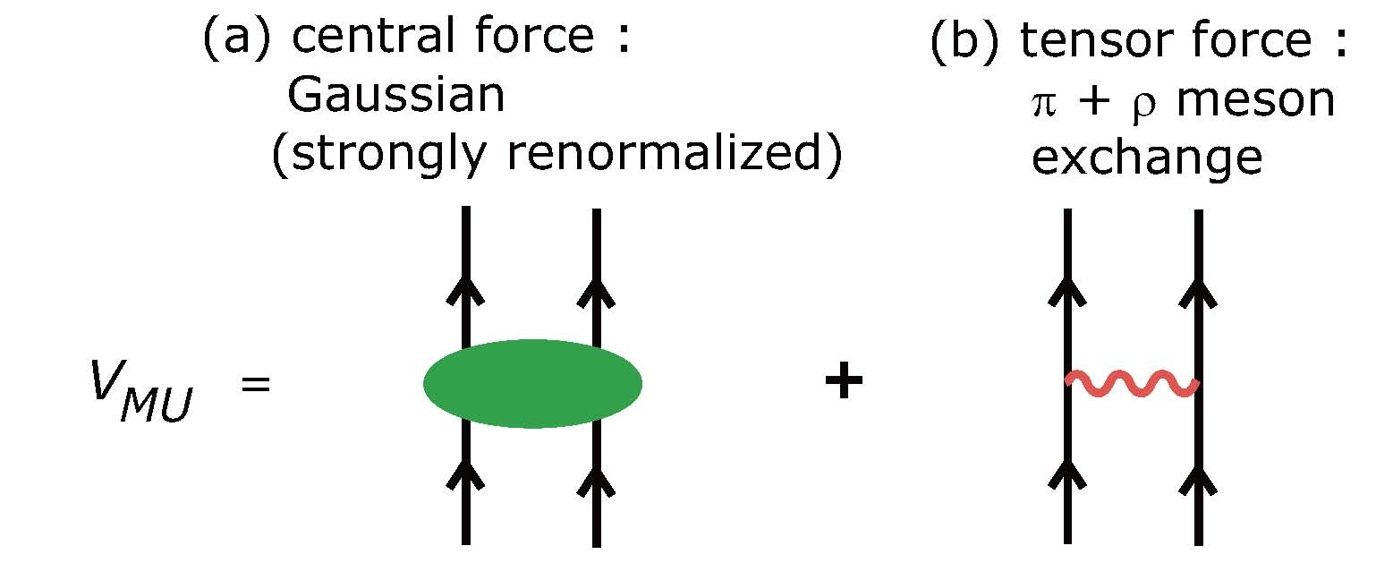
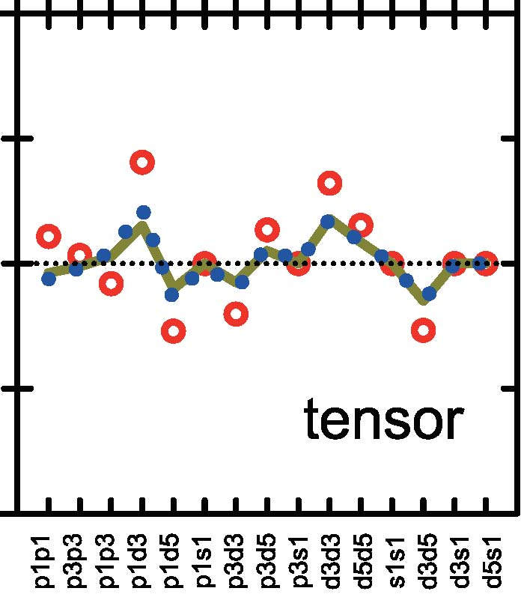
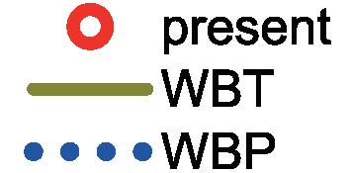





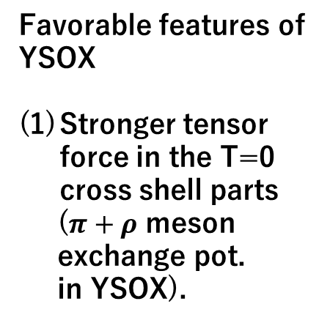



Cross-shell states: in comparison with shell models
WBT: E.K.Warburton and B.A.Brown, Phys. Rev. C 46, 923 (1992).
YSOX: C.Yuan et al., Phys. Rev. C 85, 064324 (2012).
p-shell: SFO,
sd-shell: SDPF-M,
psd cross-shell: V_{MU}
T.Otsuka et al., Phys. Rev. Lett. 104,
012501 (2010).
MK: D.J.Millener and D.Kurath,
Nucl. Phys. A255, 315 (1975).
S.Kim et al., in preparation.
Ueno13
S.Kim
Hwang17
Favorable features of YSOX
Stronger tensor force in the T=0 cross shell parts
($π+ρ$ meson
exchange pot.
in YSOX).
YSOX
Ueno13
S.Kim
T=0
$$d_{5/2}$$
⑧
⑧
$$p_{1/2}$$
$$p_{3/2}$$
$$π$$
$$ν$$
$$π$$
$$ν$$
Oxygen
Carbon

Slide 14
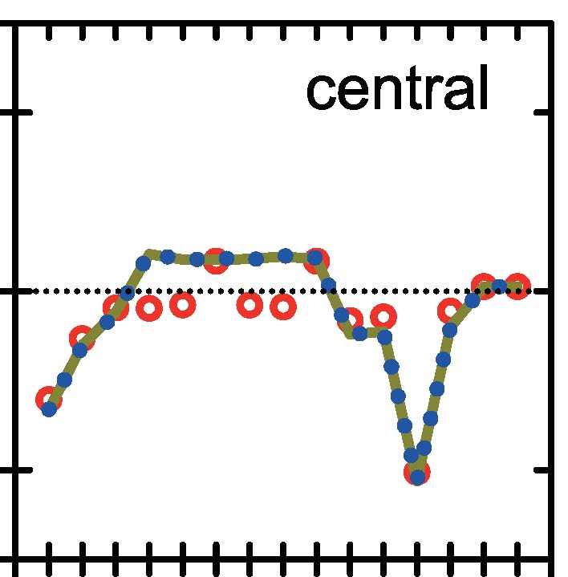
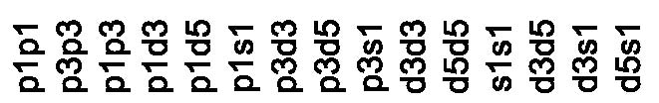



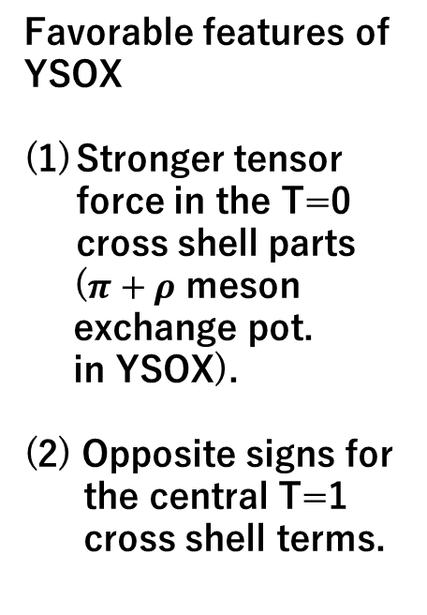



Cross-shell states: in comparison with shell models
WBT: E.K.Warburton and B.A.Brown, Phys. Rev. C 46, 923 (1992).
YSOX: C.Yuan et al., Phys. Rev. C 85, 064324 (2012).
p-shell: SFO,
sd-shell: SDPF-M,
psd cross-shell: V_{MU}
T.Otsuka et al., Phys. Rev. Lett. 104,
012501 (2010).
MK: D.J.Millener and D.Kurath,
Nucl. Phys. A255, 315 (1975).
S.Kim et al., in preparation.
Favorable features of YSOX
Stronger tensor force in the T=0 cross shell parts
($π+ρ$ meson
exchange pot.
in YSOX).
(2) Opposite signs for
the central T=1
cross shell terms.
YSOX
T=1
$$d_{5/2}$$
⑧
⑧
$$p_{1/2}$$
$$p_{3/2}$$
$$π$$
$$ν$$
$$π$$
$$ν$$
Carbon (18C)
Carbon [17C]

Slide 15
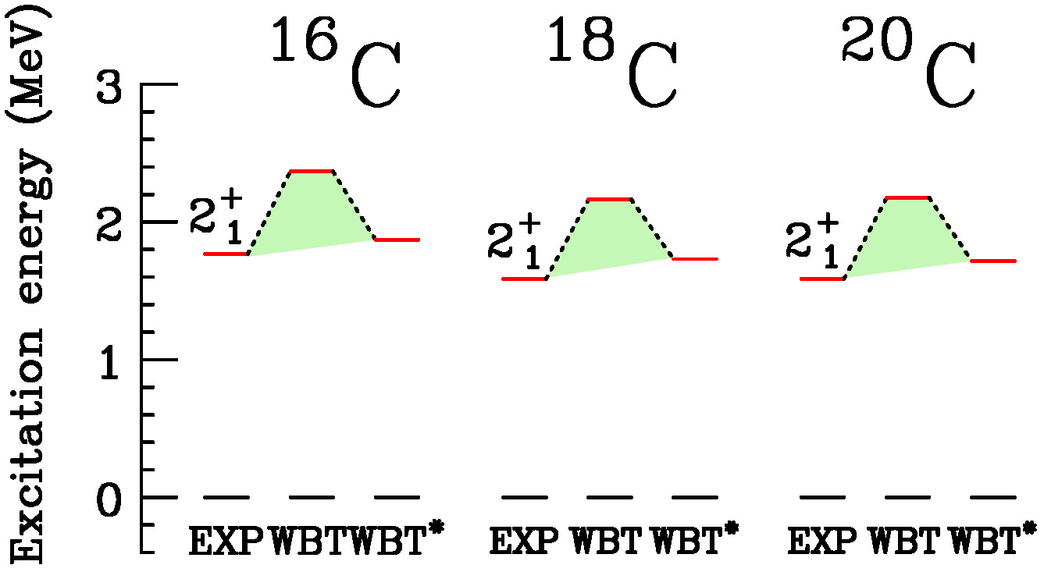
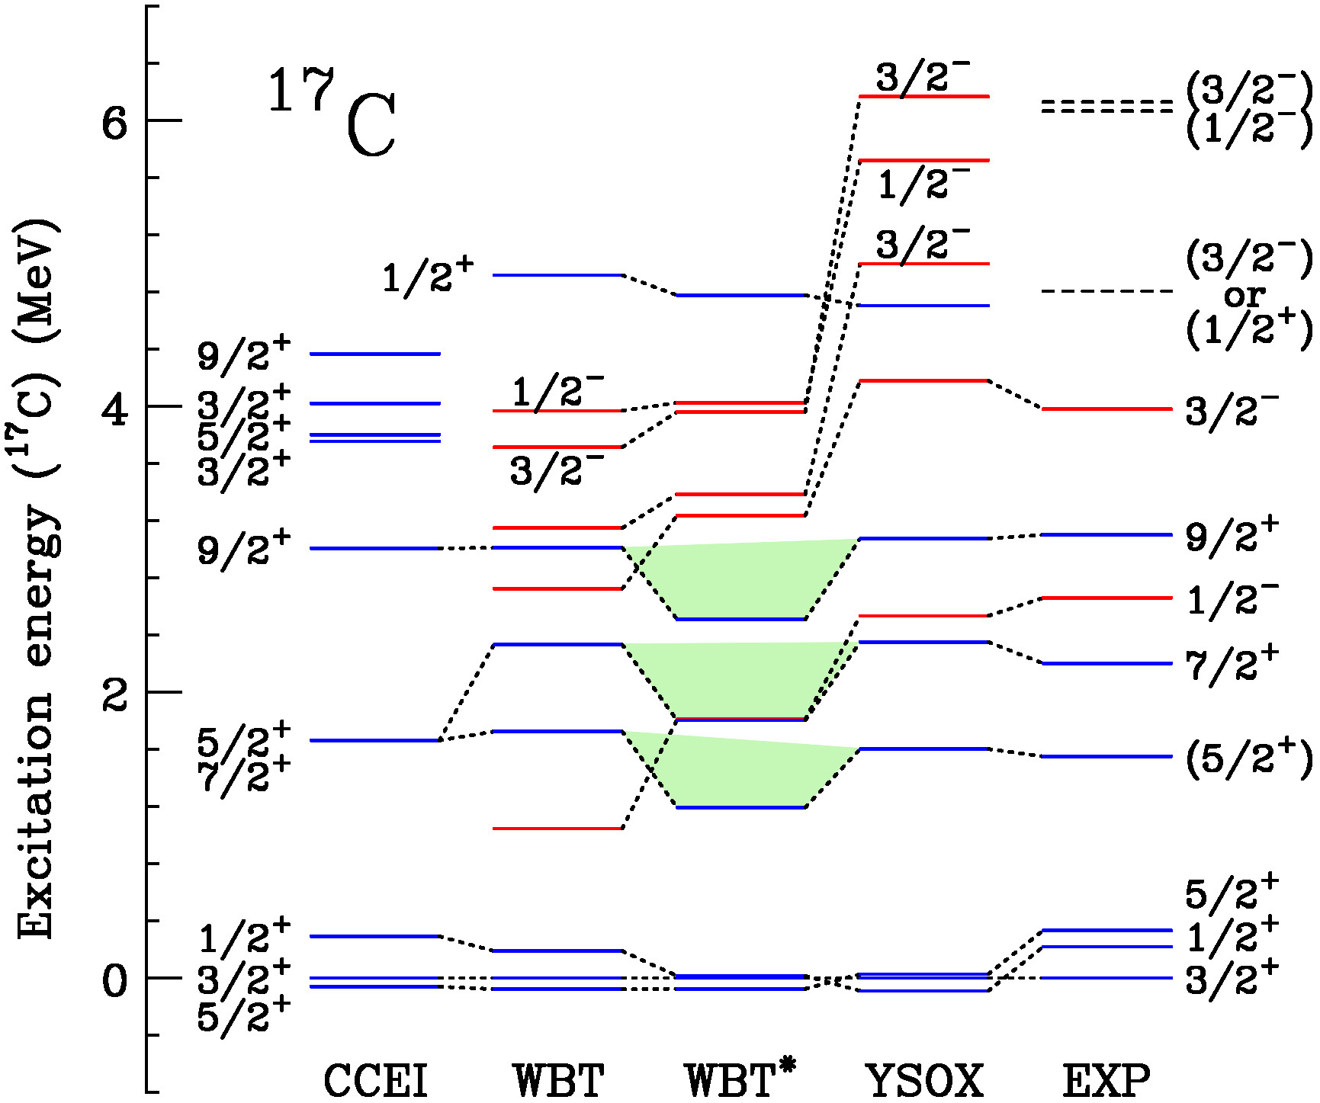
Positive parity states: in comparison with shell models
WBT*: M.Stanoiu et al., Phys. Rev. C78, 034315 (2008).
M.Petri et al., Phys. Rev. C 86, 044329 (2012).
Matrix elements in the sd part are reduced by 25%.
WBT* provides a deteriorated description for the 5/2⁺, 7/2⁺, and 9/2⁺ states in ¹⁷C.
CCEI provides a consistent description of 5/2⁺ and 9/2⁺ in ¹⁷C [present] and 2⁺ in ^{18,20}C[Jansen14].
CCEI: G.R.Jansen et al., Phys. Rev. Lett. 113, 142502 (2014).

Slide 16
Proton excited states in neutron-rich carbon isotopes
J.W.Hwang et al., in preparation.
S.Kim, K.I.Hahn et al., Experimental proposal “Proton excited states and change of the Z=6 shell gap in neutron-rich carbon isotopes”.

Slide 17
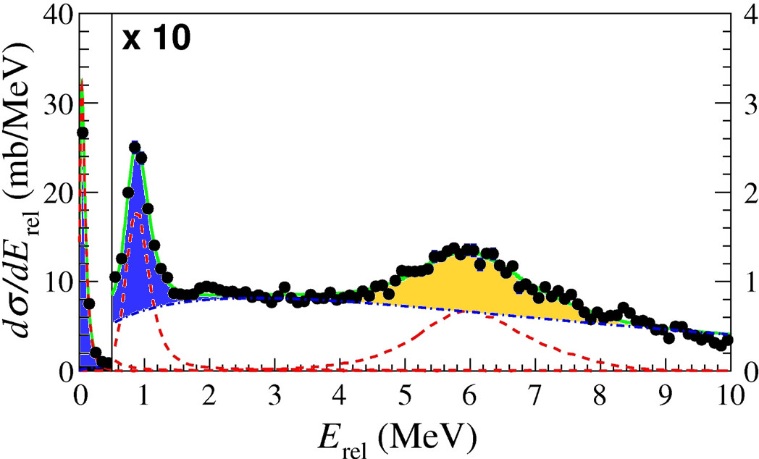
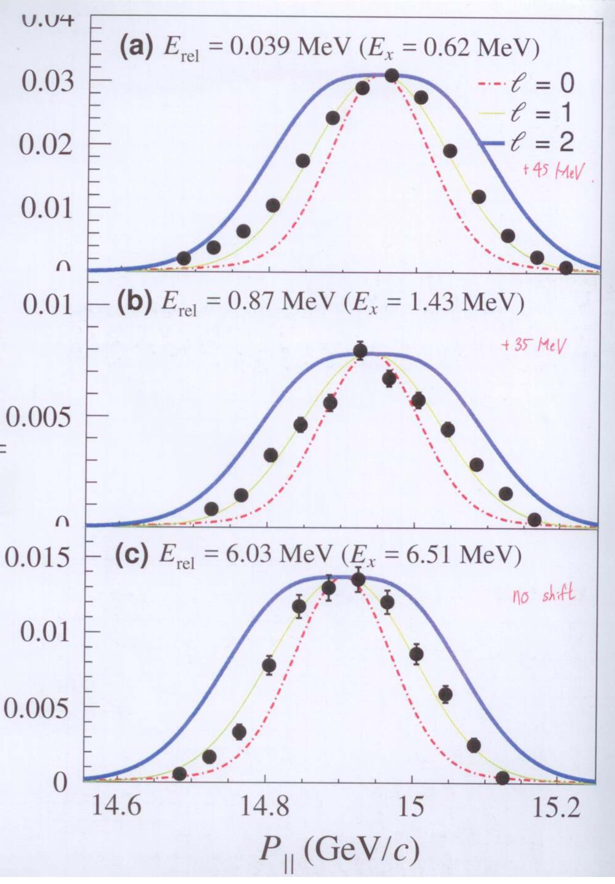
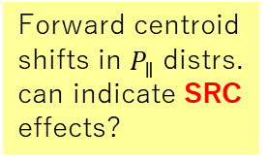
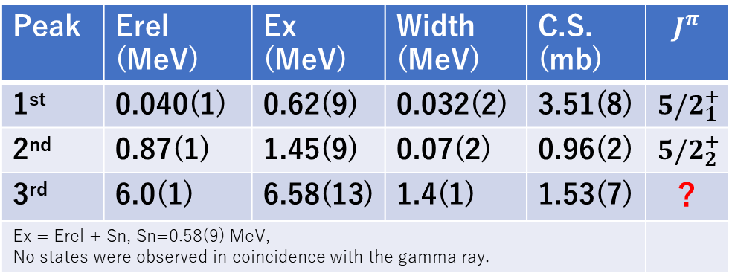
Experimental results: ²⁰N[-1p]¹⁹C*→¹⁸C+n
J.W.Hwang
High-lying,
Isolated,
narrow widthed,
single-neutron emitting
peak
3rd
MOMDIS: C.A.Bertulani and A.Gade, CPC 175 (2006) 372.
1st
1st
2nd
2nd
1st
3rd
¹⁸C
Sn=
0.58(10) MeV
+45 MeV/c
Forward centroid shifts in $P_{∥}$ distrs. can indicate SRC effects?
¹⁹C
2nd
S2n
S3n
S1n
J.W.Hwang et al., Phys. Lett. B 769, 503 (2017).
+35 MeV/c
Peak | Erel (MeV) | Ex (MeV) | Width (MeV) | C.S. (mb) | $$J^{π}$$
1st | 0.040(1) | 0.62(9) | 0.032(2) | 3.51(8) | $${5/2}_{1}^{+}$$
2nd | 0.87(1) | 1.45(9) | 0.07(2) | 0.96(2) | $${5/2}_{2}^{+}$$
3rd | 6.0(1) | 6.58(13) | 1.4(1) | 1.53(7) | ?
Ex = Erel + Sn, Sn=0.58(9) MeV, No states were observed in coincidence with the gamma ray.
3rd
Y.Satou et al., Phys. Lett. B 660, 320 (2008).
Notes:
High-lying, isolated, narrow widthed, single-neutron-emitting peak.

Slide 18
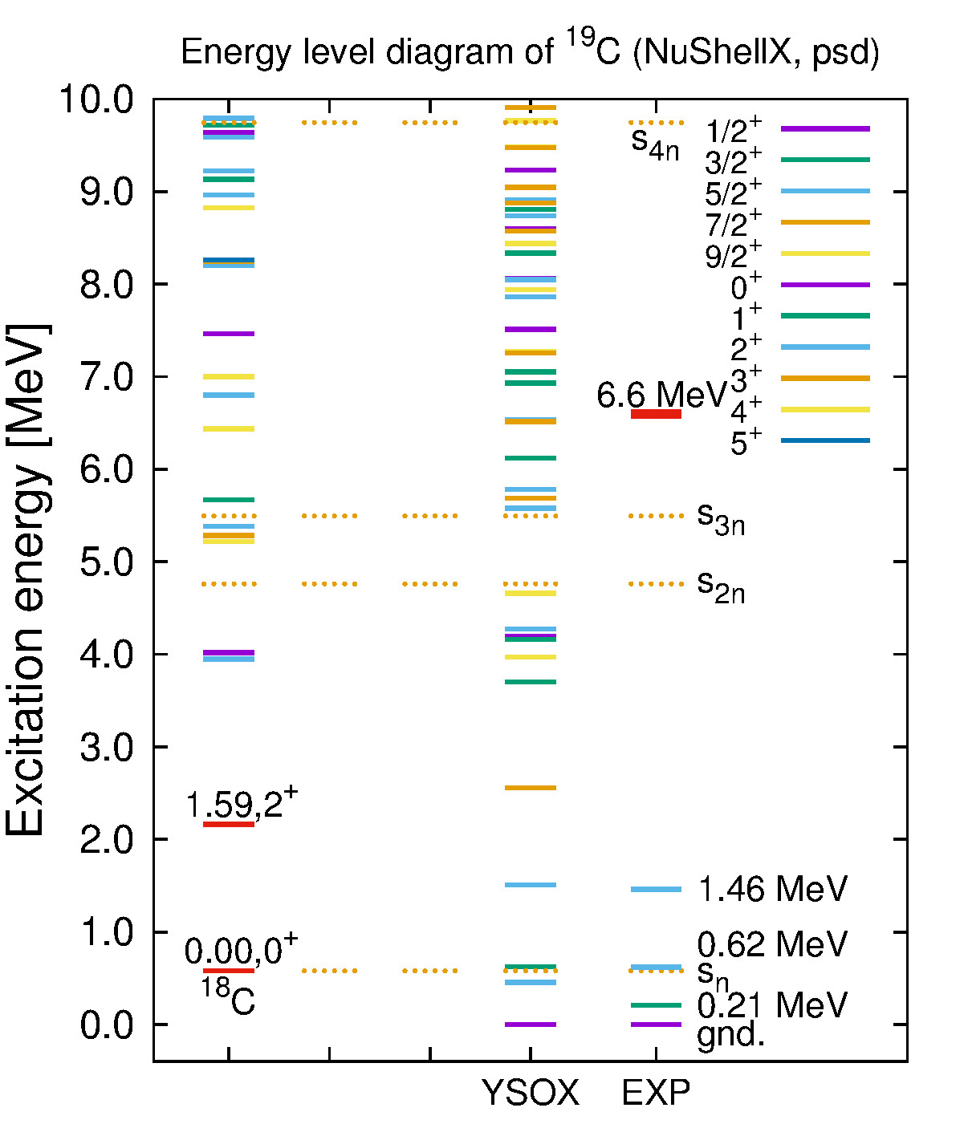



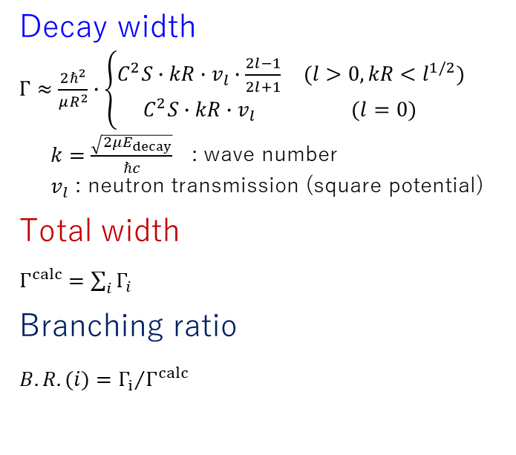
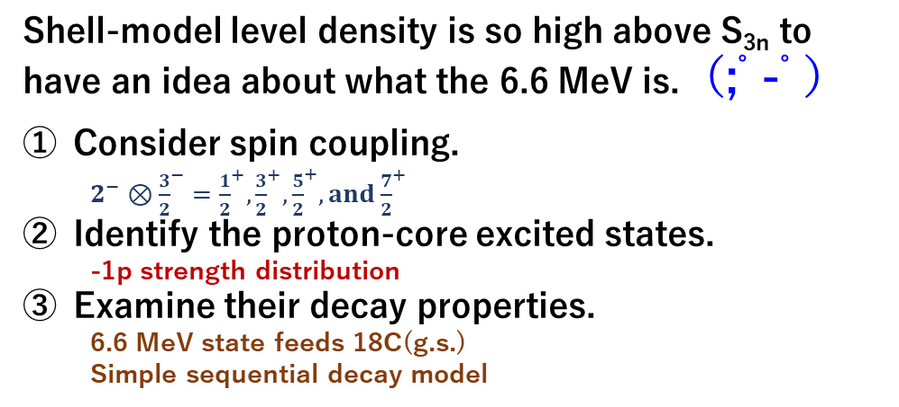
Energy level : ²⁰N(-1p)¹⁹C*→¹⁸C+n
Shell-model level density is so high above S_{3n} to have an idea about what the 6.6 MeV is.（;ﾟ-ﾟ）
Consider spin coupling.
  $2^{−}⊗{\frac{3}{2}}^{−}={\frac{1}{2}}^{+}, {\frac{3}{2}}^{+}, {\frac{5}{2}}^{+}, and {\frac{7}{2}}^{+}$
Identify the proton-core excited states.
  -1p strength distribution
Examine their decay properties.
  6.6 MeV state feeds 18C(g.s.)
  Simple sequential decay model
Decay width
$Γ≈\frac{2ℏ^{2}}{μR^{2}}∙\left\{\begin{matrix}C^{2}S∙kR∙v_{l}∙\frac{2l−1}{2l+1} & (l>0, kR<l^{1/2}) \\ C^{2}S∙kR∙v_{l} & (l=0)\end{matrix}\right.$
$k=\frac{\sqrt{2μE_{decay}}}{ℏc}$ : wave number
$v_{l}$ : neutron transmission (square potential)
Total width
$Γ^{calc}=\sum_{i}{Γ_{i}}$
Branching ratio
${{B.R.(i)=Γ}_{i}}/{Γ^{calc}}$
n
6.6 MeV
n
$$Γ_{n}$$
:
i
$$Γ_{i}$$
YSOX: C.Yuan et al., Phys. Rev. C85 (2012) 064324.
:
$$Γ_{1}$$
1
¹⁸C
Sn=
0.58(10) MeV
¹⁹C

Slide 19
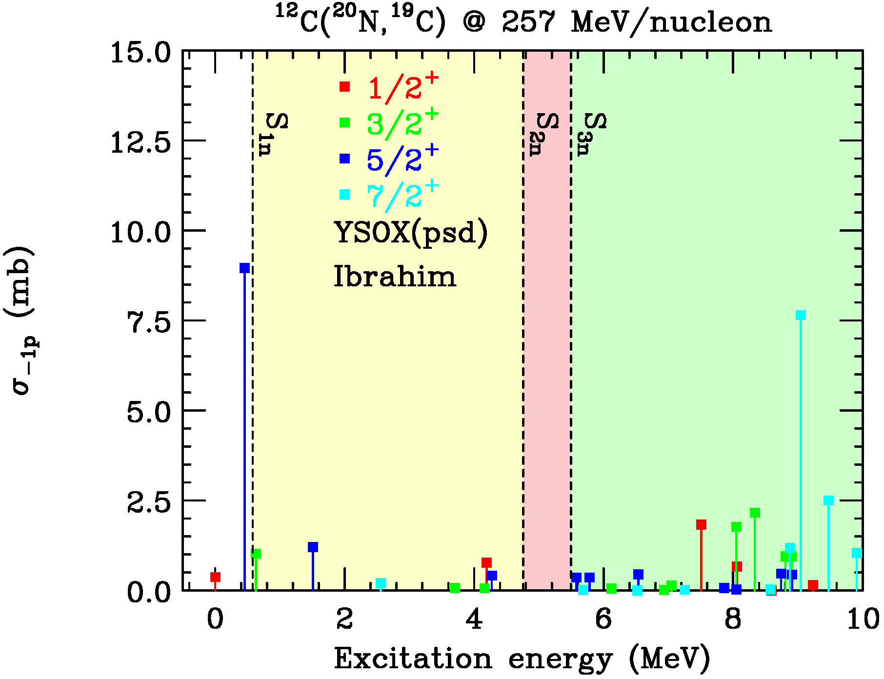
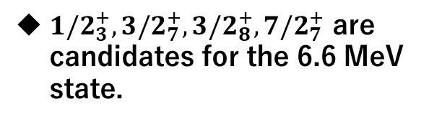
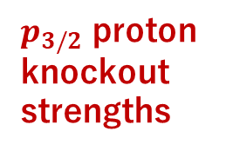
Strength distribution : ²⁰N(-1p)¹⁹C*→¹⁸C+n
MOMDIS: C.A.Bertulani and A.Gade, CPC 175 (2006) 372.
YSOX: C.Yuan et al., Phys. Rev. C85 (2012) 064324.
$p_{3/2}$ proton knockout strengths
${1/2}_{3}^{+}, {3/2}_{7}^{+}, {3/2}_{8}^{+}, {7/2}_{7}^{+}$ are candidates for the 6.6 MeV state.

Slide 20
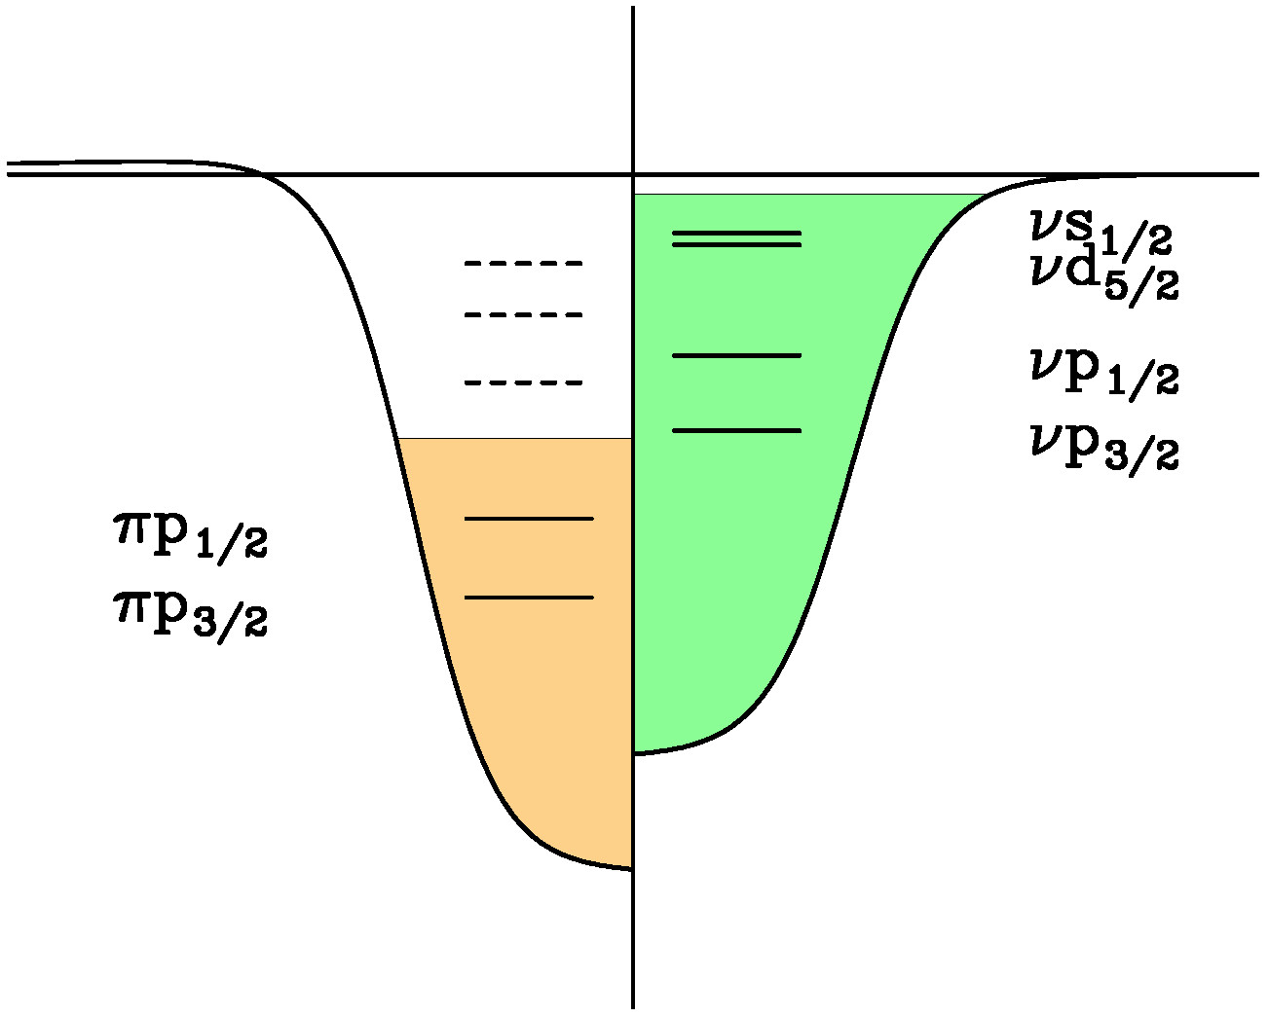
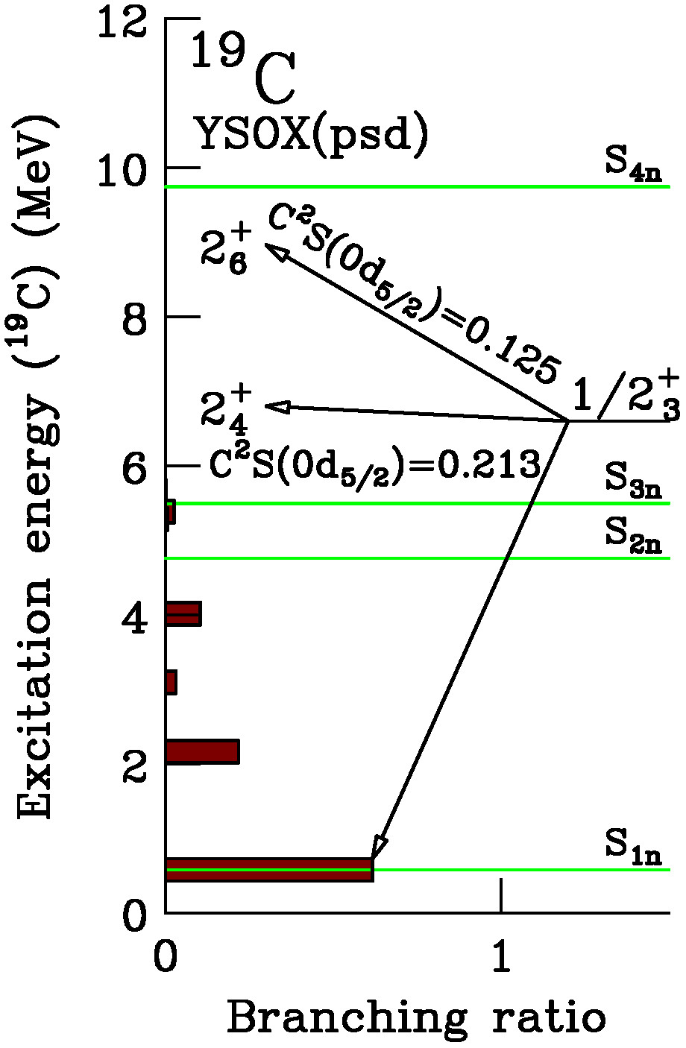
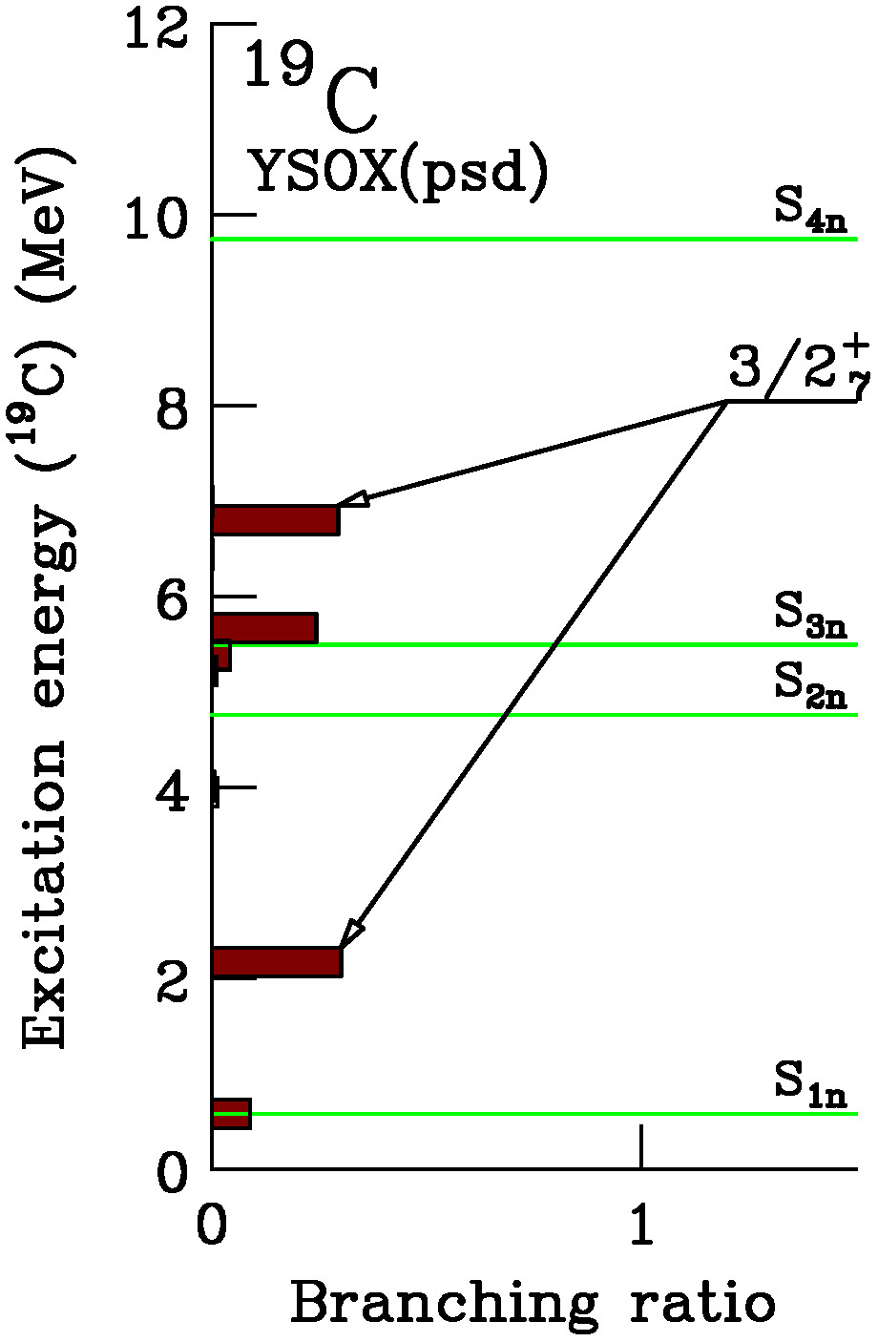
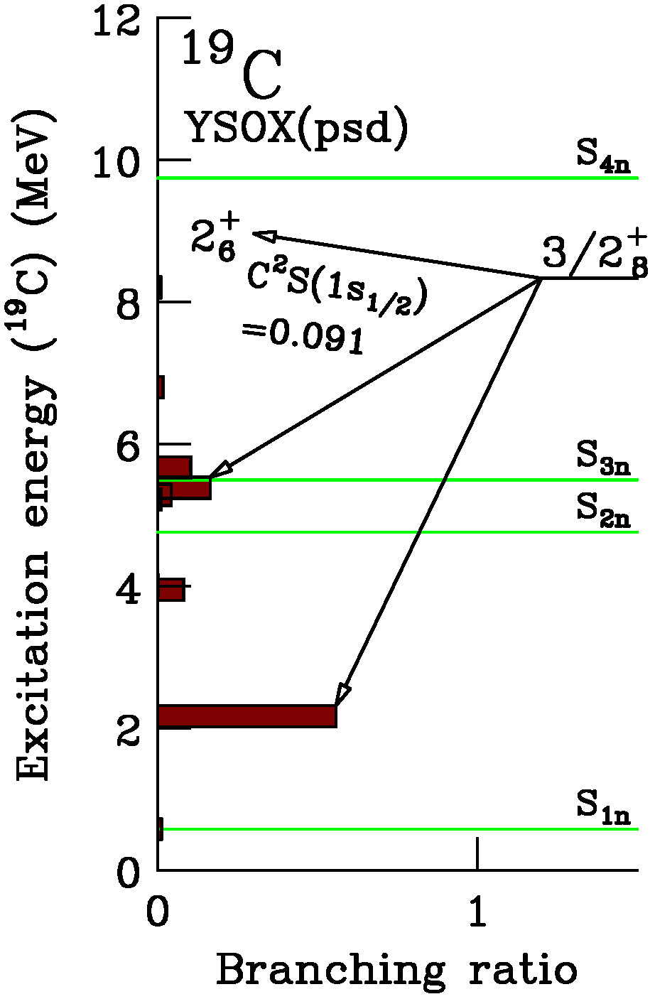
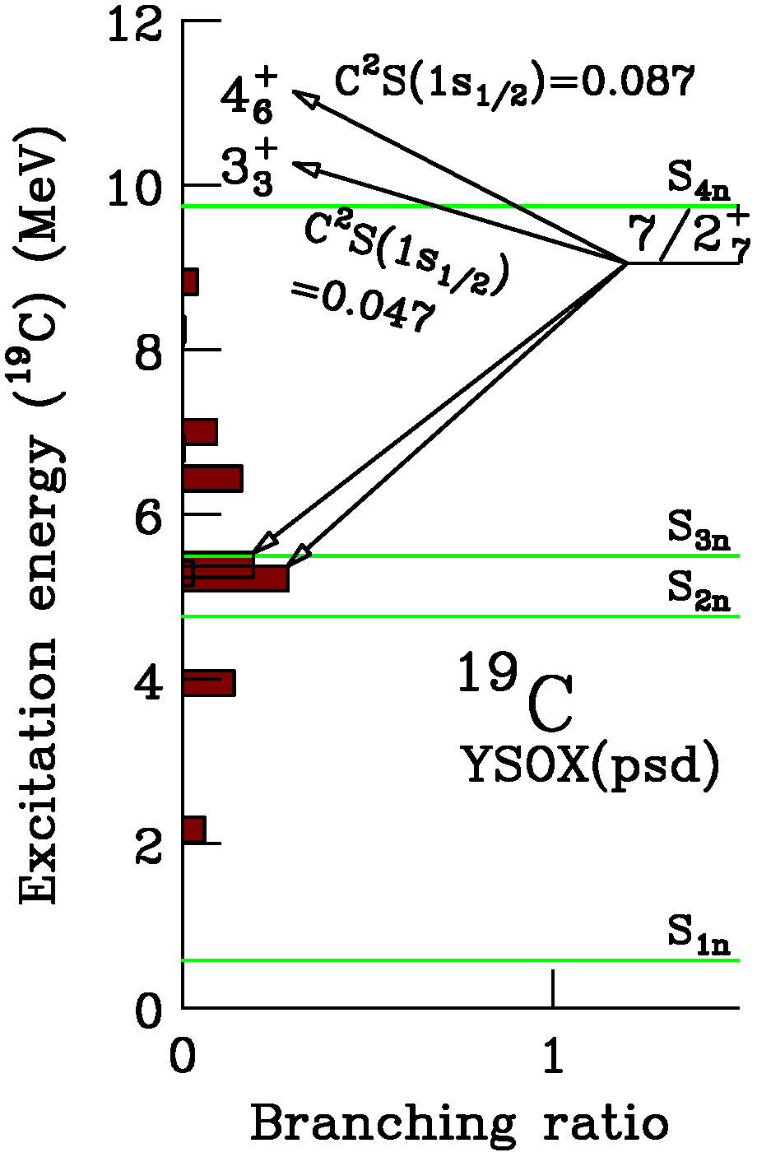
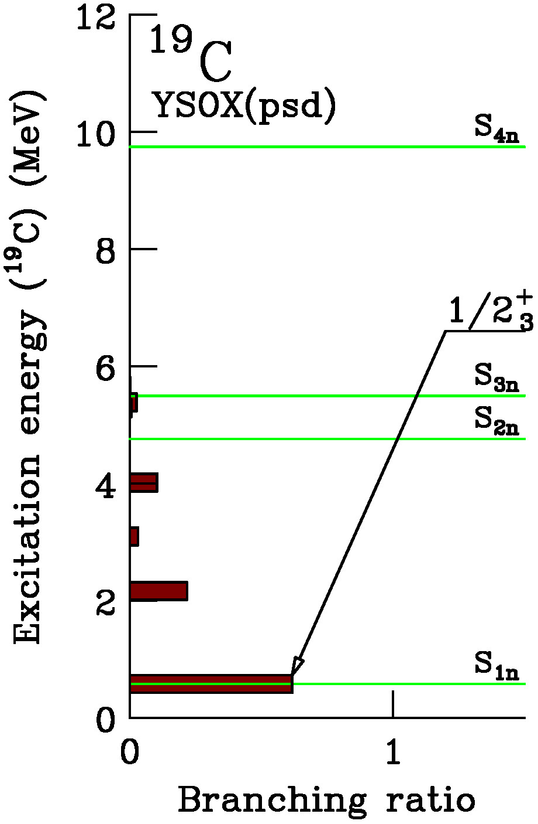






Decay properties of ${1/2}_{3}^{+}, {3/2}_{7}^{+}, {3/2}_{8}^{+}, {7/2}_{7}^{+}$ populated by ²⁰N(-1p)¹⁹C*
YSOX: C.Yuan et al., Phys. Rev. C85 (2012) 064324.
$Γ^{calc}=1.24 MeV$
$Γ^{exp}=1.4\left(1\right) MeV$
Nuclear Auger effect
$${\left|\left.2^{+}\right\rangle \right.}_{π}$$
${1/2}_{3}^{+}$, which has a large ground state branch, is a candidate for the 6.6 MeV state.
This state likely has a configuration of anti-parallel coupling of the proton core excited ¹⁸C(2⁺) and $νd_{5/2}$.
¹⁸C(2⁺)
νd_{5/2}
πp_{1/2}
$${\frac{5}{2}}^{+}$$
n
$${1/2}^{+}$$
Hyper nuclear Auger effects: A.Likar et al., Z. Phys. A 324, 35 (1986).
C.Keil and H.Lenske, Phys. Rev. C 66, 054307 (2002).
πp_{3/2}

Slide 21






Decay properties of ${1/2}_{4}^{+}, {3/2}_{7}^{+}, {5/2}_{8}^{+}, {5/2}_{9}^{+}$ populated by ¹⁸N(-1p)¹⁷C* (to be planned)
YSOX: C.Yuan et al., Phys. Rev. C85 (2012) 064324.
S.Kim proposal
${1/2}_{4}^{+}$, which has a large ${}_{}^{16}C(2_{1}^{+})$state branch, likely survives.

Slide 22










Decay properties of ${1/2}_{5}^{+}, {3/2}_{3}^{+}, {3/2}_{5}^{+},$
${5/2}_{5}^{+}, {5/2}_{6}^{+},{7/2}_{1}^{+}, {7/2}_{4}^{+}$populated by ¹⁶N(-1p)¹⁵C* (to be planned)
YSOX: C.Yuan et al., Phys. Rev. C85 (2012) 064324.
¹⁴C(2⁺)
S.Kim proposal
¹⁴C(2⁺)
νd_{5/2}
${1/2}_{5}^{+}$, which exhibits large g.s. and ${}_{}^{14}C(2_{1}^{+})$state branches, can survive, together with ${7/2}_{1,4}^{+}$.
The high excitation energy of ${1/2}_{5}^{+}$ will signify the large Z=6 shell gap in ${}_{}^{15}C$.
πp_{1/2}
$${\frac{5}{2}}^{+}$$
n
$${1/2}^{+}$$
πp_{3/2}

Slide 23

Summary
Low-lying spectroscopy of ¹⁷C was used to assess various shell-model interactions.
A high-lying, isolated, narrow-widthed, single-neutron-emitting resonance in ¹⁹C was reported.
  Resembling states may exist in ¹⁷C and possibly in ¹⁵C; finding and characterizing such states, both experimentally and theoretically, will be beneficial for our understanding of exotic properties of light neutron-rich nuclei, as open many-body quantum systems.
Observed centroid shifts in $P_{∥}$ distributions for deep proton knockout processes would worth be payed attention.

Slide 25










Reduction factors of C²S
$$R=\frac{C^{2}S^{exp}}{C^{2}S^{SM}}$$
Reduction factor
Different systematics for the asymmetry dependence of the reduction factors of C2S:
(1) (strong) one-nucleon removal reactions [Tostevin and Gade]
(2) (weak) quasifree knockout reaction [Atar et al.].
Present systematics support [Atar et al.] in the asymmetry dependence, with smaller (by ~20%) reduction factors.
J.A.Tostevin and A.Gade, PRC90, 057602(2014).
²⁰C(-1n)¹⁹C
$∆$S=$−$26.1 MeV
[1]
$$ΣC^{2}S=6$$
$$ΣC^{2}S<6$$
$$ΣC^{2}S ?$$
[2]
[3]
²⁰N(-1p)¹⁹C
$∆$S=$+$26.1 MeV
d_{5/2}
²⁴O(-1n)²³O
$∆$S=$−$22.0 MeV
L.Atar et al., PRL120,052501(2018).
Independent particle model
Configuration mixed shell model
+Short-range correlations (SRC)
[1] J.W.Hwang et al., Phys.
Lett. B 769, 503 (2017).
[2] K.Tshoo et al., Phys.
Lett. B 739, 19 (2014).
[3] Present work
(J.W.Hwang et al.).
Notes:
横軸: abscissa
“The oxygen isotopic chain offers a large variation of separation energies that allows for a quantitative understanding of single-particle strength with changing isospin asymmetry.”
“The reduction factor for the single-particle strength with respect to the independent-particle model were obtained and compared to state-of-the-art ab initio predictions. The results do not show any significant dependence on proton-neutron asymmetry.”
The single-particle strength with changing isospin asymmetry can be sensitively tested at extreme conditions utilizing major and minor nucleon knockouts of near-drip-line nuclei, leading to the same nuclear states.

Slide 26






Shell-evolution and nuclear magic numbers
T.Otsuka et al., arXiv:1805.06501v4 [nucl-th] 21 Dec 2018.
“Evolution of nuclear structure in exotic nuclei driven by nuclear forces”
Shell evolution of neutron orbits from Ni back to Ca
Tensor force play an important role in the evolution of shell structures.
$V^{ten}=\left({\vec{τ}}_{1}∙{\vec{τ}}_{2}\right)\left(\frac{S_{12}}{\sqrt{24π}}\right)f^{ten}\left(r\right)$
$S_{12}=\frac{3\left({\vec{σ}}_{1}∙\vec{r}\right)\left({\vec{σ}}_{2}∙\vec{r}\right)}{r^{2}}−\left({\vec{σ}}_{1}∙{\vec{σ}}_{2}\right)$
$$S_{12}=\left\{\begin{aligned}3/4−1/4=1/2, for (a) \\ &0−1/4=−1/4, for (b)\end{aligned}\right.$$
$$j_{>}=l+1/2, j_{<}=l−1/2$$
Spin-orbit force plays a key role for nuclear magic numbers.
Haxel, Mayer 1949

Slide 27








Experimental results: ²⁰C+¹²C→¹⁹C*→¹⁸C+n
280 MeV/nucleon
1st
J.W.Hwang et al., Physics Letters B 769 (2017) 503-508.
1st
$$d_{5/2}$$
⑧
2nd
$${dσ}/{dP_{∥} \left[mb/(MeV/c)\right]}$$
$$p_{1/2}$$
$$p_{3/2}$$
$$ν$$
3rd
Code:MOMDIS: C.A.Bertulani and A.Gade, Comp. Phys. Comm. 175 (2006) 372.
1st
2nd
3rd
Peak | Erel (MeV) | Ex (MeV) | Width (MeV) | C.S. (mb) | $$J^{π}$$
1st | 0.036(1) | 0.62(9) | < 0.015 | 61(5) | $${5/2}_{1}^{+}$$
2nd | 0.84(4) | 3.0-5.5 | < 0.02 | 4(1)
3rd | 2.31(3) | 2.89(10) | 0.20(7) | 15(3) | $${1/2}^{−}$$
Ex = Erel + Sn, Sn=0.58(9) MeV

Slide 28



Y.Satou et al., Phys. Lett. B 660 (2008) 320.
6.13(9)
19C*
2⁺
17C*
The “high-lying isolated narrow widthed single-neutron emitting peak” reminds us of the 6.13(9)-MeV state in 17C observed in a (p,p’) reaction study of the 17C beam.
Sn=0.73(2) MeV
¹⁶C
17C*
Peak | Erel (MeV) | Ex (MeV) | Width (MeV) | C.S. (mb) | $$J^{π}$$
6.13 | 3.63(9) | 6.13(9) | $${0.26}_{−0.26}^{+0.4}$$ | 0.8(1) | $${(5/2}_{4}^{+})$$
Ex = Erel + Sn + Ex(2+) Sn=0.73(2) MeV, Ex(2+)=1.77(1) MeV
¹⁷C
?

Slide 29







Decay property: relative branches to 0+ and 2+ in 16,18C
n
Decay width
$Γ≈\frac{2ℏ^{2}}{μR^{2}}∙\left\{\begin{matrix}C^{2}S∙kR∙v_{l}∙\frac{2l−1}{2l+1} & (l>0, kR<l^{1/2}) \\ C^{2}S∙kR∙v_{l} & (l=0)\end{matrix}\right.$
$k=\frac{\sqrt{2μE_{decay}}}{ℏc}$ : wave number
$v_{l}$ : neutron transmission (square potential)
Branching ratio
${{b=Γ}_{final state}}/{Γ^{calc}, Γ^{calc}=\sum_{i}{Γ_{i}}}$ (total width)
$$Γ^{calc}=1.24 MeV$$
$$Γ^{calc}=0.25 MeV$$
 | 17C | 19C
Ex | 6.13 MeV | 6.6 MeV
$Γ$(Exp) | ${0.26}_{−0.26}^{+0.4}$ MeV | 1.4(1) MeV
Feeding state | 16C($2_{1}^{+}$) | 18C($0_{1}^{+}$)
$$J^{π}$$ | ${1/2}_{4}^{+}$ (YSOX) | ${1/2}_{3}^{+}$ (YSOX)
Decay properties support the present 1/2+ assignments for the high-lying narrow widthed (proton core excited) states.
Systematic study will help us understand the migration of the $πp_{1/2}−πp_{3/2}$ gap.

Slide 30


Decay width calculation for 19C($1/{2_{3}^{+}}$)
For YSOX shell-model Hamiltonian
Ex(¹⁹C) (MeV) | J^{π}(¹⁹C) | Final state in ¹⁸C (MeV) | C²S $$\left\langle {}_{}^{19}{C|{}_{}^{18}C}\right\rangle$$ | $$Γ_{final_state}$$ (MeV) | $$Γ_{final_state}/\left(Σ_{i}Γ_{i}\right)$$ | E_{decay} (MeV)
6.6 | $$1/{2_{3}^{+}}$$ | 0.000$\left(0_{1}^{+}\right)$ | $$\left(1s_{1/2}:0.0523\right)$$ | 0.7631 | 0.6171 | 6.0200
 |  | 1.585$\left(2_{1}^{+}\right)$ | $$\left(0d_{3/2}:0.1611\right)$$ | 0.2259 | 0.2177 | 4.4350
 |  |  | $$\left(0d_{5/2}:0.0084\right)$$ | 0.0133
 |  | 2.517$\left(2_{2}^{+}\right)$ | $$\left(0d_{3/2}:0.0005\right)$$ | 5.16$×{10}^{−4}$ | 0.0310 | 3.503
 |  |  | $$\left(0d_{5/2}:0.0367\right)$$ | 0.0387
 |  | 3.4352$\left(0_{2}^{+}\right)$ | $$\left(1s_{1/2}:0.0134\right)$$ | 0.1281 | 0.1036 | 2.5848
 |  | 4.7041$\left(3_{1}^{+}\right)$ | $$\left(0d_{5/2}:0.0479\right)$$ | 0.0062 | 0.0050 | 1.3159
 |  | 4.8029$\left(2_{3}^{+}\right)$ | $$\left(0d_{3/2}:0.2628\right)$$ | 0.0286 | 0.0251 | 1.2171
 |  |  | $$\left(0d_{5/2}:0.0227\right)$$ | 0.0025
 |  | 5.0900$\left(1_{1}^{+}\right)$ | $$\left(1s_{1/2}:0.0000\right)$$ | 0.0000 | 0.0004 | 0.9300
 |  |  | $$\left(0d_{3/2}:0.0093\right)$$ | 5.43$×{10}^{−4}$
 |  |  |  | $Σ_{i}Γ_{i}=1.2367$ (MeV)
 |  |  |  | $Γ_{exp}=1.4(1)$ (MeV) [Hwang]

Slide 31


Decay width calculation for 17C($1/{2_{4}^{+}}$)
For YSOX shell-model Hamiltonian
Ex(¹⁷C) (MeV) | J^{π}(¹⁷C) | Final state in ¹⁶C (MeV) | C²S $$\left\langle {}_{}^{17}{C|{}_{}^{16}C}\right\rangle$$ | $$Γ_{final_state}$$ (MeV) | $$Γ_{final_state}/\left(Σ_{i}Γ_{i}\right)$$ | E_{decay} (MeV)
6.13 | $$1/{2_{4}^{+}}$$ | 0.000$\left(0_{1}^{+}\right)$ | $$\left(1s_{1/2}:0.0040\right)$$ | 0.0577 | 0.2325 | 5.395
 |  | 1.766$\left(2_{1}^{+}\right)$ | $$\left(0d_{3/2}:0.1105\right)$$ | 0.1128 | 0.7264 | 3.629
 |  |  | $$\left(0d_{5/2}:0.0661\right)$$ | 0.0674
 |  | 3.027$\left(0_{2}^{+}\right)$ | $$\left(1s_{1/2}:0.0005\right)$$ | 0.0048 | 0.0193 | 2.368
 |  | 3.986$\left(2_{2}^{+}\right)$ | $$\left(0d_{3/2}:0.0241\right)$$ | 0.0033 | 0.0217 | 1.409
 |  |  | $$\left(0d_{5/2}:0.0153\right)$$ | 0.0021
 |  | 4.088$\left(3_{1}^{+}\right)$ | $$\left(0d_{5/2}:0.0004\right)$$ | 4.59$×{10}^{−5}$ | 0.0002 | 1.307
 |  |  |  | $Σ_{i}Γ_{i}=0.248$ (MeV)
 |  |  |  | $Γ_{exp}={0.26}_{−0.26}^{+0.4}$ (MeV) [Ysatou08]

Slide 32



Coupling to proton excited 2+ states in 16C
Proton core excited 2+ state.
YSOX: C.Yuan et al., Phys. Rev. C85 (2012) 064324.
One-body transition density (OBTD) coefficients: $a\left(pp/nn\right)=\left\langle Ψ_{f}\left|a^{†}a\right|\left.Ψ_{i}\right\rangle \right.$
Third 2+ state in 16C has large proton excitation amplitudes, to which the fourth 1/2+ in 17C couples strongly via d-wave.

Slide 33


Coupling to proton excited 2+ states in 18C
Proton core excited 2+ states.
YSOX: C.Yuan et al., Phys. Rev. C85 (2012) 064324.
One-body transition density (OBTD) coefficients: $a\left(pp/nn\right)=\left\langle Ψ_{f}\left|a^{†}a\right|\left.Ψ_{i}\right\rangle \right.$
Fourth and sixth 2+ states in 18C have larger proton excitation amplitudes, to which the third 1/2+ in 19C couples strongly via d-wave.

Slide 34



Slide 35



Slide 36


Slide 37



Slide 38


Slide 39

SAMURAI Day-One, 2012 May
RIKEN RIBF
SAMURAI Day-1 campaign 2012
Coulomb Breakup of ¹⁹B and ²²C, Nakamura et al.
Study of ¹⁸B,²¹C, and excited states of ¹⁹B, ²²C, Orr et al.
Structure of Unbound Oxygen Isotopes ²⁵O,²⁶O Kondo et al.
Notes:
Motobayashi-san is here. Nakamura-san is here, Kondo-san is here, I am unfortunately nowhere.
But two Seoul university students, Kim Sunji and Hwang Jongwon, are here and here.
They are analyzing knockout reaction data of 18C and 20C beams, respectively.
I shown flash reports of their analyses, which are hopefully approaching a final stage.

