Slide 1
Barrel Calibration
Choi Jae Min

Slide 2
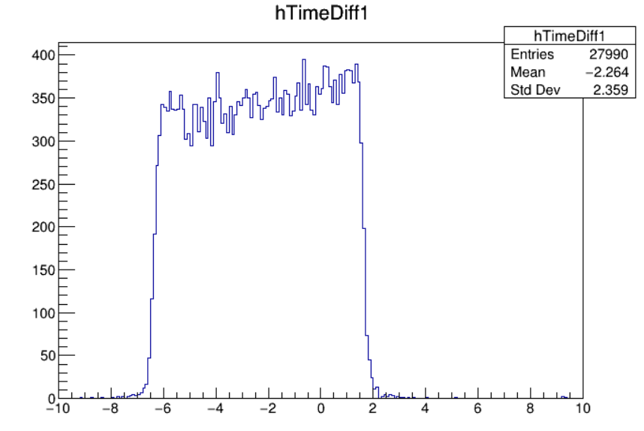
Time Calibration in single Scintillator(1)
Module 1(Run30317)
UpstreamEdge = -6.261682
DownstreamEdge
= 1.4768099
Correction = -2.397

Slide 3
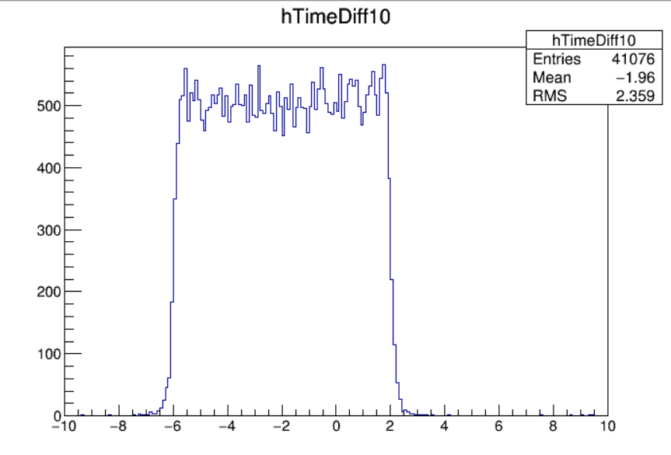
Time Calibration in single Scintillator(2)
Module 10
UpstreamEdge = -5.811922
DownstreamEdge
= 1.9260967
Correction = -1.943

Slide 4
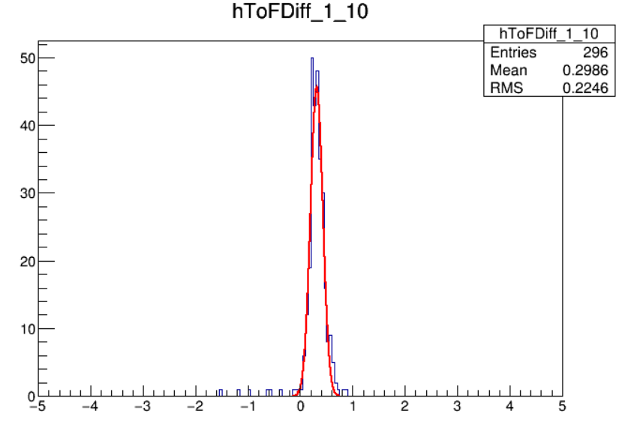
Time Calibration in inter-Scintillator(1)
Gaussian fitting
Mean = 0.3163
Error = 0.00779
Standard derivation
= 0.11794
Error of standard deviation
= 0.00636

Slide 5
Time Calibration in inter-Scintillator(2)
To make the degree of freedom of minimize,

Slide 6
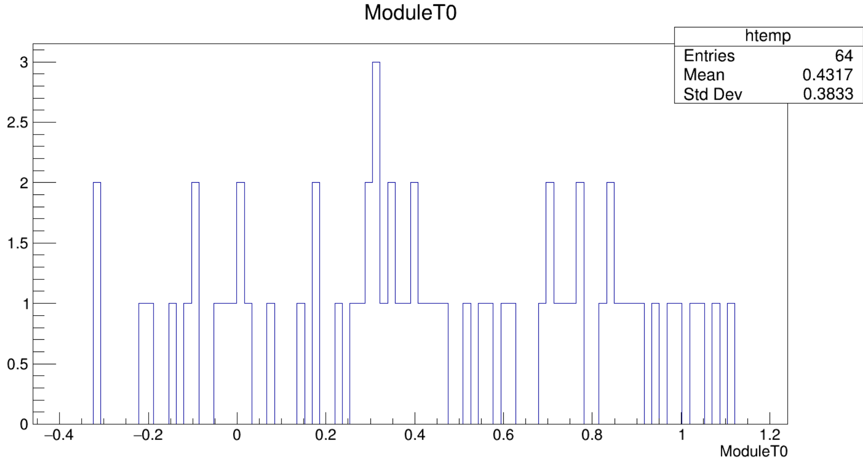
Module T0

Slide 7
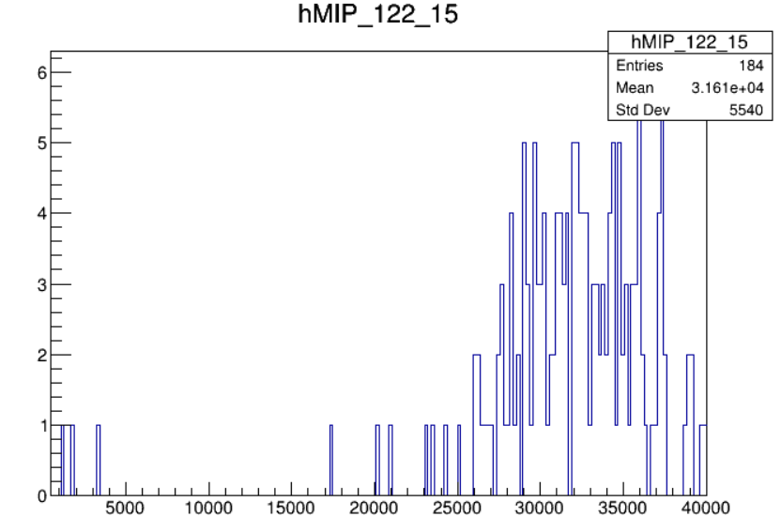
MIP

