Slide 1
Study of astrophysical ¹⁸F + p system through the ¹⁶O(⁶Li,t)¹⁹Ne measurement
Minsik Kwag
Department of physics, Sungkyunkwan University

Slide 2
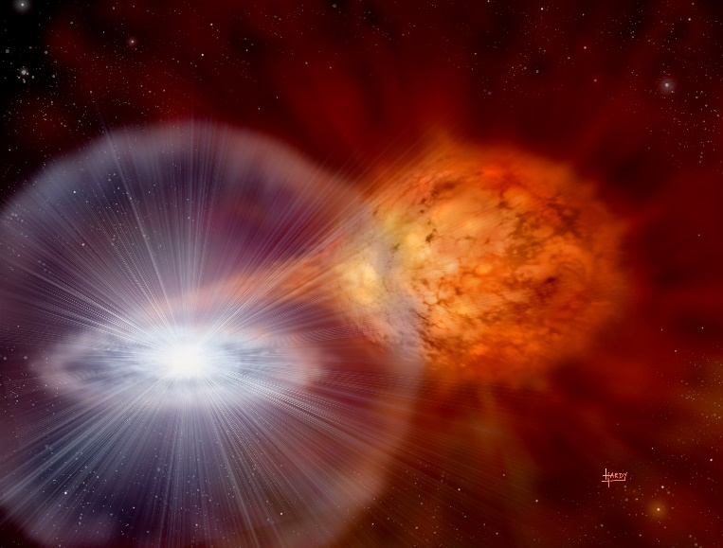
Introduction
Nucleosynthesis
β⁺-decay (t_{1/2} = 110 min.)
Nova explosion
¹⁸F
¹⁸O
e⁺
γ (511 keV)
γ (511 keV)
e⁻
The flux of 511 keV γ-ray line depends on the ¹⁸F abundance
Main destruction mechanisms of ¹⁸F: ¹⁸F(p,γ)¹⁹Ne, ¹⁸F(p,α)¹⁵O
Resonances in the ¹⁸F + p system (E_{x} > 6.41 MeV in ¹⁹Ne)

Slide 3
Introduction
Resonant thermonuclear reaction rate
$$N_{A}\left\langle σv\right\rangle =\frac{1.5399×{10}^{11}}{{\left(\frac{M_{p}M_{18F}}{M_{p}+M_{18F}}T_{9}\right)}^{3/2}}\sum_{i}{{\left(ωγ\right)}_{i}e^{{−11.605E_{i}}/{T_{9}}}} [{\text{cm}}^{3}{\text{mol}}^{−1}{\text{s}}^{−1}]$$
Resonance strength
$$ωγ=\frac{2J_{19Ne}+1}{\left(2J_{p}+1\right)\left(2J_{18F}+1\right)}×\frac{Γ_{p}Γ_{γ or α}}{Γ_{p}+Γ_{γ or α}} [\text{meV}]$$
Direct cross section measurement: hard to measure
Indirect approach: spin and parity study, Life-time and branching ratio measurement

Slide 4
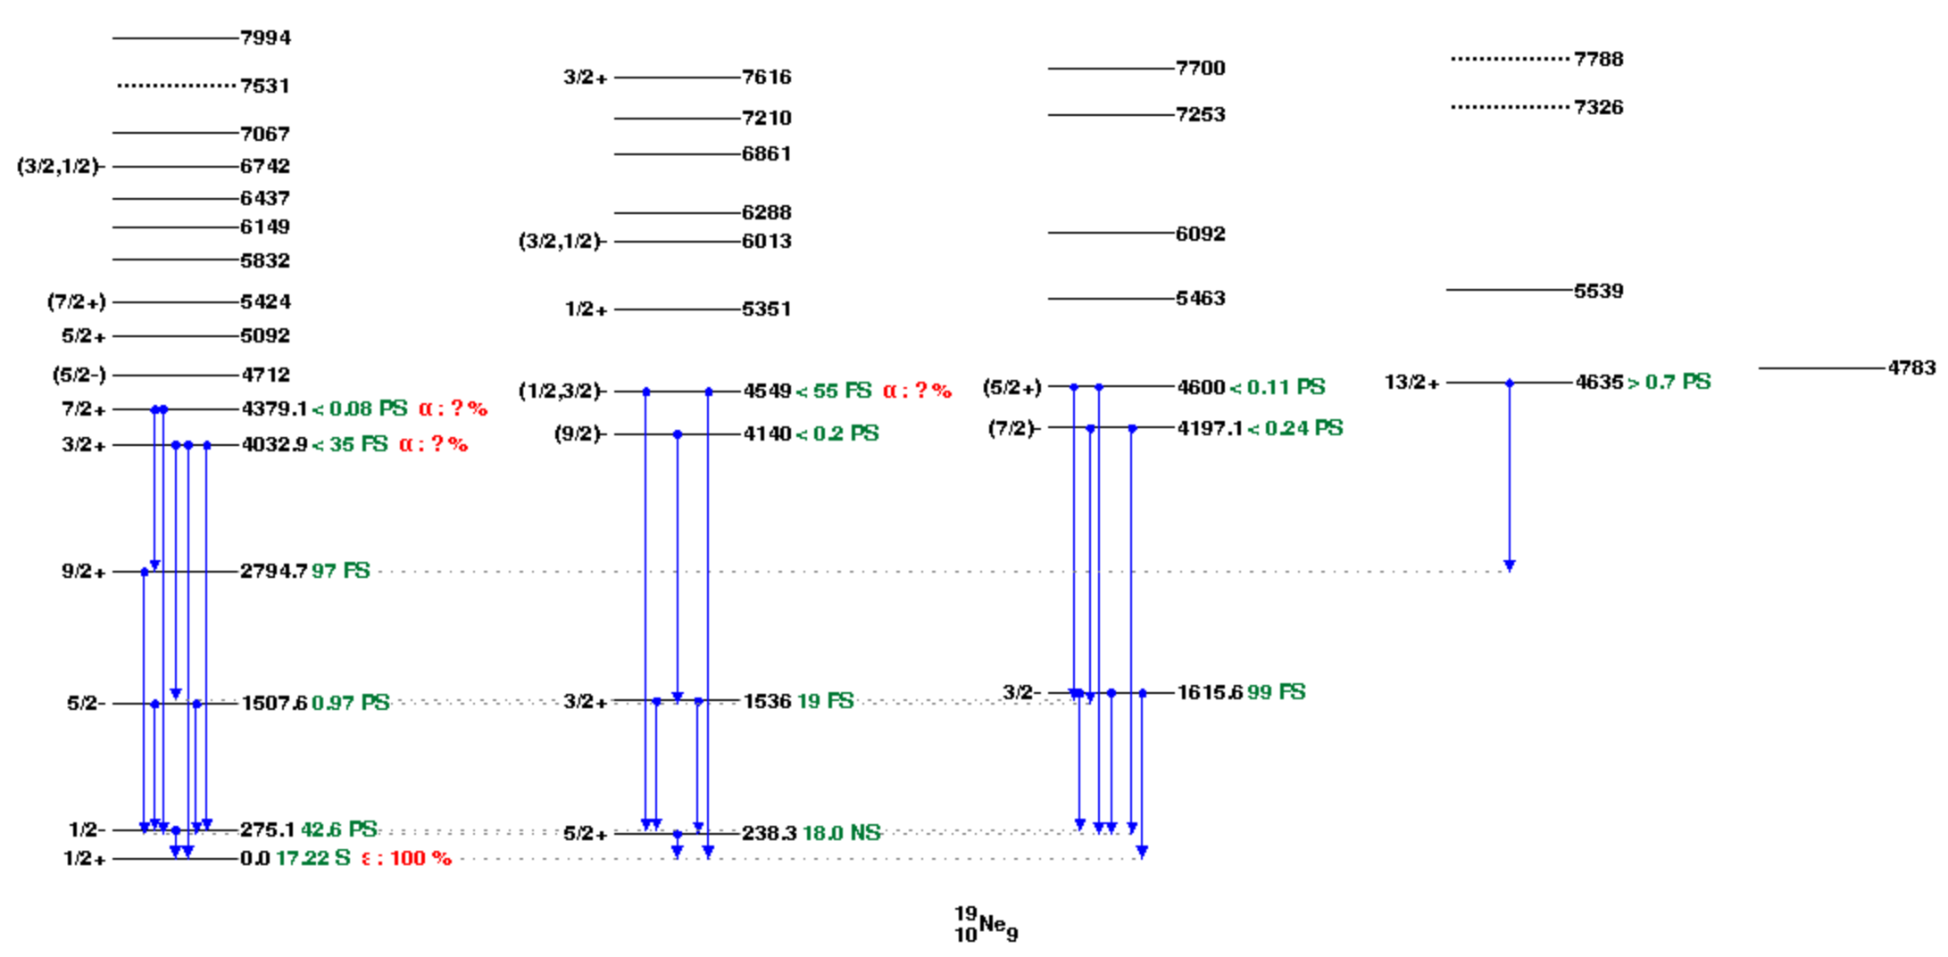
Introduction
Many spins and parities are not constrained
¹⁹Ne levels
(Taken from NNDC)

Slide 5
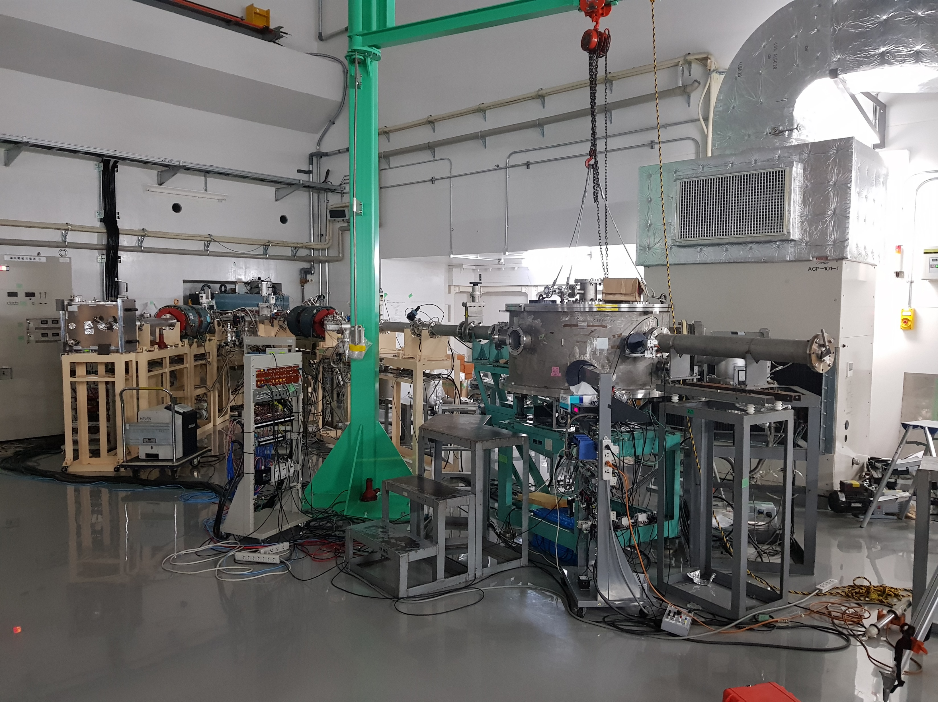
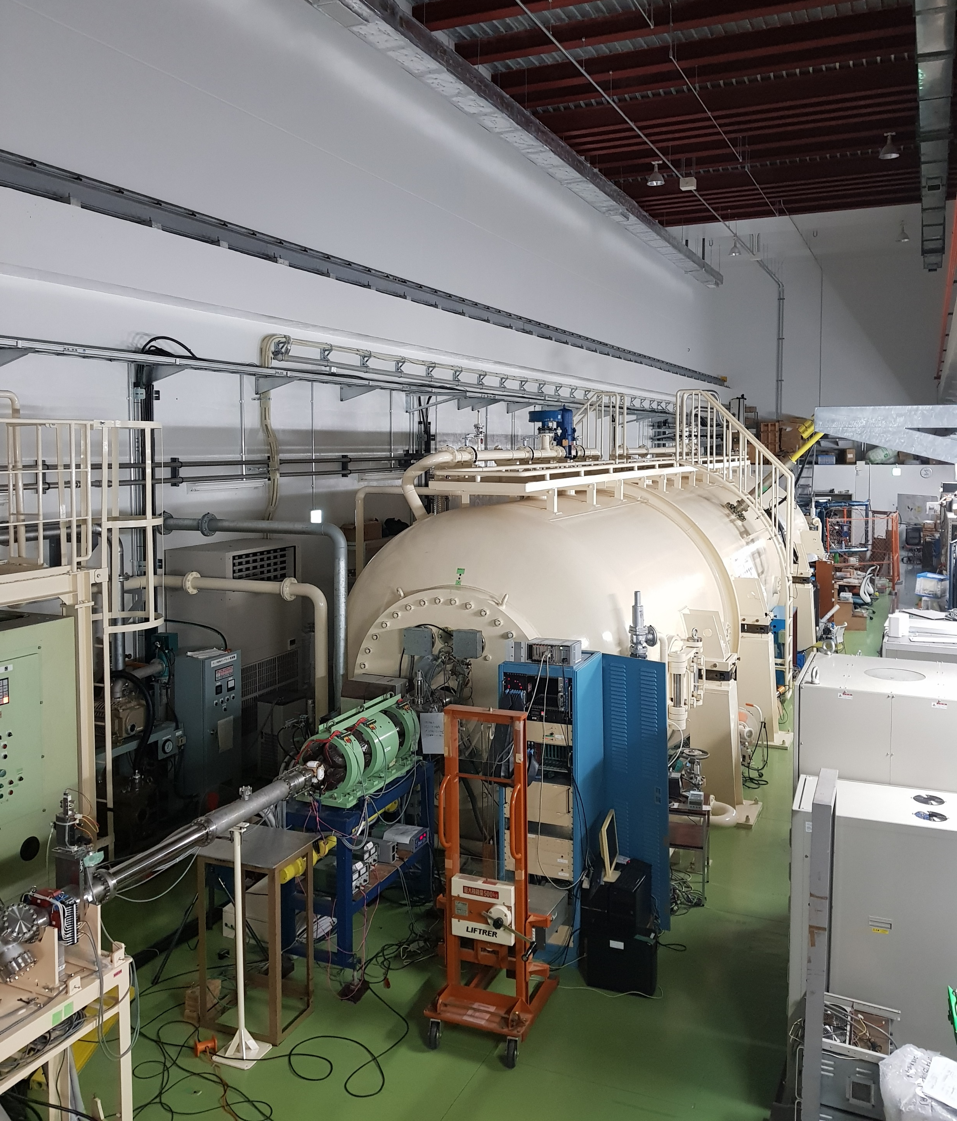
Experiment
8 MV tandem accelerator complex of Kyushu University in Japan
⁶Li beams (26 MeV)
⁶Li beams (26 MeV)
¹⁶O(⁶Li,t)¹⁹Ne measurement was performed for the spectroscopic study of levels in ¹⁹Ne by using ⁶Li beams at Kyushu University

Slide 6
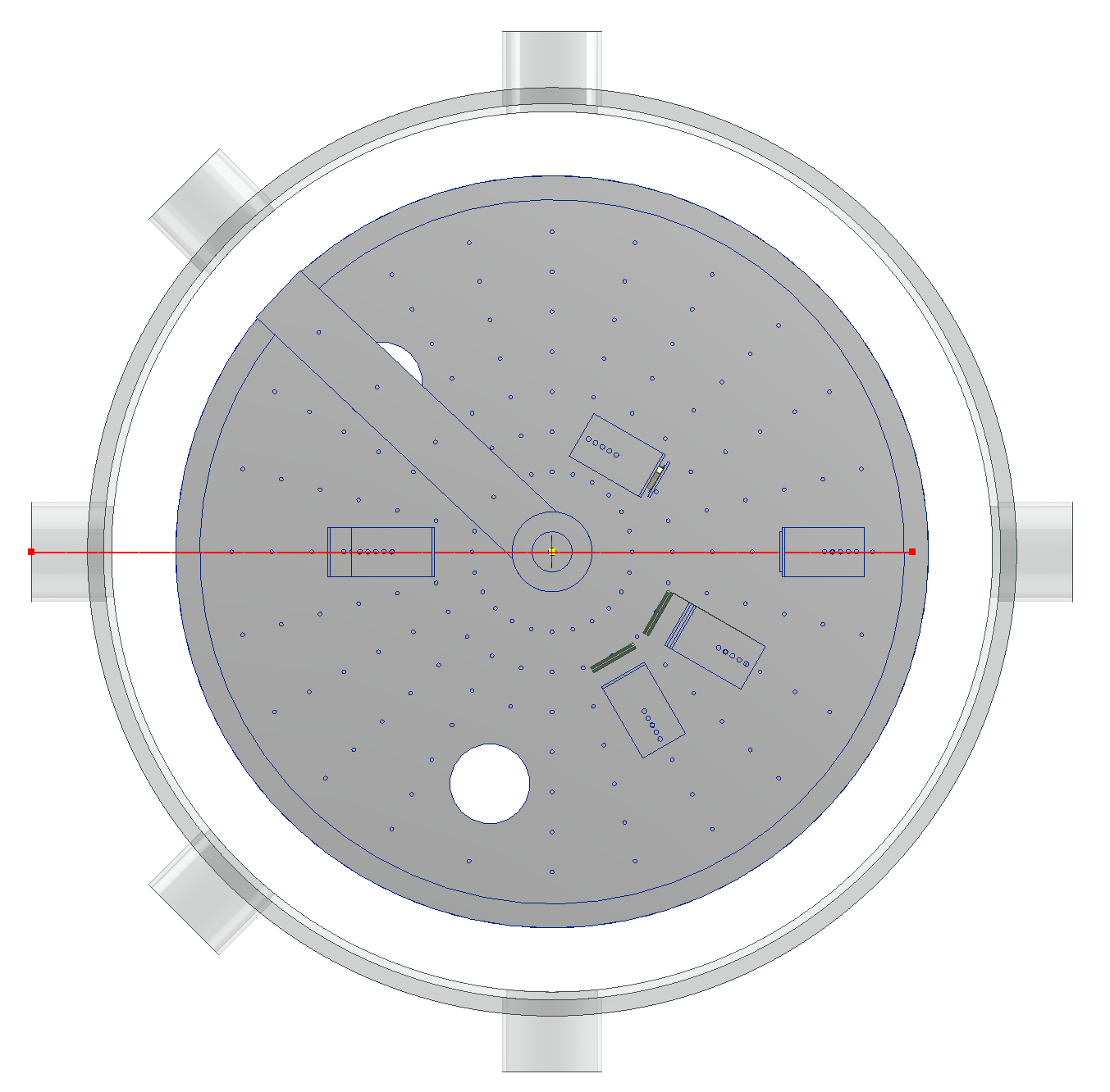
Experiment
Vacuum gauge
Pump
Telescope 1 (ΔE-E)
ΔE: 132 μm, W1, single sided, 16 ch.
E: 1026 μm, MSX-25, 1 ch.
15 cm from Al₂O₃ foil
30° tilted from beam axis
21.1° ~ 38.9° angular coverage
Telescope 2 (ΔE-E)
ΔE: 136 μm, W1, single sided, 16 ch.
E: 1516 μm, W1, double sided, 16 ch.(front) (Front 16 strips will be combined to 1 ch.)
15 cm from Al₂O₃ foil
60° tilted from beam axis
51.1° ~ 68.9° angular coverage
Silicon Surface Barrier (SSB) detector
~ 20 cm from ¹⁹⁷Au foil
150° tilted from beam axis
Target foils
Al₂O₃: 0.3 μm-thick
¹⁹⁷Au: 0.5 μm-thick
View port
SSB
Al₂O₃
¹⁹⁷Au
⁶Li³⁺, 26 MeV,
~ 0.5 pnA
Faraday cup
Telescope 1
Telescope 2
Signal feedthrough

Slide 7
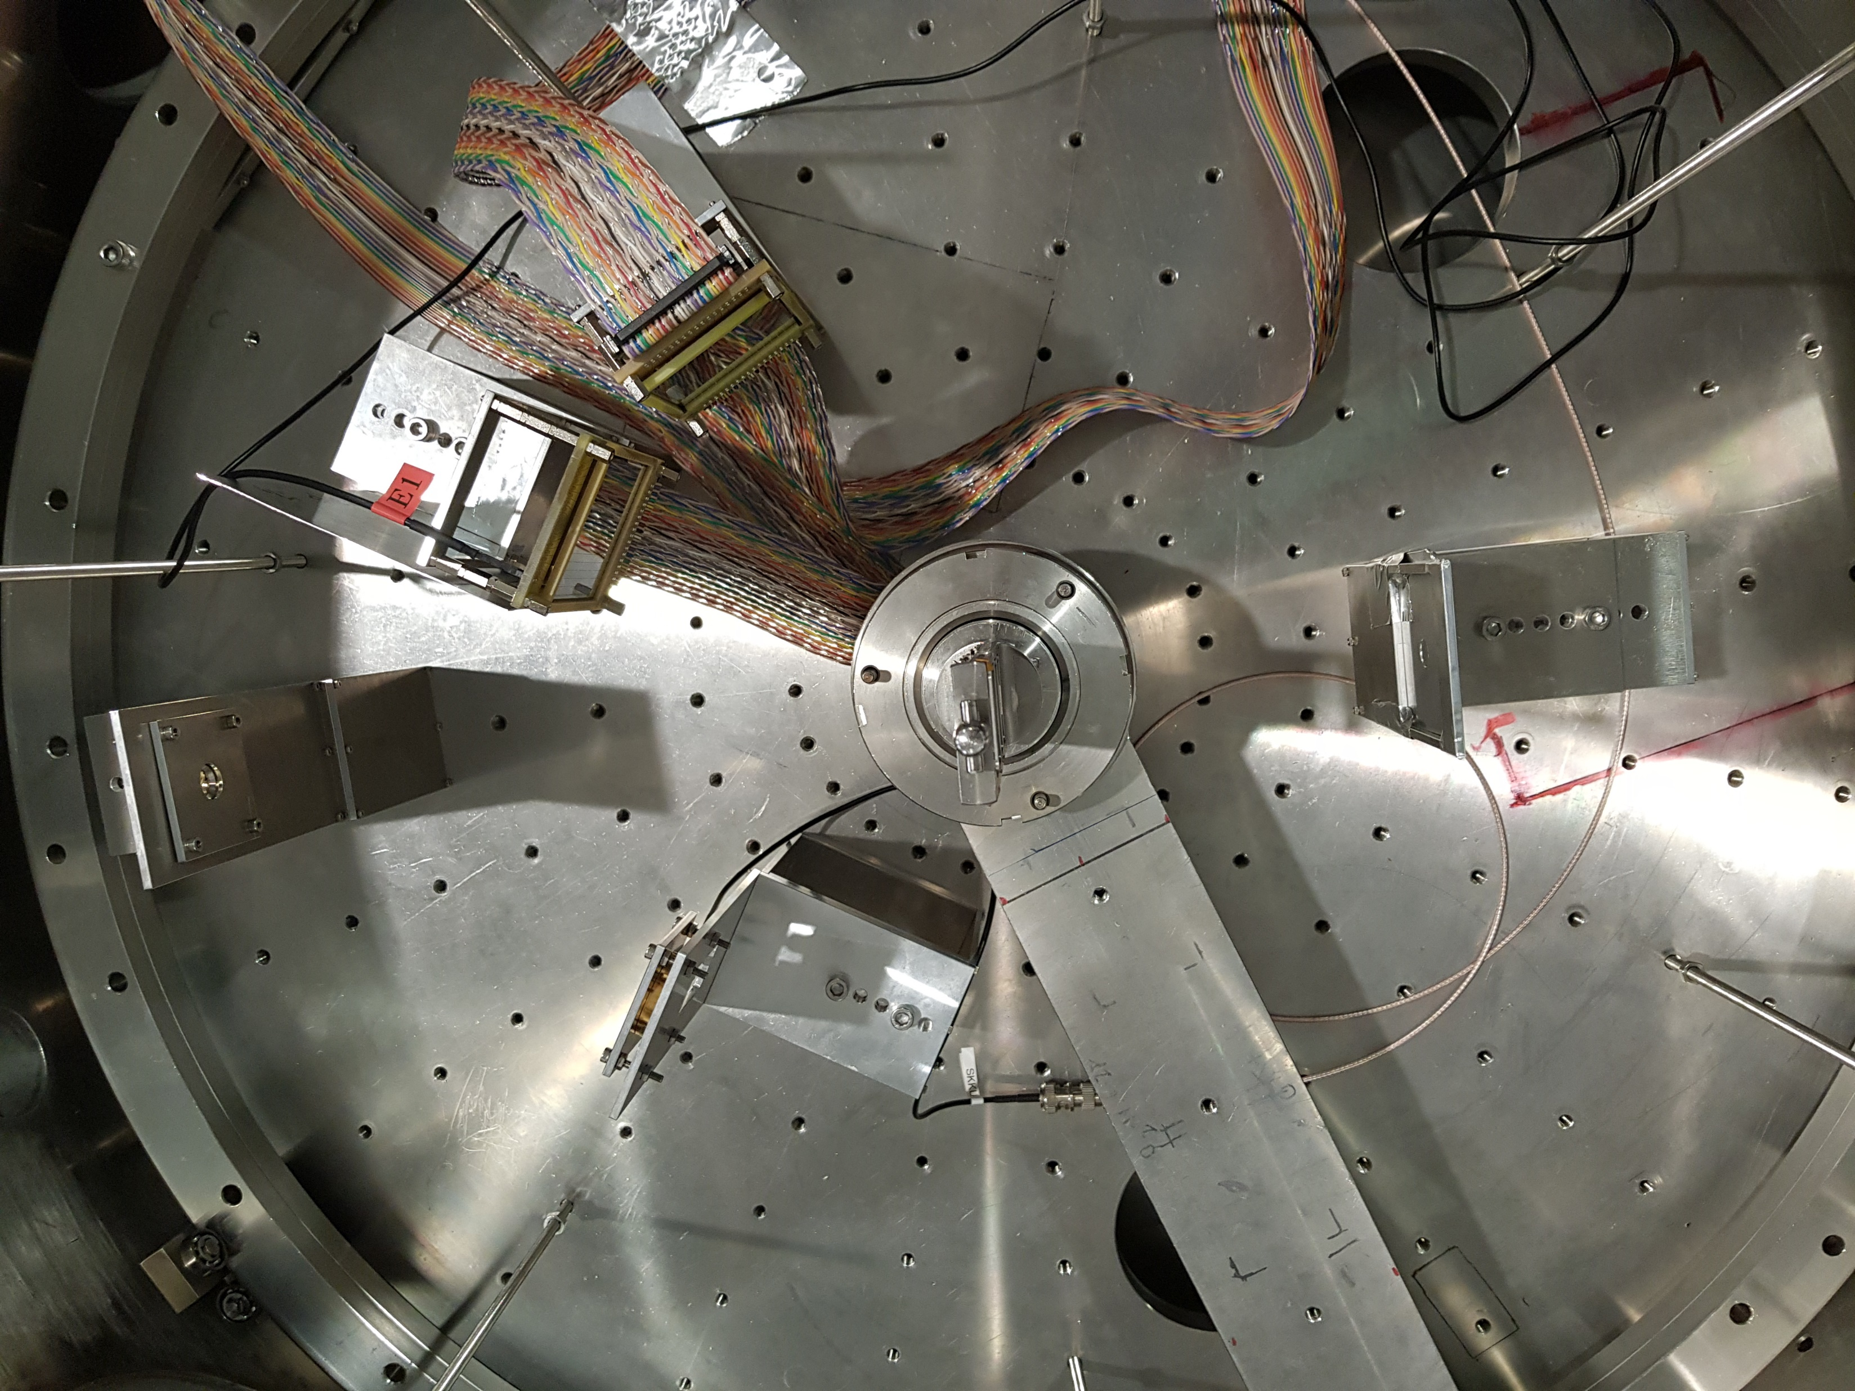
Experiment
SSB
0.3 μm-thick Al₂O₃
¹⁹⁷Au
Al₂O₃
0.3 μm-thick Al
⁶Li (26 MeV)
Telescope 1 (30°)
Phosphor
Telescope 2
(60°)

Slide 8
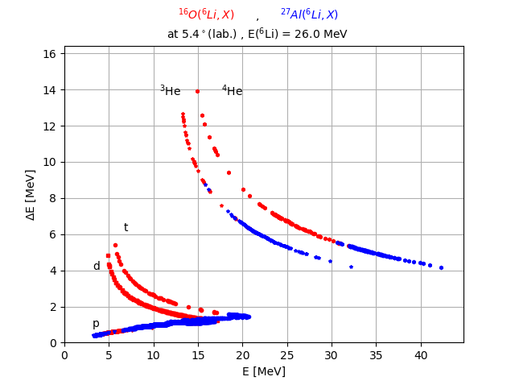
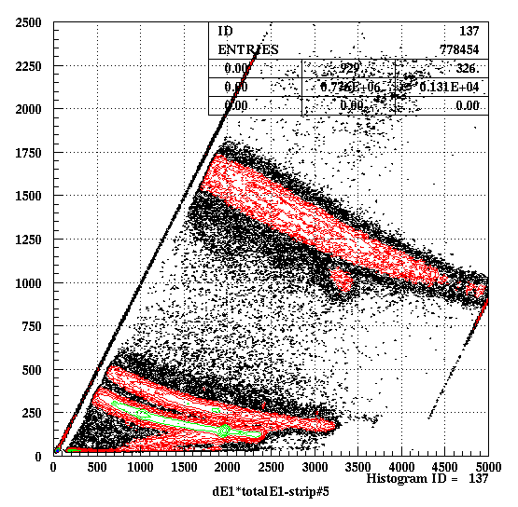
Preliminary results
PID plot (calculation)
PID plot (data)

Slide 9
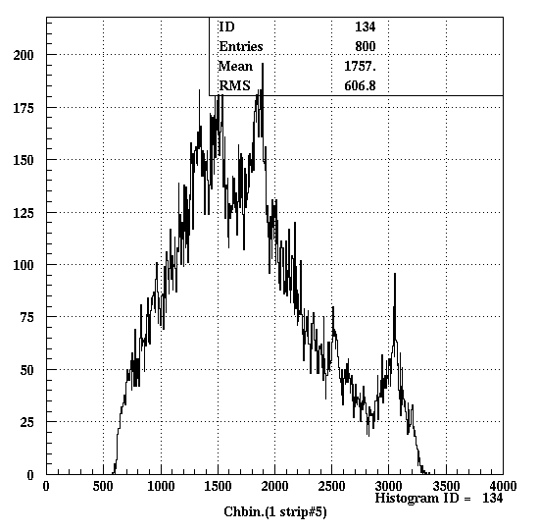
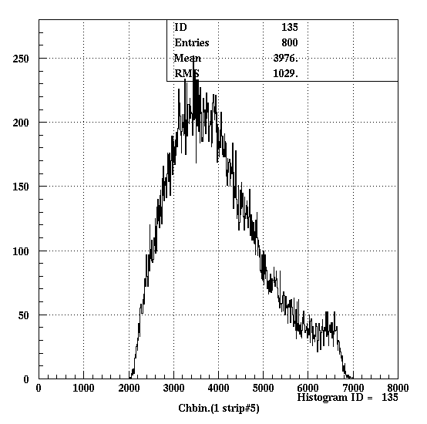
Preliminary results
³H from ⁶Li + Al₂O₃
³H from ⁶Li + Al

Slide 10
Future plan
Identification of the levels in ¹⁹Ne
Extraction of the angular distribution for the identified levels
Spin and parity assignment by using DWBA calculations
¹⁸F(p,γ)¹⁹Ne and ¹⁸F(p,α)¹⁵O reaction rate calculations
Network calculations for the final abundance of ¹⁸F in nova explosion

Slide 11
List of collaborators
Department of Physics, Sungkyunkwan University M. S. Kwag, K. Y. Chae*, S.M. Cha, N.N. Duy, G.M. Gu, D.H. Kim, M.J. Kim
Department of Physics, Kyushu University K. Goto, T. Kubo, Y. Nakajima, T. Teranishi, T. Yamada, H. Yoshida

