Slide 1
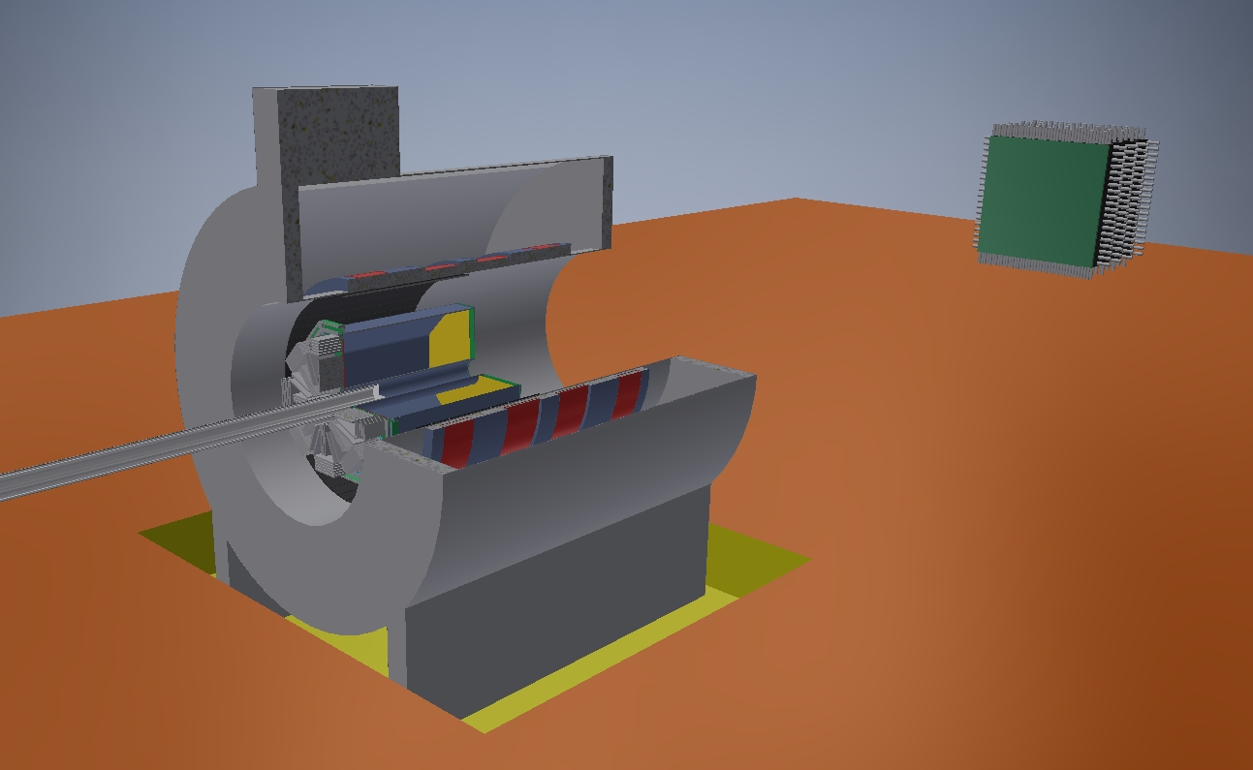
Neutron detector array
FADC0
nDAQ PC0
signal
FADC1
nDAQ PC1
usb
Solenoid magnet
UTP
FADC2
nDAQ PC2
ToF
10G optical
TPC
FADC3
nDAQ PC3
Target
Start Counter
LAMPS Trigger Electronics 2
1G/10G switch
Time stamp sync.
Slow control
&
monitoring
system
Solenoid spectrometer
1G switch
CoBo – uTCA2
Start Counter & ToF DAQ system
CoBo – uTCA1
LAMPS Trigger Electronics 1
CoBo – uTCA0
Gate & trigger signal
Control room
Control DAQ PC
Slow control PC
Control
TPC Data
Storage server
Monitoring PC
Narval DAQ PC
1G/10G switch
Event builder

Slide 2


AsAd
Experimental Hall
Sever room
AsAd
CoBo
네트워크 구축
AsAd
AsAd
MCH
AsAd
10G optical
Management Server
AsAd
CoBo
AsAd
TPC
AsAd
AsAd
AsAd
CoBo
AsAd
4port
AsAd
MCH
AsAd
AsAd
CoBo
4port
AsAd
AsAd
AsAd
data size
2.72GB/sec
Storage
AsAd
CoBo
2.42G/sec
AsAd
AsAd
MCH
AsAd
10G optical
AsAd
CoBo
AsAd
AsAd
4port
SC
ToF
:
FADC
15FADC : 30usb
PC x 3
4port
FADC
FADC
FADC
FADC
FADC
FADC
FADC
VME
ADC
usb
100G uplink
ADC
ADC
PC
확장
TDC
TDC
TDC
10G UTP
FADC
15FADC : 30usb
PC x 3
FADC
12 port
FADC
FADC
FADC
FADC
FADC
CV
neutron
FADC
15FADC : 30usb
FADC
PC x 3
10G L3 Switch
(Active-Active 가상화)
FADC
FADC
FADC
FADC
FADC
data size
1.2GB/sec
FADC
FADC
100M/sec
FADC
15FADC : 30usb
PC x 3
FADC
FADC
FADC
FADC
FADC
FADC
FADC
15FADC : 30usb
10G UTP : 1.25GB/sec
10G Optical : 1.25GB/sec
100G : 12.5GB/sec
40G InfiniBand : 5GB/sec
FADC
PC x 3
FADC
FADC
12 port
FADC
FADC
FADC
FADC
FADC
2 NIC bonding
10G L3 Switch
(Active-Active 가상화)

Slide 3

기초과학연구원- 중이온 가속기 네트웍 구성도
구성 설명
Experimental Hall
10G(UTP)
1
MVLT: Multiple Virtual Link Trunking 의 약자로 network Loop 가 없는 환경을 제공해주는 Dell의 프로토콜 입니다, 업링크용의 100G 포트를 이용하여 총 800G 네트웍 패브릭으로 구성합니다
10G(광)
MGMT
4
5
S414F8-ON
10G(광) x48port 40G 2port
100G 4port
S4148T-ON
10G(UTP) x48port 40G 4port
100G 4port
2
스토리지 네트웍의 요구 조건에 따라 고가용성 과 고대역폭을 위해 채널포트로 구성하여 Active-Active 또는 Active-Backup 구성을 합니다
100G
100G
MGMT
Switch
3
3
Dell 스위치는 서비스 포트와 별도로 Management(이하 MGMT) 포트가 1개씩 있으며, 장비를 컨트롤하기 위한 용도의 포트입니다 Mgmt 포트를 연결하기 위한 10/100/1000Base-T 스위치입니다
100G(광)
1
Single mode
MVLT
1G(광)
Sigle mode
MVLT
Server Room
MGMT
Switch
4
S4148F-ON : user port 로 10G 광 48포트 가 있으며, uplink port로 40G 광 2포트, 100G 4포트가 있는 데이타센터 용도 스위치입니다
100G
7
Z9100-ON
40G/100G 32port
MGMT
5
S4048-ON : user port 로 10G UTP 48포트 가 있으며, uplink port로 40G 광 2포트, 100G 4포트가 있는 데이타센터 용도 스위치입니다
MGMT
Server
6
Cable MGT KIT(48port)
Cable MGT KIT(48port)
40G ➔ 4port 10G Break out
6
Cable management KIT 로 12 포트의 40G로 48포트의 10G로 브레이크 아웃이 가능한 1U 크기의 FDF입니다
2
10G(광)
확장
확장
7
Z9100은 40G 및 100G 포트가 32포트 지원되는 데이타센타의 Core급 스위치 입니다.

Slide 4
AsAd
Experimental Hall
Sever room
AsAd
CoBo
AsAd
AsAd
MCH
AsAd
10G optical
Nexus 9300
48p 10/25G SFP+
6p 100G QSFP28
Management Server
AsAd
CoBo
AsAd
TPC
AsAd
AsAd
AsAd
CoBo
AsAd
4port
AsAd
MCH
AsAd
AsAd
CoBo
4port
AsAd
AsAd
AsAd
data size
2.72GB/sec
Storage
AsAd
CoBo
2.42G/sec
AsAd
Nexus 9300
48p 10/25G SFP+
6p 100G QSFP28
AsAd
MCH
AsAd
10G optical
AsAd
CoBo
AsAd
AsAd
4port
SC
ToF
:
FADC
15FADC : 30usb
PC x 3
4port
FADC
FADC
FADC
FADC
FADC
FADC
FADC
Nexus 9300
48p 10/25G SFP+
6p 100G QSFP28
VME
ADC
usb
ADC
ADC
PC
확장
TDC
TDC
Nexus 9300
48p 10G BASE-T
6p 100G QSFP28
TDC
10G UTP
FADC
15FADC : 30usb
PC x 3
FADC
12 port
FADC
FADC
FADC
FADC
FADC
CV
neutron
FADC
15FADC : 30usb
Nexus 9300
48p 10/25G SFP+
6p 100G QSFP28
FADC
PC x 3
FADC
FADC
FADC
FADC
FADC
data size
1.2GB/sec
FADC
FADC
100M/sec
FADC
15FADC : 30usb
PC x 3
10G L3 Switch
(Active-Active 가상화)
FADC
FADC
FADC
FADC
FADC
FADC
FADC
15FADC : 30usb
10G UTP : 1.25GB/sec
10G Optical : 1.25GB/sec
100G : 12.5GB/sec
40G InfiniBand : 5GB/sec
FADC
PC x 3
FADC
FADC
12 port
FADC
FADC
FADC
FADC
FADC
2 NIC bonding
Nexus 9300
48p 10G BASE-T
6p 100G QSFP28
10G L3 Switch
(Active-Active 가상화)

Slide 5
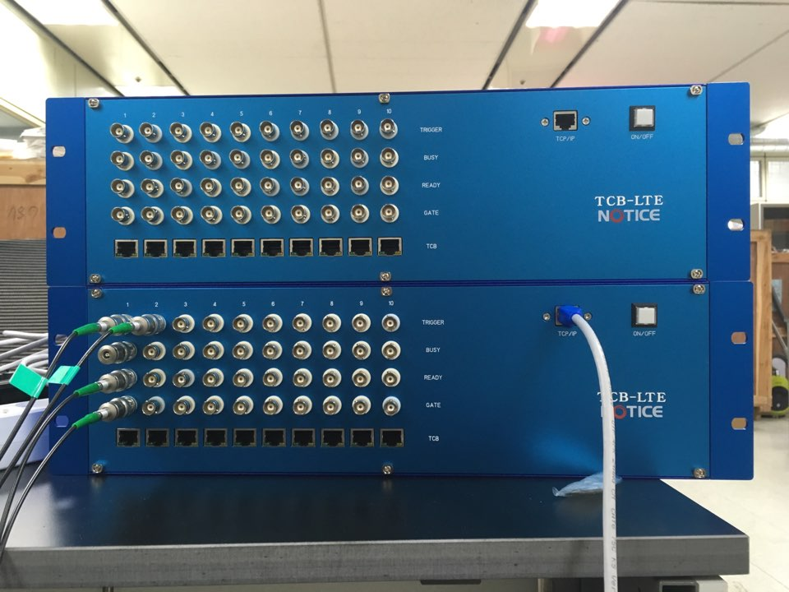
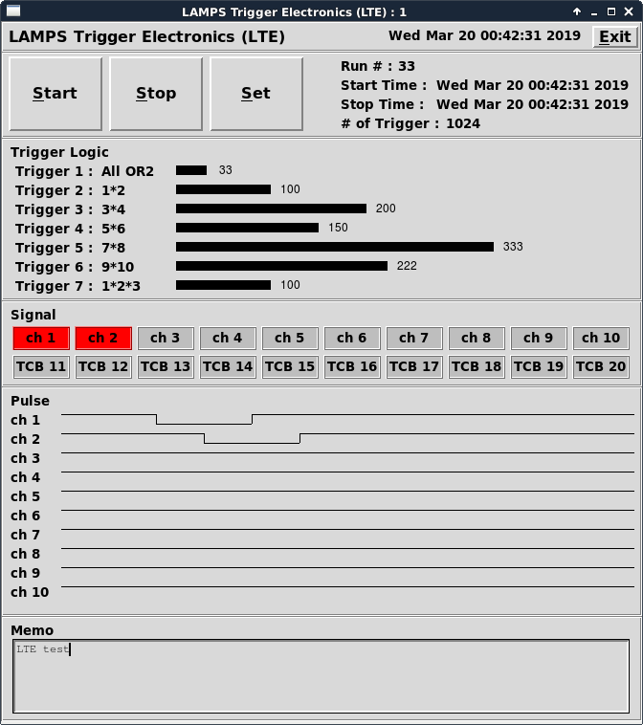
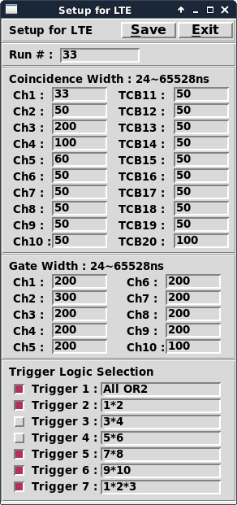
LAMPS Trigger Electronics (LTE)
Input : 10ch NIM/TTL + 10ch TCB (from FADC system) + Busy
Output : trigger ready + gate
125Mbps LVDS serial communication
Programmable trigger logic - Maximum 7 trigger logic - Multiplicity logic
Event (time) synchronized between two LTEs
Time synchronized with TCB of FADC DAQ
Save all trigger information ch : scaler : trigger # : trigger time : trigger pattern : gate flag
Trigger in
Busy in
Ready out
Gate out
TCB in
LTE control & monitoring program : c++ & perl/tk
Ready out
Gate out

Slide 6
FADC upgrade
- ontime readout / buffer full readout 선택
TCB upgrade
- trigger logic : programing – multiplicity, veto, coincidence, external mode
- time sync. From LTE
- UTP to LTE : time clock from LTE
trigger information to LTE – event #, trigger time, hit pattern (160ch – 20byte)
Run mode
1. self mode : trigger logic 을 설정 했을 때 trigger logic 에 맞으면 데이터 저장
2. external mode : LTE UTP port로 external mode가 들어오면 데이터 저장
LEMO connector 의 경우도 작동
LTE UTP 혹은 LEMO connector 선택 기능 추가
3. 내부 trigger logic을 사용하여 trigger logic 이 LTE로 넘어가서 LTE에서 로직 후 다시 external 신호로 다시 보내지면 external mode로 저장

Slide 7
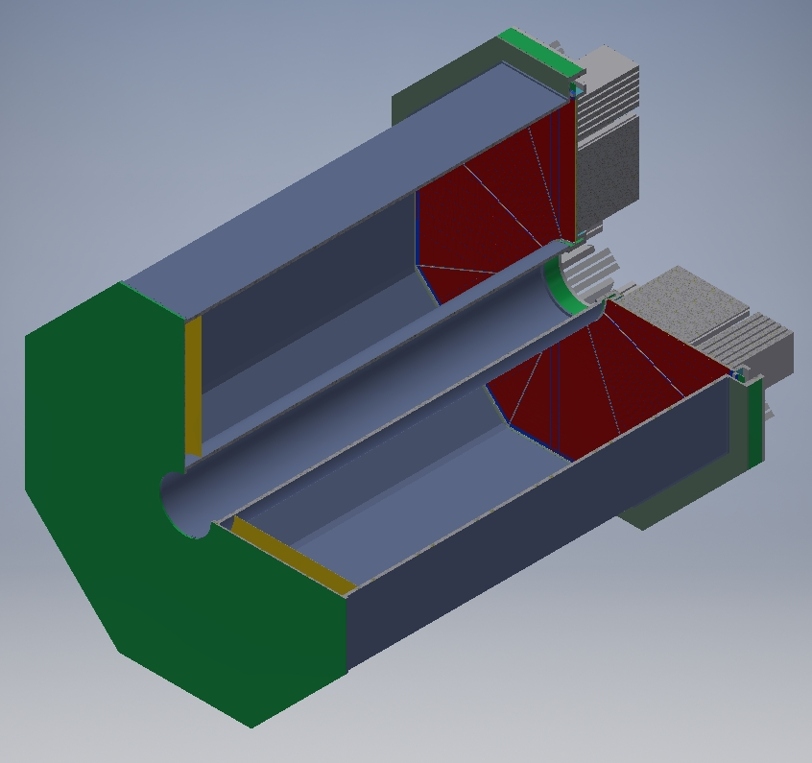
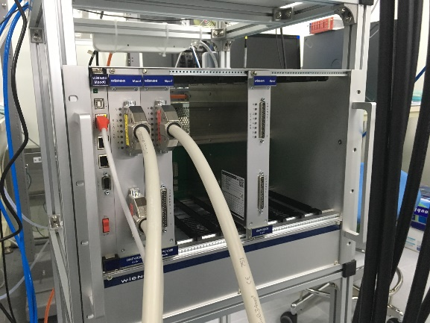
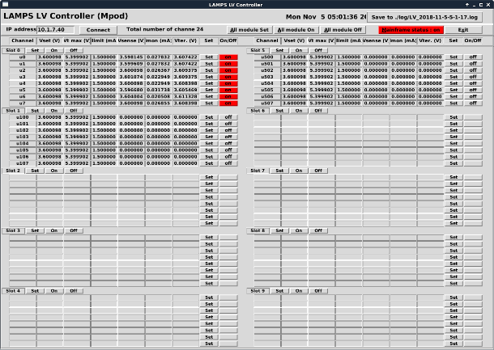
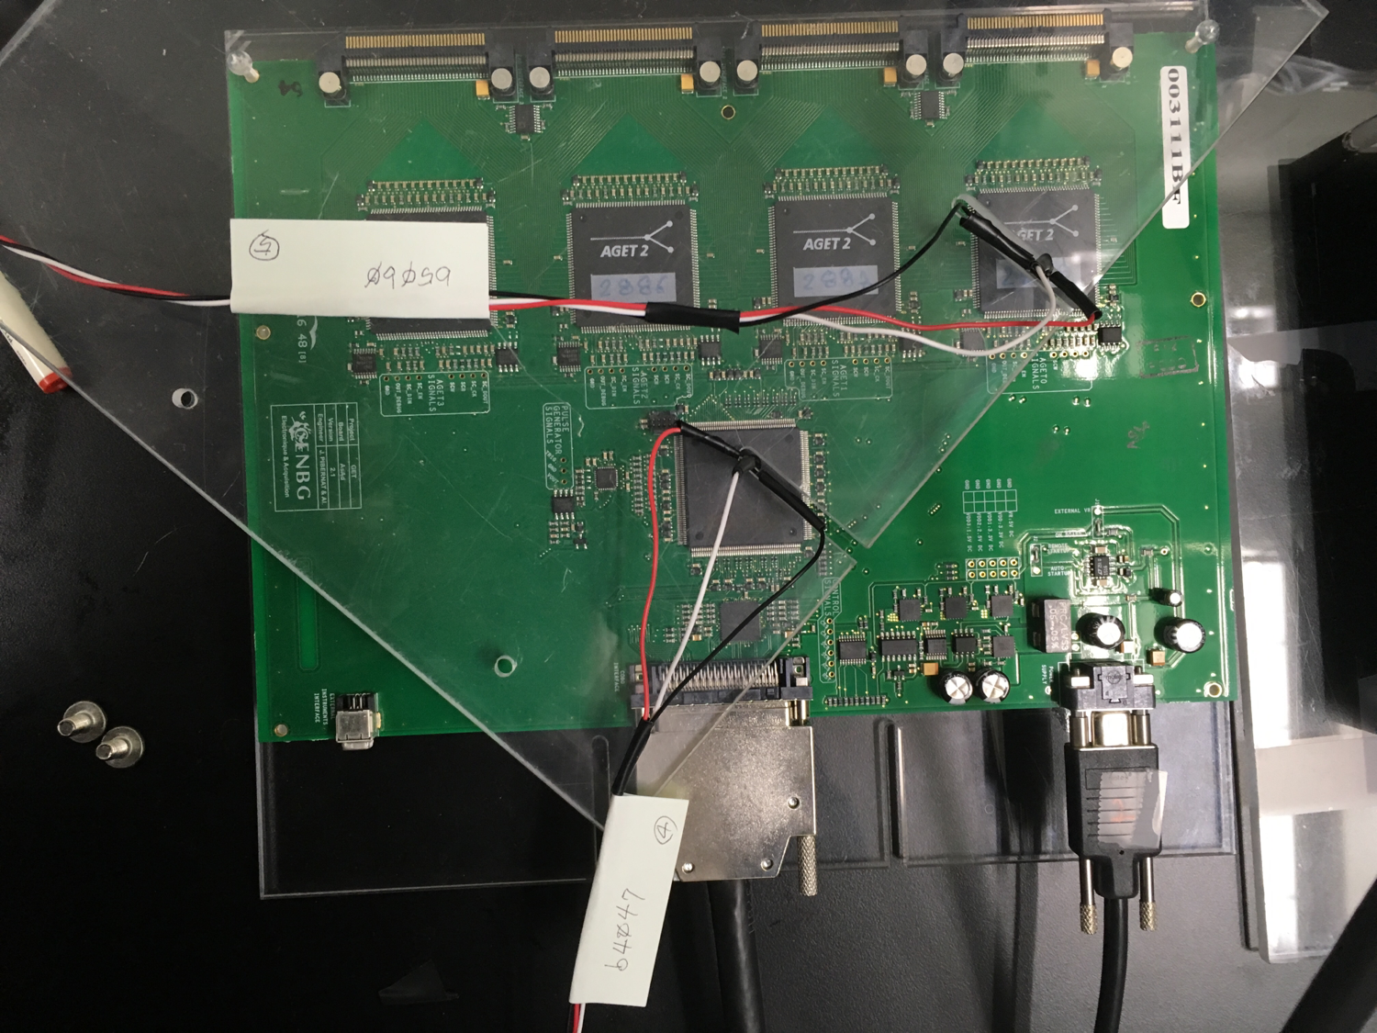
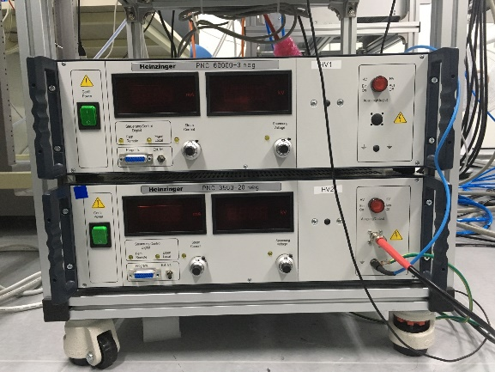
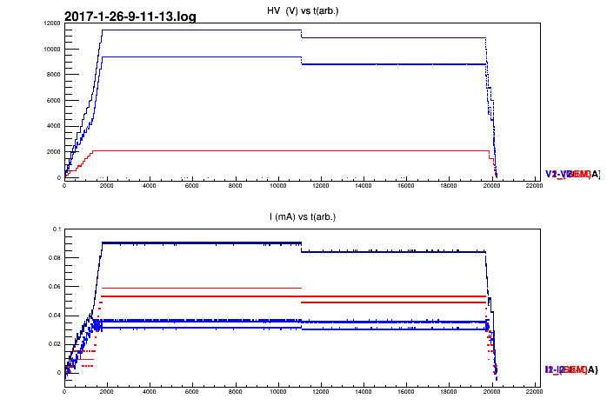
Control & monitoring system
LV system for AsAd
WIENER MPOD EC LV 10slots, 3kW
MPV8008I 8V/10A, 8ch, 50W/ch
MUSE control (network)
Control program : c++ & perl/tk
Ready for 120ch
Temperature monitoring system for AsAd and TPC
Temperature sensor : DS1820
Raspberry pi
LAMPS TPC will use for front-end electronics and TPC chamber.
HV system
PNC60000-3 : 60000VDC, 3mA
PNC3500-20 : 3500VDC, 20mA
RS232 interface
12bit for voltage and current monitoring
Control program : c++ & perl/사
Used for FC and GEM of prototype TPC for GEM test
LAMPS TPC will use HV system for FC & cathode

Slide 9
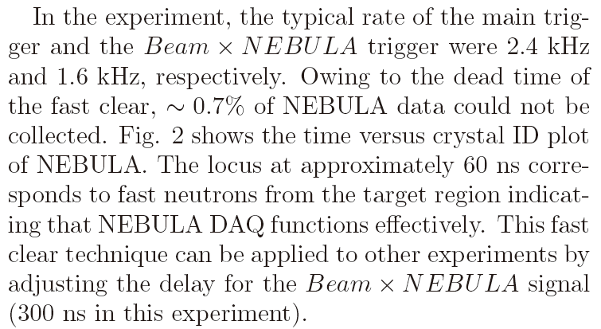
Estimation of data size
GET system
total # of channel = 2710ch x 8section = 21680ch -> 11AsAd 필요
1event with 4AsAd = 1.1M
LAMPS TPC = 11AsAd x 8section = 88AsAd
-> 24.2M/1event
full daq mode (100Hz)
24.2M/1event * 100events/1sec = 2.42G/1sec
24.2M/1event * 100events/1sec * 60m*60s = 8.712T/1hour
24.2M/1event * 100events/1sec * 24h*60m*60s = 209.088T/1day
Neutron detector
1FADC = 2USB = 2 x 4ch = 8ch
total # of channel = 80ch*4(ndet : 320ch) + 40ch*4 (CV : 160ch) = 480ch
data size : 512 time bin의 경우 0.5k/1ch/1event
-> total = 480ch x 0.5k/1ch/1event = 240k/1event
USB3 read 속도 = 100Mbyte/sec
data size = 512ns time range = 512byte/ch
count rate = USB3 read 속도 / data size / ch = (100Mbyte/sec) / (512byte/ch) / (120ch / 1PC) = 1.7k/sec = 1.7kHz - 1PC/1crate
count rate = USB3 read 속도 / data size / ch = (100Mbyte/sec) / (512byte/ch) / (80ch / 1PC) = 2.5k/sec = 2.5kHz - 2PC/1crate
count rate = USB3 read 속도 / data size / ch = (100Mbyte/sec) / (512byte/ch) / (40ch / 1PC) = 2.5k/sec = 5kHz - 3PC/1crate
(USB3 속도는 USB HUB가 switching 하는 시간을 고려하면 약 50%~70% 정도로 작아 짐.)
5kHz의 경우 : 240k/1event * 5k event/sec = 1.2GB/sec = 4layer x 3pc x 100MB/sec/layer/pc
5kHz의 경우 : 240k/1event * 5k event/sec * 60m * 60s = 4.32T/1hour = 4layer x 3 x 0.36T/1hour/layer/pc
5kHz의 경우 : 240k/1event * 5k event/sec * 24h * 60m * 60s = 103.68T/1day = 4layer x 3 x 8.64T/1day/layer/pc
samurai case : RIKEN Accel. Prog. Rep. 48
“Fast clear technique for NEBULA data acquisition for SAMURAI17 experiment”
132Sn(p,n) experiment
2.5kHz for main trigger : 1.6kHz for Beam x NEBULA trigger

Slide 10
GET system
total # of ch | 22528
trigger rate | 100 | Hz
data size / ch | 0.001074 | MB |  | track
full data mode |  |  | Partial mode | 100
total # of ch | 22528 |  | 11400
data size / 1event | 24.2 | MB | 12.246 | MB
data size / 1sec | 2.42 | GB | 1.225 | GB
data size / 1hour | 8.712 | TB | 4.409 | TB
data size / 1day | 209.088 | TB | 105.806 | TB
중성자
total # of ch | 480
trigger rate | 5000 | Hz
data size / ch | 0.0005 | MB |  | track
full data mode |  |  | Partial mode | 1
total # of ch | 480 |  | 88
data size / 1event | 0.24 | MB | 0.044 | MB
data size / 1sec | 1.2 | GB | 0.220 | GB
data size / 1hour | 4.32 | TB | 0.792 | TB
data size / 1day | 103.68 | TB | 19.008 | TB
other detector | 25.92 | TB | 4.752 | TB
total / 1day | 338.688 | TB | 129.56625 | TB
/ 1month | 10.16064 | PB | 3.8869875 | PB
 | full data mode |  | Partial mode

