Slide 1
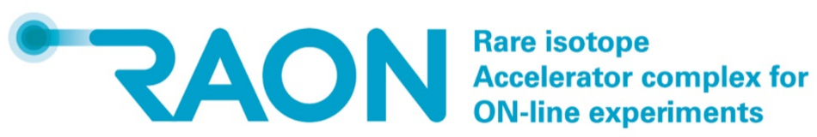



Overview of
The Rare Isotope Science Project
(RISP)
Myeun Kwon

Slide 2
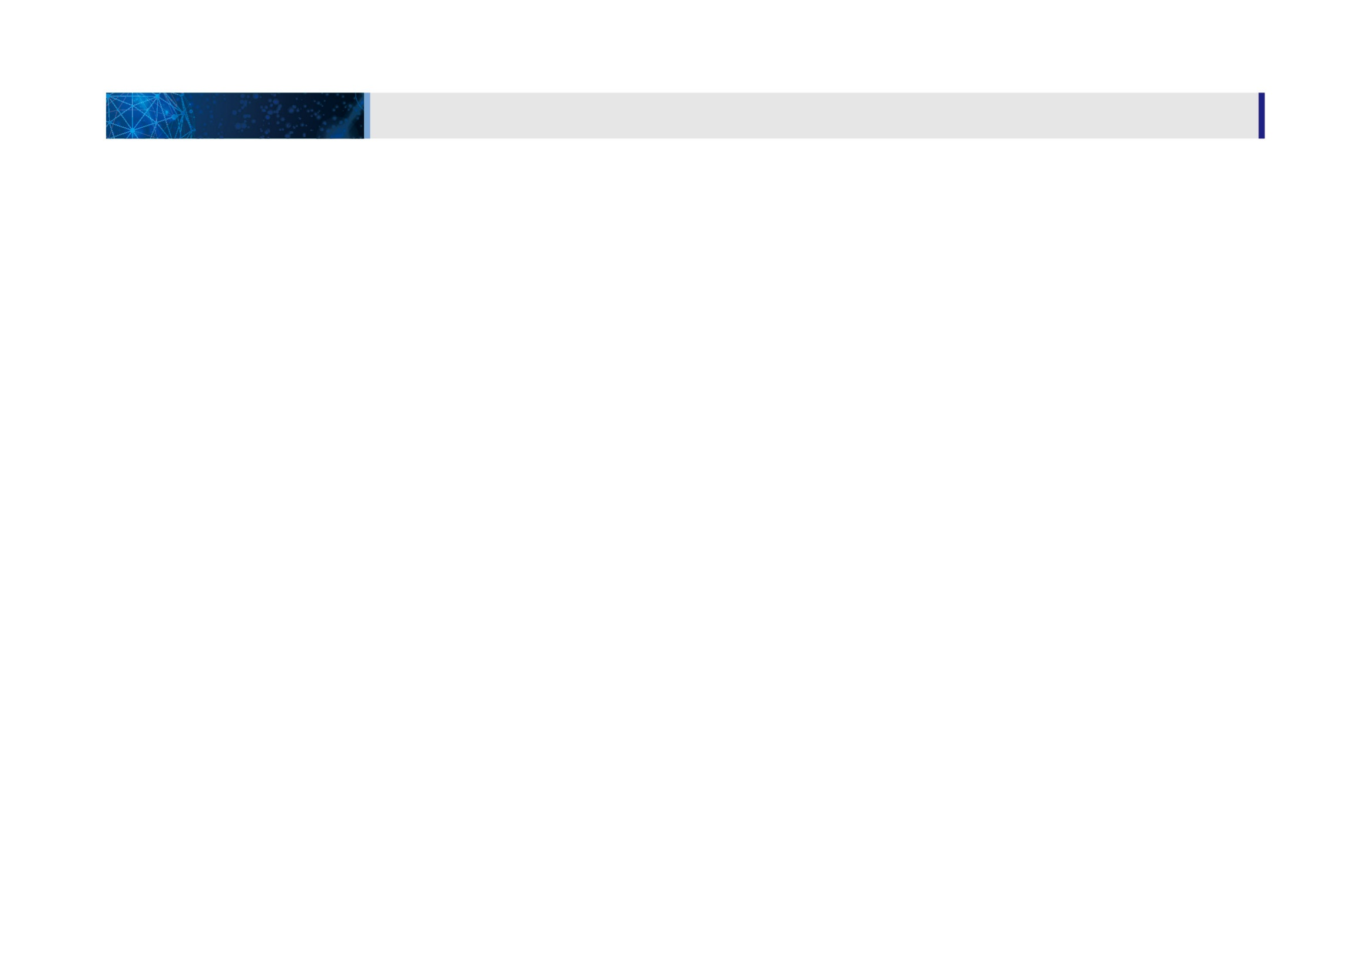
01
1. 일반현황
사업개요 및 내용
사업 일반현황
사업 개요 및 내용
CONTENTS
PART 1. Project Overview
PART 2. Construction Status
PART 3. System Installation
PART 4. Summary & Outlook

Slide 3

Part 1.
Project Overview

Slide 4
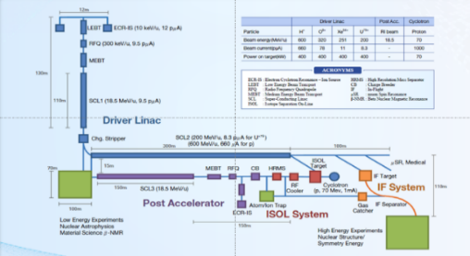
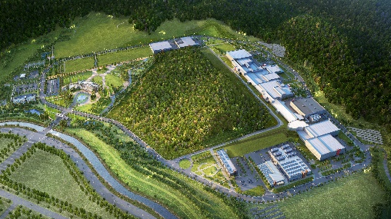
Rare Isotope Science Project (RISP)
1. Overview
Goal: To build a heavy ion accelerator complex RAON,
for rare isotope science research in Korea.
* RAON - Rare isotope Accelerator complex for ON-line experiments
Budget: KRW 1,498 billion (US$ 1.23 billion, 1$=1,209krw)
- accelerators and experimental apparatus : 502.8 billion won
- civil engineering & conventional facilities : 996 billion won (incl. site 357 billion won)
Period: 2011.12 ~ 2021.12
System Installation Project
Providing high intensity RI beams by ISOL and IF
ISOL: direct fission of ²³⁸U by 70 MeV proton
IF: 200 MeV/u ²³⁸U (intensity: 8.3 pμA)
Providing high quality neutron-rich beams
e.g., ¹³²Sn with up to 250 MeV/u,
up to 10⁹ particles per second
Providing More exotic RI beam
production by combination of ISOL and IF
Development, installation, and commissioning of the accelerator systems that provides high-energy (200MeV/u) and high-power (400kW) heavy-ion beam
Facility Construction Project
Construction of research and support facility to ensure the stable operation of the heavy-ion accelerator, experiment systems, and to establish a comfortable research environment
※ Accelerator and experiment buildings, support facility, administrative buildings, and guest house, etc.

Slide 5
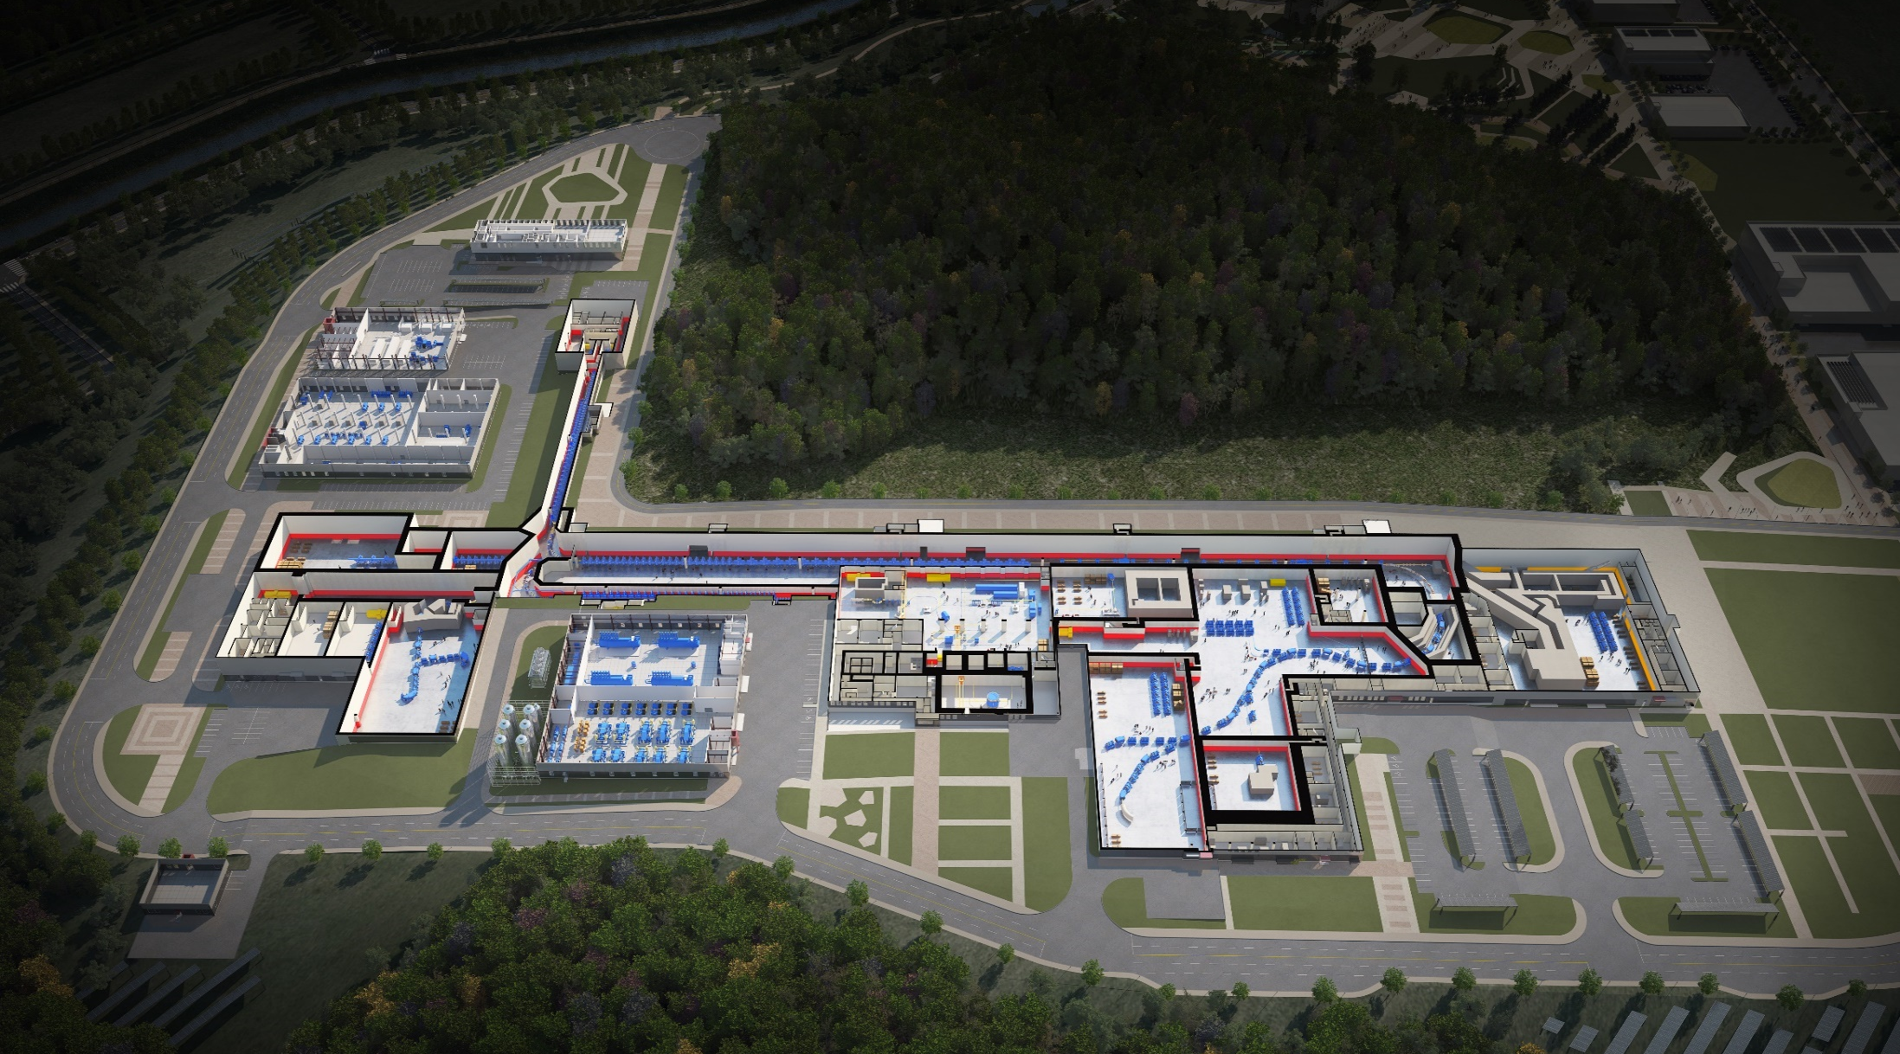

RAON Layout
1. Overview
Control
Center
Utility
ECR IS
SCL1
ISOL System
HPMMS/
CLS
IF System
SCL3
SCL2
BIS
μSR
NDPS
KOBRA
Cyclotron
HRS
LAMPS
SCL1 has been decided to postpone
: SCL3 is going to be taking a role of SCL1 in the early operation

Slide 6
1. Overview
RIBs at RAON
IF
ISOL
KOBRA
ISOL+IF
RAON will provide access to unexplored regions of the nuclear chart
“More exotic, more intense, more various RIBs”

Slide 7
1. Overview
Project History
System Installation
Facility Construction
Project General
Jan 2012 Established Master Plan for RISP
Dec 2014 Began the basic design of facility
construction
June 2016 Constructed the
SRF test facility
at Munji
March 2018
Completed
the SCL3 HWR
prototype module
performance test
2012
2013
2014
2015
2016
2017
2018
2018
2019
Feb 2011
Completed the Heavy-ion
Accelerator Conceptual Design
Dec 2011
Launched the Heavy-in
Accelerator Project
June 2013 Completed Technical Design
Report (TDR)
Sep 2013 Revised the Master Plan (1st)
(period extension (~2019),
implementation schedule
change, etc.)
April 2015 Revised the Master Plan (2nd)
(period extension (~2021),
implementation strategy
change, etc.)
Dec 2015 Completed the basic design
of facility construction
Sep 2017 Began the facility
construction
Oct 2017 Successfully completed the
SCL demo runs
Dec 2017 Project review by TF
May 2019 Revised the Master Plan (3rd)

Slide 8
1. Overview
Project Milestone
(2018)
SCL3 manufacturing
SCL2 Prototype
(2019)
SCL3 Installation
SCL2 manufacturing
(2020)
SCL3 Beam Commissioning/
Const. Completion
(2021)
SCL3 Beam Commissioning/
Project Completion
System Installation
ECR-IS beam &
ISOL beam (SI beam)
(Dec 2015)
18.5MeV/u
SI beam
(Dec 2020)
18.5MeV/u
RI beam
(Sep 2021)
SCL demo beam
(Dec 2017)
2014
2015
2016
2017
2018
2019
2020
2021
RFQ beam
(Dec 2016)
SCL
installation
(April 2019)
ISOL
Commissioning
(July 2020)
D-1
Experiment
(Jan 2021)
SCL2
(Dec 2021)
Facility Construction
Completion of basic design
(Dec 2015)
Completion of detail design
(June 2017)
Supply of utilities
(Dec 2018)
Building
Permit
(April 2021)
2014
2015
2016
2017
2018
2019
2020
2021
Beginning of priority
construction
(Feb 2017)
Beginning of construction
(Sep 2017)
Completion of construction
(Aug 2020)
Completion of inspection of the radiation facility
(Dec 2021)

Slide 9
1. Overview
Progress Rate
System Installation Project
As of Sept. 2019
(Planned: 72.01%,
Actual: 68.71%)
2011 2012 2013 2014 2015 2016 2017 2018 2019 2020 2021
As of Sept. 2019
(Planned: 58.14%,
Actual: 58.14%)
Construction Project
2015 2016 2017 2018 2019 2020 2021

Slide 10
Part 2.
Construction

Slide 11
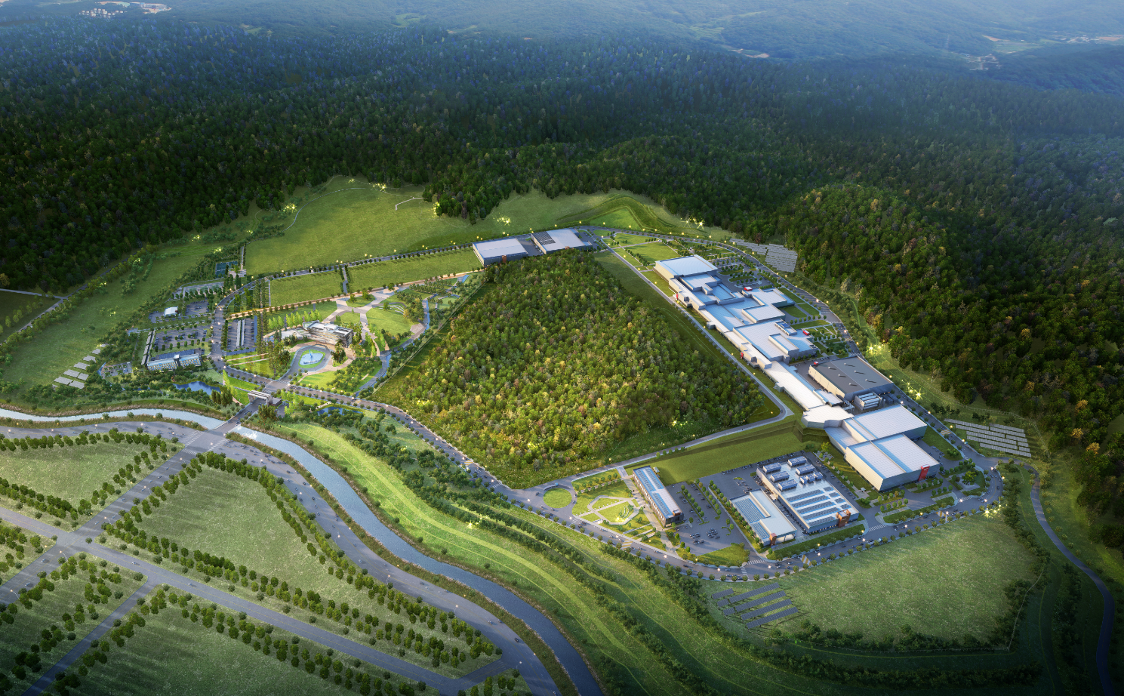
2. Construction
Building Layout
Building Layout
Campus Area : 952,066㎡ (including the reservation area of 144,640㎡)
Period : 2014 ~ 2021(8 years)
Cost : 996 billion won (incl. 357 billion won for land)
Building Area : 76,259㎡(11 Bds)
Total Bd. Area : 116,252㎡
Constructor : POSCO Consortium(11 companies)
Assembly Bd.
SRF Test Bd.
High Energy B
IF Separator / High Energy A
Waste Strorage
Cryogenics Bd.
HQ Office
Reservation
ISOL
SCL
Info. Center
Guest House
Low Energy A,B
Control Center
Utility Bd.
Electricity Bd.

Slide 12
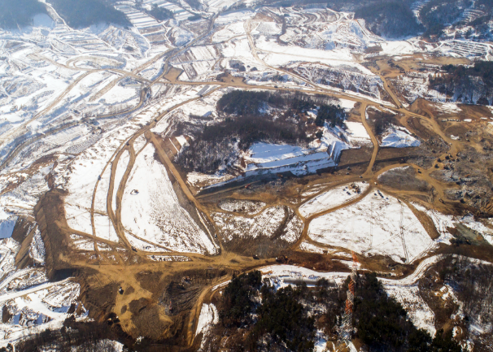
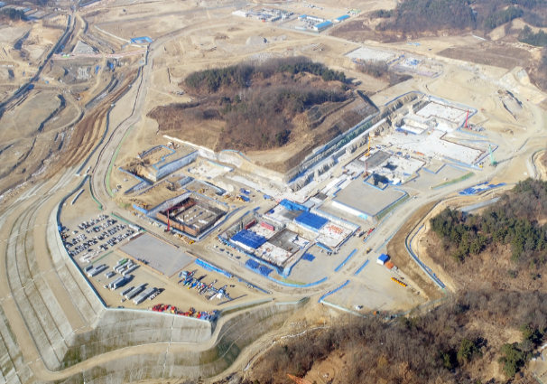
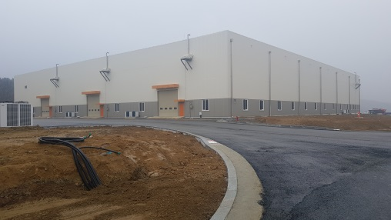
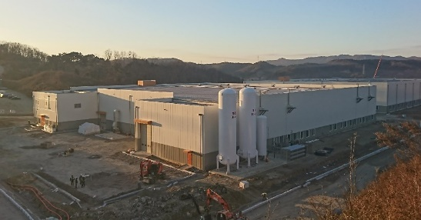
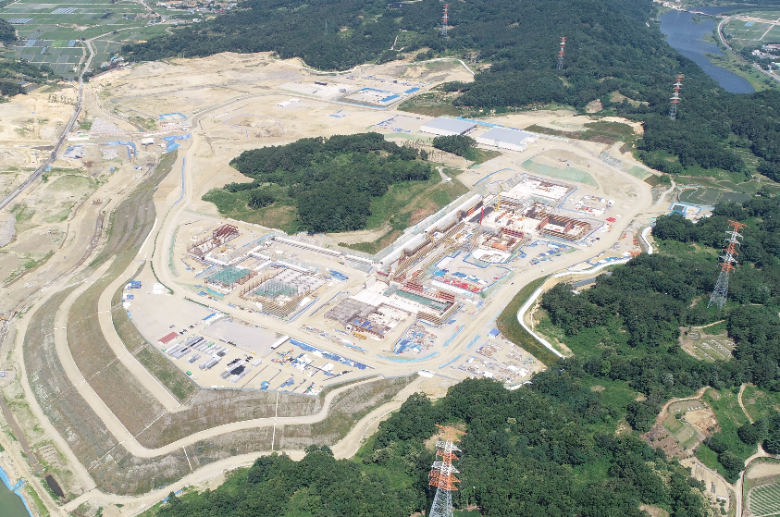
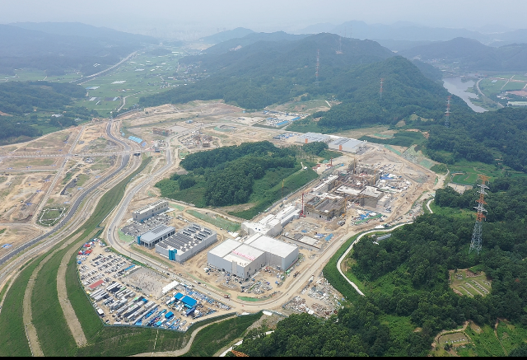
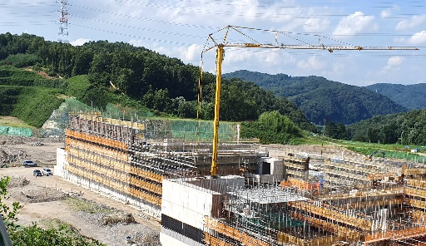
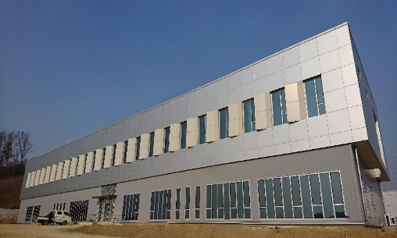
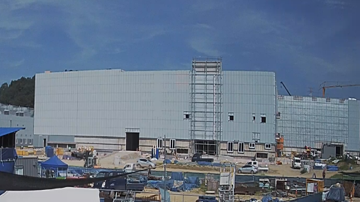
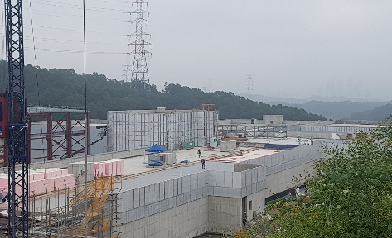
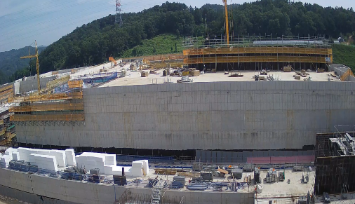
2. Construction
View of Construction Place
View of Construction Place (`19.10)
<Assembly Bd.>
<`17.01>
<`17.12>
<SRF Test Bd.>
<`18.6>
<`19.9>
<High Energy Exps.>
<Control Center>
<Low Energy Exps.>
<SCL3>
<ISOL>

Slide 13
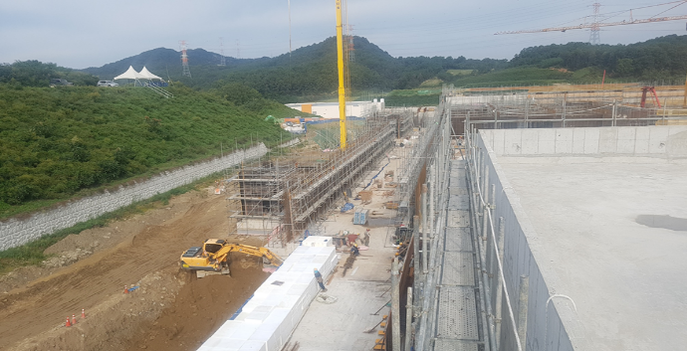
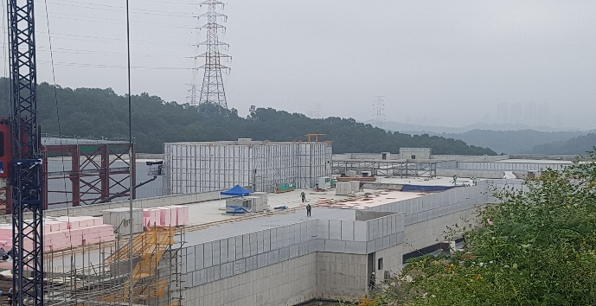
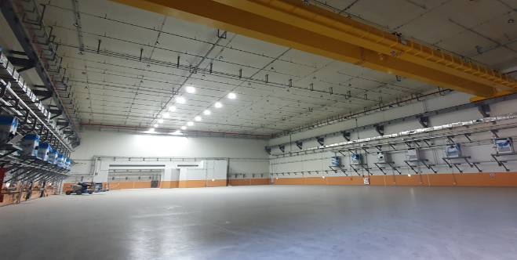
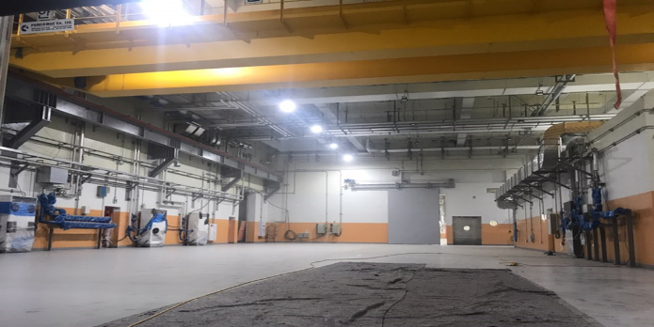
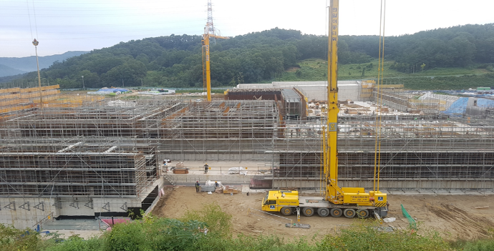
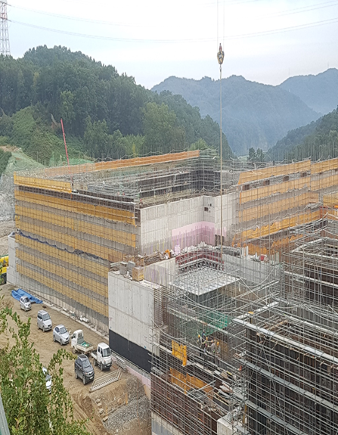
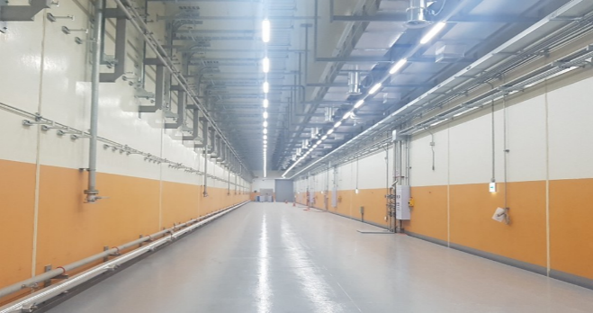
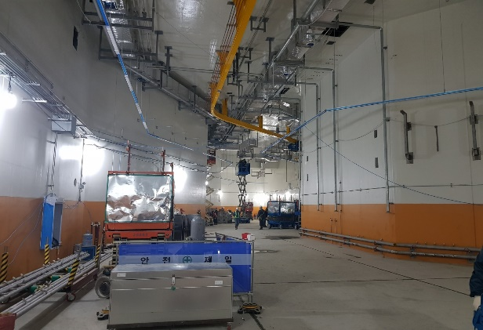
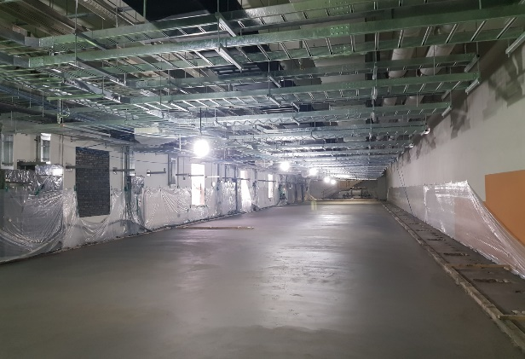
2. Construction
Conventional Facilities
SCL2
SCL3
Low Energy A/B
ISOL
IF/ High Energy A
High Energy B
SCL3
Bending Section
SCL3-gallery
Accelerator Bd.

Slide 14

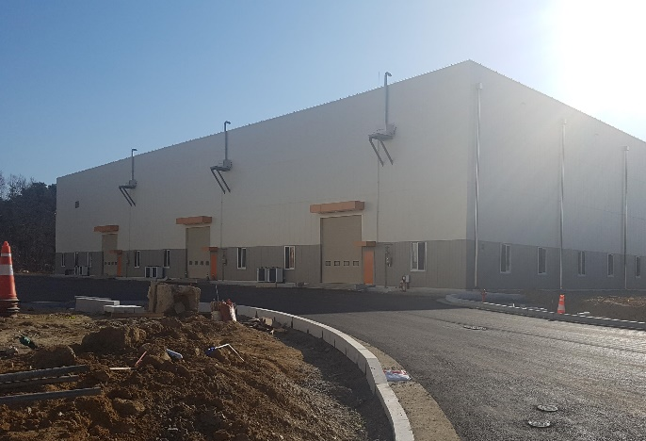

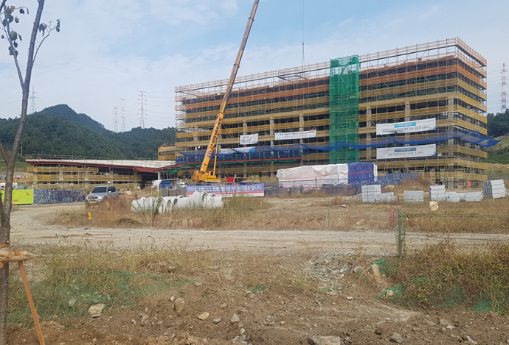
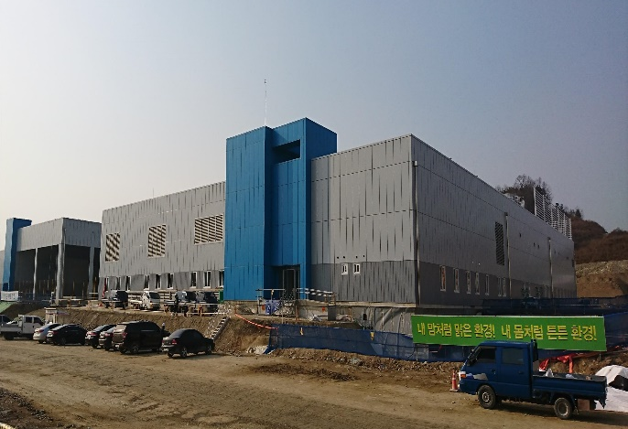
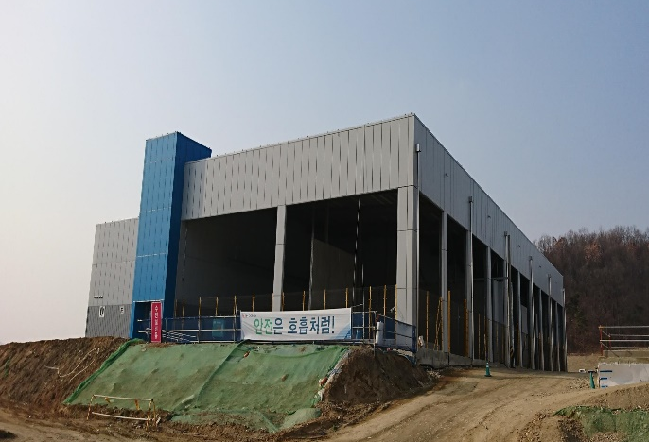
2. Construction
Conventional Facilities
SRF Test Bd.
Assembly Bd.
Control Center
HQ Office Bd.
Utility Bd.
Electricity Bd.

Slide 15
Part 3.
System Installation

Slide 16




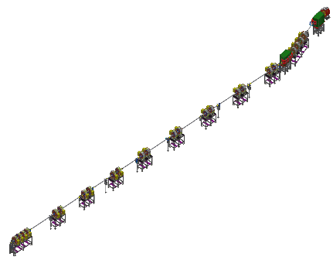
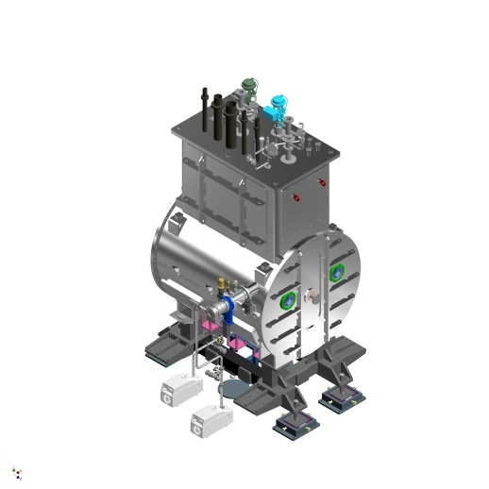
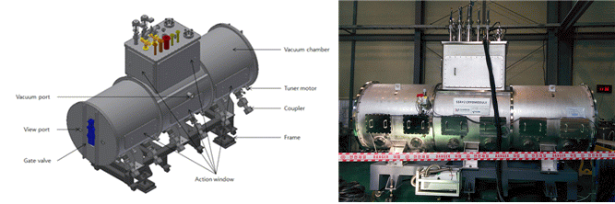
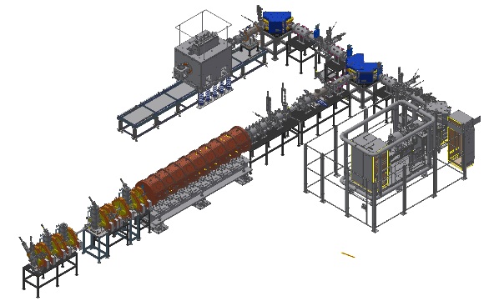
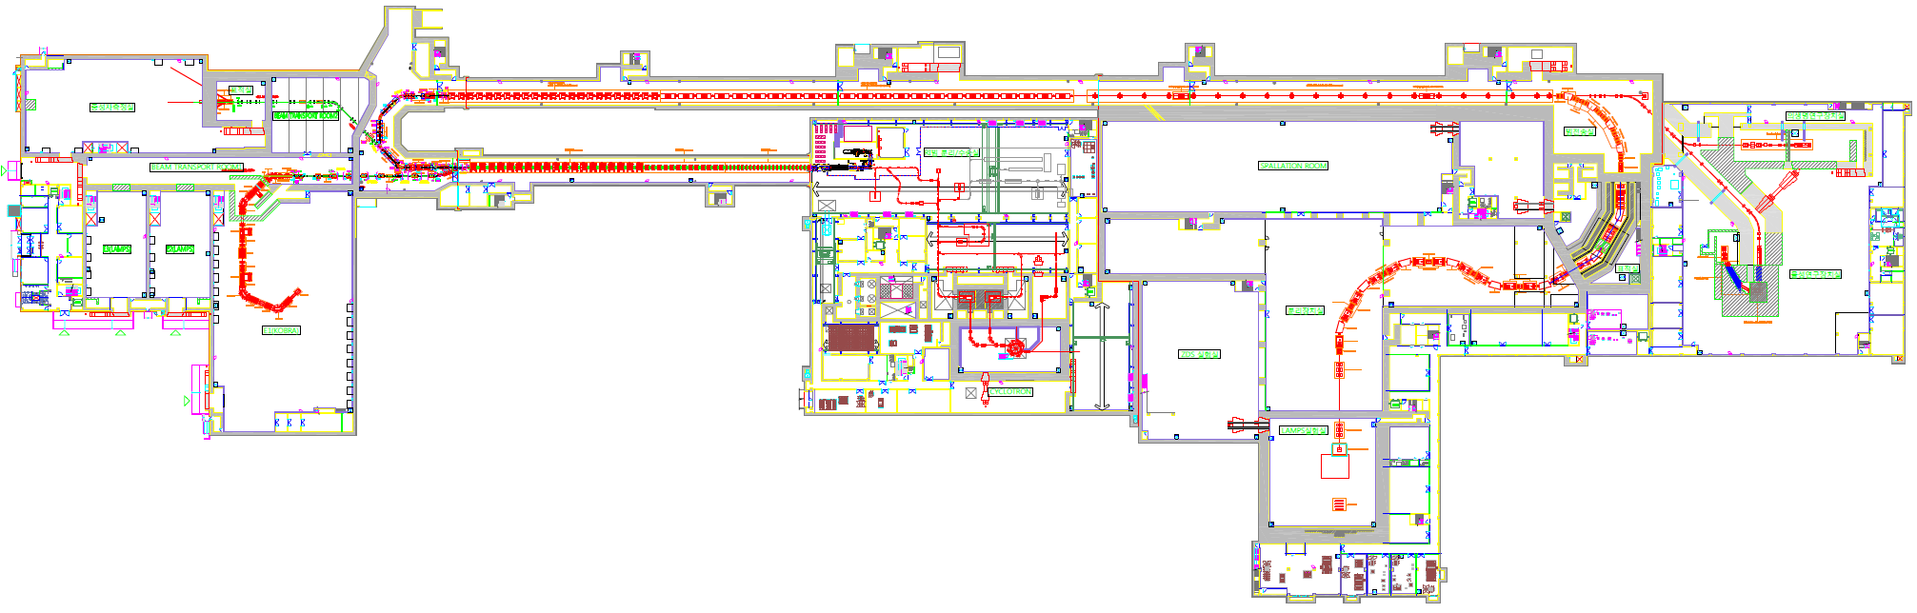
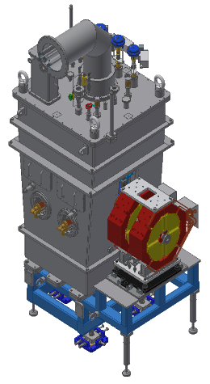
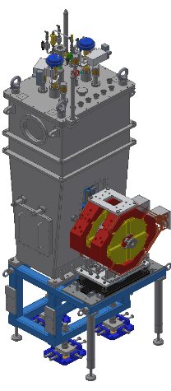
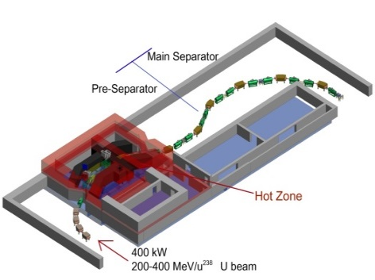
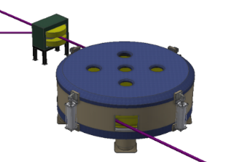
3. Sys. Install.
Accelerator System
KoBRA Beam Line
SCL2(SSR1)
SCL2(SSR2)
Injector
SCL3
(HWR)
SCL3
(QWR)
Cyclotron
IF System

Slide 17
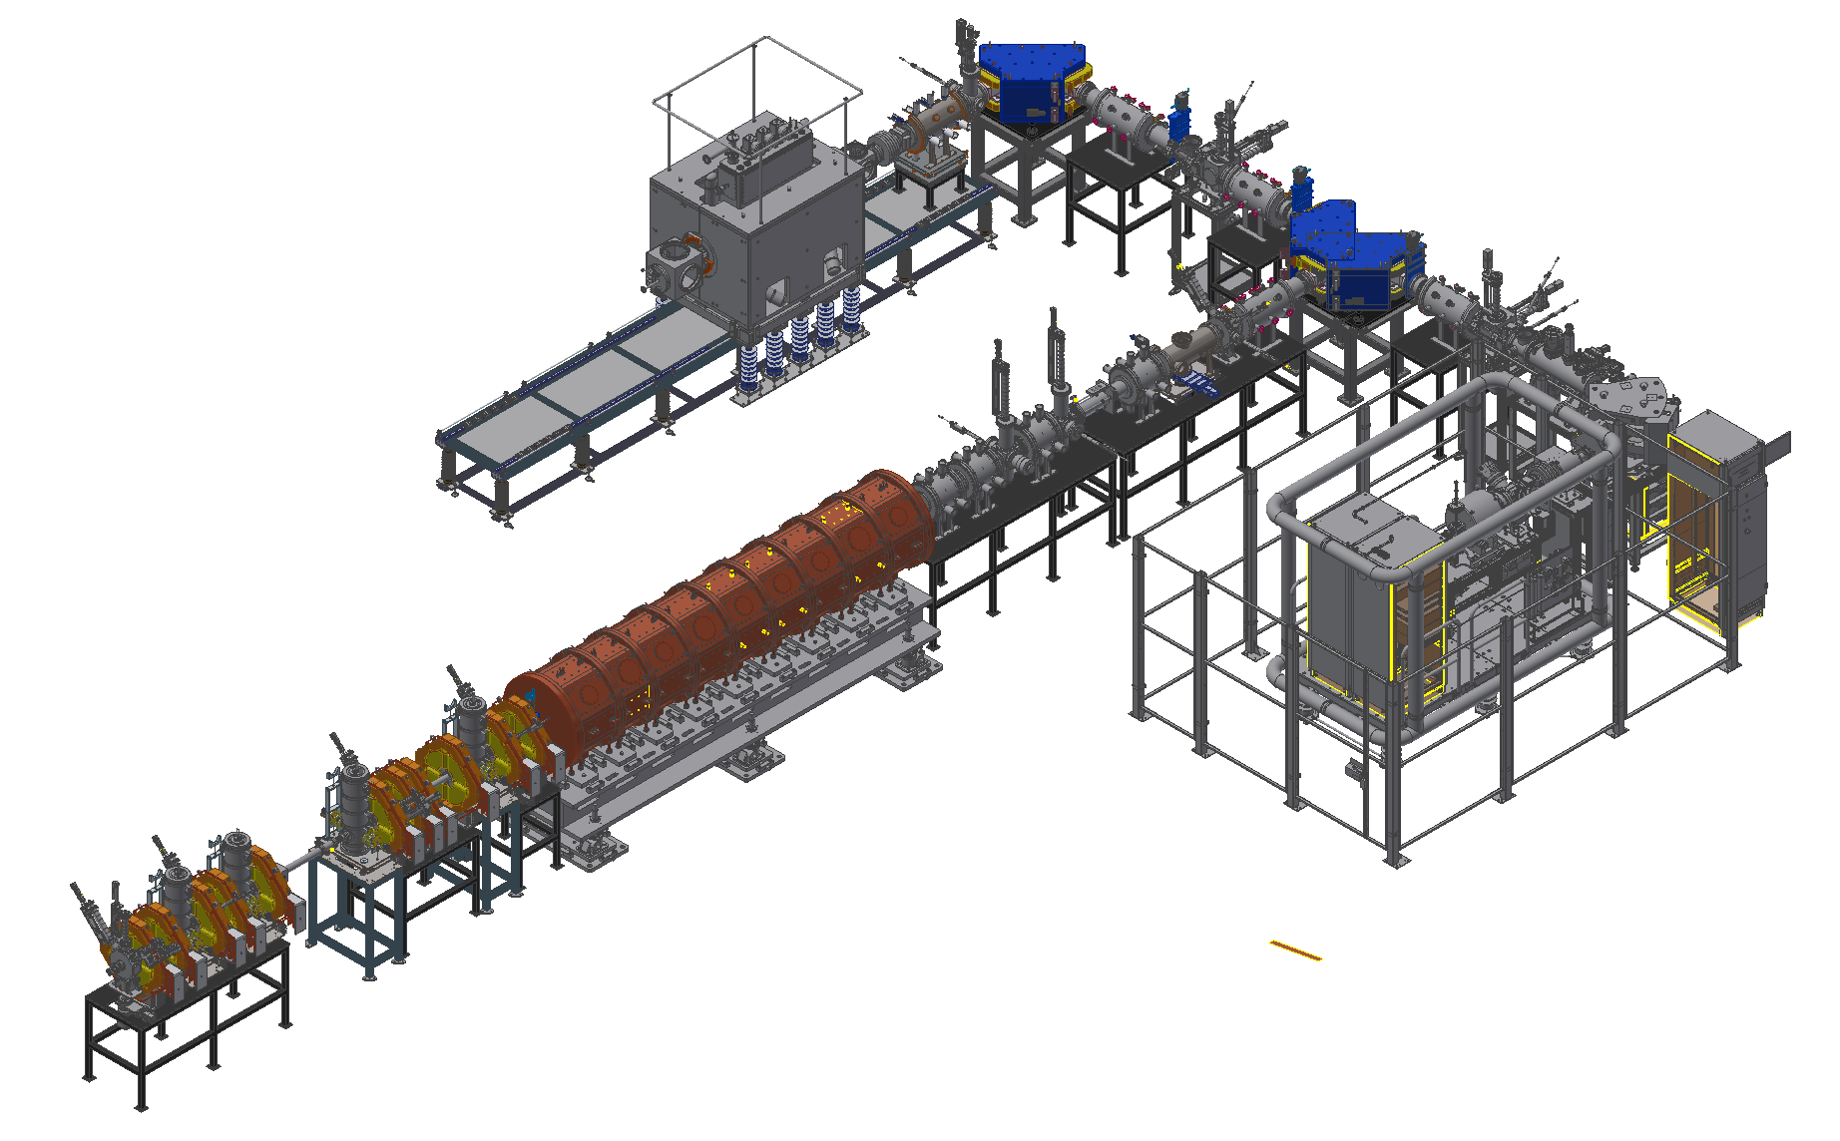
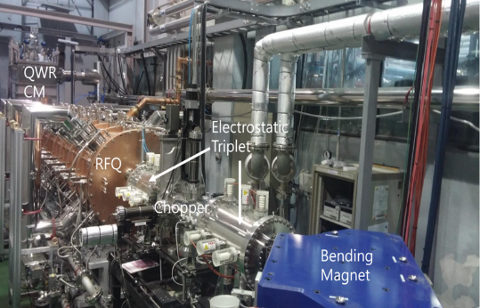
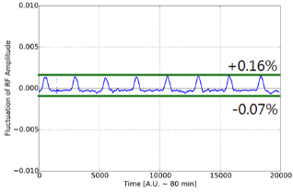
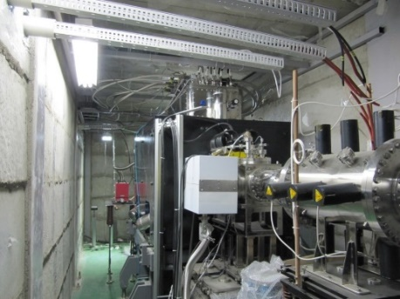
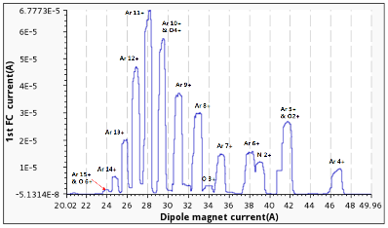
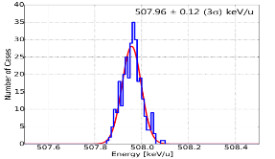
3. Sys. Install.
Accelerator System - Injector
Injector
SC ECRIS
∙ Two ECR ion sources on high voltage platforms
14.5 GHz ECR ion source
28 GHz superconducting ECR ion source
∙ LEBT (E = 10 keV/u)
Beam energy – 10 keV/u, Dual bending magnet
Chopper & Electrostatic quads, Instrumentation
∙ RFQ (E = 500 keV/u)
Frequency 81.25 MHz, Transmission Eff. ~98%
CW RF Power 94 kW (SSPA: 150 kW)
∙ MEBT (E = 500 keV/u)
Four RF bunchers (SSPA: 20, 15, 4×2 kW)
Simple quadrupole magnets, Instrumentation
LEBT
ECRIS
MEBT
RFQ
SC ECRIS commissioning
RFQ commissioning
∙ Beam experiment for the performance enhancement
∙ Basic metal beam experiment
∙ RFQ has been conditioned to 40kW, sufficient to
accelerate A/q=4.5 beams
Amplitude control of RFQ
Ar beam experiment
Charge distribution
QWR CM
ECRIS
Ar 11+ 70uA
RFQ
Output Energy of RFQ(TOF)
~508keV/u

Slide 18
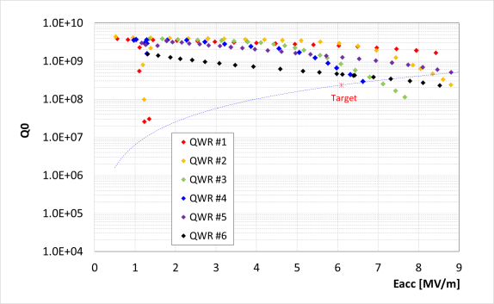
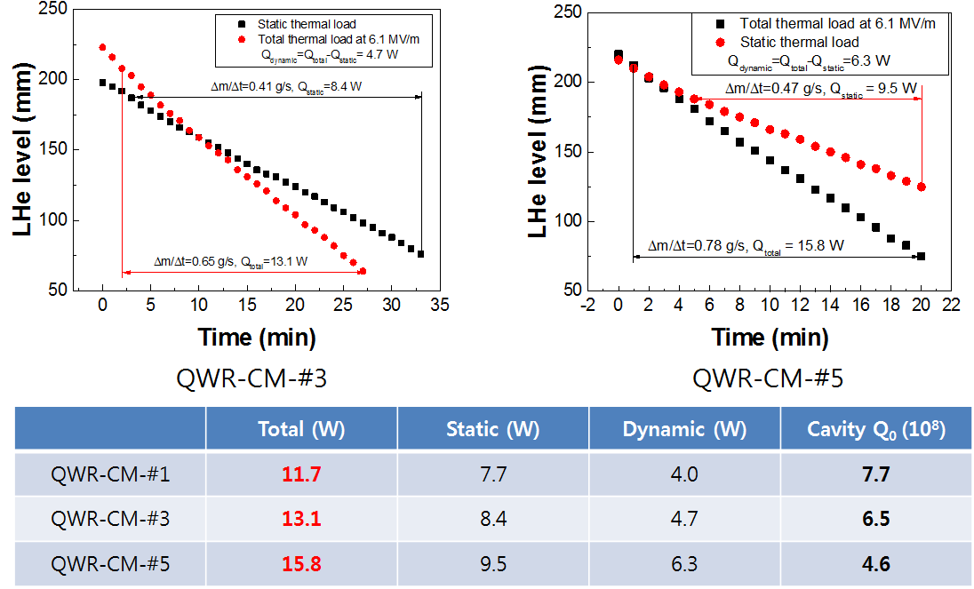
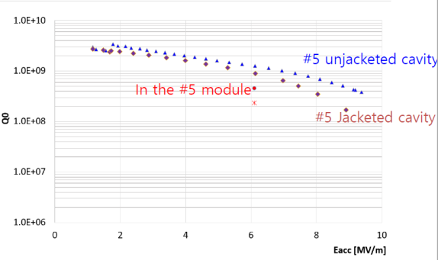
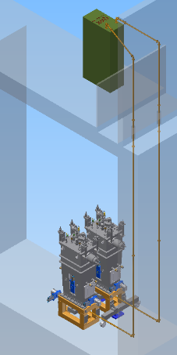
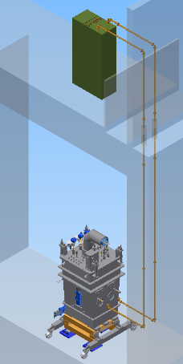



3. Sys. Install.
Accelerator System – SCL3
SCL31(QWR)
∙ Designed performance was achieved with prototypes(2017.5)
∙ Oxygen beam was accelerated with injector and one QWR module(2017.10)
500 keV/u → ~700 keV/u, Successful long-tem operation of cryomdoule
∙ Mass production was contracted with domestic vendor(2017.12)
Pre-production cavities and cryomodules passed qualification
Thermal load <20W@6.1MV/m, 4.2 K
RF System
∙ SSPA (4kW) : 2018.07~2020.04
Prototype performance test
∙ HPRF transmission line (1-5/8”)
Installation start (2019.08)
∙ LLRF control system (2019.07~2020.06)
∙ RF reference line (81.25MHz) : ~2019.12
SCL32(HWR)
∙ Designed performance was achieved with prototypes(2017.10)
Thermal load <14.1W@6.6MV/m, 2.1 K (HWR type A)
∙ Mass production was contracted with domestic vendor(2018.5)
QWR
HWR#A
HWR#B

Slide 19

3. Sys. Install.
Accelerator System – QWR
VT target: 2.4e+8 at 6.1 MV/m

Slide 20

3. Sys. Install.
Accelerator System – HWR
VT target: 2.3e+9 at 6.6 MV/m

Slide 21


3. Sys. Install.
Accelerator System – QWR HT
CM-#2
CM-#5
 | Total (W) | Static (W) | Dynamic (W) | Q₀ of cavity
QWR-CM-#1 | 11.7 | 7.7 | 4.0 | 6.0e+8
QWR-CM-#2 | 10.8 | 8.0 | 2.8 | 8.5e+8
QWR-CM-#3 | 13.1 | 8.4 | 4.7 | 5.1e+8
QWR-CM-#5 | 14.4 | 9.5 | 3.5 | 6.6e+8
All tested cryomodules meet the total thermal load requirement (20 W) though the cryomodules did not thermalized.
NO significant performance degradation of cavities during cryomodule assembly.

Slide 22







3. Sys. Install.
Accelerator System – SCL2
SCL21(SSR1)
∙ 1st prototype was manufactured by TRIUMF(2019.6)
Balloon type(less multipacting, better mechanical characteristics)
Accelerating gradient over 8.7MV/m, Multipacting below 2MV/m
∙ 2nd prototype with domestic vendor is under fabrication
RF System
∙ SSPA (8, 20 kW): 2020.01~2021.06
Requirement for RF power being optimized
∙ HPRF transmission line
3-1/8”, 4-1/16” rigid coaxial
∙ LLRF control system (2020.04~2021.06)
∙ RF reference line (81.25MHz) : ~2020.12
1st prototype
Deep drawing of half shell
SCL22(SSR2)
∙ 1st prototype of cavity is under fabrication
Designed by RISP, being fabricated by domestic vendor
Balloon type, Deep drawing (depth ~280mm)
∙ 2nd prototype with IHEP is in design stage
Cylindrical type
RISP design(balloon type)
SSR1
SSPA Prototype

Slide 23



SCL3 Warm Section – Chamber and magnets
3. Sys. Install.
Diagnostic chamber
∙ 15 sets were already fabricated.
- BPMs, Wire scanners and Faraday cups
∙ Need to assemble in the clean condition
Vacuum chamber
∙ 53 sets were are already fabricated.
- NEG pumps and gauges
∙ Need to assemble in the clean condition
Magnets

Slide 24

3. Sys. Install.
Accelerator System

Slide 25


3. Sys. Install.
Accelerator System
Until September `2020

Slide 26

3. Sys. Install.
Accelerator System-QWR unit
QWR Cryomodule
Valve Box
Warm Section

Slide 27





3. Sys. Install.
Installation Procedure
Alignment network Survey (2019. 4 ~ )
Transportation to the accelerator building

Slide 28




3. Sys. Install.
Installation Procedure
Warm section assembly
Rinse
Dry
class 100
Assemble
class 10
Leak check
class 100
(150℃, 120h)
Conditioning

Slide 29


3. Sys. Install.
Installation Procedure
Cryomodule + Warm section
∙ Assemble in front of the tunnel (ISOL building)
∙ 15-ton crane is available.
∙ Need to connect between cryomodule and warm section in the clean condition

Slide 30



3. Sys. Install.
Installation Procedure
Transport and positioning in the tunnel
∙ To prevent alignment change due to vibration
∙ To transport 10-ton HWR-B cryomodul in the tunnel
∙ For fine positioning
Impossible to use wheels
Adopting air caster

Slide 31

3. Sys. Install.
Installation Procedure
Launching celebration of the 1st QWR cryomodule installation

Slide 32


3. Sys. Install.
Installation Procedure
(Cryomodule + Warm section) + (Cryomodule + Warm section)
∙ At least one port should be assembled in the tunnel
∙ Difficult to make clean conditions due to the tight space
∙ Design a simple clean booth is underway

Slide 33




3. Sys. Install.
Cryogenic System
Now
Tasks | 2019 |  |  |  |  |  |  | 2020
 | 6 | 7 | 8 | 9 | 10 | 11 | 12 | 1 | 2 | 3 | 4 | 5 | 6 | 7 | 8 | 9 | 10 | 11 | 12 | 1
SCL3 Cryoplant (4.2 kW) SCL2 Cryoplant (13.4 kW) Cryogenic Distribution System (SCL3)
Installation and Inspection
Commissioning
Design and Fabrication
Installation & Inspection
Fabrication (QWR)
Fabrication
(HWR and end box)
Prototype test
Installation (valve boxes)
Installation (transfer line)
SCL3 Commissioning
Connection ( Valve Box – Cryomodule )
Inspection
15 m
19.5 m
SCL3 Cold Box (95 ton)
SCL2 Cold Box (130 ton)
QWR Valve Box

Slide 34










3. Sys. Install.
Control System
Control Center
Integrated Control System
Fast Protection System
Timing System
Local Control System
15m
Display Wall
Beam Diagnostics Control System
Data Storage System
SCL3 Control System
Embedded EPICS IOC Controller

Slide 35

















3. Sys. Install.
RI & Experimental System
Bio-medical facility
Neutron Facility
HPMMS
CLS
mSR
Low Energy Exp. Bldg
Ultra-low Exp. Bldg
High Energy Exp. Bldg
ISOL
KOBRA
IF
LAMPS

Slide 36


3. Sys. Install.
ISOL system
TIS.L→ Pre-sep → HRMS → user
TIS.R→ Pre-sep. → Mass sep. → HRMS → user
TIS→ Pre-sep. → HRMS → EBIS → a/q→post acc.
Test Facil. (low pow., non U) → Pre-sep → user
Now concentrating on the shortest line
TIS.L → Pre.sep → EBIS → A/q → Post.acc
A/Q separator line
Branch point
MMS
RFQ-c/b + EBIS
ISOL building ready by ‘19.12
- Ground floor: TIS, beamline,
experimental hall
- 1st floor: experimental hall, Laboratory, utilities
- 2nd floor: Control room, Analysis room
Line 1
HRMS
Line 2
Early stage operation
Bunker-L
Bunker-R
pre-mass
separator room L
TIS-L
TIS-R
pre-mass
separator room R

Slide 37

3. Sys. Install.
IF system
In-Flight separator layout

Slide 38

3. Sys. Install.
Layout of Experimental System at RAON
Nuclear science - KOBRA, LAMPS, NDPS, MMS, CLS (based on atomic physics)
Applied science - μSR (Material science), BIS (Bio & Medical application)
7 (at the beginning of RAON operation) + upgrade + α (in the future, space reserved)

Slide 39










3. ACC. & Exp.
Current Status of Experimental System
3. Sys. Install.
1. KOBRA
(KOrea Broad acceptance Recoil spectrometer & Apparatus)
∙ Research Studies of nuclear structure and nuclear
astrophysics in the energy range of < a few tens of MeV/u
∙ Current status Under fabrication (start installation from Sep. 2019)
2. LAMPS
(Large Acceptance Multi-Purpose Spectrometer)
∙ Research Studies of nuclear matter and nuclear reactions
with stable and RI beams at intermediate energy regime
∙ Current status Under fabrication (start installation from Jan. 2021)
IF separator

Slide 40








3. ACC. & Exp.
Current Status of Experimental System
3. Sys. Install.
3. MMS (Mass Measurement System)
4. CLS (Collinear Laser Spectrometer)
5. NDPS (Neutron Data Production System)
∙ Research High precision mass measurement of
short lived rare isotopes
∙ Current status Under assembly and test
(start installation from Feb. 2020)
∙ Research Model independent Studies of
nuclear ground and isomeric state properties
∙ Current status Restart development
(start installation from Jan. 2020)
∙ Research Measurement of neutron
induced reaction data for nuclear science
∙ Current status Restart development
(start installation from Jan. 2021)
MR-TOF-MS
6. μSR (Muon Spin Rotation/Relaxation/Resonance )
7. BIS (Beam Irradiation System)
∙ Research Studies of local electromagnetic structures and
exotic properties of material by using polarized muons
∙ Current status Restart development
∙ Research Biomedical studies such as cancer treatment,
human body effect by space radiation and cell mutation
∙ Current status Restart development
(start installation from Nov. 2020)
(start installation from Feb. 2021)

Slide 41
Scientific program at early phase operation(candidate)
3. Sys. Install.
Facility | Subject for early phase operation
KOBRA | ∙ Transfer reaction measurements in inverse kinematics (²⁹P(d,p)³⁰P, ²⁶Al(α,p)²⁴Si) ∙ Radiative capture reactions using batch mode RI beams (^{26g}Al(p,γ)²⁷Si) ∙ RI beam production via quasi-projectile-like fragmentation for ¹⁶O or ⁴⁰Ar
LAMPS | ∙ Ar+KCl or Xe+CsI in case of IF separator commissioning not completed
MMS | ∙ Isomer separation with using ^{26g.s.}Al and ^{26m}Al beams
CLS | ∙ Laser ionization and measurement of isomeric property for ²⁶Al
NDPS | ∙ Activation experiments with a quasi mono energy neutrons for light and heavy nuclei ∙ Surrogate reactions for fission
μSR | ∙ One of research areas of superconductivity and quantum magnetism with their scientific significance at the time of the μSR instrument completion
BIS | ∙ Physical dose distribution and linear energy transfer measurements with a ¹²C⁺⁶ beam (310 MeV/u)

Slide 42








3. Sys. Install.
International Cooperation (MOUs with 18 Intl Institutes)
27

Slide 43
Part 4.
Summary & Outlook

Slide 44
4. Summary
Summary & Outlook
Accelerator
Mass production for SCL3 is under way
SCL2 is under pre-production phase
From April, 2019, installation for SCL3 has been started
By the end of 2021, we will achieve
SI beams: Stable ion beams (¹⁶O, ⁴⁰Ar) from ECRIS → SCL3 → low E exp hall
RI beams: RIBs extraction from ISOL → re-acceleration through SLC3 → low E exp hall
Stable / RI beams will be delivered to low-E experimental hall
Early phase experiments are going to be performed using KOBRA
  RIBs production at KOBRA (A<~50, beam energy < 20 MeV/u) using SI beams from SCL3
Beam commissioning starts for SCL2
Installation and commissioning for IF, LAMPS, Neutron, bio-medical and muSR
  → Collaborative works with RUA (RAON Users Association) via RULC (RAON Users Liason Center)
Post RISP (2021 ~ )
Beam acceleration for ISOL → SCL3 → SCL2 → IF (ISOL+IF)
Beam commissioning and experiments for IF, LAMPS, Neutron, bio-medical and muSR
Ramping-up to get the 400kW beams (more than 5 yrs)
Energy upgrade to 400MeV/u (requires budget)

Slide 45

Thank you

