Slide 1
Group Meeting
2019/03/29
김지석

Slide 2
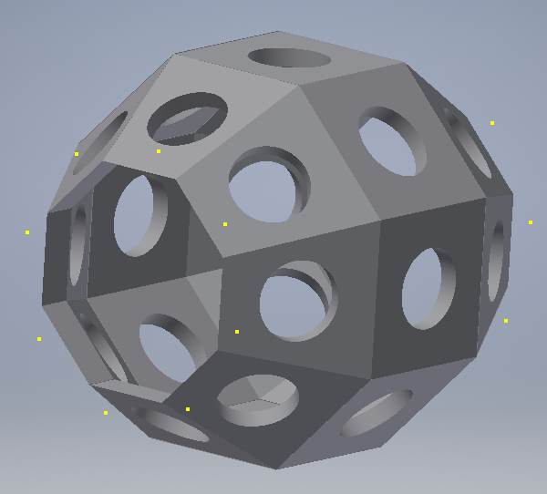
Supporting Structure
Supporting structure
for $LaBr_{3}$ detector

Slide 3
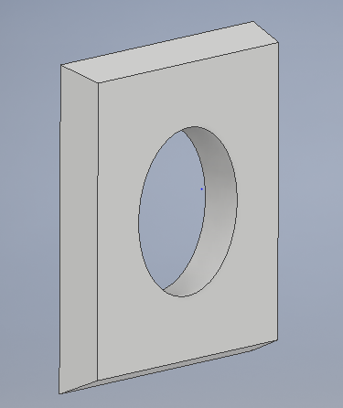
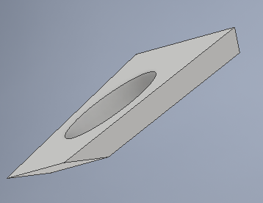
Structure Components
Middle components
Forward & Backward components
Hole diameter = 44.0 mm

Slide 4
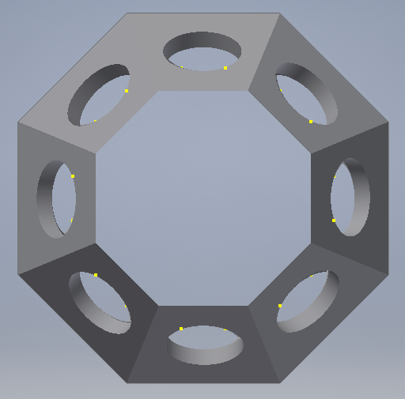
Supporting Structure(Forward)
Measuring $45˚$ each

Slide 5
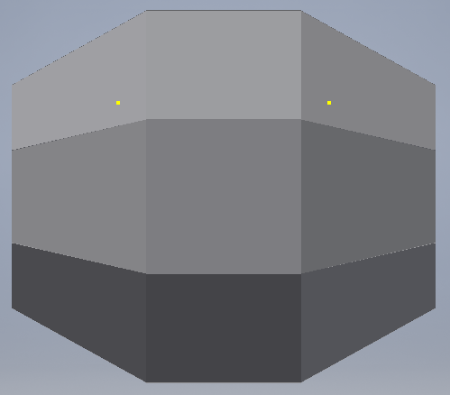
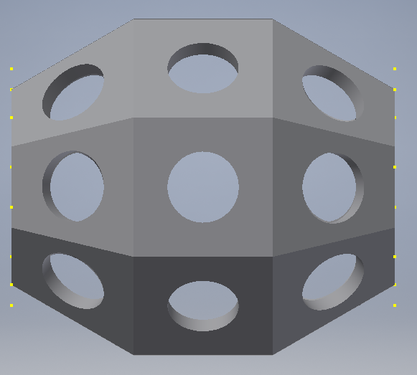
Supporting Structure(Sideway)
Measuring $30˚$ each

