Slide 1
Group Meeting
2019/03/15
김지석

Slide 2
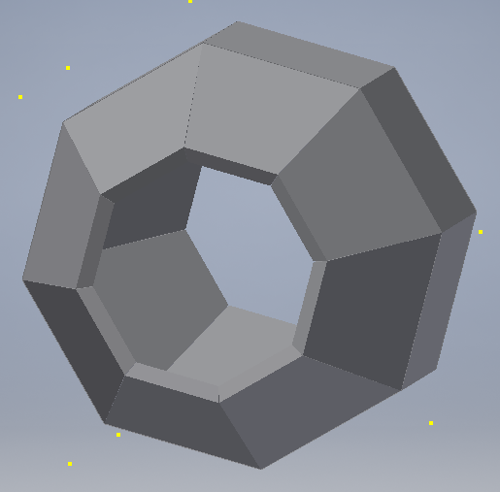
Supporting Structure
Supporting structure
for $LaBr_{3}$ detector

Slide 3
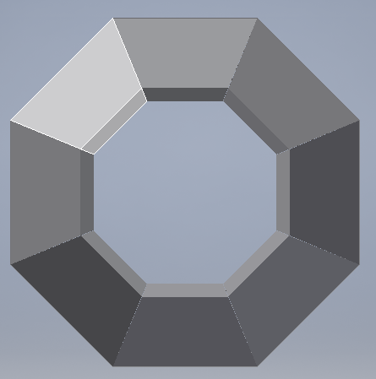
Supporting Structure(Forward)
Measuring 45 degrees each

Slide 4
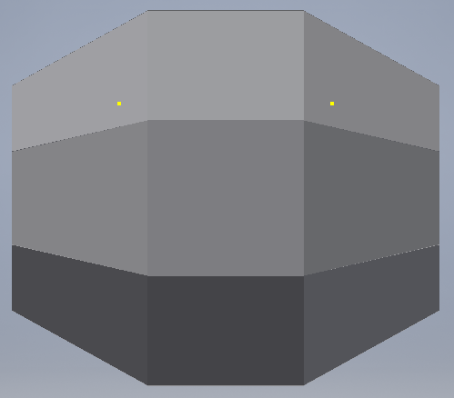
Supporting Structure(Sideway)
Measuring 45 degrees each

