Slide 1
Status of
LAMPS Time Projection Chamber
이효상
LAMPS kick-off meeting
2018.07.31

Slide 2
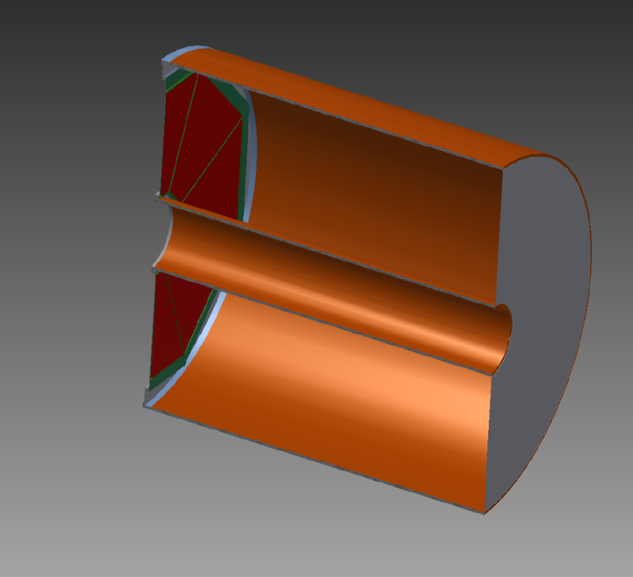
Concept of LAMPS TPC
LAMPS
Neutron detector array
Readout PAD
Outer Field Cage
Solenoid spectrometer
Solenoid magnet
Triple GEM
Gas volume
ToF
15cm
Cathode
TPC
30cm
Target
Target
50cm
Inner Field Cage
120cm
Time Projection Chamber (TPC)
- main detector for tracking of charged particles
- inside of Solenoid magnet
- complete information of momentum & PID
- Gas Electron Multiplier (GEM)
- FrontEnd electronics : GET system

Slide 3
History of LAMPS TPC R&D
LAMPS
Small GEM test
- GEM gain test : Fe55 & Cosmic-ray muon
- reduced CoBo system
Prototype TPC test
- prototype TPC design and making
- muon test : drift velocity
- positron beam test : drift velocity, diffusion and position resolution
- CoBo system with Narval DAQ
Large GEM test
- similar size of LAMPS TPC GEM
- modified CMS GEM
- GEM gain
- gain uniformity
- gain as gas
- gain as number of GEM layers

Slide 4
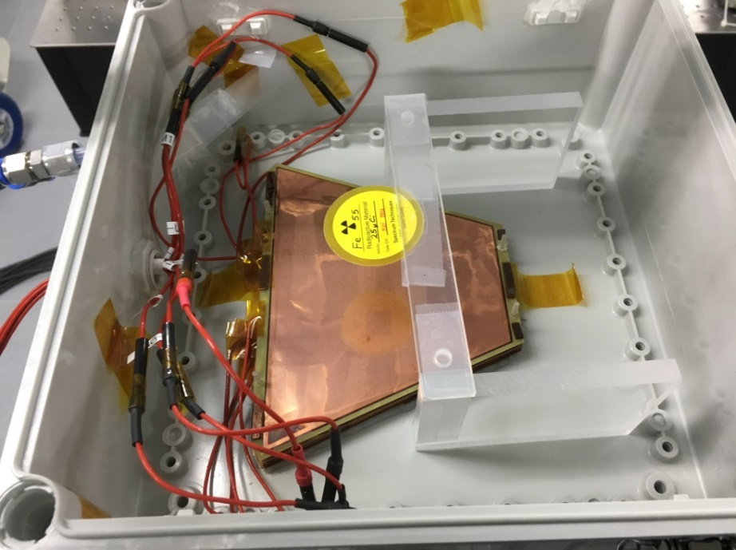
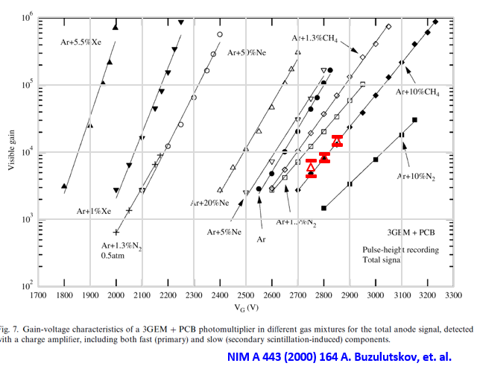
Small GEM gain test
LAMPS
GEM gain-voltage characteristic of Triple GEM (2mm)
Fe55 source
5.9keV
Triple GEM

Slide 5
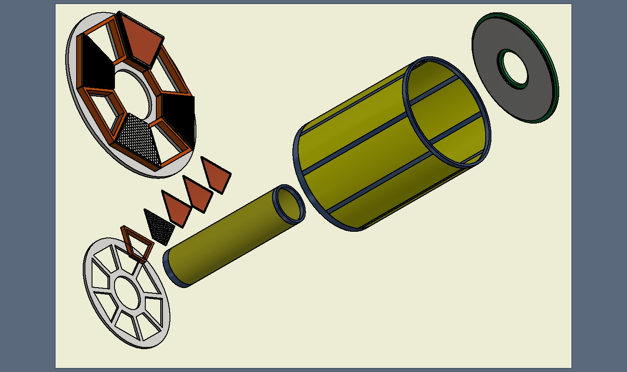
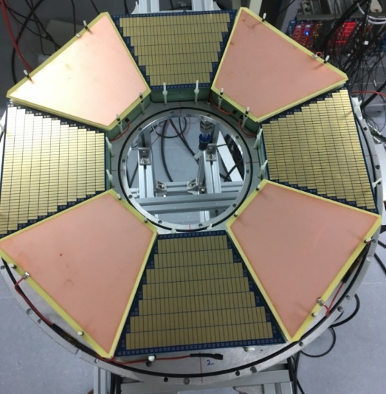
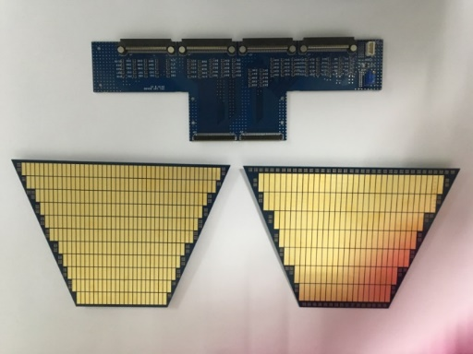
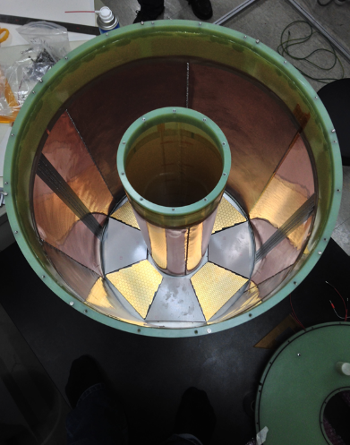
Prototype TPC for LAMPS
LAMPS
Readout PAD
1/8 volume of real TPC design
Outer Field Cage
GEM : 3 layers
Cathode
PAD
Drift length : 570 mm
3x10
357ch
4x15
175ch
150 mm
Inner Field Cage
Field Cage
490 mm
Bottom to fix PAD & GEM : Al
Concept of prototype TPC for LAMPS
Optimized design & fabrication method : 1/8 volume of real TPC
Honeycomb body for gas chamber
PAD : 3x10 mm², 4x15 mm²
GEM : GEM gain test, produced by Korean company (MECARO)
Field cage : Uniform electric field by cu strip
Readout system : GET system
Analysis : Development of reconstruction algorism

Slide 6
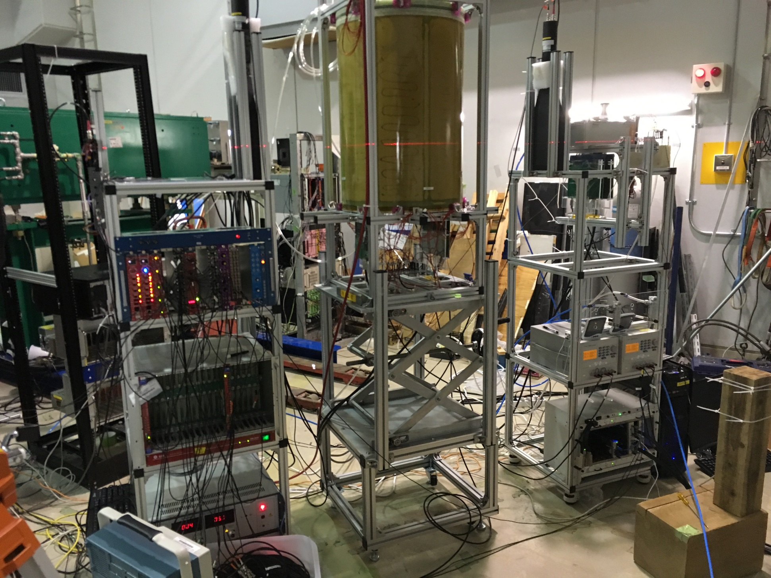
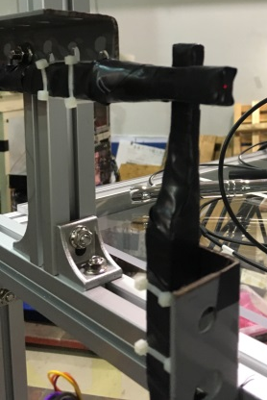
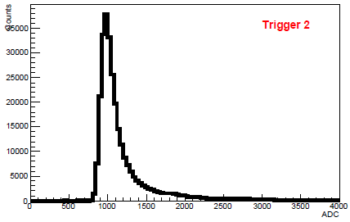
ELPH beam test setup
ELPH Beam test
Trigger counter 1
Plastic scintillators
1cm x 1cm
TPC
Trigger counter 2
Plastic scintillator
4cm x 4cm
TPC readout
GET system
μ-TCA
AsAd board
Electronic & DAQ
Trigger logic
VME DAQ
HV system
PNC 3500 (GEM)
PNC 60000 (FC)

Slide 7
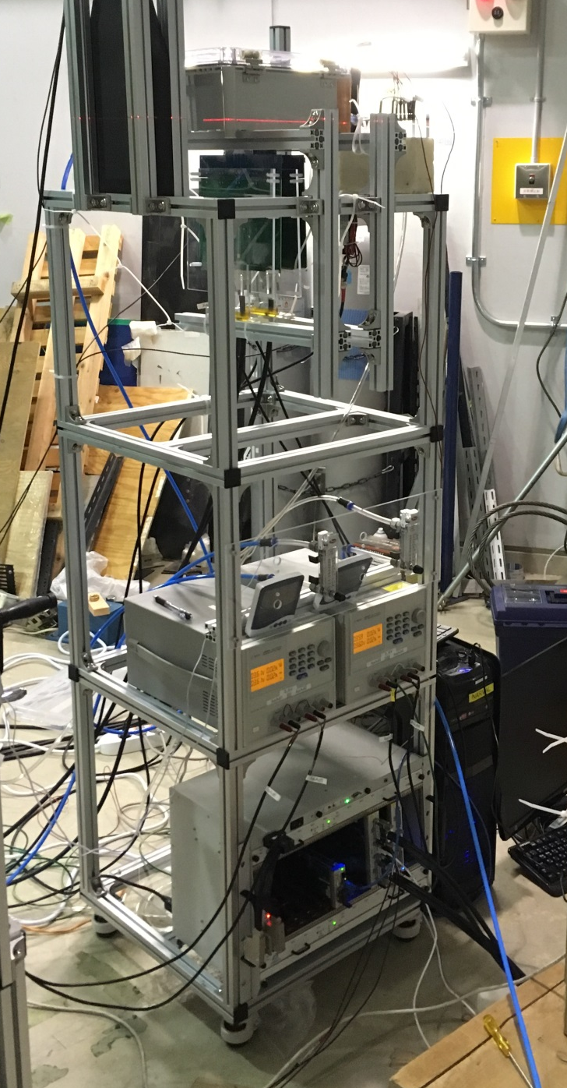
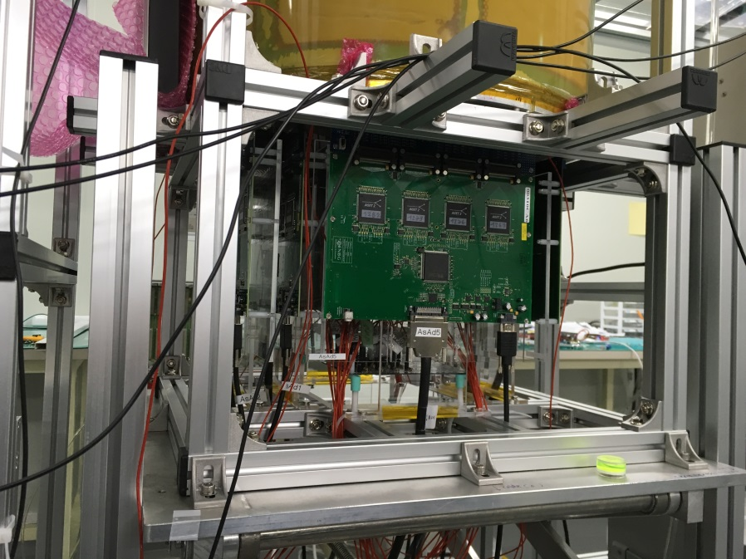
TPC readout system
ELPH Beam test
Small test chamber with 3x10 PAD
AsAd board
Gas flow meter
Low Voltage for AsAd
Run summary
- beam time : 2days (12h+12h)
- positron beam
- beam height @ TPC
: 20.24cm, 35.24cm, 50.24cm
- test gas : Ar-CH4(90:10), Ar-CO2(90:10)
- Electric field of FieldCage
: 115, 125, 135, 145, 155V/cm – P10
170V/cm – ArCO2
- Operating HV @ GEM : 345V
μ-TCA
1CoBo + 4AsAd

Slide 8
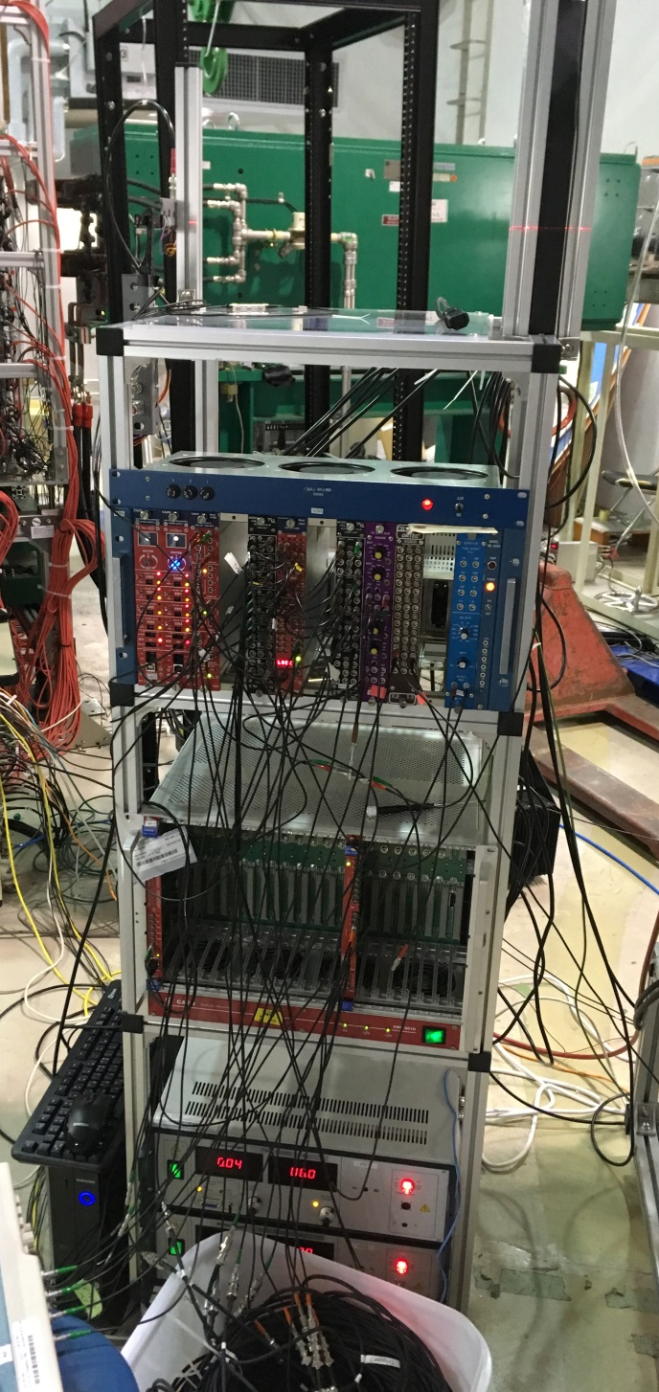
Trigger system
ELPH Beam test
Trigger logic
- Coincidence of 6 trigger counters
- monitor trigger counting @ control room
Trigger 1
Trigger 2
Trigger 3
Trigger 4
Trigger 5
Trigger 6
Linear Fan out
LED
Coin.
Level=2
Coin.
Level=4
Gate Generator
Linear Fan out
20ns delay
Veto
Coin.
Level=4
Gate Generator
Fan In/Out
+1
Fan In/Out
-1
Fan In/Out
-1
Trigger output pulse
busy out
CoBo0,1
GG8020
External trigger in
Analog
AsAd 1,2,3,4,6
NIM
TTL
LAMPS TPC prototype
VME
V792N
Delay signal : 100ns
Gate : width=200ns
VME DAQ for trigger counter ADC
V792N

Slide 9
Event display
LAMPS TPC
Raw signal
X vs Y
Z vs Y
ADC
Time Bucket (ch)
X @ front
X @ rear
50.24cm
35.24cm
20.24cm
X position
Track direction
@ front
@ rear

Slide 10
Drift Velocity
Test result
Measurement of Drift velocity
ELPH Beam test
- Beam height : 20.24cm, 35.24cm, 50.24cm
- Gas : Ar-CH4(90:10), Ar-CO2(90:10)
- Electric field
115V/cm ~ 155V/cm for Ar-CH4(90:10)
170V/cm for ArCO2
Cosmic-ray muon test
- trigger counter : 4cm & 20cm
- Gas : Ar-CH4(90:10), Ar-CO2(80:20)
- Electric field
155V/cm ~ 175V/cm for Ar-CH4(90:10)
155V/cm ~ 205V/cm for Ar-CH4(80:20)
Drift velocity as TPC electric field
P20 : 6.77 cm/μs @ 205 V/cm
P10 : 5.25 cm/μs @ 155 V/cm
Drift Time distribution as beam height @ ELPH test
Counts
ArCO2 : 1.06 cm/μs @ 170 V/cm
Time Bucket (ch)

Slide 11
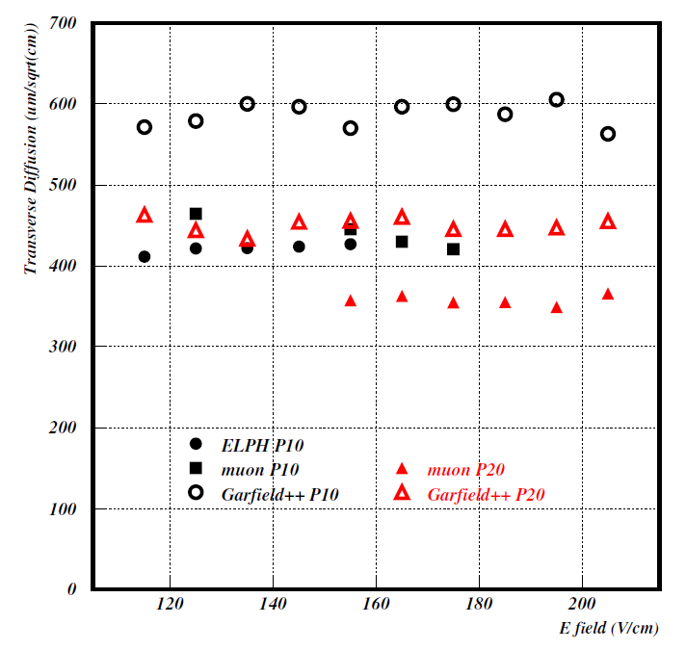

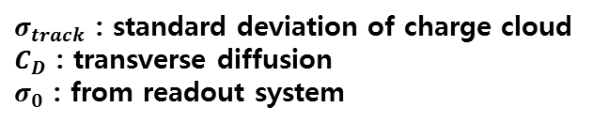

Diffusion
Test result
$σ_{track}^{2}$ = $σ_{0}^{2}$ + $C_{D}^{2}∙z$
$σ_{track}$ : standard deviation of charge cloud
$C_{D}$ : transverse diffusion
$σ_{0}$ : from readout system
P10 : 420 $μm/\sqrt{cm}$ @ 155 V/cm

Slide 12
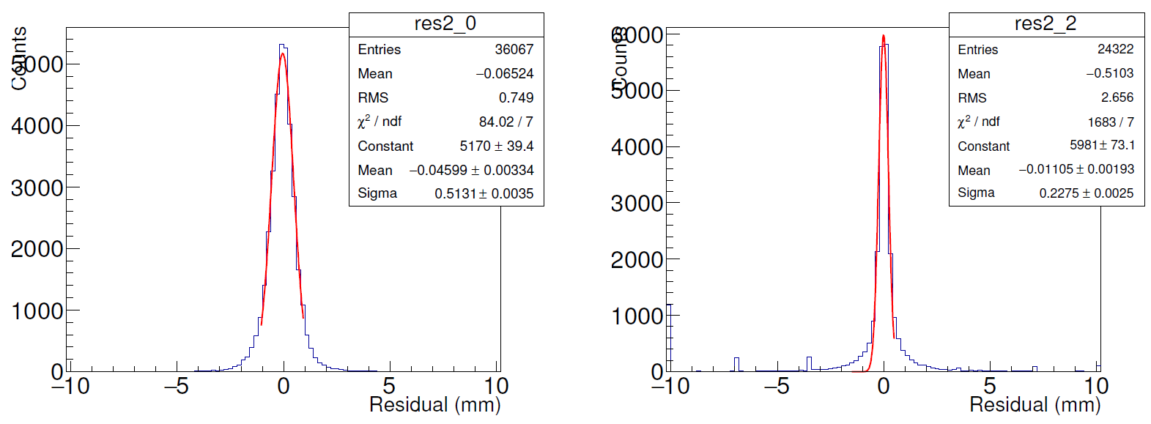
Position resolution
Test result
e+
4x15 mm² PAD
3x10 mm² PAD
Resolution : 513μm
Resolution : 228μm

Slide 13
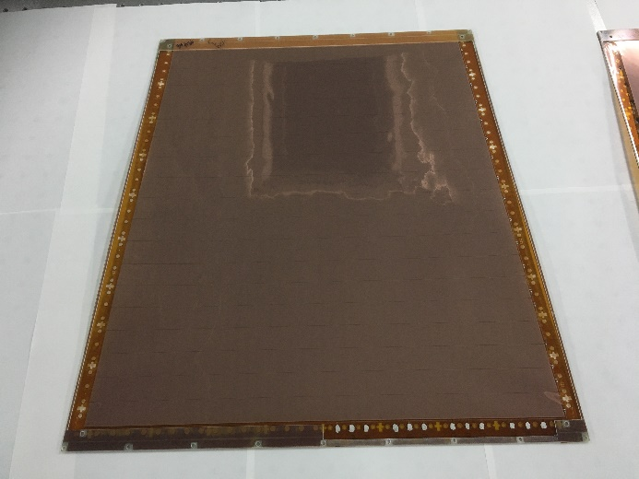
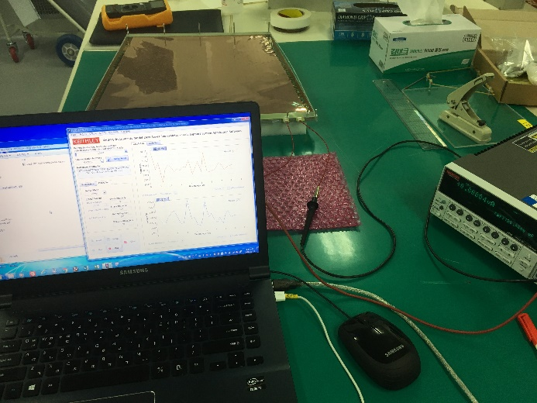
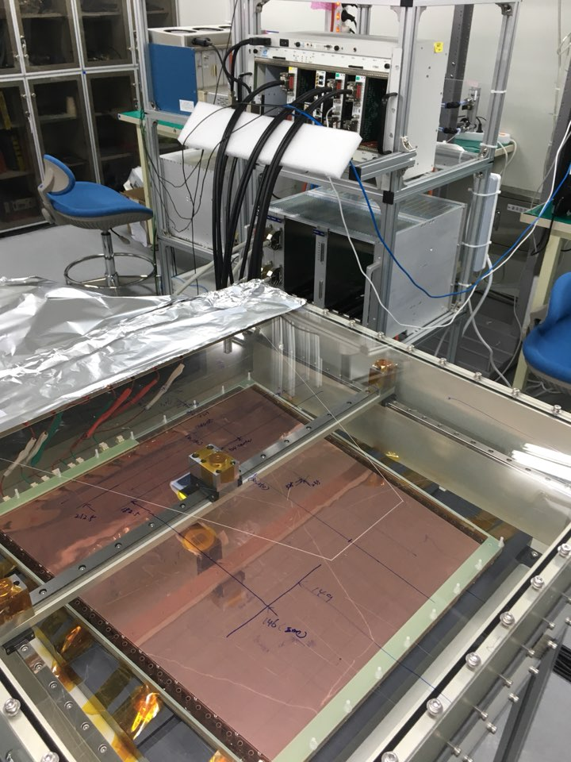
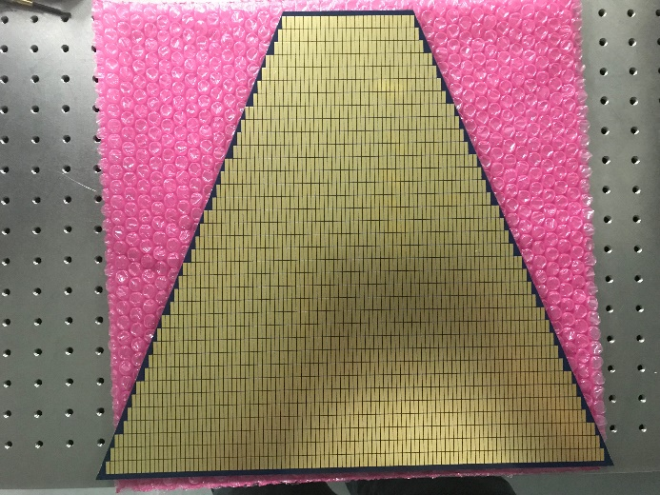
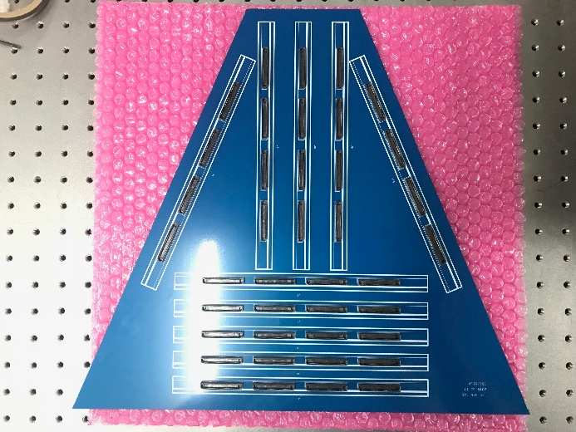
Large GEM test
LAMPS
Large GEM
Leakage current measurement
Large GEM test bench
PAD
PAD

Slide 14
Large GEM test
LAMPS
Fe55 event
muon event

Slide 15
Large GEM test
LAMPS

Slide 16
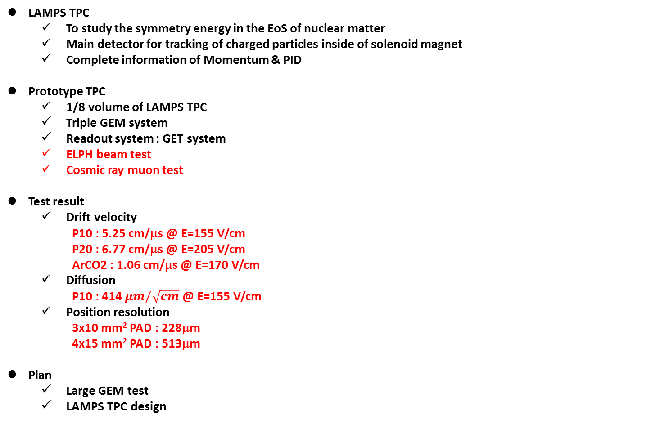
Summary
LAMPS TPC
  To study the symmetry energy in the EoS of nuclear matter
  Main detector for tracking of charged particles inside of solenoid magnet
  Complete information of Momentum & PID
Prototype TPC
  1/8 volume of LAMPS TPC
  Triple GEM system
  Readout system : GET system
  ELPH beam test
  Cosmic ray muon test
Test result
  Drift velocity
  P10 : 5.25 cm/μs @ E=155 V/cm
  P20 : 6.77 cm/μs @ E=205 V/cm
  ArCO2 : 1.06 cm/μs @ E=170 V/cm
  Diffusion
  P10 : 414 $μm/\sqrt{cm}$ @ E=155 V/cm
  Position resolution
  3x10 mm² PAD : 228μm
  4x15 mm² PAD : 513μm
Plan
  Large GEM test
  LAMPS TPC design

