Slide 1

Concluding Remarks
Hermann Wolter
University of Munich
8th International Symposium on Nuclear Symmetry Energy (NuSYM2018)
Busan, South Korea, September 10 - 13, 2018

Slide 2
The grand picture
NuSym (since 2010)
Astrophysics
Nuclear Physics
Neutron star (NS),
Supernovae (CCSN)
Lab exp. and interpretation
Many-body theory
Heavy ion collisions (HIC)
Nucl. Structure and QE react.
Facilities and detectors
Transport theory
1-body obs.
- flow
- particles, π, K
Beyond 1-body
- Fluctuations, fragmentation
- Correlations and light clusters (LC)
- Short-range correaltions (SRC)
- NuSym2018 has triggered interesting discussions of all of these
- impossible to summarize everything
- remarks, where I see important developments and needed improvements

Slide 3
The grand picture
NuSym (since 2010)
Astrophysics
Nuclear Physics
Neutron star (NS),
Supernovae (CCSN)
Lab exp. and interpretation
Many-body theory
Heavy ion collisions (HIC)
Nucl. Structure and QE react.
Facilities and detectors
Transport theory
1-body obs.
- flow
- particles, π, K
Beyond 1-body
- Fluctuations, fragmentation
- Correlations and light clusters (LC)
- Short-range correaltions (SRC)
- NuSym2018 has triggered interesting discussions of all of these
- impossible to summarize everything
- remarks, where I see important developments and needed improvements

Slide 4
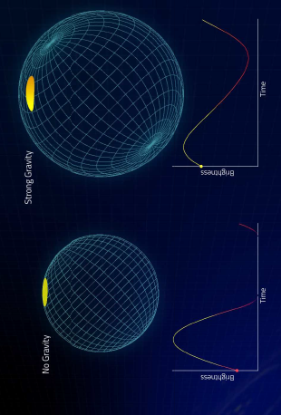
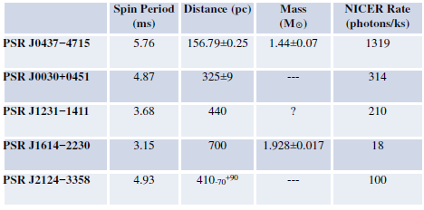
M/M•
M_{max} must be reached
by valid EoS
Astrophysics: symbiosis competition
main motivation some very precise constraints
•
•
Two solutions with same mass:
„Twin“ conjecture:
quark phase transition in the NS core (Blaschke et al.)
{M,R} measurement
would be fix point
for all EoS
{M,R} determination not yet very precise
(Steiner, Lattimer, Brown)
R [km]
However, NICER will change this (Bogdanov):
Improvement of the data,
determine M and R,
independent of NS atmospheric model
Demorest pulsar

Slide 5
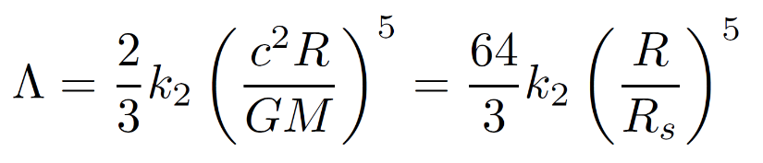
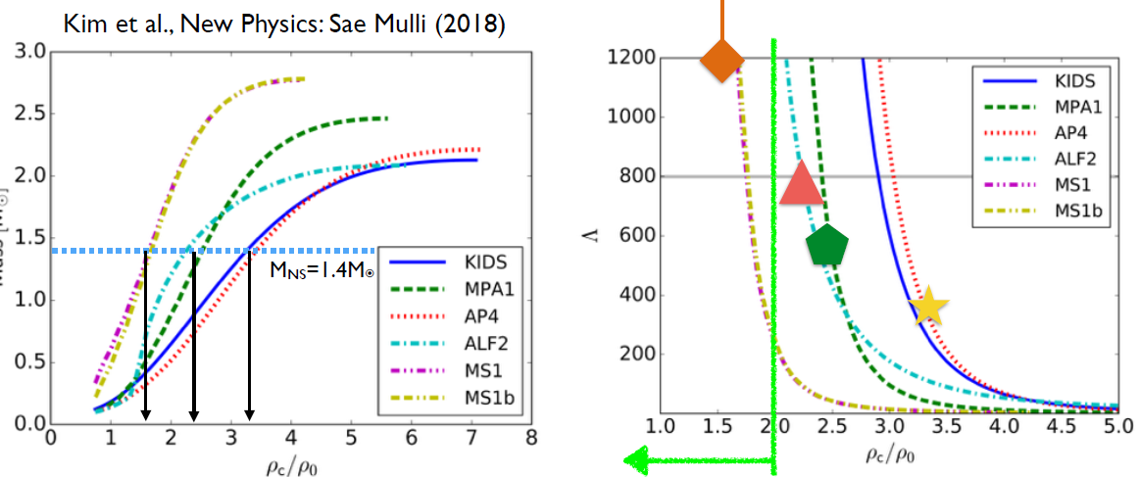
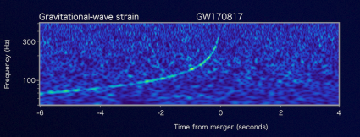
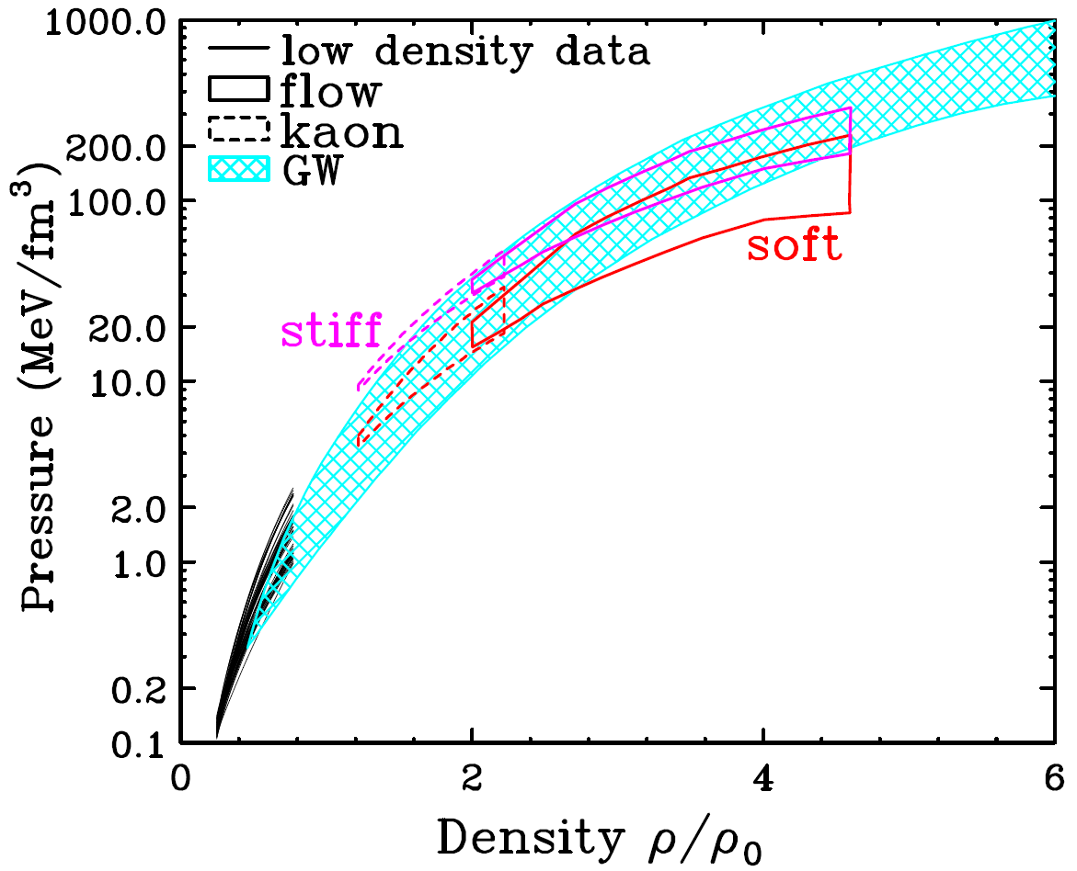
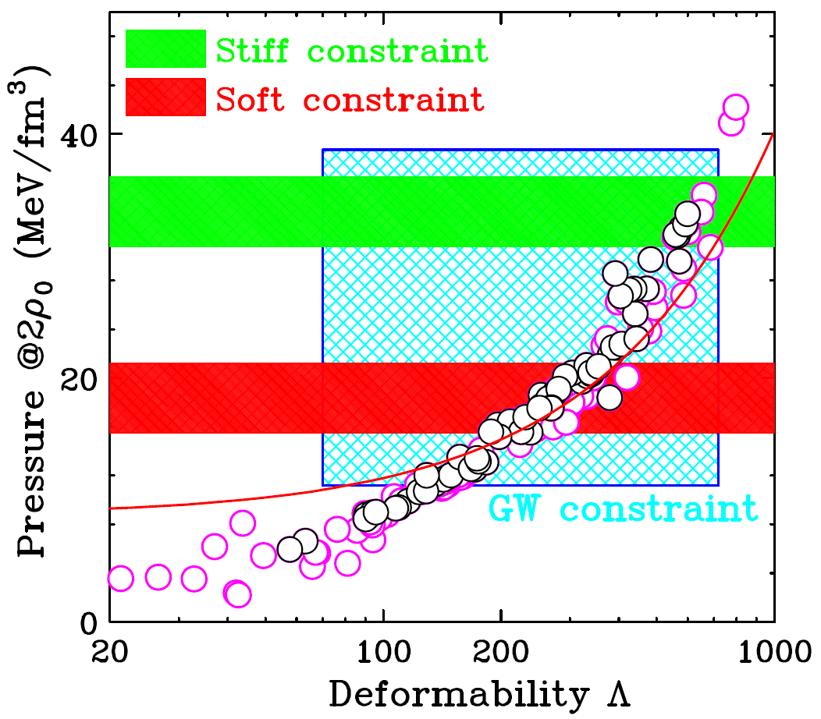
New Era of NS mergers
{M,Λ} is also a fix-point for any EoS
From Y.M. Kim
Constrain EoS from NS merger and HIC: not yet very constraining, but more events may change this.
from B. Tsang,
similar
Alvarez-Castillo
S. Choi
GW170817
arXiv:1805.11581 (2018)

Slide 6
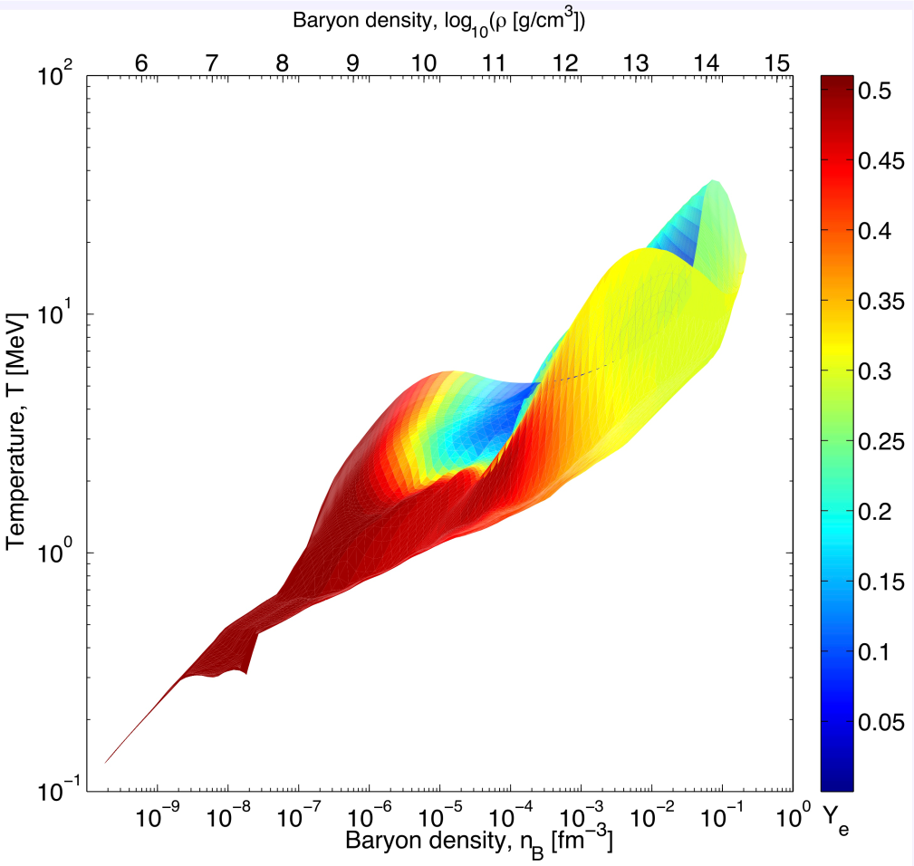
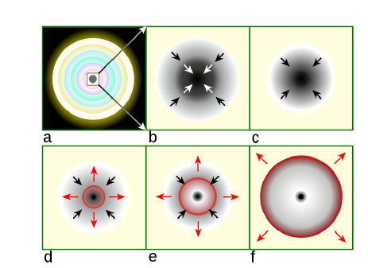
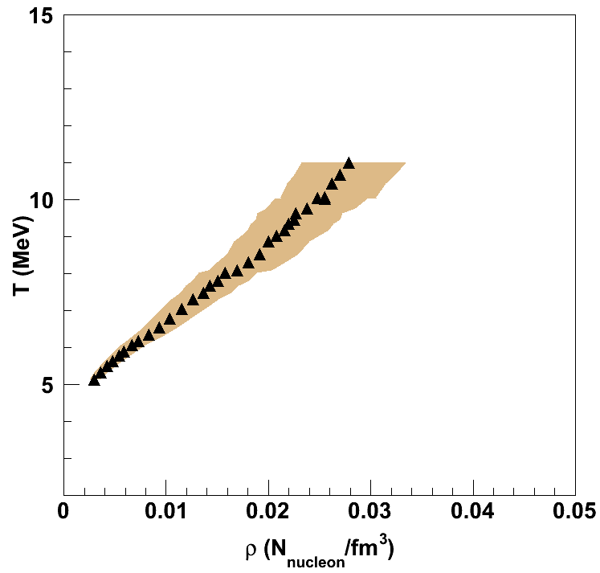
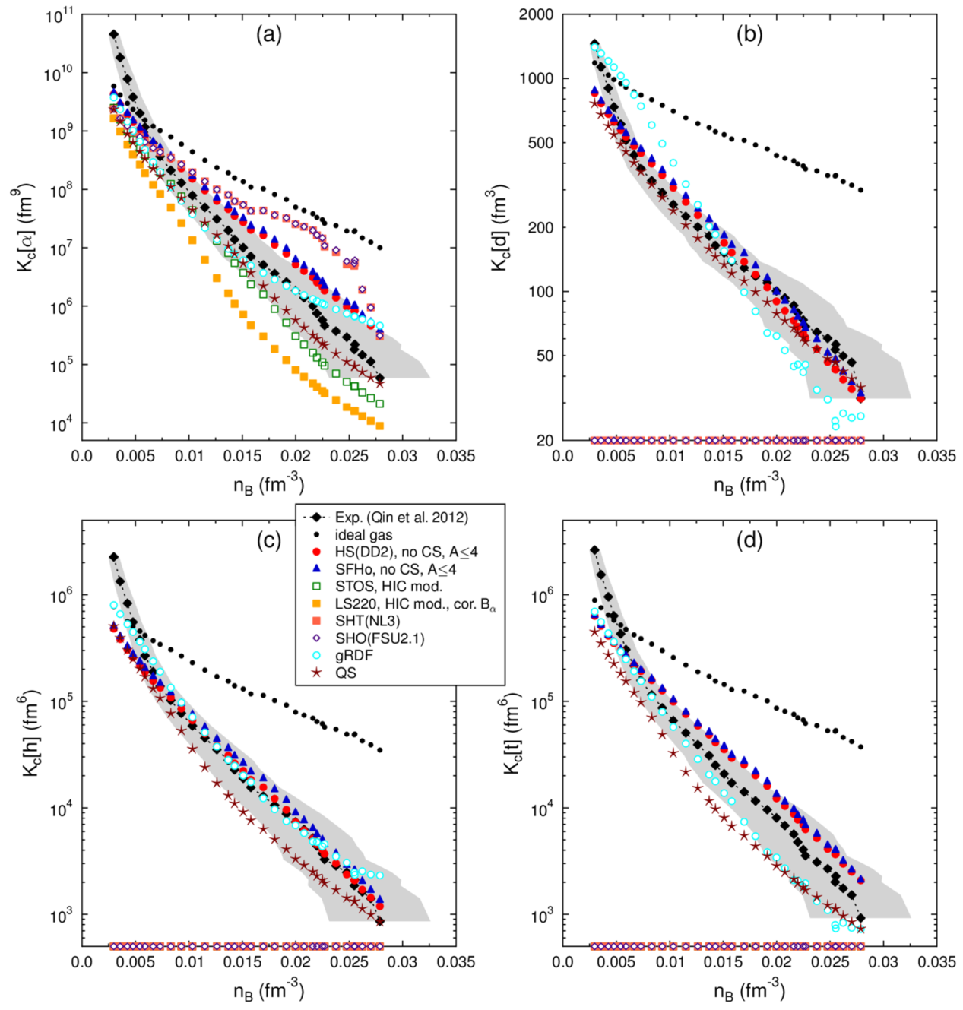
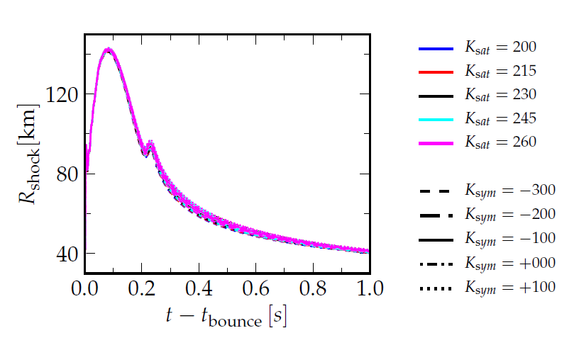
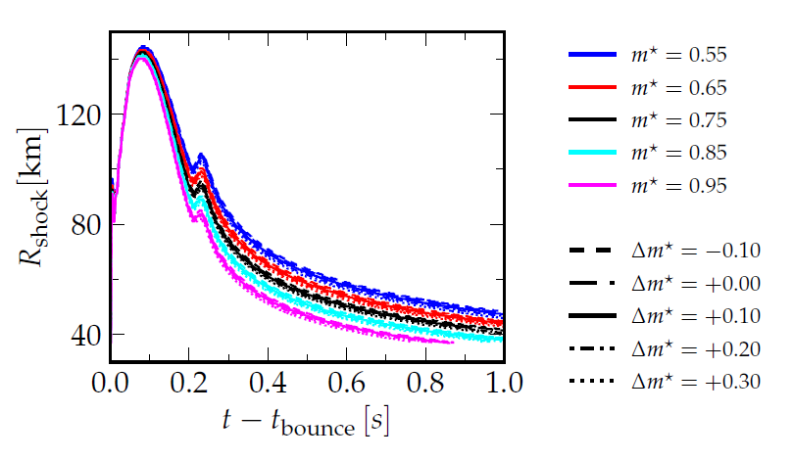
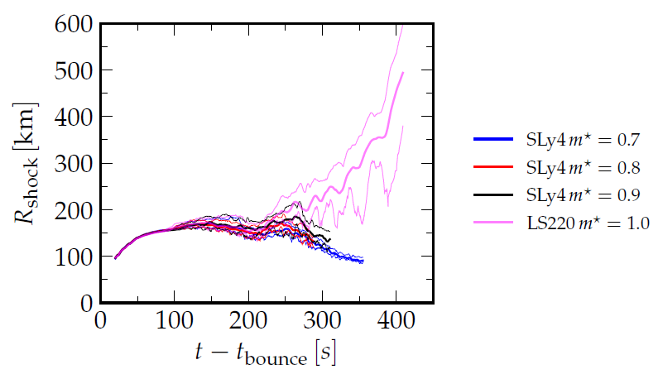
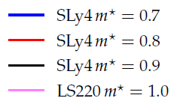
Core Collapse Supernovae: many aspects of the Symmetry Energy
Ranges of ρ, T and Y_{p} in CCSN
Shock energy depends on stiffness of EoS
matched in low energy central collisions, K. Hagel
Cooling of Proto-Neutron star (Nakazato)
ν-sphere and revival of shock, clusterization of low density matter (K. Hagel)
A. da Silva Schneider
Clustering of low density nuclear matter
Effect of EoS on CCSN properties: Shock Radius R_{shock}(t)
3D
1D CCSN simulation
change K_{sat}, K_{sym}
1D
change m*, Δm*

Slide 7
The grand picture
NuSym (since 2010)
Astrophysics
Nuclear Physics
Neutron star (NS),
Supernovae (CCSN)
Lab exp. and interpretation
Many-body theory
Heavy ion collisions (HIC)
Nucl. Structure and QE react.
Facilities and detectors
Transport theory
1-body obs.
- flow
- particles, π, K
Beyond 1-body
- Fluctuations, fragmentation
- Correlations and light clusters (LC)
- Short-range correaltions (SRC)
- NuSym2018 has triggered interesting discussions of all of these
- impossible to summarize everything
- remarks, where I see important developments and needed improvements

Slide 8
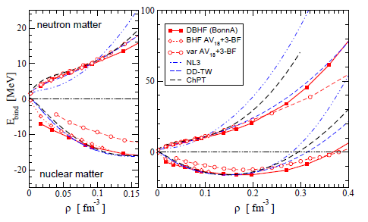
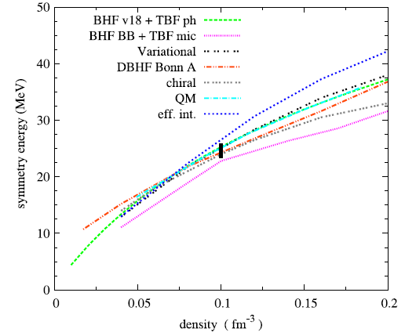
Microscopic Calculation of Symmetry energy: why not?
Microscopic calculations still differ a lot, less than 12 years ago.
--> Short range isovector correlations: tensor force
Perhaps classify into 3 classes
„fundamental“ (field theoretical)
Based on QCD-inspired or other parton field theories ,
Beautiful, but often only qualitative,
Chiral EFT, phenomenological „low energy“ constants (not density dependent), convergent
„realistic“,
Based on bare NN interact, plus 3- and higher order phenomenological interactions,
Heavy many-body „machinery“:
QMC, GFMC, Variational, Coupled Cluster, (D)BHF, No-core_SM,…
Density functional
Not really microscopic, since depends on parameters , which are fitted to nuclei and nucl. Matter,
Many different parametrizations,
Skyrme, RMF (RH), RHF,

Slide 9

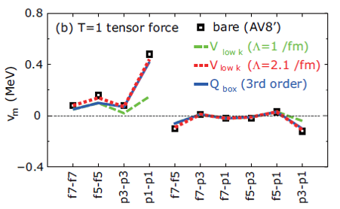
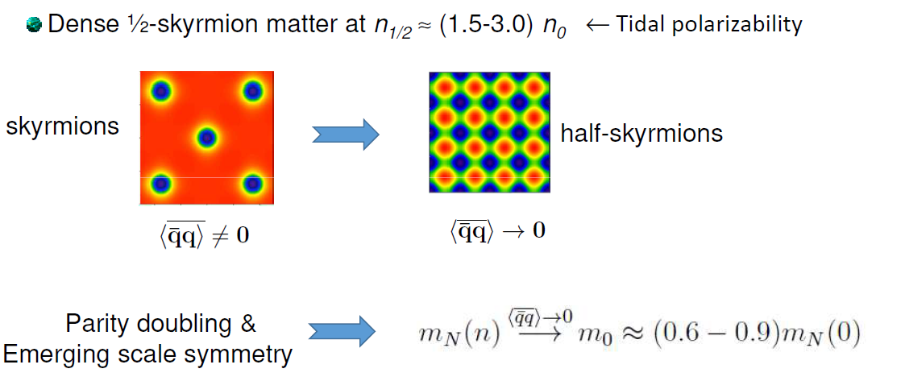
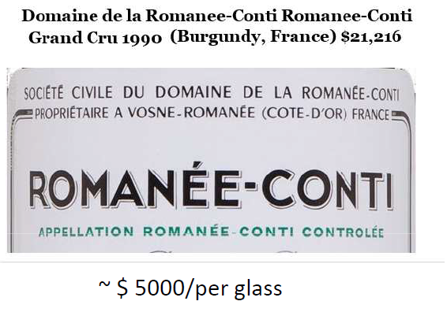
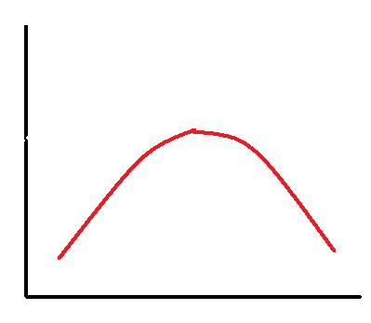
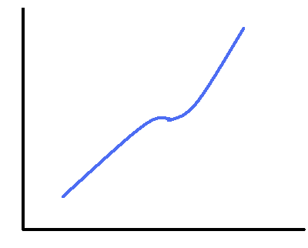
M. Rho: Half-Skyrmions
“Symmetry energy is dominated by the tensor forces”:
But T=1 tensor force is not renormalized (reduced) in matter (in contrast to T=0 tensor)
This would be explained by the half-skyrmion model or the
Parity doubling model (Harada)
Manque told us, that we all here,
only, because a committee drank some very expensive French wine
E_{sym}
(a) Without ½-s
(b) With ½-s
n
Also important consequences for the speed of sound

Slide 10
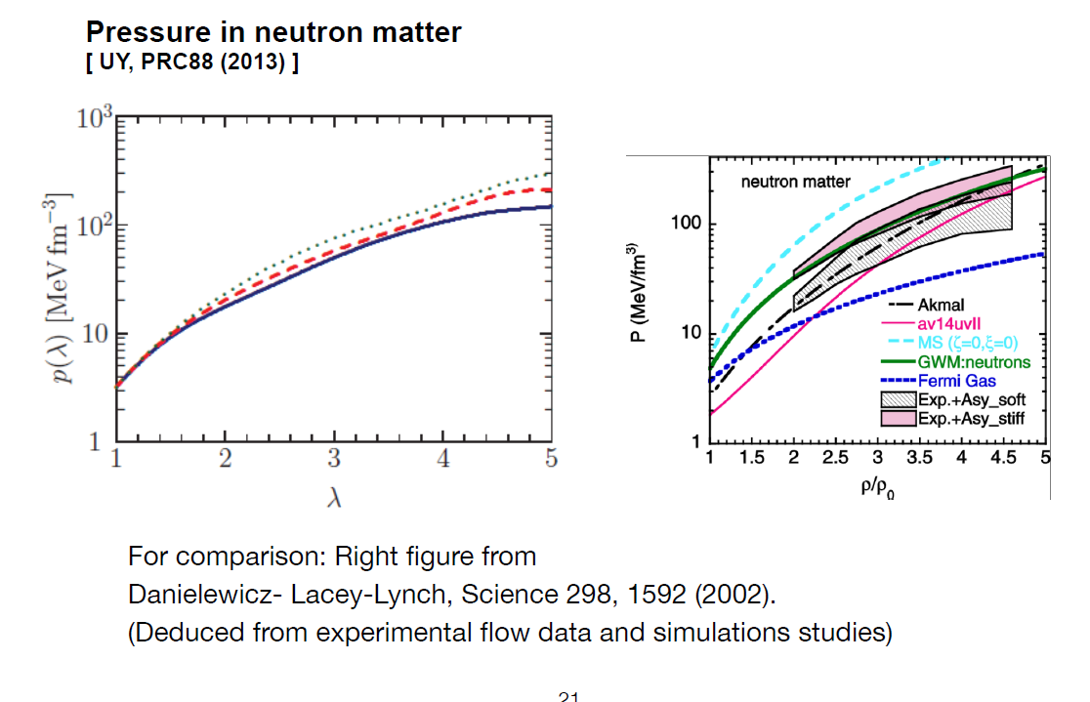

Parity doubling Model (Harada, Yakhshiev)
Partial restoration of chiral symmetry
Influenced by Δ
N* appears, stronger restoration
chiral symmetry broken phase
at vacuum
The spontaneous chiral symmetry breaking is expected to generate a part of hadron masses.
It causes mass difference between chiral partners.
N-N∗,Δ−Δ∗
Affects the Symmetry energy.
Jumps?
Yakhshiev

Slide 11
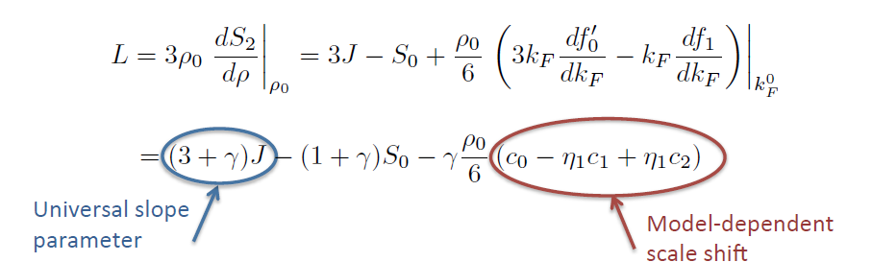
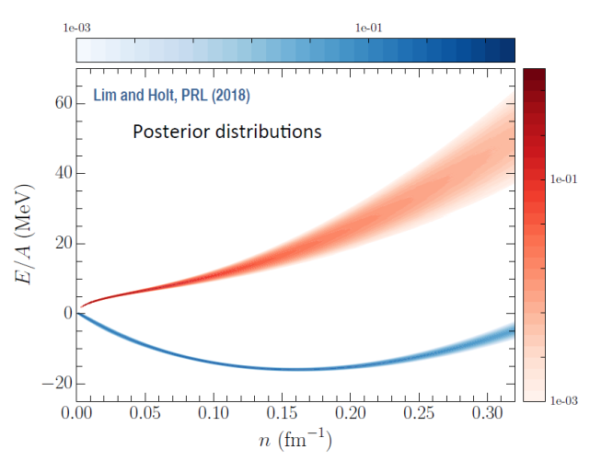
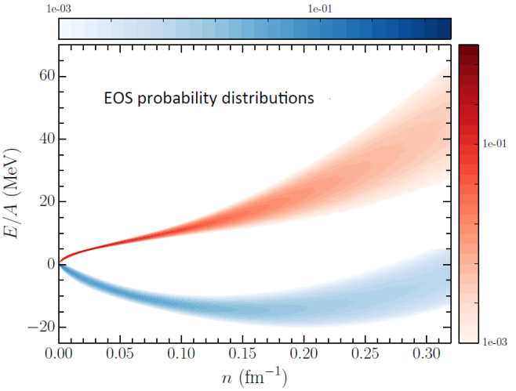
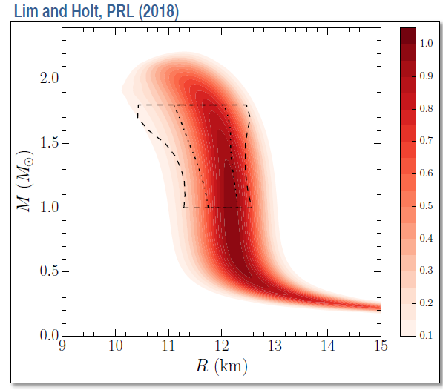
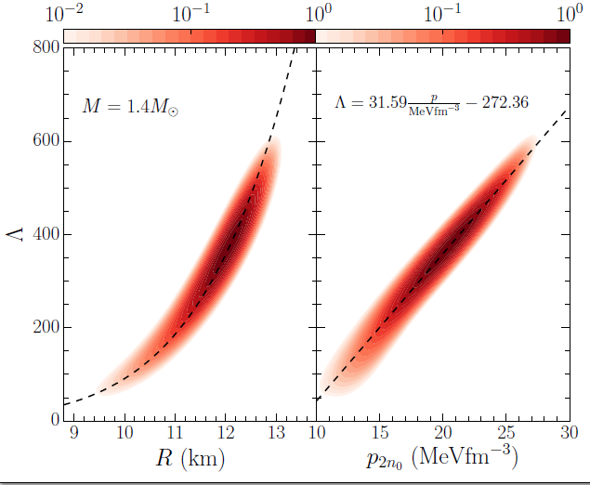
J. Holt: Connect Symmetry energy to χEFT:
Expand the SE in Fermi Liquid theory
and determine the expansion coefficients from χEFT .leads to relations between J,L,K_{sym,}
And determine residuel parameters by Baysian analysiis
Prior from χEFT
Examples of derived distributions

Slide 12
Many other contributions to microscopic methods (but mostly today):
J. Holt: neutron drops
Miyatsu: Fock terms in RMF
Jeong: QCD symm breaking
Bastian: Q-hadron EoS
Lim: SE from nuclei to neutron strs
Grasso: dilute nm
Roca-Maza: breaking of isospin symmetry
BH Sun: covariant nucleon self energy
Carbone: Ab-initio studies
I found the study of neutron drops intriguing, done because the sign-problem of Quantum MC prevents doing symmetric matter. One still can extract e.g. a skin thickness.

Slide 13
The grand picture
NuSym (since 2010)
Astrophysics
Nuclear Physics
Neutron star (NS),
Supernovae (CCSN)
Lab exp. and interpretation
Many-body theory
Heavy ion collisions (HIC)
Nucl. Structure and QE react.
Facilities and detectors
Transport theory
1-body obs.
- flow
- particles, π, K
Beyond 1-body
- Fluctuations, fragmentation
- Correlations and light clusters (LC)
- Short-range correaltions (SRC)
- NuSym2018 has triggered interesting discussions of all of these
- impossible to summarize everything
- remarks, where I see important developments and needed improvements

Slide 14
Nuclear Structure and QE Reactions
Search for S₀ and L, and often for a correlation {S₀,L}.
L slope of SE at ρ₀
S₀ value of SE
ρ/ρ₀≈1
Investigations:
1.proton and neutron densities ρ_{p} and ρ_{n}:
a) neutron skin R_{np}=(R_{n}-R_{p})↔L
PREX, CREX, MREX improve accuracy!
b) scalar and vector densities ρ_{s} and ρ_{v}, very diff shapes
IAS studies, CEX (light Ions PD, heavy ions Burello)
2. Dipole polarizability α: αS₀ ↔R_{np}↔L
main contribution GDR, but also PDR, which is not very collective?.
3. HvH theorem: {S₀,L}.↔{U_{sym,}m*_{np}} effective mass splitting,
B.A.Li, X.Han
J.Lattimer, A. Steiner, EPJA 50, 40 (2014)

Slide 15
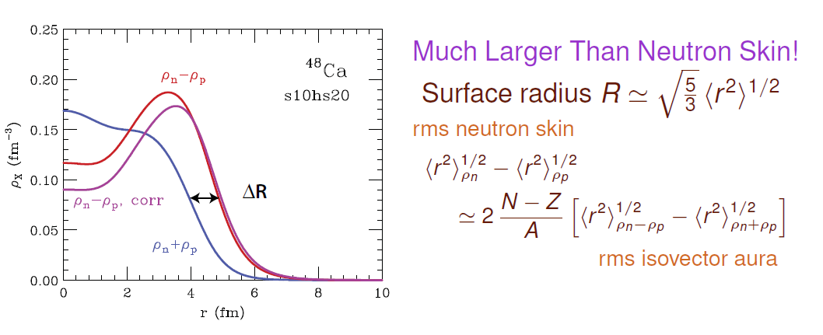
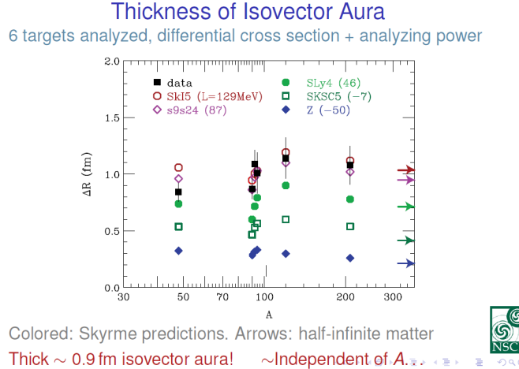
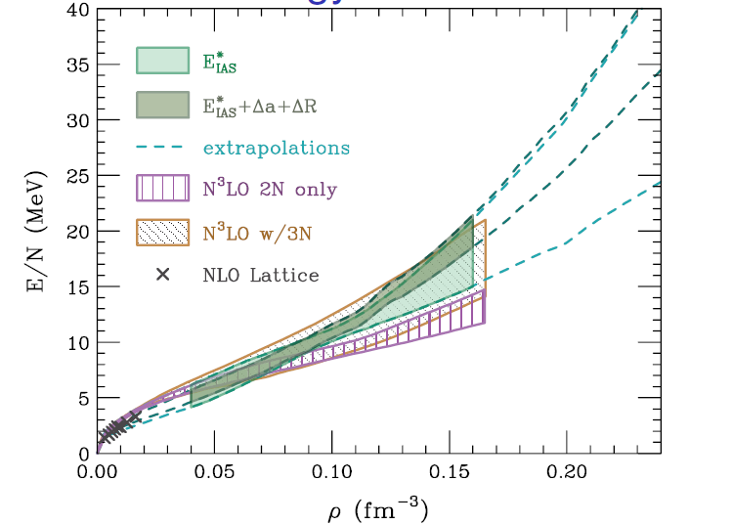
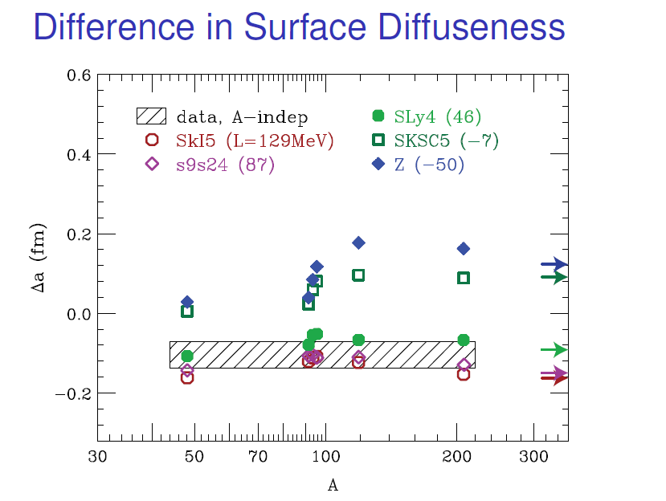
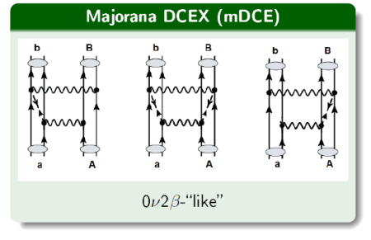
How to get information on neutron skins ↔ closely correlated to L
Pawel Danielewicz: isovector density measured by CEX reactions
Strong constraint on SE for ρ<ρ₀
Burello: CEX reactions also of large interest on a fundamental question: neutrino-less double beta decay 2β0ν

Slide 16
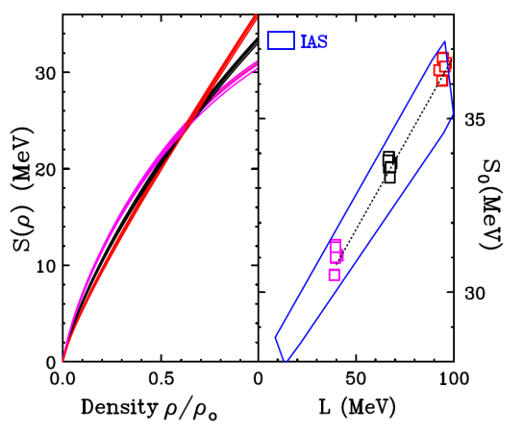
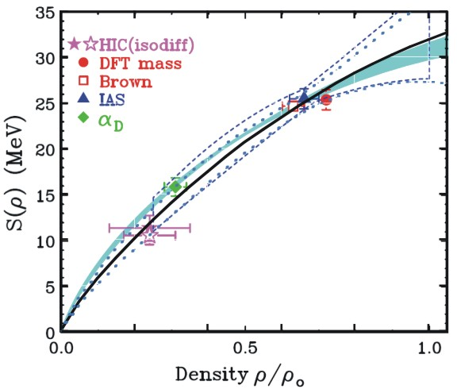
Correlations of SE parameters:
Correlation {S₀,L}.
Experiment often sensitive to S(ρ), at a particular ρ, which leads to
a trivial model-dependent correlation
S_{exp}
ρ/ρ₀
ρ_{exp}
E.g. A. Brown fit the masses of doubly closed shell nuclei, while setting different values neutron skin thicknesses of ΔR_{np}=0.16, 0.20 and 0.24 fm. All Brown fits provide S(ρ)=24.8±0.7 MeV at ρ/ρ₀=0.63±.03 as shown at left. (PRL 111,232502(13).
J.Lattimer, A. Steiner, EPJA 50, 40 (2014)
Similar with e.g.
- dipole polarizability
- isospin diffusion
- IAS
These probes thus map out S(ρ),
while I think these correlations are
misleading
W.Lynch, M.B.Tsang

Slide 17
The grand picture
NuSym (since 2010)
Astrophysics
Nuclear Physics
Neutron star (NS),
Supernovae (CCSN)
Lab exp. and interpretation
Many-body theory
Heavy ion collisions (HIC)
Nucl. Structure and QE react.
Facilities and detectors
Transport theory
1-body obs.
- flow
- particles, π, K
Beyond 1-body
- Fluctuations, fragmentation
- Correlations and light clusters (LC)
- Short-range correaltions (SRC)
- NuSym2018 has triggered interesting discussions of all of these
- impossible to summarize everything
- remarks, where I see important developments and needed improvements

Slide 18
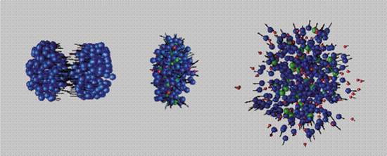
Heavy ion collisions to investigate the EoS:
Pro: - inc. energy ↔compression, maximum density
- system ↔ asymmetry
- geometry. centrality ↔ isospin tranport, very low density
Con: - non-equilibrium process
Often statistical methods are used („un-reasonbaly succéssful“
E.g. in analysis on very low density cluseriized matter.
Transport theory

Slide 19
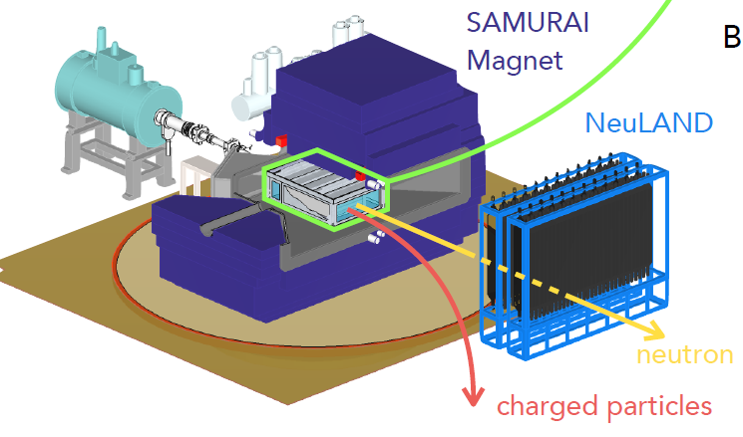
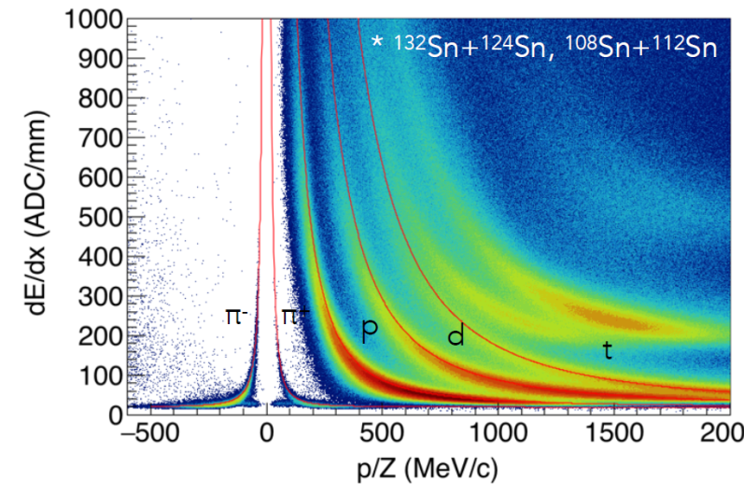
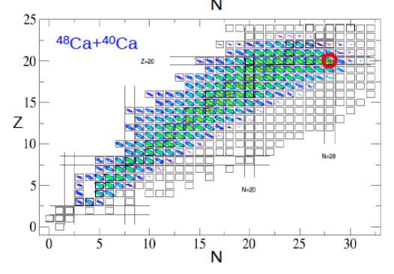
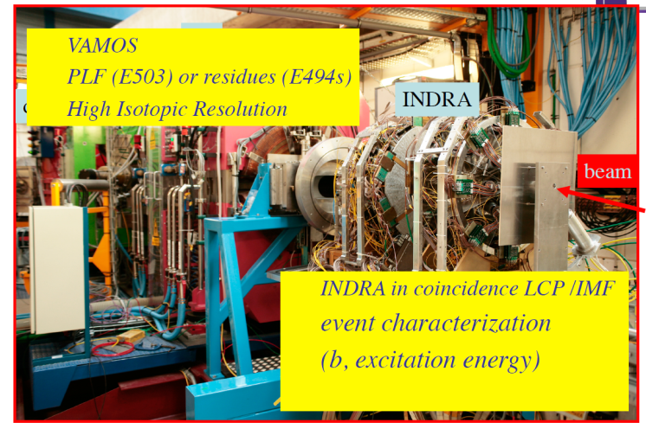
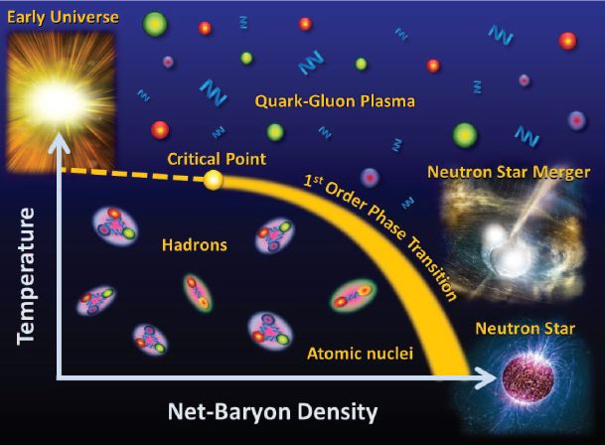
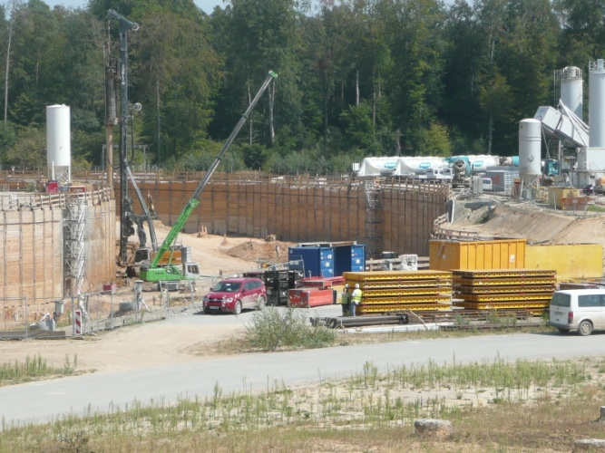
Facilities and detectors
CBM
500
IMPRESSIVE

Slide 20
The grand picture
NuSym (since 2010)
Astrophysics
Nuclear Physics
Neutron star (NS),
Supernovae (CCSN)
Lab exp. and interpretation
Many-body theory
Heavy ion collisions (HIC)
Nucl. Structure and QE react.
Facilities and detectors
Transport theory
1-body obs.
- flow
- particles, π, K
Beyond 1-body
- Fluctuations, fragmentation
- Correlations and light clusters (LC)
- Short-range correaltions (SRC)
- NuSym2018 has triggered interesting discussions of all of these
- impossible to summarize everything
- remarks, where I see important developments and needed improvements

Slide 21
Transport theory based on a chain of approximations
Martin-Schwinger hierarchy in many-body densities:
truncation, introduction of self energies (1-body quantities)
Quantum transport theory: irreversibility, Kadanoff-Baym theory
Semiclassical approximation :
Wigner transform, treat as phase space probabilities
Gradient approximation (separation of short and long scales)
Quasiparticle approximation
Spectral function→ delta function with effective momenta and masses
neglect off-shell effects (or treat approximately)
→ kinetic equation
Pauli blocking factors,
main quantum ingredienet
Mean field evolution (Vlasov) + uncorr. 2-body collisions (Boltzmann)
+ Pauli-blocking of final states (Uehling-Uhlenbeck)
physical input:
mf potential U(r,p), momentum dependent
σ^{ιn-med} in-medium cross sections
Obtainable
e.g. from Bruecker theory
Notes:
21

Slide 22
Two families of transport approaches, fluctuations
Boltzmann-Vlasov-like (BUU/BL/BLOB)
Molecular-Dynamics-like (QMD/AMD)
ΔL
r
Dynamics of the 1-body phase space distribution function f with 2-body dissipation
TD-Hartree(-Fock)
(or classical molecular dynamics with extended particles)
plus stochastic NN collisions
fluctuations around diss. solution
No quantum fluctuations,
but classical N-body fluctuations, damped by the smoothing.
Boltzmann-
Langevin eq.
However, more fluctuations than BUU, since dof are nucleons and not test particles:
→ amount controlled by width of single particle packet ΔL
f-space
Instabiity points
“All models are wrong; some models are useful”
George Box, 1919-2013 (quoted by B. Tsang)

Slide 23
Two main transport approaches
Boltzmann-Vlasov-like (BUU/BL/BLOB)
Molecular-Dynamics-like (QMD/AMD)
σ
r
Dynamics of the 1-body phase space distribution function f
with 2-body dissipation
TD-Hartree(-Fock (AMD))
(or classical molecular dynamics with extended particles)
plus stochastic NN collisions
6-dim integro-differential, non-linear eq.
6A-dim many body problem
→ very complex, simulate solutions
introduces many technical details
physical input
(EOS, σ_{inmed,}
πΔ physics, ..)
transport
code
observables
→ unique? code independent?
→Transport Code Evaluation (Comparison) Project

Slide 24
Code Comparison Project
check consistency of transport codes in calculations with same system (Au+Au), E=100,400 AMeV, identical physical input (mean field (EOS) and cross sections, BUU and QMD codes
J. Xu, et al. (31 authors); PRC 93, 044609 (2016)
HIC at b=7m (midcentral)
selected contour plots;
different evolution apparent
→compare collision numbers,
blocking, and observables
quantify spread of simulations by value of „flow“=slope of transverse momentum at midrapidity
BUU and QMD approx. consistent
uncertainity
100 AMeV: ~30%
400 AMeV: ~13%
Understand differences better („entangled“)
Notes:
24

Slide 25
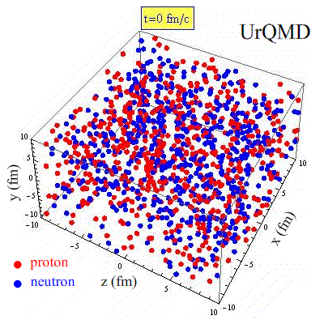
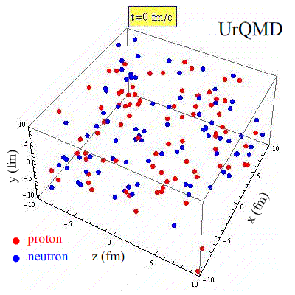
2nd stage: Box calcualation comparison
simulation of the static system of infinite nuclear matter,
→ solve transport equation in a periodic box
Useful for many reasons:
- check consistency of calculation
e.g. EoS energy dens ε vs. pressure P
- check consistency of simulation:
collision numbers, blocking
(exact limits from kinetic theory)
- check aspects of simulation separately
• Cascade: only collisions
without/with blocking
• Vlasov: only mean field propagation
• check ingredients of particle production
e.g. pion production
Code comparison in box calculations
→ workshop 14,-15.9.18
I will use some results to illustrate some points

Slide 26
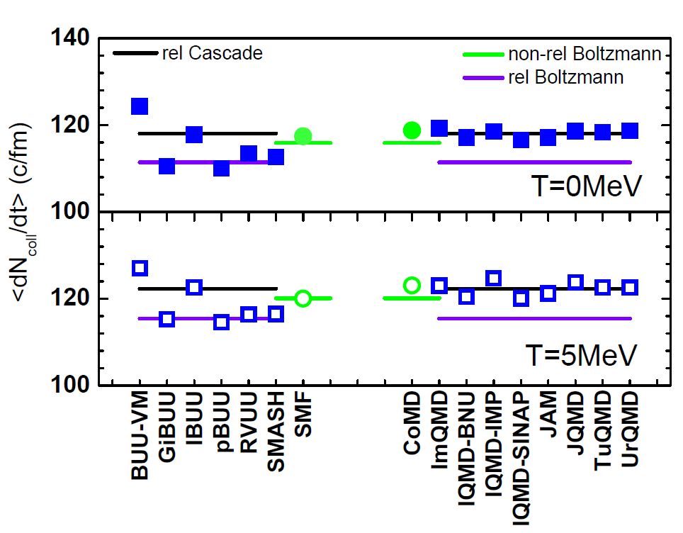
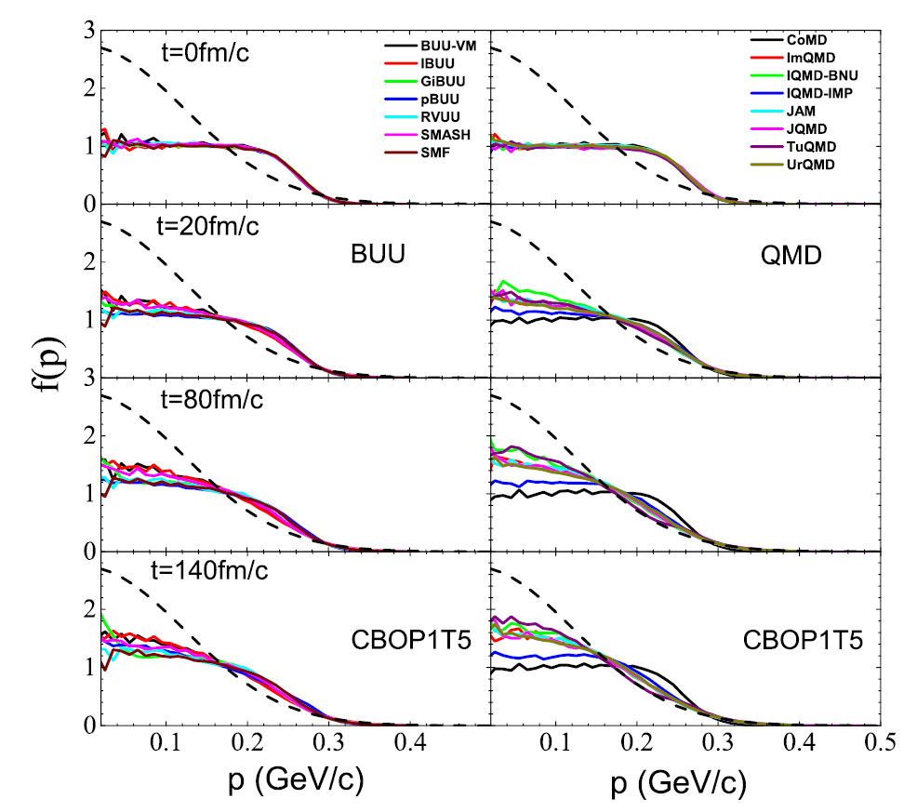
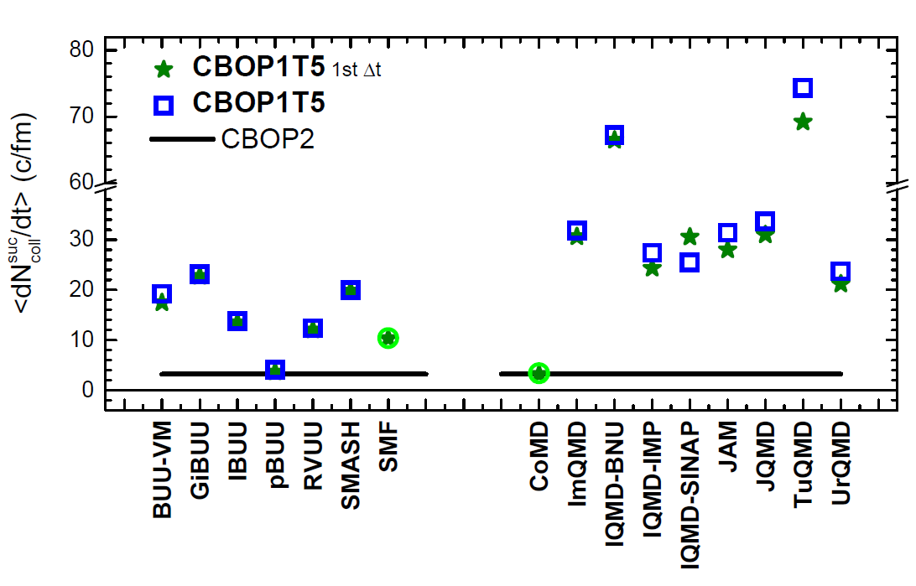
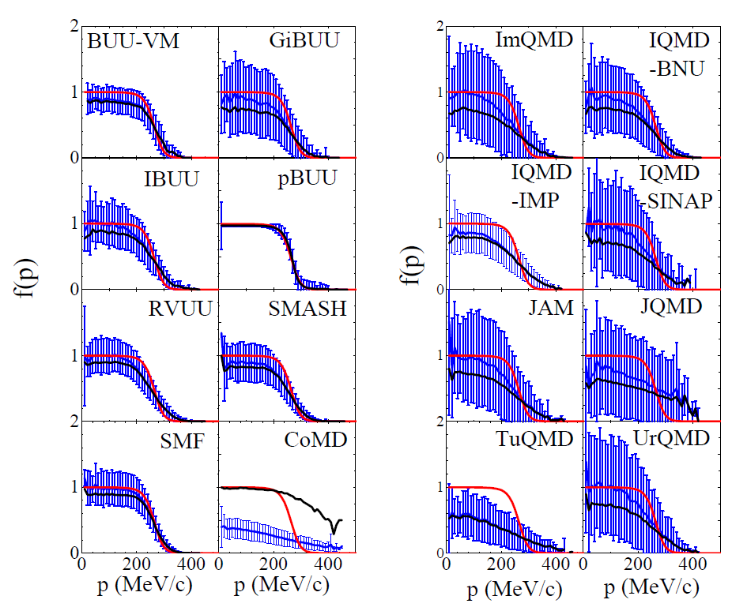
Collision term
Collision rates in a
cascade box calculation
(w/o mean field, T=0 and 5 MeV)
without blocking
Comparison to exact limit ok
with blocking
Sampling of occupation prob.
in comp. to prescribed FD distribution
(red)
Evolution of momentum distributions
--> characteristically different fluctuation in BUU and QMD models

Slide 27
The issue in fragment and cluster formation in HIC collisions:
correlations
fluctuations
Light cluster (LC) formation
Short range correlations SRC
Intermediate mass fragment (IMF) formation
LC‘s are not stabilized by the mean field but by many body correlations.
1: Introduce as explicit degrees of freedom, generated by the collision term (Danielewicz)
Fluctuation in the instable region are
Amplified and stabilized by the mean field
t=0 fm/c
t=100 fm/c
t=200 fm/c
deutron (in-medium)
transition amplitude
BUU calculation in a box with initial conditions inside the instability region: ρ=ρ₀/3, T=5 MeV, δ=0
(V.Baran, et al., Phys.Rep.410,335(05))
(P. Danielewicz and Q. Pan, PRC 46 (1992))
(d,t,3He, but no α!)
BUU: Approximations to the Boltzmann-Langevin eq.
Numerical noise small (many test particles)
and inject physical fluctuations
QMD: Rely on fluctuations due to classical
representation of phase space my nucleons of
finite size (parameter: width of wave paket)
2: Ono, Ikeno: dynamical cluster correlations

Slide 28
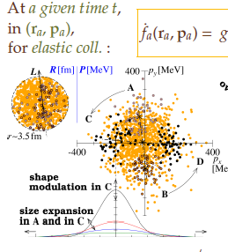
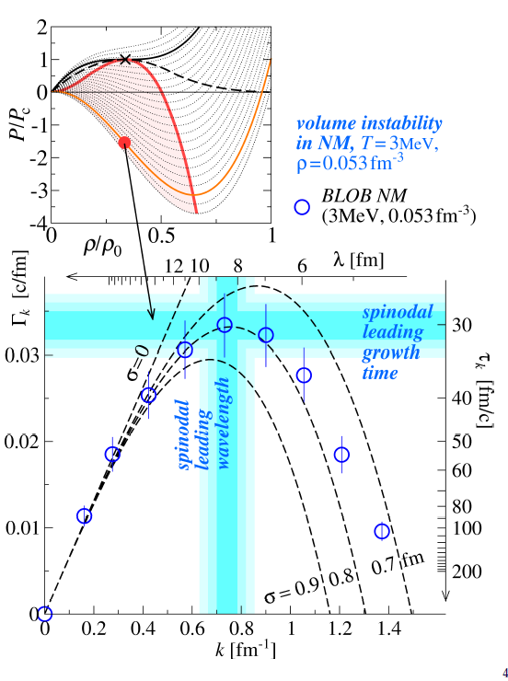

Fluctuations
BUU: statistical fluctuation of the mean field distribution function f in a Fermi
system is
f-space
Instability points
SMF (stochastic mean field): project on density fluctuations and introduce these „by hand“
BLOB (Boltzmann-Langevin One-Body dynamics) Move N_{TP} testparticles simultaneously (in p-space) to simulate fluctuation connected to NN collisions (Bertsch model)
(Napolitani)
Napolitani showed, how volumne and surface instabilities can be excited and checked against the dispersion relation
Fluctuations of occupation numbers in box calculation
The role of fluctuations in transport codes is one of the main systematical uncertainities. It should be further discussed.

Slide 29




Dynamical clusters in AMD (Ono)
In-medium wave function of cluster ,
depending on density (Mott effect) and total momentum relative to the medium
Ono considers effect of momentum P, and density by a empirical suppression factor.Couold be done more microscopically?
Typel, Röpke,.., PRC81 (2010)
Ikeno calculated pion ratios with clusters (and with different prescriptions for the blocking of the final nucleons in Δ->Nπ ). Big effect of clustering?
Not immediately obvious, but clustering changes dynmaics. More dissipative ? (see also Kaneko)

Slide 30



Role of Short-Range-Correlations
High momentum tail due to short range correlations.
In asymmetric nuclear matter, this is different for neutrons and protons, for k<k_{F}, but similar for k>k_{F}.
Could be important in HIC in particle production .
Current debate, how to take into account in transport:
Initialize momentum distribution with high momentum tail, e.g. GC Yong, PLB 765 (2017) 104
Should be quickly lost due to colliusions and is not regenerated, which should be the main effect.
Subtract correlation energy from mean field potential, e.g. B.A.Li+, PRC 91, 044601 (2015).
argument: determination of U_{sym} more realistic, since correlation energy not assumed as symmetry energy.
but: but does not affect kinetic energy and produces no high momentum tails
3.? Treat explicitely in 3-body collision, in a sense similar to problem of LC production.
short range int.
to produce high
momentum
k>k_{F}
normal interaction for
energy momentum conserv.
Rechnung von G.C.Yong

Slide 31




Symmetry energy at ρ≤ρ₀: − Isospin transport in Fragmentation
- pre-equilibrium light cluster emmision
A. Chbihi
Isospin diffusion
<N/Z>^{PLF}
Isospin drift (migration)
<N/Z>^{LCP} at diff angles
AMD describes diffusion with soft SE, but not migration ?

Slide 32

Light cluster description in transport approaches: Comparison to data
p,n spectra: free coalescence invariant (CI)
Double Ratios
¹²⁴Sn + ¹²⁴Sn
¹¹²Sn + ¹¹²Sn
Y.X. Zhang, M.B.Tsang,et al., PLB 732, 186 (2014)
D.D.S.Coupland, arXiv 1406.4546
agree only for
CI spectra
¹⁹⁷Au+¹⁹⁷Au
600 AMeV b=5 fm, |y₀|≤0.3
Role of effective mass in Light Cluster production
136Xe+124Sn, 150 MeV
m_{n}*<m_{p}*
asy-stiff
soft
¹²⁴Sn+¹²⁴Sn, 150 MeV
m*_{n}<m*_{p}
m*_{n}>m*_{p}
H. H. Wolter, et. al,
EPJ WoC, 03097 (2014)
asysoft
stiff
m_{n}*<m_{p}*
Y(n)/Y(p)
m_{n}*>m_{p}*
asystiff
(V.Giordano, et al., PRC 81(2010))
asy-soft
E_{transverse}
m_{n}*>m_{p}*
density dep. dominates for slow particles;
mom.dep. (effective mass) for fast particles,
Y. Zhang,et al., PLB 732, 186 (2014)
At high energy effective mass effect dominant
Jun Xu gave a nice overview of the effective mass studies.

Slide 33


Probes of the High-Density SE
Central higher energy collisions:
Au+Au@1AGeV
Dependence on
asy-stiffness
Au+Au, 0.6AMeV
Dynamics
3
directed and elliptic flow,
differential flow of isospin partners
Central density
2ρ₀
n/p ratio
Δ and K: production in high density phase
Pions: low and high density phase
Sensitivity to asy-stiffness
π and Δ multiplicity
Y(Δ^{0,-}) vs.Y(Δ^{+,++)}
Δ^{+,++}
K^{0,+} multiplicity
NLρδ
NLρ
NL
π⁻/π⁺
soft
stiff
K⁰/K⁺
time [fm/c]

Slide 34

The Symmetry Energy at High Density: Flow a success story
Au+Au @ 400 AMeV
new experiment ASY-EOS
(Russotto, et al., PRC)
ratio v₂^{n}/v₂^{charged}
ratio of neutron to hydrogen flow
- Elliptic flow v₂ in this energy region good probe
of high density
analysis of density dependence of SE in terms
of power law exponent γ
not very precise (yet) but indicates rather stiff SE, γ~1
Cozma.arxiv170.1300
Big step forward in constraining the high-density symmetry energy; ASYEOS II? SπRIT?
Notes:
34

Slide 35




Pions: less of an success story
NN NΔ
Nπ
ΛK
NΛK
potentials U_{p}, U_{D}, U_{K} →effective masses in medium, threshold effects
inelastic cross sections, e.g. NN→NΔ, in medium
Δ Resonances with decay widths, mass distributions, spectral fcts,
more general: off-shell transport
Discussed by
C.M. Ko
present situation unsatisfactory:
FOPI exp, Au+Au, 0.4-1.2 GeV/A
check of (π,Δ) physics in box calculations
more sensitivity in spectral distributions, Sprit experiment (MSU-RIKEN)
G. Jhang

Slide 36





π,Δ production in box cascade calculation:
(in progress, preliminary!)
Akira Ono and Jun Xu
N,Δ, no pions
kinetic solution (rate eqs.)
one- way only
energy dep cross sect.
Δ spectral function
two- ways
Looks reasonably ok! Now switch on pions

Slide 37





π,Δ production in box cascade calculation:
(in progress, preliminary!)
now including pions
kinetic solution (rate eqs.)
large
differences between models and
exact result
equilibrium values,
not quite as good for small times
(partly) due to sequence of handling collisions (C_{k}) and decays (D_{k})
ratios
ratio/(n/p)²
rate eq.
full symbol Δt as in code, usually 0.5 fm
open symbol Δt=0.2 fm, →convergence?
sym asym
→ towards a better understanding of the pion ratios

Slide 38

Strangeness production in HIC: Kaons
Kaons were a decisive observable to determine the symmetric EOS;
perhaps also useful for SE?
Kaons are closer to threshold, come only from high density, have large mean free path, small width:
α_{Au}≈0.2
Au+Au@1AGeV (HIC)
Inf. NM
Small effect
Dynamic reduction of asymmetry in HIC, thus reduction of sensitivity rel. to nuclear matter
Larger (or equally large) effect for kaons, which come
directly from high density region

Slide 39

The Status of Symmetry Energy Research
(taken from talk of W. Trautmann)
neutron star pressure
p₀ = 3.4 ± 0.7 MeV/fm³
ρ₀
2ρ₀
GW170817
Abbott et al. (2018)
LIGO & VIRGO
tidal effects
L=63±11 MeV
Soft EoS symm matter confirmed with FOPI data
Le Fèvre et al., NPA 945, 112 (2016)
Yongjia Wang et al., PLB 778, 207 (2018)
Looks encouraging, but still a way to go
Thank you for the attention, apologies to those, whom I did not mention, and thanks to the organizers

