Slide 1
Status of ILC
Yasuhiro Okada
Executive Director
High Energy Accelerator Research Organization (KEK)
2019 Joint workshop of FKPPL and TYL/FJPPL
May 8, 2019, Seogwipo KAL Hotel, Jeju Island , Korea

Slide 2
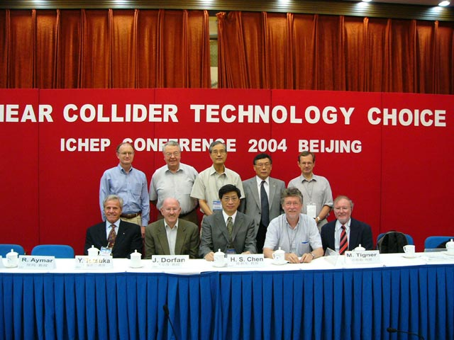
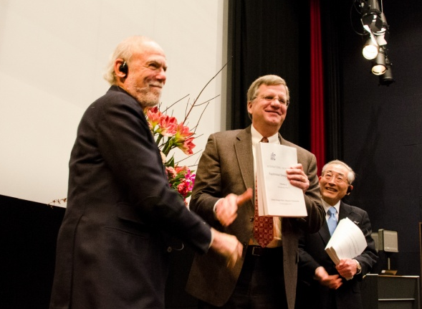
Brief history of ILC
R&D for a future e⁺e⁻ linear collider began more than 20 years ago in the three regions.
By early 2000’s, it became a consensus among the world HEP community that an e⁺e⁻ linear collider with the CM energy of about 500 GeV should be the next collider beyond the LHC.
ICFA chose the cold technology for LC as a global project, and set up a global team (GDE) for design and coordination of R&D for the ILC.
After eight years of works, the TDR of the ILC was published in June 2013. ICFA set up the Linear Collider Collaboration for engineering design phase.

Slide 3
Recent history of ILC in Japan
In October 2012, after the discovery of the Higgs boson at LHC, Japanese HEP community proposed to host the ILC in Japan as a global project. This proposal was welcomed by the HEP communities across the world.
MEXT set up the ILC Advisory Panel in May 2014.
Japanese HEP community proposed to construct the ILC as a 250GeV Higgs factory. This proposal was strongly endorsed by LCB/ICFA (November 2017).
July 2018: ILC Advisory panel of MEXT released its final report, where the panel recommended the ILC proposal be reviewed by the SCJ.
December 2018: SCJ released its report.
March 2019: MEXT presented its view with regard to the ILC project at the LCB meeting in Tokyo. Also, ILC Federation of Diet Members presented supplemental message to the LCB. According to them, MEXT and KEK released their action plans.
MEXT= Ministry of Education, Culture, Sports, Science & Technology in Japan
SCJ=Science Council of Japan

Slide 4
The SCJ report : Executive summary
The SCJ recognizes the importance of the Higgs physics “ It is agreed upon in Japanese high energy physics community that the precision measurement of the Higgs coupling is an important one among those approaches.”
“Judging from the plan and preparatory status of the project presented at the moment, the Science Council of Japan does not reach a consensus to support hosting the 250GeV ILC project in Japan.” Their main concerns are “Japan’s large share of the overall cost required for the project implementation ”, “considerable hurdles remain to be cleared (for technical issues)”, and “the uncertainty surrounding proper international cost-sharing with respect to the long-term commitment to large budget”
It should be noted that in the decision-making process by the Japanese government, the SCJ report will be taken into account along with other factors such as merit to the society.

Slide 5
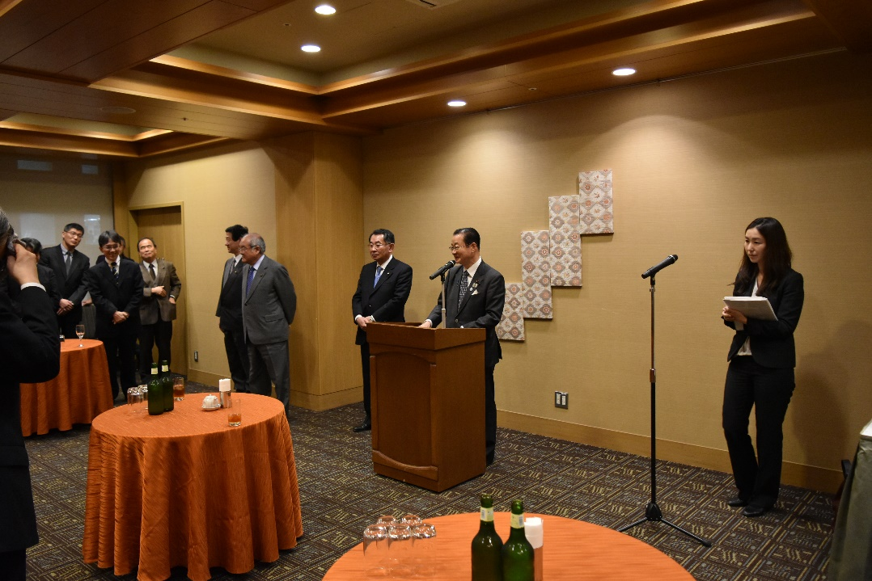
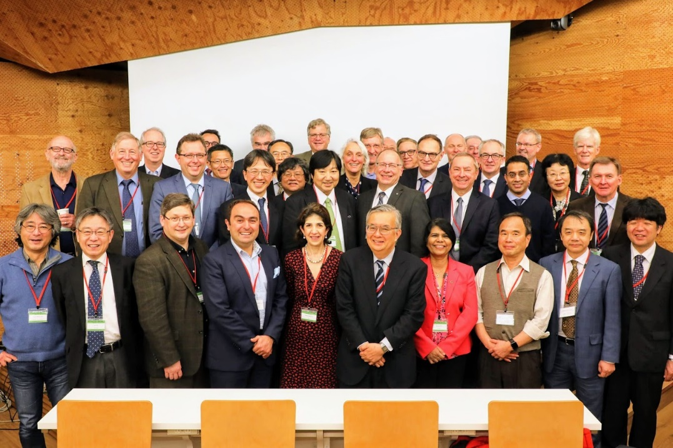
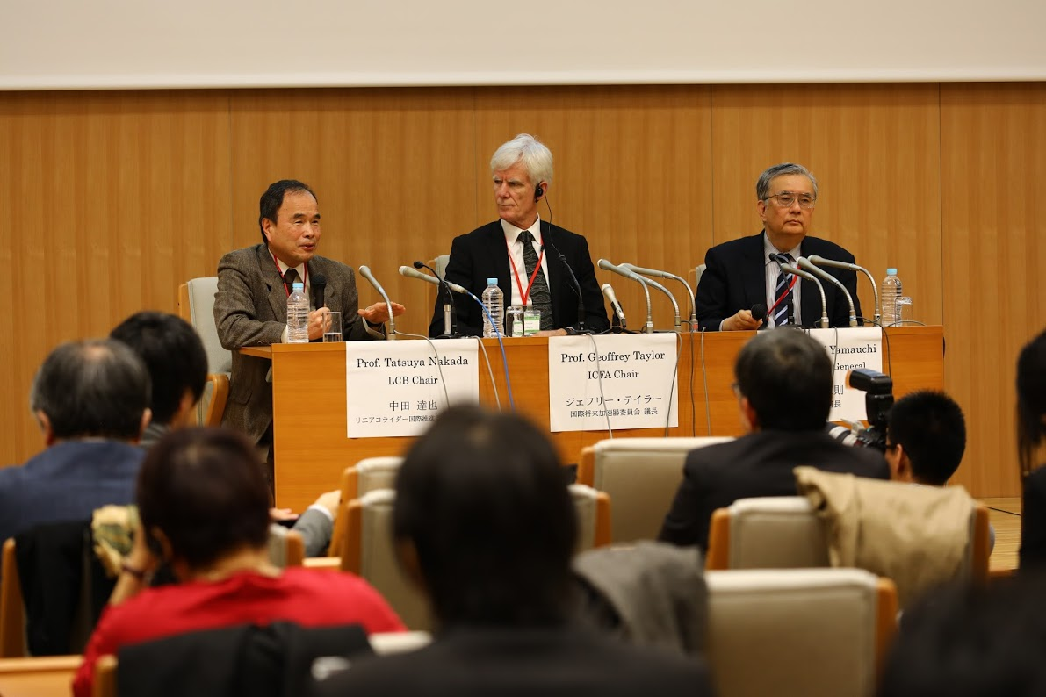
LCB and ICFA meetings in Tokyo

Slide 6
Statement by MEXT at LCB Meeting in March 2019
Following the opinion of the SCJ, MEXT has not yet reached declaration for hosting the ILC in Japan at this moment. The ILC project requires further discussion in formal academic decision-making processes such as the SCJ Master Plan, where it has to be clarified whether the ILC project can gain understanding and support from the domestic academic community.
MEXT will pay close attention to the progress of the discussions at the European Strategy for Particle Physics Update.
The ILC project has certain scientific significance in particle physics particularly in the precision measurements of the Higgs boson, and also has possibility in the technological advancement and in its effect on the local community, although the SCJ pointed out some concerns with the ILC project. Therefore, considering the above points, MEXT will continue to discuss the ILC project with other governments having an interest in the ILC project.

Slide 7
Message from the Federation of the Diet Members for ILC
I believe the ILC should be realized through politically-led efforts, cutting across different ministries and agencies. As such, we’re proceeding to realize a budgeting as a national project with a separate budget outside of the regular science and technology budget.
On the international cost sharing, we have to separate the infrastructure part of civil engineering and conventional equipment that is natural to be taken up by the host country and the apparatus part that is natural to be internationally cost-shared among technically competent countries.
As the environment has ripened socially, politically, and administratively, the next mission for politics is to secure the budget for the construction. In parallel, with the government’s administrative process, we will begin in earnest from our role as political and legislative body to obtain the necessary budget for construction.

Slide 8
ICFA Statement
ICFA views the statement of continuing interest in the ILC within MEXT and related ministries and agencies as an important milestone along the path to the ILC.
ICFA confirms the international consensus that the highest priority for the next global machine is a “Higgs Factory” capable of precision studies of the Higgs boson. At this ICFA meeting options for a Higgs Factory were discussed -- the ILC, as well as other collider technologies.
ICFA reaffirms the scientific significance of the ILC and that the ILC is in a sufficient state of technical readiness for approval for construction.
ICFA recognizes that although MEXT has interest in the ILC, and will continue to discuss the project with other governments, Japan is not yet able to declare its willingness to host the ILC. A clear statement of Japan’s position towards hosting the ILC would have had significant impact in the ongoing discussions on the formulation of the European Strategy for Particle Physics Update.
ICFA notes with satisfaction the great progress of the various options for Higgs factories proposed across the world. All options will be considered in the European Strategy for Particle Physics Update and by ICFA.

Slide 9
Actions to be done by MEXT
Answers given by MEXT at the Diet session on March 13, 2019.
In the future, while paying close attention to the progress of discussions on the European Elementary Particle Physics Strategy, we would like to deepen discussions with France and Germany at the governmental level, by proposing, for instance, to establish a standing discussion group similar to the one with the US. (Mr.Isogai)
So, also for the ILC project, we expect there will be a working group set up in the High Energy Accelerator Research Organization, so-called KEK, and at its initiative, discussions within the community of domestic and foreign researchers will proceed regarding international cost sharing, etc. (Mr.Isogai)
As I mentioned earlier, I am also aware that this is a project of great significance both from the academic research point of view and from the perspective of regional revitalization. Therefore, I would like to continue our investigations, closely collaborating with related communities while keeping an eye on the international situation. (Minister Shibayama)

Slide 10
Actions to be done by KEK
Organize the international working group with close consultation with MEXT.
Promote activities to gain a better understanding of the broader academic community in Japan.
Propose the ILC project to the SCJ Master Plan
Organize a symposium
Cooperate MEXT to establish the governmental level discussion groups with France and Germany. Also, we need to strengthen the discussion group with the US DOE.
Conducts R&D program at ATF, STF and CFF facilities collaborating with the international teams.
… and so on.

Slide 11
International WG initiated by KEK
As requested by MEXT, KEK will organize the international working group with close consultation with MEXT.
Members: 2 from Europe, 2 from North America, 3 from Asia (incl. Japan)
Update ILC-PIP to describe:
International share of the remaining technical development
Organization and governance of the ILC Laboratory
Model of international cost-sharing for construction and operation
The report will be submitted to MEXT and other governments as a recommendation from the international ILC community. Target date will be September 2019.
Draft report will be presented at the LCB meeting in August 2019. Input from LCB will be highly appreciated.
Also, a preparatory group will be organized to help discussions and report drafting at the working group.

Slide 12
Processes toward Realization of ILC
2018.12
2019.3
2020.5
2024-
Announcement
by Japanese government
Discussion among governments
Exchange of information
Agreement on governance,
operation, sharing of cost
and human resources
Start negotiations among governments
on international sharing
Strengthen US-Japan Discussion Group, cost reduction R&D,
governance discussion
Start construction of ILC
Full-scale negotiation among
governments – specification of
conditions and processes
Final agreement among governments
on construction
Government Level
MEXT
panel
Summarize
opinions of
relevant
ministries
Establish Discussion Group with
the European partners
Critical decision
process
MOU among research labs on start of
the preparation phase under approval by each government
Oct. 2019
Next Roadmap
by MEXT
SCJ committee on ILC
SCJ Master Plan
3/7
Physicists Level
LCB/ICFA mtgs. @ Tokyo
EPPSU submitted to CERN
ILC pre-lab
(4 years)
European Particle Physics Strategy Update
Establish KEK International WG
Produce draft for international sharing of
human and material resources
Draft proposal by researchers
on international cost sharing
Talks with other countries
Good enough design for the final approval of construction, resolution of remaining technical issues
＊ICFA: international organization of researchers consisting of directors of world’s major accelerator labs and representatives of researchers
＊ILC pre-lab: International research organization for the preparation of ILC based on agreements among world’s major accelerator labs such as KEK, CERN, FNAL, DESY etc.

Slide 13
Coordination Council for Realization of ILC
Courtesy
S.Yamashita
Research Council for Strategy on Science, Technology and Innovation
Chair: Hon. Kisaburo TOKAI
HQ for Promoting National Land Resilience
Head: Hon. Toshihiro NIKAI
HQ for Accelerating Reconstruction from Great East Japan Earthquake
Head: Hon. Fukushiro NUKAGA
Research Council for Strategy on Intellectual Property
Chair: Hon. Akira AMARI
Unified HQ for Implementing Regional Revitalization
Head: Hon. Takeo KAWAMURA
Coordination Council for Realization of ILC
(Representative: Hon. Takeo KAWAMURA)
Liberal Democratic Party
（Across-party group) Science and Technology Group
Chair: Hon. Hiroyuki HOSODA
(Across-party group)
Federation of Diet Members in Support of ILC
Chair: Hon. Takeo KAWAMURA
Secretary General: Hon. Ryu SHIONOYA
Knowledgeable Advisors
Hon. Hiroya MASUDA (former Minister for Internal Affairs)
Prof. Satoshi FUJII
(Counselor, Cabinet Secretariat)
Prof. Atsushi SUNAMI
(Vice President, GRIPS)
Advanced Accelerator Assoc. Promoting Science and Technology
Chair: Mr. Takashi NISHIOKA
Tohoku ILC Promotion Council
Representative: Mr. Hiroaki TAKAHASHI,
Prof. Hideo OHNO
ILC 100 People Committee
ILC Supporters

Slide 14
Resolution by the ILC Coordination Council
September 18, 2018
To position ILC as a cross-policy “national project”, covering not only science, technology and innovation but also many challenges faced by the national government;
To secure the financial resources for the realization of ILC (beyond the Olympic Games) outside the ordinary science and technology, academic or university budgets; and in addition,
To make sure that, as for the international agreement of ILC, certain critical decisions, such as the share of oversea investments be roughly half, be satisfied before the international agreement necessary for the start of construction of ILC is reached.

Slide 15
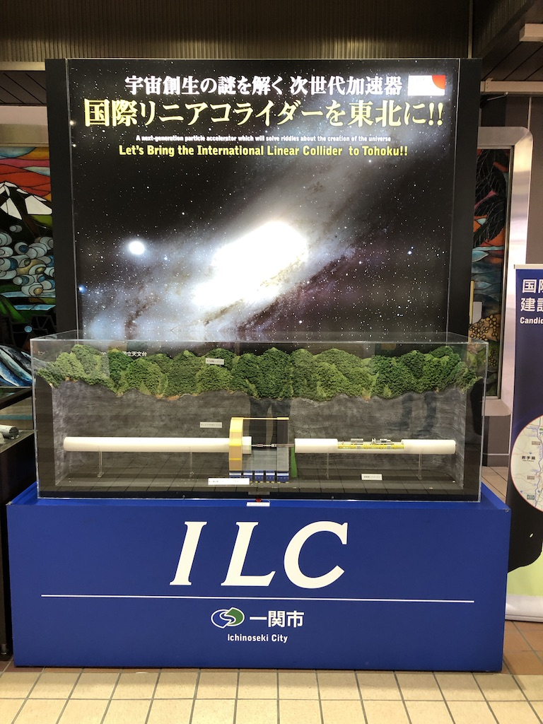
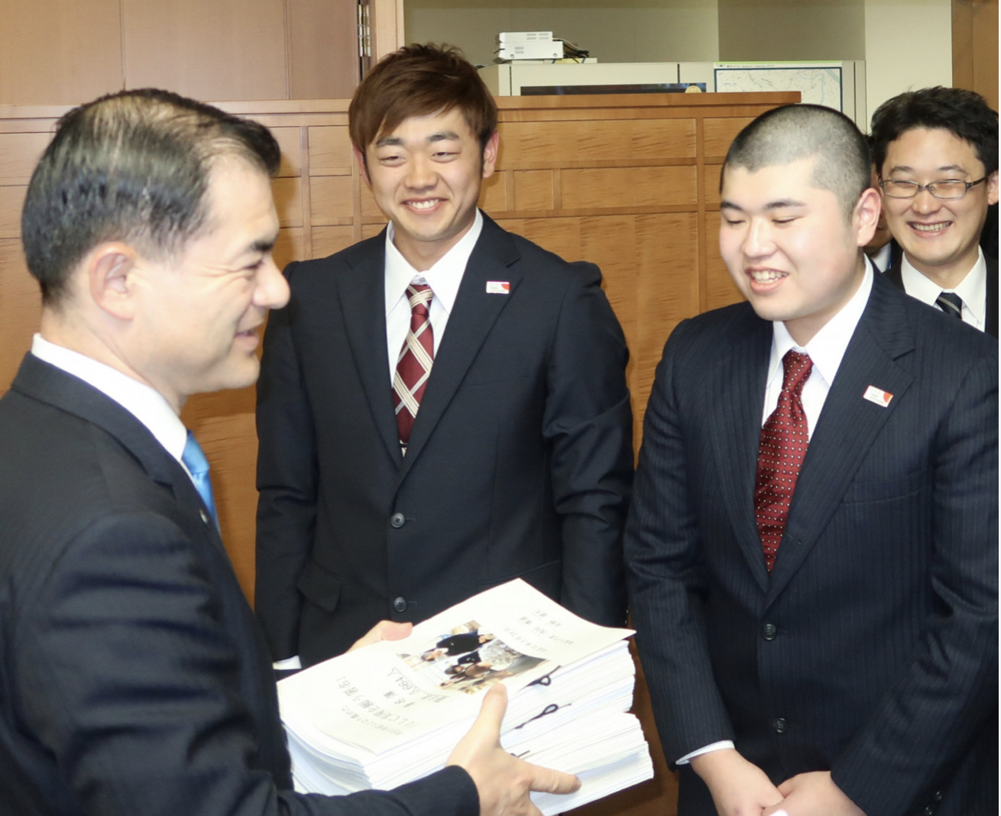
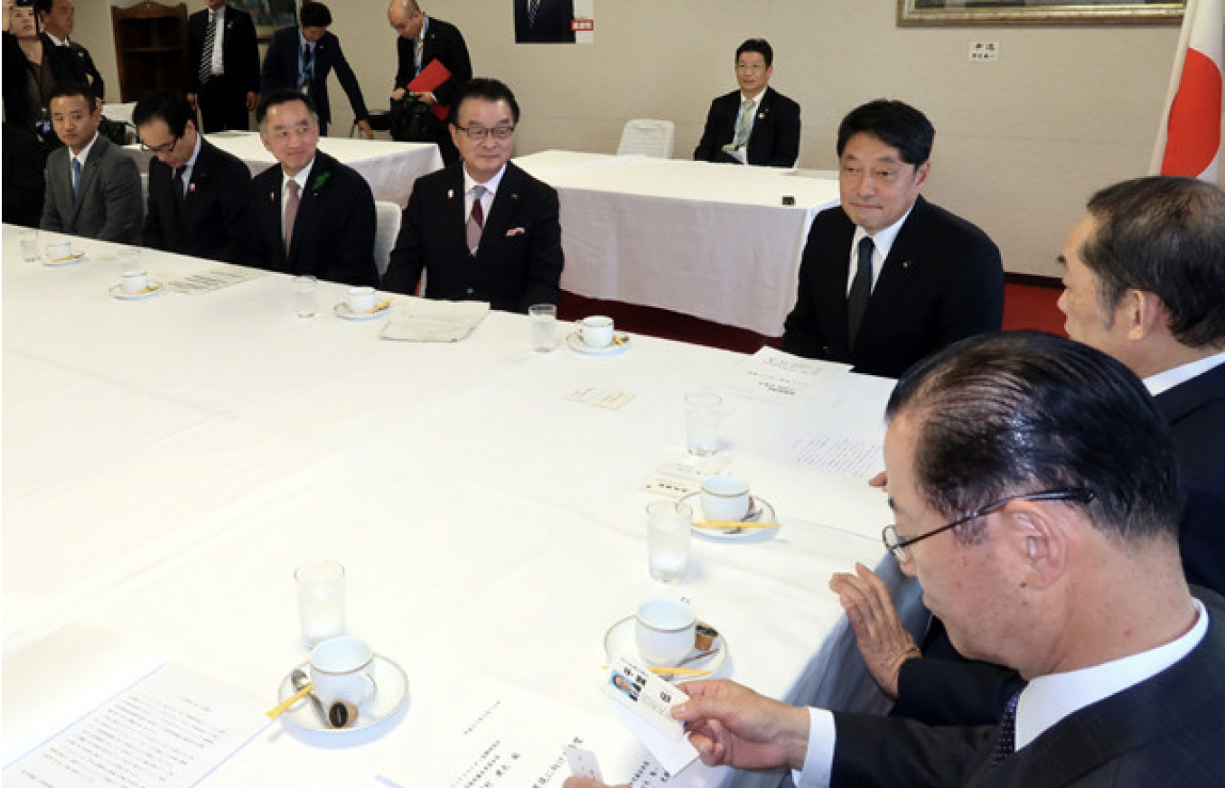
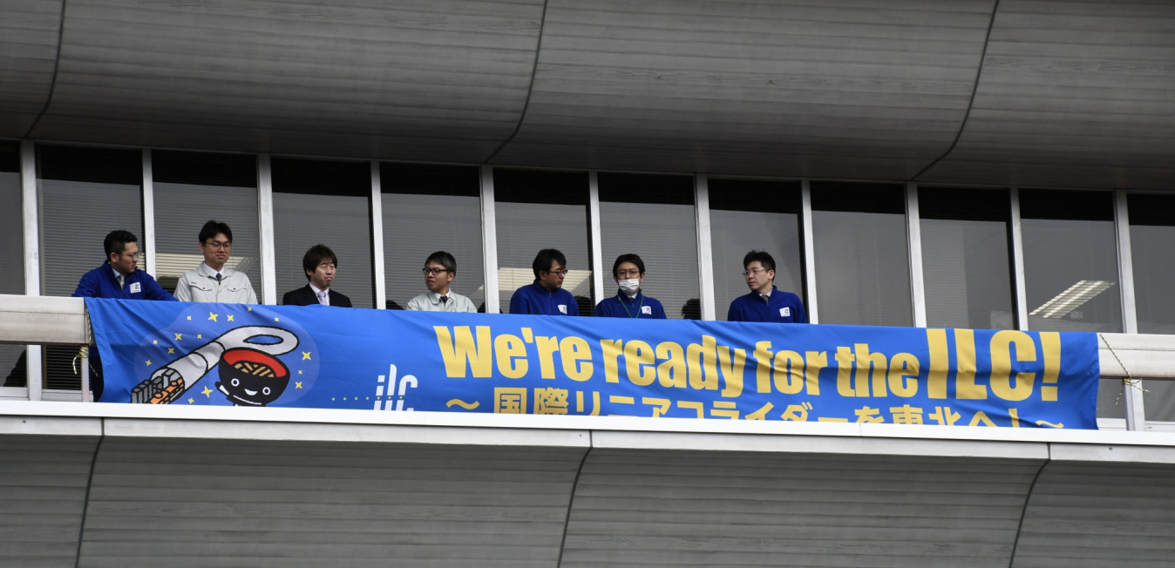
Support from Local Governments and Community
Tohoku ILC Promotion Council:
http://www.tohoku-ilc.jp/en
Iwate Prefectural ILC Promotion Council:
http://www.iwate-ilc.jp/eng/
From Iwate-Nippo
ILC Diorama permanently exhibited at Ichinoseki Station
March 28, 2019: two graduates of Ichinoseki Daiichi High School submitted a petition with signatures of 5,664 people to MEXT Minister.
April 18, 2019: 15 members of prefectural assemblies of Iwate and Miyagi submitted a petition to Chairman Kawamura of the federation of diet member for ILC
March 29, 2019: A 7m-long banner installed at 7 local public facilities including the Iwate prefectural government office as shown above.

Slide 16
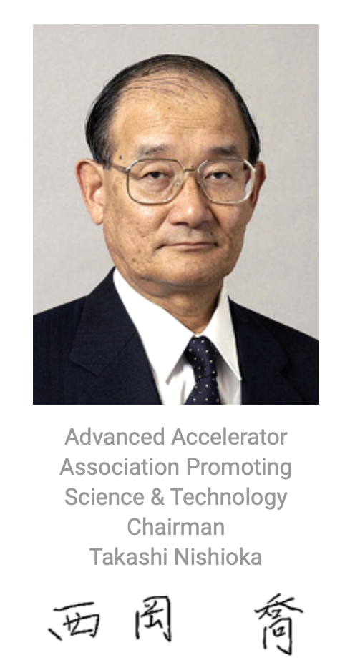
Support from Industries
Advanced Accelerator Association Promoting Science & Technology (AAA) (since 2008 with 100 companies and 40 universities and research institutions)
About MEXT’s view on ILC
http://aaa-sentan.org/en/
Regarding the Government’s View on the International Linear Collider (ILC)
March 7, 2019
Advanced Accelerator Association
Promoting Science and Technology
Takashi Nishioka, Chariman
Today, at the ICFA/LCB meeting, the Ministry of Education, Culture, Sports, Science, and Technology (MEXT) presented its view that it “will continue to discuss the ILC project with other governments while having an interest in the ILC project”. This is the first official opinion expressed in regard to the ILC project and we would like to express our respect to MEXT for having made this forward-looking decision.
In addition to international discussions by researchers and parliamentarians, there have been discussions between the US and Japanese governments. We expect that this announcement of the government’s view will expand such government-to-government discussions to Europe.
It is our great pleasure that this government statement was positively received at the ICFA/LCB meeting. We are aware that the European position regarding the ILC will be discussed in the European Particle Physics Strategy Update process.
We hope that European countries will interpret this presentation of the Japanese government positively, and position the ILC as a high priority among the policies of each country. We sincerely hope that this will make countries around the world get together and move forward toward ILC realization.
Unofficial Translation

Slide 17
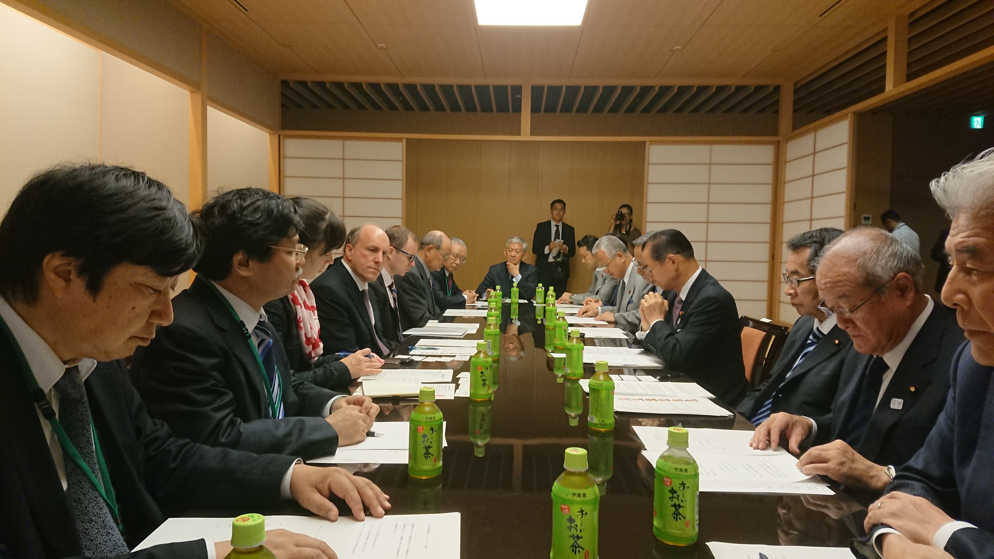
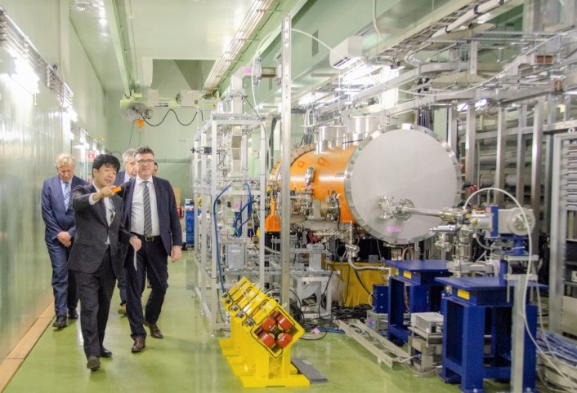
Political/governmental communications with possible foreign partners
Non-patrician Federation of Diet members for the ILC was formed in 2008. Advanced Accelerator Association Promoting Science and Technology (AAA) was also established in 2008 as an industry and academia collaboration.
These organizations have vigorously promoted the ILC project last ten years. Many visits were made to Europe and US.
The MEXT-DOE discussion group on the ILC was formed in 2016. Joint R&D program between Fermilab and KEK is being carried out under this framework.
Diet members together with governmental officials, industrial representatives and researchers visited Europe in January, 2018 and identified counterparts of Japanese representatives in France and Germany at each level.
Recent visits of the DOE Undersecretary (Dr. Paul Dabber), a German parliament member (Dr. Stefan Kaufmann) and French National Assembly members to Diet members in the fall of 2018 produced encouraging results.
Dr. P. Dabbar at a Diet member meeting
Dr. S. Kaufmann at KEK-STF

Slide 18
Summary and Outlook
Japanese MEXT released its statement on March 7 at the LCB meeting in Tokyo.
MEXT has not yet reached declaration for hosting the ILC in Japan at this moment.
MEXT will continue to discuss the ILC project with other governments having an interest in the project.
“We’re proceeding to realize a budgeting as a national project with a separate budget outside the regular science and technology budget.”
Actions to be taken in Japan:
International discussions at the government level ← MEXT
Funding plan ← Legislative sector + MEXT + other ministries
International working group ← KEK
Obtaining support from the broader academic community in Japan ← KEK and Japanese HEP community

