Slide 1
Present and expected constraints on the nuclear symmetry energy William Lynch Michigan State University
Outline
What are some of the objectives for symmetry energy studies?
What are some of the things we have been learning about the symmetry energy?
What might we expect in the near future?

Slide 2
Simplest mean field model: liquid drop or semi-empirical mass formula
Standard expression:
B_{A,Z} = a_{v}[1-b₁((N-Z)/A)²]A – a_{s}A^{2/3} - a_{c} Z²/A^{1/3} + δ_{A,Z}A^{-1/2} + C_{d}Z²/A,
Shouldn’t there be a surface correction to the symmetry energy? e.g.
B_{A,Z} = a_{v}[1-b₁((N-Z)/A)²]A - a_{s}[1-b₂((N-Z)/A)²]A^{2/3} - a_{c} Z²/A^{1/3} + δ_{A,Z}A^{-1/2} + C_{d}Z²/A,
To be more quantitative, one needs to carefully apply density functional theory to reproduce the isospin dependence of nuclear masses.

Slide 3
Skyrme Density Functional theory
One commonly utilized Skyrme density functional for symmetry energy for neutron matter.
Dutra has compiled a large number of Skyrme parameterization. A subset of these are roughly consistent with macroscopic constraints on nuclei. In general, fitting the masses does not constrain the symmetry energy at 2ρ_{0.}
effective mass
corrections
includes 3-body
terms
2-body
interactions
kinetic
energy

Slide 4
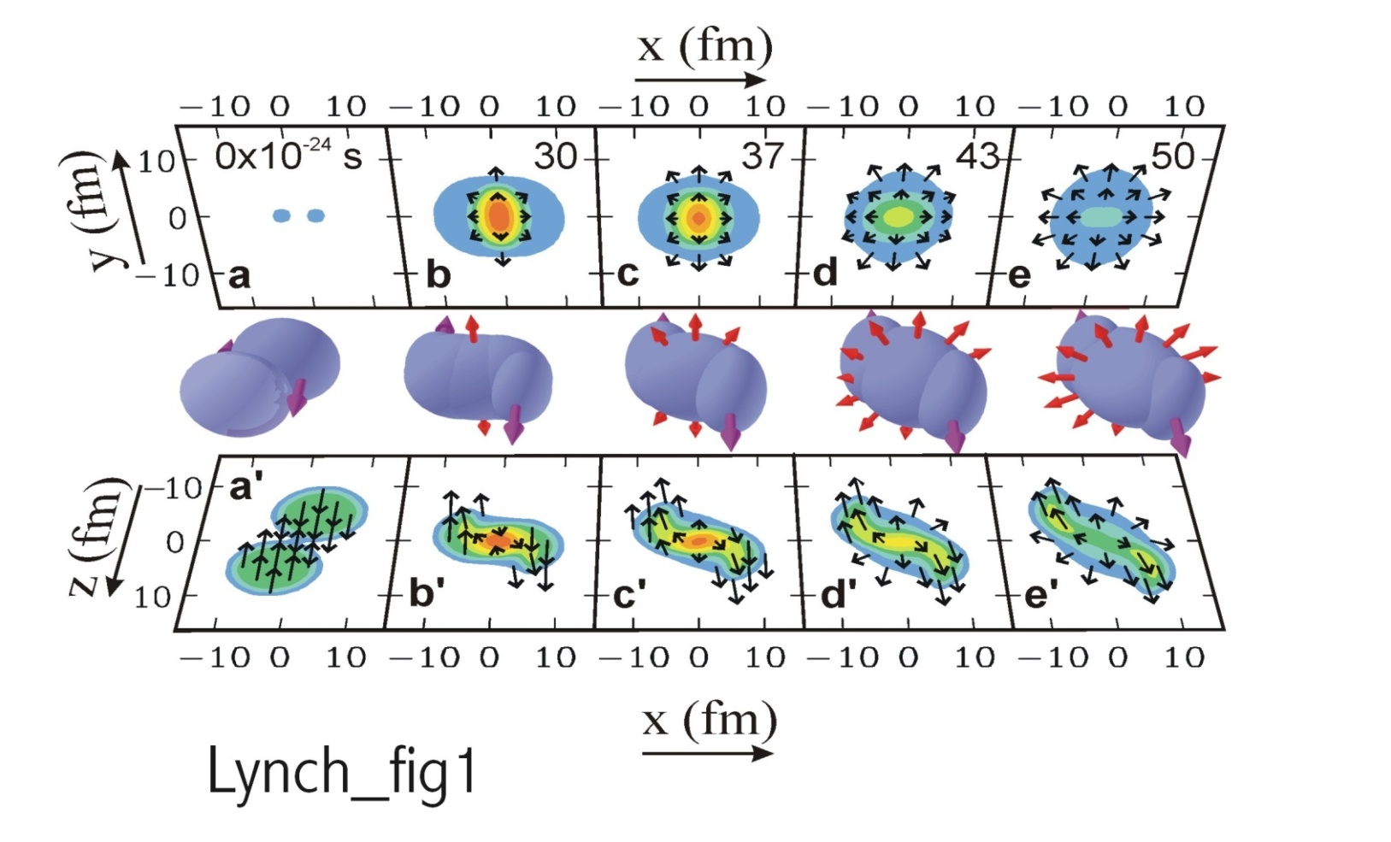
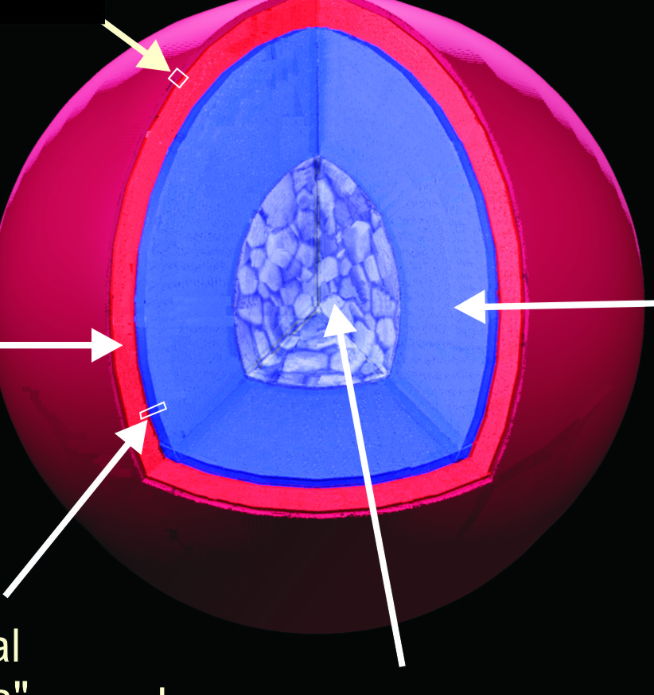
High density systems
Neutron Star
Au+Au collisions E/A=1GeV
surface
outer
core
outer
crust
inner crust
inner core
Constraints at supra-saturation densities can be provided by both Heavy Ion Collisions (HIC) and by NS observations.
The NS crust averages below saturation density but contains nuclei. The crust core transition occurs at about 0.5ρ₀.
The core is mainly at supra-saturation density. The NS radius is closely related to the EoS at 2ρ₀. Similar densities are achieved in central HIC.
Three-body and perhaps four-body forces are important here.

Slide 5
Experimental probes of S(ρ)
Experimental observables probing ρ<ρ₀:
Masses
Isobaric Analog states
Skins
E1 excitations: GDR, Pygmy dipole, E1 Polarizabilty
Isospin dependence of GMR
Isospin Diffusion
neutron vs. proton emission in HIC
Experimental observables probing ρ>ρ₀:
Comparisons of spectra and flows between member of isospin multiplets:
Comparison of to spectra and flows.
Comparison of p to n spectra and flows.
Comparison of ³He to ³H spectra and flows

Slide 6
Astronomical probes of S(ρ)
Astronomical processes sensitive to ρ<ρ₀:
Crust-core transition density and pressure in NS:
Thickness of NS crust
Crustal vibrations.
Thermal transients and cooling in crustal region
Cooling and neutrino emission from proton- neutron star. (neutron-proton effective masses)
Neutrino transport through core-collapse supernova neutrino-sphere.
Astronomical processes/properties probing ρ>ρ₀:
Mass-radius relation of neutron stars.
Deformabilities of neutron stars measured in neutrino star mergers.
Neutron star and proto-neutron star cooling.

Slide 7
Densities and probes
Next I will recall some past and current efforts to constrain the symmetry energy at various densities
I will start at low densities and work upwards in density.
To make reference to existing work, I will make use of the Taylor expansion about ρ₀, and the expansion parameters S₀, L and K_{sym}

Slide 8
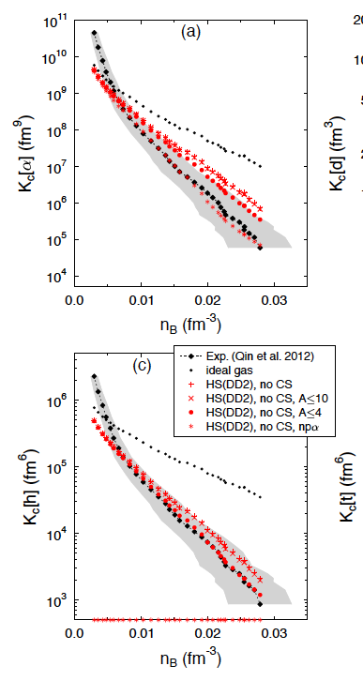
Probing the supernova neutrino-sphere EOS via fragmentation
The neutrino-sphere in a core collapse supernova has T≈5 MeV and ρ/ρ₀<0.25. It is where the neutrino wind is defined that later can produce r-process nuclei farther out.
These conditions can be approximated in fragmentation reactions and such reactions can be described via equilibrium fragmentation (NSE) models.
Can we test the NSE models of for the neutrino?
TAMU group of Hagel and Natowitz have been pursuing this.
Figure show the measured “equilibrium constant” associated with producing helium isotope as a function of a density value extracted via the coalescence model.
M. Hempel et al, Phys. Rev. C 91, 045805

Slide 9
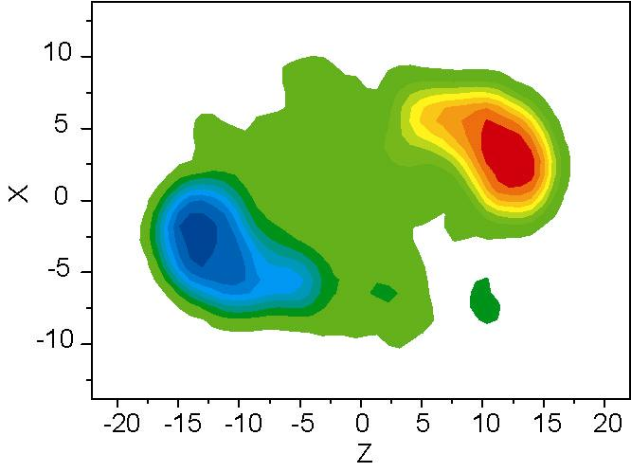
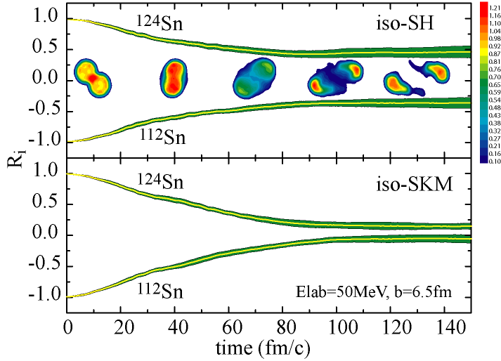
Probe: Isospin diffusion in peripheral collisions
Collide projectiles and targets of differing isospin asymmetry
Probe the asymmetry δ=(N-Z)/(N+Z) of the projectile spectator during the collision.
{
mixed ¹²⁴Sn+¹¹²Sn
n-rich ¹²⁴Sn+¹²⁴Sn
p-rich ¹¹²Sn+¹¹²Sn
Systems
Tsang et al., PRL 92 (2004) 062701
Neutron-rich projectile
R=1 no diffusion
¹²⁴Sn
Larger L
δ
R= -1: no diffusion
Smaller L
¹¹²S
R= 0 equilibrium
Neutron-deficienttarget
R= 0: equilibrium
measure asymmetry after collision
Notes:
Now we want to ultimately constraint the Symmetry energy at high densities with HIC, so we started at low densites.
I want desribe isospin diffusion.
gas in the room analogy
two nuclei one neutron rich and the other neutron deficient. are put in contact, symmetry energy speed s the equilibration process. How much this speed it is assessed by comparing collsions of neutron-rich with nuetonr deficeint to neuton rich on neutron rich.
isospin transport ratio measures the degree to which equilibrum is achieve 0 = equilibrum 1 is no difussion.
Mainly sensitive to symmetry energy in between, which is a subsaturation. If the symmetry energy is larger in this subsaturation region, then the diffusion is faster. This is true for the softer Symmetry energy, because less rapidly with decreasing density.
Transport calcuatlinos show this effect.

Slide 10
Isospin diffusion: extracting constraints
Diffusion ends when the density becomes low enough that the symmetry energy gradient across neck becomes negligible
L-S₀ constraint contour actually corresponds to a constraint of S(ρ_{s})=10.6± 1 MeV at ρ/ρ₀=0.24±0.07.

Slide 11
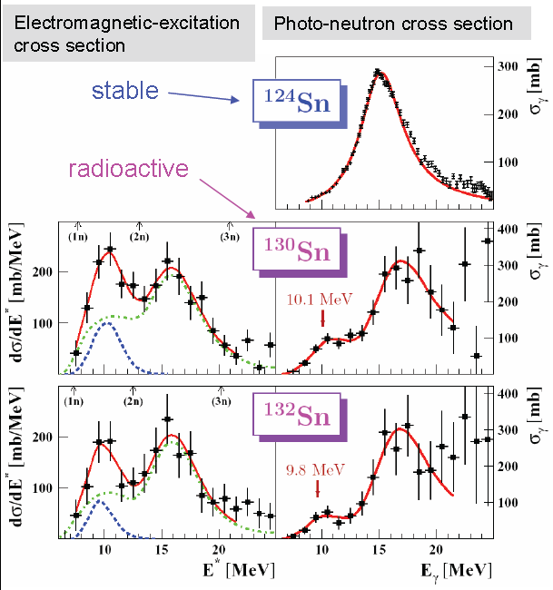
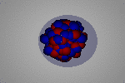
Electric dipole excitations of the neutron skin
E1 moments have increase the symmetry energy, thus E1 excitation can probe the symmetry energy. Two large sources of E1 strength are
GDR
Pigmy Dipole
Both GDR and Pigmy Dipole have been meausured and used to constrain S₀ and L.
In addition, the inverse energy weighted polarizability sum of the E1 strength has been used to combine by the GDR and pigmy contributions to obtain the E1 polarizabilities of ⁴⁸Ca, ¹²⁰Sn and ²⁰⁸Pb.
The polarizability of ²⁰⁸Pb has provided constraints on L and S as well as on S(ρ_{s})
P. Adrich et al., PRL 95 (2005) 132501
Notes:
instead will discuss what happens when you have the neutron skin and it gets excited, but before I talk specifically about skin in the point now that you can excite a nucleus with a coulomb force because the coulomb force accelerates oh pounds but not the neutrons. In most nuclei when the coulomb excitation occurs quickly as in I velocity collision youth site the giant dipole resonance neutrons off against protons from the nucleus but when there isn’t skin bound weakly to the core you can ask late but at the differenti.e. lower frequency. you can see this happening in the extremely neutron rich tan isotopes. Where there is a second peek at low energies in addition to the giant dipole at higher energies. This is the measured and the probability of excitation term

Slide 12
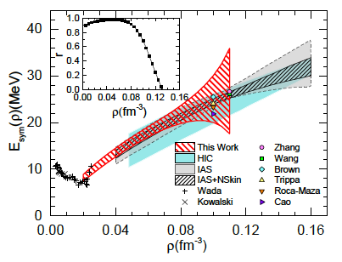
Constraints on S₀, L and S(ρ_{s})
Horowitz, et al., J. Phys. G: Nucl. Part. Phys. 41 (2014) 093001
Zhang PRC 92, 031301 (2015).
The red contour shows the constraint on S(ρ) consistent with the α_{D} measurement. The best determined value is S(ρ)=15.9±1.0MeV at ρ=0.05 fm⁻³, which is marked as the yellow square point in the figure.
A tightly correlated, but large range of values for L and S₀ are allowed by this polarizability measurement.

Slide 13
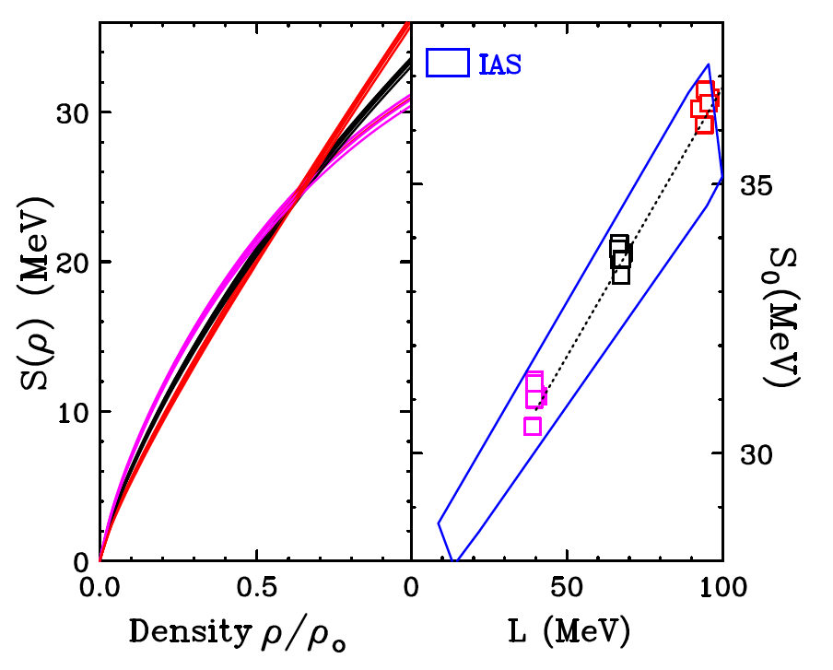
Masses
B.A. Brown, Phys. Rev. Lett. 111, 232502 (2013)
Alex Brown fit the masses of doubly closed shell nuclei, while setting different values neutron skin thicknesses of ΔR_{np}=0.16, 0.20 and 0.24 fm. All Brown fits provide S(ρ)=24.8±0.7 MeV at ρ/ρ₀=0.63±.03 as shown at left.
(31, 40)
The values for S₀ and L lie on a line in the S₀ and L plane along which S(0.63ρ₀) remains constant. This line lies perpendicular to the gradient of S(0.63ρ₀) in the the S₀ and L plane. The slope, M, of the line and the form of the function is sufficient to determine ρ/ρ₀=0.63±.03 and S(ρ)=24.8 ±0.7 MeV. From the slope of the IAS contour (in blue) one similarly obtains ρ/ρ₀=0.66±.04 and S(ρ)=25.5 ±1.1 MeV.

Slide 14
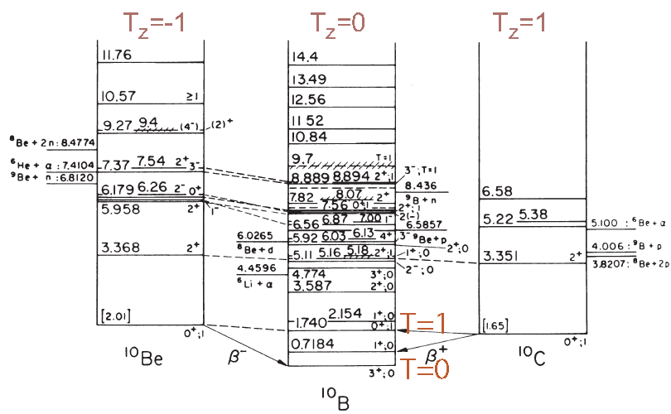
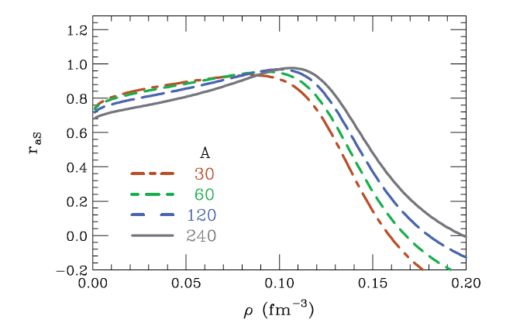
Isobaric Analog states
Information that is equivalent to the isotopic dependences of the masses can be by fitting the energies of ground and isobaric analog states within the same nuclei.
By fitting Isobaric Analog States with 30≤A≤240, Danielewicz obtained constraints on the symmetry energy over a range of densities using a Pearson correlation technique. The sensitivity of different mass ranges maps to different density ranges. Light nuclei are sensitive to lower densities than are heavy nuclei.
P. Danielewicz, and J. Lee, Nucl. Phys. A 922, 1 (2014).
Danielewicz (2006)
Notes:
Danielewicz and play an extra click just like to point out using isospin symmetry you realize that you can extract the symmetry energy by just comparing the energy of ground state’s analog states than the coulomb doesn’t matter. Of course isospin symmetry says this energy component is proportional to the square of the isospin not just the Z. component cf. reformulate a little your symmetry energy. But small correction mainly important for any posting nuclei and it basically takes care of the figures are large extent if you then applied nuclear symmetry energy which has both surface and volume components as a function of mass you can isolate the volume of the symmetry in surface symmetry energy components that was done here this figure laterin our final lecture I’ll show you what that means in terms of this of the symmetry energy term of the equation of state

Slide 15
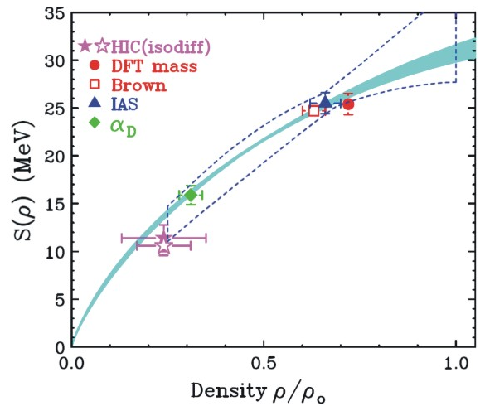
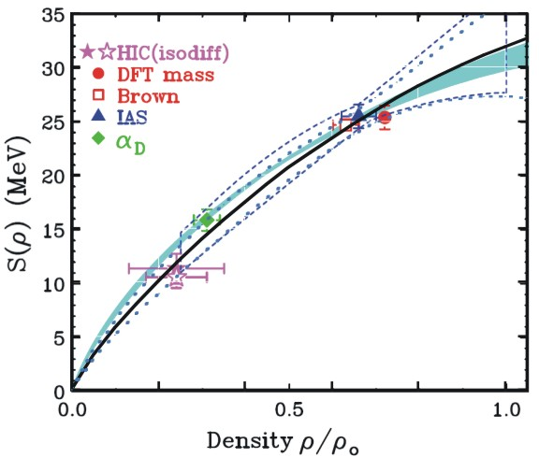
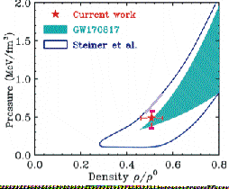
Combing constraints
Lynch and Tsang (2018)
The individual points give the best values from masses, IAS, isospin diffusion and α_{D}.
Blue shaded region is CEFT Drischeler et al., The dashed region is the Pearson analysis of Danielewicz for the IAS data.
Following Ducoin et al, C 83, 045810 (2011) you can fit these five points to obtain a best fit Taylor expansion of S(ρ) about ρ=0.1/fm³ Ducoin et al, showed that such an expansion can be used to obtain the crust-core transition density and pressure. The location for the crust-core transition density is shown as data point.
The contours are pressure contours obtained from NS mass-radius correlation (Steiner et al.) and from neutron star mergers (Abbot et al).
Lynch and Tsang (2018)

Slide 16
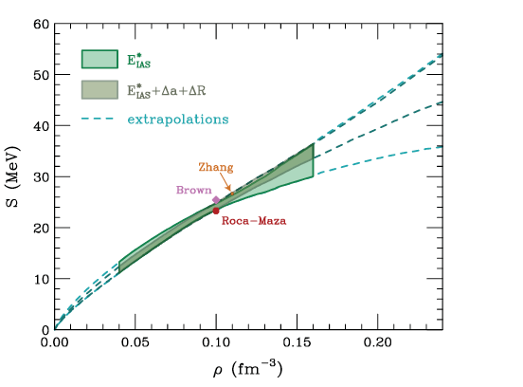

neutron and asymmetry skins
Concerning asymmetry skins, Danielewicz and Lee extracted the asymmetry skins and included them as constraint on S(ρ).
Illustrates how a strong constraint on L from skins can improve constraints on S(ρ).
With increasing value of L, the neutron matter distribution shifts to larger radii, which has two effects:
Neutron skin – Δ_{n-p}
Asymmetry skins: shift between radii and diffuseness of isoscaler and isovector potentials.
Determined by fitting optical potentials for elastic scattering and charge exchange.
We can expect the current information about neutron skins to improve from new measurements including PREX 2 and CREX.

Slide 17
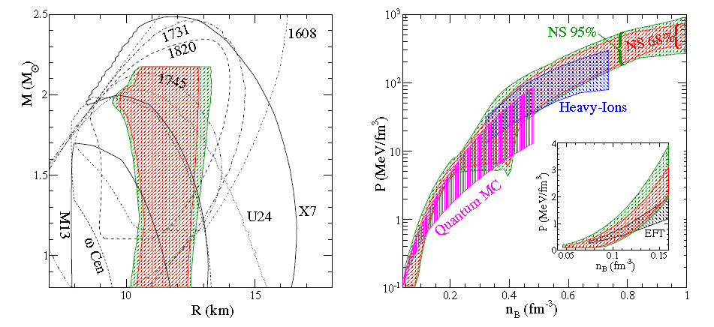
Constraining the EoS and Symmetry Energy at ρ>ρ₀
Two environments: N-stars and nuclear collisions
M/M_{Sun}
Steiner et al., ApJ 722, 33 (2012)
Example 1: Neutron star mass-radius relation
Steiner et al., ApJ 722, 33 extract R=11.5±1.5 km from X-ray bursters and quiescent binary systems. Other radius measurements have differed by the order of 2 km.
Comparable constraints on pressure of 30 MeV/fm³ < P < 86 MeV/fm³ at n_{B} =0.43 /fm^3 from neutron star R vs. M correlation and Heavy ion collisions. (Factor of 3). Uncertainties are large, yet constraints are useful. Heavy ion “constraints” appear much tighter at 0.3<n_{B}<0.4 /fm^3
Notes:
New neutron star observations since 2000 have really stimulated efforts to constraint the EoS from them.
I show two figures from the work of Steiner, Lattimer and collaborators where observations of extra bursters, and quiescent x-ray binary systems were used to constain the eos. The mass versus radii regions are shown in the lsft figure. Curve obtained by solvign the Tolman Oppenheimer Volkov equation for different EoS’s are shown as lines. From such comparisons, a contour of likely EoS was obtained brown and gree regions. Red shows that it is probably inaccurate to try to expolate from nucleaer propeties. The blue region is the constrainf from HIC. Before passing on to how that was obtained and its uncertainties, it useful to note that the uncertainty is about a factor o 3 in pressure, which represents a huge improvement in understand. But clearly there is noom to improve.

Slide 18
Laboratory Constraints on symmetric matter EOS at ρ>2 ρ₀.
E/A (ρ, δ) = E/A (ρ,0) + δ²•S(ρ) δ = (ρ_{n}- ρ_{p})/ (ρ_{n}+ ρ_{p}) = (N-Z)/A
Boundary determined by comparing relativistic Au+Au transverse and elliptical flow data to transport calculations
Lynch Prog. Part. Nucl.
Phys. 62,427 (2009)
Danielewicz et al.,
Science 298,1592 (2002).
gold
Flow confirms the softening of the EOS at high density.
Constraints from kaon production are consistent with the flow constraints and bridge gap to GMR constraints.
Note: analysis requires additional constraints on m* and σ_{NN}.
The symmetry energy dominates the uncertainty in the n-matter EOS.
Neutron star matter “constraint” includes symmetry energy uncertainties
Improved laboratory constraints on the density dependence of the symmetry energy are needed to verify and tighten the constraints.
Notes:
Transverse and elliptical flow data were compared to transport calculations with different EOS;s in order to determine which EOS describes the data best.
other quantities such as the effective masses and in-medium cross sections were varied to understand the model dependence of the calculations.
The boundary shows the pressure at 0 temperature consistent with these constraints. the line shows a quadratic EOS consistent with the monopole resonance. This shows that higher order terms soften the symmetric matter EOS.
These constraints though conservative, do rule out various theories.
If you add the constraint from kaon production, you get a consistent picture and an existence proof that such constraints can be obtained from nucleus-nucleus collisions.
However, when you add the pressure from the symmetry energy to get the pressure in neutron matter, you see that the uncertainties in the symmetry energy outweigh the remaining uncertainties in the symmetric matter eos Because the symmetry energy has not been experimentally constrained at high densities the contour lable HIC in Andrew Steiner’s graf is much wider our goal is to provide contraints on th e symmetry energy and strink it. .

Slide 19
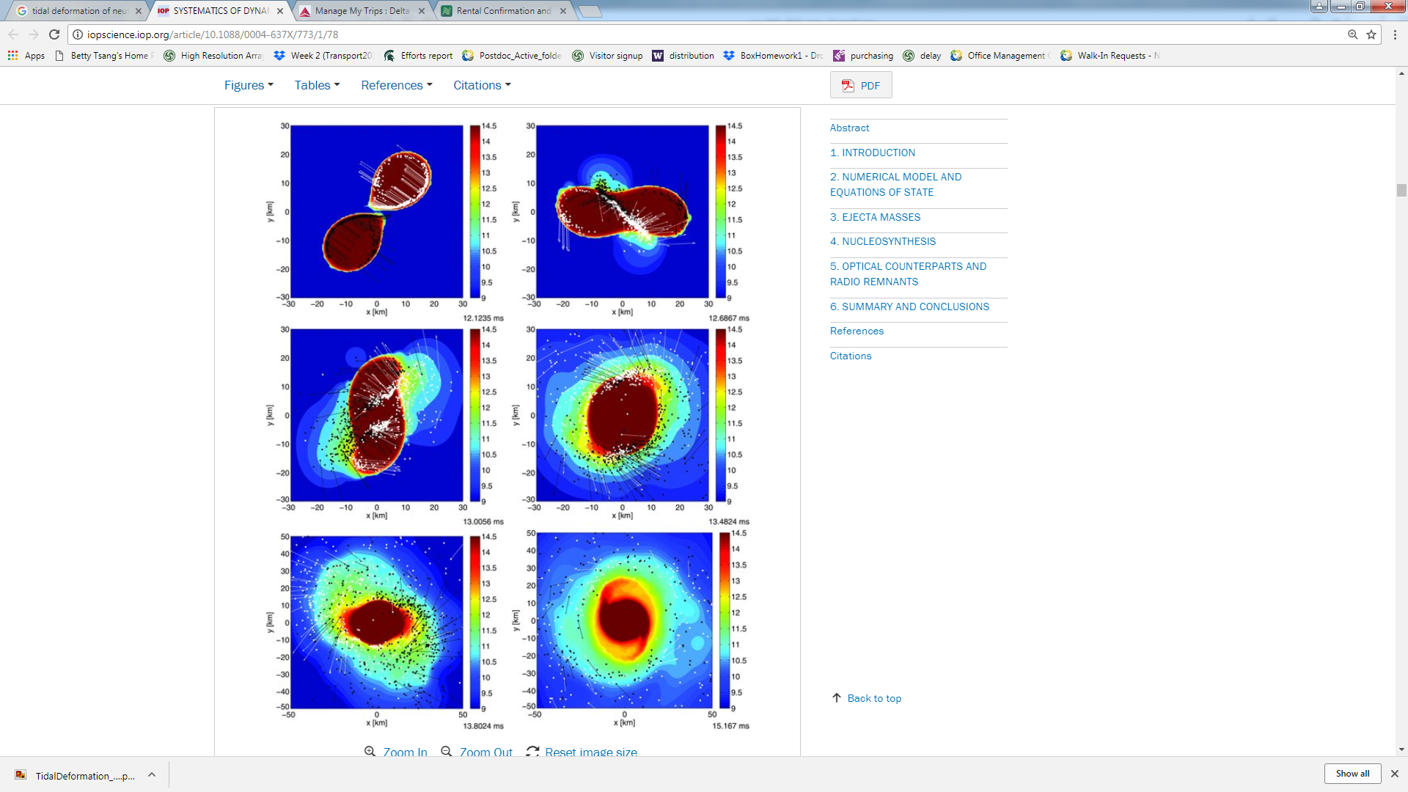
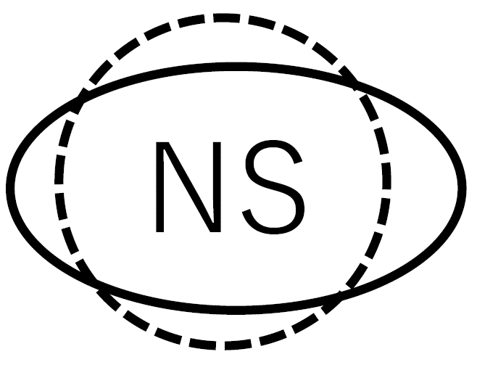

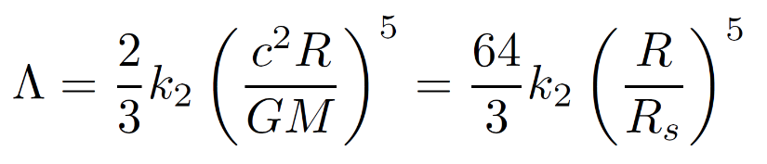
Tidal deformation of the Neutron Star
Bauswein, S. Goriely, and H.-T. Janka,
APJ, 773, 21 (2013)
Soft EoS
Large deformabilty
Stiff EoS
small deformability
Λ<800 (90% confidence)
GW170817 PRL 119 161101

Slide 20
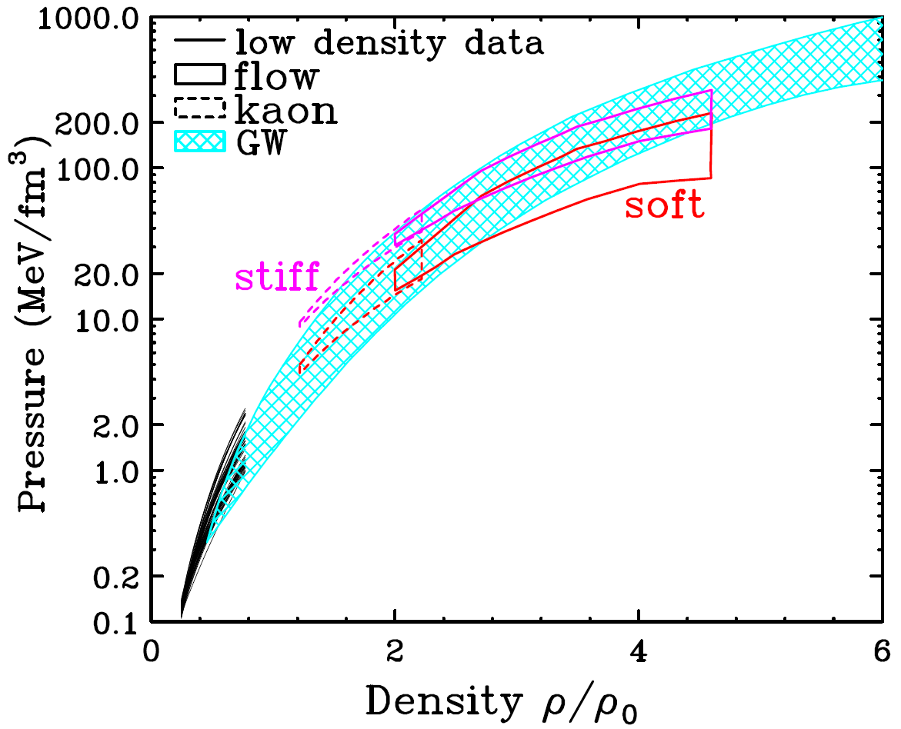
EOS from Neutron Star Merger analysis
C.Y. Tsang et al., arXiv:1807.06571
Blue region from NS mergers (B. P. Abbott, et al., arXiv:1805.11581 (2018))
Red region from Flow & Kaons (W.G. Lynch, et al., Prog. Part. Nucl. Phys. 62, 427 (2009))
Deformability and mass-radius largely set by pressure at 2ρ_{0.}
Astronomical constraints on deformability from LIGO-VIRGO, and mass vs. radius relation (NICER) will get tighter.
Nuclear experiments are needed to obtain a microscopic understanding of the pressure.

Slide 21
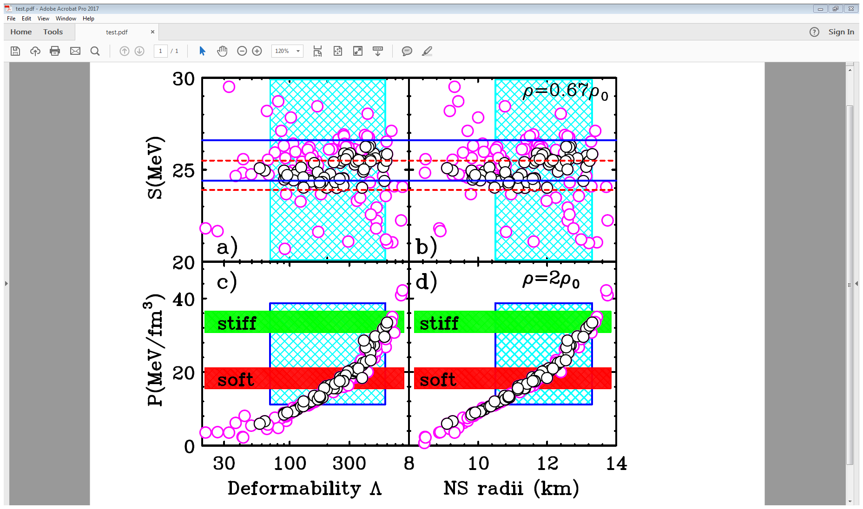
Can nuclear structure observable constrain NS’s at 2ρ₀?
C.Y. Tsang et al., arXiv:1807.06571
If you use Skyrme all interactions that reproduce these 5 low density observables, you do not adequately constrain values for NS radii or the deformability.
Measurements at the RIBF, FRIB, RAON and FAIR facilities should provide the constraints needed for a microscopic understanding of the EoS at 2ρ₀.

Slide 22
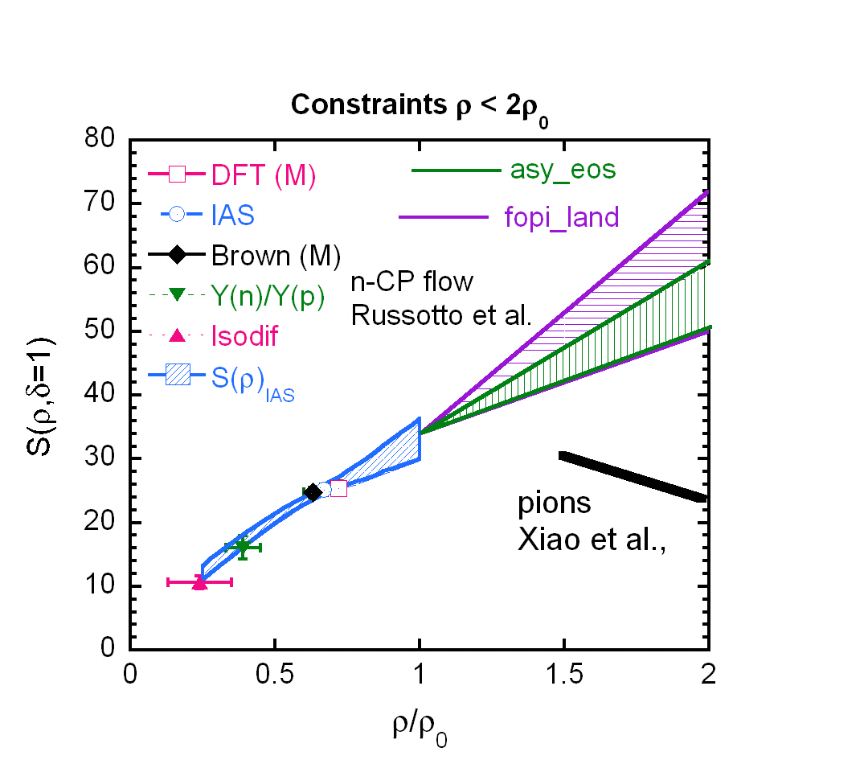
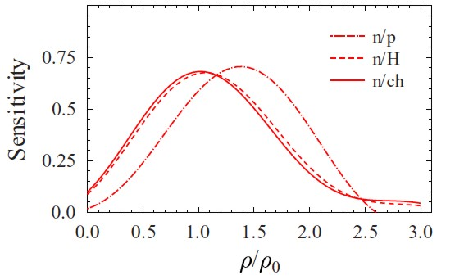
What is Status of symmetry energy at ρ > ρ₀?
Russotto et al., PLB, 697, 471 (2011)
Xiao et al., PRL 102, 062502 (2009).
Constraints at ρ>ρ₀ remain loose and somewhat contradictory.
Analyses do not reflect the knowledge obtained at lower densities.
Ratios of neutron / proton elliptical flow appear sensitive to higher densities ➔important to resolve protons.
Analyses of ratio of neutron and charged particle elliptical flow suggest a moderately stiff symmetry energy, but uncertainties could be much better defined.
Ratios of pion yields suggest a much softer symmetry energy, but more quantitative constraints will be obtained by accurately measuring spectra.
Notes:
In the past decade or more, considerable progress has been made towards constraining the density dependence of the symmetry energy.
The figure here shows the constraints in a recent report (2014). Data at subsaturation density, masses, Isobaric analog resonances and HIC have really tightened. Not shown are the new results from polarizability. The current situation is probably tighter still. Theoretical error bars are key to this enterprise.
THe situation at high denity is up in the air. and leaves room for experimental and probably theoretical improveme
Two results n/p elliptial flow almost linear
pions: paper suggested considerabl softening.

Slide 23
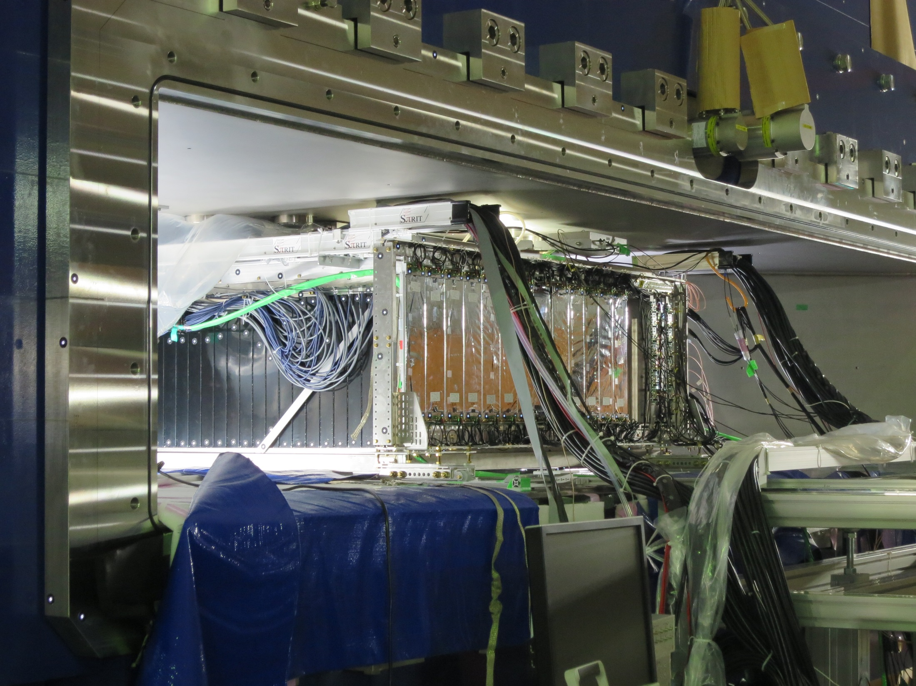
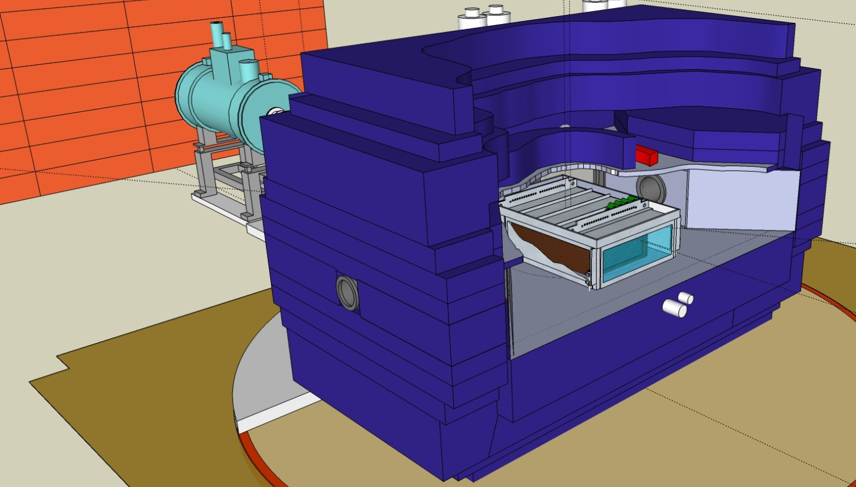
SPπRIT-Time Projection Chamber exp. at RIBF
Shane et al., NIMA 784 (2015) 513
SAMURAI dipole magnet
80cm
134 x 86 x 53 cm³ effective volume
dE/dX – Bρ particle identification.
Target at the entrance of chamber.
Readout with ~12000 pads.
Neutrons 15°<θ<30° meas. by NeuLAND
Experiment completed 6/1/2016
E/A MeV | Reaction |  | focus
280 | ¹³²Sn+¹²⁴Sn | .22 | S(ρ), m*_{n}- m*_{p}
280 | ¹⁰⁸Sn+¹¹²Sn | .08 | S(ρ), m*_{n}- m*_{p}
280 | ¹²⁴Sn+¹¹²Sn | .15 | σ_{nn}, σ_{np}, σ_{pp}
280 | ¹¹²Sn+¹²⁴Sn | .15 | σ_{nn}, σ_{np}, σ_{pp}

Slide 24
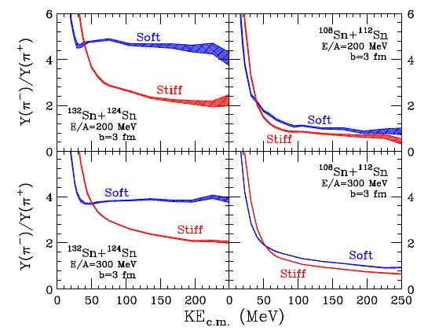
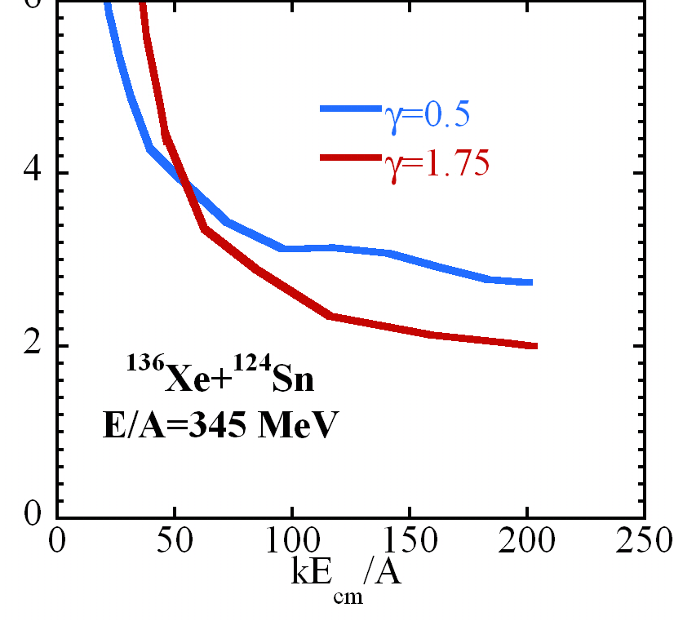
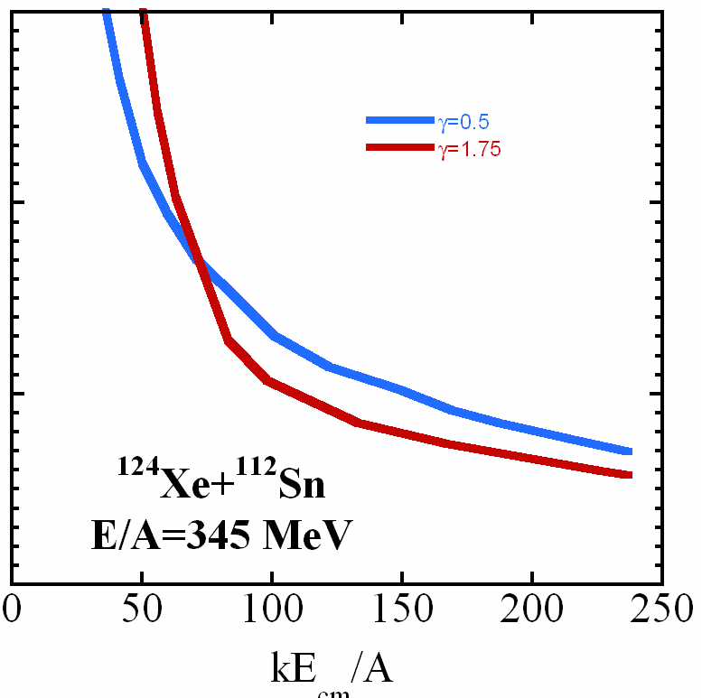
Future Studies
The incident energy of our previous experiment, E/A=270 MeV, is slightly below the N+N➔ N+N+π production threshold in free space.
Changing the bombarding energy provides an excellent test of the influence of the symmetry mean field potential.
Spectral ratio decreases with energy for soft symmetry energy. Not so much for stiff.
M.B. Tsang et al., PRC (2017).
Experiment was performed at E/A=270 MeV

Slide 25
Summary and outlook
The symmetry energy at ρ<0.75ρ₀ is becoming increasing constrained from laboratory data.
Above 2ρ₀ some constraints on total pressure on the EoS can be obtained from causality, the neutron star mass-radius relation and the observed deformability of neutron stars. These latter observations are expected to become more precise with new NICER data and with improved instrumentation at LIGO.
The mass vs. radius relation and deformabilities of neutron stars do not determine what the relative contributions of the symmetry energy and symmetric matter EoS to the total pressure.
Experiments using NeuLAND at GSI and using the SπRIT TPC within the SAMURAI spectrometer at RIBF are aimed to provide this information up to 2ρ₀ . Additional will be provided by future experimental programs at these facilities as well new programs at FRIB, FAIR and RAON.
The future is exciting.

