Slide 1



Summary of CNU Activities on LAMPS project
Dong Ho Moon
(Chonnam National University)
2018/10/12 LAMPS Collaboration Meeting

Slide 2
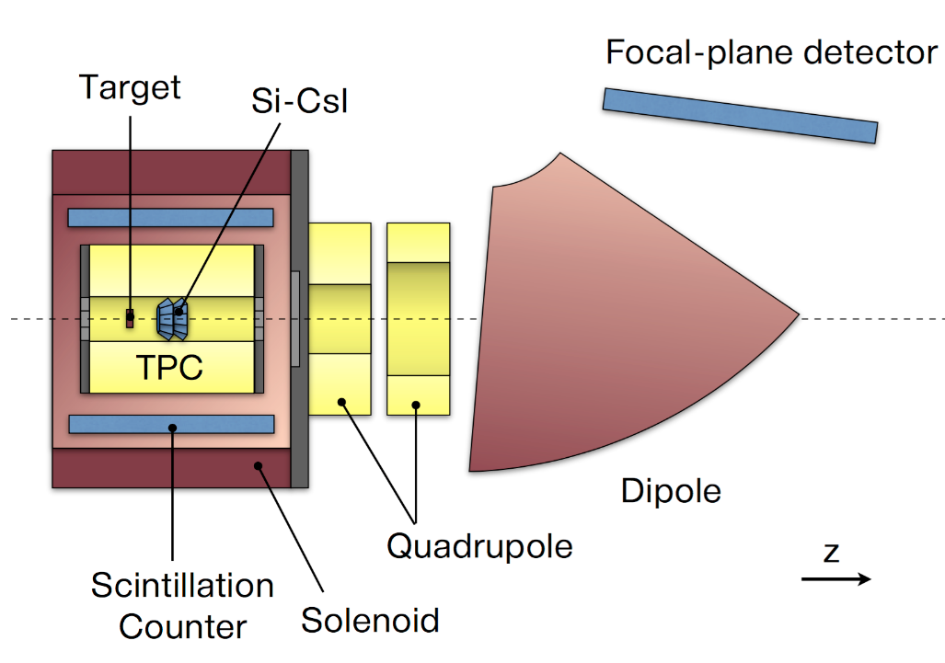
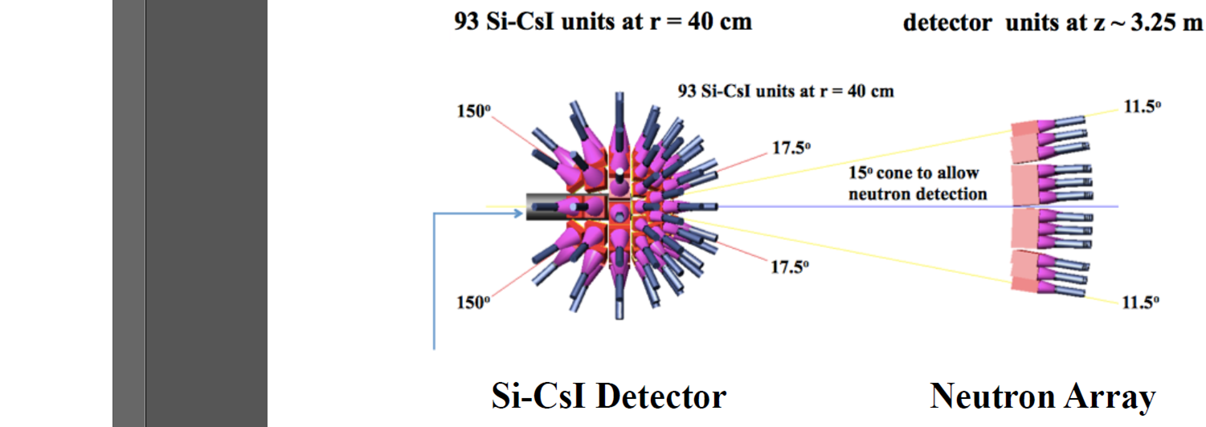
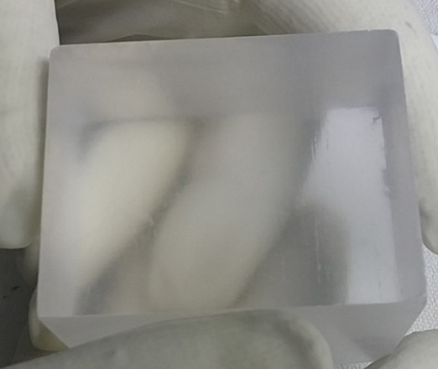
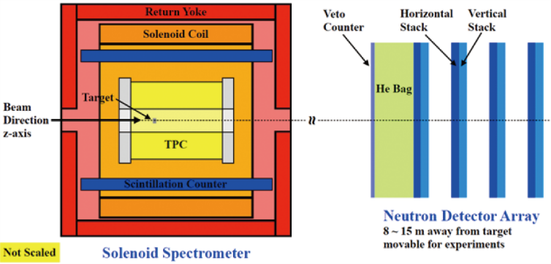
Status Report
Old High LAMPS
Old Low LAMPS
Design
New High LAMPS
CsI Crystal
CNU activities focus on CsI test and Neutron detector construction.

Slide 3
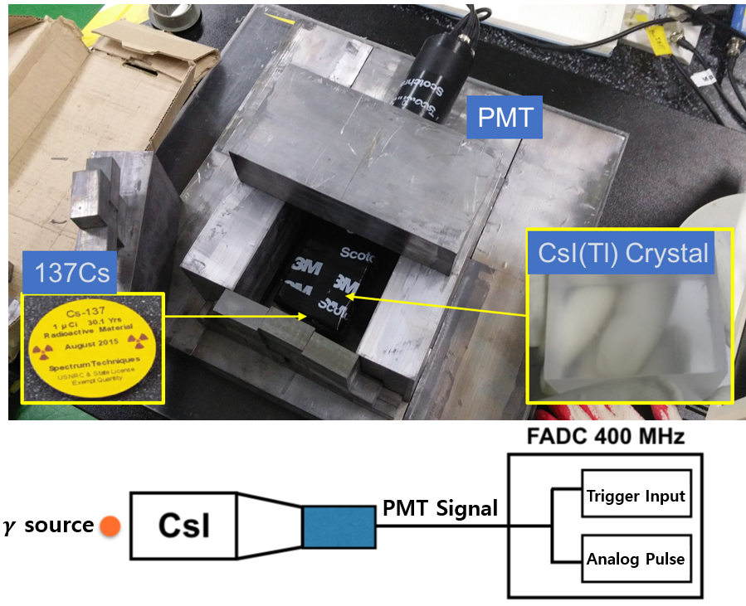
Status Report
Experimental Setup
FADC 400MHz
2 PMTs (H-7195)
VME Modules
Source (¹³⁷Cs, ⁶⁰Co, ²⁵²Cf, ⁵⁴Mn, ⁶⁵Zn and ²⁵²Cf)

Slide 4
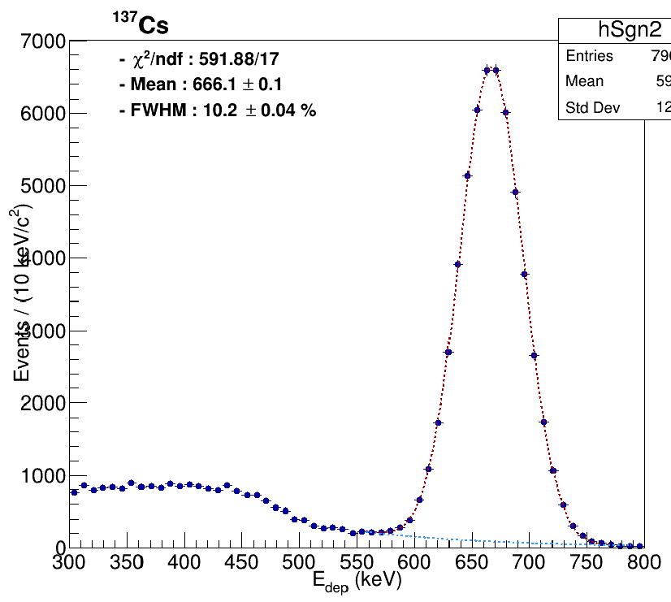
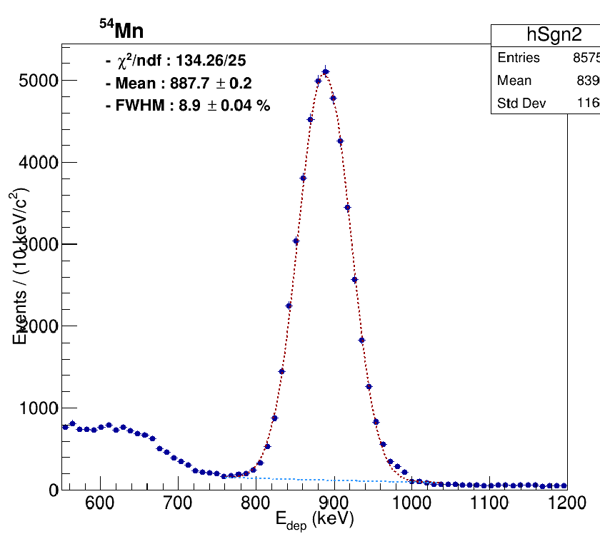
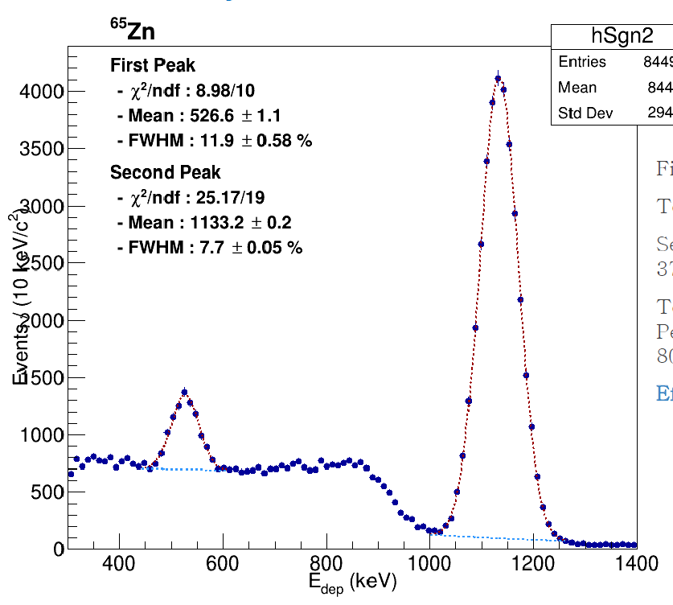
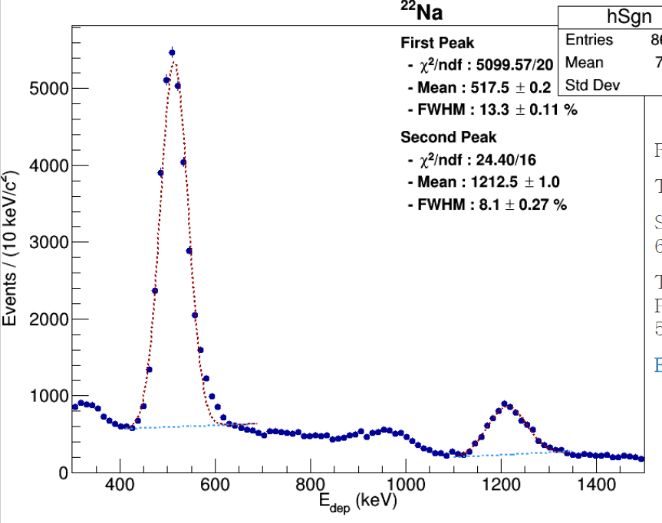
Gamma Detection Test
Scale Number : 2400 ~ 660 keV
필준 그림 넣기
Hanseul Lee & Piljoon Gwak

Slide 5
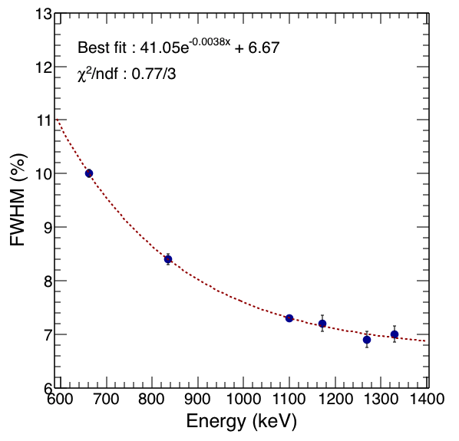
Gamma Detection Test
Scale Number : 2400 ~ 660 keV
필준 그림 넣기
Energy Resolution
Hanseul Lee & Piljoon Gwak

Slide 6
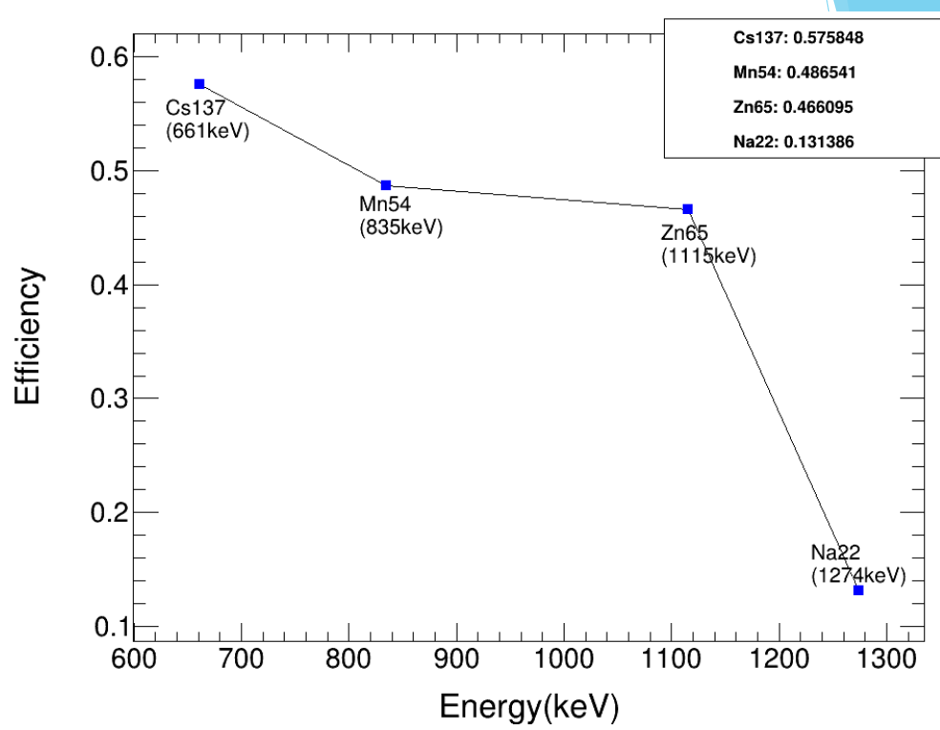
Gamma Detection Test
필준 그림 넣기
Efficiency =
# of Photopeak
# of Total Hits
Hanseul Lee & Piljoon Gwak

Slide 7
Gamma Detection Test
필준 그림 넣기
Efficiency =
# of Photopeak
# of Total Hits
Will measure again with ⁶⁰Co
Hanseul Lee & Piljoon Gwak

Slide 8
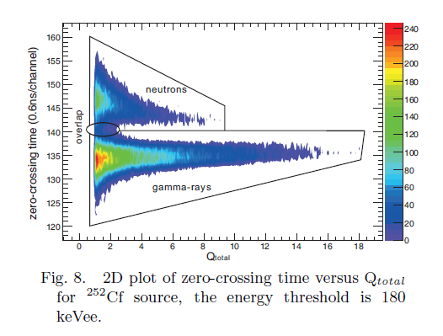
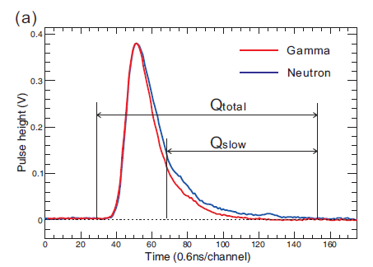
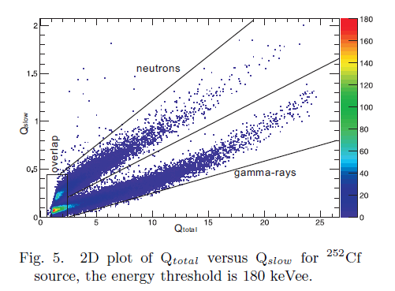
n-Gamma Separation
Pulse Shape Discrimination (PSD)
CPC 37 (2013) 010201
Variables
Q_{slow}/Q_{total} = Q_{ratio} vs Q_{total}
Q_{slow} vs Q_{total}
Hanseul Lee

Slide 9
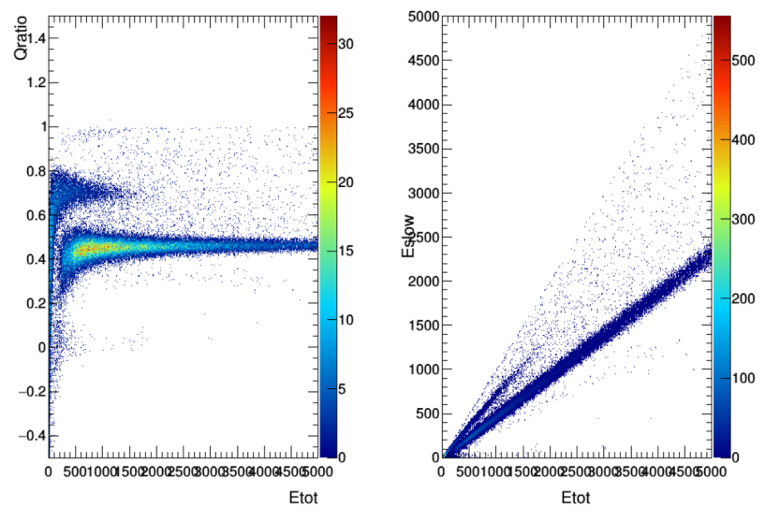
n-Gamma Separation
Pulse Shape Discrimination (PSD) Variables
Q_{slow}/Q_{total} = Q_{ratio} vs Q_{total}
Q_{slow} vs _{Qtotal}
Q_{ratio}
²⁵²Cf
²⁵²Cf
Q_{slow}
Q_{total}
Q_{total}
Scale Number : 2400 ~ 660 keV
Hanseul Lee

Slide 10
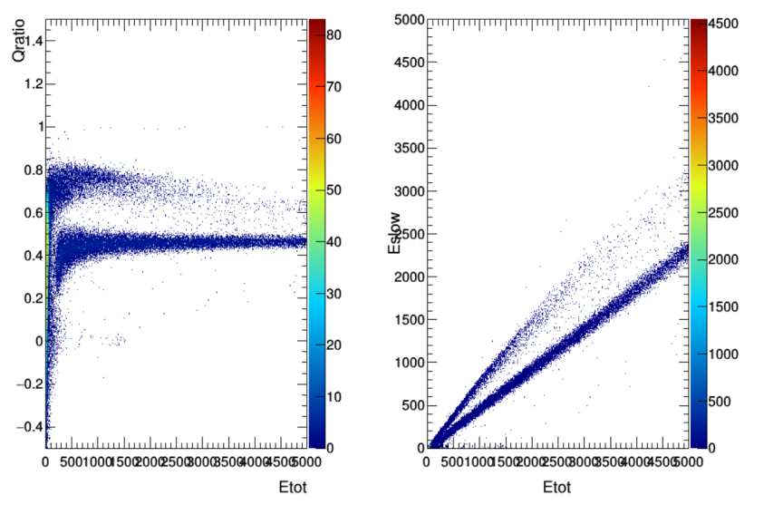
n-Gamma Separation
Pulse Shape Discrimination (PSD) Variables
Q_{slow}/Q_{total} = Q_{ratio} vs Q_{total}
Q_{slow} vs _{Qtotal}
Q_{ratio}
Noise
Noise
n-gamma Separation in CsI would be not possible ?
Q_{slow}
Q_{total}
Q_{total}
Scale Number : 2400 ~ 660 keV
Hanseul Lee

Slide 11
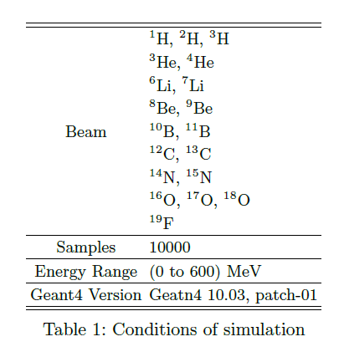
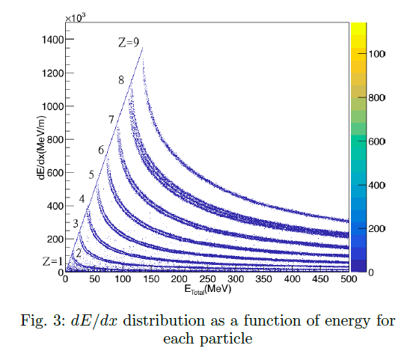
Geant4 Simulation
Particle Gun Study
Follow up Soohyun’s thesis of master course
Gyeonghwan Bak

Slide 12
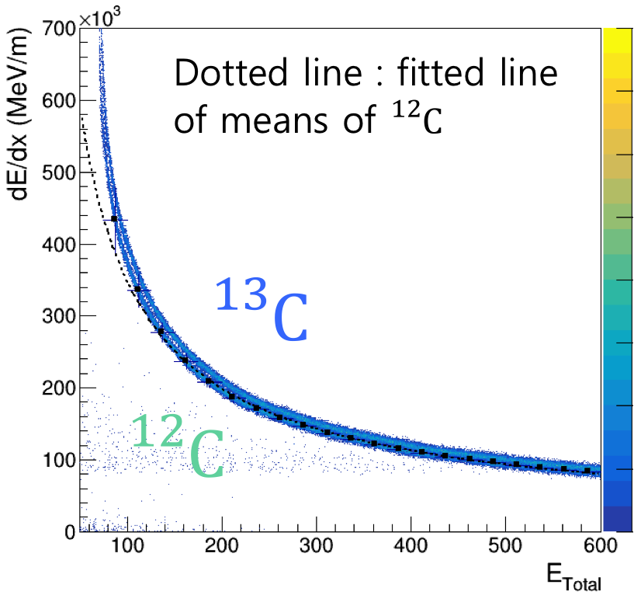
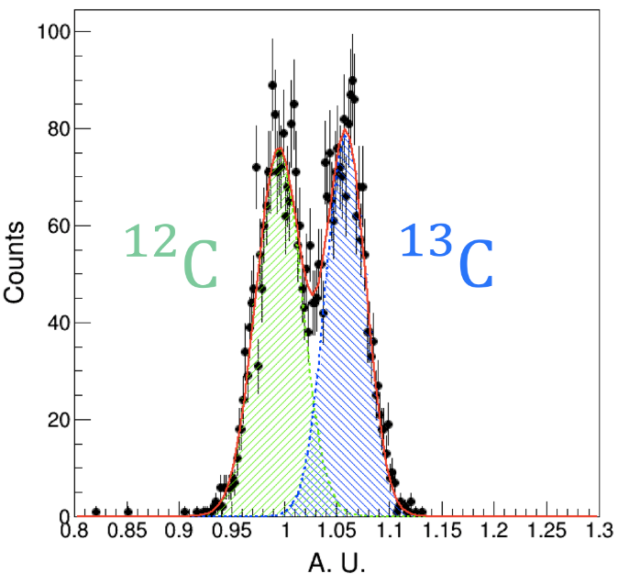
Geant4 Simulation
Particle Gun Study
Gyeonghwan Bak

Slide 13
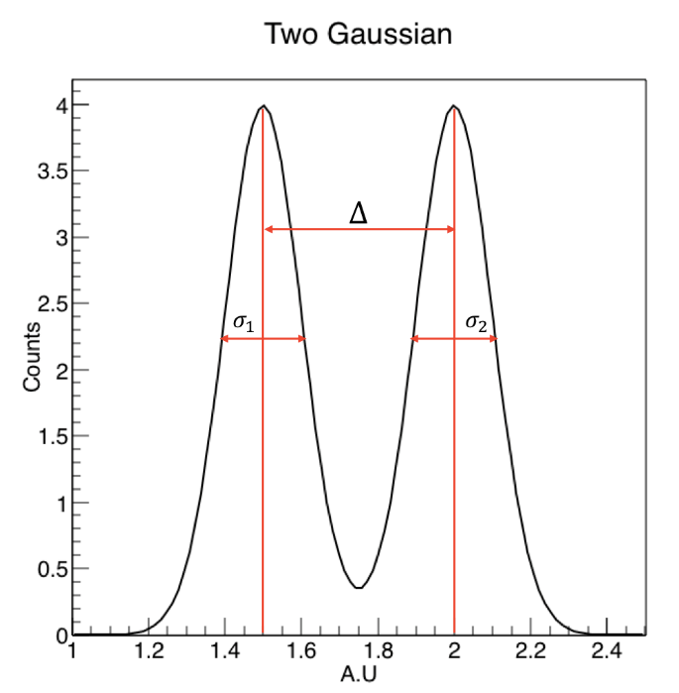

Geant4 Simulation
Particle Gun Study
Figure Of Merit
Gyeonghwan Bak

Slide 14
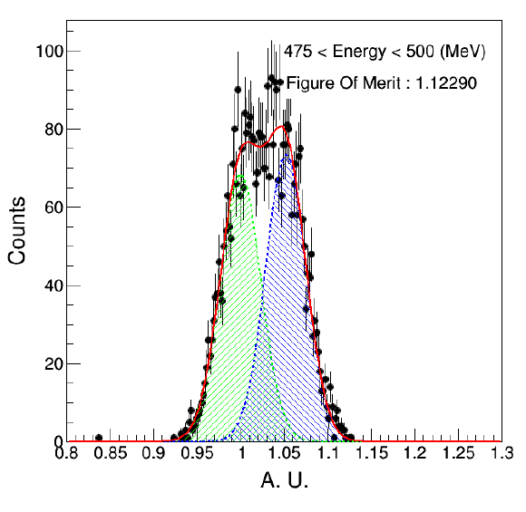
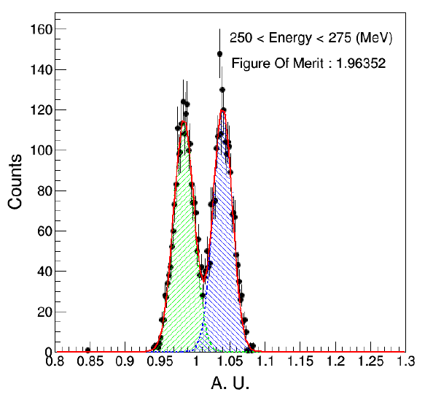
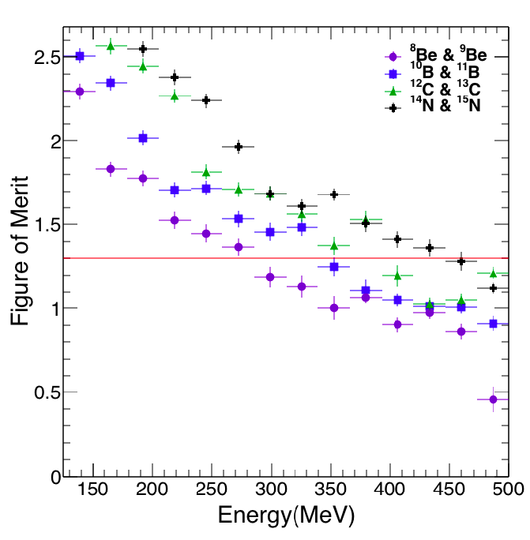
Geant4 Simulation
Particle Gun Study
Gyeonghwan Bak

Slide 15
Geant4 Simulation
Particle Gun Study
Gyeonghwan Bak

Slide 16
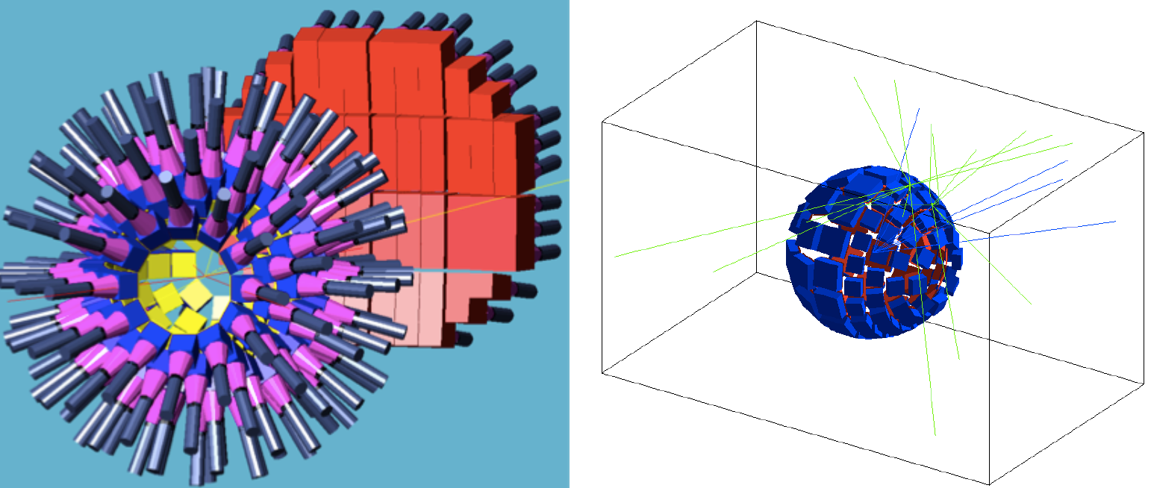
QMD Simulation
QMD Simulation with GSI Au-Au simulated data (?) given by JungWoo
Gyeonghwan Bak

Slide 17
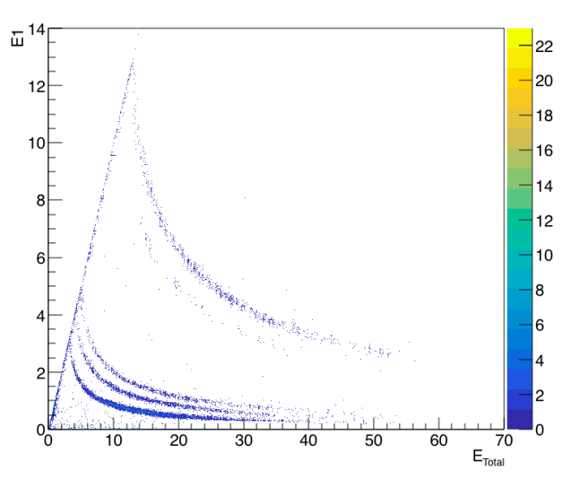
QMD Simulation
QMD Simulation with GSI Au-Au simulated data (?) given by JungWoo
Will try to measure again with Dr. Kyungil Kim’s new simulated data
Gyeonghwan Bak

Slide 18
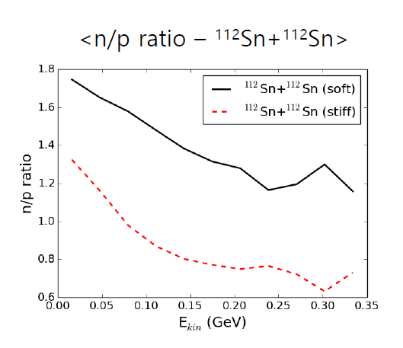

QMD Simulation
QMD Simulation given by Dr. Kyungil Kim
Blind test with ¹¹²Sn+¹¹²Sn 50 MeV/A 20000 events
Soft
Stiff
Input
Analyzed results
SungHak Lee

Slide 19
Summary & Plan
CsI Detector test with various gamma sources was done
Energy resolution and efficiency studies for gamma were done
Efficiency study again with ⁶⁰Co : plan to buy one more CsI crystal next year
Perform charged particles detection test with beta, alpha
Blind analysis for QMD model from Dr. Kyungil Kim’s simulated data with Low-LAMPS for two cases
Measure n/p ratio and compare input and analyzed results
But need to change the plan to focus on the construction of new LAMPS (two students will be available from this winter : SungHak Lee (70%) and Piljoon Gwak (30%))

