Slide 1
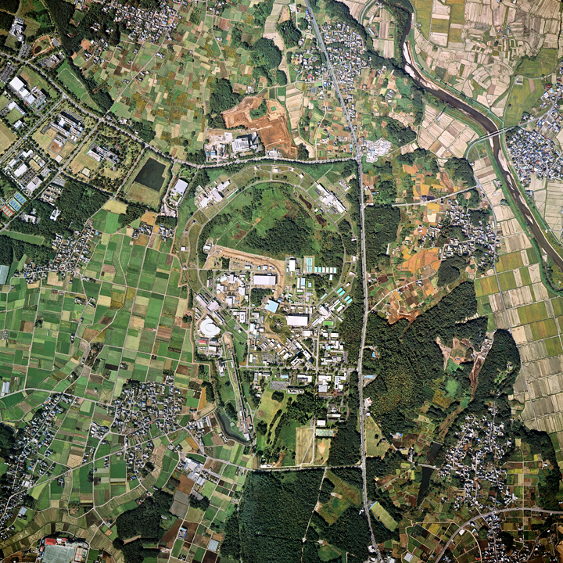

Overview of KEK Activities TYL/FKPPL meeting 2019
Katsuo Tokushuku
Institute of Particle Nuclear Studies (IPNS)
High Energy Accelerator Research Organization (KEK)

Slide 2
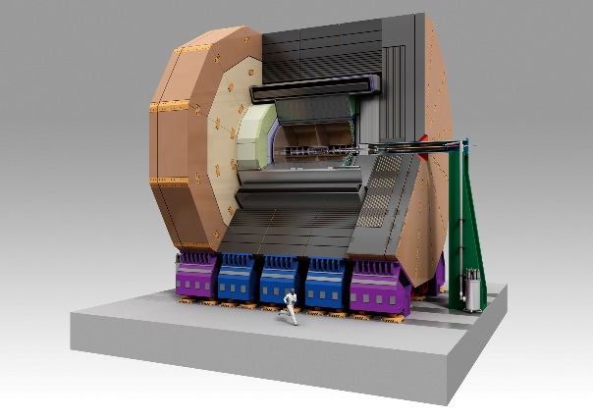
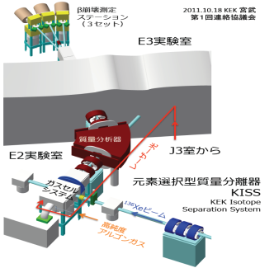
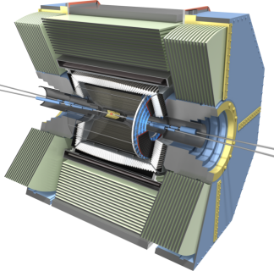
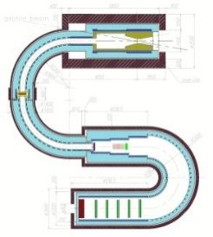
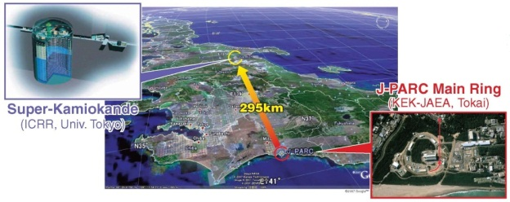
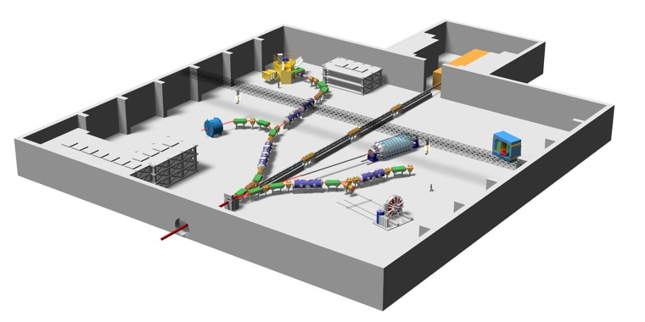
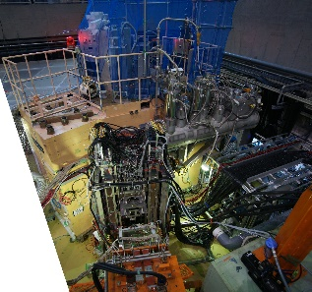
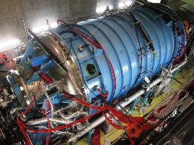
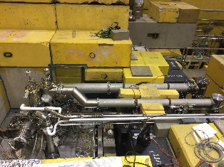
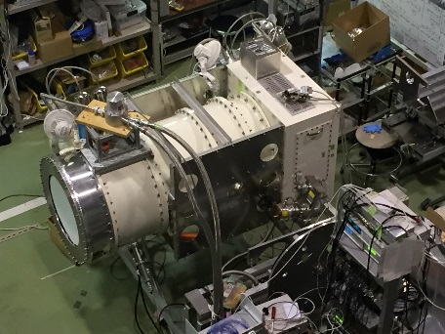
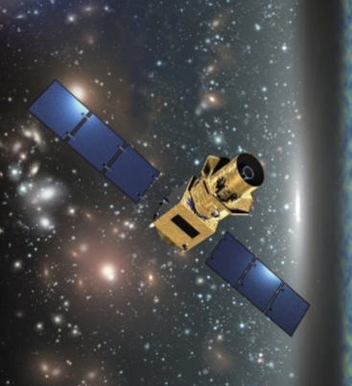
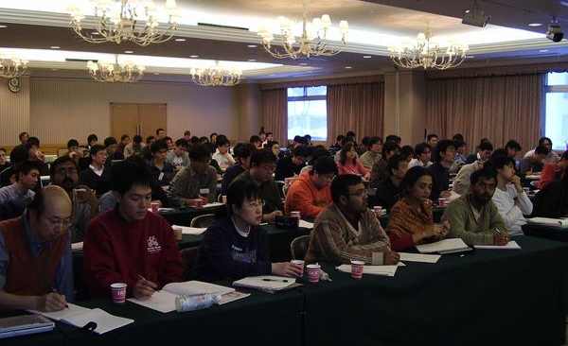
ATLAS
(CERN)
ILC
Belle-II
(KEKB)
COMET
(J-PARC)
Energy Frontier
KISS
(RIKEN)
Flavor Physics
Hadron and NuclearPhysics
Hadron hall
(J-PARC)
Neutrino
Experiments
(J-PARC)
Physics
at IPNS/KEK
KOTO
(J-PARC)
Astro- particle Physics
Theory
SKS,
Hyperball-J
UCN
(TRIUMF)
Technical Development Groups
Electronics System
Cryogenics
Mechanical Engineering
POLARBEAR-2
(Atacama)
LiteBIRD
(Space)

Slide 3



ATLAS
(CERN)
ILC
Belle-II
(KEKB)
COMET
(J-PARC)
Energy Frontier
KISS
(RIKEN)
Flavor Physics
Hadron and NuclearPhysics
Hadron hall
(J-PARC)
Neutrino
Experiments
(J-PARC)
Physics
at IPNS/KEK
KOTO
(J-PARC)
Astro- particle Physics
Theory
SKS,
Hyperball-J
UCN
(TRIUMF)
Technical Development Groups
Electronics System
Cryogenics
Mechanical Engineering
POLARBEAR-2
(Atacama)
LiteBIRD
(Space)

Slide 4
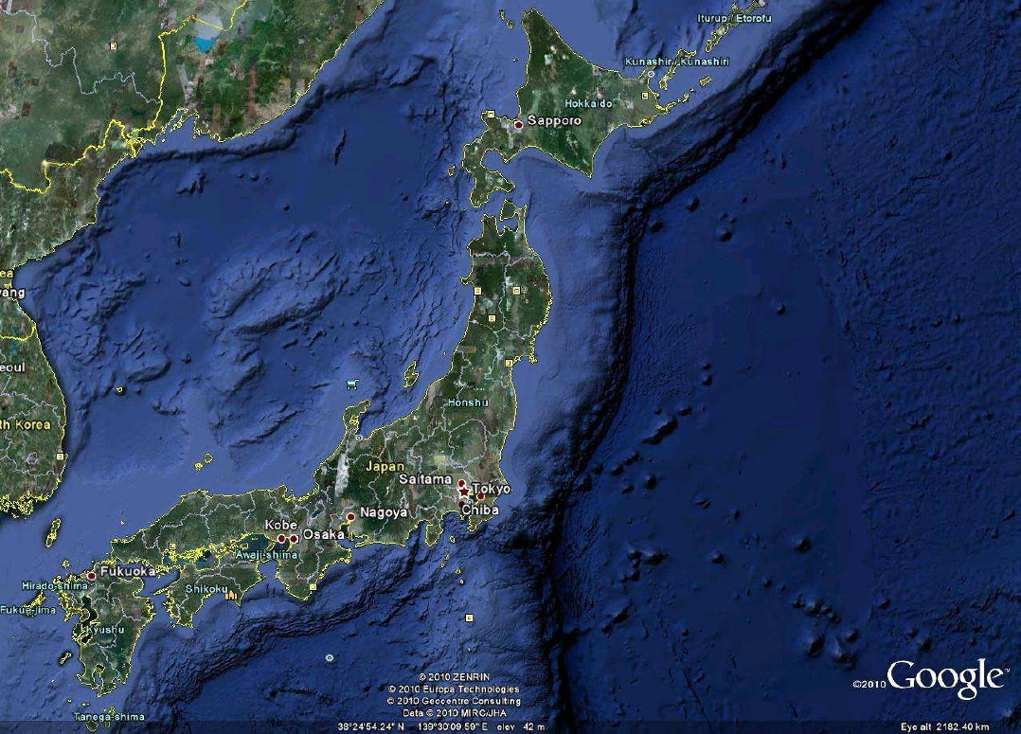
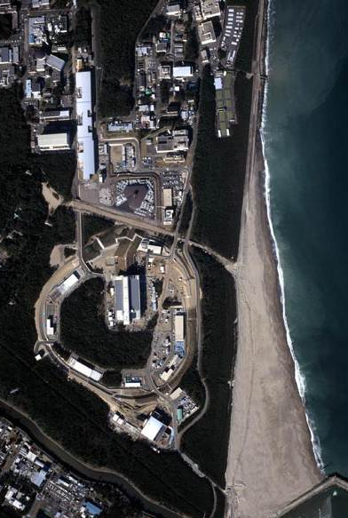
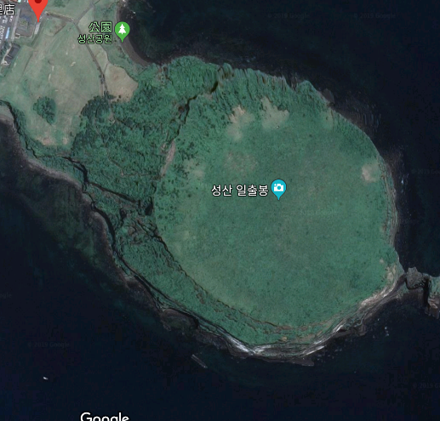
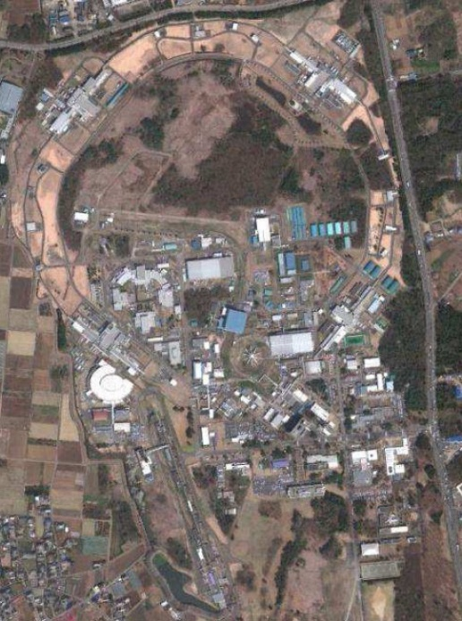
Electron machines in Tsukuba
and proton machines in Tokai
Sunrise Peak in Jeju
J-PARC
Tokai
KEKB
Tsukuba
PF, PF-AR

Slide 5
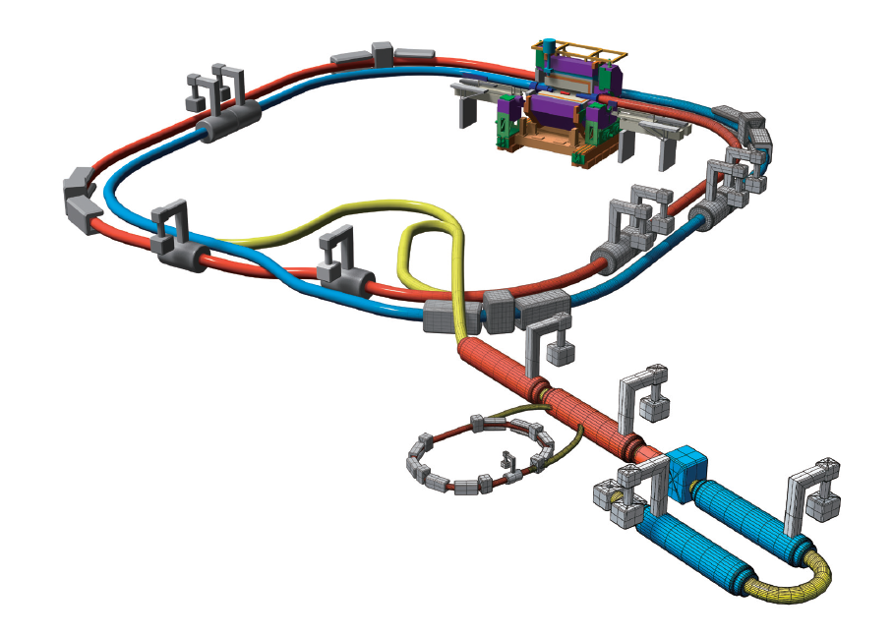

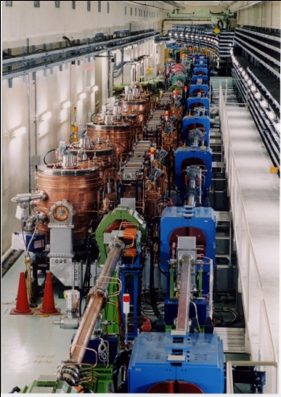

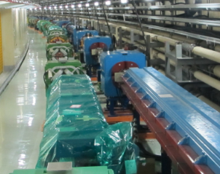

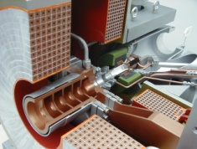
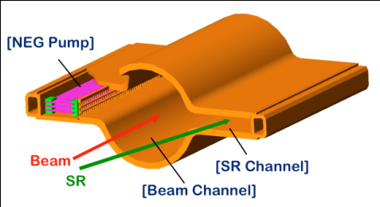
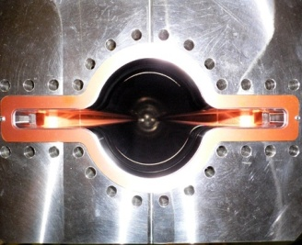

SuperKEKB and Belle II
KEKB and Belle
SuperKEKB and Belle II
Belle II
e⁺ 4GeV 3.6 A
New superconducting /permanent final focusing quads near the IP
e⁻ 7GeV 2.6 A
New IR
Colliding bunches
SuperKEKB
Target: L = 8x10³⁵/cm²/s
Replace short dipoles with longer ones (LER)
Add / modify RF systems for higher beam current
Positron source
New positron target / capture section
Redesign the lattices of HER & LER to squeeze the emittance
Damping ring
TiN-coated beam pipe with antechambers
Cu for wigglers and Al alloy for the rest
@1.1 GeV
To inject low emittance positrons
Low emittance gun
To inject low emittance electrons
5

Slide 6
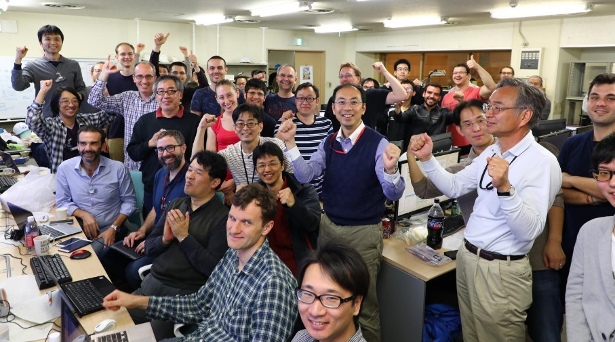
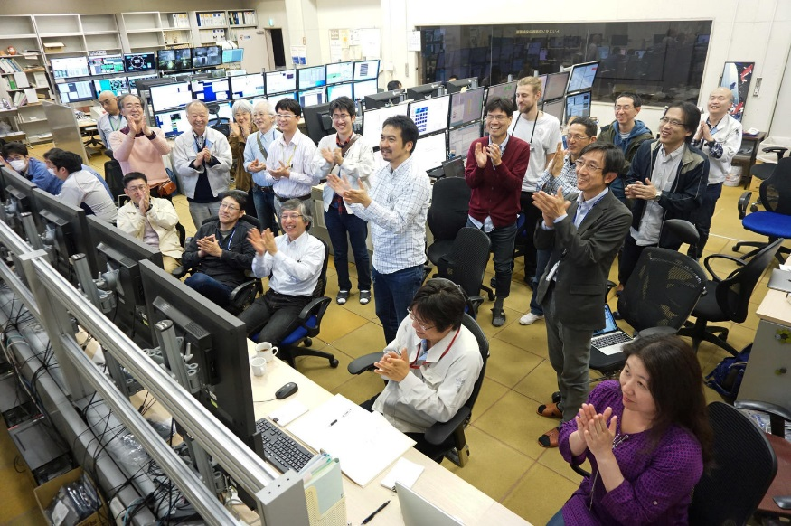
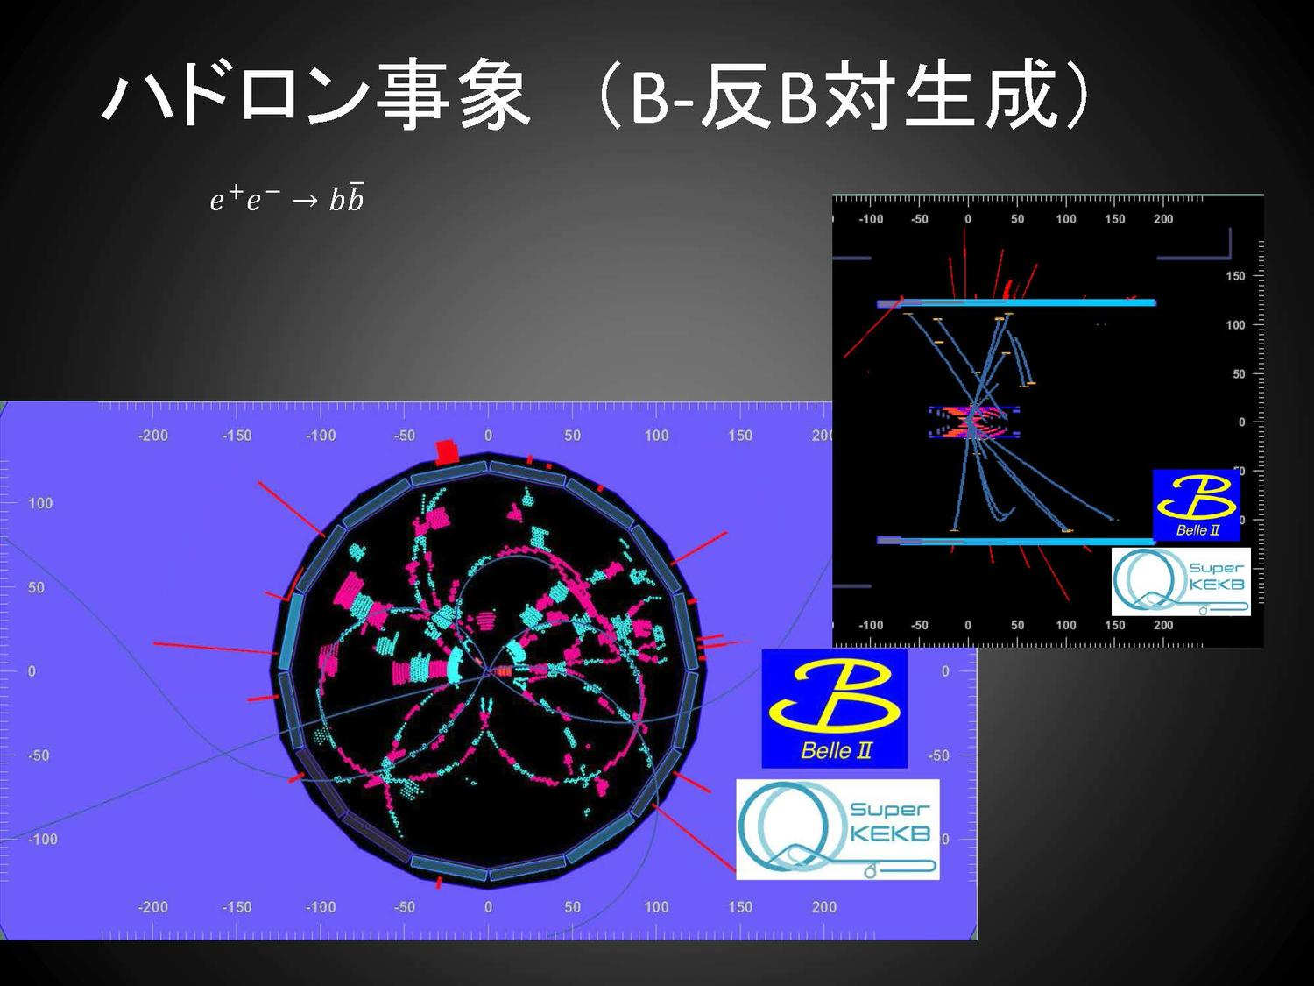
First Collisions seen in Belle II! on 26/Apr/2018
First collisions with Belle II detectors, webcasted to the public.

Slide 7
“Nano beam” operation
Vertical beam size (μm)
SuperKEKB
n
Side view
Side view
ion
Top view
Top view
Horizontal position (mm)
Longitudinal position (mm)
Vertical beam size is much smaller.
2 μm → 50 nm
Collision area is much smaller.
Even if bunch lengths are similar.
~10 mm → ~0.5 mm
Beam length
7
Luminous area

Slide 8
Comparison of machine parameters between design and Phase2
parameters | SuperKEKB Design | Phase 2 achievement | units | factor
I_{beam} (LER/HER) | 3.6/2.6 | 0.8/0.78 | A | 4.5/3.3
ξ_{y} (LER/HER) | 0.0881/0.0807 | 0.03/0.021 |  | 2.9/3.8
β_{y}* | 0.27/0.30 | 3/3 | mm | 11/10
# of bunches | 2500 | 1576 |  | 1.6
I_{bunch} (LER/HER) | 1.44/1.04 | 0.685/0.571 | mA | 2.1/1.8
Luminosity | 8 x 10³⁵ | 5.55 x 10³³ | cm⁻² s⁻¹ | 145
We are still at the very primitive stage compared with the final goal but this was a big first step of the nano-beam operation. No big show stopper was found.
Most important thing (according to the accelerator people) is to have sufficient operation time to have continuous improvement.

Slide 9
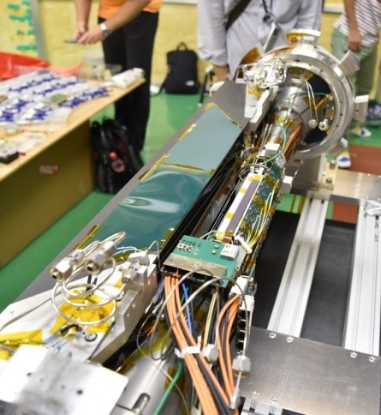
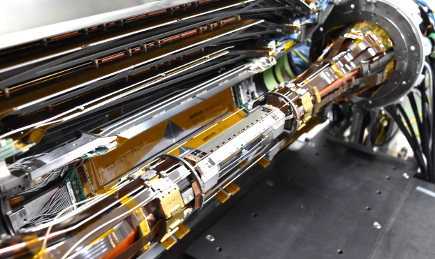
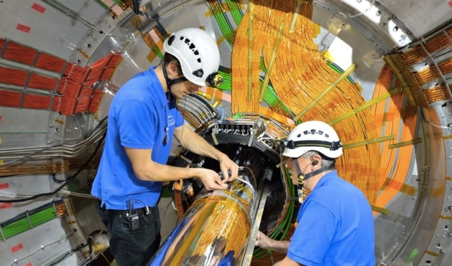
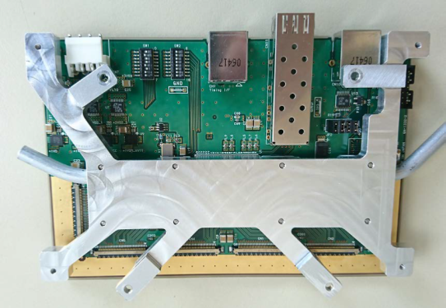
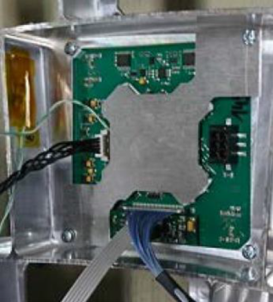
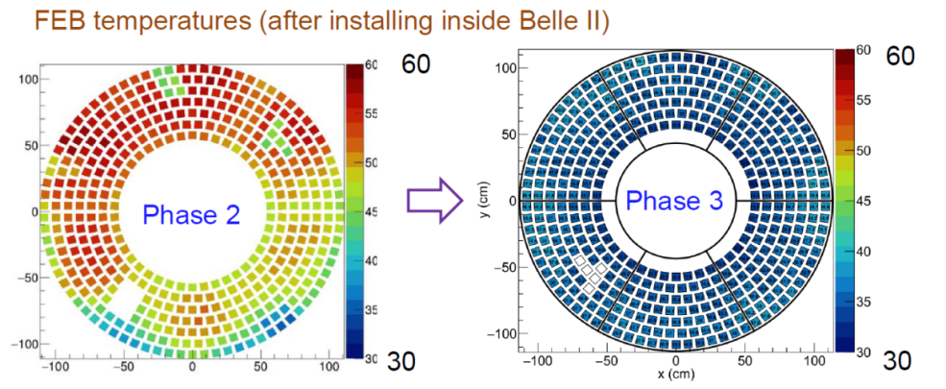
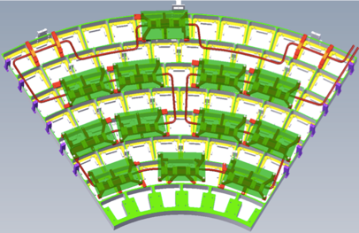
Work during shutdown in 2018
Vertex detector (instead of background monitors) is installed
Nov. 27, 2018
ARICH cooling reinforced

Slide 10
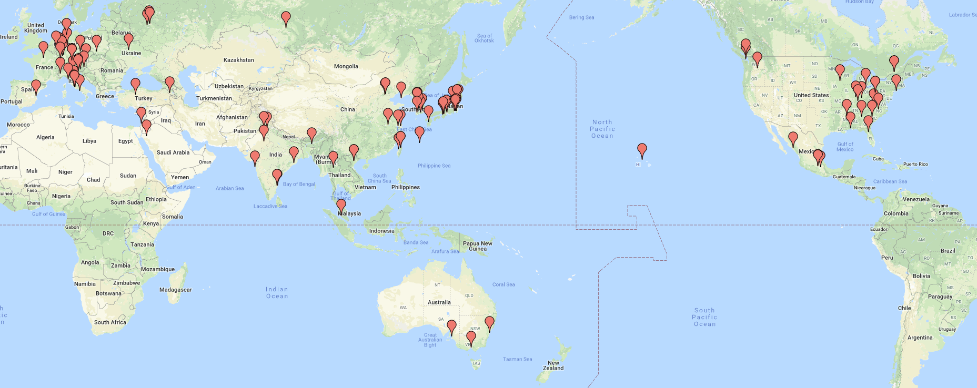
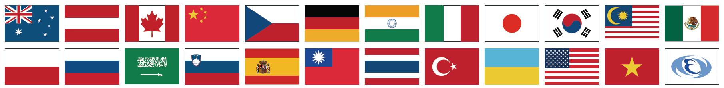



Belle II Collaboration
As of Feb. 2019
Europe | 397
Austria | 16
Czechia | 11
France | 30
Germany | 183
Israel | 5
Italy | 73
Poland | 13
Russia | 40
Slovenia | 17
Spain | 6
Ukraine | 3
26 countries/regions
113 institutions
921 researchers
Asia
Saudi Arabia | 5
Australia | 33
Armenia | 5
China | 44
India | 41
Japan | 162
 | 373
Korea | 41
Malaysia | 5
Vietnam | 2
Taiwan | 31
Thailand | 1
Turkey | 3
America | 151
Canada | 28
Mexico | 15
USA | 108

Slide 11

















Luminosity profile and potential discoveries
$$×{10}^{35}$$
$$S(K_{S}^{0}π^{0}γ)$$
$$S({φK}_{S}^{0})$$
$$X_{s}ℓ^{+}ℓ^{−}, C_{9}^{NP}$$
${P_{5}^{′}}_{ee}/$ ${P_{5}^{′}}_{μμ}$
$5σ$ (observation)
$$S(η^{′}K^{0})$$
$$B→τν$$
Integrated luminosity $[ab^{−1}]$
$3σ$ (evidence)
I$nstantaneous luminosity[cm^{−2}s^{−1}]$
$$S(ρ^{0}γ)$$
$$I_{sumrule}(Kπ)$$
$$20ab^{−1}$$
$$R(Dτν)$$
$$10ab^{−1}$$
$$R(D^{∗}τν)$$
[日/月/年]
Today
Assuming:
8 months operation per year
4 years to achieve design luminosity
Current central values

Slide 12
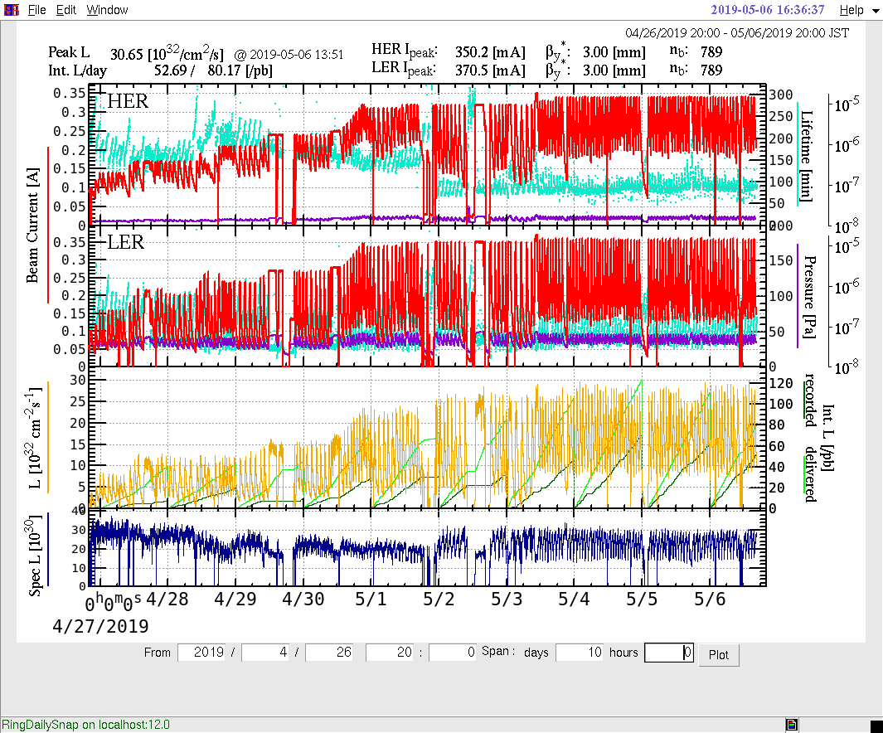
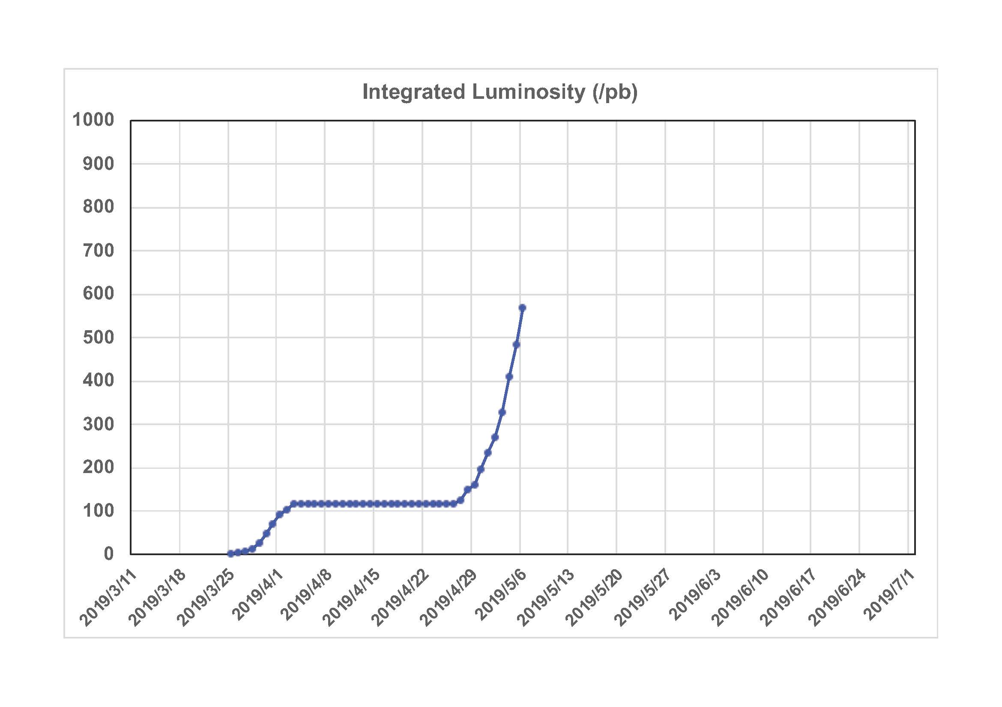
Phase 3 run started
Break after the fire incident
Phase 2 Int.L
Summer shutdown
“Platinum week” for Belle II
Peak Lumi ~3 x 10³³ with 789 bunches
Beta* y = 3mm (same as Phase II)
Background study will be performed this week for the higher luminosity

Slide 13
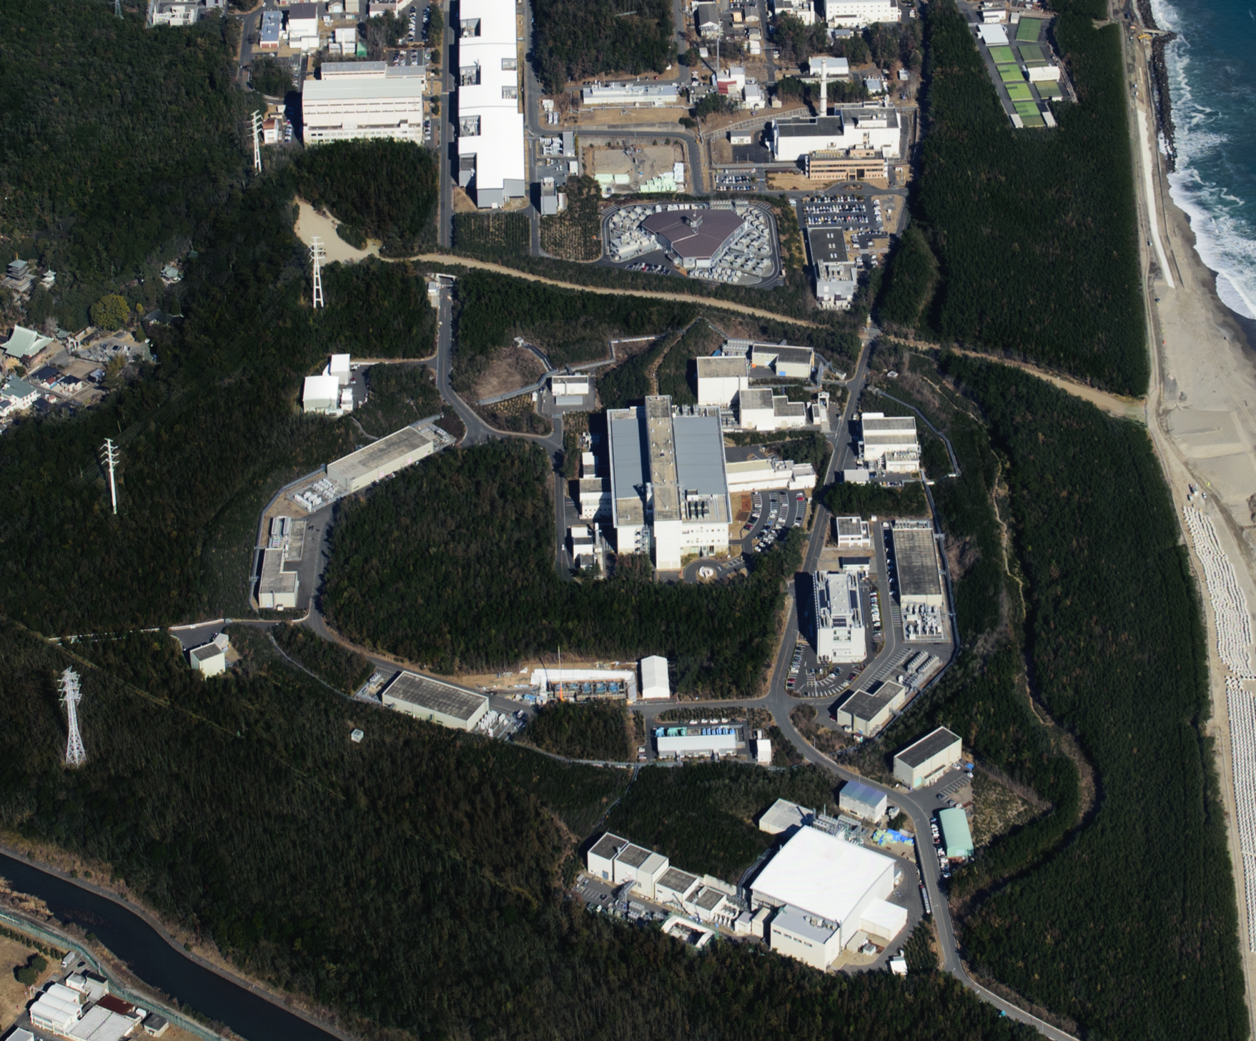


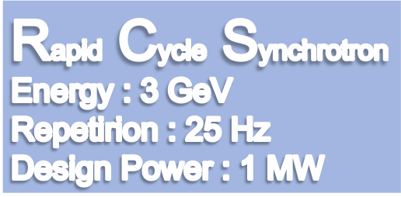




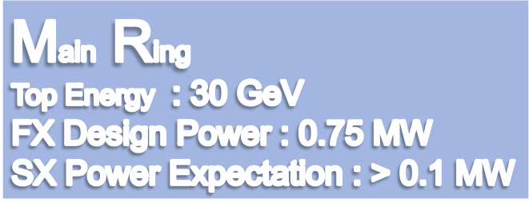
LINAC
400 MeV
Neutrino Beam to Kamioka
Currently 0.4 MW
Material and Life Science Facility
Currently 0.48 MW(FX) and 0.05 MW (SX)
Hadron Hall
Notes:
まず、こちらが、J-PARCの加速器複合施設です。陽子ビームを１８１MeVまで加速する（来年度以降４００ MeVになる）線形加速器ライナックがあり、その後、ビームは、40 msという短い時間の間に3 GeVまで加速されます。そのビームのほとんどは、この物質生命科学実験施設で中性子やミュオンを使った実験の為に使われています。

Slide 14
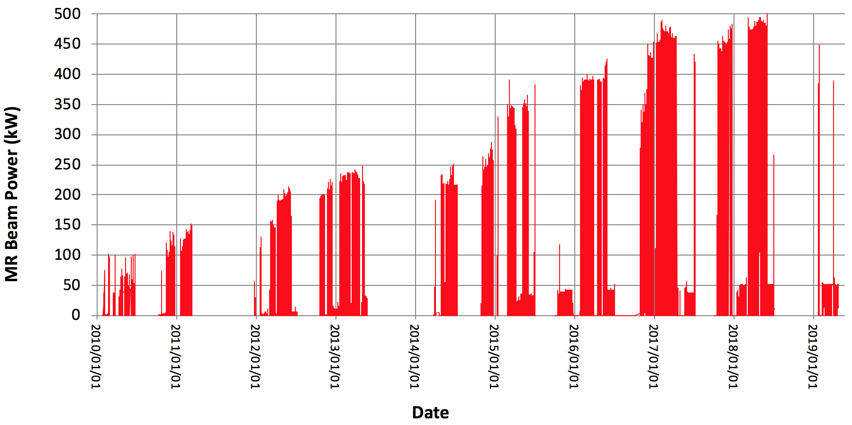
History of MR beam power
FX
Beam stop due to the radioactive material leak incident in HEF
Beam stop due to the earthquake
SX
Achieved beam power :
Fast extraction ~ 500 kW (2.6 x10¹⁴ ppp) for users, 520 kW for demonstration.
Slow extraction ~ 51 kW (5.5 x10¹³ ppp) for users , 60 kW for demonstration.

Slide 15
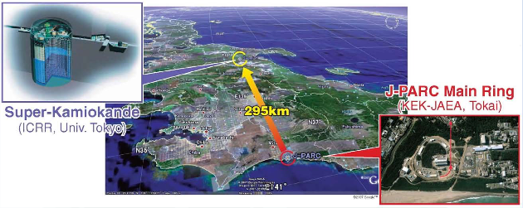

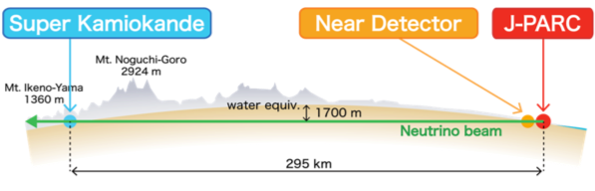




T2K(Tokai-to-Kamioka) experiment
Long base-line neutrino oscillation experiment
same?
The main physics motivations at present is
CP violation in neutrino oscillation
→ hint for the origin of matter dominate universe

Slide 16
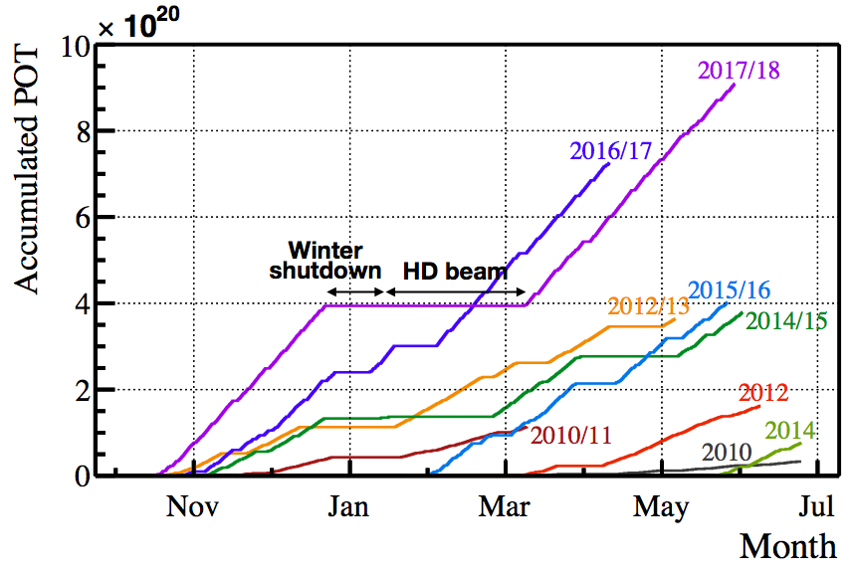

T2K data taking status
Efficient data taking with ~490kW and 87% of running efficiency
Next beam time is in the autumn 2019.
Accumulated
protons on target (POT)
[month]
Total 31.6 x 10²⁰ POT = 41% of T2K-I goal
ν beam mode : 15.1 x 10²⁰ POT
ν beam mode : 16.5 x 10²⁰ POT
2018/19 run : was scheduled to run in May-July ’19 but postponed to autumn (No beam in last autumn due to SK-refurbishment and beamline works)
Notes:
b:3m

Slide 17
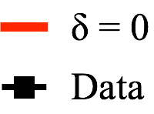

T2K: Recent results
Results with all the data collected in the 2010∼2018 period (9years)
 | Obs. |  | Expectation
 |  |  | δ=-π/2 | δ=π | δ=π/2 | δ=0
 | 90 |  | 81.4 | 68.6 | 55.5 | 68.3
 | 15 |  | 17.1 | 19.3 | 21.7 | 19.4
νμ→νe
candidates
νμ→νe
candidates
CPV
CPC
CPV
CPC
νμ→νe cand.
CP conserving values (δ=0, π) are excluded with 2σ level
Indication of neutrino CP violation ?
Need more data for confirmation
νμ→νe cand.
Notes:
b:4m

Slide 18
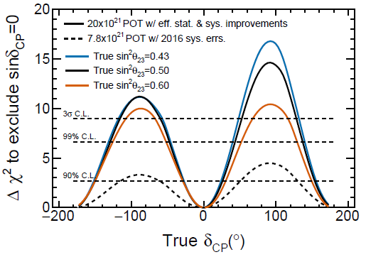
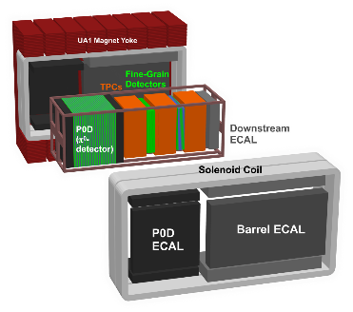
T2K: Future prospects
T2K proposes to collect 20×10²¹ POT data to search for evidence of CP violation in the lepton sector with 3σ sensitivity. (arXiv:1609.04111 [hep-ex])
J-PARC PAC recognizes the scientific merit and gave stage-1 status in 2016.
Upgrade plans
Beam improvement
750kW→1.3MW, horn 250kA→320kA.
Far Detector analysis update
Enlarge fiducial volume, etc.
Near detector upgrade:
Widen angular acceptance, etc
Aiming ×1.5 signal/POT
356.3 ν_{μ}→ν_{e} sig. expected in ν-beam
73.6 ν̅_{μ}→ν̅_{e} sig. expected in ν̅-beam (ν-beam:ν̅-beam=50:50, NH, δ_{CP}=0 is assumed)
Aiming to reduce systematic uncertainty: ex. Expectation of ν_{μ}→ν_{e} sig.: ~7% → ~4%
2021
MH known
2022

Slide 19
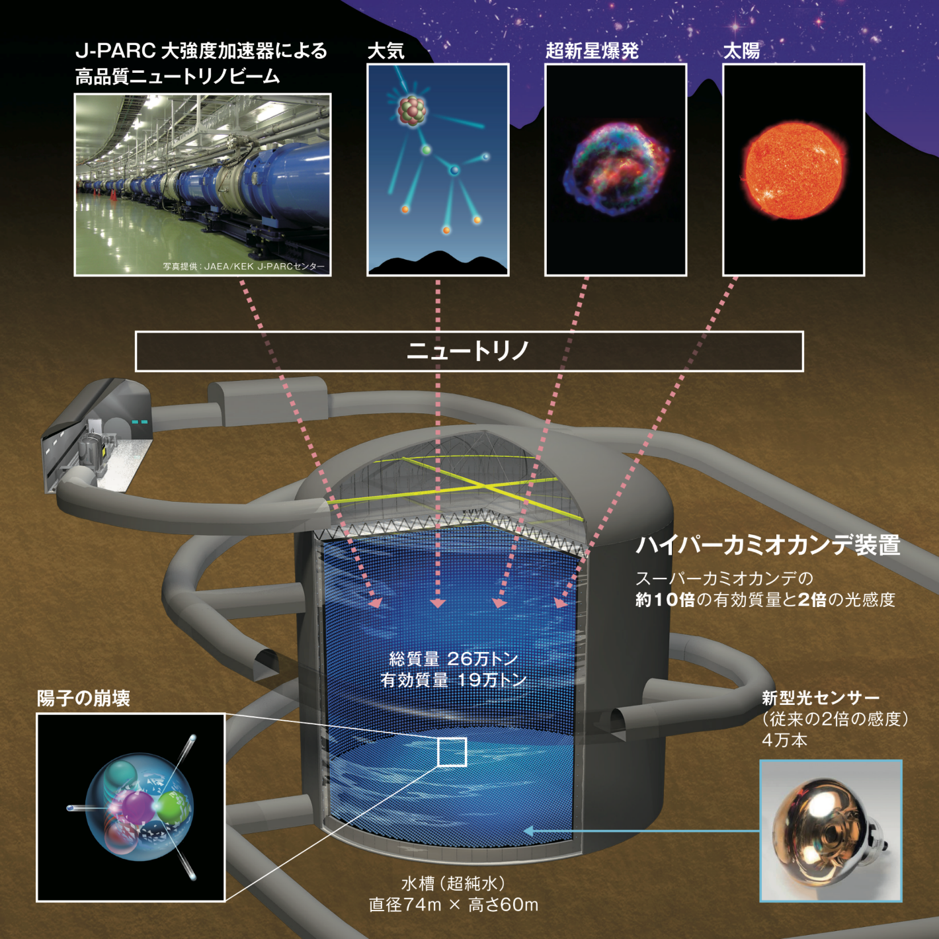
Long term plan: Hyper-Kamiokande program
Accelerator Neutrino beam from J-PARC
Atmosphere
Supernova
Sun
Listed among seven priority projects in Roadmap2017 by MEXT.
δ_{CP} accuracy 22º(δ=±90º)
Proton decay reach to 10³⁵ years (p→e⁺π⁰)
Rich ν-astronomy objects: Sun, nearby supernova, diffuse SN neutrinos, GW coincidence ν etc
Preparatory Budget was funded by the MEXT in JFY2019.
J-PARC Power Upgrade for Hyper-K is the Priority 1 in the KEK PIP.
Hyper-K international review committee has been set up by IPNS and ICRR directors. The 3rd meeting in Jun/2019.
Neutrinos
Hyper-Kamiokande
Total mass 260 kton
Fiducial 190 kton
Proton Decay
40,000 new photo-sensor w/ double sensitivity
Tank filled with pure water 74m (D) x 60m (H)
19

Slide 20

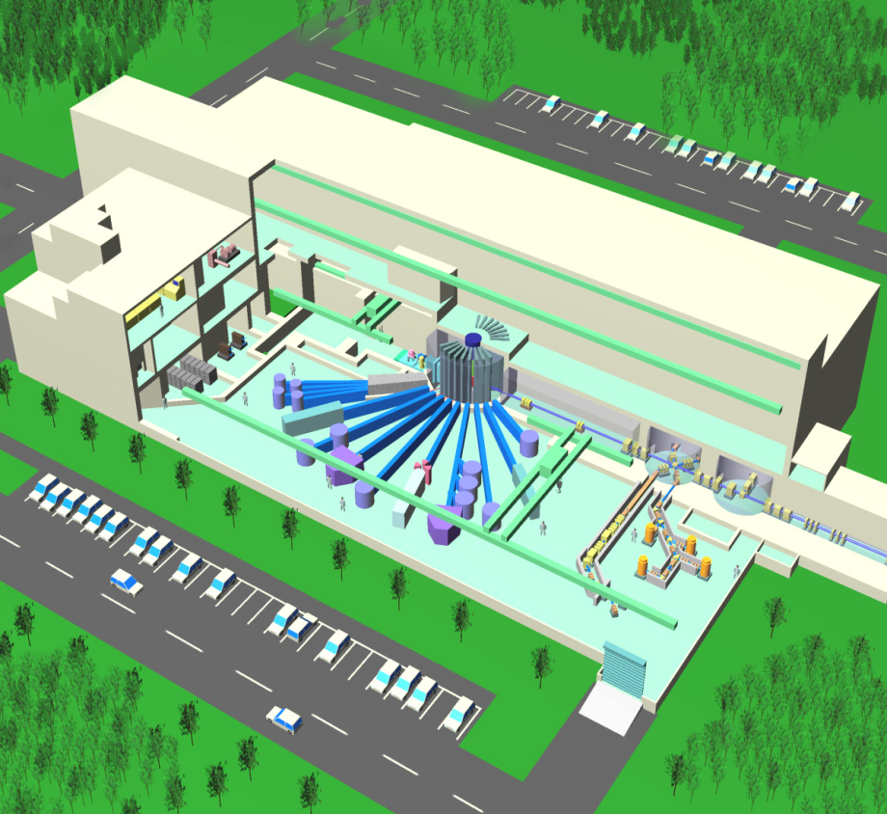
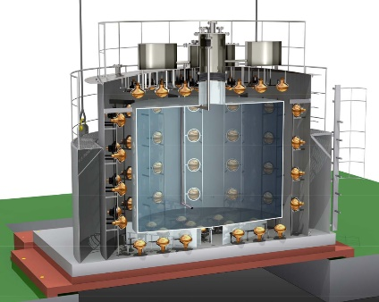






JSNS²
Search for a Sterile Neutrino at MLF
MLF building (bird’s view)
Detector @ 3rd floor
(24m from target)
Hg target = Neutron
and Neutrino source
JSNS² collaboration (57 collaborators)
6 Japanese institutions (27 members)
10 Korean institutions (20 members)
1 UK institution (3 members)
5 US institutions (7 members)
52t liquid scintillator detector
(17t Gd-LS : from DayaBay donation
35t pure LS: from RENO site)
3GeV pulsed
proton beam
Sensitivity w/ 3years running
Searching for neutrino oscillation : ν_{μ} → ν_{e} with 24m
Pure LS production @ RENO site (Korea)
Pure LS : Korea→Japan
Detector construction/preparation is in progress
Aiming to start the experiment by 2019-Fall
Competition
FNAL SBLν Exps.

Slide 21

Hadron Hall
E07 Ξ-hypernuclei with Emulsion →E40 Σp interaction
E31: Hyperon Resonance
→E62, E57 :K-atom
KOTO
E14 KOTO
Hi-p/COMET construction

Slide 22




KOTO: Search for
[based on 2015 data] Phys.Rev.Lett. 122, 021802 (2019)
no candidate event;
upper limit 3.0 x 10⁻⁹ (90% CL)
x10 improvement to the world record
Touching to Grossman-Nir limit(1.46x10⁻⁹)
cf: SM : 3.0 x 10⁻¹¹
transverse momentum
The group already has x2 more data with improved detectors
decay vertex position
Notes:
b:8m

Slide 23



E07: S=-2 Hyper nuclei
MINO Event
H.Ekawa et al., PTEP 2019, 021D01 (2019)
¹⁰_{ΛΛ}Be or ¹¹_{ΛΛ}Be or ¹²_{ΛΛ}Be
[MeV]
B_{Ξ} = 0.23 MeV (3D orbit of ¹⁶O) is assumed
IBUKI Event
Ξ⁻ + ¹⁴N → ¹⁵_{Ξ}C → ¹⁰_{Λ}Be + ⁵_{Λ}He
B_{Ξ} = ∼1.3 ± ∼0.2 MeV
Same Ξ-nucleus, but unique identification of state
c.f. KISO event (Ann. Rev. Nucl. Part. Sci 2018.68.131)
1.03±0.18 MeV (¹⁰_{Λ}Be* + ⁵_{Λ}He)
3.87±0.21 MeV (¹⁰_{Λ}Be + ⁵_{Λ}He)

Slide 24


Origin of repulsive core in nuclear force
Σp Scattering (E40) running
to confirm large repulsive core
in Σ⁺p spin-triplet channel (10)
due to Pauli effect between quarks
HAL-QCD
High statistics scattering data by
fast-readout counters (w/o image)
and pure liquid H₂ target
as Σ production and scattering
H dibaryon (E42) in preparation
SU_{f}(3) singlet channel (1) of B-B int.
resonance H ?
Simulation
HAL-QCD

Slide 25



Lambertson Magnet to B-Line
New Primary Beam Line (SY tunnel)
A line
B line
high-p
Septum magnets
COMET
Lambertson magnet
A line
B line
Collimator
Profile monitor
Branch Point

Slide 26

high-p Exp. Area
New Primary Beam Line (high-p) in Hadron Hall
FM magnet
SKS
high-p
COMET
Quadrupole magnets
A line
B line
Steering magnets
B line
Branch
Point

Slide 27


Search for μ-e conversion
J-PARC COMET exp.
Charged lepton flavor violation process
Strongly suppressed in SM (BR < 10⁻⁵⁰)
Observation = clear evidence of new physics
Sensitivity to
new physics
beyond SM
Competition
FNAL Mu2e experiment
Notes:
b:11

Slide 28


Long term plan: Hadron hall, Muon
Activities in the last 12 months.
Staging plans of the hadron-hall extension is under discussion.
Stage II approval for the muon g-2/EDM experiments.
3 GeV proton beam
( 333 uA)
Graphite target
(20 mm)
Surface muon beam
(28 MeV/c, 4x10⁸/s)
Muonium Production
(300 K ~ 25 meV⇒2.3 keV/c)
Super Precision Storage Magnet
(3T, ~1ppm local precision)
COMET Phase-II
Muon
storage
g-2 experiment

Slide 29


KEK
UCN
(TRIUMF)
ATLAS
(CERN)
KISS
(RIKEN)
POLARBEAR-2
(Atacama)
IPNS is also collaborating with other world-wide institutes for various world top class projects.

Slide 30




How are the gold and platinum synthesized ?
- KISS project since 2012 -
GW170817
Decay measurement
A
Neutron Star
Merger ?
Mass measurement
Solar r-process abundance
KEK
Isotope
Separation
System
(Z)
rapid neutron capture (r-) process
Unveil astrophysical sites
with spectroscopies of radioactive nuclei
Laser light
(N)
Gas
cell
Beam
Radioactive Isotope Beam Factory (RIBF)
High purity
Argon gas
Notes:
An ultimate goal of the KISS project is finding out how are the gold and platinum elements synthesized in the universe.
As you may know, these elements are considered to be synthesized by the rapid neutron capture process, so called as r-process, under an explosive circumstance.
This is a nuclear map indicating known and unknown nuclei. And here is an observed solar abundance pattern of the r-process.
These two peaks, the second and third abundance peaks are characterized by the nuclear properties of these specific nuclides located at neutron magic numbers of 82 and 126, respectively. These area are called as waiting regions, where we can evaluate the astrophysical condition of the process.
Unfortunately, these waiting nuclei are very far from the stability line, and nuclear information has been obtained only of a tiny part of the first and second waiting regions has been obtained.
As for the third waiting region, there has been no experimental approach, so far. This region is called as a Blank spot of the experimental nuclear physics due to its difficulty.
In the KISS project, we are going to access and measure this blank spot nuclei at least this red area.

Slide 31






KEK-IBS Collaboration for RNB Science (2016 ~ )
→ R&D of a super clover Ge & DAQ system at KISS (to KOBRA of RAON)
γ-MSPGC (M = 1)
γ-MSPGC (M = 2)
427.8(4) keV
^{195m}Os
T_{1/2} = 47(3) s
belong to ^{195m}Os
belong to ^{195g}Os
SC-Ge detectors
from IBS
^{195g}Os
I^{π} = 3/2⁻
T_{1/2} = 6.5 (4) min
4πβ-gas
counter
Counts/ 0.5 keV
Q_{β} = 2180 (6) keV
KISS
focal plane
Newly observed ^{195m}Os
E_{γ} (keV)
¹⁹⁵Ir
→ Constructing a mini-MRTOF-MS system at KISS (to ISOL of RAON)
• suitable for the heavy nuclides
→δm<100keV with 100 ions
• fast measuring time ≤20 ms
→available for short-lived nuclides
• compact (~1m)+simple principle
→many applications
He gas cell
ion cooler
Mini-
MRTOF
• high sensitivity
←identification with 2 ²⁰⁵Bi ions
• high efficiency
←simultaneous measurements
for 9 isotopes
Masses of more than 80 isotopes
Has been measured in the first campaign (2016 – 2017)
KISS Beam
Multi-trap
ion buncher
IBS
Colleague
Mass measurements in this year !!
Notes:
Before stopping my talk, I like to mention a few words for the research infrastructure.
The first item is Wako nuclear science center. This center supports user activities relevant to the KISS and MRTOF experiments.
There are 5 scientific staffs, 2 engineers, and a secretary.
The second item is a user collaboration group, SSRI-pns.
Major function of this group is managing and promoting the scientific activities with KISS, SLOWRI, and GARIS. Here is a steering committee to realize this function.
Actually, the committee calls research subject as a letter of intent and chair the ssri-pns meeting in every year before the RIBF-PAC.
So far, almost 40 letters of intent are received. And around 100 users of 30 institutes from 15 countries are interested to the science available with KISS, SLOWRI, and GARIS.
Thirdly, we have organized another type of research community, IGLIS-net, concerning to the technical development and researches for laser ionization and spectroscopy.
This community consists of 15 laboratories in the world as shown in this map.
Finally, I like to mention on the R&D collaboration between KEK and IBS.
In this collaboration, we are constructing a efficient gamma-ray detection system and the mass measurement system, as I mentioned before. These systems include newly developed super-clover Ge detectors and MRTOF, respectively.
During this collaboration period until the end of 2019, these systems are constructed and used for KISS experiments together with IBS colleagues. And afterward, they will go back to Korea for quick start of the research subjects at RAON facility.
RAON facility will have a unique feature for delivering intense accelerated RNBs. So, we are expecting there are many interesting research subjects using these systems.

Slide 32


neutron Electric Dipole Moment search by TUCAN (TRIUMF Ultra Cold Advanced Neutron)
Japanese - Canadian collaboration, 10 institutes, 45 persons
history nEDM measurement
UCN source development
- 2014
2016
2017
2019
(Now)
2021
prototype UCN source development at RCNP
9 UCN/cm³
Beam line commissioning at TRIUMF
start UCN production at TRIUMF
UCN source upgrading
aim for 6,400 UCN/cm³
KEK has been developing a high power helium cryostat
Start the upgraded source operation
Cold Neutron
Ultra Cold Neutron@ILL
Statistical limitation
Our goal
Publication Year
(B. Lauss, nEDM 2017 workshop)
UCN source at TRIUMF
UCN count spectrum

Slide 33











IPNS KEK Experimental Cosmology Group - focusing on cosmic microwave background (CMB) B-mode
Main projects: QUIET → POLARBEAR → Simons Array → LiteBIRD
Large-scale CMB B-mode for quantum gravity, fundamental physics and beginning of universe
Small-scale CMB B-mode for particle physics and cosmic evolution
CMB group
established
in 2007
2008
2012
2016
2020
2024
2028
QUIET (2008.9 First Light)
POLARBEAR
(2012.1 First Light)
LiteBIRD
Satellite
w/ JAXA,
NASA, ESA,
Kavli IPMU,
UC Berkeley
etc.
Atacama,
Chile
Simons Array
Atacama,
Chile
w/ FNAL, Chicago,
Caltech, Princeton,
Columbia etc.
w/ Berkeley, LBNL,
UCSD, Colorado, etc.
Technology development at KEK
Polarization
Modulator
POLARBEAR-2 installed at Simons Array
First light (Venus)
4/Jan/2019
Sky
Emulator
GroundBIRD
Notes:
The main scientific objective of the CMB group is to test cosmic inflation from large-scale CMB B-mode fluctuations.
Another goal is to measure the sum of neutrino masses from small-scale CMB B-mode flctuations.
CMBグループのメインのサイエンスはCMB偏光Bモードの大角度揺らぎを観測してインフレーションをテストすることです。
もう一つのゴールはBモードの小角度揺らぎを観測してニュートリノ質量和を測定することです。

Slide 34











Japanese Contribution to HL-LHC (LHC and ATLAS)
D1 magnet for HL-LHC: 2m Model coil is successfully energized.
MEXT has approved HL-LHC project in JFY2019!
ATLAS
CMS
2016 Feb
Q1-Q3 : R&D, Design, Prototypes and in-kind USA
D1 : R&D, Design, Prototypes and in-kind JP
MCBX : Design and Prototype ES
HO Correctors: Design and Prototypes IT
Q4 : Design and Prototype FR
CC : R&D, Design and in-kind USA
CC : R&D and Design UK

Slide 35


Slide 36
Summary
Diverse physics programs from Nuclear physics, HEP, and astrophysics.
SuperKEKB phase-3 Run is in progress.
J-PARC Power upgrade is in progress. One-year shutdown is planned in 2021. 750kW beam for neutrino experiments since 2022.
New beam lines in J-PARC Hadron Hall
Many opportunities for further collabrations

