Slide 1
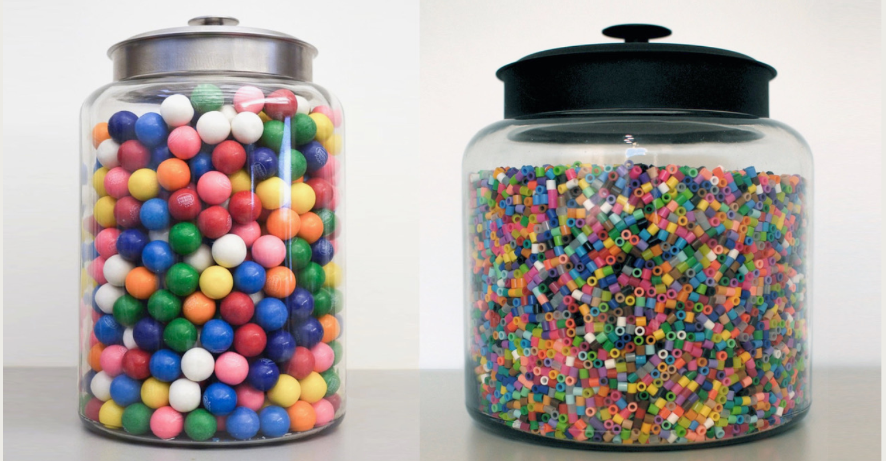
Crowd Wisdom – Educated estimates
Take “wager” from NuSYM2018 participants about “future”, announcement the winner at NuSYM2019 and …
Need to define the procedure, participants, what questions, time line -- discussions
Prize and announcement of winner; determined by the NuSYM2019 organizing committee.
First try : heavily biased so we need Input from everyone

Slide 2
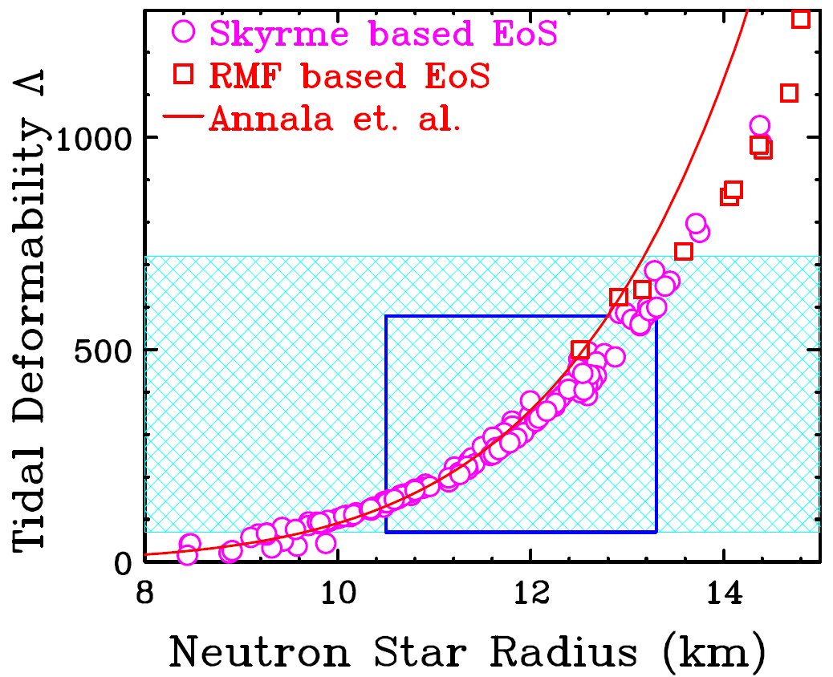
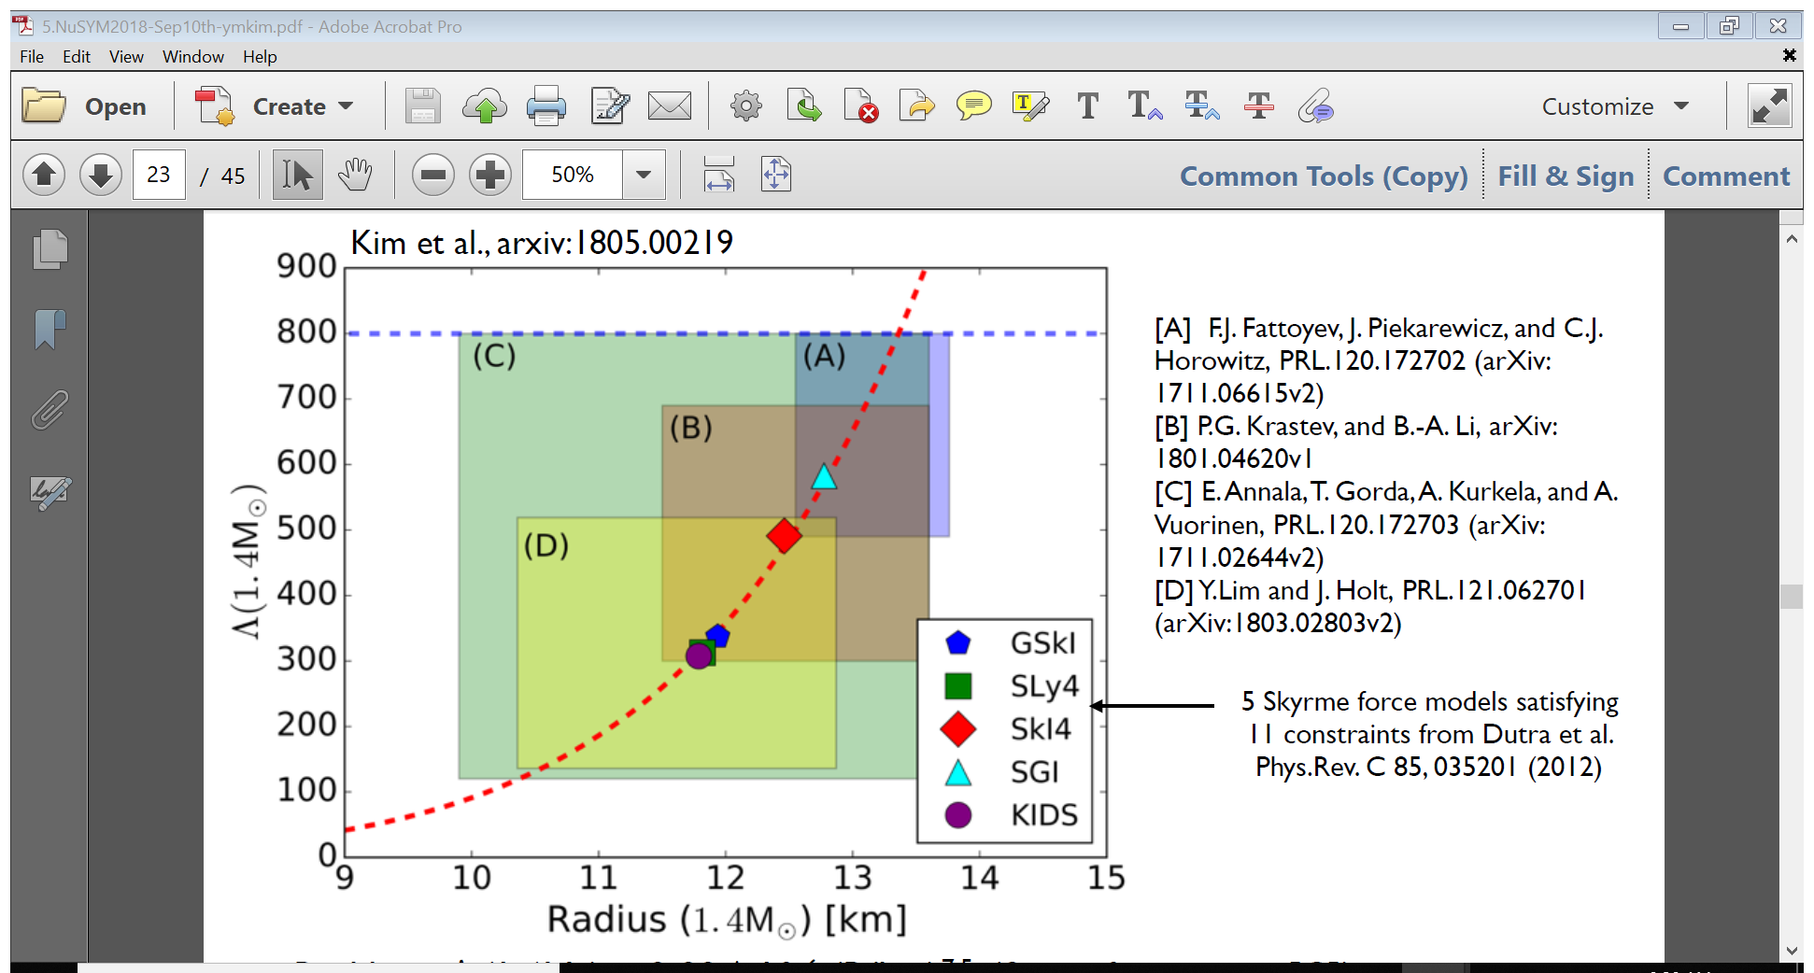
GW170817 is a game changer events for EoS research.
Already many calculations bridging between NP and Nstar
Improvements of Nstar calculations, e.g. crust EoS, causality
Should all nuclear interactions be required to produce reasonable Nstar properties?

Slide 3
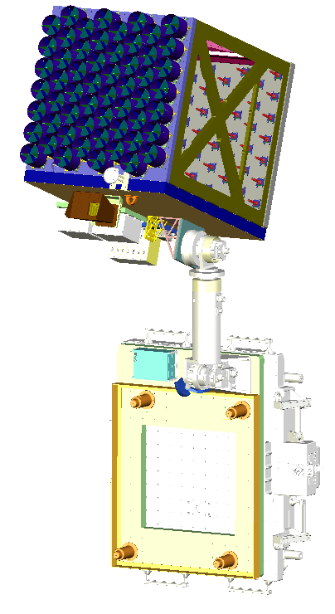
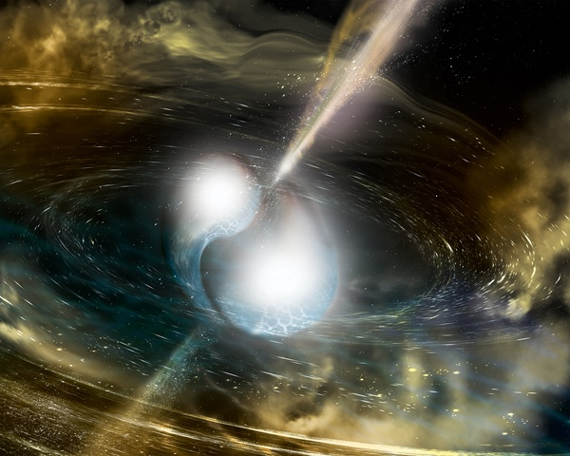
GW170817
NICER -- Measure accurate mass and radii
y
Sunshades and X-Ray Concentrators (56)
XTI
Radiator surface
Focal Plane Modules (56)
Star Tracker
GPS Antenna
Connector Bracket
Electronics
DAPS (EL/AZ, Deploy, & Latching actuators w/ EVR/EVA fixture for each)
HiPos Box
Adapter Plate
Contamination Shield (protects XRCs)
Frangibolt Launch Lock mounts (also serve as conical support when NICER is stowed)
FRAM
How many NS merger (including NS-BH) events will be observed a year?
Announced by NuSYM2019?
Predictions of maximum mass
Predictions of radius.

Slide 4
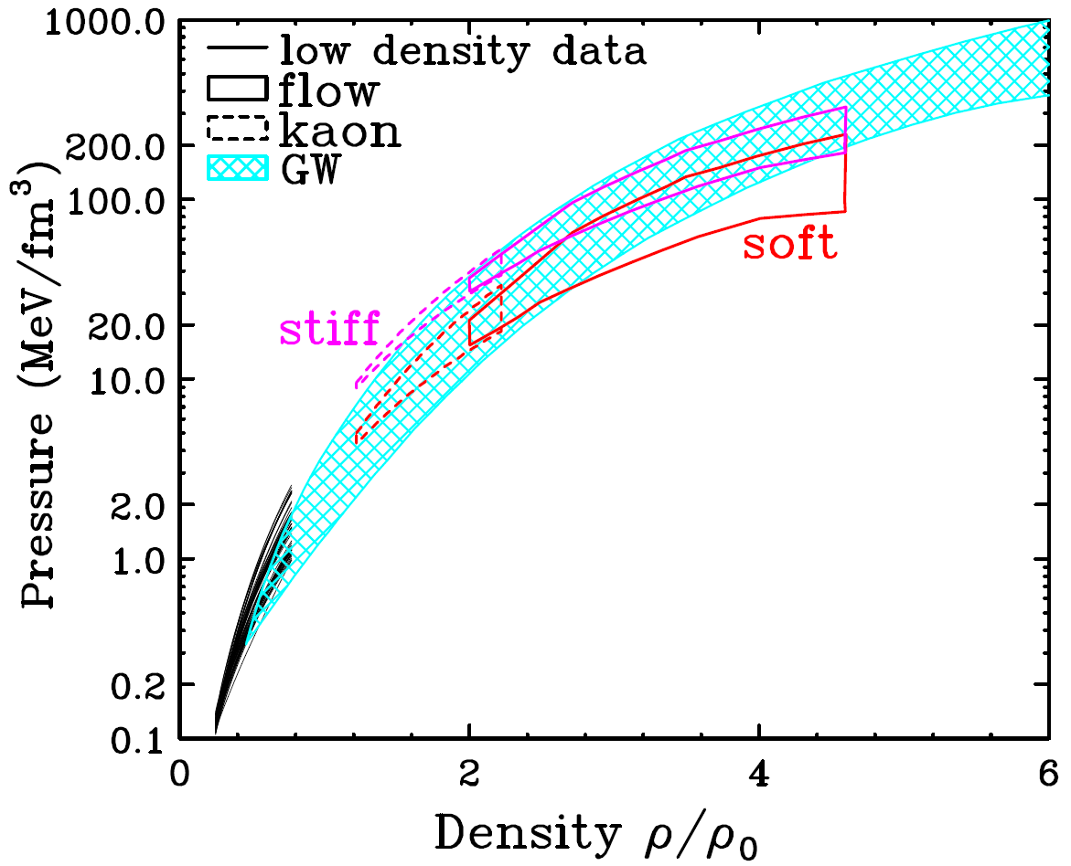
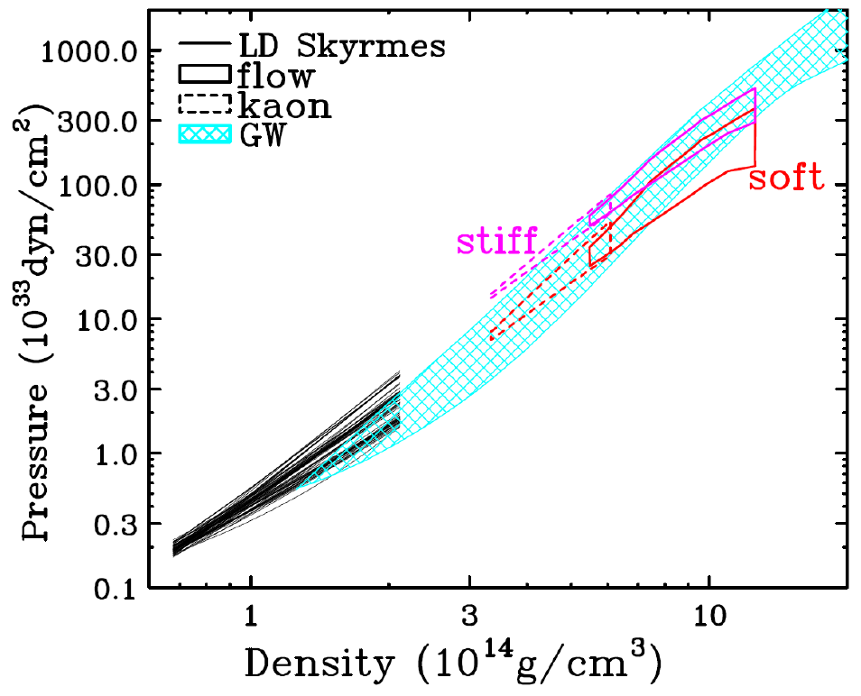
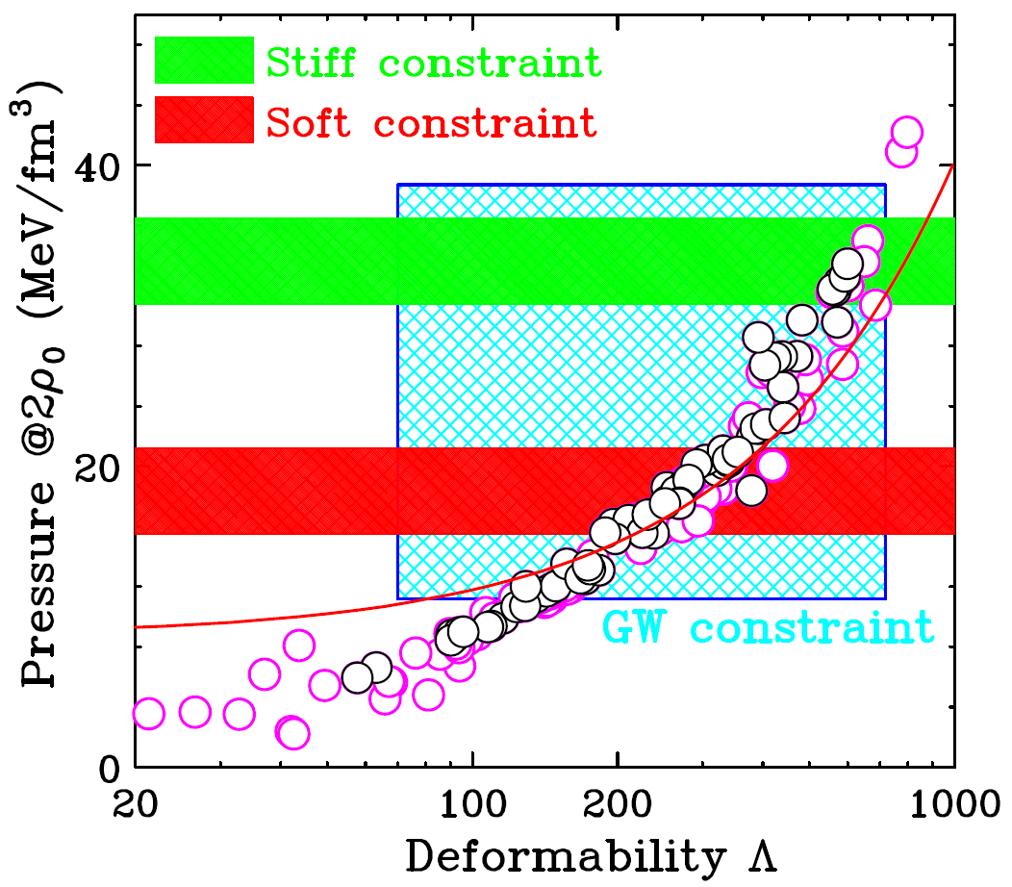
High density constraints from heavy-ion collisions
Improve current data uncertainties of symmetric matter from flow.
Predictions of pressure at 2ρ₀ from HIC measurements

Slide 5
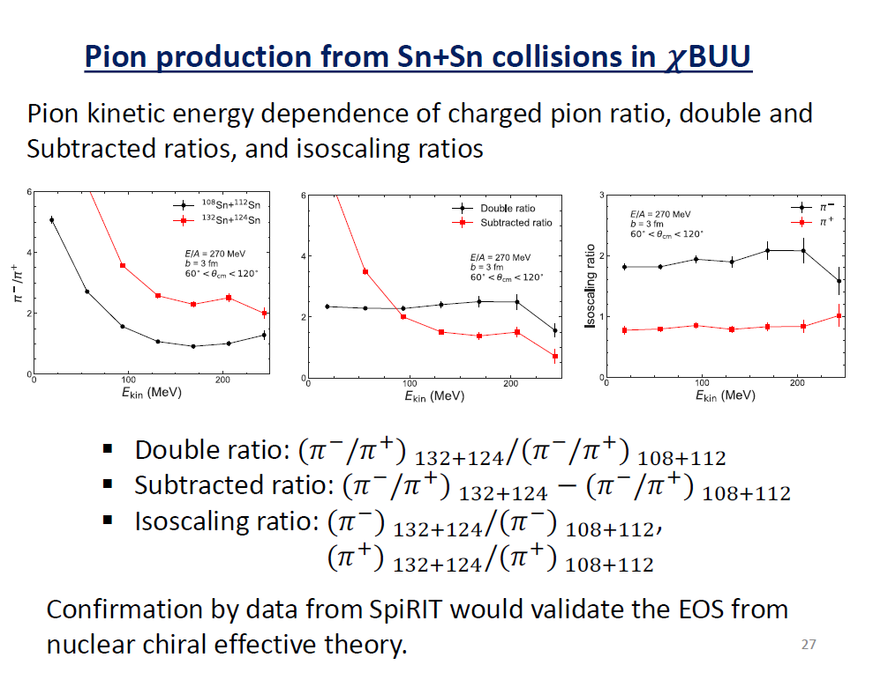
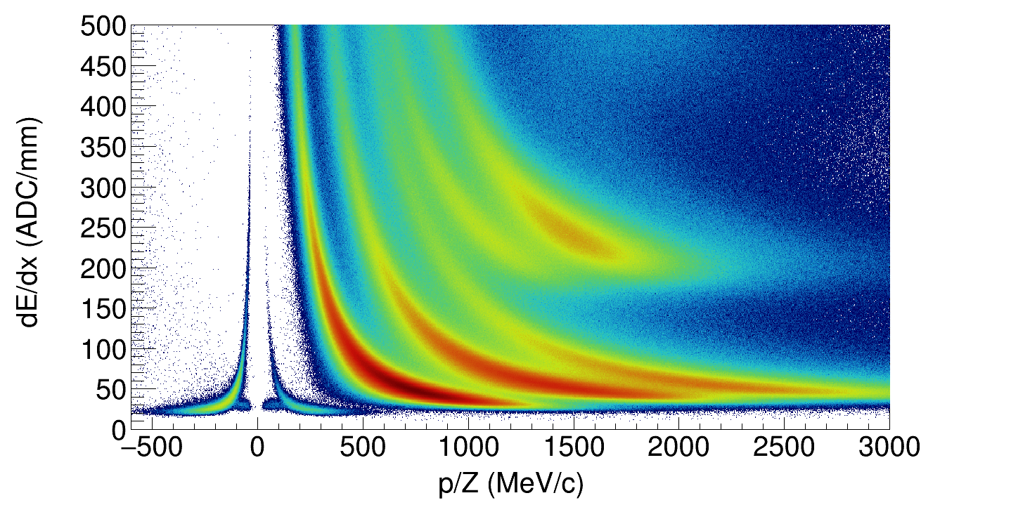
Predictions from code evaluation project

Slide 6
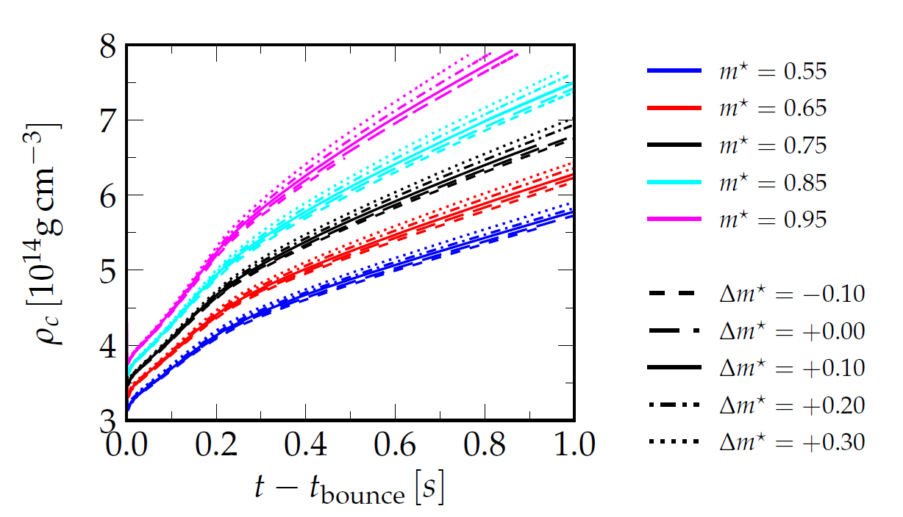
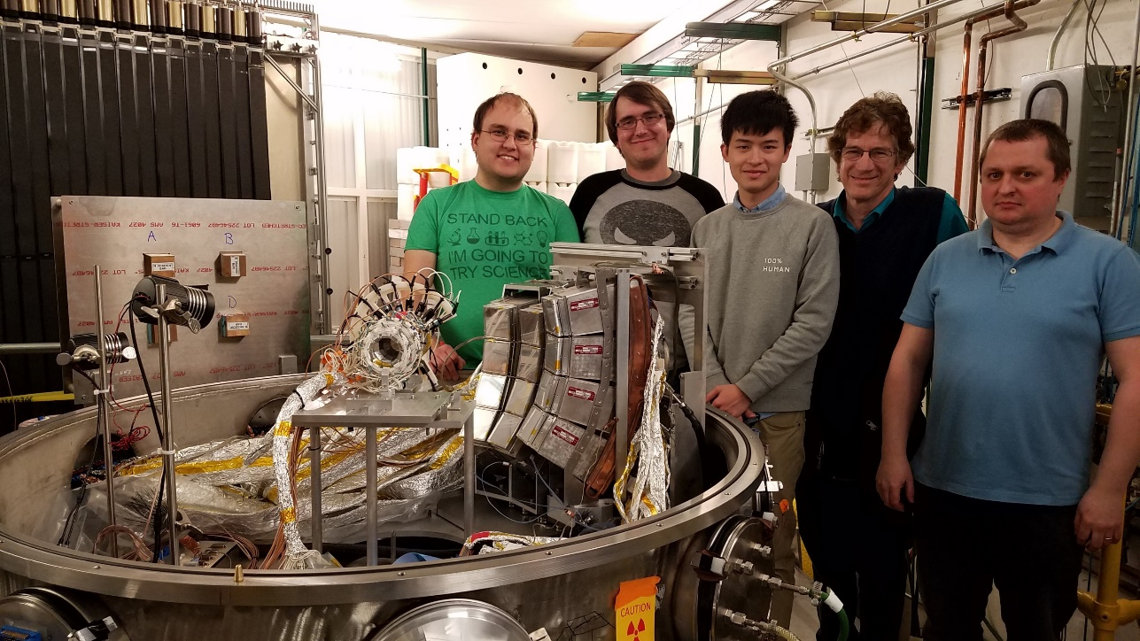
Colonna
Schneider
Isovector effective mass
m*_{n} < m*_{p}
m*_{p} < m*_{n}
Jun Xu
Mass splitting is sensitive to the isospin dynamics of heavy ion collisions including fission and quasi-fission
Predictions from m* experiments
~0.5ρ₀

Slide 7
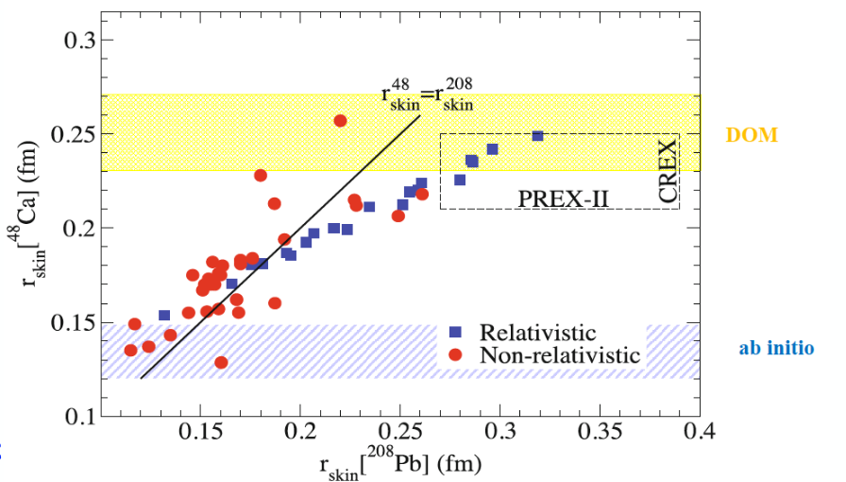
SKINS
Trautmann
∆r_{np} in ²⁰⁸Pb from different experiments
∆r_{np} (PREX I ) ~ 0.33 ± 0.18
0.18 ± 0.035 fm
0.15 ± 0.03 fm
0.165 ± 0.026 fm
± 0.05 fm
± 0.03 fm
± 0.02 fm
Predictions of CREX & PREXII measurements
Predictions from other experiments

Slide 8
Future Facilities – commission date & Day-One experiment
FRIB
FAIR
RAON
HIAF

