Slide 1



Looking for dark-sector long-lived particles with ATLAS
New HEP project
K. Hara
M-H. Genest

Slide 2




Looking for dark-sector long-lived particles with ATLAS
members
Marie-Helene GENEST
co-convener of the ATLAS Collaboration Exotics group (2017-2019).
Laboratoire de Physique Subatomique et de Cosmologie
UNIVERSITE GRENOBLE ALPES
ATLAS
from October: funding requested
agreement on “Campus-in-Campus”
PhD students
Nathan LALLOUE
Sayaka WADA
support from
FJPPL
Kazuhiko HARA, Fumihiko UKEGAWA
Institute of Pure and Applied Sciences
Tomonaga Center for the History of the Universe
UNIVERSITY of TSUKUBA
started:
“Tsukuba Honors”/JSPS being requested
Koji NAKAMURA (KEK)
FJPPL to enhance tighter collaboration
ATLAS H→ττ coordinator (-2014), ttH

Slide 3
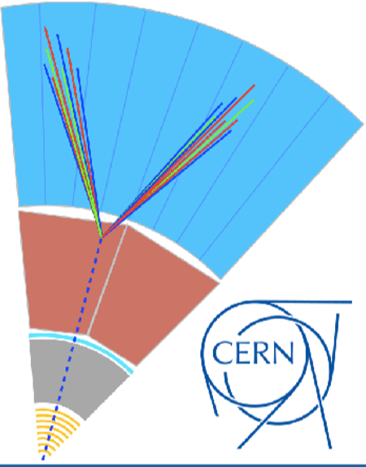
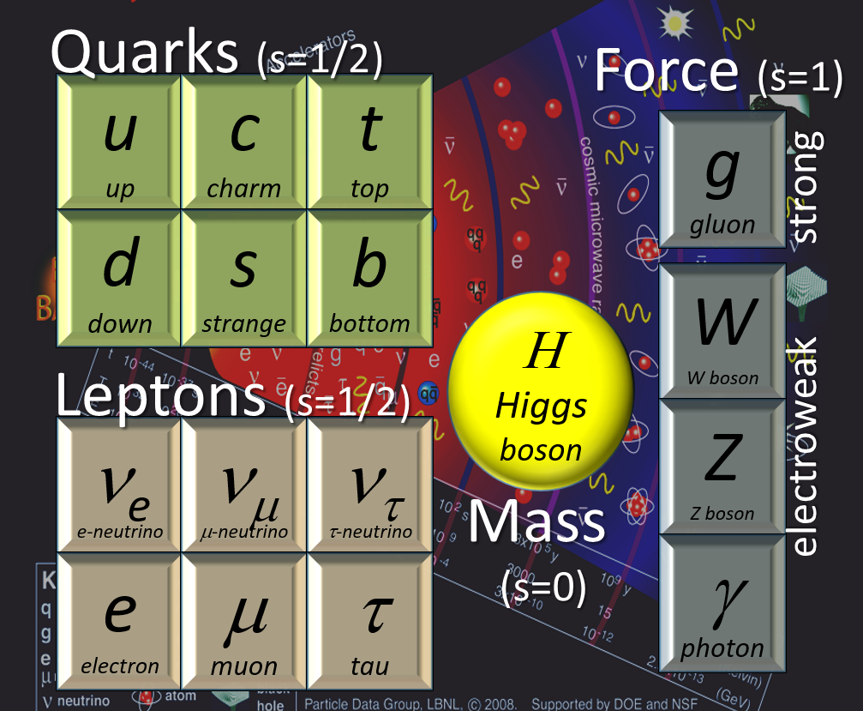
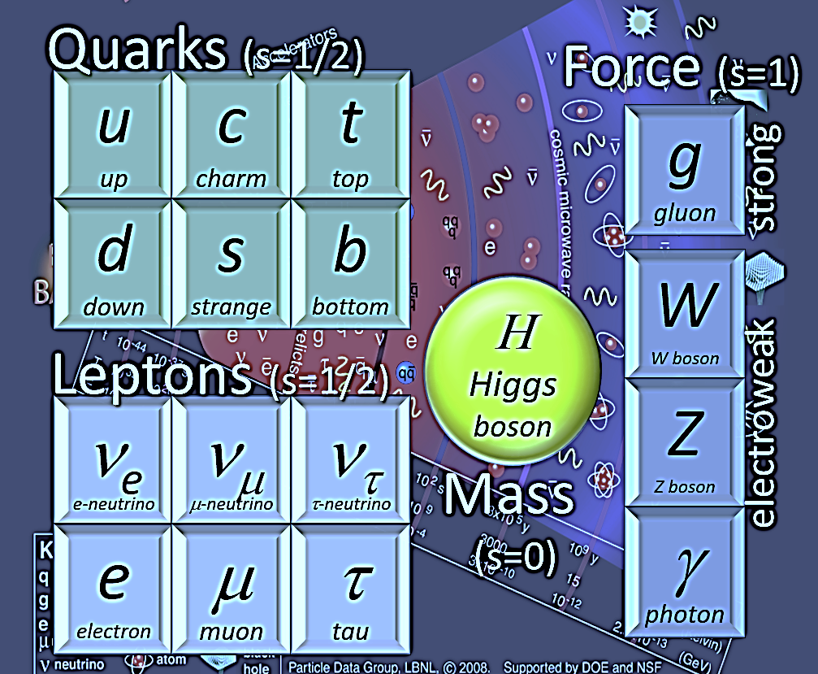
Beyond the Standard Model
After the Higgs discovery ~ “completion” of SM particle searches
What is the generation?
What are the fundamental forces?
Why is Dark matter?
Is there a “desert” above the top – no other heavy particles?
…
New Physics at O(TeV) would solve many of the above –
but no signal at the LHC yet*
gauge portal
*search at the collider is not appropriate
Λ(NP) is little bit higher
decay in stealth modes <heavy mediator, tiny coupling, compressed spectra,…>
Higgs portal
Long-Lived Particles (LLPs) may be a key to new physics
SUSY LSP
DM
Dark sector
LHC Long-Lived-Particle Community: ATLAS/CMS/LHCb with other experiments and theory/pheno. Community => White Paper2019Mar
RH v
fermion
since 2012

Slide 4
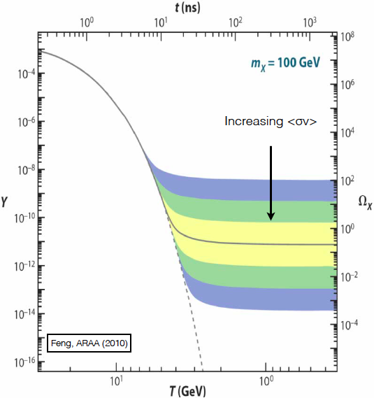
Dark Matter
Approximately 80% of the mass contents of the universe is in the form of dark matter, which could be composed of new particles.
So far, much attention has been devoted to the WIMPs (Weakly Interacting Massive Particles), mainly because of the so-called WIMP miracle:
  DM is produced in equilibrium with the SM particles in the early universe
  As the universe expands and cools down, the equilibrium breaks
    The SM particles do not have enough energy to produce DM
    The DM particles get too diluted to annihilate
    The density of DM particles freezes out to give the relic density
    When this happens depend on the cross section and the mass
  Weak-scale interactions give the correct relic density: this is the WIMP miracle!
Relic DM density
Comoving DM density
10⁻²⁶ cm³/s
The search for such particles, which could eventually be produced in the LHC, is underway with the ATLAS

Slide 5
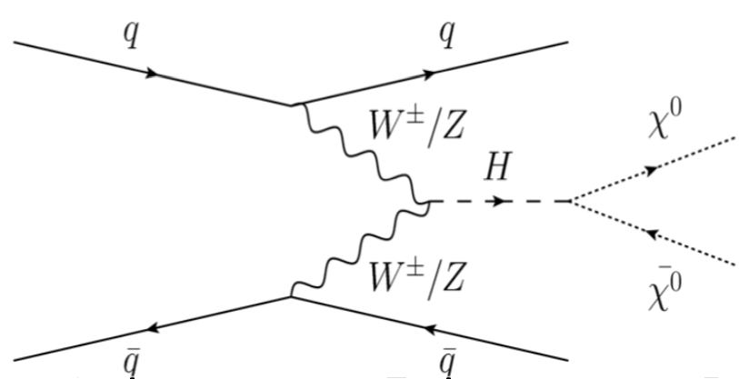
“Mainstream” WIMP-like DM searches
DM searches at the LHC have so far focused mainly on
SUSY particles (cascade decays down to the neutralinos),
direct pair production of DM particles in simplified models of
the mono-X type (X=jet, photon, V, H)
Higgs invisible decay
  - All these are very interesting searches, but they are rather well covered* already the full Run-2 analyses have already started, many of them aiming for a paper already in 2019.
  - With the start of Run-3 in 2021 and a factor 2 in integrated luminosity by the end of it, it will be possible to strenghten the limits provided by these types of searches**, but the discovery space beyond the already existing limits will not be large.
SUSY cascade
mono X
Higgs portal
*See for example https://arxiv.org/abs/1508.06608, https://arxiv.org/abs/1904.05105, https://arxiv.org/abs/1903.01400
** See for example https://arxiv.org/abs/1812.07831

Slide 6
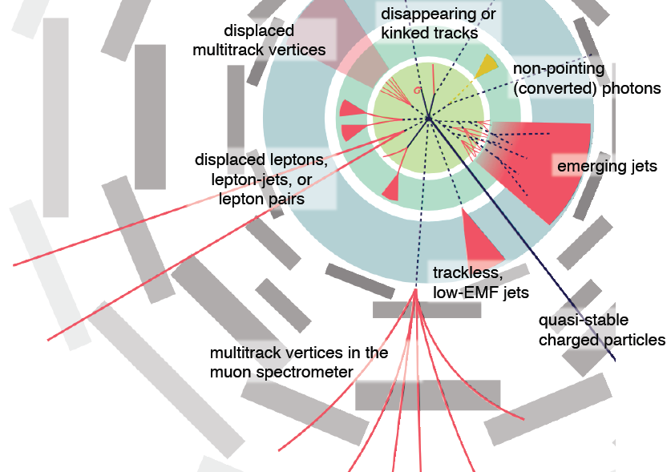
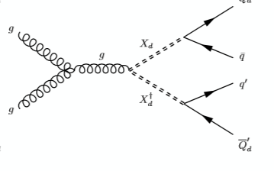
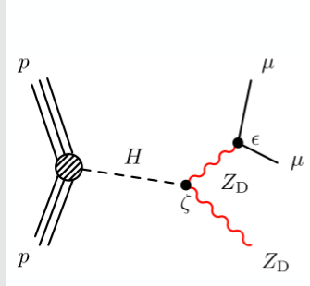
LLP: long-lived particles
• Less explored scenarios to be investigated before starting Run3
• One such place is the dark sector, leading to long-lived particles / unhabitual signatures
Searches are challenging
Non-standard reconstruction
Dedicated algorithm (calibration)
Unconventional backgrounds
~free of SM backgrounds
Require data-driven estimates
emerging jets
Higgs portal
Small coupling
Dark QCD
require a very good understanding of the objects in the detector - we have now benefit from many years of smooth data taking and analysis.
H. Russel

Slide 7
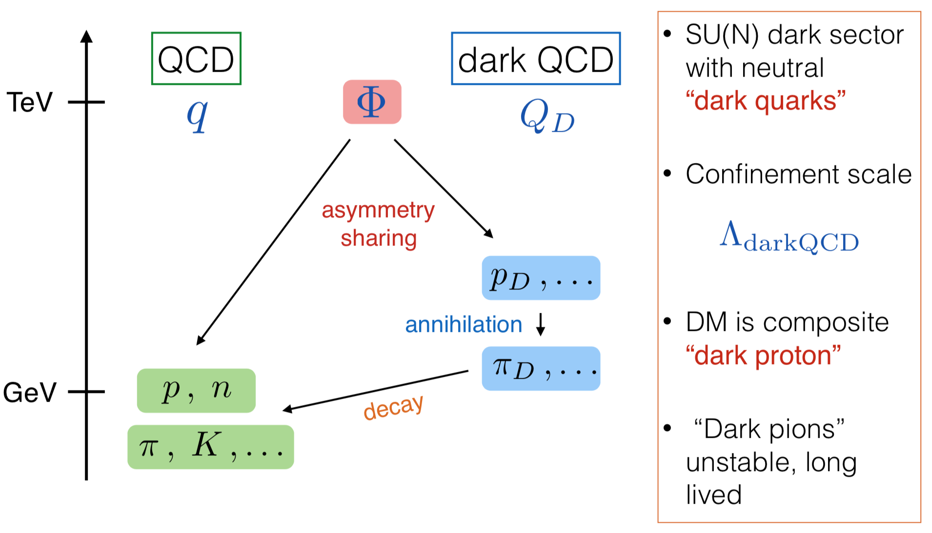
FIMP LLPs/dark QCD LLPs: Link to DM
The WIMP scenario is based on the freeze-out idea: DM particles are created in abundance in the early universe and density freezed out as the universe expands
Another idea is that we could have a ‘freeze-in’ –> DM are created from decays of SM particles but with very small couplings (FIMP = feebly interacting massive particles)
  Small couplings → if created, can be long-lived; new search domain
a more complex ‘dark sector’, as « dark QCD » where the lightest baryon might be stable and give rise to DM:
Hall et al. (JHEP2010)
P. Schwaller et al. (JHEP-2015)
P. Schwaller (Moriond EW2019)
~mass (pD,..)~O(1-10GeV)
pD,…Dark baryon number=>DM
πD…unstable decaying to SM particles
Can create dark showers in the detector
=> Detectable by unusual tracking and calorimetric properties of the jets

Slide 8
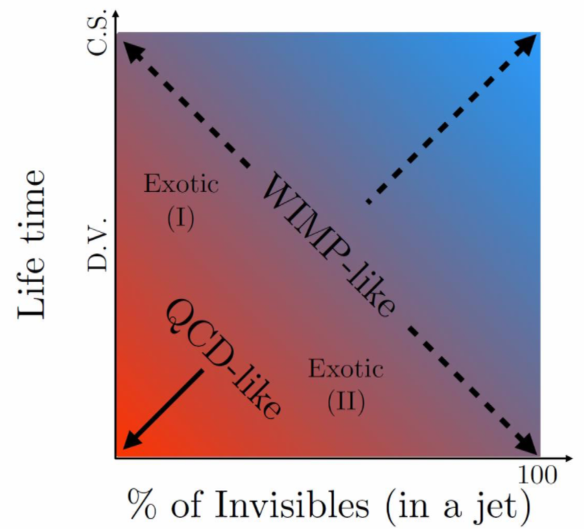
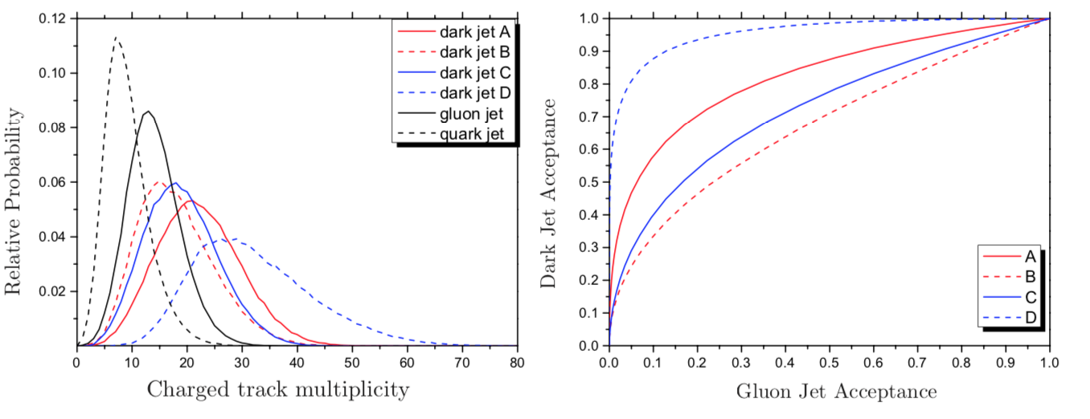
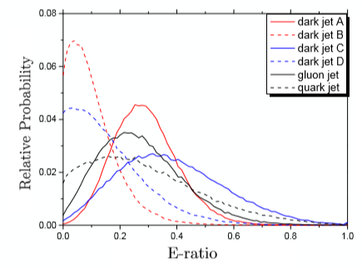
Dark QCD signature scenario
Can lead to multiple signatures*:
Lifetime pf πD vs % stable hadrons in a jet
* See Park&Zhang: https://arxiv.org/abs/1712.09279 (plots taken from there)
already considered in ATLAS
“Usual” MET+X searches
Displaced vertices in the jets
Some stable dark hadrons in a jet: MET collimated with jet => transverse mass of two leading jets can discreminate from SM jets
« Prompt » dark jet looks like a SM QCD jet – but some tracking and calo variables can be used to discriminate the two
q
g
Using the track multiplicity, the energy deposition structure in the calorimeter (em cal vs hadronic cal, substructure variables) to distinguish from SM gluon/quark jets (*)
=> studies ongoing
A-D: different dark QCD params
g
ε=0.3-0.9 for εg=0.1
q
charged multiplicity in a jet
gluon-efficiency
EM fraction in a jet
  for high-mass dark pion, one could also search in the top/bottom quark final states which may be favoured** - these could also lead to displaced signatures – not directly searched for at the LHC at the moment
** See https://arxiv.org/abs/1809.10184

Slide 9
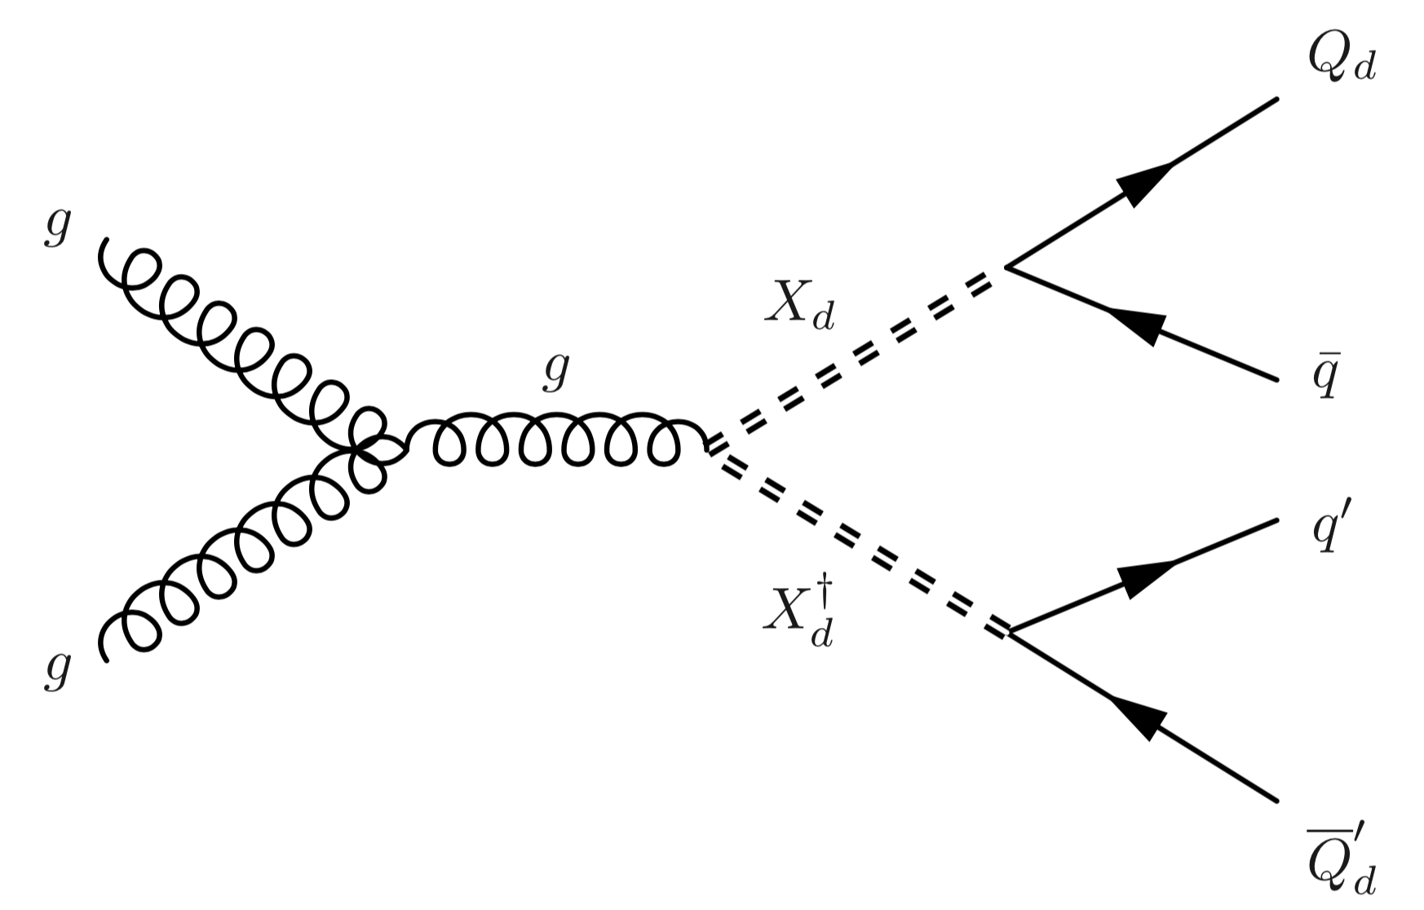
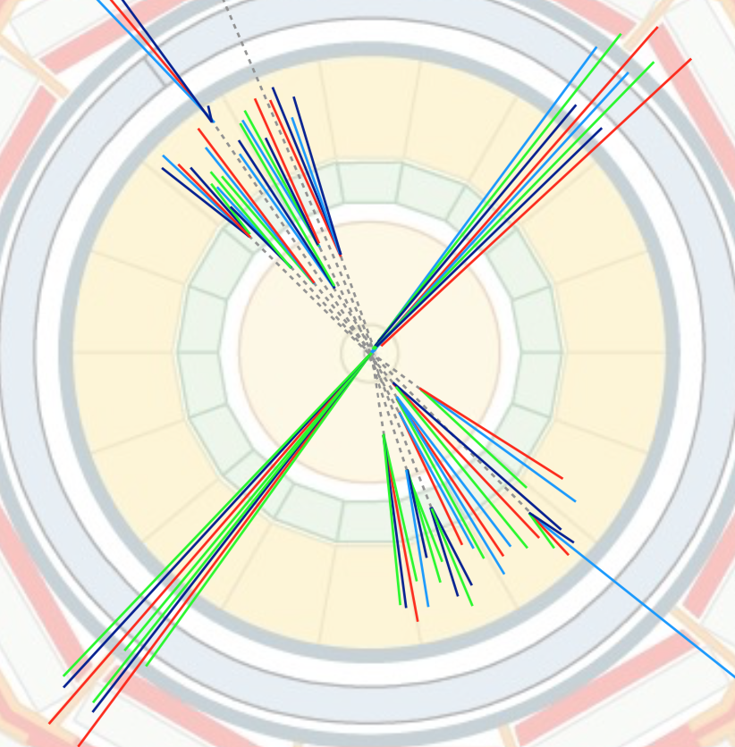
Dark QCD : “emerging jets”
Dark pion
Longer lifetime:
  can have emerging jets*:
Dark pions decay later
displaced vertices associated with the jets which look as if they ‘emerge’ at the end of the inner detector and in the calorimeter
Such an analysis was published by CMS with 16 fb⁻¹ of data**, but no result so far from ATLAS
Possibility of an analysis of the full Run-2 data for a publication during the long shutdown
* See https://arxiv.org/abs/1502.05409
** See https://arxiv.org/abs/1810.10069

Slide 10
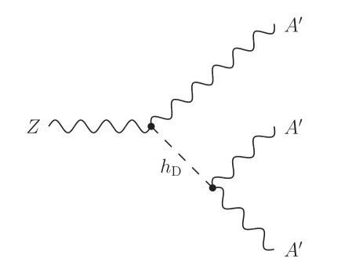



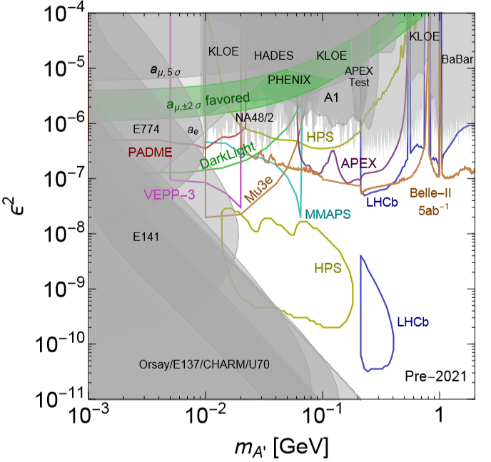
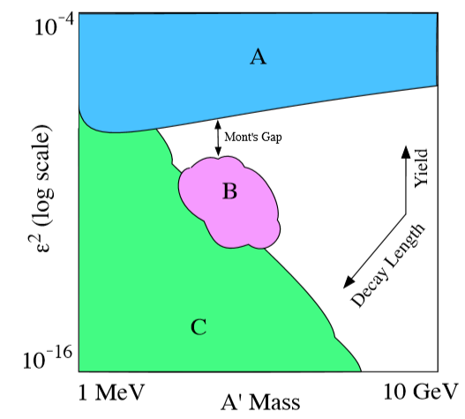
Dark photon
plots are from Dark Sector 2016 WS summary
additional U_{D}(1)’
mixing to dark sector: ～ε
dark photons
shaded: already excluded
curves: planned
prompt bump search, look for missing
displaced v
cartoon of search strategy

Slide 11

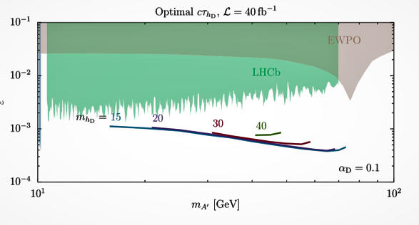

Dark photon
plots from *N. Blinov et al., P.R.D97,015009 (2018)
LHC produces many Zs exceeding the LEP stats
Rare Z decay: “Z-portal” to hidden sector
=> Signature: ~6 leptons/quarks
In the mass hierarchy (hD can decay via off-shell A’), hD decay is displaced
(better sensitivity than in opposite mass hierarchy case)
EW precision observables
=>trigger on two leptons from on-shell A’ decay
=>look for displaced vertex of hD decay
LHCb
ε
1 mm <|d0|< 200 mm
m_{hD}
dark photons
10
m_{A’}
100
LHCb:PRL120.6 (2018) 061801 (in B→Kμμ with A’→μμ, prompt+displaced)
….. resonant A’ mass peak reduces the background in searching for the displaced vertex

Slide 12
Plans
The team involving one (and possibly two) PhD student(s) would search for a dark QCD and/or dark photon to explore dark sector scenarios.
Our main goal is to build a more enhanced collaboration between the ATLAS LPSC and the University of Tsukuba on this topic, benefiting for the experience in exotics searches, calorimetry and jets at LPSC and from the extensive tracking detector experience of the University of Tsukuba
At least one publication with the full Run-2 dataset foreseen during the long shutdown: discussion ongoing within ATLAS
Preparation of the Run-3:
  work on optimizing the reconstruction performance, e.g. peculiar jet with displaced vertices associated to atypical calorimeter energy deposition
  understand possible gaps in the dark sector parameter space coverage
  study the possibility of / need for new triggers (eg using tracking with the FTK to be commissioned for Run-3)

Slide 13
Funding Request
Funding Request from France
Description |  |  | €/unit |  | Nb of units | Total (€) |  | Requested to:
Visit to Japan |  |  | 150/day |  | 7 days | 1050 |  | IN2P3
Travel |  |  | 1000 |  | 1 travel | 1000 |  | IN2P3
Total |  |  |  |  |  | 2050
Funding Request from KEK
Description |  | k¥/Unit |  |  | Nb of units | Total (k¥) |  | Requested to:
Student Stay at LPSC |  | 15/day |  |  | Twice x 2 weeks | 420 |  | KEK
Travel |  | 150 |  |  | 2 travels | 300 |  | KEK
Total |  |  |  |  |  | 720
Additional Funding from France |  |  |  |  | Additional Funding from Japan
Provided by/Requested to | Type |  |  | € | Provided by/Requested to |  | Type |  | k¥
 |  |  |  |  | JSPS |  | stay at CERN |  | 1200
 |  |  |  |  | / U Tsukuba |  | travel |  | 300
Total |  |  |  |  | Total |  |  |  | 1500

Slide 15
LPSC Grenoble
Marie-Hélène Genest:
  current convener of the ATLAS exotics group, until October 2019
  previous experience in supersymmetry searches: lepton(s)+jet(s)+MET analyses & convener of the SUSY subgroup of analyses with MET (2010-2011)
  previous experience in exotics searches of dark matter: mono-photon analysis & convener of the of the Exotics subgroup ”Jets and Dark Matter” (2015-2016)
Nathan Lalloué:
  current master student, working on prompt dark jet resonance studies (accessible analysis of dark QCD for a master thesis) until July 2019
    hope to see him continue for a PhD on dark QCD (waiting on funding confirmation by the end of the spring)
The LPSC group also has recognised expertise on LAr calorimetry (eg data quality) and also on jet reconstruction which are very relevant to these analyses

Slide 16
U. Tsukuba/KEK
Kazuhiko Hara:
  Constructed SCT detector (barrel modules and assembly)
  Design/construction of HL-LHC ITk strips and pixel detectors
  PhD Supervisor to Htt (top Yukawa coupling) analysis by Shunsuke Honda (2018 PhD)
  previous experience: CDF experiment
Fumihiko Ukegawa:
  PhD Supervisors to charged Higgs search, H->bb search and others
  Previous experience: CDF experiment
Koji Nakamura:
  Design/construction of HL-LHC ITk strips and pixel detectors
  Coordinator of ATLAS H->ττ analysis group (-2014), ttH analysis
  Previous experience: CDF experiment (PhD: discovery of single top production)
The U. Tsukuba group has recognised expertise on SCT detector operation (eg data quality) which is very relevant to these analyses

Slide 17
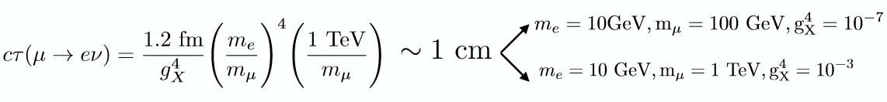
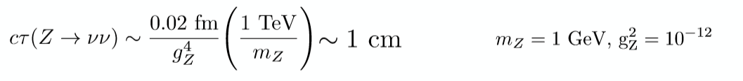
LLPs lifetime - extrapolation from SM
Large mass hierarchies/off-shell mediator => heavy E scale
RH v
Hidden valley
Compressed spectra => object threshold
SUSY
Small coupling => low rates

Slide 18
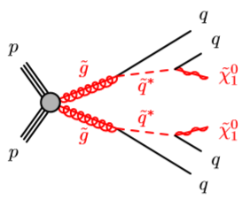
ATLAS searches with “LLPs”
Hadronic decay:
…. Typically in mass>100GeV as large missET required
Run-2 (33/fb):LLPs in events with missET>250GeV
motivated by long-lived gluinos (large mass squarks)
search for m(DV)>10GeV, sensitivity m(DV)>~100GeV Phys. Rev. D 97 (2018) 052012
Run-2(33/fb):neutral pair LLPs decaying in Calos/MS
φ(heavy neutral boson)→ss (neutral spin-0, long-lived)
in standard Hidden-Sector model=>no track, high Eh/Eem
good sensitivity in 125<m(φ)<1000 GeV, 5<m(s)<400 GeV CERN-EP-2018-351
Run-2(36/fb): φ/H→Z+Zd with Zd decaying in Calos(Et>40GeV,no track, high Eh/Eem)
excluded 0.1<cτ(s)<7 m with 5<m(Zd)<15GeV
Phys. Rev. Lett. 122, 151801 (2019)
Leptonic decay:
Run-1 (20/fb):LLPs in events with
muonPt>50GeV &track*hits in TRT/SCT but no hits in Pixel (*tracking re-run owith looser d0, z0)
EM(~photon)>120GeV &trackless (~ inefficient to non-primary tracks)
=> Set mass /lifetime limits based on SUSY models Phys. Rev. D 92, 072004 (2015)
Run-2(33/fb): di-muons with displaced vertex
set limit on H→Zd+Zd (dark photon) Phys. Rev. D 99, 012001 (2019)

