Slide 1

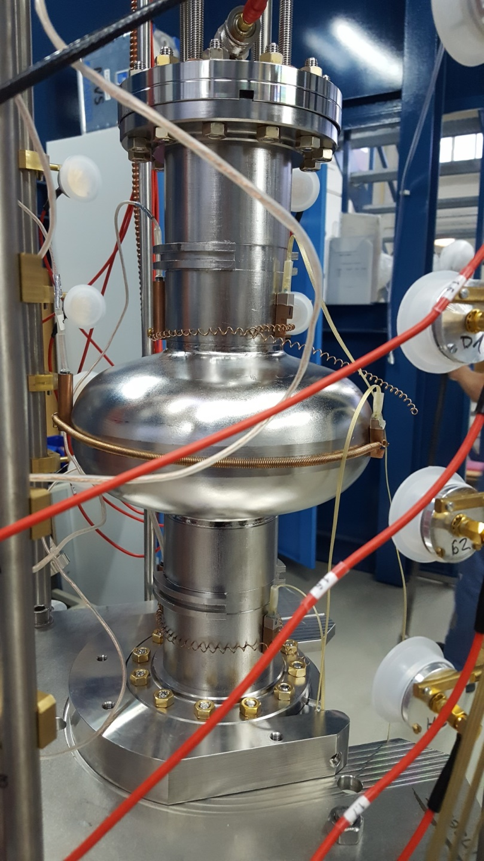
Magnetic field monitoring and management for Superconducting RF cavities
(A_RD_16)
Juliette Plouin, Enrico Cenni, Marchand Claude (Saclay)
Mika masuzawa, Kiyosumi Tsuchiya, Ryuichi Ueki (KEK)
Takafumi Okada (SOKENDAI, the Graduate University for Advanced Studies)

Slide 2
Contents
Introduction
Motivation
Sensor for magnetic field monitor
  AMR sensor
  Sensor Test
    Saclay Status
    KEK Status
Proposal Summary

Slide 3

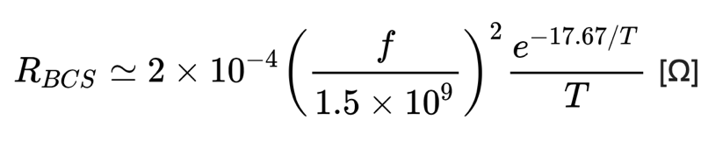
Introduction
For superconducting RF cavities, high-Q operation is desirable to reduce cryogenic loss.
To achieve high-Q, it is essential to reduce surface resistance (BCS resistance and residual resistance)of Nb.
R_{res} comes mostly from magnetic flux trapping during cooling down process
It is important to
reduce the ambient magnetic field as much as possible and
understand how the ambient magnetic field is trapped and/or expelled during the cooling down process, as this will help us design a better magnetic shield.

Slide 4

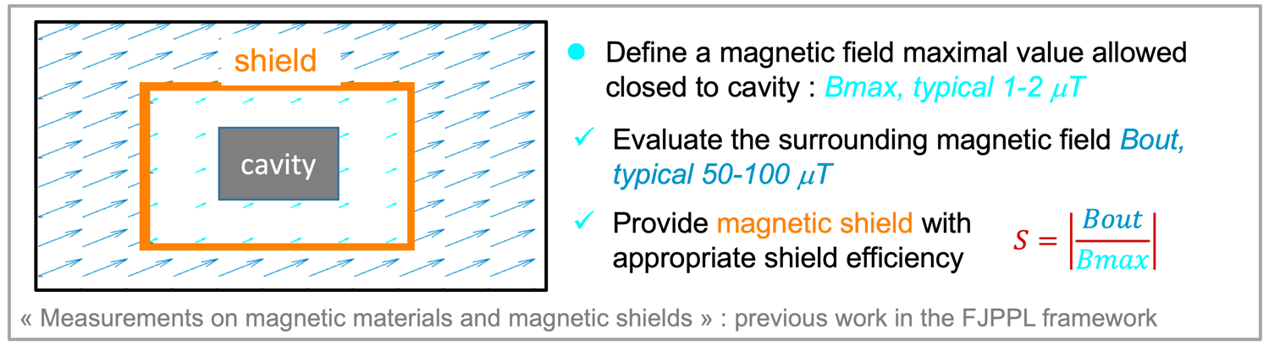
Examples of recent activities regarding magnetic shield in the framework of FJPPL:
TTC/ARIES topical workshop on flux trapping and magnetic shielding, 8-9 nov. 2018, CERN:
J. Plouin: “Magnetic field management in cryomodules and vertical cryostats at CEA-Saclay”
K. Umemori: “Study on temperature dependent EBSD measurements”, “Flux expulsion experiments with QWR at RIKEN”, “Reports on sensitivity measurements at KEK”
M. Masuzawa: Chair of Magnetic shielding session
SRF2017 (International Conference on RF Superconductivity) at Lanzhou, China
TTC (TESLA Technology meeting) at Milano, Italy

Slide 5
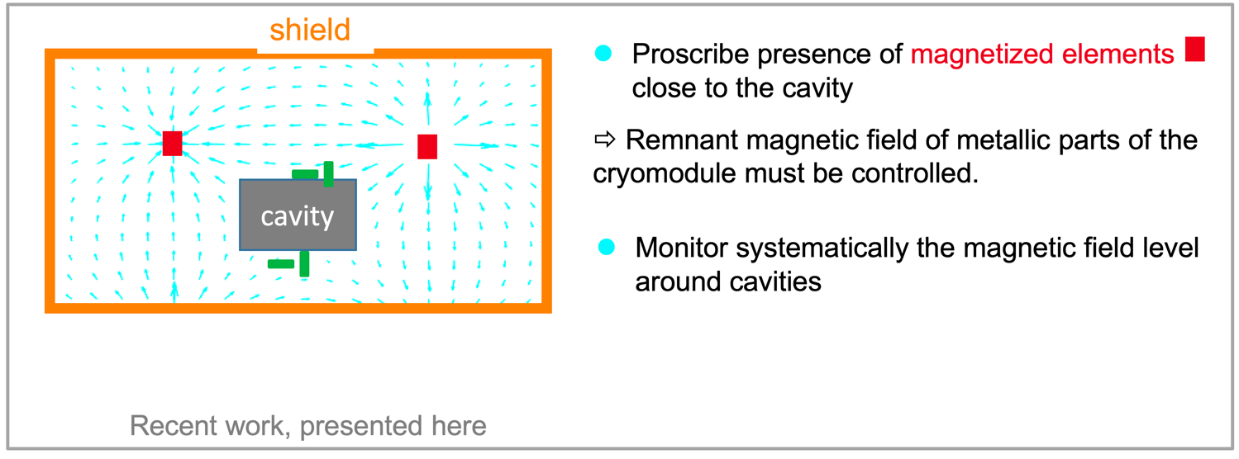
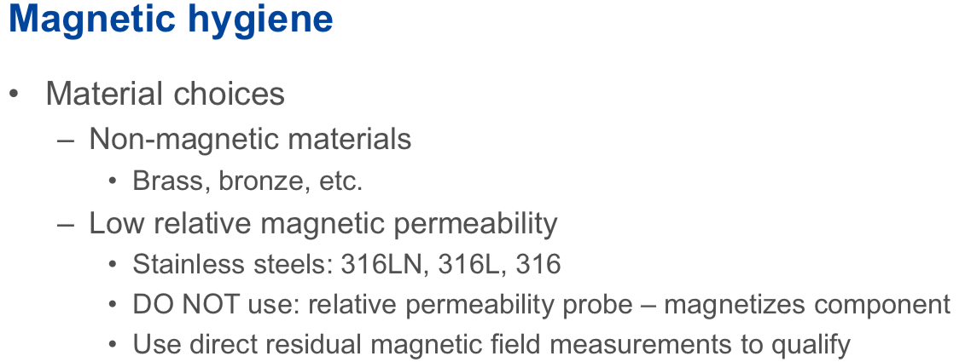
Checking of magnetic hygiene around the cavity is necessary

Slide 6
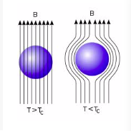
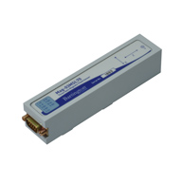
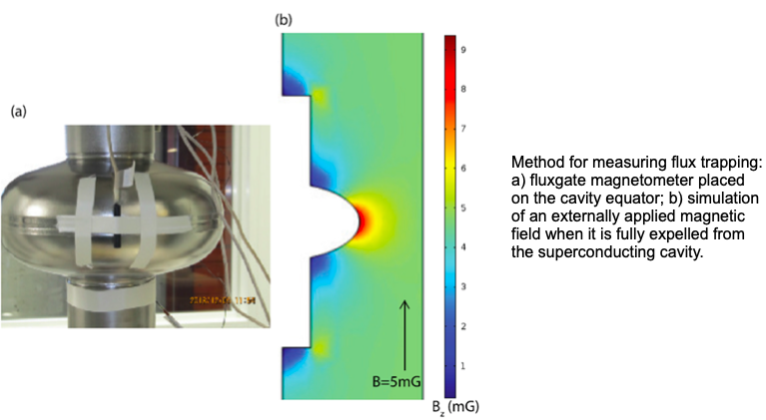
For this, we need to map the magnetic field using many sensors
A magnetometer called “flux gate sensor” has been used to measure the ambient magnetic field but it is a large sensor
Bartington Mag-03 MS 3-axis sensor has 32 mm x 32 mm x 150 mm dimensions, quite large compared to a cavity size and it is very costly , was > €5,000 in Japan. Smaller and more affordable sensors need to be searched for.
Bartington Mag-03 MS 3-axis sensor
Efficient expulsion of magnetic flux in superconducting RF cavities for high Q0Q0applications - Posen, S. et al. J.Appl.Phys. 119 (2016) 213903 arXiv:1509.03957 [physics.acc-ph] FERMILAB-PUB-16-366-TD

Slide 7
Motivation
Need for (smaller and cheaper) sensors, which can be used reliably at the room and cryogenic temperatures
We plan to
Test a few types of new sensors
Use them to actually monitor the magnetic field around the RF cavities during the cooling down/warm up
Under the collaboration with CEA Saclay and KEK in the framework of FJPPL.

Slide 8
Sensor search
Recently a sensor that utilizes the anisotropic magnetoresistance (AMR) effect is being looked into. HZB has done some study.
  An AMR sensor is much smaller (less than 10 mm x 10 mm, for example) than a flux gate sensor and less expensive.
  They are originally developed and used for rotation detection and open-close detection in a tablet PC or smartphone, for example

Slide 9
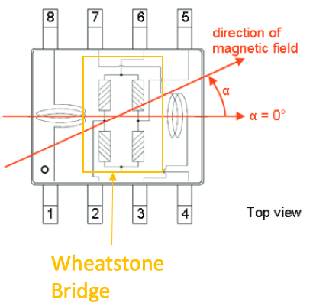
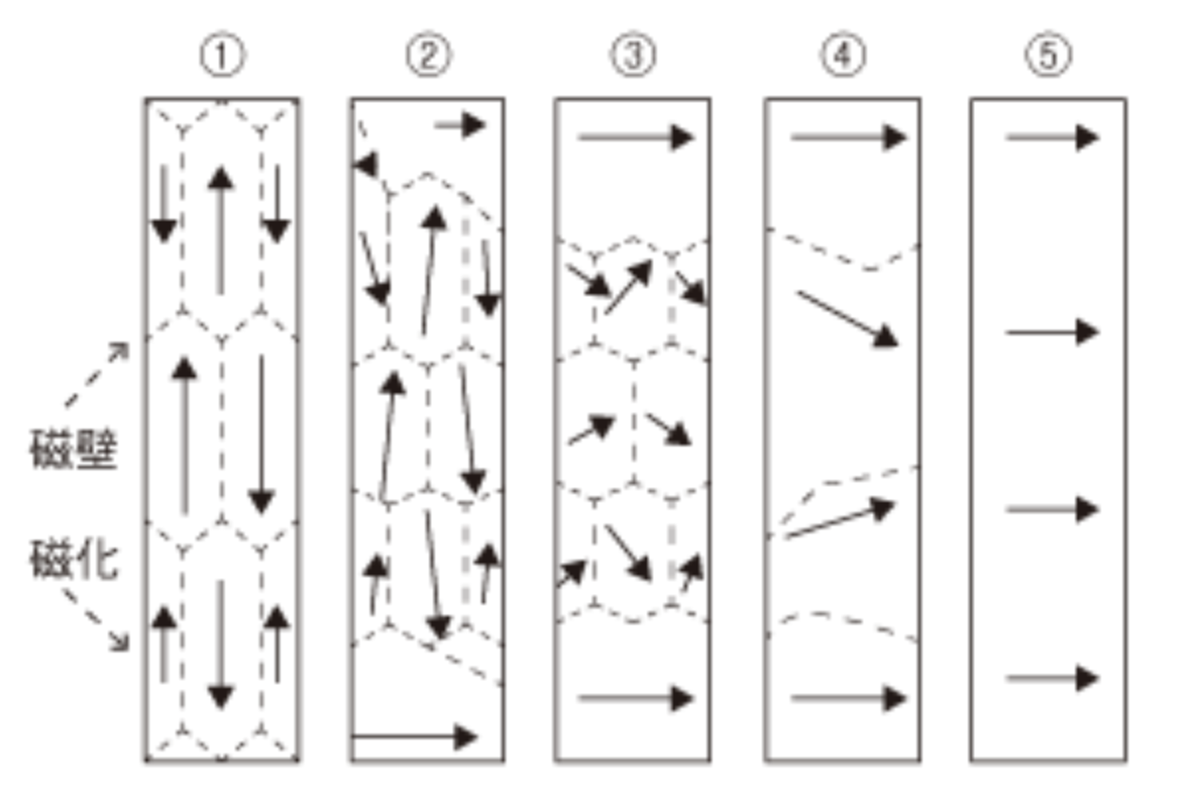
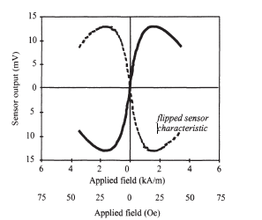
AMR sensor
Principle
Anisotropic Magneto Resistive effect : change of electrical resistance of a material with external magnetic field
4 AMR sensitive elements are place in a Wheatstone Bridge
As a result, AMR sensor gives a linear output voltage/applied field dependance for low magnetic fields
Magnet domain walls start to move when there is external magnetic field
1 AMR sensor + appropriate amplification
€10’s

Slide 10
Sensor test
has just started at CEA Saclay and KEK
Test items are:
Output as a function of ambient magnetic field
Calibration of each sensor
Reproducibility of the measurement
Sensor to sensor variation
Temperature dependence
→Comparing notes between CEA and KEK
Participating the data taking at CEA/KEK if possible, as we will learn a lot more this way

Slide 11
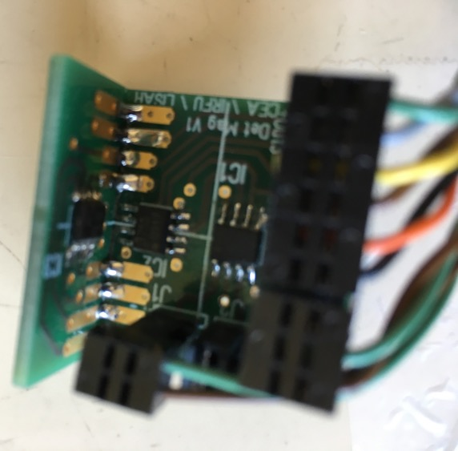
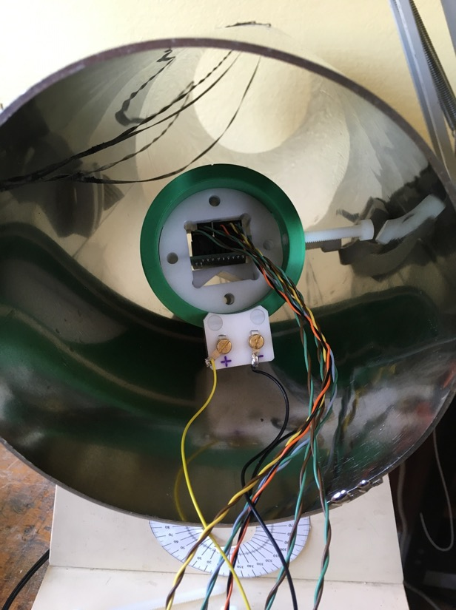
Saclay Status
Sensor calibration
Magnetic shield to eliminate ambiant field
AMR sensors in a controlled Helmholtz coil
AMR sensors,
3 directions, X,Y,Z

Slide 12
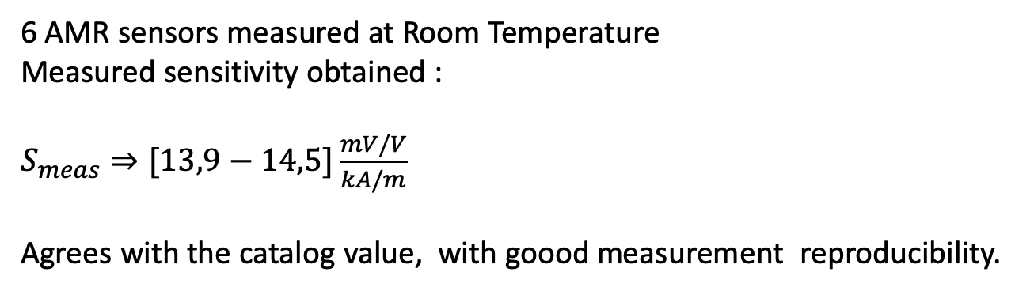
Saclay Status
6 AMR sensors measured at Room Temperature
Measured sensitivity obtained :
$S_{meas}⇒[13,9−14,5]\frac{mV/V}{kA/m}$
Agrees with the catalog value, with goood measurement reproducibility.
Latest from Juliette Plouin
Up to now, we tested the circuit with analog measurement and it works well.
The measurement with fluxgate sensors were satisfying.
Then, the difference is that you first need to make a calibration in order to check the actual sensitivity, which can slightly differ from one sensor to the other.
It's not like buying a Bartington fluxgate and use it directly.

Slide 13
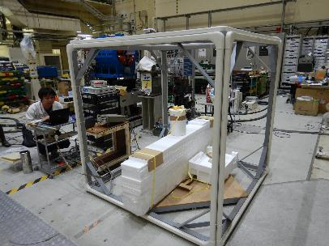
KEK Status
Helmholtz coils in 3-directions to cancel ambient magnetic field and create an uniform field in one direction for sensor calibration.
The same AMR sensors were purchased.
We checked the output signal as a function of the external field and sensor to sensor variation.
First look from the 4 sensors
We see that there is a sensor to sensor variation.
Variation was also seen in the experiment carried out at Saclay in April.

Slide 14
KEK Status
First look from 4 AMR sensors (see the slope of red lines) at room temperature
0.6mV/Gauss
6.74 mV/Gauss
6.75 mV/Gauss
6.65 mV/Gauss
Something is probably wrong with this #1 sensor
Broken?
~6.71 mV/Gauss ⇒ ~16.8 (mV/V)/(kA/m)
Agree with the catalog data.
Measurement reproducibility needs to be checked.

Slide 15
KEK Status
First look from 4 AMR sensors (see the slope of red lines) at liquid N₂ temperature (77K)
Sensitivity increase from
6.1mV/G to 16.4mV/G was seen.

Slide 16
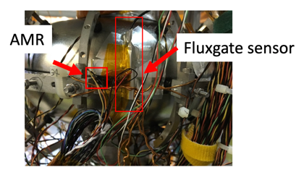
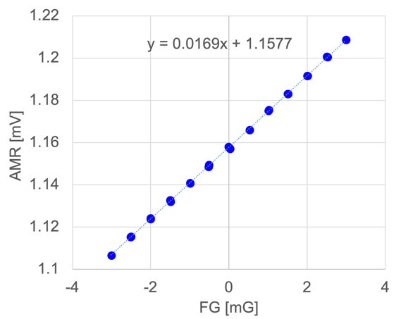
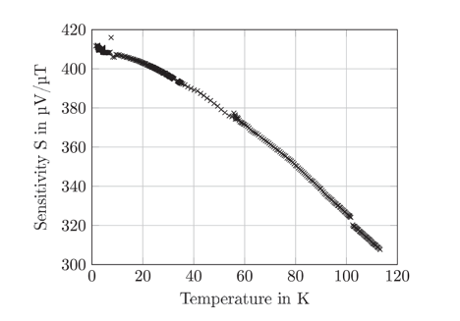
KEK Status
First look from 4 AMR sensors (see the slope of red lines) at liquid He temperature (4K)
Sensitivity at 4K is 16.9 mV/G, not much increase from
16.4 mV/G at 77K, while HZB reports larger enhancement (~15%) …

Slide 17
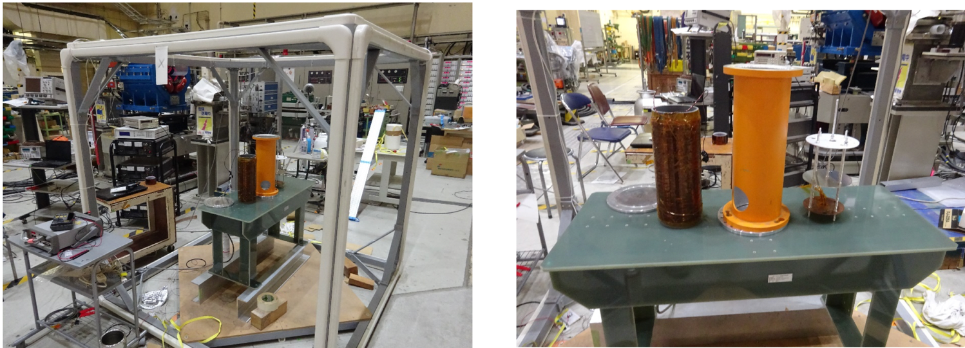
KEK Status
Measurement bench for mass measurment (@RT and 77K) is being designed and prepared.This system calibrates each AMR sensor, we will need 36 ×3 = 108 sensors for the cavity experiment (see next page). Calibration @4K is also being investigated.

Slide 18
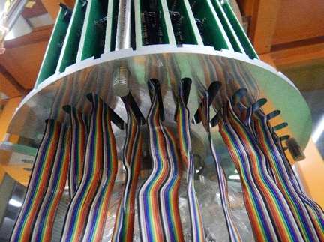
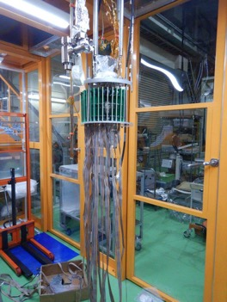
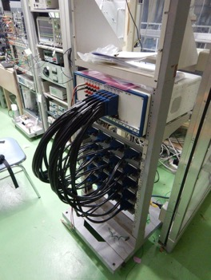
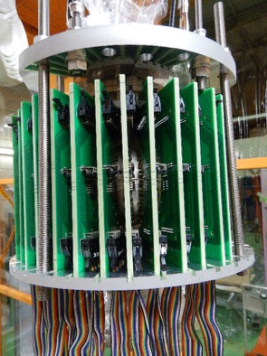
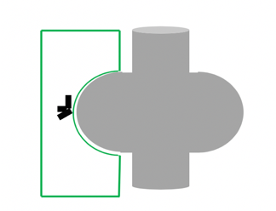
KEK Status
3 AMR sensors/board
1 board by every 10 degree around the equator

Slide 19
Proposal Summary
To reduce the amount of trapped flux during the cooling down process of a superconducting RF cavity, it is important to:
(a) Reduce the ambient magnetic field as much as possible; and,
(b) Understand how the ambient magnetic field is trapped and/or expelled during the cooling down process, as this will help us design a better magnetic shield.
For this, we need to map the magnetic field using many sensors.
A sensor that utilizes the anisotropic magnetoresistance (AMR) effect is being looked into. An AMR sensor is much smaller (less than 10 mm x 10 mm, for example) than a flux gate sensor, and also much less expensive.
We will check the feasibility of using an array of AMR sensors for mapping the ambient magnetic field, including at cryogenic temperatures, within the framework of FJPPL with Saclay CEA.
(Option) Some other types of sensors will also be looked into and tested.

Slide 21
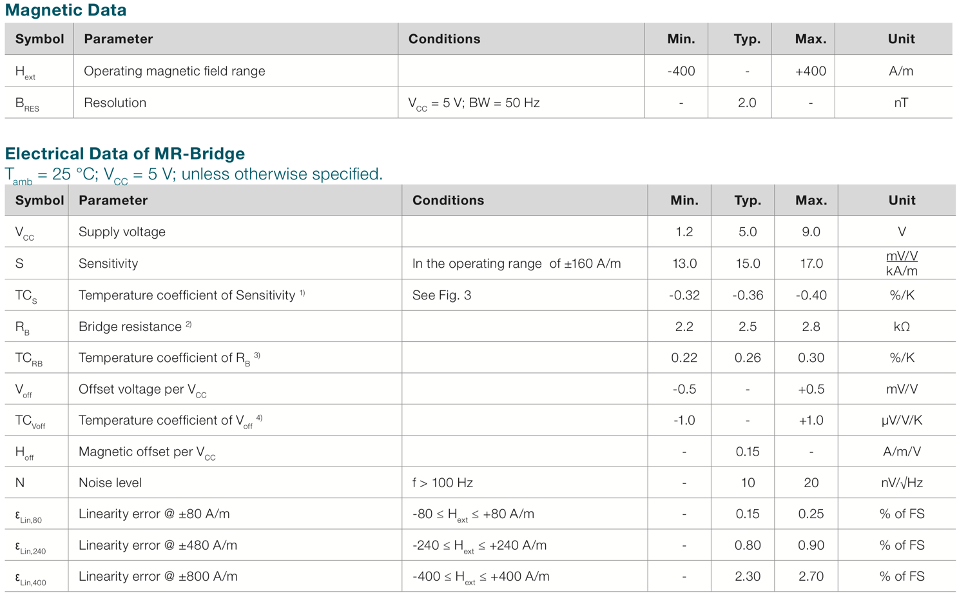
-5 G 〜 +5 G

Slide 22
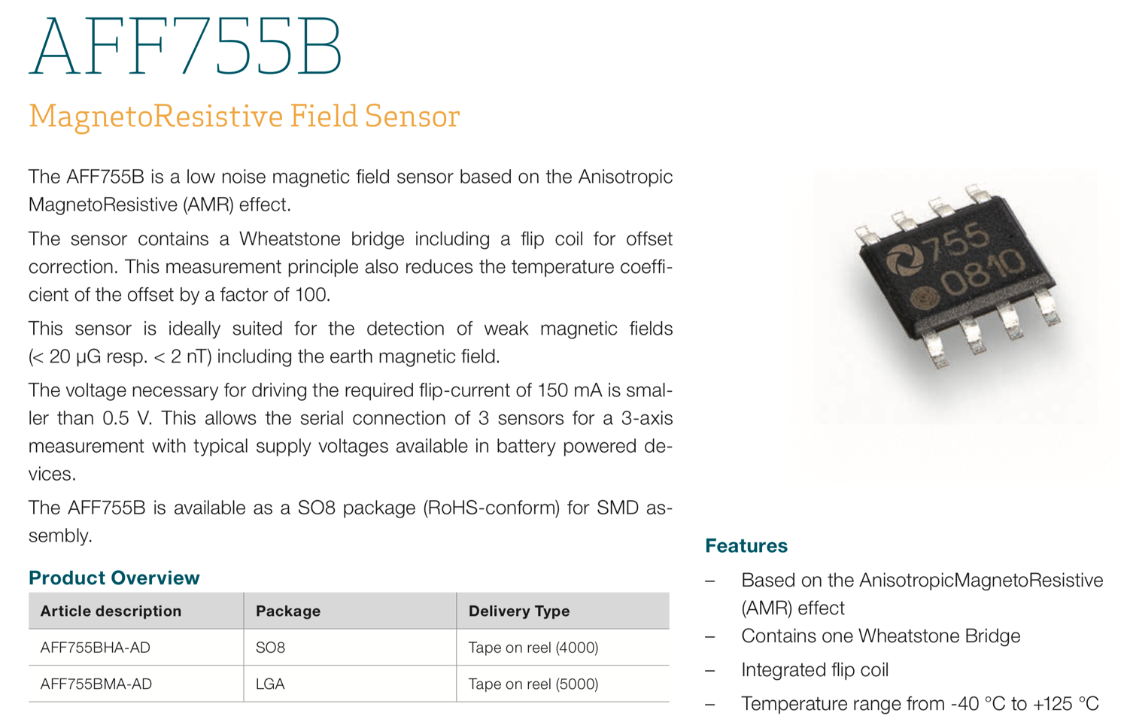
AMR sensor
?

