Slide 1

Direction-sensitive dark matter detection with gaseous tracking detectors (new proposal / D_RD_21)
Kentaro Miuchi
(KOBE University) CoｰPI:Daniel Santos (LPSC/IN2P3)
@ 2019 Joint workshop of FKPPL and TYL/FJPPL

Slide 2
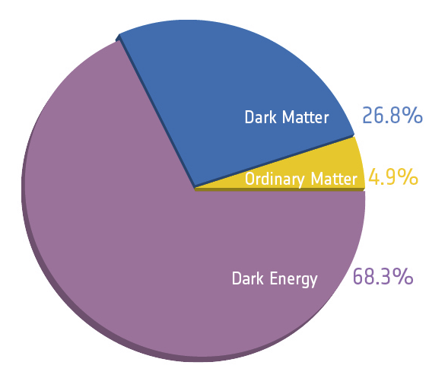
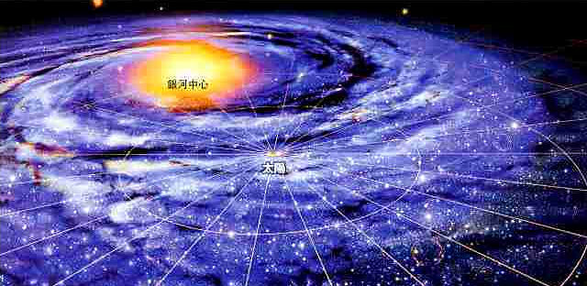
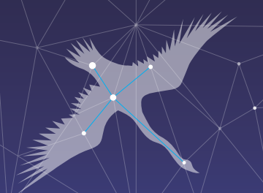
Physics case : dark matter
～1/4 of the universe
(can be) unknown particle beyond standard model direct search: DM-nucleus interaction
the universe
(energy pie chart)
Our GALAXY （dark matter “HALO”）
GC
DM
@ lab (direct search)
constellation “CYGNUS”
SUN
nucleus
nucleus
SIGNAL E_{R}<～100keV

Slide 3
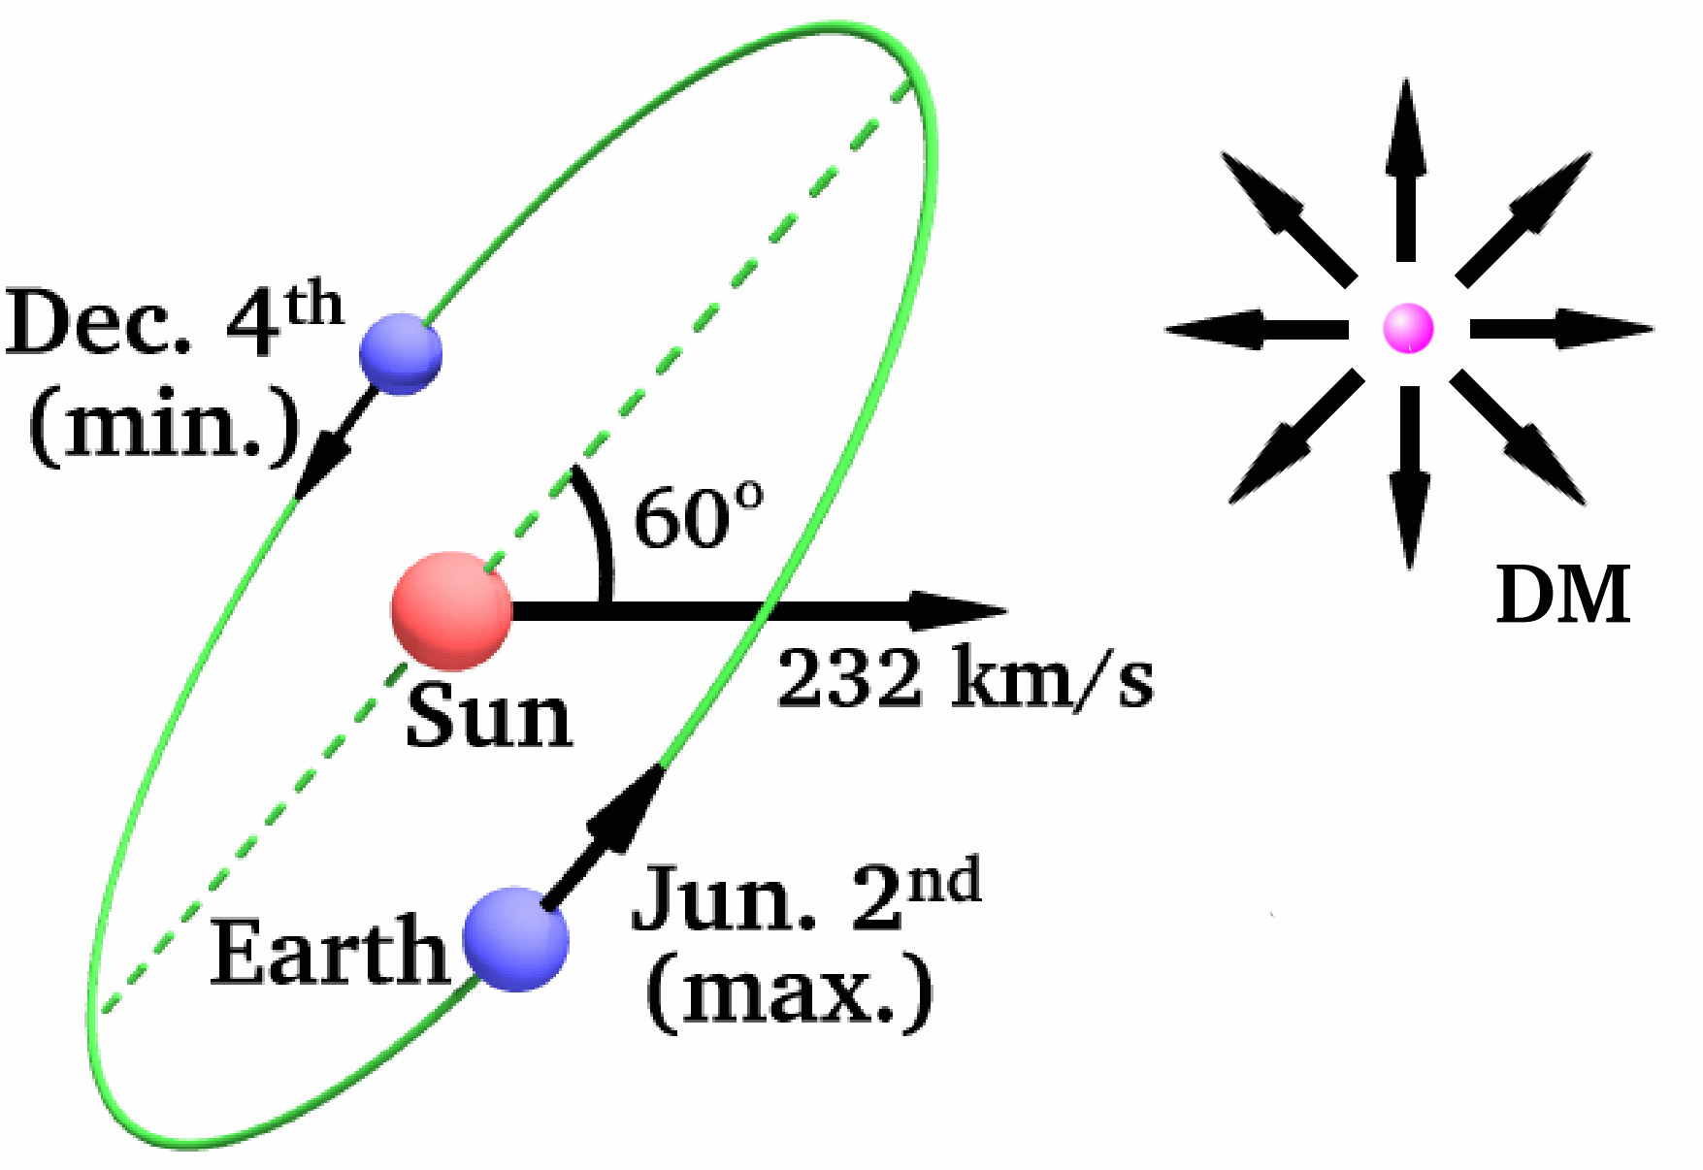
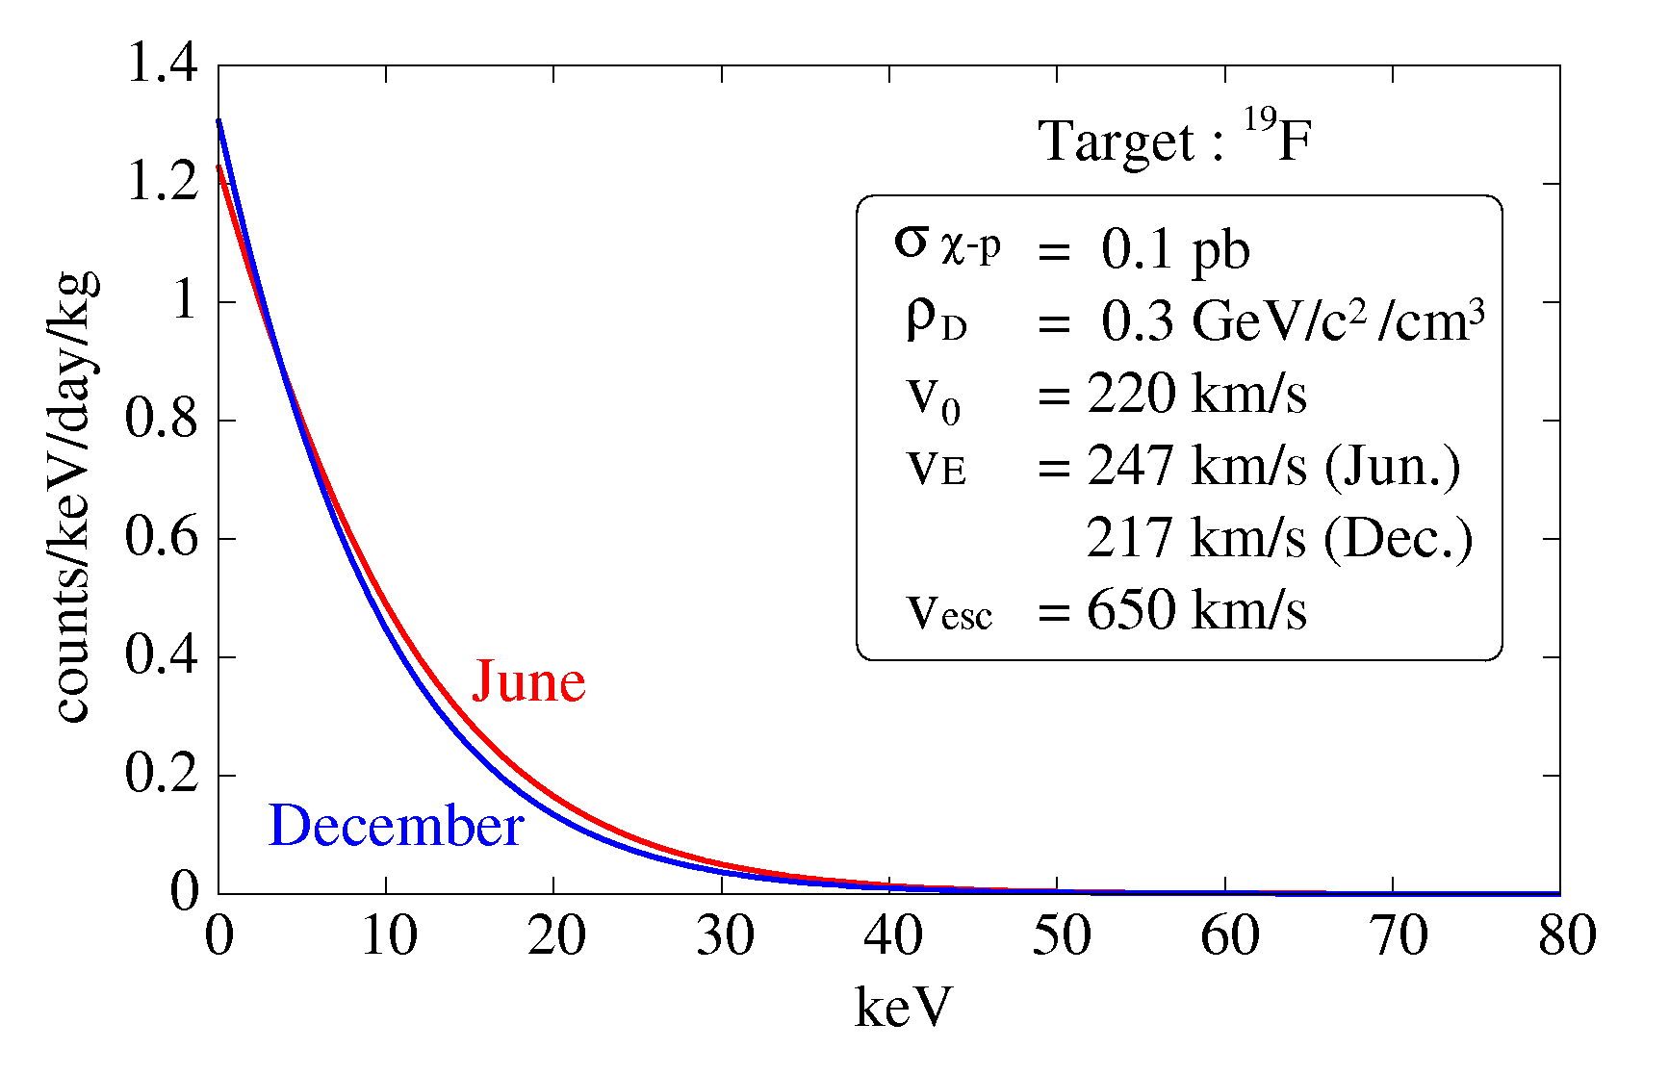
DM direct search
DM
nucleus
nucleus
SIGNAL E_{R}<～100keV
expected direct DM signals
① observed * events ② energy spectrum
③ seasonal modulation
④ material dependence
⑤ direction-sensitive

Slide 4
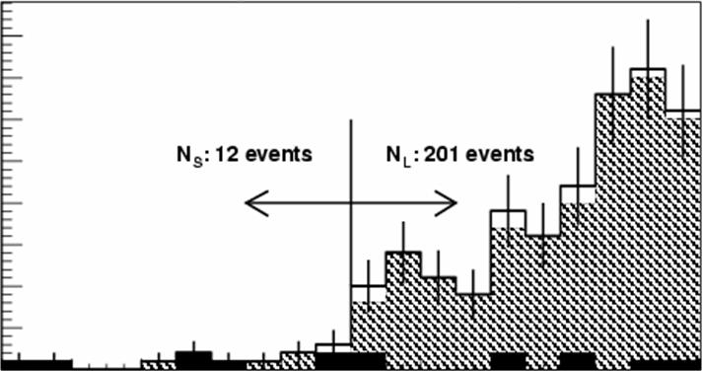
“direction-sensitive” dark matter direct search
detect the direction of the recoil nuclei
Our GALAXY
GC
constellation “CYGNUS”
DM
@ lab
SUN
40
directionality (expected)
M=80GeV
σ=0.1pb
θ
nucleus
θ
nucleus
SIGNAL E_{R}<～100keV
[count/3m³/year/bin]
20
forward recoil would be a “smoking-gun” evidence
0
-1
0
1
cosθ

Slide 5
proposal overview
Title：Direction-sensitive dark matter detection with gaseous tracking detectors
Plan: 2019-2020 detector calibration @ Grenoble 2020- Dark matter search @ Kamioka
Member：Japan Kentaro Miuchi（Kobe）（PI）
Kiseki Nakamura, Tomonori Ikeda, Hirohisa Ishiura, Takuma Nakamura, Takuya Shimada （Kobe）
France Daniel Santos (LPSC/IN2P3) (PI) Charling Tao (CPPM/IN2P3), Fabrice Naraghi, Olivier Guillaudin, Jean-François Muraz (LPSC/IN2P3)
Funding request (2019-2020)： Japan 1700k \ France 5k €

Slide 6
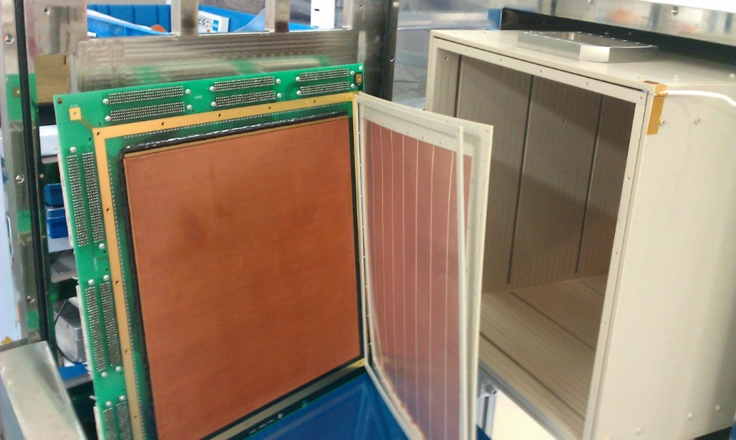
Background
Miuchi and Santos are leading two major direction-sensitive experiments: NEWAGE and MIMAC
Both use MPGD (micro-patterned gaseous detectors)
No co-working before
NEWAGE
Kamioka underground
MIMAC
Moderne underground
40cm
30cm
μ-PIC (400μm pitch)
direction-sensitive limit
Underground
25cm
10cm
PTEP (2015) 043F01s

Slide 7
We are in the same “CYGNUS” community.
Bi-annnual workshop 2007-
This TYL/FJPPL would be a good kick-off for a important collaborative work.

Slide 8
pre-works
2×review papers

Slide 9
NEWAGE: 3D-tracking
New general WIMP search with an Advanced Gaseous tracker Experiment
μ-PIC(MPGD) based TPC
3-D tracks SKYMAP
CF₄ gas for SD search
Proposal PLB 578 (2004) 241
First direction-sensitive limits
PLB654 (2007) 58
Underground results
PLB686 (2010) 11, PTEP (2015) 043F01s
Phase for “low BG detector”
40cm
30cm
SKYMAP (measured DATA)

Slide 10
Expertise of MIMAC: COMIMAC
J.F. Muraz, J. Médard, D. Santos et al., NIMA 832 (2016), 214

Slide 11
COMIMAC measures Quenching Factor (nuclear tracks ionize less effectively than electron tracks) ⇒important as a “calibration ” for a DM detector
QF=0.36
QF=0.25

Slide 13
Expertise of NEWAGE: Negative-Ion TPC
original study by New Mexico group
readout electronics development by NEWAGE
intensive SF₆ gas study
2017 JINST 12 P02012
several species of ions with different velocities
averaged waveform (Tomonori Ikeda)
NEWAGE Background schematics
z-fidutialzation → Background killer!

Slide 14
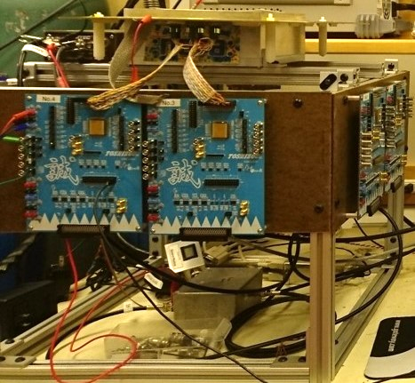
NEWAGE electronics for SF₆
2019 J. Inst. 14 T01008
Kobe-KEK(Liq Ar group) ASIC development
first-ever detected 3D tracks in SF₆ gas

Slide 15
This proposal ① (2019-2020):
averaged waveform (Tomonori Ikeda)
＋
¹⁹F quenching factor measurement @ LPSC Grenoble low energies (1-50 keV) low pressure SF₆ gas

Slide 16
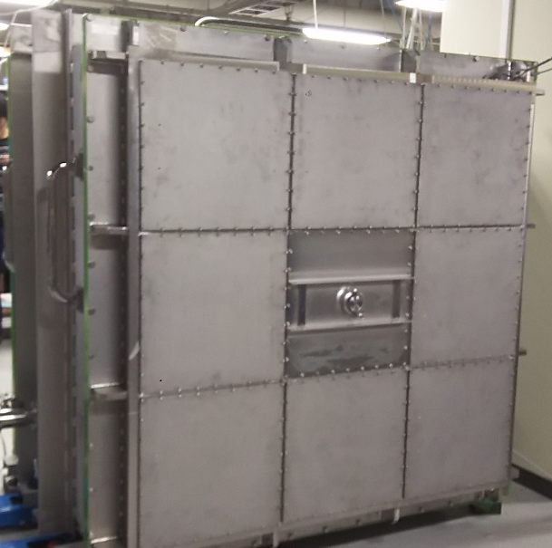
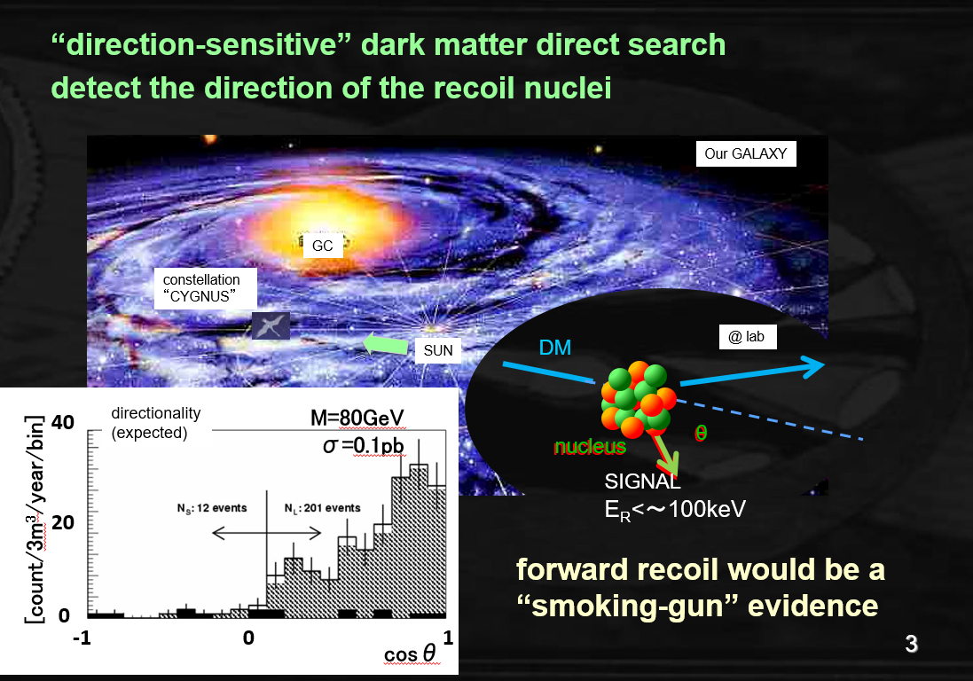
This proposal ② (2020-) :
MIMAC low background MIcromegas
CYGNUS/NEWAGE multi-window chamber
＋
direction-sensitive dark matter search @ Kamioka

Slide 17
Summary
New Proposal: Direction-sensitive dark matter detection with gaseous tracking detectors
By Miuchi (NEWAGE leader) and Santos (MIMAC leader)
QF measurement (2019-2020)
Dark Matter Search (2020-)

Slide 18
BACKUPS

Slide 19
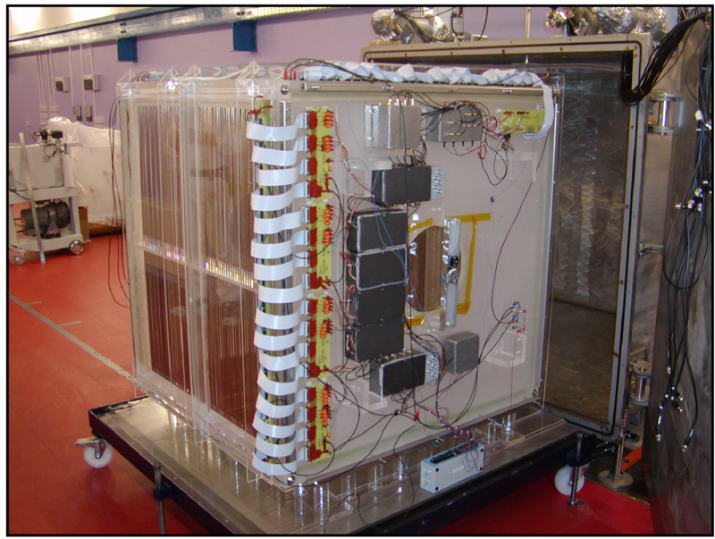
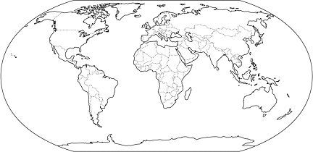
low pressure gas TPCs
DRIFT
[UK+US]
NEWAGE
[Kobe+]
40cm
MWPC (2mm pitch)
First started direction-sensitive method
Underground
Low background
Large size (1m³)
30cm
1m
μ-PIC (400μm pitch)
direction-sensitive limit
Underground
50cm
D3 [Hawaii]
MIMAC [France]
10cm
NITEC/CYGNO [Italy]
10cm
2cm
pixel/optical
25cm
Pixel readout (ATLAS FE-I4) chip
R&D in the surface lab
Micromegas (~400μm pitch)
quenching factor measurement
Underground
Notes:
In order to get nuclear track, it is usual to use Time Projection Chamber (TPC).
This is schematic image of TPC.
First, dark matter interact to nuclear.
And then, nuclear run in the gas ionizing around gas molecular.
Ionized electrons are dragged to MPGD by electric field.
MPGD detect 2-dimensional projection of track.
And using the time electron reached to MPGD, we can get another 1-dimensional information.
Thus, TPC detect 3-dimensional nuclear track.
Typical length of nuclear track scattered by dark matter is about 1cm.
So, MPGD is suitable for direction-sensitive dark matter search.
By the way, information of nuclear track have another advantage.
The length of nuclear event is short but electron events recoiled by Compton scattering is long.
If we know track length, we can discriminate gamma-ray event from nuclear event.
This graph is detection efficiency of electron events.
Using MPGD, detector have gamma ray rejection power.

Slide 20
T.Ikeda JPS Sep ２０１７

Slide 21
物理目的：稀事象実験
応用例② ニュートリノ-原子核コヒーレント散乱
2017年 ”COHERENT” 実験によって初検出。
かならずある反応。 例えば太陽から。
expected
^{WIMPS}
¹⁰B
ecliptic coordinate
solar
atmospheric

Slide 22
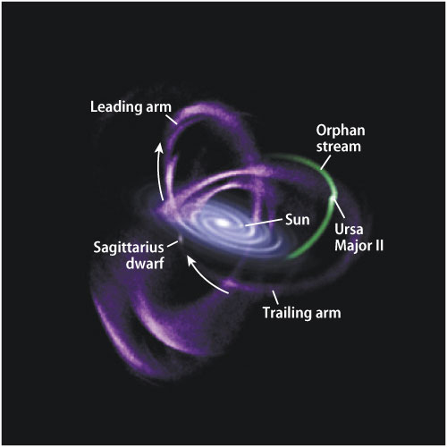
“CYGNUS” physics after discovery
Test the DM motion
ex. Sagittarius stream
Our GALAXY
expected
standard HALO
GC
Sagittarius stream
SUN
constellation “CYGNUS”
standard HALO + stream
galactic coordinate
streams, halo model…

Slide 23
“CYGNUS” physics after discovery
Test the interaction by scattering angle
SI
SD
some operators are distinguishable

Slide 24
“CYGNUS” physics after discovery
Test the interaction by scattering angle ②
iDM (inelastic scatterings dark matter) and normal darkmatter ( FFeDM (form factor elastic dark matter)) show different angular DISTRIBUTION

