Slide 1

Vibration monitoring and analysis in SuperKEKB M. MAZUSAWA¹, H. YAMAOKA¹, P. BAMBADE², G. BALIK³, L. BRUNETTI³, S. DI CARLO², A. JEREMIE³ , M. SERLUCA³ 1: KEK, High Energy Accelerator Research Organization, Tsukuba, Japan
2: LAL, Laboratoire de l'Accélérateur Linéaire, Orsay, France
3: LAPP-IN2P3-CNRS, Université de Savoie Mont Blanc, Annecy, France
Joint workshop of TYL/FJPPL and FKPPL, Jeju, 9-11 May 2019
http://nuclear.korea.ac.kr/indico/conferenceDisplay.py?confId=395
Notes:
5/10/19
Entrez votre nom
1

Slide 2
Vibration monitoring and analysis in SuperKEKB
Contents
Description of our proposal (A_RD_14)
SuperKEKB site
Status
Experimental setup
Preliminary measurements
1st observation
Modelling
Hardware upgrade
Summary( Schedule& Budget : 2019)

Slide 3
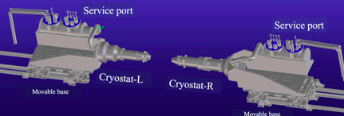
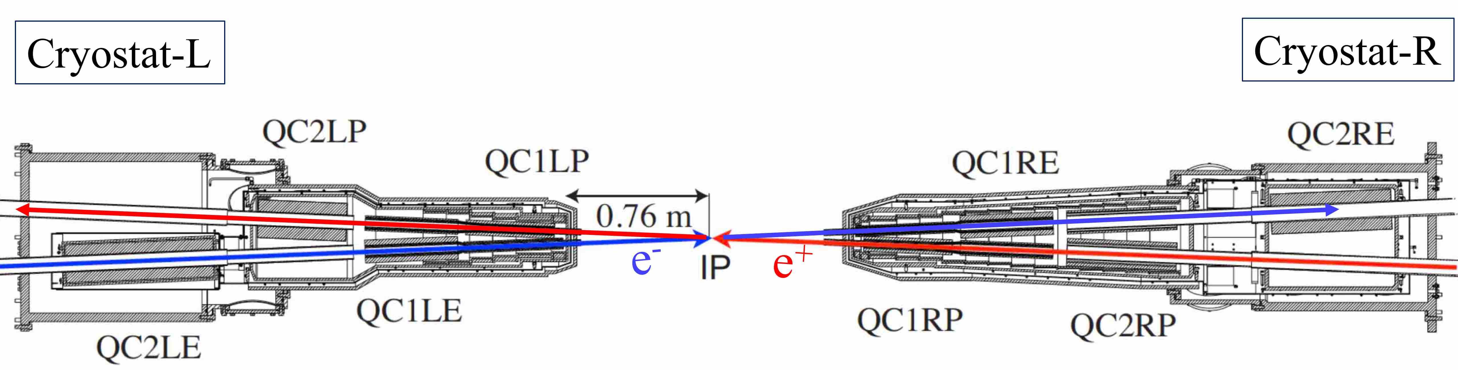
Description of our proposal
Target:
Measure the vibration due to the seismic activities and the cultural noise, near the IP.
Check a correlation between vibration and luminosity when with/without the collision orbital feedback running.
Procedure:
4 seismic sensors (Guralp 6T) running real time (a few minutes / hour) 24 hours a day, on a large bandwidth [0,1 – 100] Hz in vertical and horizontal directions
Location:
Two sensors at each side of the Belle II detector. One (A) as close as possible to the IP and one (B) along the collider which could be moved time to time for coherence monitoring / diagnostic in time..
IP
3

Slide 4
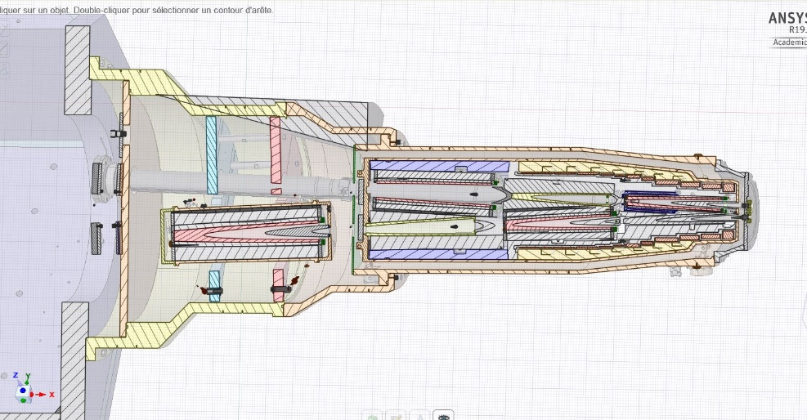
Description of our proposal
Status:
Two visits to KEK (two persons per visit) during the last year.
Two sensors, one each side of the IP, are installed.
Data have been taken. Access from France has become possible.
Data analysis being done.
Schedule:
Continuation of measurements and modelling of the vibration of each magnet in the cryostat.
The setup will be upgraded during next year.
Budget:
Last slide
There are 4 quadrupole magnets and many correction magnets in a cryostat. Do all quads vibrate coherently when cryostat vibrates?
4

Slide 5
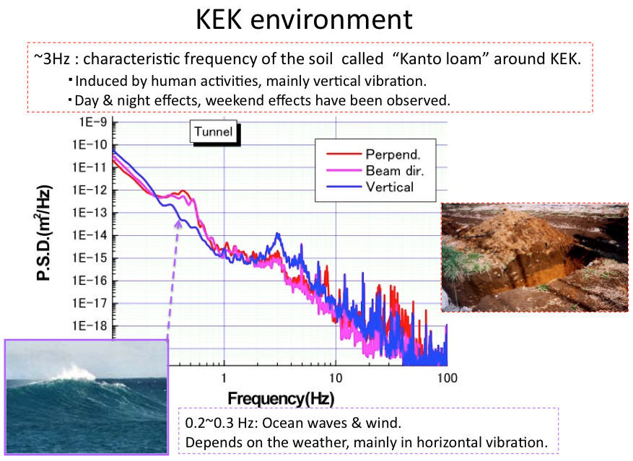
SuperKEKB site
Not quiet at all
A_RD_14

Slide 6
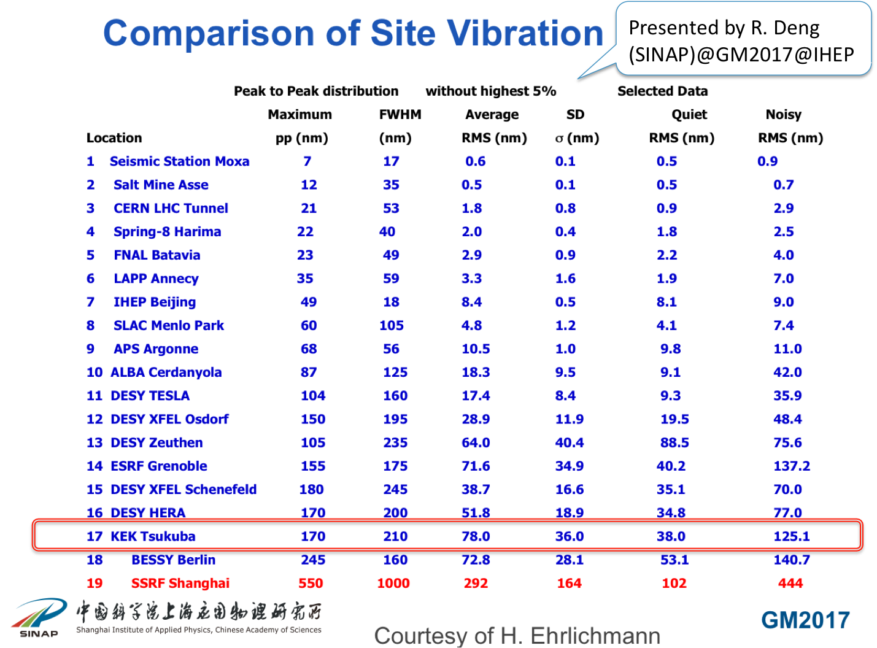
SuperKEKB site
Not quiet at all

Slide 7

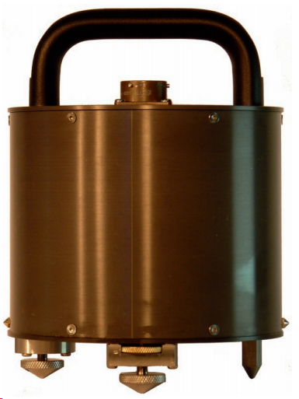
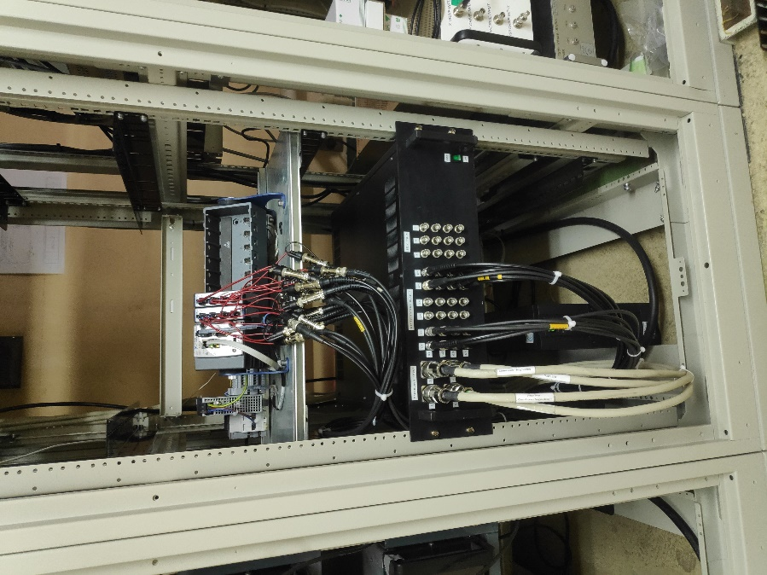
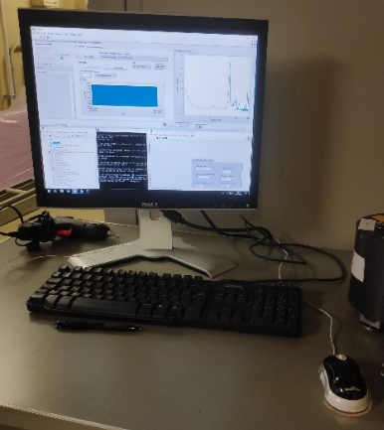
Experimental Setup
Description of the installed setup:
Real time measurement National Instrument setup
Remote
access
2
Seismic sensor
Guralp 6T
1
Sensors power supply and signal conditioning
Labview:
Monitoring & logging
1 :The sensors were used at ATF2 experiment at KEK originally and now they are moved to SuperKEKB tunnel.
2 The DAQ real time National Instruments is lent by the LAPP mechanics department for one year.
 | Designation | Characteristics
cRIO 9022 | Real-Time Embedded Controller | 533 MHz, 2GB storage, 256 MB DRAM
Chassis Ni 9114 | Virtex-5 LX50 FPGA CompactRIO Chassis | 8-Slot
Module NI 9239 | C Series Voltage Input Module (x2) | 2x4 analog channels +/- 10V, 24 bits, upt to 50 kHz
Geophones | 4 seismic sensors CMG-6T | 30 s – 100 Hz, 2 × 1200 V/m/s
7

Slide 8
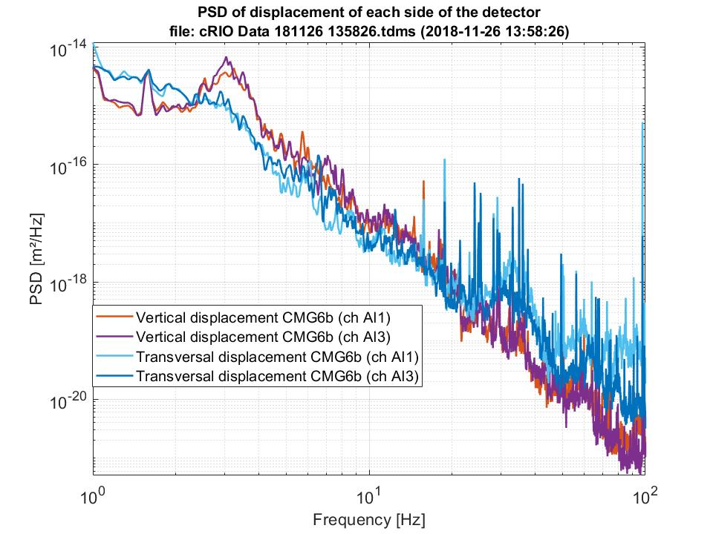
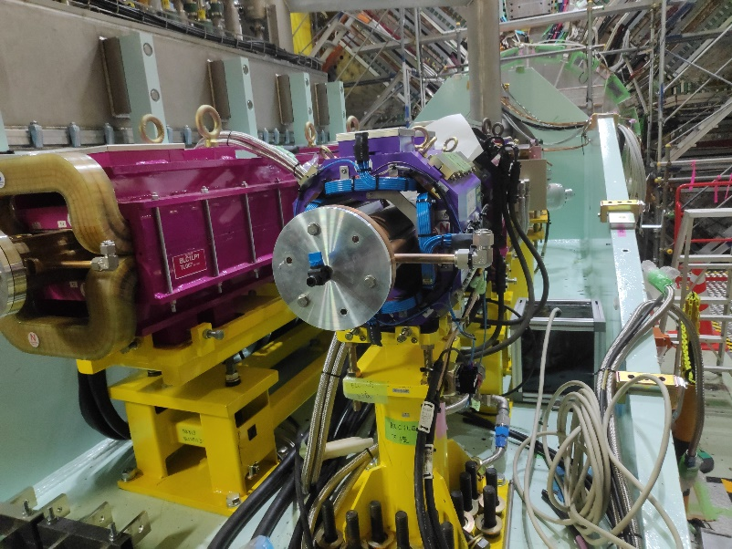
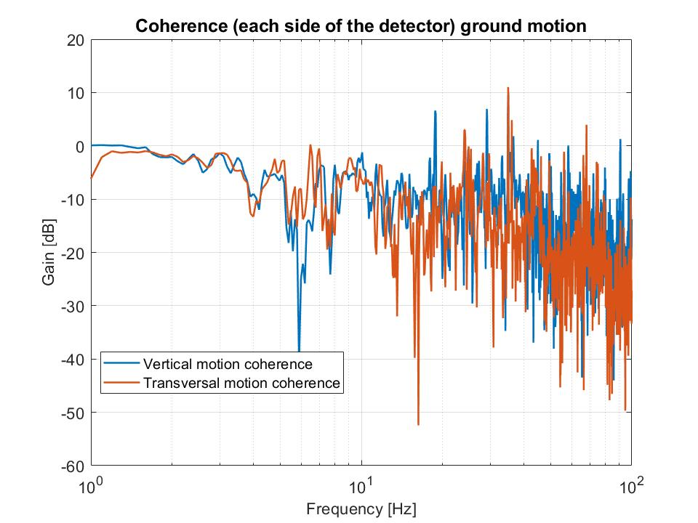
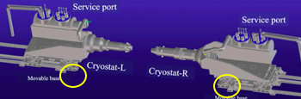
Preliminary measurements (November 2018)
Measurements carried out at the both sides of the IP to check coherency
PSD
1 10 100(Hz)
IP
Coherence in vertical and transversal directions

Slide 9
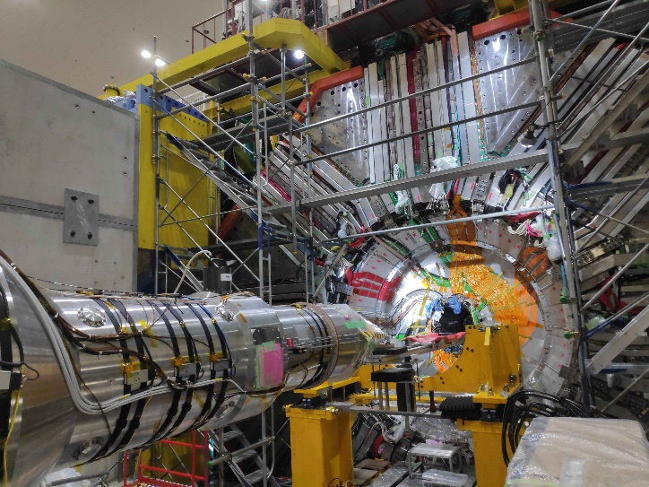
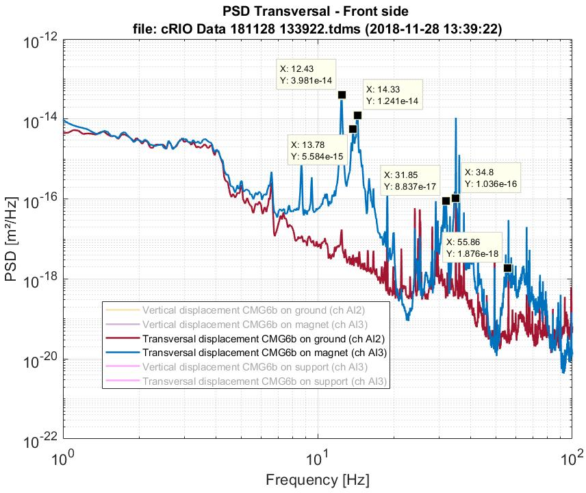
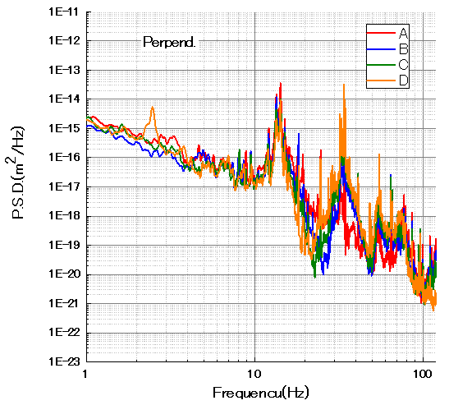
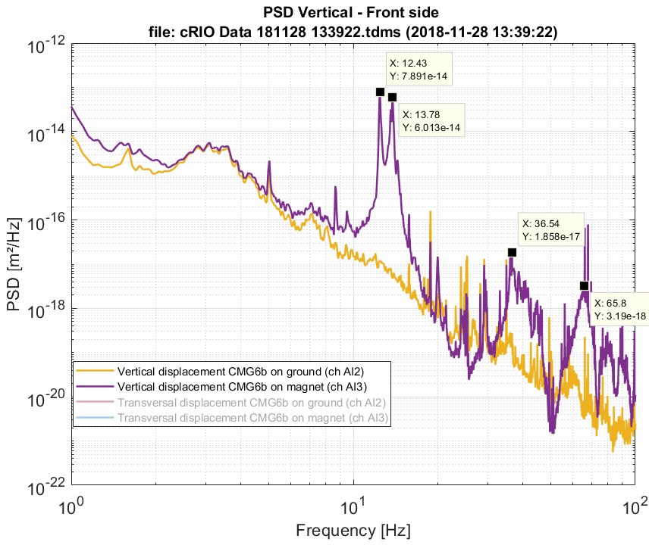
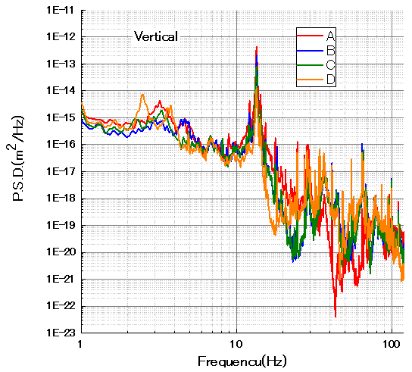
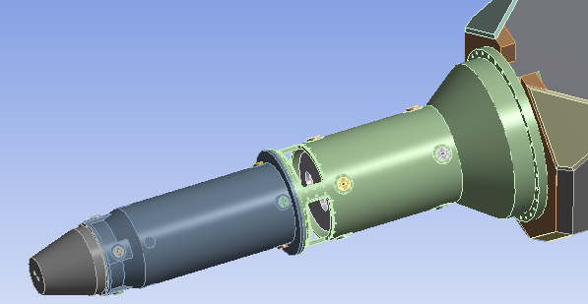
Preliminary measurements (November 2018)
LAPP sensor “health” checkup
Comparison between LAPP & KEK : Data taken on the Cryostat for final focus superconducting quadrupole magnets
LAPP
KEK
Measurements on the cryostat (LAPP)
Horizontal
D
C
LAPP
B
KEK
A
Vertical

Slide 10
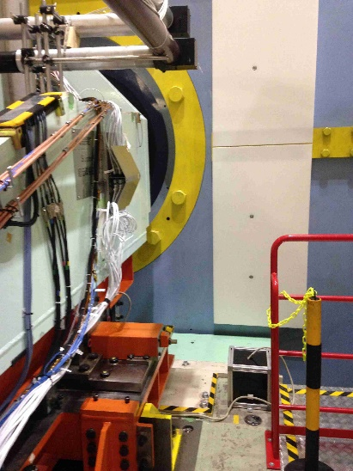
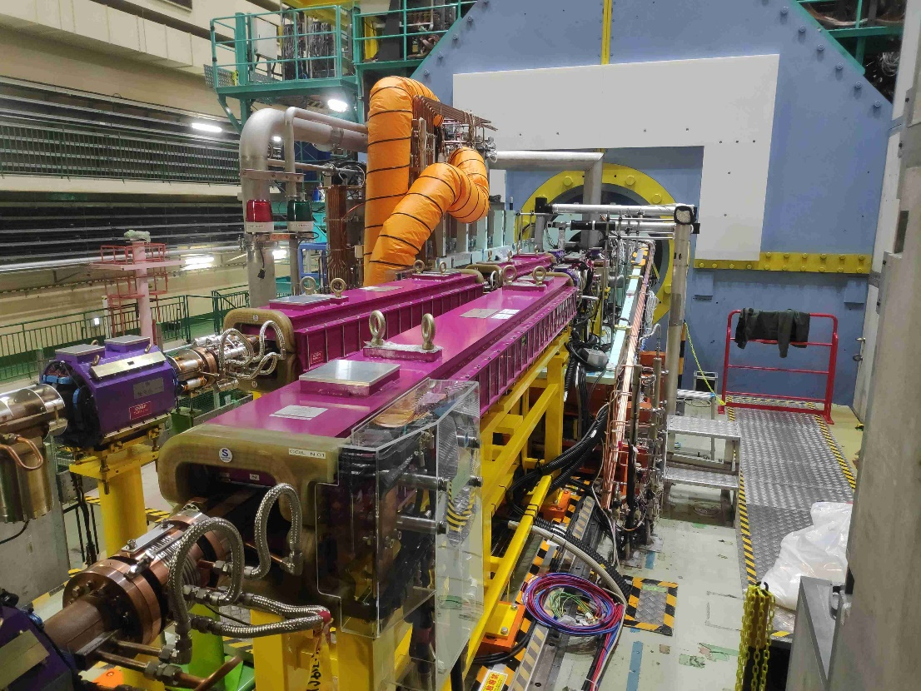
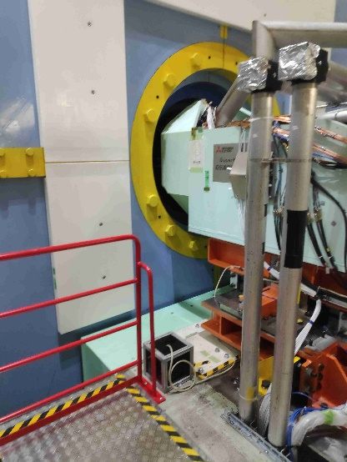
Installation (February 2019)
The sensors are placed inside a box made of lead and mu-metal, for protection from radiation, magnetic field and human activities during the machine maintenance.

Slide 11
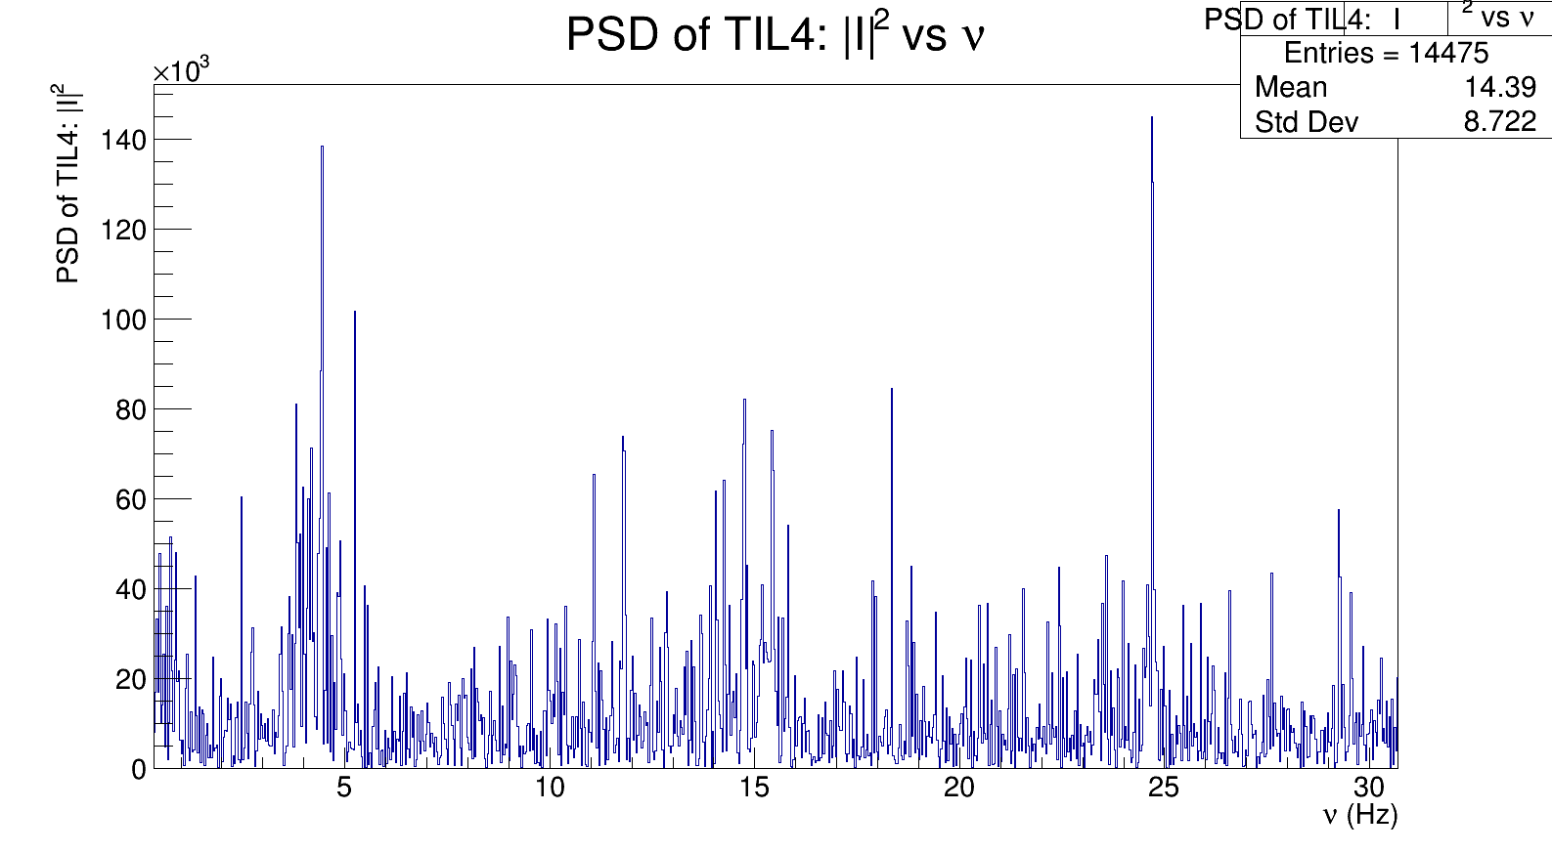
First observations
Example: irregular (not permanent) peaks (1.6Hz)
Mysterious peak
Source identified?
19th April
PSD of displacements : observed peak at 1.4 Hz
Comparison between the luminosity and vibration started

Slide 12
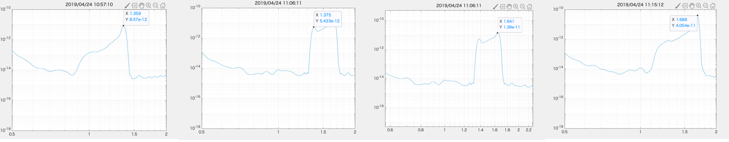
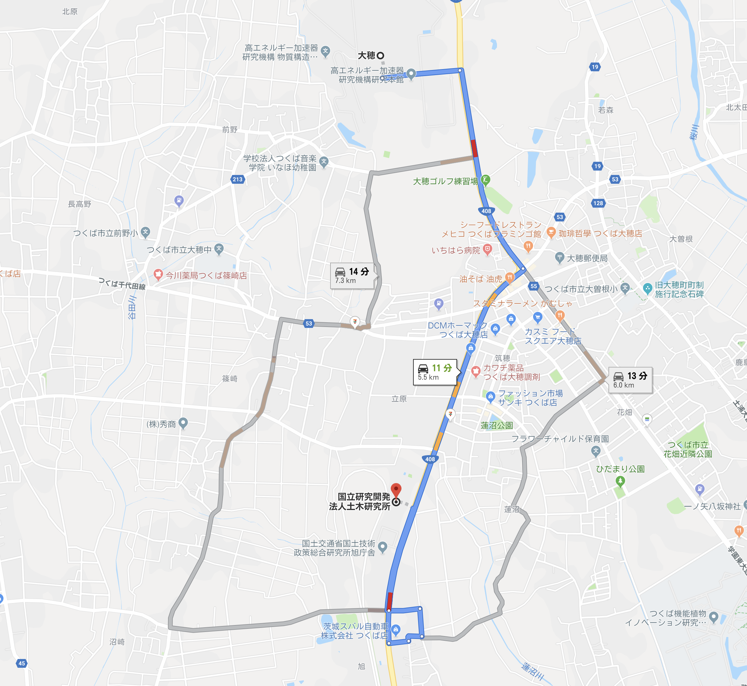
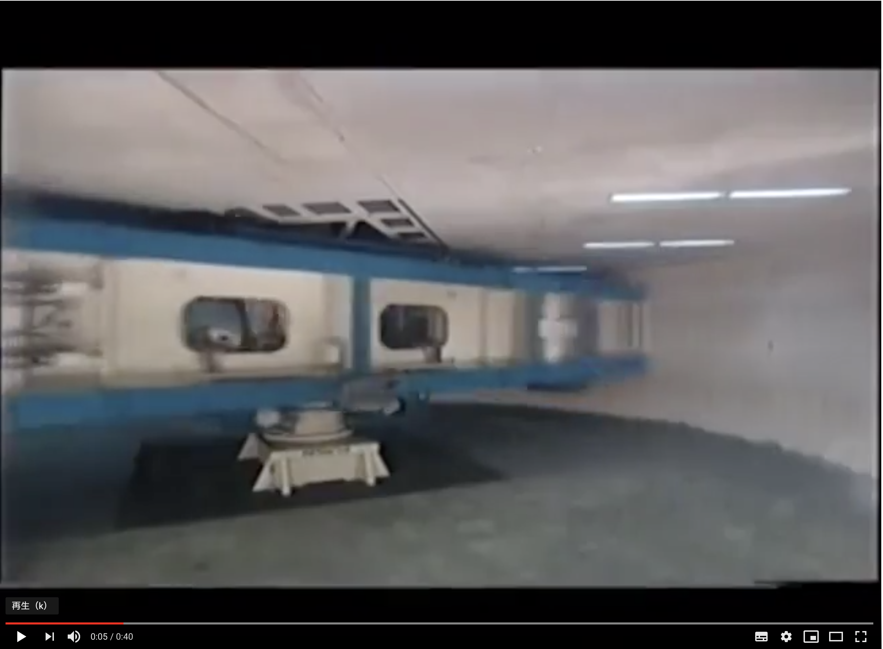
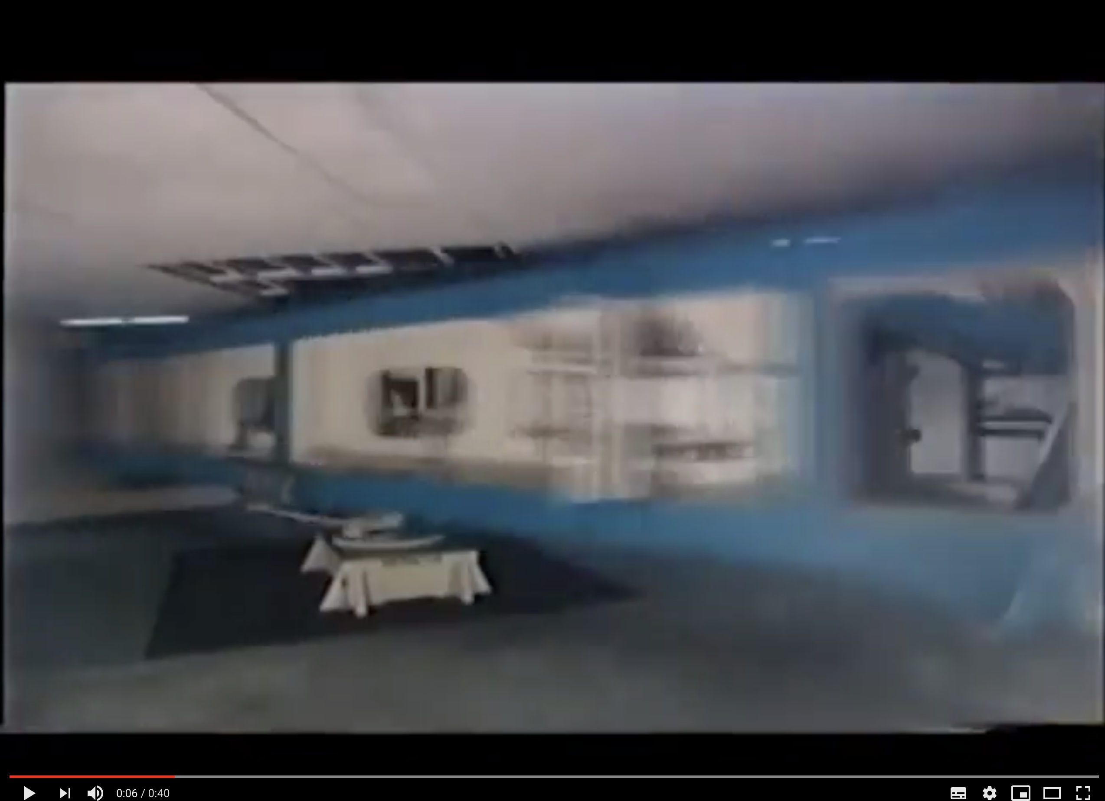
1.36 Hz
1.38 Hz
1.64 Hz
1.69 Hz
Vibration peak frequency matched with
spinning frequency (→centrifugal load).
f=mrω²
KEK
https://www.youtube.com/watch?v=b-kNqO-ohwA
Large dynamic centrifugal load test equipment
https://www.pwri.go.jp/eindex.html

Slide 13
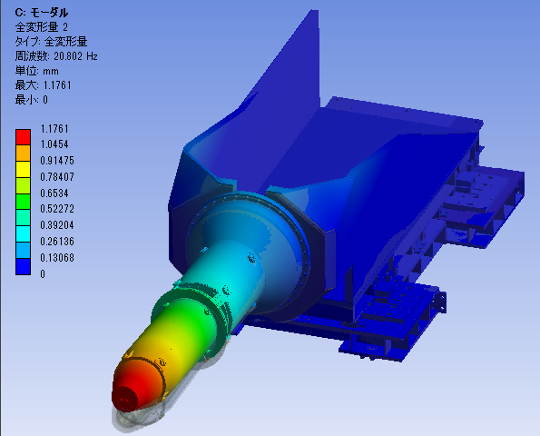
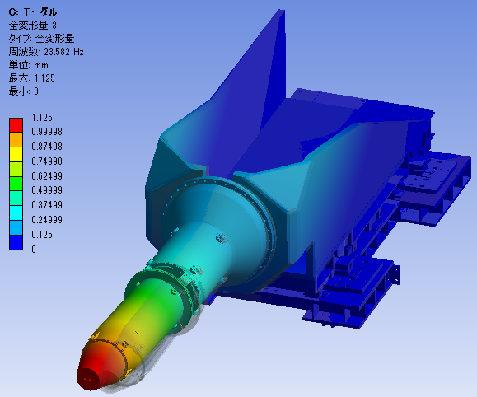
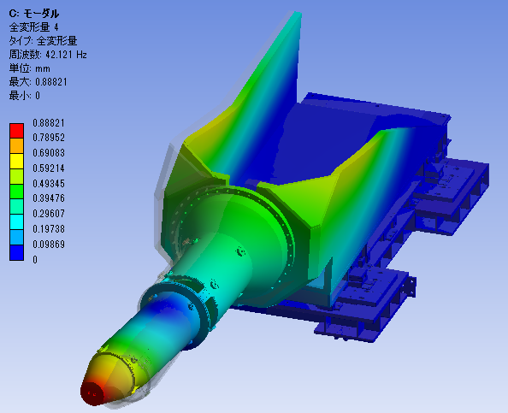
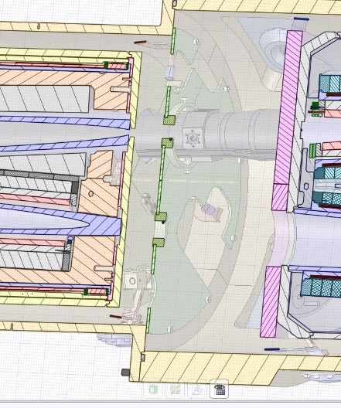
2019 - Modelling
Modelling (KEK):
The objective is to complete the initial model done by KEK to estimate the final focusing magnets inside the cryostat in function of the measured vibrations on the ground (particularly the differential motion between the focusing magnets)
21Hz
23Hz
42Hz

Slide 14
2019 - Modelling

Slide 15
2019 - Hardware upgrade
cRIO new generation
 | Designation | Characteristics
cRIO 9056 | Real-Time Embedded Controller | 533 MHz, 2GB storage, 256 MB DRAM
Module NI 9239 | C Series Voltage Input Module (x2) | 2x4 analog channels +/- 10V, 24 bits, upt to 50 kHz
The current cRIO is almost no longer commercialized by NI
The initial setup has allowed to start the experiment in time. The final one will be suitable to the long term schedule of the project
The budget is supported by LAPP.
CompactRIO (or cRIO) is a real-time embedded industrial controller made by National Instruments for industrial control systems. The CompactRIO is a combination of a real-time controller, reconfigurable IO Modules (RIO), FPGA module and an Ethernet expansion chassis

Slide 16
Summary
Data acquisition started.
Remote access to the system from LAPP has become avaiable.
Data are taken during SuperKEKB Phase 3 run.
During the summer shutdown, we plan to do the followings:
Upgrade of the system
Data taking of the cryostat vibration when cryostat is pushed back for its maintenance.
Modelling of the each quadrupole magnet in the cryostat using the cryostat data.
2019l budget of the project:
Hardware: new system (5K)
Missions on site (2 persons)
Total about 11 Keuros
FJPPL request:
Total 6 Keuros
Missions on site (2 persons)
16

