Slide 1
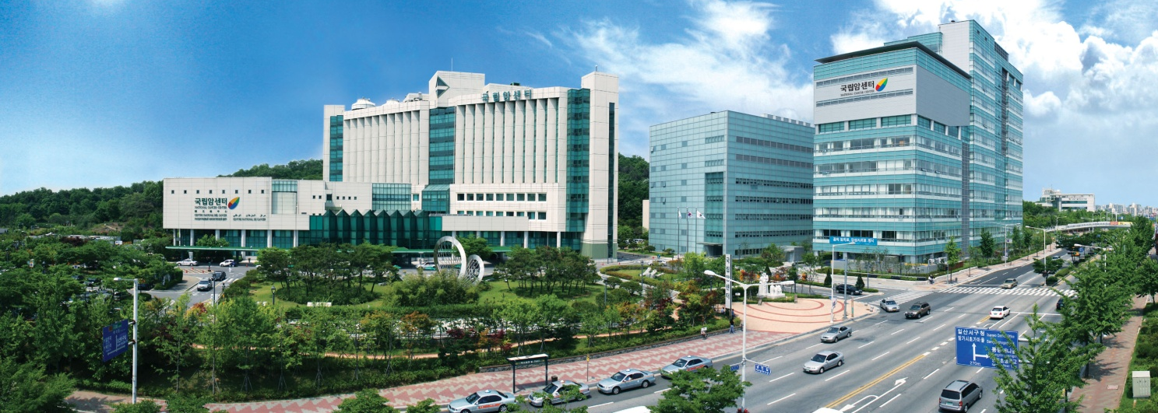


Geant4 simulations and experiments at National Cancer Center, Korea
Se Byeong Lee – National Cancer Center, Goyang-si, Korea
Sebastien Incerti – CNRS / IN2P3 / CENBG
on behalf of the « Med-1/Protontherapy » team
TYL-FKPPL Joint Workshop, Jeju Island, May 8-10, 2019

Slide 2
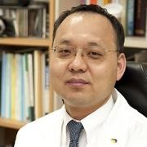
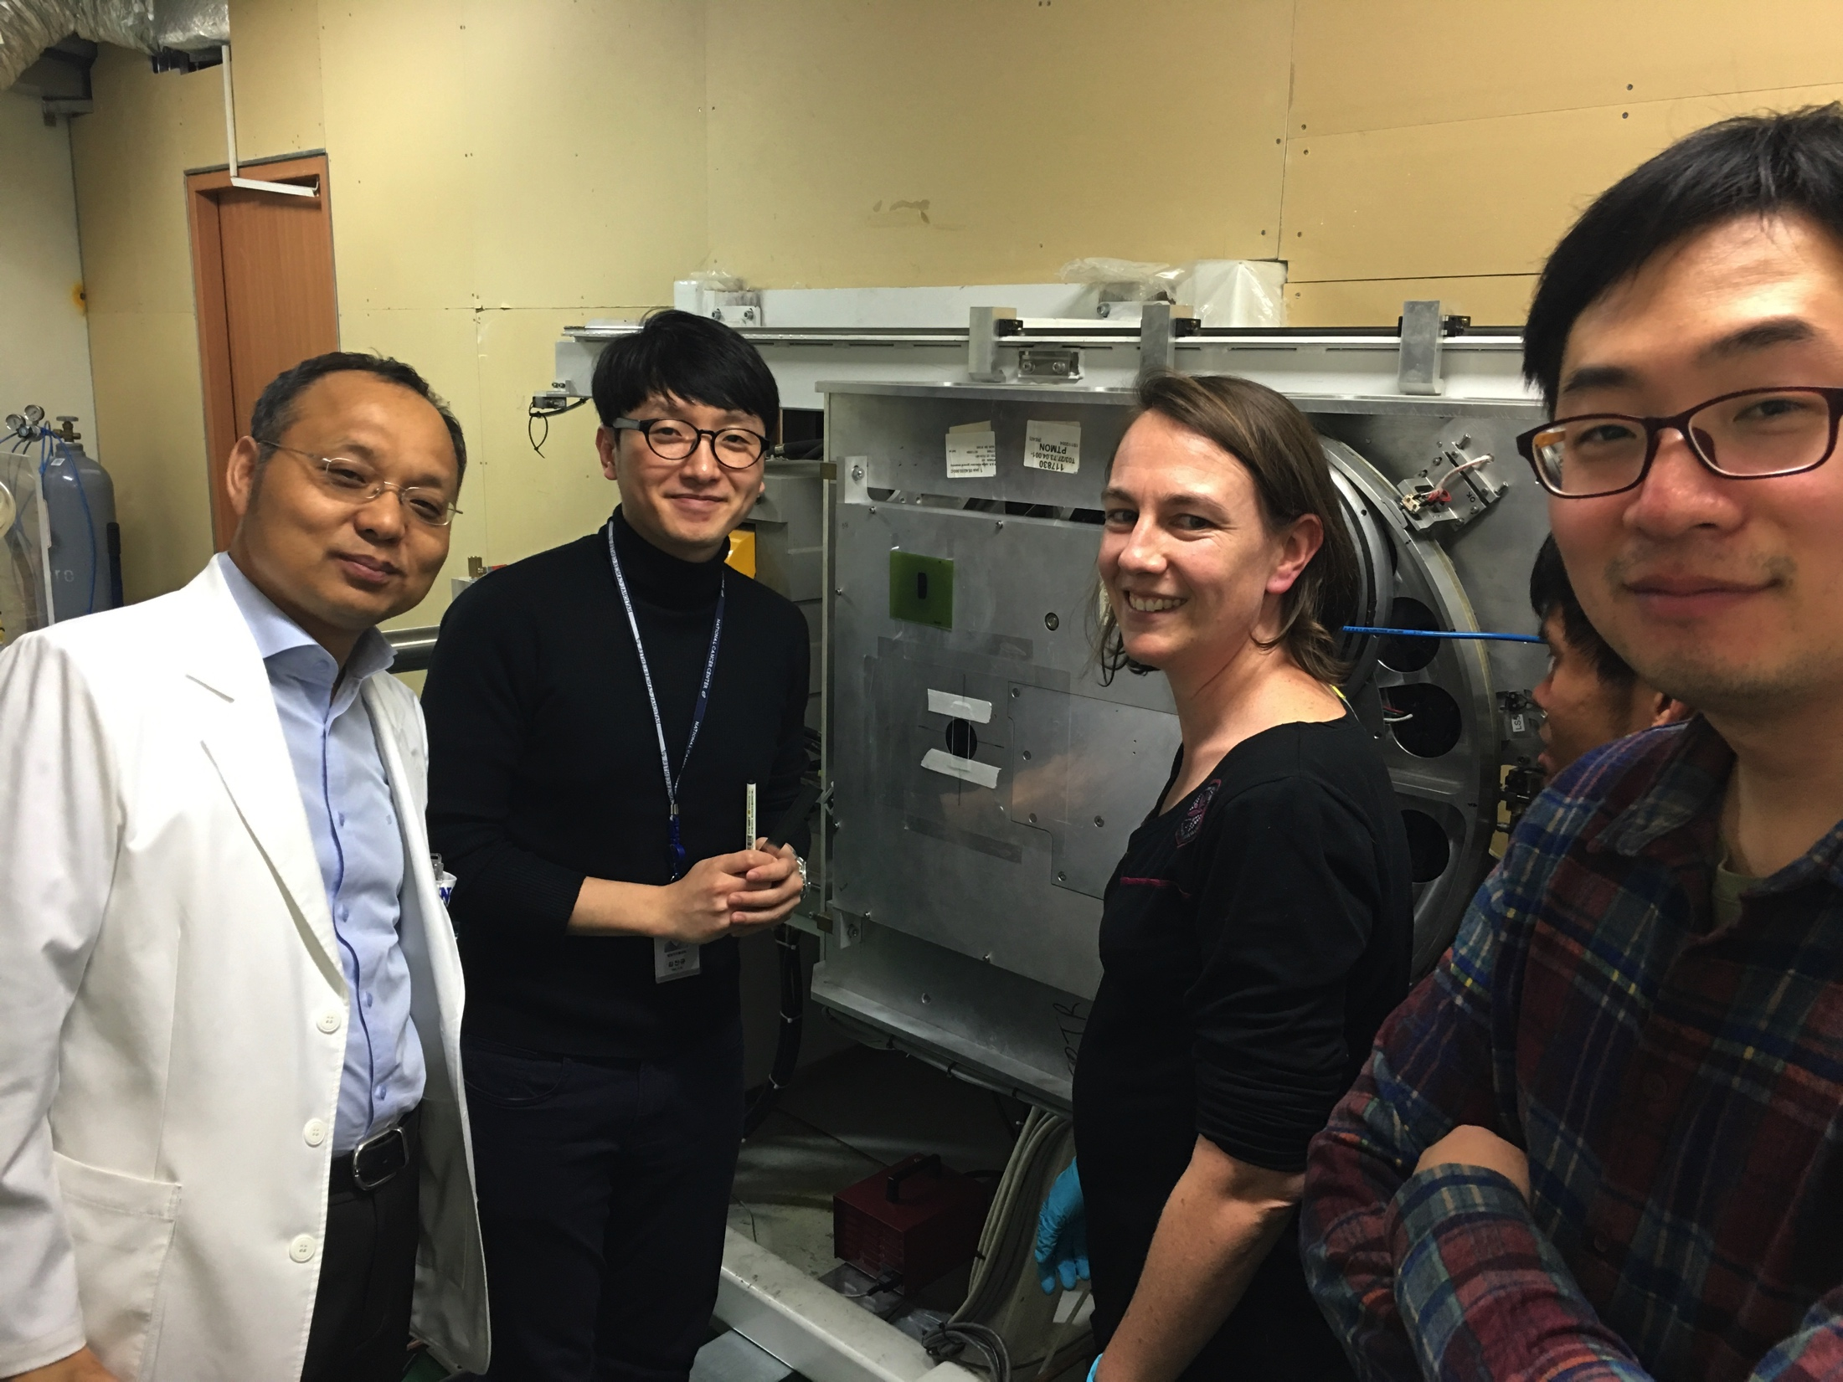
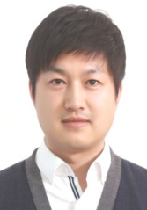
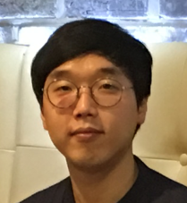
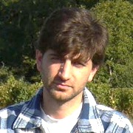
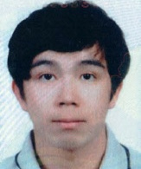
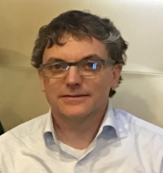
Overview
Our team
Three main activities were undertaken in the 2016-2019 period
  Proton irradiation campaigns @ NCC for astrobiology
  Geant4-DNA: review of track structure examples & improvement of physics models
  Geant4 international tutorials in Korea - at the Physics-Medicine frontier
    In collaboration with « BEAM » team (KISTI: K. cho, LLR: M. Verderi)
Gathering 4 partners
  National Cancer Center (NCC)
    Se Byeong Lee (senior medical physicist), Chan Kyu Kim (researcher)
  Yonsei University
    Chul Hee Min (associ. professor), Hyun Joon Choi (PhD student)
  Laboratory of Astrophysics of Bordeaux (LAB/INSU/Bordeaux U.)
    A. Le Postollec (engineer), M. Dobrijévic (a. professor)
  Centre d’Etudes Nucleaires de Bordeaux Gradignan (CENBG/IN2P3/ Bordeaux U.)
    W. G. Shin (PhD student), S. Incerti (researcher)
Notes:
Laboratoire Leprince-Ringuet
아 레 포조ㄹ엑
엠 도브리예비치예
Center for nuclear study of Bordeaux Gradignan

Slide 3
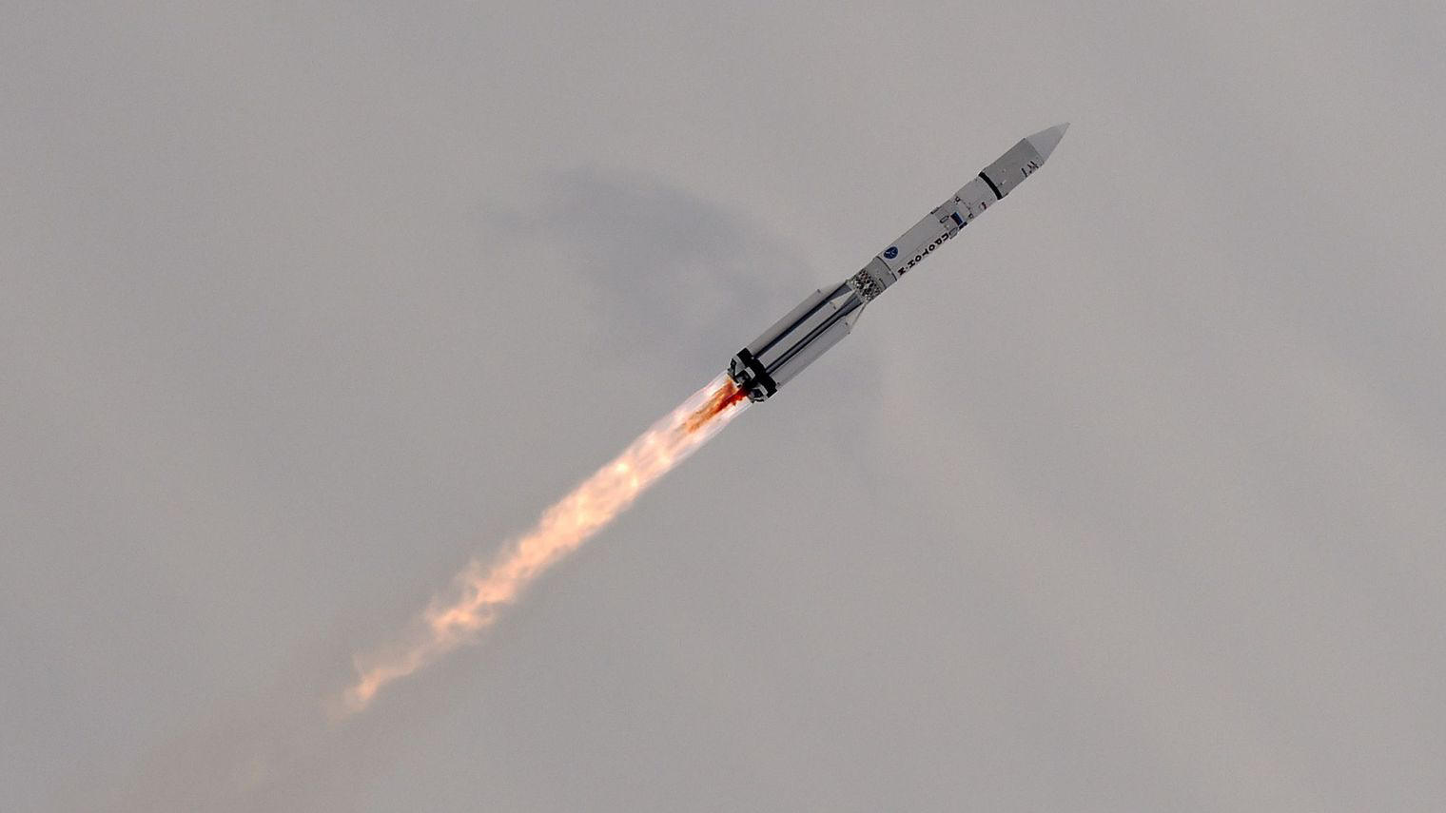
1) Proton irradiation for Astrobiology
@ NCC
« Russian cargo vessel PROGRESS M-24M toward ISS»
July 23rd, 2014
Reproduce the irradiation of hypothetical organic matter on Mars
CNRS press release
http://www2.cnrs.fr/presse/communique/3667.htm
afp.com/KIRILL KUDRYAVTSEV

Slide 4
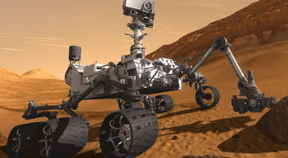
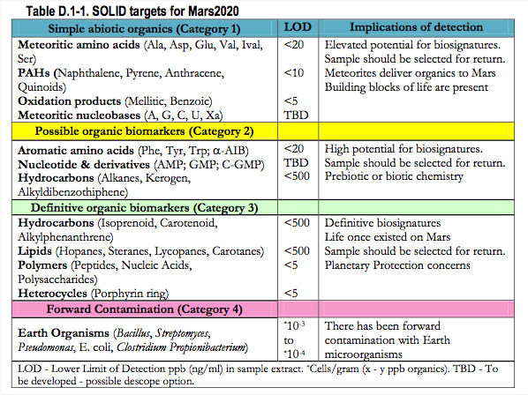
Context
The search for extraterrestrial life is one of the greatest challenges in astrobiology : Mars exploration
Biochips are currently recommended by space agencies
“Signs Of LIfe Detector” project (Victer Parro Gracia et al. INTA– CSIC, Spain)
    Antibody biochip to detect molecules of interest (e.g. amino acids)
We need to demonstrate their resistance to radiation
Mars 2020/NASA
Principle
Expected molecular targets
Notes:
Proposé, bien accueilli par Mars 2020 mais recalé : pas sélectionné pour Mars 2020 car on doit démontrer sa résistance aux radiations
Polycyclic Aromatic Hydrocarbons
Prebiotic (chemistry), inorganic or organic chemistry in the natural environment before the advent of life on Earth
Proposed, welcomed by March 2020 but stalled: not selected for March 2020 because it must demonstrate its resistance to radiation

Slide 5
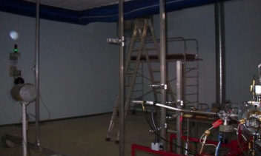
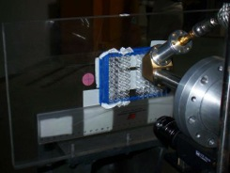

History
This activity is based on a long term collaboration between the Laboratoire d’Astrophysique de Bordeaux and CENBG
  10 publications in astrobiology, 1 PhD
1st step : Geant4 simulations
  Radiation environment encountered by a biochip on a mission to Mars (travel & one month stay on the ground)
  Radiation environment outside the International Space Station (cosmic spectra from CREME96 @ 1 AU)
  Preparation of irradiation experiments with several beam qualities
2nd step: irradiations on AIFIRA platform@CENBG to study antibody (Ab) & aptamer
resistance to protons and neutrons (3 MeV)
Geant4
Protons @ CENBG
Neutrons @ CENBG
Array of samples
Samples
Notes:
Les aptamères sont des oligonucléotides (segments d’ADN ou d’ARN) structurés capables de reconnaître un grand nombre de cibles (protéines, peptides, toxines, acides nucléiques, petites molécules, cellules, virus) avec une haute affinité et une haute spécificité.
De par leurs propriétés, les aptamères peuvent être comparés fonctionnellement aux anticorps monoclonaux ; ils représentent une alternative pertinente pour toutes les applications traditionnelles des anticorps et se révèlent même supérieurs pour des utilisations particulières.
As the composition of Galactic Cosmic rays (GCRs) is roughly 85–90% protons, 10–13% helium, about 1% electrons and about 1% heavier nu- clei (O’Neill 2010), we chose to perform protons, electrons and carbon ions irradiations. Approximately 9 MeV electrons, 62 MeV nuc−1 carbon ion and 15–30 MeV protons effects were tested on prepared Ab surfaces. We also decided to perform neutron experiments, as neutrons are abundant on Mars’ sur- face due to particles interactions with Mars’s atmosphere and r (Hassler et al. 2012; Köhler et al. 2014). Controls were prepared with the same immobilization procedure and condi- tioning, and were transported in the same conditions than irra- diated samples but were not exposed to particles radiations.

Slide 6
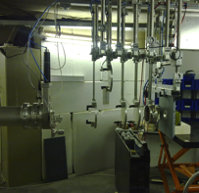
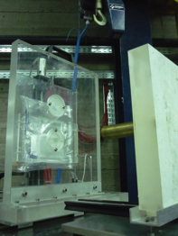
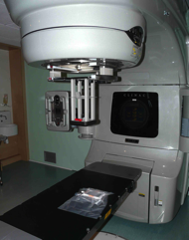
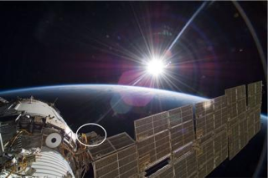
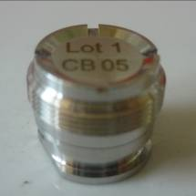

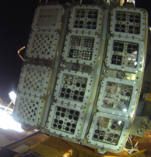
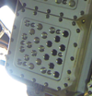


Irradiation campaigns (1/2)
Protons, neutrons @ Leuven
3rd step: irradiations of antibodies at higher energies / with other beam qualities
  Protons and neutrons irradiations at Louvain-la-Neuve, Belgium (15-30 MeV)
  C and O ions irradiations at LNS Catania, Italy (62 MeV/u)
  Electrons at Bergonié Institute in Bordeaux, France (9 MeV)
4th step: participated to the EXPOSE-R2 mission outside the International Space station for 18 months
C, O @ LNS
Ab showed resistance to radiation
Electrons@ Bergonié Inst.
ISS
Universal Platform of the
Russian module Zvezda
Trays
Cell
Ab showed resistance to radiation
Notes:
: We found that the recognition ability of fluorescently labelled aptamers was not significantly
affected during all these experiments. Further studies are required to improve the detection
step since the fluorescent dye we used was somewhat affected by temperature variations.
ISS

Slide 7
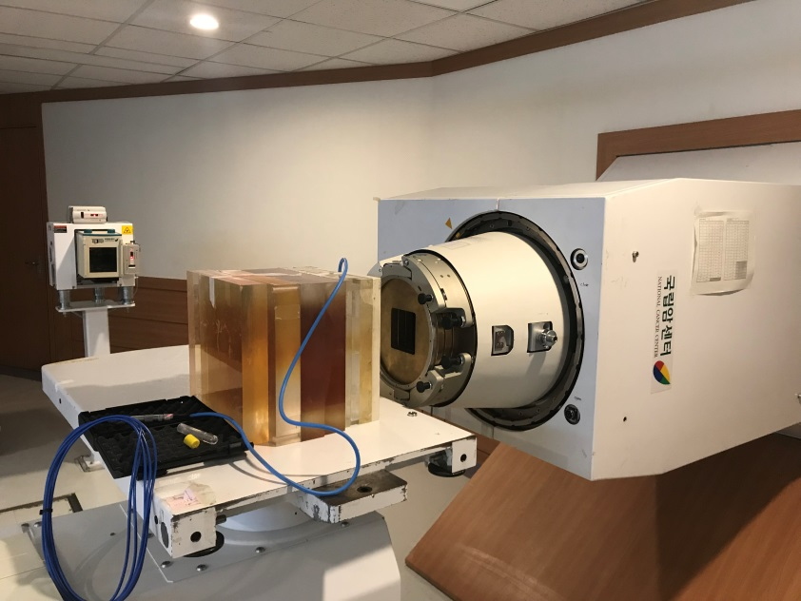
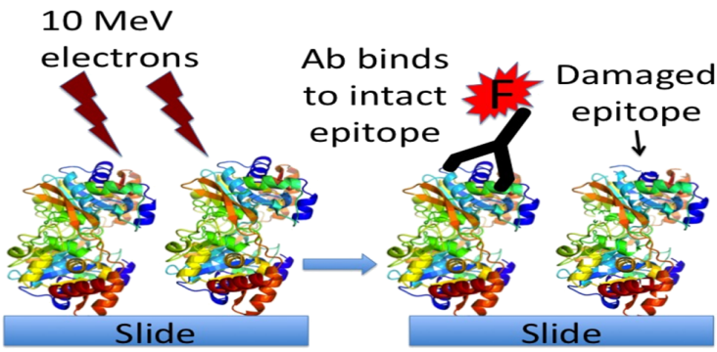
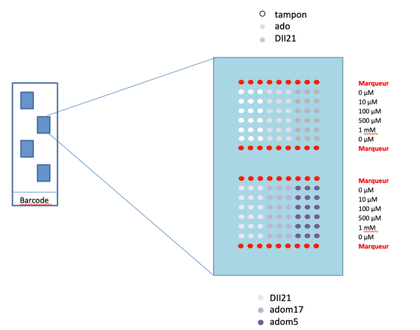
Irradiation campaigns (2/2)
5th step: in 2017 we reproduced at NCC long duration radiation exposure (1 – 10 My at Mars surface) of molecular targets (peptides) in order to confirm that a biochip equipped with antibodies can detect them : 200 MeV protons, peptides, 3 doses: 3.6 kGy 7.2 kGy 36 kGy
In addition, exp. at 156 MeV, antibodies, 3 doses: 6 Gy, 30 Gy, 150 Gy
(for comparison to previous exp. in Sweden)
Protons @ NCC
Radiation
6th step: end 2018, at low dose (1 and 10 Gy)
of protons, we propose to study
  Aptamers biochips (target = adenosine & several controls)
    analysis being finalized
  ultra performance liquid chromatography (UPLC) columns
    new CNES R&D activity
0.2 mGy/day on Mars, 0.5 mGy/day during cruise (Hassler et al. 2014)
1 My = 77 kGy
Notes:
Epitope = zone sur la molécule et non molécules, ce sont des zones d’accroche
the part of an antigen molecule to which an antibody attaches itself

Slide 8
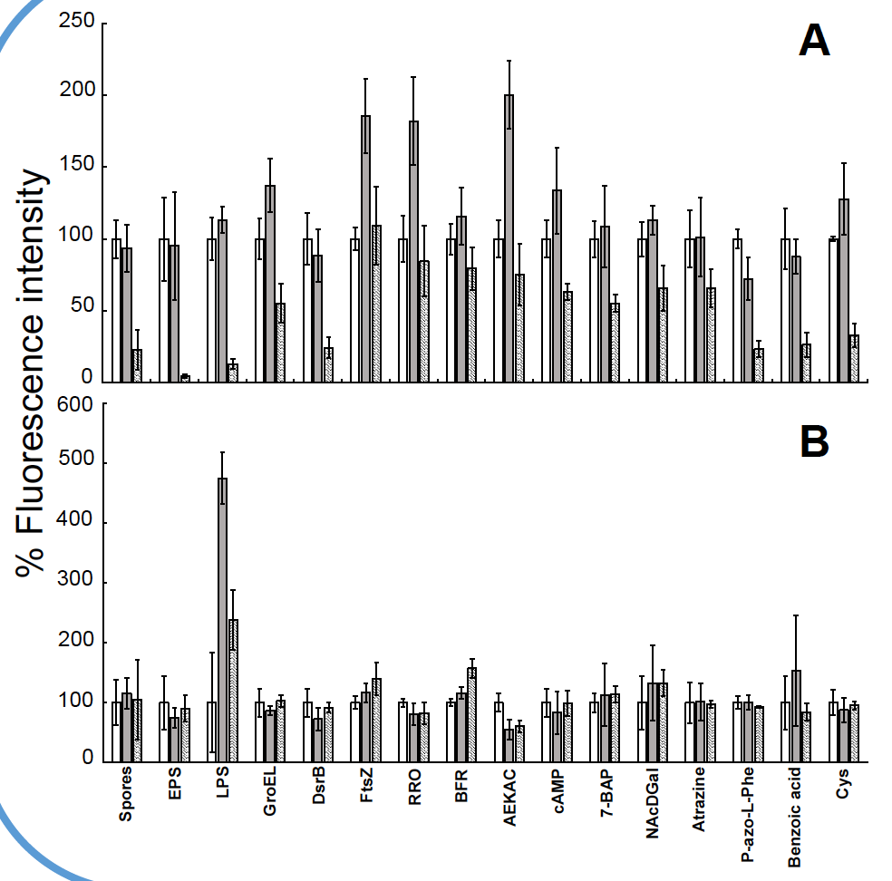
Results
Courtesy of Y. Blanco et al. (INTA-CSCI, Madrid)
Conditions: radiation doses equivalent to about 100 Kyr and 1 Myr of exposure at 1 m of the Martian surface (based on MSL data).
Figures: non-irradiated molecules (whitebars), irradiated at low doses (5.5kGy and 7kGy) (grey) and irradiated at high doses (55kGy and 70kGy) (hatched)
3 MeV
Effects produced by a particular dose strongly depend on proton energy
Although unprotected planetary surfaces as Europa and Mars receive high energy (>100MeV) protons, those of lower energies (<10MeV) are the most harmful for biopolymers
200 MeV
Potential indicators of extant or extinct life on Mars
Notes:
Mars Science Laboratory(MSL)

Slide 9
Liquid chromatography in space ?
New R&D with National Center for Space Science (CNES)
  Collaboration CENBG + LAB + IC2MP (Poitiers, France) + NCC started in summer 2018
  Motivation
    exobiology: search for traces of life in the solar system
    develop Ultra Performance Liquid Chromatogrophy (UPLC) in space
    test UPLC columns ability to separate molecules
  No specific space mission yet, only R&D
    For this irradiation campaign: Mars context
Notes:
Institut de Chimie des Milieux et Matériaux de Poitiers
Claude Geoffroy

Slide 10
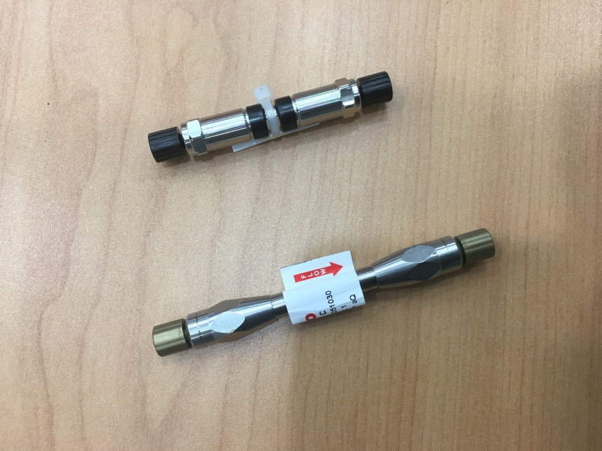
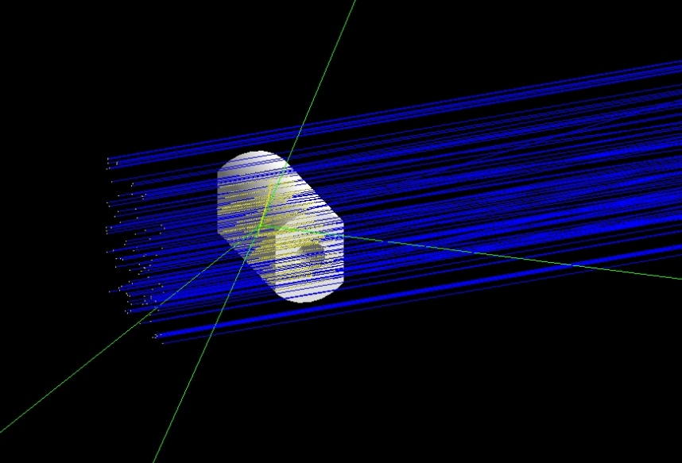
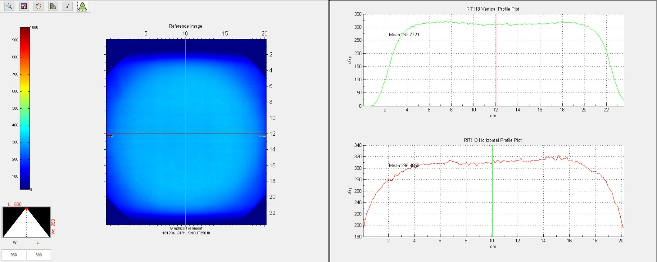
UPLC samples
Two types of UPLC columns
  Purchased from industry (ThermoScientificTM)
    20 (length, stainless steal) x 2.1 mm (capillary diameter)
    50 x 1 mm
  Target is the stationary phase composed of glass microballs and water/acetonitril mix
    90% SiO₂, 1% ACN (C₂H₃N), 9% H₂0; d = 2.186 g/cm³
Two types of irradiation
  1 Gy and 10 Gy, + 1 control
  Settings
    Energy: 200 MeV,
    12 x 12 cm² square beam spot (100% dose region)
    0.2 Gy/min
    a pause about every 2 min (or 2 Gy)
  Irradiation durations calculated using Geant4
Geant4 10.4
Notes:
Ultra Performance Liquid Chromatogrophy

Slide 11
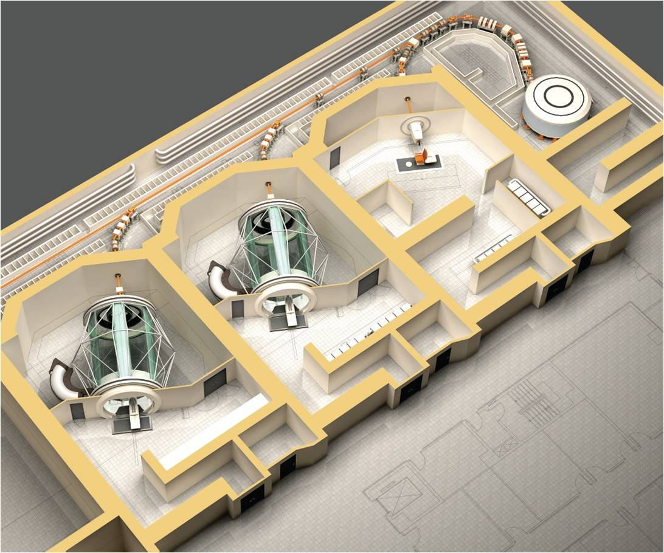
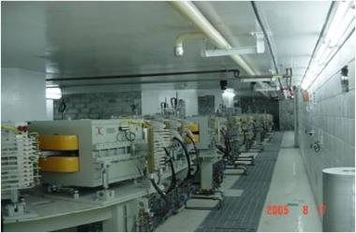
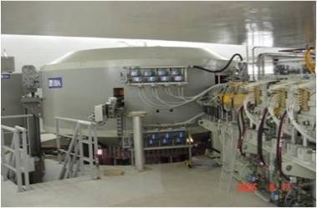
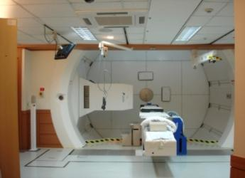

Proton beam facility
at the National Cancer Center
Fixed proton beam line
IBA Proteus 235
Weight : 220 tons Height : 210 cm Diameter : 434 cm
Energy : 230 MeV
Max. extracted beam current : 300 nA
RF frequency : 106 MHz

Slide 12
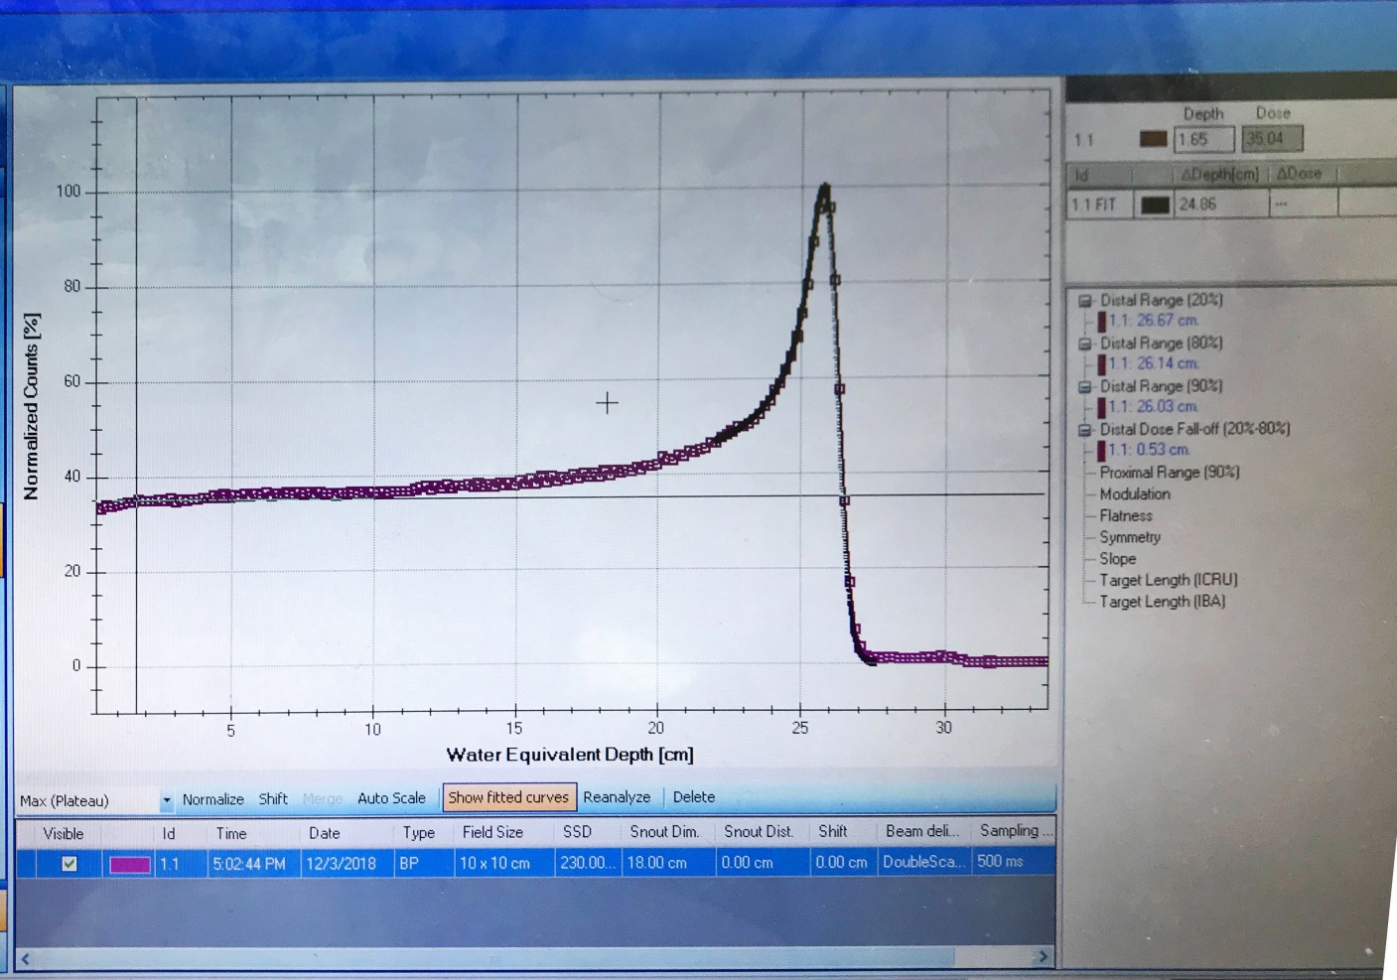
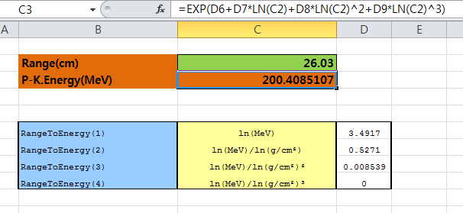
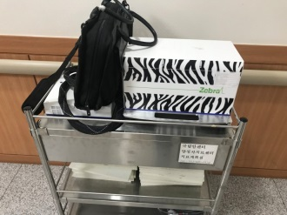
Beam output: range
2018
200.4 MeV protons (nominal value from IBA)
Distal range (90%):
26.03 cm in water
Zebra(MLIC),IBA

Slide 13
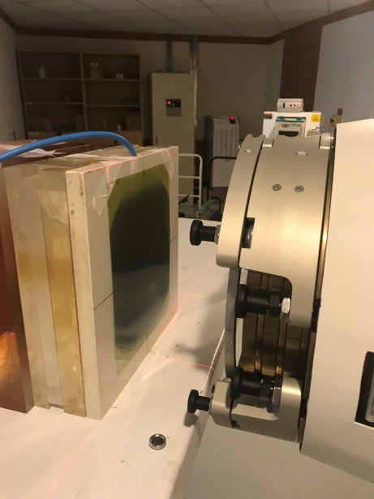
Beam output: shape
2018
Radius 7.0cm
  +- 3.0% dose variation
  IBA beam tuning typical setting
Film Measurements (EBT3 scan)
12.0 cm x 12.0cm (100% dose region)

Slide 14
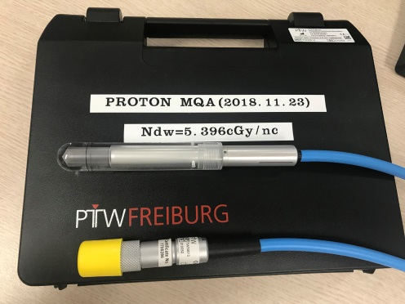
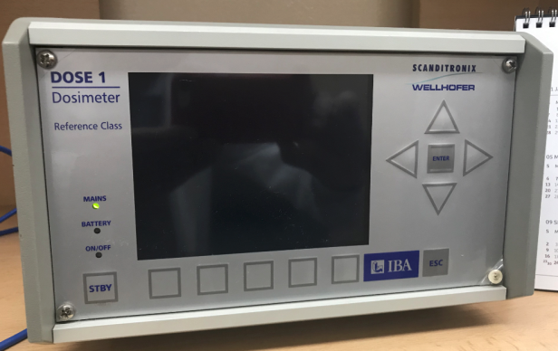
Beam output: dosimetry
2018
Proton Dosimetry Protocol: TRS398
Farmer chamber (PTW, Serial no. 010052)
Two delivered doses on surface exposed to beam
  1.0 Gy for 109.6 MU (NCC PTC)
  10.0 Gy for 1096 MU (NCC PTC)
  ~0.2 Gy/min for 2.5 nA (from cyclotron exit)

Slide 15
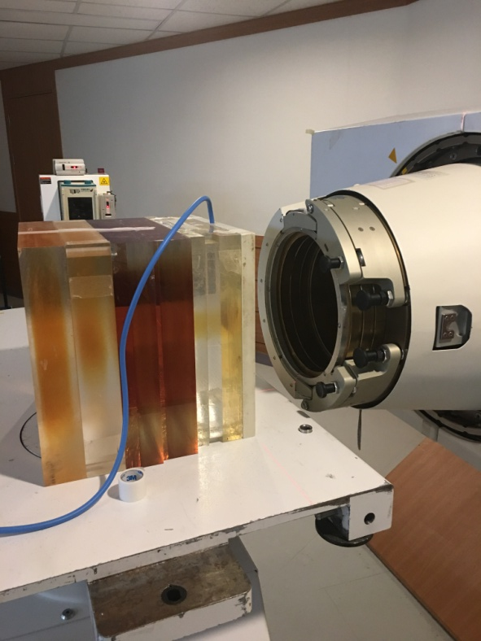
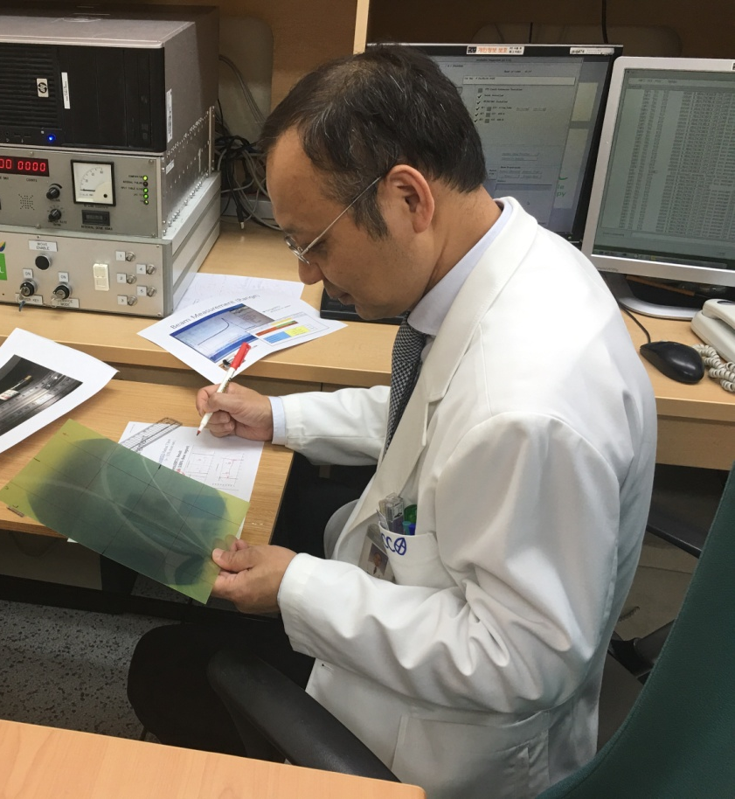
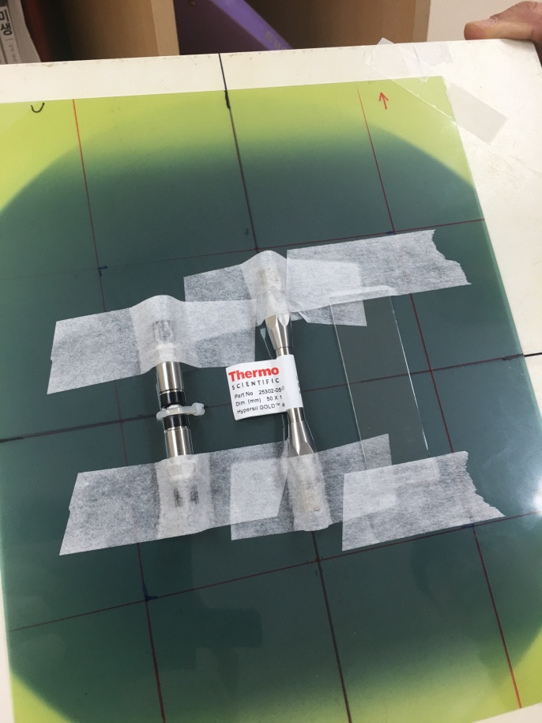
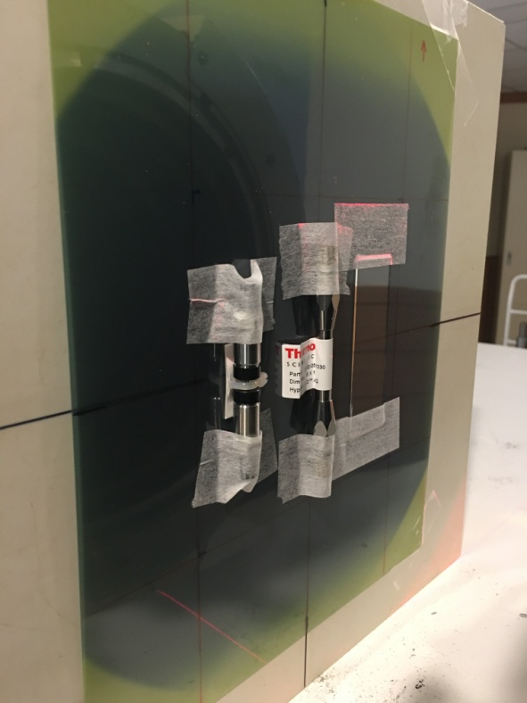
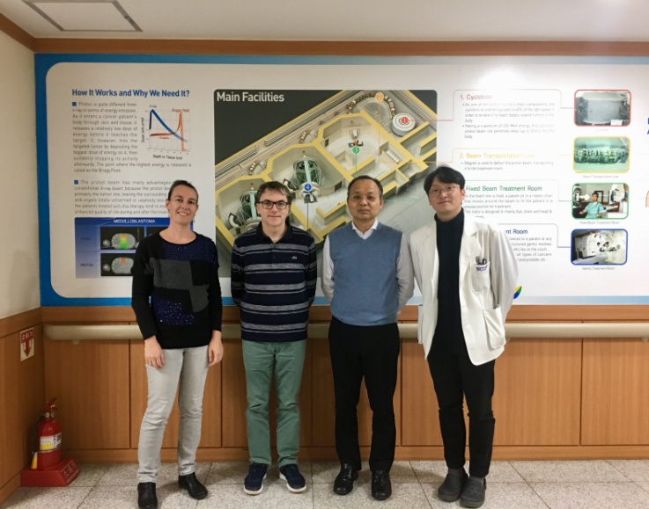
2018
EBT3 film
3 samples: 2 columns, 1 slide
Beam nozzle
Vertical irradiation
200 MeV
0.2 Gy/min

Slide 16

Liquid chromatography: first results
2018
Both columns are still functional after irradiation
One column seems robuster than the other
Some slight differences observed after irradiation
13 injected molecules have been tested
  Only two show a slight intensity decrease
  All others show intensity increase
Few modifications of retention times
These first results are promising for the feasability of UPLC in space
New analyses in progress to better understand irradiation impact
➔ Poster presentation at IUPAC (World Chemistry Congress)

Slide 17

2) Geant4-DNA Physics
http://geant4-dna.org
« Extending Geant4 for radiobiology »
Physical stage
step-by-step modelling of physical interactions of incoming & secondary ionising radiation with biological medium
(liquid water)
Excited water molecules
Ionised water molecules
Solvated electrons
Physico-chemical/chemical stage
Radical species production
Diffusion
Mutual chemical interactions
Geometrical models
DNA strands, chromatin fibres, chromosomes, whole cell nucleus, cells…
for the prediction of damage resulting from direct and indirect hits
DIRECT DNA damage
INDIRECT DNA damage
REPAIR
t=0
t=10⁻¹⁵ s
t=10⁻⁶ s

Slide 18
Geant4-DNA for Track Structure simulations
http://geant4-dna.org
Geant4-DNA is today the first and only open access simulation platform for Track Structure simulations (TS) of particles in biological medium (liquid water, DNA material…): no equivalent platfom available in the community
We have published in September 2018 a Special Report for the Medical Physics journal presenting a review of all Geant4-DNA features for TS simulations, including a variety of user examples:
  Key quantities: range, stopping power, mfp, dose point kernels, slowing down spectra, W-values, S-values, microdosimetry…
  It is the FOURTH Geant4-DNA Collaboration paper, supported by FKPPL
  Represents 10 years of development
  Available in Open Access

Slide 19
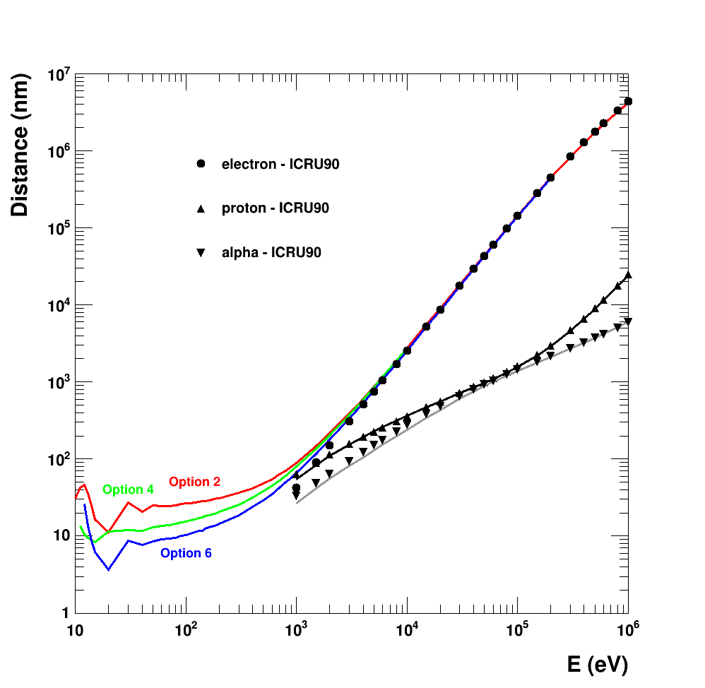
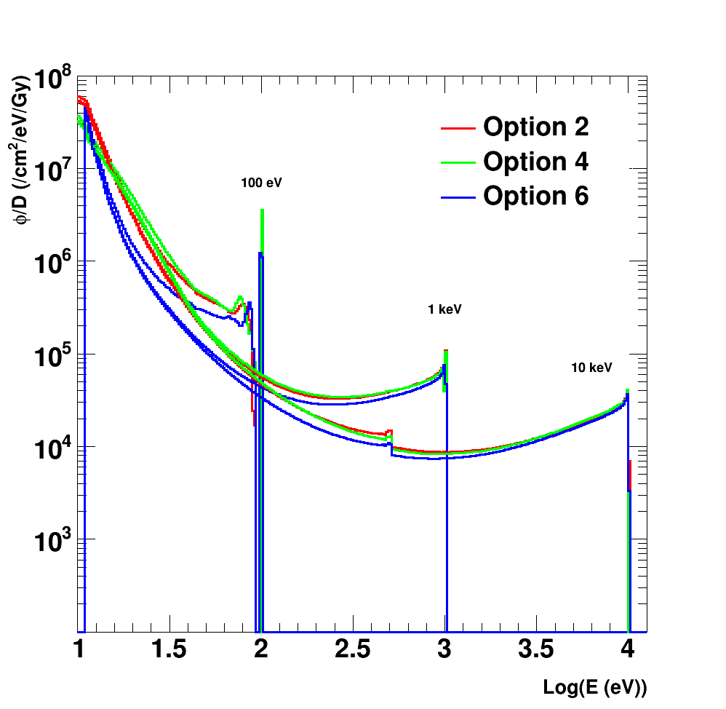
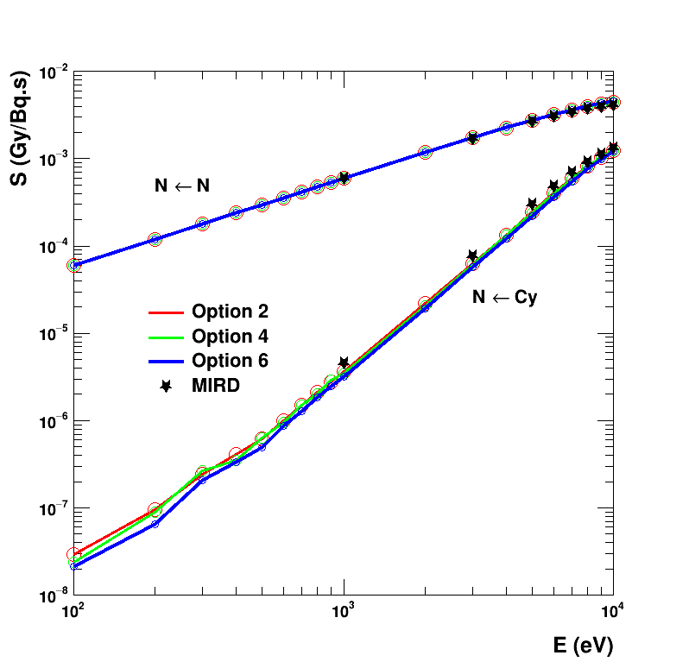
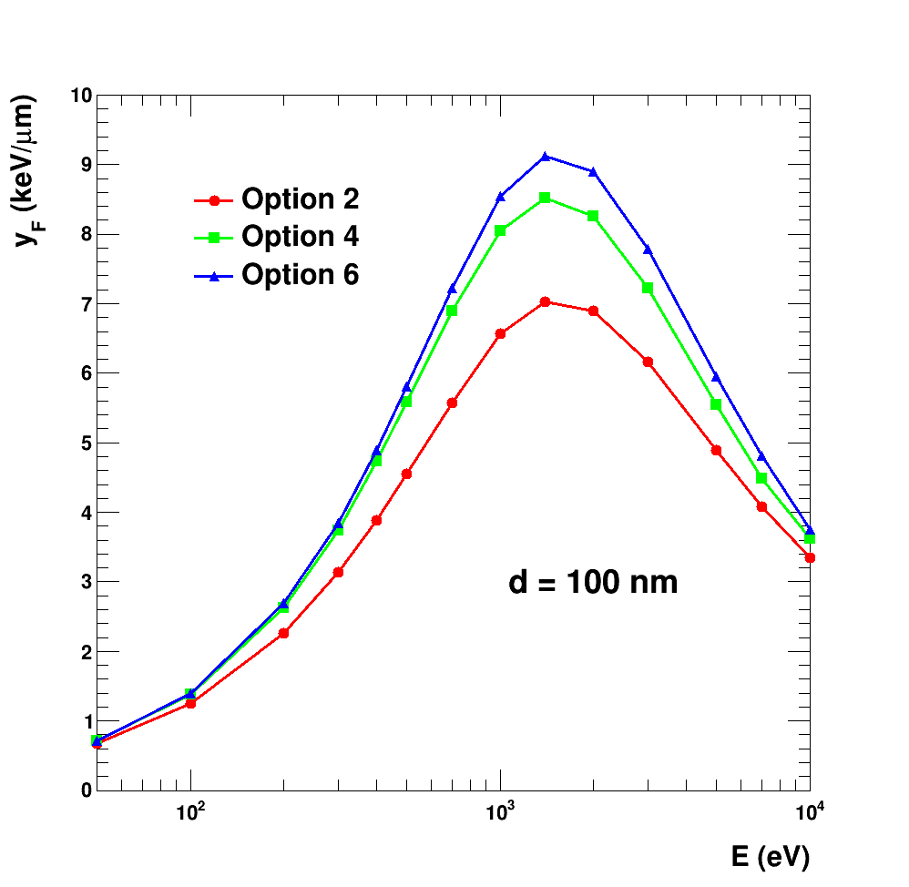
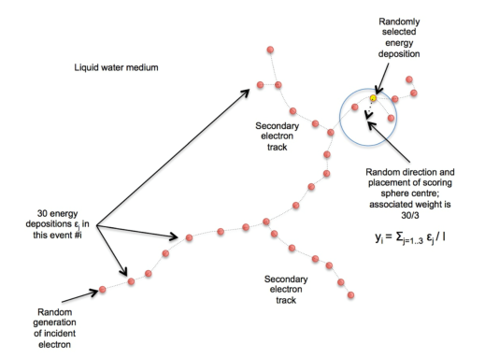
range
2018
slowing
S-value
lineal energies
Cy
N

Slide 20
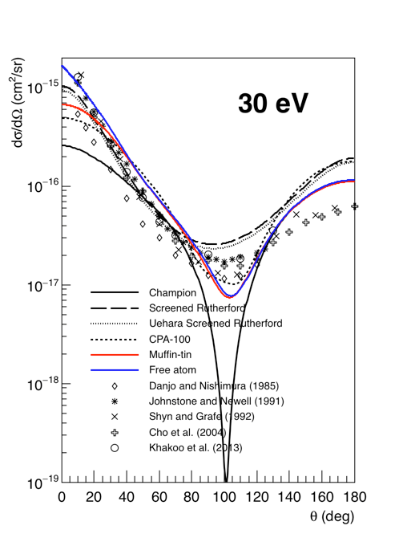
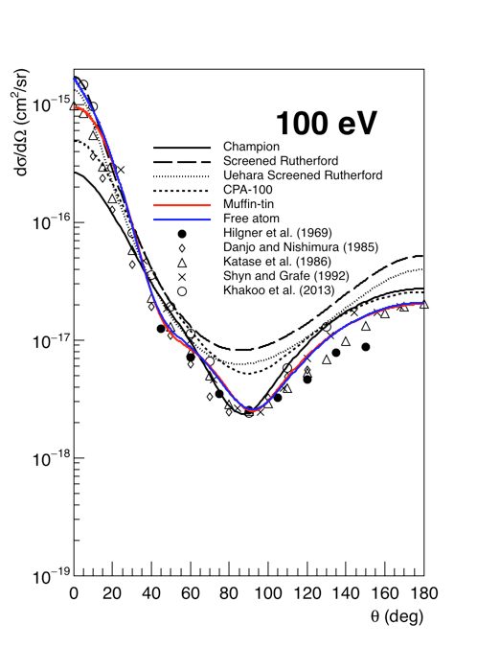
New Geant4-DNA Physics models
Differential cross section
Geant4-DNA is equipped with a complete set of physics model for the accurate description of discrete physical interactions of particles in liquid water down to the eV scale
  A requirement for nanodosimetry in biological targets such as DNA
We initiated within FKPPL a new activity aiming at improving the simulation of electron elastic scattering in liquid water in order to replace our current model with a more accurate one based on ELSEPA (relativistic partial-wave) calculations
  Elastic scattering is the dominant process < 100 eV
  Two theoretical approches:
    Muffin-tin potential
    Free atom approximation
In collaboration with F. Salvat (« father » of PENELOPE MC code)
First paper just published by W. G. Shin, cotuelle PhD student (Bordeaux U. & Yonsei U.)
  J. Appl. Phys. 124 (2018) 224901
$$V\left(r\right)=V_{st}\left(r\right)+V_{ex}\left(r\right)+V_{cp}\left(r\right)−iW_{abs}(r)$$
Notes:
$$V\left(r\right)=V_{st}\left(r\right)+V_{ex}\left(r\right)+V_{cp}\left(r\right)−iW_{abs}(r)$$
(1)
where $V_{st}\left(r\right)$ is the electrostatic interaction potential, $V_{ex}\left(r\right)$ is the exchange potential, $V_{cp}\left(r\right)$ is the correlation-polarizability potential, and $W_{abs}(r)$ is the magnitude of the imaginary absorption potential. In ELSEPA, users can select the models for the interaction potentials and can use various options listed in Table 1.
ELSEPA provides a potential model in the free atom approximation for the vapour-state phase and the Muffin-tin approximation adapted to the solid-state phase [44,45] (see 6th column of Table 1).
In contrast of the free atom approximation using equation (1), the Muffin-tin potential assumes that the Z electrons of the neutral atom are confined within a sphere of a certain radius $R_{mt}$ centered on the nucleus to approximate solid-state. This assumption implies that at distances r>$R_{mt}$ the electrostatic interaction potential $V_{st}\left(r\right)$ of a bound atom is smaller (in magnitude) than that of a free atom.

Slide 21

2 on-going theses
2018
First FKPPL cotutelle thesis
  candidate is Mr Wook Geun Shin, started on 11/2017
  cotutelle between Bordeaux University and Yonsei University in Wonju
  fully funded by Bordeaux U. for 3 years : IDEX funding for international doctorates in specific destinations (« AIL »)
  advisors: Chul Hee Min, S. Incerti
  conditions
    18 months in France, 18 months in Korea, 100 h of lectures in France…
    reciprocity condition: another PhD thesis started in October 2018 and is fully funded by Yonsei U.
  Topic : « Geant4-DNA physics and chemistry developments for biological damage prediction in a protontherapy context »
Second thesis
  candidate is Mr H. J. Choi, started on 10/2018
  fully funded by Yonsei University in Wonju
  Topic: « Development of the integrated prompt gamma (PG) and positron emission tomography (PET) measurement technique to validate the in-vivo dose distribution in proton therapy »
Support of FKPPL is crucial to support travel to & from Korea

Slide 22
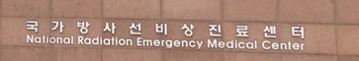

3) Outreach : Geant4 tutorial 2018
Strong support of FKPPL and Korean institutions (KISTI, NCC, KIRAMS) for the organization of regular Geant4 tutorials in Korea
About 60 participants (PhD students, postdocs, researchers)
3 teachers: M. Asai (SLAC), M. Novak (CERN), S. Incerti (IN2P3)
9 tutorials since 2009 in Korea thanks to FKPPL partners !
  Geant4 tutorial, July 9-13, 2018 – KIRAMS, Seoul, Rep. Korea
  Geant4 tutorial, July 24-28, 2017 – KIRAMS, Seoul, Rep. Korea
  Geant4 tutorial, Dec. 9-10, 2016 – KISTI, Daejeon, Rep. Korea
  Geant4 tutorial, Oct. 30 - Nov. 1, 2015 - National Cancer Center, Ilsan, Rep. Korea
  Geant4 tutorial, October 27-29, 2014 - KISTI, Seoul, Rep. Korea
  Geant4 Tutorial - October 29 - November 2, 2012 - KISTI, Seoul, Rep. Korea
  2011 Fall Training Course on Geant4 and GATE - October 31- November 4, 2011 - KISTI, Seoul, Rep. Korea
  2010 Summer Training Course on Geant4, GATE and Grid Computing - July 7-10, 2010 - Seoul, Rep. Korea
  Introduction to Geant4, November 10, 2009 - KISTI, Daejeon, Rep. Kore

Slide 23
Summary
Several irradiation Campaigns for exobiology at NCC:
  Peptides, antibodies, aptamers, ultra performance liquid chromatography columns
3 papers published
3 Geant4 International Schools
1 co-tutelle PhD thesis (Bordeaux U. / Yonsei U.)

Slide 24
Future
Continuation of NCC irradiation experiments for astrobiology
  Finalyze analysis of 2018 data (UPLC, aptamers)
  Submit publication:
  « Searching for life on Mars: effects of proton radiation on the structural integrity of biomarkers and organic molecules »,
  Y. Blanco, M. Moreno-Paz, D. Viúdez-Moreiras, A. Le Postollec, M. Dobrijevic, S. Incerti, C. Kim, S. B. Lee, V. Parro
  Submit abstract at IUPAC:
  « Study of liquid chromatography exposed to spatial conditions: Effect of radiation and extreme temperature on stationary phase.»
  T. Ribette, A. Le Postollec, M. Dobrijevic, S. Incerti, S. B. Lee, C. K. Kim, P. Poinot, C. Geffroy
Continuation of Geant4-DNA development and applications
  Release of new elastic models for electrons in liquid water in Geant4 (June 2019)
  Investigate influence of this new model on:
    water radiolysis modelling (radiochemical yields)
    early DNA damage in a whole cell nucleus
    On-going
A 5-day Geant4 general scope tutorial in Korea
- Nov. 18-22, 2019, Institue for Basic Science(IBS), Daejeon, Rep. Of Korea.

Slide 25
Thanks for your attention !

Slide 26
Backup

Slide 27

Irradiation @ AIFIRA - CENBG
March 8, 2017
Energy: 3 MeV
Current : 550 pA
Flux: 9E9 p/cm²/s
2 doses : 50 kGy and 500 kGy
12 slides
    10 slides to irradiate: 5 slides/dose
    2 reference slides
Analysis is on-going…

Slide 28




Experiment preparation
Target dose
    Proton irradiation
    Up to a few My of accumulated absorbed dose
    MSL Curiosity measurements: 0.21 mGy/day on Mars (1My = 77kGy)
Spots geometry
    Assessed with microscopy
    2 types:
      Cones: diameter = 46 um, height = 40 um
      Tubes: diameter = 150 um, height = 10 um
Geant4 simulations
    To assess doses deposited
    into samples spots
Optical Microscope
Confocal Microscope
Scanning Electron Microscope

Slide 29
First experiment: high dose irradiation of peptpides
Prepared by Spanish collaborators : V. Parro and Y. Blanco (CAB, Madrid)
Molecules are printed by triplicate spot pattern on glass slides
"Spots" are microdroplets that have evaporated: only molecules remain at the surface
200 MeV
114 spots
7.5 mm
7.5 mm
29
29
29
30
30
26
30
Geant4
25
25
25
26
26
27
27
28
28
27
28
21
21
22
21
22
22
23
1 cm²
23
23
24
24
24
17
20
17
17
18
18
18
19
19
19
20
20
70 mm
13
13
13
14
14
14
15
15 15
16
16 16
10
10
10
11
9
9
9
11 11
12
12 12
5
5
5
6
6
6
7
7
7
8
8
8
1
1
1
2
2
2
3
3
3
4
4
4
A
A
A
A
A
A
B
B
B
C
C
C
a
a
a
b
b
b
c
c
c
d
d
d
22 mm
30 peptides (15 aminoacids) were printed (150 microns diameter spots) onto microscope slides in 4 microarray replicates per slide.
Schematic of a printing pattern layout (by triplicate) of the antibodies:
a-d, fluorescent preimmune antibody as a frame reference in 1X printing buffer and 0.01% Tween-20;
A, 1X printing buffer with 0,01% Tween-20;
B and C, BSA (bovine serum albumin at 1 and 0.5 mg/mL in 1X printing buffer and 0.01% Tween-20);
1-30 (by triplicate spots): each peptide (15 aminoacids + PEG-linker to minimize steric hindrances + Lys for coupling to surfaces).
Notes:
Les peptides ont des épitopes
Ce sont des assemblage d’AA
Pour ces peptides: répond aux objectifs des agences spatiales (see slide 4) puis ils ont pris ceux pour lesquels ils ont des anticorps
A, B, C = tampons (les blancs)
a-d : anticorps fluorescents de contrôle

Slide 30
Second experiment: high energy irradiation of antibodies
156 MeV
  similar to previous exp. @ Uppsala
144 spots
7.5 mm
37
37
37
38
38
38
39
39
39
40
40
40
7.5 mm
33
33
33
34
34
34
35
35
35
36
36
36
29
32
29
29
30
30
26
30
31
31
31
32
32
25
25
25
26
26
27
27
28
28
27
28
21
21
22
21
22
22
23
1 cm²
23
23
24
24
24
17
20
17
17
18
18
18
19
19
19
20
20
70 mm
13
13
13
14
14
14
15
15 15
16
16 16
10
10
10
11
9
9
9
11 11
12
12 12
5
5
5
6
6
6
7
7
7
8
8
8
1
1
1
2
2
2
3
3
3
4
4
4
A
A
A
A
A
A
B
B
B
C
C
C
a
a
a
b
b
b
c
c
c
d
d
d
22 mm
Eight antibodies were printed (150 microns diameter spots) onto microscope slides in 4 microarray replicates per slide.
Schematic of a printing pattern layout (by triplicate) of the antibodies:
a-d, fluorescent preimmune antibody as a frame reference in 1X printing buffer and 0.1%Tween-20;
A, 1X printing buffer with 0,1%Tween-20;
B and C, BSA (bovine serum albumin at 1 and 0.5 mg/mL in 1X printing buffer and 0.1% Tween-20); 1-40 (by triplicate spots):
1-5: anti-ABC transporter protein at 0.8, 0.6, 0.4, 0.2 and 0.08 mg/mL,
6-10: anti-B. subtilis spores (antibody 1) at 0.8, 0.6, 0.4, 0.2 and 0.08 mg/mL,
11-15: anti-B. subtilis spores (antibody 2) at 0.8, 0.6, 0.4, 0.2 and 0.08 mg/mL,
16-20: anti-Microcystis aeruginosa at 0.8, 0.6, 0.4, 0.2 and 0.08 mg/mL,
21-25: anti-DsrB protein at 0.8, 0.6, 0.4, 0.2 and 0.08 mg/mL,
26-30: anti-streptavidin protein at 0.8, 0.6, 0.4, 0.2 and 0.08 mg/mL,
31-35: anti-GroeL protein at 0.8, 0.6, 0.4, 0.2 and 0.08 mg/mL
36-40: anti-viral protein 7 of the blue tongue virus at 0.8, 0.6, 0.4, 0.2 and 0.08 mg/mL.
Notes:
1 à 5 même anticorps mais à des concentrations différentes
Idem 6 à 10
8 anticorps testés à 5 concentrations, tous en triplicats = 120
+ ABCD = 12
+ 12 de plus

Slide 31

First results from the 2017 campaign
Irradiated molecules are peptides
Protons of 200 MeV
Three doses: 0, 7.2 kGy et 72 kGy
?
These first results indicate no degradation of antibody detection ability:
molecules of interest should be detected after about 1 MY on Mars
To be confirmed: 2018 analysis is on-going…
Notes:
Plus de dégradation à 3 MeV qu’à 200 MeV
At least, the sites were antibodies attach are not degraded

