Slide 1
Observing Critical Fluctuations in the Dynamics of
Heavy Ion Collisions
Proposal: HAD_03
Marlene Nahrgang
(SUBATECH, Nantes)
Masakiyo Kitazawa
(Osaka U., Osaka / KEK)
2019 FKPPL & TYL/FJPPL meeting, Jeju, May. 9, 2019

Slide 2

QCD Phase Diagram
T
Quark-Gluon Plasma
150MeV
ＱＣＤ Critical Point
Hadron Phase
(confined)
Color SC
~10¹⁵g/cm³
μ
Our Universe

Slide 3
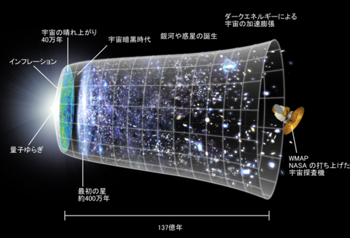
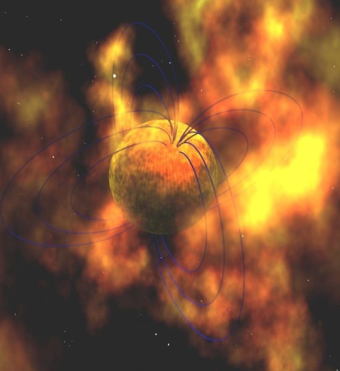
QCD Phase Diagram
T
Early Universe
Quark-Gluon Plasma
150MeV
ＱＣＤ Critical Point
Hadron Phase
(confined)
Color SC
Compact
Stars
~10¹⁵g/cm³
μ
Our Universe

Slide 4
Beam-Energy Scan Program in Heavy-Ion Collisions
T
high
Quark-Gluon Plasma
beam energy
150MeV
ＱＣＤ Critical Point
low
Hadron Phase
(confined)
Color SC
~10¹⁵g/cm³
μ
Our Universe

Slide 5
Beam-Energy Dependence

Slide 6
Beam-Energy Dependence
High energy
Low energy
Nuclear transparency
Baryon stopping
net-baryon #: small
net-baryon #: large

Slide 7
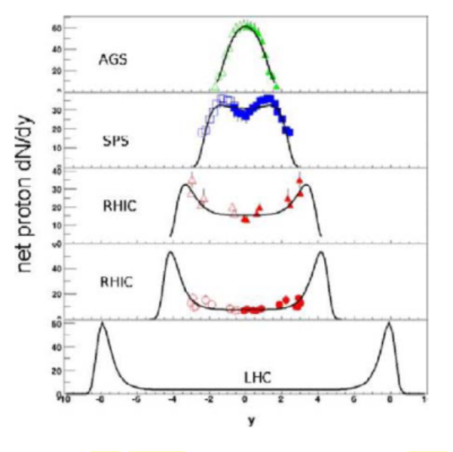





Baryon Stopping
rapidity dep. of net-proton #
stopping
Baryons stop at collision point
transparency
Baryons pass through
rapidity

Slide 8




AGS
-1996
SPS
1994-2000
RHIC
2000-
LHC
2010-
creation of quark-gluon plasma,
strongly-interacting QGP
~2010
History of HIC = increasing energy
Heavy-Ion Collisions

Slide 9
AGS
-1996
SPS
1994-2000
RHIC
2000-
LHC
2010-
RHIC-BES
2010-
creation of quark-gluon plasma,
strongly-interacting QGP
BES-II
2019-
NICA
2020-?
~2010
History of HIC = increasing energy
FAIR
2023-?
2010~
Beam-energy scan
Low-energy exp.
Heavy-Ion Collisions
J-PARC-HI
2026~?

Slide 10
Searh for QCD Phase Structure with Fluctuation Observables
T
high
Quark-Gluon Plasma
beam energy
150MeV
ＱＣＤ Critical Point
low
Hadron Phase
(confined)
Color SC
~10¹⁵g/cm³
μ
Our Universe

Slide 11
Thermal Fluctuations
Observables are fluctuating even in an equilibrated medium.
P(N)
N
V
N
Phase transition → Large fluctuation
Non-Gaussian fluctuations: good observables of QCD-CP
Stephanov, PRL (2009); Asakawa, Ejiri, MK, PRL (2009)
Review: Asakawa, MK, PPNP90 (’16)

Slide 12
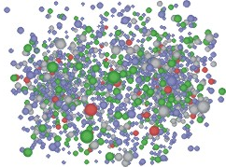
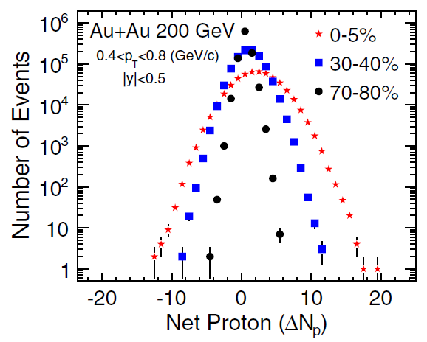
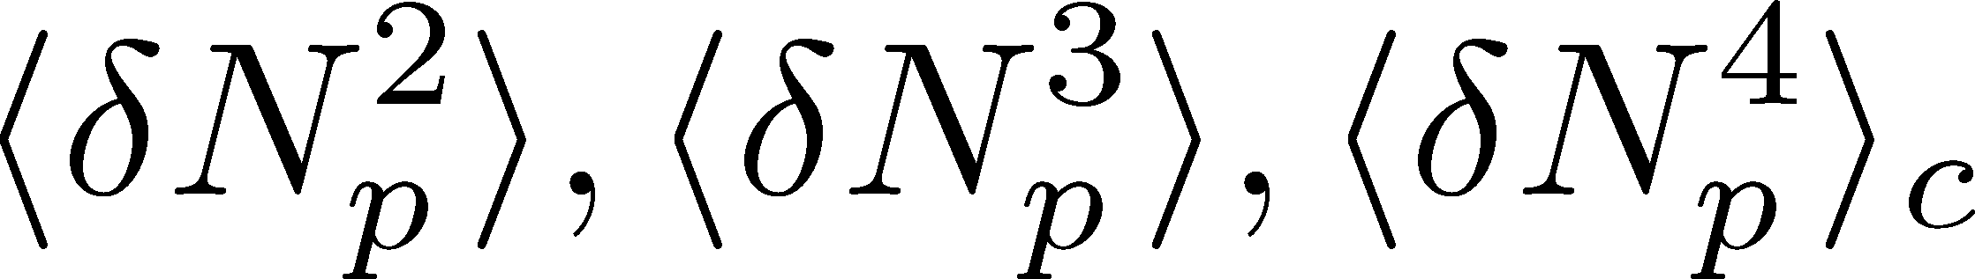
Event-by-Event Fluctuations
Review: Asakawa, MK, PPNP 90 (2016)
Fluctuations can be measured by e-by-e analysis in experiments.
STAR, PRL105 (2010)
Detector
Cumulants

Slide 13
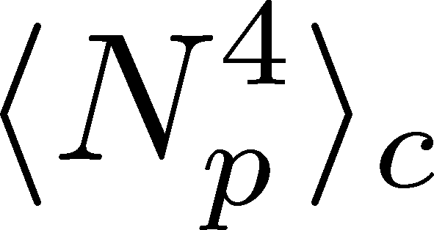
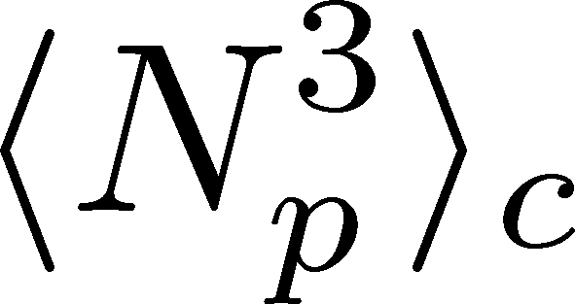
Higher-Order Cumulants
STAR Collab.
2010~
Enhancement
Enhanement in non-Gaussian cumulants
has been observed!
Have we measured critical fluctuations?

Slide 14


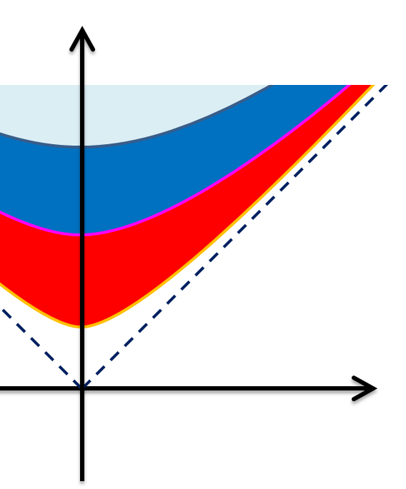



Time Evolution of Fluctuations
Asakawa, Heinz, Muller (2000)
Jeon, Koch (2000)
Shuryak, Stephanov (2001)
Detector
t
Hadronic
Particle-number fluctuations
in a phase space continue to
change during the time
evolution.
QGP

Slide 15
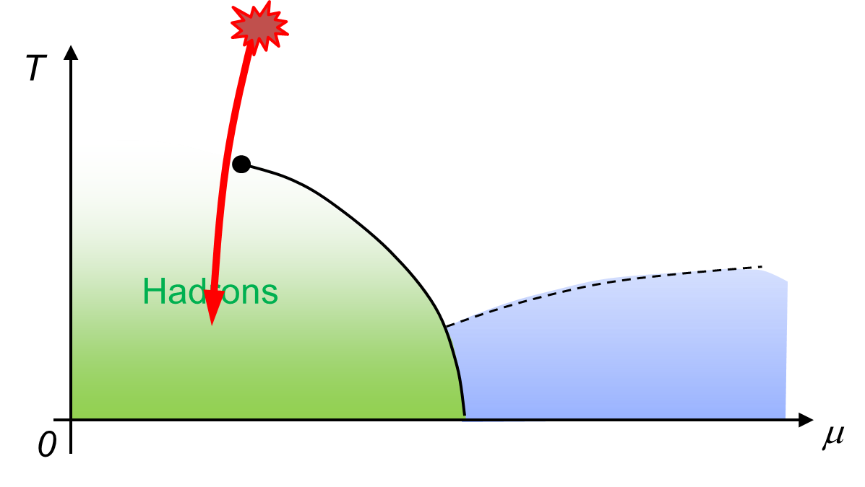
Effect of Dynamical Evolution
Growth
Growth of the critical fluctuation is limited by the critical slowing down.
Decay by diffusion
Fluctuations developed at CP are modified by the time evolution in later stage before observation.
So far, these problems have not been studied seriously…

Slide 16





Two Groups Working Actively on Dynamics
Osaka
Nantes
Masakiyo Kitazawa
(Osaka University/KEK)
Marlene Nahrgang
(SUBATECH)
Diffusion in Brownian model
2014~
Thermal blurring effects
2016
Stochastic diffusion model
2017~
Chiral fluid dynamics: model building
2011~
chiral fluid dynamics: applications
2014~
diffusion of non-Gaussianity
2018~

Slide 17
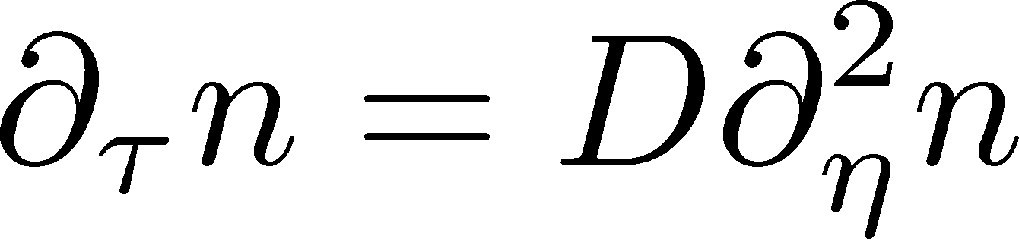
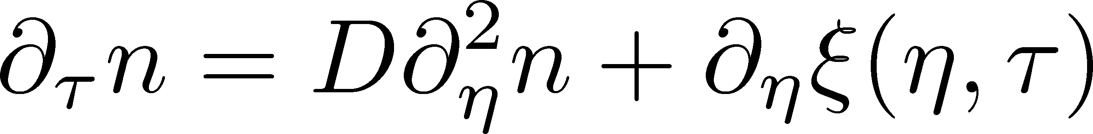
Stochastic Diffusion Equation
Sakaida, MK, et al.
PRD95, 064905 (2017)
Diffusion equation
Describe a relaxation of a conserved density n toward uniform state without fluctuation
Stochastic diffusion equation
Describe a relaxation toward fluctuating uniform state
Only Gaussian fluctuations
Review: Asakawa, MK, PPNP 90 (2016)

Slide 18
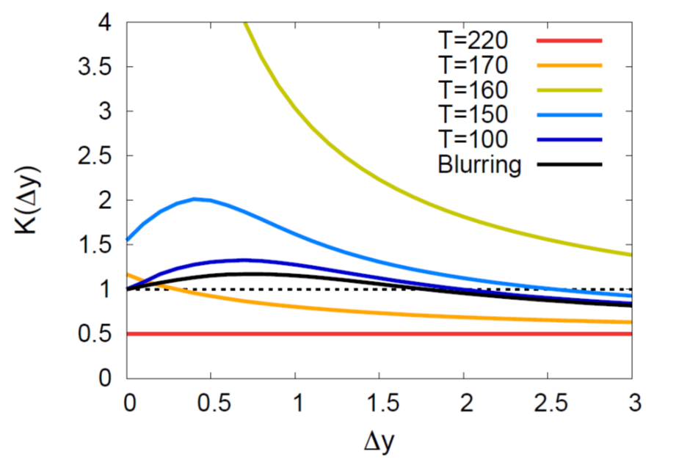

Evolution of Fluctuation
Sakaida, MK, et al.
PRD95, 064905 (2017)
Solve the time evolution analytically
for Gaussian fluctuations
Non-monotonic Δy dep.
as a signal of QCD-CP

Slide 19
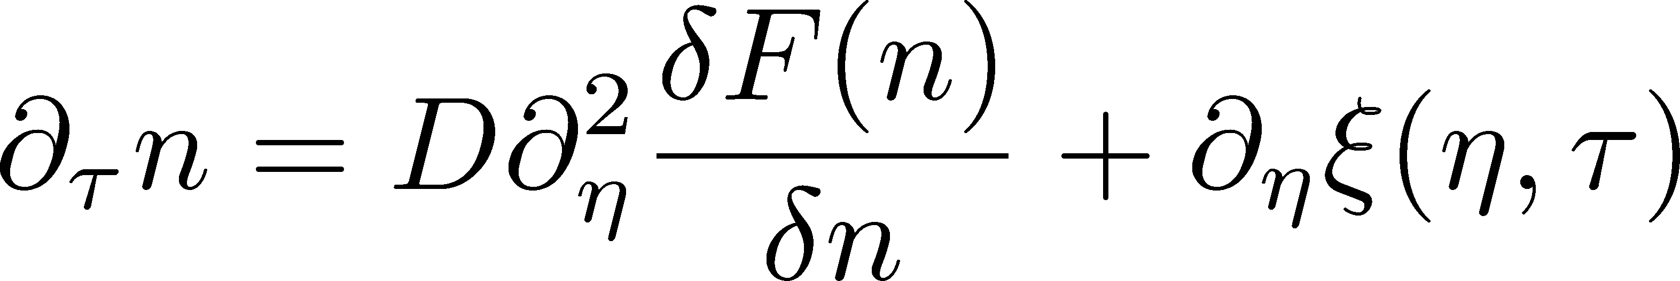
Extension to Non-Gaussianity
Nahrgang, Bluhm, et al.
arXiv:1804.05728
Include non-linear effects
Solve the time evolution stochastically including
non-Gaussian fluctuations

Slide 20
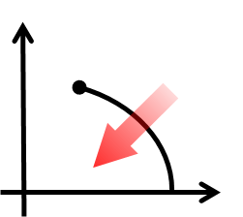
Activity in 2018: First-Order Transition
T
μ
Domain formation
Non-uniform system
Nonaka (M2), MK, Akamatsu,
Bluhm, Nahrgang,
JPS meeting, 2019 Mar.
Herold, Nahrgang, et al. (2011~); Steinheimer, Randrup (2012; 2013)

Slide 21



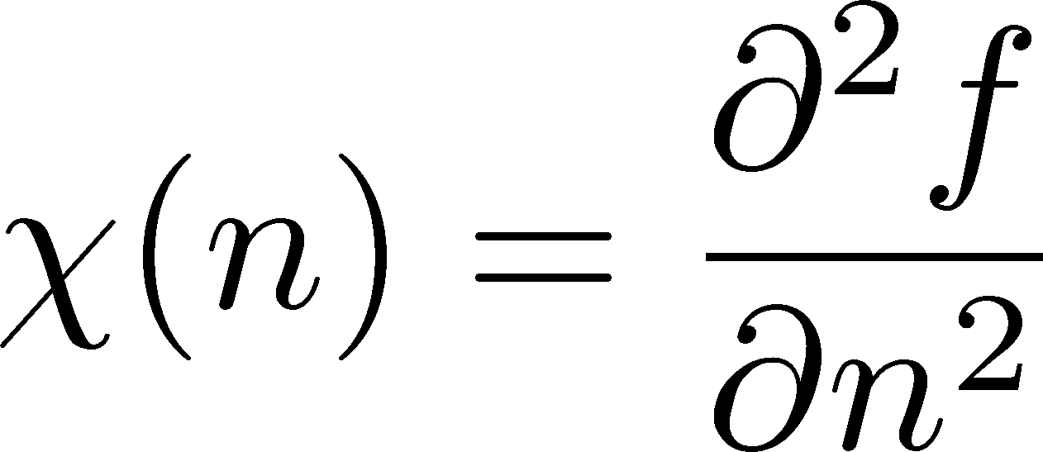


Free Energy
At 1st transition point
Large and small n
Poisson

Slide 22



Time Evolution
Numerical Simulation in 1+1d System
1st transition leads to formation of domains.

Slide 23
Correlation Function
Correlation Function
τ= 2fm
τ= 5fm
τ=10fm
τ=20fm
Peak
structure
rapidity gap Δy
Domain leads to a peak structure in C(y).
The peak can survive even in the final state.

Slide 24
Many Things To Do
Gaussian
Analytic
Non-Gaussian
Numerical
Stochastic diffusion
model
FS2018

Slide 25
Many Things To Do
Gaussian
Analytic
Non-Gaussian
Numerical
Stochastic diffusion
model
analytic result
for non-Gaussian
parameter
dependence
1st order transition
FS2018

Slide 26

Many Things To Do
Gaussian
Analytic
Non-Gaussian
Numerical
Stochastic diffusion
model
analytic result
for non-Gaussian
parameter
dependence
1st order transition
FS2018
Diffusion on
Brownian particle
model
Comparison
  for better understanding
Coupling to
chiral condensate
in chiral-fluid model

Slide 27

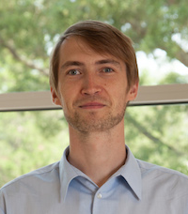
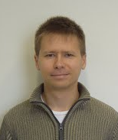
Many Things To Do
Gaussian
Analytic
Non-Gaussian
Numerical
Stochastic diffusion
model
analytic result
for non-Gaussian
parameter
dependence
1st order transition
FS2018
Diffusion on
Brownian particle
model
Comparison
  for better understanding
Coupling to
chiral condensate
in chiral-fluid model
Dynamical evolution in
realistic space-time evolution
Realistic description of fluctuation dynamics
New methodology to search for phases of QCD

Slide 28
Activity / Budget
FS 2018
No budget use
because of typhoon No.21 / Birth of a baby
Discussions: 2019 Mar. Germany / 2019 Apr. Germany
workshop
organized by
FS 2019
June: Nahrgang, Bluhm will visit Osaka.
Sept.: Kitazawa will visit Nantes.
No budget request to French side as the budget is carried forward.
Mutual visitings are quite helpful
to accelerate our collaboration!

Slide 29

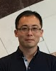
Summary
Beam-energy scan: world-wide exciting topics!
Fluctuations: important observables for the search for QCD phase structure
Proper description of dynamics of fluctuations is necessary, but has not been studied well.
Osaka-Nantes bilateral collaboration will play a crucial role in resolving these problems!!
Osaka Group
Nantes Group
Masakiyo
Kitazawa
Yukinao
Akamatsu
Marlene
Nahrgang
Iurii
Karpenko
Marcus
Bluhm
and young students…

