Slide 1


Effects of isospin asymmetry on the energy isotropy ratio of nucleons in heavy-ion collisions
Kyungil Kim
Sep. 11th , 2018, NuSYM2018

Slide 2
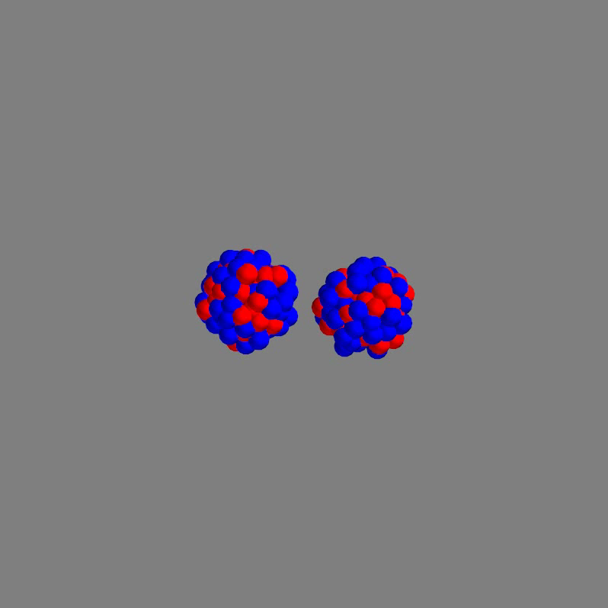
Motivation
Particles have information of the compressed matter!

Slide 3
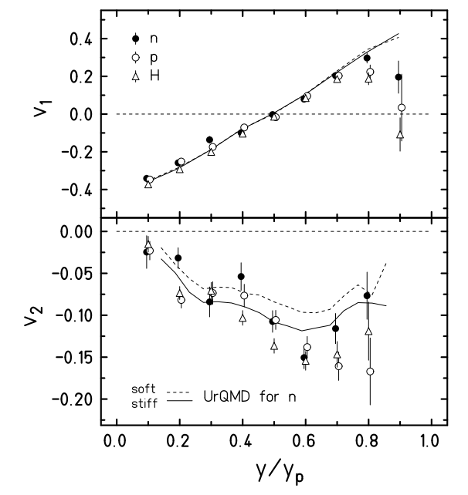
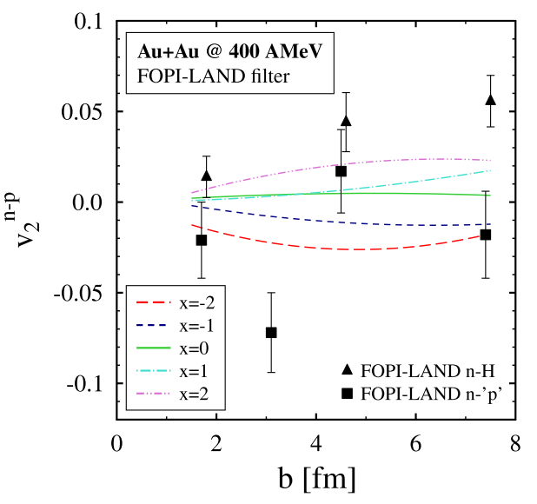
Motivation
<Flow observables>
To fix the equation of state, flow is not sufficient.
P. Russotto, et al. EPJ A 50 (2014) 38

Slide 4
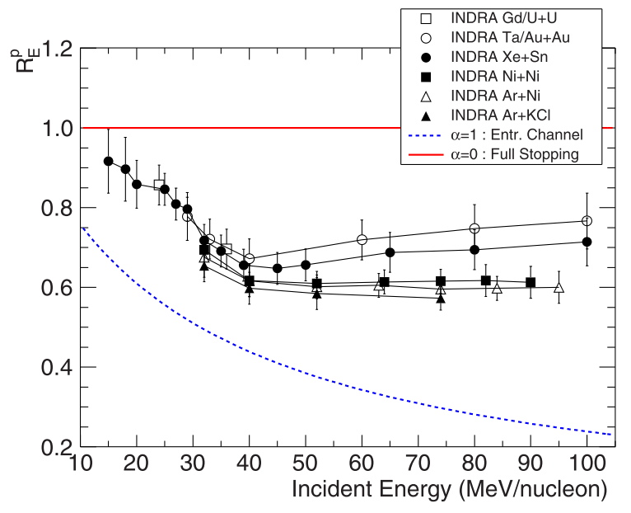

Motivation
<Stopping ratio>
Various beam-targets
E_{beam} = 15-100 MeV/n
Plateaus or slight increases from the Fermi energy
<Energy-based isotropy ratio>
O. Lopez et al. PRC 90, 064602 (2014)

Slide 5
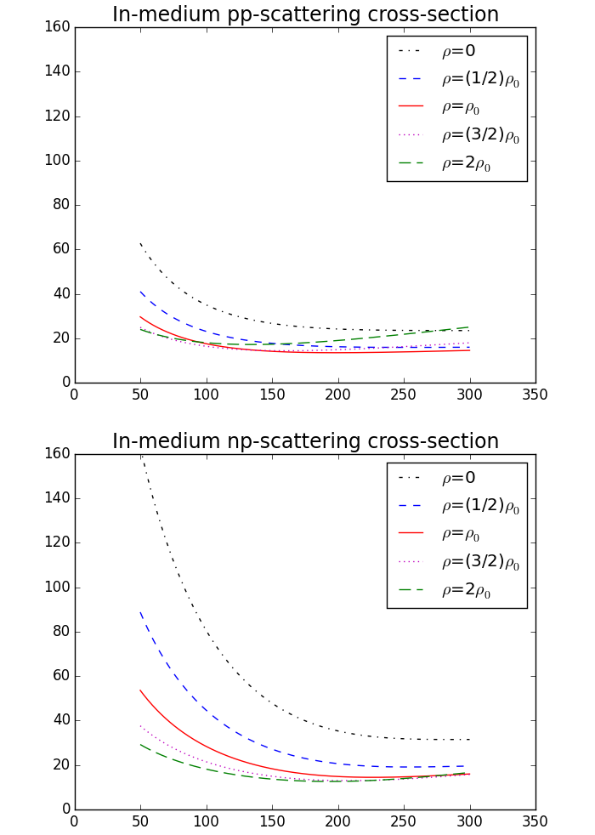
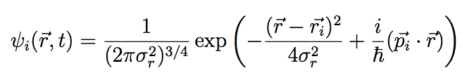

Transport Model
Nucleon-nucleon collisions
In-medium cross-section :
Interaction among nucleons
Wavefunction :
Potential :

Slide 6
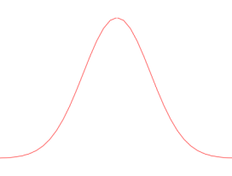
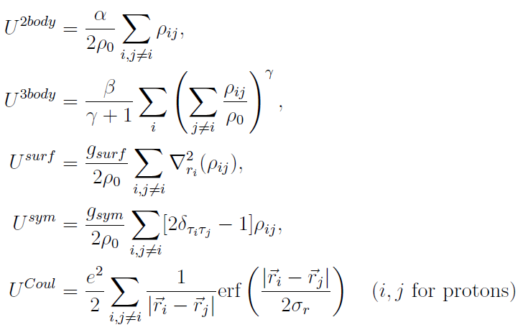
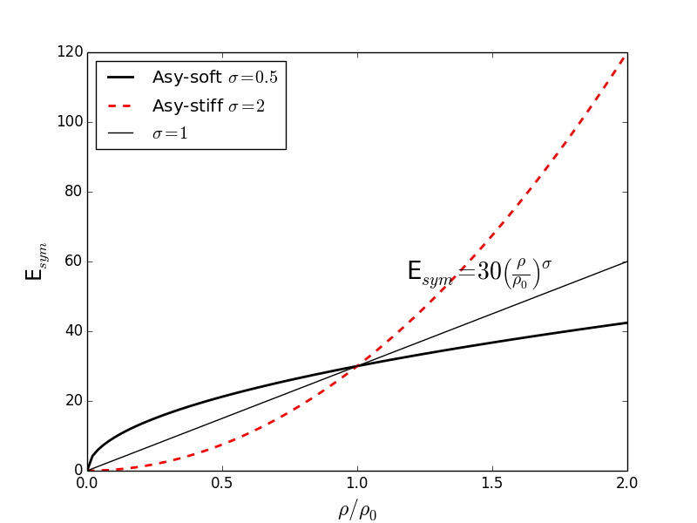
QMD Model - Potential
Nucleon -> Gaussian wave packet
Gaussian w.f.
Skyrme parametrization for NN potential
K=236 MeV

Slide 7

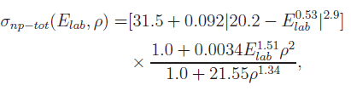
QMD Model - Collisions
Ref.) G.Li and R.Machleidt PRC 48, 1702, PRC 49, 566

Slide 8

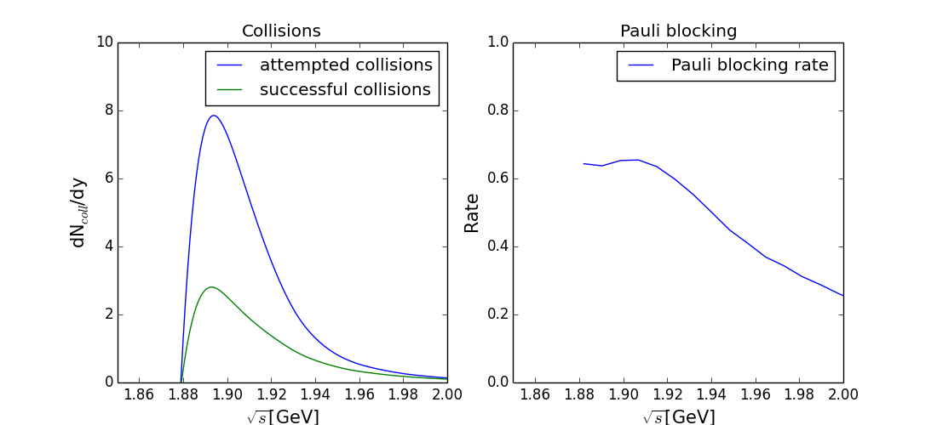


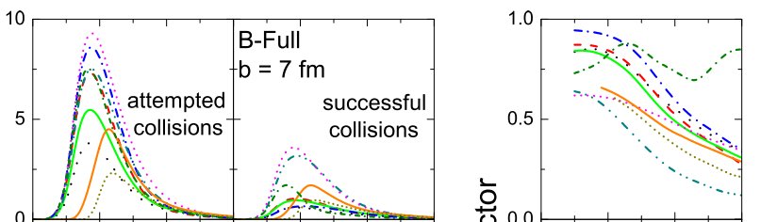
QMD Model – Pauli Blocking
<x-space>
<p-space>
<Phase space density for i th particle>
ref. J. Xu, et al. PRC 93 (2016) 044609

Slide 9
Simulation
¹²⁹Xe+¹²⁰Sn
E_{beam}=39, 65, 100 MeV/n
N_{event} = 20000
O. Lopez et al. PRC 90, 064602 (2014)

Slide 10
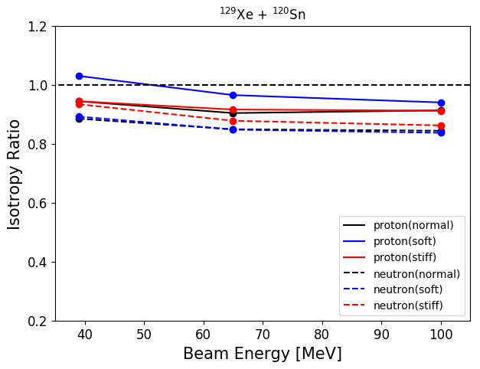
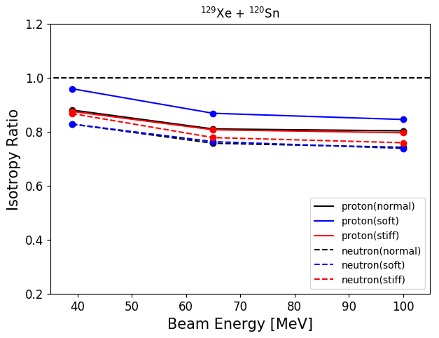
Results – E_{sym} Dependence
b_{max} = 2 fm
b_{max} = 4 fm
Larger differences between protons and neutrons are obtained for the soft symmetry energy.

Slide 11
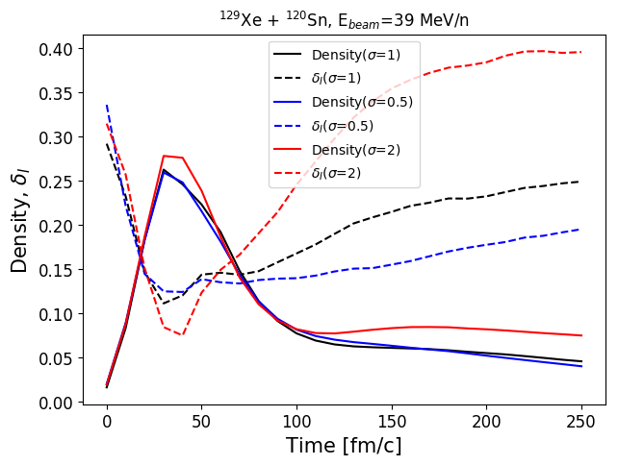
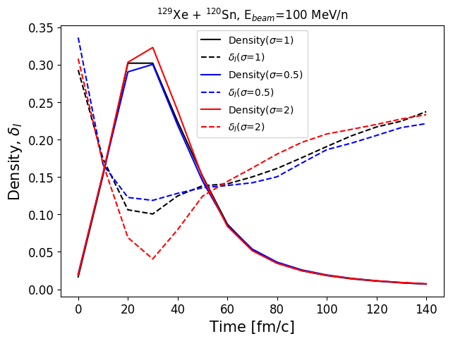
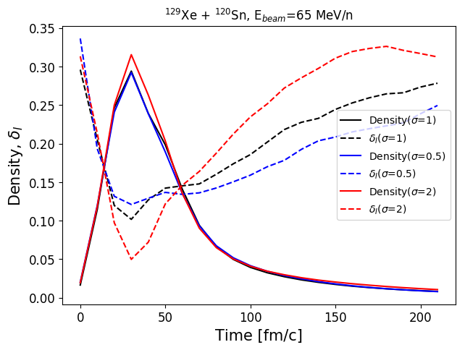
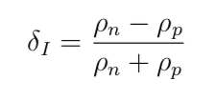
Results – Central Densities
<Isospin ratio>

Slide 12
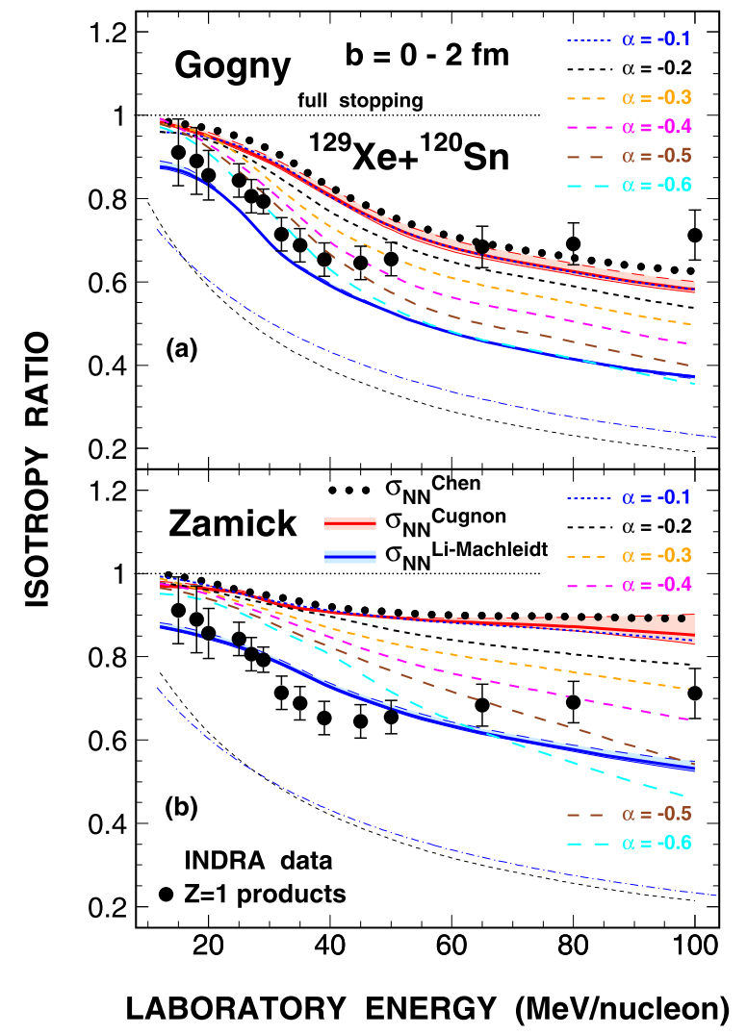
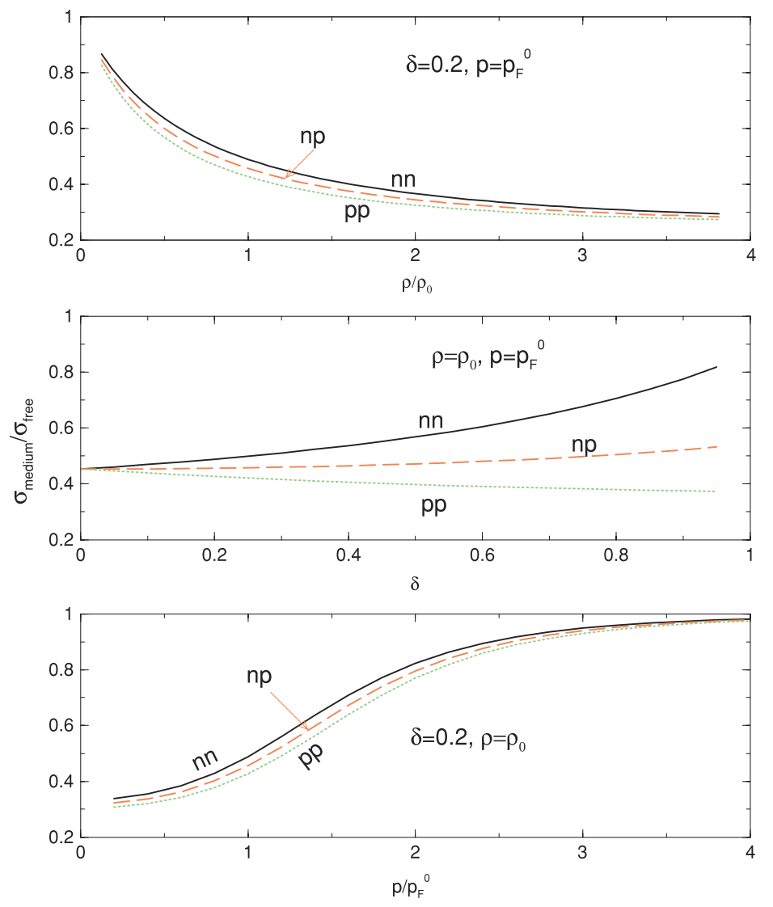
NN Cross Section in Medium
Z. Basrak, P. Eudes, and V. de la Mota
PRC 93, 054609 (2016)
L.Chen and B.Li PRC 72, 064611 (2005)

Slide 13
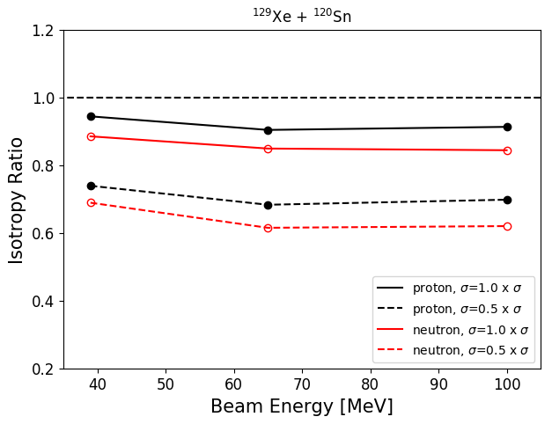
Results – Cross-Section Dependence

Slide 14
Summary
We investigate the energy-based isotropy ratios of protons and neutrons in ¹²⁹Xe+¹²⁰Sn with our QMD code.
These ratios have a dependence of symmetry energy.
As well as the potential, the in-medium NN cross-section gives large effect on the ratio.

Slide 15
Thank you for your attention!!

