Slide 1
The Symmetry Energy of Low Density Nuclear Matter
K. Hagel
8th International Symposium on Nuclear Symmetry Energy
Busan, South Korea
10-Sep-2018

Slide 2
Symmetry Energy
Characterizes the dependence of nuclear binding energy on neutron/proton
asymmetry
Governs phenomenon from nuclear structure to astrophysical processes.
Fundamental ingredient in the investigation of exotic nuclei, heavy-ion collisions and astrophysical phenomena.
Fundamental ingredient of the nuclear EOS.
Heavy-ion collisions allow the study the EOS of asymmetric matter under controlled laboratory conditions.
$$δ=\frac{N−Z}{A}=\frac{ρ_{n}−ρ_{p}}{ρ}$$
$$E\left(ρ,δ,T\right)= E_{0}\left(ρ,T\right)+ E_{sym}\left(ρ,T\right)δ^{2}+O(δ^{4})$$

Slide 3
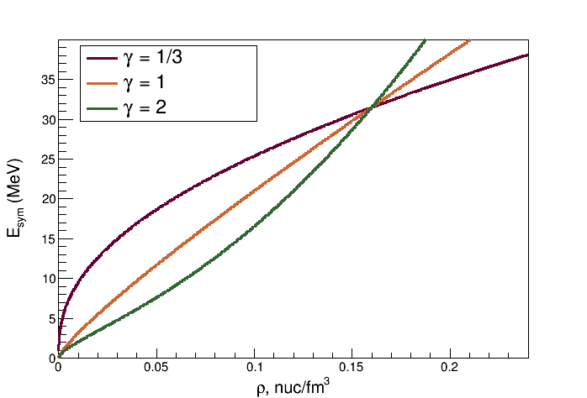
Dependence on Nuclear Density
Normal density nuclear matter
Symmetry energy results primarily from binding energies of nuclei.
Bethe-Weizsacher mass formula → $E\left(ρ_{0},0\right)=$28-34 MeV
Low density nuclear matter
Change resulting from additional binding of symmetric matter due to formation of clusters.
$$E_{sym}\left(ρ\right)=\frac{C_{s,k}}{2}{\left(\frac{ρ}{ρ_{0}}\right)}^{2/3}+\frac{C_{s,p}}{2}{\left(\frac{ρ}{ρ_{0}}\right)}^{γ}$$

Slide 4
Low Density Nuclear Matter
Correlations and cluster formation are essential and have to be taken into account.
Cluster formation dominates structure of low density symmetric matter in low temperature limit.
Cluster formation increases the symmetry energy at very low densities
Important in modeling of core collapse supernovae
Most of the recently used treatments do not give the correct low-density limit that is governed by cluster formation
Mean-field approaches cannot describe the quantum state of matter at low densities because correlations are neglected.
Skyrme interaction
Relativistic mean-field (RMF) approximation
Fail to give correct low temperature low density limit
Correct low density limit recovered only if formation of clusters properly accounted for.
Quantum Statistical models that include in-medium effects
Include clusters in a virial expansion.

Slide 5
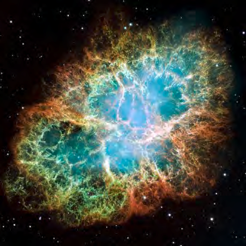
Crab Nebula, HST Image
Supernova
Mass: 4.6 ± 1.8 M☉ ($\sim$9.2x10³⁰kg)
V⊥
TLF
PLF
Nuclear Reaction from
Heavy Ion Collision
IV
IV Source femtonova
~ ½v_{p}
~v_{p}
V‖
Mass: 20-30 amu ($\sim$3.3x10⁻²⁶ kg)

Slide 6
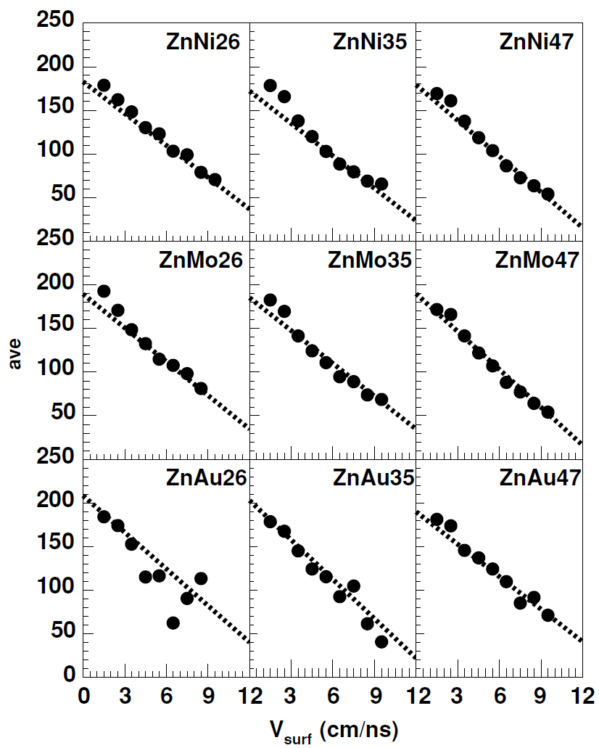
Experiment Analysis
47 MeV/u Ar + ^{112,124}Sn
Select the most violent collisions
Identify the femtonova
Intermediate velocity source
nucleon-nucleon collisions early in the reaction
Choose light particles at 45º because moving source fits suggest that most products at that angle originate from that source.
Use coalescence analysis to estimate density
Temperature from Albergo model
Time scale from velocity of products from intermediate velocity source
t_{avg}, fm/c
v_{surf}, cm/ns
PRC 72 (2005) 024603

Slide 7
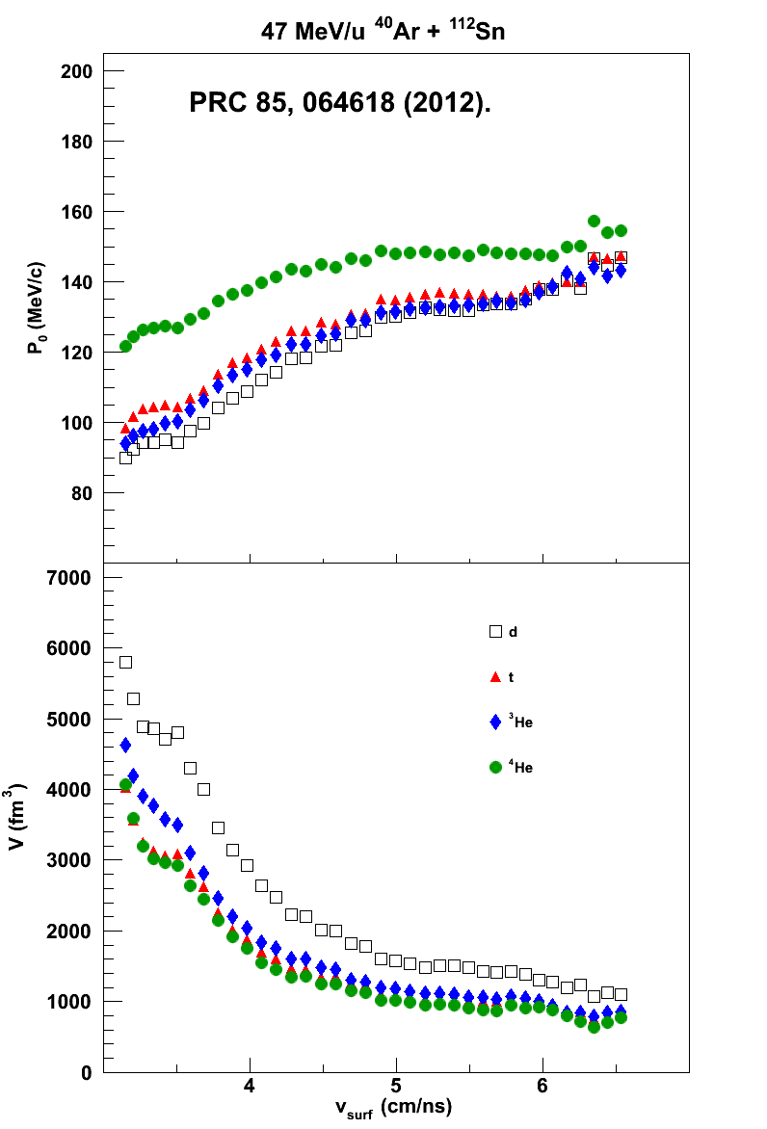
Coalescence Parameters
Awes et al., PRC 24, 89 (1981).
$$\frac{d^{3}N(Z,N)}{dp^{3}}∝R_{np}^{N}f(P_{0}){\left[\frac{d^{3}N(1,0)}{dp^{3}}\right]}^{A}$$
$$\frac{d^{3}N(Z,N,E_{A})}{dE_{A}dΩ}=R_{np}^{N}\frac{A^{−1}}{N!Z!}{\left\{\frac{\frac{4π}{3}P_{0}^{3}}{{\left[2m^{3}\left(E−E_{c}\right)\right]}^{1/2}}\right\}}^{A−1}{\left[\frac{d^{3}N(1,0,E)}{dEdΩ}\right]}^{A}$$
Mekjian et al., PRC 17, 1051 (1978).
$$\frac{d^{3}N(Z,N)}{dp^{3}}=R_{np}^{N}\frac{A^{3}\left(2s+1\right)e^{\left(E_{0}/T\right)}}{2^{A}}{\left(\frac{h^{3}}{V}\right)}^{A−1}{\left[\frac{d^{3}N(1,0)}{dp^{3}}\right]}^{A}$$
$$V= {\left[\left(\frac{Z!N!A^{3}}{2^{A}}\right)\left(2s+1\right)e^{\left(E_{0}/T\right)}\right]}^{\frac{1}{A−1}}\frac{3h^{3}}{4πP_{0}^{3}}$$

Slide 8
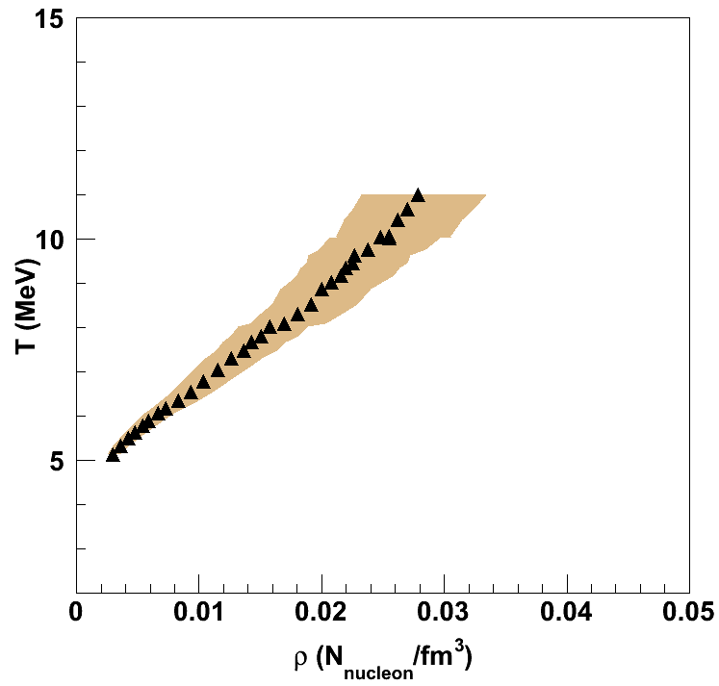
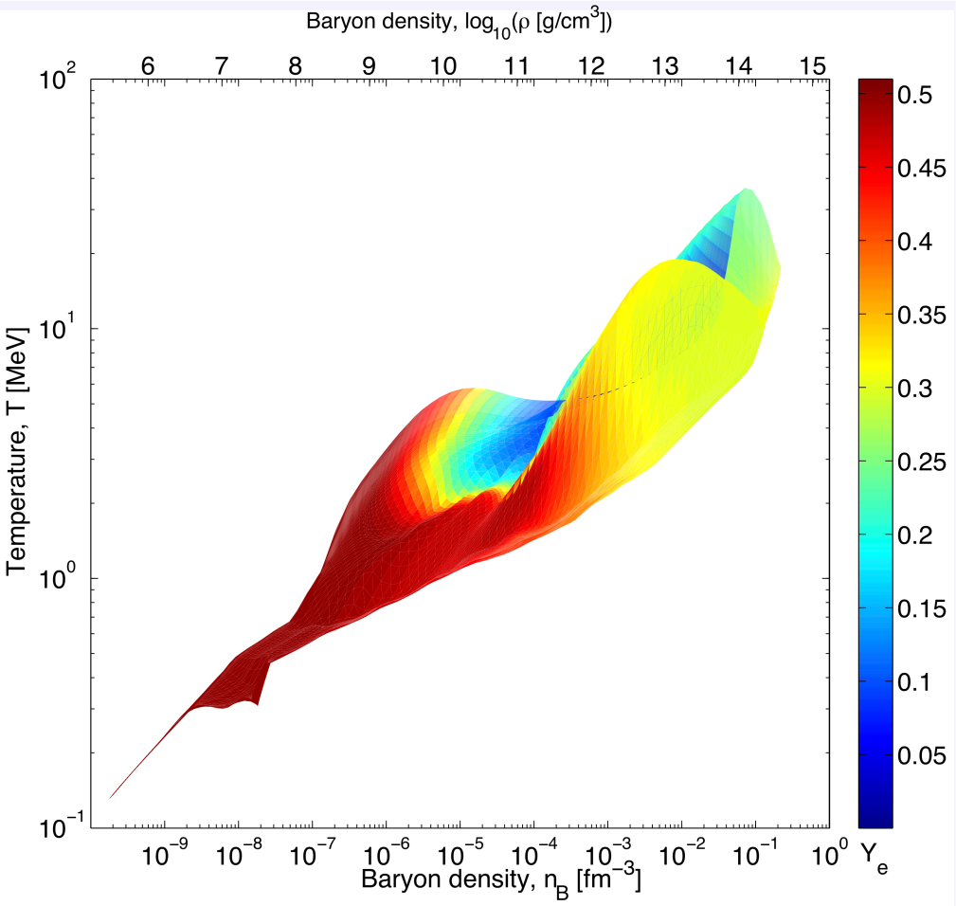
Temperatures and Densities
Recall v_{surf} vs time calculation
System starts hot and expands as it cools
47 MeV/u ⁴⁰Ar + ¹¹²Sn
Core collapse supernova simulation
←
Time
T. Fischer et al., ApJS 194, 39 (2011)

Slide 9
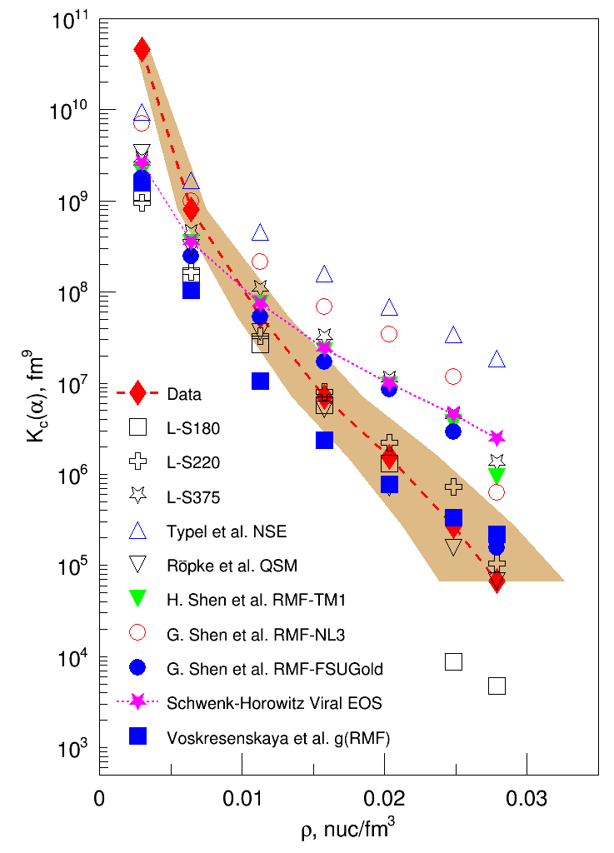
α Equilibrium constant model predictions
Models converge at lowest densities, but are significantly below data
Lattimer & Swesty with K=180, 220 show best agreement with data
QSM with p-dependent in-medium binding energy shifts
PRL 108 (2012) 172701.

Slide 10
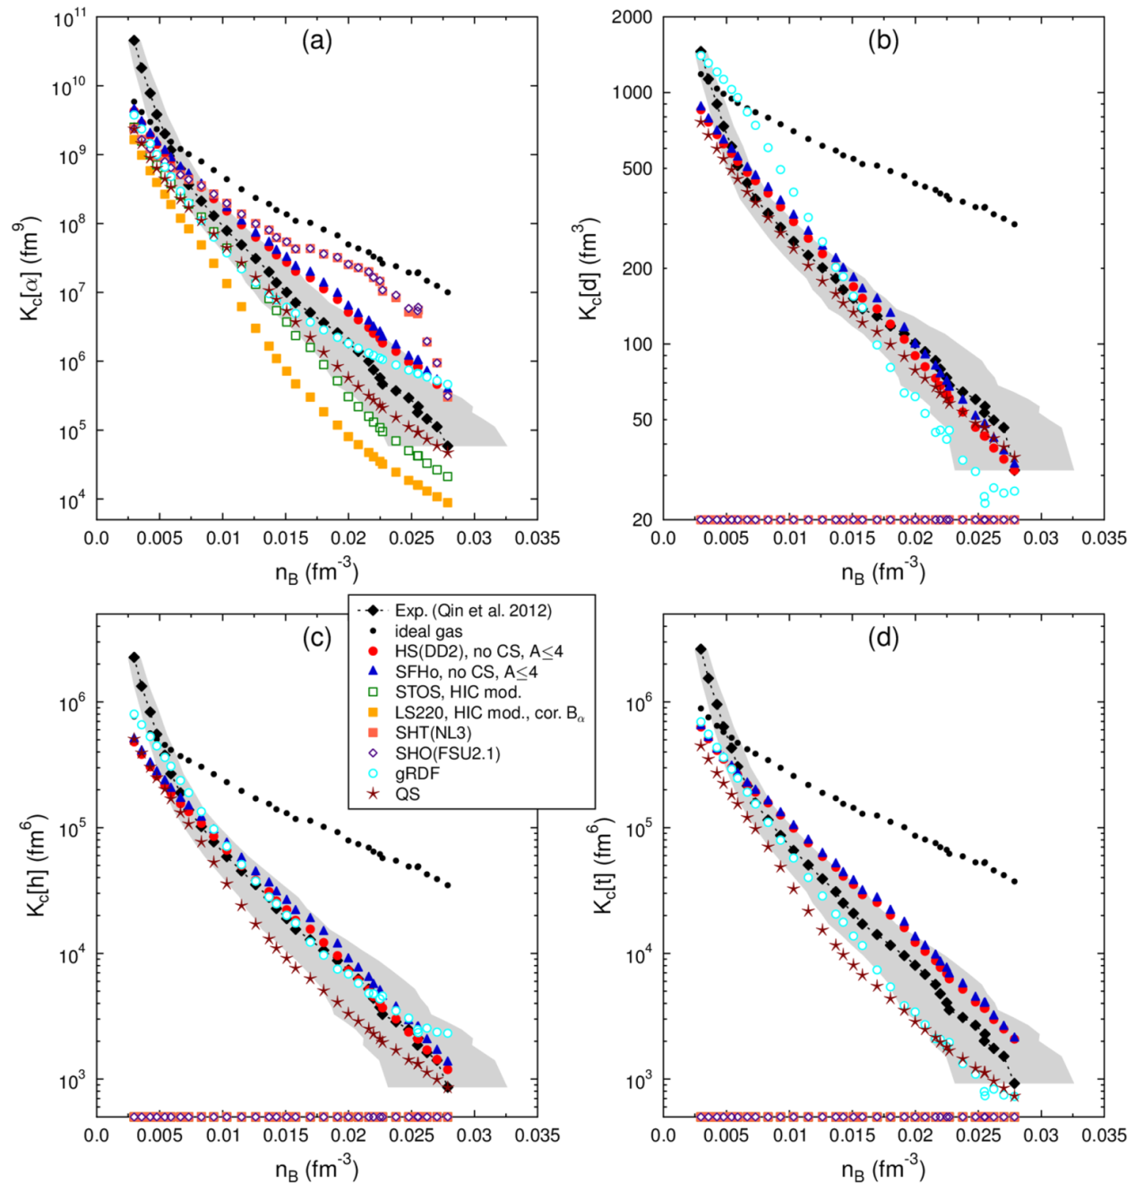
Comparison of all models together
⁴He
d
Two groups of calculations
n, p, α calculations which predict K_{eq}(α), but cannot predict other species.
Models with n, p, d, t, ³He, α
Low densities
All K_{eq}(α) converge to ideal gas
They are below experimental data which result from the very late stages of the reaction
Models that treat all light particles are generally within error bars
³He
t
Phys. Rev. C 91, 045805 (2015).

Slide 11
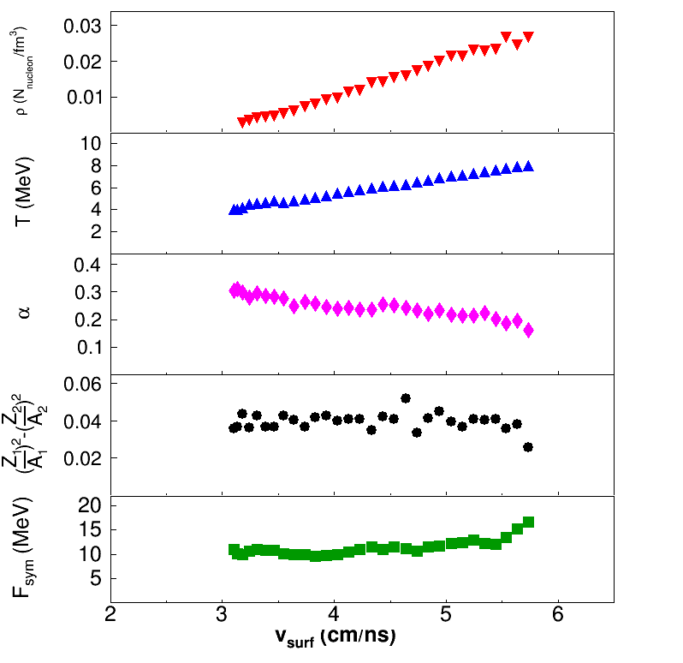
Isoscaling parameters
$$T_{HHe}=\frac{14.3}{ln\left(\sqrt{9/8}\left(1.59R_{v_{surf}}\right)\right)}$$
$$\frac{Y_{1}}{Y_{2}}=Ce^{αN+βZ}$$
$$α=\frac{4F_{sym}}{T}\left[{\left(\frac{Z_{1}}{A_{1}}\right)}^{2}−{\left(\frac{Z_{2}}{A_{2}}\right)}^{2}\right]$$
T, ρ increase with v_{surf}
Decrease in α with v_{surf}
F_{sym} extracted for light particles (liquid)

Slide 12
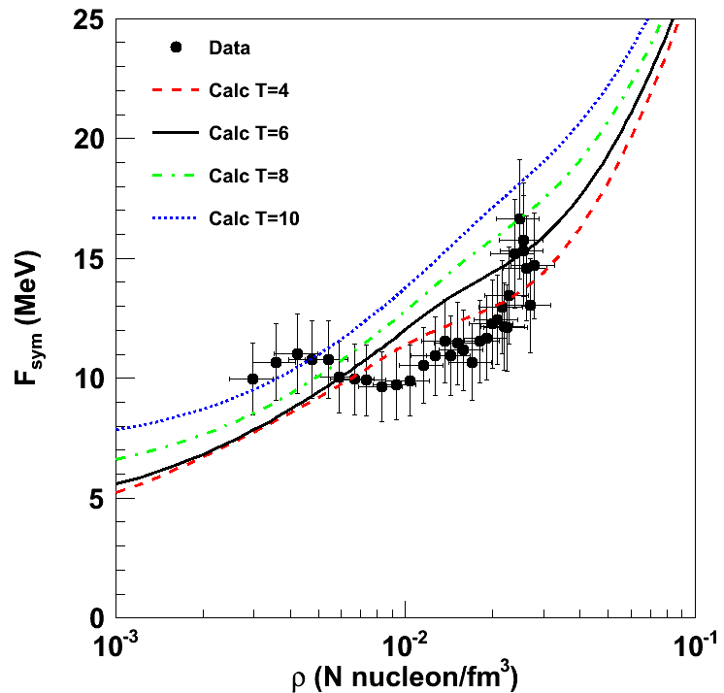
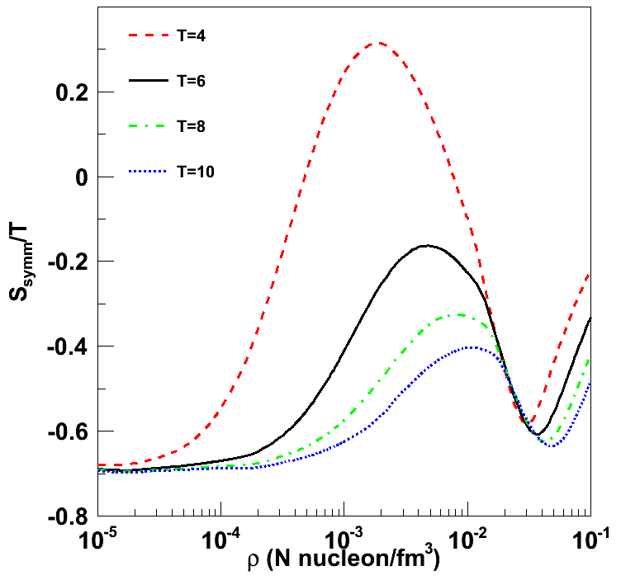
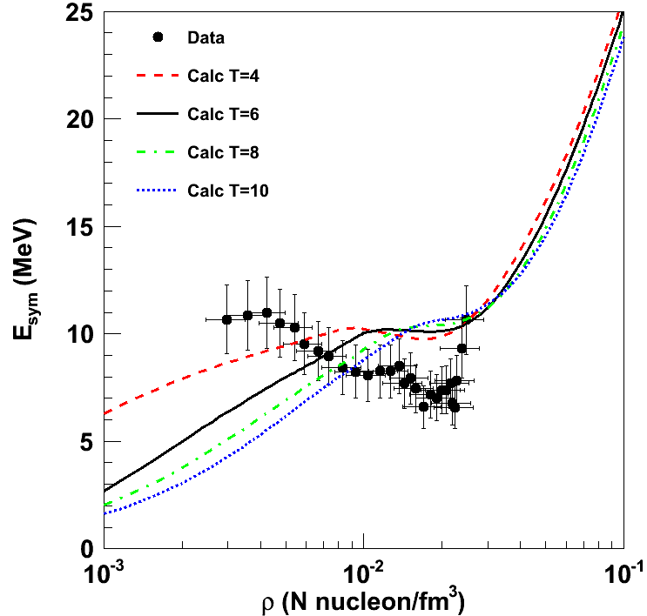
Symmetry energy
S. Typel et al., Phys. Rev. C 81, 015803 (2010).
Symmetry Free Energy
T is changing as ρ increases
Isotherms of QS calculation that includes in-medium modifications to cluster binding energies
Entropy calculation (QS approach)
Symmetry energy (E_{sym} = F_{sym} + T∙S_{sym})

Slide 13
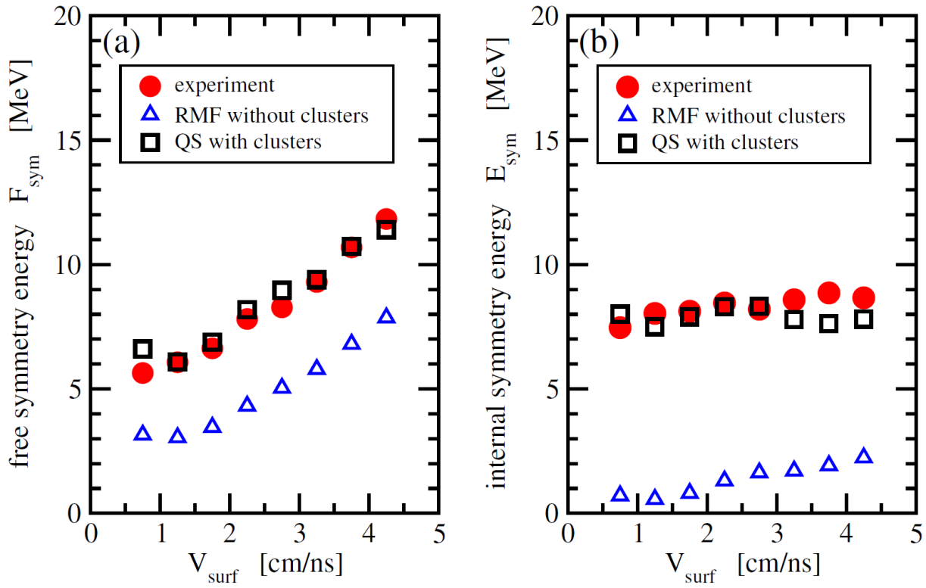
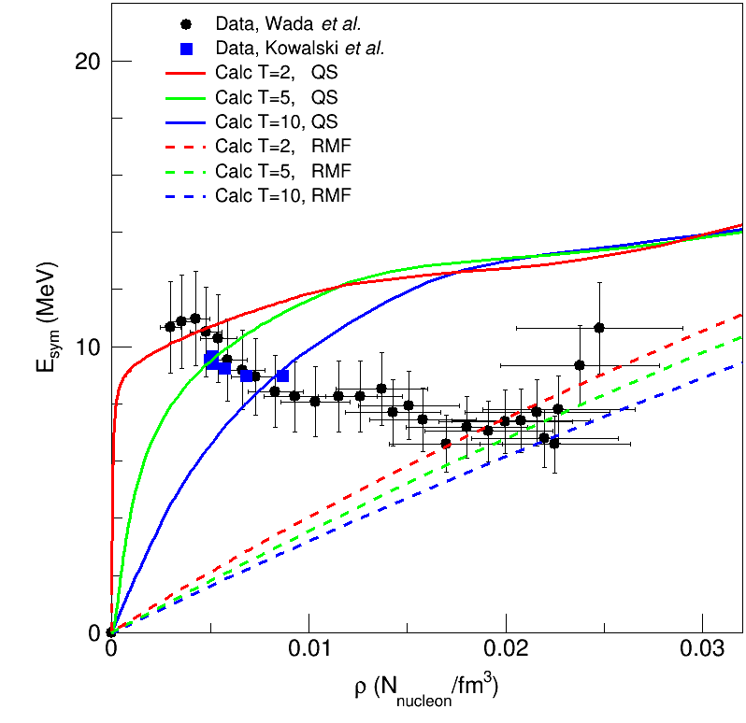
Comparison with QS and RMF
PRL 104 202501 (2010)
EJPA 50 39 (2014)
QS model shows better agreement with data.
Medium-dependent cluster formation necessary ingredient in theoretical models reproduce low-density dependence of the symmetry energy observed in experiments.

Slide 14
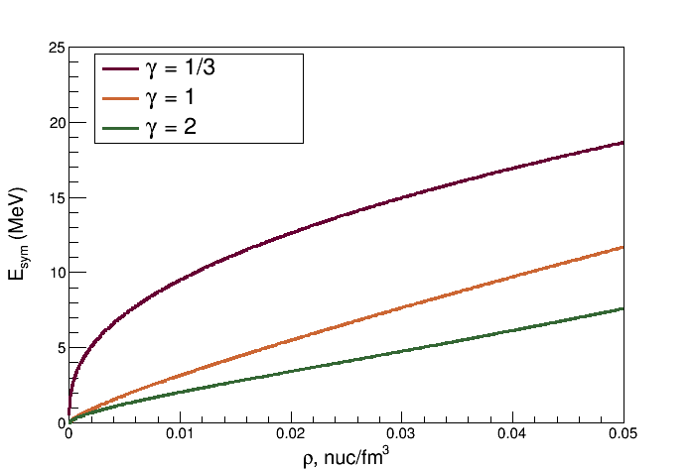
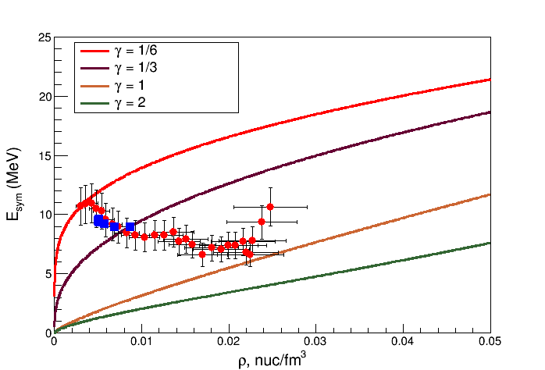
Symmetry Energy EOS

Slide 15
Summary
Low Density Nuclear Matter
Coalescense analysis
$0.003< ρ<0.03$ is sampled
Equilibrium constants
Constraints on model calculations
Models that treat in-medium effects fit the data better
Soft EOS is suggested
Density dependence of symmetry energy at low density
Symmetry free energy → Symmetry Energy
Models that treat clusters properly (Quantum Statistical) describe data
Account for in-medium effects

Slide 16
Outlook
Explore isospin degree of freedom of different quantities on the density dependence at low densities.
Light ION Guide at TAMU Cyclotron being commissioned.
Use RIB with Upgraded NIMROD to explore dependencies on y_{p}
Should be able to reach 0.39 < y_{p} < 0.46

Slide 17
Collaborators
L. Qin, K. Hagel, R. Wada, J. B. Natowitz, S. Shlomo,
Bonasera, G. Röpke, S. Typel, Z. Chen, M. Huang,
J. Wang, H. Zheng, S. Kowalski, M. Barbui,
M. R. D. Rodrigues, K. Schmidt, D. Fabris, M. Lunardon,
S. Moretto, G. Nebbia, S. Pesente, V. Rizzi, G. Viesti,
M. Cinausero, G. Prete, T. Keutgen, Y. El Masri,
Z. Majka, and Y. G. Ma,

