Slide 1
High Intensity Positron Sources for Circular Colliders (SuperKEKB, FCC-ee)
A_RD_13 2019:
Yoshinori Enomoto (Accelerator Laboratory, KEK)
On befalf of collaborators:
I. Chaikovska, R. Chehab, H. Guler,
T. Suwada, T. Kamitani, M. Satoh, F. Miyahara, Y. Seimiya, H. Sugimura and K. Furukawa

Slide 2
Outline
Introduction
Positron source
Relationship
Timing
Comparison between FCC-ee and SuperKEKB
Role sharing
Positron source setup for SuperKEKB
Status of SuperKEKB positron source
Activity in FY2018 and FY2019
Summary

Slide 3
Introduction 1 - positron source
Positron source is critical component of the future linear or circular collider.
To achieve higher luminosity, higher beam intensity is required.
e+ are produced within large 6D phase space value (e+/e- pairs produced in a target-converter).
Thermo-mechanical effects in the target limit the e+ source intensity (sophisticated targets and cooling systems).
e+ produced are transported and transferred to the DR with their phase space characteristics (transport and injection at high 6D emittance).
Positron source
e- gun
Linac
target
capture section
Linac
Damping Ring

Slide 4
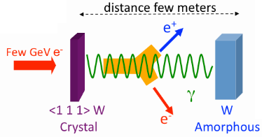
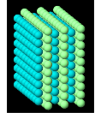
Introduction 2 – relationship
LAL / IPNL and KEK have a long-standing collaboration on the positron source.
KEK electron positron injector LINAC has keep producing positrons since 1980’s (TRISTAN, KEKB, SuperKEKB), and collaboration started at the beginning.
For last several years, noble target, such as hybrid target and granular target, are actively studied in our collaboration.

Slide 5
Introduction 3 - timing
Design of the positron source for FCC-ee project have started recently.
LAL team takes the responsibility of the total positron source design not only the target but capture section and beam transportation etc.
SuperKEKB commissioning are on going
Phase 1: 2016 (successful)
Phase 2: 2018 (successful)
Phase 3: 2019 (ongoing)
Positron source is about 50% of designed spec.
There are several point to be improved.
It’s time to strengthen and expand the collaboration!!

Slide 6
Introduction 4 – comparison between FCC-ee and SuperKEKB
FCC-ee adopt same method, similar but slightly ambitious parameters.
→SuperKEKB positron source is the best step toward FCC-ee positron source.

Slide 7
Introduction 5 – role sharing
What KEK can offer
What LAL can offer
●Take part in the SuperKEKB commissioning and test process.
●Data analysis.
●Start to end simulations.
・improve the performance of the
SuperKEKB positron source.
・design/optimization of the
FCC-ee positron source.
●New ideas
・Hybrid source with compact/bulk
or granular converter.
●Experiments using world’s highest intensity positron source in operation.
・test new ideas.
・validate simulation results. ●experimental data will be fed back to simulation parameters.
●Gain operational experiences.
・beam commissioning.
・radiation damage.
・kinds of troubles.

Slide 8
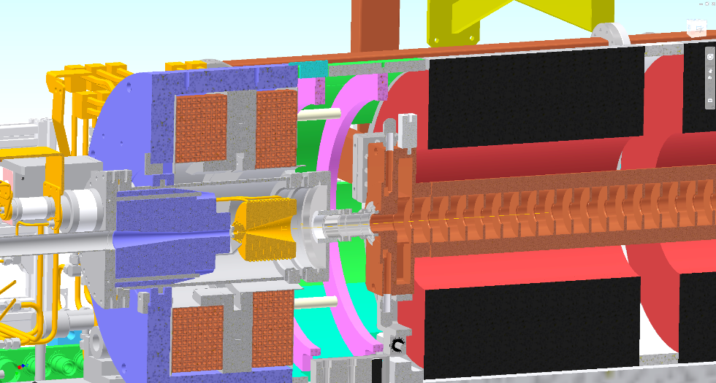
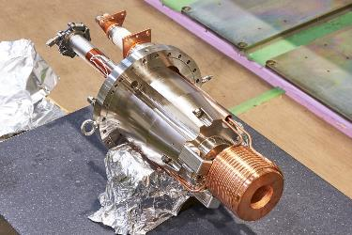
Positron source setup for SuperKEKB
FC head + BC + target = FC assembly
BC (bridge coil)
LAS (large aperture S-band)
target
FC(flux concentrator) head
solenoid

Slide 9
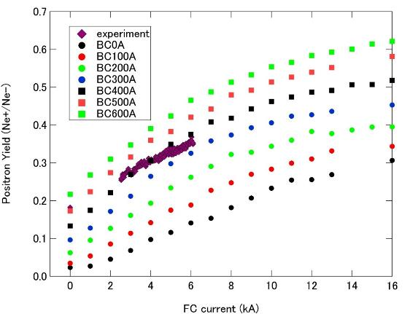
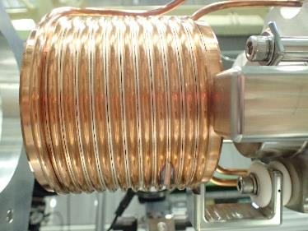
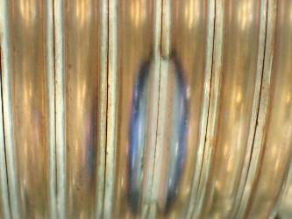
Status of the SuperKEKB positron source
Simulation by F. Miyahara
design
Positron Yield=SP_16_5_Q/SP_15_T_Q
design
FC current is limited by 50% of the designed value
due to discharge between gap

Slide 10
Activity in FY2018
Dr. I. Chaikovska and Dr. Y. Han visit KEK and stayed for two weeks in Feb. 2019.
Visit test facility of positron source in KEK
Presentation in accelerator seminar on 15 Feb.
FCC positron source
Simulation of the Hybrid positron target

Slide 11
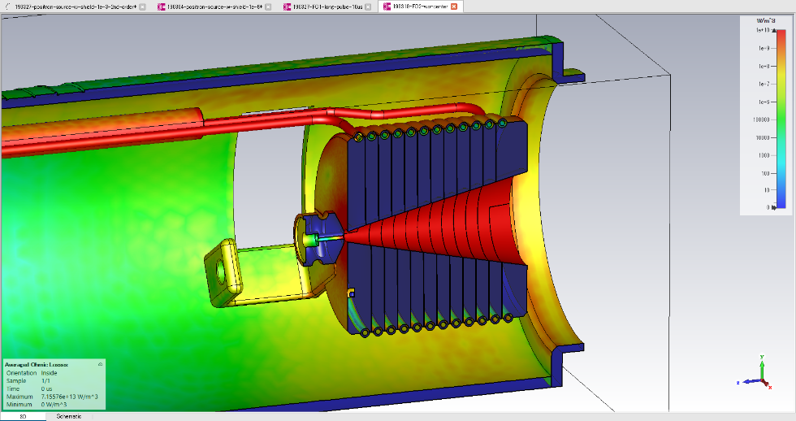
Activity in FY2018
Detailed Simulation started in full swing
Simulation results and models will be shared

Slide 12
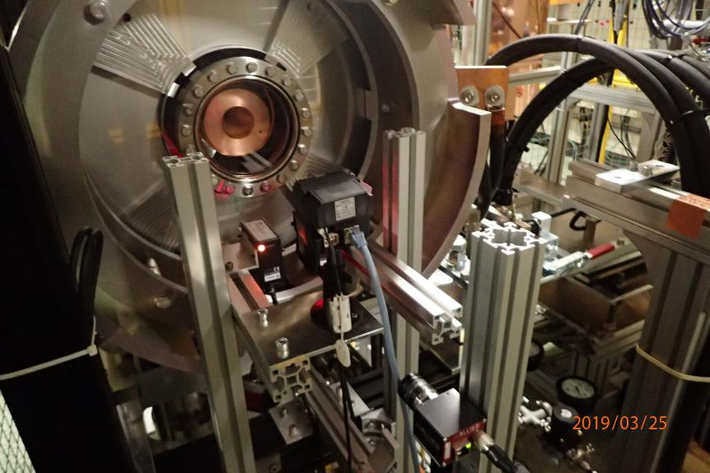
Activity in FY2018
New test facility for positron source got in operation.
Simulation method and results are validated by the experiments

Slide 13
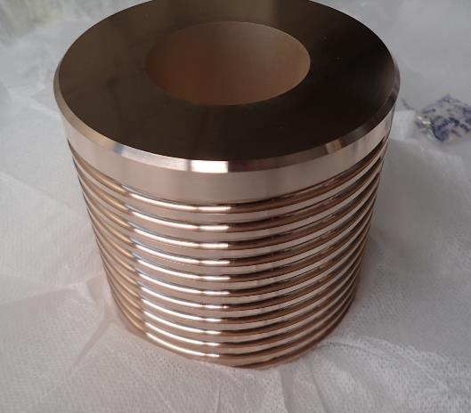
Activity in FY2018
FC head made of NC50 Cu alloy
Cu Alloy material for FC head is evaluated
x40
Stronger material is required to keep gap in FC
against pulsed magnetic force

Slide 14
Activity in FY2019
A new posdoc will join LAL group from June 2019.
Y. Enomoto will visit LAL and attend FCC week in June 2019
LAL group will visit KEK and join operation exchange work of positron source etc.

Slide 15
Activity beyond FJPPL
Two researchers from IHEP visit KEK in Feb 2019
They are in charge of design of the CEPC positron source.
Collaboration with ILC positron source group
Join weekly meeting in KEK
Present recent status about SuperKEKB positron source in Asian linear collider workshop 2018
KEK/LAL collaboration is going to be the core of the high energy positron source in the world.
FJPPL
IHEP
CEPC
KEK
ILC
KEK
SuperKEKB
LAL
FCCee

Slide 16
Summary
Design of FCC-ee positron source and commissioning of SuperKEKB positron source are ongoing.
It’s best time to collaborate for both of us.
Collaboration between KEK and LAL makes it possible for us to accelerate the development of positron sources.
Mutual feed back between experiment and simulation is expected.
Still there are many things to do for positron source of SuperKEKB.
Final performance of the FCC-ee positron source will definitely benefit from the lessons learned during the SuperKEKB commissioning and operation.
Practical and engineering aspect of the new positron source will be more robust through the experiences of the operation of the present source.

Slide 17
Back up

Slide 18
Activity in FY2019
FC head made of NC50 Cu alloy
A new FC head is in production,
will be delivered in this summer,
will be tested at test facility,
and will be installed in this autumn.

Slide 19
x2.25
1/25
x50 more positron injection is required
→increase bunch charge x4
→increase duty and rep. rate

Slide 20
Positron source setup for Super KEKB 1
Positron target and capture section

Slide 21
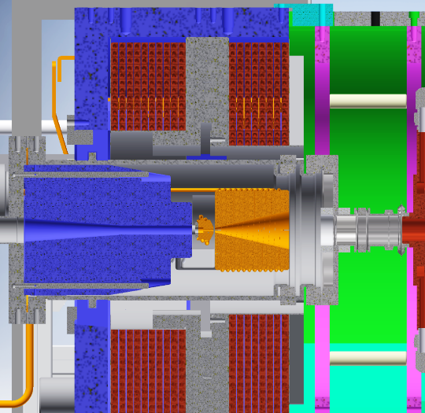
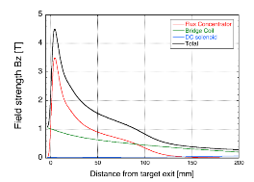
Positron source setup for SuperKEKB 4
How the FC works?
Bridge coil
DC magnet
I = 600～750 A
e⁻
Flux Concentrator
pulsed magnet
I = 6000～12000A
target
e⁺
Electron hit small point of the target.
Positron comes from small spot.
Angle distribution is large.
Calculated by T. Kamitani
target
e⁺
Adiabatically expand position distribution.
Angle distribution decrease.
Matched to the aperture of the following LAS.
Ratio B @ target / B @ entrance of the LAS is important
stronger field is preferred in the following solenoid section
much stronger field is required @ target

Slide 22
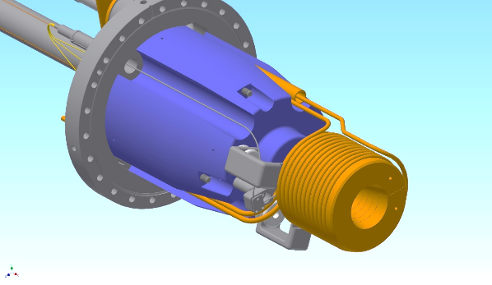
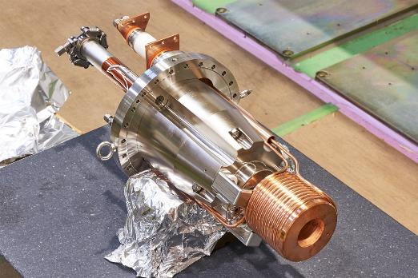
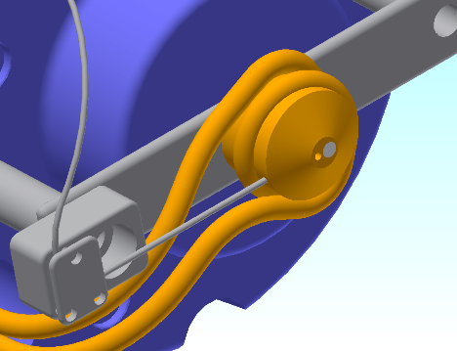
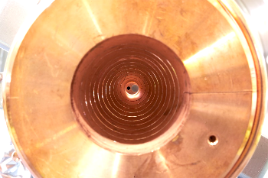
Positron source setup for SuperKEKB 3
beam
W target
Φ2 mm hole for electron
Temp sensor
Cooling water pipe

