Slide 1
Study of phase structure of nuclear matter based on a parity doublet mode
Masayasu Harada (Nagoya University)
＠NuSYM2018
(Busan, KOREA, September 12, 2018)
Based on
Y. Motohiro, Y. Kim and M. Harada, Phys. Rev. C 92, 025201 (2015) Erratum: Phys. Rev. C 95, 059903 (2017).
Y. Takeda, Y. Kim and M. Harada, Phys. Rev. C 97, no. 6, 065202 (2018).
Y. Takeda, H. Abuki and M. Harada, Phys. Rev. D 97, no. 9, 094032 (2018).
Notes:
I will summarize our recent studies on the phase structure of nuclear matter based on a parity doublet structure. In the former half, I will show our recent study on the phase structure of dense hadronic matter including Delta(1232) as well as N(939) based on the work done in Ref.[1]. Our results show that, in symmetric matter, Delta enters into matter in the density region of about one to four times normal nuclear matter density. In the latter half, I will show our study on the dual chiral density wave (DCDW) in nuclear matter based on the work done in Ref.[2], where we find, in addition to the ordinary DCDW phase where the space average of the chiral condensate vanishes, a new DCDW phase with a nonvanishing space average. [1] Y. Takeda, Y. Kim and M. Harada, Phys. Rev. C 97, no. 6, 065202 (2018). [2] Y. Takeda, H. Abuki and M. Harada, Phys. Rev. D 97, no. 9, 094032 (2018).

Slide 2
1. Introduction
Notes:
[going] Let me start introduction of my talk by

Slide 3
Spontaneous chiral symmetry breaking
chiral symmetry broken phase
at vacuum
chiral symmetric phase
at high T and/or density
The spontaneous chiral symmetry breaking is expected to generate a part of hadron masses.
It causes mass difference between chiral partners.
Changing T and/or density will cause some change of hadron masses.
Notes:
[coming] saying that the spontaneous chiral symmetry breaking is one of the most important properties in the low energy hadron physics.
As some of you know, the existence of non-zero chiral condensates is the origin of the spontaneous chiral symmetry breaking.
This spontaneous chiral symmetry breaking is expected to generate a part of hadron masses, and also causes mass difference between chiral partners. We expect that changing temperature or density will cause some change of hadron masses.
[going]
Then,

Slide 4

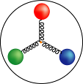
Phase diagram of Quark-Gluon system
high
temperature
Early
Universe
Quark-Gluon Plasma Phase
Chiral Symmetry Restration
Deconfinement of Quarks
1 trillion
kelvin
Hadron Phase
Spontaneous Chiral Symmetry Breaking
Confinement of Quarks
RIBF
RAON
Neutron Star
Normal Nuclei
High density
100 million ton/cm³
Notes:
[coming]
it is interesting to study this phase structure of hot and dense QCD.
In these days, I have been mainly studying this high density region.
I think that studying high density region is important for physics studied in RAON in Korea.

Slide 5
Outline
In this talk, I will summarize our recent study of phase structure of high density nuclear matter using hadronic models based on the parity doublet structure:
  N*(1535) is included as the chiral partner to N(939)
  Δ(1232) is included with its chiral partner Δ(1700)
Introduction
Nuclear Matter constructed from a parity doublet model
Effect of Δ(1232) to the chiral symmetry breaking in a parity doublet model
Study of Dual Chiral Density Wave in a parity doublet model
Summary
Notes:
In this talk, I will summarize our recent study of phase structure of high density nuclear matter using hadronic models based on parity doublet structure. In our model, N*(1535) is included as the chiral partner to ordinary nucleon, and the Delta baryon is included with its chiral partner.
This is the outline of my talk.
I finished brief introduction. Next, I will explain how the nuclear matter is constructed from our parity doublet model, Then, I will show our result on the study of effect of Delta baryon to the chiral symmetry breaking. In this section, I will briefly show our recent result on the study of dual chiral density wave. Finally, I will give a short summary.

Slide 6
2. Nuclear Matter constructed from a parity doublet model
Y. Motohiro, Y.Kim, M.Harada, Phys. Rev. C 92, 025201 (2015); Erattum: Phys. Rev. C 95, 059903 (2017).
Notes:
OK. Let me explain our parity model.

Slide 7

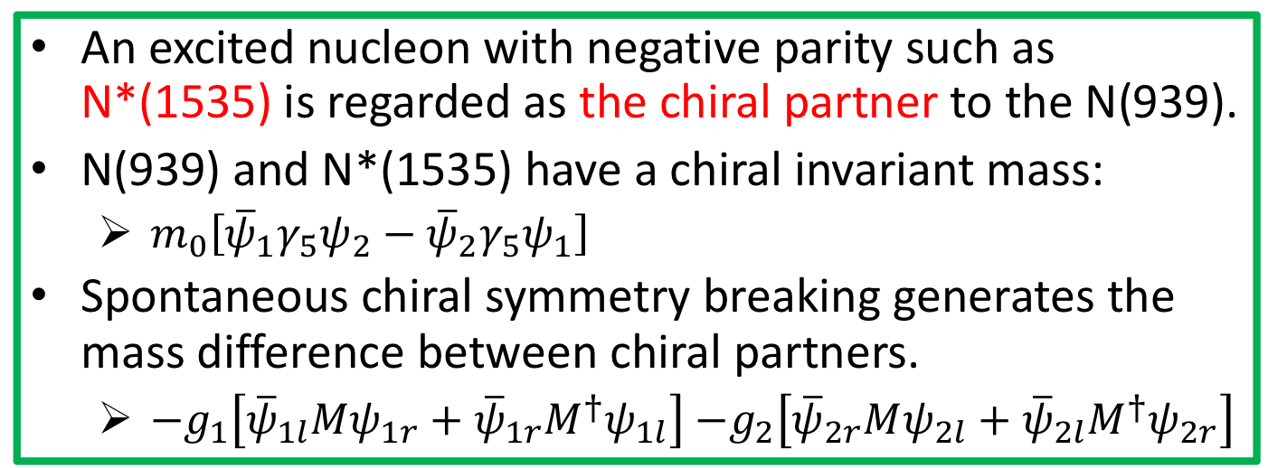
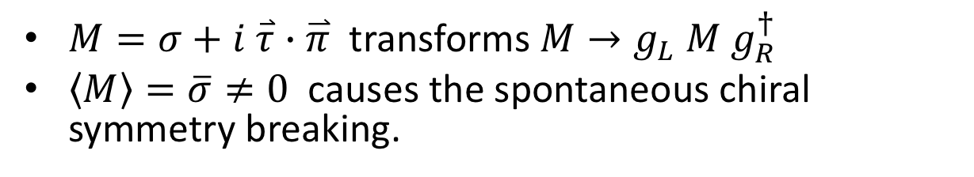
Parity Doublet Model
C.DeTar, T.Kunihiro, PRD39, 2805 (1989)
D.Jido, M.Oka, A.Hosaka, PTP106, 873 (2001)
An excited nucleon with negative parity such as N*(1535) is regarded as the chiral partner to the N(939).
N(939) and N*(1535) have a chiral invariant mass:
  $m_{0}\left[{\overline{ψ}}_{1}γ_{5}ψ_{2}−{\overline{ψ}}_{2}γ_{5}ψ_{1}\right]$
Spontaneous chiral symmetry breaking generates the mass difference between chiral partners.
  $−g_{1}\left[{\overline{ψ}}_{1l}Mψ_{1r}+{\overline{ψ}}_{1r}M^{†}ψ_{1l}\right]$ $−g_{2}\left[{\overline{ψ}}_{2r}Mψ_{2l}+{\overline{ψ}}_{2l}M^{†}ψ_{2r}\right]$
$M=σ+i \overset{⃑}{τ}∙\overset{⃑}{π}$ transforms $M→g_{L} M g_{R}^{†}$
$\left\langle M\right\rangle =\overline{σ}≠0$ causes the spontaneous chiral symmetry breaking.
Notes:
The parity doublet model is first introduced by Detar and Kunihiro in 1989. In this model, an excited nucleon with negative parity such as N*(1535) is regarded as the chiral partner to the N(939).
One of the interesting points is that these nucleons have a chiral invariant mass, m0. Here please note that this m0 term is invariant under the chiral symmetry transformation. Then the spontaneous chiral symmetry breaking generates the mass difference between chiral partners.
This is the formula for the masses.
[go]

Slide 8
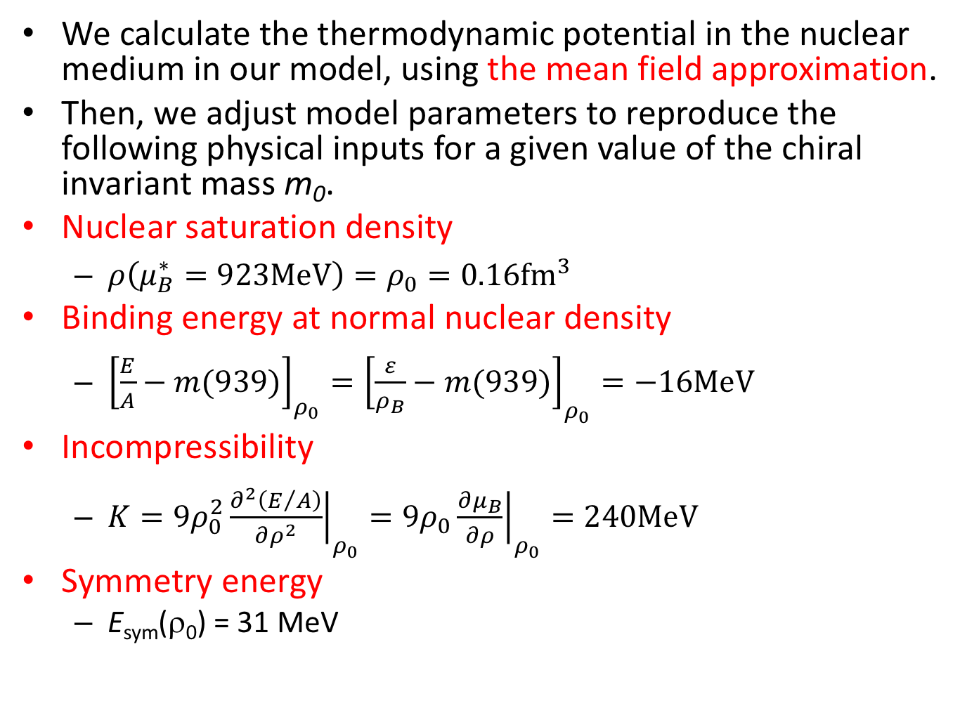
Nuclear Matter from Parity Doublet Model
We calculate the thermodynamic potential in the nuclear medium in our model, using the mean field approximation.
Then, we adjust model parameters to reproduce the following physical inputs for a given value of the chiral invariant mass m₀.
Nuclear saturation density
  ${ρ\left(μ_{B}^{∗}=923\text{MeV}\right)=ρ}_{0}=0.16{\text{fm}}^{3}$
Binding energy at normal nuclear density
  ${\left[\frac{E}{A}−m(939)\right]}_{ρ_{0}}={\left[\frac{ε}{ρ_{B}}−m(939)\right]}_{ρ_{0}}=−16\text{MeV}$
Incompressibility
  $K=9ρ_{0}^{2}{\left.\frac{∂^{2}\left(E/A\right)}{∂ρ^{2}}\right|}_{ρ_{0}}=9ρ_{0}{\left.\frac{∂μ_{B}}{∂ρ}\right|}_{ρ_{0}}=240\text{MeV}$
Symmetry energy
  E_{sym}(ρ₀) = 31 MeV
Notes:
Now, we calculate the thermodynamic potential in the nuclear medium in our model, using the mean field approximation.
Then, we adjust determine model parameters to reproduce these physical values for a given value of the chiral invariant mass m0.
This is the nuclear saturation density, and we use this value as an input. We also use the binding energy, the incompressibility and the symmetry energy at normal nuclear matter as an input.

Slide 9
3. Effect of Δ(1232) to the chiral symmetry breaking in a parity doublet model
Y. Takeda, Y. Kim and M. Harada, Phys. Rev. C 97, no. 6, 065202 (2018).
Notes:
Next, let me show our result on the study of effect of Delta baryon to the chiral symmetry breaking.

Slide 10
Chiral Partner Structure of Delta
D.Jido, T.Hatsuda, T.Kunihiro, PRL84, 3252 (2000)
D.Jido, M.Oka, A.Hosaka, PTP106, 873 (2001)
Δ(1232) and Δ(1700) are regarded as chiral partners.
We regard m_{Δ0} as a parameter.
We use masses of Δ(1232) and Δ(1700) as inputs to determine the values of g_{Δ1} and g_{Δ2} for a given value of m_{Δ0}.
We study dependence of our results on the value of m_{Δ0}.
Notes:
In our analysis, we adopted a chiral partner structure for Delta baryon following these papers. In these papers, this Delta baryon and Delta(1700) are regarded as chiral partners, and their masses are written in these forms. Here, this m0Delta is the chiral invariant mass for delta baryons, and these g1-bar and g2-bar are Yukawa couplings of Delta baryons to sigma meson. In our analysis, we regard the chiral invariant mass of Delta baryon as a parameter. Then, we use masses of these two delta baryons as inputs to determine the values of these two Yukawa couplings for a given value of the chiral invariant mass. Then, we study dependence of our results on the value of the chiral invariant mass.

Slide 11
Phase structure & Density
m_{N0} = 500 MeV
g_{ωΔΔ} = g_{ωNN}
Phase structure
N liquid-gas coexistence
stable N phase
coexistence of Delta-N matter and nuclear matter
stable N-Delta matter
stable N-Delta, N(1535) matter
stable N-Delta, N(1535), Delta(1700) matter
Stable N-N(1535) matter
1
2
3
4
ρ_{B}/ρ₀
m_{Δ0} = 550 MeV
Baryon Density vs. ρ_{B}
ρ_{N}/ρ₀
ρ_{N(1535)}/ρ₀
ρ_{Δ}/ρ₀
1
2
3
4
ρ_{B}/ρ₀
Notes:
(phase) This is a typical example of phase structure when the chiral invariant mass of nucleon is 500 MeV and the omega coupling to Delta is set to be equal to the nucleon coupling.
Here, the horizontal axis shows the baryon number density scaled by the normal nuclear density, and the vertical axis shows the value of the chiral invariant mass of Delta in unit of MeV. There are several phases in this figure. For explaining a typical phase structure, let me pick up the case where the chiral invariant mass for Delta is 550 MeV.
This figure (density) shows the densities of baryons against the baryon number density. Here both the horizontal and vertical axes show the baryon number density scaled by the normal nuclear matter density. The red curve shows the density of nucleon, the blue curve shows the Delta density, and the green curve shows the density of N*(1535), and the pink curve the density of Delta(1700).
First, this figure (density) shows that only nucleon exists when the baryon number density is smaller than the normal nuclear matter density. As is well known, the pressure in this region is negative, so we call this region the ``N liquid-gas coexistence'', which is indicated by the red area in this figure for phase structure.
When the nucleon density is between the normal nuclear density and about 1.7 times of the normal nuclear density, the ordinary nuclear matter exists and we call this region the ``stable N phase'' indicated by the green area in this phase structure.
At this point (density), the Delta baryon enters into matter, and both the nucleon and Delta exist in matter in higher density region. We checked this matter is stable, so that we call this the “stable N-Delta matter” as indicated by cyan region in this phase diagram.
It is interesting that, in the density region of about 2.5 times of normal nuclear density indicated by this black area, N*(1535) enters into matter, which is a reflection of the partial restoration of chiral symmetry accelerated by Delta matter. Furthermore, in this yellow region, Delta(1700) also enters.

Slide 12
Chiral Condensate
m_{N0} 500 MeV = m_{Δ0} = 550 MeV; g_{ωΔΔ} = g_{ωNN}
With Delta
Without Delta
N*(1535) enters at μ_{B} ~ 1300 MeV
= first order chiral phase transition
Chiral phase transition (cross-over)
at μ_{B} ~ 1950 MeV
= Chiral symmetry restoration
is delayed by Δ matter
Delta matter appears (μ_{B} ~ 1050 MeV)
= Partial restoration of chiral symmetry
is accelerated by Δ matter
Catalysis of partial chiral symmetry restoration by Delta matter
This is not a chiral phase transition.
Notes:
This plot shows the density dependence of the chiral condensate sigma. Here, the horizontal axis shows the baryon number chemical potential and the vertical axis shows the value of the chiral condensate. This blue curve is obtained with Delta baryons and this red curve is without Delta.
The blue curve shows a kink at mu_B equals 1050 MeV, where Delta enters into the matter. This shows that the partial restoration of chiral symmetry is accelerated by Delta matter.
For the red curve, N*(1535) enters at mu_B ~ 1300 MeV, which is identified with the first order chiral phase transition.
For the blue curve, on the other hand, the chiral phase transition is cross-over transition which occurs here (mu_B ~1950 MeV). This implies that the critical chemical potential is increased when the existence of Delta is considered. In other word, the chiral symmetry restoration itself is delayed by Delta matter.

Slide 13
Symmetry Energy
m_{N0} = 500 MeV; g_{ωΔΔ} = g_{ωNN} ; g_{ρΔΔ} = g_{ρNN}
m_{Δ0} = 500 , 550 , 590 MeV
The symmetry energy suddenly changes its value around the density where Delta enters into the matter.
Notes:
Let me show our prediction of the symmetry energy. Here, the red curve is for the chiral invariant mass of Delta equal 500 MeV, and this green curve is for 550 MeV, and the blue curve is for 590 MeV. This figure shows that the symmetry energy suddenly changes its value around the density where Delta enters the matter.

Slide 14
4. Study of Dual Chiral Density Wave in a parity doublet model
Y. Takeda, H. Abuki and M. Harada, Phys. Rev. D 97, no. 9, 094032 (2018).
Notes:
Next, let me show our recent study of dual chiral density wave in a parity doublet model.

Slide 15
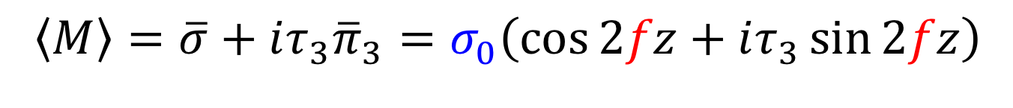
Dual Chiral Density Wave in NJL model
E.Nakano and T.Tatsumi, PRD71, 114006 (2005)
$$\left\langle M\right\rangle =\overline{σ}+iτ_{3}{\overline{π}}_{3}=σ_{0}\left(\cos{2fz}+iτ_{3}\sin{2fz}\right)$$
z
Notes:
Thirteen years ago, using the Nambu-Jona-Lasinio model, these people found a new phase called the dual chiral density wave, which is characterized by the existence of this type of condensate. Here the direction of the vacuum depends on the position. Namely, at this point sigma field is condensed while at this position the neutral pion field is condensed.

Slide 16

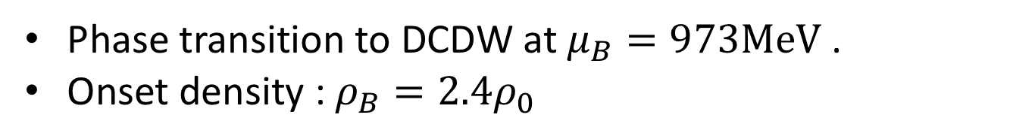


DCDW in a Parity Doublet Model
A.Heinz, F.Giacosa, D.H.Rischke, NPA933, 34 (2015)
$$\left\langle M\right\rangle =\overline{σ}+iτ_{3}{\overline{π}}_{3}=σ_{0}\left(\cos{2fz}+iτ_{3}\sin{2fz}\right)$$
$$σ_{0}$$
$$f$$
DCDW
Phase transition to DCDW at $μ_{B}=973\text{MeV}$ .
Onset density : $ρ_{B}=2.4ρ_{0}$
Note: This may be related to half-Skyrmion phase.
M.Harada, H.K.Lee, Y.L.Ma, M.Rho, PRD91, 096011 (2015)
Notes:
About three years ago, these people used a model with parity doublet structure and showed that the chiral density wave exists in high density nuclear matter. They showed that the phase transition occurs at muB equals to 973 MeV, and the onset density is about 2.4 times of normal nuclear density.

Slide 17
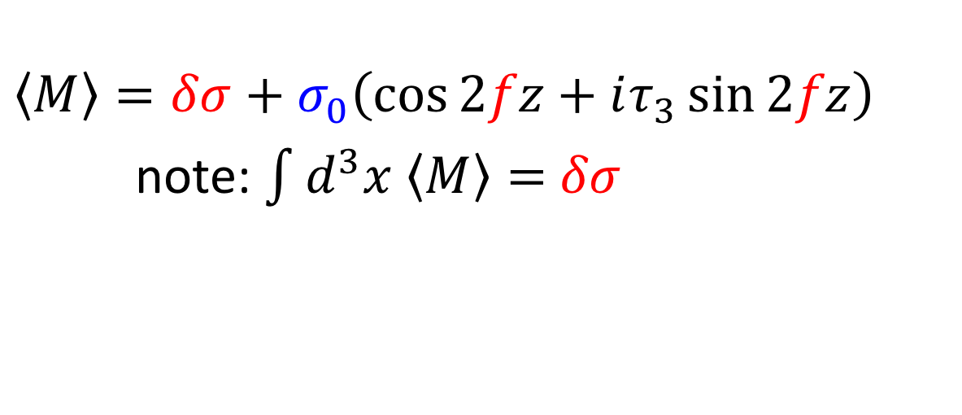
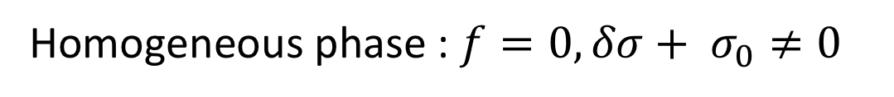
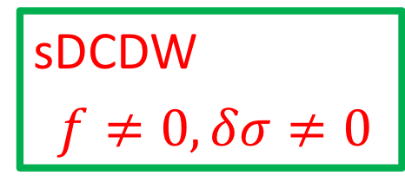
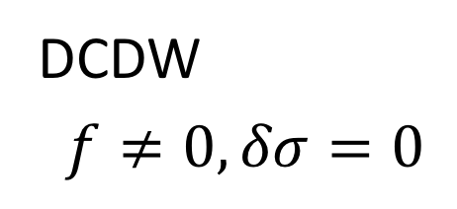
shifted DCDW (sDCDW)
Y.Takeda, H.Abuki, M.Harada, PRD97, 094032 (2018)
$$\left\langle M\right\rangle ={δσ+σ}_{0}\left(\cos{2fz}+iτ_{3}\sin{2fz}\right)$$
note: $\int{d^{3}x \left\langle M\right\rangle =}$ $δσ$
Homogeneous phase : $f=0, δσ+ σ_{0}≠0$
DCDW
$f≠0, δσ=0$
sDCDW
$f≠0, δσ≠0$
Notes:
Quite recently, we used the parity doublet model and found a new phase, which we named shifted DCDW phase.
This shifted DCDW phase is characterized by the existence of this delta-sigma term in the condensate. This implies that the space average of condensate is non-zero, while it vanishes in the ordinary DCDW phase. This is the phase diagram we obtained. Here the horizontal axis shows the baryon number chemical potential, and the vertical axis shows the chiral invariant mass of nucleon. Our result shows that the shifted DCDW phase exists in this low density region.

Slide 18
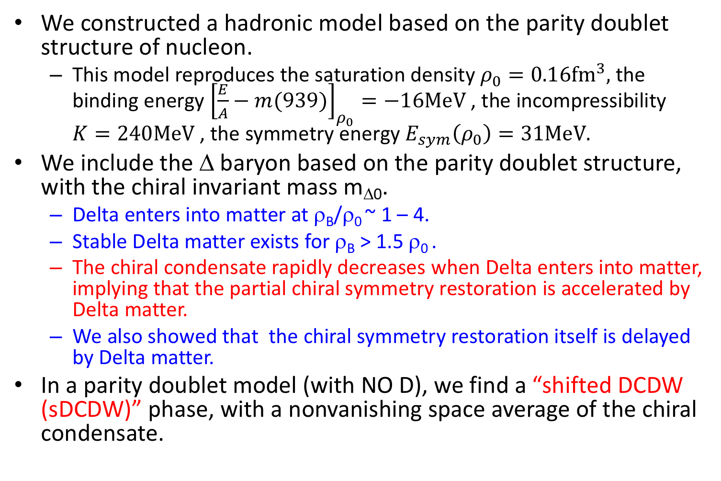
5. Summary
We constructed a hadronic model based on the parity doublet structure of nucleon.
  This model reproduces the saturation density $ρ_{0}=0.16{\text{fm}}^{3},$the binding energy ${\left[\frac{E}{A}−m(939)\right]}_{ρ_{0}}=−16\text{MeV}$, the incompressibility $K=240\text{MeV}$, the symmetry energy $E_{sym}\left(ρ_{0}\right)=31\text{MeV}.$
We include the Δ baryon based on the parity doublet structure, with the chiral invariant mass m_{Δ0}.
  Delta enters into matter at ρ_{B}/ρ₀ ~ 1 – 4.
  Stable Delta matter exists for ρ_{B} > 1.5 ρ₀ .
  The chiral condensate rapidly decreases when Delta enters into matter, implying that the partial chiral symmetry restoration is accelerated by Delta matter.
  We also showed that the chiral symmetry restoration itself is delayed by Delta matter.
In a parity doublet model (with NO D), we find a “shifted DCDW (sDCDW)” phase, with a nonvanishing space average of the chiral condensate.

Slide 19
The End
Notes:
Thank you very much for your patience.

Slide 20
of Hadrons
?
Origin of Mass
of Us
=
One of the Interesting problems of QCD
Notes:
[coming] asking this question, namely, what is the origin of mass ?
Of course, the answer depends on the people who I ask.
[1] Here, to be more specific, I would say what is the origin of mass of hadrons,
[2] or what is the origin of mass of us.
[3] I think that this is one of the interesting problems of QCD,
[going]
This question is closely related to

Slide 21
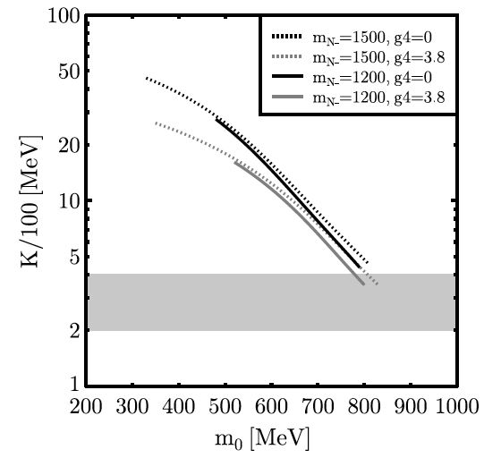
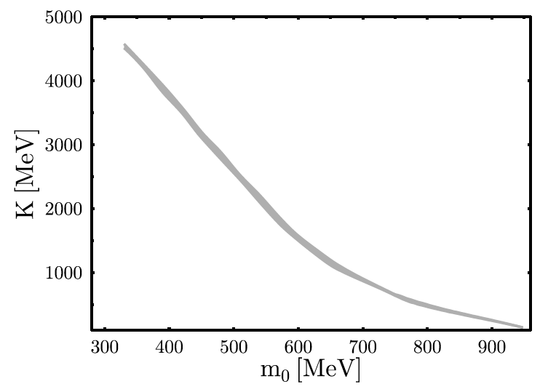
Nuclear matter in parity doublet models
A parity doublet model including omega meson with 4-point interaction is used in a Walecka-type mean field analysis.
  Large value of m₀ is needed to reproduce the incompressibility.
Rho meson is further included with 4-point interaction.
  m₀ > 800 MeV is needed to have 100 < K < 400 MeV
In our analysis [Y.Motohiro, Y.Kim, M.Harada, Phys. Rev. C 92, 025201 (2015)], we construct a model with a 6-point interaction of sigma, but without 4-point interaction for vector mesons.
Our results show that K = 240 MeV is reproduced for m₀ = 500 - 900 MeV.
D.Zschiesche et al., PRC75, 055202 (2007)
V.Dexheimer et al., PRC77, 025803 (2008)
Notes:
[coming] some analysis of nuclear matter in parity doublet models preferred large value of the chiral invariant mass.
Actually, there are several studies of the nuclear matter using parity doublet models.
In this paper, they use a parity doublet model including the omega meson with four-point interaction. They showed that large value of m0 is needed to reproduce the incompressibility.
In this paper, rho meson is further included with four-point interaction. They also showed that large m0 is needed to get a reasonable value for the incompressibility.
[click]
In our analysis in this paper, we constructed a model, in which this value of incompressibility is reproduced for a wide range of the chiral invariant mass.

Slide 22
Density Dependence of Mean fields
〈σ〉 (MeV)
m_{N0} = 500, 700 MeV
m_{N0} = 700 MeV
m_{N0} = 500 MeV
ρ_{B}/ρ₀
ρ_{B}/ρ₀
I will use m_{N0} = 700 MeV as a typical example.
Notes:
Here, let me show density dependences of mean fields.
This left figure shows the density dependence of the chiral condensate sigma. Here the horizontal axis shows the baryon number density divided by the normal nuclear matter density, while the vertical axis shows the value of the condensate in unit of MeV. This red curve is for m0 = 500 MeV, while this blue curve is for m0 = 700 MeV.
This right figure shows the density dependence of the omega mean field. In our model, this mean field is simply proportional to the baryon number density, so that this is actually straight line.
In the following I will use m0 = 700 MeV as a typical example. In this case, the value of sigma mean field becomes about 70 % of the vacuum value.
[go]

Slide 23
Phase diagram
Critical μ_{B} for chiral phase transition is smaller for smaller m₀.
  Yukawa couplings of σ to nucleons are larger for smaller m₀.
Notes:
These two graphs show the phase diagrams for m0 = 500 MeV and 900 MeV.
Solid line shows the first order phase transition, and the dotted line shows the cross-over. This table shows that the critical values of the baryon chemical potential at zero temperature. This (mu_Blg^c) shows the critical chemical potential for the liquid-gas phase transition and this (rho_Blg^c) shows the corresponding density. Since we used these values of inputs, these do not depend on m0. This (mu_B-chi^c) shows the critical chemical potential for the chiral phase transition, and this (rho_B-chi^c) shows the corresponding density. As you can see, the critical chemical potential for the chital phase transition is smaller for smaller value of the chiral invariant mass m0. This is because the Yukawa couplings of sigma to nucleons are larger for smaller m0.

Slide 24
Determination of the parameters at vacuum
Masses of parity eigenstates
Determination of parameters at vacuum (D.Jido et al., PTP106, 873 (2001))
  Inputs : m₊ = 939 MeV, m₋ = 1535 MeV, σ₀ = f_{π} = 93 MeV, and g_{πN+N-} = 0.7 obtained from Γ_{N*→πN} = 75 MeV.
  Outputs : m₀ = 270 MeV , g₁ = 9.8 , g₂ = 16 .
Global fit in an extended model (S.Gallas et al., PRD82, 014004 (2010) ) shows m₀ = 460 +- 136 MeV.
Notes:
[coming] This is the formula for masses of positive and negative parity baryons in the parity doublet model.
In this paper, using two masses of baryons, the pion decay constant and this N-star to pi-N decay, the authors determined the model parameters.
The result shows that the chiral invariant mass is small.
On the other hand, this paper uses an extended version of the model and estimated the chiral invariant mass of about a half of the nucleon mass.
These show that the analysis done in vacuum seems to prefer rather small value of the chiral invariant mass.
[going] On the other hand,

Slide 25
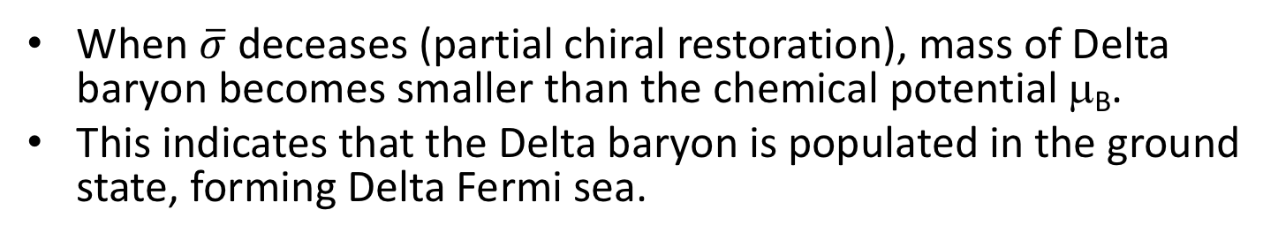
Effective masses vs. Chemical potential
m_{N0} = m_{D0} = 500 MeV
m_{N0} = m_{D0} = 700 MeV
g_{ωΔΔ} = g_{ωNN}
g_{ωΔΔ} = 0.5 g_{ωNN}
μ_{B}
μ_{B}
1
ρ_{B}/ρ₀
2
3
2
ρ_{B}/ρ₀
4
6
When $\overline{σ}$ deceases (partial chiral restoration), mass of Delta baryon becomes smaller than the chemical potential μ_{B}.
This indicates that the Delta baryon is populated in the ground state, forming Delta Fermi sea.
Delta Matter ?
Notes:
Let me show the density dependence of the effective masses together with the baryon number chemical potential.
In the left panel, both the chiral invariant masses for nucleon and Delta are taken as 500 MeV, and in the right panel they are taken as 700 MeV.
Here the horizontal axis shows the baryon number density scaled by the normal nuclear matter density, and the vertical axis shows the values of masses in unit of MeV.
These red curves show the mass of Delta when the value of omega-Delta-Delta coupling is set to be same as omega-N-N coupling, while the blue curves show the mass when the value of omega-Delta-Delta coupling is half of the value of omega-N-N coupling.
Please note that these pink curves show the density dependence of the baryon chemical potential mu_B.
Then, these figures show that the effective mass of Delta becomes smaller than the baryon chemical potential when the baryon number density is about 2 or 3 times of the normal nuclear matter density. This indicate that the Delta baryon is populated in the ground state, forming Delta Fermi sea.

Slide 26
Pressure, Density, Phase structure
Pressure vs. μ_{B}
m_{N0} = 500 MeV, m_{Δ0} = 550 MeV
g_{ωΔΔ} = g_{ωNN}
number Density vs. ρ_{B}
μ_{B}
ρ_{N}/ρ₀
850
900
950
1000
1050
ρ_{N(1535)}/ρ₀
ρ_{Δ}/ρ₀
m_{Δ0}
Phase structure
1
2
3
4
ρ_{B}/ρ₀
N liquid-gas coexistence
stable N phase
coexistence of Delta-N matter and nuclear matter
stable N-Delta matter
stable N-Delta, N(1535) matter
stable N-Delta, N(1535), Delta(1700) matter
Stable N-N(1535) matter
1
2
3
4
ρ_{B}/ρ₀
Notes:
Here, let me show typical examples of pressure, density and phase structure for this parameter choice of the chiral invariant masses and couplings to omega meson.
This shows the resultant relation between the pressure and the chemical potential muB. Here the horizontal axis shows the chemical potential in unit of MeV, and the vertical axis shows the pressure. in unit of MeV fm^(-3).
Since the stationary condition for the mean field of sigma is non-linear, we often have a few solutions for a given baryon chemical potential with fixed parameters. Then, there exist a few values of pressure for a given chemical potential. According to the thermodynamic stability, the state with largest pressure should be realized, and the state with smaller pressure is unstable.
This figure (density) shows the densities of nucleon, Delta, N*(1535) and Delta(1700) against the baryon number density, which is given as sum of these four densities. Here both the horizontal and vertical axes show the baryon number density scaled by the normal nuclear matter density. The red curve shows the density of nucleon, the blue curve shows the Delta density, and the green curve shows the density of N*(1535) (scaled by the normal nuclear matter density).
This figure (phase) shows the phase structure. Here, the horizontal axis shows the baryon number density scaled by the normal nuclear matter density, and the vertical axis shows the value of the chiral invariant mass of Delta in unit of MeV.
First, this figure (density) shows that only nucleon exists when the baryon number density is smaller than the normal nuclear matter density. Since the pressure in this region is negative, we call this region the ``N liquid-gas coexistence'', which is indicated by the red area in this figure for phase structure.
When the pressure increases along the curve from the point D to G in this figure, the nucleon density increases from the normal nuclear density to about 2.7 times of the normal nuclear density as shown in this figure. Here the ordinary nuclear matter exists and we call this region the ``stable N phase'' indicated by the green area in this phase structure.
Along the curve from G to E, there is a solution in which the nucleon density keeps increasing. This corresponds to the baryon density from 2.7 to 3.4 times of the normal nuclear matter density in this figure (density). In this region we have another solution having larger pressure for the same value of the chemical potential along the curve GH. Then, the region between G and E is not energetically favored. Along the curve from E to G through F, the Delta baryon appears in matter as in this figure (density). This region is also unfavored since we have another solution having the larger pressure for the same value of the chemical potential along DG. We call this region (2.7-4) the ``coexistence of Delta-N matter and nuclear matter'' indicated by the blue area in this figure (phase).
At the point G in this figure (pressure), there is a solution (rho_B/rho_0 ~ 4), at which both the nucleon and Delta exist in matter. At the point H (rho_B/rho_0 ~ 4.2), N*(1535) also enters into the matter as can be seen in this figure (density). Between the points G and H, there is a stable matter including the Delta baryon and the nucleon, which we call the ``stable N-Delta matter'' indicated by cyan region in this figure (phase).
In this figure (phase), I show a summary of phase structure. This shows that, when the chiral invariant mass of Delta is 500 MeV, the red region for ``coexistence of Delta-N matter and nuclear matter’’ exists in the wide density region smaller than 4 times of the normal nuclear matter density. This implies the non-existence of normal nuclear matter, and so this parameter choice is excluded. When the chiral invariant mass of Delta is larger than 500 MeV, on the other hand, there exists the liquid-gas phase transition of ordinary nuclear matter at normal nuclear matter density from the ``nucleon liquid-gas coexistence'' indicated by red area to the ``stable N matter'' by the green area.
When the chiral invariant mass of Delta is 510 MeV, the “coexistence of Delta-N matter and nuclear matter” starts at 1.2 times of normal nuclear matter density. The onset density of the appearance of Delta increases with increasing chiral invariant mass of Delta when the chiral invariant mass is smaller than 600 MeV. For these values of the chiral invariant mass, the ``stable N-Delta phase'' indicated by cyan area appears at about 4 times of the normal nuclear matter density, independently of the value of the chiral invariant mass. This implies that the first order phase transition occurs from the “stable N matter” to the “stable Delta-N matter”. On the other hand, when the chiral invariant mass of Delta is larger than 600 MeV, the “stable N matter” by green area is smoothly connected to the “stable N-Delta matter” indicated by cyan area.
It is interesting that, in this high density region (rho_B/rho_0 ~ 4.2 – 4.5) indicated by black area, N*(1535) enters into matter, which is a reflection of the partial restoration of chiral symmetry accelerated by Delta matter. Furthermore, in this yellow region, Delta(1700) also enters. I will investigate these point later in detail.

Slide 27
Relation to chiral limit (m_{π}=0)
We take m_{π} = 0 with keeping other parameters intact.
Liquid-gas phase transition
Appearance of Δ matter
m_{π} = 140MeV
Chiral phase transition
(cross-over)
With Delta
Without Delta
m_{π} = 0
Chiral restoration
Chiral phase transition
(1st order)
Notes:
Here, to check that the small bump here (around mu_B ~ 1140 MeV) implies the cross-over chiral phase transition, we investigated the phase structure in the chiral limit where the pion mass at vacuum is set to be zero by hand. This left panel shows the plot.
Here, the red curve is without Delta, and the blue curve is with Delta. The red curve jumps here (muB ~ 970 MeV), which corresponds to the first order chiral phase transition. The blue curve jumps here (muB ~ 930 MeV) and here (muB ~ 1070). Since the sigma vanishes here (muB ~ 1070 MeV), the first order chiral phase transition occurs at this point. The first order transition at this point (muB ~ 930) just indicates the appearance of Delta matter.
[click]
To show that the first order chiral phase transition at this point (muB ~ 1070 in the left panel) is connected to the crossover at this point (muB~1140 in right panel), we studied the chiral condensate sigma with changing the pion mass. This figure shows the resultant chiral phase structure. Here the horizontal axis shows the value of the chemical potential and the vertical axis shows the value of the pion mass. This shows that the first order chiral phase transition (pink solid curve) at this point (m_pi = 0, muB ~ 1070) is actually connected to the cross-over transition at this point (m_pi = 140, mu_B ~ 1140). Furthermore, two critical chemical potentials for the ordinary liquid-gas phase transition indicated by red curve and the appearance of Delta matter by green curve also increase when the pion mass is increased.

Slide 28
Pressure
symmetric matter
m_{N0} 500 MeV, m_{Δ0} = 700 MeV; g_{ωΔΔ} = g_{ωNN}
asymmetric matter (μ_{I} = - 60 MeV)
m_{N0} 500MeV, m_{Δ0} = 700MeV; g_{ωΔΔ} = g_{ωNN}
Delta
matter
nuclear matter
nuclear matter
Delta matter
The pressure of Δ-N matter is smaller than that of the ordinary nuclear matter.
⇒ The Delta softens the equation of state as expected.
Notes:
Next, let me show predicted pressure of the matter. Left panel shows the pressure in symmetric matter and the right panel shows the pressure in asymmetric matter.
This blue curve in the left panel shows the density dependence of the pressure in symmetric matter. For comparison, we show the pressure obtained by assuming that only nucleons exist in matter by the red curves. This green area is the coexistence phase of Delta-N matter and nuclear matter. You can clearly see that the pressure indicated by the green curve suddenly changes to decrease around 3.5 times of normal nuclear matter density where the Delta baryons enter the matter. The qualitative structure is similar for asymmetric matter. Then, we concluded that the pressure of Delta-N matter is smaller than that of the ordinary nuclear matter, and that the Delta softens the equation of state as expected.

Slide 29
Effective masses
m_{N0} 500 MeV, m_{Δ0} = 550 MeV; g_{ωΔΔ} = g_{ωNN}
nuclear matter
Delta matter
Both the effective masses of nucleon and Delta suddenly change their values associated with the appearance of the Delta baryons in matter.
Notes:
Now, let me study other physical quantities associated with the chiral phase transition.
This figure shows the effective masses of nucleon and Delta. Here the horizontal axis shows the density scaled by the normal nuclear matter density, while the vertical axis shows the mass in unit of MeV. Red curve shows the effective mass of nucleon and the blue curve shows the effective mass of Delta.
Please note that this green area shows the coexistence of Delta-N matter and nuclear matter. Then we can see that both the effective masses of nucleon and Delta suddenly change their values associated with the appearance of the Delta baryons in matter.

