Slide 1



Some Quality Assurance for TPC Data Analysis in Medium Energy Heavy Ion Collisions
Outline:
Brief introduction
QAs: Geant4, theoretical formula, event display.
Efficiency estimation
Summary
Rensheng Wang
Soochow University, Suzhou, China
Notes:
In this talk, I would like to introduce some quality assurance method used in the spirit TPC data analysis.
1, The TPC has been used to detect the products of nuclear collision by measuring the high energetic charged particle track, especially in the high energy physics. It has been used successfully to find the quark gluon plasma, antimatter, higs, and lots of important phenomenon. But in the low and medium energy region, the TPC will have some other characters which does not exist, or not serious in the high energy collision.
2, The principle of TPC has been introduced by the previous JunWoo’s talk, so I won’t repeat it. Now let’s look at some characters of the SpiRIT TPC （unique in intermediate energy heavy ion collisions.）

Slide 2
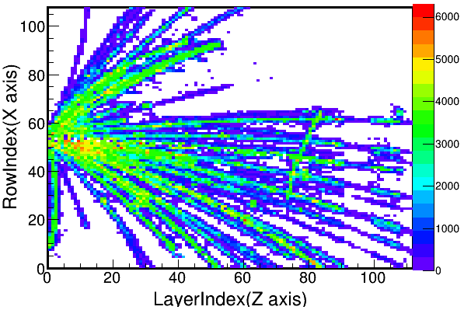

Characteristics of fixed target heavy ion collisions detected in TPC
High track density near the target region ( 30-60 tracks/event ).
- Overlapping each other.
Large dynamic range( pion -> He, ~100 ).
- Shadow problem.
Large amount of data, 1 event in TPC: 12096 channels* 270 samples.
$$π^{−}$$
Top plane view
Notes:
1, fix target experiment => forward focused high density tracks near the target (almost all the tracks, about 30-60 tracks come from one point, there are must be a serous overlapping near the target region)
2, Large dynamic range: from pion to Li, and the saturated effect of electronics will also cause the shadowing problem.
3, large amount of experiment data: 1event = 12096 channels * 270 samples.

Slide 3
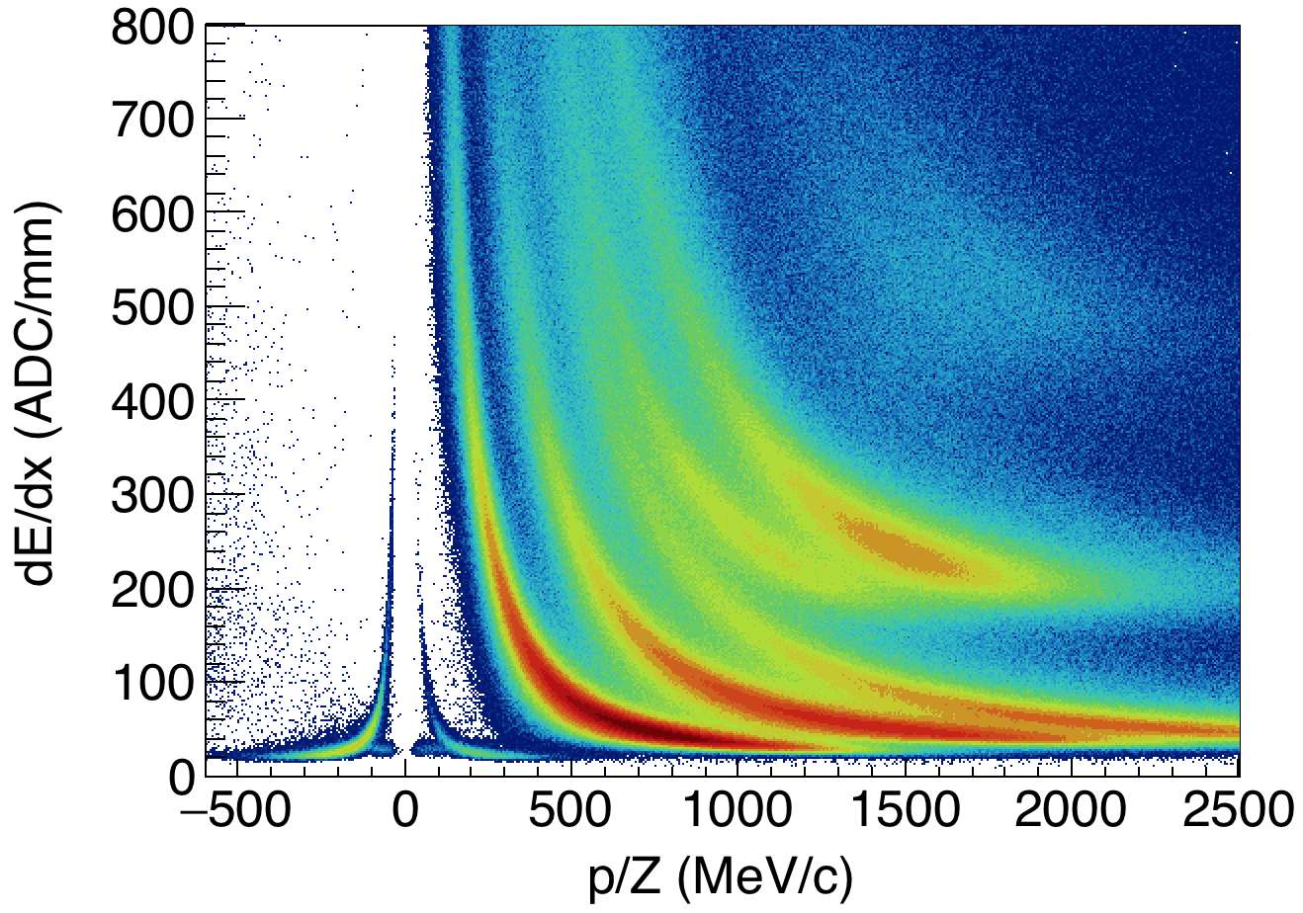








PID: (¹³²Sn/¹²⁴Sn)+(¹⁰⁸Sn/¹¹²Sn)
Very good PID, clear separation from pions to Z=2.
Is the measurement of dE/dX and momentum correct?
What is the efficiency of the track reconstruction?
$$Li$$
$$4He$$
$$3He$$
$$T$$
$$D$$
$$π^{−}$$
$$π^{+}$$
$$P$$
Compare well with WELL known things.
Notes:
This is the best PID that we have obtained. The PID clearly separates the pions and particles up to Li.
Now, there are two questions: how do we know the tracks that we reconstruct are right, and if they are right, what is the efficiency of track reconstruction.
For this purpose, we compare the results with the well defined or well known quantities. By studying the differences, we can find the problems, and that is the QA process of data analysis.

Slide 4
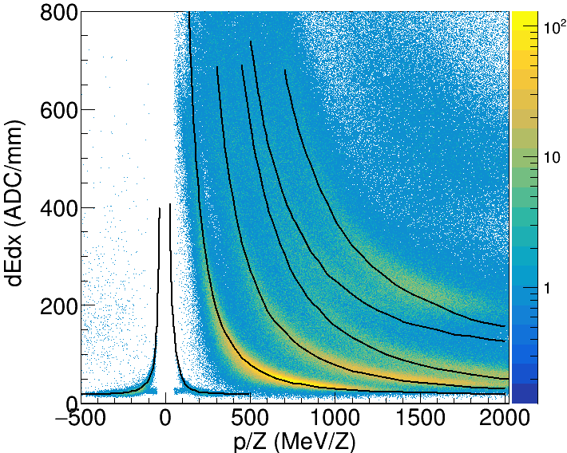
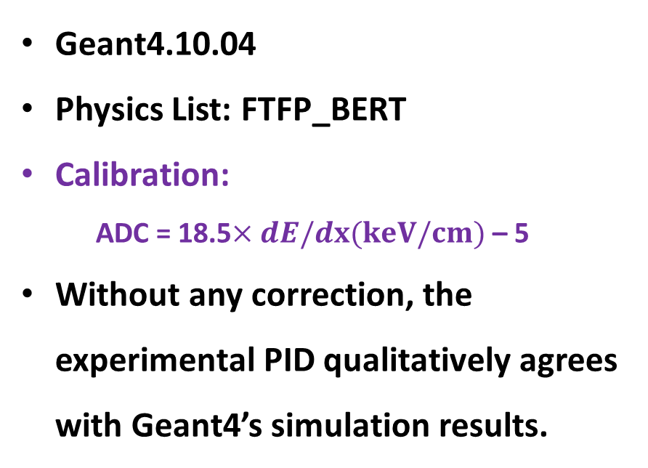
QA – dE/dX ( Energy Deposition )
Geant4’s PID central line
Geant4.10.04
Physics List: FTFP_BERT
Calibration:
ADC = 18.5$×dE/dx(keV/cm)$ – 5
Without any correction, the experimental PID qualitatively agrees with Geant4’s simulation results.
Notes:
The first thing that we need to check: does the relation of dE/dX and the momentum in the PID is correct?
Because the ionization of the charged particle in the working gas is just a EM process, so the most general and precise way is compare with the Geant4’s simulation results. So the first QA tools is the Geant4.
With the newest Geant4 version, and the FTFP_BERT physics list, and the same method to calculate the dE/dX, and a linear calibration function, we get a very nice qualitative match.

Slide 5
QA – Measured point number
Geant4 predictions
Experiment
charged particle
read out pad plane：
Different momentum
Different track
Different cluster
virtual central plane
Measured point( hit cluster )
There should be correlation between predicted hit clusters number to the experimental one.
Hit Clusters
Momentum
Notes:
The second checking is the Measured point number. This is the read out pad plane, and when a charged particle get through the TPC, it will induces signals on several readout pad of each layer. So if we define a virtual central plane on the center of each layer. Then with the center-of-gravity method, we can get a measured point on each layer. We also can call this measured point hits cluster. By fitting this hit clusters, we can get the radius of the track, and continually get the momentum. So the question is does this momentum will really produce so many hit clusters.
With another words, without any effects of overlapping and shadowing from other tracks, how many clusters will be produced by this momentum? By comparing this theoretical value with the measured value, we can QA the track finding, also can estimate the effects of overlapping and shadowing. But we know the sTPC is a cubic, the magnetic field is along the y direction, the target also not in the center, it cause: different momentum will have different clusters, so the left question is how we can get the cluster number for the whole momentum space?

Slide 6
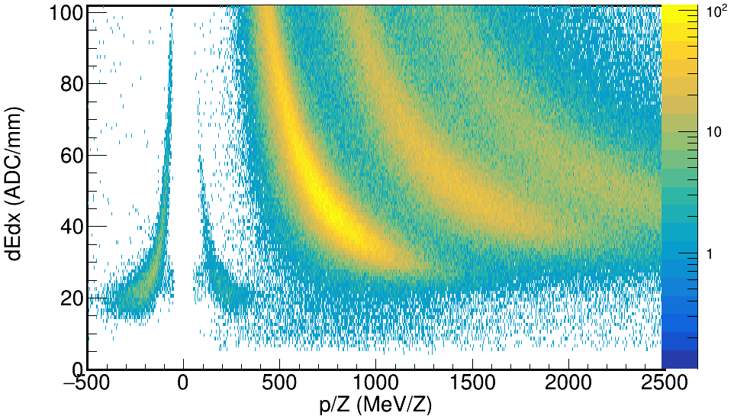
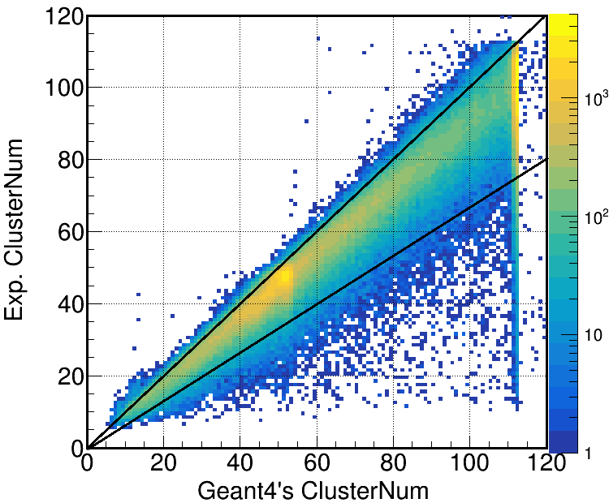
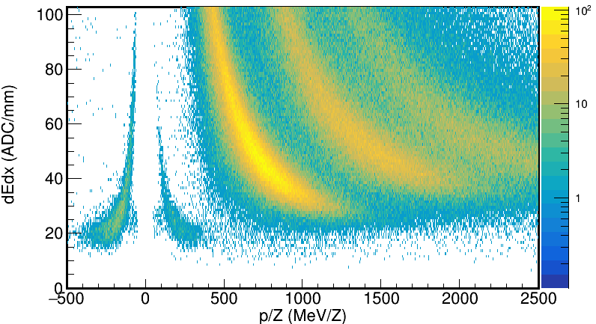
N_{exp} = N_{Geant4}
N_{exp} = 0.7N_{Geant4}
Cluster number of Exp. and the Geant4 are clearly correlated.
If make a cut on this correlation graph, the background of the PID becomes less.
Notes:
With the database, the first thing is comparing the measured cluster number with the Geant4. We can see a very clearly correlation. Most of tracks can find more than 70% clusters. If we make a cut on this correlation graph, we can find the background of the PID becomes less. But we still can find some bad tracks in the PID graph, especially in the region between the pion and the proton. We start another kinds of QA, event display of background.

Slide 7
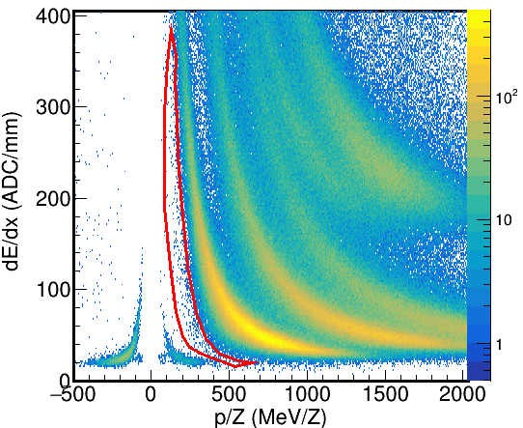
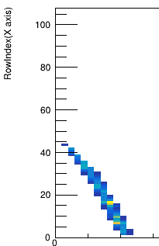
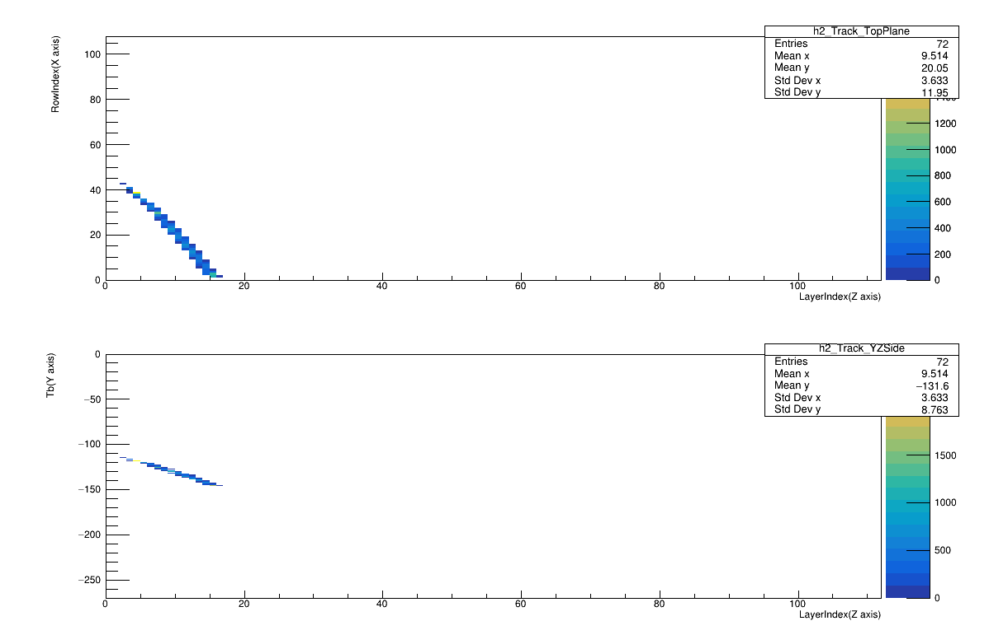
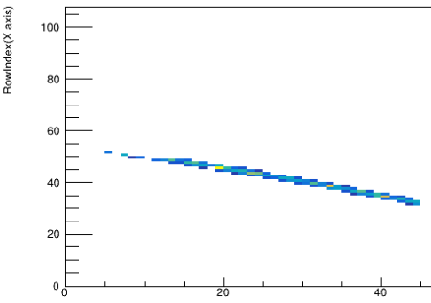
QA – Improving tracks in the background
Make cut on the PID, study the character of tracks, especially in the background.
Throw away “junk” track. <= Reasonable cut.
“Repair” the “good” track.
Samples between pi+ and proton:
An energetic charged particle should have a continued track.
where does the background comes from? : “junk” tracks; worse theoretical resolution.
Notes:
Making a cut on the interesting region of PID graph, and find the common characters. Analyze the characters, and find the reasons. For example, these are three tracks between the pion and the proton. we can see these tracks has a common characters: at the very begin region, the track is thinner than the outside. But we know, a track should be a continued curve. So by 3D event display, we find this is caused by the shadowing effect. Of course, when we figure out the problem, we perform a “Pad responding function” checking in the track reconstruction, and this step help us remove more background.
But we know, because of the limits of TPC geometry, some momentum will has a short track, and a worse theoretical resolution.

Slide 8
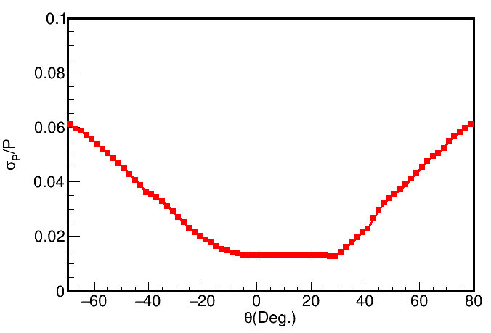
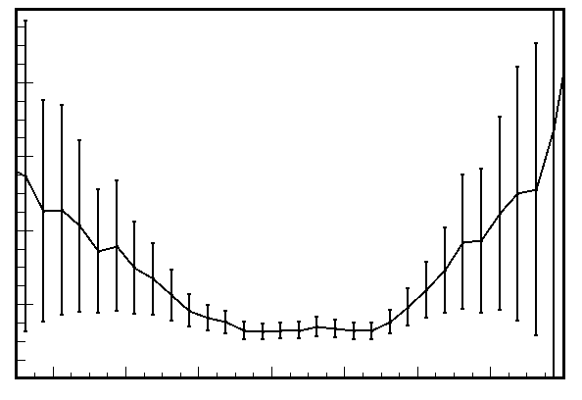
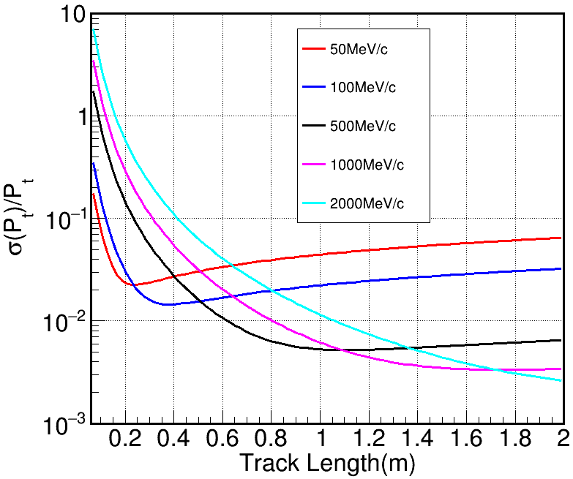
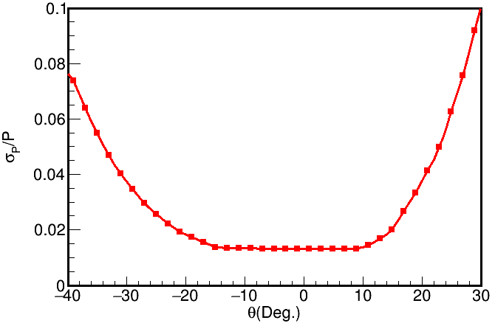
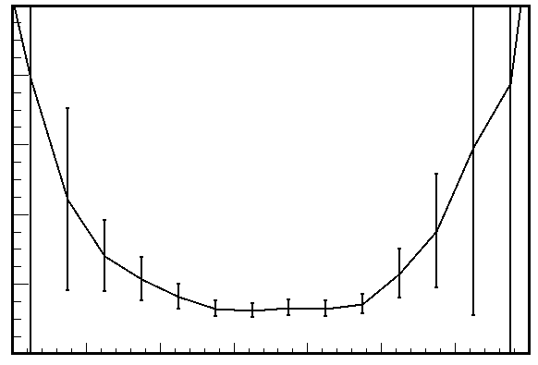



QA - Momentum resolution
500MeV/u Proton, Horizontal :
Track length, Cluster number & momentum
-$∎$- Theoretical formula
-$∙$- Geant4 track reconstruction
y
x
z
$$θ$$
500MeV/u Proton, Vertical :
y
Claus Grupen, et al NIM1963(24): 381-389
$$θ$$
z
Geant4’s input momentum can be reconstructed to the input value.
The distribution of reconstructed momentum is consistent with the theoretical formula.
Notes:
The momentum resolution has be well studied by the high energy physics people. From this NIM paper, we know the Momentum resolution is related to the track length, cluster number and the momentum itself. For the SpiRIT tpc, the track is measured continually, the track length is related to the cluster number, so the momentum resolution is mainly determined by the track length and the momentum itself. Here is a example for .

Slide 9
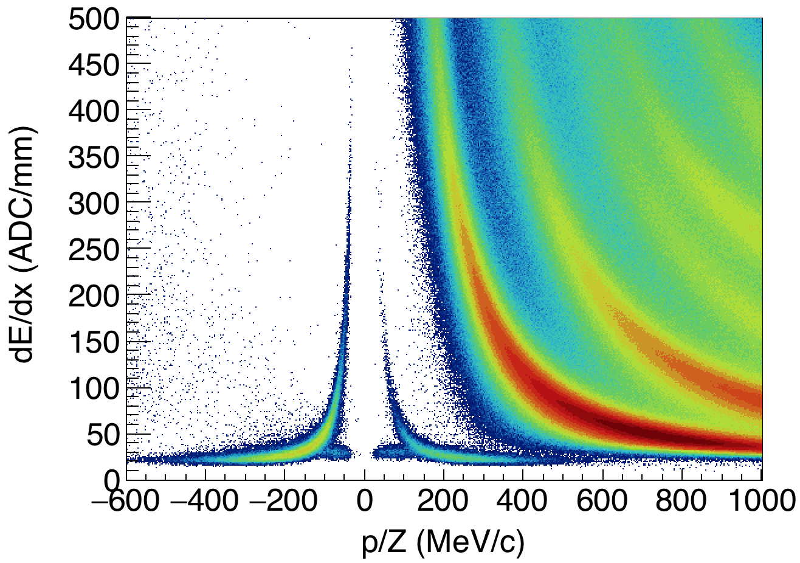
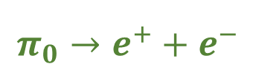
QA on particles with minimum ionizations – pions & electronics
$$π_{0}→e^{+}+e^{−}$$
e⁺ and e⁻ is a good probe to check the efficiency of track reconstruction for positive and negative charged particles, especially in the low momentum region.
Notes:
Except the event display, in the medium energetic HIC, we has another good probe to estimate the difference of positive and negative charged particles: e+/e-.
The high energetic e+/e- come from pi0 decay, so the yield of e+ and e- must be same exactly. So the ratio of e-/e+ can reflect the efficiency of different charged particle, especially in the low momentum region.
By study the events, which has e+/e-, but lose another one, we can study the different efficiency reason and also can estimate the efficiency of different charged particle, especially for the low momentum particles.

Slide 10
Diagnose of single track.
Efficiency of track reconstruction.
Notes:
The mentioned above is mainly for diagnosing the single track that we can find, from the dE/dX, cluster number, to the momentum resolution. So the next question, how many tracks we lost. It is the so called efficiency of track reconstruction.

Slide 11
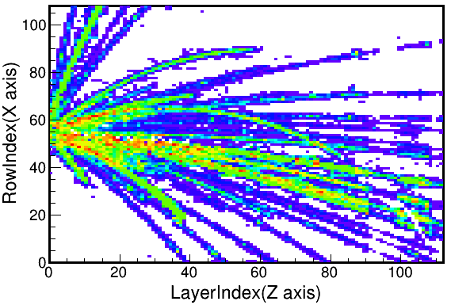
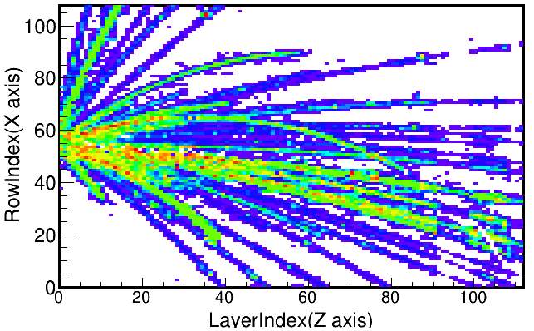
Efficiency from Embedding procedure – in progress
Exp. Events
Embedding
Geant4 Tracks
PSA
Energy deposition
Electron drift and diffusion
Pad responding function
Standard pulse function
1GeV/c embedded proton
Track finding
Digitization
Clustering
Study the track reconstruction algorithm.
Study the effect of shadowing and overlapping.
Study the efficiency of track finding.
Track Fitting
Notes:
To quantify the efficiency, we need a systematic and quantitative method, embedding method.
From the momentum resolution study, we know we already can analyze the Geant4 tracks like the experimental tracks. So here also can embed a geant4 track into the real event. And with this method, we can study the effect of overlapping and shadowing. This graph is an event display, and this graph is the same event, but embed a 1GeV/c proton.
Now, this method is in progress.

Slide 12
Summary
The experimental results match well with Geant4’s simulation results or well known formulas: PID, cluster number, momentum resolution.
The event display of the background of PID can be used to debug and improve the track reconstruction algorithm.
The efficiency of track reconstruction can be obtained from examining the balance of e⁺/e⁻ qualitatively; the quantitative embedding method is in progress.

Slide 13
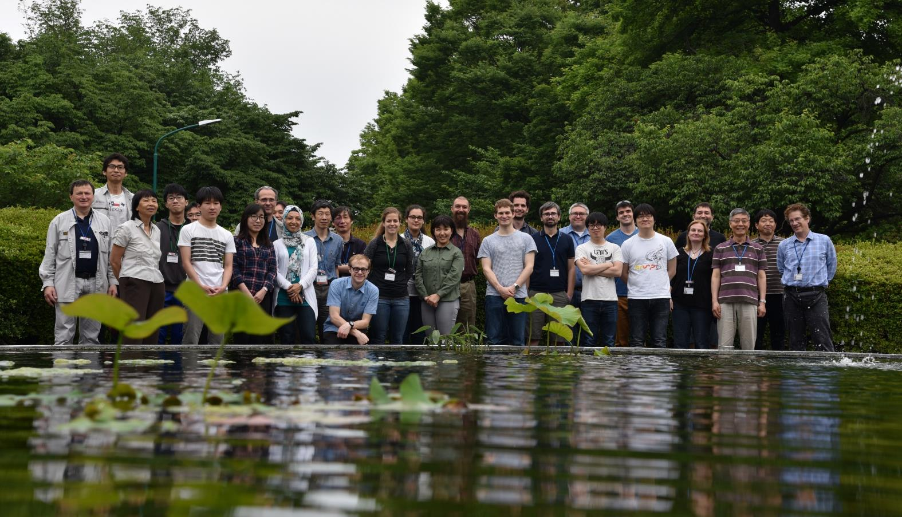
SπRIT Collaboration
MSU/NSCL
  C. Anderson
  J. Barney
  G. Cerizza
  J. Estee
  G. Jhang
  W. G. Lynch*
  J. Manfredi
  P. Morfouace
  C. Santamaria
  H. Setiawan
  R. Shane
  S. Tangwancharoen
  C. Y. Tsang
  M. B. Tsang*
Kyoto University
  M. Kaneko
  T. Murakami*
Texas A&M University
  A. B. McIntosh
  S. J. Yennello
RIKEN
  H. Baba
  N. Fukuda
  T. Ichihara
  N. Inabe
  T. Isobe*
  D. Kameda
  T. Kubo
  Y. Nakai
  M. Kurata-Nishimura
  S. Nishimura
  H. Otsu
  H. Sato
  H. Sakurai
  H. Shimizu
  H. Suzuki
  F. Takeda
  K. Yoneda
Korea University
  B. Hong
  J.W. Lee
RISP, Korea
  H. Sang Lee
  Y. Kim
  Y.J. Kim
INP, Poland
  K. Pelczar
  J. Lukasik
  P. Pawlowski
  P. Lasko
Tokyo Technical University
  Y. Kondo
  T. Nakamura
Tsinghua University
  R. Wang
  Z. Xiao
  Y. Zhang
Rikkyo University
  K. Ieki
  K. Kurita
  J. Murata
Tohoku University
  T. Kobayashi
NeuLAND Collaboration
  L. Atar
  T. Aumann
  A. Horvat
  D. M. Rossi
  H. Scheit
  H. Toernqvist
  K. Boretzky
  Y. Leifels
  I. Gasparic
This work is supported by the U.S. DOE under Grant Nos. DE-SC0004835, DE-SC0014530, DENA0002923, US NSF Grant No. PHY-1565546, and the Japanese MEXT KAKENHI grant No. 24105004.
*SπRIT Spokespersons
Thank you for your attention!

Slide 14
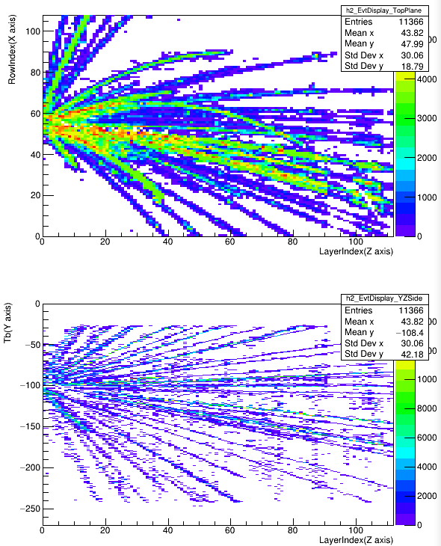
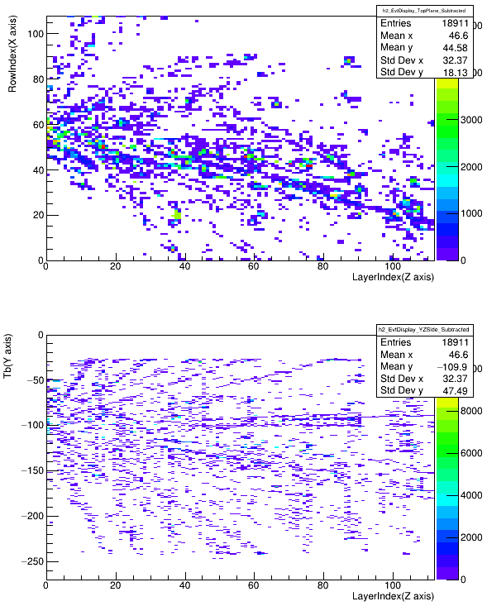
Event display – unused hits
No undetected tracks in residuals.
All the hits found by PSA.
The unused hits.
Notes:
How
For the efficiency estimation, the first thing we can do is a qualitative estimate: event display.
1, This is the hits distribution of all the hits that we found, we can see the continued curved tracks. This is the unused hits distribution. By comparison, we can estimate the track reconstruction efficiency.
2, Now, by the eyes, we check about several hundred events, almost all the unused hits looks like this. From this comparison, we can get the first qualitative conclusion: the efficiency of track finding is very high, can be up to 90%-95%. ( With the different cut, this value will change. But only from the track finding view, the efficiency is relatively high. )

Slide 15


Exp. events
500MeV/u Proton, Horizontal :
Geant4 Tracks
-$∎$- Theoretical formula
-$∙$- Geant4 track reconstruction
y
x
Energy deposition
PSA
z
$$θ$$
Electron drift and diffusion
Pad responding function
Standard pulse function
Clustering
Digitization
Track Finding
500MeV/u Proton, Vertical :
y
Track Fitting
$$θ$$
z
Geant4’s input momentum can be reconstructed to the input value.
The distribution of reconstructed momentum is consistent with the theoretical formula.
Notes:
For diagnose our track reconstruction algorithm first, we use the Geant4 tracks as the input, and by the digitization procedure, like the experiment data, take the Geant4 tracks as the input, and with the same method to analyze the Geant4 tracks. Here we can compare the reconstructed momentum, we also can calculate the momentum resolution. This is a 500MeV/c proton, emitted along the horizontal plane, the red point line is the theoretical formula estimation, and the black point line is the Geant4 reconstructed resolution. We can see it has a very good match. It also means our reconstruction algorithm has a good agreement with the previous tracker studies. And this is the protons, emitted along the Y-Z plane. it also has a very good agreement with the formula.

Slide 16
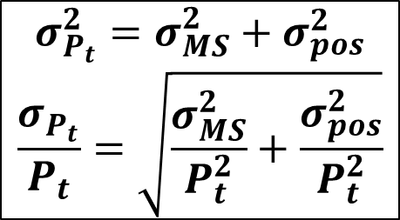
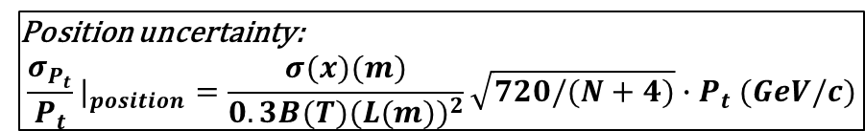
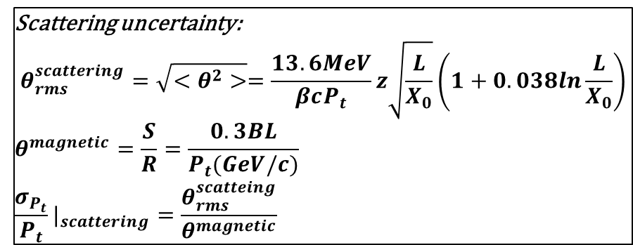
QA - Momentum resolution
Track length
Cluster number
momentum
$$σ_{P_{t}}^{2}=σ_{MS}^{2}+σ_{pos}^{2}$$
$$\frac{σ_{P_{t}}}{P_{t}}=\sqrt{\frac{σ_{MS}^{2}}{P_{t}^{2}}+\frac{σ_{pos}^{2}}{P_{t}^{2}}}$$
Scattering uncertainty:
$$θ_{rms}^{scattering}=\sqrt{<θ^{2}>}=\frac{13.6MeV}{βcP_{t}}z\sqrt{\frac{L}{X_{0}}}\left(1+0.038ln\frac{L}{X_{0}}\right)$$
$$θ^{magnetic}=\frac{S}{R}=\frac{0.3BL}{P_{t}(GeV/c)}$$
$$\frac{σ_{P_{t}}}{P_{t}}|_{scattering}=\frac{θ_{rms}^{scatteing}}{θ^{magnetic}}$$
Position uncertainty:
$$\frac{σ_{P_{t}}}{P_{t}}|_{position}=\frac{σ(x)(m)}{0.3B(T){(L(m))}^{2}}\sqrt{720/(N+4)}∙P_{t} (GeV/c)$$
Particle Detectors, Claus Grupen, Boris Schwartz.
Nucl. Inst. Meth., 1963(24): 381-389
Notes:
With this NIM paper, we know that the error of momentum comes from the multi-scattering and position measurement. With this formula, we know the error, coming from the scattering is related to the track length and the speed; the error coming from the position measurement, is related to the position resolution, the track length, the cluster number and the momentum value. So for the sTPC, the momentum resolution will change with the track length, the cluster number, the momentum value.
Consider these two factor, for the different momentum pion, the momentum resolution is related to the track length. we can find for the large momentum, the resolution turns to be better as the track length increase, but for the small momentum, the resolution turn to be better as the track length increase, but also will turn to be worse for the multi-scattering.
This is the theoretical calculation results, how about our track reconstruction algorithm?

