Slide 1
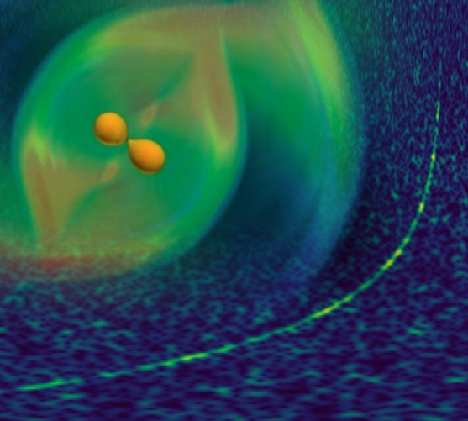
NUSYM 18, 10-13, September, 2018, Hanhwa Resort, Busan, Korea
Nuclear Symmetry Energy
in
Compact Star Matter
Hyun Kyu Lee, Hanyang University

Slide 2
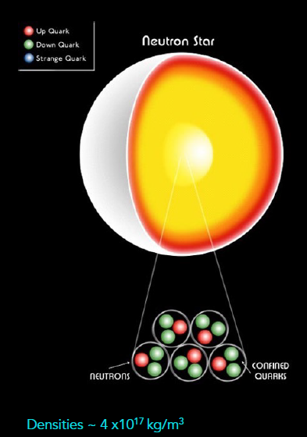
I. Introduction
A. neutron star : dense hadronic matter
neutron, proton (hyperon, quarks)
~ 1-2 solar mass
number of hadrons ~ 10^57
size of neutron star: ~ 10 km
highly dense hadronic matter
Sathyaprakash(2017)

Slide 3
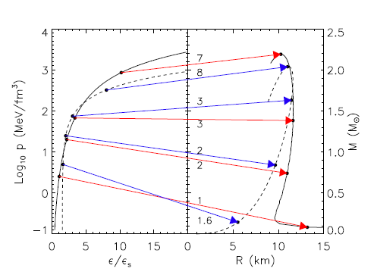
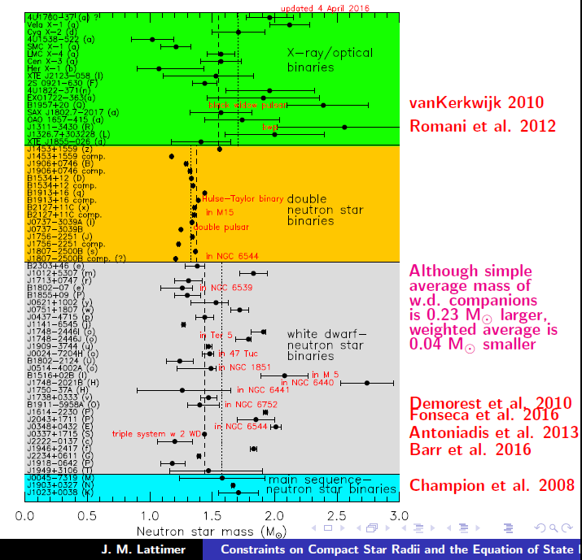


- Core density of neutron stars
Lattimer, arXiv: 1305.3510

Slide 4

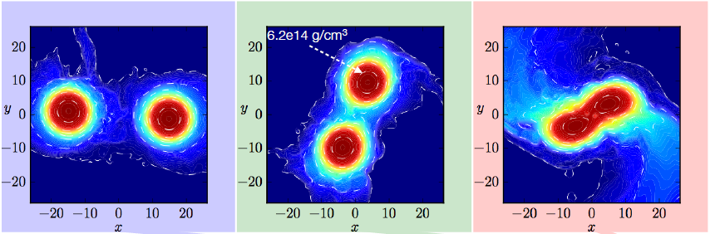
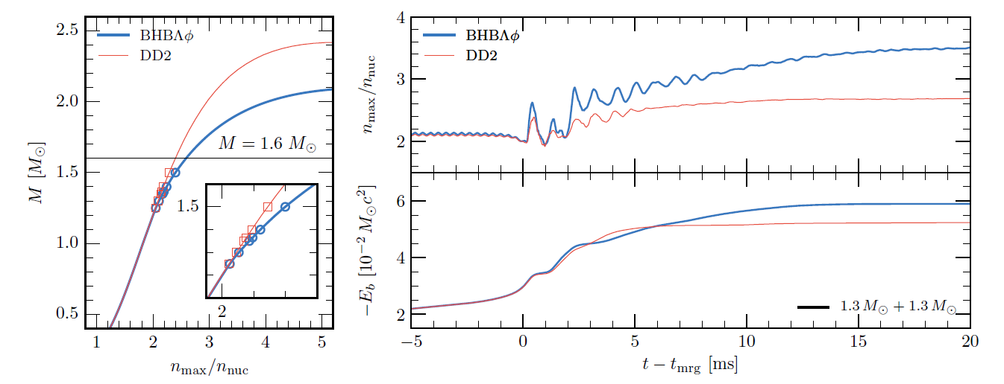
- Binary Neutron Star Merger Remnant
cosmic collider
n > 2 n₀
Radice et al. arXiv:1612.06429v2

Slide 5

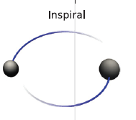


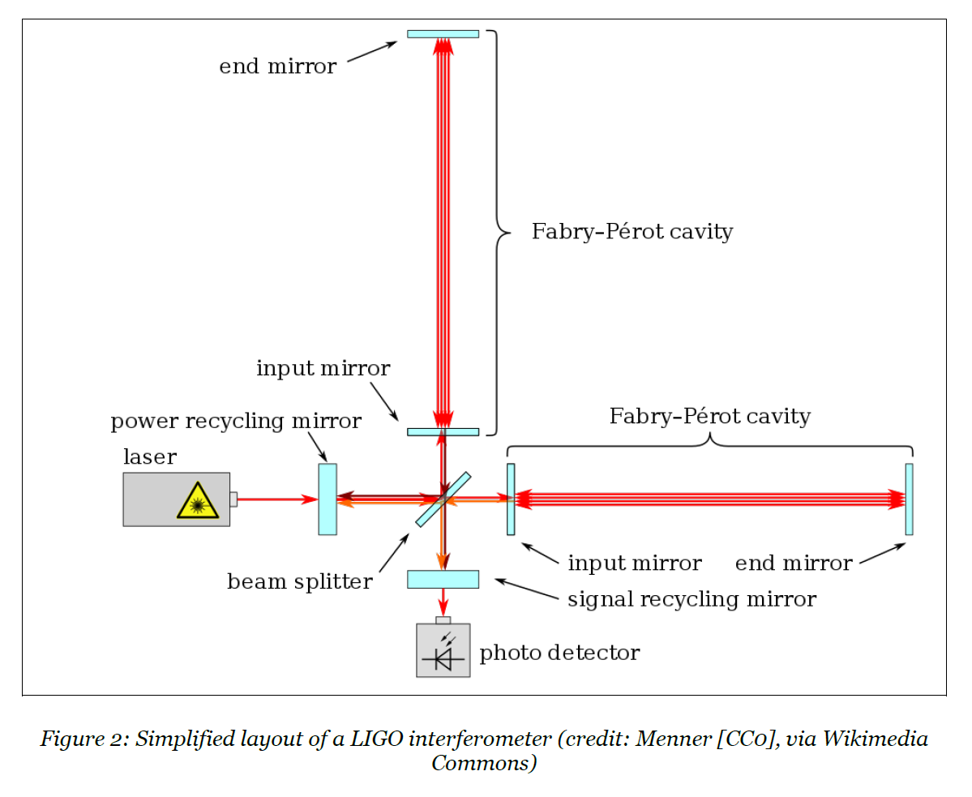
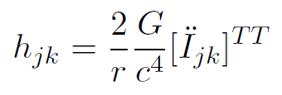

B. Gravitational waves from binary neutron star (GW170817)
→ equation of state
LIGO – a gigantic interferometer
Notes:
Strain h

Slide 6



C. Underlying basic interactions
a. QCD(hadrons)
effective theory of hadrons
b. Gravity(energy momentum tensor)
Einstein field equation
pressure and energy density :

Slide 7


a. QCD in hadronic degree of freedom
nuclear interaction : isospin symmetric
- Symmetry energy
Measure of p-n asymmetric configuration
Fermi-Dirac statistics, nuclear interactions
p-n asymmetry: configurartion dependent

Slide 8
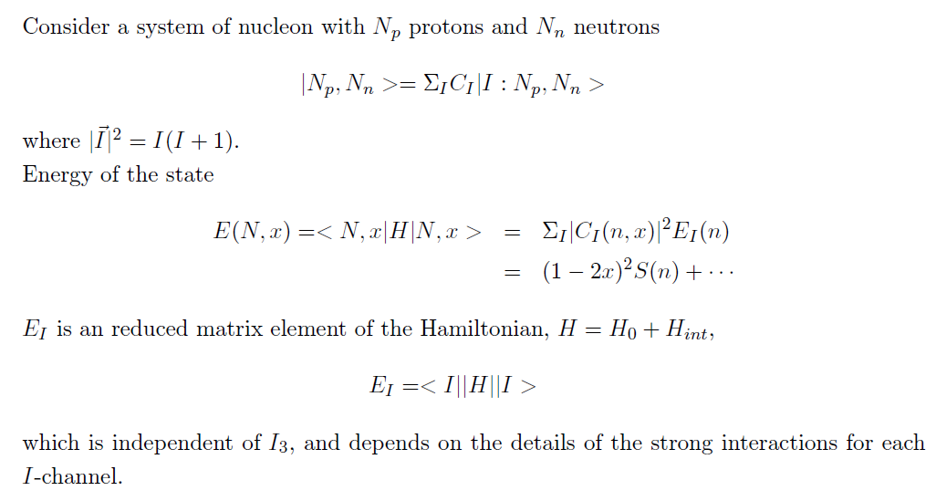
Iso-spin symmetry and symmetry energy
Examples: symmetric nuclear matter (I=0, … )
pure neutron matter( I = 0, ….)

Slide 9
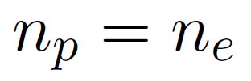


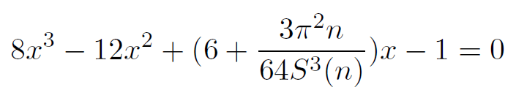
Asymmetric configuration as a ground state
strong interaction → symmetric configuration
electromagnetic and weak interaction → asymmetry
Compact star matter
a. charge neutrality
b. weak equilibrium

Slide 10

b. Gravitational interaction
Not a direct probe for n-p asymmetry
Gravitation: isospin-independent
Gravity does not interfere with strong interaction
Star matter coupled to Gravity only through
energy momentum tensor
n-p asymmetric part symmetry energy

Slide 11
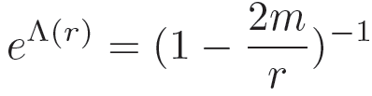



II. Compact star matter: dense hadronic matter under strong gravity
A. Tolman-Oppenheimer-Volkov(TOV) Equation
metric for a spherically symmetric(static, non-rotating) configuration
perfect-fluid stellar matter

Slide 12
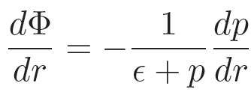
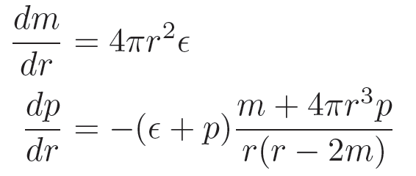
Tolman-Oppenheimer-Volkov(TOV) Equation
→ Mass and radius
Role of symmetry energy

Slide 13
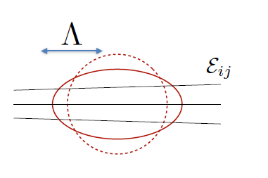



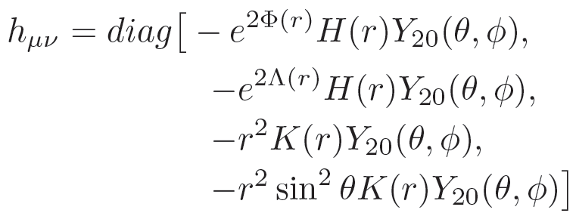
B. Tidal deformation
Einstein field equation for tidal perturbation
TOV Eqs.

Slide 14
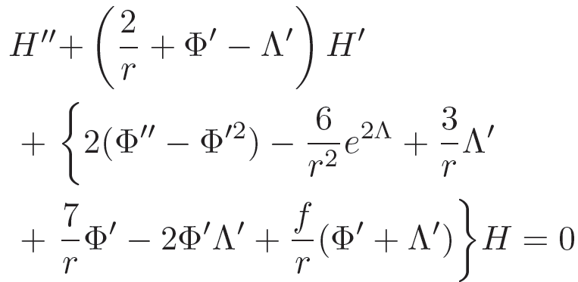
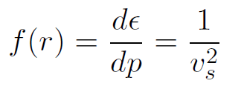
Role of symmetry energy through energy and pressure
Speed of sound

Slide 15
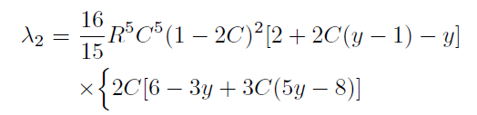


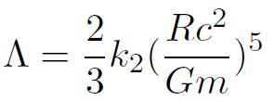
Deformability
dimensionless tidal deformation parameter

Slide 16
II. GW170817

Slide 17
Large-scale Collision
Binary coalescence up-to merger
Cosmic distance ~ 40 Mpc
Bartos, Brady, Marka, Class.Quant.Grav. 30 , 123001(2013)

Slide 18
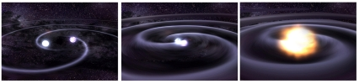
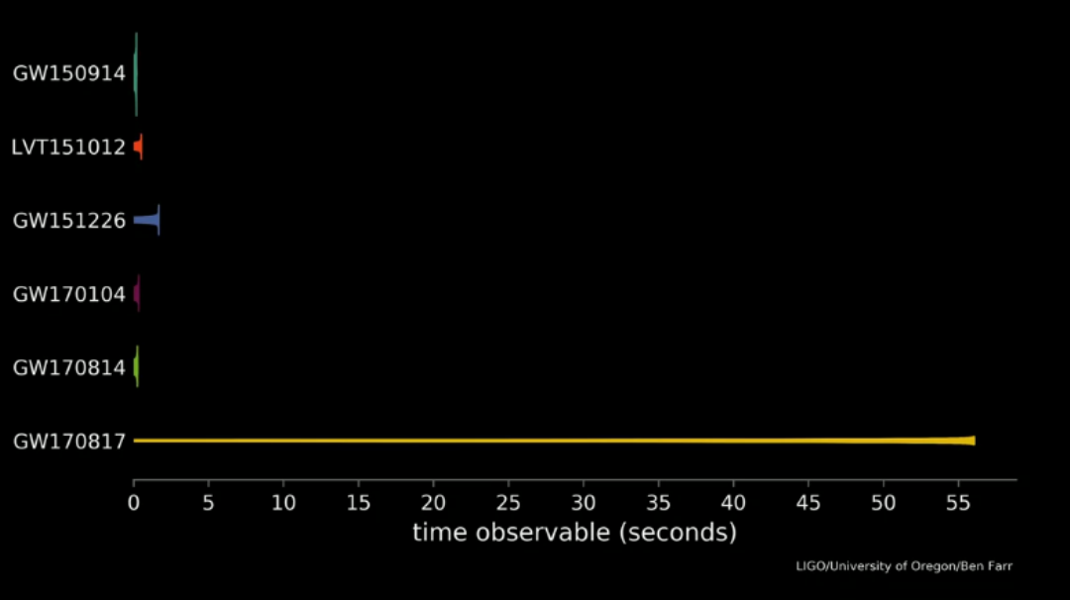

Slide 19
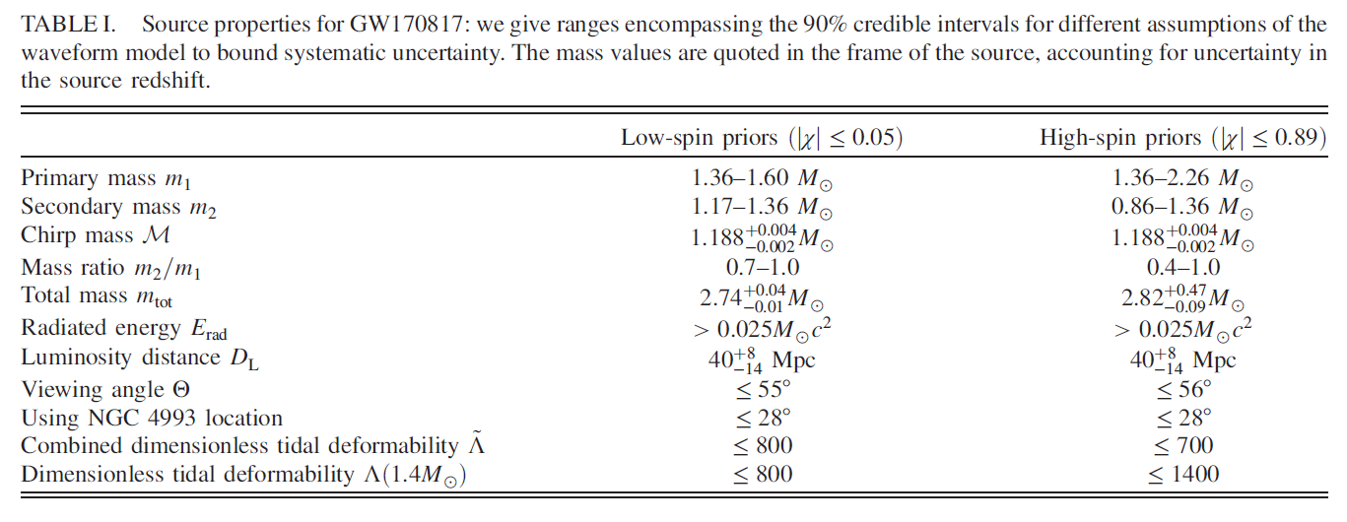
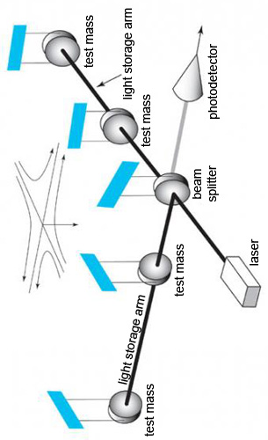

Slide 20
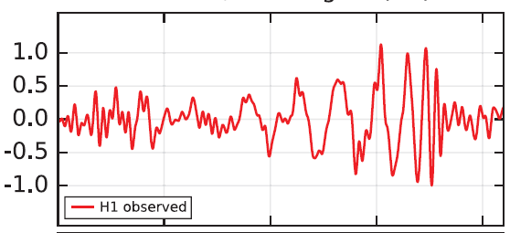



- Mass
GW 150914 (binary black hole)

Slide 21
- Tidal deformation

Slide 22
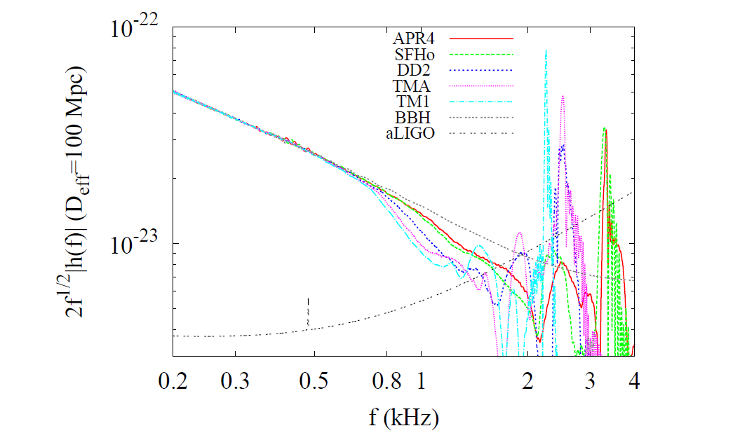
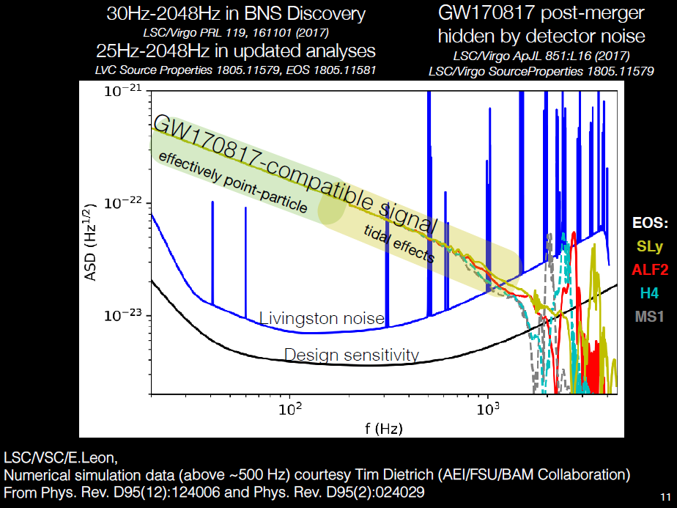
- Deviation from point particle approximation
Hotokezaka, Kyutoku, Sekiguchi, Shibata. Phys. Rev. D93, 064082(2016)
J. Read, 2018

Slide 23
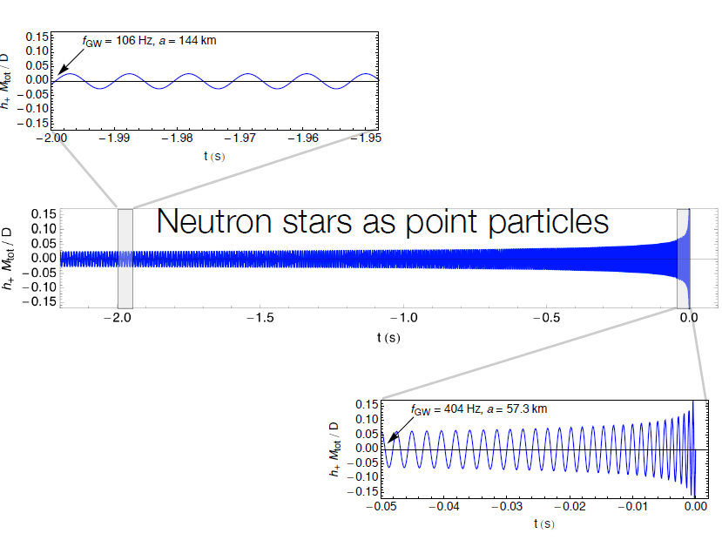
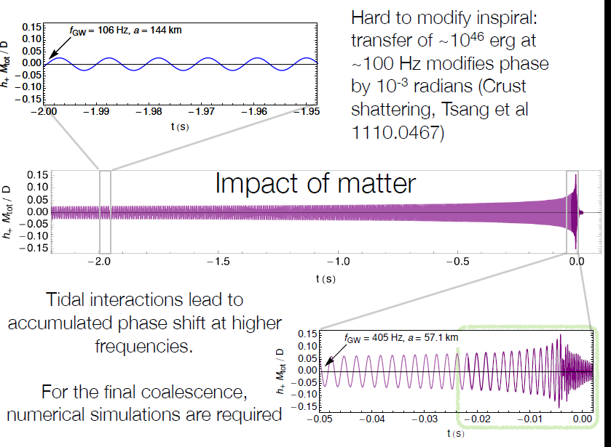
J. Read, Amaldi 2017

Slide 24




Constraint from GW170817
→ Some of EoS/effective models are not favored
- Degeneracy between E_0 and E_{sym}
stiffer EoS ~ stiffer symmetry energy
See more discussions in NuSYM18 !!

Slide 25

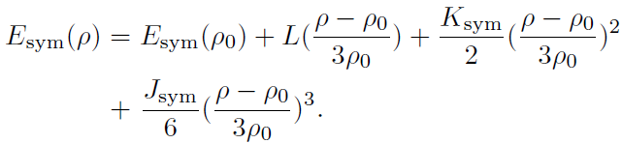
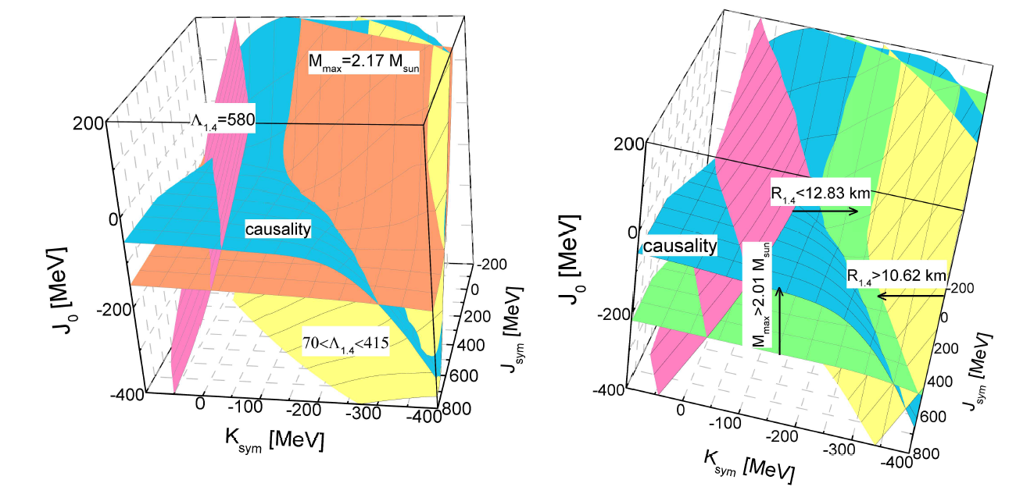


Parametrized symmetry energy
N.B. Zhang and B.A.Li , arXiv:1807.07698

Slide 26
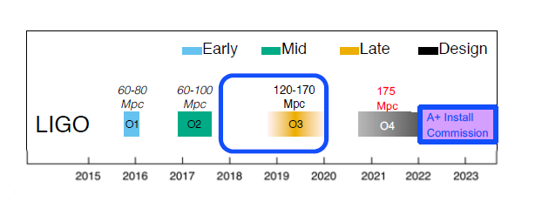
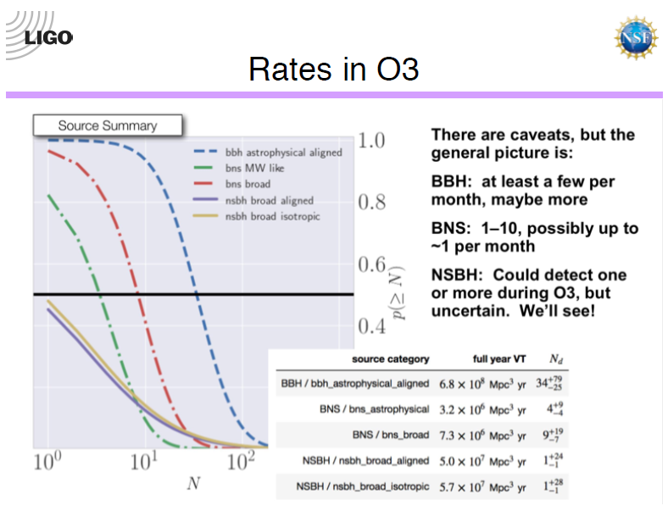




III. Advanced LIGO/Virgo: O1,O2 → O3
D. Shoemaker,KIW, 2018
- GW(binary neutron stars) : 1-10/yr
- More on EoS : Mass, Radius, Tidal deformation, Spin, …
- More on EoS : GW peaks from merger remnants
- EM follow-up, Fermi(GRB) , Icecube(neutrino) , ….

