Slide 1

Status of RAON
Young Kwan KWON
NuSYM2018
Sep 10-13, 2018

Slide 2
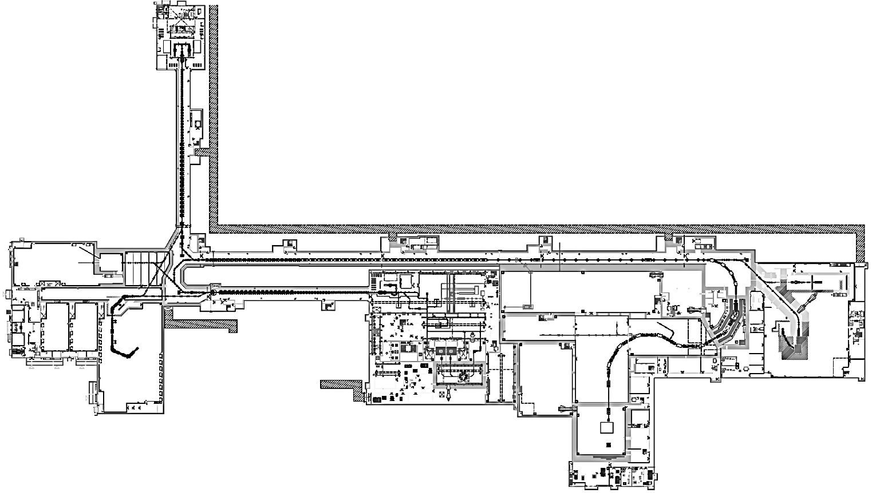
RAON: Rare Isotope accelerator complex for ON-line experiment
Goal: To build a heavy ion accelerator complex RAON for RI science researches
Providing high intensity RI beams by ISOL and IF
ISOL: direct fission of ²³⁸U by 70 MeV proton
IF: 200 MeV/u ²³⁸U (intensity: 8.3 pμA)
Providing high quality neutron-rich beams
e.g., ¹³²Sn with up to 250 MeV/u, up to 10⁹ particles per second
Providing More exotic RI beam production by combination of ISOL and IF
SCL1
○ Project period : 2011.12 - 2021.12
○ Total Budget : ~$ 1.43 billion
(Facilities ~ $ 0.46 bill., Bldgs & Utilities ~ $ 0.97 bill.) (include initial experimental apparatus)
Low energy experimental hall B
SCL2
SCL3
Spallation room for future extension
IF facility
High energy experimental hall B
Low energy experimental hall A
ISOL facility
High energy experimental hall A

Slide 3
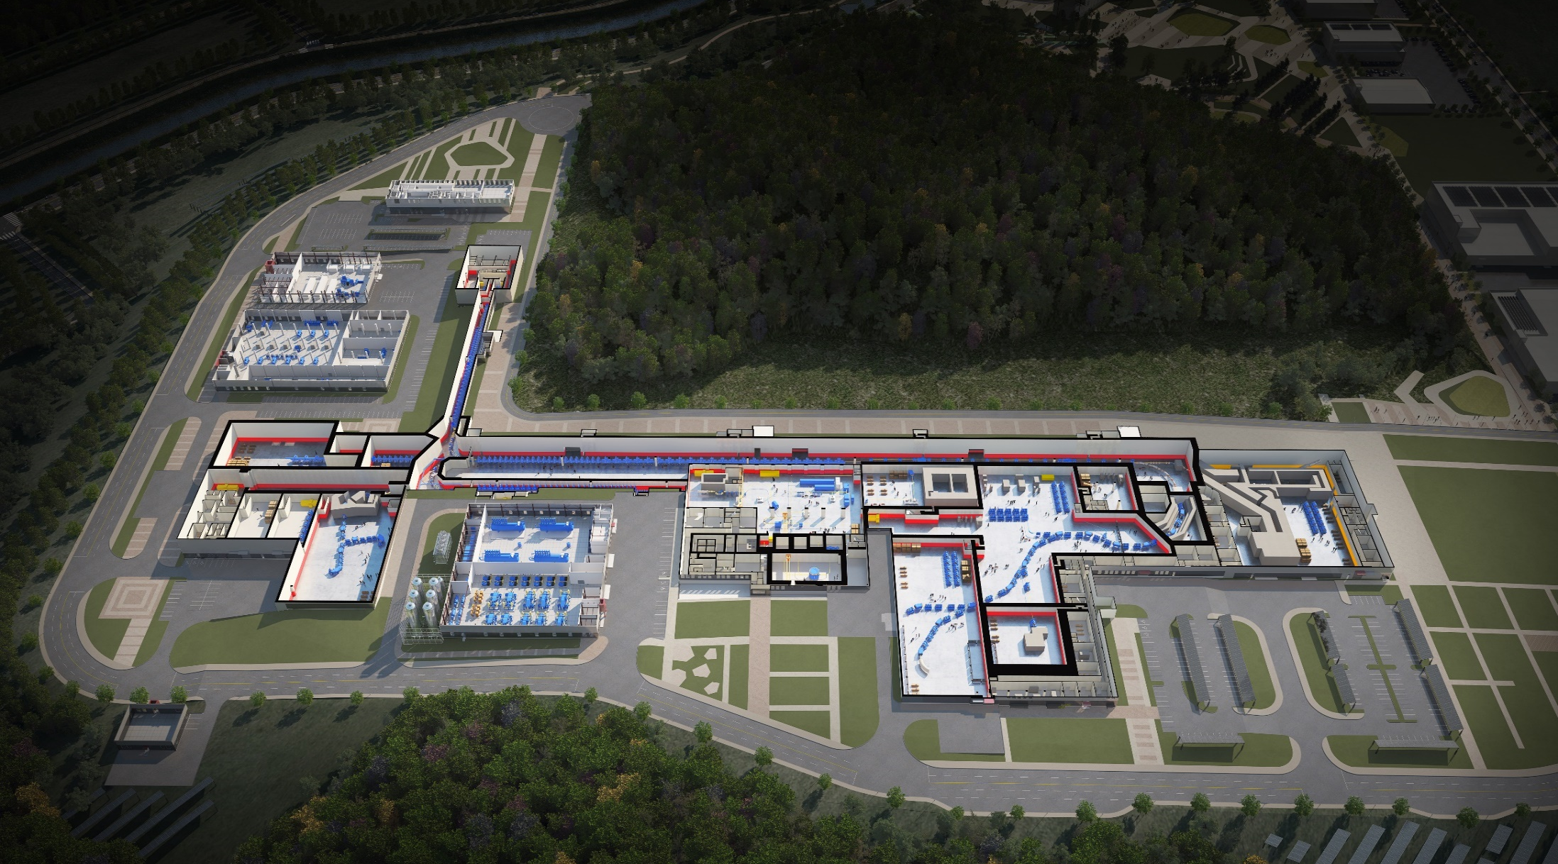
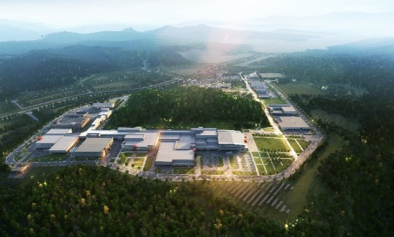
RAON Layout
Control
Center
Utility
ECR IS
SCL1
ISOL System
HPMMS/
CLS
IF System
SCL3
SCL2
BIS
μSR
NDPS
KOBRA
Cyclotron
HRS
LAMPS
SCL1 has been decided to be pended
: SCL3 is going to be taking a role of SCL1 in the early operation

Slide 4
RISP Organization
1 department, 3 divisions, and 11 teams
Director
International Advisory Committee(IAC)
Civil Engineering Advisory Committee
Deputy
Director
Project
Coordination
Department
Project Planning Team
Research & Budget Mgt. Team
Risk & Schedule Control Team
System
Installation
Division
Facility
Construction
Division
Administration
Division
System Integration Team
Accelerator Systems Team
Accelerator Engineering Team
RI Experimental Systems Team
Construction Management Team
Facility & Safety Management Team
Administration & Communication Team
General Affairs & Management Team

Slide 5
Project Major Milestones
Facility
18.5MeV/u
SI beam
(December 2020)
18.5MeV/u
RI beam
(September 2021)
ECR-IS beam &
ISOL beam (SI beam)
(Dec 2015)
SCL demo beam
(Dec 2017)
2014
2015
2016
2017
2018
2019
2020
2021
RFQ beam
(Dec 2016)
SCL
installation
(April 2019)
ISOL
(July 2020)
D-1
Experiment
(Jan 2021)
SCL2
(Dec 2021)
Construction & Civil Engineering
Completion of basic design
(Dec 2015)
Completion of detail design
(June 2017)
Supply of utilities
(October 2018)
Building
Permit
(April 2021)
2014
2015
2016
2017
2018
2019
2020
2021
Beginning of priority
construction
(Feb 2017)
Beginning of construction
(Sep 2017)
Completion of construction
(Dec 2020)
Completion of inspection of the radiation facility
(Dec 2021)

Slide 6
Construction
Feb, 2017
May, 2017
Aug, 2017
Dec, 2017
Aug, 2017
Mar, 2017

Slide 7
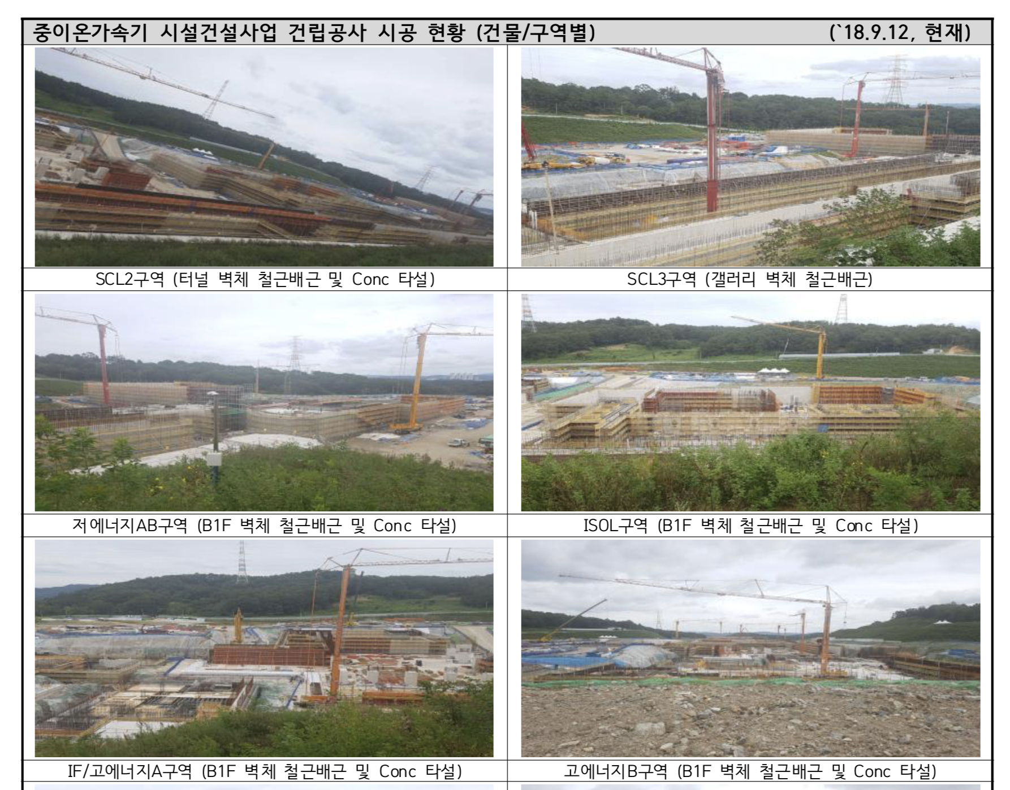

Slide 8
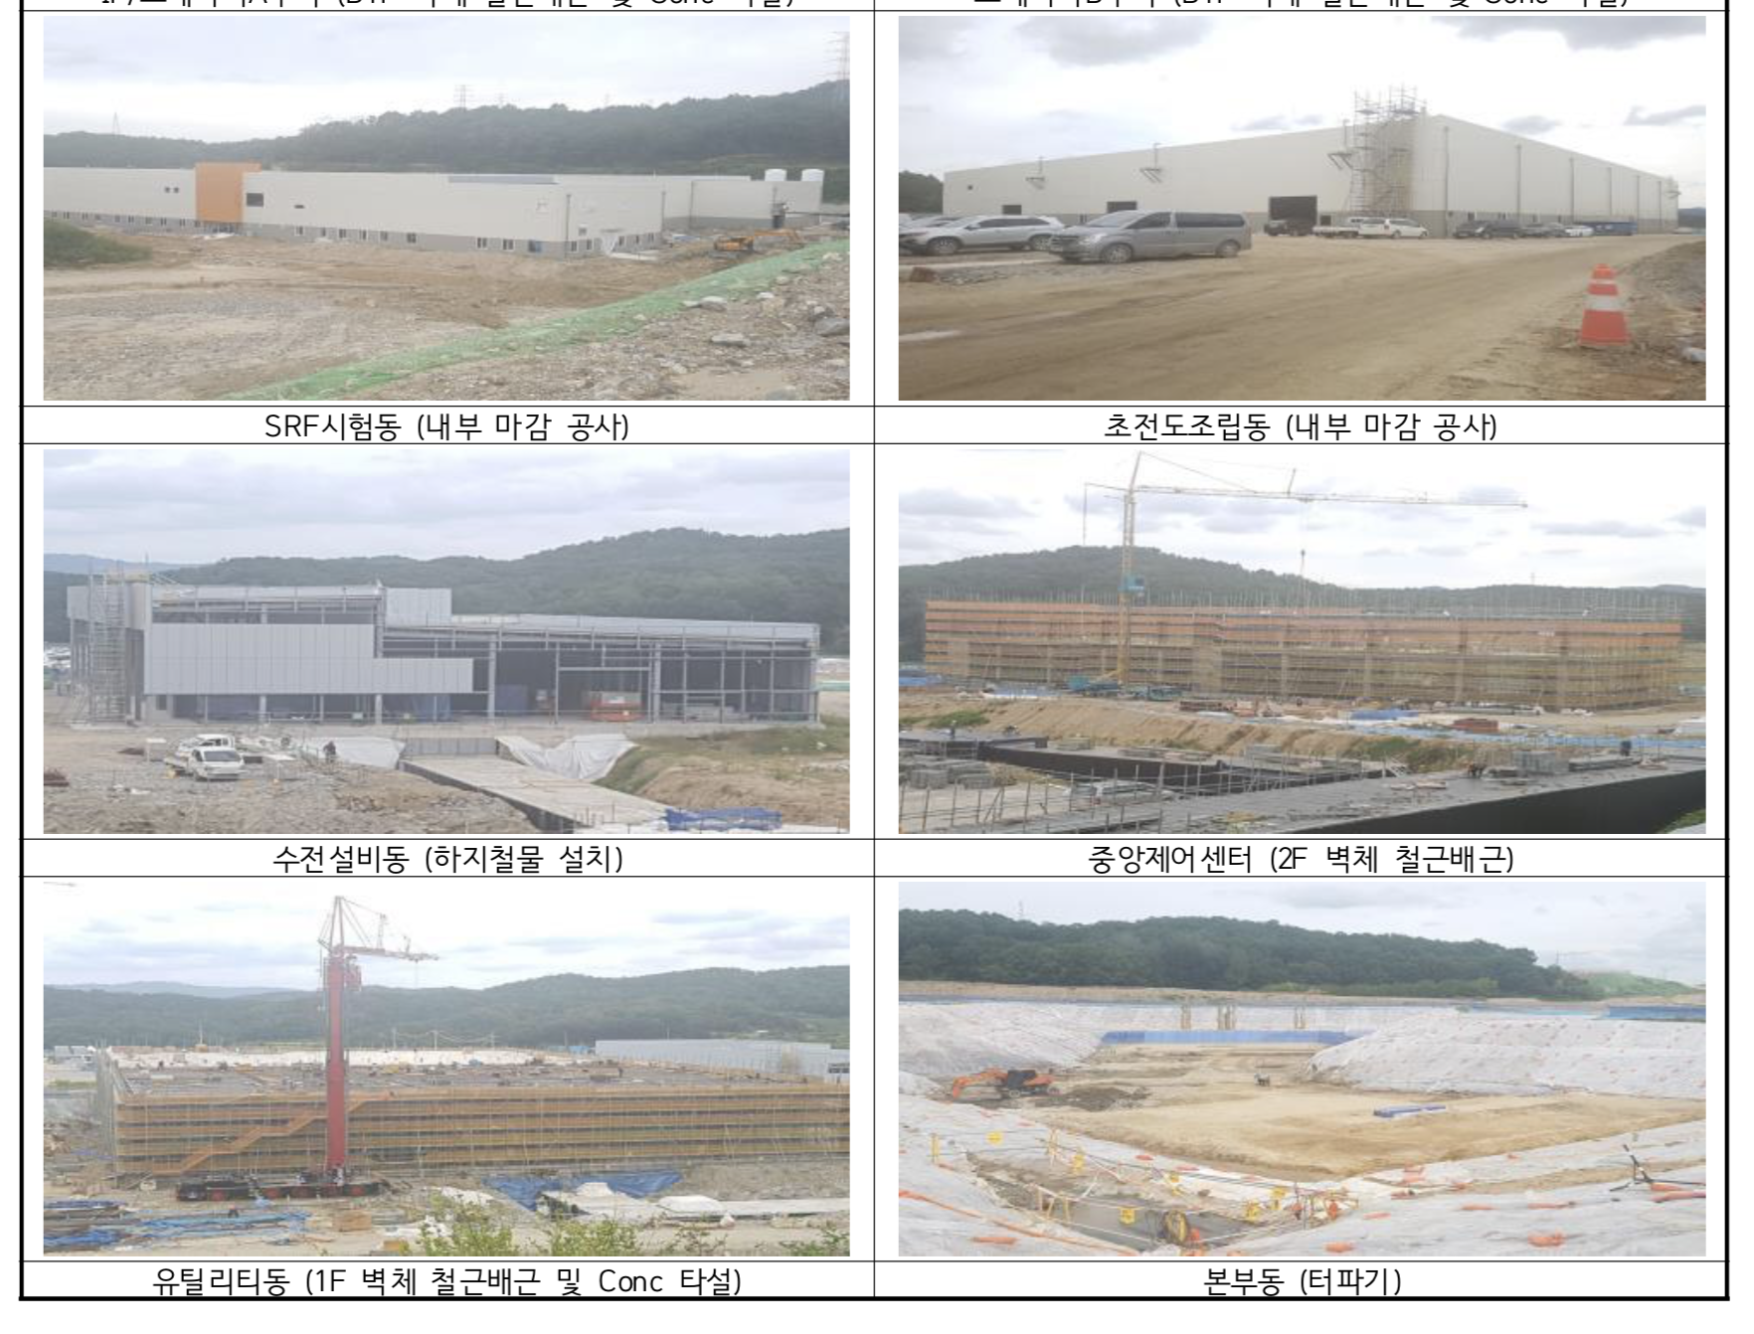

Slide 9
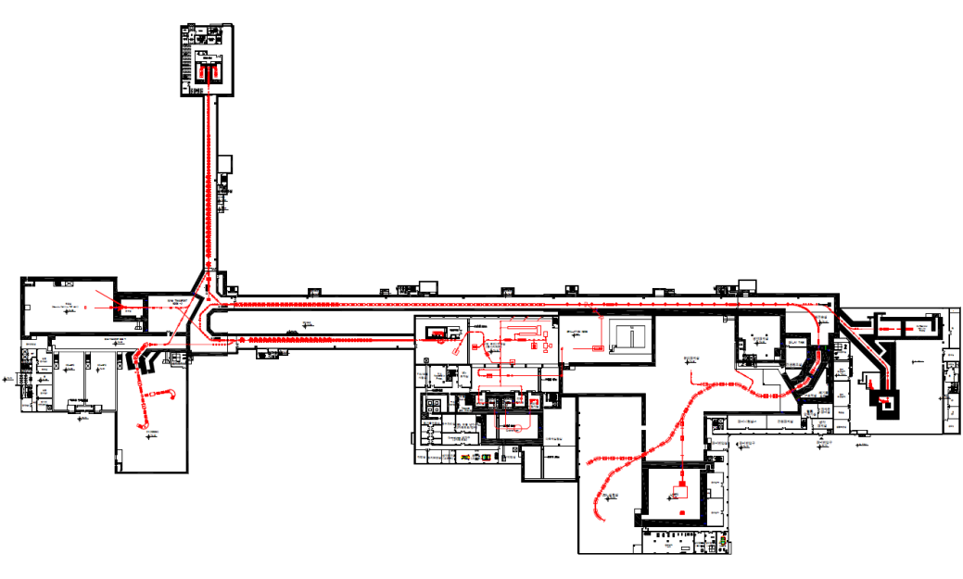
Lineup of RIB production & Separation
ISOL→IF
: ISOL→SCL3→SCL2→IF
: ISOL→SCL3→KOBRA
IF→Re-Acc
(future upgrade)
: IF→stopped beam→SCL
KOBRA (low E IF)
ISOL
IF (high E)
Driver
SCL3 or SCL1
Cyclotron
SCL3→2 or SCL1→2
Post acc
SCL3 or SCL3→2
Production mechanism
Direct reactions
- (p,d), (³He,n) etc
, MNT
p induced U fission
PF, U fission
Available RIB energy
< a tens of MeV/u
> a few of keV/u
< a hundreds of MeV/u

Slide 10
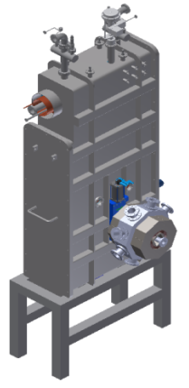
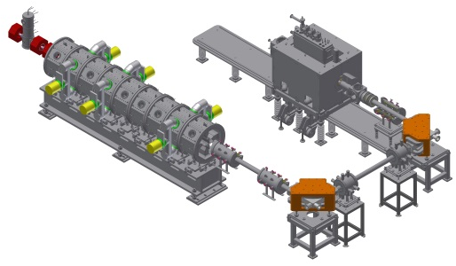
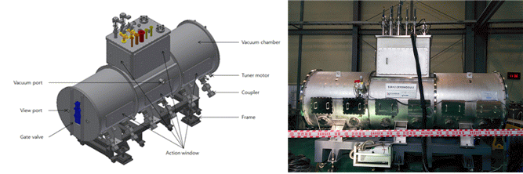
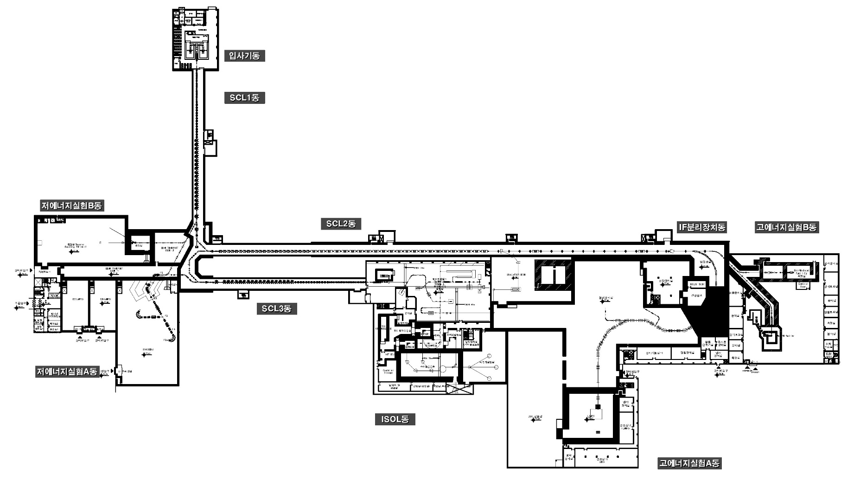
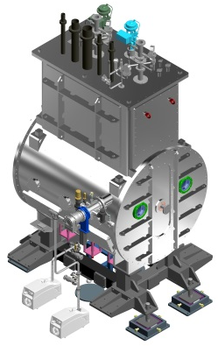
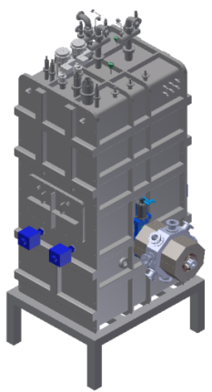
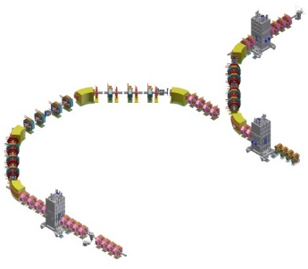
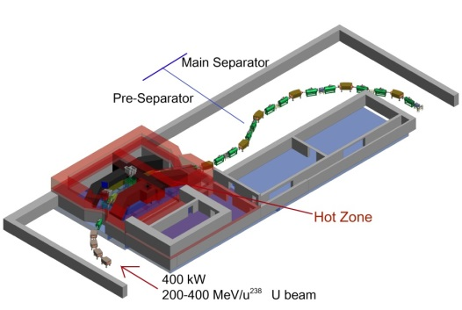
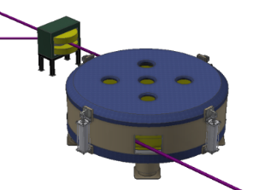
RAON Layout : Accelerator System
SCL2(SSR1)
SCL2(SSR2)
Injector
SCL1&3(QWR)
SCL1&3(HWR)
Bending Section
Cyclotron
IF System

Slide 11
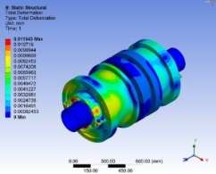
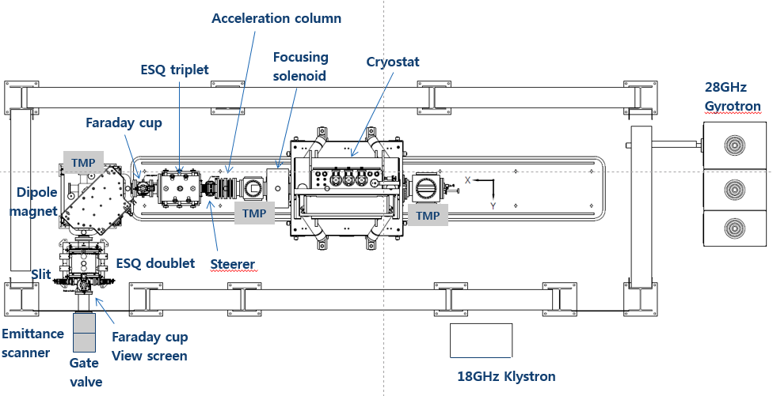
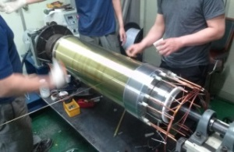
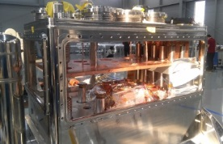
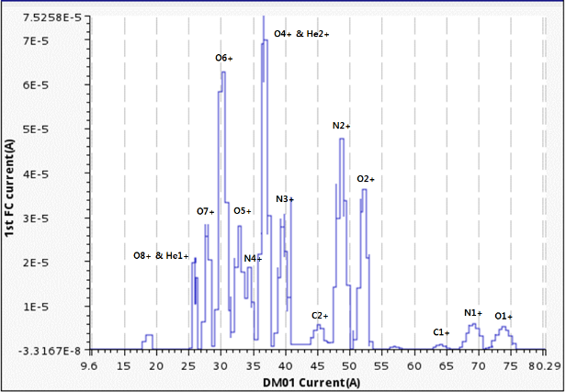
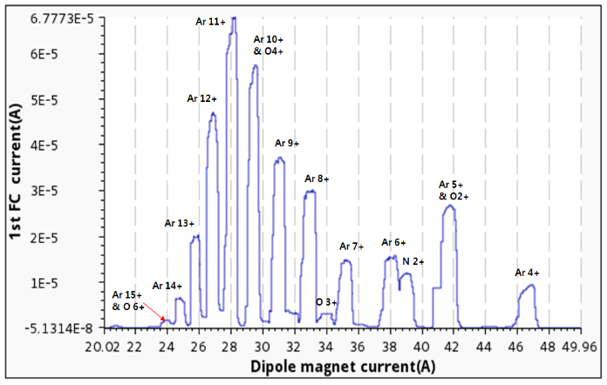
ECR Ion Source(28GHz, 14.5GHz)
Design & Fabrication
Installation & Test (Munji Campus)
Transfer to main site
Commissioning
Operation
28GHz
2011 ~ 2014
~ 2019.06
~ 2019.12
2020
2021
28GHz ECR test results
• As an early test stage,
- O⁷⁺ of 30euA was extracted
- Ar¹¹⁺ of about 70euA was extracted.
• After cryo-cooler maintenance,
cooling capacity margin is improved.
14.5GHz
Purchasing process
Manufacturing
Installation & Commissioning
Operation
2018
~ 2019
~ 2020.5
2020.6~
• 14.5GHz ECRIS for a secondary ion source.
• 14.5GHz ECRIS and 28GHz ECRIS will supply a stable isotope beam to SCL3 alternately
• 14.5GHz ECRIS will be a main ion source when 28GHz ECRIS moves to SCL1

Slide 12
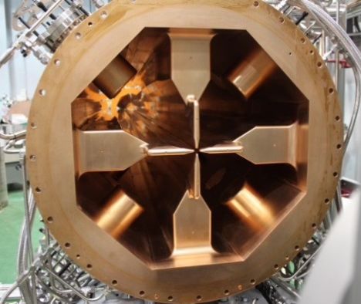
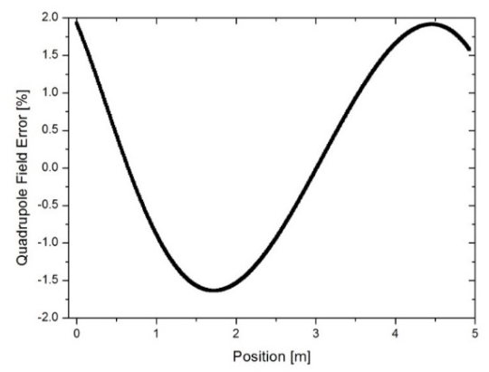
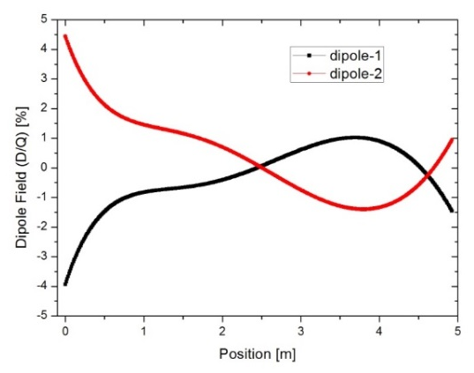
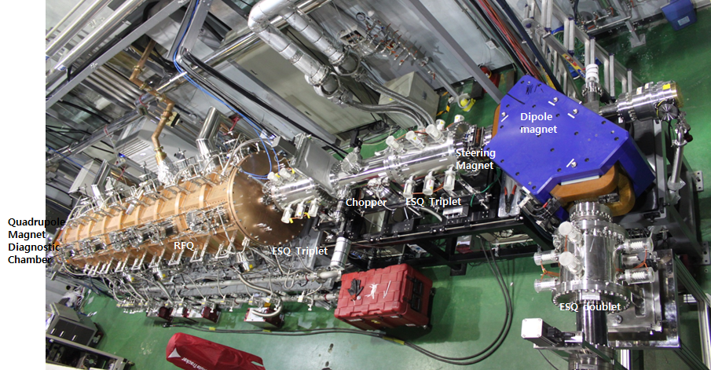
Injector
Conceptual design
Prototype
Test & Upgrade
Installation
Commissioning
Operation
2011 ~ 2012
~ 2015
~ 2018
2019
2020
2021
Installation & Test of injector @ SCL demo
• Completion of RFQ manufacturing and tuning (Quad. Field < ±2%, Dipole Field < ±5% of Q.)
• Installation of injector and test for beam acc. Performance of RFQ (>500keV/u)
<RFQ tuning result>
RFQ at SCL DEMO
<Energy spectrum of beam from RFQ>

Slide 13
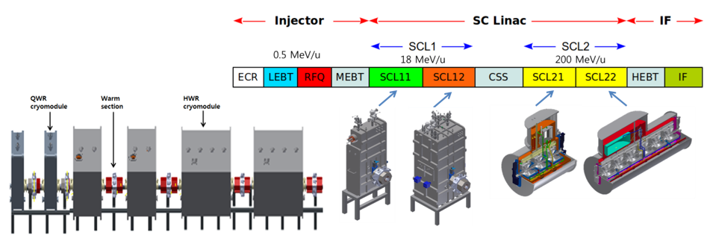
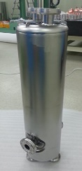
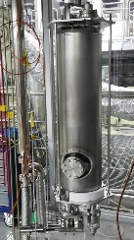
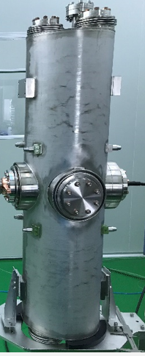
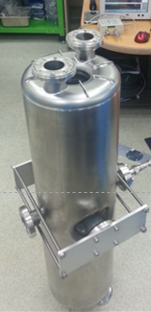
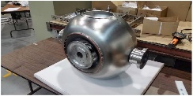
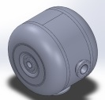
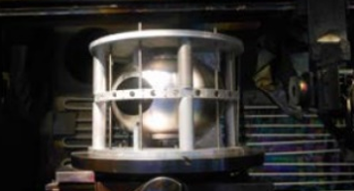
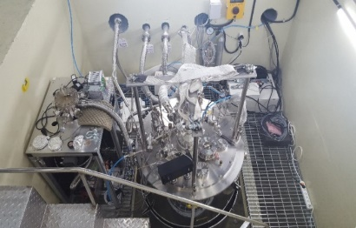
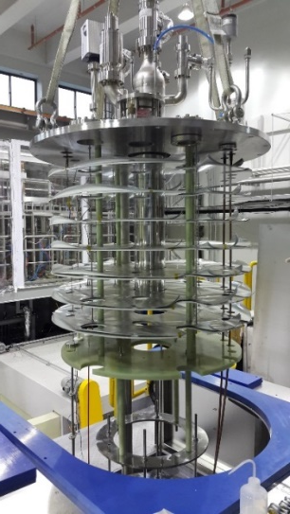
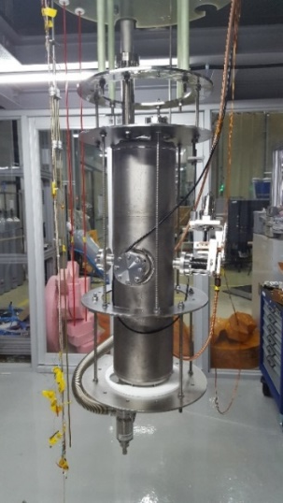
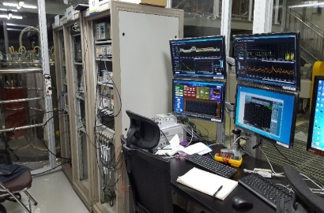
SuperConducting Linear accelerators (SCL3, SCL2)
SCL3
(QWR, HWR)
Conceptual design
Prototype
Test and Manufacturing
Installation
Commissioning
Operation
2011 ~ 2012
~ 2016
~ 2018
2019
2020
2021
SCL2
(SSR1, SSR2)
Conceptual design
Prototype
Test and Manufacturing
Installation & Commissioning
Operation
2011 ~ 2012
~ 2018
~ 2019
~ 2021
2022
SSR2
QWR
HWR
Superconducting cavity test
• SRF test facility @ KAIST Munji Campus
• Manufacturing and Performance test for QWR x 4, HWR x 6, SSR1 x 1 is under way (‘18)
<Result of HWR cavity performance test>
<Cavity test pit, Cryostat, Control room>

Slide 14
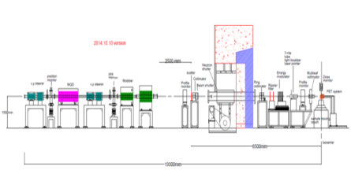
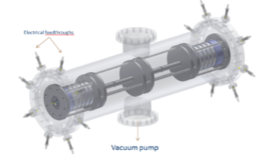
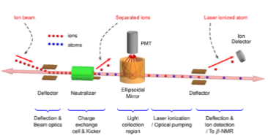
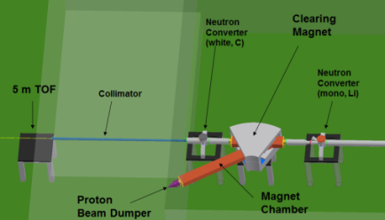
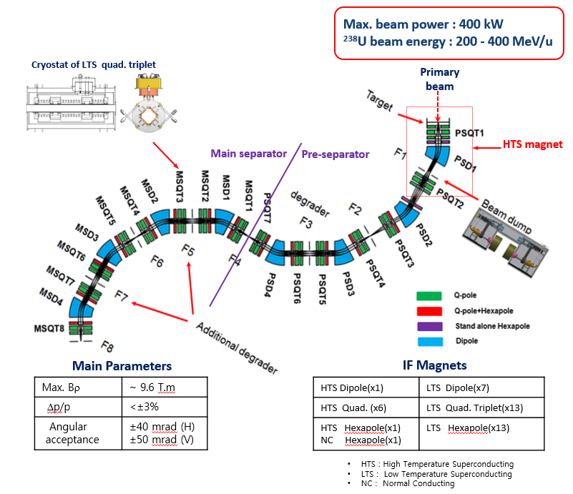
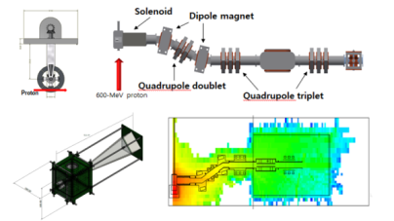
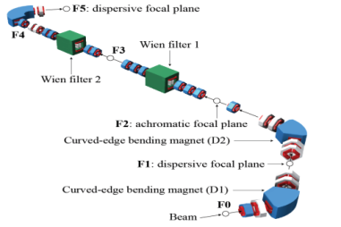
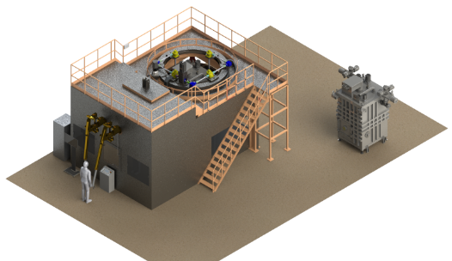
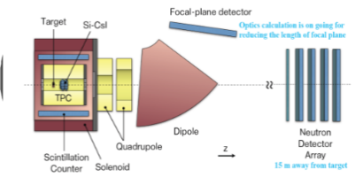
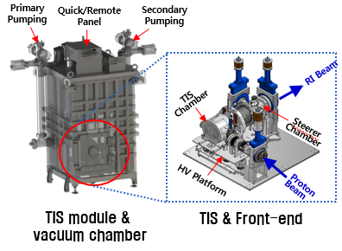
RAON Layout : RI & Experimental System
Bio-medical facility
HPMMS
CLS
Neutron Facility
IF
Low Energy Exp. Bldg
Ultra-low Exp. Bldg
High Energy Exp. Bldg
μSR
KOBRA
ISOL
LAMPS

Slide 15
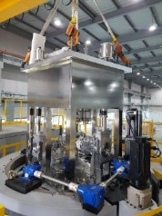
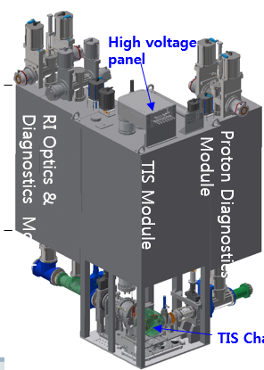
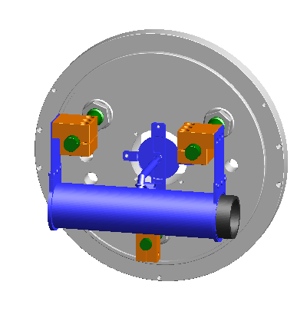







ISOL System
Conceptual design
Prototype
Manufacturing
Installation
Commissioning
Operation
2011 ~ 2012
~ 2017
~ 2019.3
~ 2020.7
2021.6
2021
System | Specification | Current Status
Target Ion Source | ㆍUCx Fission Target 10kW ㆍSIS, RILIS, FEBIAD | ㆍManufacturing(partly)
Beamline, Remote handling, Hot cell System (incl. A/q Separator) | ㆍR_{A/q} : ~200 (for EBIS) ㆍE + B Combination | ㆍPurchasing process
RFQ cooler & Buncher | ㆍCooling time : <100 ms ㆍTransmi. Effi. : >50%(Sn) ㆍOutput emittance: <3 ㆍCapacity: <10⁸ ions/bunch | ㆍUnder design
EBIS-Charge Breeder | ㆍE/A : 10 keV/u ㆍA/q : 10 keV/u ㆍEffi. : 15%(¹³³Cs²⁷⁺) ㆍBreeding time: 50~100 ms ㆍCapacity: <10⁸ /bunch | ㆍStart integrate assembling - E-gun/collector - SC solenoid - Drift tube ㆍBreeding test (‘18.12~)

Slide 16

IF System
Conceptual design
Prototype & Test
Manufacturing
Installation
Commissioning
Operation
2011 ~ 2012
~ 2018
~ 2020.11
~ 2021.7
2021.12
2022~

Slide 17




KoBRA (KOrea Broad acceptance Recoil spectrometer and Apparatus)
Conceptual design
Prototype & Test
Manufacturing
Installation & Commissioning
Operation
2011 ~ 2012
~ 2017.9
~ 2019.4
~ 2020.12
2021.1~
A first part of stage1 (stage1 part1) has been contracted with foreign and domestic companies in April 2018, and production is ongoing.
The present design of second part of stage1 (stage1 part2) was finally decided among the various design options in June 2018 by consultation with domestic potential users, and is scheduled to bid in August 2018.
Stage1 will be installed in Low Energy Experimental room (E1) until the end of June 2020.
The commissioning of Stage1 will be started from beginning of 2021 with stable ion beam.
PPAC
- We have 2 10 x 10 cm², 2 20 x 20 cm², 1 40 x 20 cm² active area PPACs
- 4 10 x 10 cm² and 1 40 x 20 cm² PPACs will be produced
SSD
- We have 2 5 x 5 cm² active area, 50 μm thick, 16 channel SSD
- Energy resolution ~ 0.7%, S/N ~ 272 for 5.486 MeV α inside vacuum
Stage 1
Plastic scintillator detector
- We have 2 10 x 10 cm² active area, 100 μm thick both side readout
plastic detector
- Time resolution < 42 ps for 5.486 MeV α inside vacuum

Slide 18


Slide 19





LAMPS (Large Acceptance Multi-Purpose Spectrometer)
Conceptual design
Prototype & Test
Manufacturing
Installation
Commissioning
Operation
2011 ~ 2012
~ 2018.12
~ 2020.12
~ 2021.7
2021.12
2022~
Beam Energy: up to 250 MeV/u
Solenoid Spectrometer
- Max. 1T solenoid magnet
- TPC (~ 3π sr acceptance, charged particle tracking)
- Scintillation counter (trigger & ToF)
Neutron Wall (neutron tracking)
Solenoid Magnet
Time Projection Chamber (TPC)
Forward Neutron Detector Array
- Test with prototype of TPC completed
- Fulfill the requirement of TPC
- Based on test results, change TPC design
Both side readout → one side readout
P-10 gas → P-20 gas
Design change
- Normal to superconducting magnet
- Coil radius: 1 m → 0.8 m
- Fulfill requirement
operation B-field: 0.5 T
maximum B-field: 1 T, ΔB/B < ±1% at Time Projection Chamber region
- Completed all R&D processes
- Finalized Array frame design
- Detector production in progress
2 veto detectors (total: 20)
10 neutron detectors (total: 160)
- Complete integration & test by the middle of 2019

Slide 20



High Precision Mass Measurement System (MR-TOF)
Conceptual design
Manufacturing & Test
Installation
Commissioning
Operation
2011 ~ 2012
~ 2020.1
~ 2020.10
~ 2021.12
2022~
MRTOF-MS construction under the collaboration
R&D work, led by WNSC MRTOF group (Leader : Prof. Wada)
Additional beam line to the MRTOF-MS, already constructed (2017)
Differential pumping system, gas cell (or catcher), Trap system, and MRTOF analyzer have been assembled, waiting for offline ion source test.
Test of the differential pumping system with the gas cell filled with 1 mbar helium gas, performed : 3.4x10⁻⁴ Pa upstream side (acceptable)
Optimizing the beam transmission through the φ 2-mm gas cell hole, performed : 72% efficiency, but will be improved by additional beam steerer.
A picture of MRTOF-MS system and others
at RISP-KEK/WNSC
Gas cell (catcher)
Trap system

Slide 21
Summary & Outlook
Accelerator
Mass production for SCL3 is under way
SCL2 is under pre-production phase
From April, 2019, installation for SCL will start from SCL3
Test facility for cavities and cryomodules will operate from next Jan.
By the end of 2021, we will achieve
SI beams: Stable ion beams (¹⁶O, ⁴⁰Ar) from ECRIS → SCL3 → low E exp hall
RI beams: RIBs extraction from ISOL → re-acceleration through SLC3 → low E exp hall
Stable / RI beams will be delivered to low-E experimental hall
Early phase experiments are going to be performed using KOBRA (with low intense RI beams)
RIBs production at KOBRA (A<~50, beam energy < 20 MeV/u) using SI beams from SCL3
Beam commissioning starts for SCL2
Installation and commissioning for IF, LAMPS, Neutron, bio-medical and muSR
→ Collaborative works with RUA (RAON Users Association) via RULC (RAON Users Liason Center)
Post RISP (2021 ~ )
Beam acceleration for ISOL → SCL3 → SCL2 → IF (ISOL+IF)
Beam commissioning and experiments for IF, LAMPS, Neutron, bio-medical and muSR
Ramping-up to get the 400kW beams (more 5 yrs)
Energy upgrade to 400MeV/u (require budget)

Slide 22

Thank you

