Slide 1

Constraining the effective mass dependence of nuclear symmetry potential with heavy-ion collisions
Zbigniew Chajęcki
Western Michigan University
for the HiRA Collaboration

Slide 2
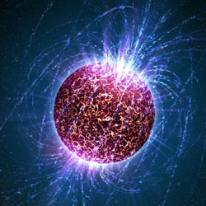
Anatomy of Neutron Stars
Neutron stars are a rich playground for the EoS and symmetry energy
Inner crust: ρ < ρ₀
Mix of neutron gas and lattice of finite nuclei
S(ρ) determines the thickness of the crust, frequency of star quakes
Boundary region → pasta
Outer core: ρ > ρ₀
Neutron-rich nuclear matter
Determines radii, moments of inertia
Inner core → ????
Photo credit: Casey Reed
Need to know both high and low density S(ρ) to understand neutron stars. Only laboratory measurements allow us to probe the nuclear matter at various densities.

Slide 3
Symmetry energy How does the potential energy of nuclear matter depend on density and momentum?

Slide 4
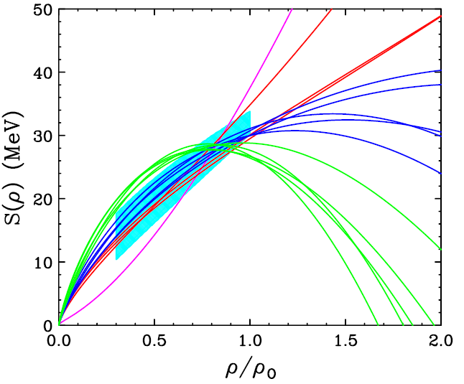
Symmetry Energy
E/A (ρ,δ) = E/A (ρ,0) + δ²⋅S(ρ)
δ = (ρ_{n}- ρ_{p})/ (ρ_{n}+ ρ_{p}) = (N-Z)/A
To probe the EOS of asymmetric nuclear matter (neutron stars) we need to be able to study the nuclear matter at various densities and asymmetries
The only way we can do it in the laboratory is via heavy ion collisions:
nucleus – nucleus collisions at higher densities ⇒ require higher beam energies and new detectors
Increase sensitivity to symmetry energy by increasing δ (asymmetry between the # of neutrons and protons)
Stiff
Soft

Slide 5
Density Dependence of Symmetry Energy Potential
δ=0.3
E/A (ρ,δ) = E/A (ρ,0) + δ²⋅S(ρ)
δ = (ρ_{n}- ρ_{p})/ (ρ_{n}+ ρ_{p}) = (N-Z)/A
stiff
n and p potentials have opposite signs and slightly different density dependence
soft
U_{asy} (MeV)
Observables:
n vs p and t vs ³He emission and flow
Pion production
Correlations
Isospin transport ratios
….
u =

Slide 6
Reaction probes: Isospin multiplets
Y_{n}(E_{CM})
Y_{p}(E_{CM})
δ=0.3
R_{n/p}(E_{CM})=
stiff
PLB 664 (2008) 145
soft
U_{asy} (MeV)
Soft
Stiff
E_{CM} (MeV)
repulsive (attractive) potential for neutrons (protons) enhances (suppresses) the neutron (proton) emission
u =
¹²⁴Sn: 50 protons, 74 neutrons δ~0.20

Slide 7
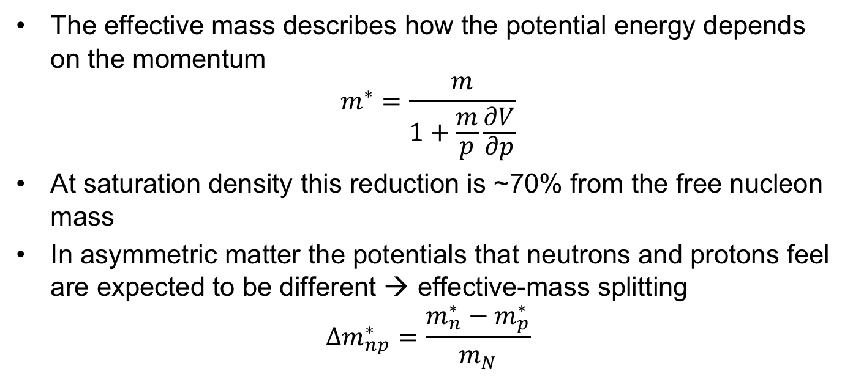
Momentum Dependence of Symmetry Energy Potential
Effective mass
The effective mass describes how the potential energy depends on the momentum
$$m^{∗}=\frac{m}{1+\frac{m}{p}\frac{∂V}{∂p}}$$
At saturation density this reduction is ~70% from the free nucleon mass
In asymmetric matter the potentials that neutrons and protons feel are expected to be different → effective-mass splitting
$${Δm}_{np}^{∗}=\frac{m_{n}^{∗}−m_{p}^{∗}}{m_{N}}$$

Slide 8
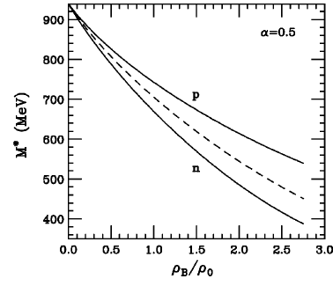
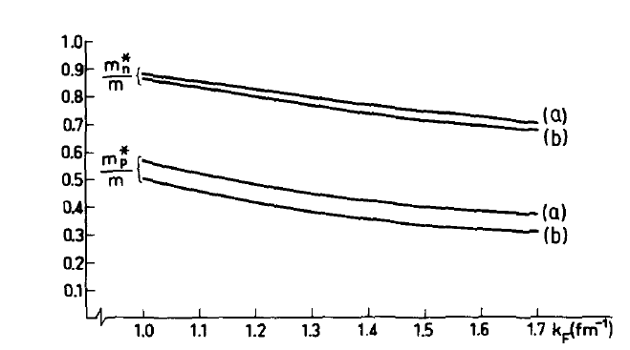
Effective-mass splitting
Neutron-rich systems show effective-mass splitting
Landau-Fermi Liquid Theory
RMFT
O. Sjoberg, Nuc Phys A265, 511-516 (1976)
B. Liu, et al Phys Rev C65, 045201, (2002)
Theoretical models disagree whether $m_{p}^{∗}>m_{n}^{∗}$ or $m_{n}^{∗}>m_{p}^{∗}$

Slide 9
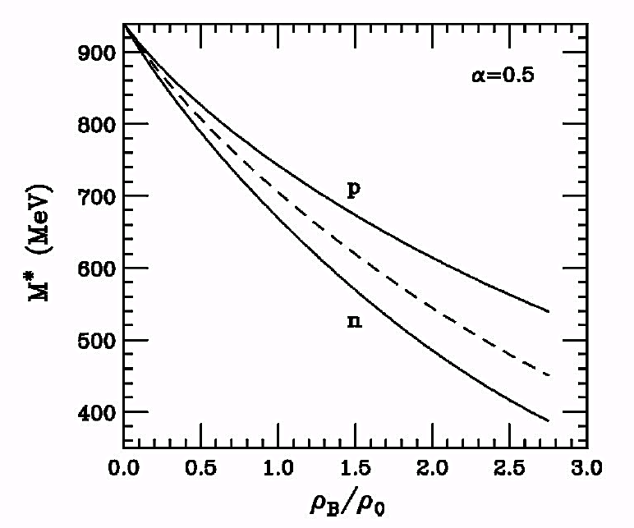
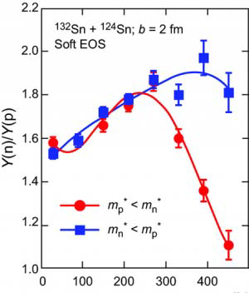
Influence of effective mass
Transport simulations: ¹³²Sn+¹²⁴Sn
J. Rizzo et al, Phys. Rev. C72, 064609 (2005)
m*_{n}<m*_{p} - more neutrons accelerated to high energies
B. Liu et al. PRC 65(2002)045201
p_{T} [MeV/c]
acceleration:
m*_{p}<m*_{n} - more protons accelerated to high energies
High energy sensitive to effective mass

Slide 10
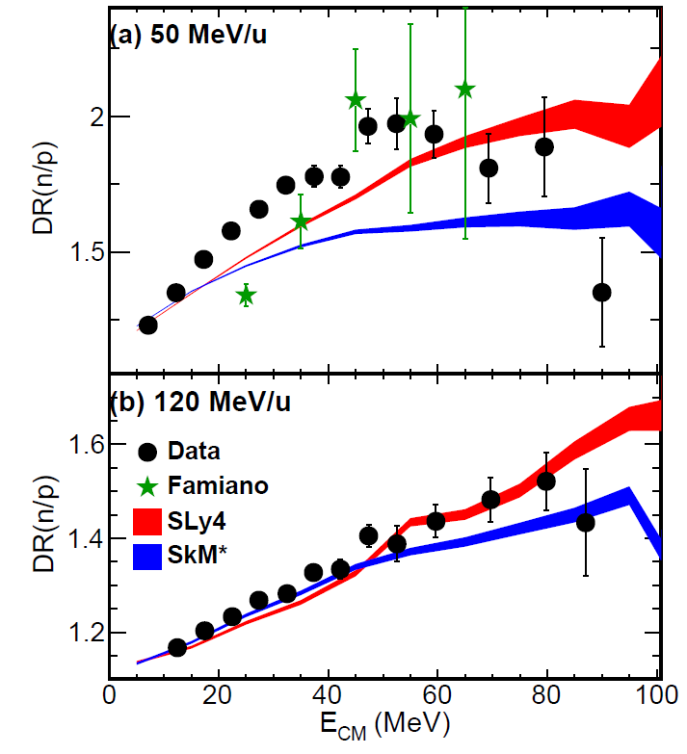
Constraining effective mass (I)
Current status
Divide n/p ratios for two reactions
Minimize systematic uncertainties in detection efficiencies of neutrons and charged particles
Reduces effects from the Coulomb force
Uncertainties large between theory and experiment
m_{n}*<m_{p}*
m_{n}*>m_{p}*
m_{n}*<m_{p}*
m_{n}*>m_{p}*
D. D. S. Coupland et al, PRC 94, 011601 (R) (2016)

Slide 11
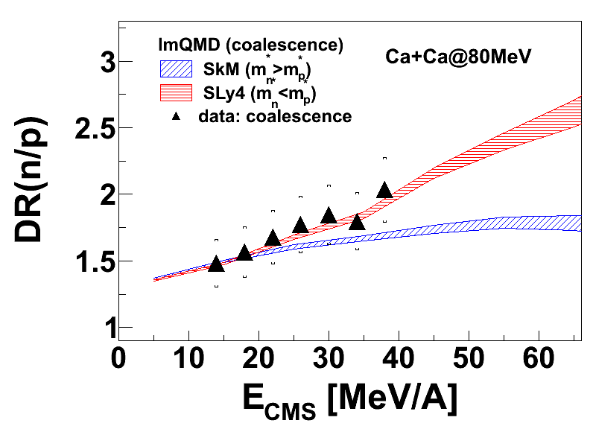
Constraining effective mass (II)
Current status
Use coalescence n/p spectra
Obtain pseudo-neutrons from chemical potential scaling. Don’t need to measure neutrons.
m_{n}*<m_{p}*
m_{n}*>m_{p}*

Slide 12
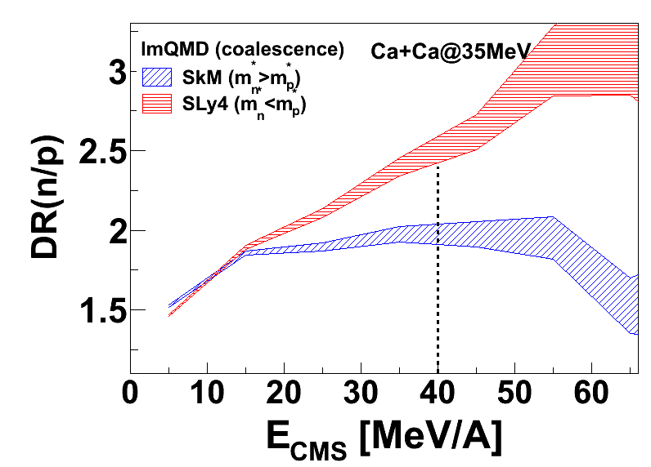
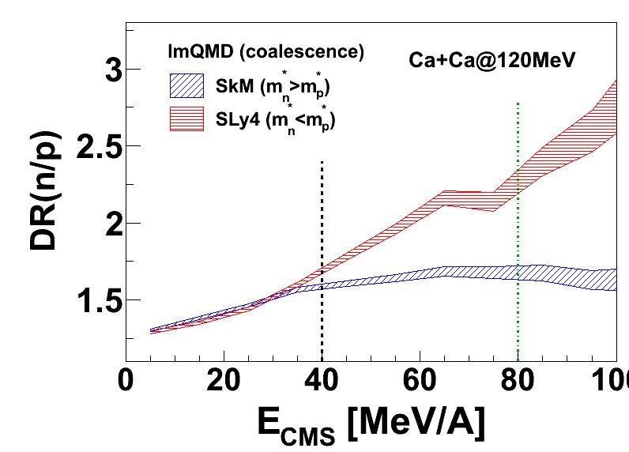
Motivation for recent
experiment
Improvements:
Single ratio has better sensitivity BUT need better understanding of experimental system → simulations
Need to probe at higher energies
Requires upgrade to our experimental setup
Need to measure particles at energies > 40MeV/A to constrain the effective mass of n and p.
- requires detector upgrades

Slide 13
Experimental details
Goal is to measure the n/p spectral ratios for a series of heavy-ion collisions
The Ca+Ni systems are easy/reliable to calculate with transport models
The Ca+Sn is more sensitive to the momentum dependence
We ran beams of ^{40,48}Ca on 4 targets (systems in the table), measuring the neutrons and light-charged particles emitted
Main improvements over previous work (details to follow)
Development of a charge-particle veto wall to fully cover the neutron walls
Extended length CsI crystals → high E protons
Beam | Target | δ_{np}
⁴⁰Ca | ⁵⁸Ni/⁶⁴Ni | 0.020/0.077
⁴⁰Ca | ¹¹²Sn/¹²⁴Sn | 0.079/0.146
⁴⁸Ca | ⁵⁸Ni/⁶⁴Ni | 0.094/0.143
⁴⁸Ca | ¹¹²Sn/¹²⁴Sn | 0.125/0.186
δ_{np}= (n_{sys}–p_{sys})/(n_{sys}+p_{sys})
8 systems at two different energies (56 and 140 MeV/A)

Slide 14
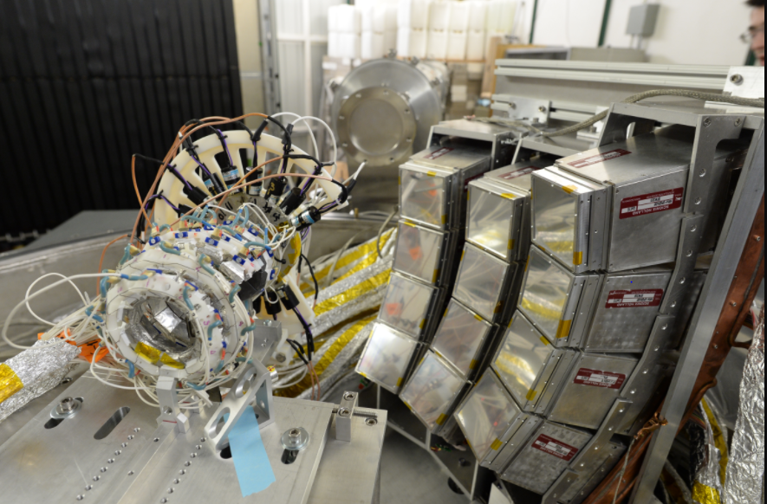
Experimental setup
NW
VW
HiRA
FA
Beam
Microball

Slide 15
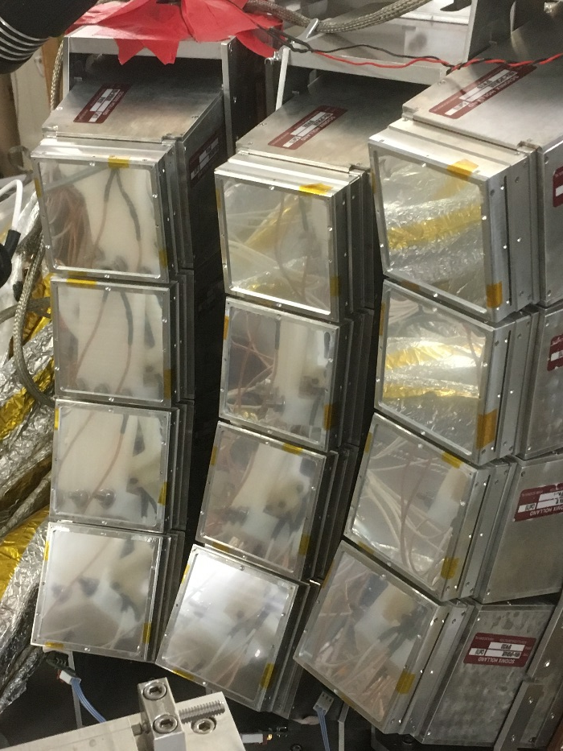
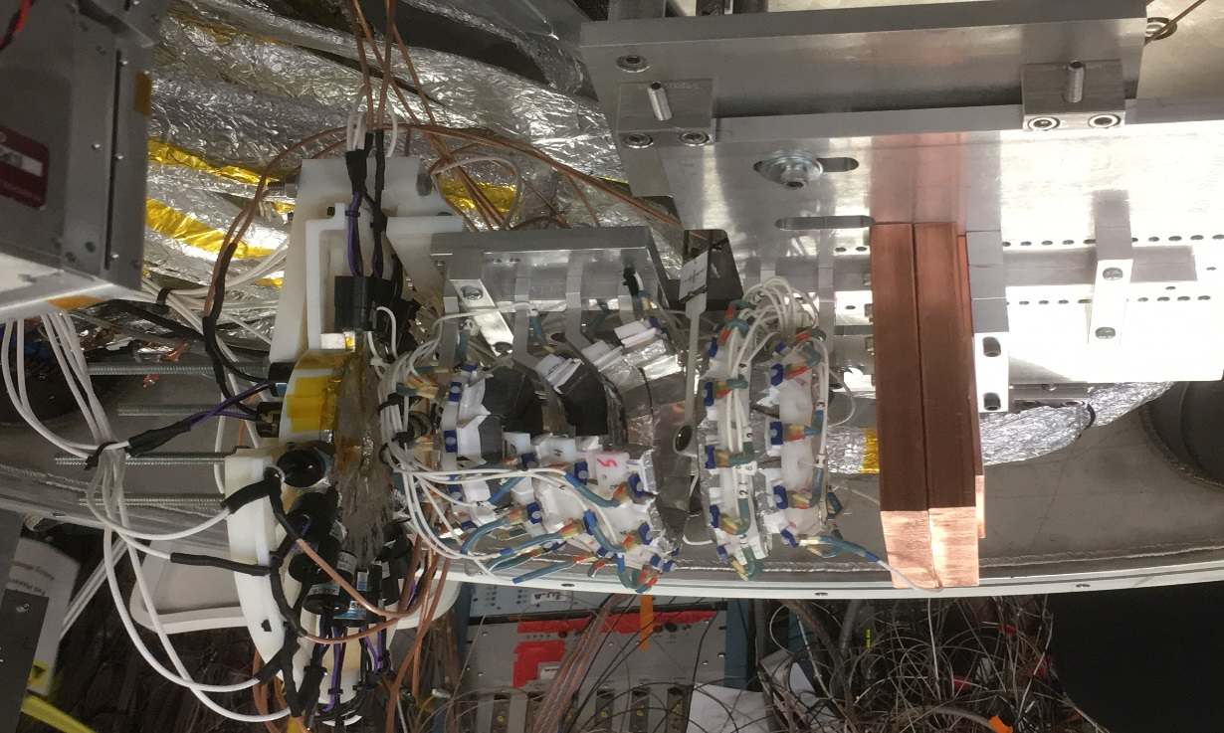
Experiment: Charged particle detection
Upgraded HiRA10
Microball
12 Silicon-CsI(Tl) telescopes
Each telescope has 4, 10-cm CsI(Tl) crystals and a 1.5mm thick DSSD with 32 strips on each side
At ~50 degrees off the beam axis, covers ~30 to ~70 degrees
Rings of CsI Crystals
Used as a Multiplicity trigger
Used for impact parameter determination

Slide 16
Experimental setup
NW
VW
HiRA
FA
Beam
Microball

Slide 17
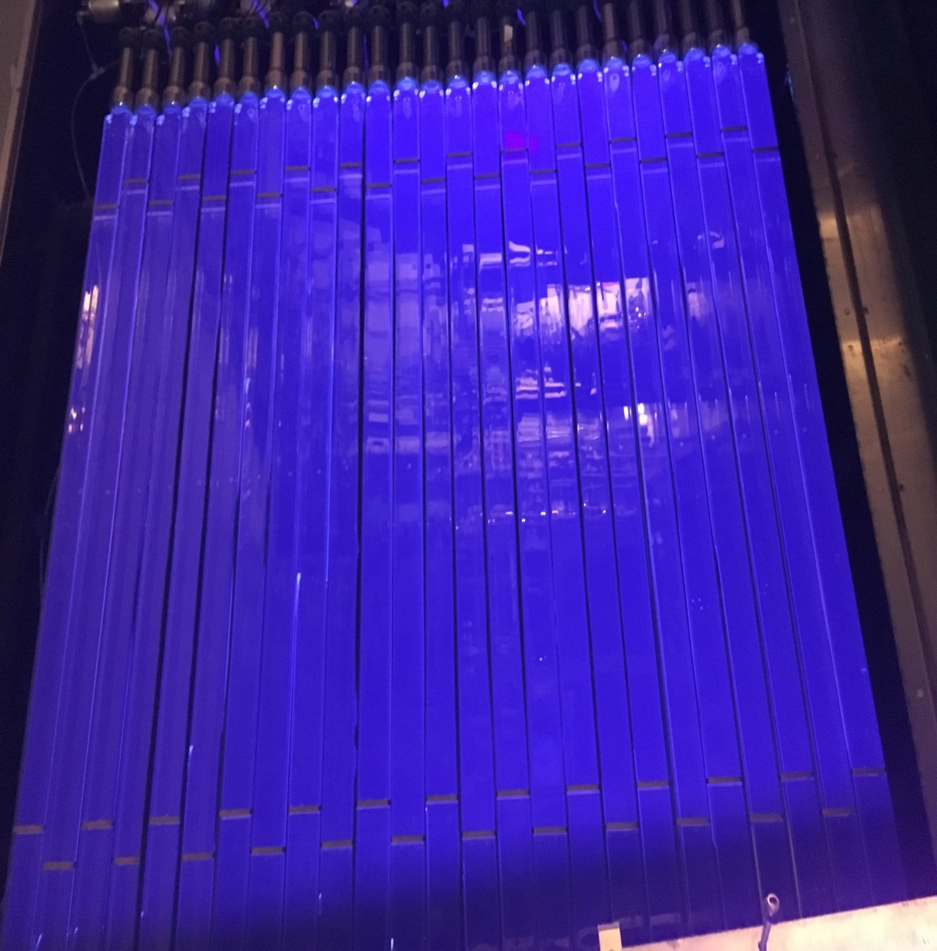
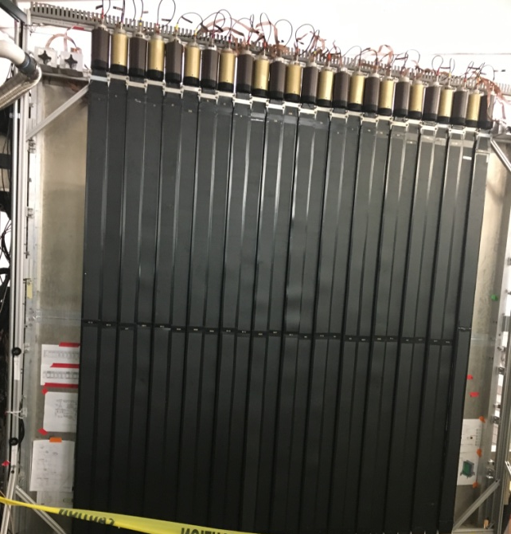
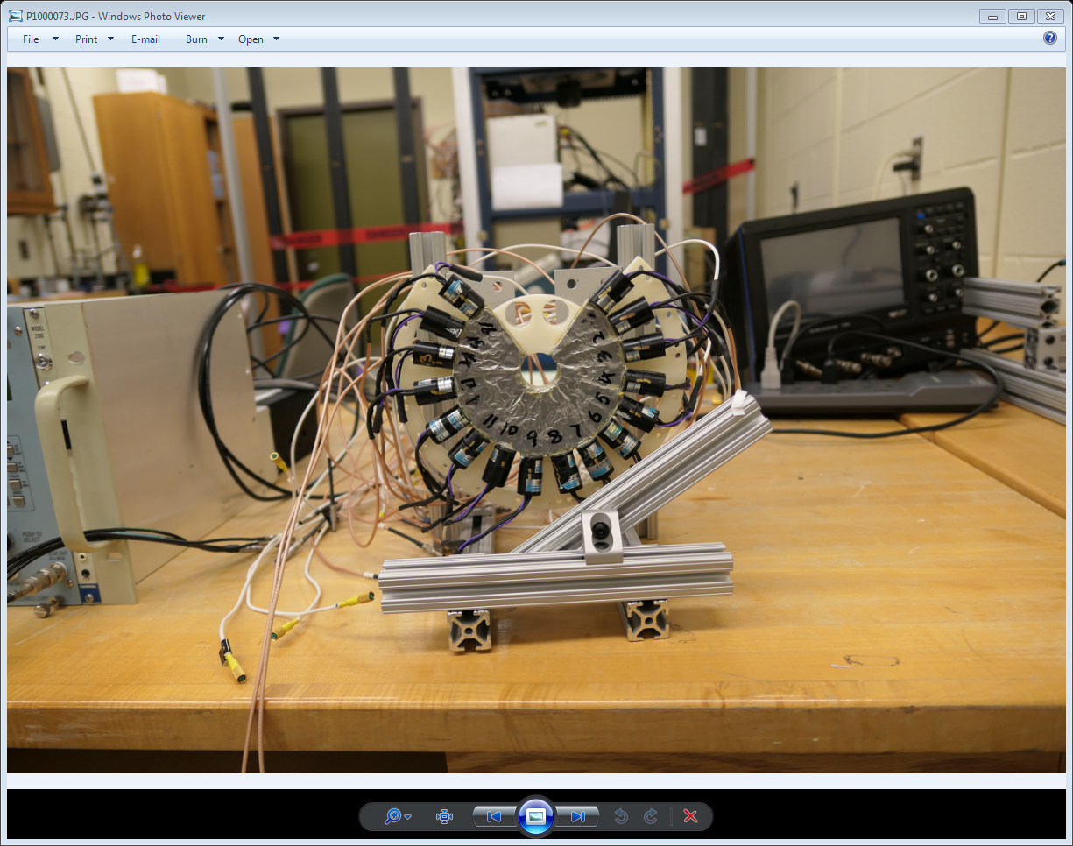
Neutron detection
Neutron Walls
Proton Veto Wall
Forward array
Made at WMU
25 Plastic Scintillator bars
Used to remove charged particles from the NW Spectra
18 Plastic scintillator wedges
Used as the start time for the neutron time of flight
Use NE-213 liquid scintillator for Pulse Shape Discrimination

Slide 18
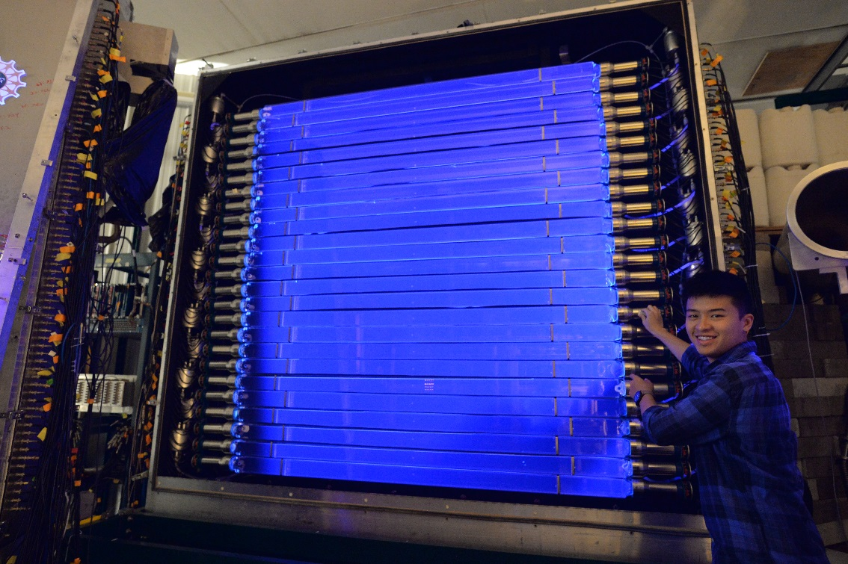
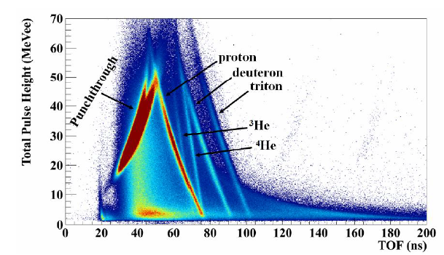
Large Area Neutron Array
LANA is comprised of:
Two Walls of 25 scintillator bars
2 meters long, 7.7 cm square cross-section
NE-213 liquid scintillator
In previous work, the veto of charged particles was not perfect
The veto detector was small, close to the target and did not have position information in 2D; Not all of the charged particles could be rejected

Slide 19
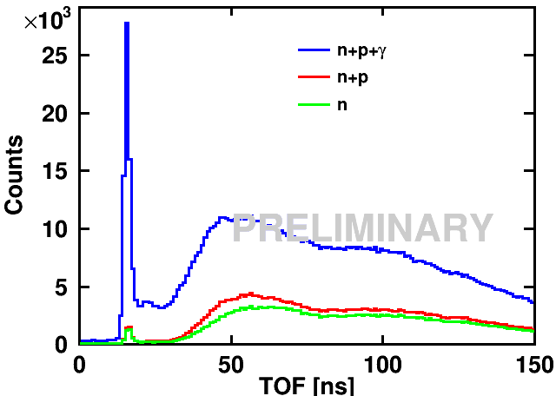
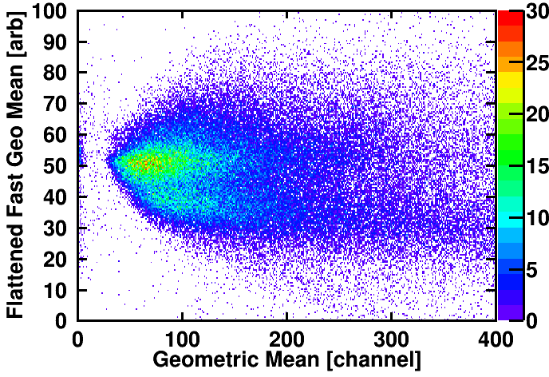
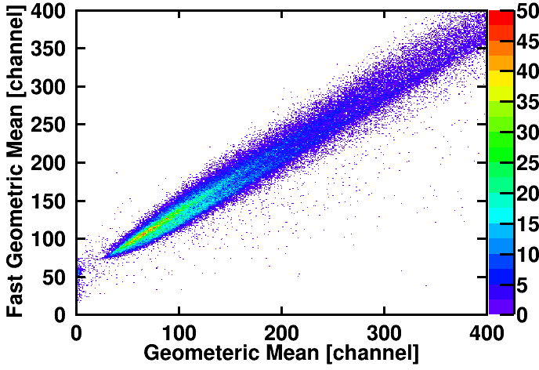
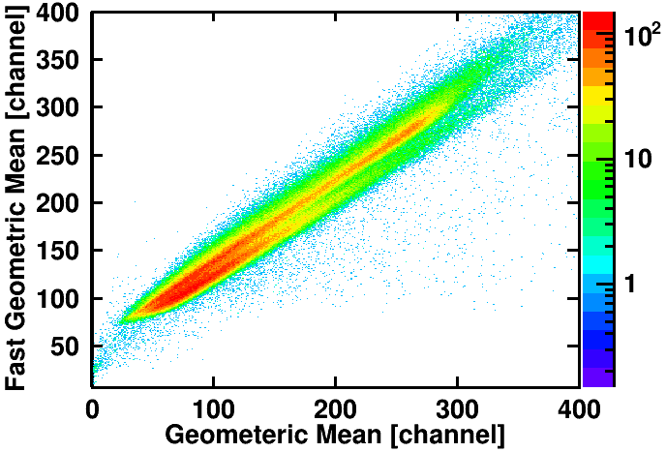
Analysis: Neutron Walls
PSD gates checked initially with ²⁴¹AmBe source. >24Hrs of data for both walls
In raw fast vs total, separation good but not ideal
A flattening algorithm is employed to improve this separation
Then using the start time from the Forward Array, TOF spectra can be made
Gates are drawn on the 2D spectrum for neutrons and gammas
Particles hitting the veto wall are rejected (to be improved)
KE spectra made using precise distance to each bar (laser measured)
Preliminary results
⁴⁸Ca+¹²⁴Sn, E/A = 56 MeV
γ
neutrons
Credit to Zhu Kuan

Slide 20
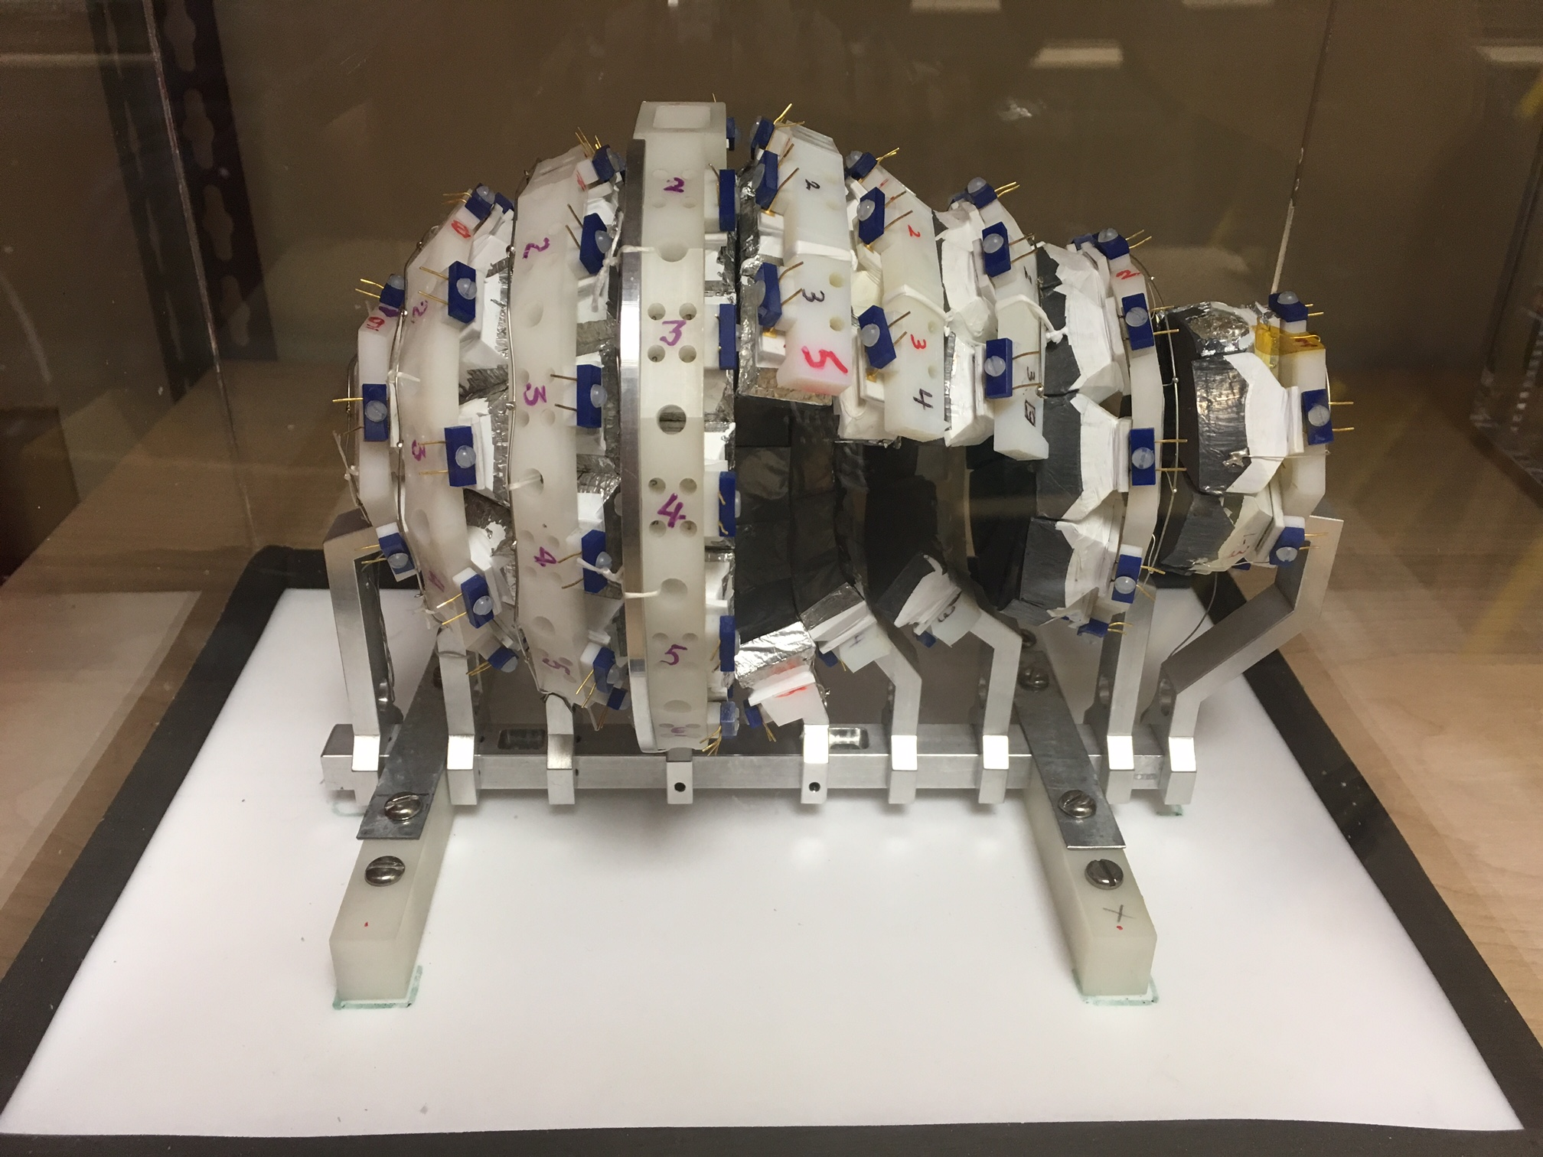
Experimental setup: Centrality
NW
VW
HiRA
FA
Microball
Beam
Microball

Slide 21
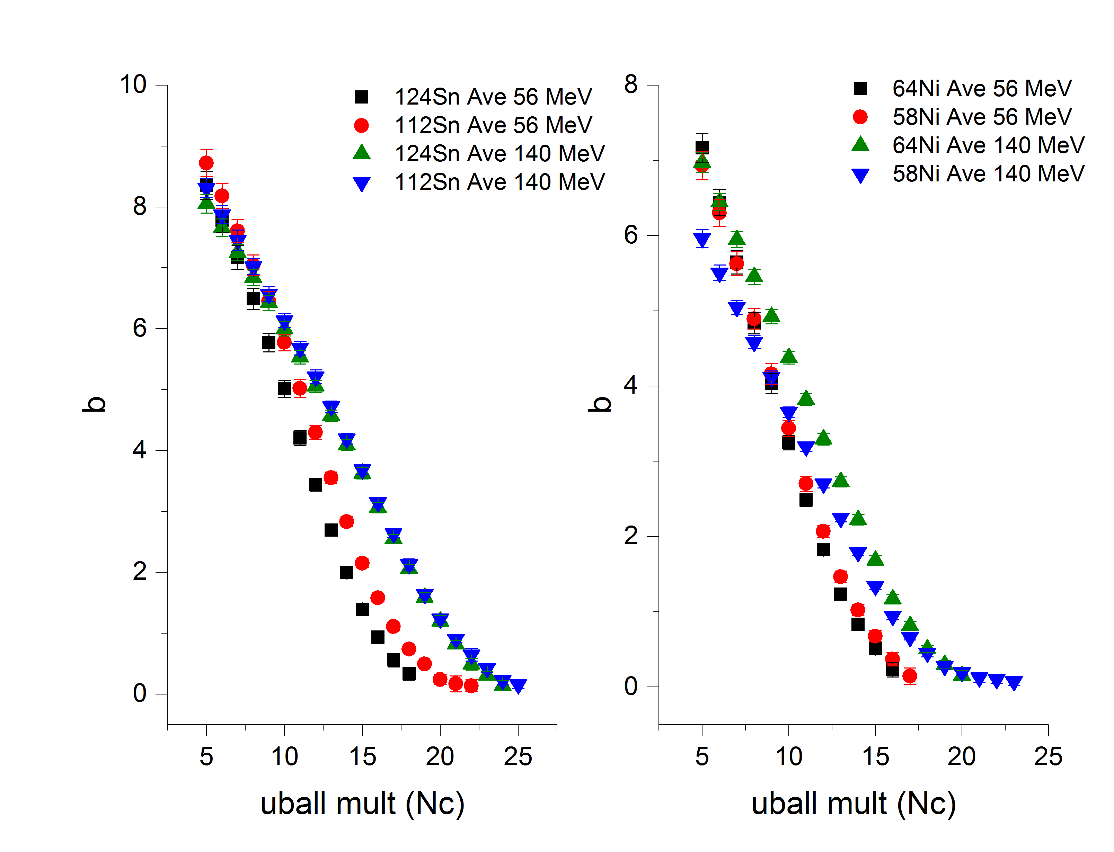
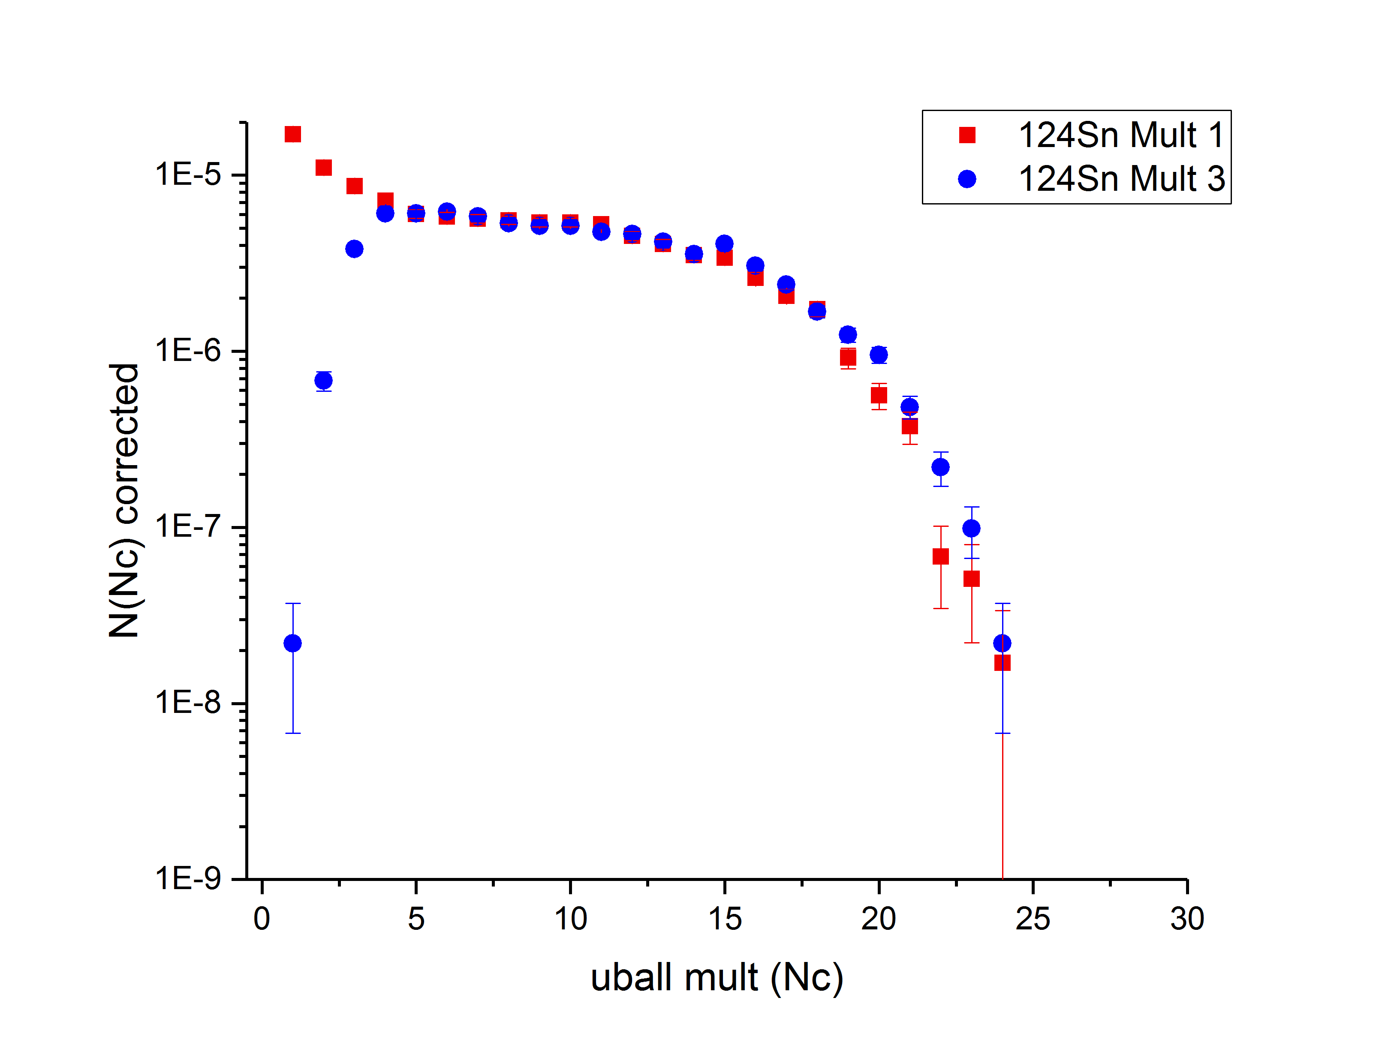
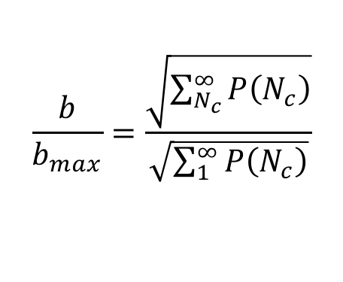
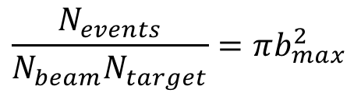
Analysis: Impact parameter selection
Impact Parameter ⁴⁸Ca Beam
We can relate the impact parameter to the normalized probability of detecting a certain charged-particle multiplicity
$$\frac{b}{b_{max}}=\frac{\sqrt{\sum_{N_{c}}^{∞}{P\left(N_{c}\right)}}}{\sqrt{\sum_{1}^{∞}{P\left(N_{c}\right)}}}$$
Preliminary
Have these
Need this
Assuming a geometric cross section
$$\frac{N_{events}}{N_{beam}N_{target}}=πb_{max}^{2}$$
Credit to Sean Sweany

Slide 22
Analysis is ongoing….

Slide 23
Summary
Heavy ion collisions provide a unique probe to study the physics of neutron stars in the laboratory - symmetry energy
Recent experiments at NSCL will allow us further constraints of symmetry energy and effective mass at various densities of nuclear matter and also to validate theoretical models
Collaboration between theorists and experimentalists beneficial for both sides

Slide 24
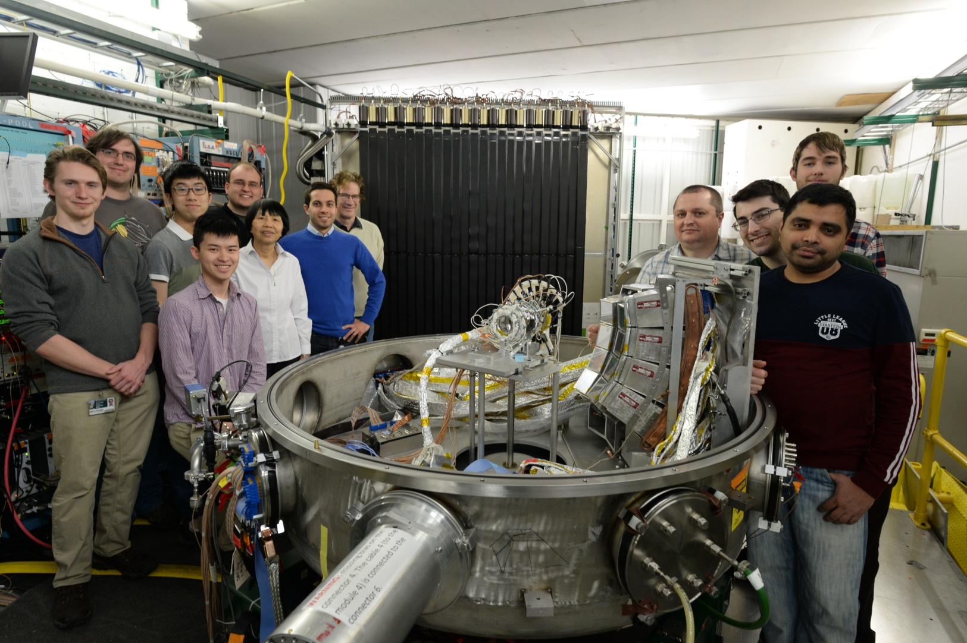
Thank you

Slide 25
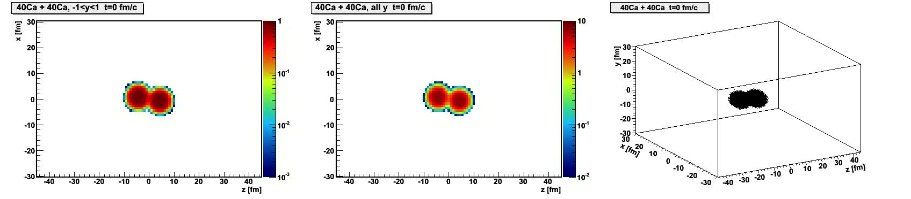
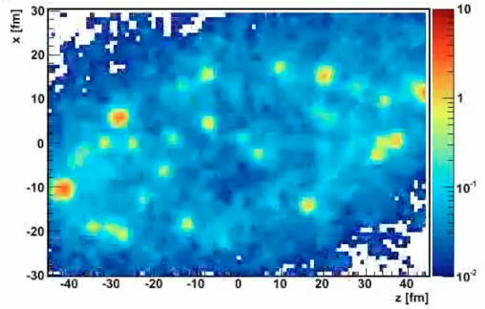
Modeling heavy ion collisions
Our tool: Transport models
BUU – Boltzmann-Uehling-Uhlenbeck
QMD – Quantum Molecular Dynamics
AMD – Antisymmetrized Molecular Dynamics
Simulates the time-dependent evolution of the collision
Main ingredients
Nucleons in mean-field
Symmetry energy
Momentum-dependent nuclear interaction ➔effective mass
In-medium cross section
Cluster production
Danielewicz, Acta. Phys. Pol. B 33, 45 (2002)
Danielewicz, Bertsch, NPA533 (1991) 712

Slide 26
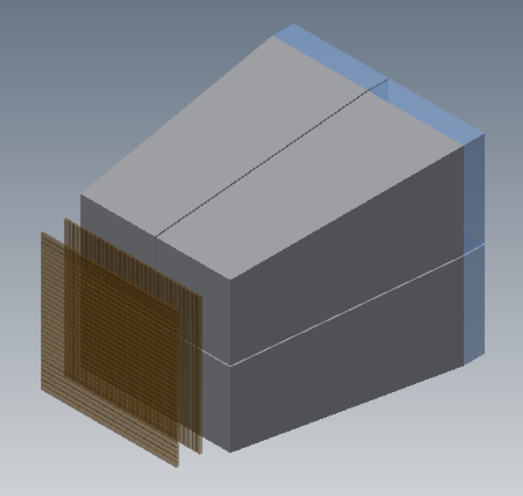
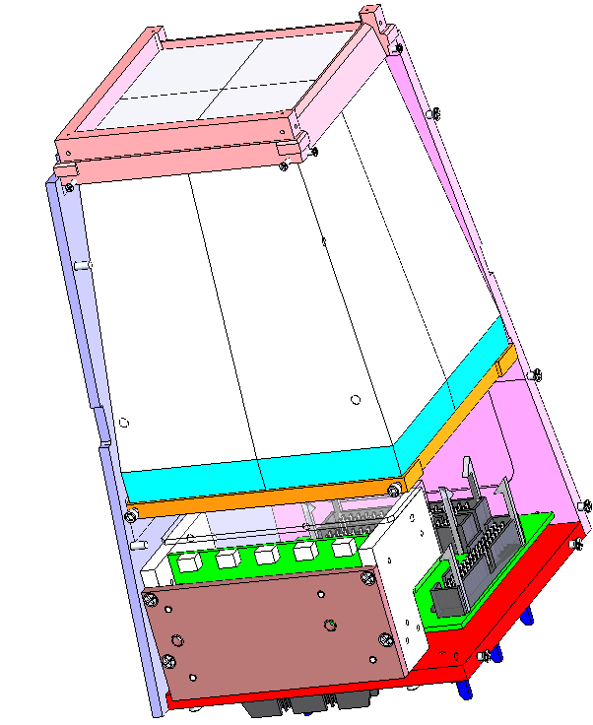
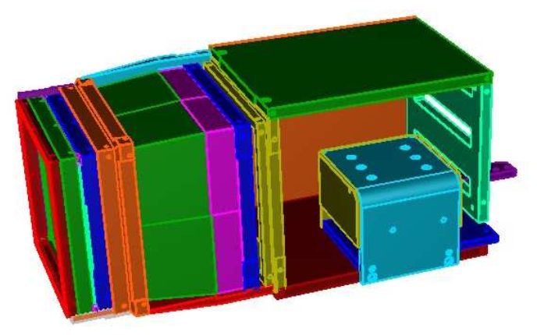
HiRA Upgrade
Old HiRA
HiRA Upgrade
Light Guides
CsI(Tl) Crystal
Double Sided Strip E (1.5mm)

Slide 27
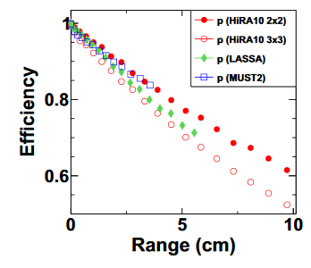
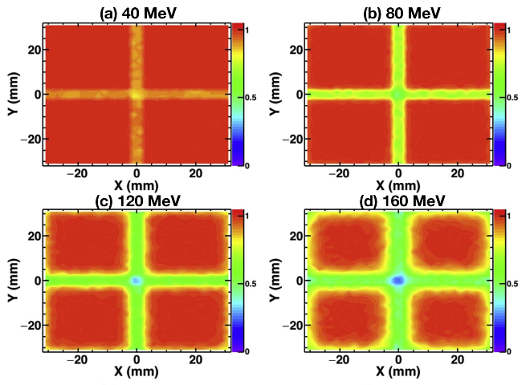
HiRA upgrade
We exchanged the 4-cm-long CsI(Tl) crystals for 10 cm crystals -> increased dynamic range
This increase comes at the cost of loss in efficiency due to out-scattering and nuclear reactions
This efficiency is also a function of energy, so the most dramatic losses will occur for the highest energy particles
Isotope | 4 cm CsI (MeV) | 10 cm CsI (MeV)
p | 116 | 200
d | 157 | 265
t | 186 | 314
P. Morfouace et al, NIM A 848, 45 (2017)

Slide 28

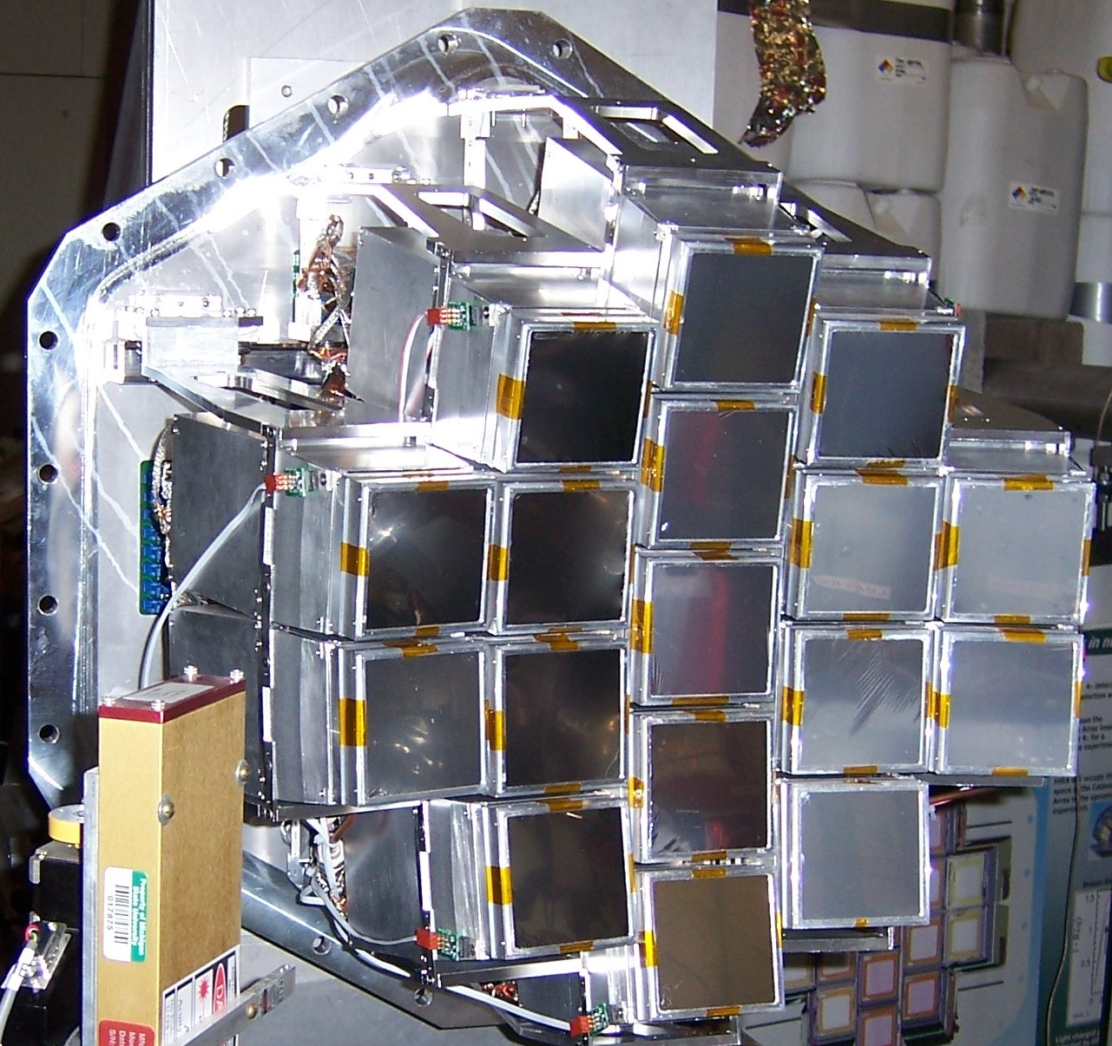
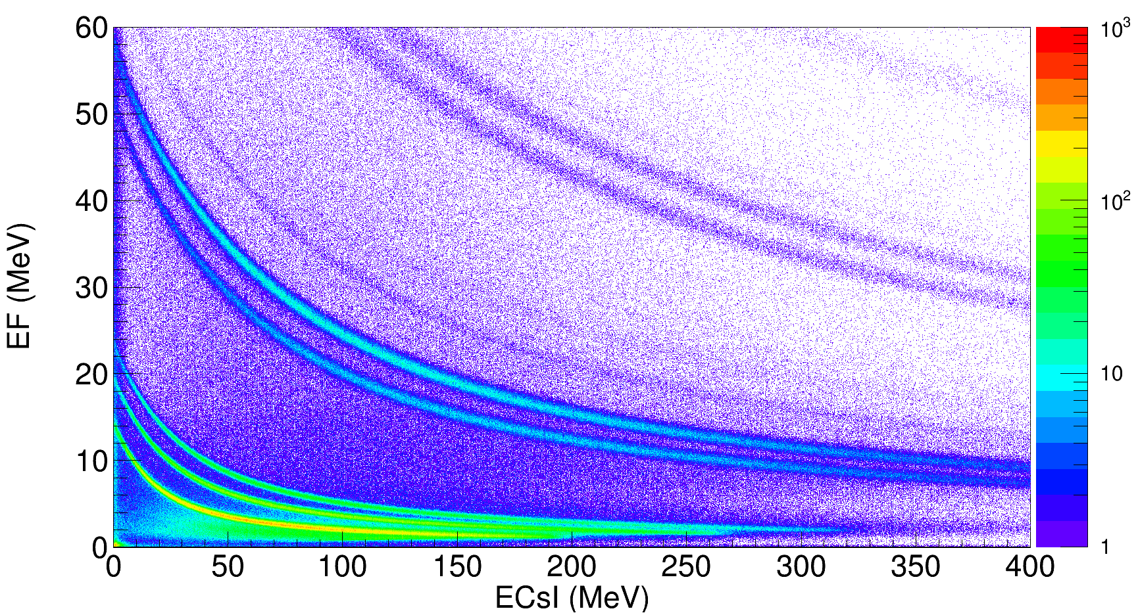
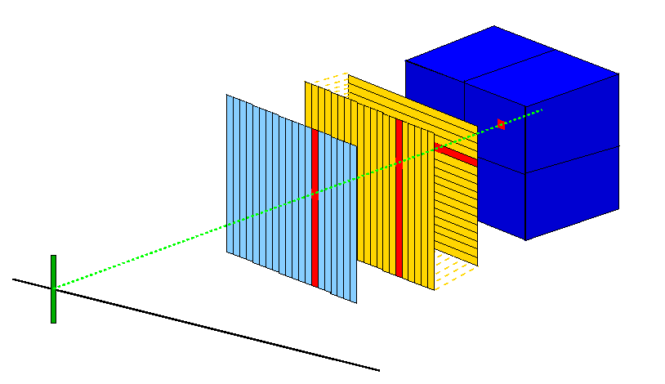
Charged particle identification
= High Resolution Array
Particle identification
⁷Li
⁷Be
⁶Li
⁴He
³He
t
Si-E 500 μm
4x CsI(Tl)
d
p
Si-ΔE 65 μm

Slide 29








