Slide 1
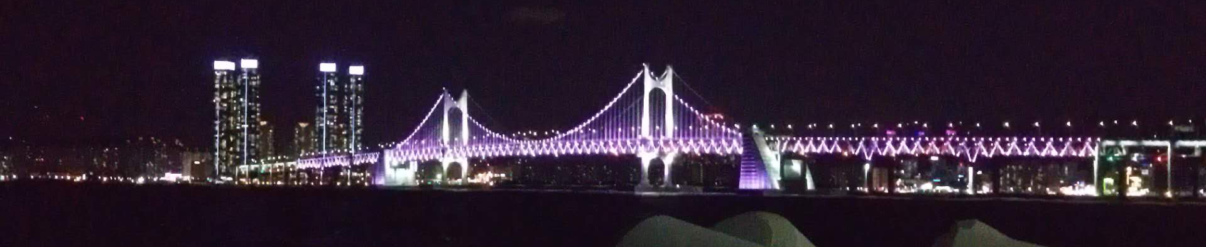
NuSYM18, BUSAN, Sep.10-14, 2018
Precise force calculation in QMD and theoretical study on in-medium NN-ND cross section
Yingxun Zhang(张英逊)
China Institute of Atomic Energy;

Slide 2
Outline
1, why? Requirements from the improvement of transport code
2, Precise force calculations in QMD and its influence
3, Isospin dependent medium correction on NN-ND xs
4, summary and outlook

Slide 3
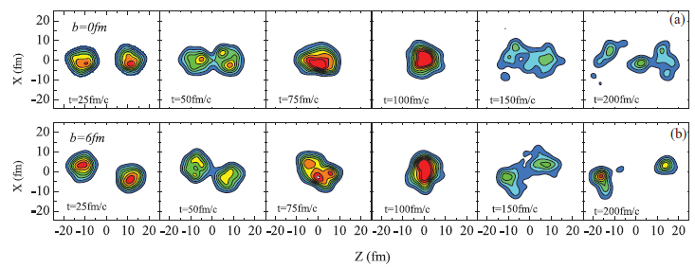
Transport model is used for simulating heavy ion collisions, and very important for understanding the reaction mechanism, extracting the nuclear equation of state, ….

Slide 4
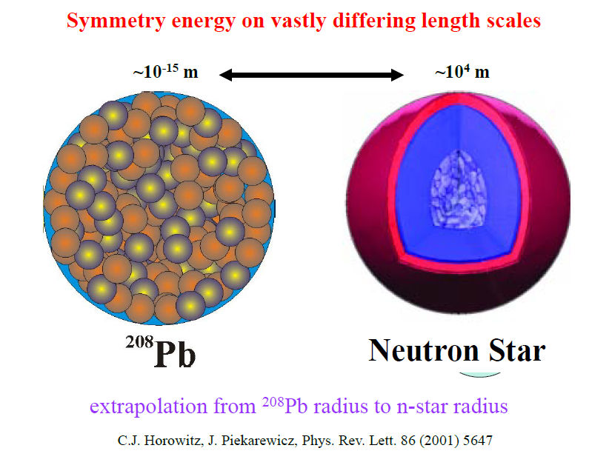
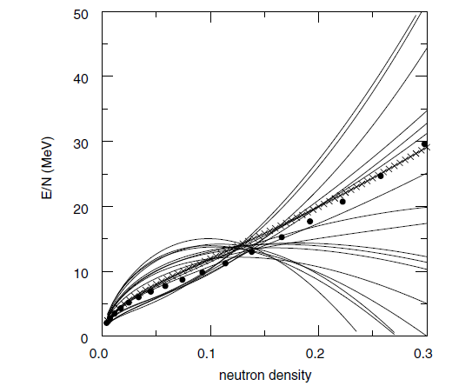
Isospin asymmetric Equation of State
It is a fundamental properties of nuclear matter, and is very important for understanding
properties of nuclear structure
properties of neutron star
properties of heavy ion reaction mechanism
Brown, PRL, (2000)
NEOS
Extract S(ρ) from HIC！

Slide 5
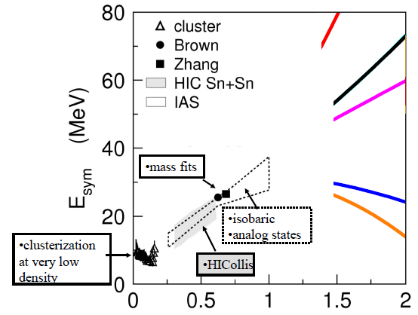
Constraints on the symmetry energy at suprasaturation density
Feng et al.
pions
Ko et al.
pions
Cozma
PRC 95, 014601 (2017)
pions
Hong et al.
PRC 90, 024605 (2014)
pions
Xiao et al.
pions
Xiao et al.
pions
Xie et al.
pions
Model dependent conclusions !
We need go back again to do re-search on transport models

Slide 6
Strategies for improving the transport codes:
1, understanding the difference of the different codes, and dig out the reasons:
Code comparison under control (transport code comparison project, 2009-2017, workshop after nusym18)

Slide 7
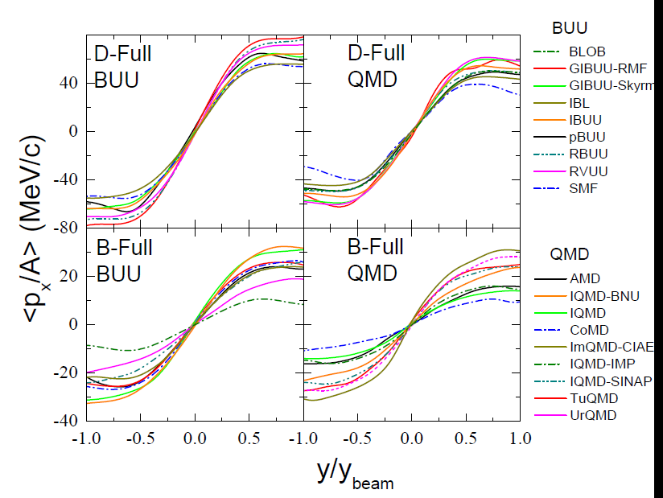
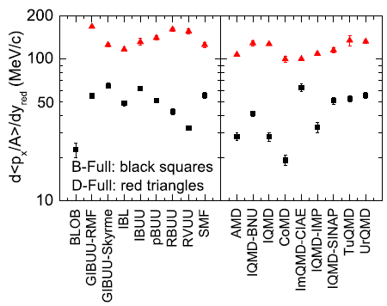
Results for real simulations HIC (all the above mentioned effects are mixed, and it leads to about 30% theoretical errors )
Xu, et al, PRC(2016)
Box simulations, benchmark the transport codes!
PRC97, 034625(2018)

Slide 8
2, improve transport models, before fitting the data
1, stability of initial nucleus,
2, mean field
3, in-medium cross section
……

Slide 9
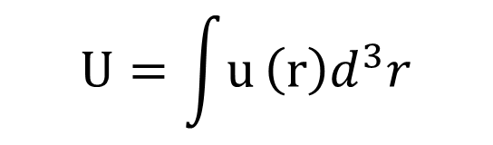

Improvements in transport model:
Precise force calculation
In QMD model, mean field part
$$ϕ_{k_{i}}\left(r\right)=\frac{1}{{\left(2πσ_{r}^{2}\right)}^{\frac{3}{4}}}\exp{[−\frac{{\left(r−R_{i}\right)}^{2}}{4σ_{r}^{2}}+\frac{{ip}_{i}}{ℏ}⋅\left(r−R_{i}\right)]}$$
$$\frac{∂<p_{i}>}{∂t}=<∇_{R}V(R)>≈−\frac{∂U\left(R_{1},…, R_{N}\right)}{∂R_{i}}$$
$$\frac{∂R_{i}}{∂t}=\frac{<p_{i}>}{m}$$
$$U=\int{u}\left(r\right)d^{3}r$$

Slide 10
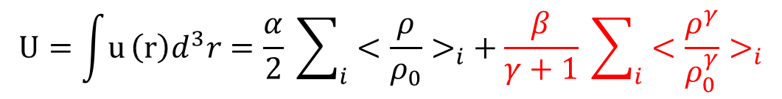
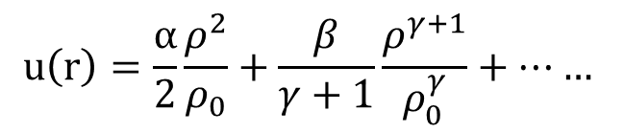
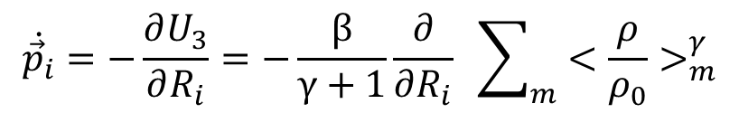
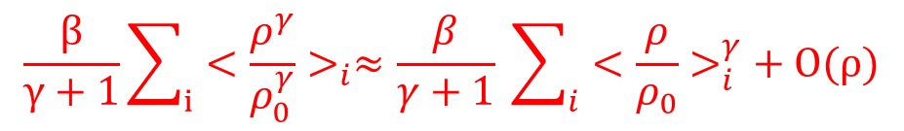
$$u\left(r\right)=\frac{α}{2}\frac{ρ^{2}}{ρ_{0}}+\frac{β}{γ+1}\frac{ρ^{γ+1}}{ρ_{0}^{γ}}+……$$
$$U=\int{u}\left(r\right)d^{3}r=\frac{α}{2} \sum_{i}{<{\frac{ρ}{ρ_{0}}>}_{i}}+\frac{β}{γ+1} \sum_{i}{<{\frac{ρ^{γ}}{ρ_{0}^{γ}}>}_{i}}$$
Gamma non-integer
$$\frac{β}{γ+1}\sum_{i}{<{\frac{ρ^{γ}}{ρ_{0}^{γ}}>}_{i}≈\frac{β}{γ+1} \sum_{i}{<{\frac{ρ}{ρ_{0}}>}_{i}^{γ}}}+O(ρ)$$
$$\dot{{\vec{p}}_{i}}=−\frac{∂U_{3}}{∂R_{i}}=−\frac{β}{γ+1}\frac{∂}{∂R_{i}} \sum_{m}{<{\frac{ρ}{ρ_{0}}>}_{m}^{γ}}$$
Is widely used in many QMD codes

Slide 11
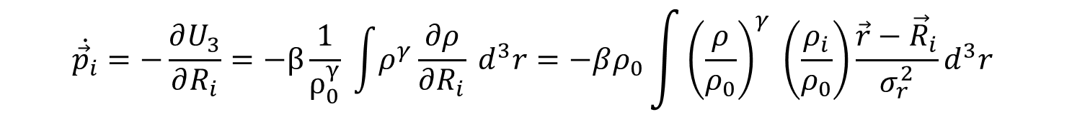
Zhang, PRC2012,
Larger variance on density during HICs, and high order term should be included.
Accurate numerical method
$$\dot{{\vec{p}}_{i}}=−\frac{∂U_{3}}{∂R_{i}}=−β\frac{1}{ρ_{0}^{γ}} \int{ρ^{γ}}\frac{∂ρ}{∂R_{i}} d^{3}r=−βρ_{0}\int{{\left(\frac{ρ}{ρ_{0}}\right)}^{γ}} \left(\frac{ρ_{i}}{ρ_{0}}\right)\frac{\vec{r}−{\vec{R}}_{i}}{σ_{r}^{2}}d^{3}r$$

Slide 12
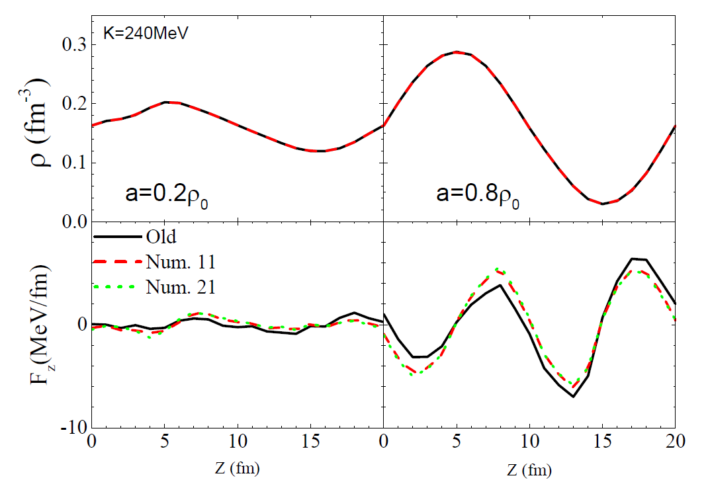

Given density profile in one QMD event and the force
$ρ\left(z\right)=ρ_{0}+a_{ρ}sin⁡(kz)$
Prepare for submission
Stronger repulsive at suprastaturation density;
Weaker repulsive at subsaturation denisty

Slide 13
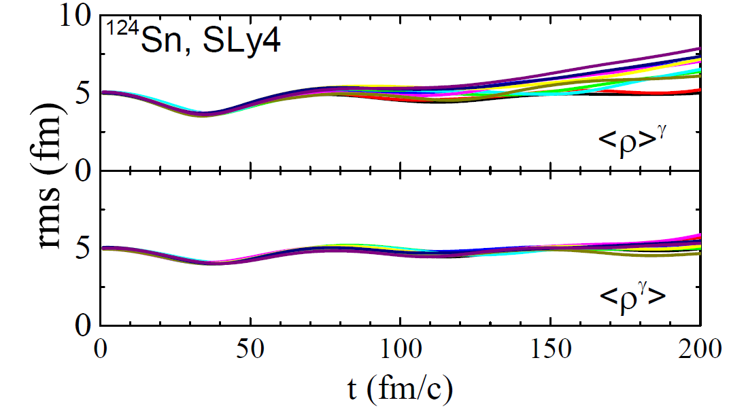
Stability of initial nucleus and fragmentation
Prepare for submission

Slide 14
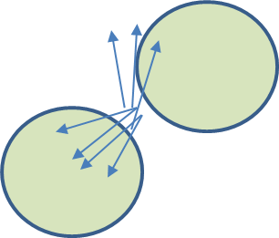
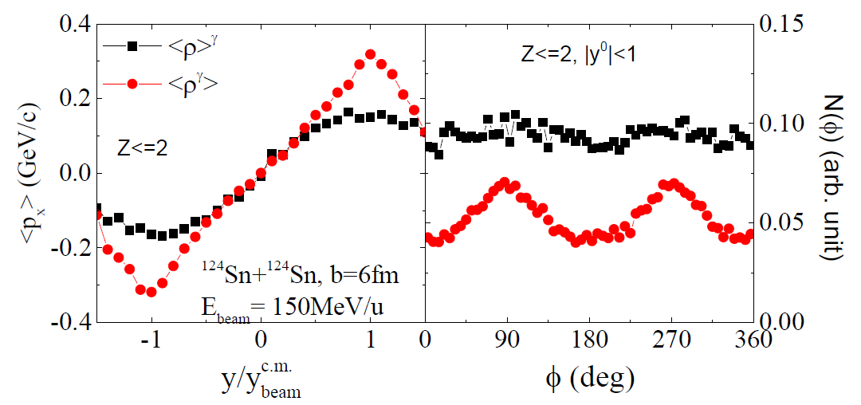
collective flow
Prepare for submission
Improve the shape of px as function of rapidity, especially around projectile/target region

Slide 15
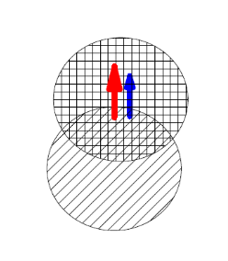
Stopping power
Prepare for submission
Decrease the transparency, and refine the deficiency of QMD codes
Vartl: 0.466→ 0.647

Slide 16
Summary 1:
precise force calculations in QMD can improve the description of stability of initial nuclei, light particle production, flow and stopping power

Slide 17
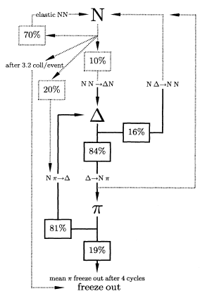
In-medium NN-N\Delta cross section
Relativistic Dirac-Brueckner approach
    B. ter Haar, R. Malfliet, Phys. Rev. C 36 (1987) 1611.
One-pion exchange model (OPEM)
    A.B. Larionov, U. Mosel, Nuclear Physics A 728 ,135 (2003)
S. A. Bass, et al., PRC 51, 3343 (1995).

Slide 18
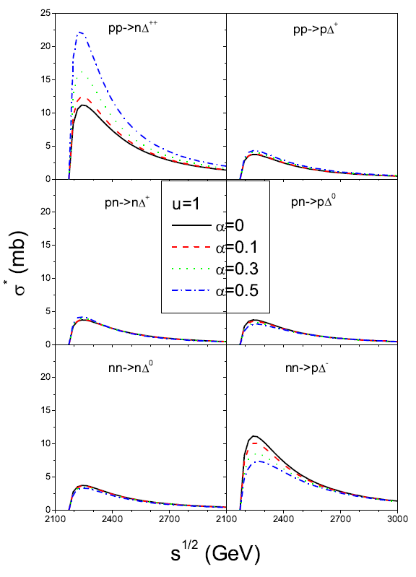
Relativistic Boltzmann-Uehling-Uhlenbeck (RBUU) Model
    Q. Li and Z. Li Physics Letters B 773, 557 (2017)
    Guang jun Mao, Zhuxia Li, Yizhong Zhuo, Yinlu Han, Zi qiang Yu, Phys. Rev. C 49 ,3137 (1994)
    ……
    Q. Li and Z. Li Physics Letters B 773, 557 (2017)

Slide 19
Energy conservation in isospin asymmetric nuclear medium
Canonical momentum (symmetric nuclear and asymmetric)

Slide 20
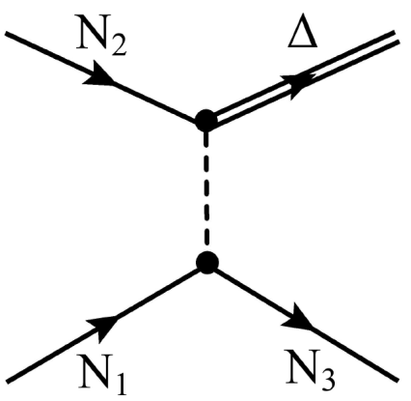
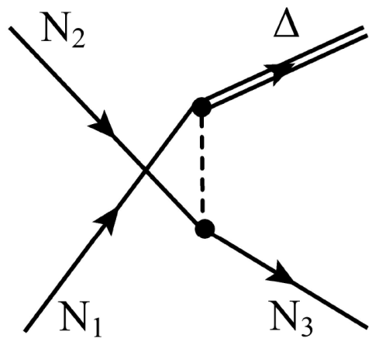


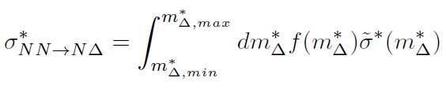




In-medium NN→NΔ cross section

Slide 21

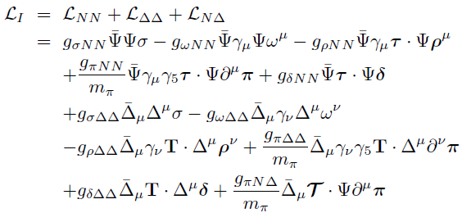
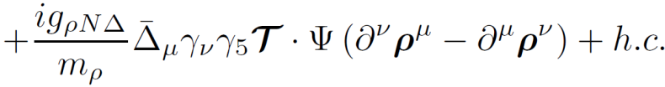
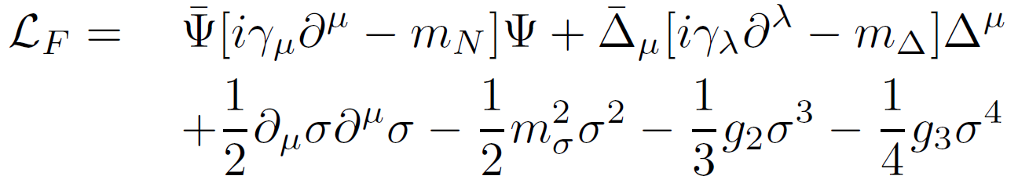
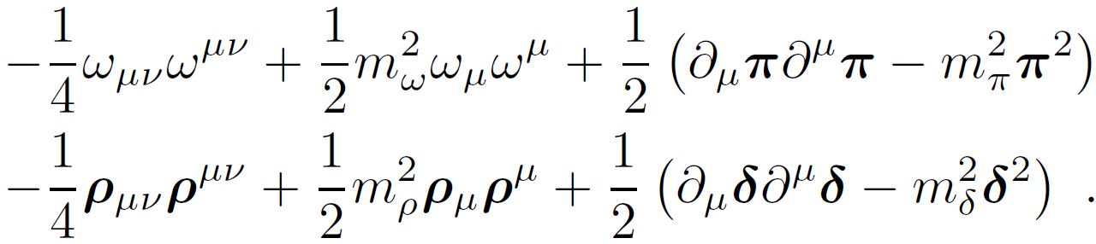
The Lagrangian density

Slide 22
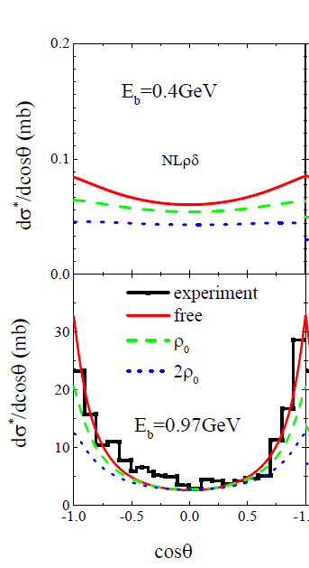
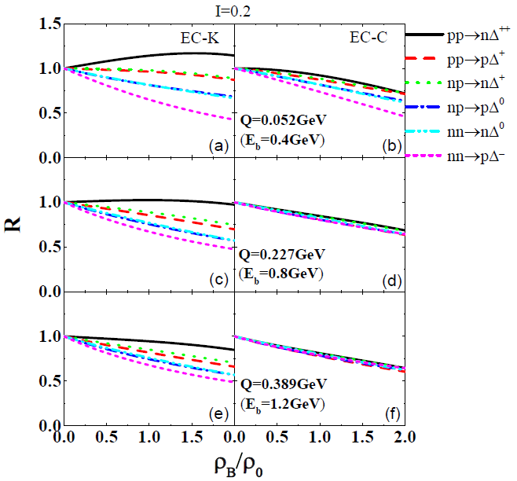
Medium correction factor
Submitted to PRC

Slide 23
Summary 2
in-medium correction factor for NN-ND is isospin dependent around the threshold energy and this should be investigated
Outlook
theoretical improvements are still needed, such as pauli blocking, cluster formation, ……, to enhance the reliability of transport code predictions.

Slide 24
Collaborators:
Zhuxia Li, Ying Cui, (CIAE),
NSCC-TJ for calculations
All the code comparison participants,
M. Colonna, P.Danielewicz, A. Ono, MB. Tsang, HH.
Wolter, J. Xu,
D. Cozma, Zhao-Qing Feng, Jun Su, T. Ogawa, Taesoo Song, Janus Weil, Dmytro Oliinychenko, Guoqiang Zhang, Swagato, H. Peterson, ……
Lie-Wen Chen, Fengshou Zhang, ……
Che-Ming Ko, Bao-An Li, Qing-Feng Li, Ning Wang, ……
Thanks for your attention!

Slide 25


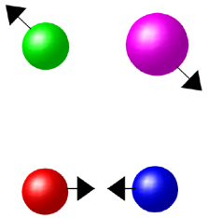
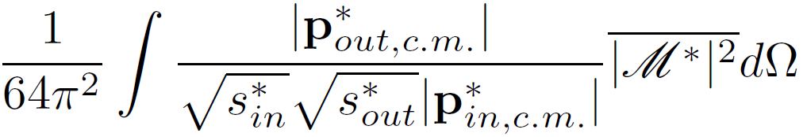





Energy conservation in in-medium NN→NΔ cross section
nuclear matter rest frame
How to calculate p* and m* ?

Slide 26
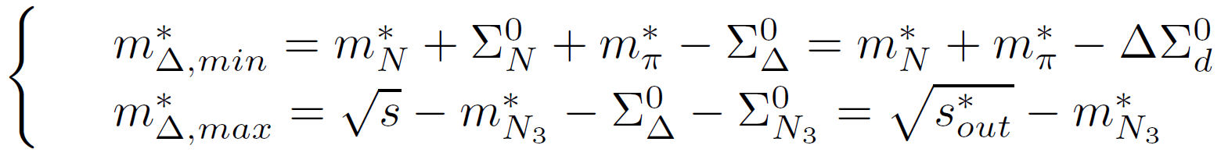
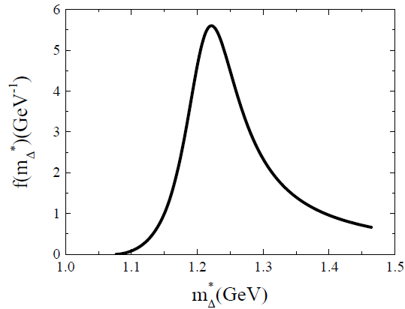
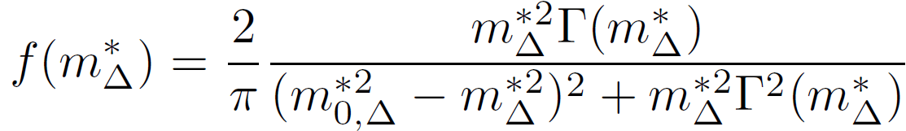
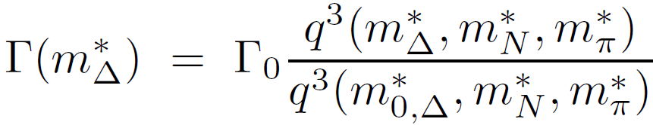
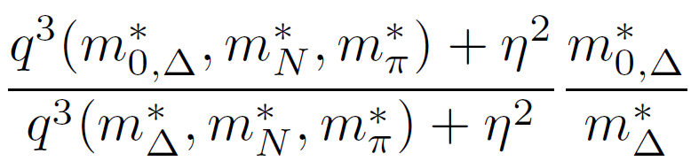
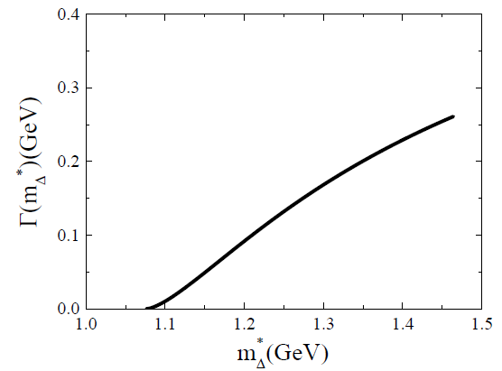
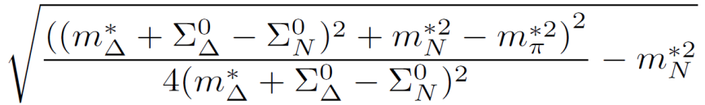

M*_{Δ,min}, M*_{Δ,min}, and Δ mass distribution in isospin asymmetric nuclear matter
Breit-Wigner form and decay width

Slide 27






Energy conservation at kinetic momentum
(EC-K)
Energy conservation at canonical momentum (corrected energy conservation)
(EC-C)

Slide 28
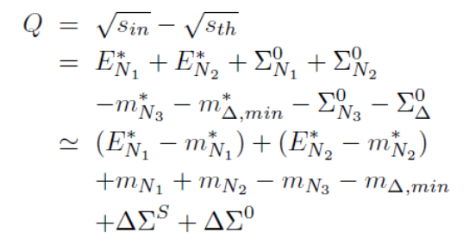

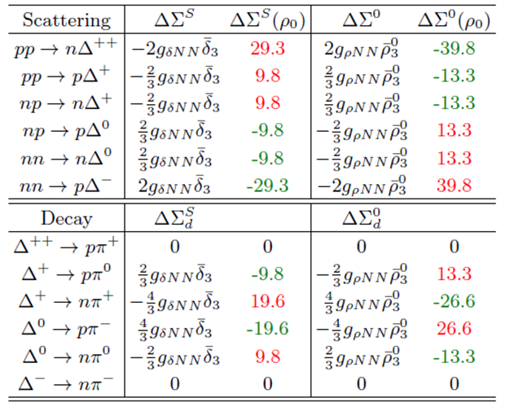

Slide 29
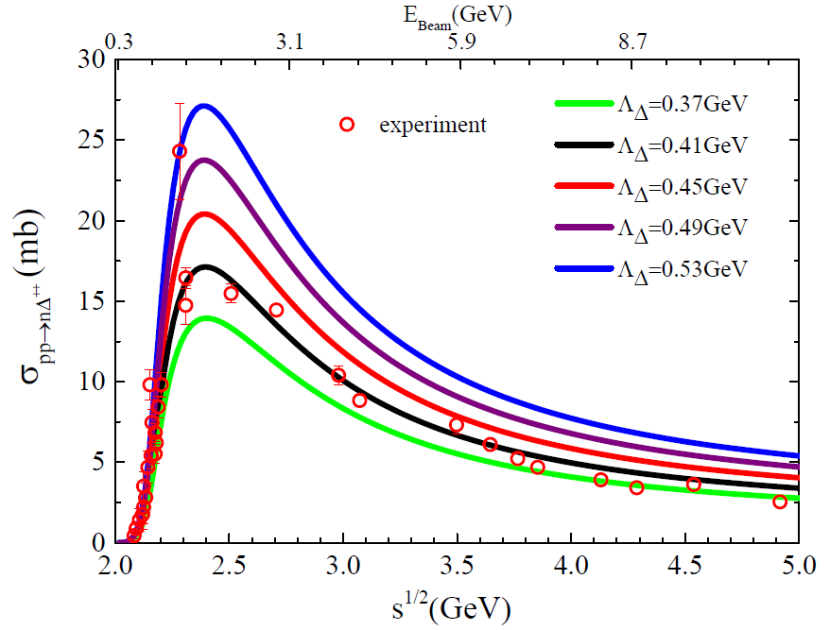
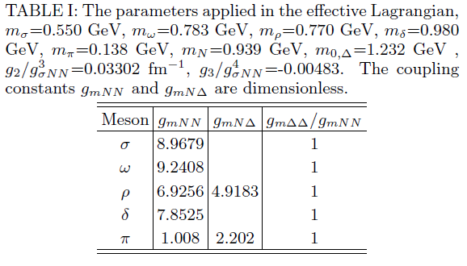

Parameter set in Lagrange density, are NLρδ ¹
1. B. Liu, H. Guo, M. Di Toro, and V. Greco. Eur. Phys. J. A 25, 293 (2005)

Slide 30
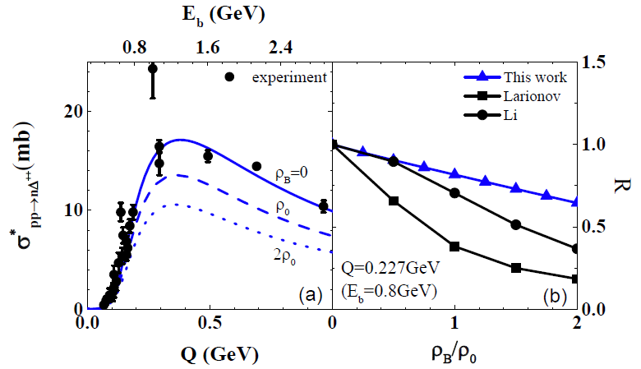


Cross section and medium correction factor for symmetric nuclear matter
Submitted to PRC
A.B. Larionov, U. Mosel, Nuclear Physics A 728 (2003) 135–164.
Q. Li and Z. Li Physics Letters B 773, 557 (2017).

Slide 31
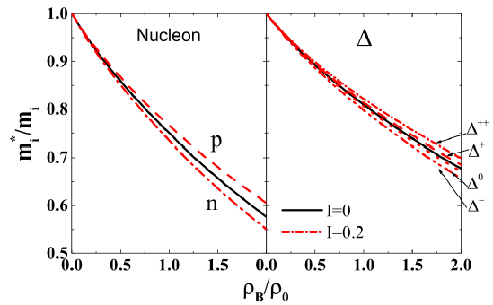
Effective masses of Ns and Δs
Submitted to PRC

Slide 32

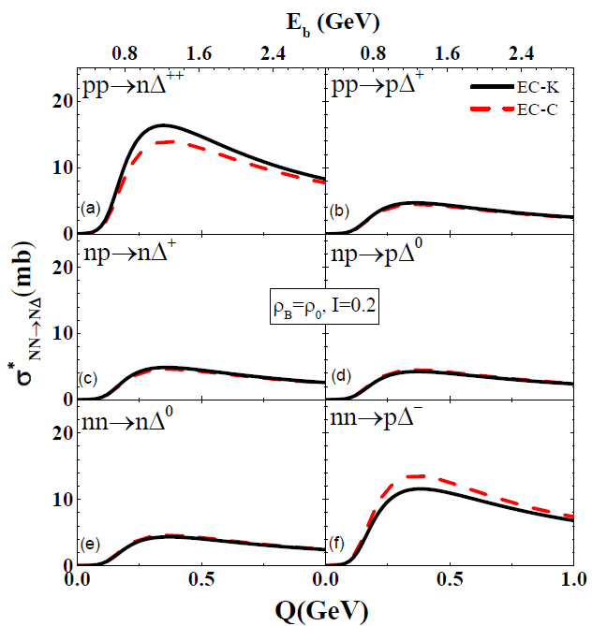
Cross section for EC-K and EC-C at
Submitted to PRC
1, For pp→ nΔ⁺⁺, EC-C reduces the cross section relative to EC-K
2, For nn→ pΔ⁻, EC-C enhances the cross section relative to EC-K

Slide 33
