Slide 1




FKPPL, Jeju
May 9, 2019
Overview of
The Rare Isotope Science Project
(RISP)
Kwon Myeun

Slide 2
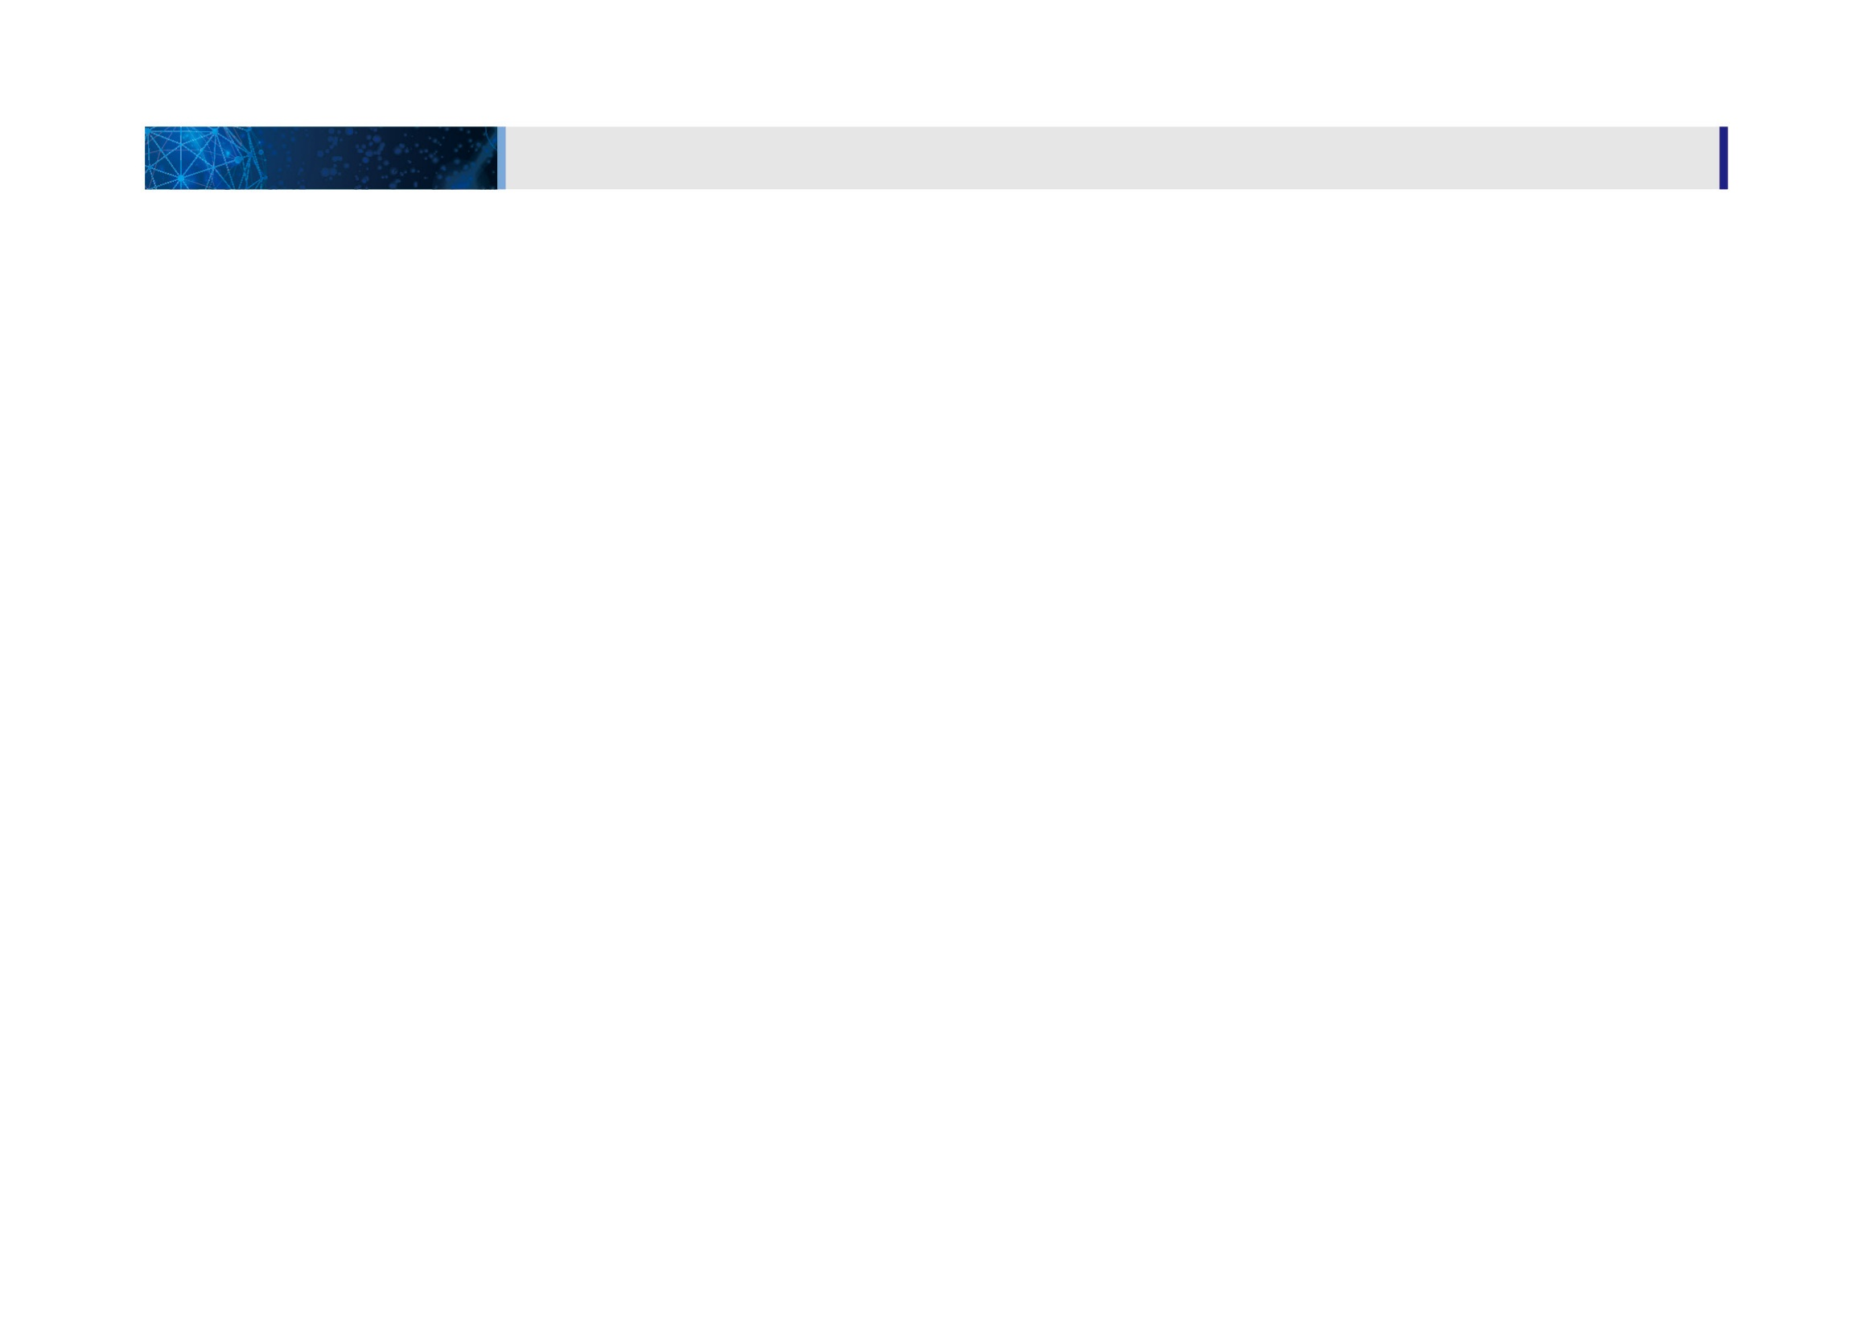
01
1. 일반현황
사업개요 및 내용
사업 일반현황
사업 개요 및 내용
CONTENTS
PART 1. Project Overview
PART 2. Construction Status
PART 3. System Installation
PART 4. Radiation Safety
PART 5. Summary & Outlook

Slide 3

Part 1.
Project Overview

Slide 4
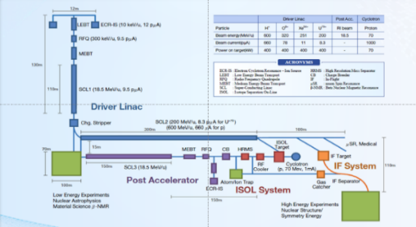
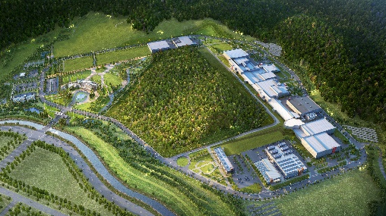
Rare Isotope Science Project (RISP)
1. Overview
Goal: To build a heavy ion accelerator complex RAON,
for rare isotope science research in Korea.
* RAON - Rare isotope Accelerator complex for ON-line experiments
Budget: KRW 1,432 billion (US$ 1.26 billion, 1$=1,135krw)
- accelerators and experimental apparatus : 460.2 billion won
- civil engineering & conventional facilities : 972 billion won (incl. site 357 billion won)
Period: 2011.12 ~ 2021.12
System Installation Project
Providing high intensity RI beams by ISOL and IF
ISOL: direct fission of ²³⁸U by 70 MeV proton
IF: 200 MeV/u ²³⁸U (intensity: 8.3 pμA)
Providing high quality neutron-rich beams
e.g., ¹³²Sn with up to 250 MeV/u,
up to 10⁹ particles per second
Providing More exotic RI beam
production by combination of ISOL and IF
Development, installation, and commissioning of the accelerator systems that provides high-energy (200MeV/u) and high-power (400kW) heavy-ion beam
Facility Construction Project
Construction of research and support facility to ensure the stable operation of the heavy-ion accelerator, experiment systems, and to establish a comfortable research environment
※ Accelerator and experiment buildings, support facility, administrative buildings, and guest house, etc.

Slide 5
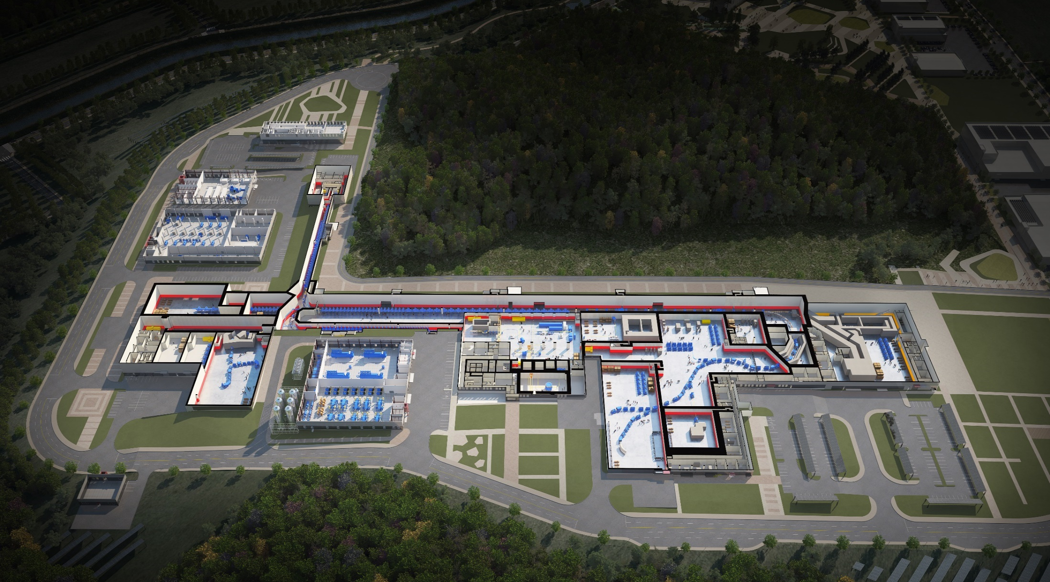

RAON Layout
1. Overview
Control
Center
Utility
ECR IS
SCL1
ISOL System
HPMMS/
CLS
IF System
SCL3
SCL2
BIS
μSR
NDPS
KOBRA
Cyclotron
HRS
LAMPS
SCL1 has been decided to be postponed
: SCL3 is going to be taking a role of SCL1 in the early operation

Slide 6
1. Overview
Project Milestone
(2018)
SCL3 manufacturing
SCL2 Prototype
(2019)
SCL3 Installation
SCL2 manufacturing
(2020)
SCL3 Beam Commissioning/
Const. Completion
(2021)
SCL3 Beam Commissioning/
Project Completion
System Installation
ECR-IS beam &
ISOL beam (SI beam)
(Dec 2015)
18.5MeV/u
SI beam
(Dec 2020)
18.5MeV/u
RI beam
(Sep 2021)
SCL demo beam
(Dec 2017)
2014
2015
2016
2017
2018
2019
2020
2021
RFQ beam
(Dec 2016)
SCL
installation
(April 2019)
ISOL
Commissioning
(July 2020)
D-1
Experiment
(Jan 2021)
SCL2
(Dec 2021)
Facility Construction
Completion of basic design
(Dec 2015)
Completion of detail design
(June 2017)
Supply of utilities
(Dec 2018)
Building
Permit
(April 2021)
2014
2015
2016
2017
2018
2019
2020
2021
Beginning of priority
construction
(Feb 2017)
Beginning of construction
(Sep 2017)
Completion of construction
(Aug 2020)
Completion of inspection of the radiation facility
(Dec 2021)

Slide 7
1. Overview
Progress Rate
System Installation Project
As of Feb 2019
(Planned: 62.13%,
Actual: 61.19%)
2011 2012 2013 2014 2015 2016 2017 2018 2019 2020 2021
Construction Project
As of Feb 2019
(Planned: 40.67%,
Actual: 40.47%)
2015 2016 2017 2018 2019 2020 2021

Slide 8
Part 2.
Construction

Slide 9
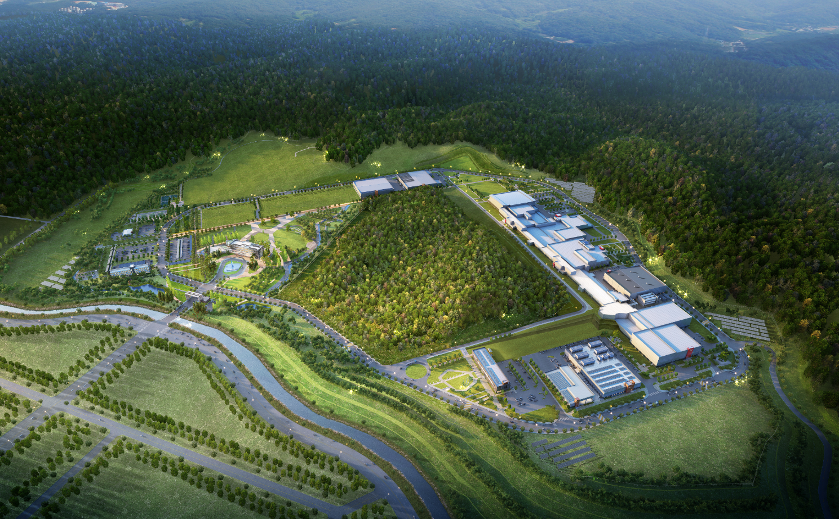
2. Construction
Building Layout
Building Layout
Campus Area : 952,066㎡ (including the reservation area of 144,640㎡)
Period : 2014 ~ 2021(8 years)
Cost : 972 billion won (incl. 357 billion won for land)
Building Area : 76,259㎡(11 Bds)
Total Bd. Area : 116,252㎡
Constructor : POSCO Consortium(11 companies)
Assembly Bd.
SRF Test Bd.
High Energy B
IF Separator / High Energy A
Waste Strorage
Cryogenics Bd.
HQ Office
Reservation
ISOL
SCL
Info. Center
Guest House
Low Energy A,B
Control Center
Utility Bd.
Electricity Bd.

Slide 10
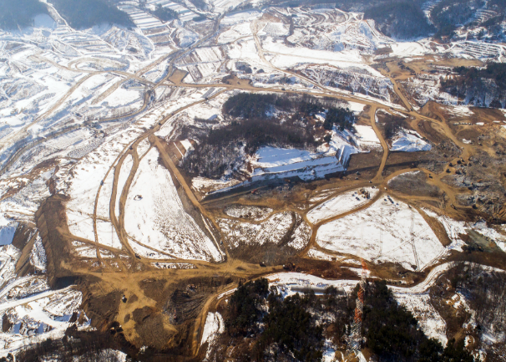
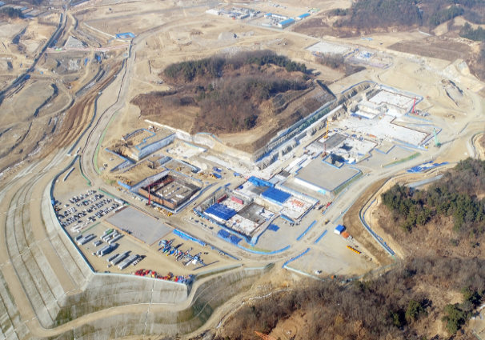
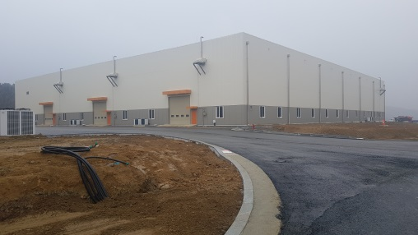
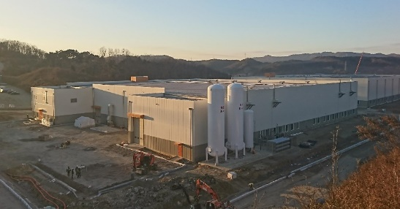
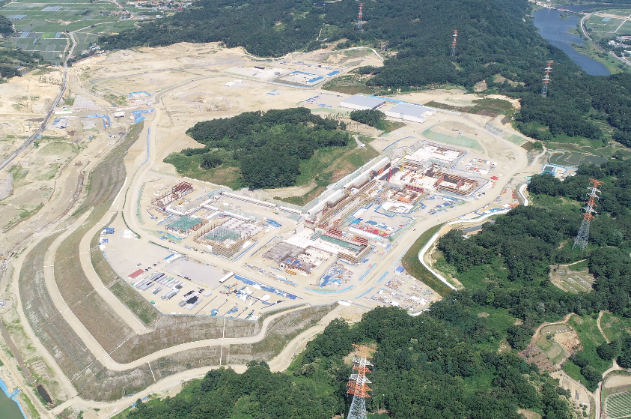
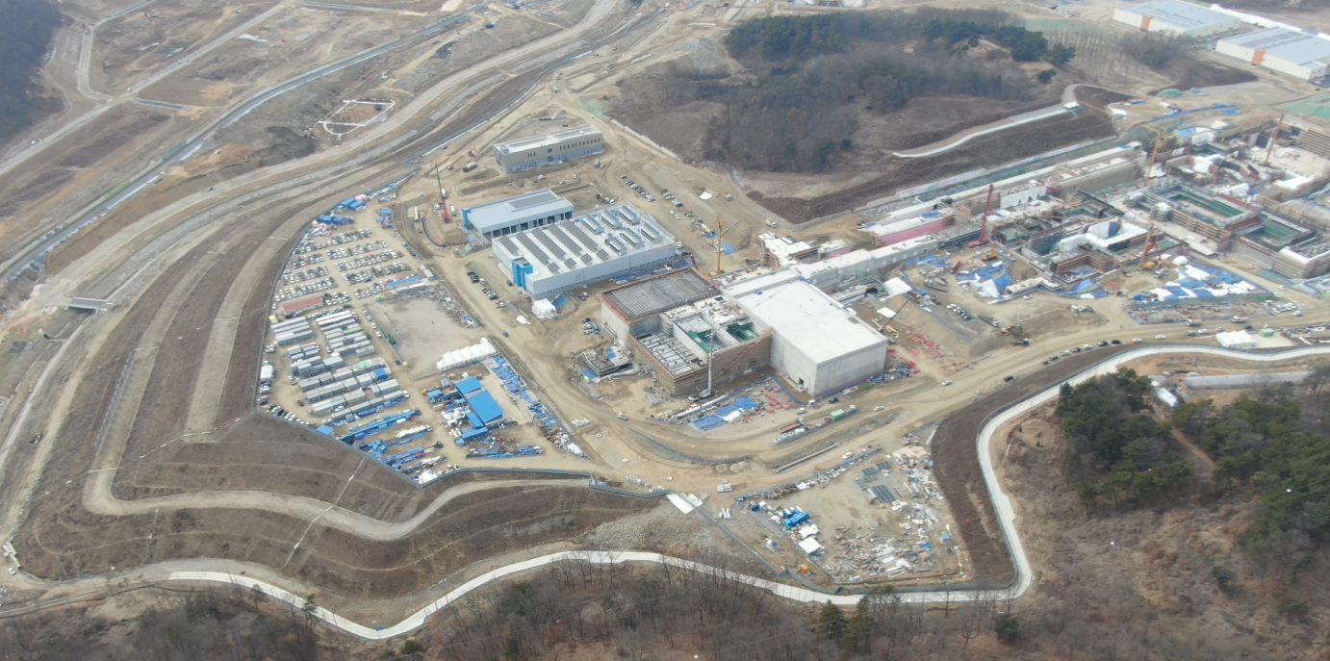
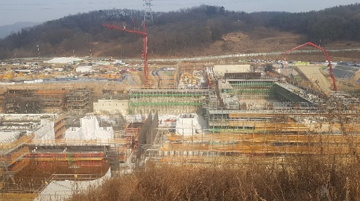
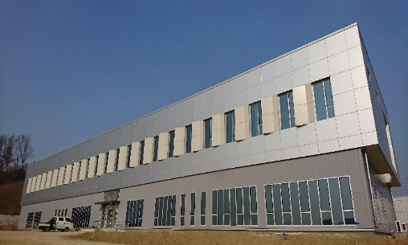
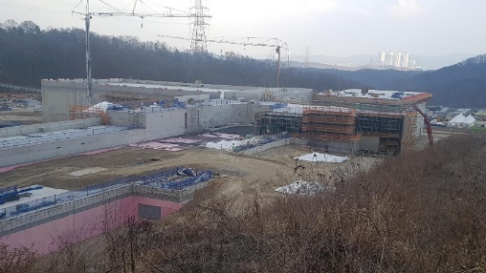
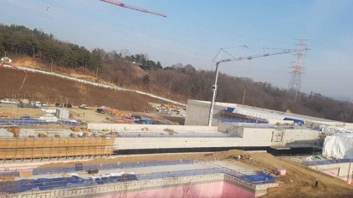
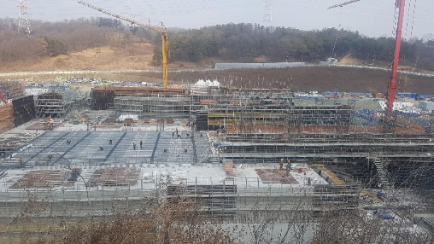
2. Construction
View of Construction Place
View of Construction Place (`19.3)
<Assembly Bd.>
<`17.01>
<`17.12>
<SRF Test Bd.>
<`18.6>
<`19.3>
<High Energy Exps.>
<Control Center>
<Low Energy Exps.>
<SCL3>
<ISOL>

Slide 11
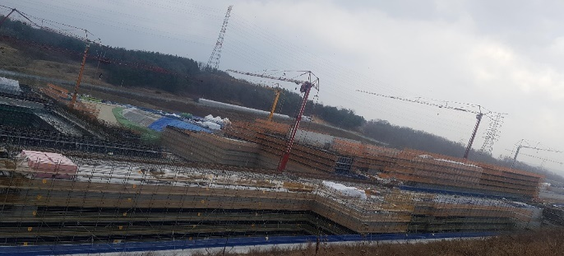


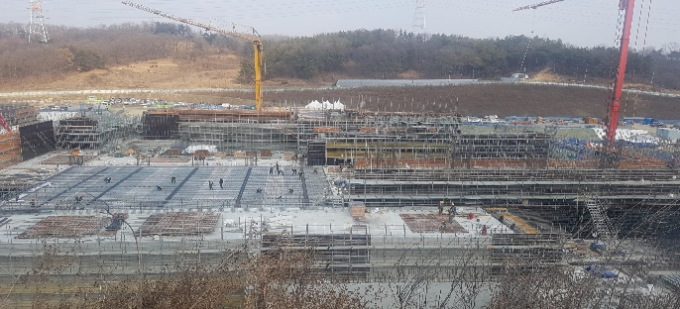

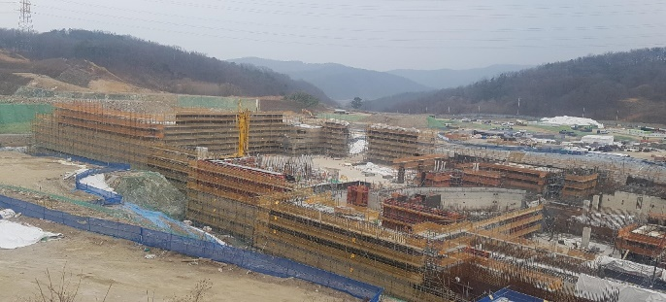
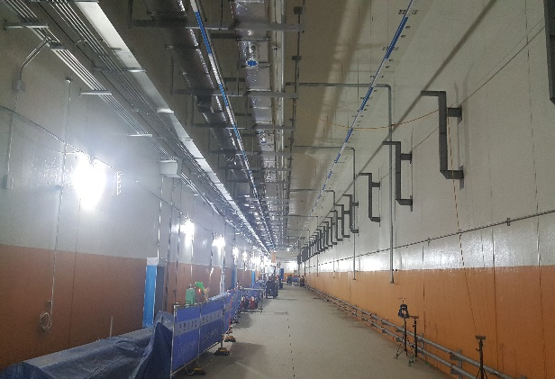
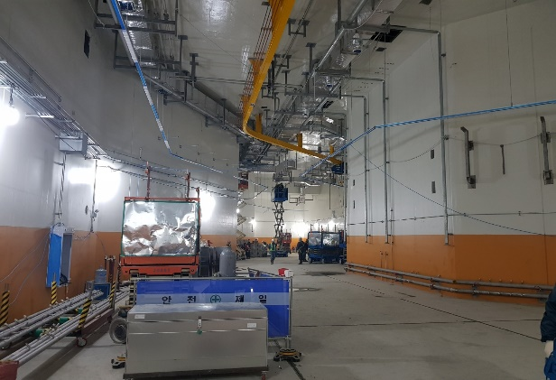
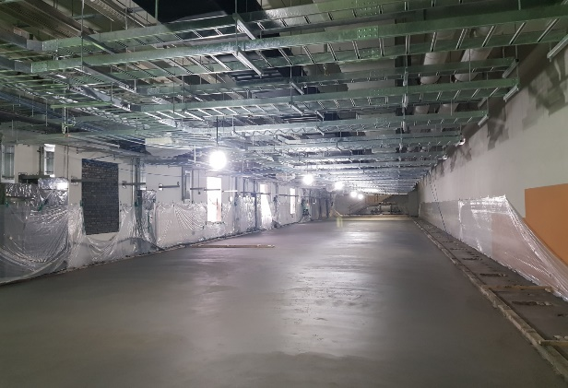
2. Construction
Conventional Facilities
SCL2
SCL3
Low Energy A/B
ISOL
IF/ High Energy A
High Energy B
SCL3
Bending Section
SCL3-gallery
Accelerator Bd.

Slide 12

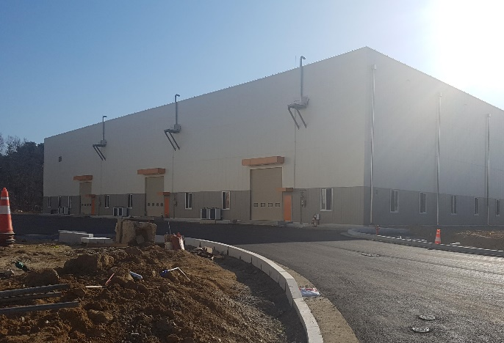

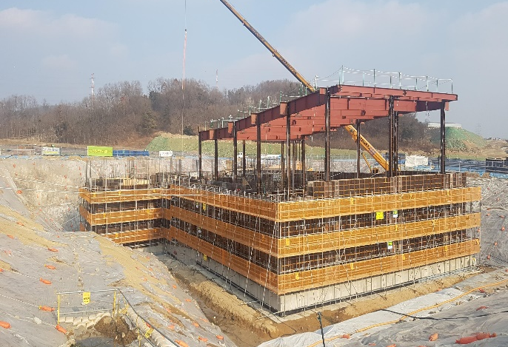
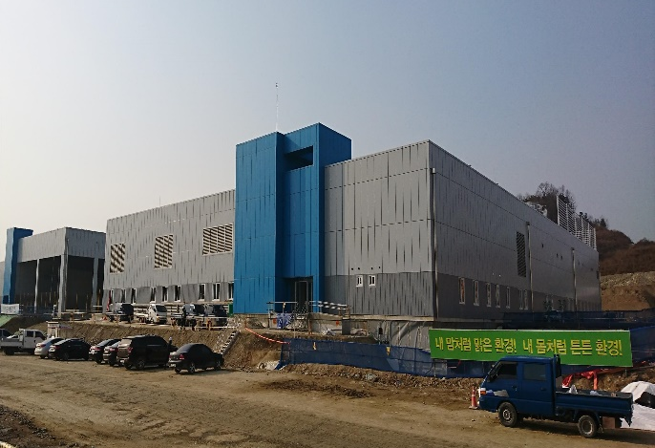
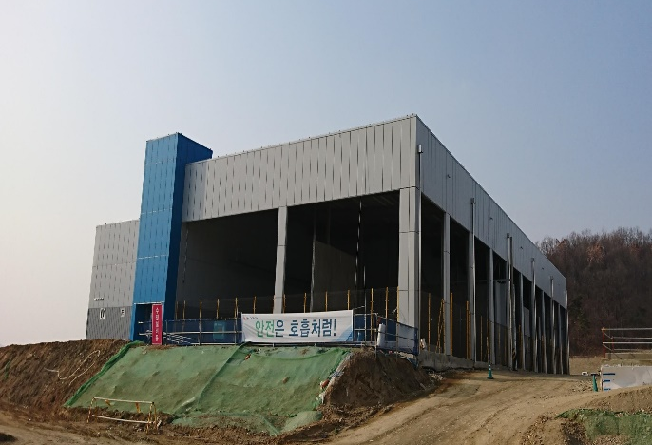
2. Construction
Conventional Facilities
SRF Test Bd.
Assembly Bd.
Control Center
HQ Office
Utility Bd.
Electricity Bd.

Slide 13
Part 3.
System Installation

Slide 14
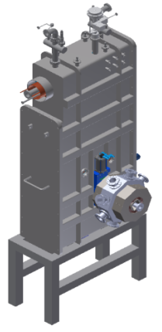
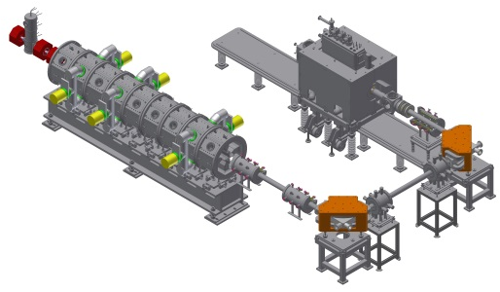
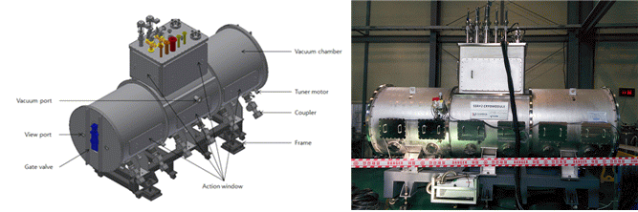
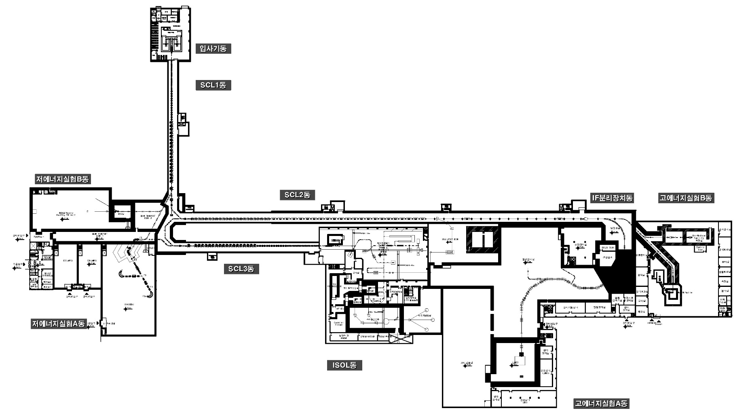
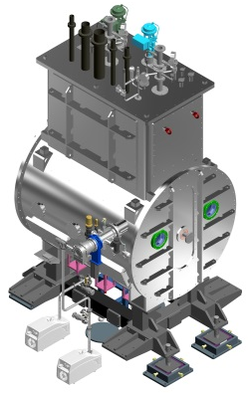
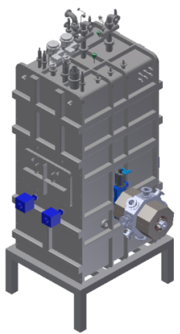
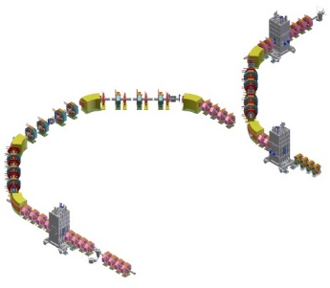
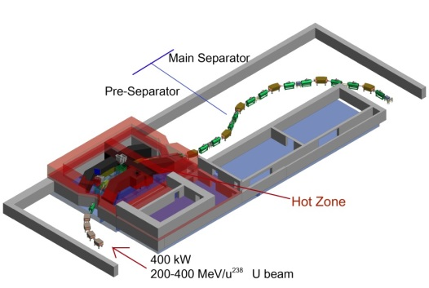
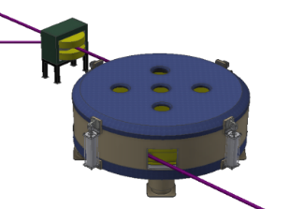
3. Sys. Install.
Accelerator System
SCL2(SSR1)
SCL2(SSR2)
Injector
SCL1&3(QWR)
SCL1&3(HWR)
Bending Section
Cyclotron
IF System

Slide 15
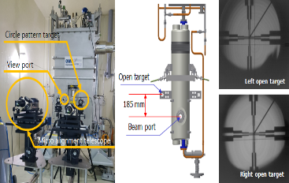
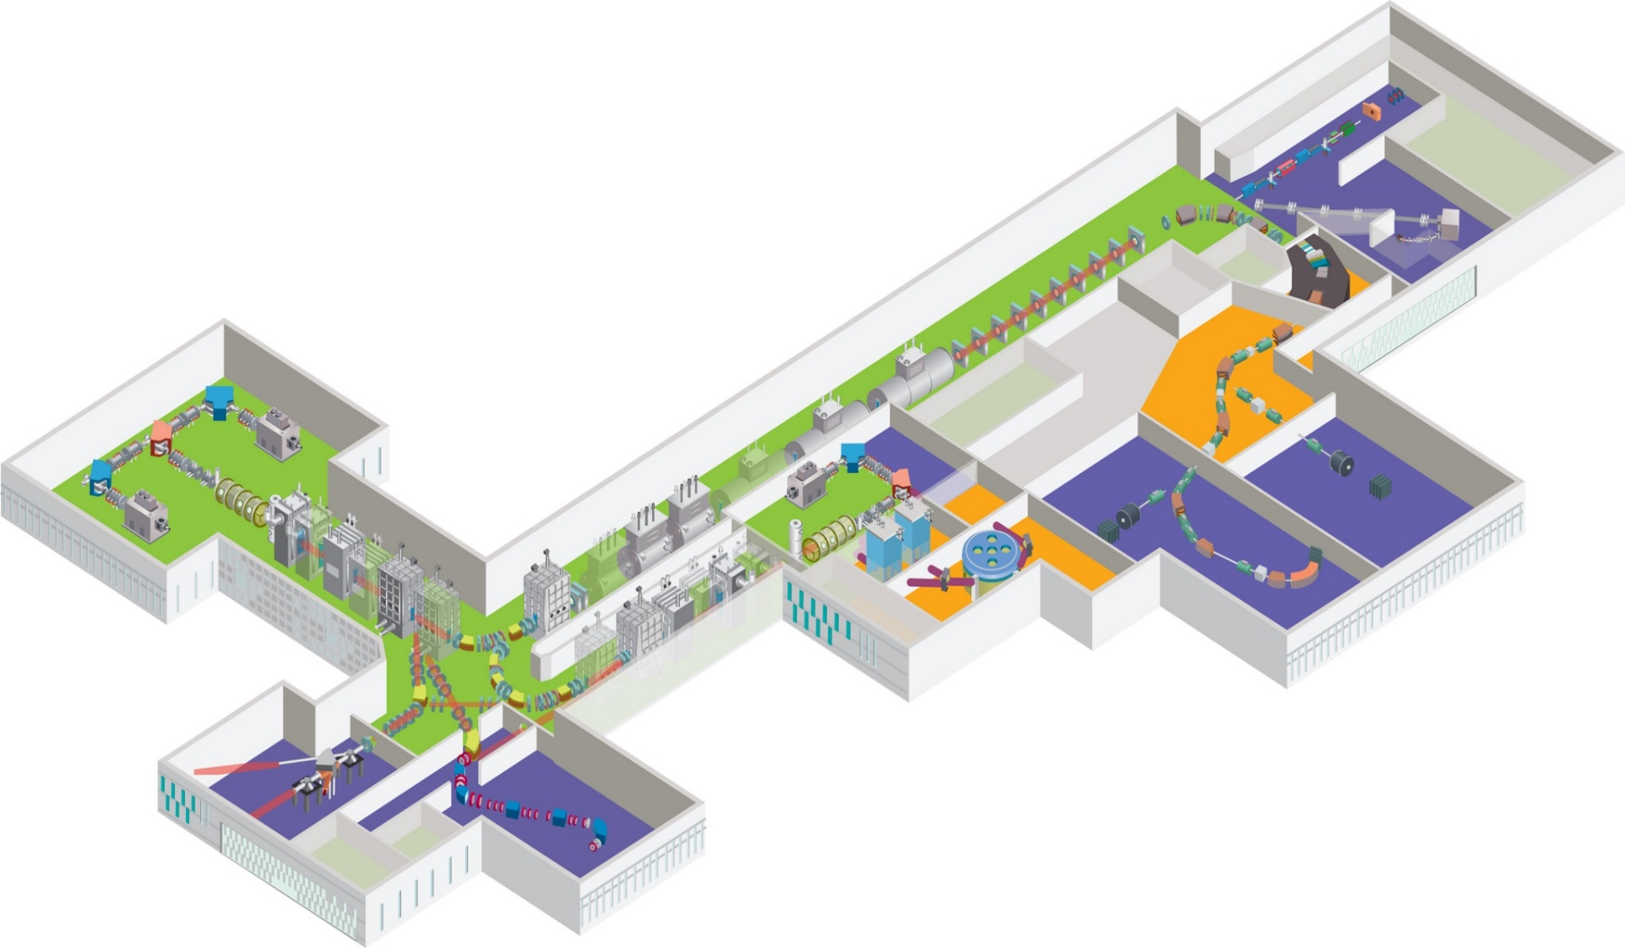
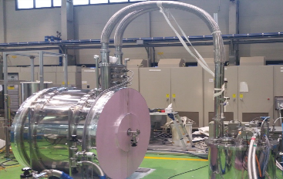
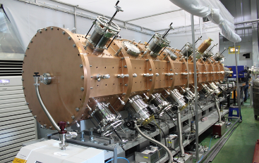
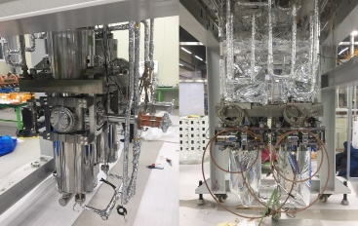
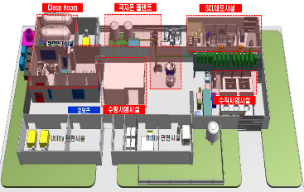
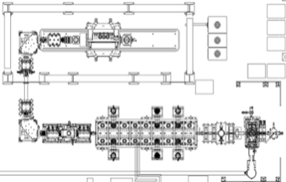
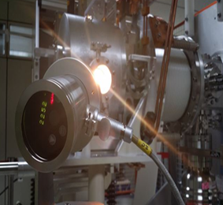
3. Sys. Install.
Major achievements
Achievement of low temperature test for LTS and HTS quadrupole prototype magnet (LTS 2016.1, HTS 2017.1)
QWR cryomodule test complete
(2017.05)
1st Oxygen Ion beam acceleration with RFQ(2016.12)
HWR cryomodule test complete
(2018.03)
1st Oxygen Ion beam acceleration with QWR module, SCL Demo(2017.10)
High purity Sn beam extraction
using RILIS (2015.12)
Superconducting RF Test facility(2016.06)
ECR 이온원
RFQ
QWR
LEBT
MEBT

Slide 16
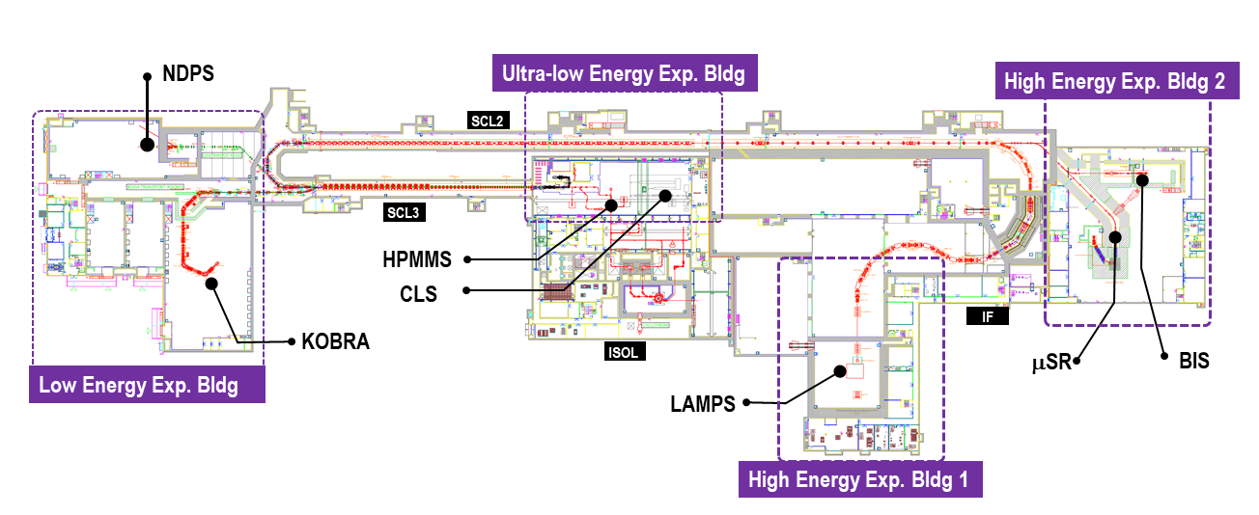
3. Sys. Install.
RIBs at RAON
ISOL→IF
: ISOL → SCL3 → SCL2 → IF
: ISOL → SCL3 → KOBRA
KOBRA (low-E IF)
ISOL
IF (high E)
Driver
SCL3
Cyclotron
SCL3→SCL2
Post accelerator
SCL3 or SCL3→SCL2
Production mechanism
Direct reactions
- (p,d), (³He,n) etc.
Multi Nucleon Transfer
p induced U fission
PF, U fission
Available RIB energy
< a tens of MeV/u
> a few of keV/u
< a hundreds of MeV/u
Broad energy range, Variety, High intensity of RIBs will be available at RAON

Slide 17
3. Sys. Install.
RIBs at RAON
IF
ISOL
KOBRA
ISOL+IF
RAON will provide access to unexplored regions of the nuclear chart

Slide 18
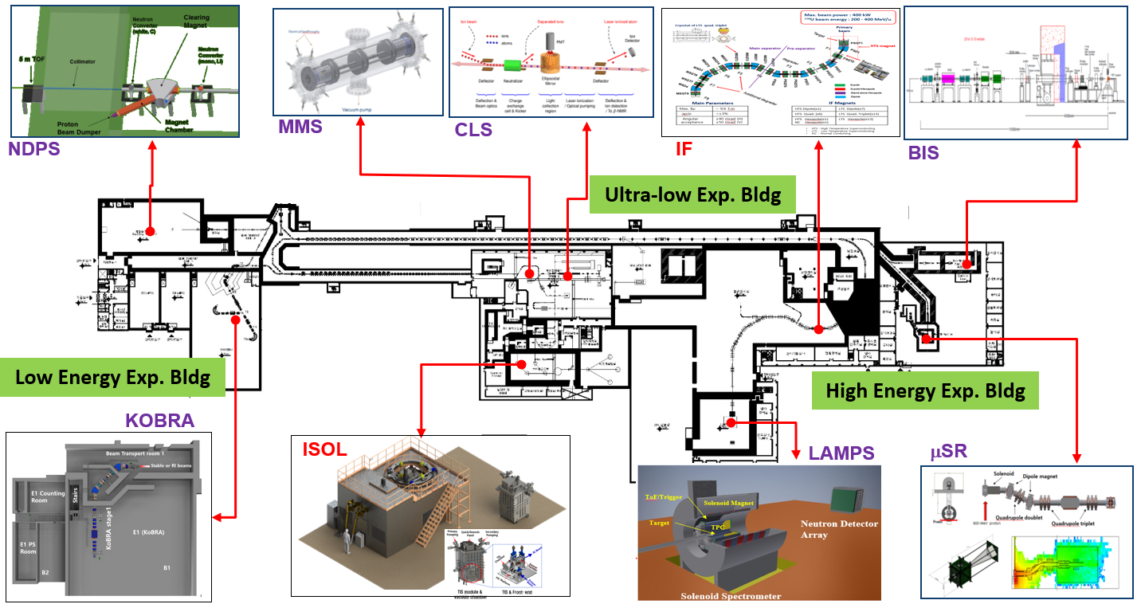
3. Sys. Install.
Layout of Experimental System at RAON
Nuclear science - KOBRA, LAMPS, NDPS, MMS, CLS (based on atomic physics)
Applied science - μSR (Material science), BIS (Bio & Medical application)
7 (at the beginning of RAON operation) + upgrade + ?? (in the future, space reserved)

Slide 19
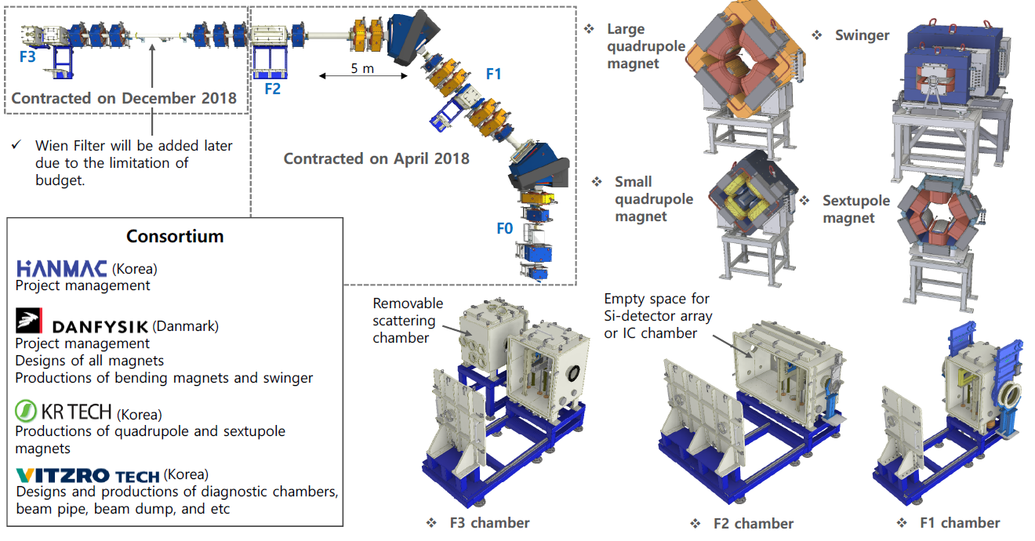
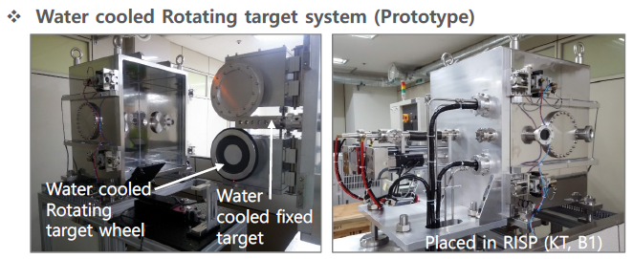
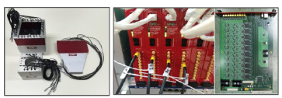
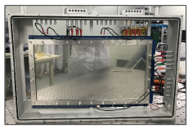
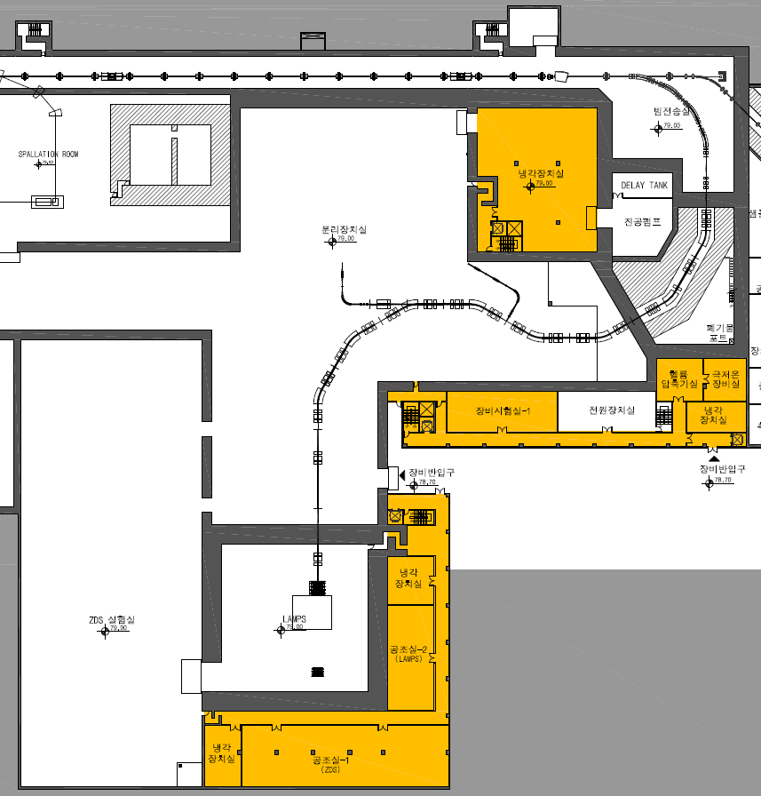





3. Sys. Install.
Current Status of Experimental System
1. KOBRA
(KOrea Broad acceptance Recoil spectrometer & Apparatus)
∙ Research Studies of nuclear structure and nuclear
astrophysics in the energy range of < a few tens of MeV/u
∙ Current status Under fabrication (start installation from Sep. 2019)
2. LAMPS
(Large Acceptance Multi-Purpose Spectrometer)
∙ Research Studies of nuclear matter and nuclear reactions
with stable and RI beams at intermediate energy regime
∙ Current status Under fabrication (start installation from Jan. 2021)
IF separator

Slide 20








3. Sys. Install.
Current Status of Experimental System
3. MMS (Mass Measurement System)
4. CLS (Collinear Laser Spectrometer)
5. NDPS (Neutron Data Production System)
∙ Research High precision mass measurement of
short lived rare isotopes
∙ Current status Under assembly and test
(start installation from Feb. 2020)
∙ Research Model independent Studies of
nuclear ground and isomeric state properties
∙ Current status Restart development
(start installation from Jan. 2020)
∙ Research Measurement of neutron
induced reaction data for nuclear science
∙ Current status Restart development
(start installation from Jan. 2021)
MR-TOF-MS
Collaboration:
KEK/WNSC (JAPAN)
6. μSR (Muon Spin Rotation/Relaxation/Resonance )
7. BIS (Beam Irradiation System)
∙ Research Studies of local electromagnetic structures and
exotic properties of material by using polarized muons
∙ Current status Restart development
∙ Research Biomedical studies such as cancer treatment,
human body effect by space radiation and cell mutation
∙ Current status Restart development
(start installation from Nov. 2020)
(start installation from Feb. 2021)

Slide 21
3. Sys. Install.
Scientific program at early phase of operation
Facility | Subject for early phase operation
KOBRA | ∙ Transfer reaction measurements in inverse kinematics (²⁹P(d,p)³⁰P, ²⁶Al(α,p)²⁴Si) ∙ Radiative capture reactions using batch mode RI beams (^{26g}Al(p,γ)²⁷Si) ∙ RI beam production via quasi-projectile-like fragmentation for ¹⁶O or ⁴⁰Ar
LAMPS | ∙ Ar+KCl or Xe+CsI in case of IF separator commissioning not completed
MMS | ∙ Isomer separation with using ^{26g.s.}Al and ^{26m}Al beams
CLS | ∙ Laser ionization and measurement of isomeric property for ²⁶Al
NDPS | ∙ Activation experiments with a quasi mono energy neutrons for light and heavy nuclei ∙ Surrogate reactions for fission
μSR | ∙ One of research areas of superconductivity and quantum magnetism with their scientific significance at the time of the μSR instrument completion
BIS | ∙ Physical dose distribution and linear energy transfer measurements with a ¹²C⁺⁶ beam (310 MeV/u)

Slide 22
Part 4.
Radiation Safety

Slide 23
4. Rad. Safety
Radiological Features of the Facility
High Power Targets
IF : 400 kW, ISOL : 30 ~ 70 kW
induce high activation in concrete, air, cooling water, machine parts
need robust remote handling in target areas
Use of Uranium Material
fission products contaminate ISOL target system, IF beam dump, etc.
generation of radioactive waste containing actinides-> need a long-term storage space of the waste until ready to transfer to the national site
Various Reactions to analyse
Experiments | Beams | Targets
IF | O, Ca, …, Kr, .., Sn, Xe, U, ~20 species | C
ISOL | p | UC
KOBRA | He, B, O, Ar, U | Be, Cu
Bio-medical | C | Fe
muSR | P | C
LAMPS | Ca, Ni, Zr, Sn | Ca,….
Neutron Exp. | p, d | C
various beam and target combination
wide energy range (low 18~40MeV/u, high 200~320 MeV/u, 600 MeV p)
need to find correct simulation codes and conditions

Slide 24

4. Rad. Safety
Radiation Safety Licensing : Completed!! (18.10)
Preparation
many domestic experts joined radiological analysis
facility basic design by a experienced company
Documents for Review
radiation safety report
(shielding, activation, env. Influence, RMS/PSIS,
exhaust, accident analysis, radioactive waste, etc..)
description of accelerators and experiments
details in radiological analysis (codes, input/output)
geological survey report
stability assessment of building and ground
quality assurance plan/procedures
fire hazard analysis
NSSC
(Nuclear Safety and Security Commission)
Extensive Reviews
License Submission
& Approval
Technical Review Request
& Review Report
by more than 30 KINS reviewers
382 cases of answers/further assessment/correction/design improve and changes
multilevel review(KINS, NSSC, Advs..)
RISP
Technical Detail
Inquiry & Answer
KINS
(Korea Institute of Nuclear Safety)

Slide 25
4. Rad. Safety
Plan – First Facility Inspection
mandatory step before operation (every year after the first inpection)
’19 |  |  |  | ‘20 |  |  |  | ‘21
1Q | 2Q | 3Q | 4Q | 1Q | 2Q | 3Q | 4Q | 1Q | 2Q | 3Q | 4Q
Arragned with KINS
to make 3-steps inspection
Ion Source
SCL3, KOBRA, ISOL
SCL2+IF, h.e.Exps
check items
RMS Equipments in the site
Environment Monitor | 12
Area Monitor | 94
Area Air Monitor | 11
Stack Monitor | 6
Hand & Foot Monitor | 11
Nuclide Analyser | 6
Paging Phone | 88
CCTV camera | 101
Emergency Stop & Alarm | 174
Vehicle Radiation Monitor | 2
safety organization / manpower
record of quality assurance activity
performance of all RMS & PSIS systems
implementation of fire protection
performance of exhaust/draining/remote system
readiness of preventive and mitigative measures for possible accidents of more once in 30 years
procedures to handle radioactive wastes
etc..
Safe Facility for workers & vistors & citizens !

Slide 26
Part 5.
Summary & Outlook

Slide 27
4. Summary
Summary & Outlook
Accelerator
Mass production for SCL3 is under way
SCL2 is under pre-production phase
From April, 2019, installation for SCL will start from SCL3.
By the end of 2021, we will achieve
SI beams: Stable ion beams (¹⁶O, ⁴⁰Ar) from ECRIS → SCL3 → low E exp hall
RI beams: RIBs extraction from ISOL → re-acceleration through SLC3 → low E exp hall
Stable / RI beams will be delivered to low-E experimental hall
Early phase experiments are going to be performed using KOBRA
  RIBs production at KOBRA (A<~50, beam energy < 20 MeV/u) using SI beams from SCL3
Beam commissioning starts for SCL2
Installation and commissioning for IF, LAMPS, Neutron, bio-medical and muSR
  → Collaborative works with RUA (RAON Users Association) via RULC (RAON Users Liason Center)
Post RISP (2021 ~ )
Beam acceleration for ISOL → SCL3 → SCL2 → IF (ISOL+IF)
Beam commissioning and experiments for IF, LAMPS, Neutron, bio-medical and muSR
Ramping-up to get the 400kW beams (more than 5 yrs)
Energy upgrade to 400MeV/u (requires budget)

Slide 28

Thank you

Slide 29

3. Sys. Install.
Schedule of Experimental System at RAON

